Slide 1
FCC LCCO
Local Chromatic Correction Optic
November 13th, 2023
Pantaleo Raimondi
SLAC National Accelerator Laboratory

Slide 2
Outline
LCCO rationale
Ring layout
Hardware requirements
Performances
Conclusions

Slide 3
Local Chromatic Correction Optic
LCCO based on the development of optics solutions that allow/rely on chromatic and harmonic corrections as
local as possible. This has led to the development of:
HFD ARC lattice.
The OIDE “Short” 90/90 lattice has been modified by introducing a “beta&phase-modulation”
that results in a second-order achromat and nearly anharmonic lattice. The lattice is periodic over 5 Hybrid-FODO cells.
The optimized phase advance for ttbar operations is about 95/85.
A weaker lattice that utilizes all the ttbar magnets that has a phase advance of about 45/42 is achromatic and
anharmonic as well. It is considered to be used for Z operations and all modes that require a large
momentum compaction.
Both lattices have a MA in excess of +/-3%, with no implementation of sextupole families
Long Straight Section matching
The insertion of the straight sections is performed by requiring the “Transparency Conditions”.
This allows the virtually transparent insertion of any SS in a Ring, without any significative degradation of
Its characteristics (DA/MA, detuning etc), neither requiring the introdusction of sextupole families.
The TCs can be applied for any given SS, provided that 4 quadrupoles/side are available to match the conditions.
Final Focus.
LCCO requirements are fulfilled by correcting the low-beta IP chromaticity in the FF in both planes and nearly entirely.
LCCO also results in the need of placing the Crab sextupoles in a nearly “chromatic-free” region: the FF outer ends.
This solution has been developed for the SuperB and has been adopted by CEPC as well.

Slide 4
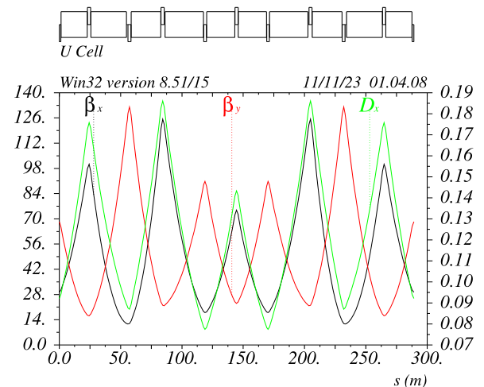
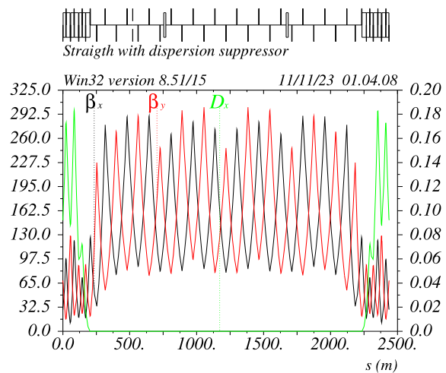
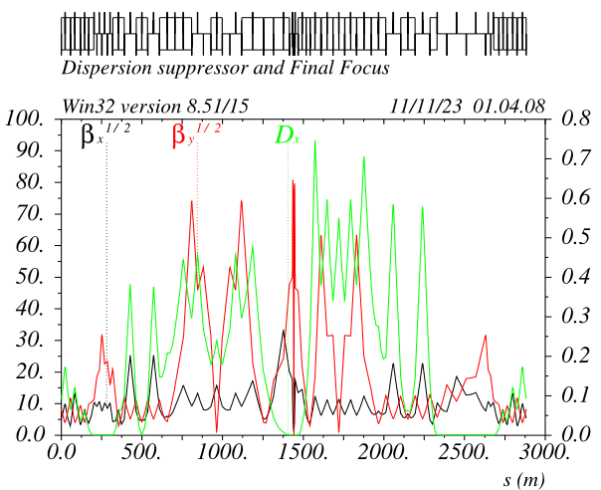
Ring layout v_74 ttbar
V_74 optic matches the baseline layout:
- LSS 2032m long as baseline
- ARCs bending radius as baseline
- FF section length set to match overall ring circumference: 90658.609m (tunnel length 90657.609)
Specialized LSS optics (injection, collimation, RF) presently not included.
31 cells/octant
4 Long Straight Sections
4 Final Focus systems
*In the following ttbar case only will be shown

Slide 5
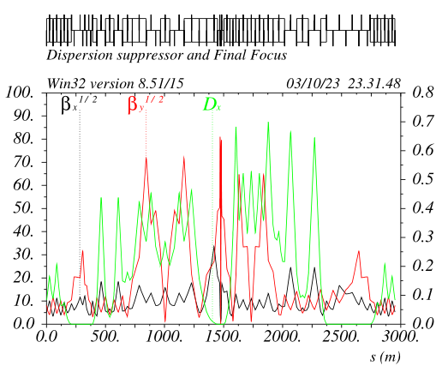
Local Chromatic Compensation FF asymmetric layout ttbar optic
The FF geometry is adjusted in order to recover entirely
the beams separation. Dipoles ARCs modification is not necessary.
Beams start to split @300m and are back @2300m
(Present separation in the ARCs is set to 40cm)
CCsX_Left section is short and has “strong bends”
CCsY_Left section is long and has “weak bend”
CCsY_Right section is short and has “strong bends”
CCsX_Right section is long and has “weak bend”
Details in next slides

Slide 6
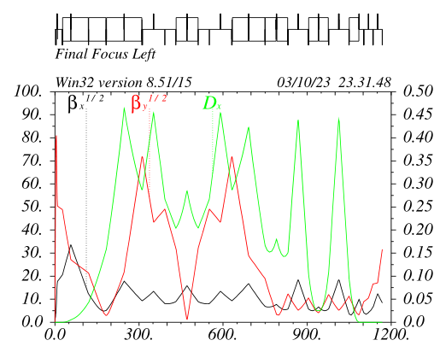
Left Final Focus ttbar optic
Last 3 dipoles EC~130KeV
CCSy optic has the largest dispersion (so far) for a given bend angle in the –I, presently Dx=0.303m@SDs
“Standard” non-linear optimization is performed as usual
Betas&Alfas at IP-phase sextupoles are optimized to reduce the DA reduction from Crab sextupoles
CCSy/x_L/R lengths and ratio between their total bend angles are optimized to have maximum dispersion on CCSy_Left and minimum overall emittance growth and radiation
CCSy sextupoles (0.6m long) are very weak Ks_madx~0.7 @ttbar, Ks~0.9 @Z. In fact ARCs sextupoles can be used in the FF as well

Slide 7
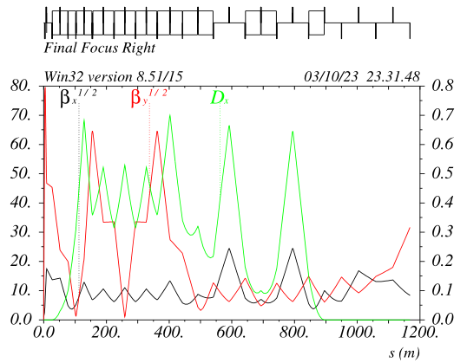
Right Final Focus v_67 ttbar optic
All dipoles in the CCSy have same field, best configuration to recover the beams separation
CCSy optic has the largest dispersion (so far) given the above requirement in the –I, presently Dx=0.370m@SDs
“Standard” non-linear optimization is performed as usual
CCsX has been shortened and pushed back, helping to recover the geometry. Incidentally this has originated a very long dispersion free straight section, ~400m when included the ARC DS part
Two drift sections about 100m long are also present in the CCsX “-I”
Alfay in the CCSx_LR is not zero to symmetrize the F_LR non linear optic

Slide 8
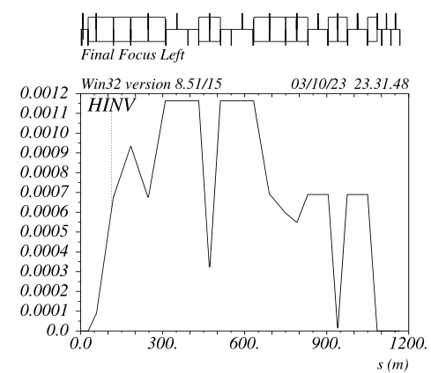
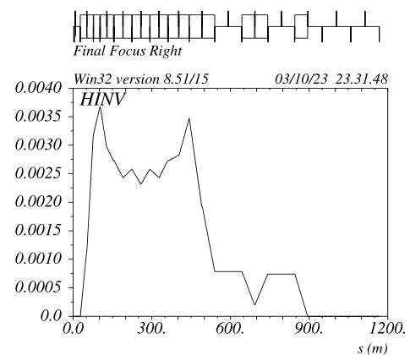
Curl_H optimization v_67 ttbar optic
CCsY Curl_H does not matter because
the dipoles are very weak
CCSX Curl_H is not optimal because the NL optimization requirement
* ARC Curl_H ~ 0.00045
CCsY Curl_H drives the emittance and is almost optimal
CCSX almost optimal as well

Slide 9
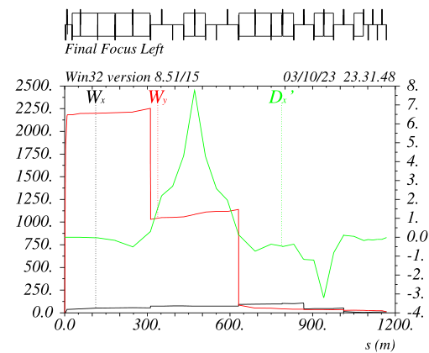
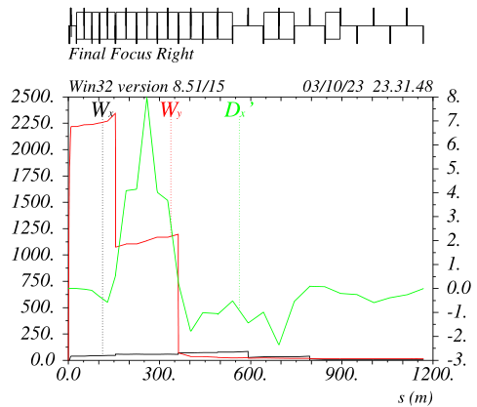
Second order dispersion optimization v_67 ttbar optic
FF_Left ddx behavior is practically perfect
Some ddx’ leakage is still present in the FF_right
Presently, NL leakage in the ARCs is just ddx, the last two ARC SF sextupoles (on each side) do compensate it.
Their modulation is about 15%@ttbar and 7%@Z. The effect on DA/MA is negligible

Slide 10
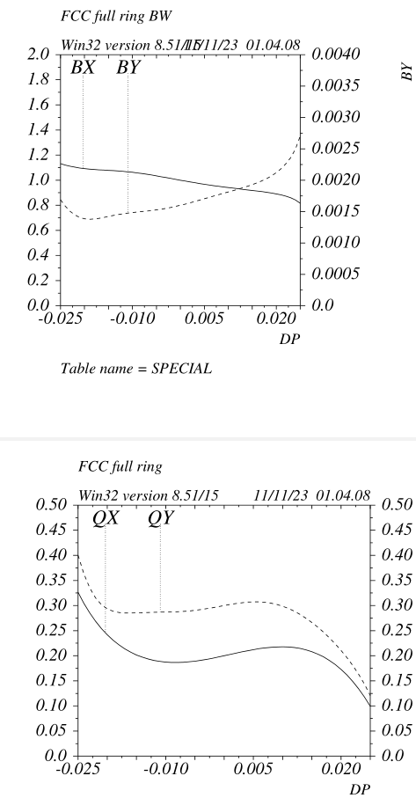
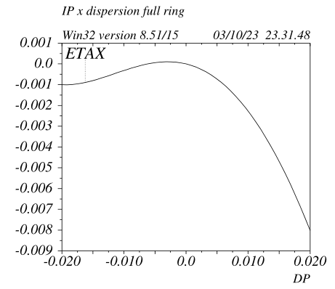
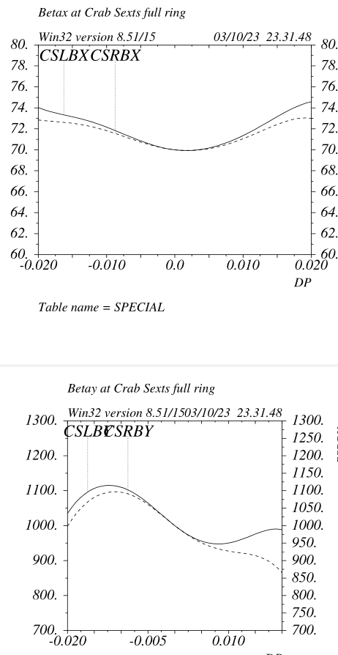
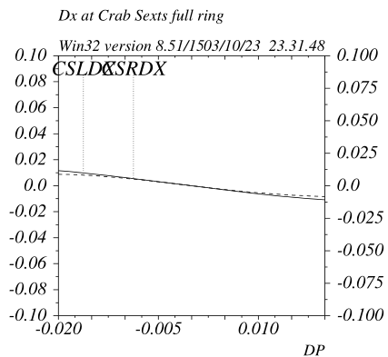
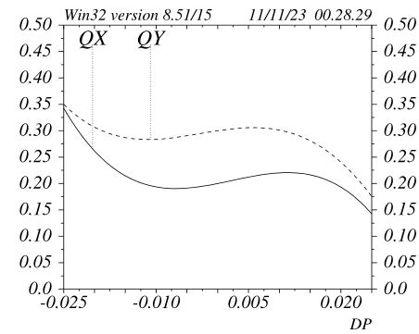
Full ring chromatic properties v_67 ttbar optic
Two very different FF do have nearly identical non linear dynamics.
Crab sextupoles dynamic betas are nearly optimal
Full ring chromaticity
ARC&LSS chromaticity

Slide 11
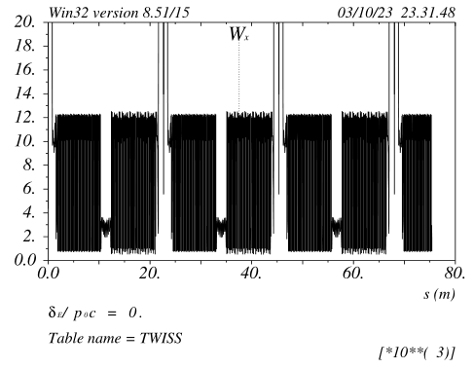
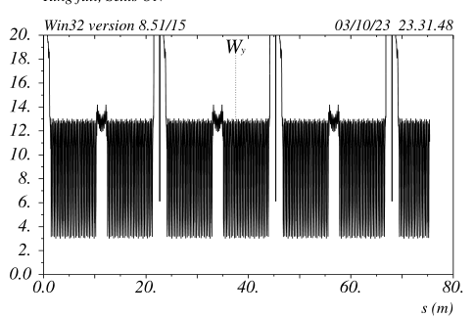
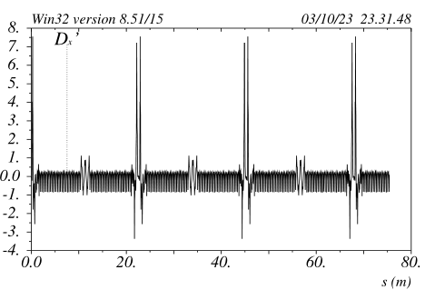
Full ring chromatic properties ttbar optic
Chromaticity in the ARCs is periodic and about 12 in both planes
This is extremely beneficial to reach and maintain top performances in a very short time
No sextupole families are needed
Because the “Full Achromat” FF property, there is no need to change the ARCs&FF sextupoles (and CS) setting when the beta-squeeze is done with the beta-matching quads This is extremely beneficial to reach top performances, it will be extremely useful to level the luminosity on the 4 IPs as well.

Slide 12
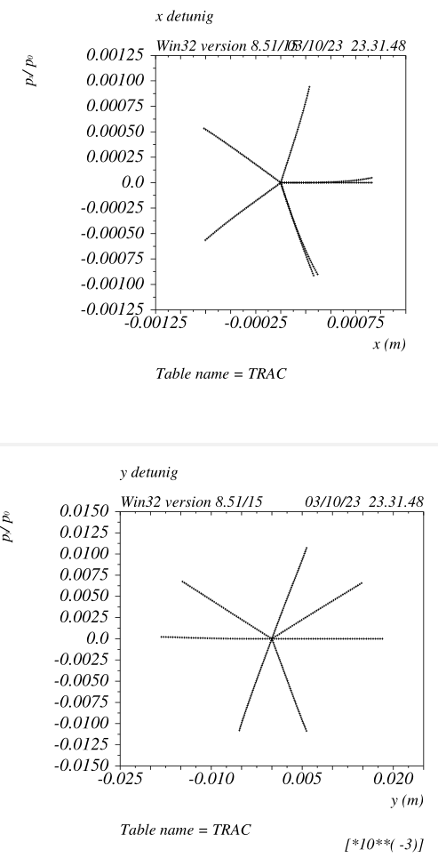
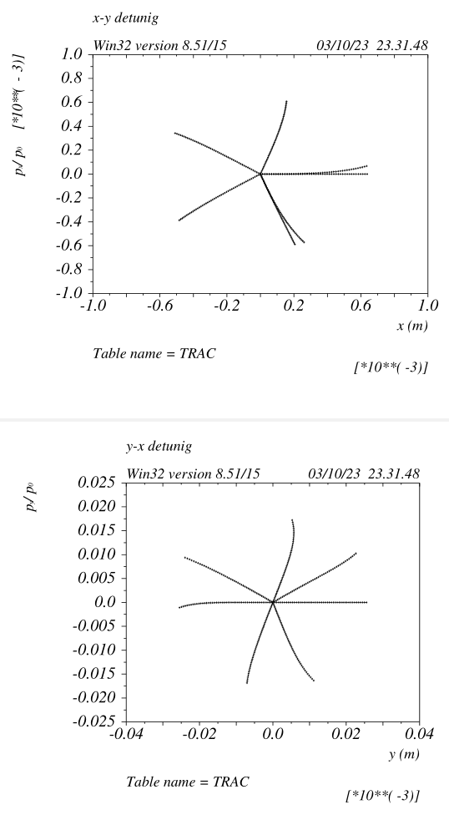
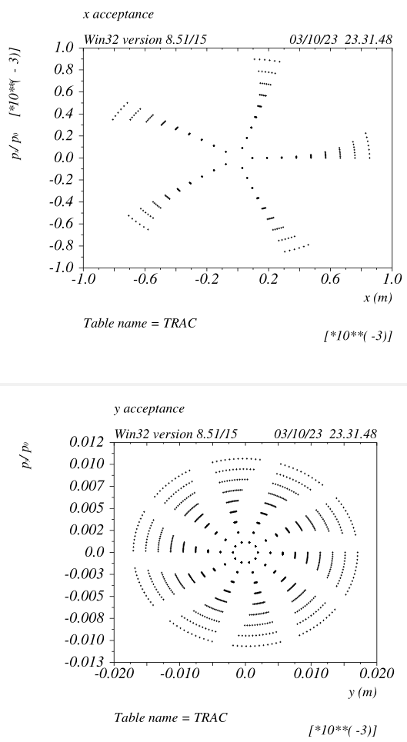
Full ring transverse DA v_67 ttbar optic
On energy dynamic is linear.
“Resonances” are virtually not existing.
Extremely favourable dynamics to minimize BeamBeam degradation (DS)
The quest/dream for a “quasi”
time-independent trajectory is
at reach!

Slide 13
Hardware requirements
ARC quadrupoles@ttbar HFD Baseline
Number of quads: 2408 2836
Total quads length (m): 5954 8224
Total integrated gradient K1L : 119 160
ARC sextupoles@ttbar
Number of sextupoles: 880 2336
Total sextupoles length (m): 571 3036
Total integrated gradient K2L : 786 2171
4*FF quadrupoles@ttbar
Number of quads: 128 160
Total integrated gradient K1L : 20 20
4*FF sextupoles@ttbar
Number of sextupoles: 56 16
Total integrated gradient K1L : TBC TBC
Energy loss per turn@ttbar (GeV): 9.0 10.4

Slide 14
Hardware requirements
    HFD Baseline
Number of ARC BPMs: 1024 2836
Number of ARC correctors: 1024 2836
- HFD ARC does not have Short straight sections, the sextupoles sit on the same support of the nearby quad. The combinations QF+SF and QD+SD have very similar length ~3.0m (SF/SD lengths ~0.40m/0.80m)
- HFD ARC alignment requirements are around 30um for quad-sext relative alignment and around 50-100um from quad to quad (see M Hofer/ S Liuzzo studies)
- Orbit stability requirement at the sextupoles scales with the optic sensitivity to sextupole misalignments (MH/SL/DS), for HFD is larger than 20um (@Z) in the ARCs and about 1um in the FF.
- FF SF/SD sextupoles have same characteristics (length and integrated gradient) of the ARCs SFs/SDs
- Remains to be checked that/if two quadrupoles powered by 8 coils do require less power wrt two paired quadrupoles powered with 2 coils (from a back-of-the-envelope calculation it seems to be the case)
- ARCs defocusing quads can be twice shorter (trade off between power consumption and SR and construction cost) bringing
down the total quads length to about 4800m
- HFD Quads+Sexts power consumption is around 1.5-2 times lower wrt baseline

Slide 15
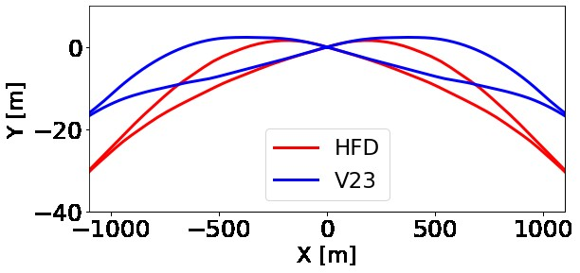
FF layout
IP position for v_74 is shifted further outward
by about 10mt wrt baseline.
On the positive side the width of the tunnel is significantly reduced
A few meters can be recovered by lengthening the
FF by about 100m (incidentally further increasing the
dispersion on the sextupoles and weakening the dipoles)
This will make the location where the two beams split more similar to the baseline.
Finally I will study the case were the CCSy-incoming
dipoles are reversed. This will make the layouts virtually identical. The challenge is to be able to control the high order chromatic functions when negative contributions are added (e.g. second order dispersion) and ensuring large dispersion at the SDs

Slide 16
Some LCCO highlights
ARC tuning nearly identical to the EBS one (highest energy ring with lowest horizontal emittance existing so far)
FF tuning knobs are very standard and can be built accordingly to the SLC/NLC/LEP ones
Large orthogonality of many fundamental quantities, that can be varied separately with no need to retune other quantities:
- ARC chromaticities
- Machine tunes
- FF chromaticities
- Individual IP betas
- Individual CS pairs
- Local FF tuning knobs
All requirements on tolerances and stabilities for LCCO are very relaxed (M Hofer S Liuzzo)

Slide 17
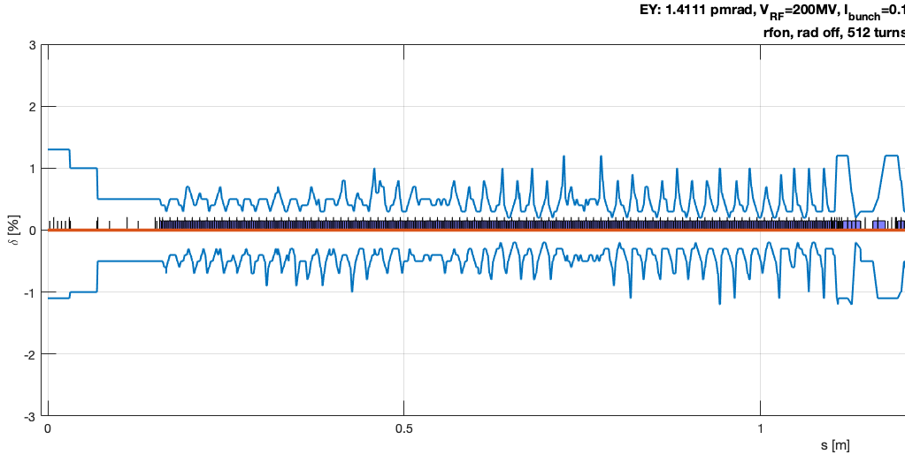
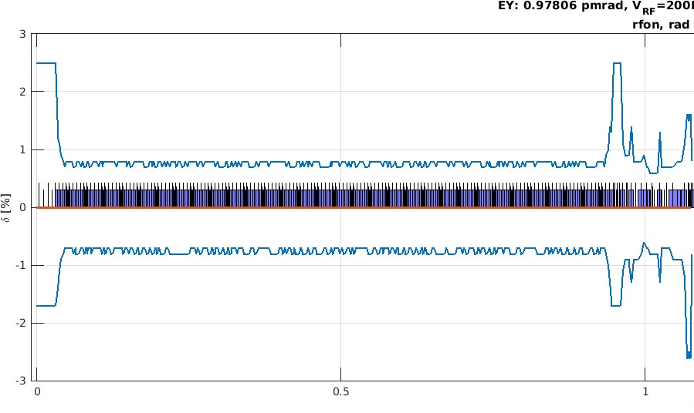
Local Momentum Acceptance
Local Momentum Acceptance is a convolution of DA and MA,
were DX<>0, additional local nonlinearities reduce it even further
For baseline LMA drops to a few e-3 in the ARCs.
Adding errors and BB, DA&MA degradation will reduce it even further,
down to 1e-3 or less
Potential drawbacks: gas, tousheck lifetime, background, instabilities?
In all cases LMA must be evaluated with errors and BB,
consequences on machine parameters and hardware requirements
Reassessed
Given the high non-linearties (for LCCO as well), it is necessary
to compute the X&Y Local Dynamic Aperture as well
(although in principle it should be flat…)
Baseline Z optic
LCCO Z optic

Slide 18
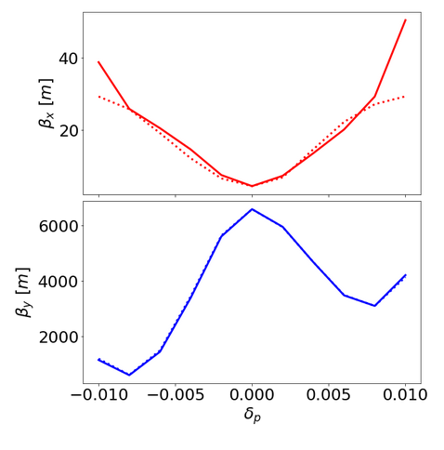
Crab sextupole beam dynamics
Z-optic LCCO
Z-optic baseline
Twiss parameters not defined for abs(de)>0.01
- Baseline CS optics requirements for BB compensation valid for a very narrow energy range (~1e-3)
Very large off energy DA and MA reduction are compensated with sextupoles families.
- Large nonlinearities and delicate high order cancelations are necessary through the ARCs
- LCCO does not compromise CS effectiveness with other requirements.
For Baseline and LCCO a fallback solution (and relative parameters set) that does not rely on CS should
be made as well

Slide 19
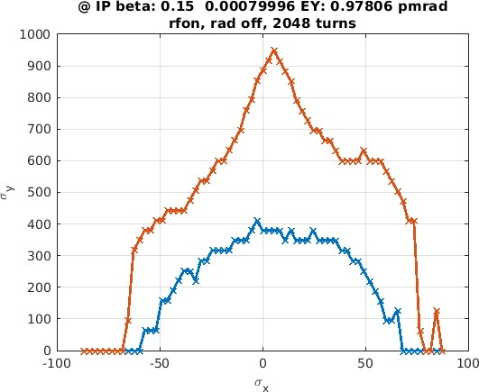
To be studied
DA and MA without SR is extremely large.
The shrinkage due to the different contribution should be quantified:
- dipoles
- ARC quads
- FF quads
- FD quads
Solutions to mitigate the reduction should be studied
Z-mode
- Baseline MA is very small (<1e-3) without the implementation of sextupole families.
LCCO has DA&MA comparable or better wrt baseline (~2-3%) with no sextupole families
LCCO with some very moderate sextupoles modulation can lead to even better performances.
This possibility should be carefully studied and its pro and cons evaluated.
- Low-muy HFD ARC lattice delivers lower emittance @ttbar and has much lower residual third order chromaticity
This possibility should be analyzed as well.

Slide 20
Conclusions
LCCO includes all the know-how and experience acquired in designing, building, commissioning and operating most of the high-energy and high-luminosity linear and circular colliders that have been operating in the past 30 years.
Many innovative solutions developed in the very active (and forefront) Synchrotron Radiation Accelerator community are utilized as well
LCCO hardware requirements are in line with standard (and cheap) solutions adopted for most of the colliders built so far
LCCO is an invaluable opportunity to further progress in Accelerator Physics and push forward the frontier of High Energy Science

