Slide 1

INVITATION TO TENDER
IT-4763/EP – Bidders’ conference 18 September 2023

Slide 2


IT-4763/TE
Commercial documents

Slide 3
Key dates
Invitation to Tender issued: 25 August 2023
Compulsory bidders’ conference: today
Bids to be returned to CERN by 29 September 2023
Finance Committee: December 2023
Contract negotiation and notification
Start of the contract: 1st April 2024

Slide 4

IT documents
Tender form
Technical specification + annexes
Evaluation questionnaire
Working on the CERN site
Letter from Swiss OCIRT
General Conditions of CERN Invitations to Tender CERN/FC/6674/I
General Conditions of CERN Contracts CERN/FC/6674/II
…

Slide 5

Clarification Process
All questions shall be addressed in writing to
Charles.Carayon@cern.ch with cc to procurement.service@cern.ch and Burkhard.schmidt@cern.ch
Requests for clarification should be received earlier than 19 September 2023

Slide 6
Clarification Process
CERN’s response will be sent to all bidders, including the request for clarification but without identifying its source
Bidders shall acknowledge receipt of the email
Cover letter with bid shall acknowledge each individual CERN clarification correspondence received

Slide 7


Basis of Award
The contract shall be awarded on
«Best Value for Money» basis to the bidder submitting
the most economically advantageous bid

Slide 8
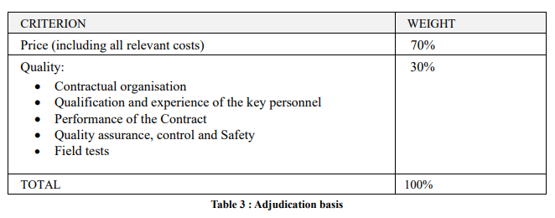
Selection & Adjudication Criteria
The following criteria and weights will be applied by CERN to evaluate the bids:

Slide 9

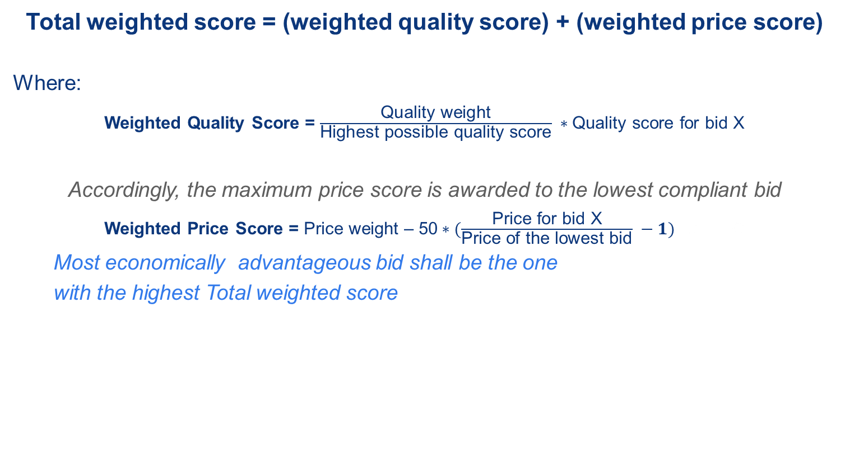
Scoring
Total weighted score = (weighted quality score) + (weighted price score)
Where:
Weighted Quality Score = $\frac{\text{Quality} \text{weight}}{\text{Highest} \text{possible} \text{quality} \text{score}} ∗\text{Quality} \text{score} \text{for} \text{bid} \text{X}$
Accordingly, the maximum price score is awarded to the lowest compliant bid
Weighted Price Score = Price weight – 50$∗(\frac{\text{Price} \text{for} \text{bid} \text{X}}{\text{Price} \text{of} \text{the} \text{lowest} \text{bid}} −1)$ C G
Most economically advantageous bid shall be the one
with the highest Total weighted score

Slide 10
Quality assessment
Will be based on the Evaluation questionnaire
Bear in mind that: “The questionnaire duly signed constitutes the bidder’s technical offer, which terms shall become binding in case of award of contract. ’’

Slide 11

Price Basis
All prices shall be quoted in CHF, free of taxes, not subject to revision until 31 March 2025.

Slide 12
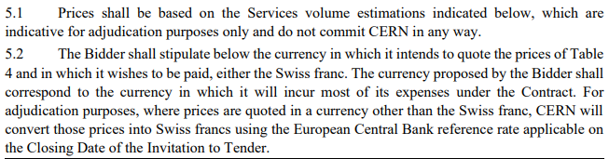
Price basis for adjudication

Slide 13
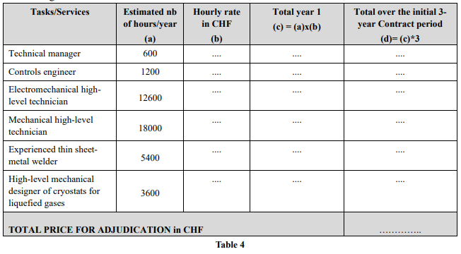
Price Table

Slide 14
Abnormally low bids
CERN reserves the right to reject abnormally low bids after having given the bidder the opportunity to explain the basis on which its bid was made.
The bidder will have to prove that its bid:
is compliant with all tender requirements and applicable law
is economically viable, and
has taken into account any substantial risk.
If the explanations provided by the bidder are insufficient or inconclusive, CERN reserves the right to reject the bid.

Slide 15
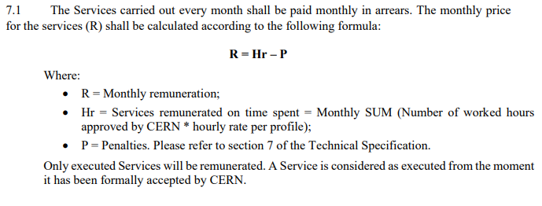
Remuneration

Slide 16
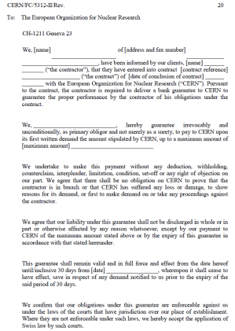
Remuneration
The first invoice shall be accompanied by a bank guarantee from a bank approved by CERN (BBB+ at least) of 10 % of 1st year contract price and valid until six months after the contract end

Slide 17
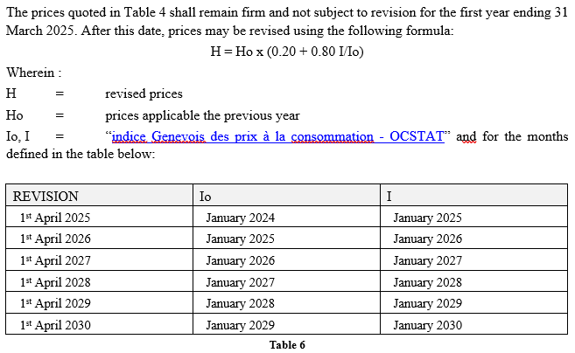
Price revision

Slide 18

VAT
Prices shall take into account CERN’s exoneration from VAT and import duties
VAT shall be subject to the rules and invoicing instructions as defined under the following link:
https://procurement.web.cern.ch/system/files/document/vat-and-invoicing-guide-en_0.pdf

Slide 19

Instructions for submission
CERN will apply a double-envelope procedure for the opening of the bids
Bidders shall establish a commercial and a technical bid to be submitted in two separate links bearing the reference of the invitation to tender:
-http://cds.cern.ch/record/2868283,(IT-4763/EP/COMMERCIAL);
-http://cds.cern.ch/record/2868286 (IT-4763/EP/TECHNICAL).

Slide 20
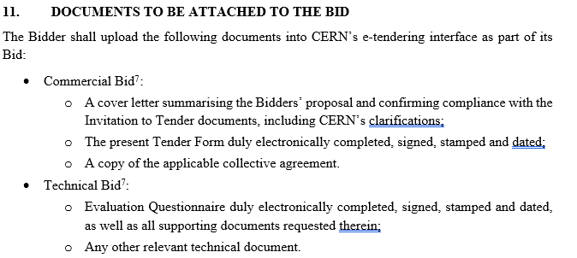
Instructions for submission
CERN will apply a double-envelope procedure for the opening of the bids

Slide 21
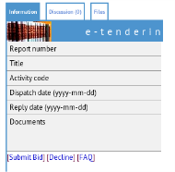
e-tendering instructions
Bids shall in no event be sent by post, e-mail or fax
All documents comprising the bid have to be uploaded on the CERN e-tendering application by using the button [Submit Bid] in the CERN e-tendering application
The uploading may take time so we advise you to start at least one hour before the time limit
In case you do not intend to submit a bid, please inform us, by using the button [Decline] in the CERN e-tendering application
If you have any problems or enquiries regarding the registration of your firm, the upload of your bid please consult the [FAQ] in the CERN e-tendering application or contact procurement.service@cern.ch

Slide 22

Return Date
Bids shall be RECEIVED by CERN on
29 September 2023, 4 P.M
at the latest

Slide 23
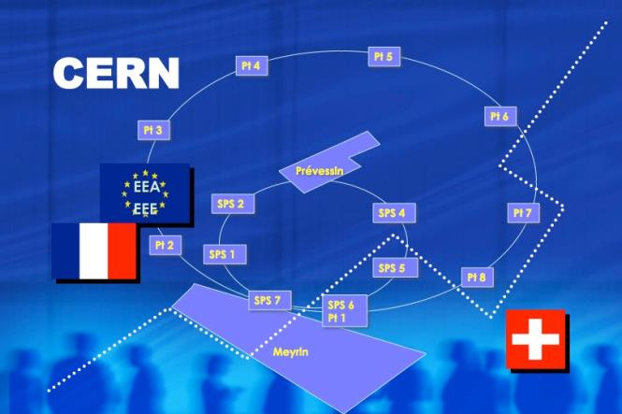
Law Applicable to Contractor’s Personnel

Slide 24

Reminder
According to its status CERN has the right to establish its own rules (i.e. SRR, safety rules, CPR) which are applicable to all
HOWEVER: Contractors shall comply with common law as well as CERN rules

Slide 25
















According to the principle of territoriality established under the Swiss-French agreement of 1965, contractors must comply with the law of their country of origin as well as with a number of provisions concerning the working conditions of their staff applicable in the country where services are executed
2 territories where services are executed
= 2 applicable laws in addition to the one in their country of origin
+
+
Note: territoriality applies to the current “FSU” contracts

Slide 26
The application of the principle of territoriality creates practical and legal problems for contractors and their staff. The two host countries, with CERN, have therefore defined a new system:
2 territories where services are executed
=
only 1 applicable law in addition to the one in their country of origin
or
+

Slide 27






Areas Concerned
rest time & leave
the minimum wage
hygiene, safety and health at work
protection for young workers and pregnant women or have just given birth
equal treatment
temporary work
The other areas such as hiring, contract termination and personnel representation are not concerned by this new regime

Slide 28
4P
The applicable law is determined on the basis of the “Part Prépondérante Prévisible de la Prestation” = 4P
The 4P for this contract is located on the Swiss part of the CERN domain. The applicable law is thus Swiss law
This rule applies to the entire contract, including subcontractors unless subcontracting concerns only one territory

Slide 29
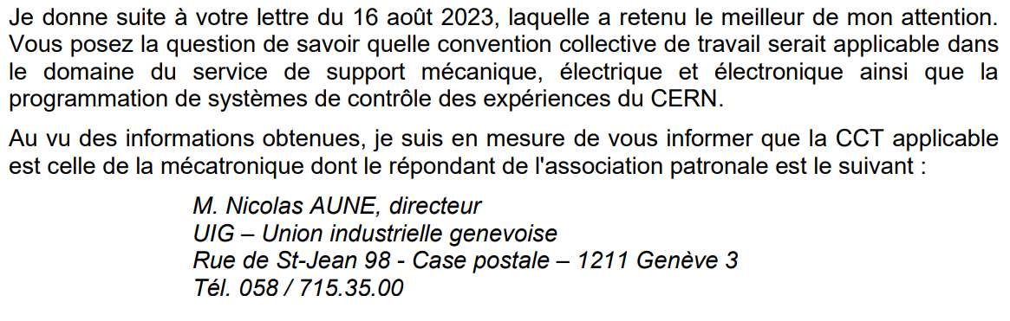
Collective agreement
OCIRT has informed CERN that the collective agreement applicable for the provision of services is Mécatronique (see OCIRT letter)

Slide 30
Relations with Host States
Switzerland / Suisse:
Office cantonal de l'inspection et des relations du travail (OCIRT)
Rue David-Dufour 5
CH-1211 Genève 8
T. +41 22 388 29 29
F. +41 22 388 29 69
reception.ocirt@etat.ge.ch

Slide 31


Slide 32
IT-4763/EP
Evaluation questionnaire

Slide 33

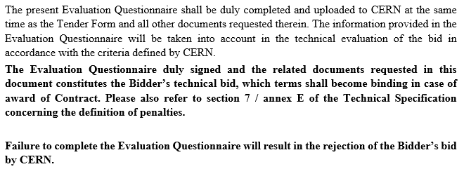

Evaluation questionnaire

