Slide 1
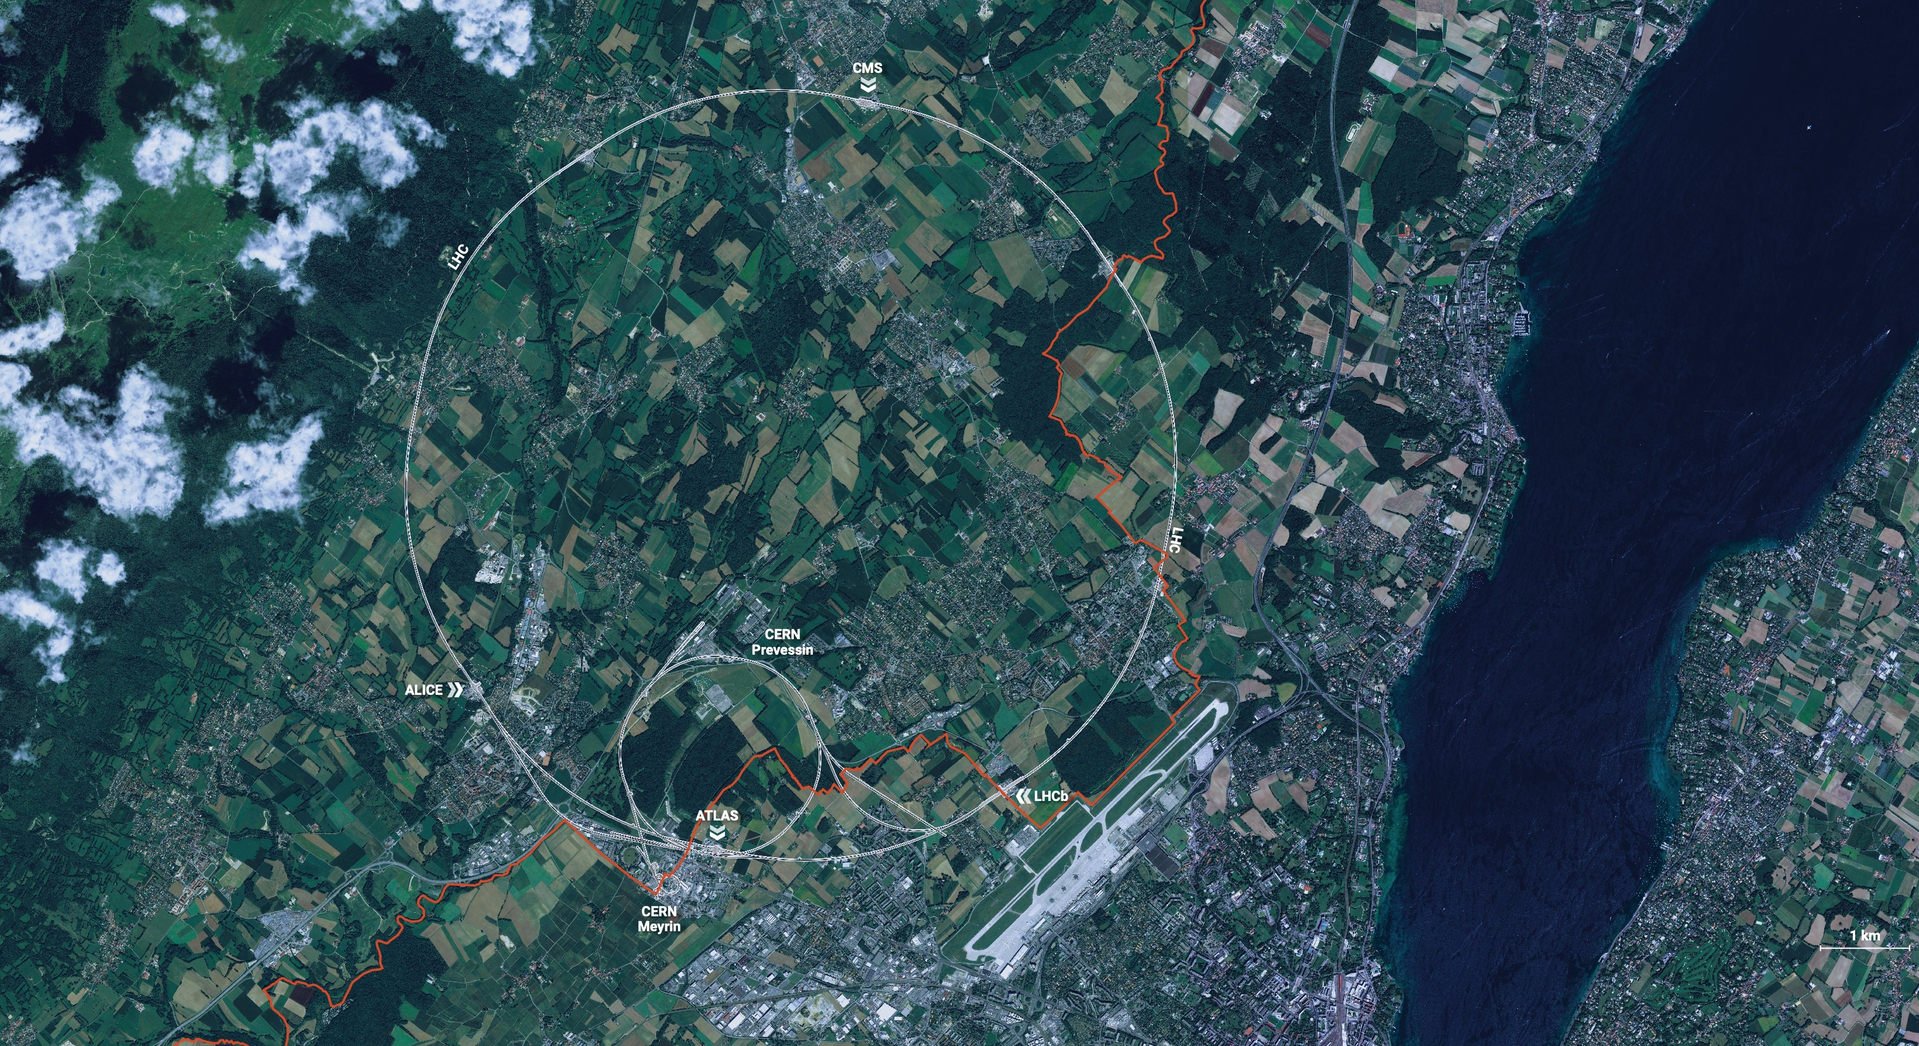
CERN is the world’s biggest laboratory for particle physics.
Our goal is to understand the most fundamental particles and laws of the universe.

Slide 2
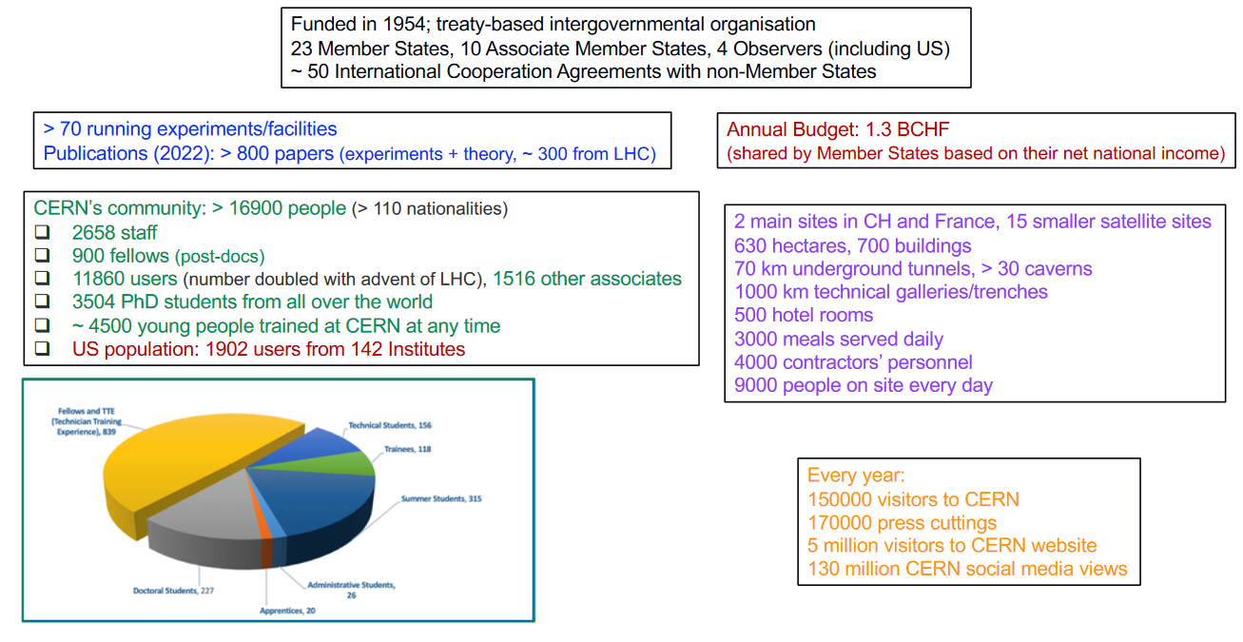
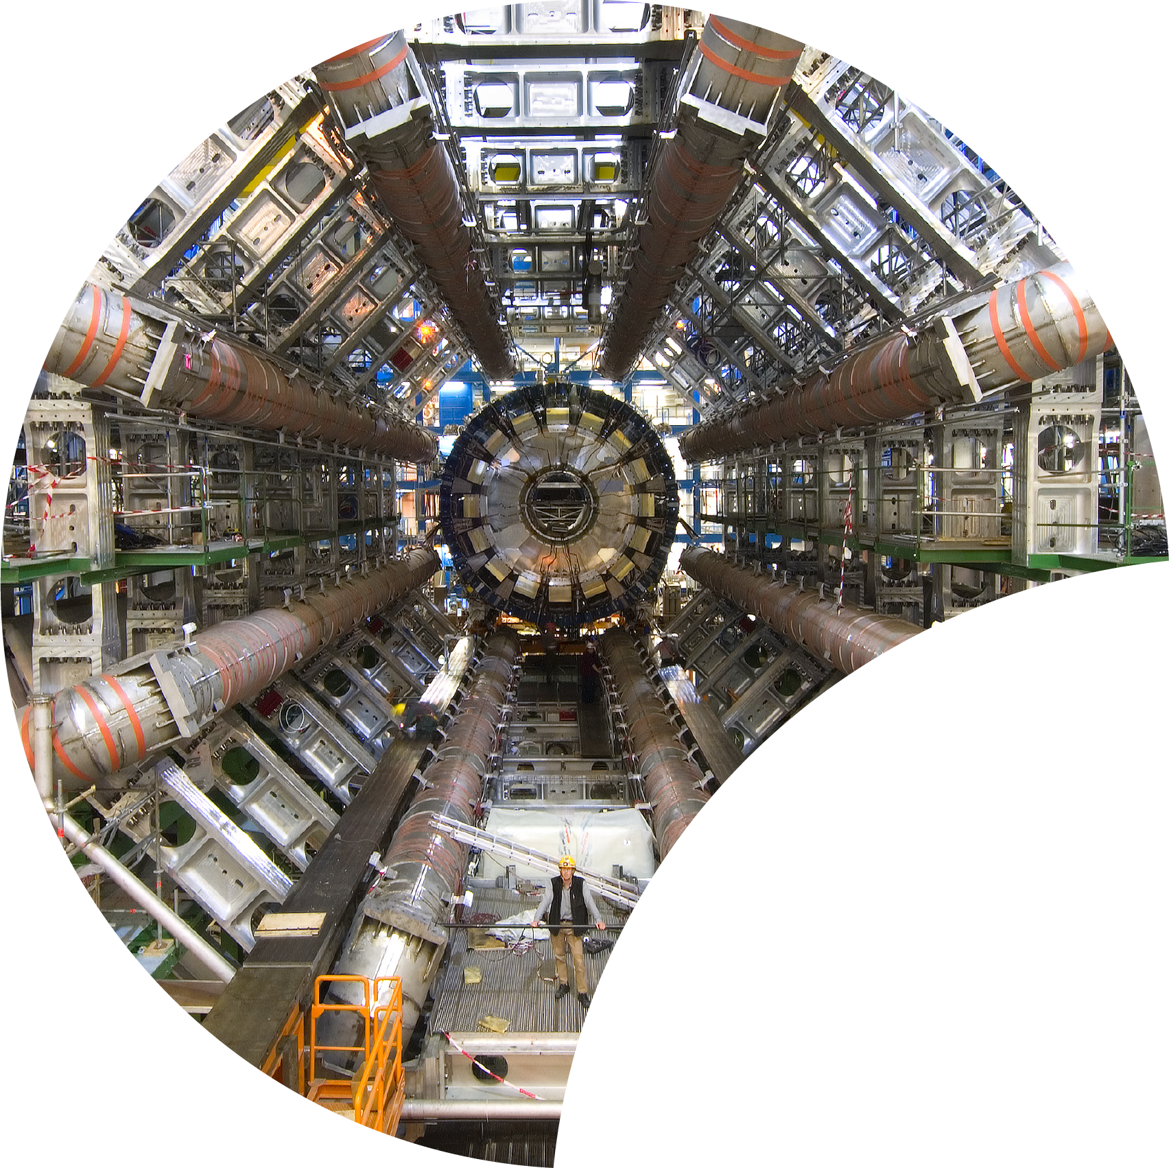
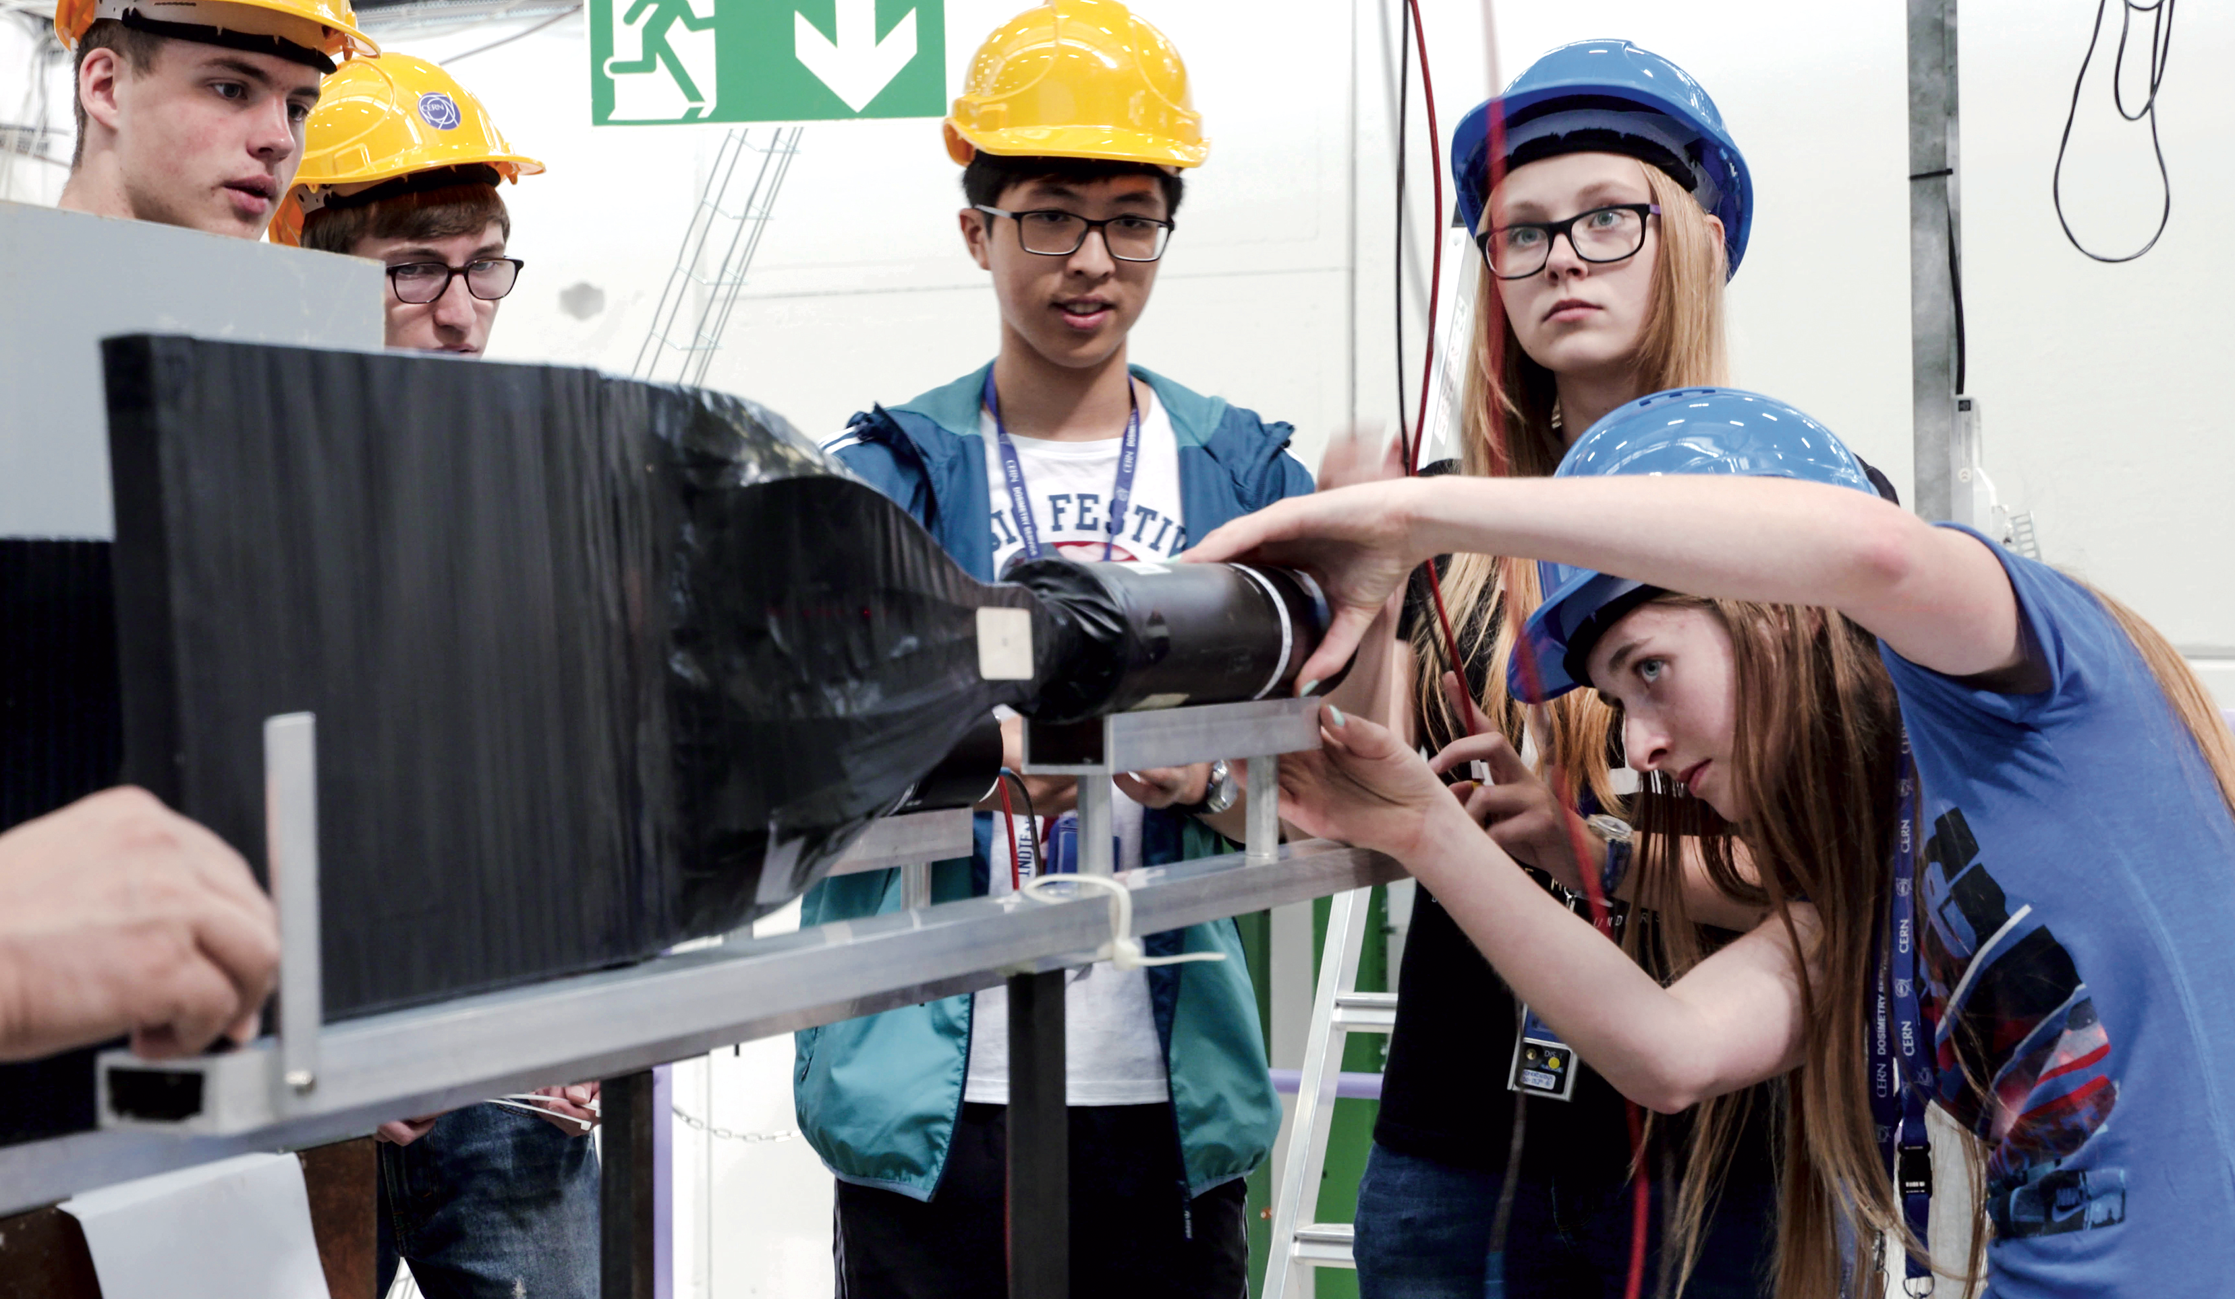

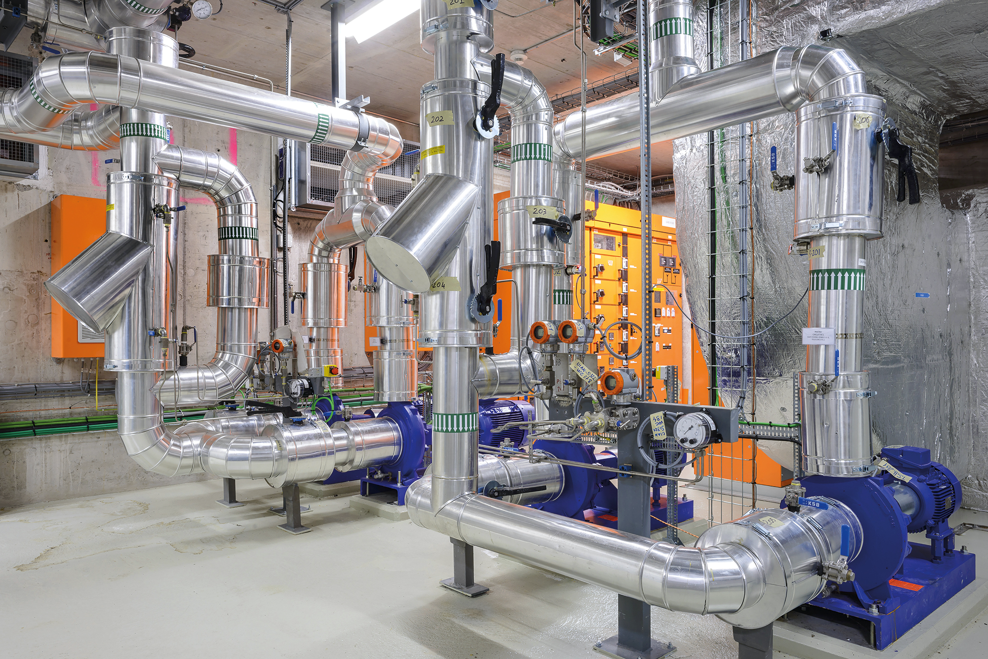

CERN in numbers
RESEARCH
EDUCATION & TRAINING
COLLABORATION
TECHNOLOGY & INNOVATION
Presentation Rotary Wien-Hietzing
8 March 2023
Notes:
This slide introduces the four pillars that underpin CERN’s mission:
Research: To perform world-class research in experimental and theoretical particle physics; and to provide the particle physics community a range of accelerators that enable that research
Collaboration: To unite people from all over the world in the common goal of advancing the frontiers of human knowledge, in a spirit of equal collaboration and openness
Innovation: To push the technology underpinning accelerators, detectors and computing, to drive innovation in order to transfer knowledge to other scientific and technological areas, for the benefit of society
Education and Training: To train future physicists and engineers, to promote careers in science and engineering, and to foster citizens’ engagement in particle physics and in fundamental research.
FROM THIS POINT FORWARD, THE PRESENTATION IS DIVIDED INTO FOUR SECTIONS: ONE SECTION PER PILLAR

Slide 3
Four pillars underpin CERN’s mission
RESEARCH
EDUCATION & TRAINING
COLLABORATION
TECHNOLOGY & INNOVATION
Notes:
This slide introduces the four pillars that underpin CERN’s mission:
Research: To perform world-class research in experimental and theoretical particle physics; and to provide the particle physics community a range of accelerators that enable that research
Collaboration: To unite people from all over the world in the common goal of advancing the frontiers of human knowledge, in a spirit of equal collaboration and openness
Innovation: To push the technology underpinning accelerators, detectors and computing, to drive innovation in order to transfer knowledge to other scientific and technological areas, for the benefit of society
Education and Training: To train future physicists and engineers, to promote careers in science and engineering, and to foster citizens’ engagement in particle physics and in fundamental research.
FROM THIS POINT FORWARD, THE PRESENTATION IS DIVIDED INTO FOUR SECTIONS: ONE SECTION PER PILLAR

Slide 4
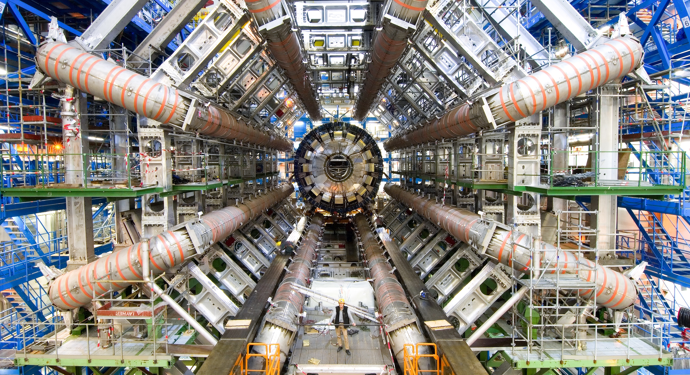
RESEARCH
Notes:
This is the title slide for the section on “Research”.
It can be shown for just enough time for viewers to take in the beauty and impact of the image.
(THIS SECTION HAS 13 SLIDES, INCLUDING ONE OPTIONAL SLIDE)

Slide 5
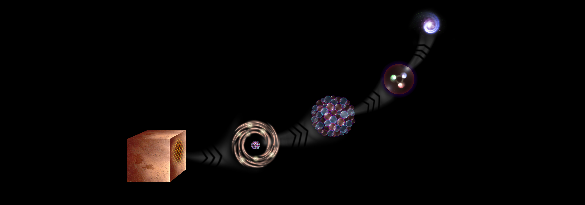
What is the universe made of?
We study the elementary building blocks of matter and the forces that control their behaviour
Quark
<10⁻¹⁸ m
Proton
~10⁻¹⁵ m
Nucleus
~10⁻¹⁴ m
Electron
Matter
0,1 m
Atom
~10⁻¹⁰ m
Notes:
This slide and the next address the questions that underpin research in particle physics.
One of the questions is “What are we made of?”
To answer this question, we study the fundamental particles that make up matter.
The speaker takes the visitors on a brief journey from visible matter to the electron and the quark: electrons and quarks are the fundamental particles of matter

Slide 6
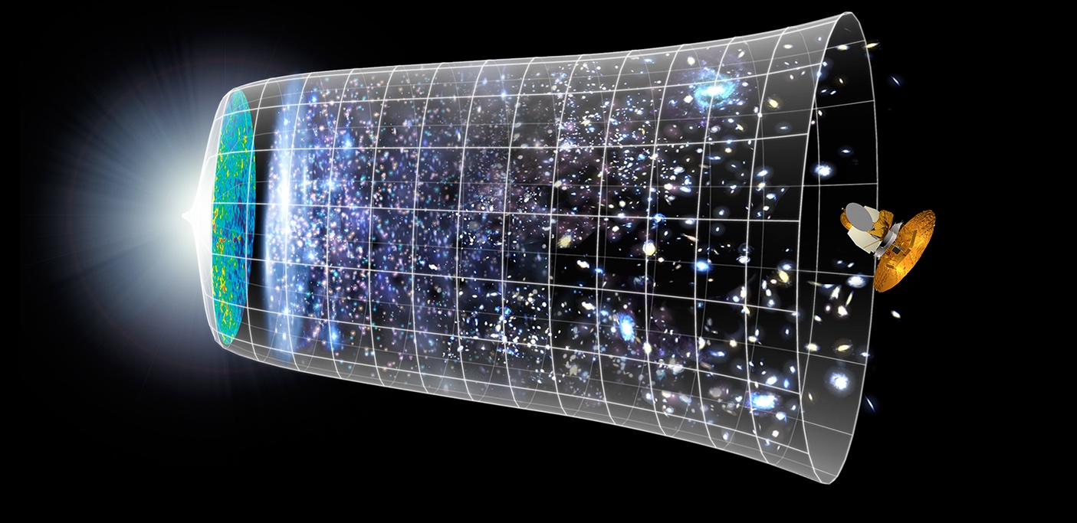

How did the universe begin?
Big Bang
We reproduce the conditions a fraction of a second after the Big Bang, to gain insight into the structure and evolution of the universe.
Telescopes
Accelerators
380 000 years
13.8 Billion Years
Today
10²⁸ cm
Notes:
The other question that underpins research in particle physics is “How did the Universe begin?”
We gain insight into the structure and evolution of the Universe, from the first billionth of a second (10⁻¹²s) after the Big Bang.
From the very small (particle physics at modern accelerators allows us to study the fundamental laws of nature on scales down to smaller than 10⁻¹⁸ m) to the very big (telescope-based astrophysics), we gain knowledge about the laws and evolution of the universe.

Slide 7
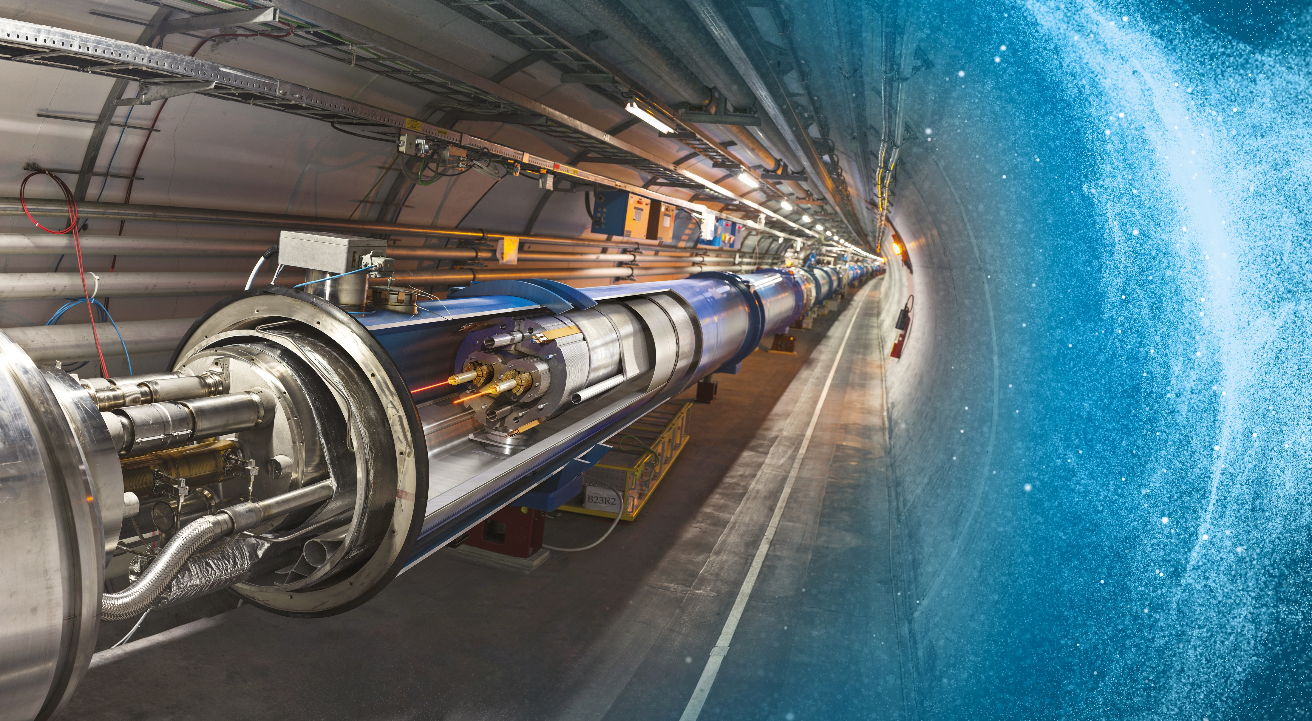
Large Hadron Collider (LHC)
27 km in circumference
About 100 m underground
Superconducting magnets steer the particles around the ring
Particles are accelerated to close to the speed of light
Presentation Austria
16 December 2022
Notes:
The LHC is CERN’s flagship accelerator.
Possible additional information to complement what is on the slide (TIME PERMITTING):
It is the world’s largest and most powerful particle accelerator
Protons (and lead ions) circulate in two beams, which travel in opposite directions in two separate beam pipes
Protons are accelerated to 99.9999991% the speed of light (11 245 turns/second)
The beam pipes are under ultrahigh vacuum, to avoid collisions between the particles and gas molecules. The vacuum in the beam pipes is 10⁻¹³ atm – similar to the atmosphere on the moon (10⁻¹⁵ atm)
It is one of the coldest places in the Universe (1.9K; -271.3°C)
Superconducting magnets are used to focus the beam (quadrupole magnets) and bend the beam around the circular accelerator (dipole magnets)
The LHC is built in the same tunnel where CERN’s previous flagship accelerator was located – LEP, which accelerated electrons

Slide 8
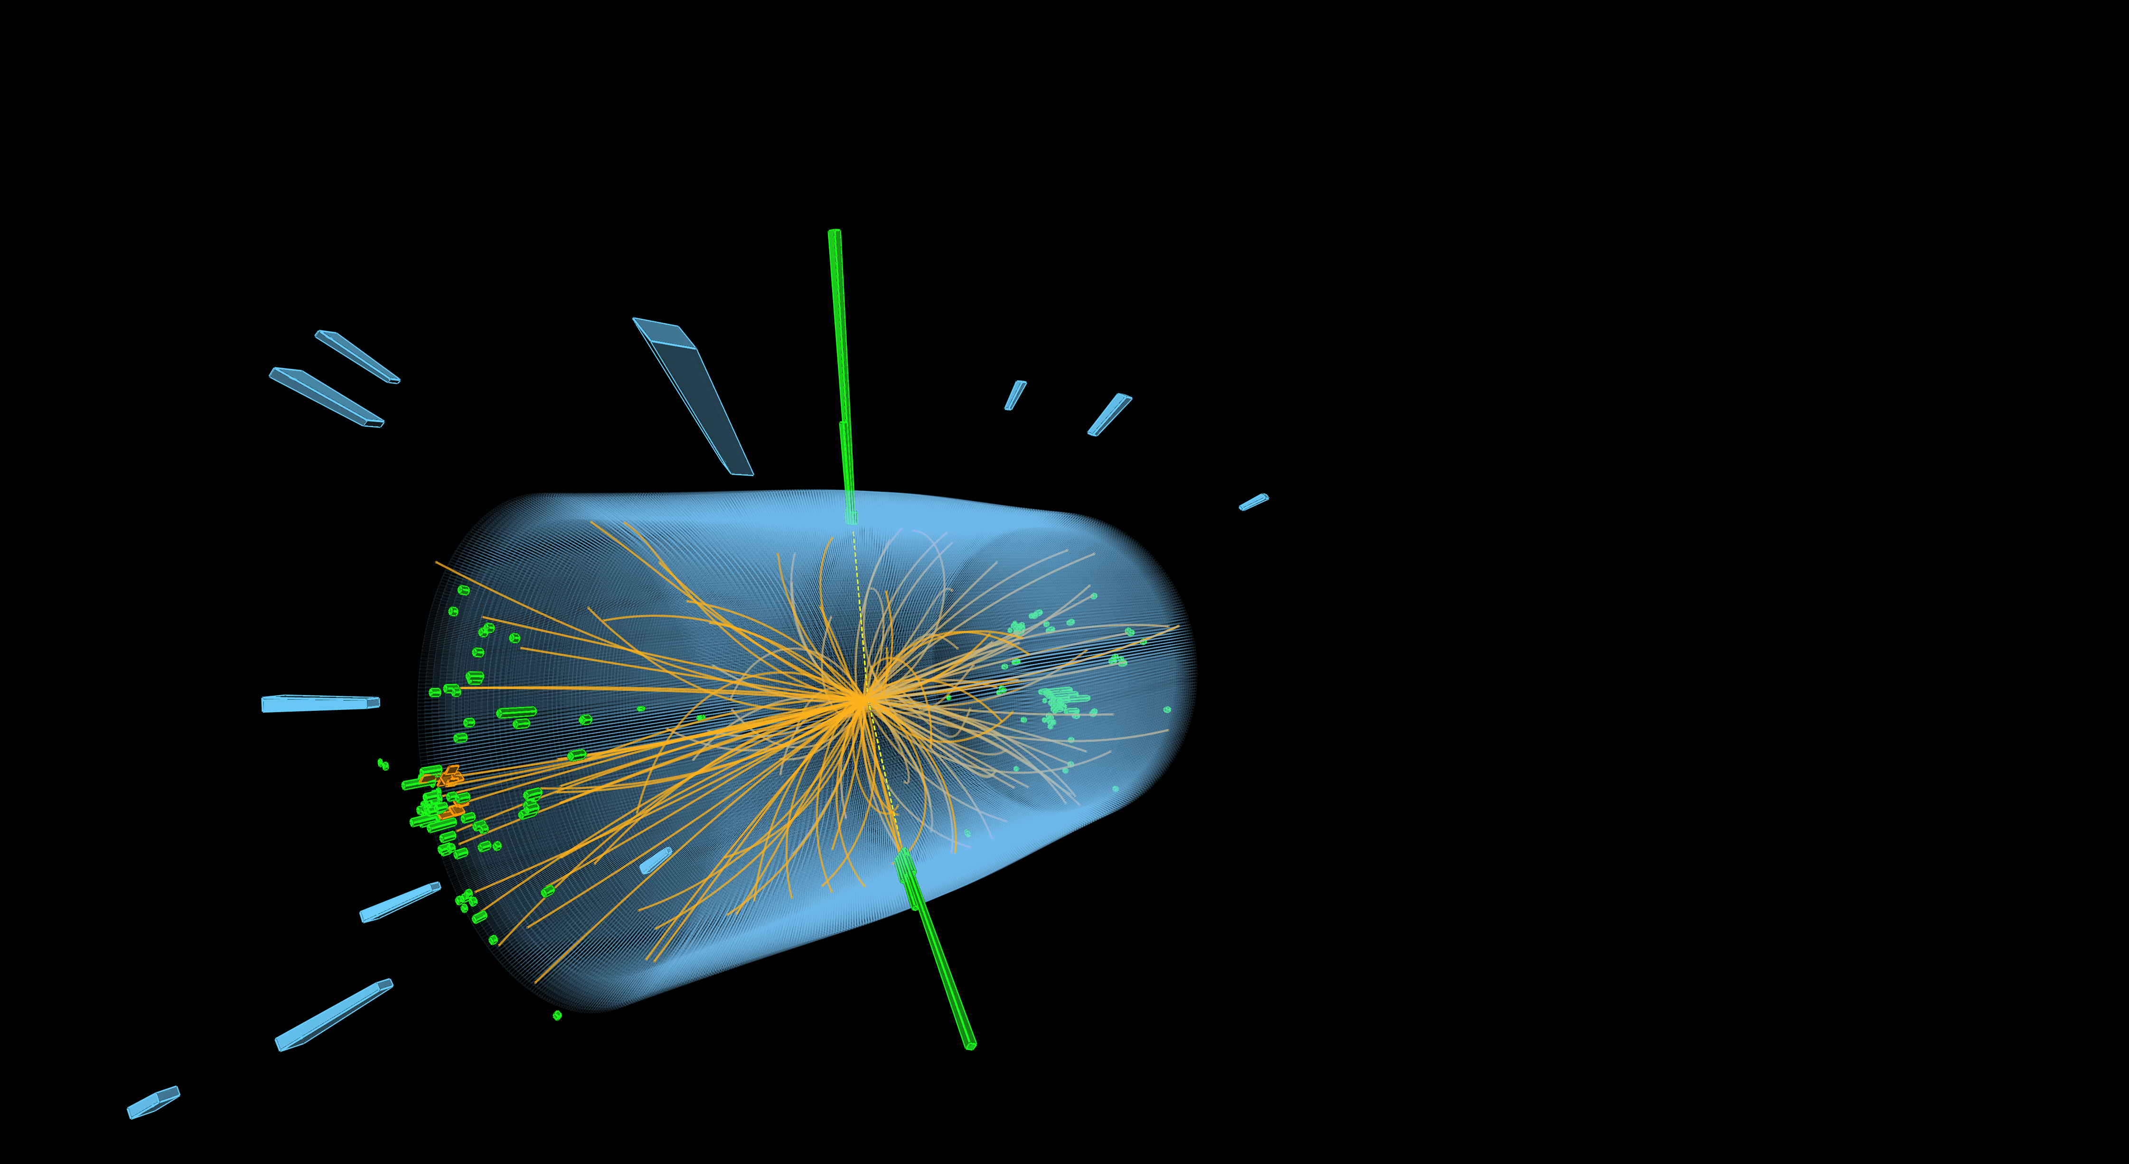
The LHC produces more than 1 billion particle collisions per second
The energy of the particles in collision is converted into new particles.
Notes:
Possible complementary information (TIME PERMITTING)
- At collision point, the energy density or temperature is equivalent to 10⁻¹²s after Big Bang (10¹⁶°C).
- The two proton beams collide at a combined energy of 13 TeV. A flying mosquito has about 4 trillion electronvolts of energy, so a collision in the LHC generates the energy of about 3 flying mosquitoes. But the energy is crammed into a space about 1 trillion times smaller across than the insect.
Nowhere else on Earth can we concentrate energy to that extent.

Slide 9
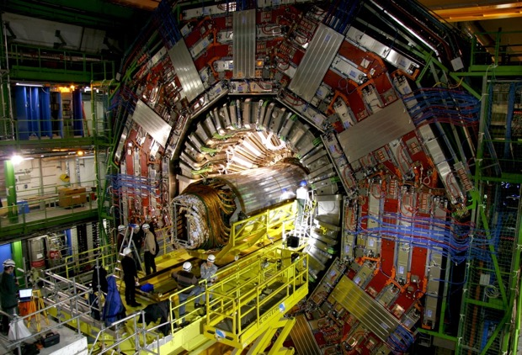
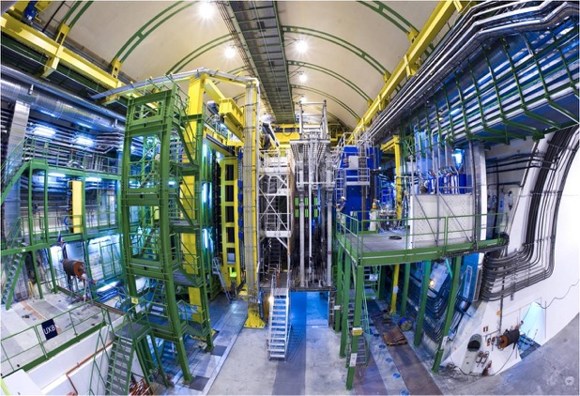
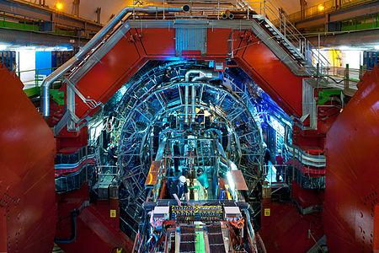
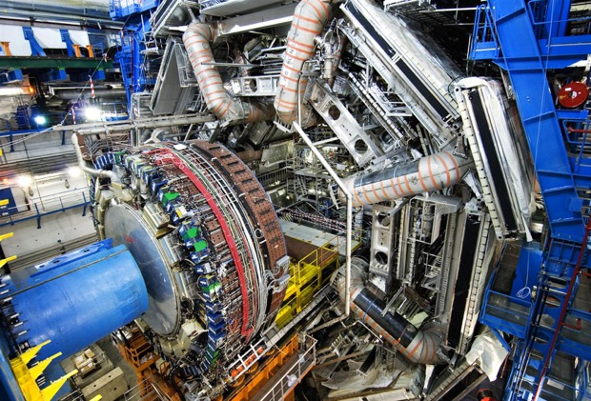
CMS
LHCb
ALICE
ATLAS

Slide 10
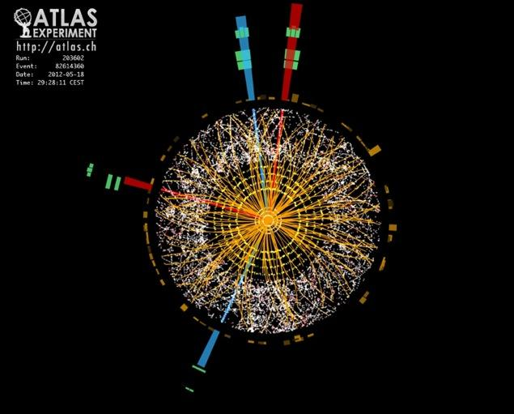
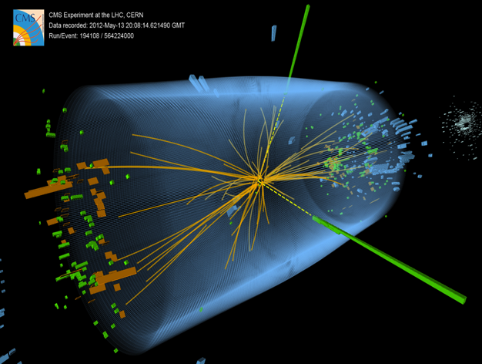
Higgs boson
Discovered in 2012

Slide 11
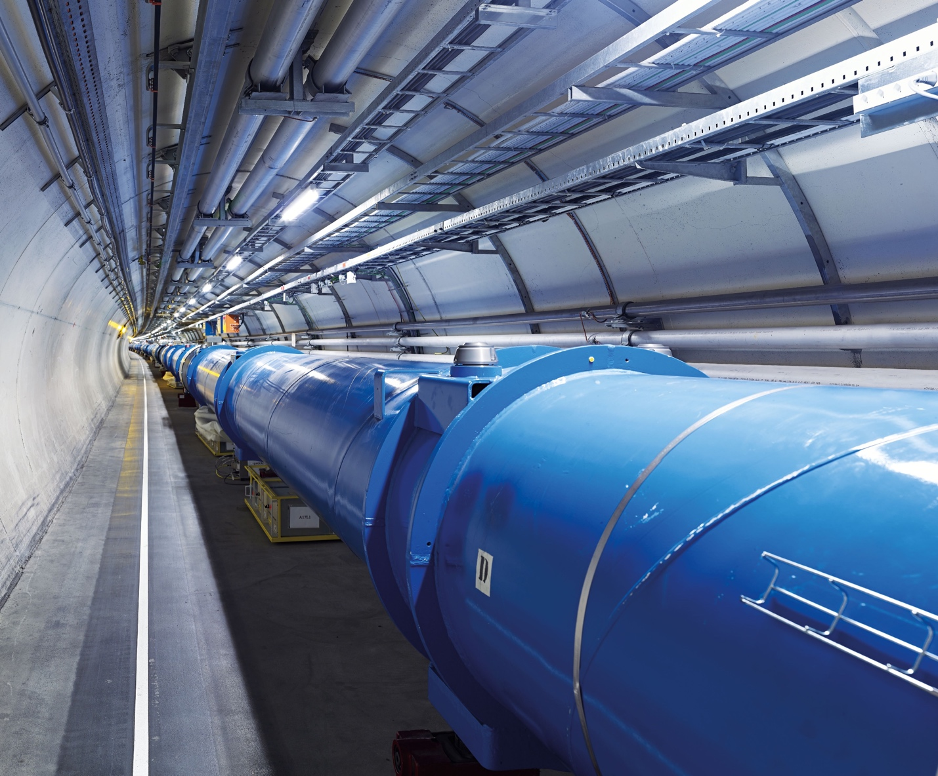
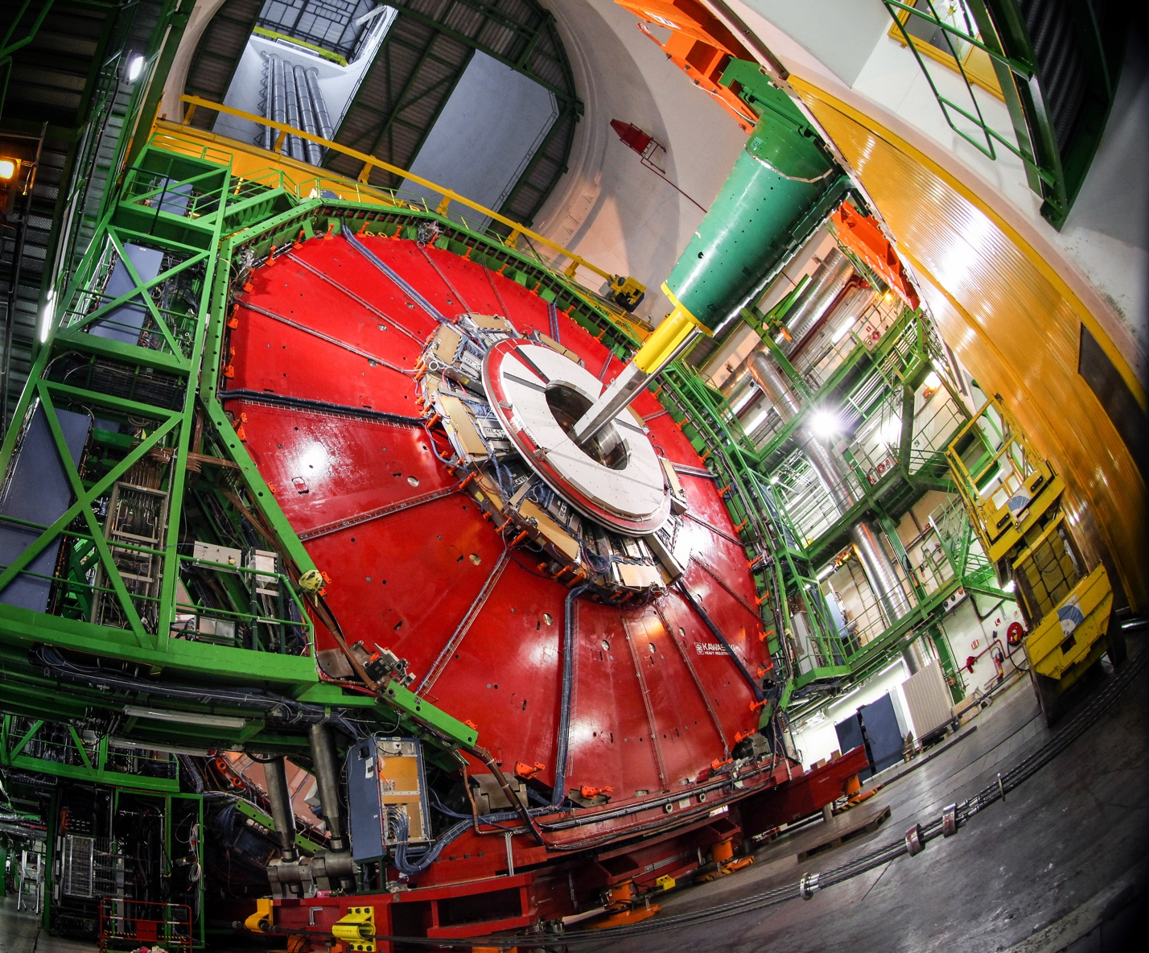
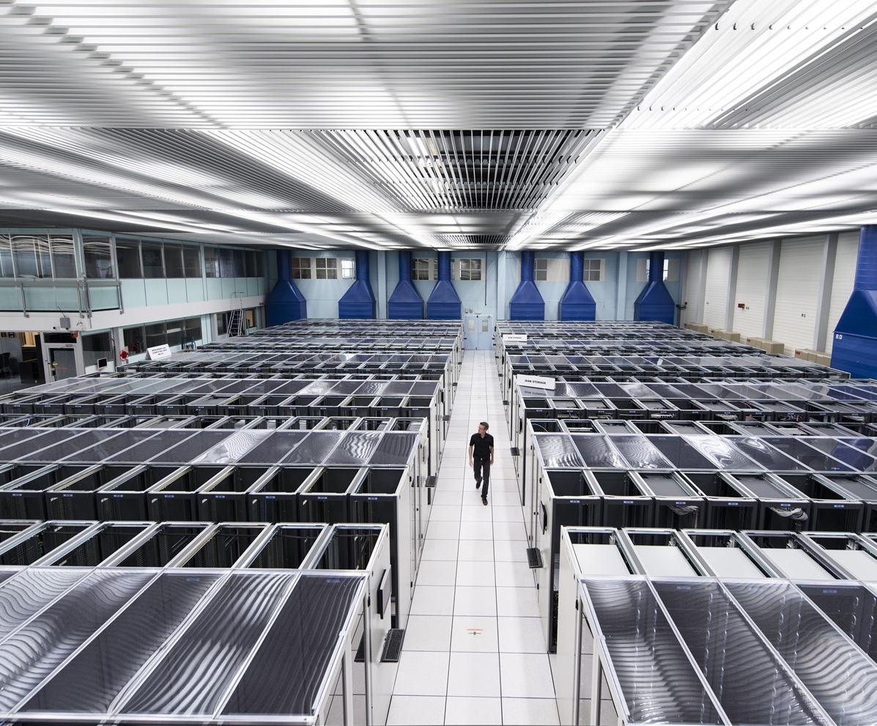
We develop technologies in three key areas
ACCELERATORS
DETECTORS
COMPUTING
Notes:
This slide presents the three technological fields that allow CERN to answer the questions presented earlier.
The following slides focus on each of these fields, so here the speaker may give a 1-2 sentence description of each.
For example:
Accelerators - We build and maintain a range of particle accelerator facilities, where particles are accelerated to almost the speed of light
Detectors – built by consortia of physicists and engineers from across the globe, this is where collisions occur and where new, hitherto unknown particles may be formed, and new interactions between particles identified.
Computing – experiments at CERN generate enormous amounts of data. This data is collected at CERN and sent around the world to be processed and stored.

Slide 12
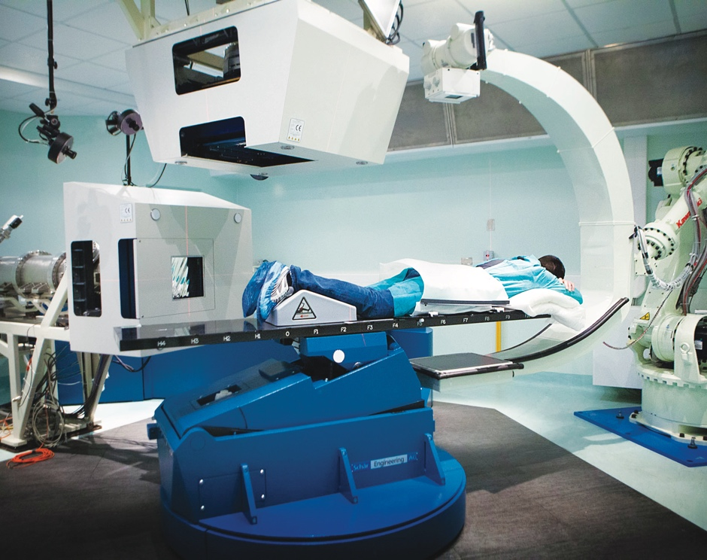
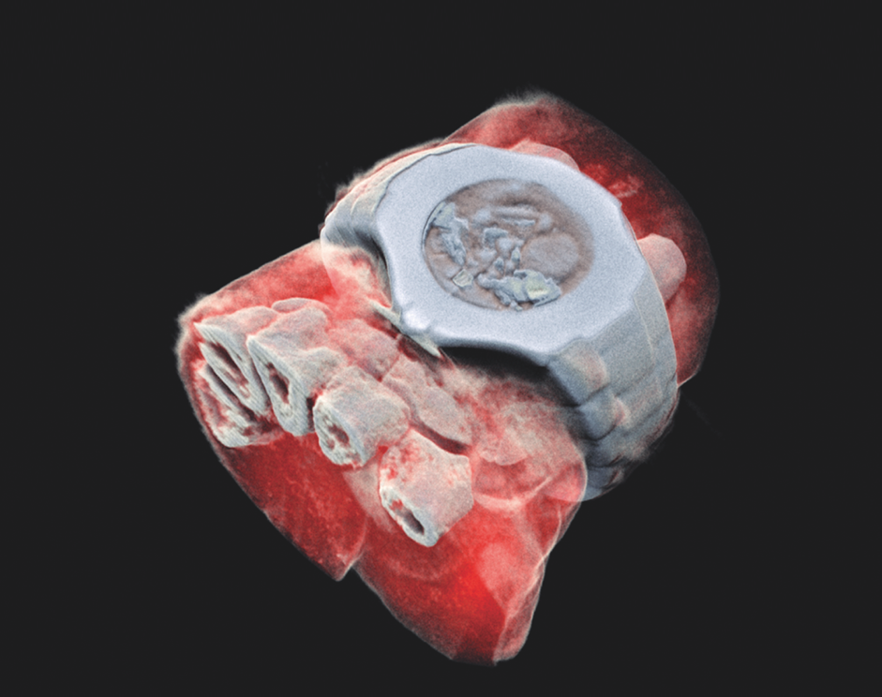
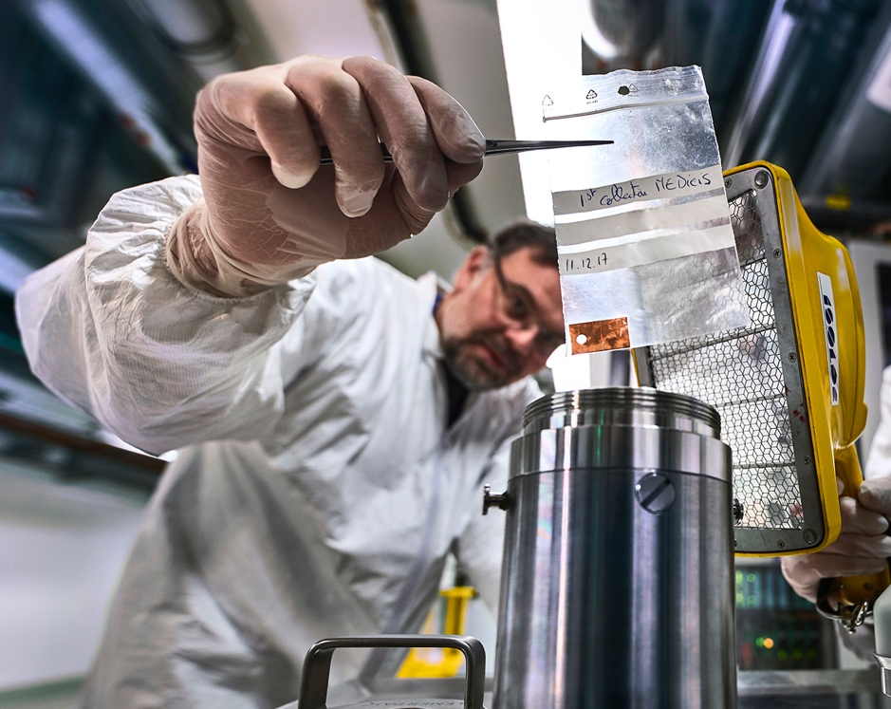
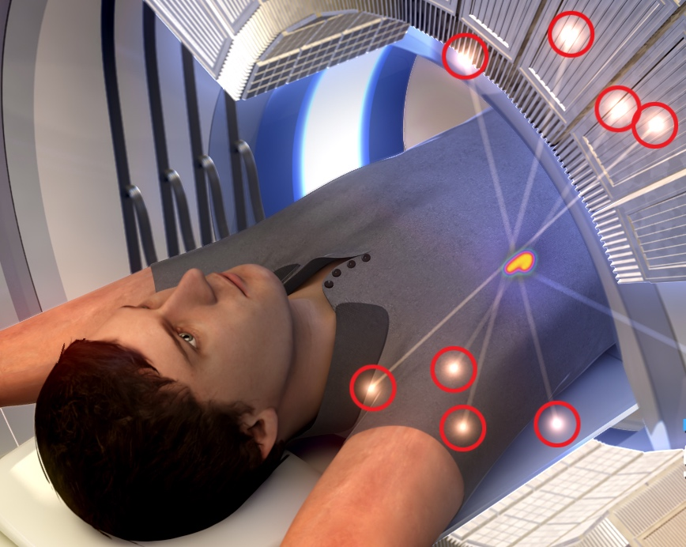
CERN’s technological innovations have important applications in medicine and healthcare
Technologies applied
at CERN are also used in PET, for medical imaging and diagnostics.
CERN produces innovative radioisotopes for nuclear medicine research.
© marsbioimaging
© CNAO
© ENVISION / ENLIGHT
Accelerator technologies are applied in cancer radiotherapy with protons, ions and electrons.
Pixel detector technologies are
used for high resolution 3D colour X-ray imaging.
Notes:
Background information (THE SPEAKER SHOULD NOT GO INTO THE DETAIL BELOW; THE INFORMATION IS PROVIDED AS SUPPORT FOR QUESTIONS AND, IF TIME PERMITS, TO ADD TO THE KEY INFROMATION ON THE SLIDE:
Cancer radiotherapy using protons and other ions instead of photons (used in conventional radiotherapy):
CERN has contributed to the birth of the proton- and carbon-ion treatment centres CNAO, in Italy, and MedAustron, in Austria, and continues to collaborate with them;
CERN also developed an RFQ technology now used by a company in an innovative linac for proton therapy (2021, system under test at STFC Daresbury);
CERN is now involved in the development of cutting-edge technologies for next-generation ion therapy facilities and of a facility for treating tumours with very high-energy electrons at ultra-high dose rates (FLASH therapy, with CHUV Lausanne)
Medical imaging:
CERN contributed to early developments in PET instrumentation (70s-80s);
Since 1995, the Crystal Clear collaboration has been engaged in the development of several organ-specific (breast, pancreas, prostate) and animal-dedicated PET scanner prototypes, and in pushing the limit of coincidence time resolution for time-of-flight (TOF) PET;
overall, the requirements of large-scale physics experiments often drive the mass production for specific equipment (e.g. the BGO crystals for the L3 detector at LEP), and make it possible for other applications to obtain the technology at a reasonable cost for e.g. building PET scanners.
New 3D colour X-rays of human extremities (2018) using CERN-developed Medipix 3 technology, by a start-up in New Zealand.
Nuclear medicine
CERN-MEDICIS (Medical Isotopes Collected from ISOLDE) is a one-of-a kind infrastructure designed to produce a new generation of non-conventional radioisotopes with potential applications in precision medicine and theranostics. Since December 2017, MEDICIS has been providing innovative radioisotopes to partner research institutes. MEDICIS aims to increase the range of radioisotopes available for biomedical research, thanks to its unique set-up that includes an irradiation station on a high energy proton beam and a radioisotope mass-separation beam-line.
THIS IS THE LAST SLIDE IN THE “TECHNOLOGY AND INNOVATION” SECTION

Slide 13
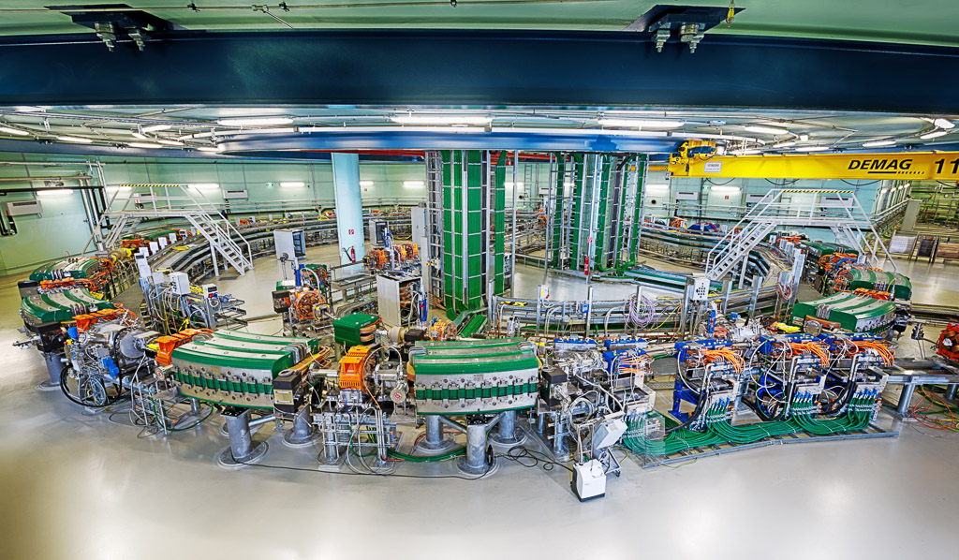
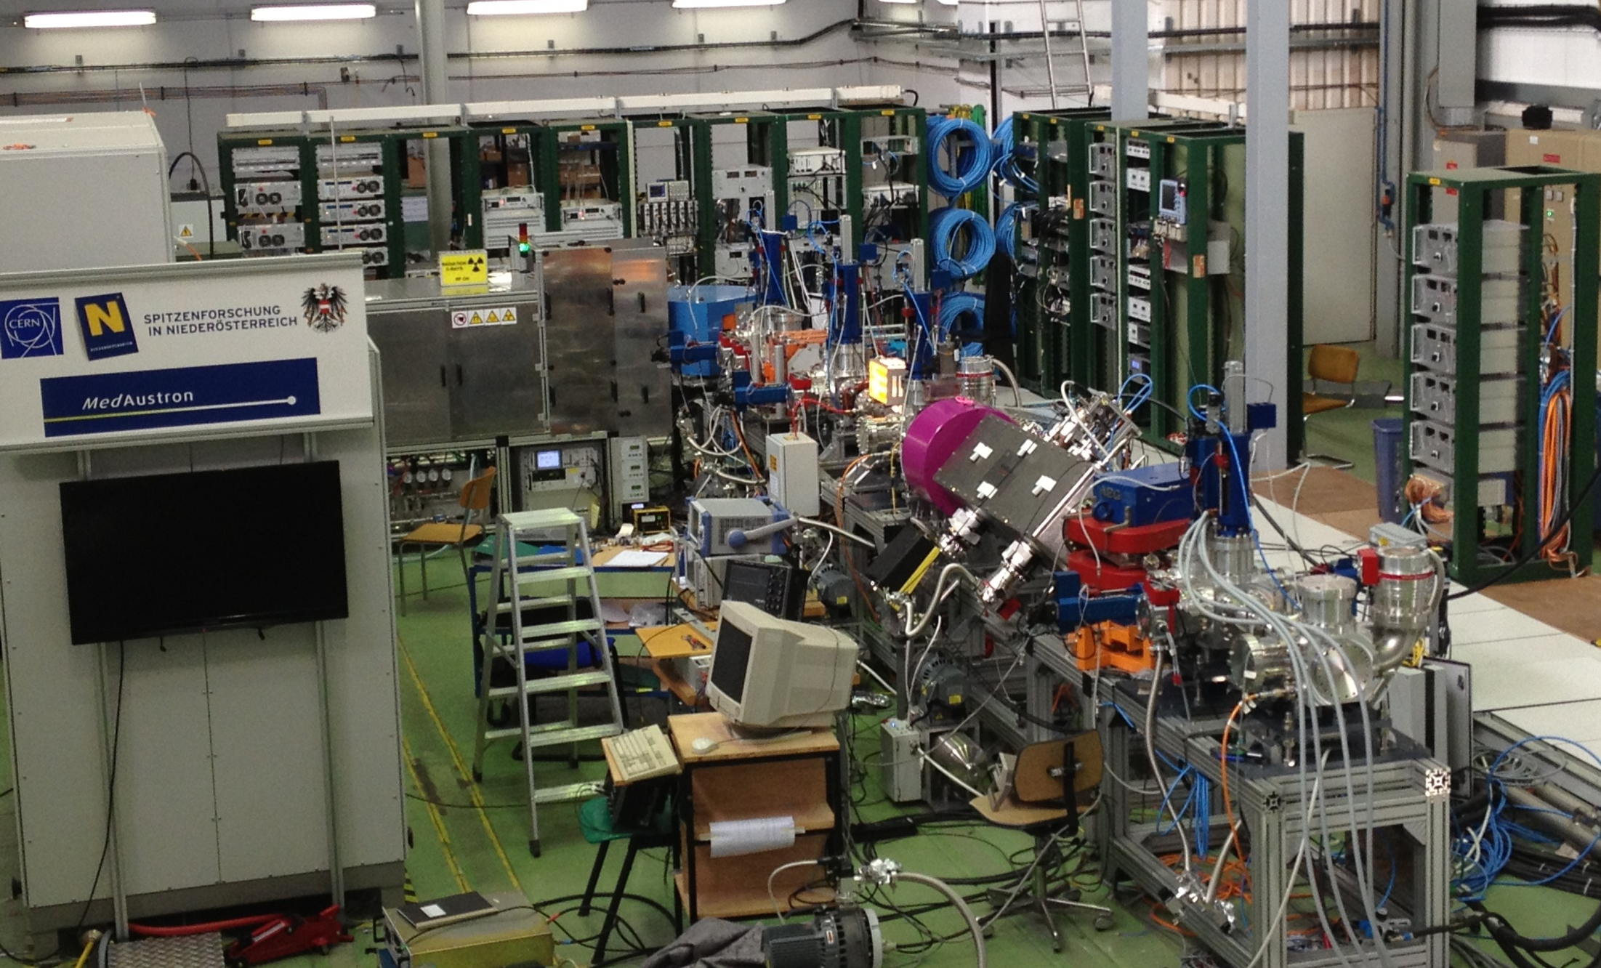
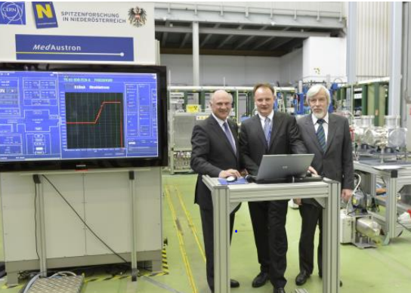
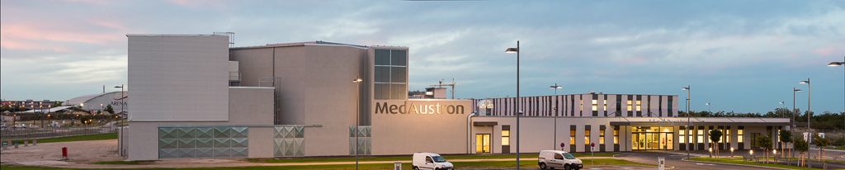
CERN MedAustron Kooperation 2008 - 2014
Insgesamt 19 Absolventen des CERN - österreichischen Technologiestudentenprogramms sind/waren beteiligt an Design/Konstruktion und Betrieb von MedAustron
Technologietransfer über Köpfe
Teststand CERN 2012 erster MedAustron Strahl

Slide 14
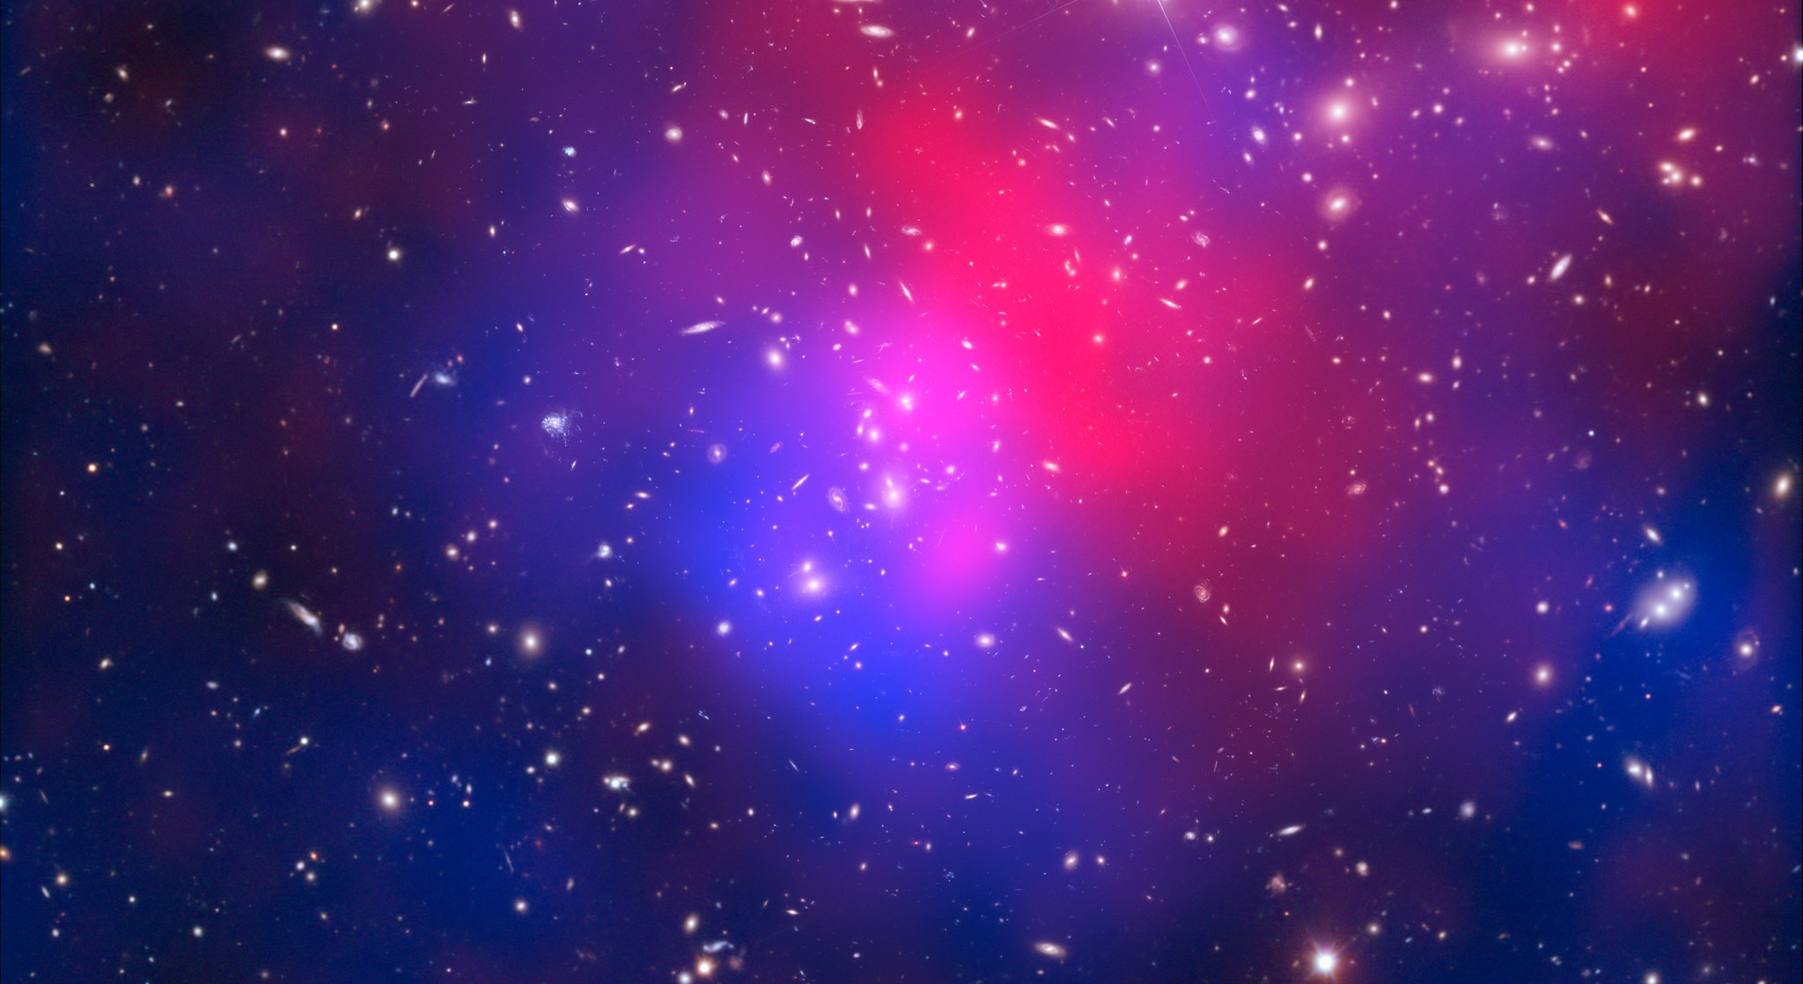
There are many unanswered questions in fundamental physics
Including
What is the unknown 95% of the mass and energy of the universe?
Is there only one Higgs boson, and does it behave exactly as expected?
Why is the universe made only of matter, with hardly any antimatter?
Why is gravity so weak compared to the other forces?
Presentation Austria
16 December 2022
Notes:
This slide is a preamble to the following two slides, which focus on CERN’s future projects, aimed at moving closer to answering the questions shown on the slide (and others).

Slide 15

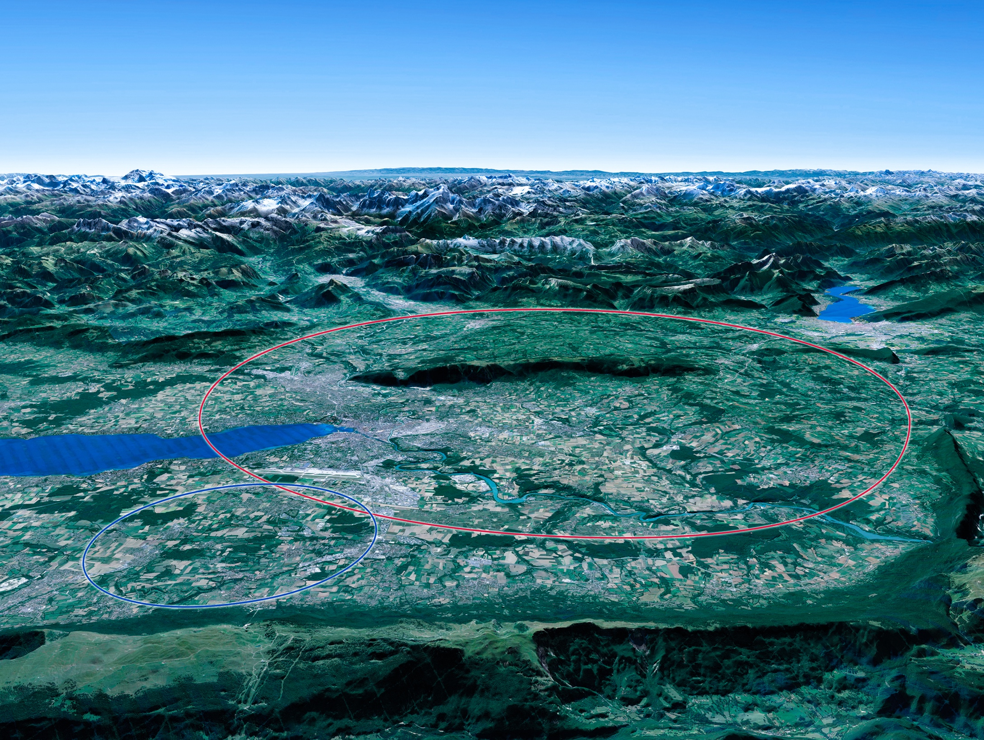

Scientific priorities for the future
Implementation of the recommendations of the 2020 Update of the European Strategy for Particle Physics:
• Fully exploit the HL-LHC
• Build a Higgs factory to further understand this unique particle
• Investigate the technical and financial feasibility of a future energy-frontier 100 km collider at CERN
• Ramp up relevant R&D
• Continue supporting other projects around the world
LHC
Notes:
For information, the ESPPU recommendations in more detail:
Full exploitation of the HL-LHC
An electron-positron Higgs factory is the highest priority after the LHC
Ramp up R&D efforts for advanced accelerator technologies
Support long-baseline neutrino projects in Japan and US
Investigation of feasibility of a future 100 TeV hadron collider at CERN
THIS IS THE LAST SLIDE IN THE “RESEARCH” SECTION

Slide 16
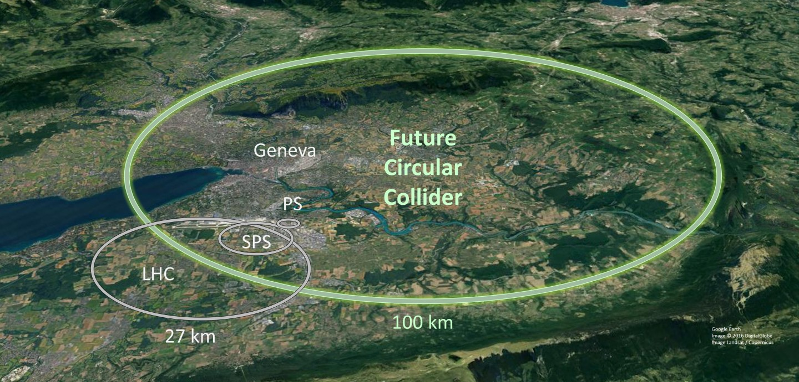
The Future Circular Collider

Slide 17

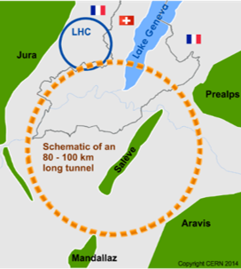
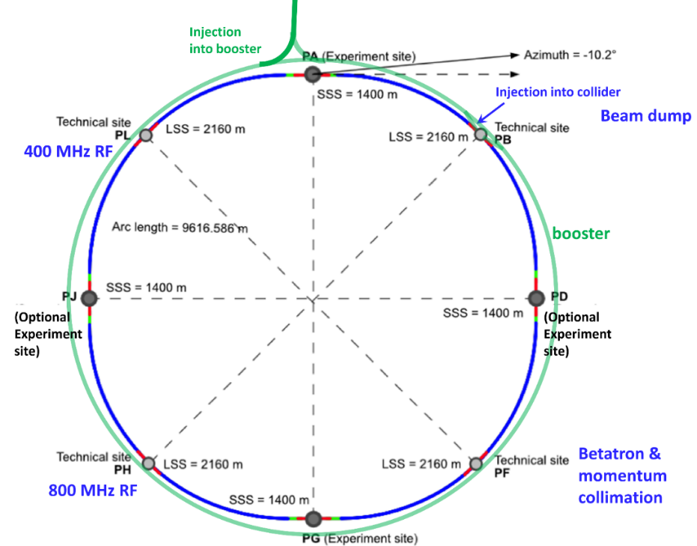
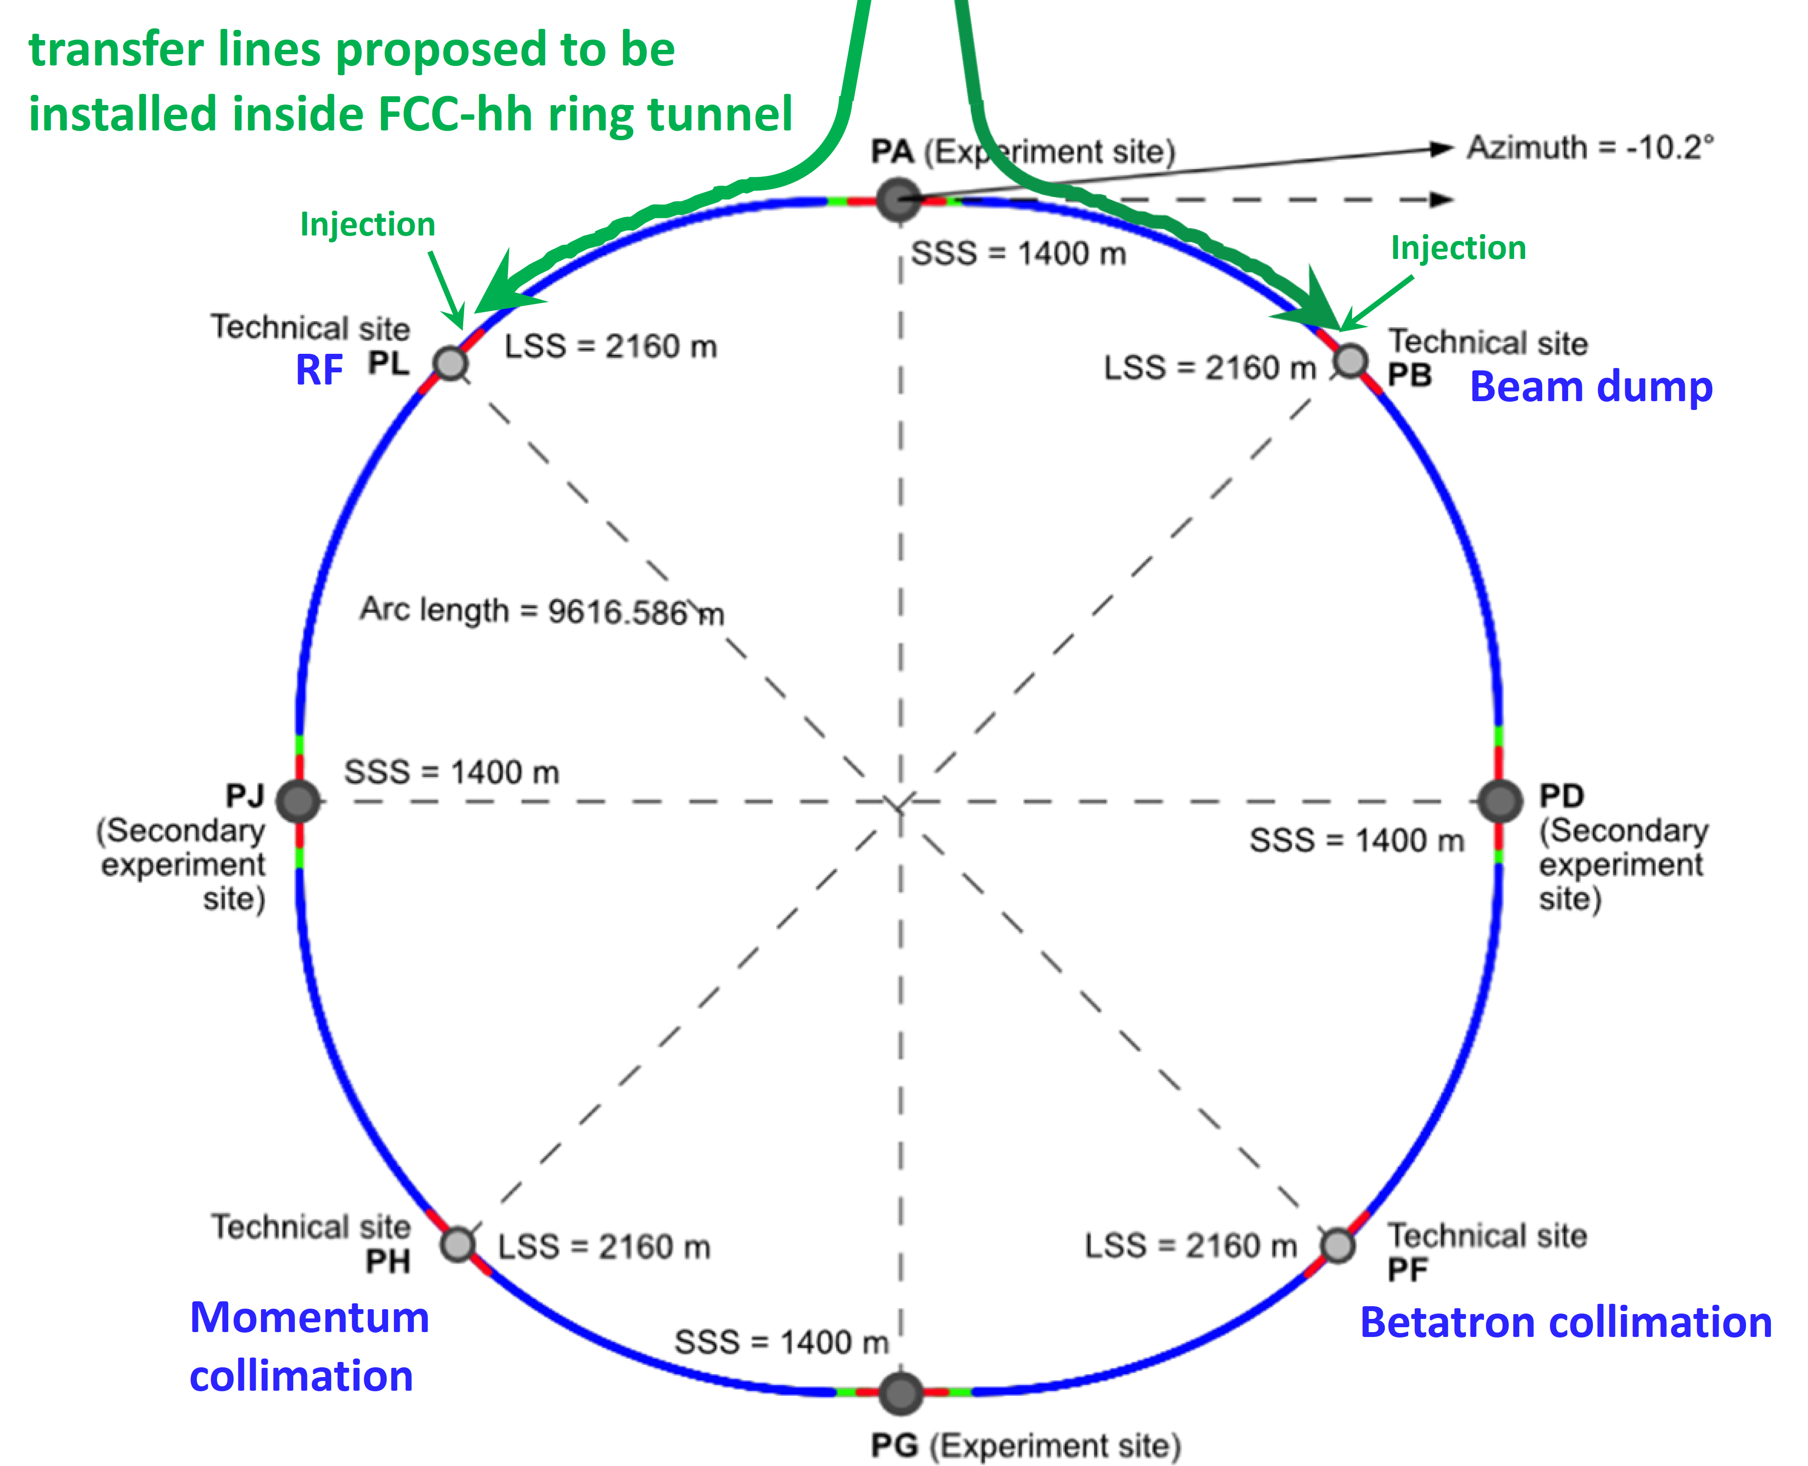
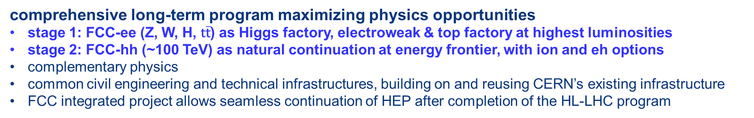
FCC integrated program
inspired by successful LEP – LHC programs at CERN
comprehensive long-term program maximizing physics opportunities
stage 1: FCC-ee (Z, W, H, $\text{t}\overline{\text{t}}$) as Higgs factory, electroweak & top factory at highest luminosities
stage 2: FCC-hh (~100 TeV) as natural continuation at energy frontier, with ion and eh options
complementary physics
common civil engineering and technical infrastructures, building on and reusing CERN’s existing infrastructure
FCC integrated project allows seamless continuation of HEP after completion of the HL-LHC program
FCC-ee
FCC-hh
2020 - 2040
2045 - 2060
2065 - 2090
a similar two-stage project CEPC/SPPC is under study in China

Slide 18

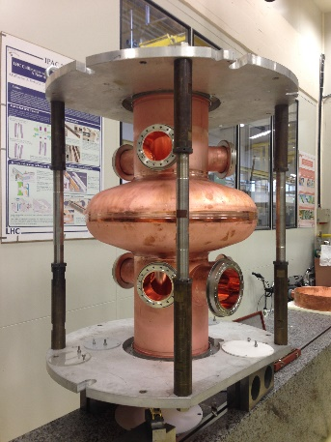
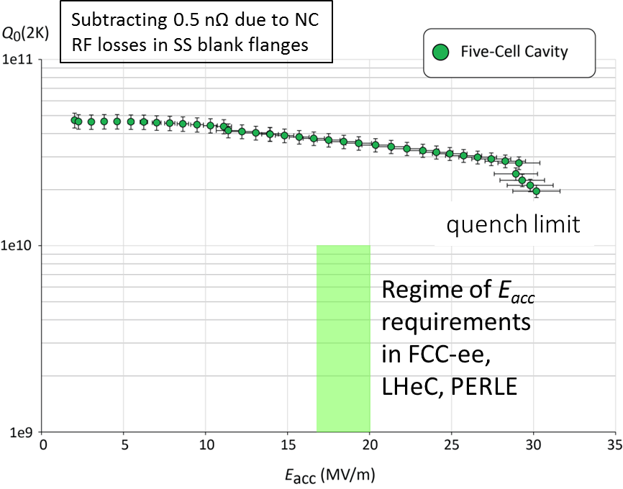
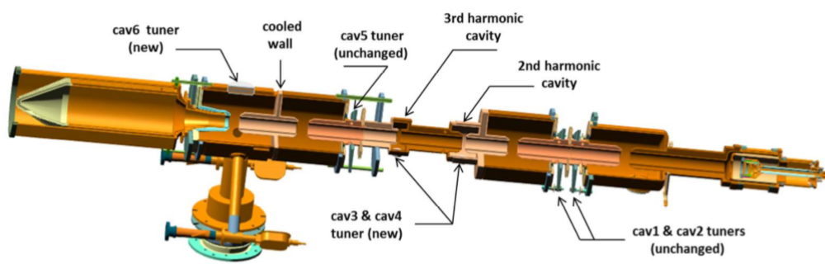
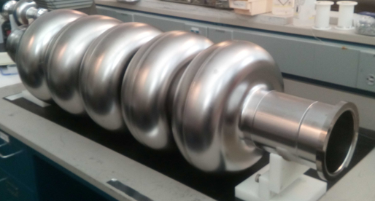
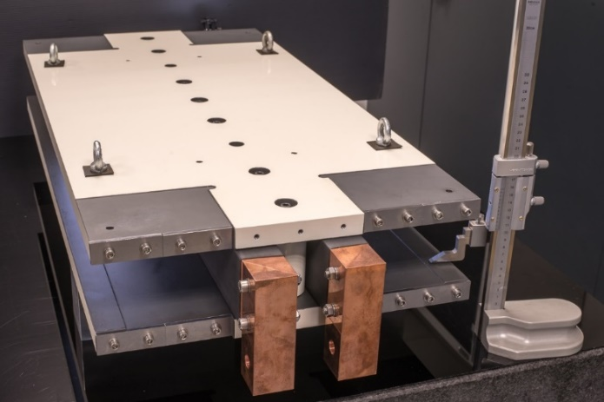
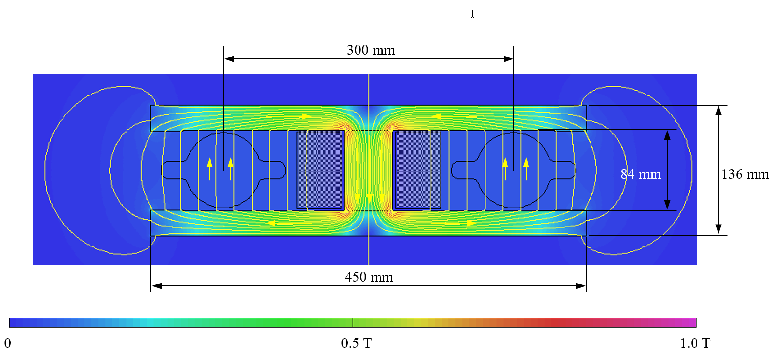

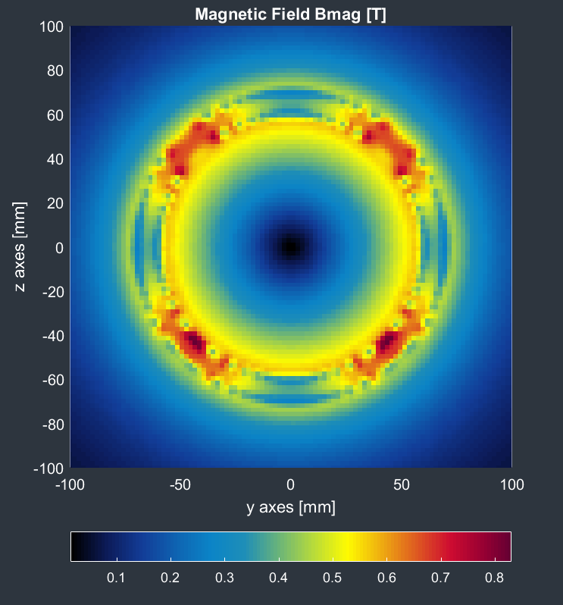
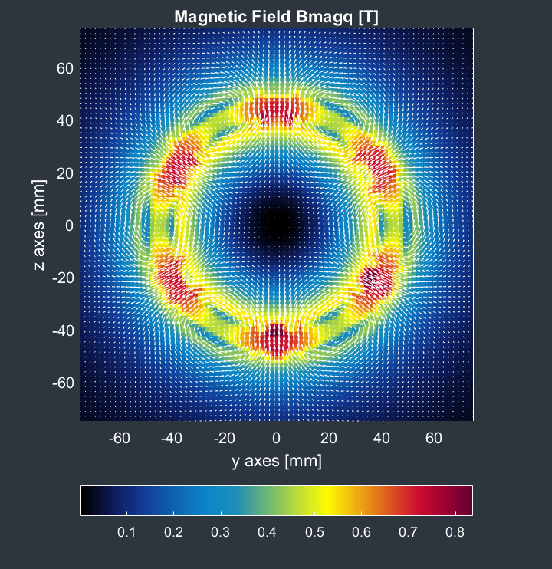
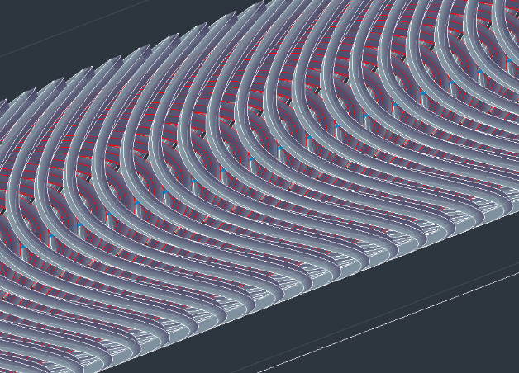

FCC-ee accelerator R&D examples
efficient RF power sources
(400 & 800 MHz)
efficient SC cavities
I. Syratchev
400 MHz 1-,2- & 4-cell Nb/Cu , 4.5 K
F. Marhauser
800 MHz 5-cell Nb
prototype / JLAB, 2 K
FPC & HOM coupler, cryomodule, thin-film coatings…
energy efficient twin aperture arc dipoles
under study: CCT HTS quad’s & sext’s for arcs
A. Milanese
M. Koratzinos

Slide 19
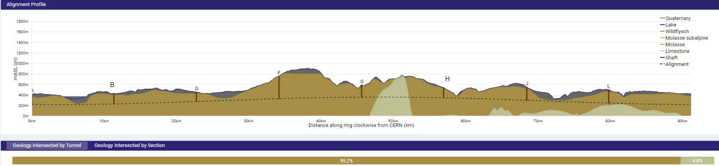
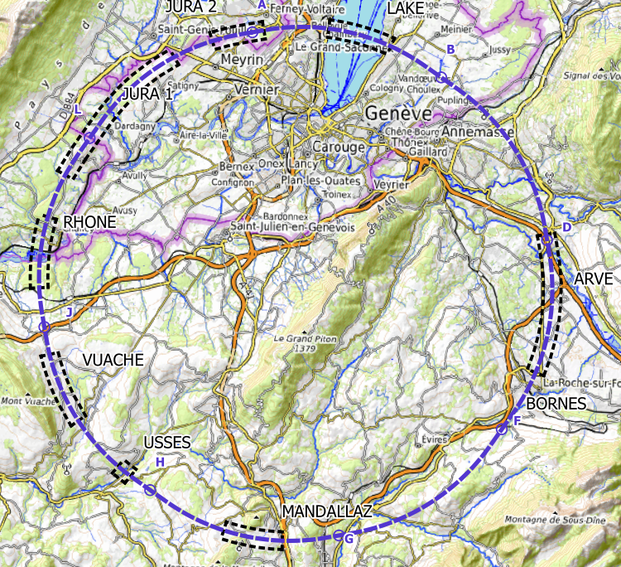
FCC implementation - footprint baseline
Present baseline implementation
91 km circumference
95% in molasse geology for minimising tunnel construction risks
8 surface sites with ~5 ha area each.
Site investigations planned for 2024 and 2025 in areas with uncertain geological conditions:
Limestone-molasse border, karstification, water pressure, moraine properties, water bearing layers, etc.
~40-50 drillings, 100 km of seismic lines

Slide 20
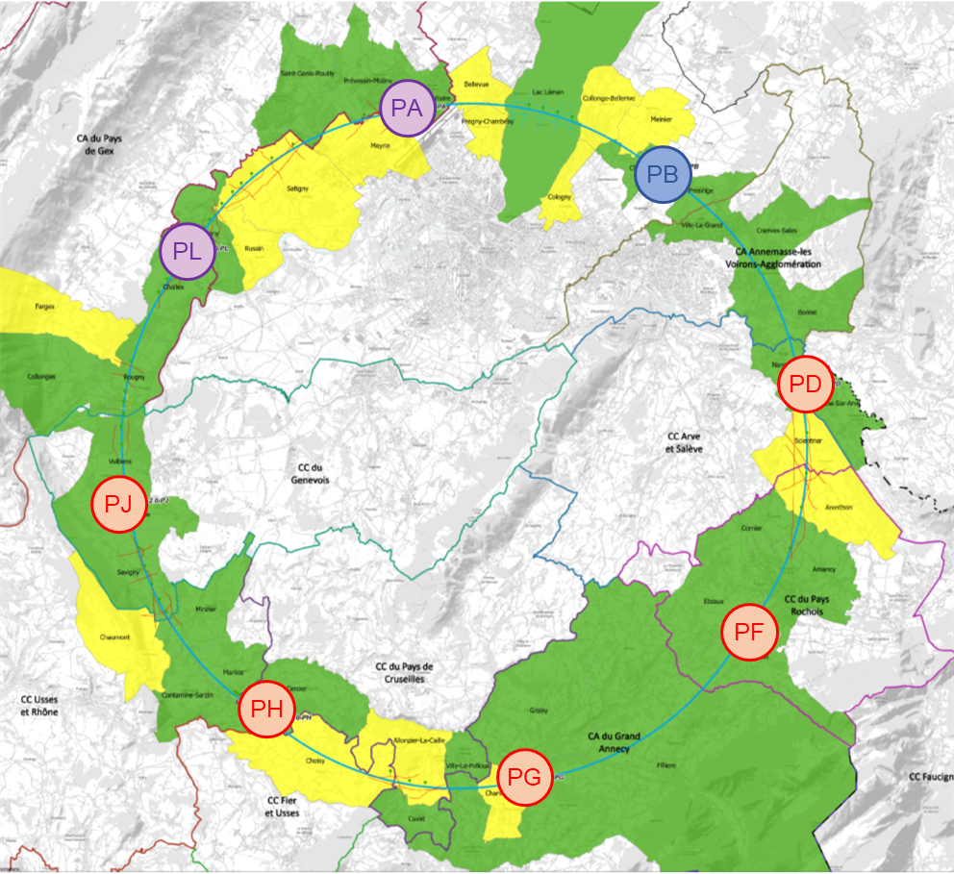
Implementation baseline PA31-3.0 91 km
1. PA – Ferney Voltaire (FR) – experimental site
2. PB – Présinge/Choulex (CH) – technical site
3. PD – Nangy (FR) – technical/experimental site
4. PF – Etaux (FR) – technical site
5. PG – Charvonnex/Groisy (FR) – experimental site
6. PH – Cercier (FR) – technical site
7. PJ – Vulbens/Dingy en Vuache (FR)
– technical/experimental site
8. PL – Challex (FR) – technical site
First meetings with communes concerned in France (31) and Switzerland (10)
Rencontrée
Rendez-vous proposé / programmé

Slide 21
FCC key points
FCC-ee and FCC-hh are long-term largest-scale technology projects
Requiring R&D in all technical areas with medium- and long-term opportunities for cooperation with industrial partners
Development – production – operation – maintenance
Looking forward to common R&D projects

