Slide 1



Non – ferrous metals for particle accelerators
Ignacio Avilés Santillana
CERN EN / MME – MM
Email: iaviles@cern.ch
Mechanical & Materials Engineering
for Particle Accelerators and Detectors

Slide 2
The most important slide of this presentation
Materials are your friends.
"Close friends are truly life's treasures. Sometimes they know us better than we know ourselves.” Vincent Van Gogh
CAN I BE YOUR FRIEND?
Get to know them as good as you can.
Do not ask them for things they cannot do.

Slide 3
Outline
Environmental conditions of particle accelerators
General rules for selection of materials in particle accelerators
Families of non – ferrous materials:
    Aluminum
    Copper
    Titanium
    Niobium
Conclusions

Slide 4
Environmental conditions of particle accelerators
Cryogenic temperatures.
Ultra – high and extreme vacuum.
Electro – magnetic fields.
Radiation.
High temperatures and high strain rate.

Slide 5
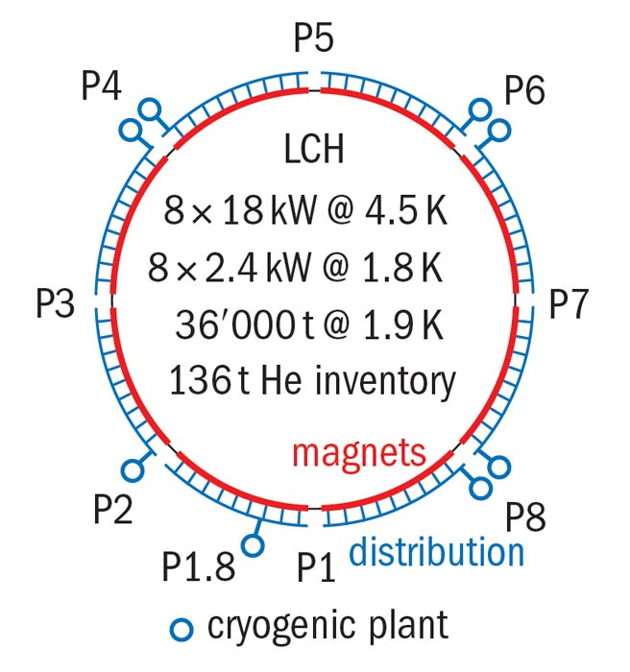
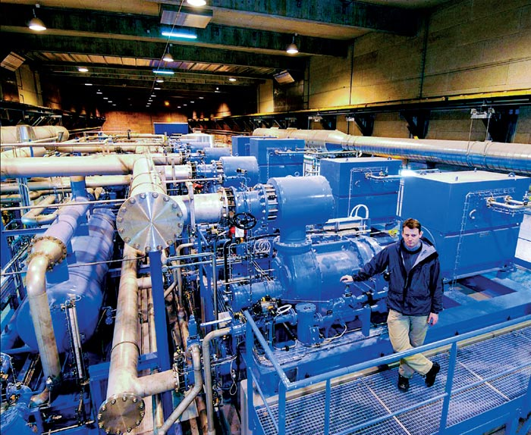
Environmental conditions of particle accelerators
Cryogenic temperatures → down to 1.9 K (superfluid helium).
Ultra – high and extreme vacuum → down to 10 ⁻¹¹ mbar.
Electro – magnetic fields.
Radiation.
High temperatures and high strain rate → beam intercepting devices (dumps, collimators, targets).

Slide 6
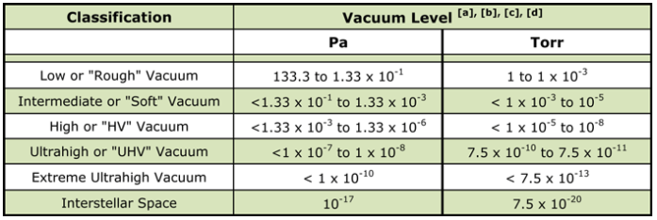
Environmental conditions of particle accelerators
Cryogenic temperatures → down to 1.9 K (superfluid helium).
Ultra – high and extreme vacuum → down to 10 ⁻¹¹ mbar.
Electro – magnetic fields.
Radiation.
High temperatures and high strain rate → beam intercepting devices (dumps, collimators, targets).
From: Herring, Daniel H., Vacuum Heat Treatment, BNP Custom Media Group, 2012.

Slide 7
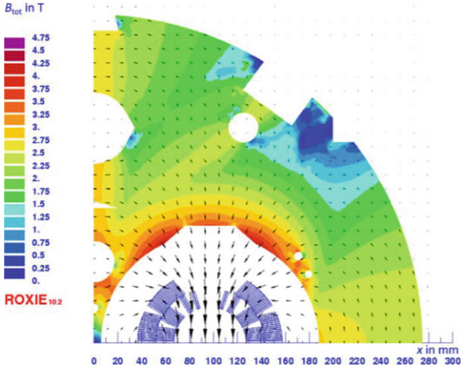
Environmental conditions of particle accelerators
Cryogenic temperatures → down to 1.9 K (superfluid helium).
Courtesy of
B. Bordini
Ultra – high and extreme vacuum → down to 10 ⁻¹¹ mbar.
Electro – magnetic fields.
Radiation.
High temperatures and high strain rate → beam intercepting devices (dumps, collimators, targets).

Slide 8
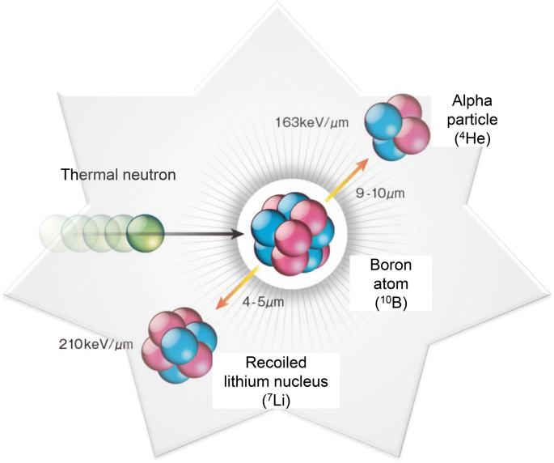
Environmental conditions of particle accelerators
Cryogenic temperatures → down to 1.9 K (superfluid helium).
Ultra – high and extreme vacuum → down to 10 ⁻¹¹ mbar.
Electro – magnetic fields.
Radiation.
High temperatures and high strain rate → beam intercepting devices (dumps, collimators, targets).

Slide 9
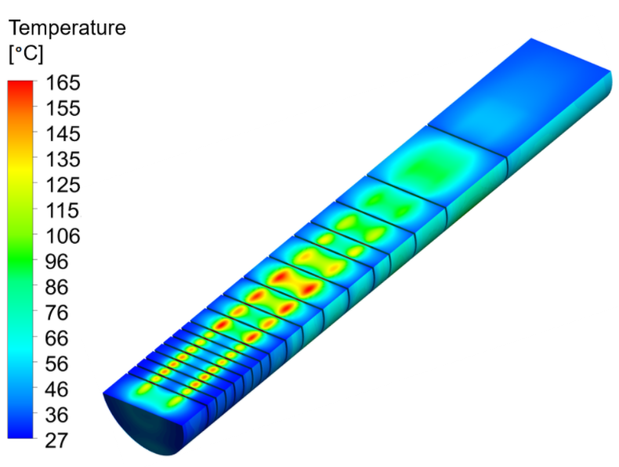
Environmental conditions of particle accelerators
Cryogenic temperatures → down to 1.9 K (superfluid helium).
Ultra – high and extreme vacuum → down to 10 ⁻¹¹ mbar.
Electro – magnetic fields.
Courtesy of
E. Lopez Sola
Radiation.
High temperatures and high strain rate → beam intercepting devices (dumps, collimators, targets).

Slide 10


General rules for materials’ selection in particle accelerators
The golden rule to be remembered (from S. Sgobba in stainless steel, can be extended to any material):
    “A material for an accelerator part is not a mere chemical composition or designation”
    Low / high temperature, magnetism, ultrahigh vacuum, radiation, require special care.
Material designation
Notch
sensitivity
Transformations
Weldability
Inclusion content
Temper state
Strain rate
sensitivity
Physical properties
Controlability

Slide 11
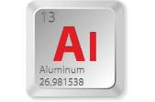

Non – ferrous materials
Aluminium
  Second-most abundant metallic element in Earth's crust after silicon.
  The name comes from its compound form, a mineral rock called ‘alumen’ (meaning binding) used as dyeing fixative.
  Silver from clay
The legend sais that Tiberius beheaded a goldsmith who first crafted aluminium since it could devaluate the price of gold.

Slide 12

Non – ferrous materials
Aluminium
  Two millennia after, the extraction of Al from bauxite was very scarce. Al was more precious than gold (as Tiberius feared).
Napoleon III had, for his most distinguished guests, Al cutlery. The rest had to settle for gold.

Slide 13
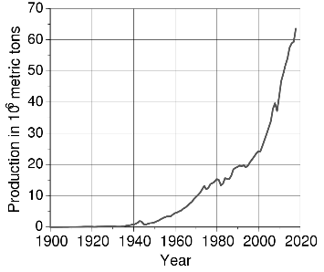
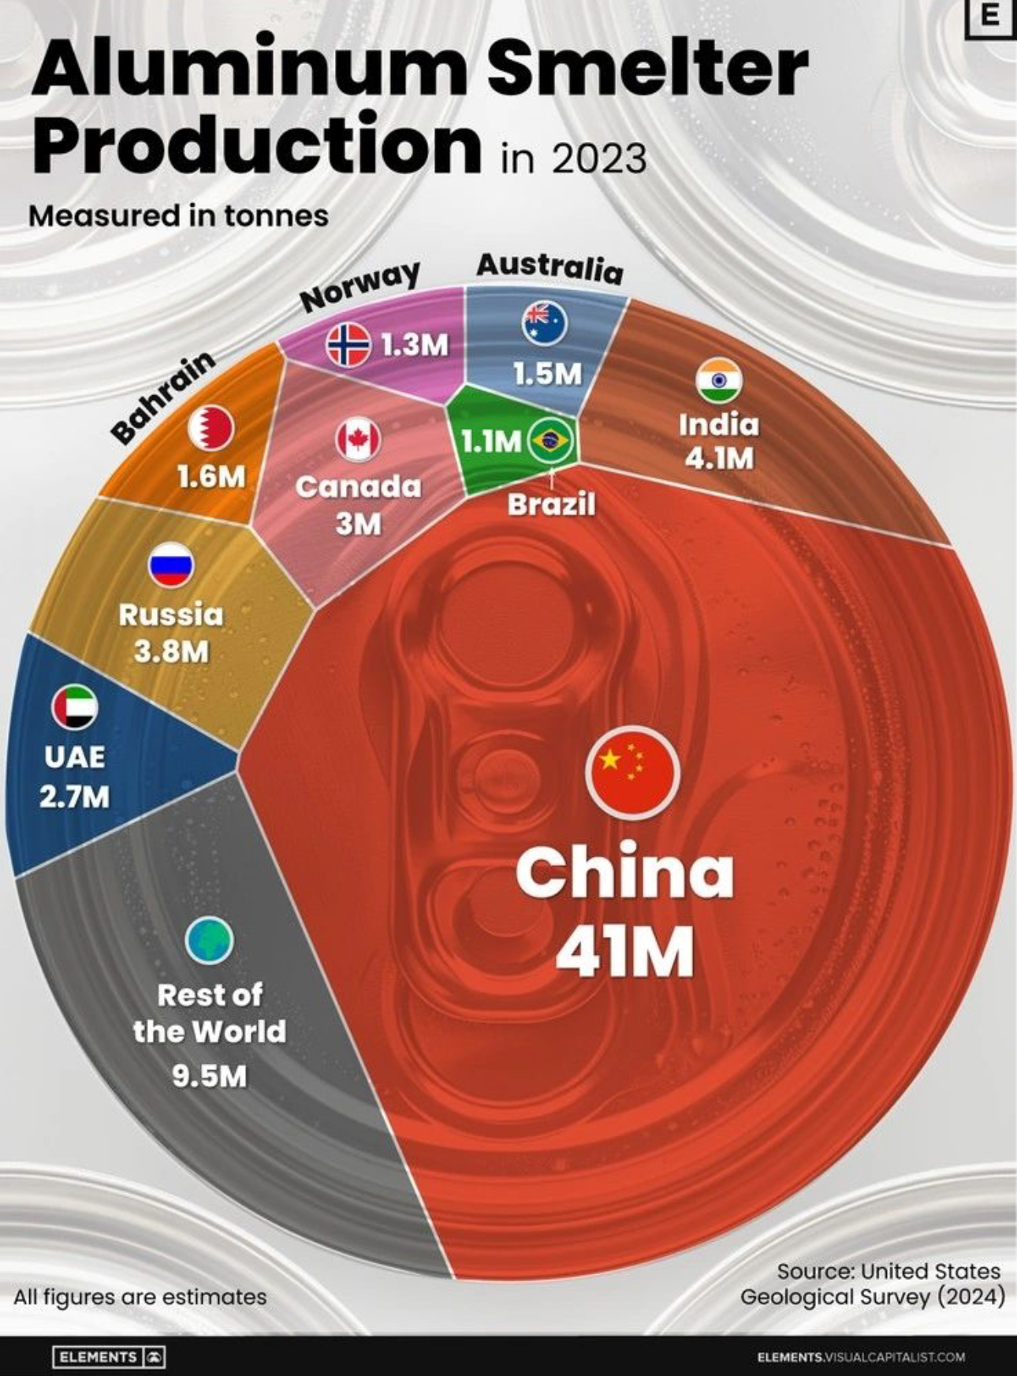
Non – ferrous materials
Aluminium
  Electrolysis (Hall – Héroult process) of alumina (Bayer process).
  Victim of its own success: it is produced in similar quantities than all other non-ferrous metals combined
~ 70M tons in 2023

Slide 14
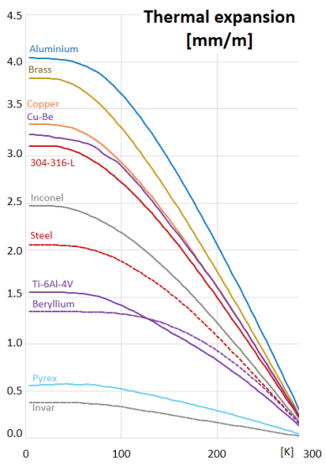
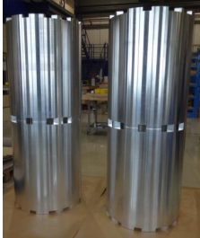
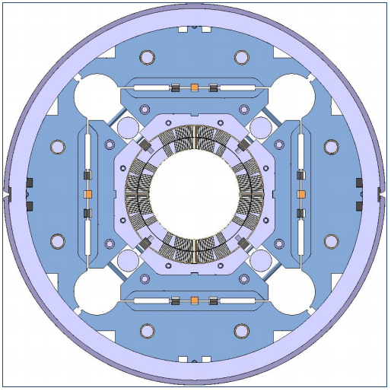
Aluminium for particle accelerators
  Low modulus of elasticity
  High thermal contraction coefficient
  Paramagnetic
Al shrinking cylinders for
MQXF
quadrupoles
H
H = 1366 mm
Ø_{ext} = 614 mm
Source: DUTHIL, Patxi. Material properties at low temperature. arXiv preprint arXiv:1501.07100, 2015.

Slide 15
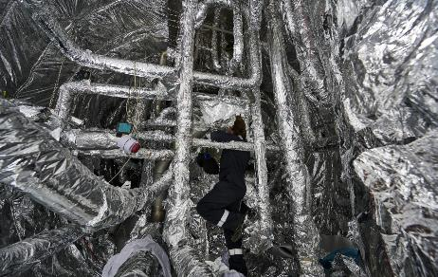
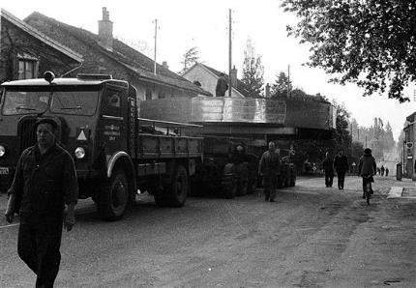
Aluminium for particle accelerators
  Very low thermal emissivity
  High thermal and electrical conductivity
MLI (Al coated Mylar) HL – LHC’s cold box
Al coil for CERN’s first particle accelerator:
The Synchrocyclotron

Slide 16
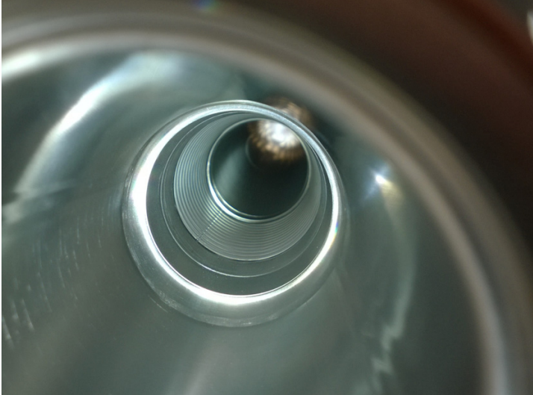
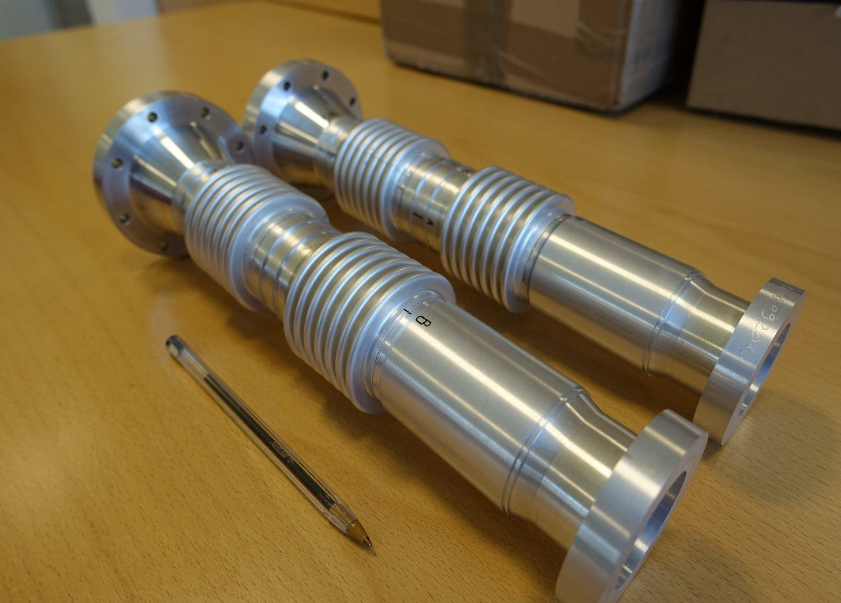
Aluminium for particle accelerators
  Feeble interaction with particle beams
    Low density
    Low atomic number
Developments of Al vacuum chambers and bellows

Slide 17
Wrought aluminum alloys
Designation AA | Major alloying elements | Alloy group | Heat treatable? | Examples
1xxx | - | Pure Al | No
2xxx | Cu | Al – Cu | Yes | 2219
3xxx | Mn | Al – Mn | No | 3003
4xxx | Si | Al – Si | No | Filler
5xxx | Mg | Al – Mg | No | 5061
6xxx | Mg, Si | Al – Mg - Si | Yes | 6082
7xxx | Zn, Mg | Al – Zn | Yes | 7050
8xxx | any |  | (yes) | 8090
Can be strengthened by a suitable thermal treatment (heat treatable)
Can only be strengthened by hot or cold working (non – heat treatable)

Slide 18
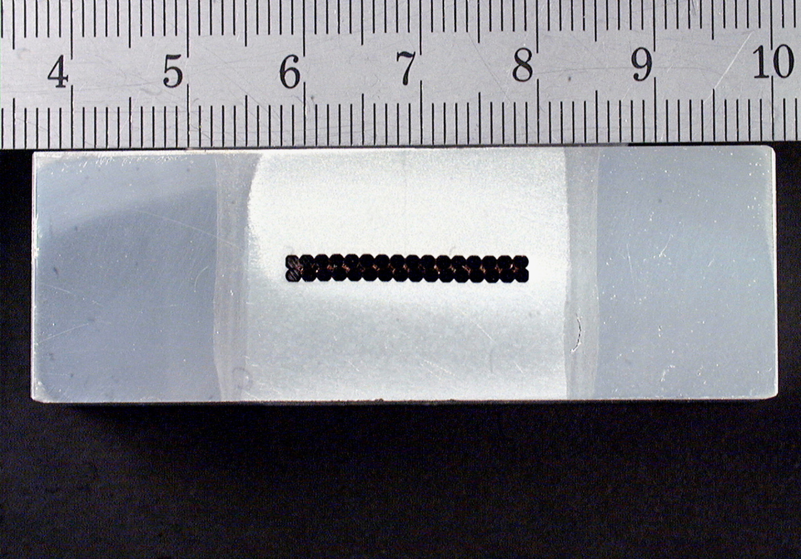
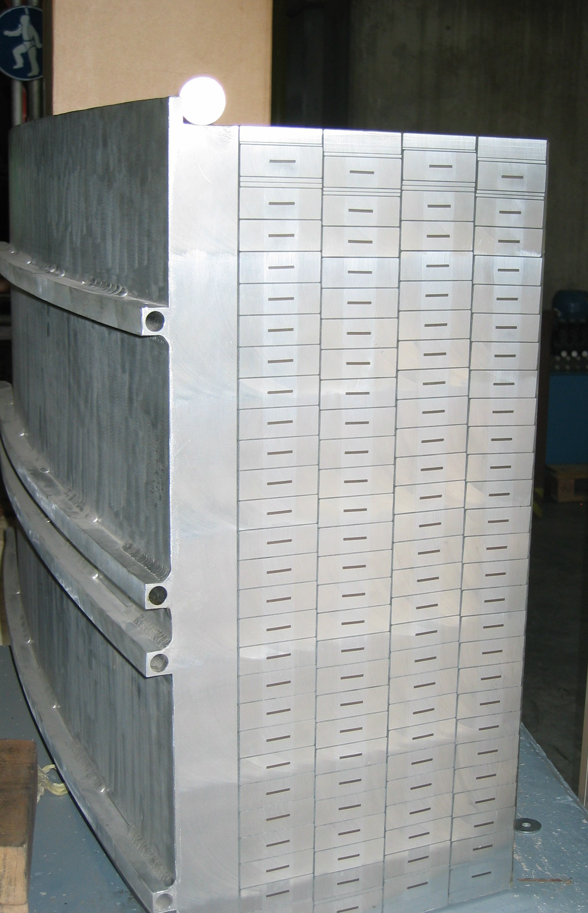
Wrought aluminum alloys designations
1xxx series (pure Al)
Excellent workability & ↑ conductivity
4N (99.99 %) Al stabilizer
Example: CMS conductor

Slide 19
Wrought aluminum alloys designations
↑ Mechanical properties
↓ corrosion resistance
2xxx series (Al – Cu)
    Example: EN AW 2219 T6
Example: vacuum chamber bodies. (NEG coated).

Slide 20
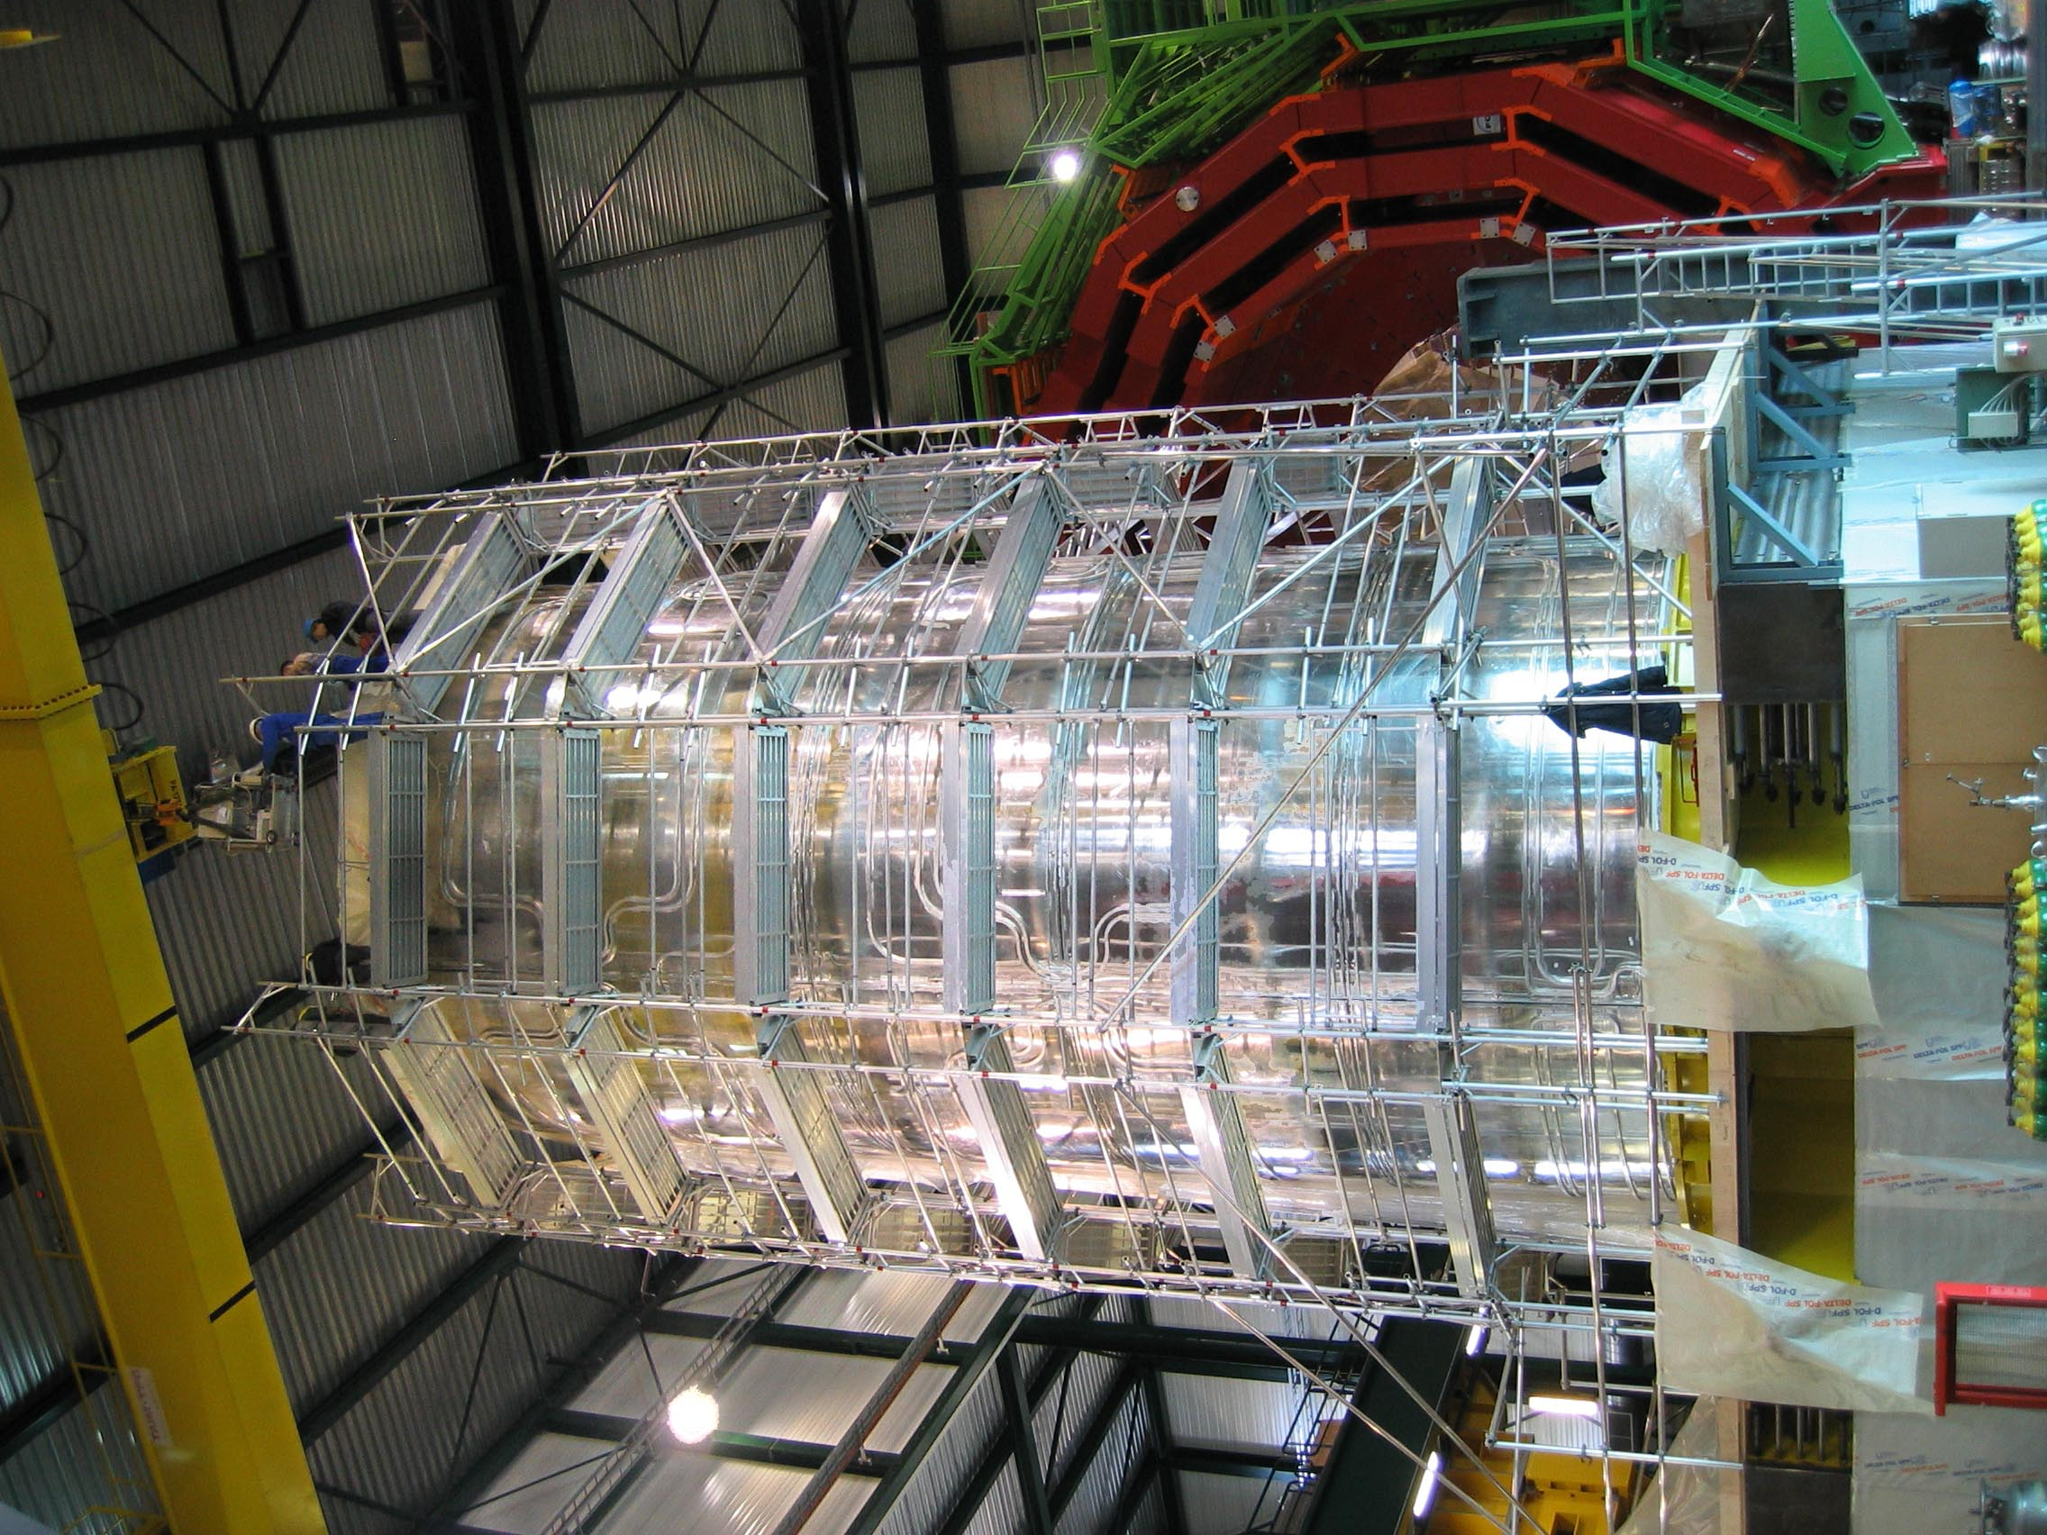
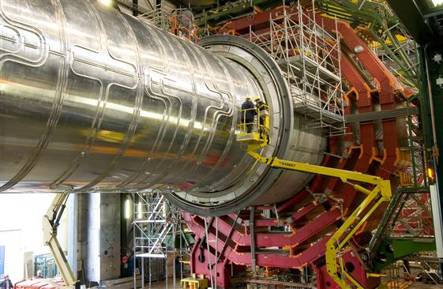
Wrought aluminum alloys designations
Moderate mechanical properties, workability,
Corrosion resistance and th. conductivity
3xxx series (Al – Mn)
    Example: EN AW 3003 H22
Example: CMS Solenoid thermal shield

Slide 21
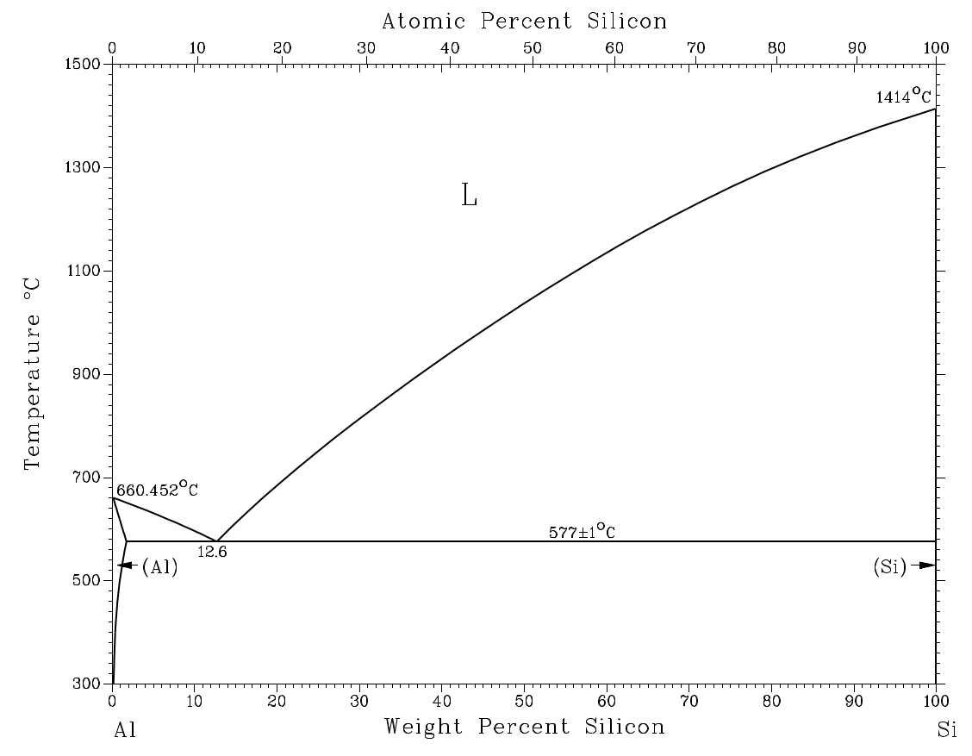
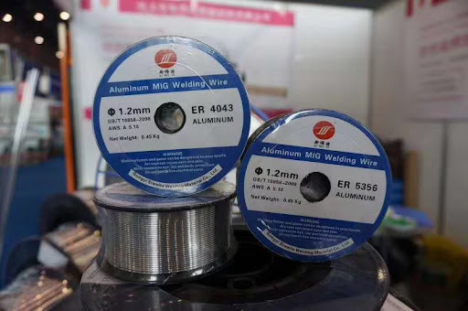
Wrought aluminum alloys designations
4xxx series (Al – Si)
    Major alloying element of this group is silicon, added in sufficient quantities (around 12%), cause substantial lowering of the melting point without producing brittleness (eutectic point).
    Al - Si alloys are used in welding wire and as brazing alloys.

Slide 22
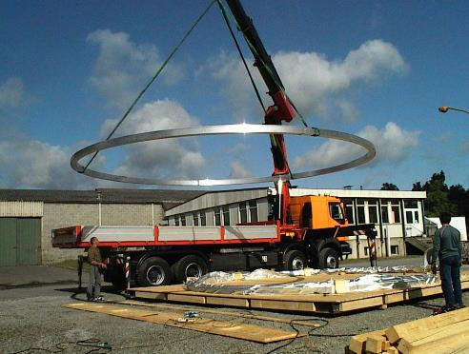
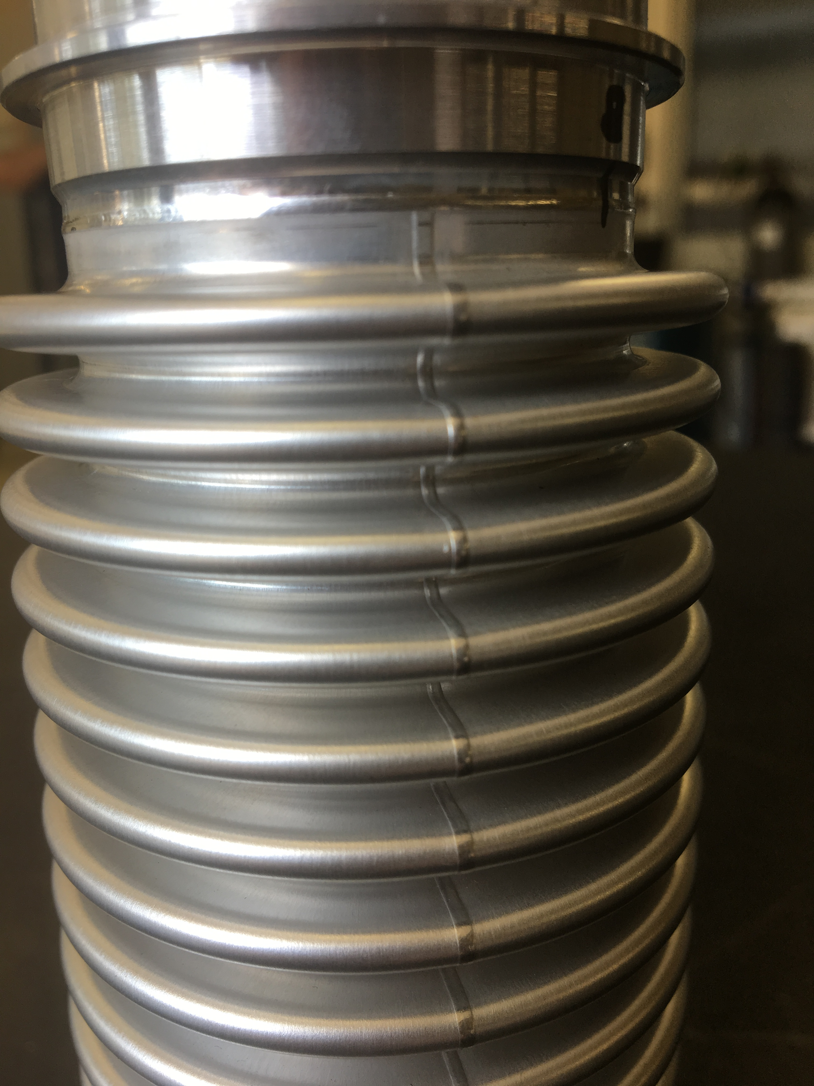
Wrought aluminum alloys designations
moderately ↑ mechanical properties
↑ ductility, weldability
5xxx series (Al – Mg)
    EN AW 5083 H321, H116 and H111
Example: Mandrels for CMS coil
Example: hydroformed bellows

Slide 23
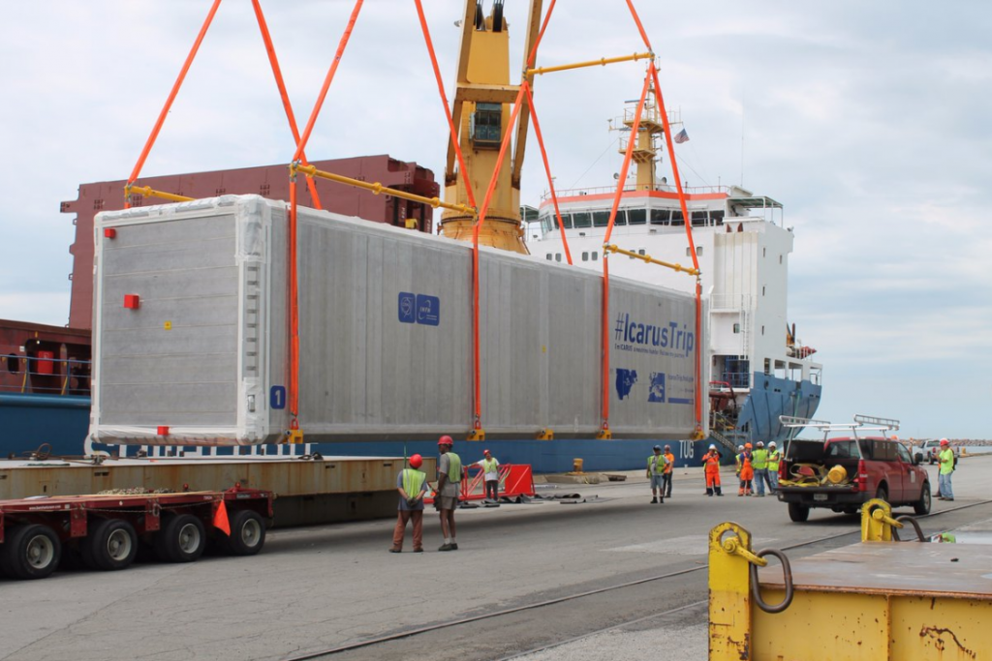
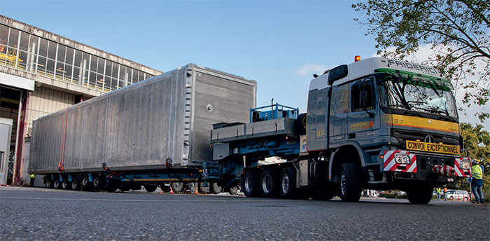
Wrought aluminum alloys designations
6xxx series (Al – Mg – Si)
    Example: EN AW 6082 T6
Combination of formability, mechanical strength, weldability and weight
Example: ICARUS neutrino detector

Slide 24
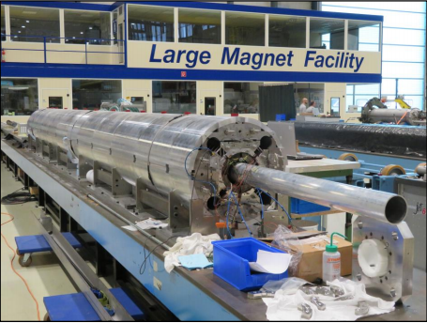
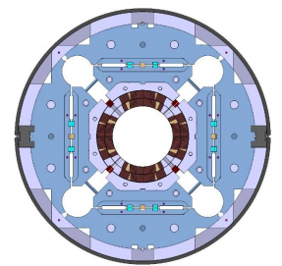
Wrought aluminum alloys designations
7xxx series (Al – Zn – Mg)
    Example: EN AW 7075 T6
↑ Mechanical properties
Al shell
Example: Al shells MQXFBP1 magnet

Slide 25
Wrought aluminum alloys designations
8xxx series
    Reserved for miscellaneous compositions. Alloying elements include: iron, lithium, copper, zinc, magnesium, silicon, manganese, vanadium, zirconium, titanium, chromium & bismuth.
    Al – Li alloys, for weight reduction. Al - Li alloys possess increased Modulus of Elasticity, high specific stiffness, increased fatigue strength and cryogenic strength.

Slide 26
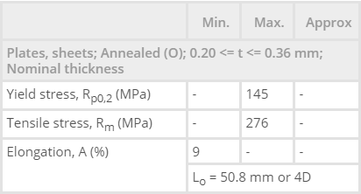
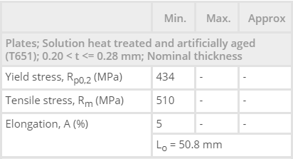
Wrought aluminum alloys: temper states
Alphanumeric designations that contain information about the thermomechanical history of the material to achieve the desired properties.
AA 7075
AA 7075

Slide 27

Wrought aluminum alloys: temper states
materials
“Men are like steel: if they loose their temper, they loose their worth”

Slide 28
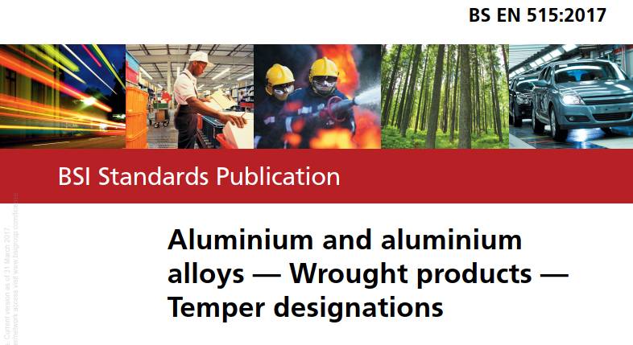
Wrought aluminum alloys: temper states
A capital letter indicating the major class of fabrication treatment(s) used + one (or more) numbers providing more speciﬁc information about how the processing was carried out.

Slide 29
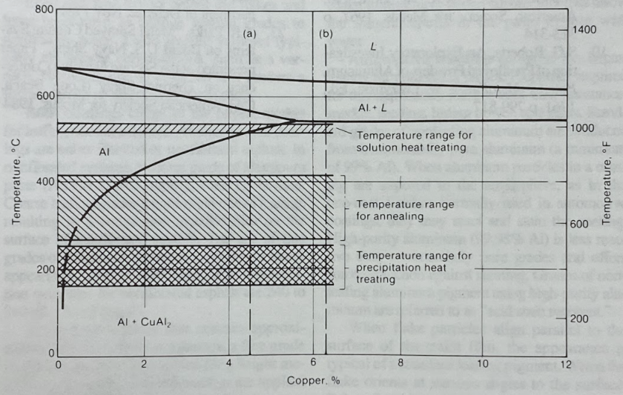
Wrought aluminum alloys: temper states
O, annealed: given a high – temperature treatment, sufficient to remove the effects of prior working, usually resulting in complete recrystallization of the material. Lowest strength and maximum ductility and toughness.
Portion of Al – Cu
phase diagram
Source: ASM aluminium and
aluminium alloys handbook

Slide 30

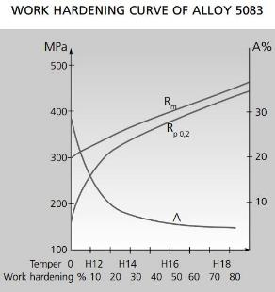
Wrought aluminum alloys: temper states
H, strain hardened: non-heat-treatable wrought alloys that have had their strength increased by strain hardening. H is always followed by two or more digits:
    The ﬁrst number after the H tells whether the strain-hardened alloy has been thermally treated
    The second number indicates the approximate amount of cold work
% cold work
HX8
HX1
Source: Aluminium in Commercial Vehicle – European Aluminium Association – 2011

Slide 31
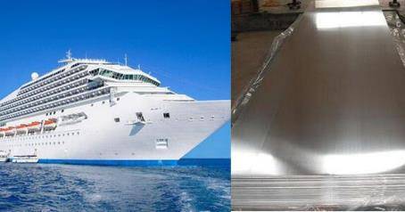
Wrought aluminum alloys: temper states
H, strain hardened: non-heat-treatable wrought alloys that have had their strength increased by strain hardening. H is always followed by two or more digits:
    The ﬁrst number after the H tells whether the strain-hardened alloy has been thermally treated
    The second number indicates the approximate amount of cold work
    Any subsequent numbers deﬁne special practices, variations of the normal indicated by the ﬁrst two numbers.
Example:
AA 5083 H116 (marine grade)

Slide 32
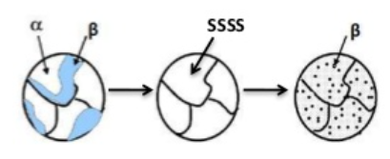
Wrought aluminum alloys: temper states
T, thermally treated to produce stable tempers: heat-treatable wrought alloys that have followed a solution heat treatment followed by a quench and either natural or artiﬁcial aging.
Heat treatment to increase the strength of Al alloys is a three step process:
  Solution heat treatment: dissolution of soluble phases
  Quenching: development of supersaturation
  Age hardening: precipitation of finely dispersed precipitates

Slide 33
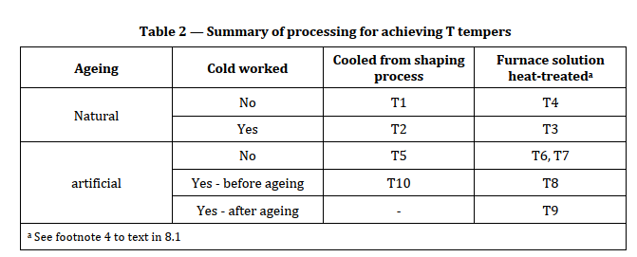
Wrought aluminum alloys: temper states
T, thermally treated to produce stable tempers: heat-treatable wrought alloys that have followed a solution heat treatment followed by a quench and either natural or artiﬁcial aging. T is always followed by one or more digits:
    The ﬁrst digit after the T can be any from 1 to 10. It is a combination of:
      Cooled from elevated temperature or solution heat treatment
      Cold worked or not cold worked
      Naturally aging or artificial ageing
From EN 515:
Al and Al alloys
- Wrought products -
Temper designations

Slide 34
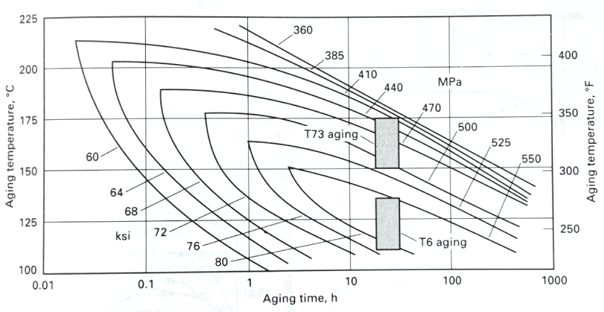
Wrought aluminum alloys: temper states
Source: ASM aluminium and
aluminium alloys handbook
Iso – yield – strength curves for EN AW 7075

Slide 35
Wrought aluminum alloys: temper states
T, thermally treated to produce stable tempers: heat-treatable wrought alloys that have followed a solution heat treatment followed by a quench and either natural or artiﬁcial aging. T is always followed by one or more digits:
    The ﬁrst digit after the T can be any from 1 to 10. It is a combination of:
      Cooled from elevated temperature or solution heat treatment
      Cold worked or not cold worked
      Naturally aging or artificial ageing
    Additional numbers indicate a variation in treatment that signiﬁcantly alters the product characteristics that are or would be obtained using the basic treatment. There is not a full list of all such possible variations.

Slide 36
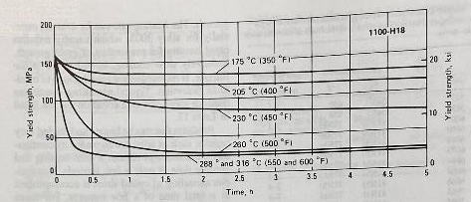
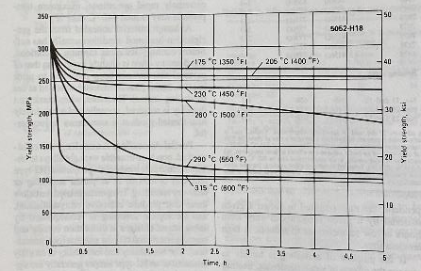
Wrought aluminum alloys: weldability
Most non – heat treatable alloys plus series 6xxx can be fusion welded, and precaution should be taken with heat treatable high strength alloys.
    When non – heat treatable alloys are welded, they loose the effect of an eventual work hardening → softening of HAZ.
Source: ASM aluminium and
aluminium alloys handbook

Slide 37
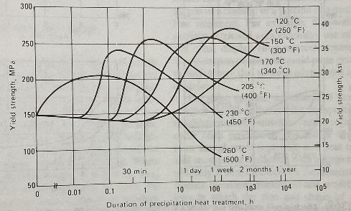
Wrought aluminum alloys: weldability
Most non – heat treatable alloys plus series 6xxx can be fusion welded, and precaution should be taken with heat treatable high strength alloys.
    When welding heat – treatable alloys → redistribution of hardening constituents → softening of HAZ. Attention to liquation cracking.
Source: ASM aluminium and
aluminium alloys handbook
EN AW 6061

Slide 38
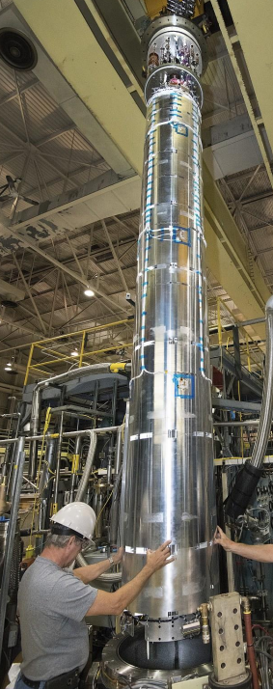
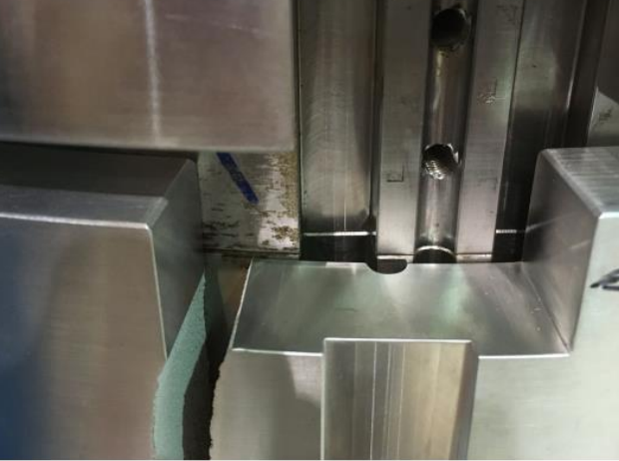
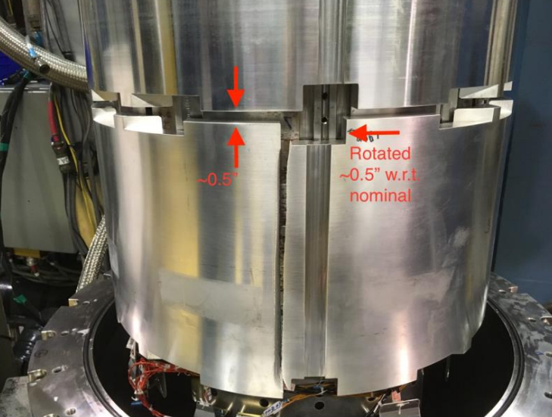
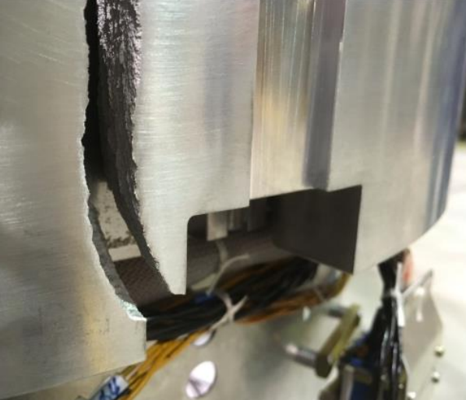
Wrought aluminum alloys: failure analysis
Catastrophic failure of MQXFAP2
Al shell. Failure analysis:
EDMS 2088319

Slide 39
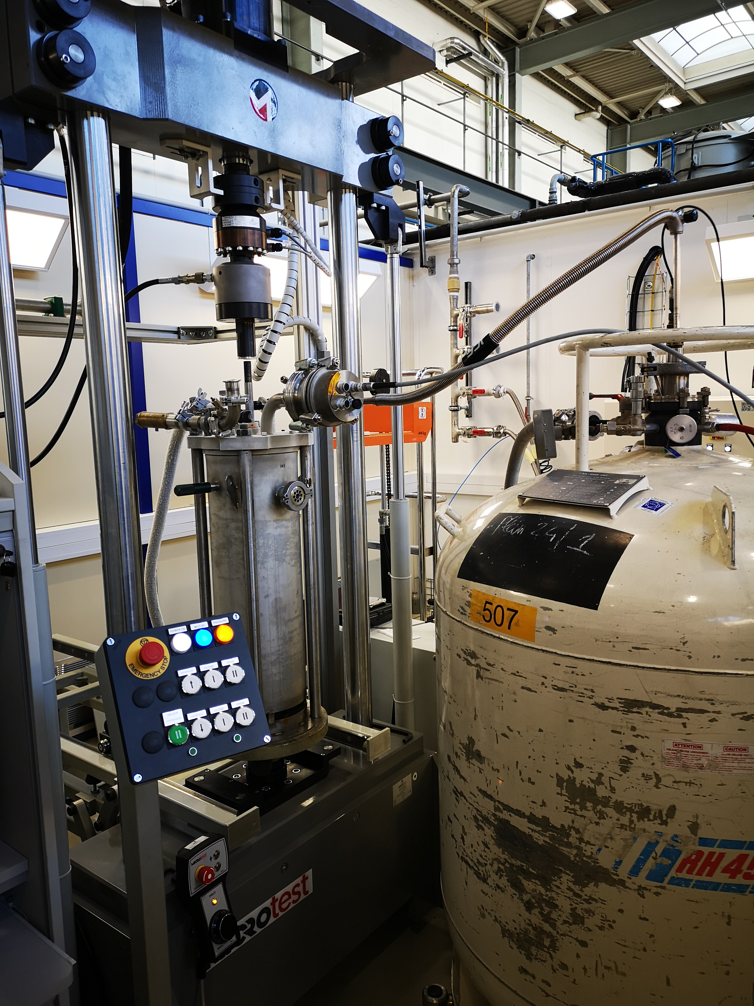
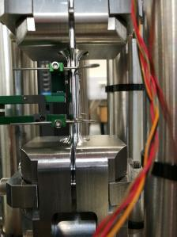
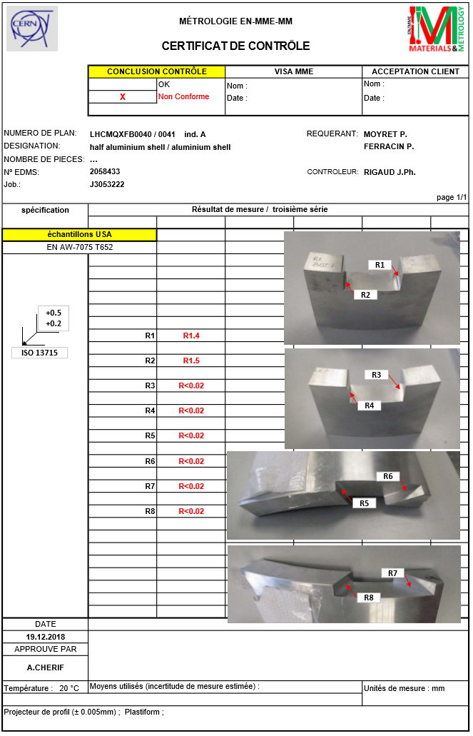
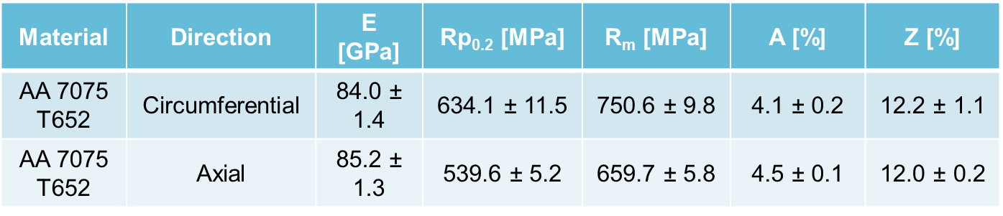
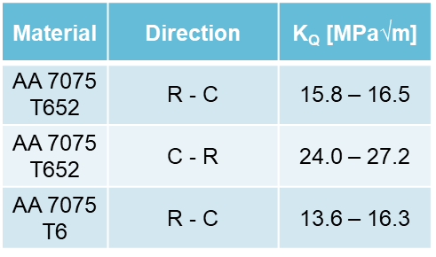
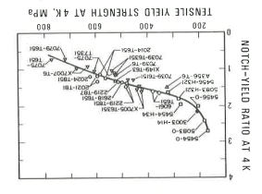
Wrought aluminum alloys: failure analysis
Mechanical testing at cryogenic temperature shows the material choice is correct
Aluminium alloy shell:
failure analysis and material properties at cryogenic temperature. EDMS 2088319
However, EN AW 7075 T651 is sensitive to the presence of sharp notches at 4 K.

Slide 40



Non – ferrous materials
Copper
  Its name comes from ‘cuprum’, meaning “from the island of Cyprus”.

Slide 41


Non – ferrous materials
Copper
  One of the oldest materials known, and one of the most produced.
~ 21.5M tons in 2023

Slide 42

Copper for particle accelerators
  Elastic modulus close to Nb₃Sn
  Diamagnetic
Courtesy: M. Crouvizier

Slide 43


Copper for particle accelerators
  Extremely high thermal and electrical conductivity
Courtesy:
P. Moyret
HIE ISOLDE quarter wave resonator substrate
18 kA HL-LHC current leads

Slide 44


Copper for particle accelerators
  Ductile and tough down to 4 K
Face centered
cubic (FCC)
crystal structure
See also →
CAS course on “Mechanical & Materials engineering”, K-P. Weiss, Mechanical testing
Stress vs strain curve OFE – copper. ¼ hard (H01) temper state.

Slide 45



Copper for particle accelerators
  High availability, moderate price, formability, machinability.
RF fingers of
a collimator
Cu gasket Conflat flange UHV
RFQ

Slide 46



Wrought copper alloys: temper states
Cold worked tempers
Annealed tempers
Notes:
The annealing temperature of Cu depends on the amount of cold work introduced in it.For OFE copper, it can go up to 650 C if you want a dead soft annealed state, but it can also be as low as 300 C

Slide 47



Copper and copper alloys
Source: ASM copper and
copper alloys handbook
“electrical coppers”
Cu OFE, C10100
Cu OF, C10200
Cu OFS, C10700
99.8Cu-0.15Al₂O₃, C15715
CERN Phase II collimator.
Glidcop© sectorized jaw

Slide 48


Copper and copper alloys
High strength copper alloys
Cu-2%Be, C17200
Cu-0.3%Be-0.5%Co, C17410
Cu-1%Cr-0.15%Zr,C18150
C18150 for TIDVG dump’s core & cooling plates
C17410 RF fingers of a
secondary LHC collimator

Slide 49

Copper and copper alloys
C70600 for the cooling circuit of phase II collimators
70Cu-30Ni, C71500
90Cu-10Ni, C70600

Slide 50



OFE Copper
Weldability / brazeability
Ease of machining

Slide 51



OFE Copper
Courtesy:
P. Moyret
18 kA HL-LHC current lead during machining.
R_{a} = 5 nm
CLIC accelerating structure.
Diamond turning / milling
Courtesy: S. Atieh
See also →
CAS course on “Mechanical & Materials engineering”, J. Tschoepel, Machining
Ø_{o} = 83 mm

Slide 52



Non – ferrous materials
Titanium
    The name comes from Titan, son of Gaea.
    High corrosion resistance, low density, high mechanical resistance.
Titanium
    Everyone knows it from the song of David Guetta
    High corrosion resistance, low density, high mechanical resistance.
If price is not a problem,
Ti overwhelms Al in many
aspects

Slide 53


Titanium in particle accelerators
  High specific strength.
  Paramagnetic
  Lower thermal expansion / contraction than stainless steel
Courtesy: C. Loffler
Cross section MQXF. Ti pole

Slide 54



Titanium in particle accelerators
  Certain grades are ductile and moderately tough at cryogenic temperature.
  Thermal contraction closer to Nb than stainless steel.
  Weldable with Nb (total solubility)
Titanium (II) He tanks of the crab cavities for HL - LHC

Slide 55

Titanium grades
Microstructures of Ti
α Ti – hexagonal closed packed (HCP)
β Ti – body centred cubic (BCC)
We privilege compact structures (α – Ti) for cryogenic application

Slide 56




Titanium grades
Extra – low interstitials (ELI)
We privilege ELI grades for cryogenic application

Slide 57


Titanium grades
Pure Ti
He tanks surrounding
Crab cavities. Ti grade 2

Slide 58

Titanium grades
RF feedthrough flanges of the crab cavities.
Ti grade 23
Grade 5
& Grade 5 ELI
(grade 23)

Slide 59



Titanium grades
Source: S. Sgobba et al. (2003, July). Manufacturing, quality control and assessment of the cryogenic properties of a titanium alloy for application to the coil suspension system of the Compact Muon Solenoid (CMS). In Proc. 10th World Conference on Titanium (pp. 13-18).
CMS longitudinal tie rods
Grade 6
& Grade 6 ELI
Axial force tie rods of the ATLAS
barrel toroid magnet
Source: P. Jenni (CERN), ATLAS overview, status and plans. Workshop on cooperation in HEP between CERN and China. Beijing, 14 – 15 May 2005.

Slide 60


Non – ferrous materials
Niobium
  Element of the periodic system with the highest critical temperature.
  The name comes from Niobe, the daughter of Tantalus:

Slide 61


Non – ferrous materials
Niobium
  Element of the periodic system with the highest critical temperature.
  The name comes from Niobe, the daughter of Tantalus:
    Nb is found in combination with Ta (Coltan)
    You can still find it in old texts by Cb (columbium)
Mineral Coltan, a combination of columbite and tantalite
Source: Bauer, W. (1980). Fabrication of niobium cavities. In Proc. 1st Workshop RF Supercond., M. Kuntze, ed., Karlsruhe (p. 271).

Slide 62


Families of non – ferrous materials
Niobium
  90 % of its production is used to alloy stabilized steel grades or high temperature superalloys.
Nb, Ti carbides and nitrides in dark grey and yellow respectively. Inconel 718 for ITER magnet supports.
Inconel 718 for ITER magnet supports.

Slide 63




Non – ferrous materials
Niobium
  90 % of its production is used to alloy stabilized steel grades or high temperature superalloys.
  Superconducting wires for high field magnets (NbTi, Nb₃Sn).
See also →
CAS course on “Mechanical & Materials engineering”, S. Sanfilippo, Superconducting Magnets
11T dipole
LHC dipole
11T dipole’s coil section
NbTi wire
Nb₃Sn wires

Slide 64



Non – ferrous materials
Niobium
  90 % of its production is used to alloy stabilized steel grades or high temperature superalloys.
  Superconducting wires for high field magnets (NbTi, Nb₃Sn)
  Ultrahigh purity Nb
DQW crab cavity
5 cell elliptical cavity
RFD crab cavity

Slide 65





Niobium for SCRF cavities
  High critical temperature (9.2 K)
  High critical magnetic field
  High formability, ‘easy’ to machine and weldable.
  Available in practically any size
Spoke cavity
High order mode (HOM) antenna
Ø_{o} = 440 mm
Courtesy: S. Atieh
Buffered
chemical
polishing
(BCP)
Electron beam
melting
Ø_{o} = 440 mm
Source: Shepard, K. W et al, (1999). Prototype 350 MHz niobium spoke-loaded cavities.
Ø_{i} = 74 mm
Notes:
Apart from the elliptical and crab cavities I showed before, the hagh formability, machinability and availability allows to fabricate more exotic cavities like this spoke cavity and other RF equipment such as this antenna to dump high order modes in the crab cavities. Everything which is in green is made of niobium

Slide 66





Niobium grades
ASTM B392 & B393
RRR = residual resistivity ratio
An accurate measurement of the
purity above 99.999%

Slide 67



Niobium grades & SCRF
RF performance DQW cavities
CERN technical specification
  Equilibrium between:
    RF performance
    Mechanical robustness
    Material soundness
NDT of Nb technical specification
Courtesy: E. Cano Pleite
Displacements (in mm) of RFD cavity. 1 bar external pressure
See also →
CAS course on “Mechanical & Materials engineering”, T. Lucas, RF applications
Notes:
CERN technical specification, inspired from DESY, is an equilibrium of RF performance, mechanical robustness and material soundness

Slide 68




SCRF Nb: failure analysis
RFD Pole forming trials held at CERN Main Workshop (May 2022).
Same material specification
Same material supplier
2 different material lots
Same tooling
Same operators
Same forming procedure
Same press machine
Courtesy: A. Gallifa
Material | n _{0.02 – 0.20} | R_{p0.2}/R_{m}
Lot OK | 0.35 – 0.38 | 0.31 – 0.33
Lot NOK | 0.28 – 0.30 | 0.42 – 0.50
A. Gallifa Terricabras, et al Optimizing the Manufacture of High-Purity Niobium SRF Cavities Using the Forming Limit Diagram: A Case Study of the HL-LHC Crab Cavities RFD Pole.
Material that shows bad formability complies with CERN Nb spec. & DESY Nb Spec.!
See also →
CAS course on “Mechanical & Materials engineering”, F. Carra, Computational tools
Strain hardening coefficient ‘n’ value seems to be significantly different, as well as the ratio R_{p0.2}/R_{m}

Slide 69
Conclusions
Key takeaways:
    Materials are your friends, get to know them as good as you can.
    “A material for an accelerator part is not a mere chemical composition or designation”:
        Specification. Fabrication route. Temper state
        Controls
        Price
    Attention to “the hidden iceberg properties” (e.g. notch sensitivity, strain hardening) and to the butterfly effect.
The very particular environment of particle accelerators limits the choice.
Time (and problems) are saved if material selection is integrated from the beginning of the conceptions.
    Advanced non conventional materials require extensive prior R&D

Slide 70

Thank you for your attention.
Questions?
Mechanical & Materials Engineering
for Particle Accelerators and Detectors

Slide 71
Additional slides

Slide 72


Precipitation strengthening
Dislocations are the carriers of plastic deformation
Precipitates hinder dislocation motion. There are 2 types: coherent and incoherent
A dislocation cuts through a
coherent particle, i.e. it passes
through the precipitate on the same
slip plane as in the matrix
Dislocation bows out between
incoherent precipitates
A loop is left around
each particle
From R. E. Smallman and A. H. W. Ngan. Physical Metallurgy and Advanced Materials. Elsevier, 2007

Slide 73




Wrought aluminum alloys: temper states
H, strain hardened: non-heat-treatable wrought alloys that have had their strength increased by strain hardening. H is always followed by two or more digits:
    The ﬁrst number after the H tells whether the strain-hardened alloy has been thermally treated:
H1
H2
Cold worked
H3
H4

Slide 74




Wrought aluminum alloys: temper states
T, thermally treated to produce stable tempers:
Cold
worked
Aging
Natural
T1
No
Artificial
T5
Cooled from elevated temperature
Natural
T2
Yes
Artificial
T10

Slide 75






Wrought aluminum alloys: temper states
T, thermally treated to produce stable tempers:
Cold
worked
Aging
Natural
T4
No
T7
Artificial
T6
Overaged
Solution heat treatment
Natural
T3
Yes
T9
Artificial
T8

Slide 76
Prices
Aluminium and alloys
  Al and Al alloys general purpose → 5 EUR / Kg
  EN AW 2219 forged blanks → 80 EUR / Kg
  Special forgings, EN AW 6061 → 15 EUR / Kg
Coppers
  OFE Cu → 25 - 40 EUR / Kg (3D forged)
  OF Cu→ 10 EUR / Kg (basis)
  CuBe, high (low) Be → 40 - 90 EUR / Kg (strips)
  Glidcop → 55 EUR / Kg
Titanium
  Grade 2→ 50 EUR / Kg (plates)
  Ti6Al4V (ELI) → 50 (140) EUR / Kg
Niobium
  Nb (RRR 300) → 600 EUR / Kg

Slide 77




Books

