Slide 1
CAS
Mechanical & Materials Engineering for Particle Accelerators and Detectors
June 2024, Sint-Michielsgestel, Netherlands
Vacuum Brazing
S. Mathot
EN/MME

Slide 2
Outline:
Introduction
Brazing / Soldering
Wetting
Vacuum Brazing
Vacuum Furnace
Vacuum Brazing assembly
Metal/Metal Vacuum Brazing Examples
Case of Glidcop
Brazing and partial Diffusion Bonding
Vacuum Soldering Examples
Case of the RFQ
Vacuum Brazing of Alumina (Ceramic)
With Metallisation
With Active Alloys
Vacuum Brazing by Diffusion Brazing
Vacuum Brazing of large quantities

Slide 3
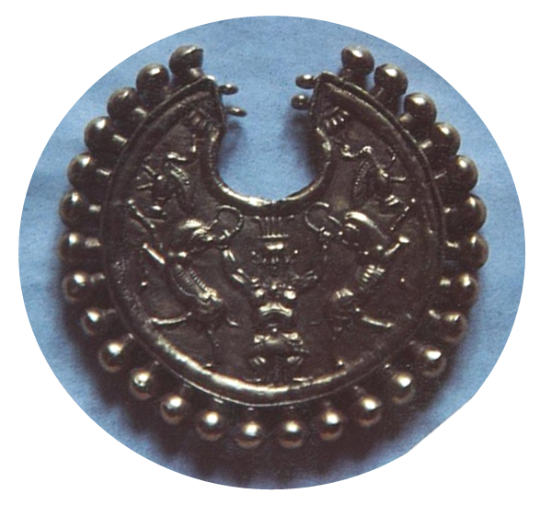
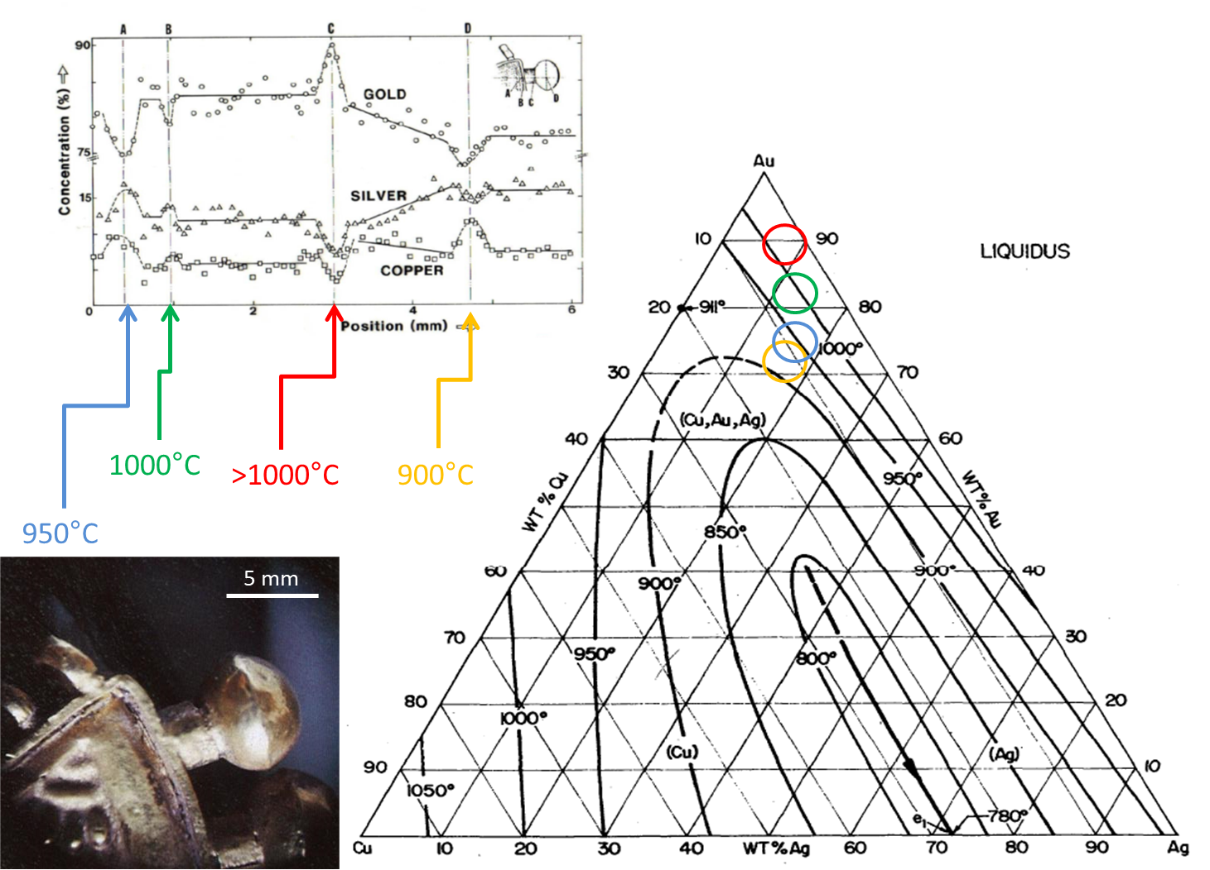
Brazing – a “old” story
PIXE analysis – LARN
Achéménide pendant - 4° s. B.C. (Louvre)

Slide 4
Brazing & Soldering
Temperature
Time
° Brazing & Soldering: Assembly with a filler metal having a melting point lower than for the assembled materials
° Soldering: Melting point of the filler metal < 450 °C, Brazing: > 450 °C.
° Allow the assembly of different metals and no-metals (ceramics).
° Allow high precision assembly.
° Mechanical resistance generally less than for welding.
° Wetting of the filler metal obtained using a flux or with vacuum / reductive atmosphere (and coating if needed).
Air brazing & soldering
Vacuum brazing & soldering

Slide 5
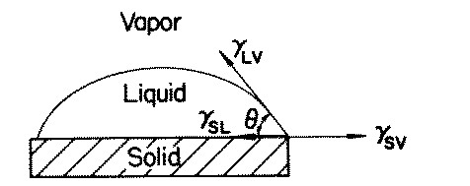
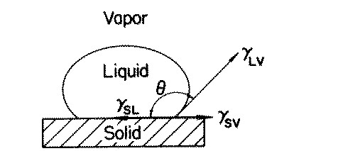
The Wetting
ϒSL + ϒLV cos (Θ) = ϒSV (Young’s relation)
- Interaction - cos(Θ) ↑
ϒSL ↓ Θ↓
(Ex.: Cu-Ag on Cu)
- Pas d’interaction - cos(Θ) ↓
ϒSL ↑ Θ ↑ , cos(Θ) > 90°
(Ex.: Cu-Ag on Alumina)
Brazing / Soldering: θ < 30° …. Ideally 0° for good brazing by capillarity.
What prevents good wetting (a good interaction) on a metal is oxidation!
Two solutions: the flux or the vacuum

Slide 6
Vacuum Brazing
Main objective of the vacuum brazing: Oxide reduction at high temperature / low O₂ partial pressure
Example with Copper (Cu):
Gibbs energy of metal oxide formations:
G = H – TS H = U + PV
For the reaction:
→
For CuO₂, A= -169881 and B= 74.43 [Source: CRC Handbook]
At 800°C, ΔG = -90 kJ → ΔG = -180 kJ for 1 mole of O₂.
With ΔG = -180 kJ,
With P = 760 Torr,
At equilibrium, for the production of one mole of O₂:
If :
→
The oxide is stable
→
The oxide decompose

Slide 7
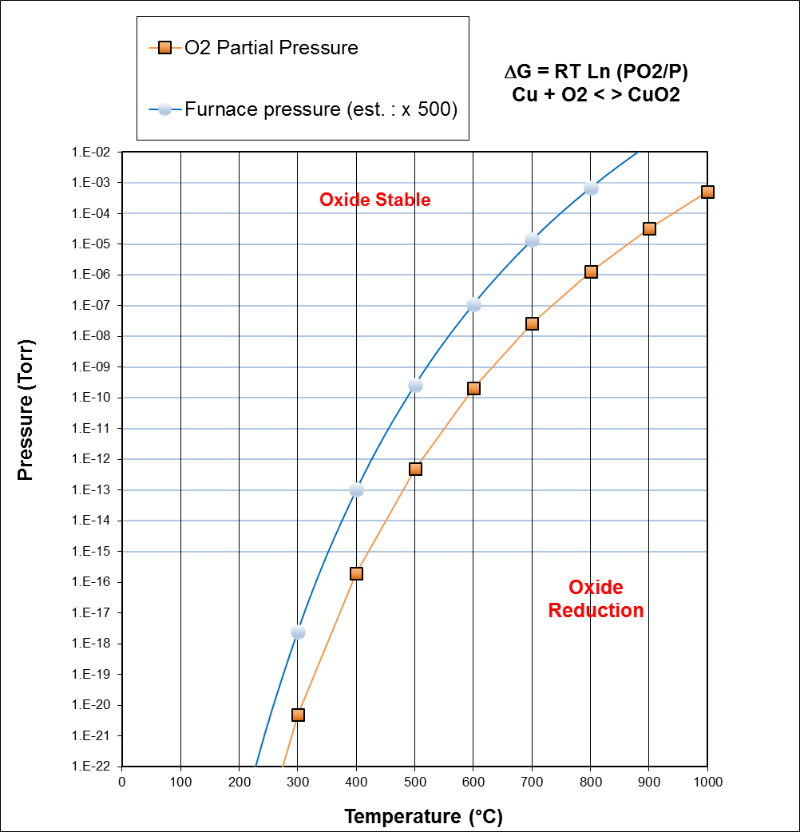

Slide 8
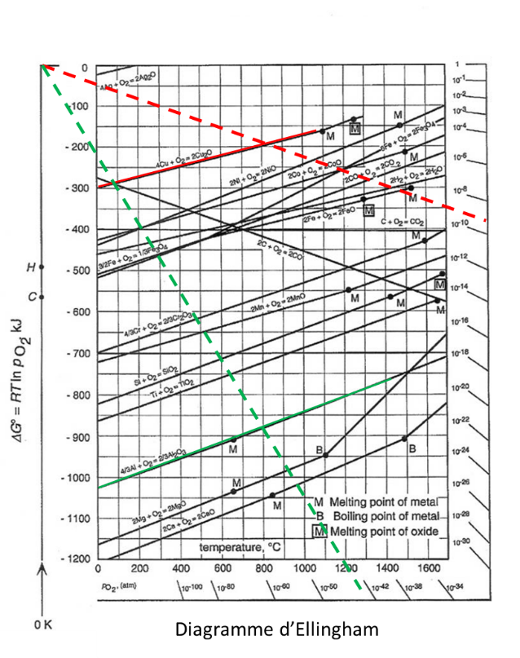
Vacuum Brazing – The Ellingham diagram
For CuO₂, A= -169881 and B= 74.43 [Source: CRC Handbook]
At 800°C, ΔG = -90 kJ → ΔG = -180 kJ for 1 mole of O₂.
With ΔG = -180 kJ,
With P = 760 Torr,
Reduction of the Copper Oxyde possible at 800 °C in a vacuum furnace.
For Al₂O₃, A= -1689572 and B= 328.66 [Source: CRC Handbook]
At 800°C, ΔG = -1337 kJ → ΔG = -891 kJ for 1 mole of O₂.
With ΔG = -893 kJ,
With P = 760 Torr,
Reduction of the Alumiun Oxyde (Alumina) impossible in a vacuum furnace.
Ellingham diagram

Slide 9
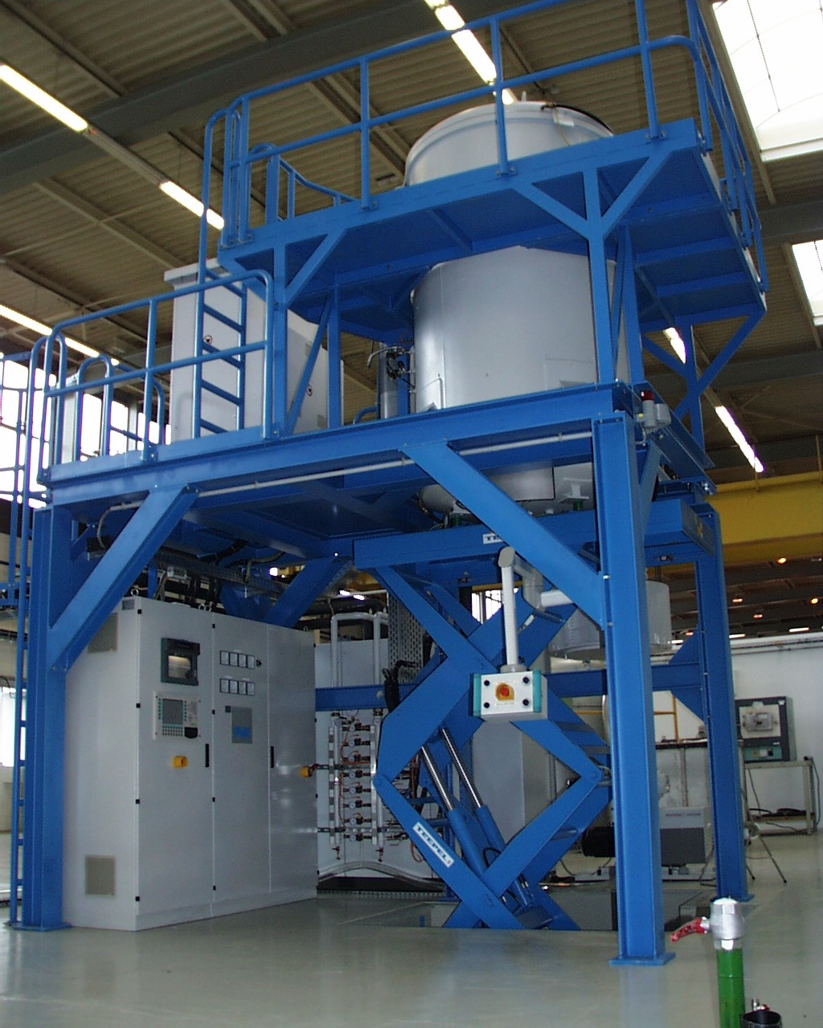
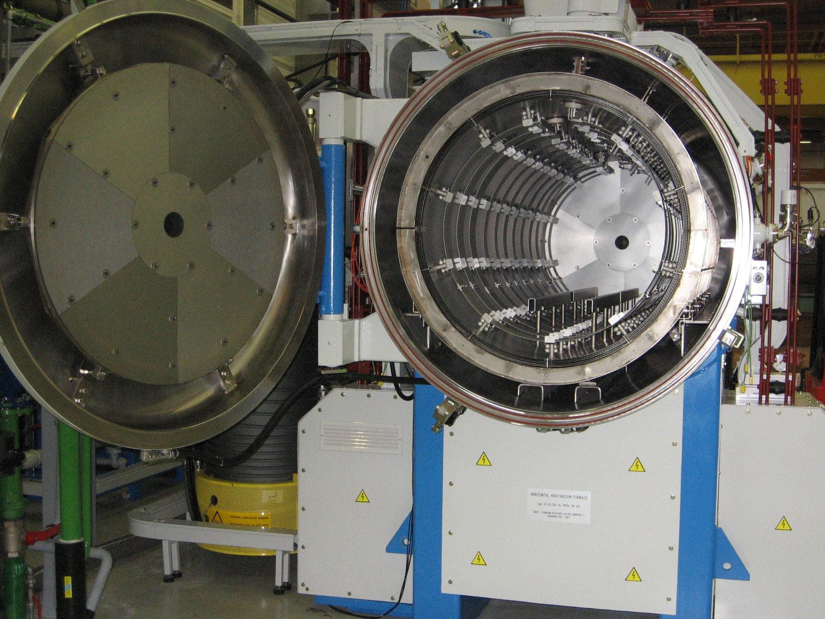
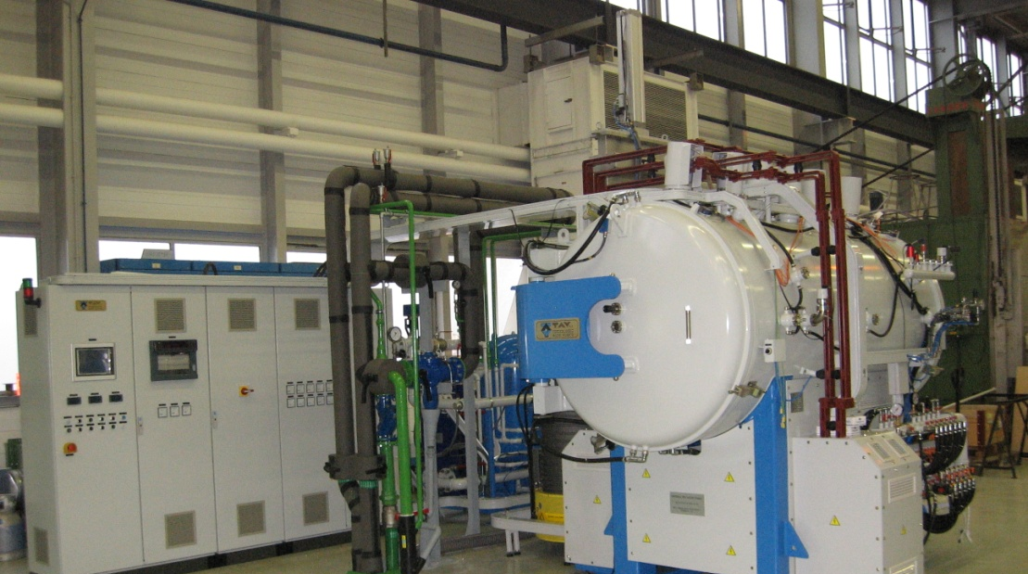
Vacuum Furnace
1
6
5
7
4
3
2
Vertical(1) or Horizontal(2) configuration, made of a high-speed vacuum pump (diffusion pump)(3), vacuum chamber with double walls water cooled(4), stainless steel / molybdenum screens(5), molybdenum heaters(6), molyddenum support(7), electrical cabinet(8).
(case for a all-metal vacuum furnace)
Visit 112-R-A10
8

Slide 10
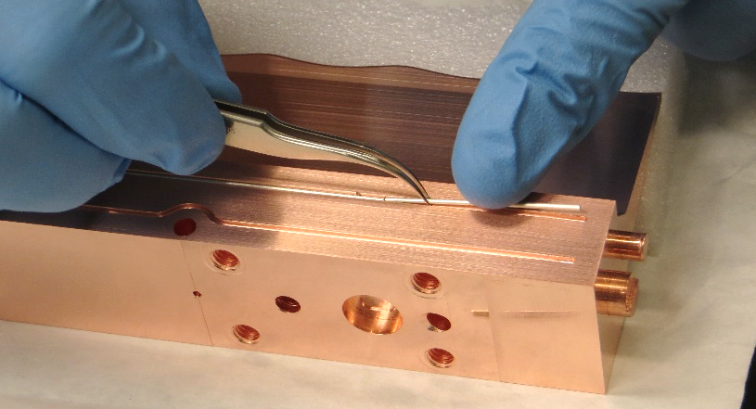
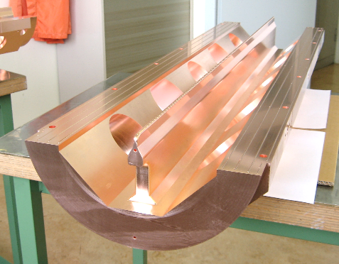
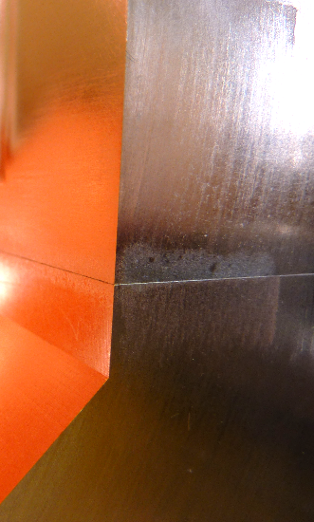
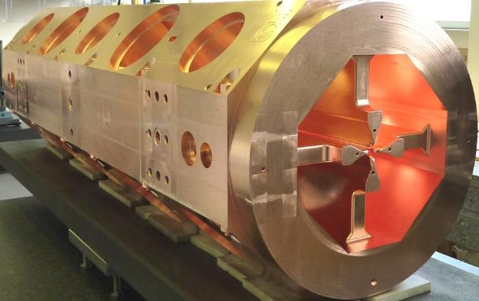
Vacuum Brazing assembly
° Wetting is generally excellent.
° Brazing on large surfaces possible.
° Allow very good thermal and electrical contacts.
° Assembly clean and UHV compatible.
(Filler metal and material with low vapor pressures!)
° Dissimilar materials can be join.
° Allow high precision assembly with little or no
distortion of the components
But:
° Heat treatment can affect the properties of
the base materials.
° Mechanical tolerances are tight
Filler metal seen on the vacuum side

Slide 11

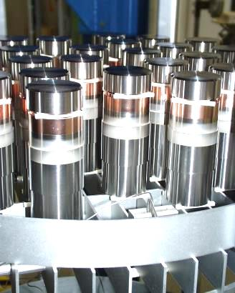

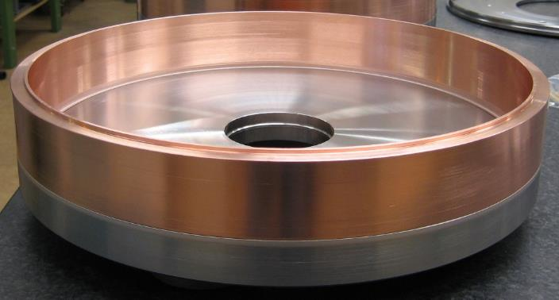
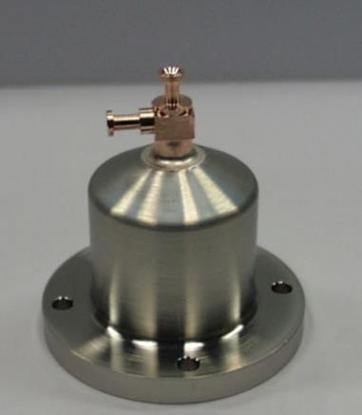
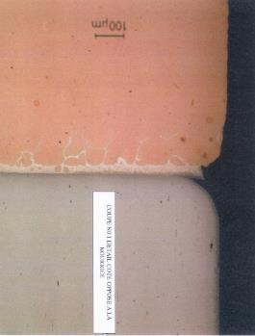
Metal/Metal Vacuum Brazing Examples
Joint configuration:
- Groove, no gap (Ra ≈ 0.8 µm)
- Groove on a diameter
- Chamfer
- Foil
- Paste
Copper (OFE) / Stainless Steel (316LN)

Slide 12
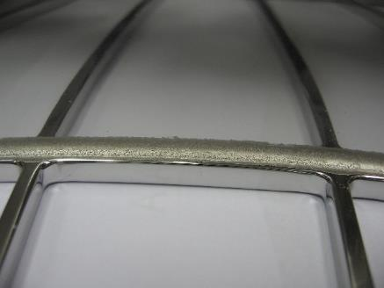
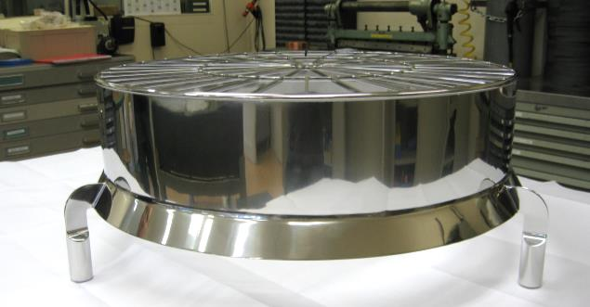
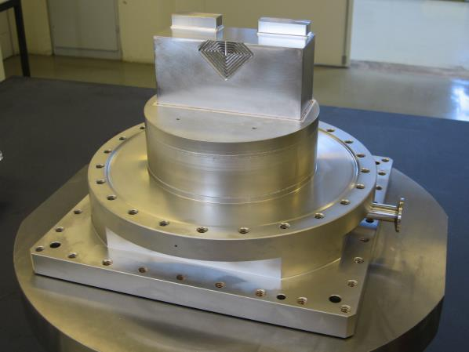
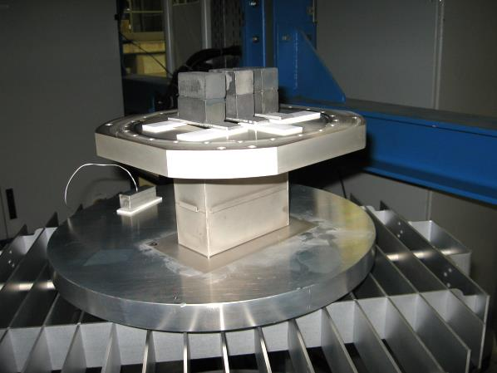
Metal/Metal Vacuum Brazing examples
Stainless Steel / Stainless Steel (316LN)

Slide 13
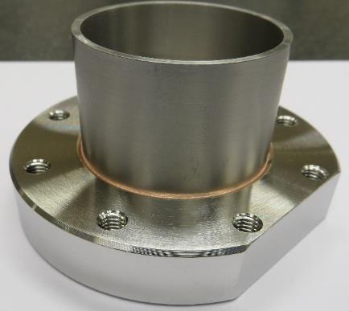
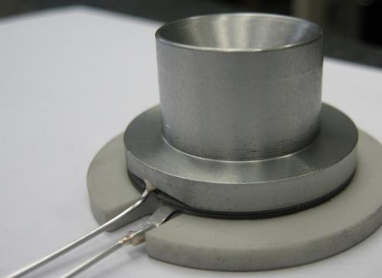
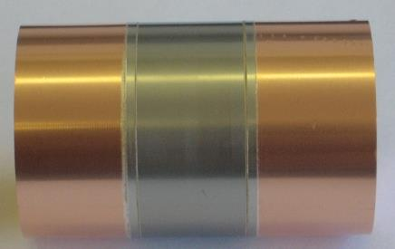
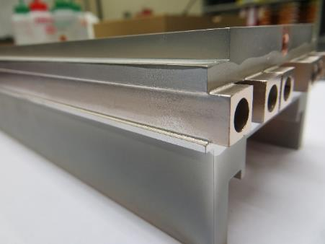
Metal/Metal Vacuum Brazing examples
Nb – Stainless steel
Mo – Stainless steel
Cu – Stainless steel - Ti
Glidcop - CuNi

Slide 14
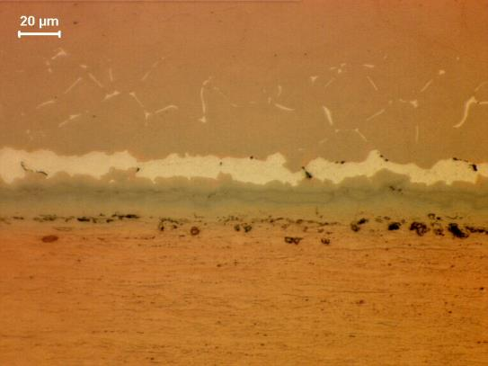
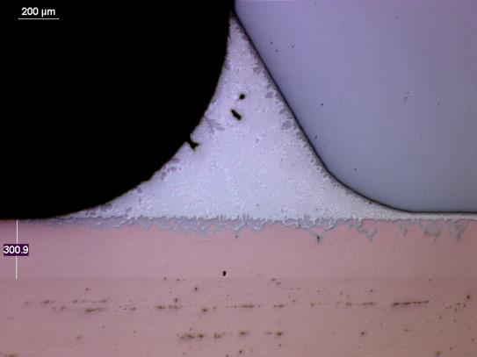
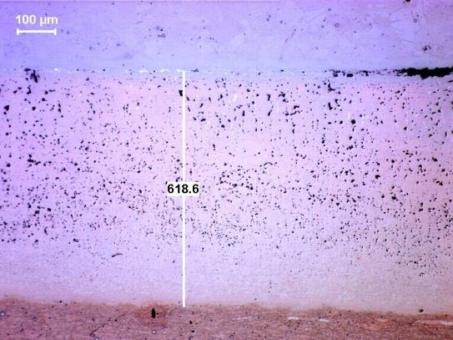
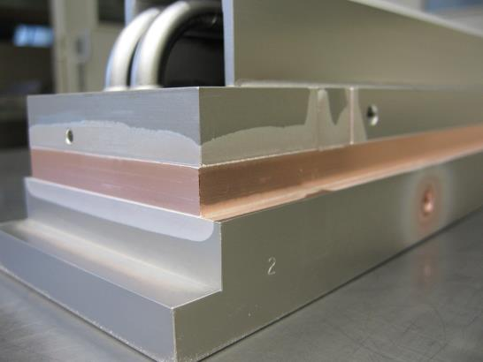
Metal/Metal Vacuum Brazing examples
Case of Glidcop

Slide 15
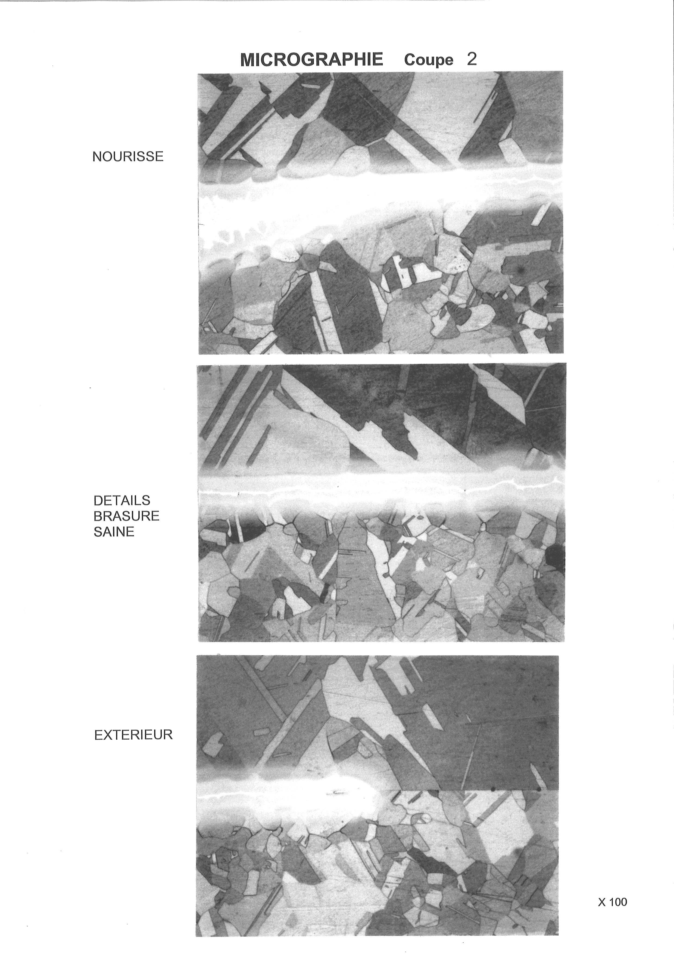
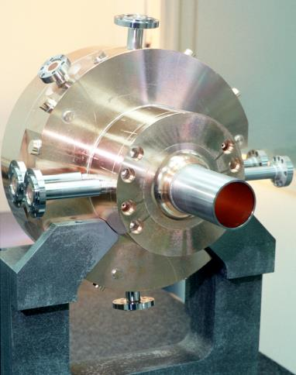
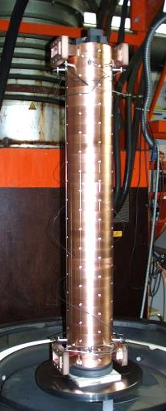
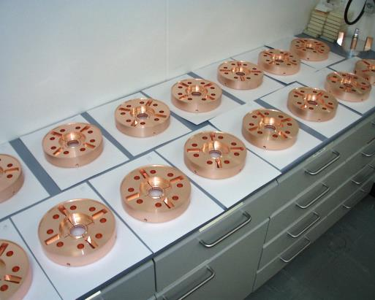
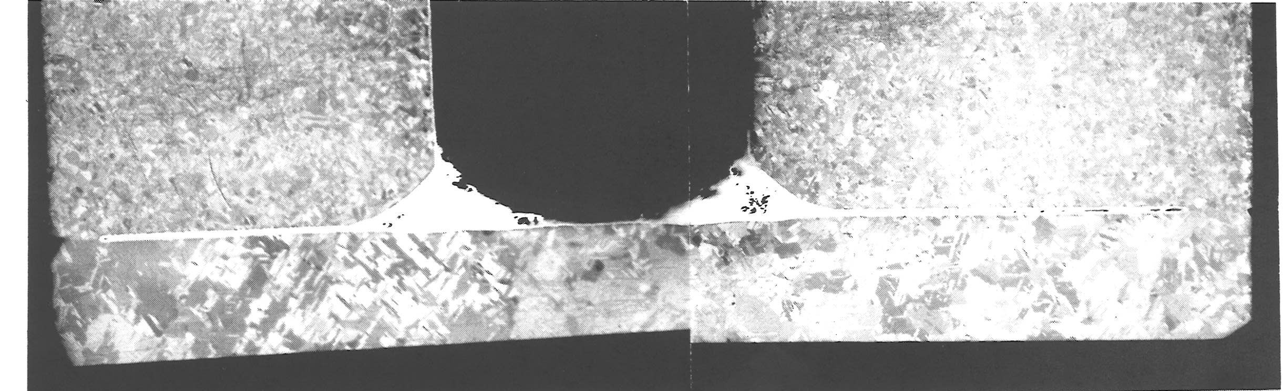
Metal/Metal Vacuum Brazing examples
Brazing & Partial Diffusion Bonding
a
b
c
a
b
c

Slide 16
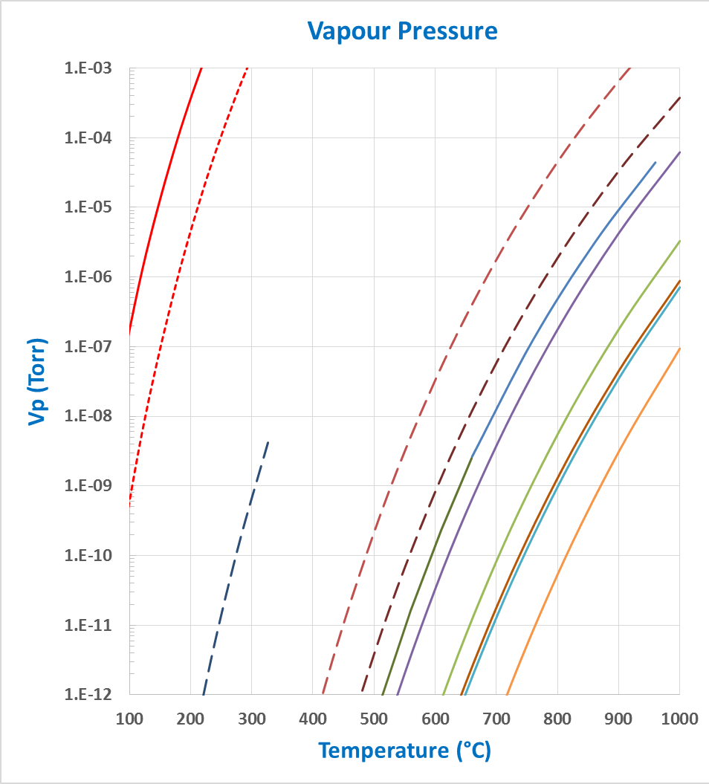
Metal/Metal Vacuum Soldering examples
° High purity SnAg or SnPb solders can be used in vacuum …
- Typical solders:
SnAg (eutectic): m.p. 221°C
SnPb (eutectic): m.p. 183°C
- Wetting acceptable on:
Cu and Ag
Zn
Cd
Al
Cu
Au
Ag
Pd
Fe
Sn
Ni
Pb

Slide 17
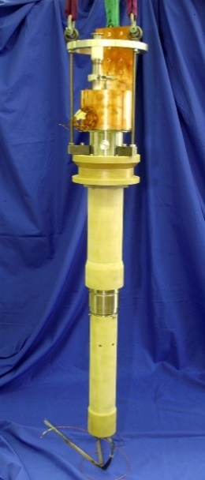
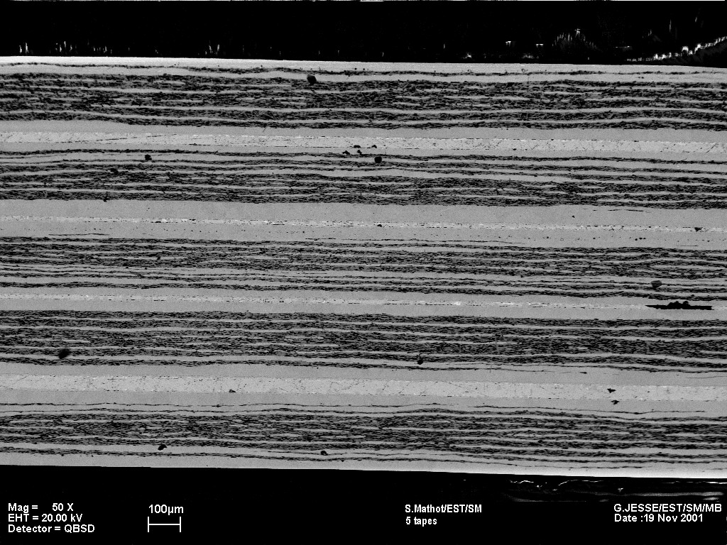
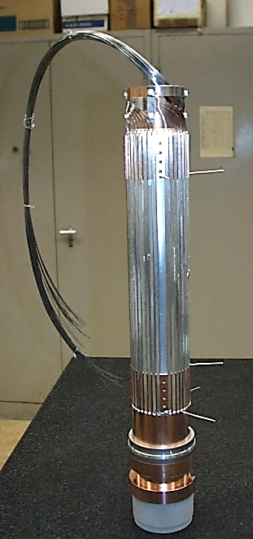
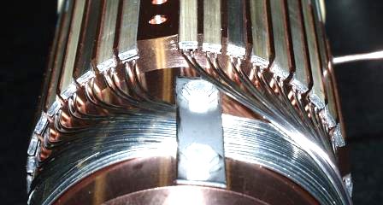
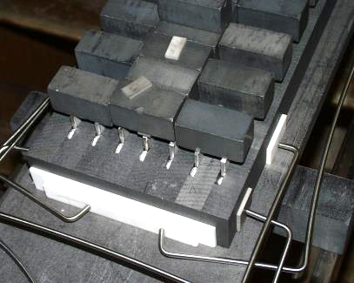
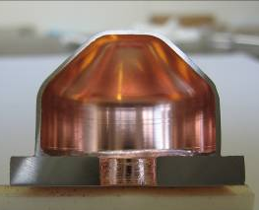
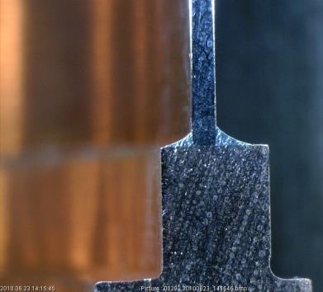
Metal/Metal Vacuum Soldering examples
Vacuum soldering of High Temperature Superconductor (HTS) tapes for the LHC current leads.
HTS stacks soldering – SnPb
HTS tapes soldering – SnAg
Kovar “boxes” – SnAg

Slide 18
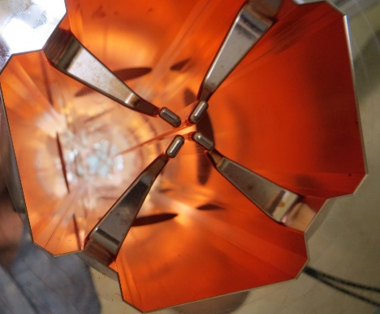
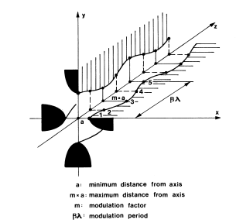
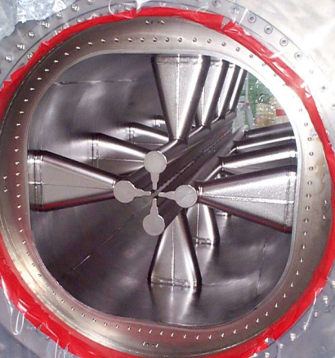
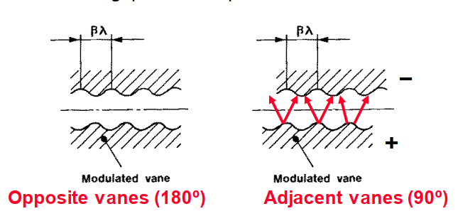
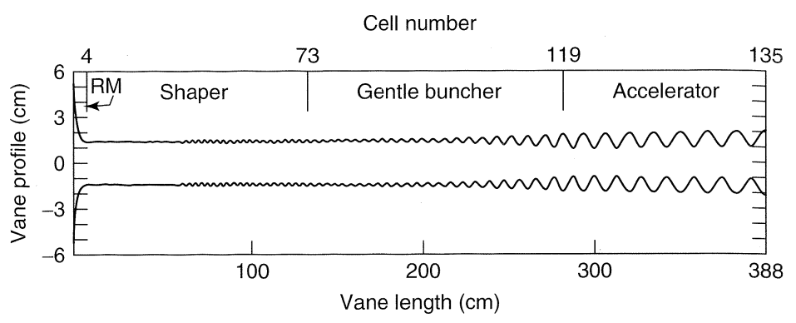
Metal/Metal Vacuum brazing examples
Case of the RFQ
4-Vanes
The RFQ (Radio Frequency Quadrupole)
4-Rods
Perturbation (Modulation) of the Electrodes (Vanes) produces a longitudinal electric field for the acceleration of the ions.
RFQ Performances:
- The RF field allows the Focusing, Bunching and Acceleration
- Is the only linear accelerator accepting a low energy continuous beam
- Acceleration up to 5 - 10 MeV for protons
T. P. Wangler (2011)

Slide 19
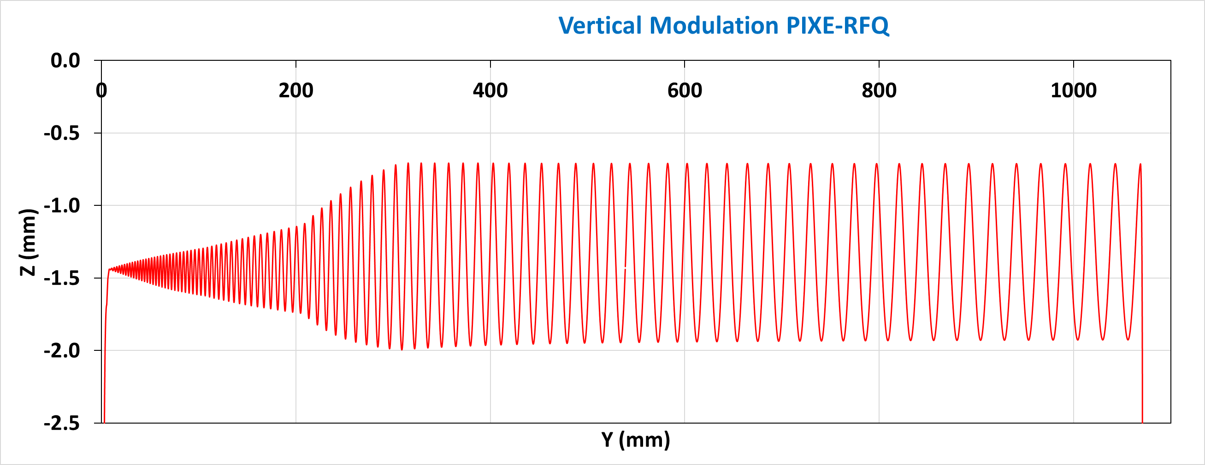
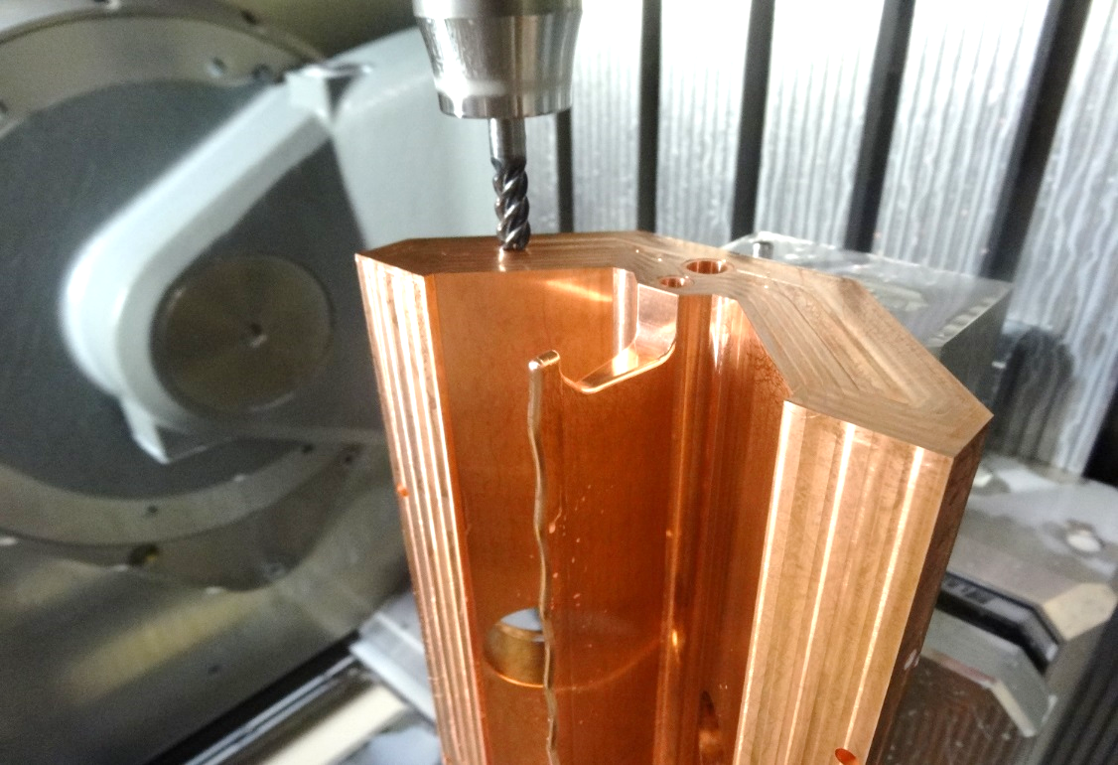
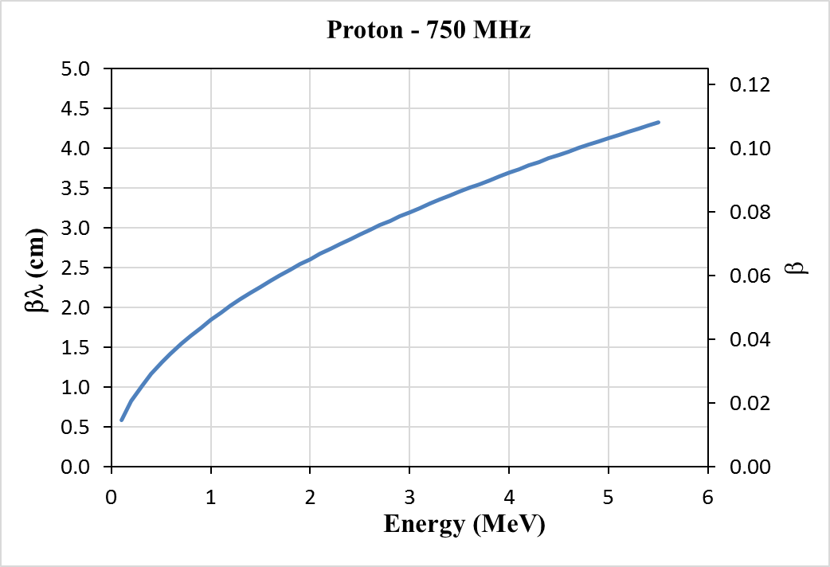

Metal/Metal Vacuum brazing examples
Case of the RFQ
Synchronism between the modulation and the velocity of the particle in an RFQ
Views of the high energy side (last cells) of the vane for two RFQ’s at same frequency, same ion but different end-energy.
2.6 cm
4.1 cm
PIXE-RFQ (2MeV)
(750 MHz)
HF-RFQ (5MeV)
(750 MHz)

Slide 20



Metal/Metal Vacuum brazing examples
Case of the RFQ
RFQ are generally used as an injector (LINAC4), but (recently) can be used as well as stand alone accelerator (ELISA)

Slide 21


Metal/Metal Vacuum brazing examples
Case of the RFQ
Mechanical Tolerances
Tolerances are very tight for an RFQ … but good machining and good alignment are not enough. Deformations during brazing must be anticipate!
Recipe:
1. Discuss a cavity design which reduce the machining time and constraints and limit the risks during brazing.
2. Alternate machining and heat treatment steps, last machining before brazing must be very “light”.
3. Have a good alignment strategy (and good metrology).
4. Have a good tooling reducing possible movement during brazing.
5. Use a thermal cycle adapted to the size of the piece.
Brazing surface L
Brazing surface R
Braz. surf. L
Braz. surf. R
Flatness of the Left and Right brazing surfaces: After machining and after heat treatment at 800 °C

Slide 22






Metal/Metal Vacuum brazing examples
4-Vanes design
Case of the RFQ
Machining with shape tools

Slide 23



Metal/Metal Vacuum brazing examples
Case of the RFQ
Metrology – Alignment –Machining of reference surfaces

Slide 24





Metal/Metal Vacuum brazing examples
Case of the RFQ
First brazing : alignment and assembly

Slide 25





Metal/Metal Vacuum brazing examples
Case of the RFQ
First brazing : Fixture and brazing

Slide 26




Metal/Metal Vacuum brazing examples
Case of the RFQ
Second brazing : Fixture and brazing

Slide 27




Metal/Metal Vacuum brazing examples
Case of the RFQ
Good job …. One module finished ….

Slide 28



Vacuum brazing of Alumina (Ceramic)
First process = Mo-Mn metallization
Mo + MnO (Mn) powder on alumina (Al₂O₃) @ T > 1200 °C and P_{H2O} / P_{H2} > 10⁻⁴ induce:
- Mo reduction and MnO/Al₂O₃/SiO₂… vitreous phase formation. - Interaction with the Alumina base material and the binder.
- Sintering of the Mo powder in the vitreous phase during cooling.
- Formation of Mo-Mn layer strongly adhering the support.
- Ni layer added to improve the brazing.

Slide 29


Vacuum brazing of Alumina (Ceramic)
TCF = Thermomechanical Compatibility Factor
$TCF≅\frac{ε_{y}}{σ_{y}∗ε_{T}}$
With
$$ε_{y}=Metal elastic elongation at brazing temp.$$
$$σ_{y}=Metal yield strength.$$
$$ε_{T}=Delta elengation between metal and ceramic$$
Max. TCF => Min. Stress
Metal thermal expansion AND metal yield strength should be taken into account for Metal / Alumina brazing.
Métal | TCF
Niobium Platine Tantale Cuivre Titane Kovar Nickel CuNi Fe-42Ni Monel Invar Molybdène Inox 304 Inconel 600 Tungstène | 88 33 28 20 8.8 7.7 6.7 4.8 4.5 4.0 3.7 3.5 2.9 2.1 2.0

Slide 30






Vacuum brazing of Alumina with Metallization - Examples
Kovar (Dilver) – Alumina
Ti – Alumina – Cu
Cu – Alumina (up to diameter 400 mm!)

Slide 31

Vacuum Brazing of Ceramic
Second process = Active Brazing
- Brazing alloy containing reductive metal: Ti, Zr, Be, …
- At brazing temperature, under high vacuum, strong interaction with oxides (alumina), carbide, nitrite, ….
- Complex chemical reactions formed at the ceramic / brazing metal interface. Ex.: SiC/Ti > Ti₃SiC₂, Ti₅Si₃C, Ti₅Si₃C_{x},….
- ↑ Interaction (wetting) possible with several types of ceramics.
- ↓ Possible formation of brittle phases.
- Example of Active Brazing Alloys:
CuSil ABA (Ag 63, Cu 35.25, Ti 1.75)
Silver ABA (Ag 92.75, Cu 5, Al 1, Ti 1.25)
Gold ABA (Au 96.4, Ni 3, Ti 0.6)
TiO₂
Al₂O₃
ZrO₂
2 BeO
Ellingham diagram

Slide 32





Vacuum Brazing of Ceramics with Active Alloy - Examples
Sapphire
(Φ 115 mm)
Nb
Dilver
Diamond (Φ 5 mm) – Ti
Alumina
Carbon – CuSil ABA – CuNi
AlN – Dilver

Slide 33







Vacuum Brazing of Ceramics with Active Alloy - Examples
° Active brazing on ceramics
Alumina – Ti
Alumina – Cu
ZrO₂ – Ti
Alumina – Monel
Alumina – Ti

Slide 34


Vacuum Brazing of Metals with Active Alloy - Examples
Cu – W
(CuSil ABA)
Ta tube /316LN with CuSil ABA
(A. Gerardin)

Slide 35




Vacuum Brazing by Diffusion brazing
Diffusion brazing: The filler metal is form by diffusion during the heat treatment.
Example: Alumina/Cu, Metallized ceramic with a Silver layer, Cu with Silver layer
Porosities

Slide 36





Vacuum Brazing of large quantities
Vacuum brazing (and vacuum furnaces) are adapted to produce large quantities of similar pieces. Not common at CERN, but why not when needed ….
Hundreds of Cu/Stainless steel junctions
18000 brazing for the thermal links
23 km of HTS tapes vacuum soldered in stacks

Slide 37
Final remarks - comments
Vacuum brazing is a technique that allows highly precision assemblies,
which allows different materials, including ceramics, to be assembled.
The preparation of parts and machining is always high precision. But success begins with the discussion of the design and the follow-up of a very precise procedure, including for surface treatments.
High temperature brazing always modifies the properties or even the dimensions of the parts... this must always be taken into account.

