Slide 1




Magnets for a Muon Collider
Presented by L. Bottura, CERN
on behalf of the Muon Magnets Working Group
Funded by the EU under Grant Agreement 101094300

Slide 2
Outline
The muon collider in the HEP landscape
The magnet challenges of the muon collider
Magnet development targets
Summary and perspective

Slide 3
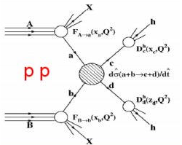
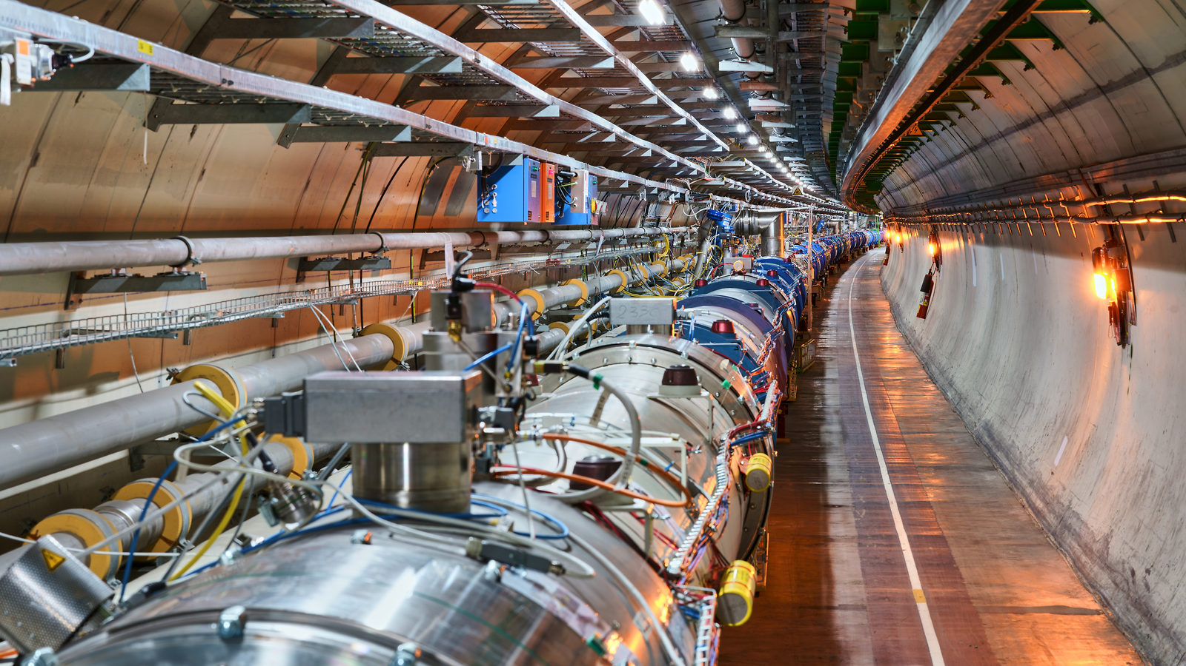
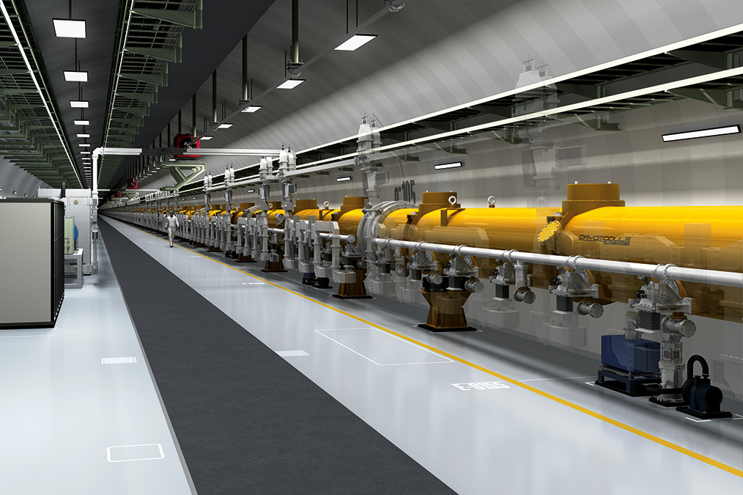
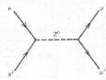
Collider Choices
Hadron collisions: compound particles
  LHC collides 13.6 TeV protons
  Protons are mix of quarks, anti-quarks and gluons
  Very complex to extract physics
  But can reach high energies
Lepton collisions: elementary particles
  LEP reached 0.205 TeV with electron-positron collisions
  Clean events, easy to extract physics
  Lepton collisions ⇒ precision measurements
  Hard to reach high energies
e⁺e⁻

Slide 4
Energy Limit
accelerating cavities
magnets
N
N
Electron-positron rings (multi-pass colliders) are limited by synchrotron radiation
S
S
Electron-positron linear colliders avoid synchrotron radiation, but are single pass
Typically cost proportional to energy and power proportional to luminosity,
Hence present energy frontier is probed by proton rings
Novel approach: the muon collider
Large mass suppresses synchrotron radiation => circular collider, multi-pass
Fundamental particle yields clean collisions, requires less energy than protons
But lifetime at rest only 2.2 μs (increases with energy)
The muon collider is part of the European Accelerator R&D Roadmap
e⁻: 0.511 MeV
μ: 106 MeV
p⁺: 938 MeV

Slide 5
Muon Collider: Physics ?
https://doi.org/10.48550/arXiv.2203.07261
Muon collisions in the range of 10 TeV have comparable discovery potential to hadron collision in the range of 100 TeV
Equivalence between proton (hadron) and muon (lepton) center of mass energy at collision for selected production and decay channels

Slide 6
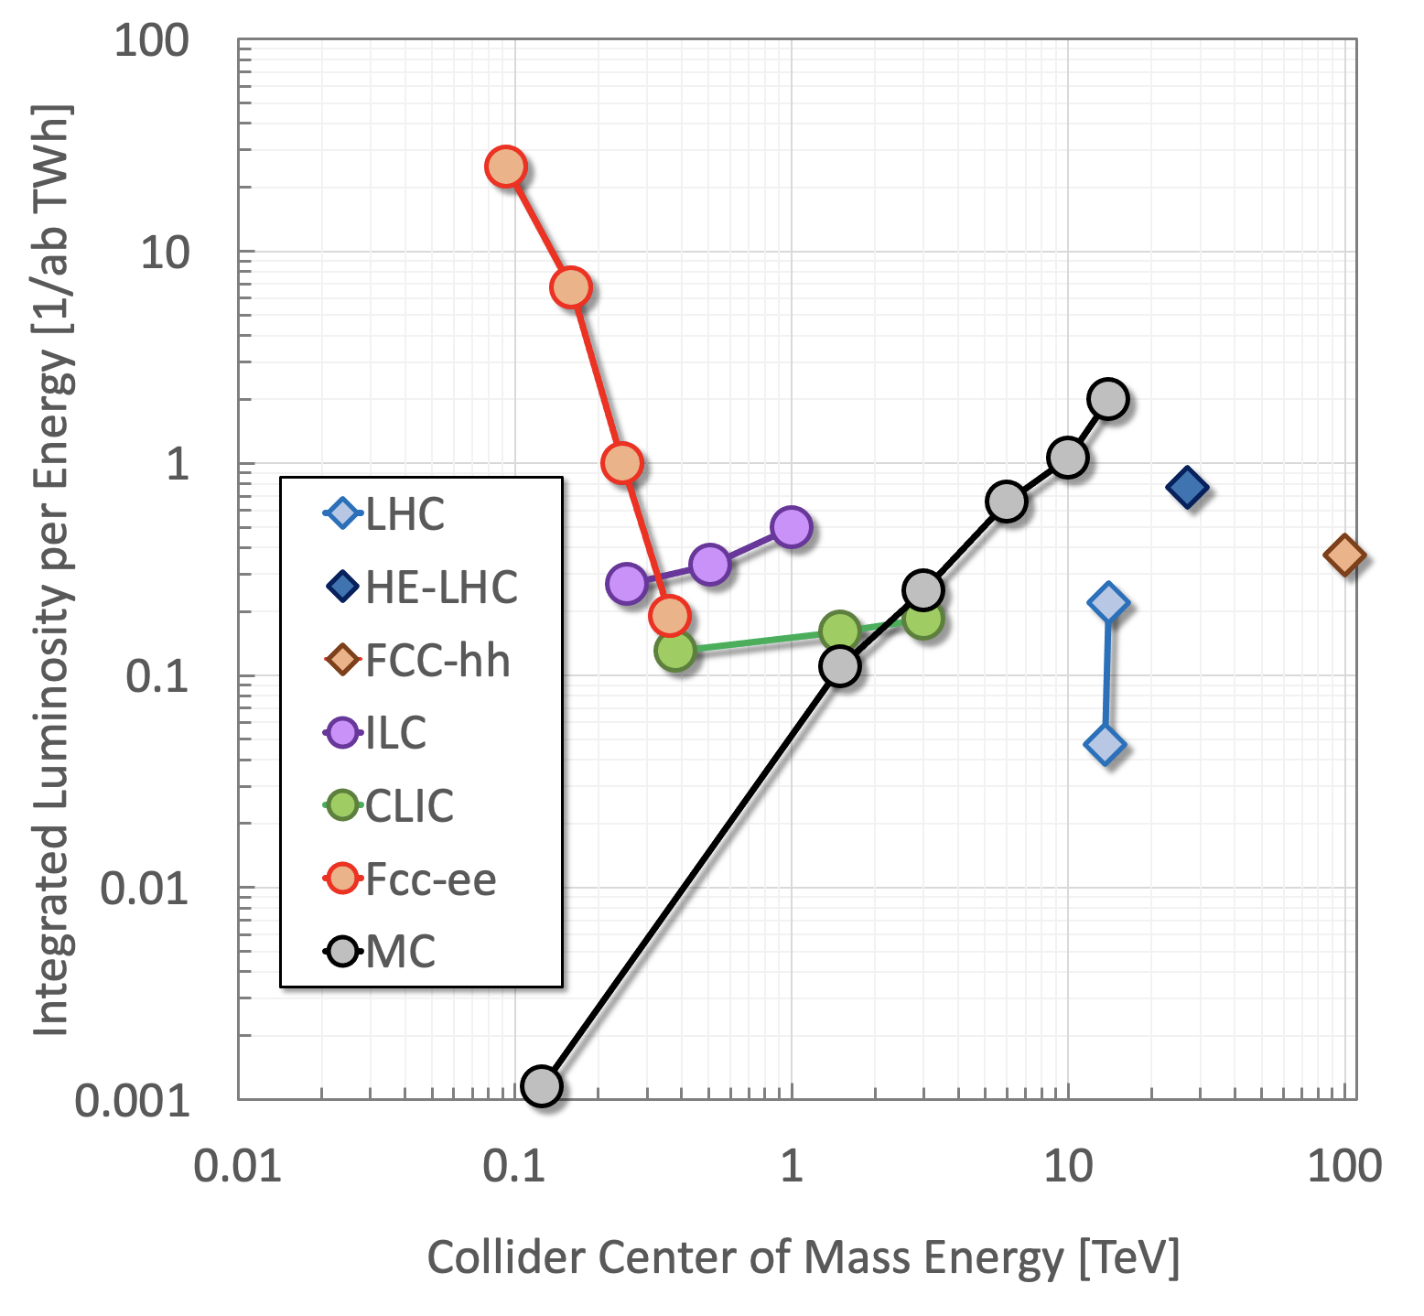
Muon Collider: Sustainable ?
K.Long et al, Nature Physics, v.17, p.289, 2021
A muon collider at 10 TeV can provide the highest integrated luminosity per unit energy consumption

Slide 7
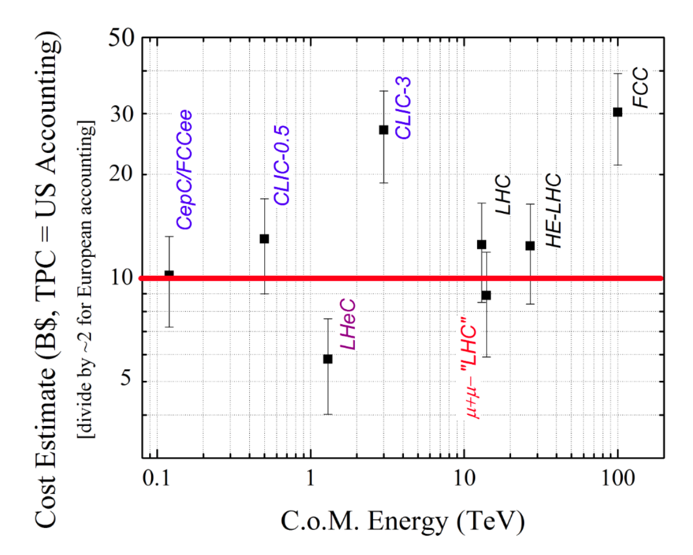
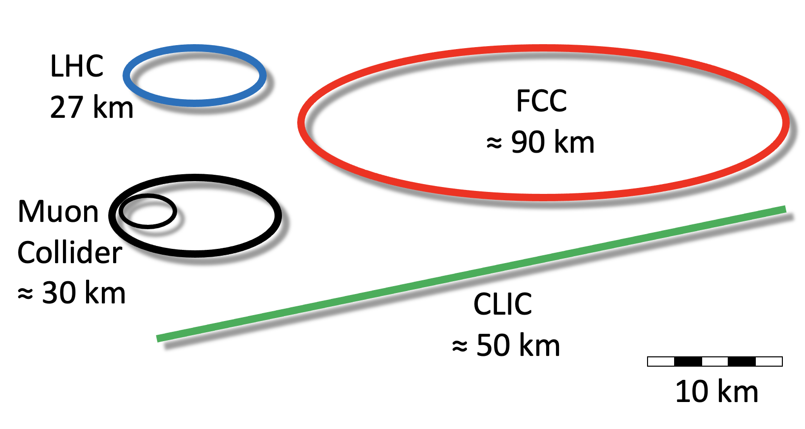
Muon Collider: Affordable ?
A 10 TeV muon collider profiting from the LHC infrastructure could be the most cost-effective energy frontier collider
D. Neuffer and V. Shiltsev 2018 JINST 13 T10003

Slide 8

Proton-driven Muon Collider Concept
Produce a low emittance muon beam…
… collide !
Steady state
Pulsed
Pulsed
Steady state
Steady state
pions
… accelerate muons…
Beam intensity
protons
muons
100…200 ms
Time

Slide 9
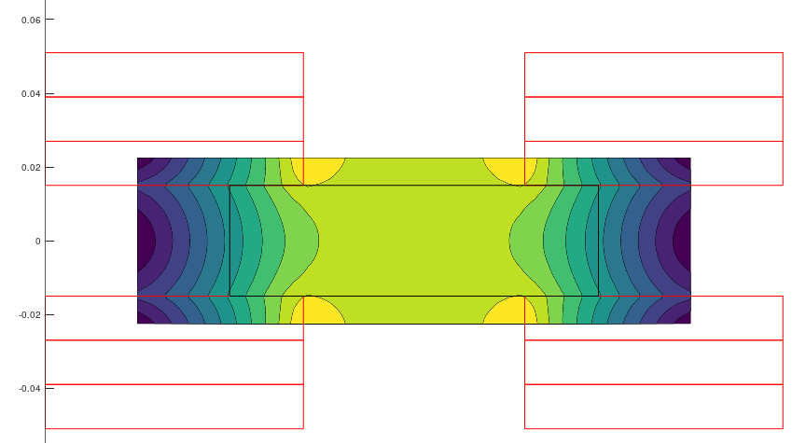
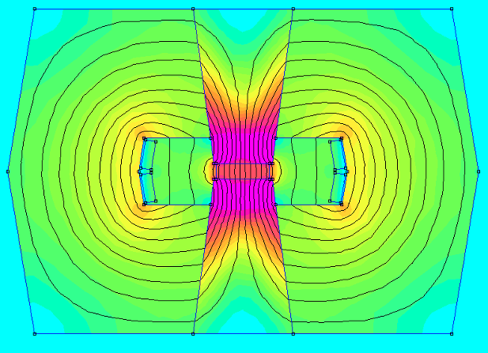
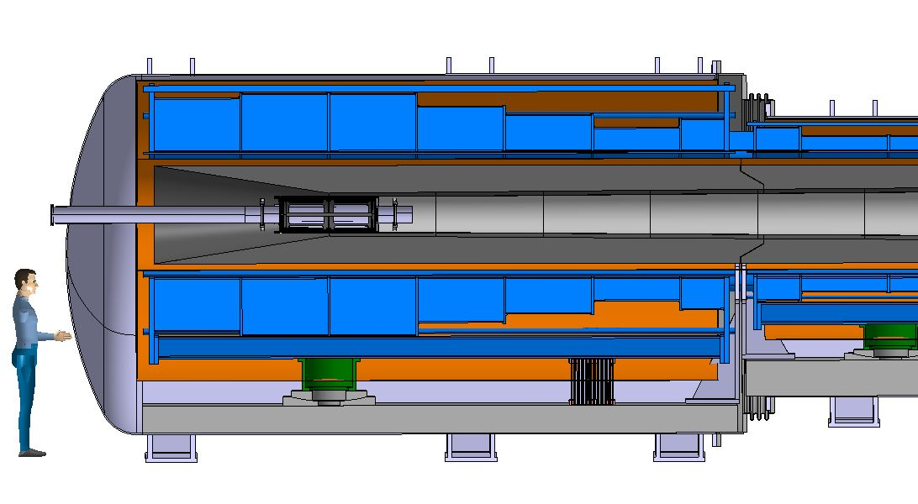
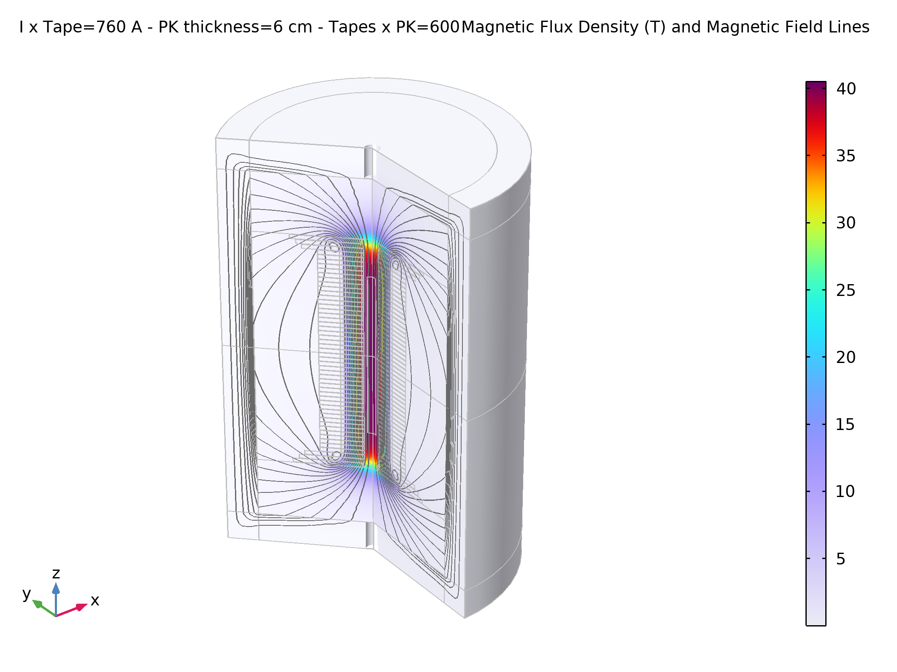
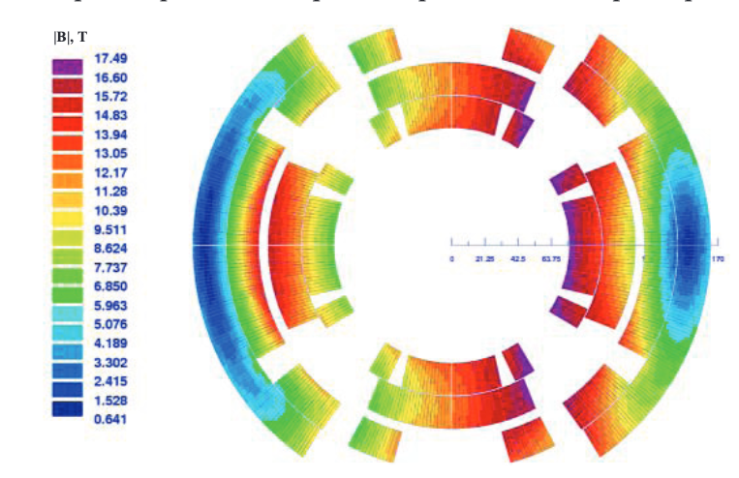
Muon Collider magnets
20 T, 200 mm
Radiation heat load ≈ 5…10 kW
Radiation dose: 80 MGy
NC ±1.8 T, 400 Hz 100 mm x 30 mm
SC < 10T
100 mm x 30 mm
SC dipole
NC dipole
NC dipole
SC dipole
RCS
> 40 T, 60 mm
16 T peak, 160 mm
Radiation heat load ≈ 5 W/m
Radiation dose ≈ 20…40 MGy

Slide 10
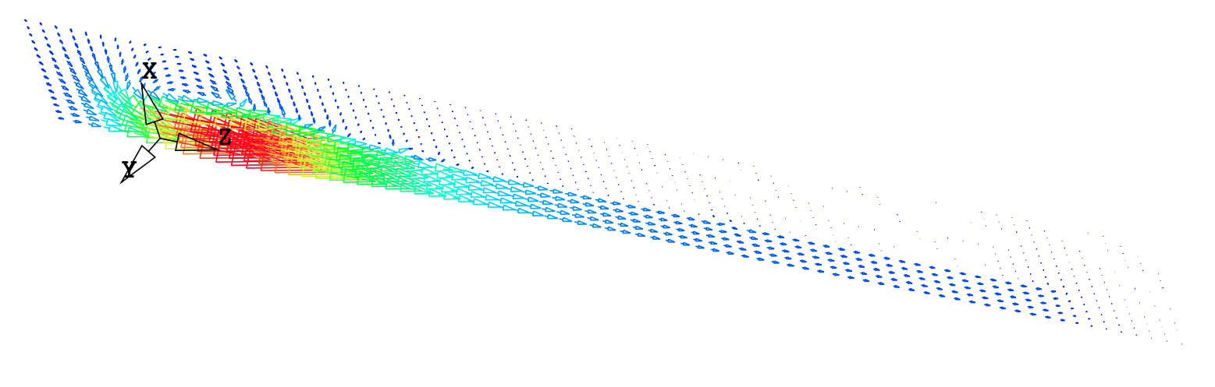
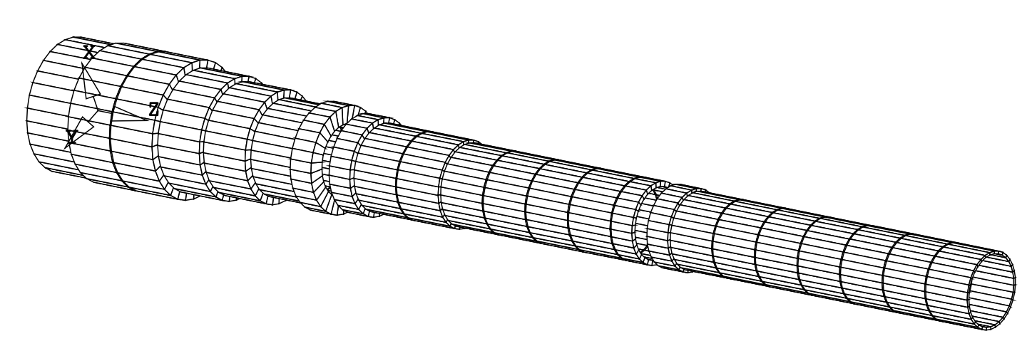
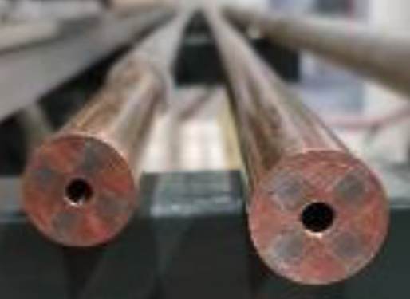
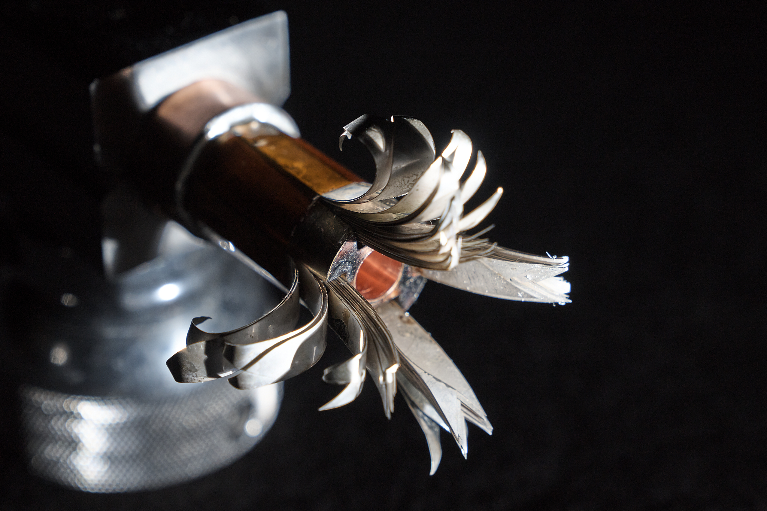
Target and capture solenoid (20 T)
A Portone, P. Testoni, J. Lorenzo Gomez, F4E
Operating field: 20 T
Operating temperature: 20 K
MIT “VIPER” conductor
MuCol HTS conductor
Operating current: 61 kA
M. Takayasu et al., IEEE TAS, 21 (2011) 2340
Z. S. Hartwig et al., SUST, 33 (2020) 11LT01
See A. Portone, et al., 2PoA01-02 on Tuesday 12/9/2023

Slide 11
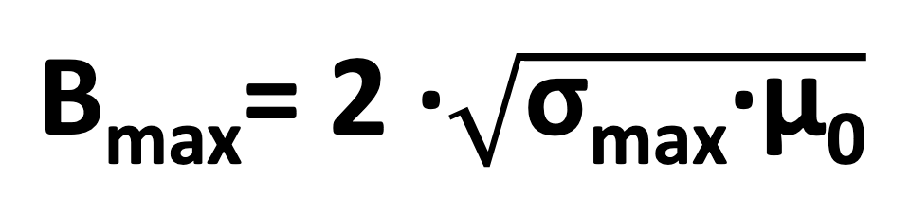

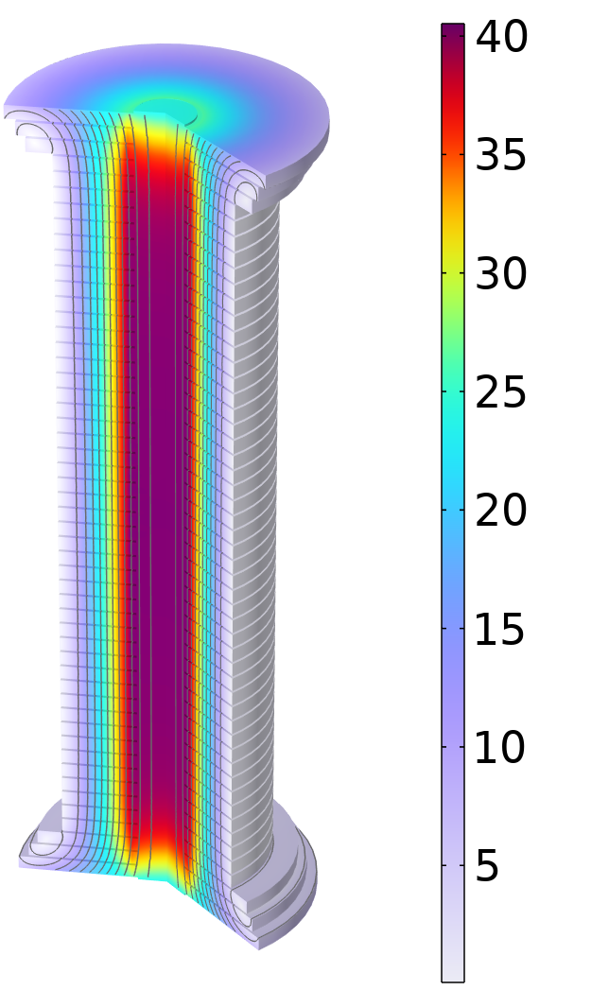
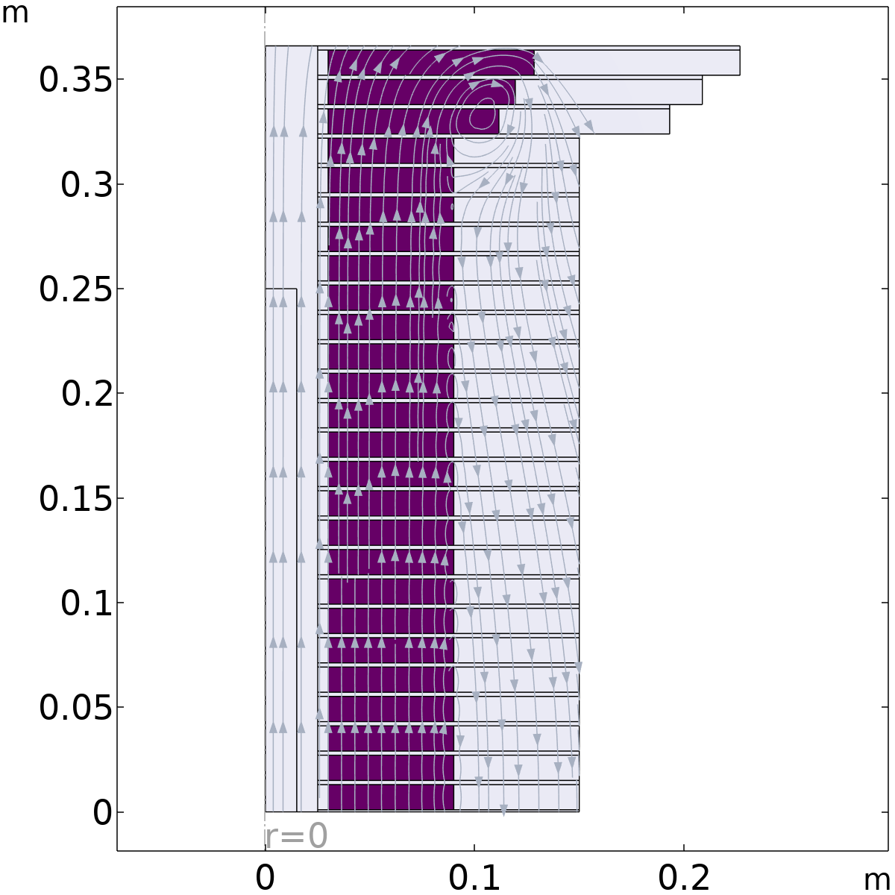
Final cooling (40 T) magnetics
σ_{max} = 600 MPa
  Modular pancake design with supporting ring and plates to manage hoop, radial and vertical stresses
  Free bore 50 mm
  Inner ring thickness 5 mm
  Coil winding thickness 60 mm
    J_{e} = 632 A mm⁻² → 40 T
  Outer ring thickness 60 mm
    Outer radius 150 mm
  Horizontal plate thickness 2 mm
Cross Section of ¼ Solenoid
Inner Ring
‘Correction’ Coil
Outer Ring
Bore
lines represent the field direction
Magnetic Field Modulus, T
‘Modular’ Coil
1 % Field Homogeneity
Support Plate
  46 identical ‘modular’ pancakes and 6 ‘correction’ pancakes are used to straighten the field lines at the solenoid ends
Courtesy of B. Bordini and A. Dudarev, CERN

Slide 12
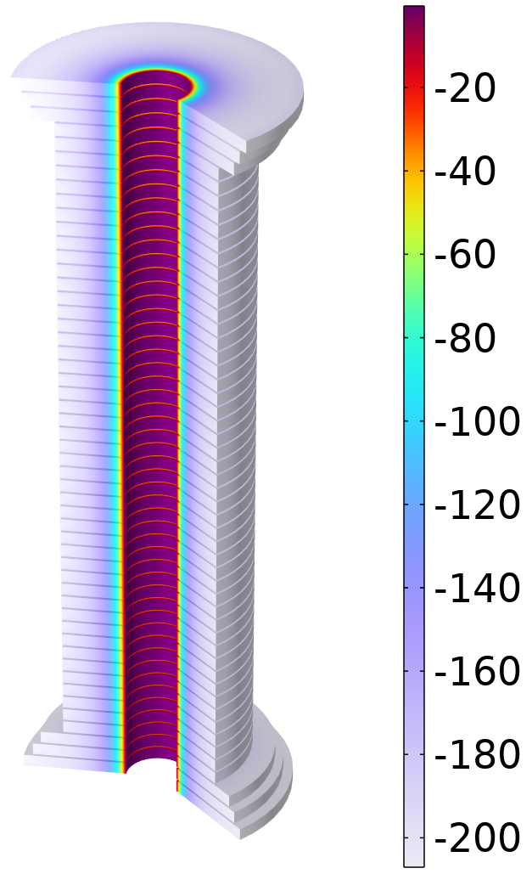
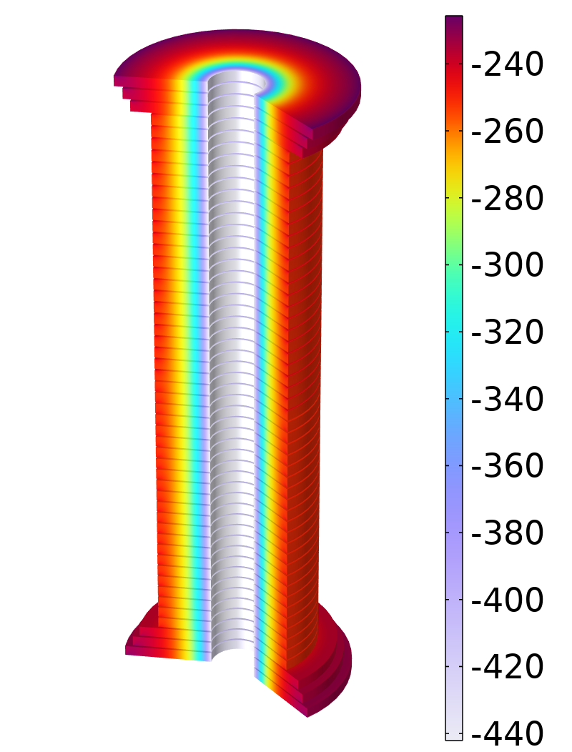
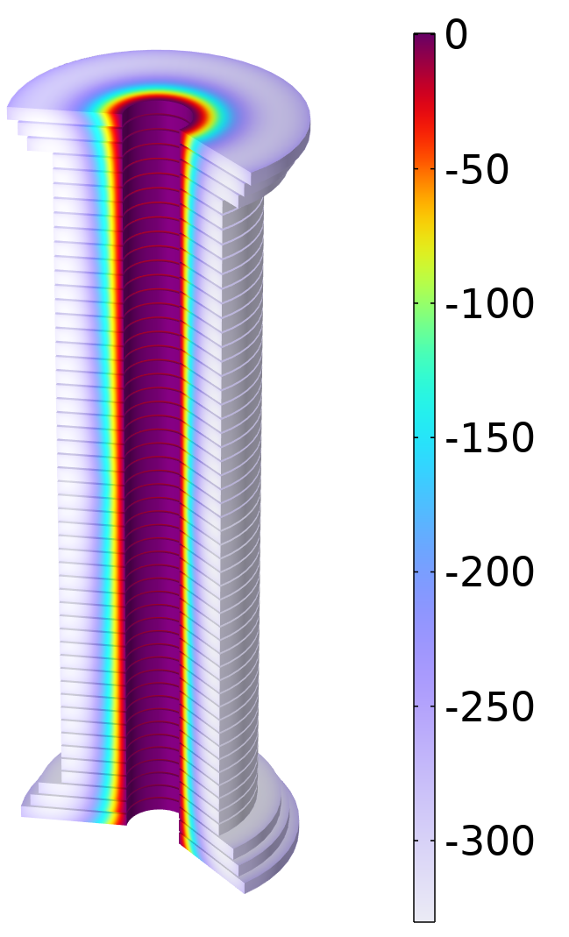
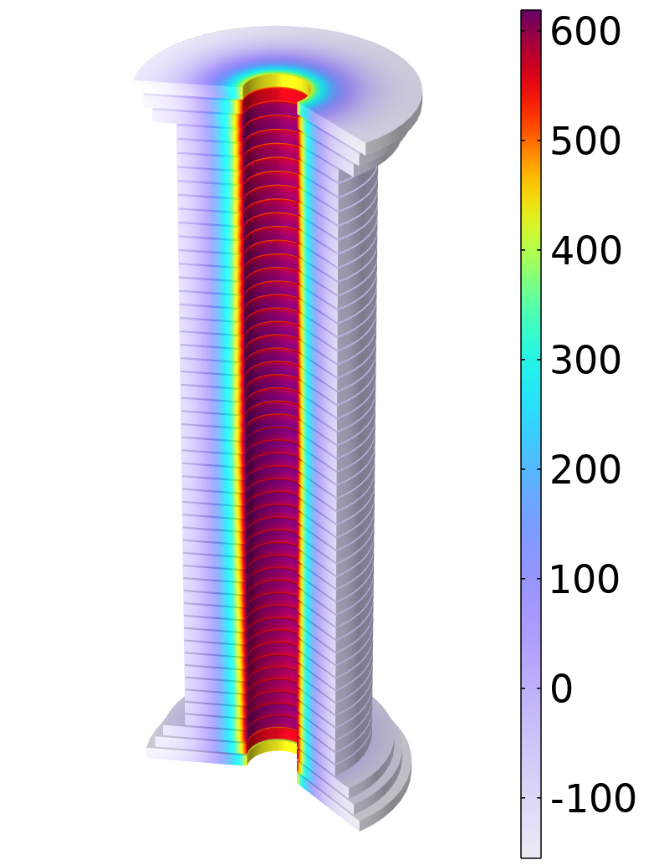
Final cooling (40 T) mechanics
Solenoid not Energized
Solenoid Energized to 40 T
Radial Stress, MPa
Hoop Stress, MPa
Radial Stress, MPa
Hoop Stress, MPa
  Preloading, a radial precompression of ~ 200 MPa is essential to limit the conductor hoop stress to acceptable values and to prevent tensile radial stress.
  Electro-mechanical design and tests are in progress to validate the concept and identify issues/solutions towards assessing the performance limits.
Courtesy of B. Bordini and C. Accettura, CERN

Slide 13
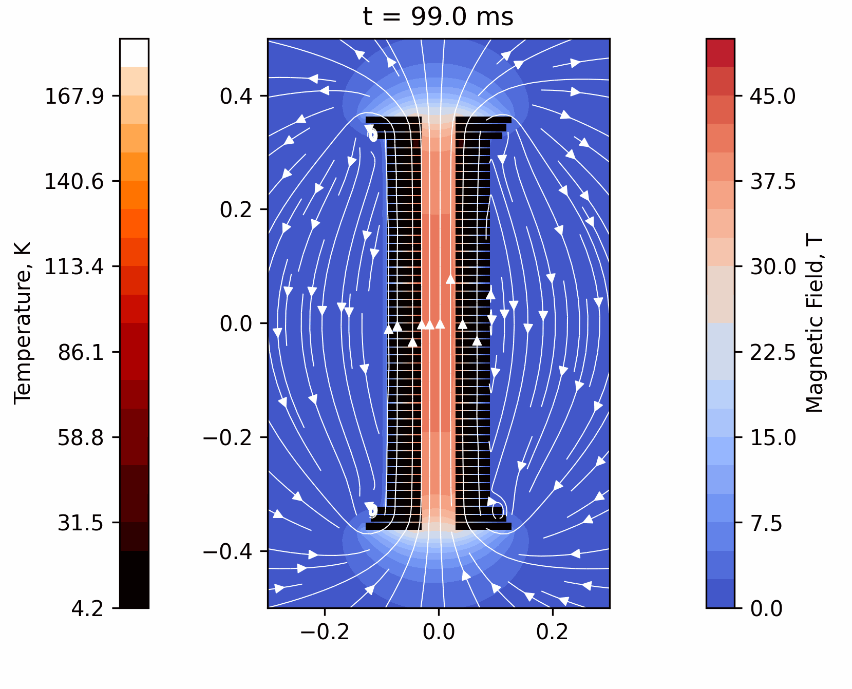
Final cooling (40 T) quench
  At this magnet scale (i.e. stored energy and size) a non-insulated winding seems to be a good option for quench management.
  Transverse resistance control in a range suitable for operation, balancing protection, mechanics, ramp time and field stability will be crucial (priority R&D)
  Singe and stacked pancake tests are planned to validate the concept and identify issues/solutions towards assessing the performance limits.
Courtesy of T. Mulder, CERN

Slide 14
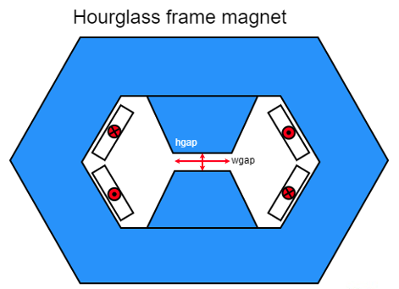
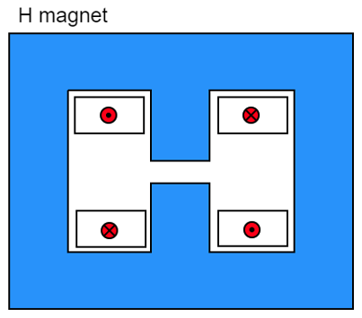
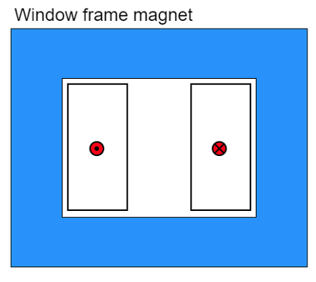
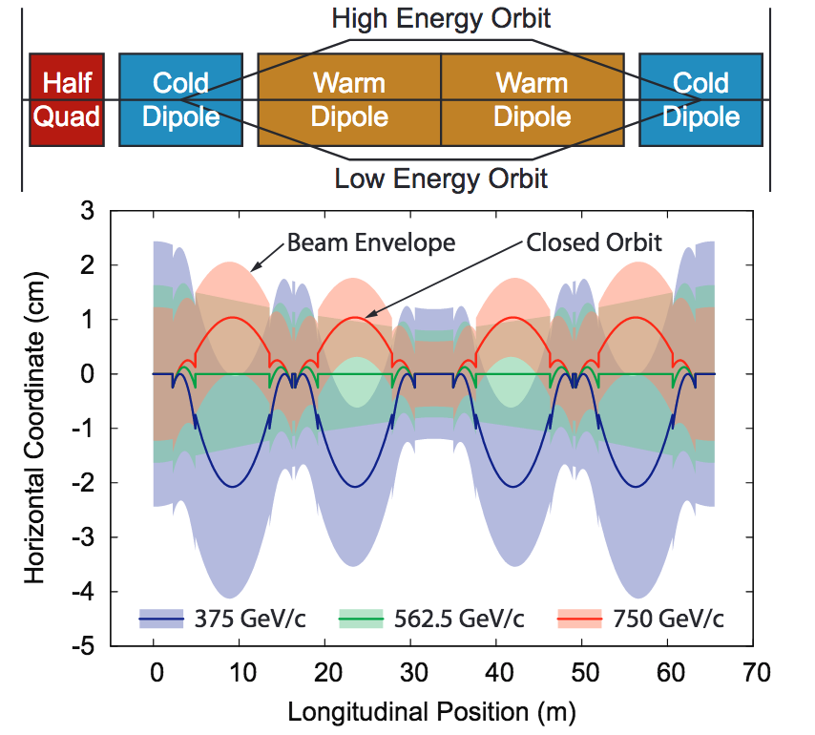
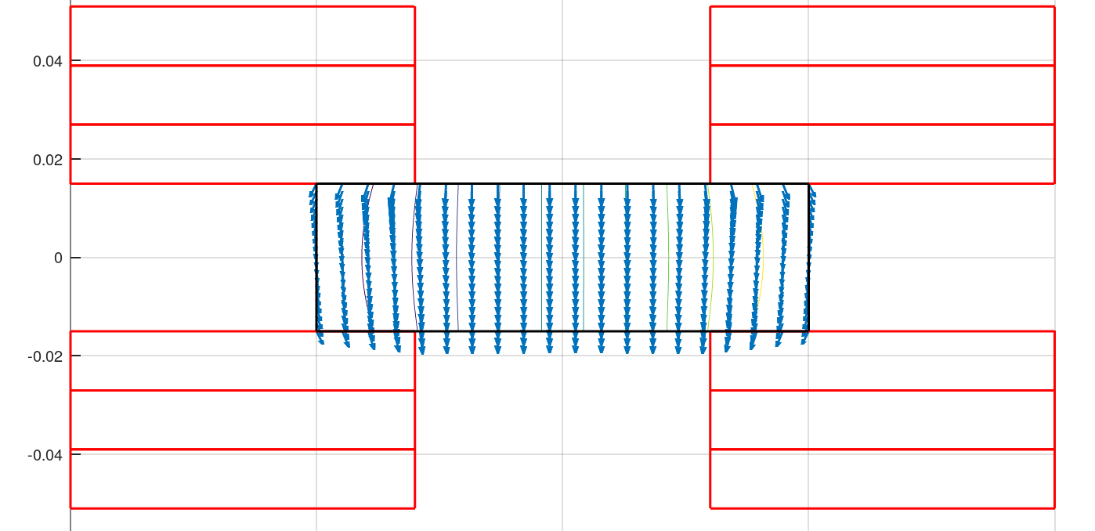
Accelerator magnets (±1.8 T)
Warm dipoles are pulsed from
-Bmax to +Bmax at high speed (0.35 to 6.37 ms) every 200 ms
5.07 kJ/m
5.65…7.14 kJ/m
5.89 kJ/m
The main challenge is the management of the power in the resistive dipoles (several tens of GW):
Minimum stored magnetic energy
Highly efficient energy storage and recovery
A simple HTS racetrack dipole could match the beam requirements and aperture
HTS flat racetracks
b3 = -7.2 units
b5 = -1.4 units
b7 = -0.03 units
peak field
10.4 T
Cold dipoles provide a steady baseline field of about 10 T
Rectangular magnet bore 100 mm x 30 mm
See M. Breschi, et al., 4PoA02-04 on Thursday 14/9/2023
F. Boattini, CERN

Slide 15
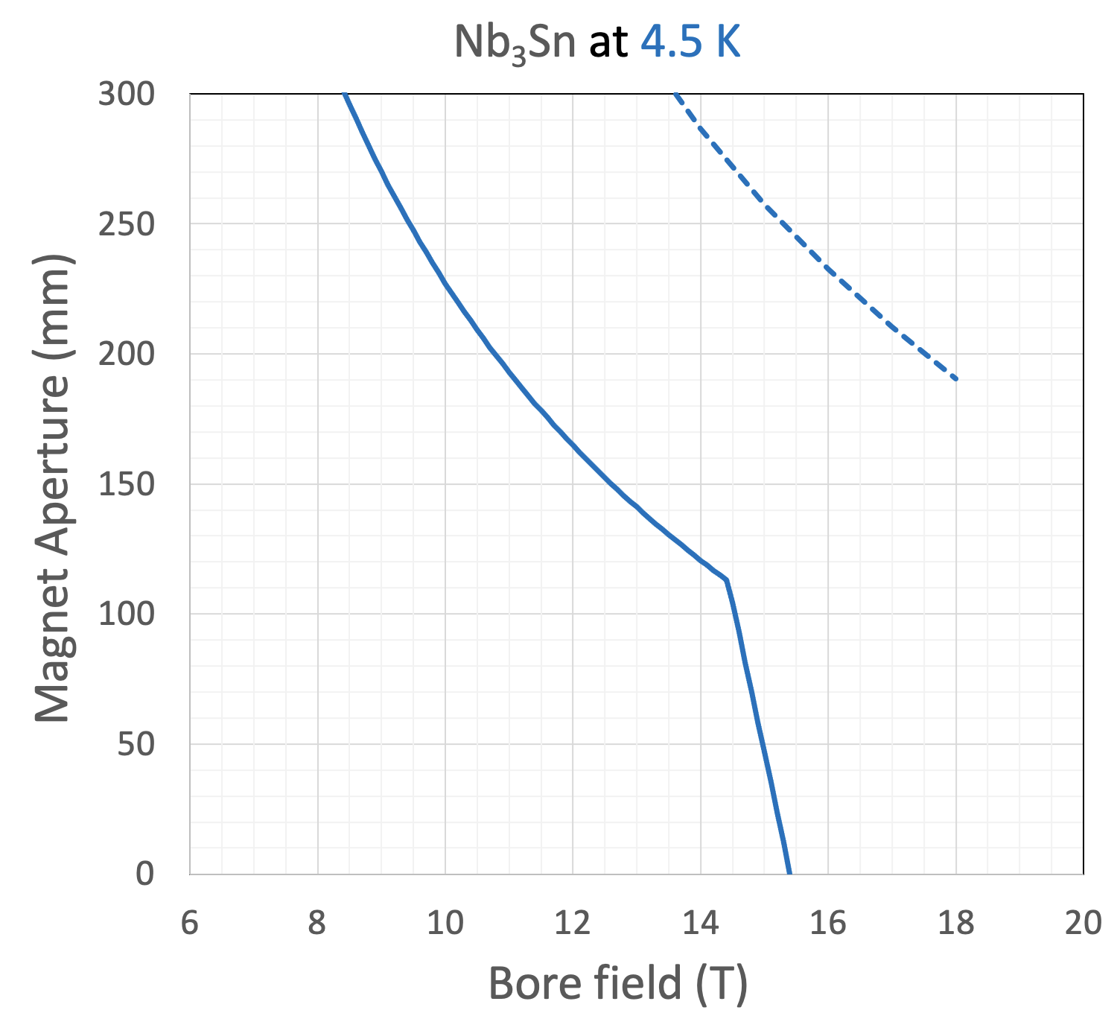
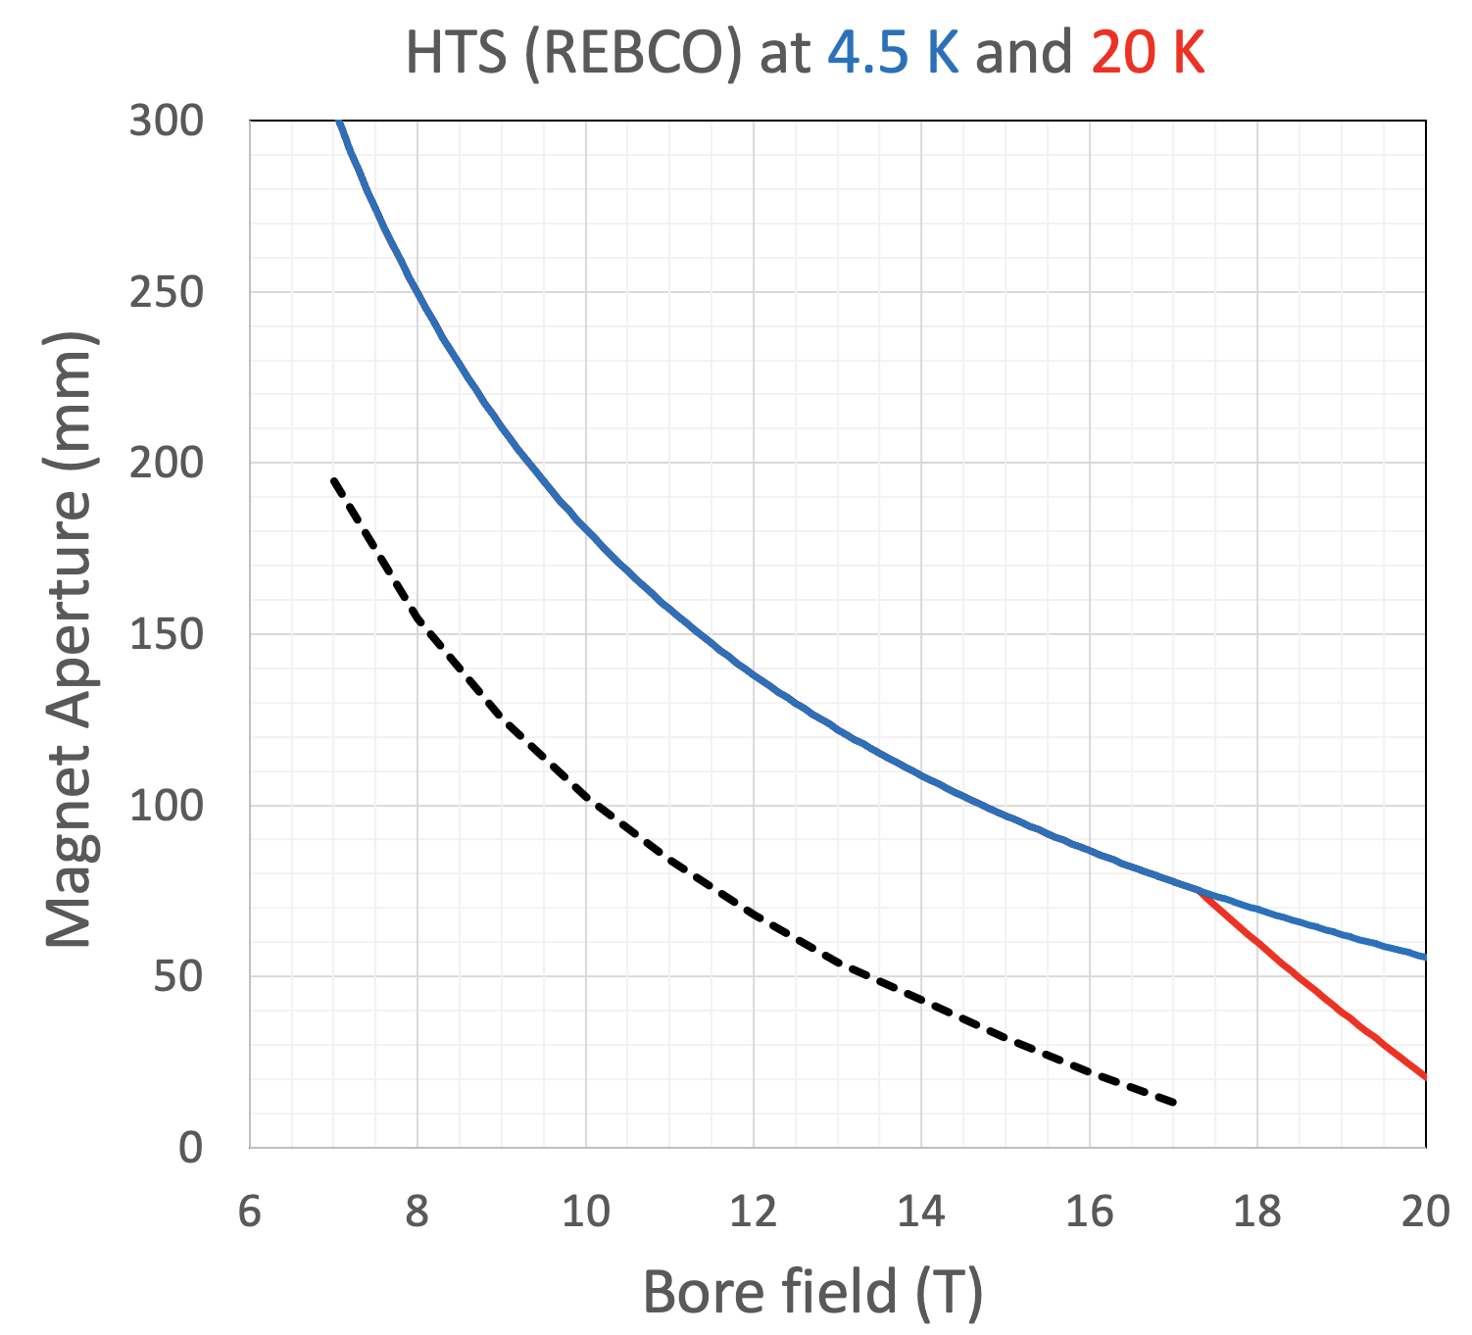
Collider magnets limits – A-B plots
Margin limit
Protection limit
Stress limit
Stress limit
Design range
Protection limit
Design range
Aspirational cost: 700 EUR/kg
Peak stress: 150 MPa
Hot spot tempeature: 350 K
Aspirational cost: 2500 EUR/kg
Peak stress: 300 MPa
Hot spot tempeature: 200 K
Margin limit
Work in progress to provide analytical expression for the magnet design limits (including protection and cost)
Nb₃Sn falls short of required performance because of operating margin and peak stress (at affordable cost !)
HTS falls short of required performance because of peak stress and protection (at affordable cost !) – Need to devise alternative protection schemes
See D. Novelli, et al., 5PoM01-04 on Friday 15/9/2023

Slide 16
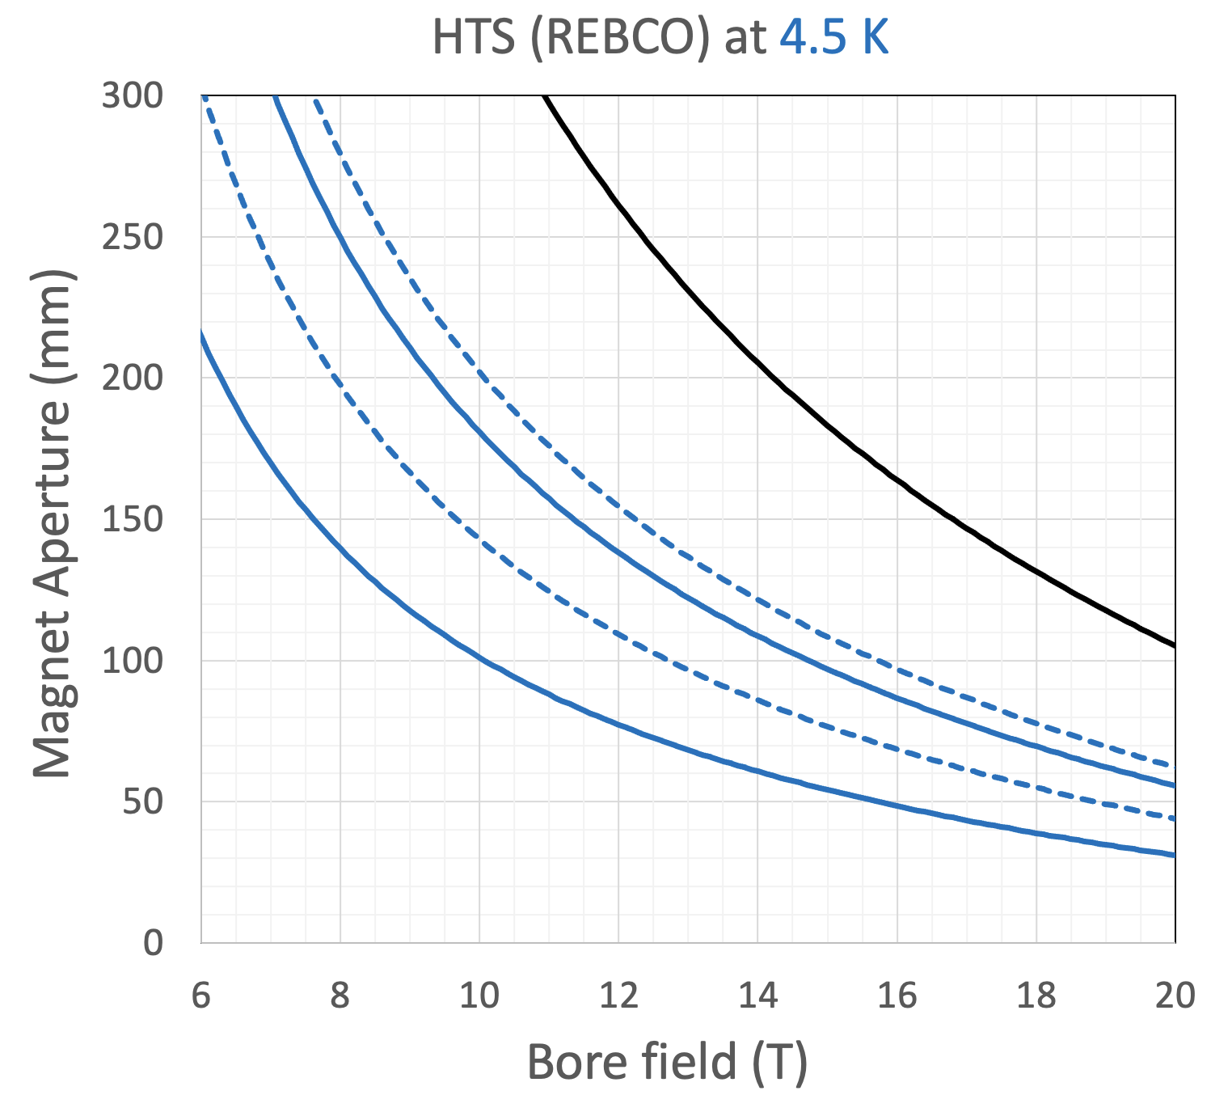
Collider magnets limits – A-B range
A reduction of HTS cost will result in wider design A-B range
  Reducing unit cost by a factor four doubles the allowable magnet aperture at 16 T
  A reduction of one order of magnitude would be required to reach (16 T, 150 mm)
Operation in the range of temperature 10 K…20 K (above liquid helium) will reduce magnet aperture requirements
  Acceptable heat loads is increased by a factor 2…4, thus reducing the need for shielding
Cost reduction factor
1/10
1/4
1/3
1/2
1/1
Design range
Present cost
Iterate with beam physics as the nominal optics and adjust design targets in accordance. Typical A-B range can be (12 T,160 mm) to (16 T, 100 mm)
Include quadrupoles in the analytical evaluation of A-B limits
See D. Novelli, et al., 5PoM01-04 on Friday 15/9/2023

Slide 17
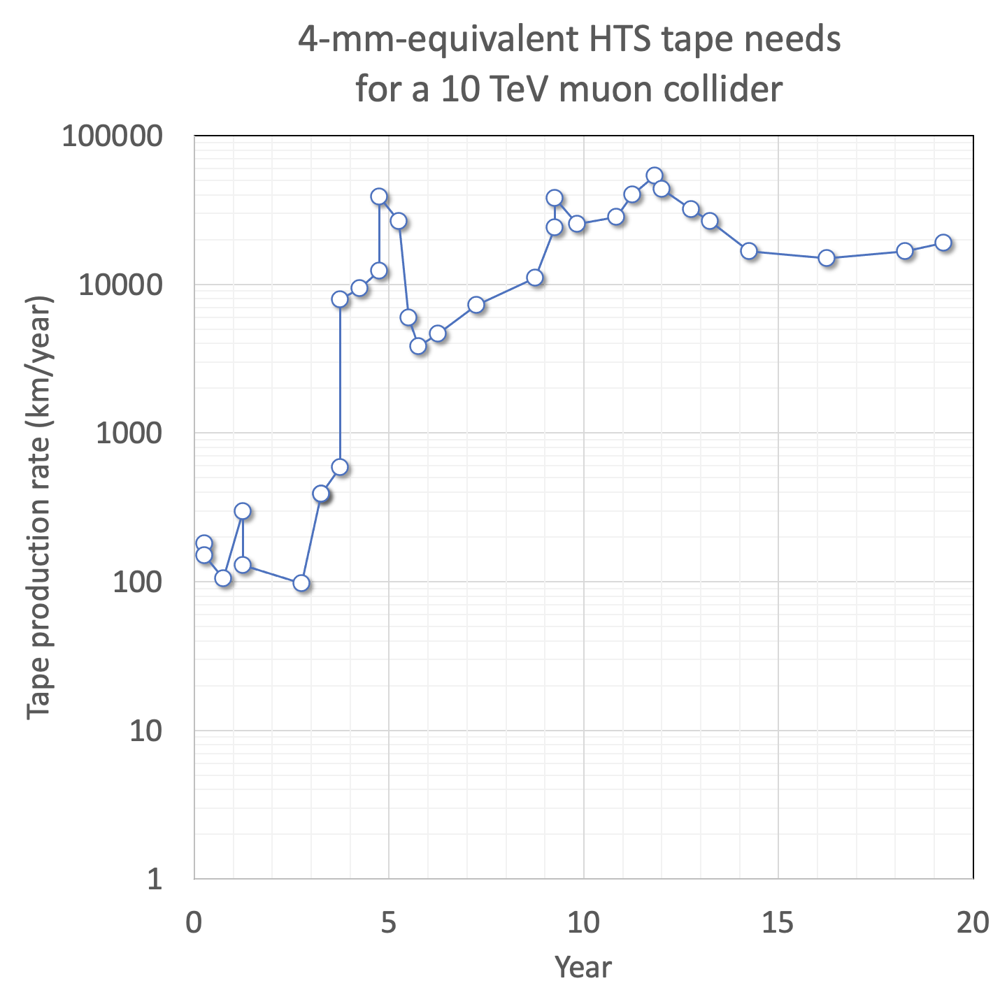
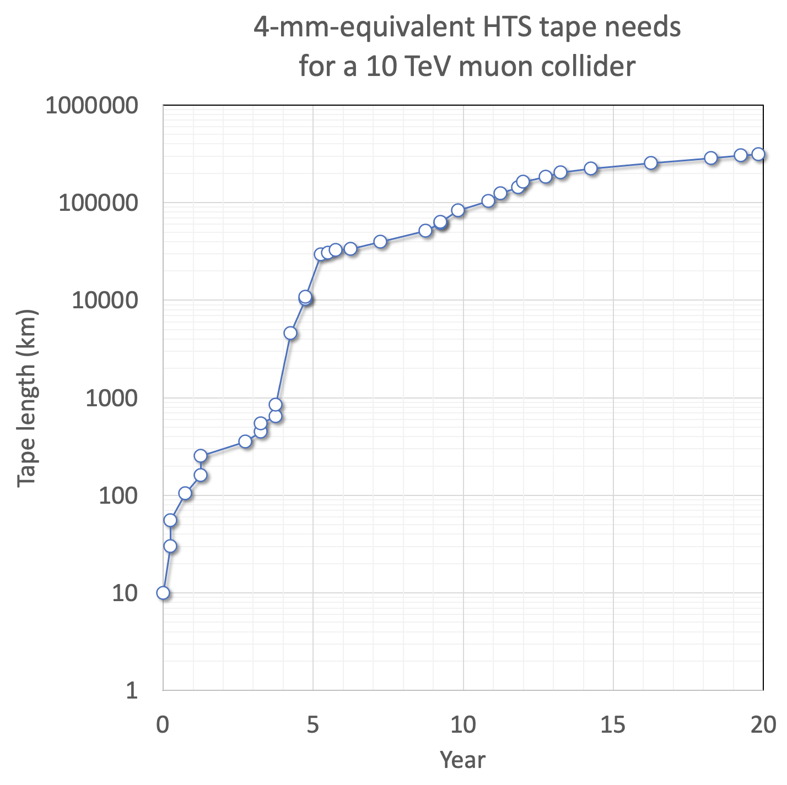
HTS needs for a muon collider
Total length required (whole collider complex): 300,000 km
Series production:
10…20 Mm/year
R&D and demonstration:
100…200 km/year
Massive, but not unreasonable: LHC wire was the same order of magnitude

Slide 18
Magnet development targets
Complex | Magnet | Aperture (mm) | Length (m) | Field (T) | Ramp rate (T/s) | Temperature (K)
Target, decay and capture channel | Solenoid | 1200 | 19 | 20 | SS | 20
6D cooling channel | Solenoid | 90…1500 | 0.08…0.5 | 4…15 | SS | 4.2/20
Final cooling channel | Solenoid | 50 | 0.5 | > 40 | SS | 4.2
Rapid cycling synchrotron | NC Dipole | 30x100 | 5 | ± 1.8 | 4200 | 300
Rapid cycling synchrotron | SC Dipole | 30x100 | 1.5 | 10 | SS | 4.2/20
Collider ring | Dipole | 160 | 10 | 12 | SS | 4.2/20
 |  | 100 |  | 16

Slide 19
Summary and perspective
A muon collider is one of the very interesting options for high energy physics at the energy frontier
  Precision and energy frontier, small footprint, cost, sustainability
High temperature superconductors may be the best technology to make a muon collider affordable and efficient
  Target high engineering current density (up to 1000 A/mm²) and operation at high cryogenic temperature (up to 20 K)
There are many challenges and crucial developments ahead
However…
Magnet technology R&D for a muon collider:
  Has close and tight relation to the advances needed for other science and societal applications (e.g. fusion, material and life sciences, NMR, energy)
  Will provide a sure return of investment
Notes:
The reason for this talk is that we have received a strong recommendation from the group that proposes priority for particle physics in Europe. The recommendation, received in March 2020 and approved at the Council session of June 2020, contains a very strong statement on the need to ramp-up R&D effort on high-field accelerator magnets

Slide 20
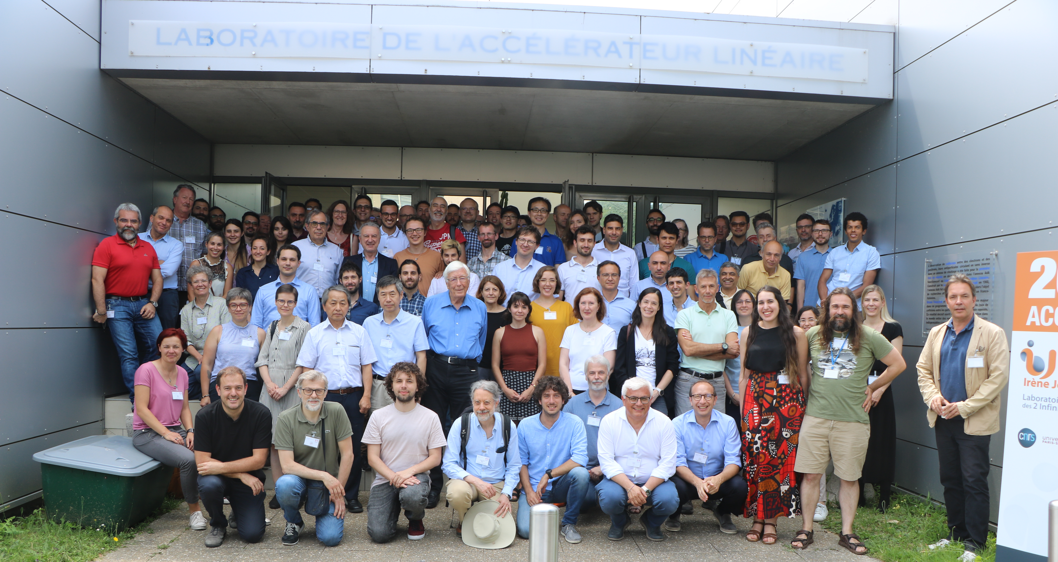
Grateful thanks to many !
C. Accettura, N. Amemiya, B. Auchmann, J.S. Berg, A. Bersani, A. Bertarelli, F. Boattini, B. Bordini, M. Breschi, B. Caiffi, X. Chaud, F. Debray, A. Dudarev, M. Eisterer, S. Fabbri, S. Farinon, P. Ferracin, H. De Gersem, A. Kario, A. Kolehmainen, J. Kosse, J. Lorenzo Gomez, R. Losito, S. Mariotto, M. Mentink, T. Mulder, R. Musenich, D. Novelli, T. Ogitsu, M. Palmer, J. Pavan, H. Piekarz, A. Portone, L. Quettier, E. Rochepault, L. Rossi, T. Salmi, H. Schneider-Muntau, C. Senatore, M. Statera, P. Tavares, H.H.J. Ten Kate, P. Testoni, G. Vallone, A. Verweij, M. Wozniak, A. Yamamoto, Y. Yang, Y. Zhai, A. Zlobin, and the Muon Magnets Working Group

Slide 22
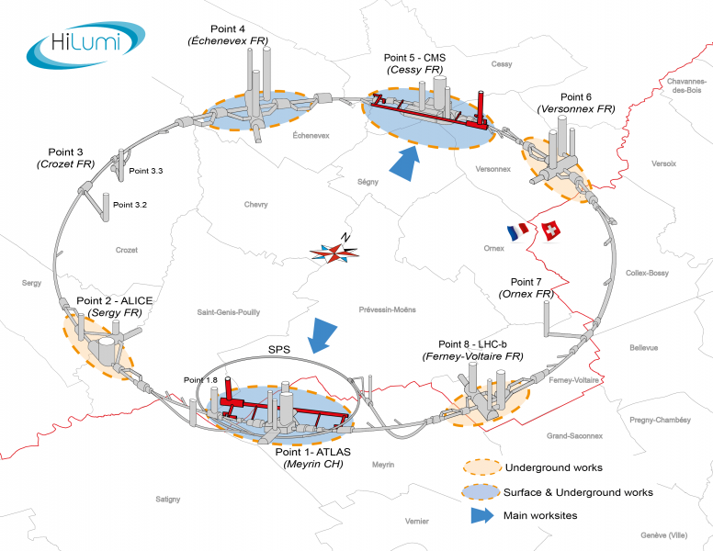
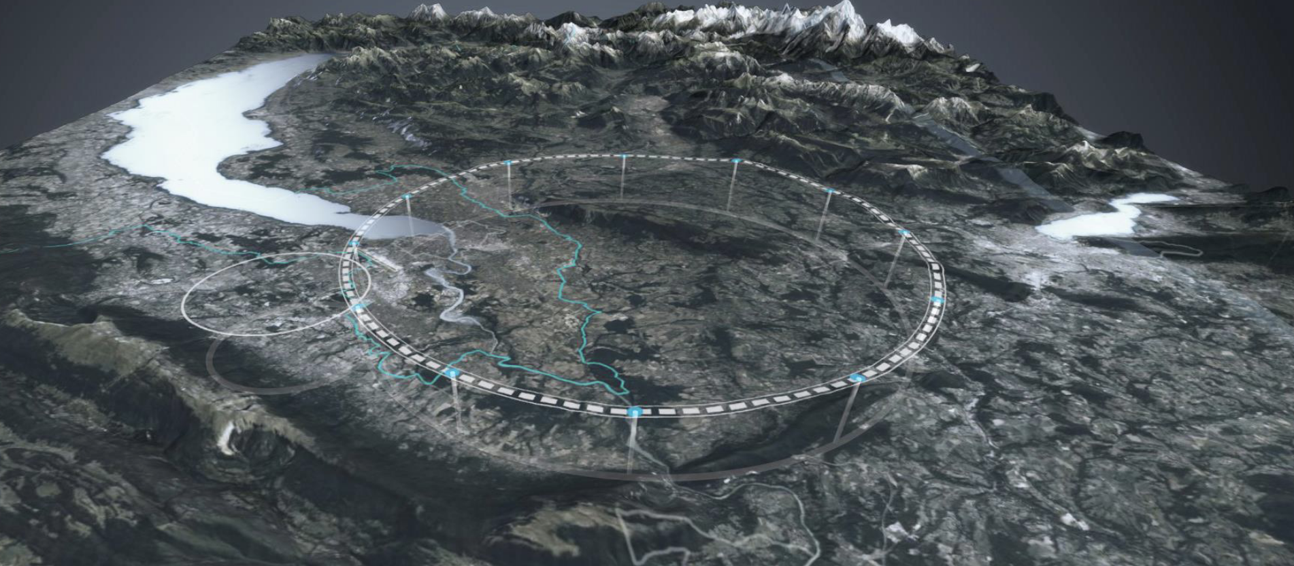
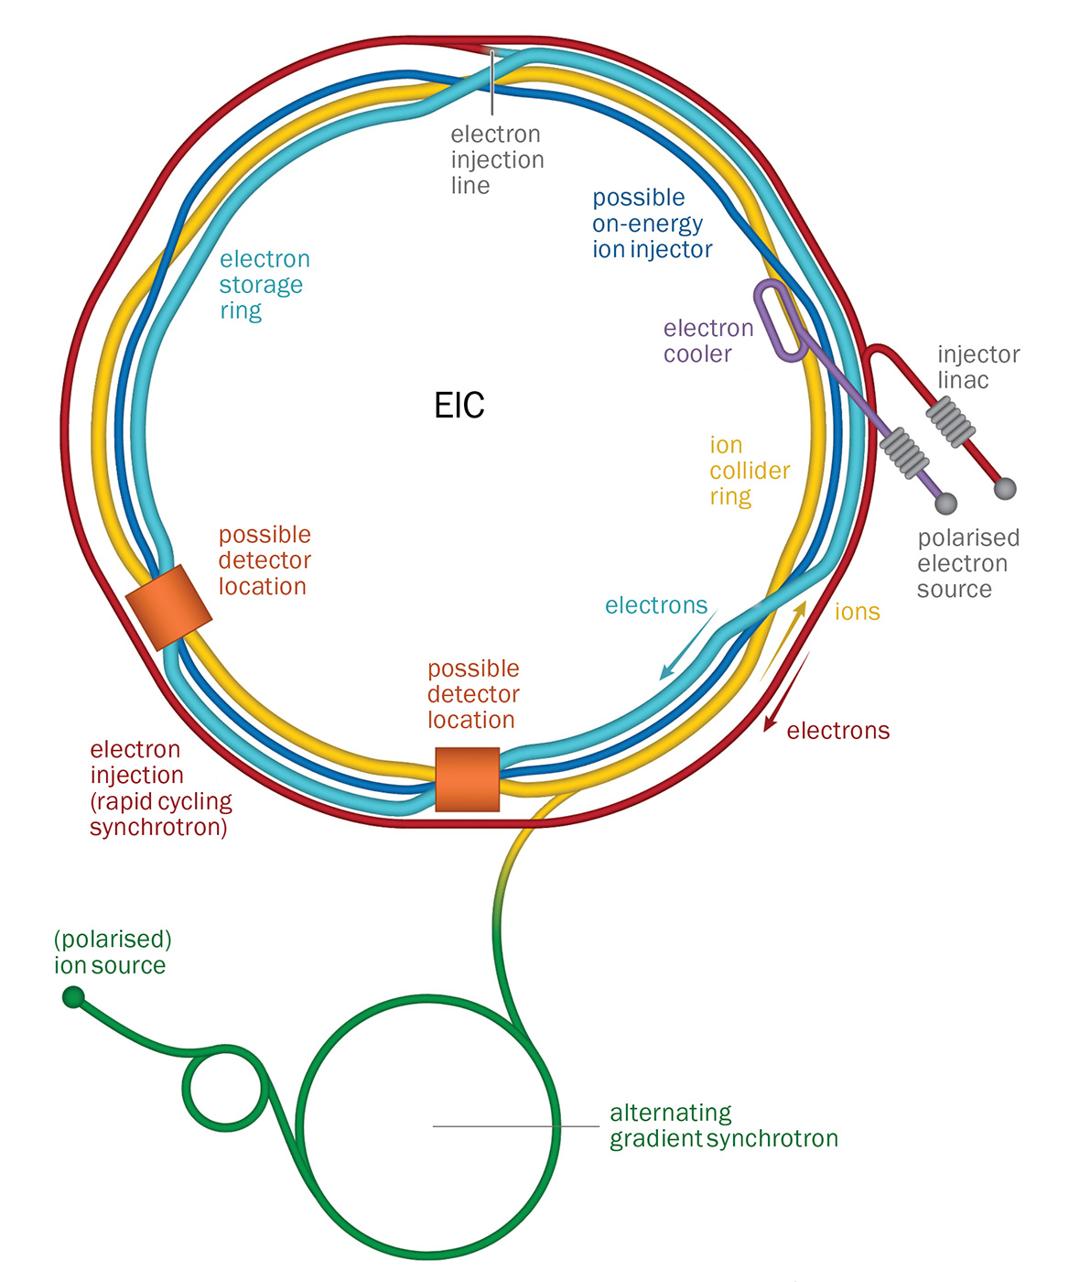
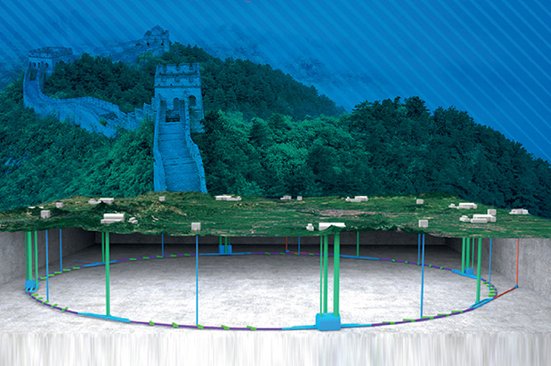
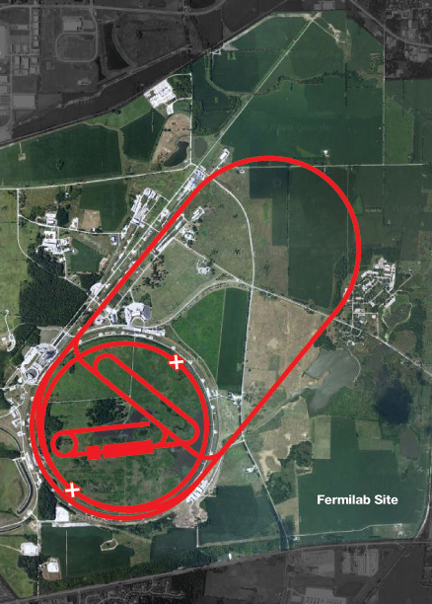
HEP Landscape - Circular Colliders
HL-LHC (CERN)
Installation 2026
Commissioning 2029
FCC-ee (CERN)
FCC-hh (CERN) – 2070-2090
CEPC (IHEP)
SppC (IHEP) > 2040
EIC (BNL)
In construction
CD4 June 2030
μ Collider > 2040

Slide 23
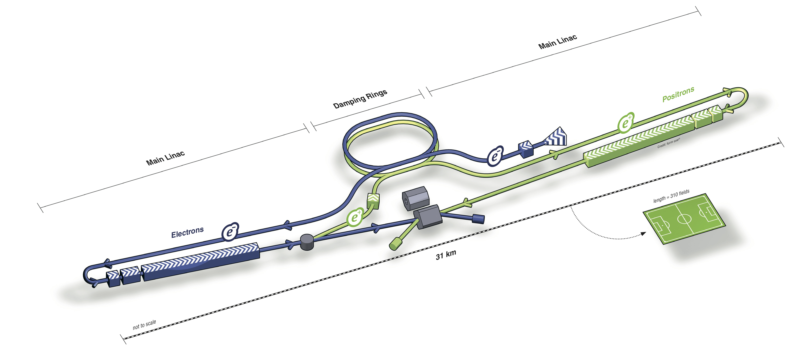
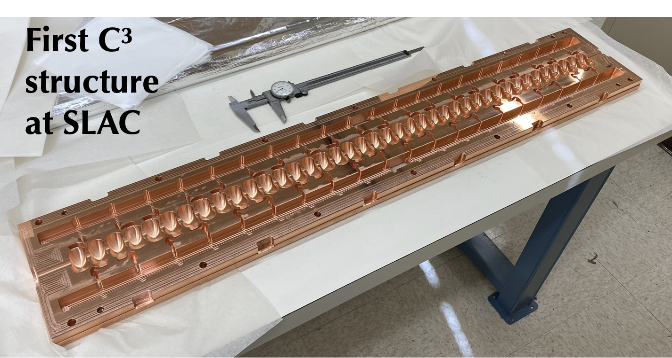
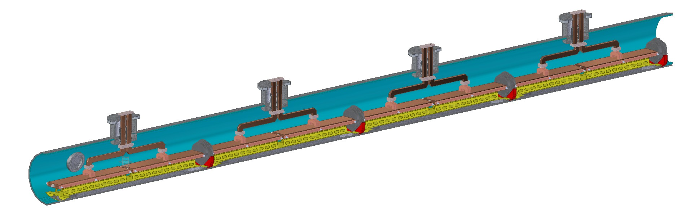

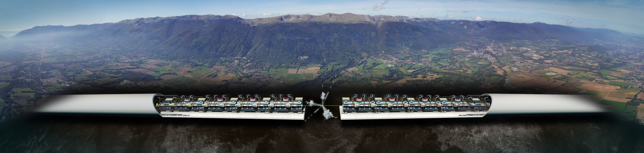

HEP Landscape - Linear Colliders
ILC
250 GeV…1 TeV
TBD
C3 (SLAC)
250 GeV…500 GeV
TBD
CLIC (CERN)
500 GeV…3TeV
TBD

Slide 24
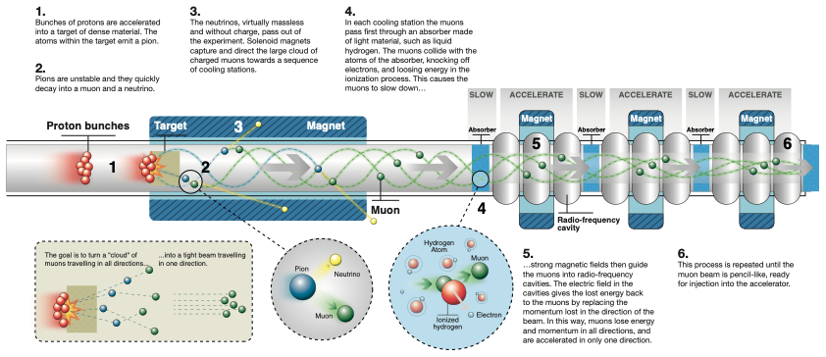
Muon beam generation and cooling
Absorber
RF field
“cooled” muon
p⊥
Decreased p⊥
Increased p//
p//

Slide 25
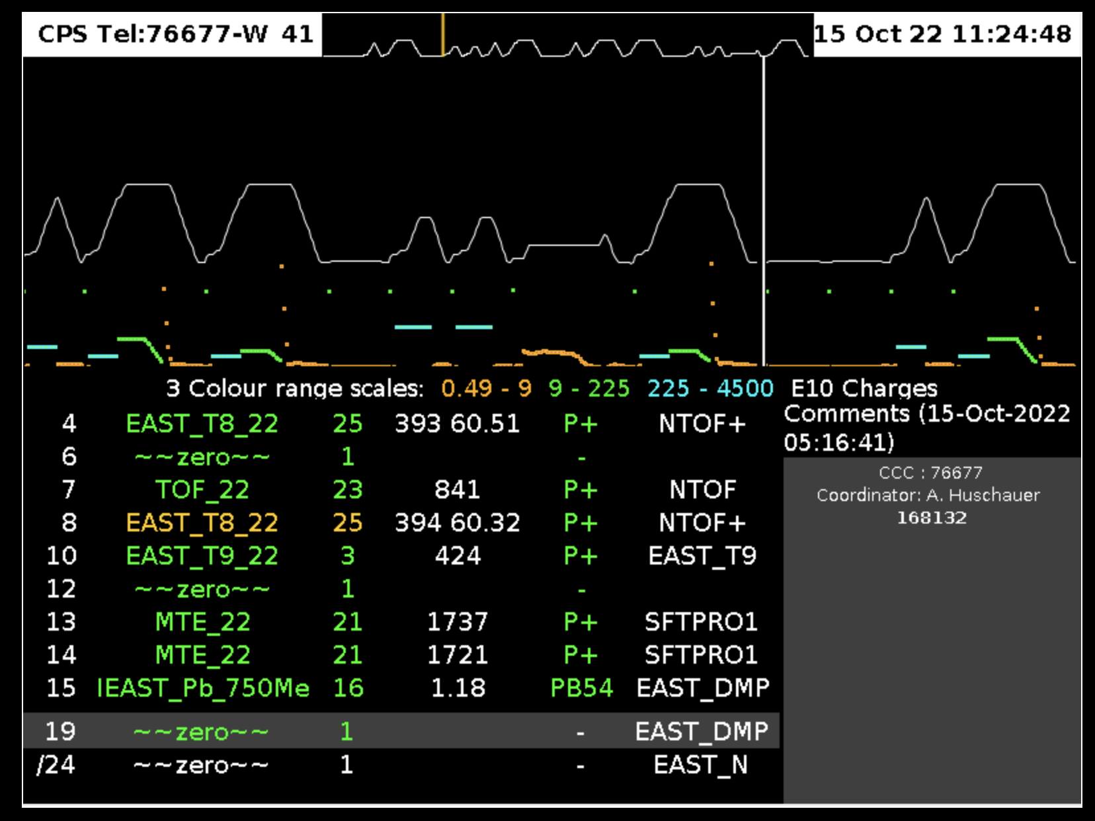
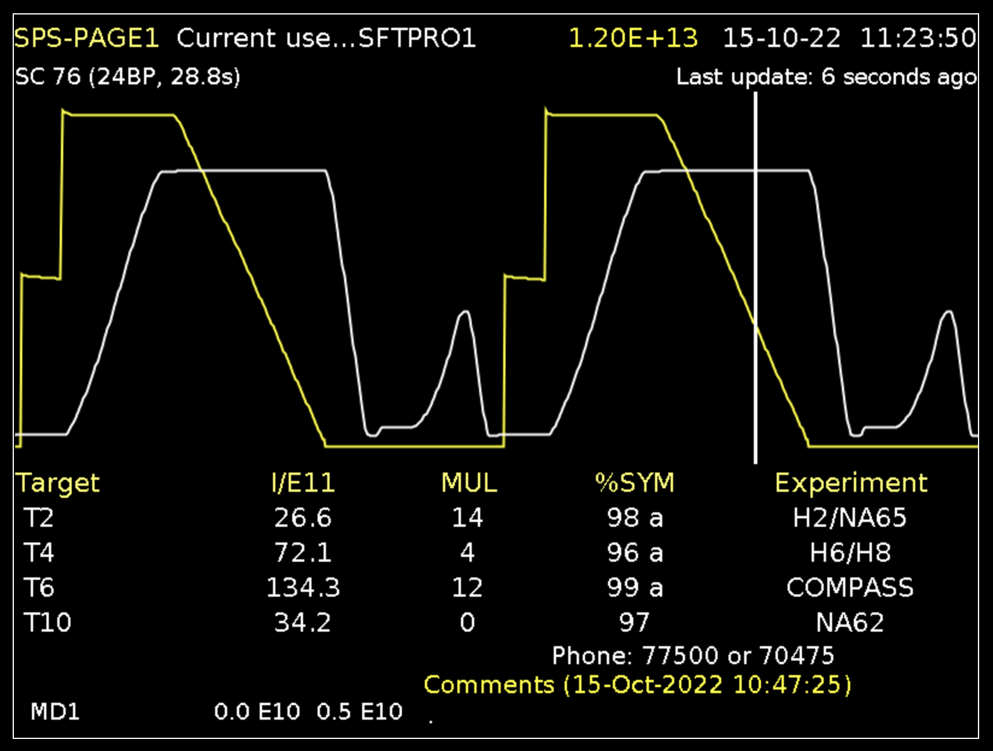
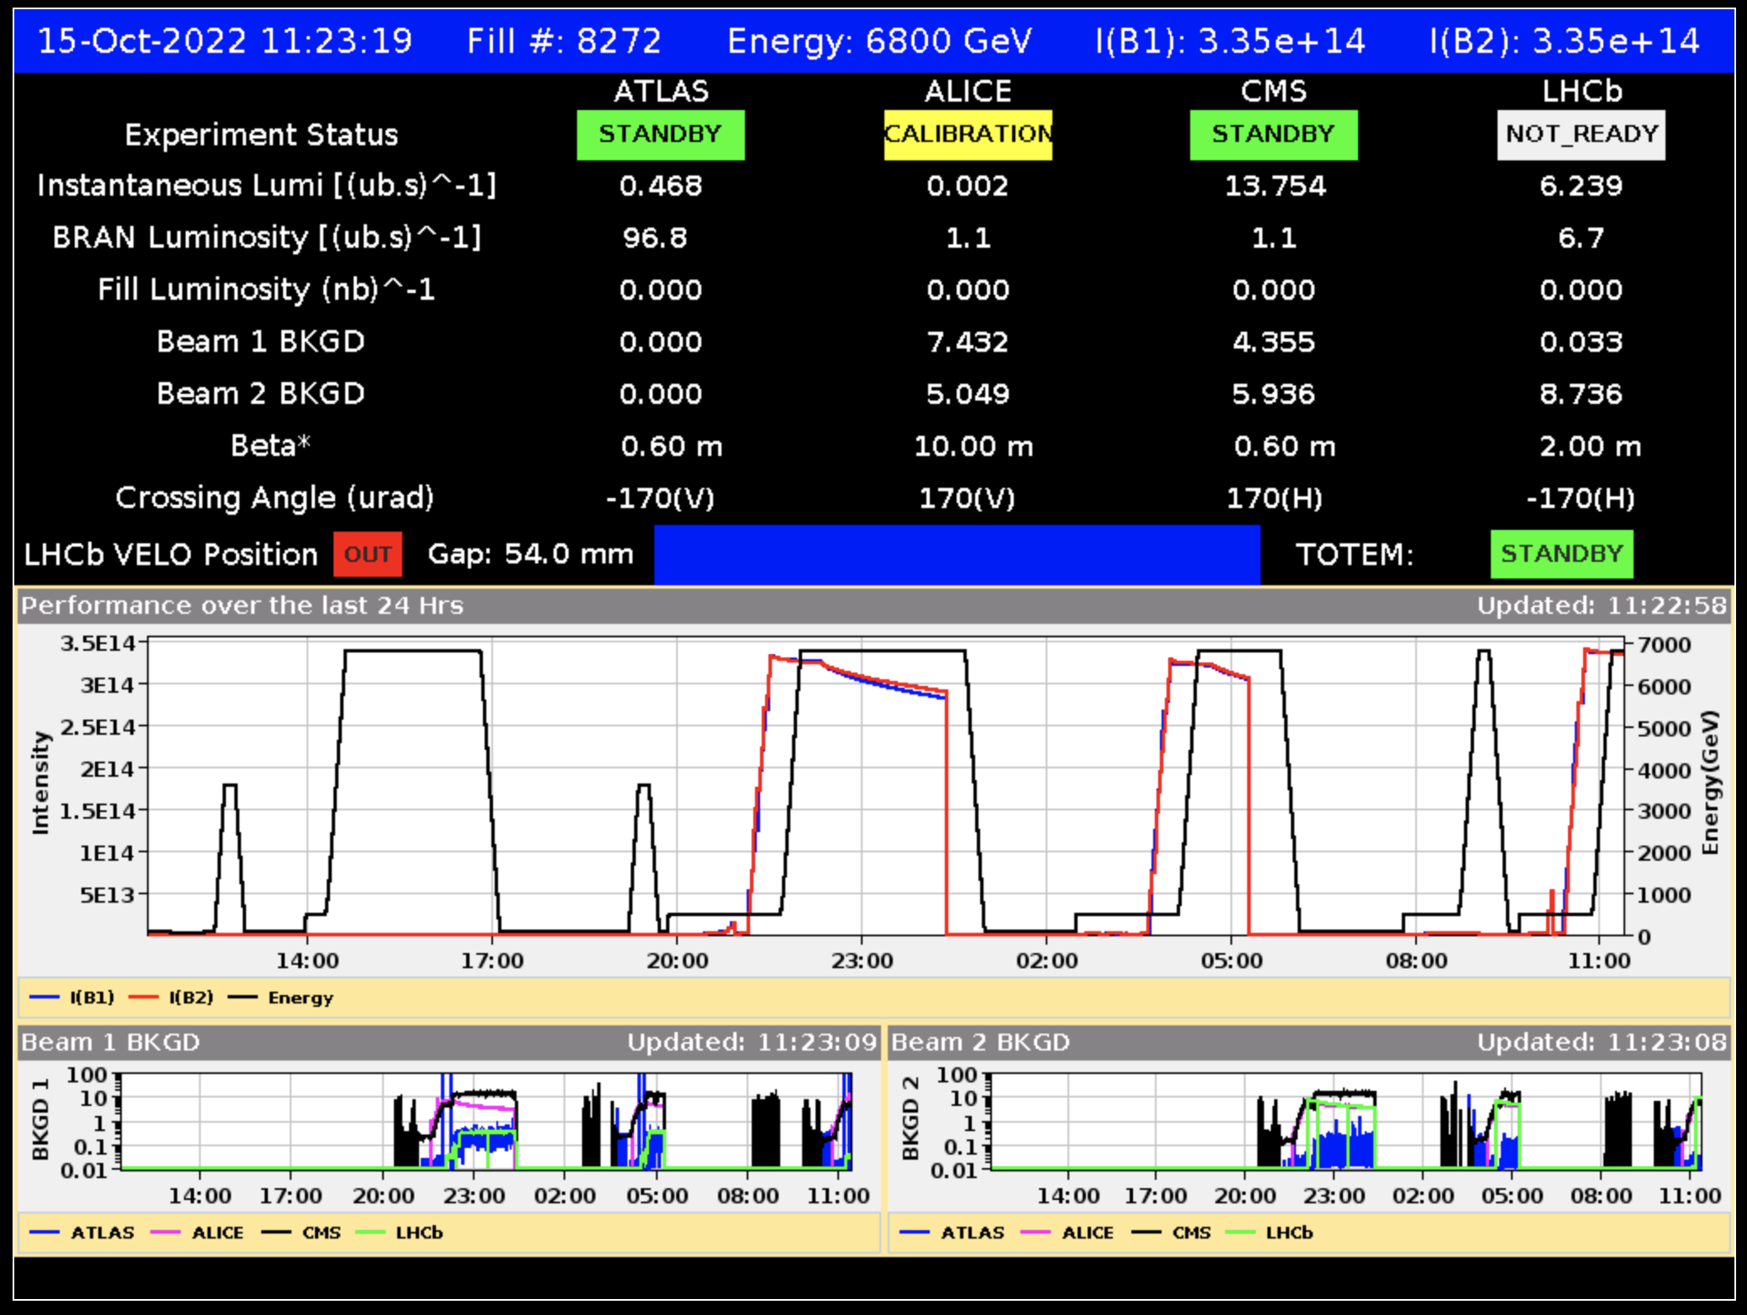
The need for energy
CERN uses today 1.3 TWh per year of operation, with peak power consumption of 200 MW (running accelerators and experiments), dropping to 80 MW in winter (technical stop period)
Electric power is drawn directly from the French 400 kV distribution, and presently supplied under agreed conditions and cost
Supply cost, chain and risk are obvious concerns for the present and future of the laboratory

Slide 26

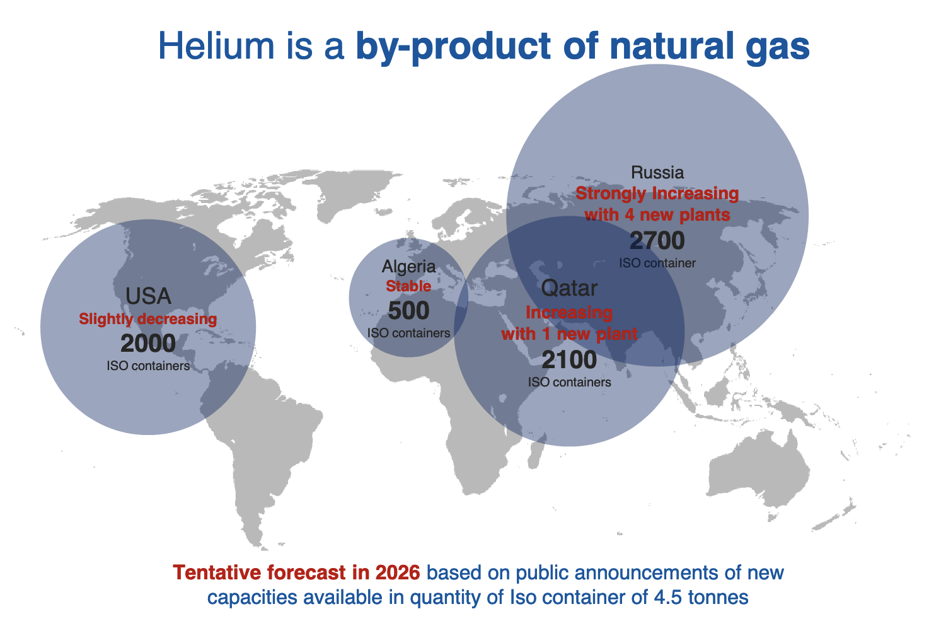
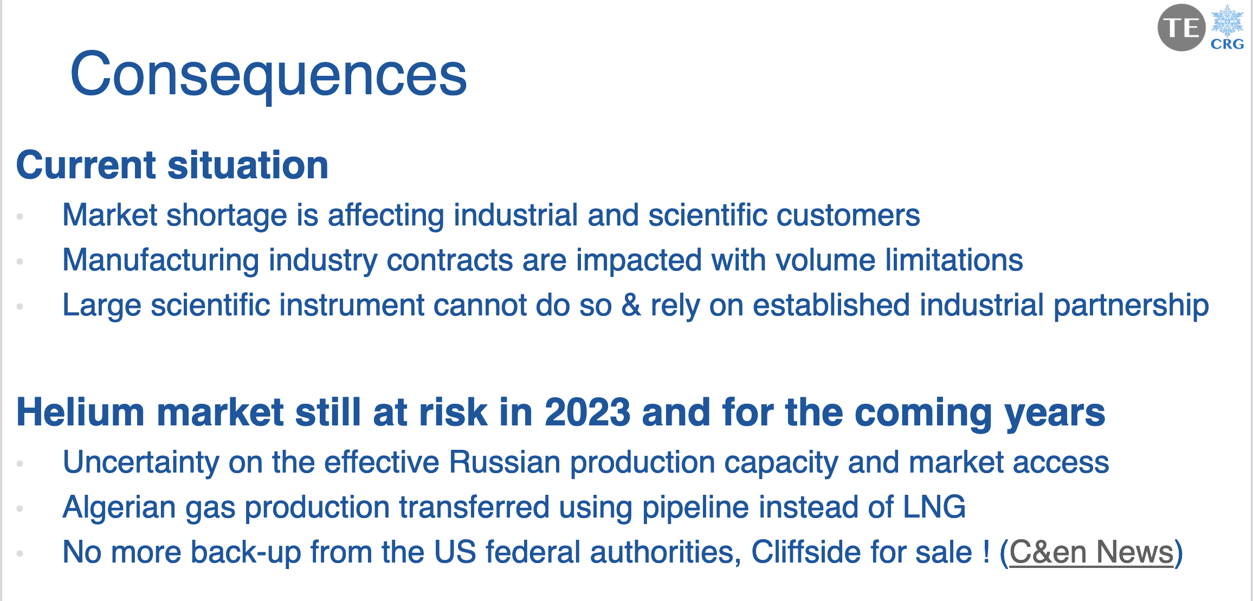
Future helium supply is limited and entails a substantial economical and availability risk
Courtesy of F. Ferrand, CERN

Slide 27






Energy efficient cryogenics
W/Q = (T_{h}-T_{c})/T_{c}
Credits to P. De Sousa and R. Van Weelderen, CERN
LHC
(FCC)
Need efficient cryo-plant and heat removal scheme in the range of 10…20 K (see work at ESS)
RHIC
Tevatron
HERA
LHC
Nb-Ti
8T
5T
ESS
The 60…80 K range would be a dream…
Nb₃Sn
16T
12…14T
This could be the best range of operating temperature of a future HEP collider
HTS
40…60T
20…40T
a few T
1.9
4.2
77
HTS may be the only path towards a future collider

Slide 28





Conductor cost
Grateful thanks to fusion !
Based on CERN orders and requests for quotations 2010-2022
Normalised costs are not aligned to currency, nor corrected for inflation
Impressive cost reduction in HTS !

Slide 29

Compact HTS windings
Need to increase the winding current density to fall in a reasonable range of tape length
Unresolved issues:
Winding geometry for tapes and stacks (ends, alignment, transposition, …)
Mechanics of coils under the exceptional electromagnetic loads (600 MPa longitudinal, 400 MPa transverse)
Quench management at high current and energy density (up to 300 MJ/m³)
Radiation hardness of materials and coils (40…80 MGy and 10²² n/m²)
350 A/mm²
500,000 km
950 A/mm²
150,000 km

Slide 30


The HEP push towards HTS
Operate SC magnets at higher cryogenic temperature (gas)
Reduce energy consumption
(FCC-ee 350 MW, FCC-hh 580 MW)
Increase energy efficiency
(COP at 1.9 K is about 1000)
Avoid large liquid helium bath and operate with gas (lower density)
Risk with helium supply chain
(FCC-hh would require 900 tons of lHe)
Reduce SC cost per unit length and current
Infrastructure (magnet) cost
(FCC-hh quoted at 9 BCHF)
Increase coil current density to decrease conductor inventory
Calculation example
(T. Lecrevisse, CEA)
Compact HTS windings
Target J_{E} 1000 A/mm²
Operation in gaseous He
Range of 15…25 K
5 T at 2800 A
J_{E} = 250 A/mm²
16 T at 2800 A
J_{E} = 850 A/mm²

Slide 31





Muon collider vs. high field magnets
Muon final cooling magnet
40 T at 4.2 K, 60 mm
LNCMI/CEA Nougat
HTS insert
32.5 T in 50 mm
(12. 5 T HTS + 20 T resistive)
HTS insert of NHMFL all SC 32 T
32 T in 40 mm (15 T LTS + 17 T HTS)
Sunam NI one-body
HTS magnet
26.4 T in 35 mm
(26.4 T HTS multi-width)
NHMFL HTS Little Big Coil
45.5 T in 14 mm (14.5 T HTS + 31 T resistive)

Slide 32



Muon collider vs. fusion
Muon collider target magnet
20 T at 20 K, 1.2 m
10 kW, 80 MGy
ITER Central Solenoid Model Coil
13 T at 4.5 K, 1.7 m (LTS)
MIT/CFS SPARC TF Coil prototype
20 T at 20 K (HTS)
Large bore solenoids, large heat and radiation

Slide 33







Muon collider vs. life science
Muon final cooling magnet
40 T at 4.2 K, 60 mm
14 T HTS MRI
800 mm
28.2 T LTS+HTS
54 mm
Push field performance beyond state-of-the-art

Slide 34



Muon collider vs. power generation
HTS dipole designs
10…20 T, 50 mm
Saddle coils design for generator
Small-size stator for PM generator
Design of 10 MW HTS wind generator
Develop compact saddle HTS windings

