Slide 1
Overview of Berkeley Lab’s quantum computing and quantum information science capabilities
Bert de Jong
Deputy Director Quantum Systems Accelerator
Director AIDE-QC Program
wadejong@lbl.gov

Slide 2
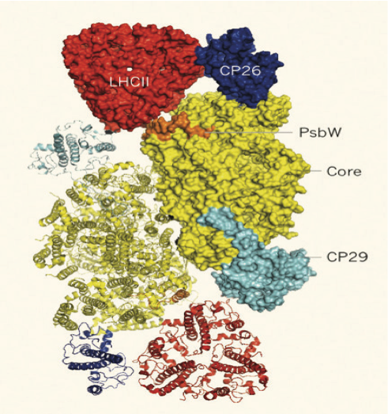
Promise of quantum computing is exciting
Algorithmic speedups over classical computing
Quantum simulation
Efficient optimization algorithms
“Unbreakable” encryption protocols
Notes:
Add cover times or something….

Slide 3
Moving towards quantum advantage for science
Scientific algorithms and software
Hardware technology
Increasing qubit count
Increasing lifetimes
Increasing fidelity and reducing errors
Reducing qubit count
Decreasing operation counts
Incorporating error resiliency

Slide 4
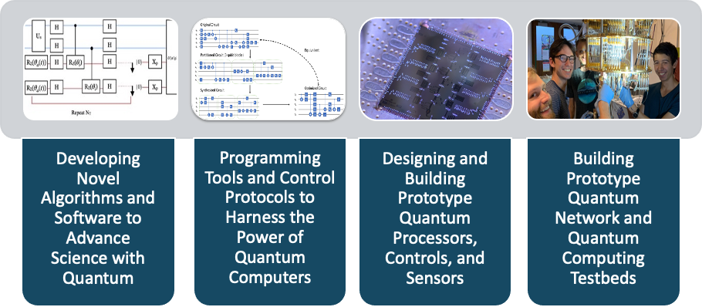
Full stack Quantum Information Science at Berkeley Lab

Slide 5
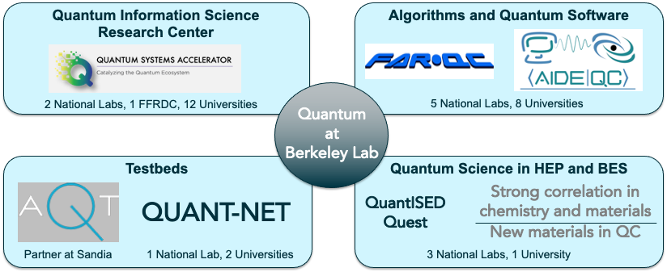
Research programs in Quantum Information Science

Slide 6
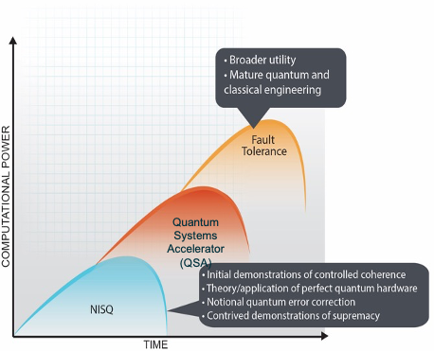
Quantum Systems Accelerator Vision
The QSA is catalyzing national leadership in quantum information science through co-design of the quantum devices, algorithms, and engineering solutions to deliver certified quantum advantage in Department of Energy scientific applications.

Slide 7
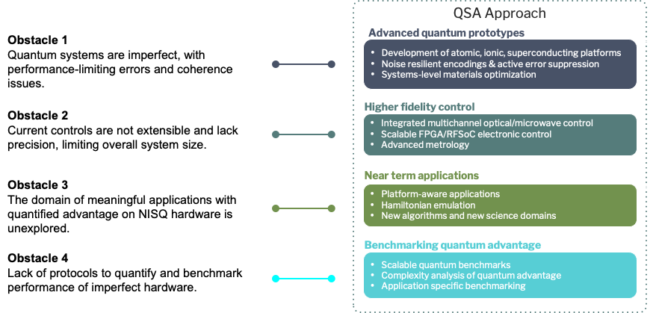
QSA addressing major challenges in quantum computing

Slide 8
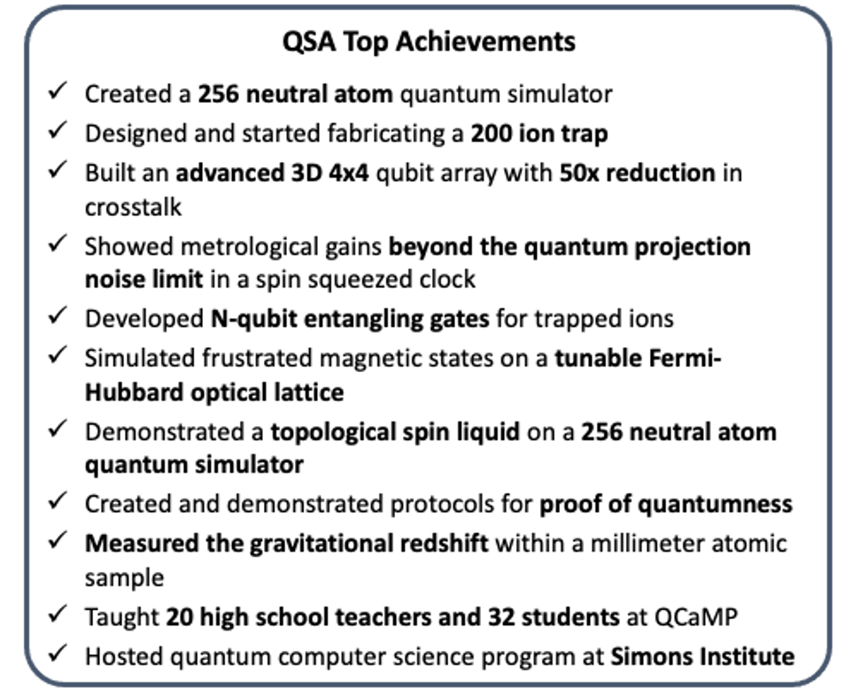
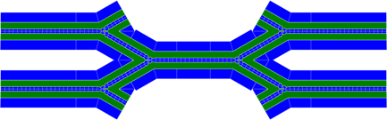
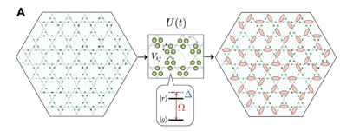
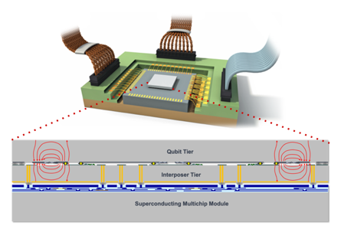
QSA is making major advances in QIS

Slide 9
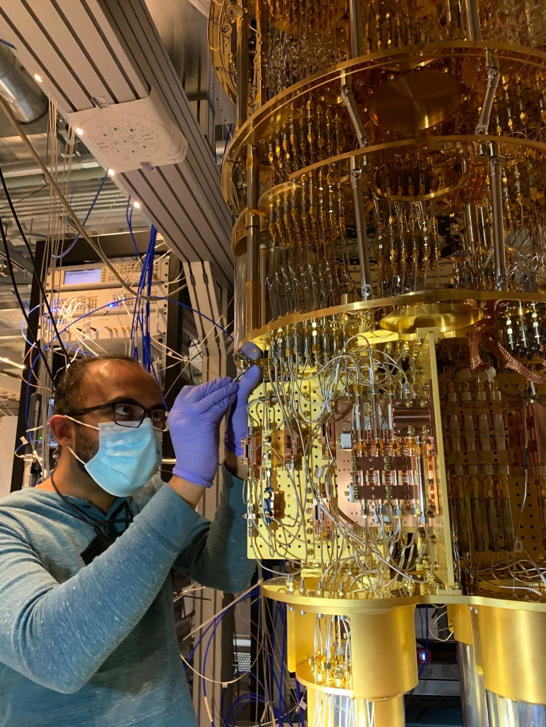
Advanced Quantum Testbed mission
To serve as an advanced superconducting platform for full-stack quantum computation, and to foster deep research collaborations with users selected through an open, competitive proposal process, synergistic with other resources available to the researcher community.

Slide 10
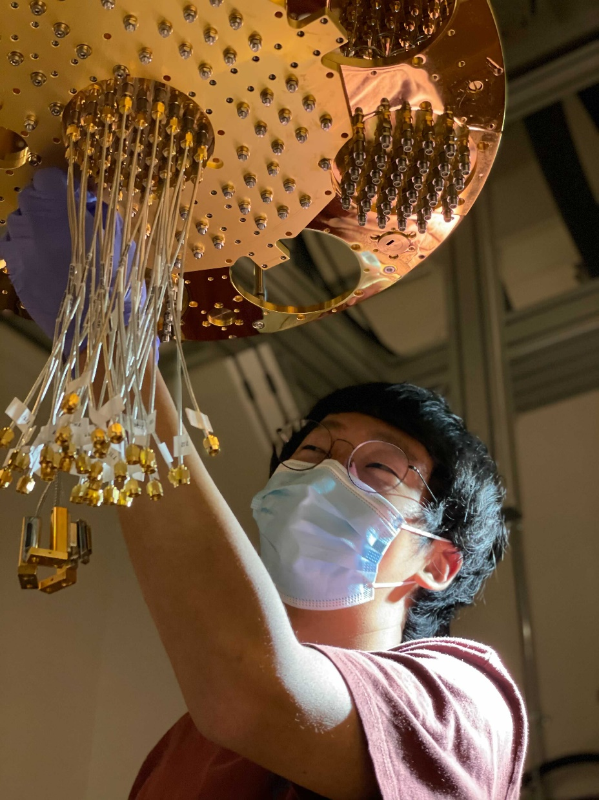
AQT delivers a unique research environment
Unique Quantum Platform
A state-of-the art open platform based on superconducting circuits for the scientific exploration of quantum computing, including quantum circuit fidelity, control/compilation, and processor architecture.
Deep User Collaborations
A highly-qualified team assists and partners in the development, execution, and optimization of short- and long-term scientific projects.
Broad Exploration of Technology
AQT deploys an evolving suite of circuits, controls, classical hardware, and algorithms developed at LBNL and via commercial partnerships.
Developing Future QIS Experts
An ideal platform for training the next generation of scientists and engineers on cutting-edge hardware and real-world problems.

Slide 11
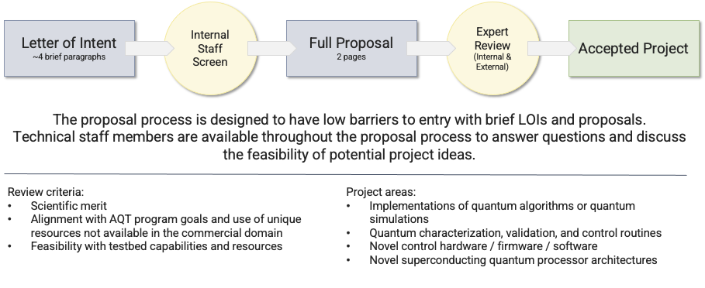
AQT runs an annual widely-announced Open Call

Slide 12
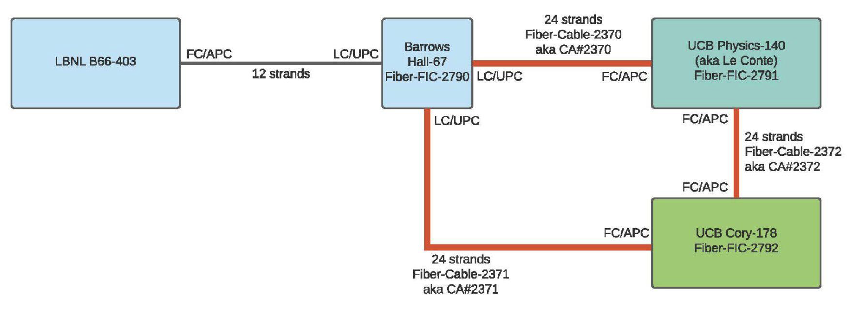
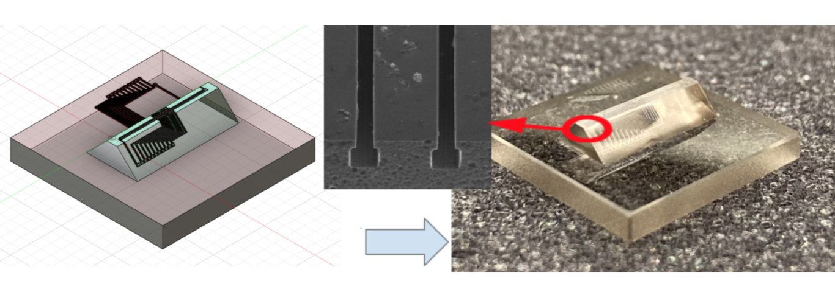
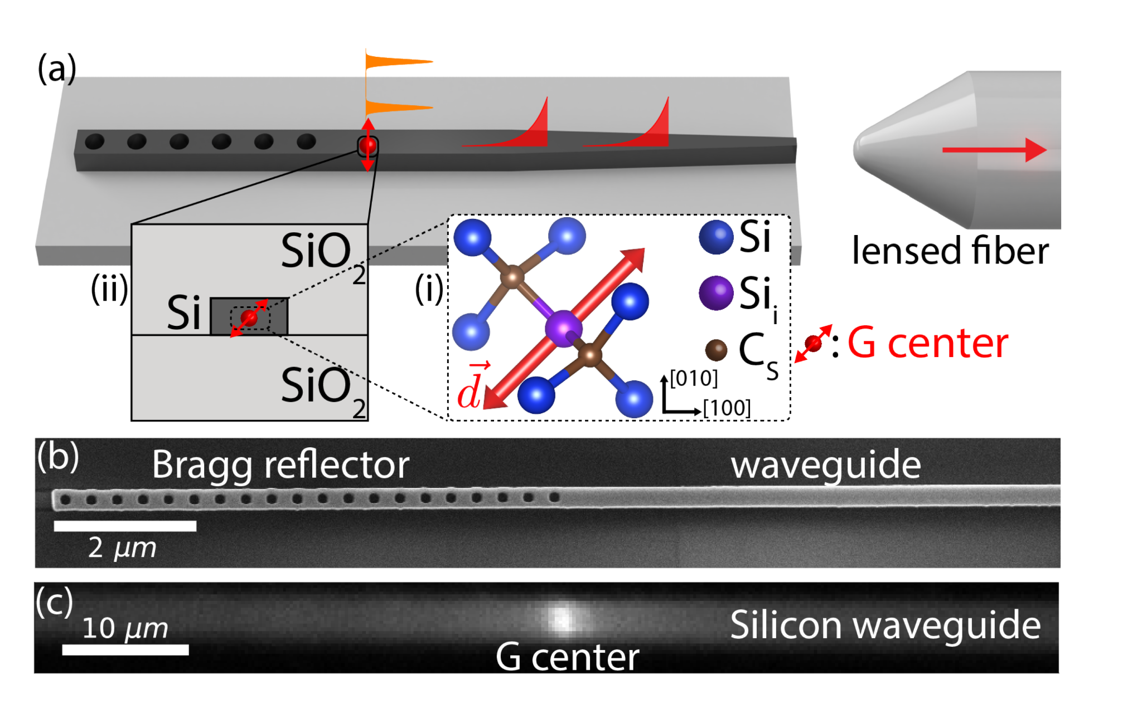
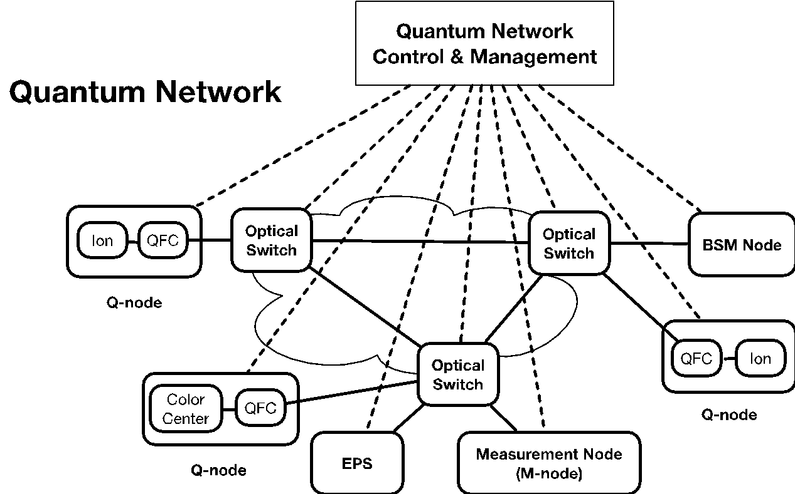



QUANT-NET program in a nutshell
Quantum Application Network Testbed for Novel Entanglement Technologies aims to build a proof-of-concept quantum network based on entanglement
quantnet.lbl.gov
- 11 -

Slide 13
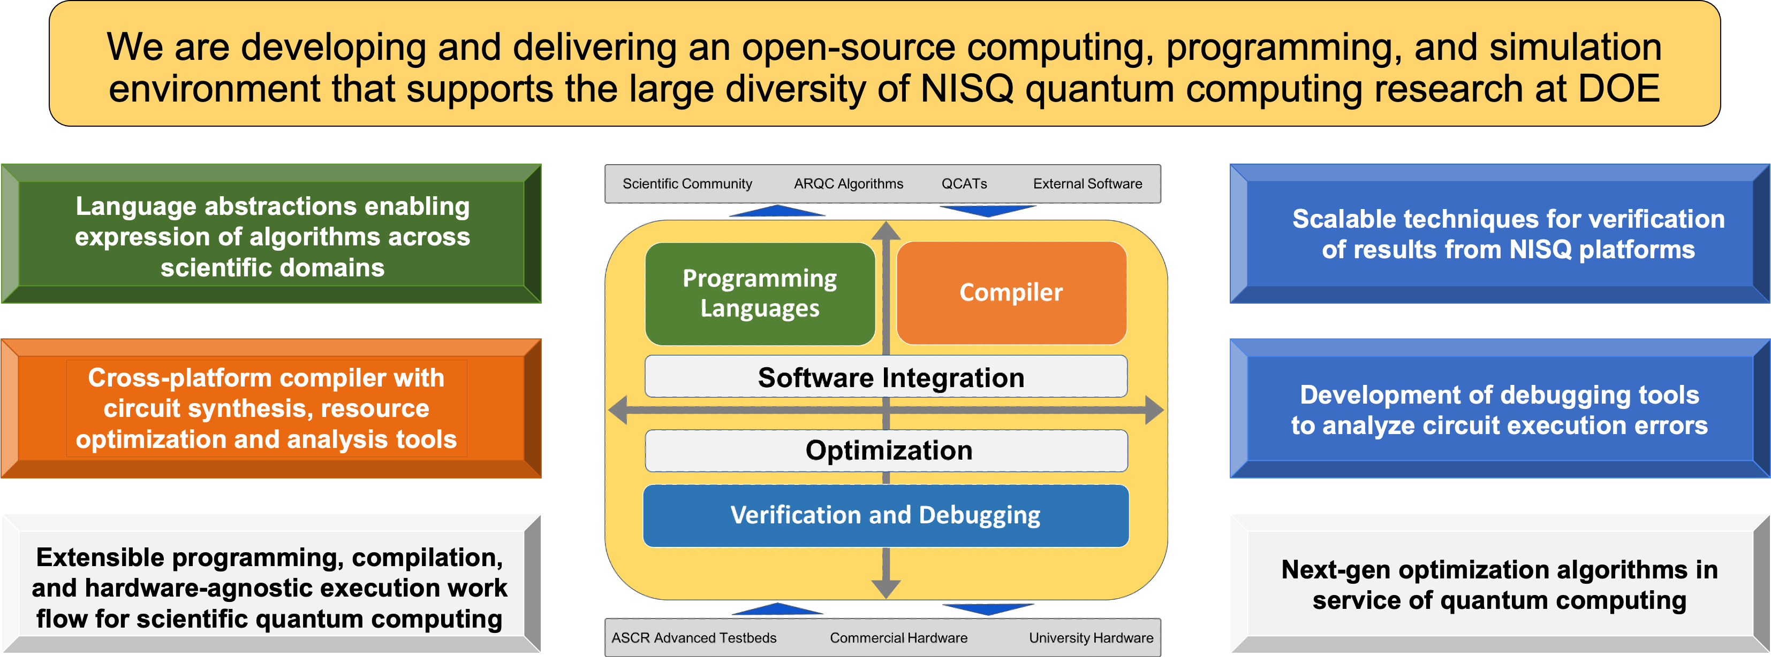
AIDE-QC program in a nutshell
Director: Bert de Jong
- 12 -
Web site: aide-qc.org

Slide 14
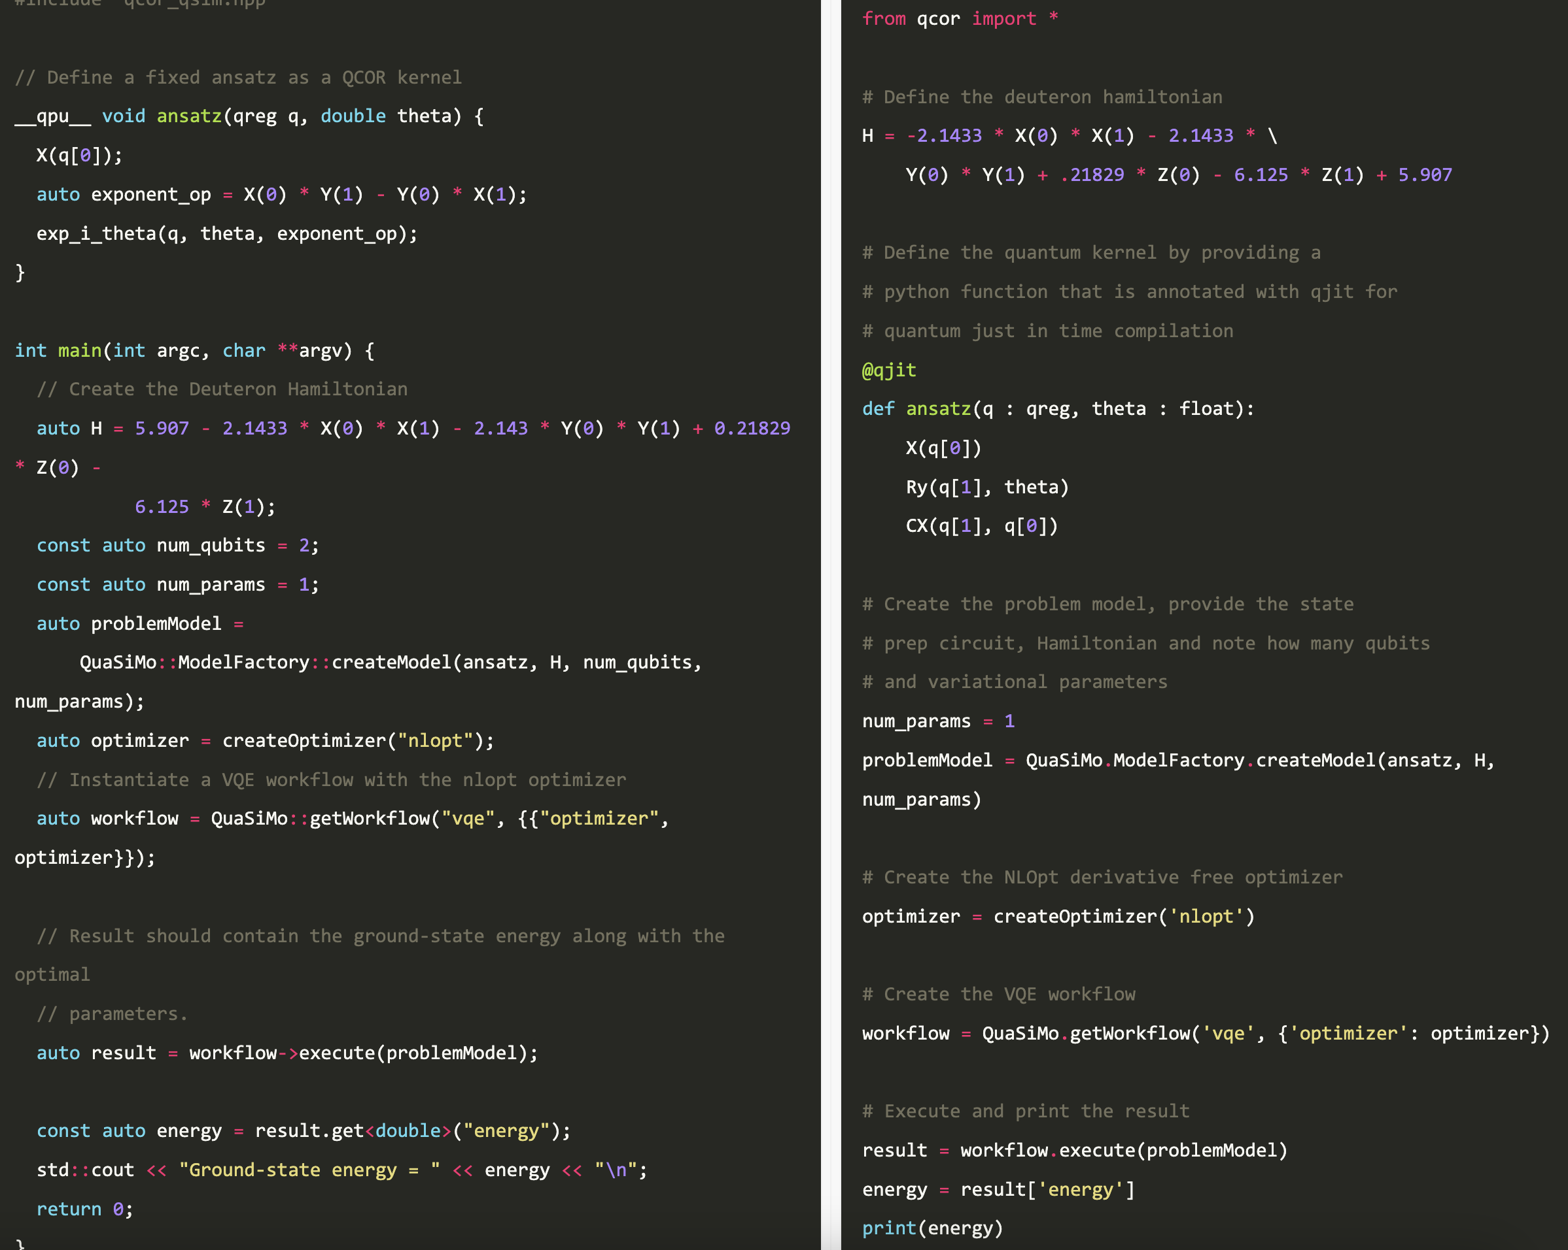
Flexible programming for scientists in C++ and Python
C++
Python
- 13 -
http://aide-ac.org/Software

Slide 15
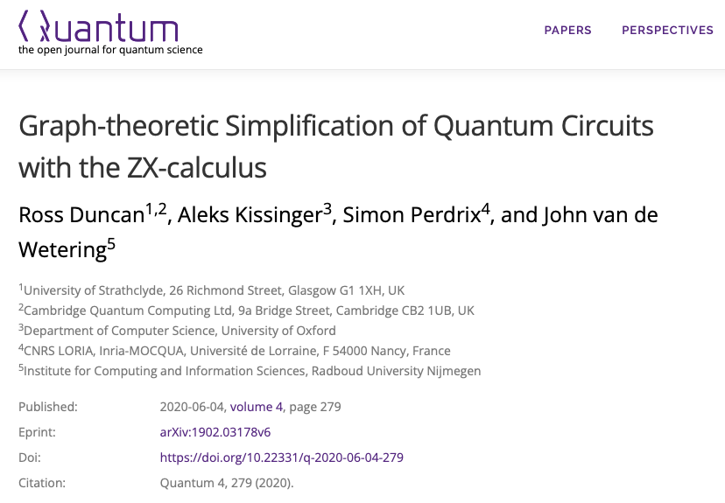

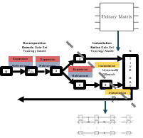
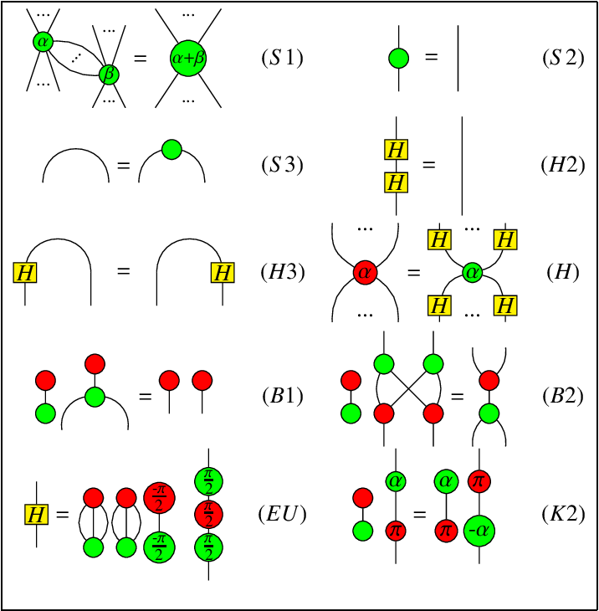

Compilers are a critical piece in the tool chain
QFast
https://bqskit.lbl.gov
QUEST
Compilation is an NP-hard problem and for large qubit counts needs HPC

Slide 16
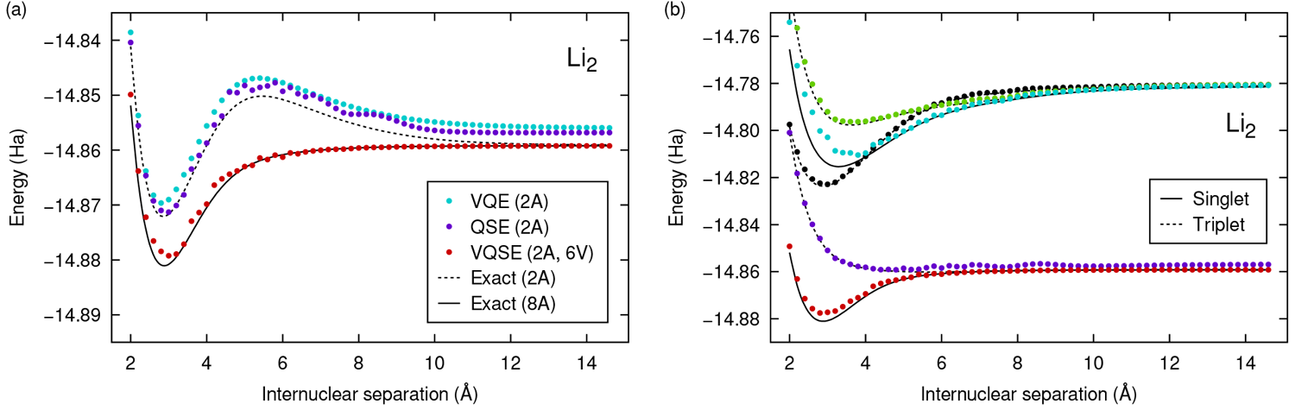
Towards chemical accuracy for battery relevant systems
Special care needs to be taken in general eigensolver due to noise in data!
- 15 -
Urbanek, Van Beeumen, et al., J. Chem. Theory Comput. 16, 5425 (2020)

Slide 17
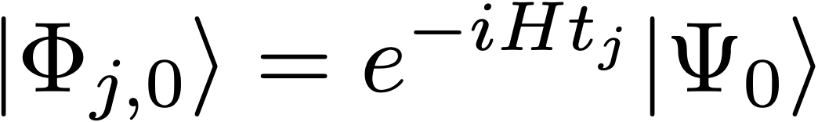

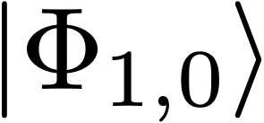
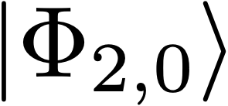
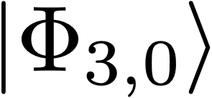
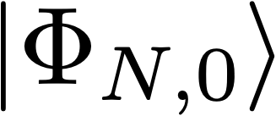

Building on Quantum Subspace Expansion:
Real-time evolution for eigenvalue extraction
Real time evolution to generate a basis of expansion states:
…
Initial vector
Use as a basis to solve:
Possible to extract eigenstates by the cancellation of phases of components of the initial vector.
Promising because unlike imaginary, real time evolution is native to quantum computing.
- 16 -
Klymko, de Jong, Tubman et al., PRX Quantum 3 (2022)

Slide 18
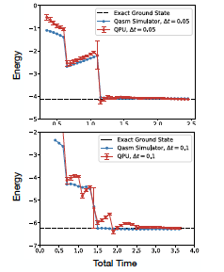
Building on quantum subspace expansion to extract excited states:
Variational Quantum Phase Estimation (VQPE)
Toeplitz structure means that we only need a linear number of measurements instead of quadratic
Approach allows extraction of the maximal number of excited
states!
- 17 -
Klymko, de Jong, Tubman et al., PRX Quantum 3 (2022)

Slide 19
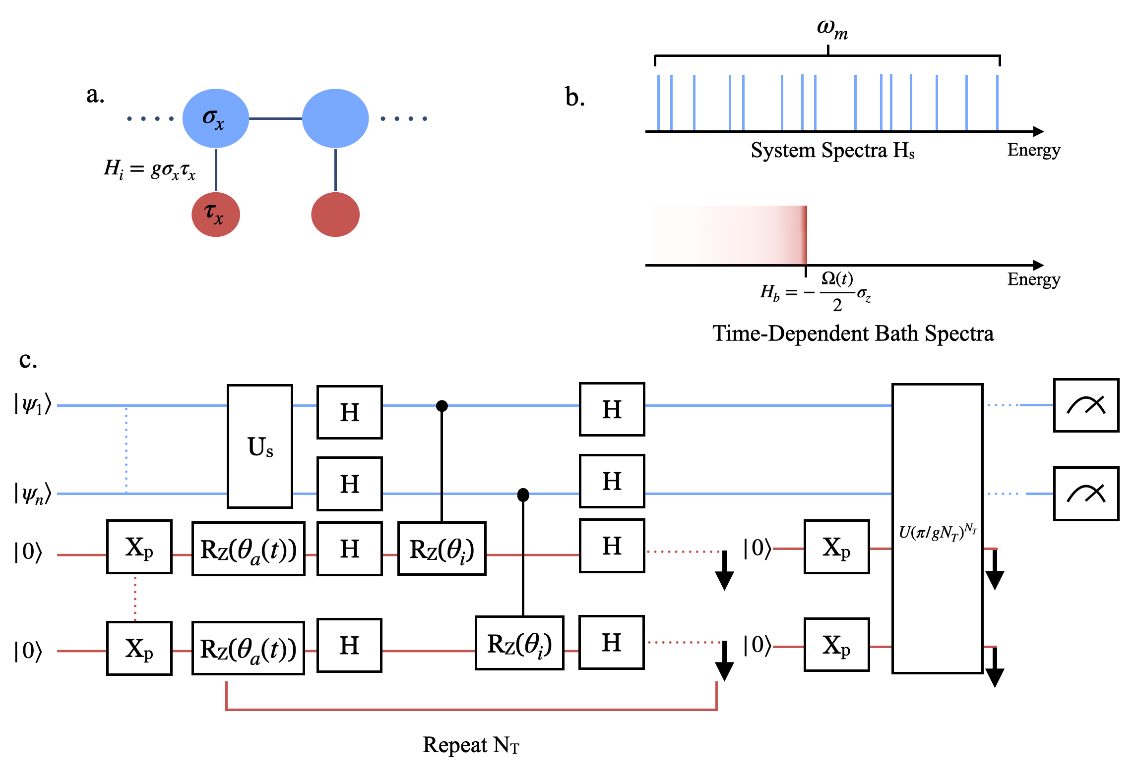


Quantum Markov Chain Monte Carlo with Driven Dissipative Dynamics on Quantum Computers
Development of a quantum algorithm to sample from Boltzmann distributions on quantum computers by engineering open-quantum system dynamics
Algorithm can prepare robust, thermal states on quantum computers enabling finite-temperature simulations on quantum computers relevant to chemistry, materials and machine learning quantum applications
a) Principal qubits (blue) locally connected to ancilla qubits (red). b) Time-dependent ancilla frequency combs the system energy spectra and resonantly exchanges energy with different energy transitions in the system at different times c) Quantum circuit to implement the interaction cycle dynamical map
Metcalf, Stone, Klymko, Kemper, Sarovar, de Jong Quant. Sci. Tech. 7, 025017 (2022)
- 18 -
Notes:
Notes: Include 200 word highlight summary….

Slide 20
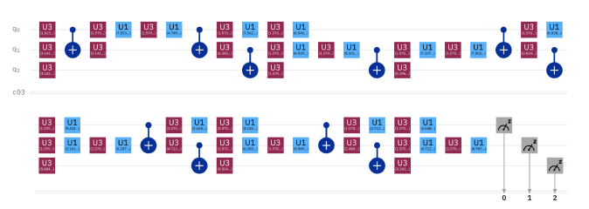

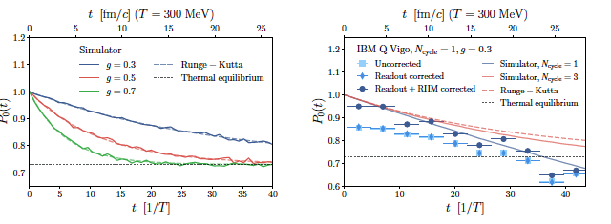

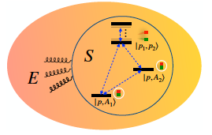
Open quantum systems in heavy-ion collisions
Two-level system of heavy quark-antiquark pair (H_{s}) interacting with quark-gluon plasma (H_{e}) via interaction Hi with strength g.
de Jong, Metcalf, Mulligan, Ploskon, Ringer, Yao, Phys. Rev. D 104, 051501 (2021)
- 19 -

Slide 21
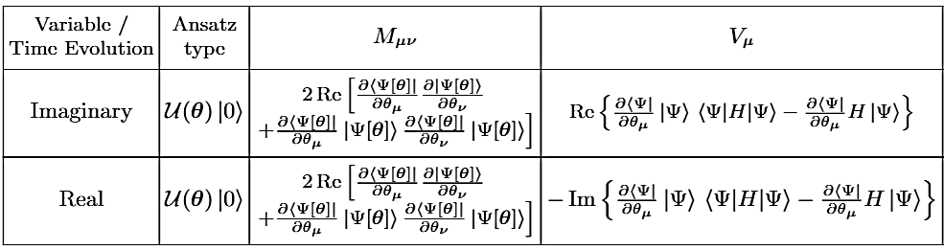
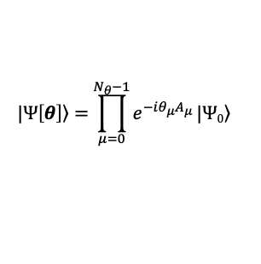
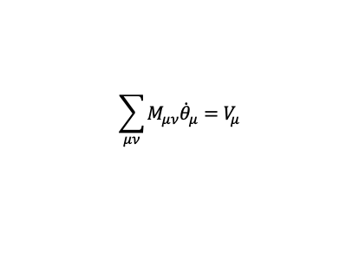
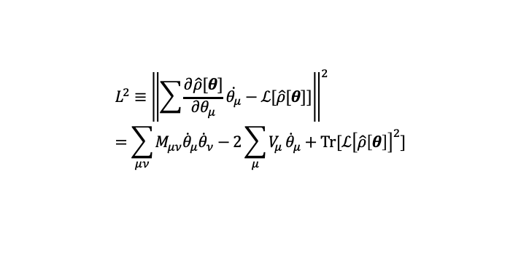
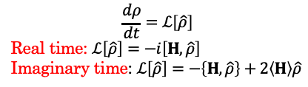

Adaptive Variational Quantum Dynamics Simulations
Variational form
Von Neuman equation
McLachlan distance
$$|\left.Ψ\left[θ\right]\right\rangle =\prod_{μ=0}^{N_{θ}−1}{e^{−iθ_{μ}A_{μ}}}|\left.Ψ0\right\rangle$$
$$L^{2}≡{\left\|\sum{\frac{∂\hat{ρ}[θ]}{∂θ_{μ}}\dot{θ_{μ}}}−ℒ[\hat{ρ}[θ]]\right\|}^{2} =\sum_{μν}{M_{μν}{\dot{θ}}_{μ}{\dot{θ}}_{ν}}−2\sum_{μ}{V_{μ}}{\dot{θ}}_{μ}+Tr[ℒ{\left[\hat{ρ}\left[θ\right]\right]}^{2}]$$
$$\frac{dρ}{dt}=ℒ\left[\hat{ρ}\right]$$
Real time: $ℒ\left[\hat{ρ}\right]=−i\left[H,\hat{ρ}\right]$
Imaginary time: $ℒ\left[\hat{ρ}\right]=−\left\{H,\hat{ρ}\right\}+2\left\langle H\right\rangle \hat{ρ}$
Time dependent variational parameters
Distance between exact and variational time evolution
$$\sum_{μν}{M_{μν}{\dot{θ}}_{μ}=V_{μ}}$$
$M_{μν}$ and $V_{μ}$ are measured on QPU
Accuracy is limited by the form of the ansatz
- 20 -

Slide 22
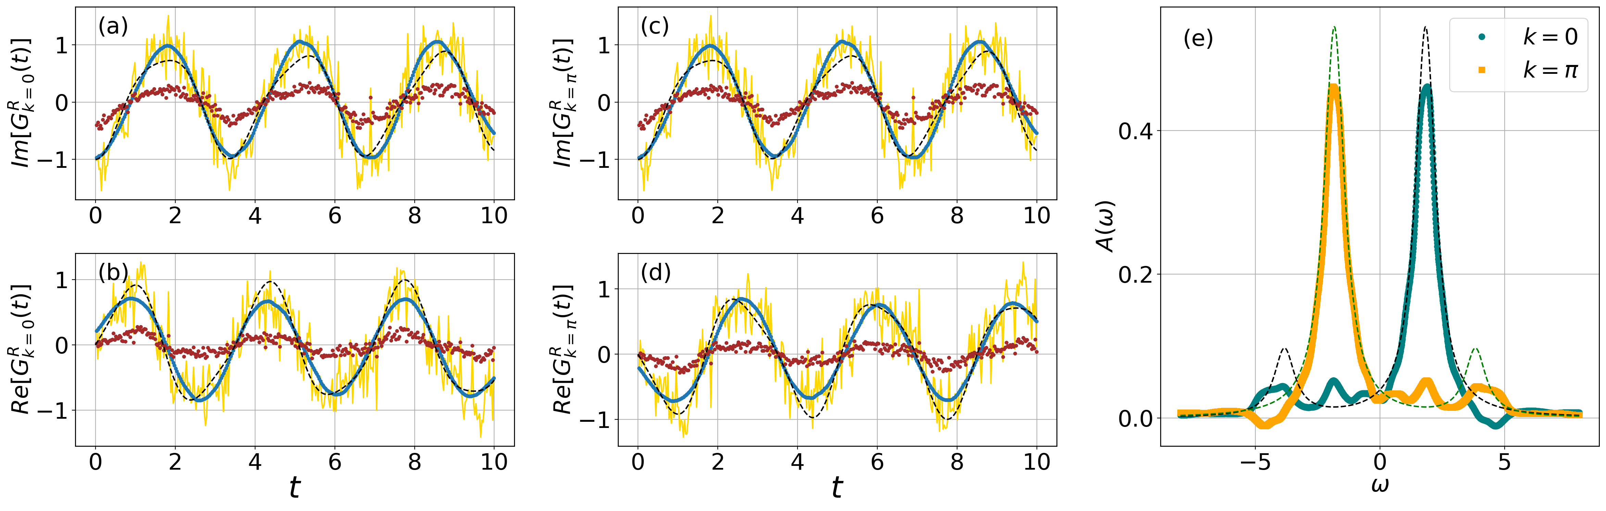
Using AVQDS to calculate Green’s functions
Retarded Green’s function versus time
Spectral function
Two site Hubbard model on 4 qubits of IBM Kolkata quantum computer
Imaginary part of $G^{R}(ω)$ using Pade approximation
- 21 -

Slide 23
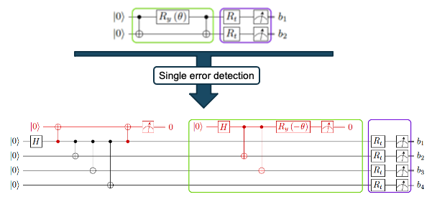
Simple error detection and mitigation works
[[4,2,2]] error correction code
2 logical qubit H₂ molecule on 6 qubits with minimal basis
Urbanek et al, Phys. Rev. A 102, 022427 (2020)

Slide 24
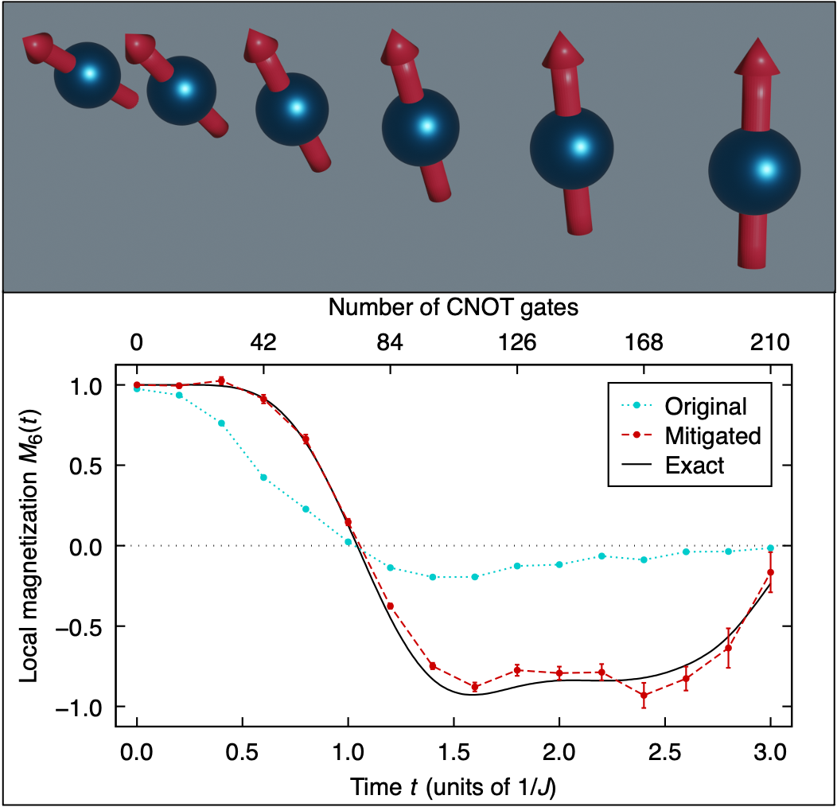
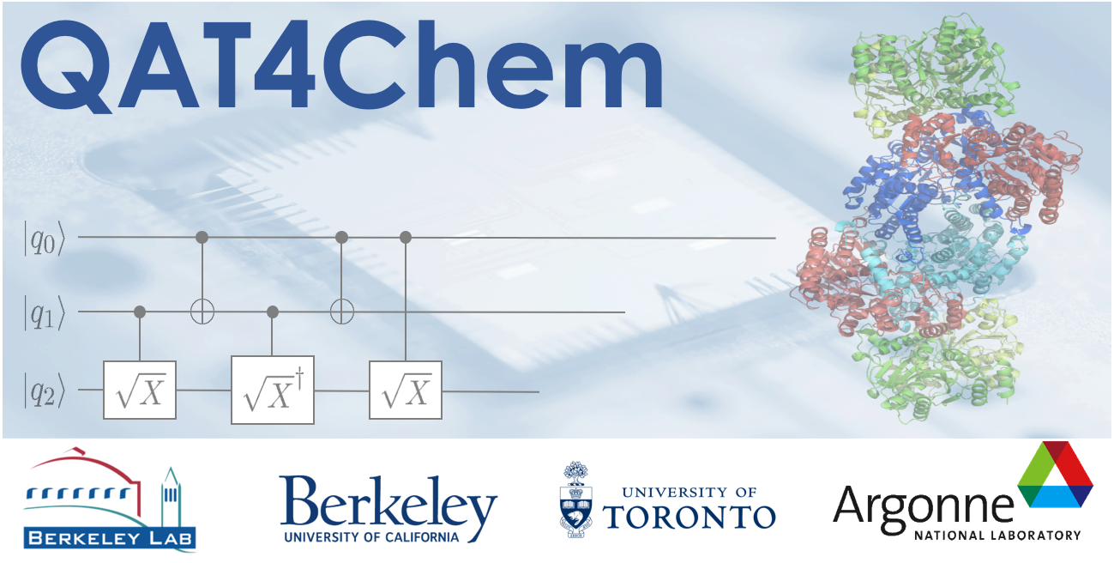
Accurate magnetic materials simulation with quantum computers
Scientific Achievement
Design of a practical mitigation strategy for drastically reducing errors and noise present in quantum computers based on superconducting qubits opens new opportunities for scientific discovery.
Significance and Impact
Combination of both existing and LBNL’s new mitigation approaches enables larger scale simulations leading to quantum circuits with hundreds of operations to be run on quantum computers.
Additional Details
Only Google has done better, but with simplified problems
Team science, requiring physicists, chemists, computer scientists and applied mathematicians needed to achieve this result
Science “Cutting Through the Noise” highlighted on CSA website, DOE ASCR Web Highlight in development, picked up by science outlets
Would require a Quantum Volume of > 48,000; Current hardware as QV of 2048!
Effect of mitigation: Time evolution of a six-qubit magnetic model calculated without and with error mitigation.
Longest time = 210 CNOTs
Phys. Rev. Lett. 127, 270502 (2021)
- 23 -
HEP QuantiSED

Slide 25



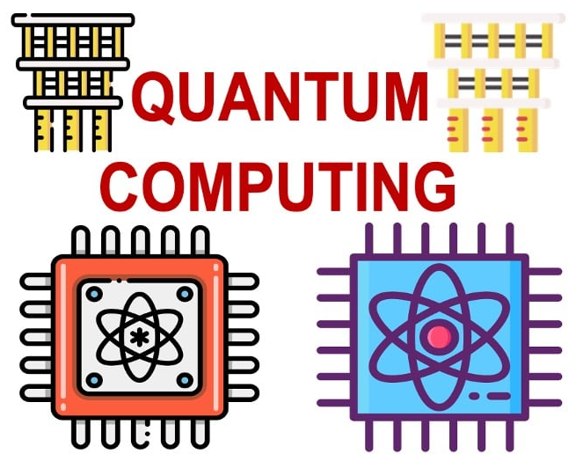
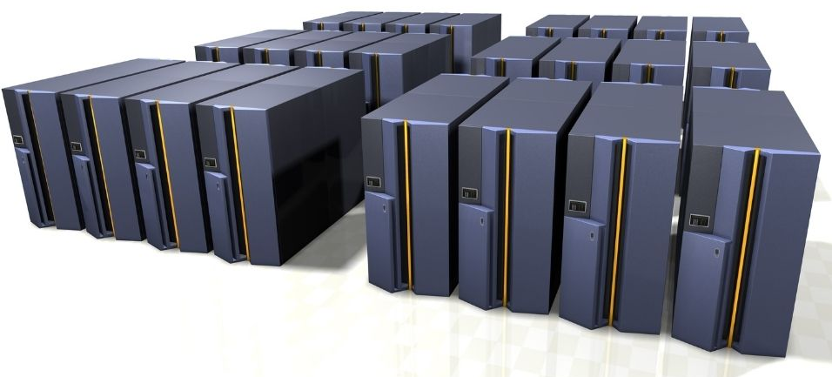
Using cloud-based quantum computer as black box
User
Cloud Provider
from SomeSimulationPackage import Molecule, SCFDriver
from SomeSimulationPackage import GroundStateEigensolver
molecule = Molecule(geometry=[['H', [0., 0., 0.]], ['H', [0., 0., 0.735]]],
charge=0, multiplicity=1)
driver = SCFDriver(molecule = molecule, basis='sto3g’)
calc = GroundStateEigensolver(algorithm=VQE, qubits=4)
res = calc.solve(driver)
Queue
Compute Answer or new circuit
Final answer
Target is the end-users in academia and industry without quantum knowledge
Notes:
Software startups play a major role here

Slide 26
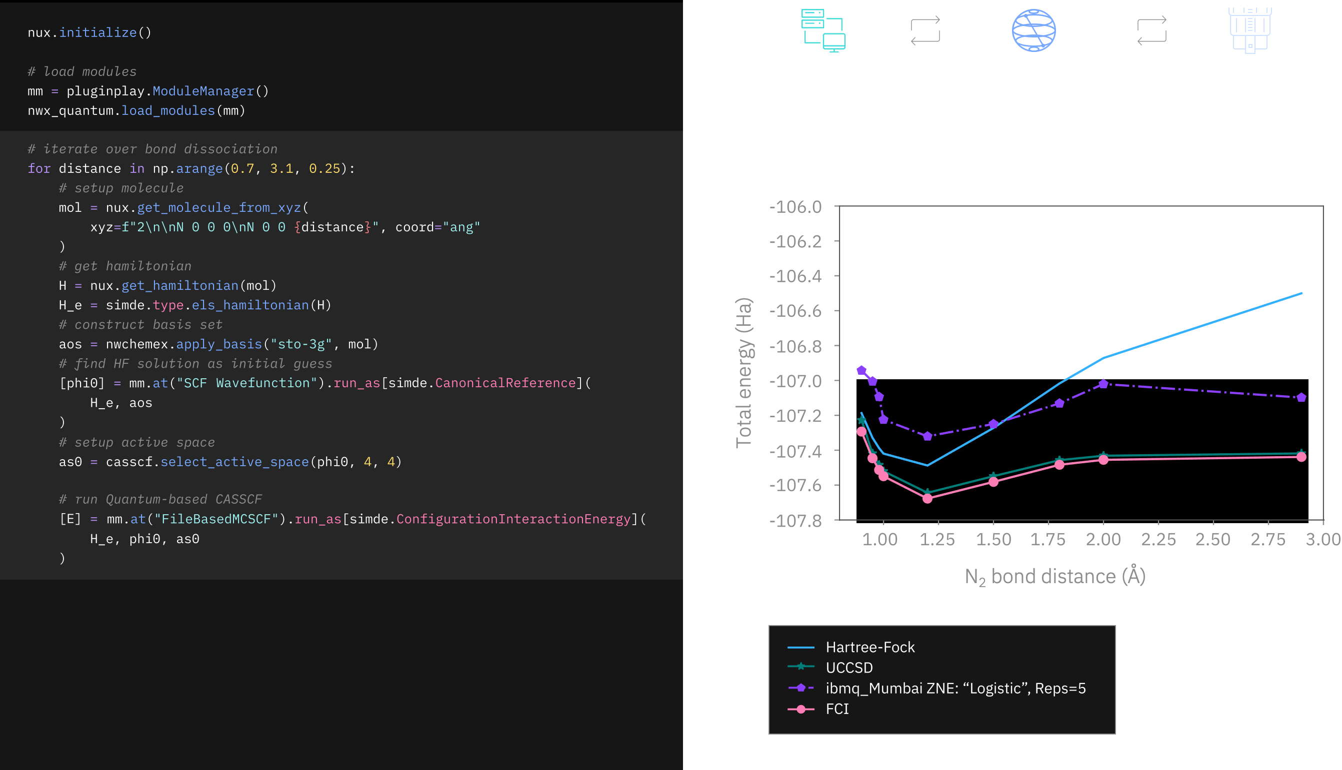
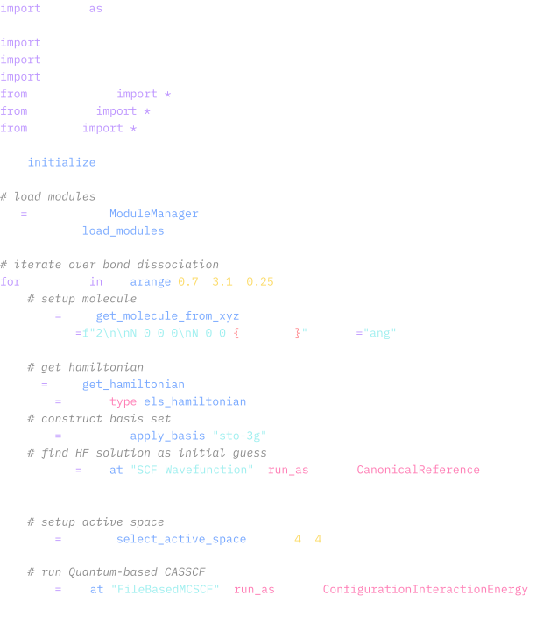
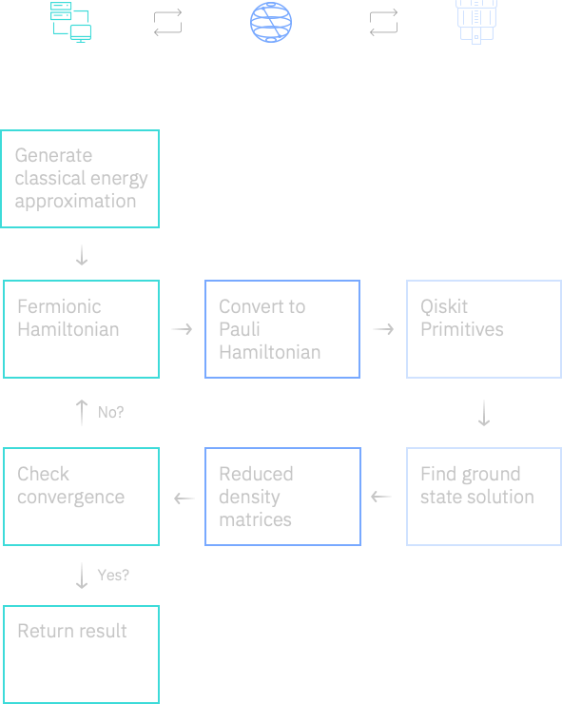
MCSCF with Qiskit requires iterations between quantum and HPC
HPC codes with quantum acceleration:
Quantum chemistry’s MCSCF requires a tight loop and integration into large HPC codes
- 25 -

Slide 27
AIDE-QC is advancing the software ecosystem
Scalable approaches for debugging and verification
Novel optimization methods for quantum computing
Scalable, hardware-agnostic compilers
New programming language abstractions
Extensible hardware-agnostic software stack

Slide 28

Exponential speedup not only factor for quantum advantage
Power: 20 MW + 10 MW for cooling
Cost: US$600M (estimated cost)
Space: 2225 m² (7,300 sq ft)
24,000 house holds
Quantum computers could solve larger problems faster compared to classical computing hardware
Quantum computers are cheaper and use less energy than classical computers, increasing accessibility to large scale computing

Slide 29
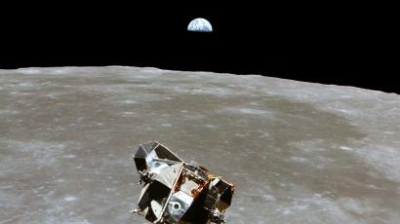
Race to the moon delivered many ancillary technologies
Quantum-inspired algorithms speedup classical computing
Novel quantum hardware technologies find way into classical computing hardware
Better understanding of quantum physics to lead to advances in classical computing
CMOS sensor, using integrated circuits….
Race for a universal quantum computer is already showing impacts beyond quantum computing

Slide 30
Acknowledgements
This work was supported by DOE
Office of Advanced Scientific Computing Research (ASCR) through the QAT and ARQC
Office of Basic Energy Sciences (BES)
Quantum Systems Accelerator
Member of the ORNL IBM Q Network
This research used computing resources of the National Energy Research Scientific Computing Center

Slide 31
quantum.lbl.gov
quantumsystemsaccelerator.org
aide-qc.org
aqt.lbl.gov
Bert de Jong wadejong@lbl.gov

