Slide 1
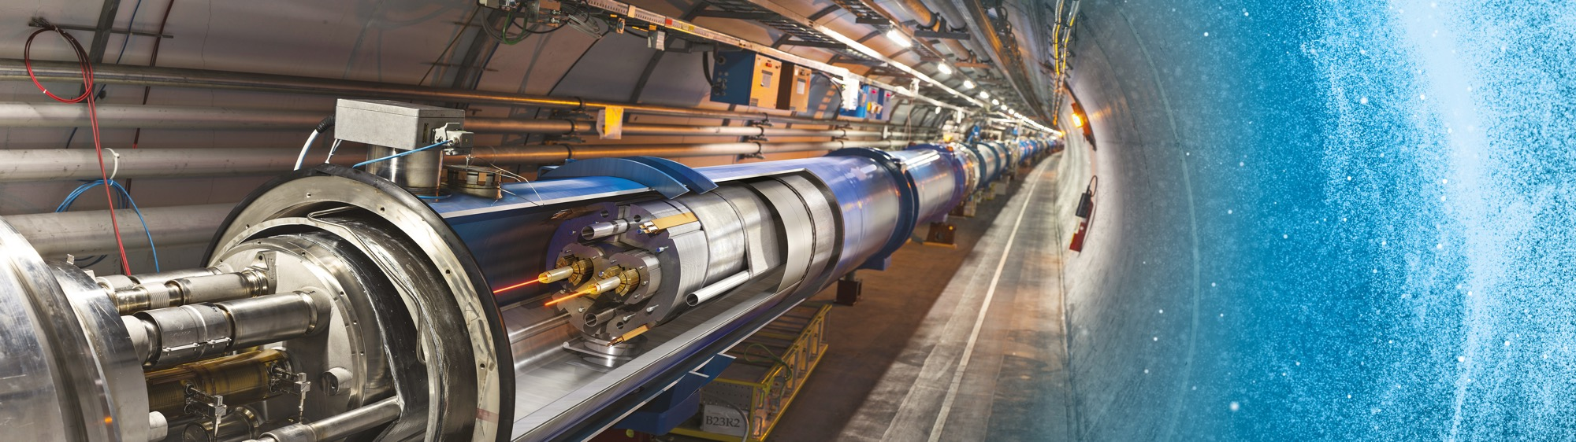
Welcome and introduction to CERN
Salvatore Danzeca
27 November 2023

Slide 2
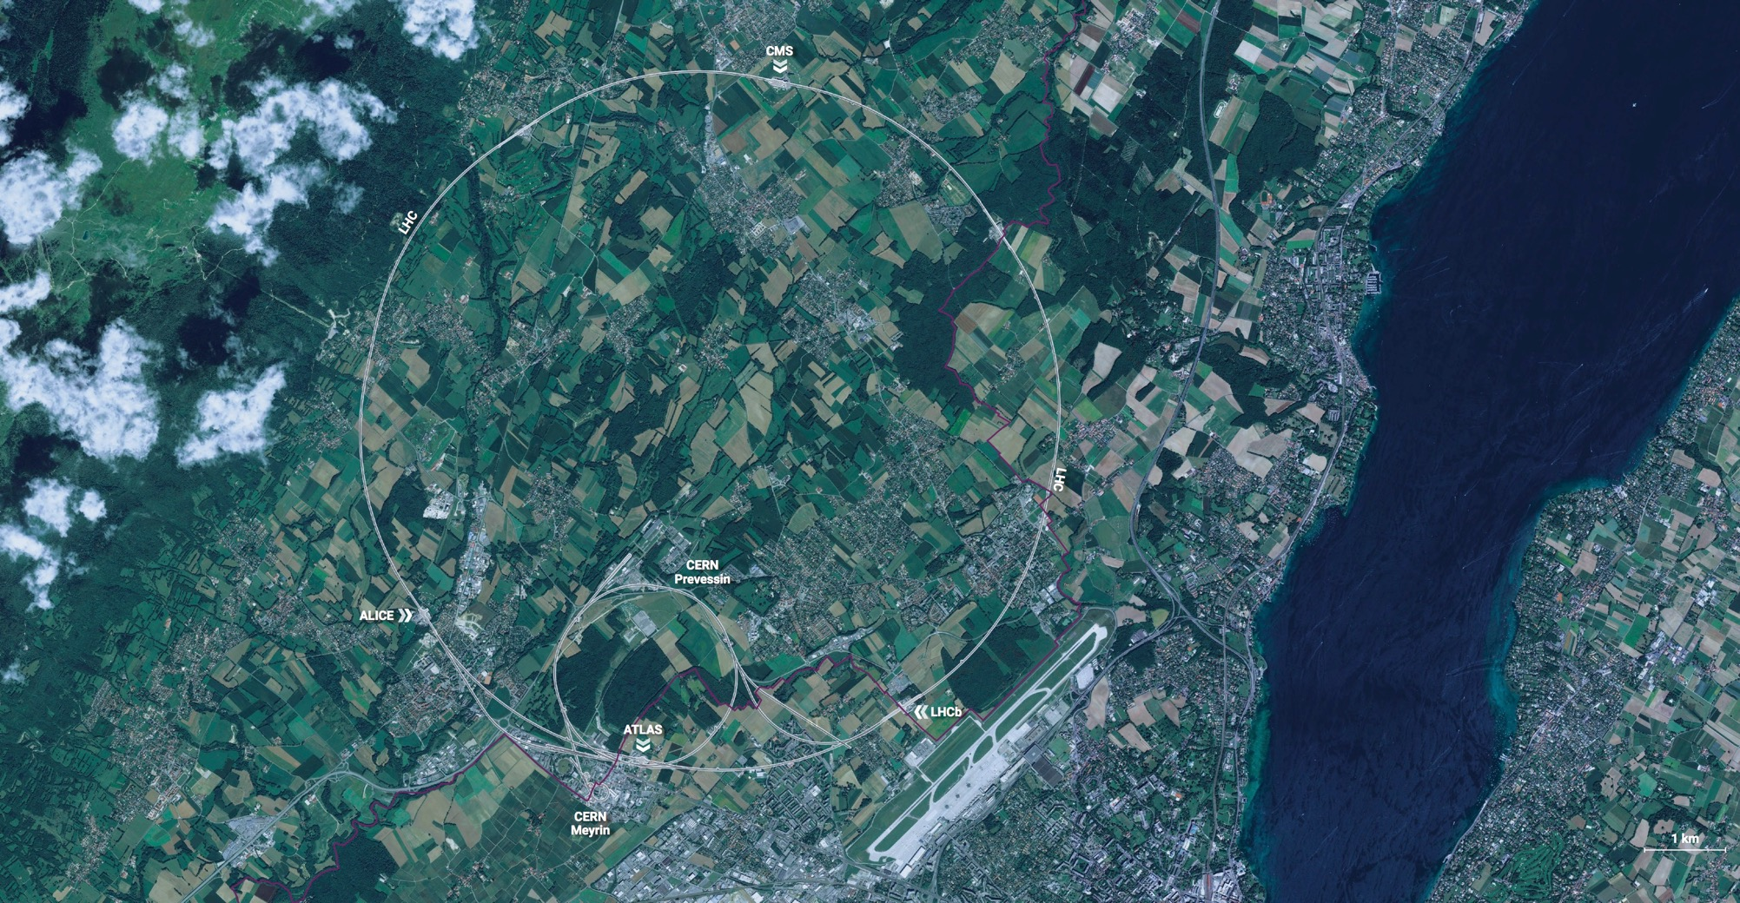
CERN - the world’s biggest laboratory for particle physics.
International Organization
established on 1 July 1953 -
“Science for Peace”.
Immunity of jurisdiction
and execution.

Slide 3
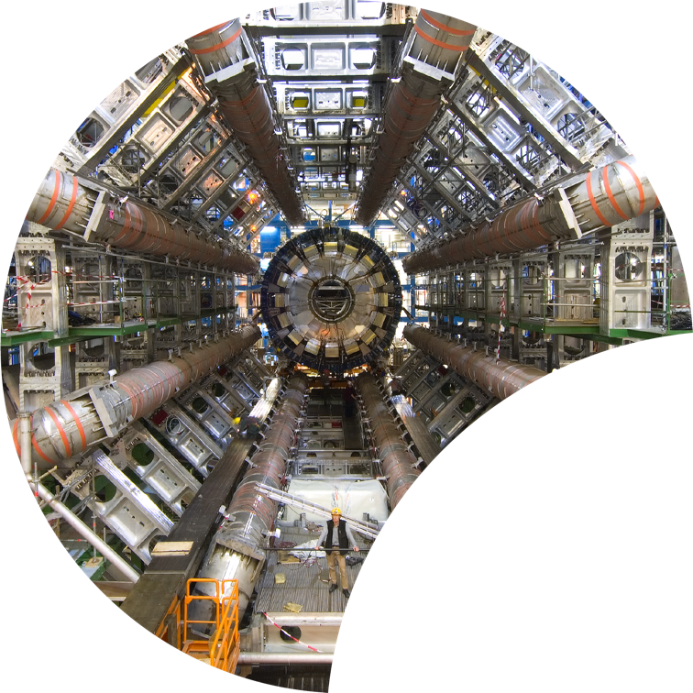
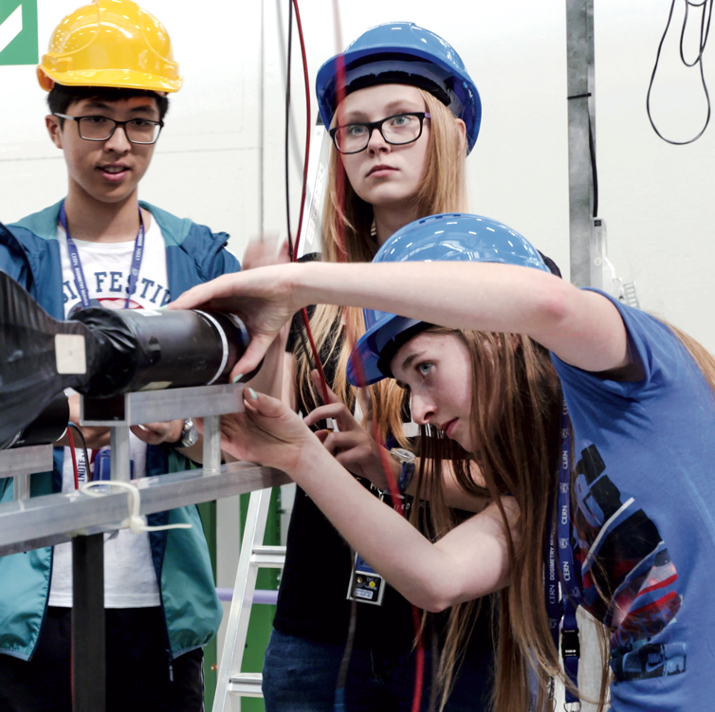

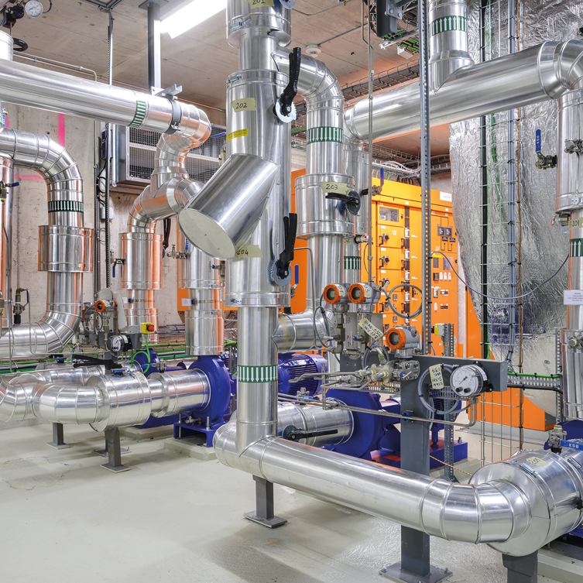

Four pillars underpin CERN’s mission
RESEARCH
EDUCATION
& TRAINING
COLLABORATION
TECHNOLOGY
& INNOVATION

Slide 4
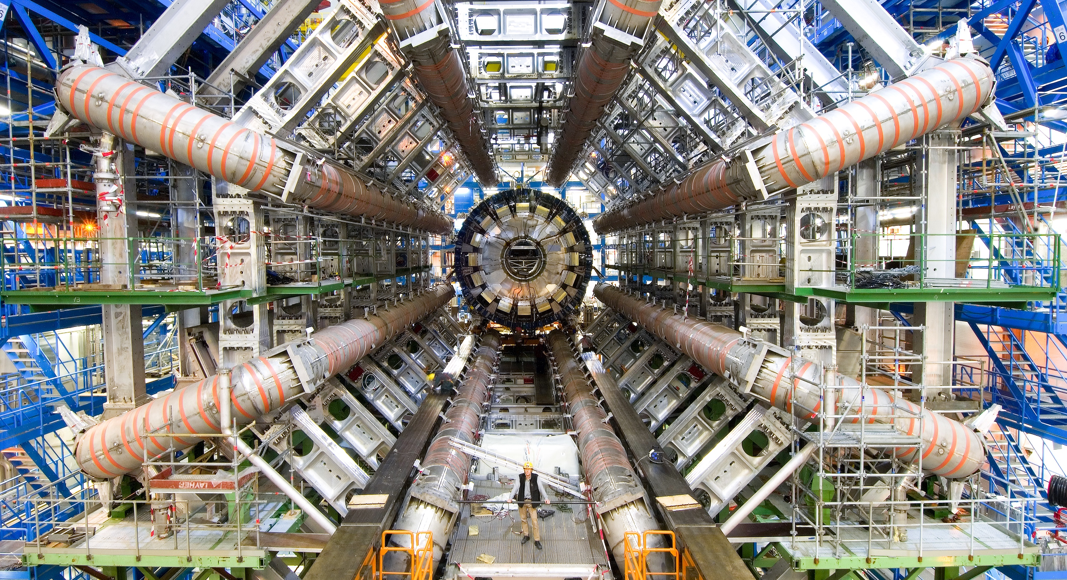
RESEARCH

Slide 5
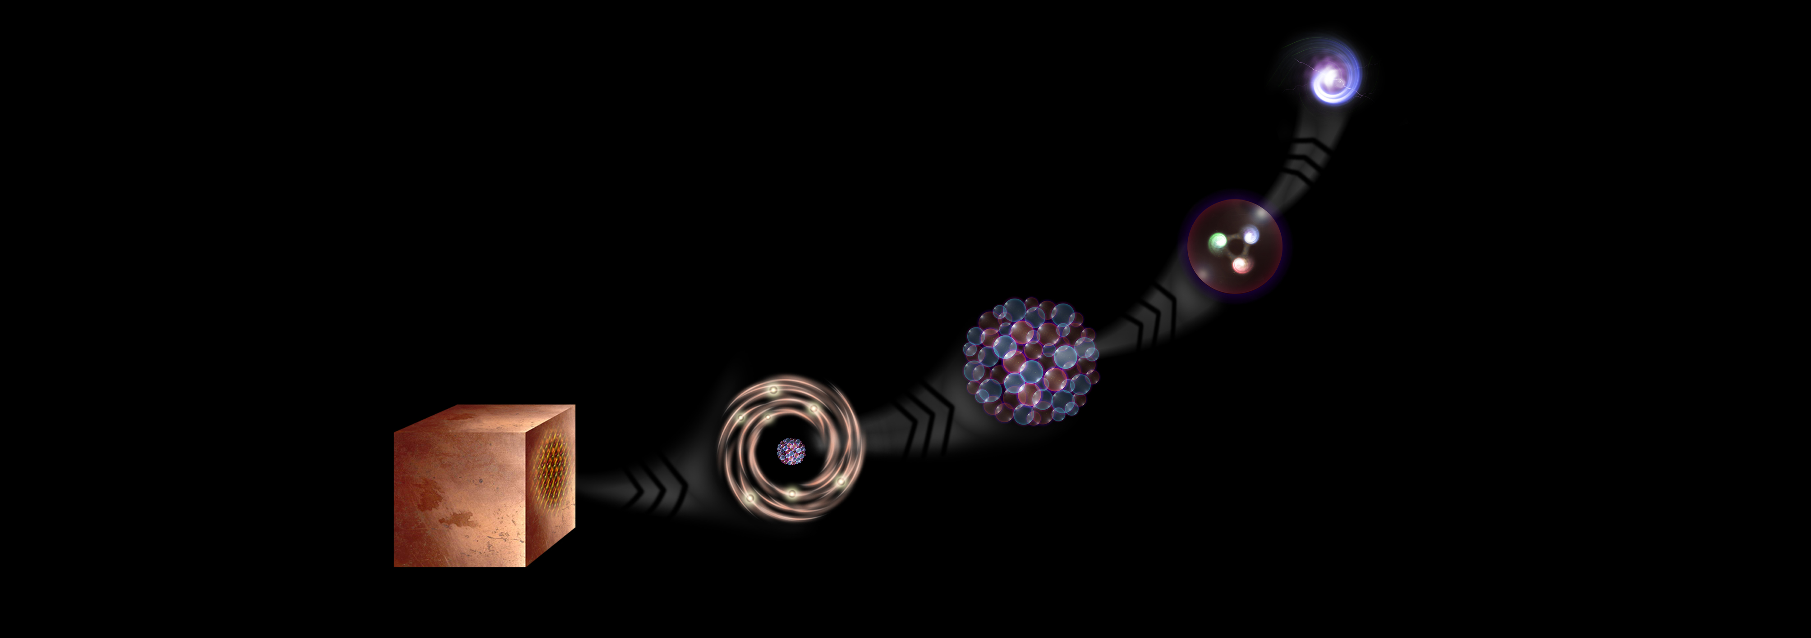
What is the universe made of?
CERN studies the elementary building blocks of matter and the forces that control their behaviour
Quark
<10⁻¹⁸ m
Proton
~10⁻¹⁵ m
Nucleus
~10⁻¹⁴ m
Electron
Matter
0,1 m
Atom
~10⁻¹⁰ m

Slide 6
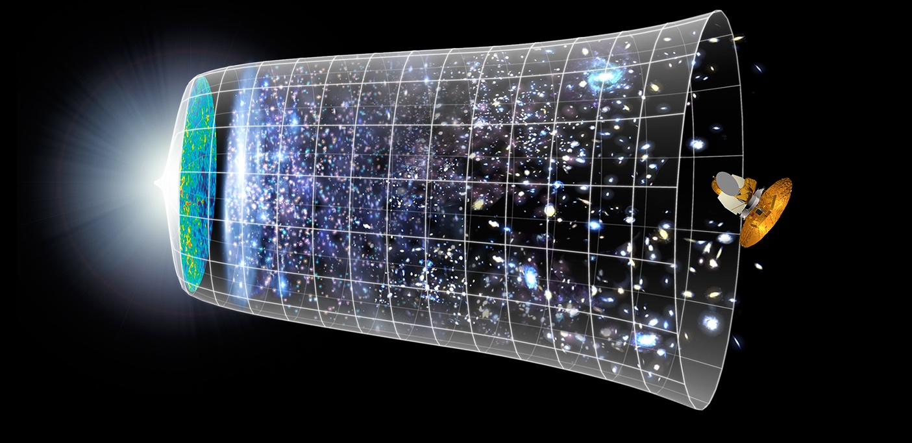

How did the universe begin?
Big Bang
CERN reproduces the conditions a fraction of
a second after the Big Bang, to gain insight into the structure and evolution
of the universe.
Telescopes
Accelerators
380 000 years
13.8 Billion Years
Today
10²⁸ cm

Slide 7
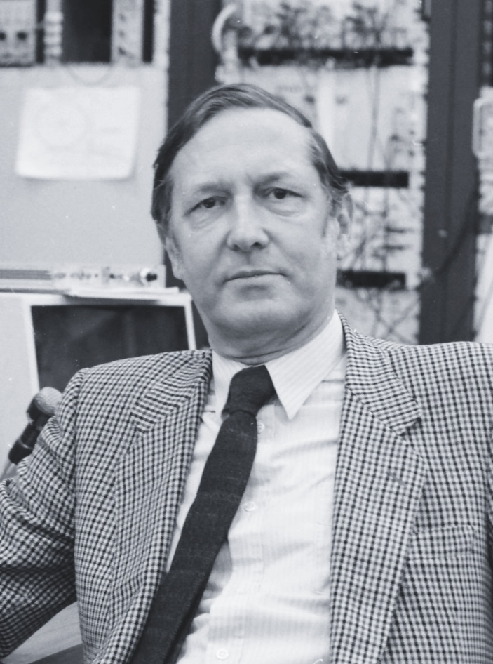
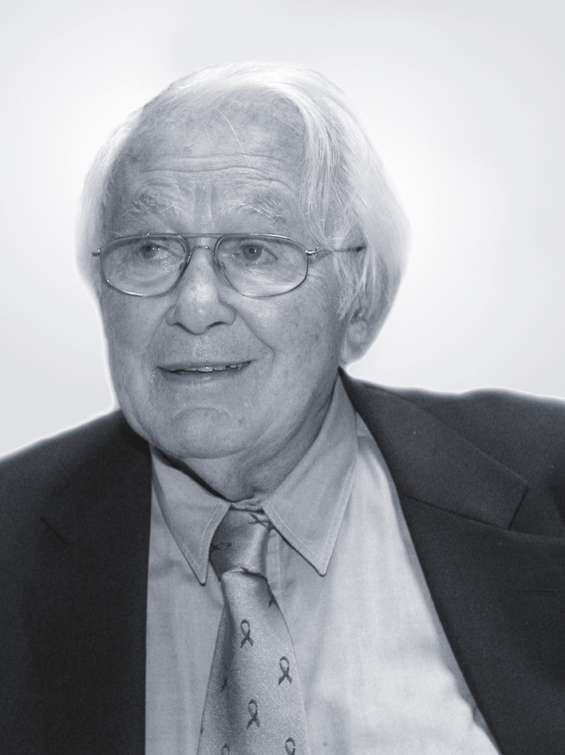
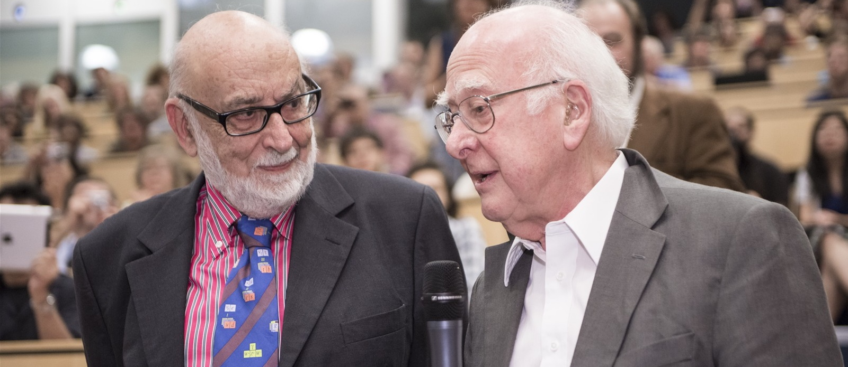
CERN helps to answer these questions
The Higgs boson was discovered in 2012; without it fundamental particles would be massless
and atoms could not form.
Carlo Rubbia
Simon Van der Meer
Georges Charpak
Several CERN scientists have received
Nobel Prizes for key discoveries
in particle physics.
François Englert and Peter Higgs. With Robert Brout, they proposed the mechanism in 1964.

Slide 8
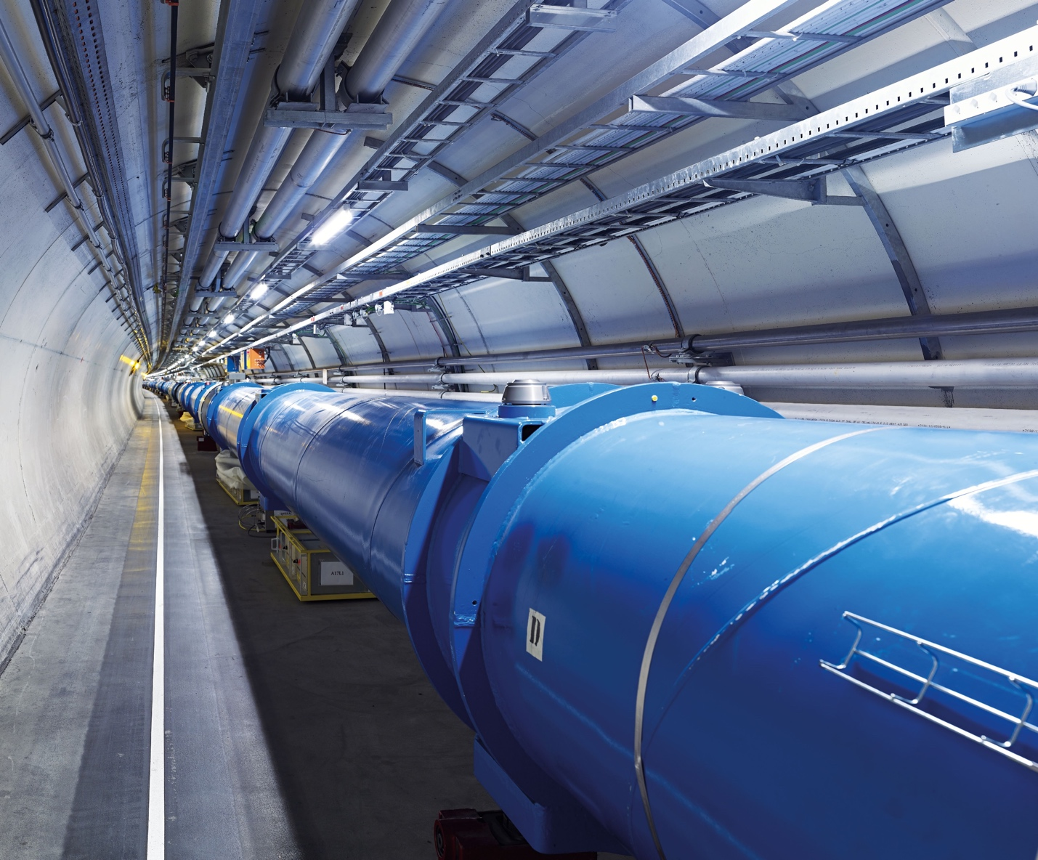
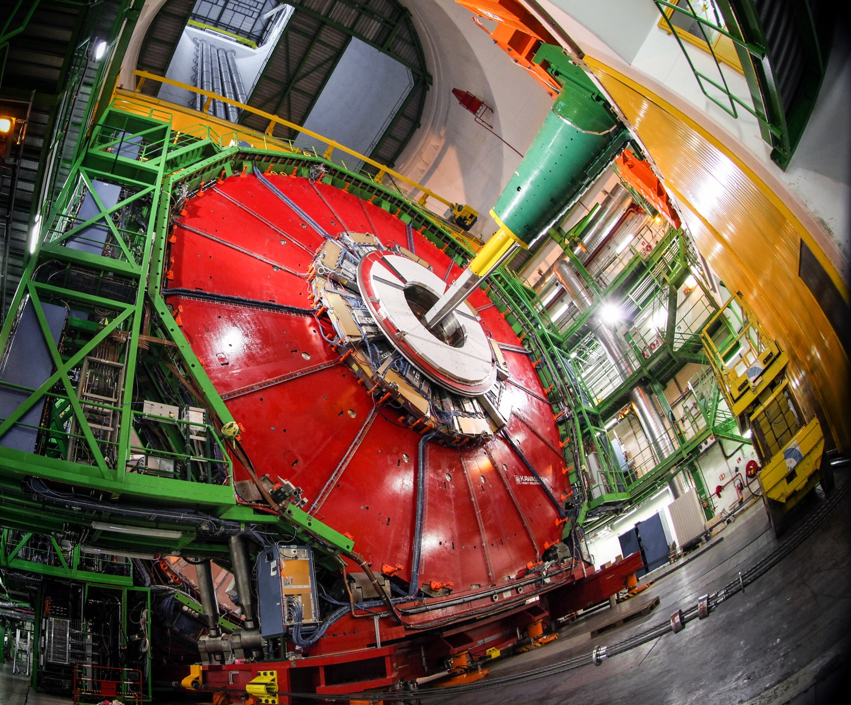
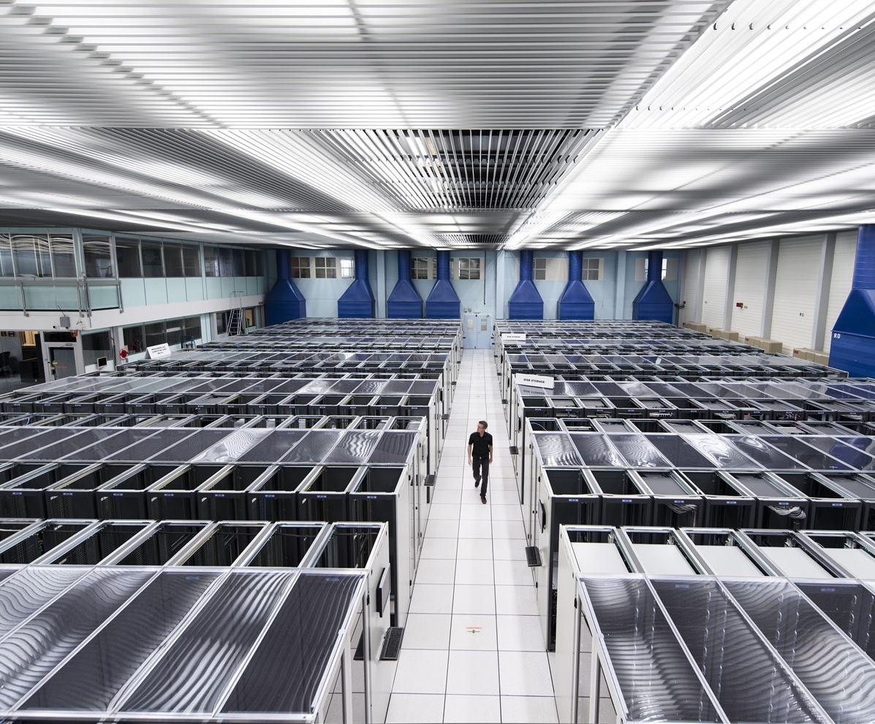
CERN develops technologies in three key areas
ACCELERATORS
DETECTORS
COMPUTING

Slide 9
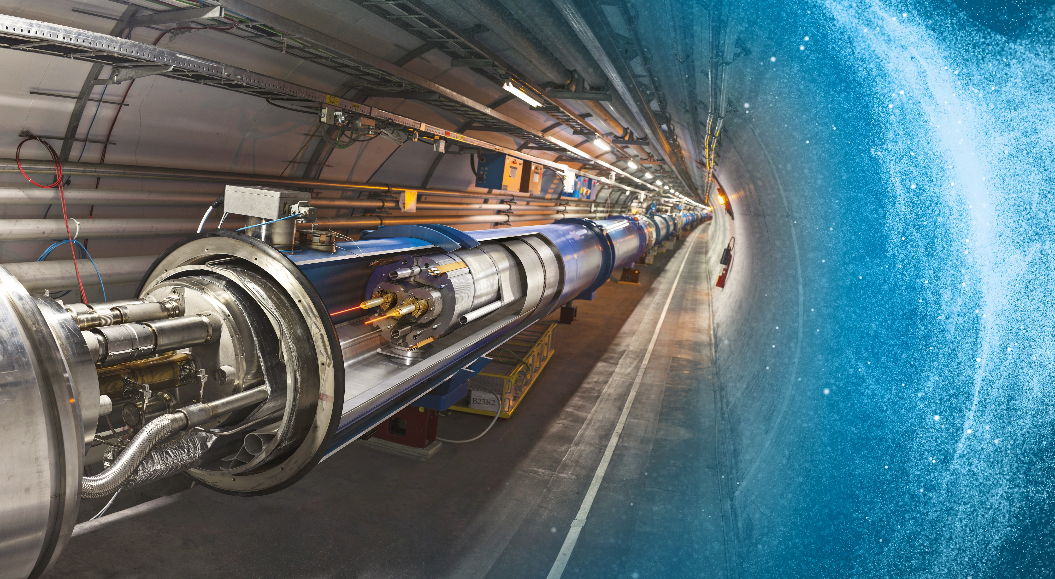
Large Hadron Collider (LHC)
27 km in circumference
About 100 m underground
Superconducting magnets steer the particles around the ring
Particles are accelerated
to close to the speed
of light

Slide 10
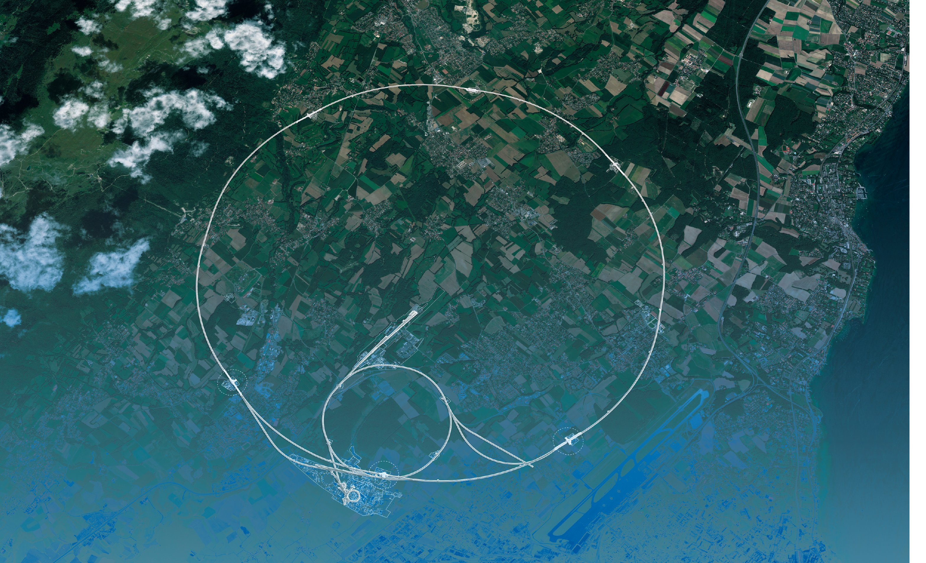
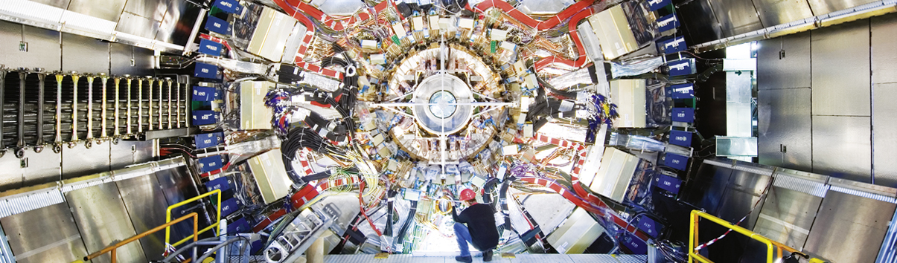
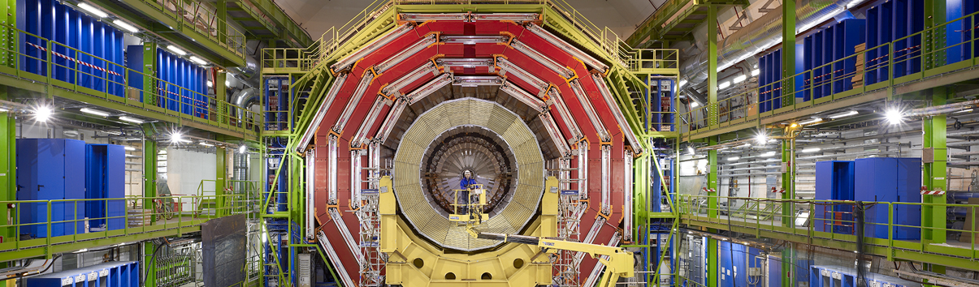
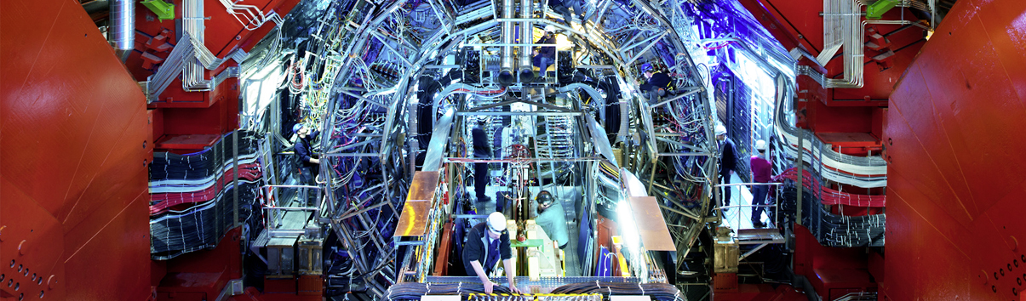
Giant detectors record the particles formed at the four collision points
ATLAS
CMS
CMS
ALICE
ALICE
ATLAS
LHCb
LHCb

Slide 11
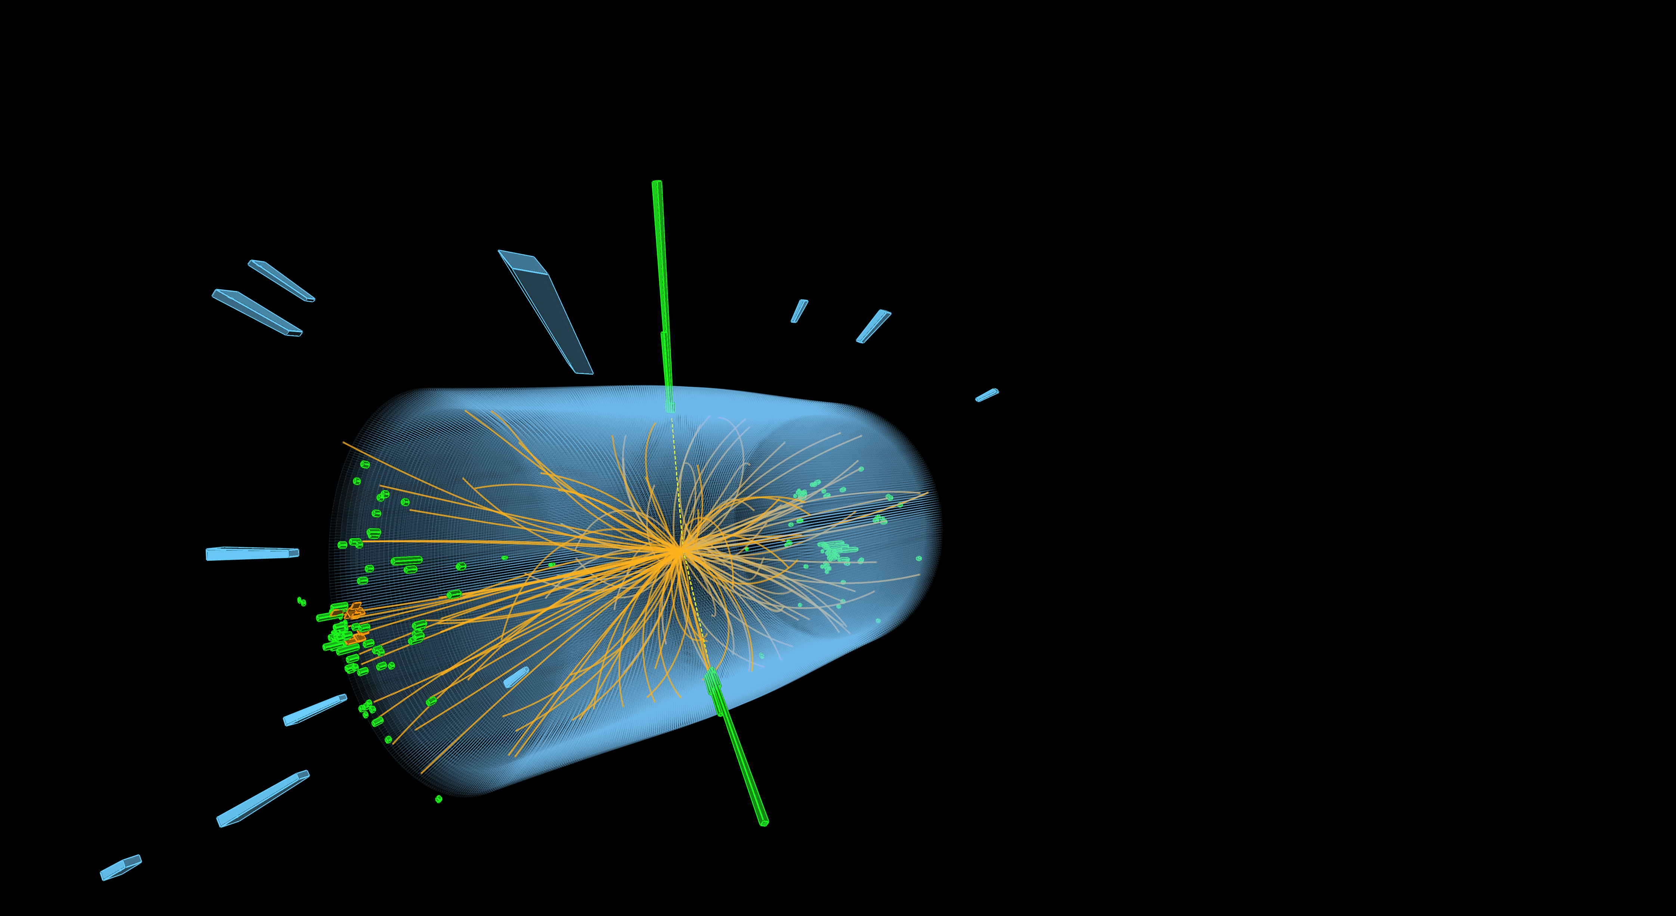
The LHC produces more than 1 billion particle collisions per second
The energy of the particles in collision is converted into new particles.

Slide 12




The LHC detectors are analogous to 3D cameras
The detectors measure the energy, direction and charge of new
particles formed.
They take 40 million pictures
a second. Only 1000 are
recorded and stored.
The LHC detectors have been built by international collaborations covering all regions of the Globe.

Slide 13
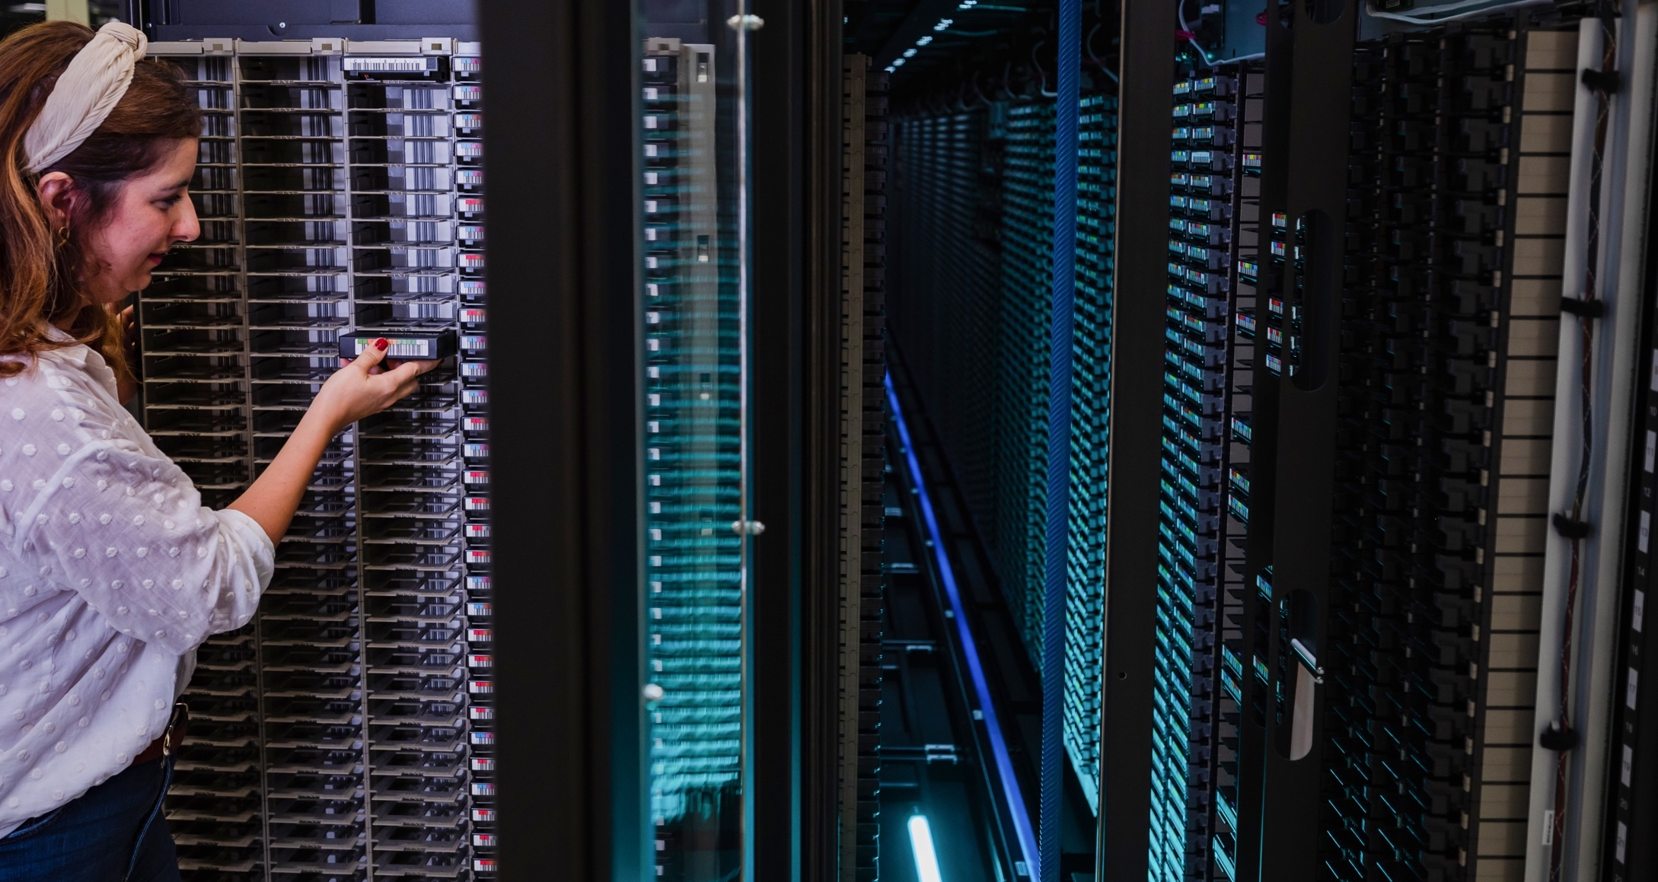
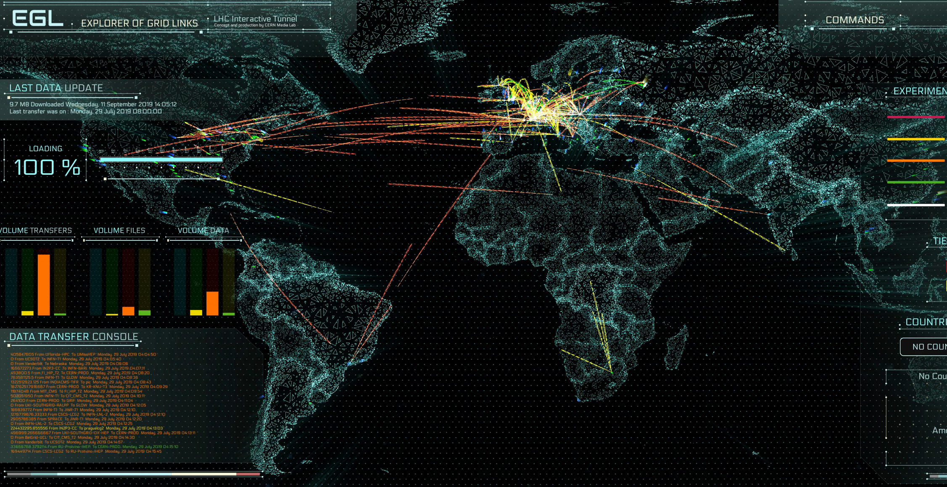
The Worldwide LHC Computing Grid (WLCG)
Used to store, distribute, process and analyse data.
1 million processing cores in about 170 data centres
and 42 countries.
More than 1000 Petabytes of CERN data stored world-wide.

Slide 14
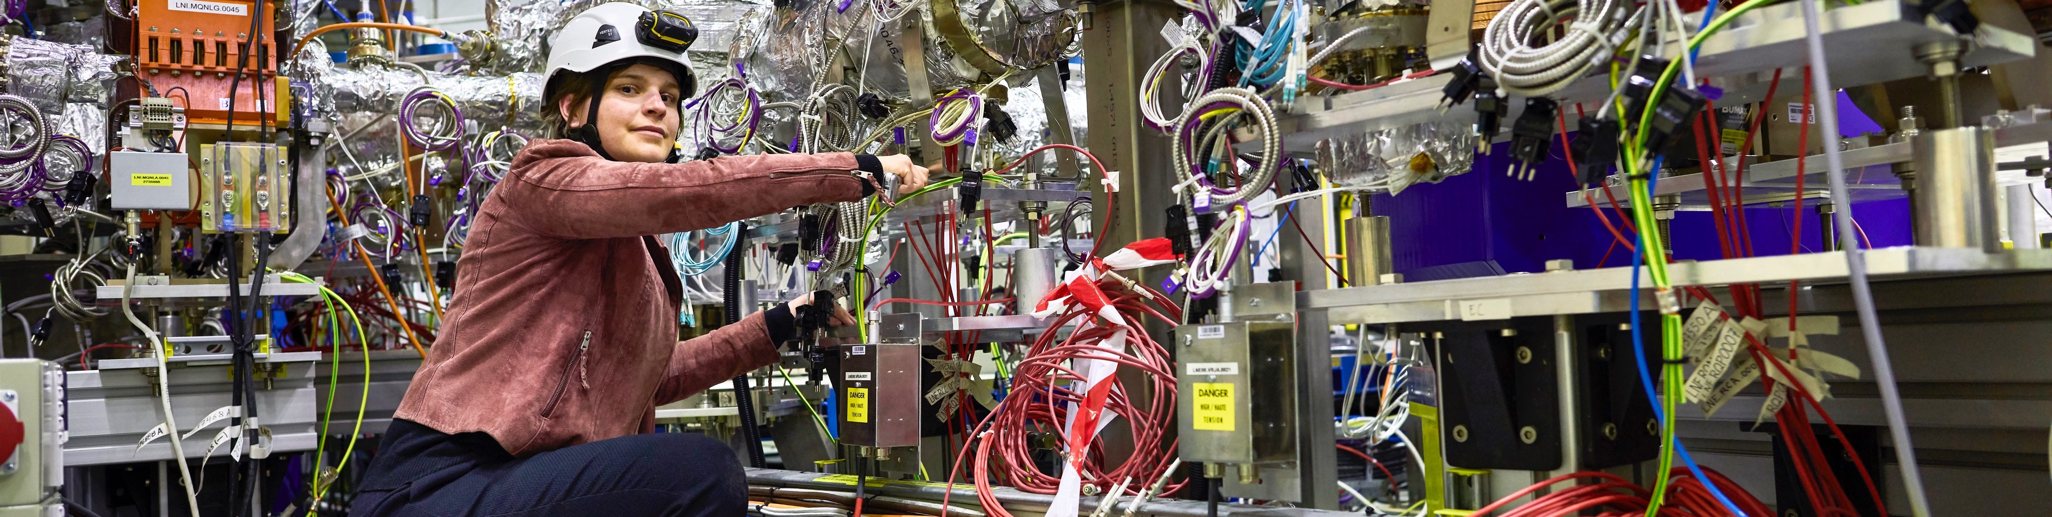
CERN has a diverse scientific programme
Nuclear Physics
(ISOLDE)
Antimatter Research
(Antiproton Decelerator)
Cosmic rays and cloud formation
(CLOUD)
Fixed-target experiments,
which include searches for rare phenomena
Contribution to the Long Baseline
Neutrino Facility in the USA (LBNF)

Slide 15
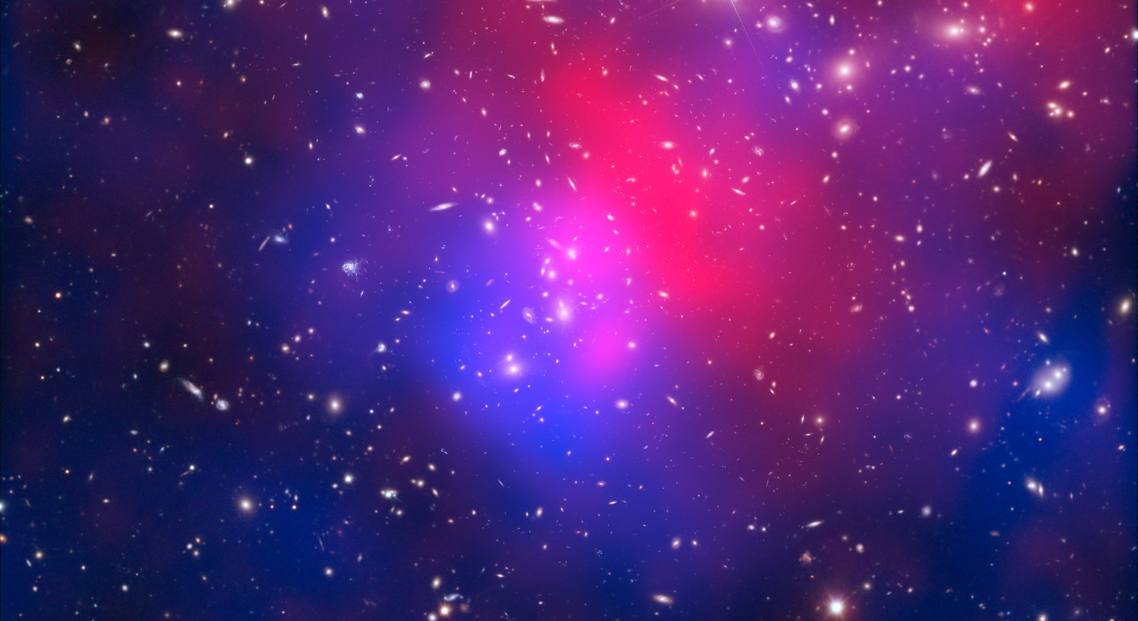
There are many unanswered questions in fundamental physics
Including
What is the unknown 95% of the mass
and energy
of the universe?
Is there only one Higgs boson, and does it behave exactly as expected?
Why is the universe made only of matter, with hardly any antimatter?
Why is gravity so weak compared to the other forces?

Slide 16

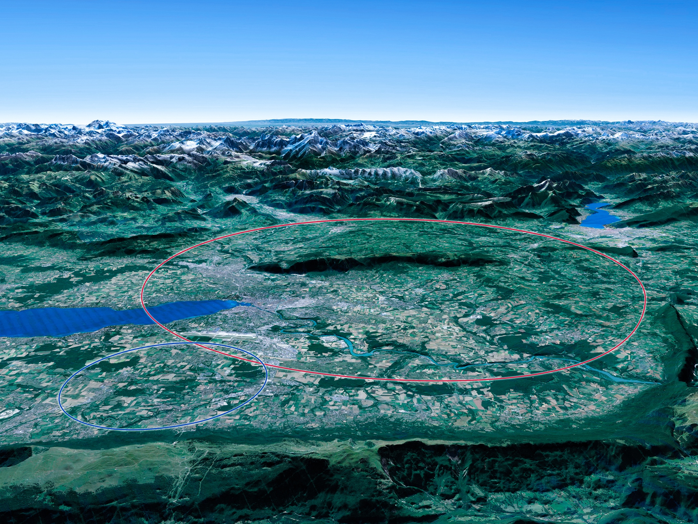

Scientific priorities for the future
Implementation of the recommendations
of the 2020 Update of the European Strategy
for Particle Physics:
• Fully exploit the HL-LHC
• Build a Higgs factory to further understand this unique particle
• Investigate the technical and financial feasibility of a future energy-frontier 100 km collider at CERN
• Ramp up relevant R&D
• Continue supporting other projects around
the world
LHC

Slide 17
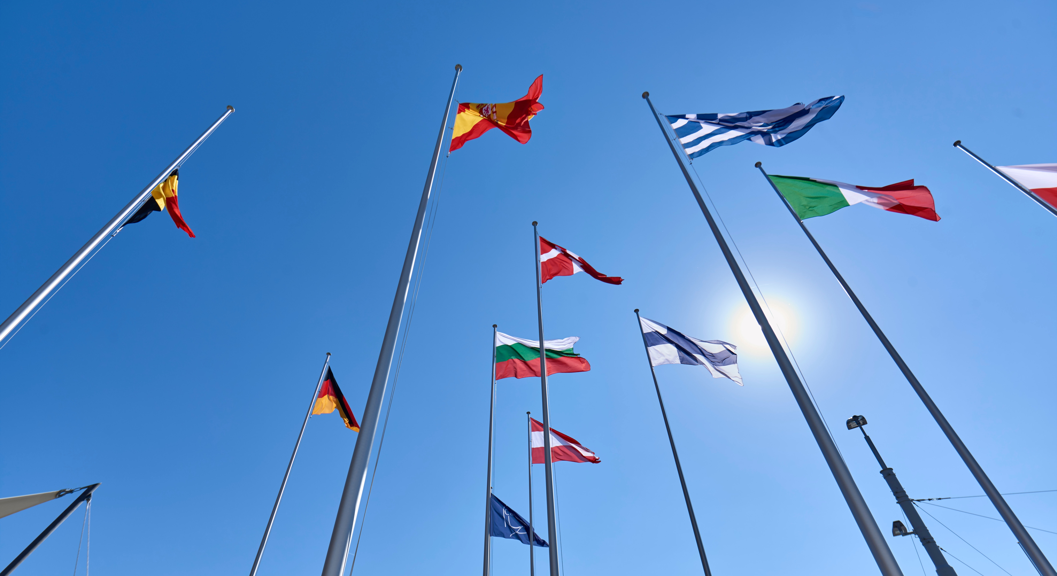
COLLABORATION

Slide 18

A laboratory for people around the world
In 1954 CERN had 12 Member States (23 in 2022)
Geographical & cultural diversity
Users of 110 nationalities
19.4% women
CERN’s annual budget
is ~1200 MCHF (equivalent
to a medium-sized European university)
23 Member States
Austria – Belgium – Bulgaria – Czech Republic
Denmark – Finland – France – Germany – Greece Hungary – Israel – Italy – Netherlands – Norway
Poland – Portugal – Romania – Serbia – Slovakia Spain – Sweden – Switzerland – United Kingdom
As of 31 December 2021
Employees:
2676 staff, 783 fellows
Associates:
11 175 users, 1556 others
Contractor’s employees: ~2000
3 Associate Member States
in the pre-stage to membership
Cyprus – Estonia – Slovenia
7 Associate Member States
Croatia – India – Latvia – Lithuania – Pakistan
Türkiye – Ukraine
6 Observers
Japan – Russia (suspended) – USA
European Union – JINR (suspended) – UNESCO
Around 50 Cooperation Agreements
with non-Member States and Territories
Albania – Algeria – Argentina – Armenia – Australia – Azerbaijan – Bangladesh – Belarus – Bolivia -Bosnia and Herzegovina - Brazil – Canada – Chile – Colombia
Costa Rica – Ecuador – Egypt – Georgia – Honduras - Iceland – Iran – Jordan – Kazakhstan - Lebanon – Malta – Mexico – Mongolia – Montenegro – Morocco
Nepal - New Zealand – North Macedonia – Palestine - People's Republic of China – Peru – Philippines – Qatar – Republic of Korea – Saudi Arabia – Sri Lanka
South Africa – Thailand - Tunisia – United Arab Emirates – Vietnam

Slide 19
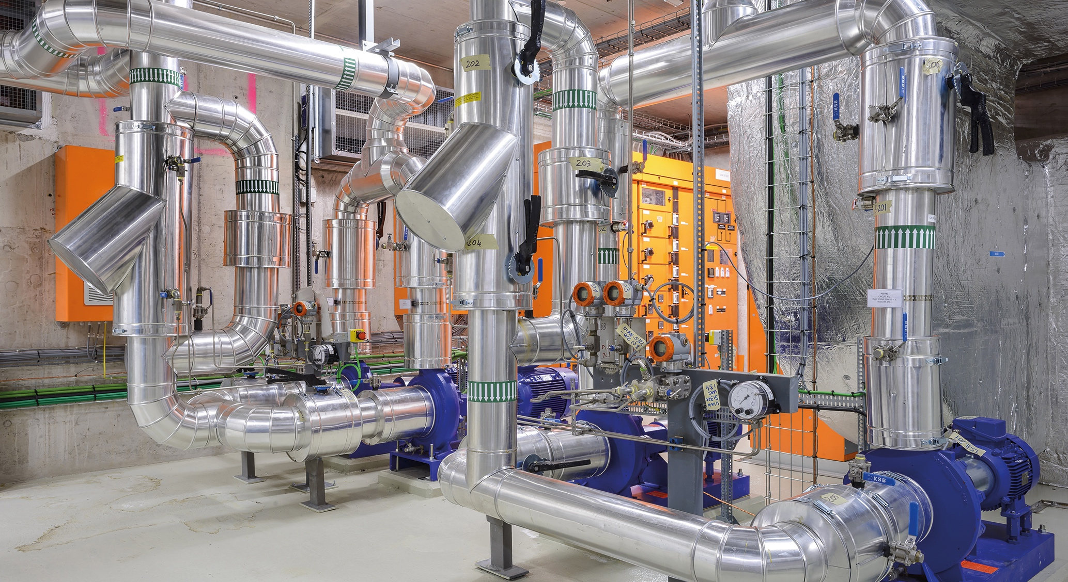
TECHNOLOGY & INNOVATION

Slide 20

CERN’s technological innovations have applications in many fields
CERN is the birthplace of the World Wide Web
And there are many more examples
Medical imaging, cancer therapy, material science, cultural heritage, aerospace, automotive, environment, health & safety, industrial processes.

Slide 21
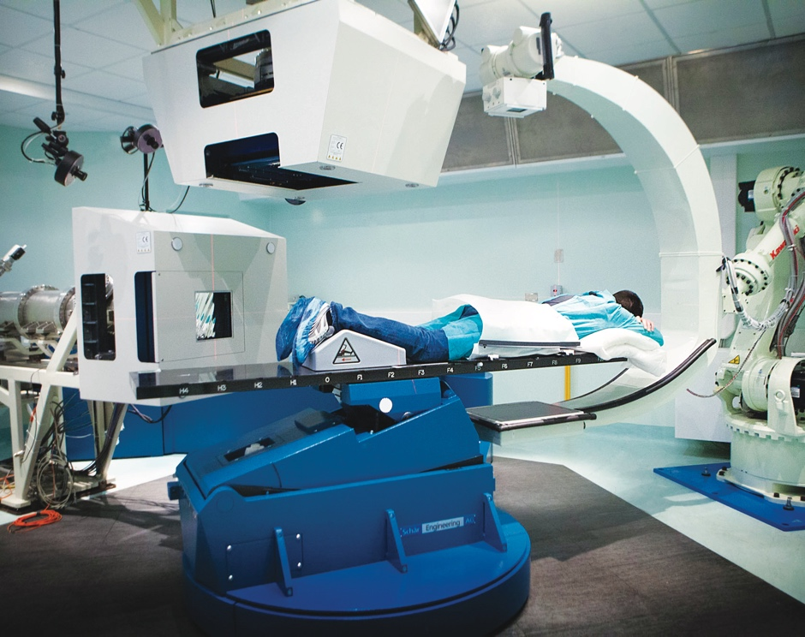
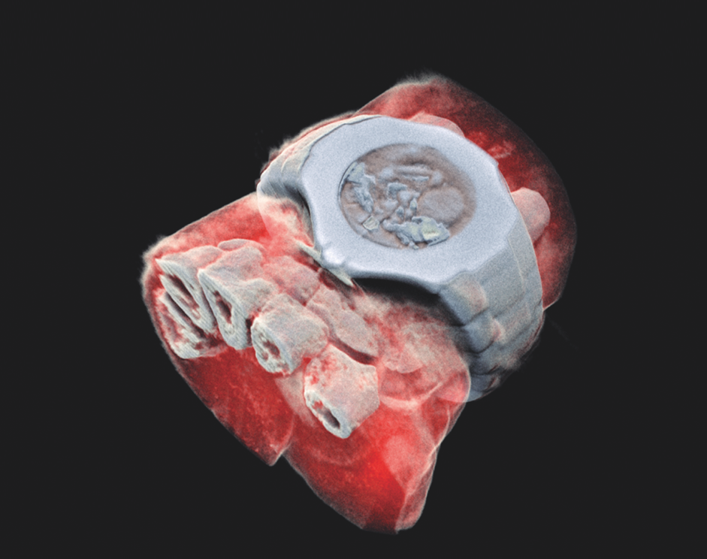
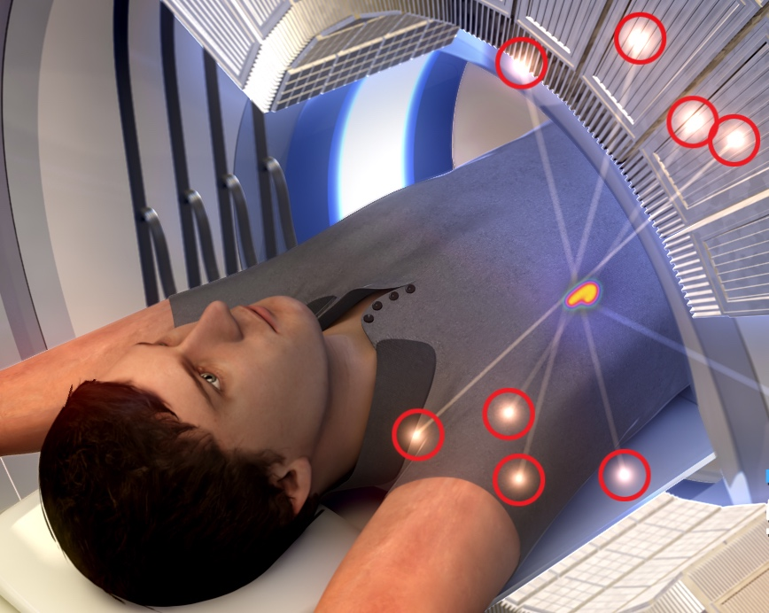
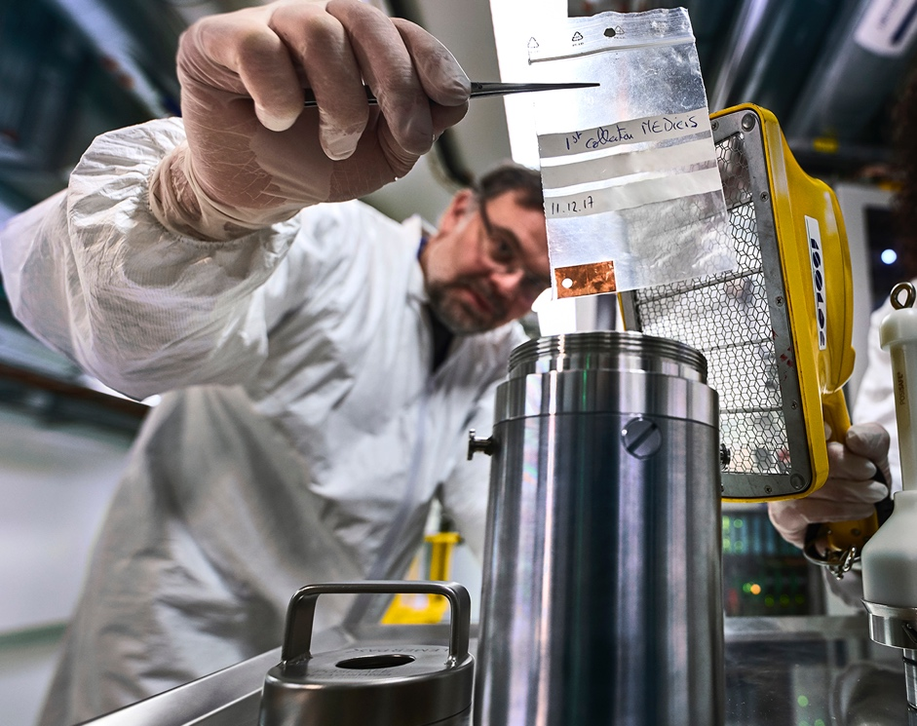
CERN’s technological innovations have important applications in medicine & healthcare
Technologies applied
at CERN are also used in PET, for medical imaging and diagnostics.
CERN produces innovative radioisotopes for nuclear medicine research.
© marsbioimaging
© CNAO
© ENVISION / ENLIGHT
Accelerator technologies are applied in cancer radiotherapy with protons, ions and electrons.
Pixel detector technologies are
used for high resolution
3D colour X-ray imaging.

Slide 22
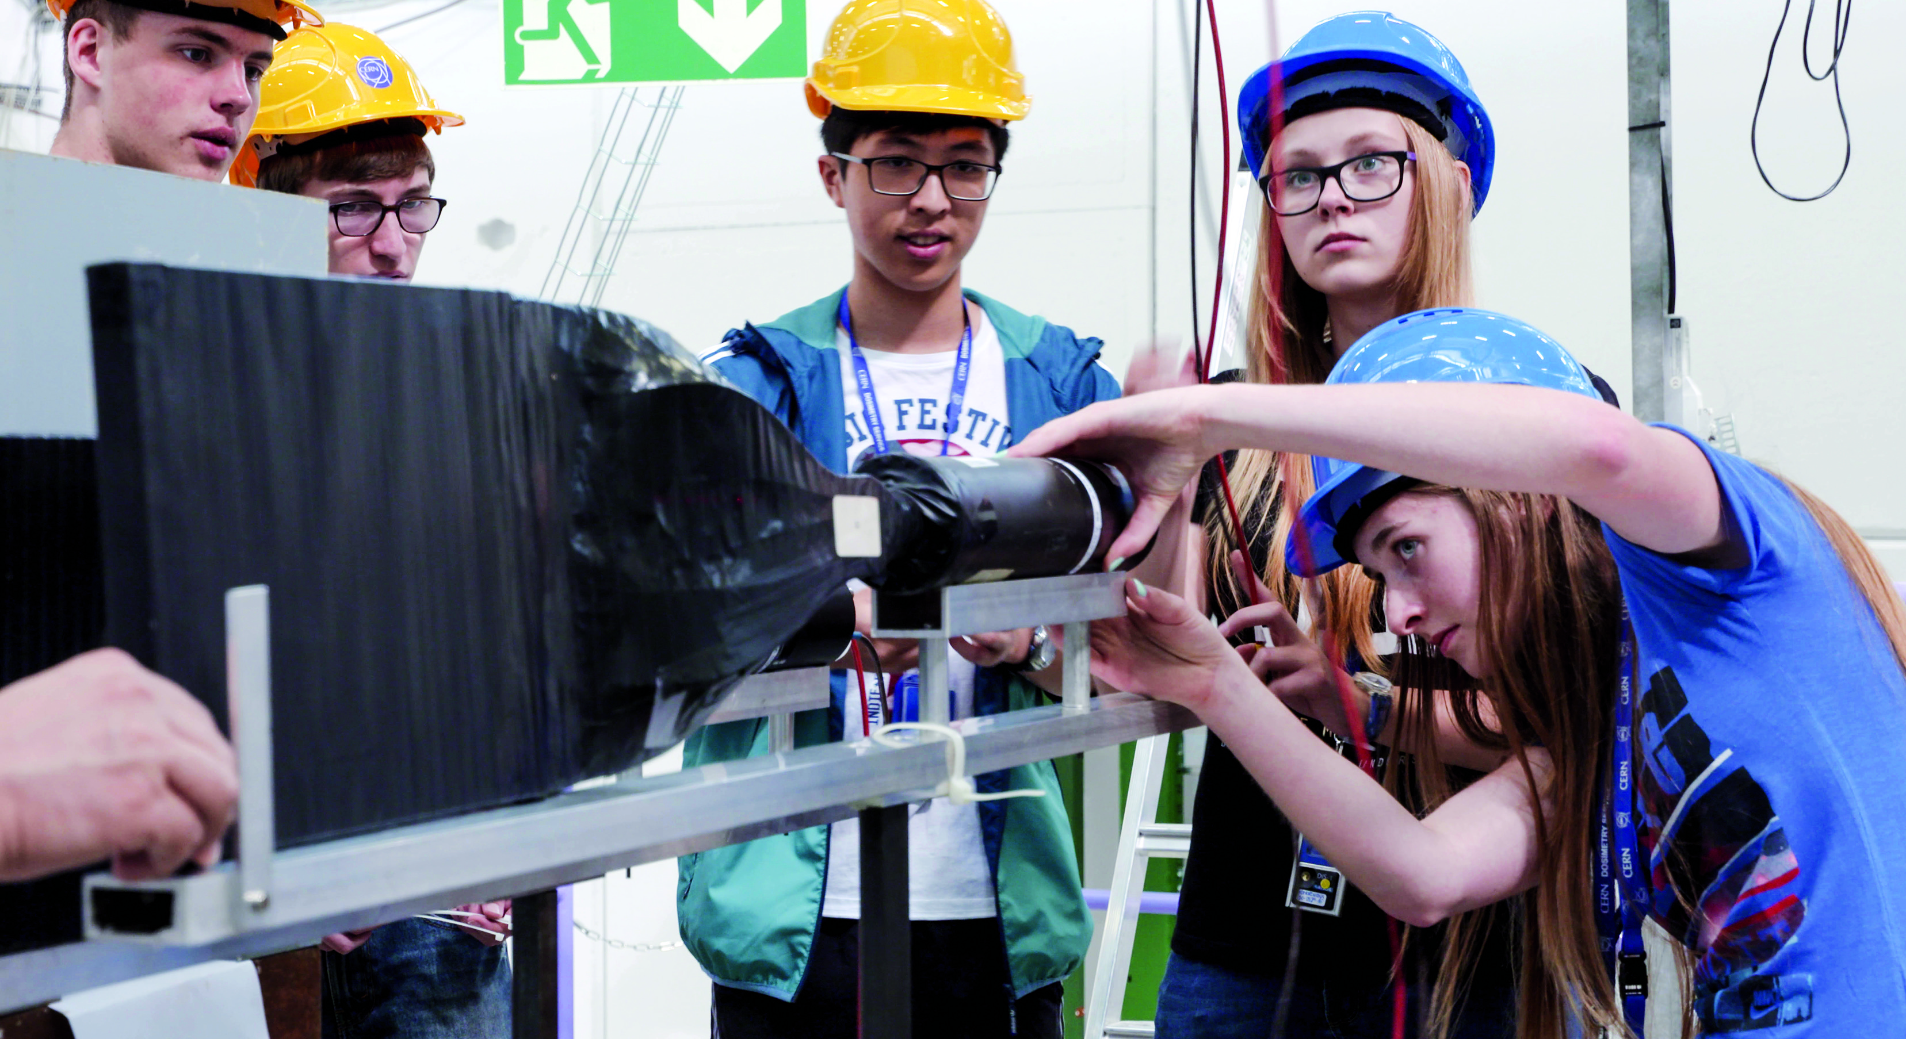
EDUCATION
& TRAINING

Slide 23
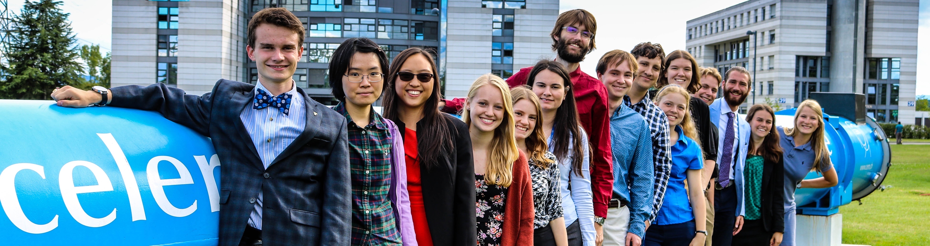
CERN trains the next generation of physicists, engineers and technicians
>3000 PhD students are registered at CERN.
600 PhD theses
are completed each year.
300 undergraduate students in Summer programmes.
~800 fellows in research and applied physics, engineering and computing.
~200 Technical and Doctoral Students in applied physics, engineering and computing.
CERN organises schools for undergraduates and postgraduates, in all regions.

Slide 24
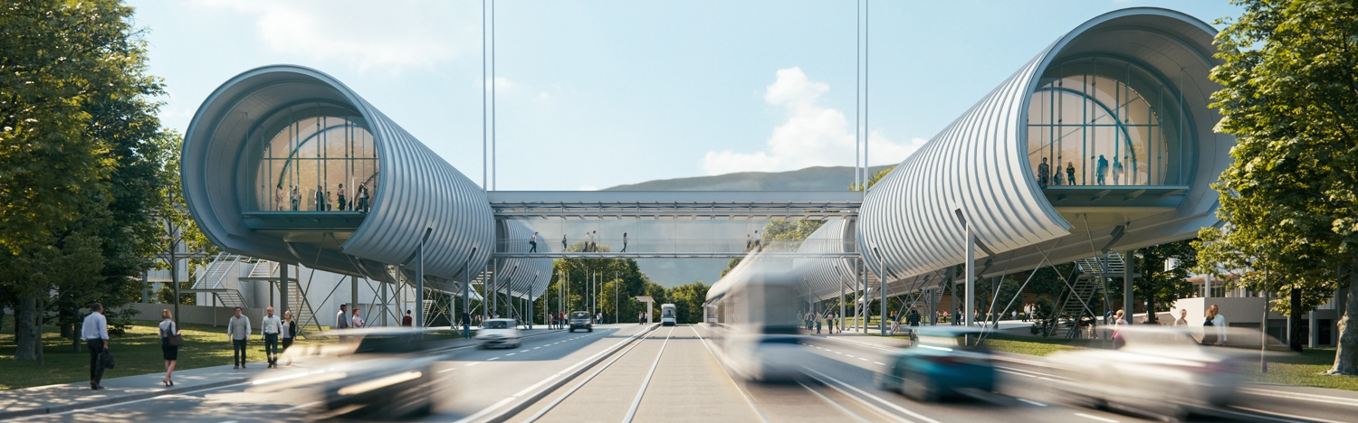
CERN Science Gateway
CERN’s new education and outreach centre for all
publics aged 5-plus.
Opened since October 2023
Immersive exhibitions, education labs, events
and shows.

Slide 25
There are many unanswered questions
in fundamental physics
CERN will continue to play a crucial role
in the journey of exploration

Slide 26
Thank you

