Slide 1

Doing Business with CERN
Thematic Industry Day 28 November 2023
Nordine Azizi
Procurement Officer

Slide 2
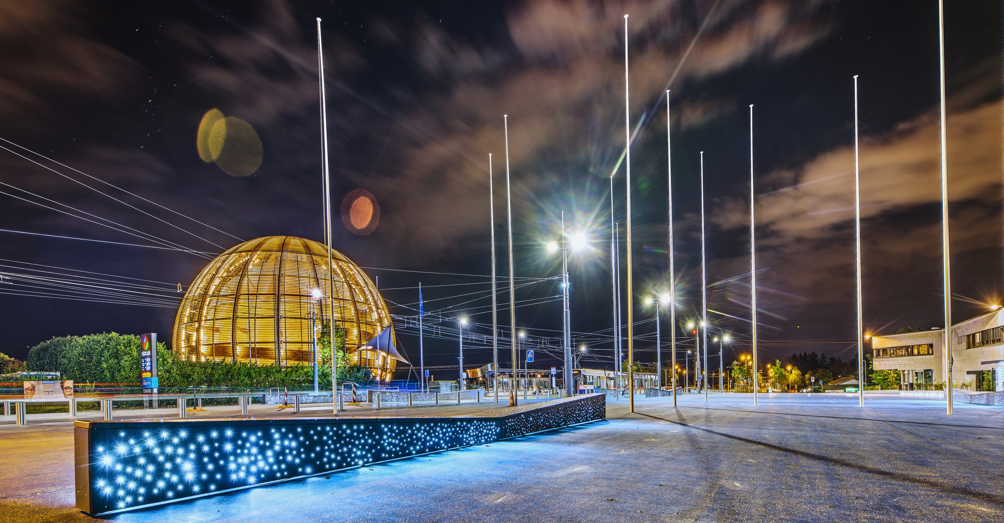
AGENDA
Introduction
    Legal Framework
    Budget
    What we buy
Procurement @ CERN
    Procurement Service
    Procedures
Procurement website

Slide 3

INTRODUCTION

Slide 4
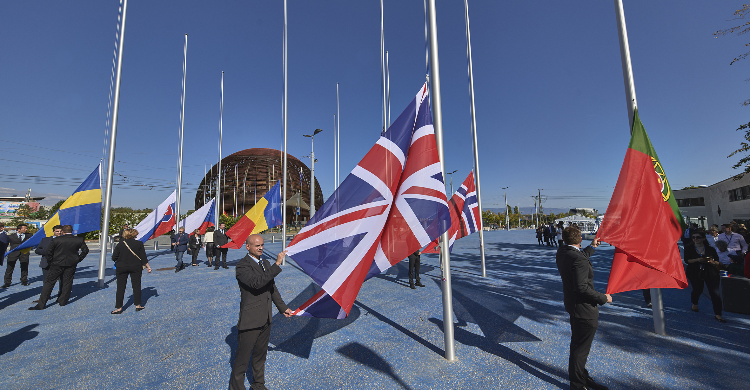
Legal Framework
CERN, an Intergovernmental Organization, was established in July 1953, by the “Convention for the establishment of a European Organization for Nuclear Research”;
As an Intergovernmental Organization, CERN is not a legal entity under national law but governed by public international law;
CERN is therefore entitled to establish its own internal rules necessary for its proper functioning, such as the rules under which it purchases equipment and services.

Slide 5

In 1954 CERN had 12 Member States
Today CERN has 23 Member States
23 Member States
3 Associate Member States in the pre-stage to membership
7 Associate Member States
5 Observers
Geographical & cultural diversity
110 nationalities,
from 77 countries
~ 2 500 Staff members
~ 2 000 Contractors’ employees
~13 000 Physicists /users
Yearly budget ~ 1200 MCHF
5
Notes:
The speaker can highlight CERN’s second mission as stated when it was established: to foster peaceful collaborations between nations that had recently been at war.
This slide will have information on the country of the visiting delegation:
Location on the world map
Date of accession (if Member State or Associate Member State)
For information:
Member States – Austria, Belgium, Bulgaria, Czech Republic, Denmark, Finland, France, Germany, Greece, Hungary, Israel, Italy, Netherlands, Norway, Poland, Portugal, Romania, Slovak Republic, Spain, Sweden, Switzerland, United Kingdom
Associate Member States in the pre-stage to membership – Cyprus, Serbia, Slovenia
Associate Member States – India, Lithuania, Pakistan, Turkey, Ukraine
Observers – USA, Russia, Japan, (EU, JINR, UNESCO)

Slide 6
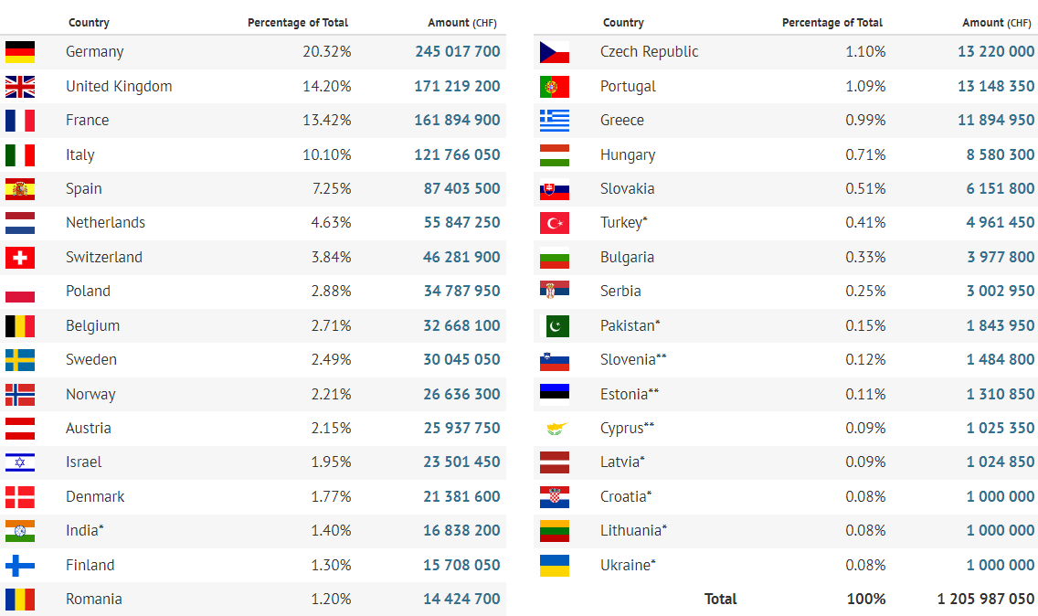
Yearly Budget (contributions 2022)

Slide 7

What we buy
Recurrent supplies & services
Accelerator technologies required for consolidation projects and new developments
Notes:
Before showing you what we buy, it’s important to realise that with 10k people, we are somehow like a small town.
We have 3 restaurants, hotels on site, bank and post offices, we have our own fire brigade, a kindergarden. So we need a large range of recurrent supplies and services to run the org on a daily basis.
On the other hand, we have very specific requirements related to our accelerator complex

Slide 8
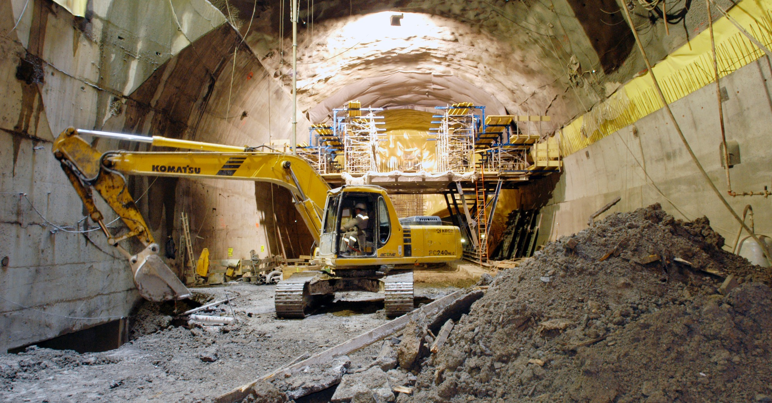
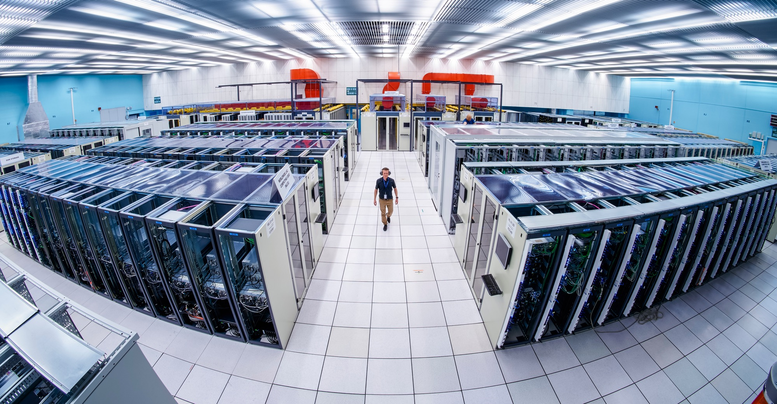
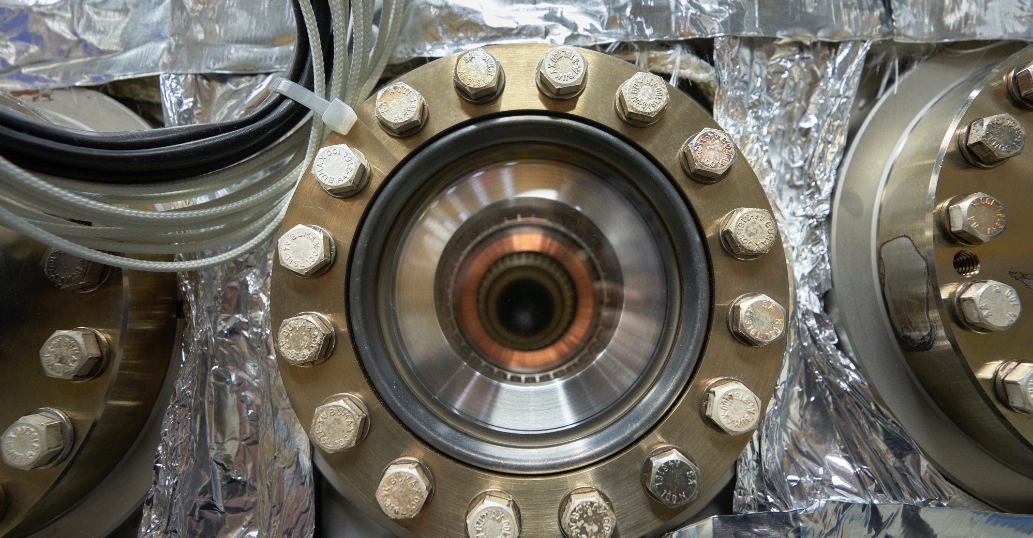
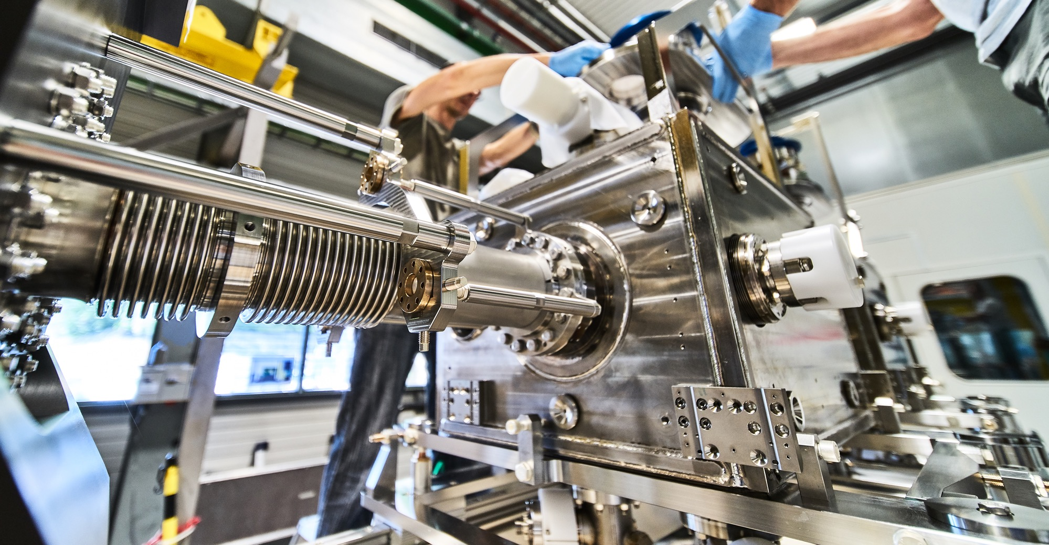
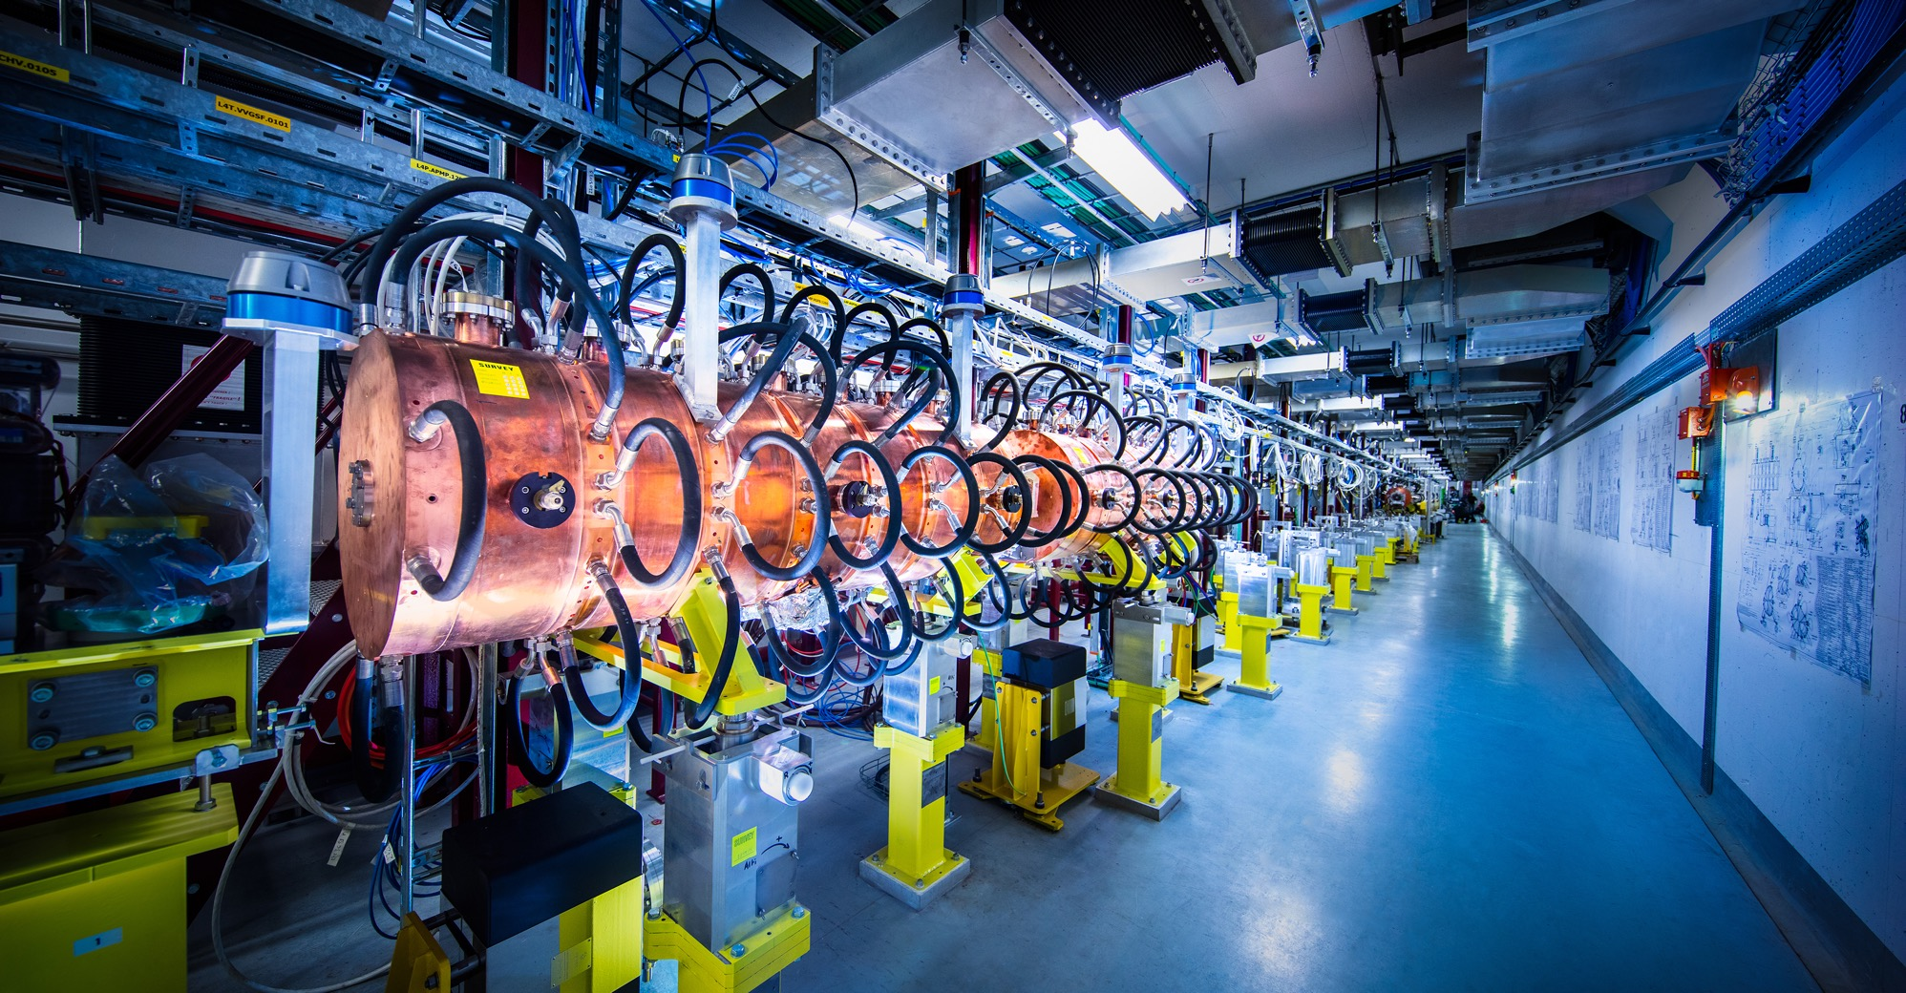
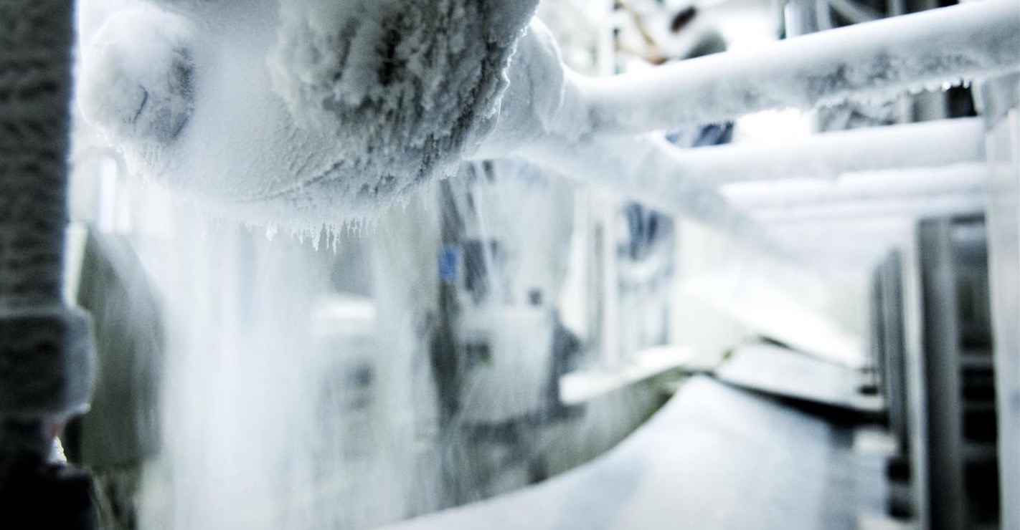
What we buy
Civil engineering
Cooling and ventilation
Electrical engineering and magnets
Information Technology
Mechanical engineering and raw materials
Electronics and radiofrequency
  Cryogenic and vacuum equipment
  Health and safety equipment,
  Transport and handling equipment
  Office supply, furniture
  Industrial services on the CERN site
Notes:
We have more than 700 bldg on site. We aneed to construct new buildings, to renovate the old ones
Cooling and ventilation equipment
Electrical engineering with cables or power supplies for example
We need magnets
IT, we have a big datacentre and are currently building a new one
Mechanical engineering, we have machining requirements, we need different types of raw material
Electronics, with PCBs and assembly of components on these PCBs
As well as Cryogenic, vacuum, handling equipment to move around all these supplies
And of course, for 10k people we need office furniture

Slide 9
Procurement Expenditure

Slide 10


PROCUREMENT @CERN

Slide 11
The Procurement Service
The mission of the Procurement Service is to procure all supplies and services for CERN
Meeting all requirements:
specified and contractual technical, delivery
and performance requirements
At the lowest possible overall cost
While :
Achieving balanced industrial return for CERN Member States
Respecting CERN Procurement Rules

Slide 12
Adjudication basis
Award for supplies (and services, exceptionally) based on:
Lowest compliant bid
Technical
Financial
2
Delivery

Slide 13

3 Types of Enquiries
“Price Enquiry” (DO) :
  Enquiries < 10’000 CHF
  10’000 CHF ≤ Enquiries < 200’000 CHF
“Invitation-to-Tender” (IT) :
  3. Enquiries ≥ 200’000 CHF

Slide 14
Enquiries < 10’000 CHF
“Price Enquiry” (DO)
Price enquiry by Technical Officer or Procurement Officer;
  (Users may issue enquiries directly provided CERN procurement rules are followed)
Minimum of 3 bids requested;
Purchase Order (PO) made to the lowest compliant bidder.

Slide 15
10’000 CHF ≤ Enquiries < 200’000 CHF
“Price Enquiry” (DO)
Price Enquiry prepared / managed by Procurement Officer;
Technical specification prepared by Technical Officer;
Submission deadline: 4 weeks from date of dispatch;
Minimum of 3 bids requested;
All price enquiries above 50’000 CHF are sent to the
Industrial Liaison Officers (ILOs) for information;
PO made to the lowest compliant bidder.

Slide 16

Enquiries ≥ 200’000 CHF
Start-up Meeting + Announcement
Phase 1: MS / “Market Survey”
  “Technical Description” + “Qualification Questionnaire” - Specification Committee;
  Submission deadline: 4 weeks, or more if the MS is still online.
Phase 2 : IT / “Invitation-to-Tender”
  Tender Form, Technical Specification and all Annexes, Specification Committee;
  Submission deadline: 4 weeks – Clarification – Bidders Conference as required;
  Bids shall be submitted via CERN’s e-tendering application.
Phase 3 : Opening & Evaluation of the bids
  Technical verification, recalculation of unit prices, clarification as necessary;
  Alignment rule applicable?

Slide 17
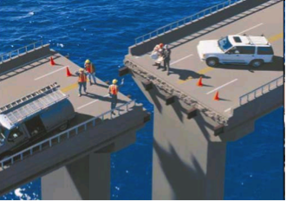
Alignment Rule
Under certain conditions as defined in CERN Procurement Rules,
a bidder offering goods originating* in poorly balanced Member States is allowed to align his price to that of the lowest bidder and thereby be awarded the contract.
RULE
1
Supplies Contract only, adjudicated on the
Lowest Compliant Basis
2
With a total amount exceeding
100’000 CHF.
3
Price difference shall not exceed 20%

Slide 18
Country of Origin
SUPPLIES
“Country(ies) where the supplies (including their components and sub-assemblies) are manufactured or undergo the last major transformation by the contractor or its sub-contractor”
If at least 60% of the total amount of the bid comes from a poorly balanced MS, then the whole bid will be treated as that from a bidder in a poorly balanced MS.
SERVICES
“Country(ies) in which the bidder is established.”
If at least 40% of the total amount of the bid comes from a poorly balanced MS, then the whole bid will be treated as that from a bidder in a poorly balanced MS.

Slide 19


Industrial Return Coefficient
The Industrial Return Coefficient (IRC) of a Member State is defined as the ratio between that Member State's percentage share of the value of all Supply contracts and that Member State's percentage contribution to the CERN Budget over the same period.
Well balanced Member States: IRC ≥ 1
Poorly balanced Member States: 0.40 ≤ IRC < 1
Very Poorly balanced Members States : IRC < 0.40

Slide 20
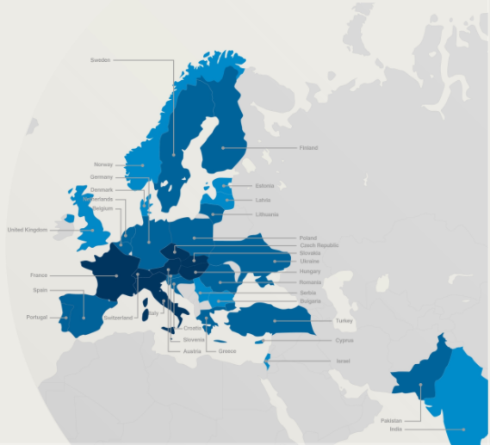
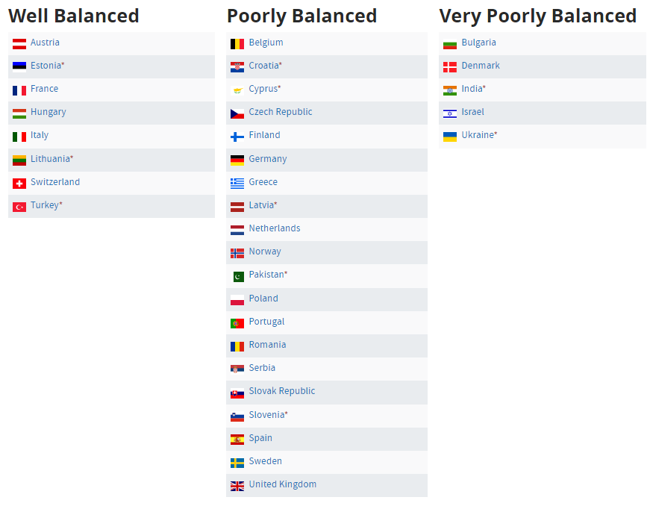

Member State Balancing (Supplies)
(1st March 2023 – 29 February 2024, based on the previous 4 calendar years):
*Associate Member States

Slide 21

Alignment Rule
Scenario 1:
Lowest bid from a PB MS
=> contract placed
Scenario 2:
Lowest bid from a WB MS
  1st bidder (within 20%) from PB MS aligns
=> contract placed
Scenario 2.1:
  if not, 2nd lowest bidder (within 20%) from PB MS aligns
=> contract placed
Scenario 2.2:
  if no alignment, contract placed with lowest bidder from WB MS

Slide 22
Procurement for Experiments
Funding | Deviations from rules
No CERN money | Open to all Collaboration MS¹ No alignment
All CERN money | None
Common Fund (some CERN money) | Open to all Collaboration MS² No alignment
¹ The Collaboration can request that 50% of the contract originates in the country of the institute providing the funds
² Unless only CERN and CERN MS contribute to the Common Fund, in which case origin shall be a CERN MS

Slide 23

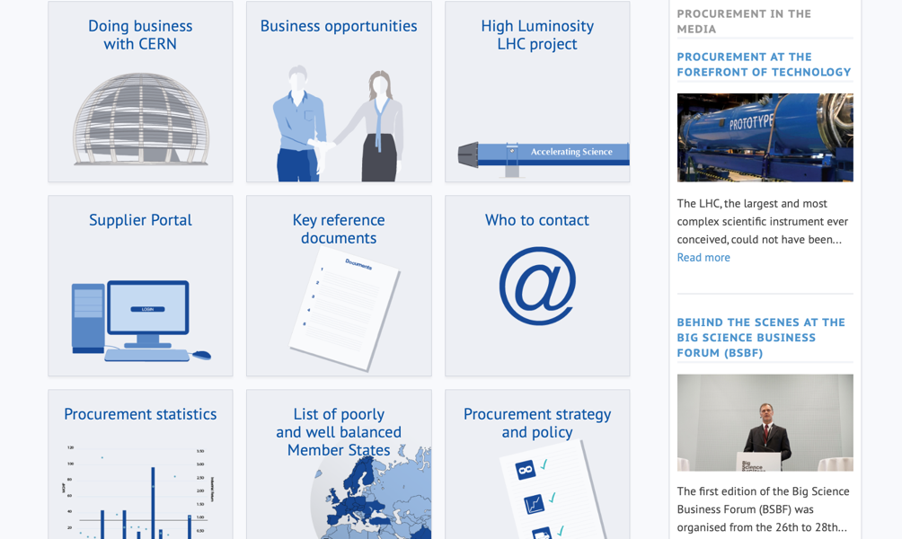
PROCUREMENT WEBSITE

Slide 24
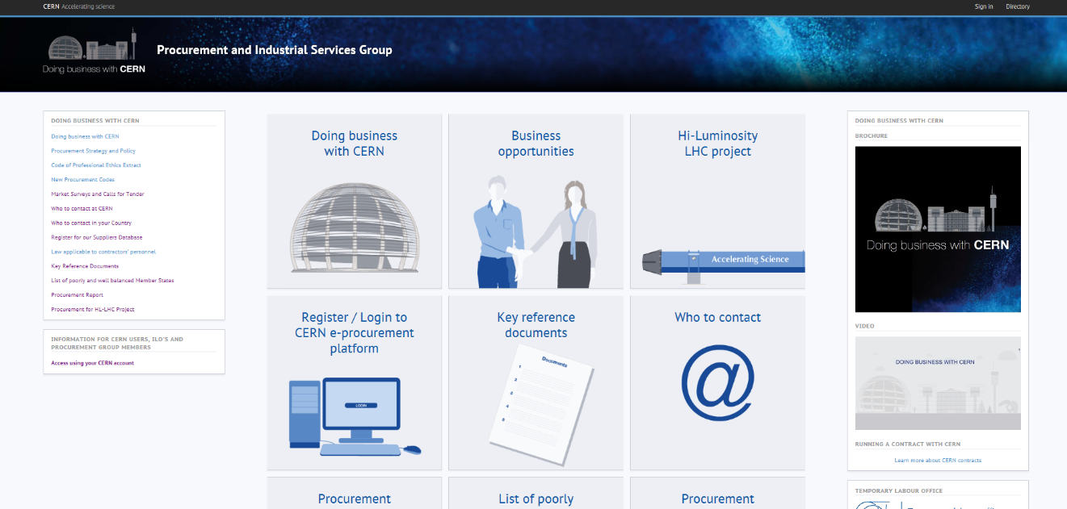
Procurement Website
http://procurement.web.cern.ch

Slide 25
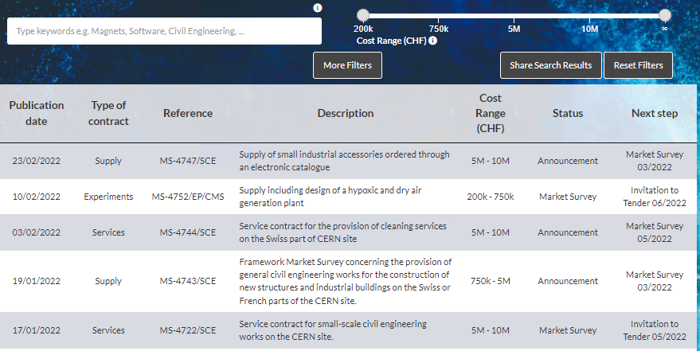
CERN Shopping List
https://forthcoming-ms.app.cern.ch/#!/

Slide 26
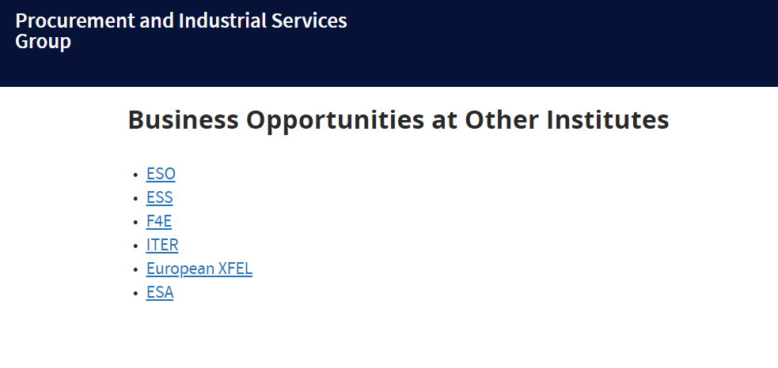
Opportunities at Other Institutes
https://procurement.web.cern.ch/home/business-opportunities-other-institutes

Slide 27
Procurement Website
http://procurement.web.cern.ch

Slide 28
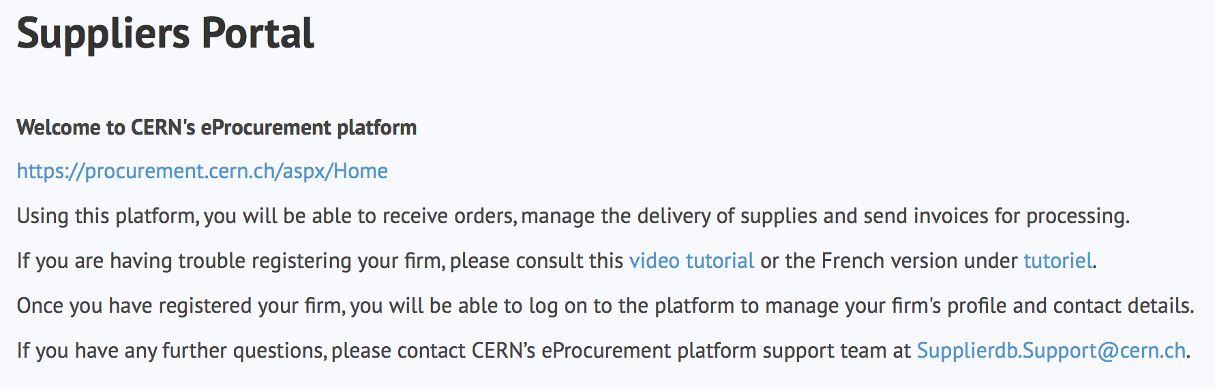
Suppliers must register in the Suppliers Portal
for all exchanges with CERN, in particular to:
Be visible for future opportunities
(with the procurement codes you have indicated),
Receive and follow-up orders,
Send invoices.
MANDATORY
Supplierdb.Support@cern.ch.

Slide 29
Procurement Website
http://procurement.web.cern.ch

Slide 30
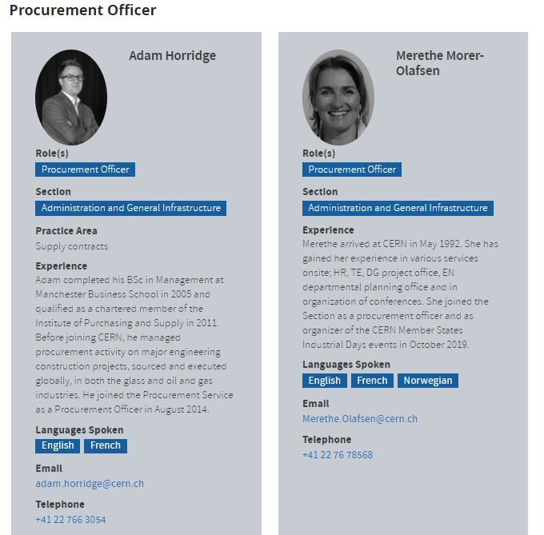
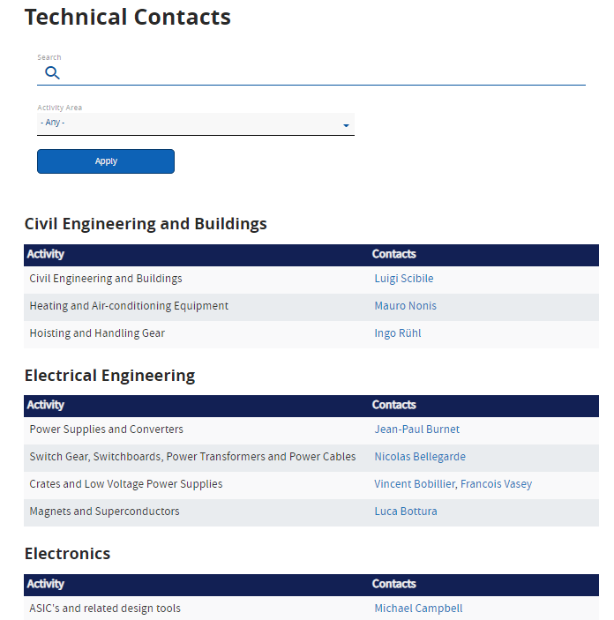
Contact at CERN
Procurement Officers:
Technical Contacts

Slide 31
Contacts in your country
ILO: Industrial Liaison Officer
Who to contact in your Country
    Industrial Liaison Officers (ILO's) are appointed by CERN's Member States to facilitate the flow of communication between CERN and its suppliers. ILO's can provide advice on the opportunities available for doing business with CERN and the support available to firms in their local regions.
ILOs are essential in order to:
Increase competition in bidding
Balance Industrial Return
Raise awareness
Transmit information to potential suppliers
Advise CERN about potential suppliers
Support contractors & suppliers on any general technical, organisational and procedural aspects of CERN;
Promote registration in suppliers DB
Encourage long-term participation of industry in CERN’s mission

Slide 32
Thank you

Slide 33
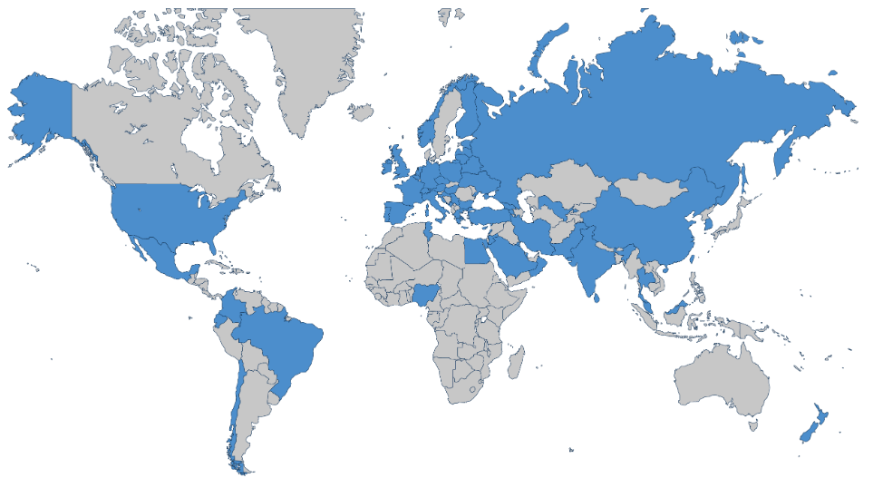
CMS Member States
3394 Physicist
  2166 PhD Physicist
  1228 Physical Doctoral Students
1102 Engineers
282 Technicians
247 Institutes
57 Countries and Regions

Slide 34
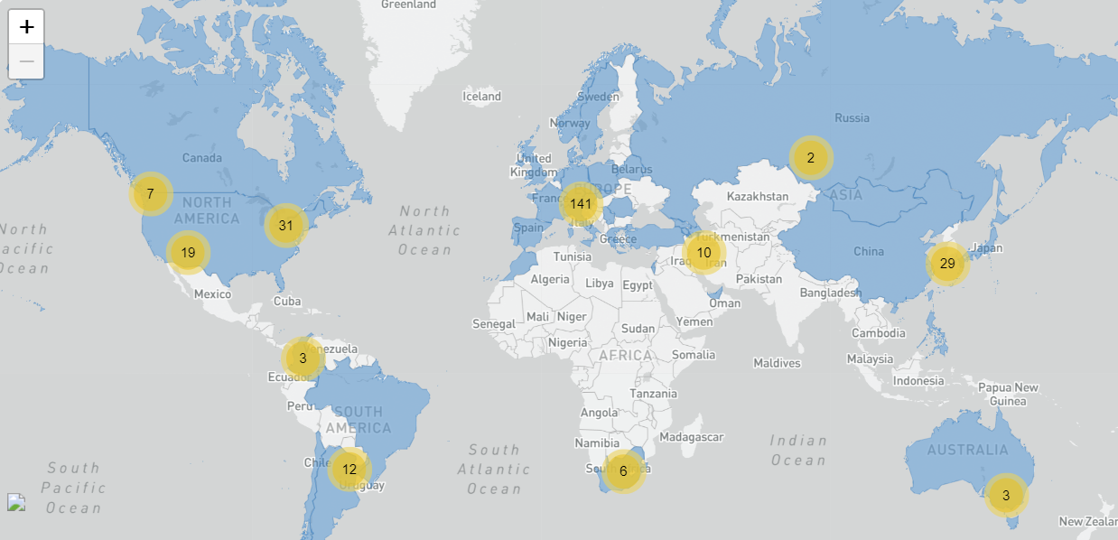
ATLAS Member States
3000 Scientific Authors
1200 Doctoral Students
182 Institutions
42 Countries

Slide 35
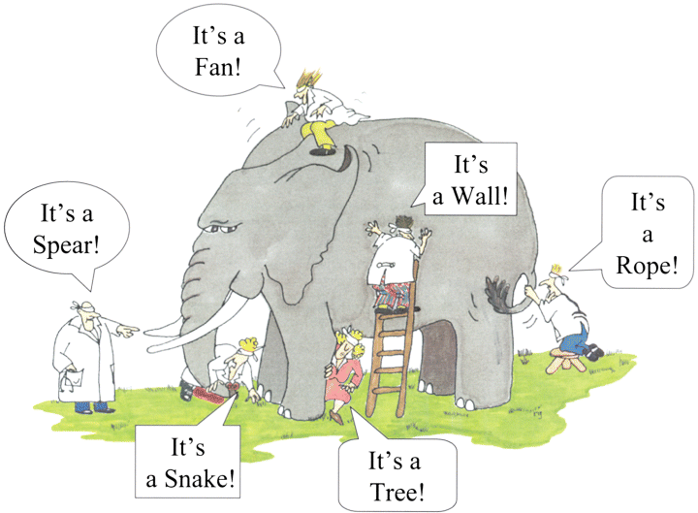

How do we buy?
  Off-the shelf or non-standard products which can be produced with existing manufacturing techniques or technologies:
  Functional specification
  Non-standard products where industry has neither the required know-how nor the interest to develop and design the products:
  Build-to-Print specification
Prototypes and or Pre-series might be required.
35

