Slide 1
Thematic Industry Day-PCB and Electronics Cards Assembly Manufacturing
Beams (BE) Department
Controls Electronics and Mechatronics (CEM) group
Electronics Production & Radiation Tolerant (EPR)
R. Berberat, S. Danzeca

Slide 2
Introduction to the BE-CEM-EPR Electronics Service
BE-CEM-EPR section offer an Electronics Service providing CERN-wide support in the domain of Printed Circuit Boards (PCB) and Electronic Module Assembly
The main activities of the service are:
CERN Altium & Cadence Libraries: creation and maintenance
Layout design for electronics boards and crates
Manufacturing of bare PCB internally at CERN or by subcontracting
Mechanical parts production in collaboration with Mechanical and Materials Engineering (MME) Group
Assembly and integration of electronic modules, internally or by subcontracting
Electronics components procurement for CERN users
&
Radiation tests campaigns for electronics components for the qualification of components candidate for the electronics installed in the CERN accelerators’ radiation environment, representing approx. 400 kCHF per year.
  These test campaigns are done internally at CERN High energy AcceleRator Mixed field/facility (CHARM) and at CERN Cobalt-60 (CC60) facility. Both CHARM and CC60 are under EPR section responsibility
  But also externally at Paul Scherrer Institute in Villigen, Switzerland

Slide 3
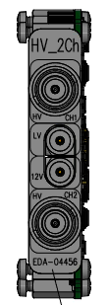
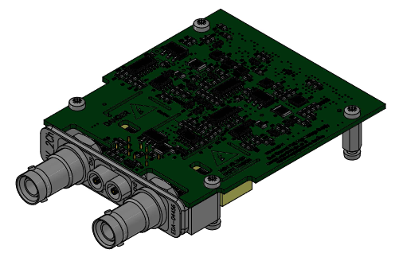
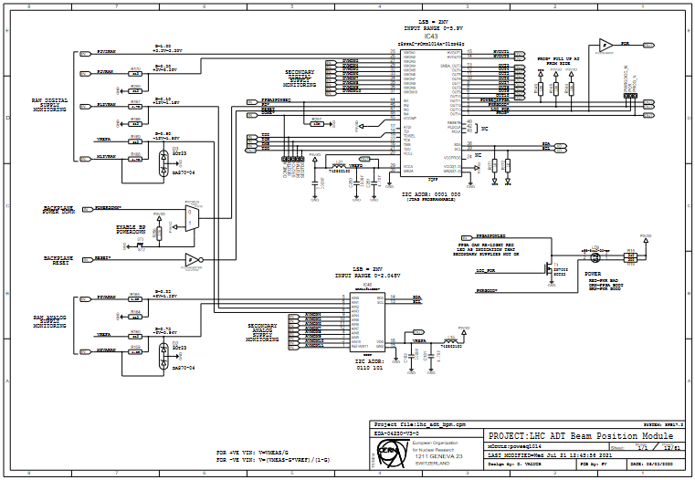
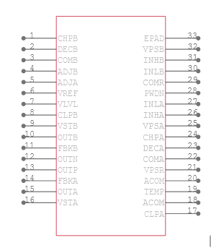
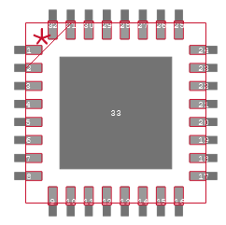
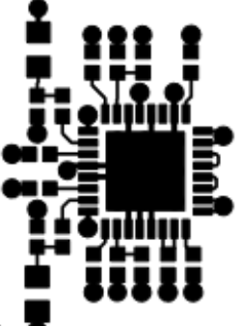
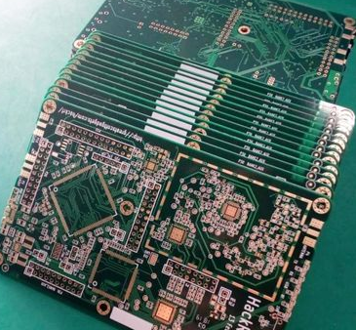
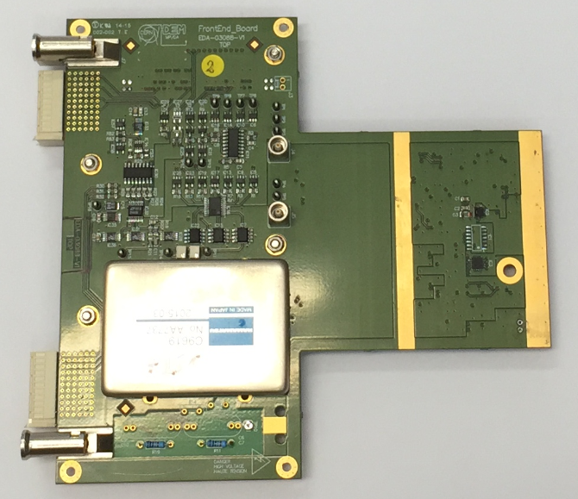
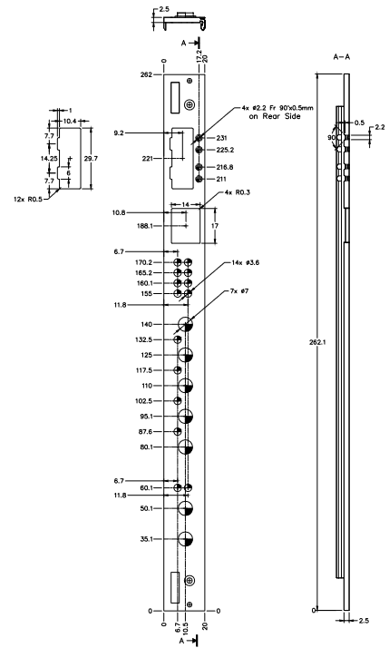

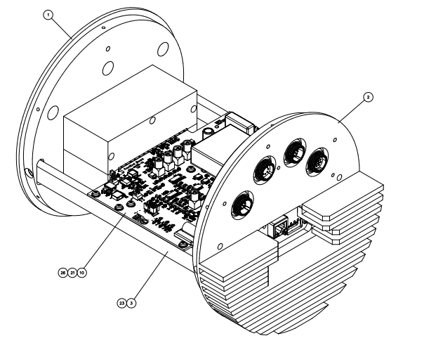
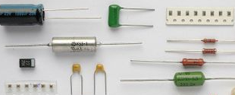
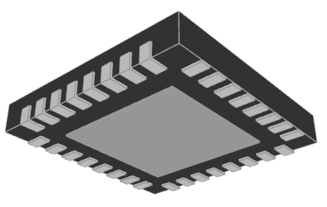
Introduction to the BE-CEM-EPR Electronics Service
Engineers develop
We deliver
We take care of all processes involved prior and during electronic production
BE-CEM-EPR Electronics Service
Schematic Libraries
PCB Libraries
Layout and integration
PCB and components procurement
PCB assembly
Mechanical production in collaboration with EN-MME
3D Model

Slide 4
Introduction to the BE-CEM-EPR Electronics Service
A team of 18 members coming from the industry and composed of 7 CERN employees and 11 members of external contractors
2 Engineers specialized in production processes, dedicated to design reviews
for the jobs done in our Design Office, subcontractor validation and planning follow-up
2 Engineers & Technicians specialized in PCB assembly and special repair
1 ADMIN student, working on bare PCB subcontracting activities and cost invoicing
2 Early-Career Professionals (ORIGIN) program members, real work opportunity in a technical or administrative field
&
6 contractor technicians for the design of standard and special PCB layouts
2 contractor technicians specialized in CAD libraries (free of charge for all CERN users)
3 contractor technical assistants for ordering components and assembly, which is a real advantage for users of the service when producing more than 10 units (free of charge)

Slide 5

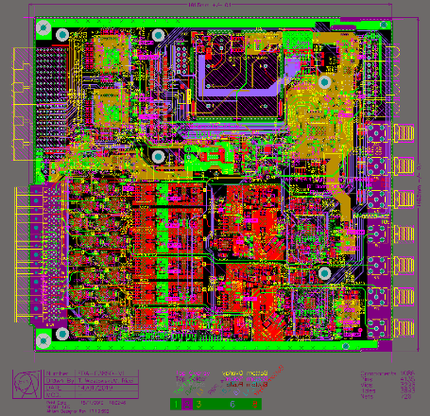
BE-CEM-EPR Electronics Service
Schematic Libraries
PCB Libraries
Layout and integration
PCB procurement and
some components
PCB assembly
Mechanical production in collaboration with EN-MME
3D Model
Layout design for electronics boards and crates

Slide 6
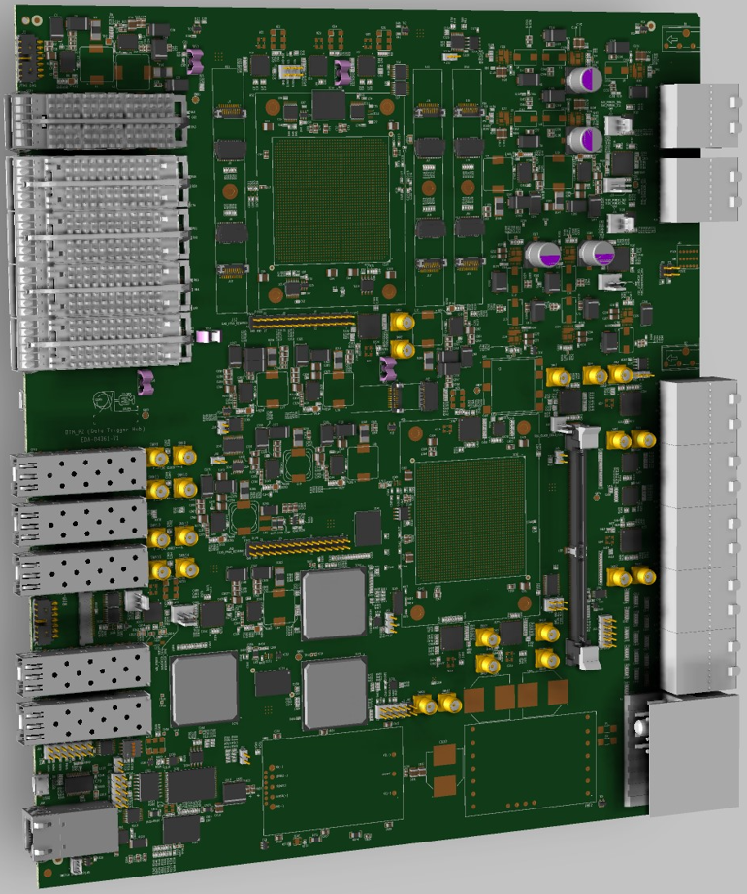
Layout design for electronics boards and crates
Example: Complex layout design managed by the design office for EP-CMD (CMS - DAQ & Trigger)
Some specifics of this design:
280mm x 322mm
22 layers
0.075mm minimum trackwidth
12’811 holes and via holes
controlled impedance lines, filled & capped via holes
You may find more information about this board here: https://cms-daq-dth-p2.web.cern.ch/
DTH_P2 (Data Trigger Hub)

Slide 7
BE-CEM-EPR Electronics Service
Schematic Libraries
PCB Libraries
Layout and integration
PCB procurement and
some components
PCB assembly
Mechanical production in collaboration with EN-MME
3D Model
Some numbers regarding BE-CEM-EPR Electronics Service

Slide 8
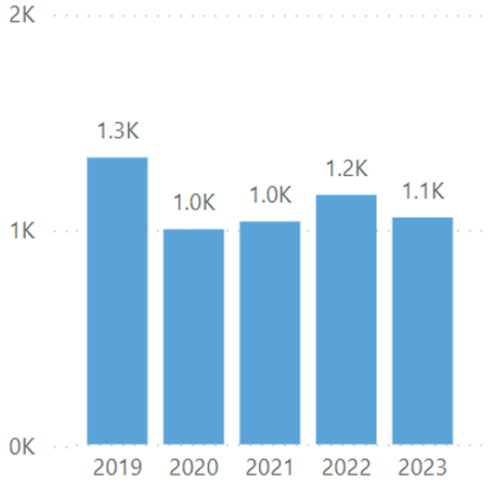
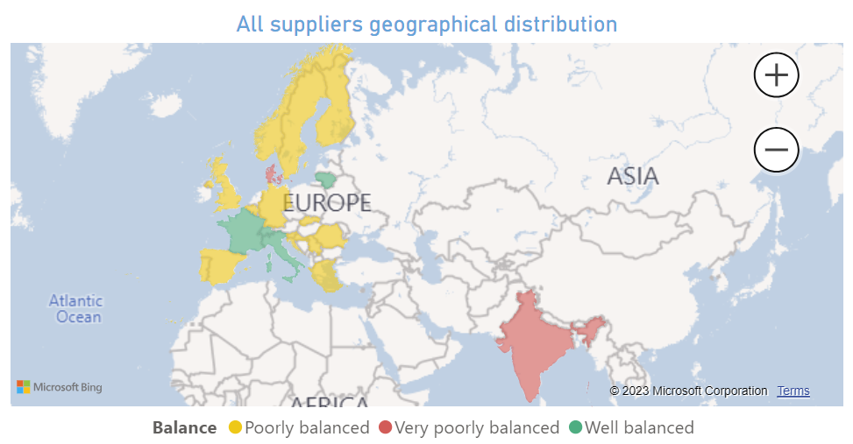
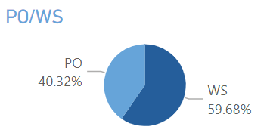
Introduction to the BE-CEM-EPR Electronics Service
Working with 21 Member States - Associate Member States and Associate Member States in the pre-stage to Membership
Supplier geographical distribution
Number of JOB created per year
Subcontracted [PO] vs Internal projects [WS]

Slide 9
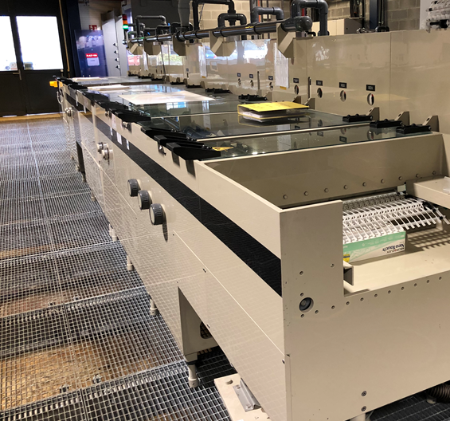
BE-CEM-EPR Electronics Service
Schematic Libraries
PCB Libraries
Layout and integration
PCB procurement and
some components
PCB assembly
Mechanical production in collaboration with EN-MME
3D Model
Manufacturing of bare PCB by subcontracting or at CERN with EP-DT-EF

Slide 10
Printed Circuit Boards (PCB) specifics
One of the most expensive single parts of an assembly
A defective PCB may result in the complete loss of components
Defects in PCB may be hidden and introduce reliability problems during operation and/or for safety of critical equipment
The PCB must withstand the assembly process (RoHS, High Tg) and CERN safety rules (halogen-free base material)
As compared to “off the shelf “ components, each PCB is a new product made in limited quantity and each production may be impacted by technical issues during the complex manufacturing processes
  Selection of PCB supplier is critical

Slide 11
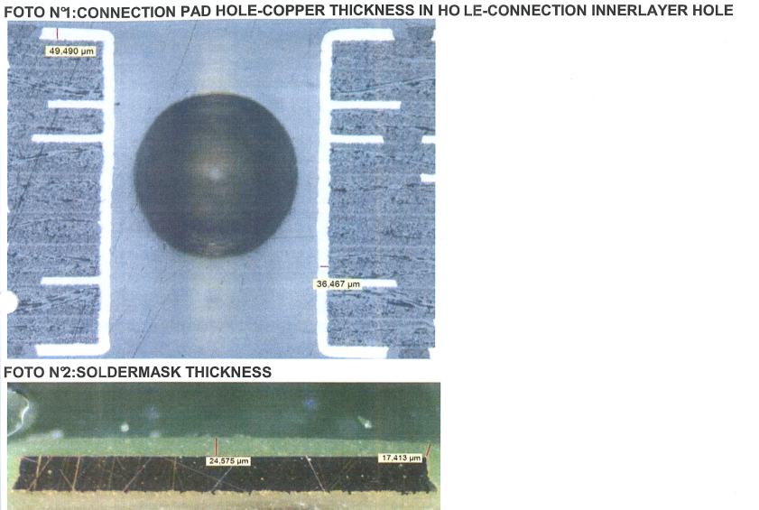
PCB Supplier Requirements
ISO 9001:2015 certified company in a CERN member state
Halogen-free base materials (CERN Standard IS41)
All process steps shall be done in-house, no subcontracting allowed
Manufacturing according to relevant IPC standards
Acceptance of PCB shall be compliant with IPC-A-600 class 3
Controlled impedances shall be measured by the PCB manufacturer
Blind and buried via holes according to IPC-DR-572
Cold room for material storage and laboratory for measuring process chemistries on a daily basis
Test coupons and micro-section report is an important part of the deliverables for each order with >2 copper layers

Slide 12
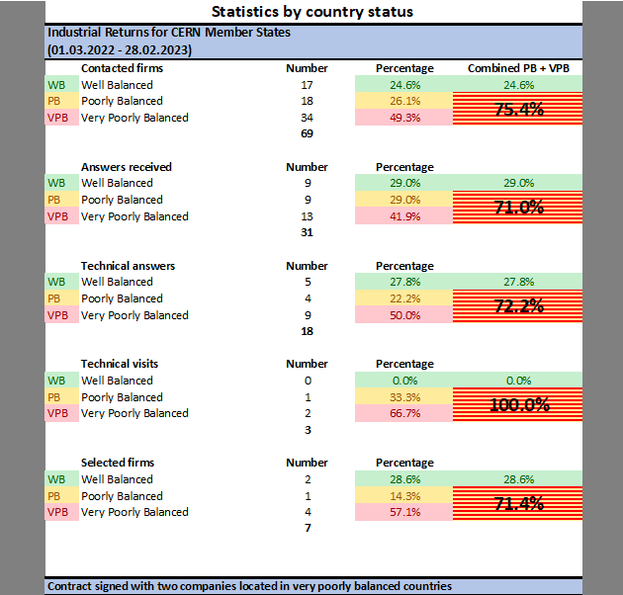
PCB procurement strategy
Creation of Open Contracts with validated firms in CERN Member states
Market Survey (MS) sent (in July 2022) to 69 firms in 23 Member States
  31 answers received
  13 companies declined and 18 sent technical answers
  7 selected based on their replies to the Technical Questionnaire
  3 technical audits done on companies' production plants
  7 short listed after technical audits
Invitation to Tender (IT) sent to the 7 firms
  Based on a list of samples of representative PCB designs produced in the past years
  A pricing model was part of the deliverable (to guarantee that the costs of the future orders will comply with those announced for the Invitation to Tender)
2 contracts established in July 2023 and for 3 years with two companies

Slide 13
PCB procurement strategy
Advantage of the contract:
Orders <5kCHF are managed as small orders by purchasing office (instead of <1kCHF)
With the pricing model, no bad surprises, the costs remain under control
We have the guarantee for 3 years of the lowest prices for the quality and lead-time required
The companies validated during the IT phase represent an alternative to keep the pressure on Price, Quality and Lead-times
&

Slide 14
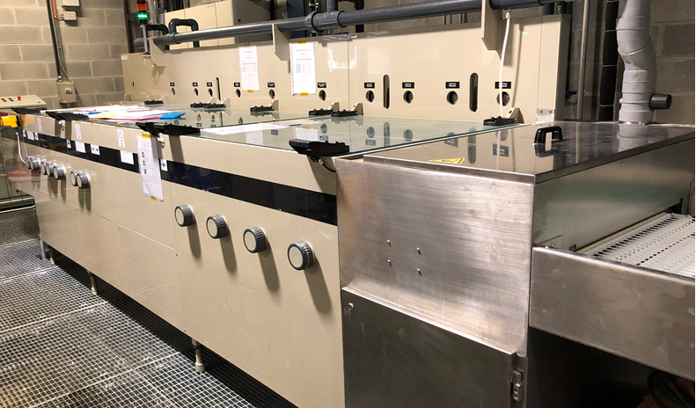
PCB procurement strategy
In parallel with the external contracts, some productions are given to CERN PCB manufacturing plant with the Detector Technologies (DT) group in the Experimental Physics (EP) department
Low volume or prototypes
Fast Track production
Specific designs, too risky to subcontract
Process validation and trials
Chemical processes must be maintained operational by EP-DT and in perfect conditions for manufacturing of physics detectors. Our PCB production requests help to maintain the minimum workload and the machines/chemicals “operational”

Slide 15
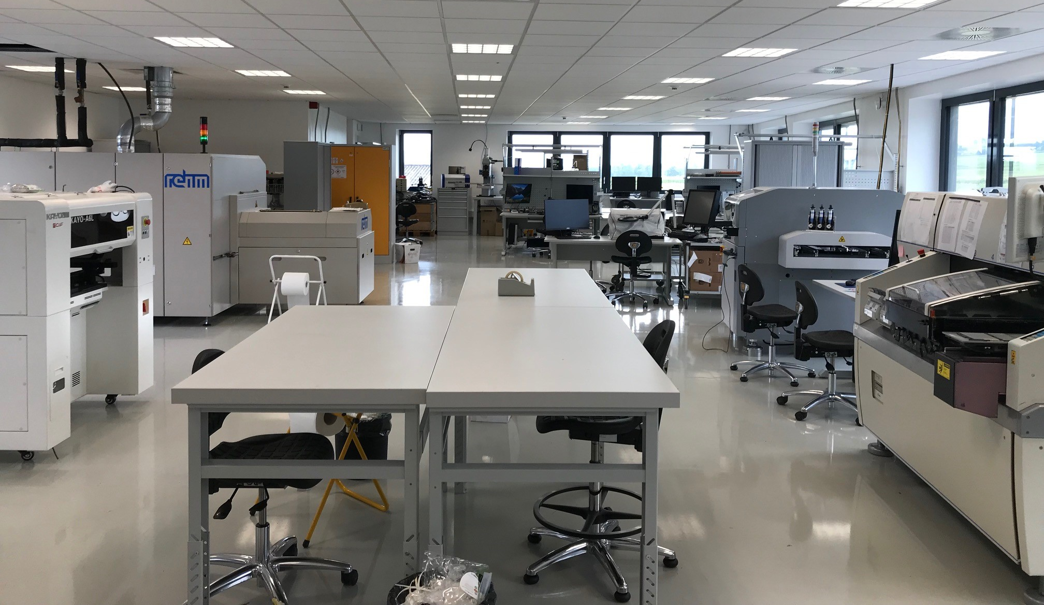
BE-CEM-EPR Electronics Service
Schematic Libraries
PCB Libraries
Layout and integration
PCB procurement and
some components
PCB assembly
Mechanical production in collaboration with EN-MME
3D Model
Assembly and integration of electronic modules, by subcontracting or internally

Slide 16
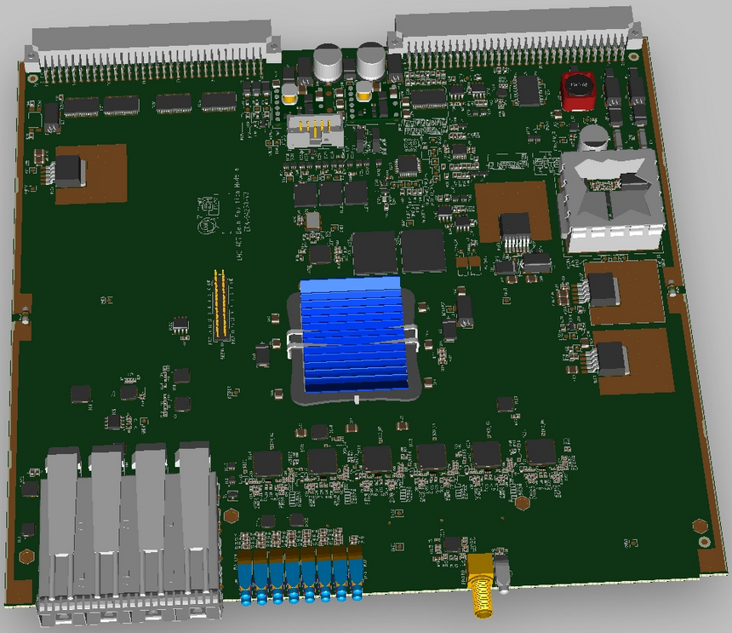
Electronic assembly procurement strategy
  3 categories of assemblies
    Simple: through hole components, low density
    Intermediate: Through hole and simple SMD components
    Complex: BGA, QFN, LGA packages
  Each category has its assembly requirements, leading to
  different processes and equipment
  A firm equipped for the assembly of complex boards
  will not be competitive for simple ones
  Urgent projects often require proximity to the firm
  Too varied to establish a standard pricing model and create an Open Contract. An Open Contract requires a pricing model to guarantee the best cost at any time and for any project. For assembly, a price model is not easy to establish or will be too expensive
LHC ADT Beam Position Module

Slide 17
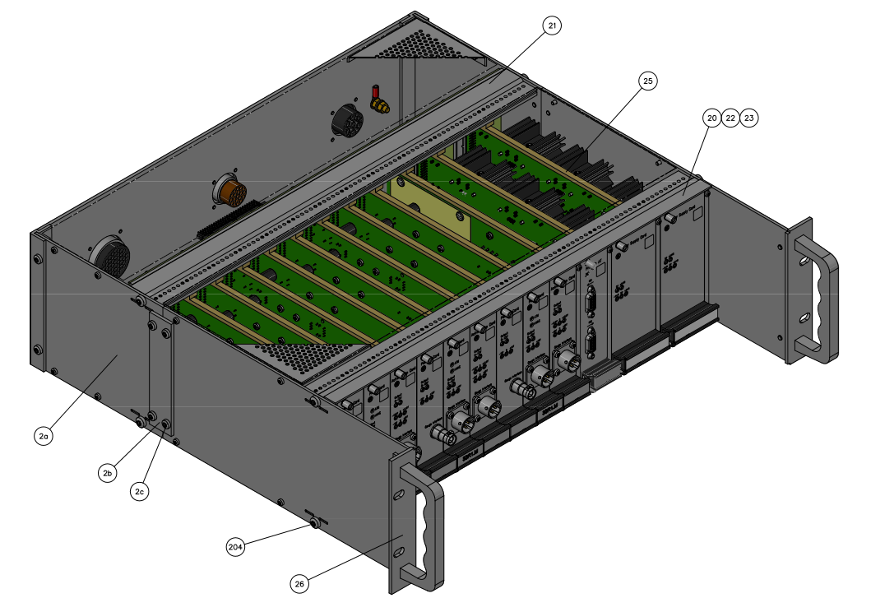
Electronic Assembly Requirements
ISO 9001:2015 certified company
In a CERN Member State or Associate Member States
All process steps shall be done in-house, no subcontracting allowed
Industrial cleaning process in-house is mandatory
Vapour phase oven is a real advantage
Assembly processes according to J-STD-001 and IPC/JEDEC-J-STD-033
Acceptance of electronic assemblies in compliance with IPC-A-610 and IPC-A-620
  Class 1 -- General Electronic Products
  Includes products suitable for applications where the major requirement is function of the completed assembly.
  Class 2 -- Dedicated Service Electronic Products
  Includes products where continued performance and extended life is required, and for which uninterrupted service is desired but not critical.
  Typically the end-use environment would not cause failures.
  Class 3 -- High Performance Electronic Products
  Includes products where continued high performance or performance-on-demand is critical, equipment downtime cannot be tolerated, end-use environment may be uncommonly harsh, and the equipment must function when required, such as life support or other critical systems.

Slide 18
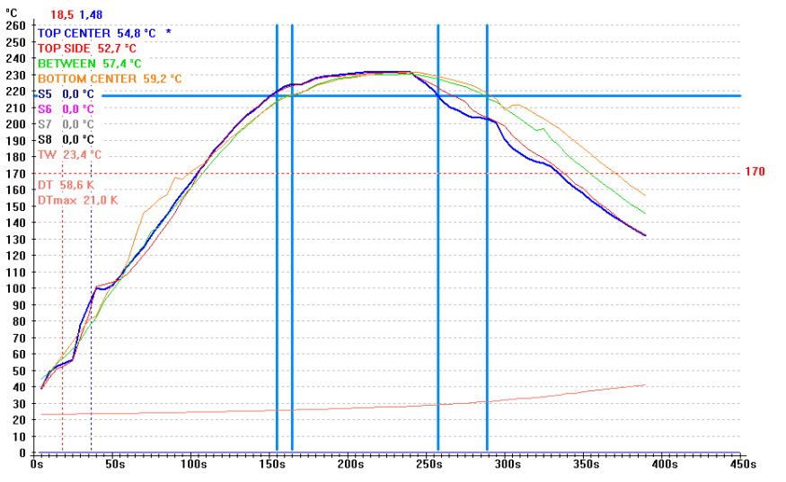
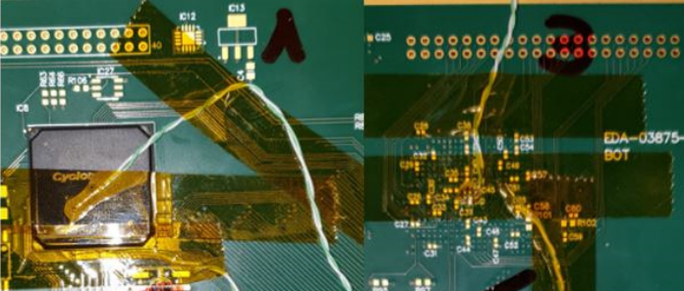
Electronic Assembly Requirements
Measurement of thermal
profile for reflow process validation prior production
Mandatory for “complex” assemblies
When BGA, LGA and specific components are on present on board to be assembled
Thermal parameters defined in our documentation
Measured using real PCB & dummy components
Critical for high quality assemblies

Slide 19
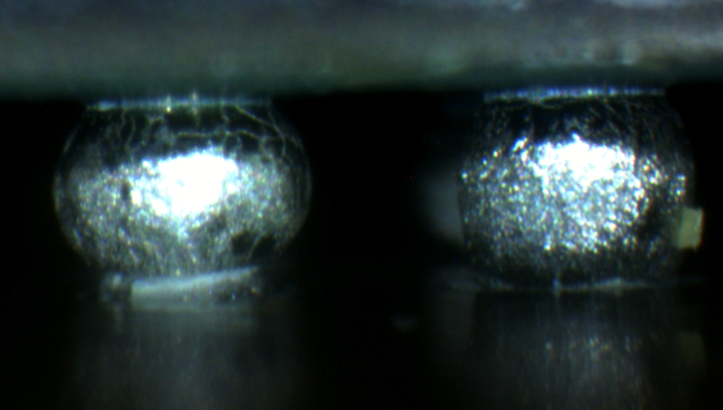
Electronic Assembly Requirements
Measurement of thermal
profile for reflow process validation prior production
Mandatory for “complex” assemblies
When BGA, LGA and specific components are on present on board to be assembled
Thermal parameters defined in our documentation
Measured using real PCB & dummy components
Critical for high quality assemblies
To avoid bad solder joint

Slide 20
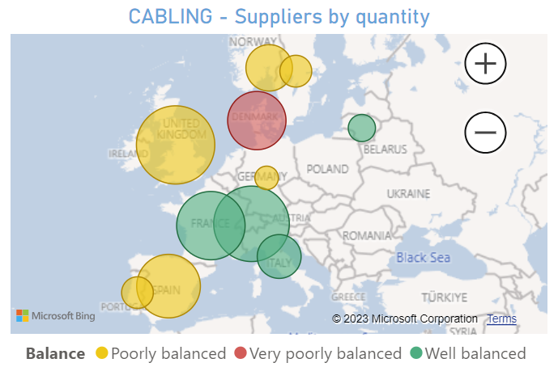
Purchasing of Electronic Assemblies
Electronic Assembly subcontractors geographical distribution
24 firms based in 11 Member States
7 firms in well balanced countries
15 firms in poorly balanced countries
2 firms in very poorly balanced countries
We are looking for firms doing electronic assembly for PCB and mechanical integration

Slide 21
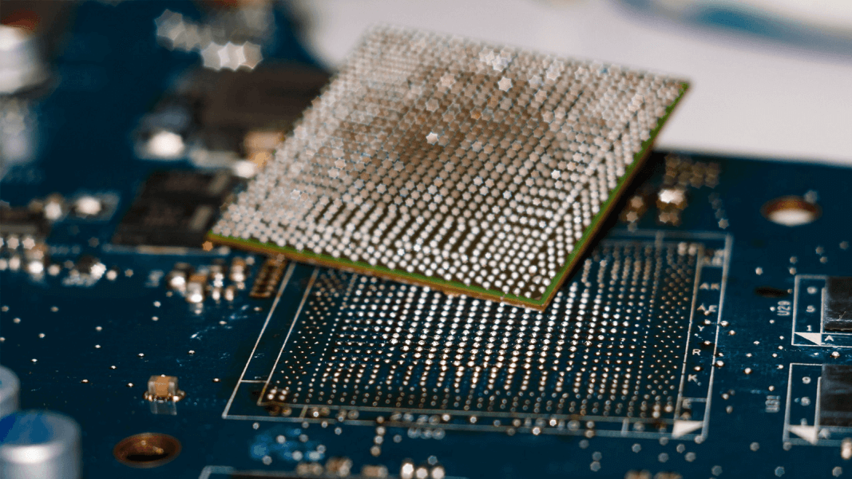
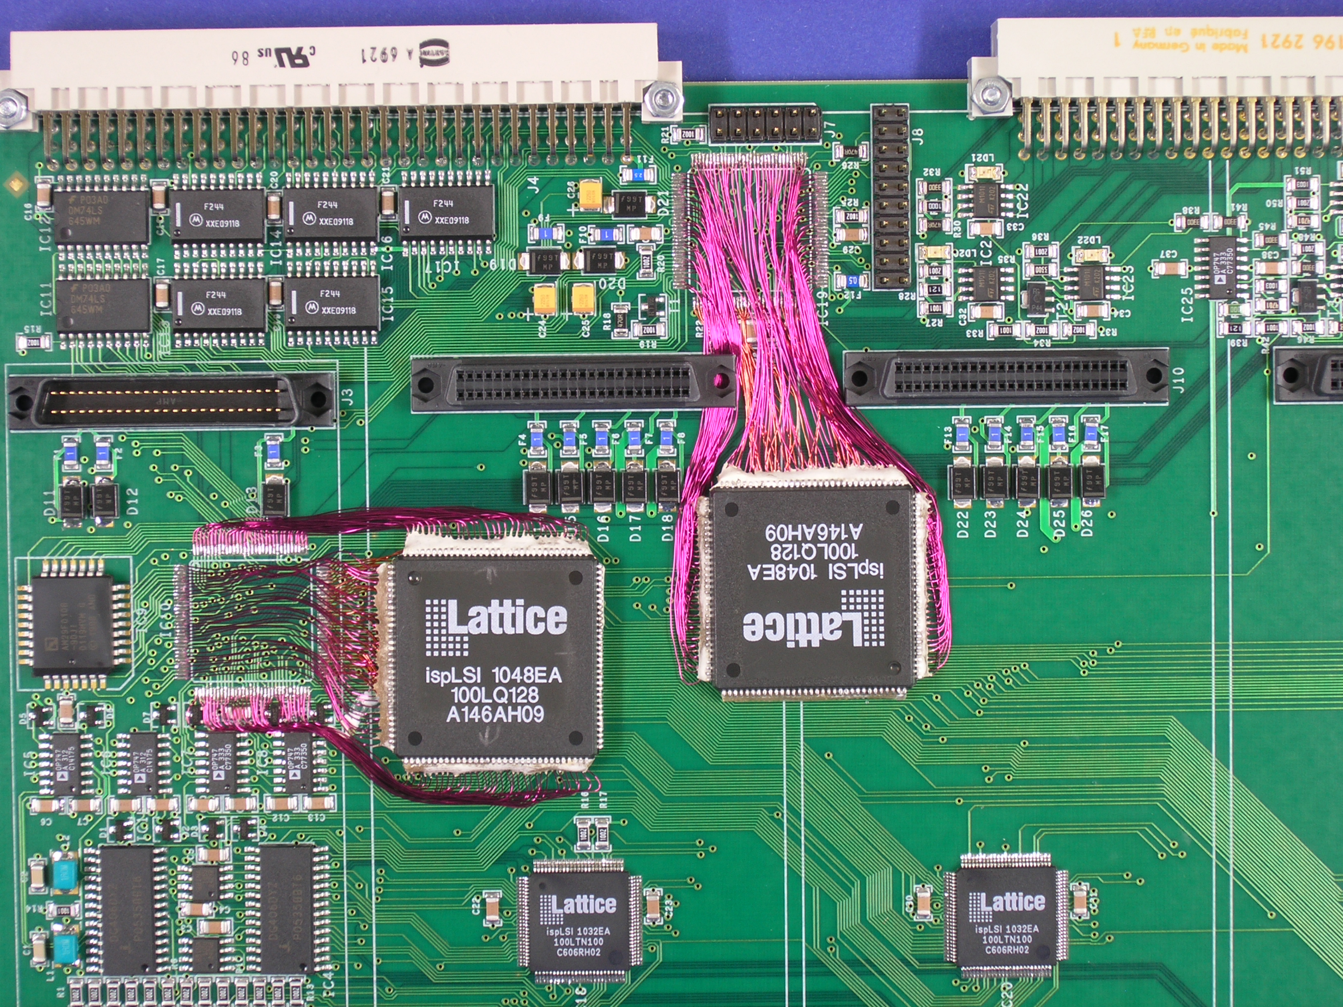
Internal Electronics Assembly Workshop
Prototypes -> in general 10 PCB or 10 panels
Same rules as when outsourced
Impossible-to-subcontract assemblies
→ The lead-time may be long due to limited resources
Repair/rework of almost any component type
Board/assembly modification
On-demand PCBA cleaning

Slide 22
Conclusions
Engineers develop
We deliver
We are looking for subcontractors for bare PCB manufacturing and Electronic assembly and/or final integration with mechanical parts
BE-CEM-EPR Electronics Service
Schematic Libraries
PCB Libraries
Layout and integration
PCB procurement and
some components
PCB assembly
Mechanical production in collaboration with EN-MME
3D Model

Slide 23
Thank you for your attention!

Slide 24
Layout design for electronics boards and crates, with production
Example: Typical production we have managed for SY-RF
Some characteristics of this design:
233mm x 221mm
10 layers
0.1mm minimum trackwidth
3’291 holes and via holes
Signal integrity / Controlled impedance lines
Filled & Capped via holes
Holes tolerances for press-fit connectors
92 different references of components
Quantity produced:
A total of 18 units in fast production time
LHC ADT Beam Position Module

Slide 25
Layout design for electronics boards and crates, with production
Example: Typical production of a crate. This production done for TE-VSC-ICM
Crate including:
6 different types of populated PCB
Internal cables
Mechanical parts produced in collaboration with EN-MME
Quantity for production:
A total of 186 units assembled

