Slide 1
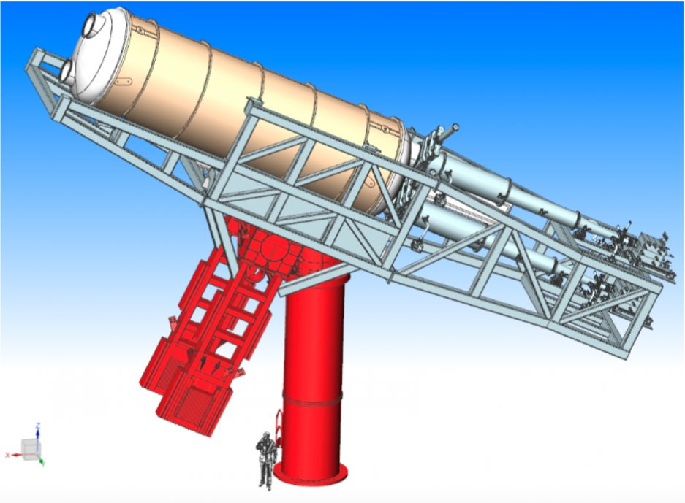


Microbulk detectors for the BabyIAXO experiment
Authors: Ana Quintana García oh behalf of IAXO
Micromegas detector group
RD51 Collaboration Meeting, 04-dec-2023

Slide 2
Content
IAXO/BabyIAXO Physics
Microbulk detectors
IAXO-D1- Saclay at CEA-Saclay
Characterization
Tests performed at CEA-Saclay: position scanning
Solar axions
Microbulk Micromegas detector
BabyIAXO Microbulk X-ray detectors
Prospect
Summary
BabyIAXO
X-ray detector requirements

Slide 3
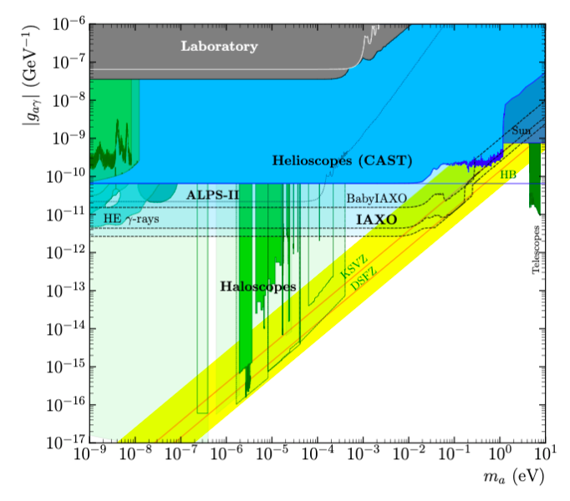
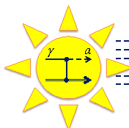
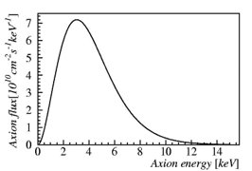
The International AXion Observatory (IAXO): Physics
AXIONS → Predicted solution of the strong CP problem.
→ Dark matter candidate.
Production: axions are produced from thermal photons via the Primakoff effect inside the stars.
Detection: axions converted back into photons in the presence of an intence magnetic fields.
Well into the QCD axion region
Expected solar axion flux
Expected X-ray excess when the magnet points to the Sun.

Slide 4
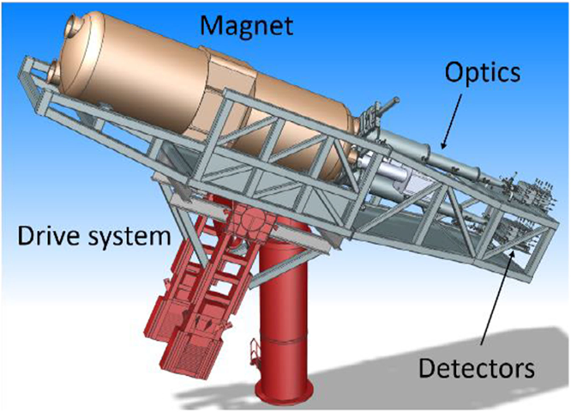
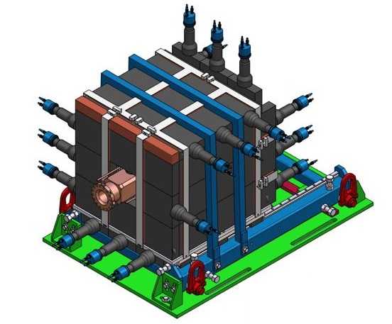
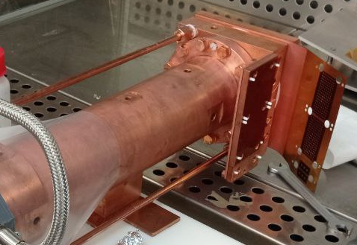
BabyIAXO
Intemediate-scale version of IAXO with physics potential
Detector + shielding
Passive shielding: several centimeters of lead around the detector
Magnet
Optics
Tracking system
Detectors
Active shielding: plastic scintillator as a cosmic muon veto.
IAXO collaboration, Conceptual design of BabyIAXO, the intermediate stage towards the International Axion Observatory, JHEP 05 (2021) 137 [2010.12076].

Slide 5
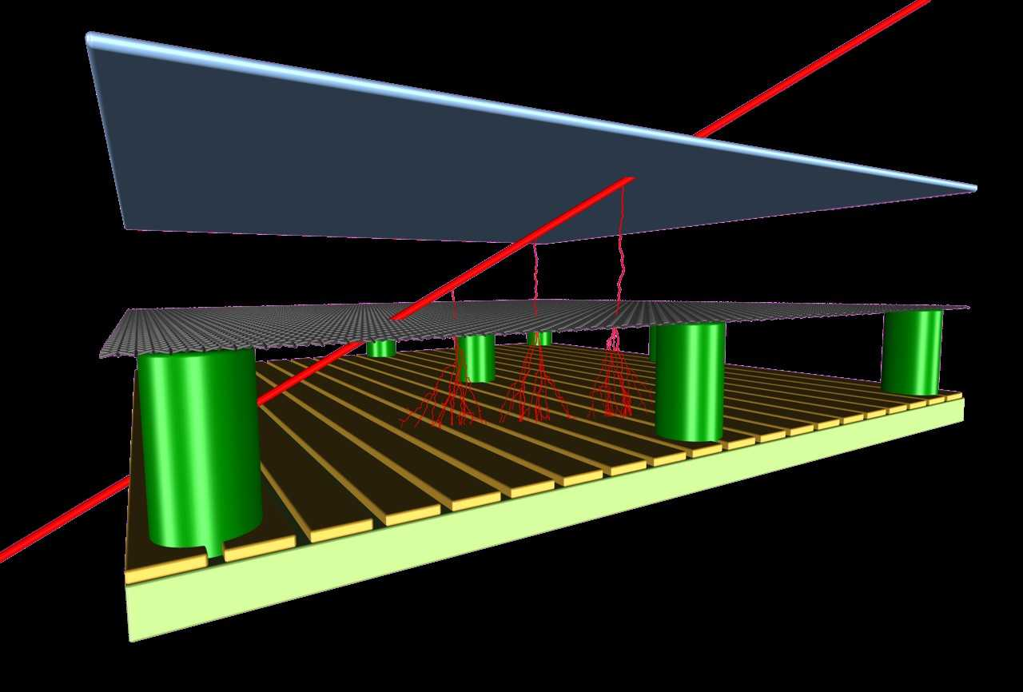
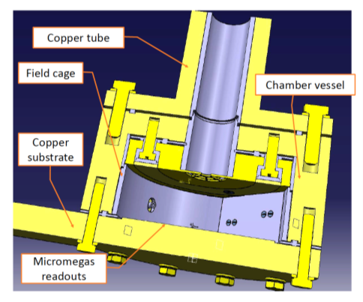
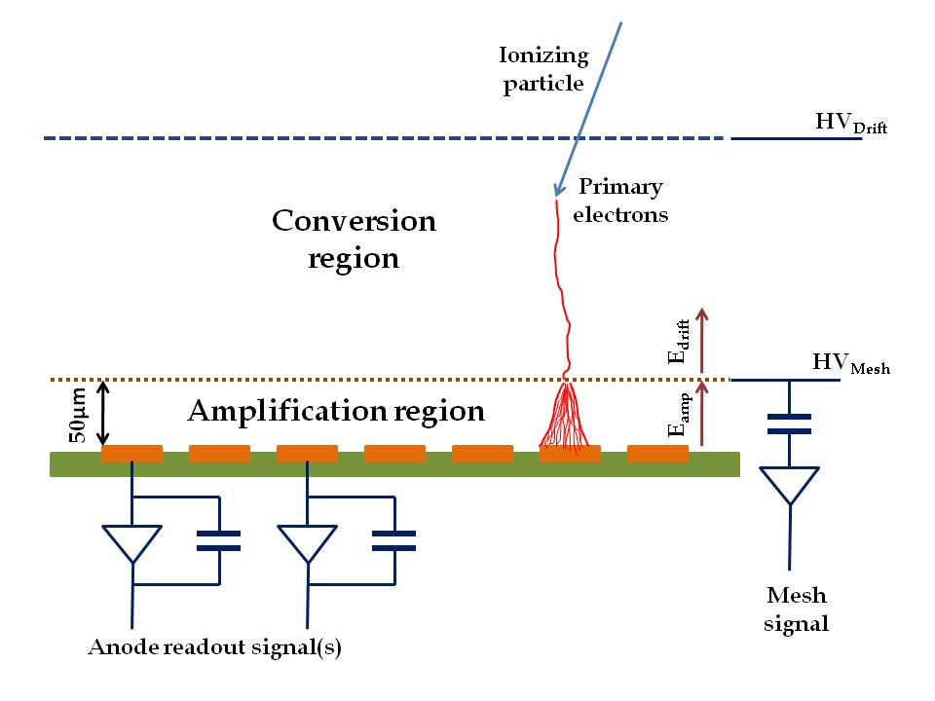
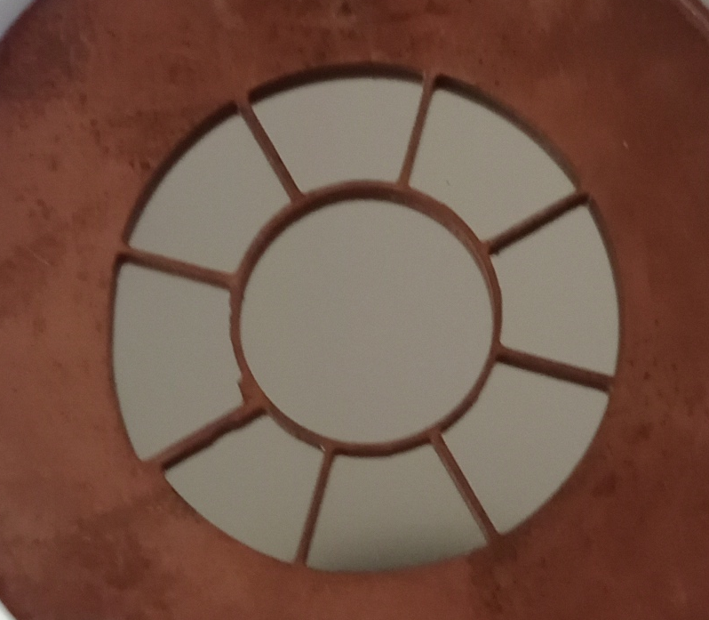
X-ray detector for BabyIAXO
High detection efficiency in the RoI: 0-10 keV.
Very low background (<10 keV): 10⁻⁷ c/keV/cm²/s.
  Shielding (pasive + active)
  Radiopurity of construction materials
  Advanced event discrimination stragedies
Time Projection Chamber (TPC) with Microbulk readout.
Vacuum pipe to magnet
X-ray window
8.5 mm
3 cm

Slide 6
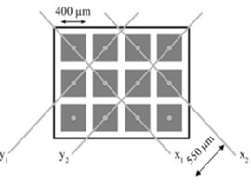
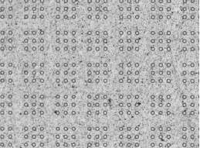
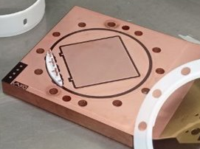
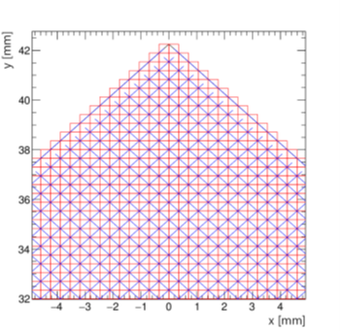
Microbulk Micromegas detector
Microbulk readout:​
Intrinsic radiopurity.
Very homogeneous amplification gap, uniform gain.
Good energy resolution @5.9keV (⁵⁵Fe peak).​
Pixelized readout gives topological information.
High power to discriminate X-rays signal from background events.
Cu (5μm)
Kapton (50μm)
Strips in 2D
S. Andriamonje et al. JINST 2010 5 P02001
Micromegas readout:
120 x 120 strips
Pitch = 0.5 mm
(6 x 6 cm²)
Micromesh grid
Prototypes:​
IAXO-D0 at Zaragoza​
IAXO-D1-LSC at the Underground Laboratory of Canfranc​
IAXO-D1-Zgz at Zaragoza​
IAXO-D1-Saclay at CEA-Saclay

Slide 7
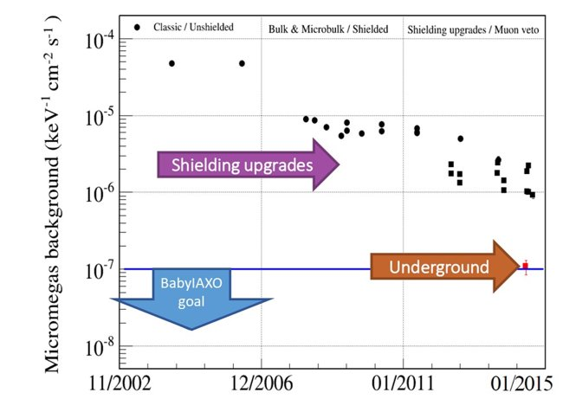
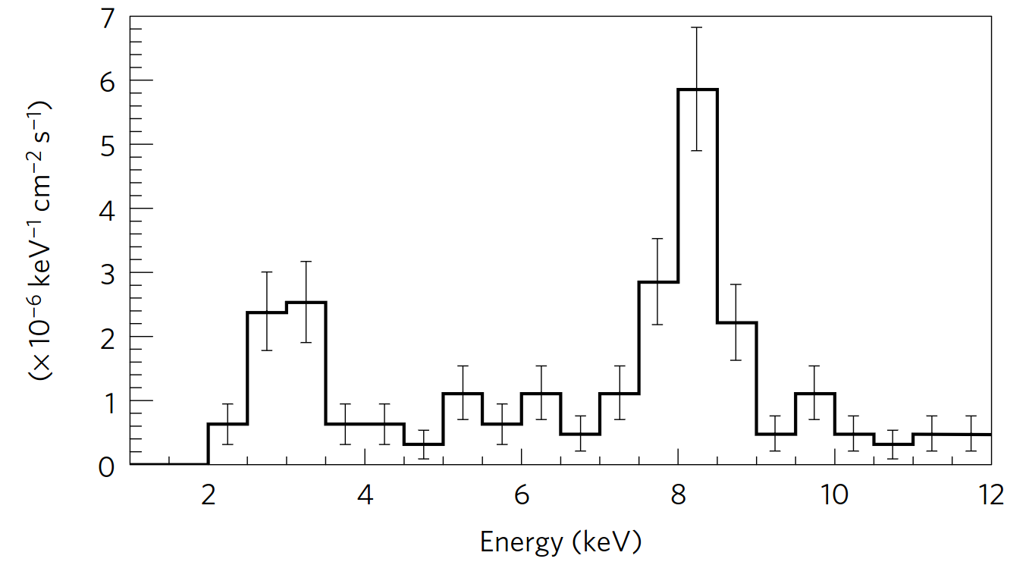
Background rejection in BabyIAXO
Radiopurity: inner components.
Passive shielding: lead shell.
Active shilding: muon vetos (PMT scintillators).
Event discrimination strategies: G4 simulation and prototype measurments.
Background evolution in CAST
CAST background measurement,
NATURE PHYSICS (2017)

Slide 8
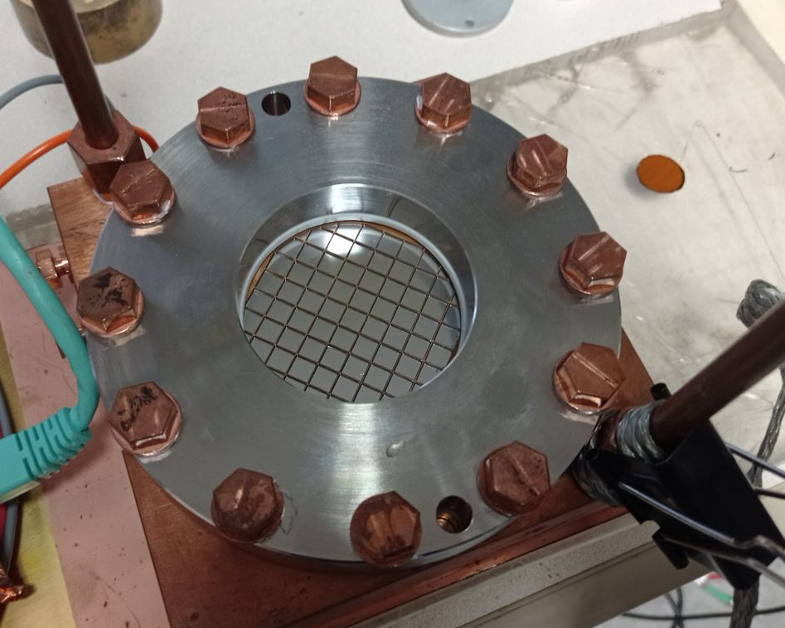
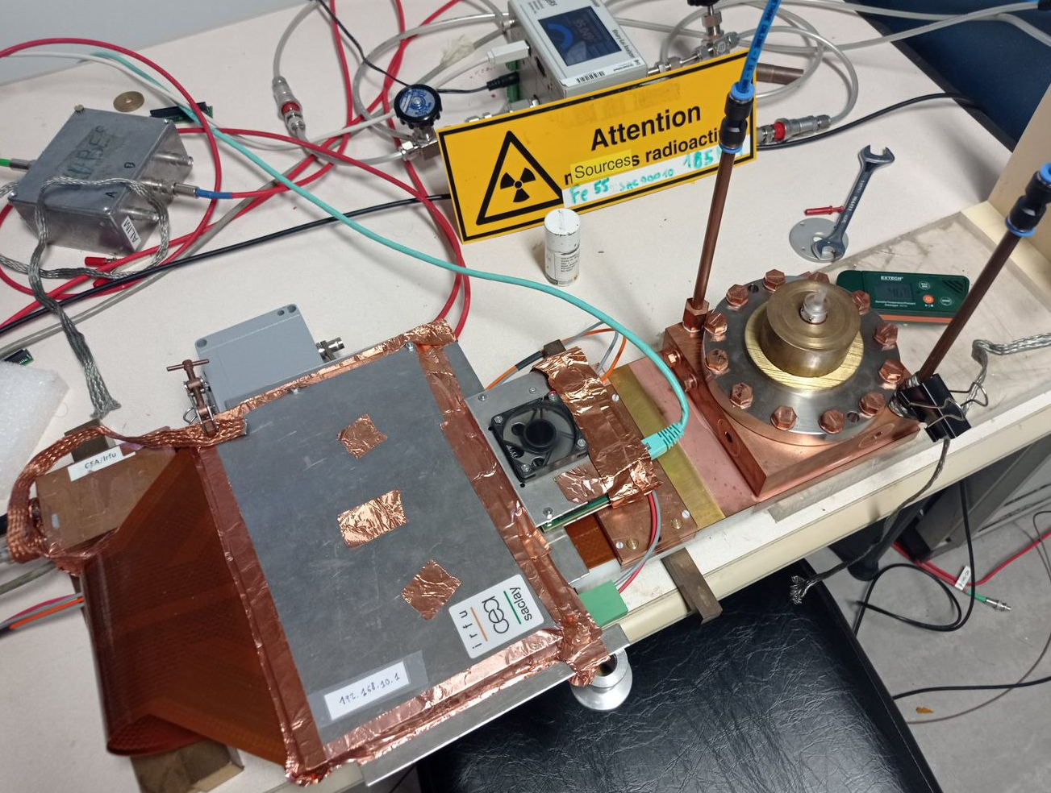
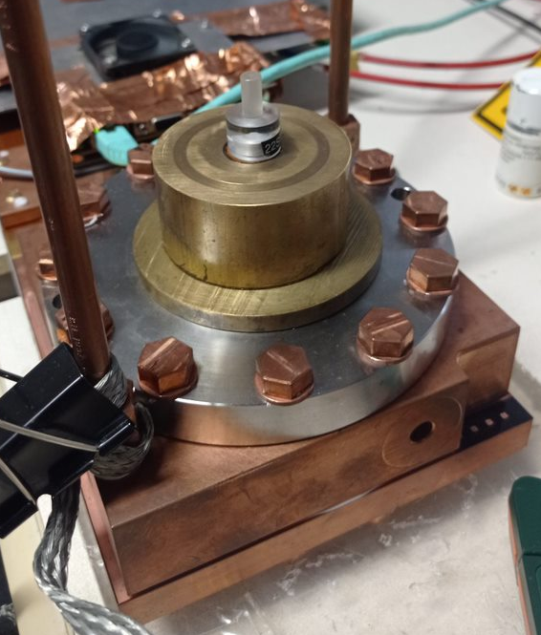
IAXO-D1 at CEA-Saclay
Characterizations and tests:
Gain, transparency and resolution: mesh & strips.
Position scan over the window (mapping).
Stability over time.
Characterization of a new Micromegas detector design IAXO-D1
Fe55 Source
r = 30 mm
Window replaced -> be able to illuminate most the Micromegas surface
Mesh acquisition:
  + PA ORTEC
  + Shaper
  + MCA
Strip acquisition:
+ AGET chip: S. Anvar et al., AGET, the get front-end asic, for the readout of the time projection chambers used in nuclear physic experiments, IEEE Nucl. Sci. Symp. Conf. Rec. (2011)
  + REST framework: REST-for-Physics, a ROOT-based framework for event oriented data analysis and combined Monte Carlo response, Comput. Phys. Commun. 273 (2022) 108281 [2109.05863]
Detector chamber:
Ar-ISO mixture
Flat cable
AGET card

Slide 9
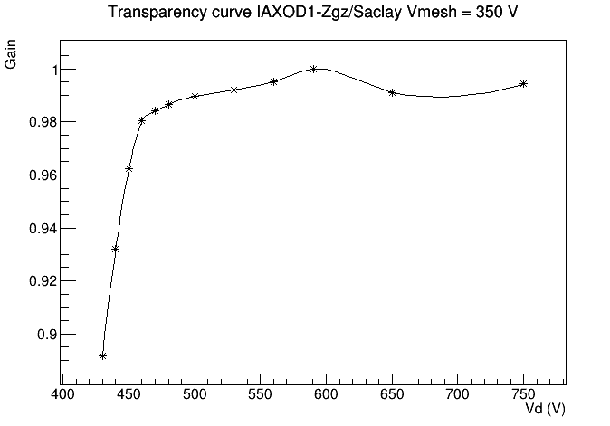
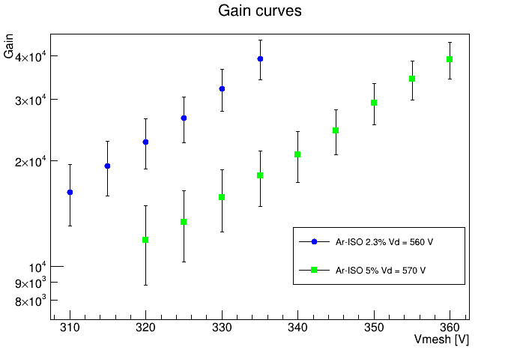
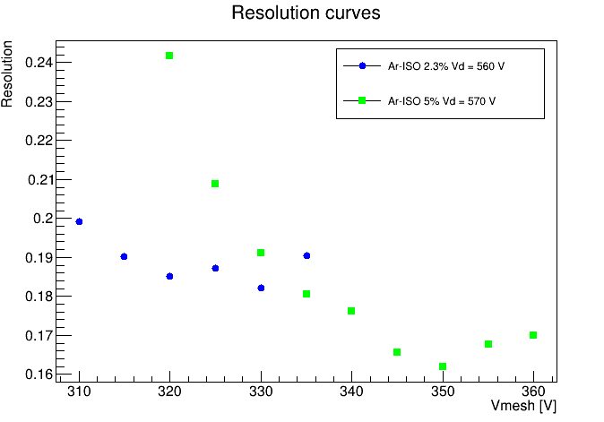
IAXO-D1-Saclay: characterization (mesh)
Ar-ISO(5%)
Standard behaviour
Gains over 10⁴
Resolution @5.9 keV -> 16% (FHWM) with Ar + 5% ISO

Slide 10
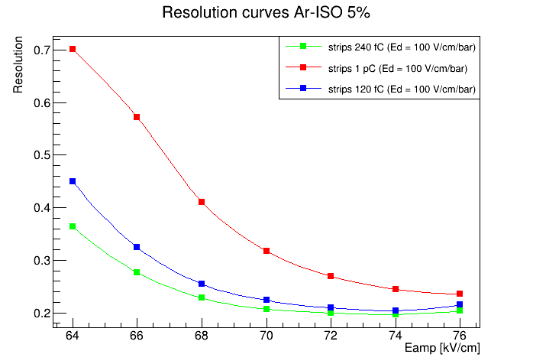
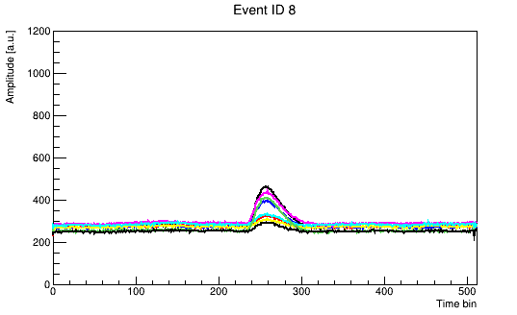
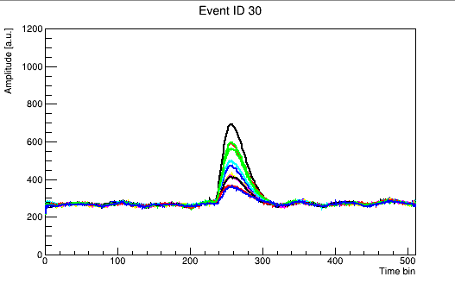
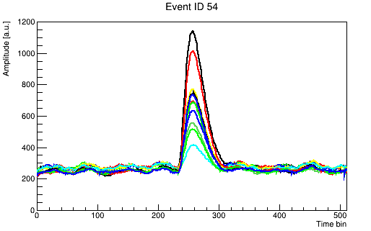
IAXO-D1-Saclay: characterization (strips)
V_{m} = 350 V, E_{d} = 100 V/cm
Gain 0x2 (1 pC)
Gain 0x1 (240 fC)
Gain 0x0 (120 fC)
Gain concordance between different dynamic ranges (AGET gains).
240 fC gives better resolution that the other dynamic ranges.
The energy resolution is worse than expected: noise not completely controlled.
Study of the gain and resolution at different AGET gains (dynamic ranges)

Slide 11
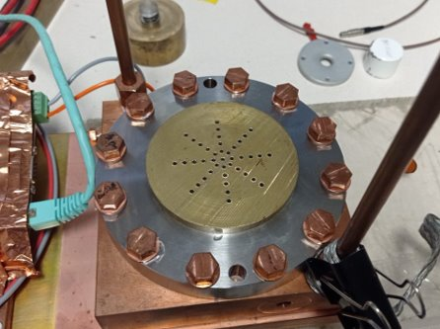
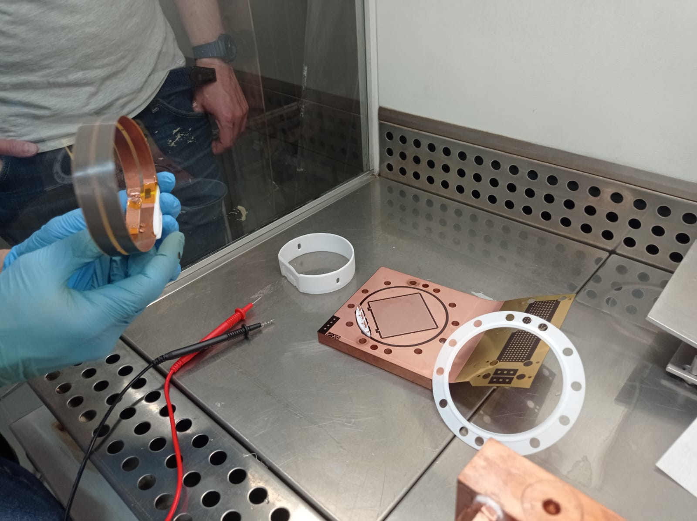
IAXO-D1-Saclay: position scan
Readout
90º
Study of the uniformity of the gain and resolution in the different positions over the window.
Only with the readout powered
Adding the RIM
Connecting the field shapers
y
0º
RIM
x
Field shapers

Slide 12
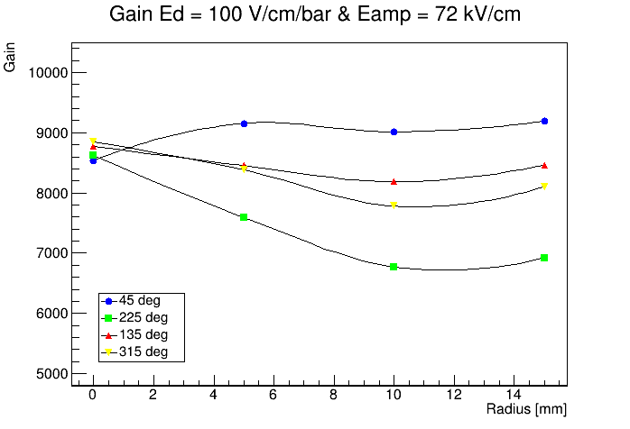
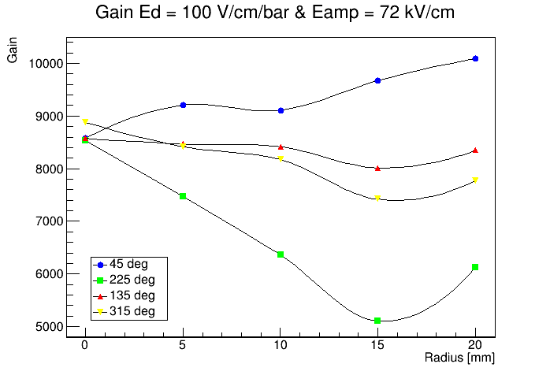
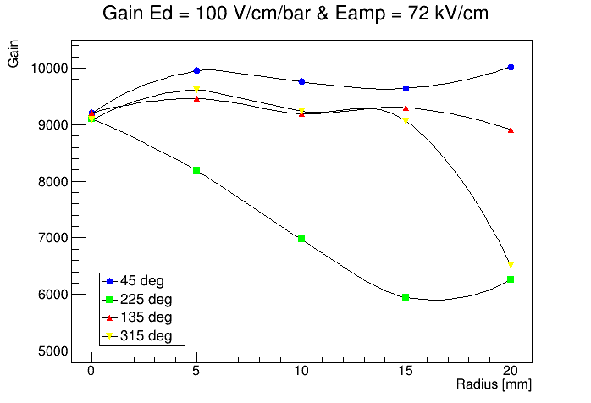
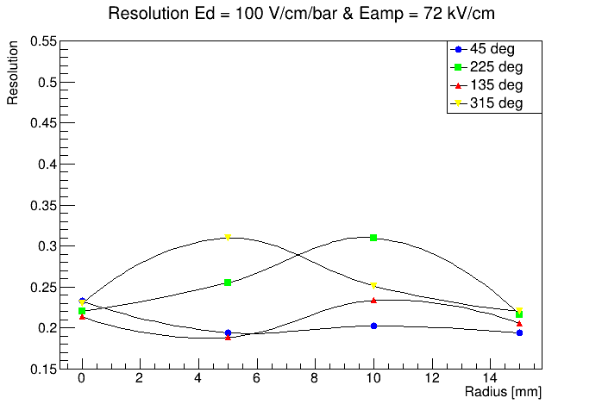
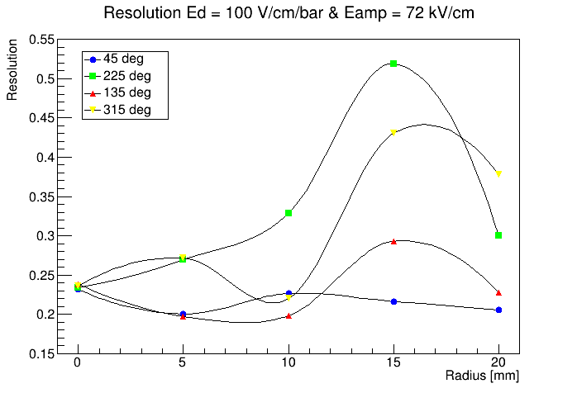
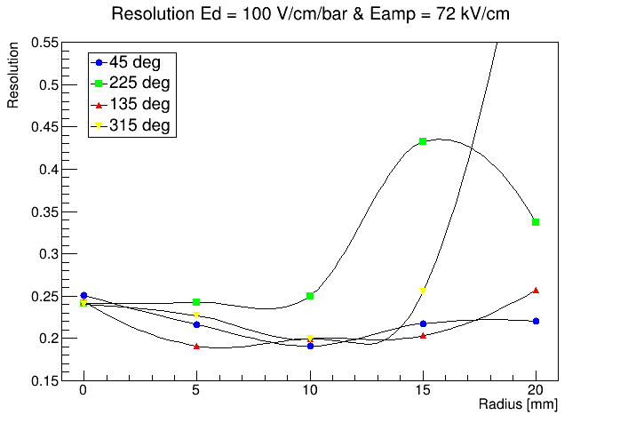
IAXO-D1-Saclay: position scan
+ Field Shaper
+ RIM

Slide 13
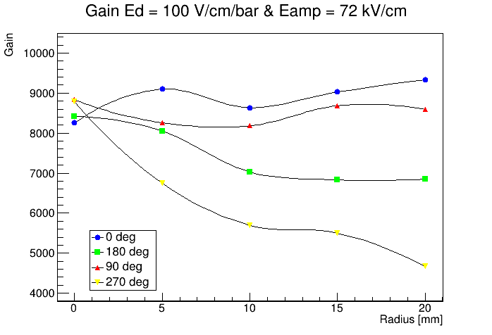
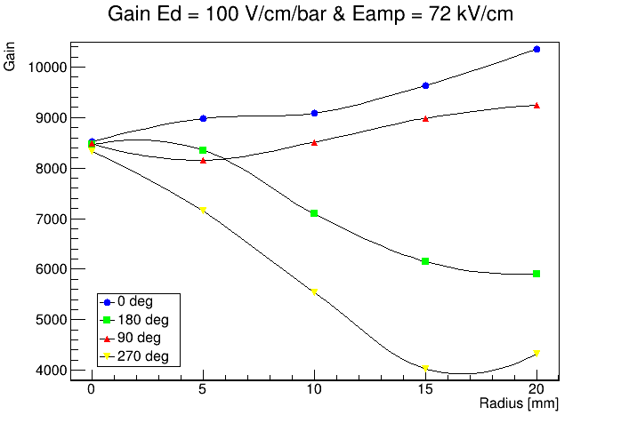
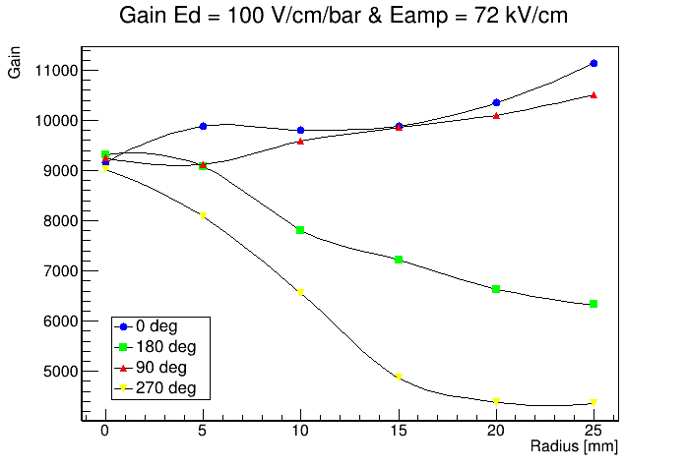
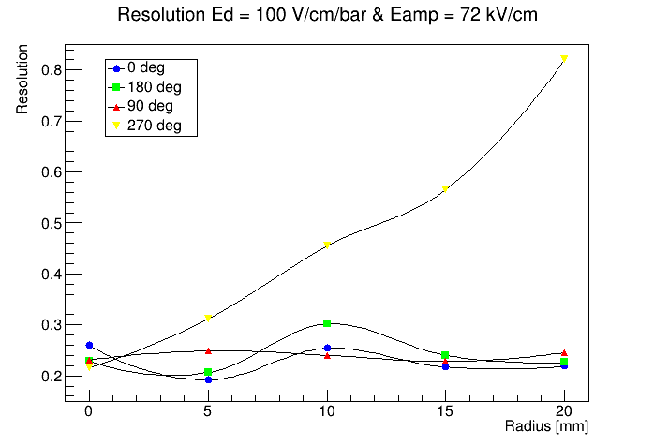
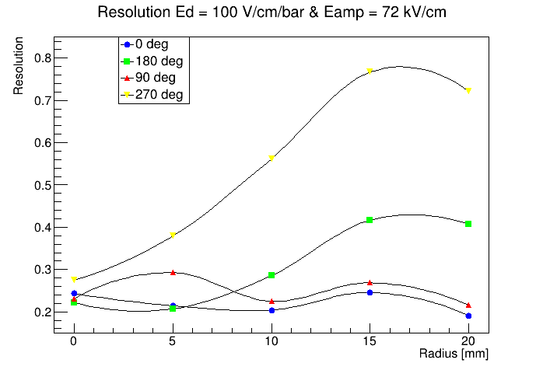
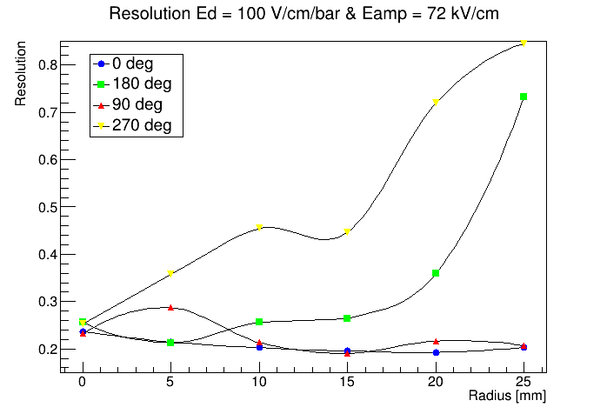
IAXO-D1-Saclay: position scan
+ Field Shaper
+ RIM

Slide 14
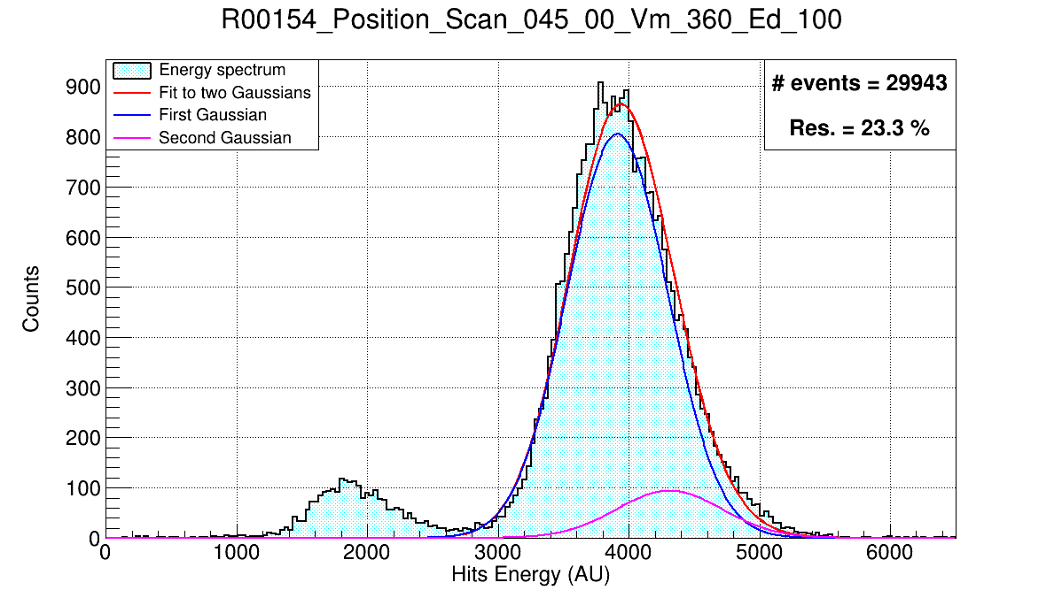
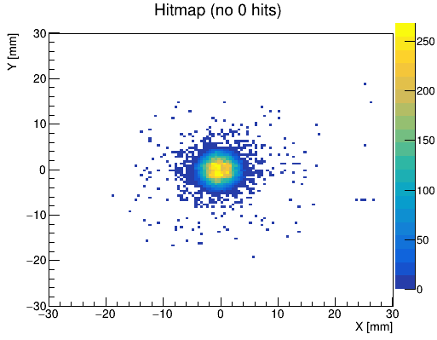
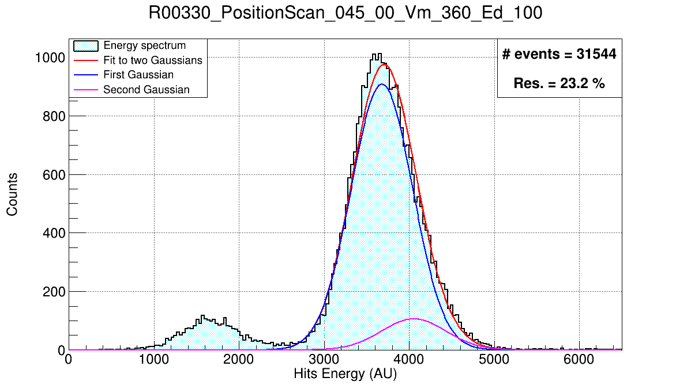
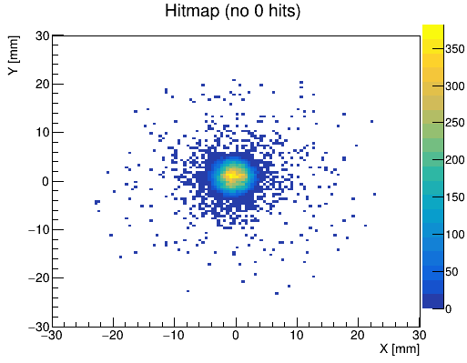
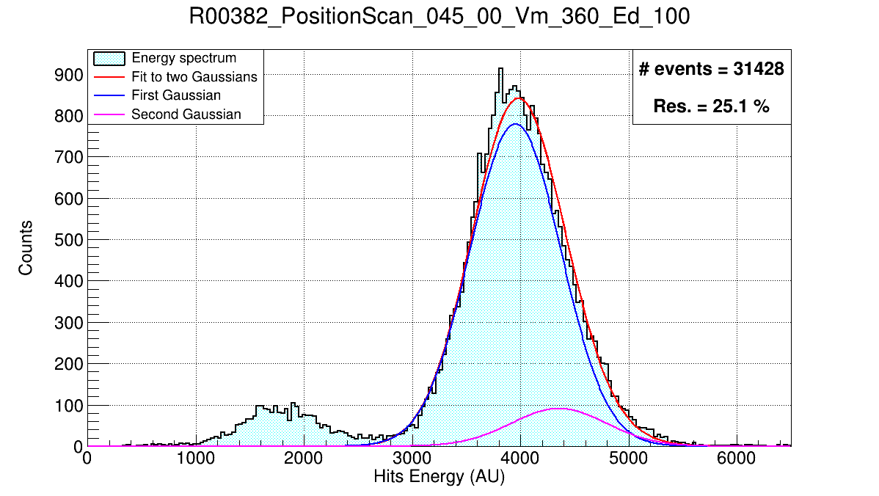
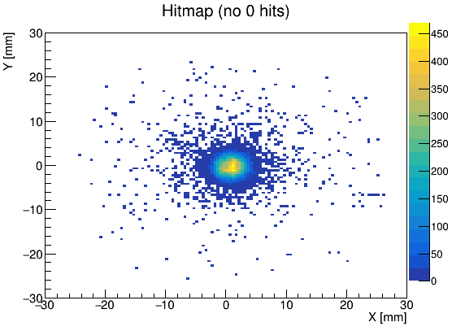
IAXO-D1-Saclay: position scan
+ RIM
Applying the (V_{cath}-V_{mesh})/2 to the field shapers
The sensitive zone is wider
Slightly improvement on the center resolution
Applying the V_{mesh} to the RIM
Increase in the number of events away from the center
The general behavior is the same
+ Field shapers

Slide 15
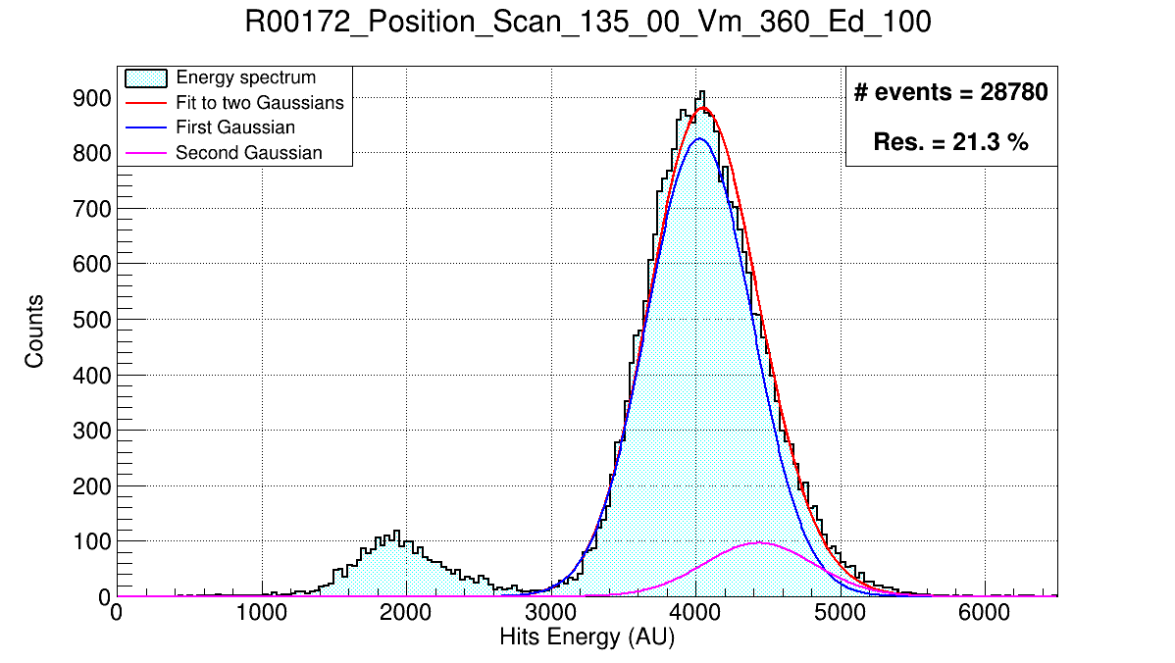
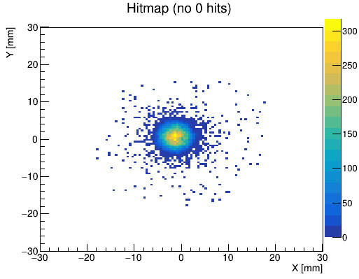

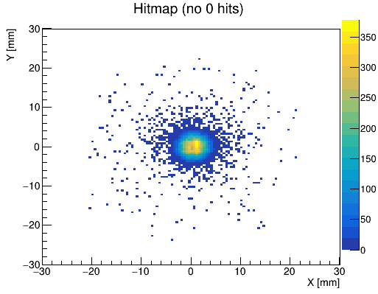


IAXO-D1-Saclay: position scan
+ RIM
Applying the (V_{cath}-V_{mesh})/2 to the field shapers
The sensitive zone is wider
Slightly improvement on the center resolution
Applying the V_{mesh} to the RIM
Increase in the number of events away from the center
The general behavior is the same
+ Field shapers

Slide 16






IAXO-D1-Saclay: position scan
+ RIM
Applying the (V_{cath}-V_{mesh})/2 to the field shapers
The sensitive zone is wider
Improvement on the point-shape of the source
Applying the V_{mesh} to the RIM
Increase in the number of events away from the center
The general behavior is the same
+ Field shapers

Slide 17






IAXO-D1-Saclay: position scan
+ RIM
Applying the (V_{cath}-V_{mesh})/2 to the field shapers
The sensitive zone is wider
Improvement on the point-shape of the source
Applying the V_{mesh} to the RIM
Increase in the number of events away from the center
The general behavior is the same
+ Field shapers

Slide 18





Summary and prospects
Summary:
Axions searches with helioscopes requires ultra-low background x-ray detectors -> Microbulk Micromegas
Characterization: gain, resolution, uniformity and stability are being performed on the IAXO-D1-Saclay prototype.
Prospects:
Complete the characterization of the test set-up with gain stability tests and optimization of the shapping time of the electronics.
Estimation of the background level: first in this set-up, then placing it insde the lead-shielding and finally covering it with the muon vetos.
Continue the effort of optimising the algorithms for background rejection in order to reach the BabyIAXO background requirement.
IAXO-D0/IAXO-D1-Zgz
IAXO-D1-LSC
Xe:
Ar:
IAXO-D1-Saclay

