Slide 1
2023 beam test of μRGroove and plan of 2024
Tian Xiangqi, He Siqi, Zhou Yi
State Key Laboratory of Particle Detection and Electronics
University of Science and Technology of China
2023.12.08

Slide 2
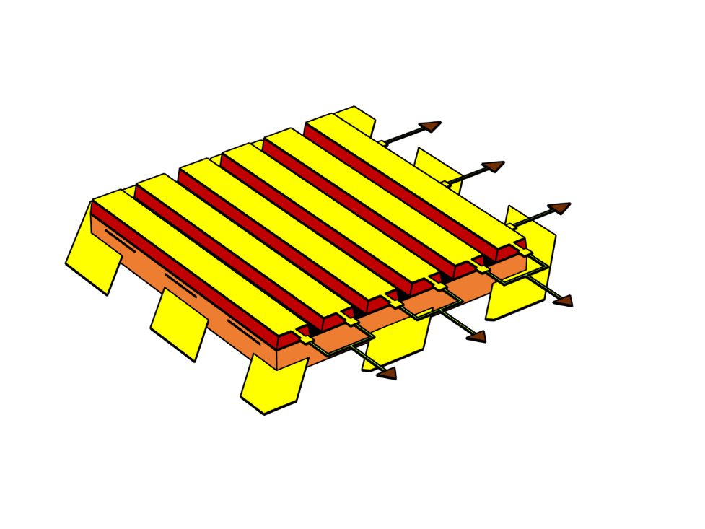
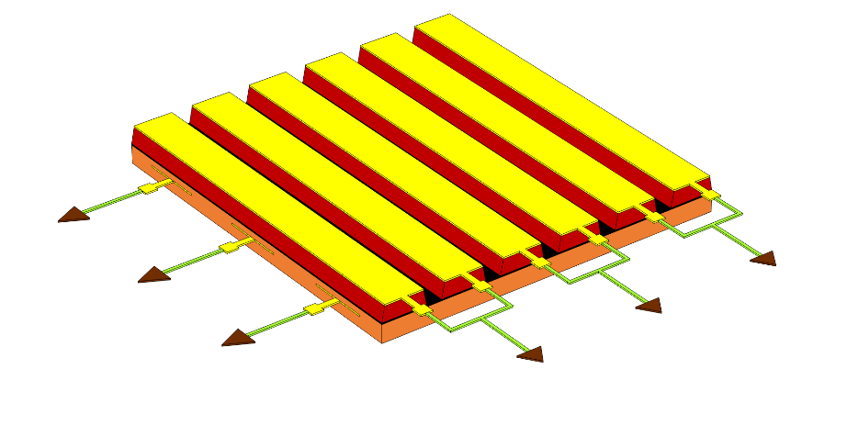
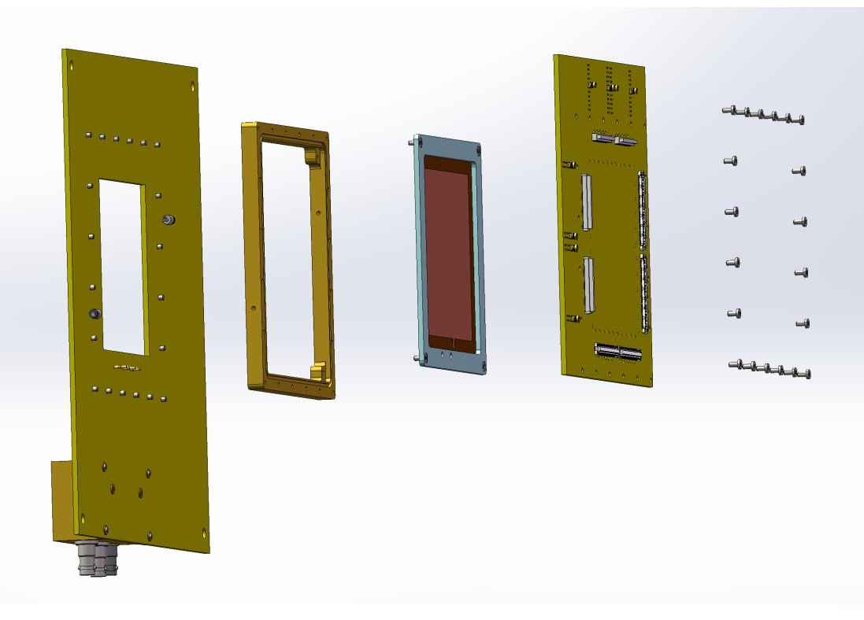
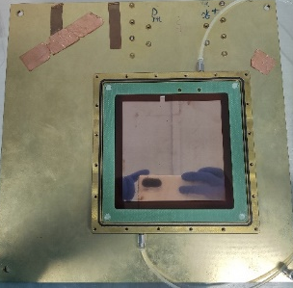
μRGroove prototypes of 10cm×10cm
XY-readout μRGroove
XYV-readout μRGroove
Drift electrode
μRGroove PCB
The two prototypes have the same groove geometry but different readout structures.
XY-μRGroove has only one layer of readout strip
XVY is designed for evaluating the spatial resolution of XV readout

Slide 3
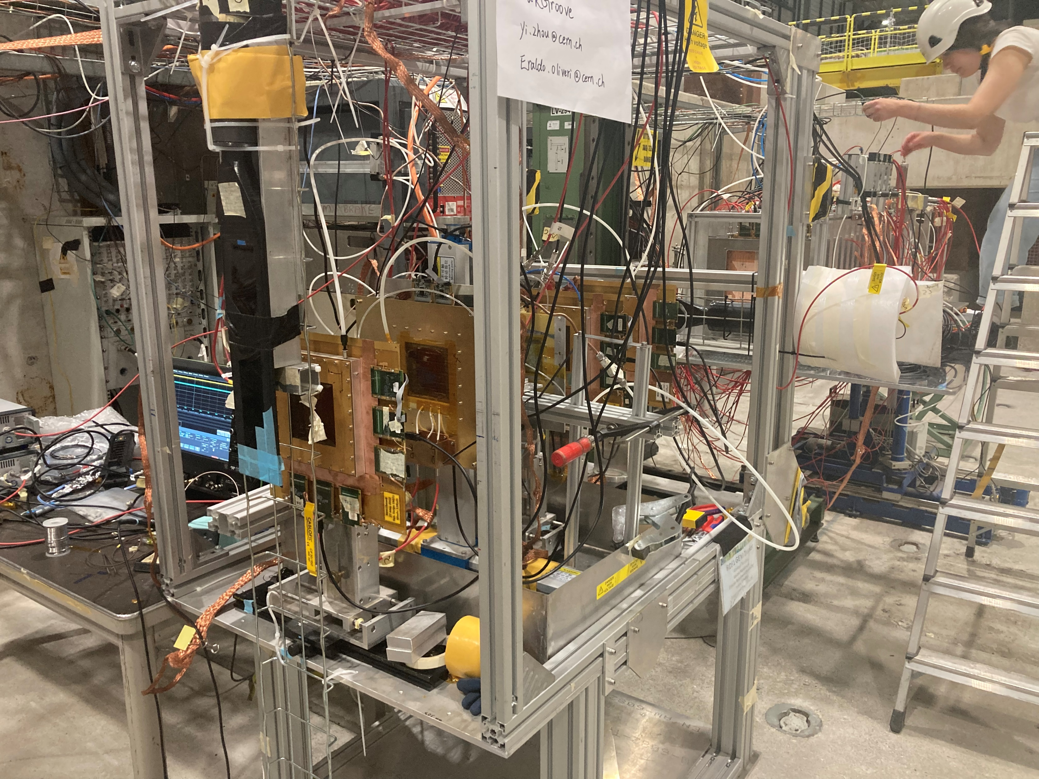
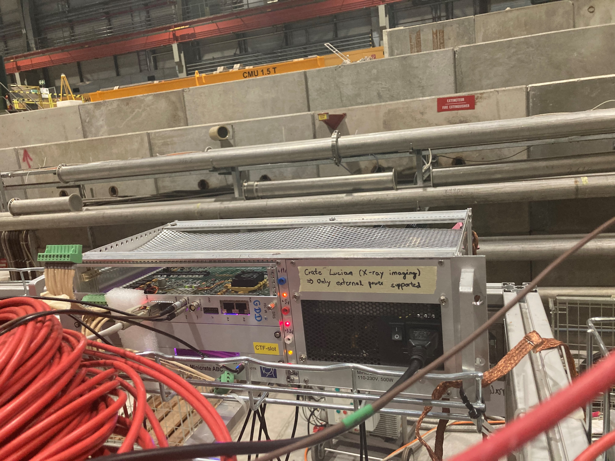
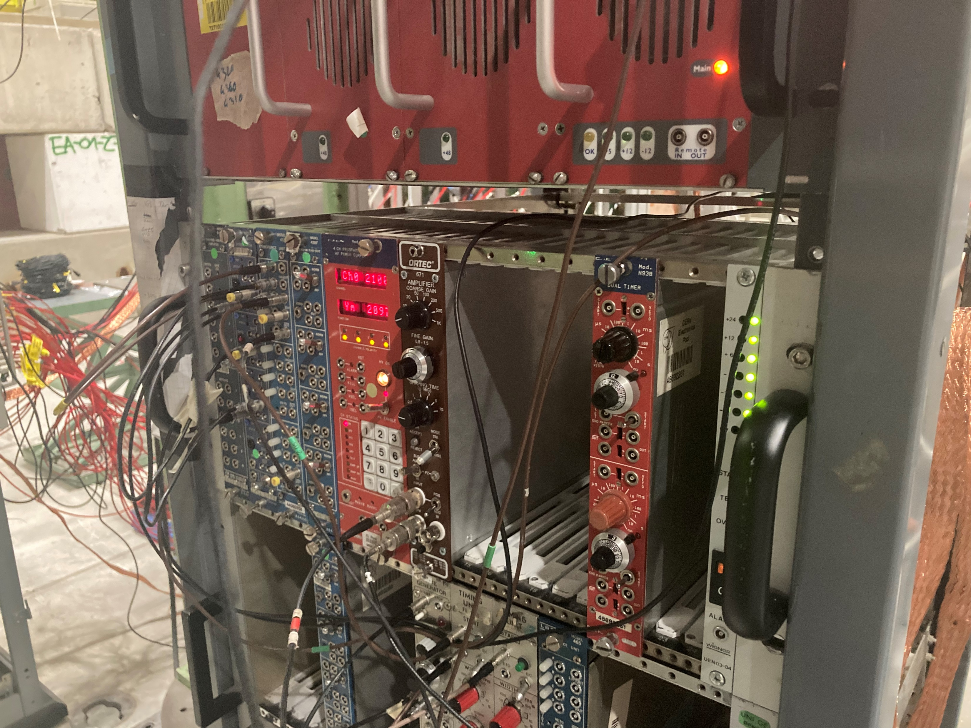
Beam Test setup
mm1
μRGroove
mm2
mm3
μ beam
trigger
257mm
trigger
625mm
952mm
Ar:iC4H10 = 95:5
(μRGroove)
mmDAQ+SRS+APV25

Slide 4
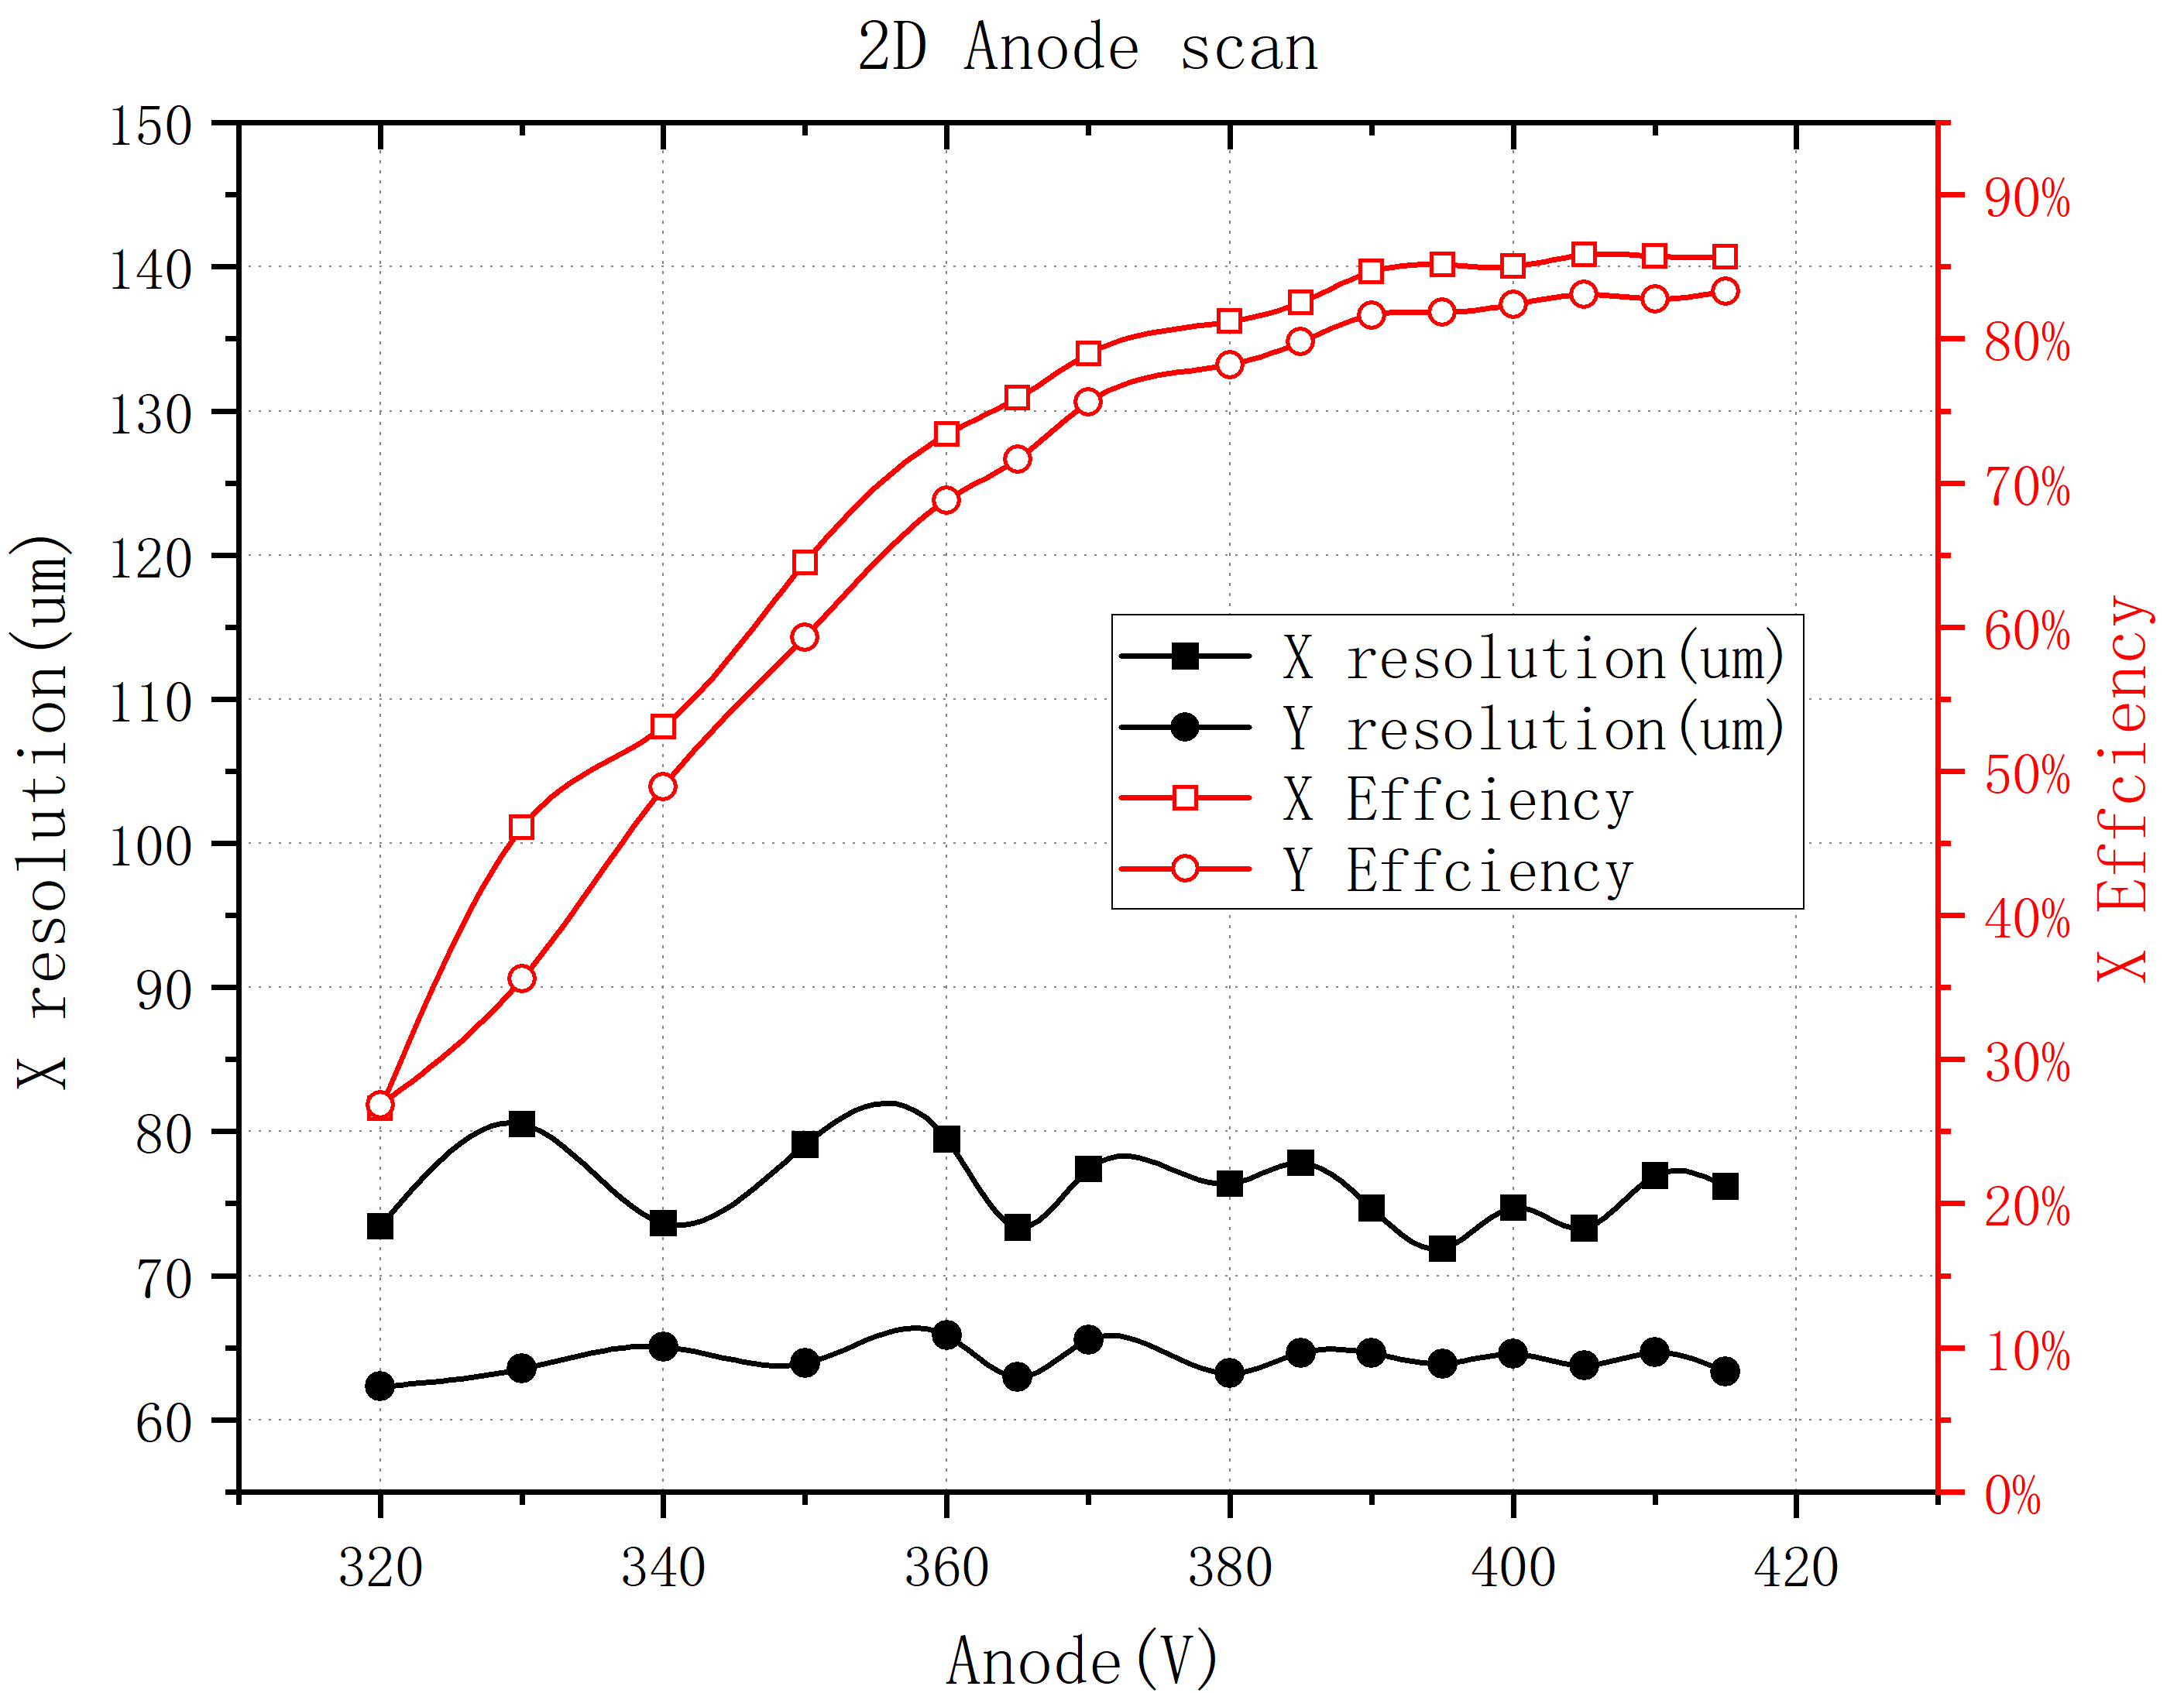
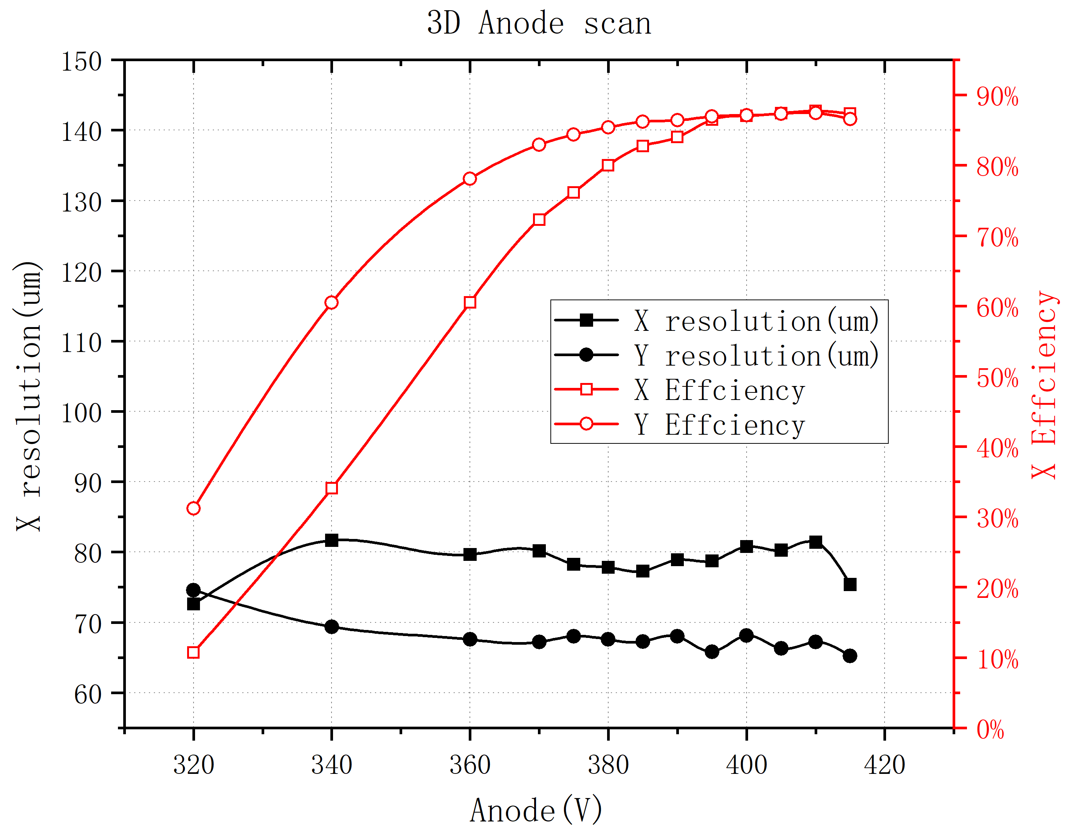
Preliminary result of beam test
Preliminary
Preliminary

Slide 5
Test plan of 2024
Detector Group1(No magnet needed)：
    10cm×10cm μRGroove ×4
    Used for as the tracker of c-μRWELL/c-μRGroove
    50cm×50cm μRGroove ×1
    Used for the study of μRGroove rate capability
    50cm×50cm μRWELL ×2
    Used for the study of large area high rate μRWELL
Detector Group2(Magnet needed)：
    c-μRWELL/c-μRGroove
R&D of STCF inner tracker

Slide 6
Request to RD51: Detector Group1
APV25
Telescope：
GEM or MM Tracker
3 scintillators for trigger
Trigger1&2
GEM/MM1
μRGroove
GEM/MM2
GEM/MM3
Trigger3
Electronics：
APV25 FEE × 12 for Tracker
APV25 FEE × 4 for test detectors
DAQ
PC
Gas：
Ar:CO₂ 70:30/93:7 for GEM/MM
Ar:iC₄H₁₀ 95:5 for μRWELL/μRGroove
LTD
Expected beam time：
1st beam in 2024
2nd beam in 2024
LOGIC

Slide 7
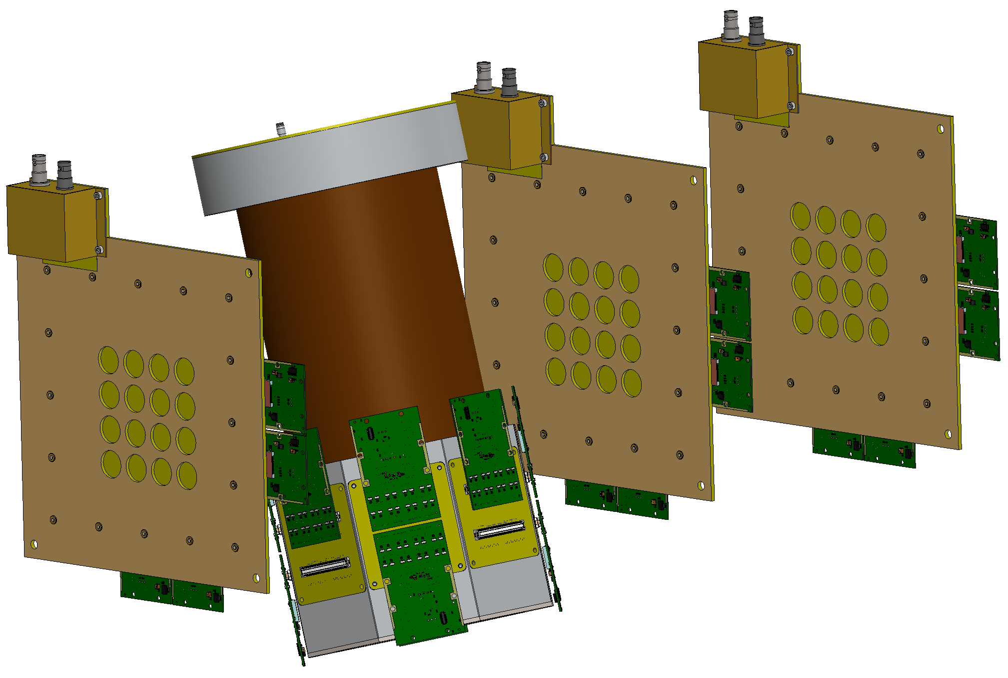
Request to RD51: Detector Group2
Electronics：
APV25 FEE × 12 for μRGroove Tracker
APV25 FEE × 6 for c-μRWELL/c-μRGroove
Gas：
Ar:iC₄H₁₀ 95:5 for all detectors
Expected beam time：
2nd beam in 2024
3rd beam in 2024
We will use μRGroove tracker, it is still under building;
We need magnet, and we will remotely control the rotation of the detector;
The real beam test time depends on the progress of detector & tracker manufacture;

Slide 8
THANKS！

Slide 9
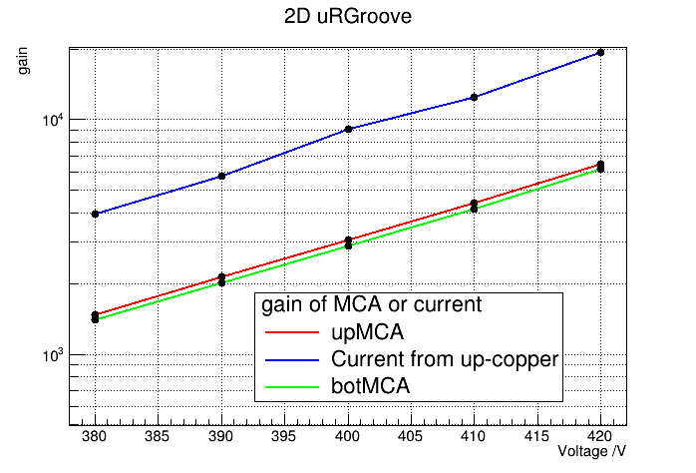
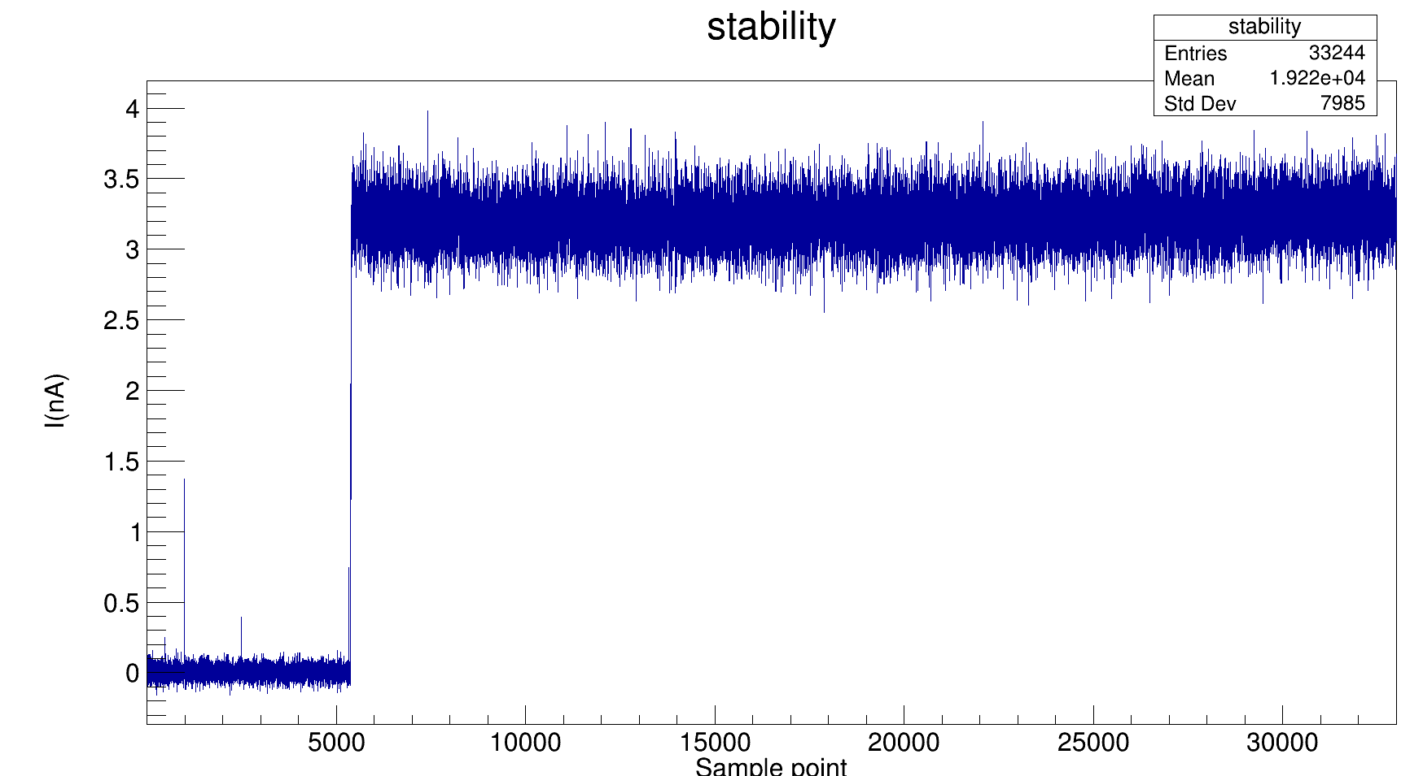
Backup

