Slide 1
Synchrotron Radiation Background Studies @ FCC-ee
K.D.J. André for the MDI study group

Slide 2
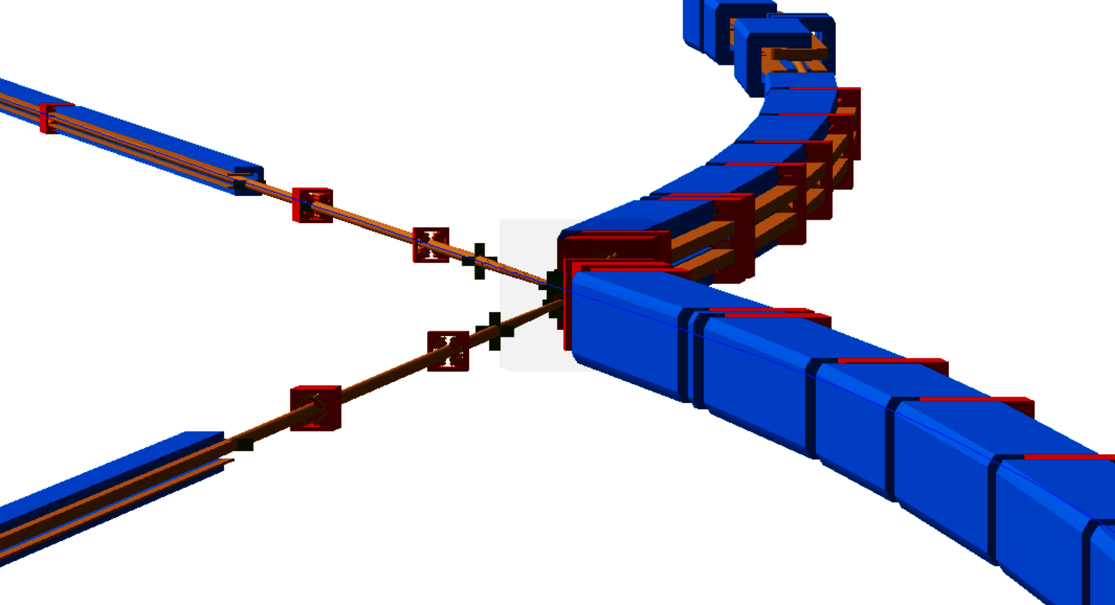
Outline
Updates since FCC-ee week 2023
  SR from beam position and divergence tolerances
  SR from uniform and exponential beam halo
  Mask geometry

Slide 3
From FCC week 2023

Slide 4
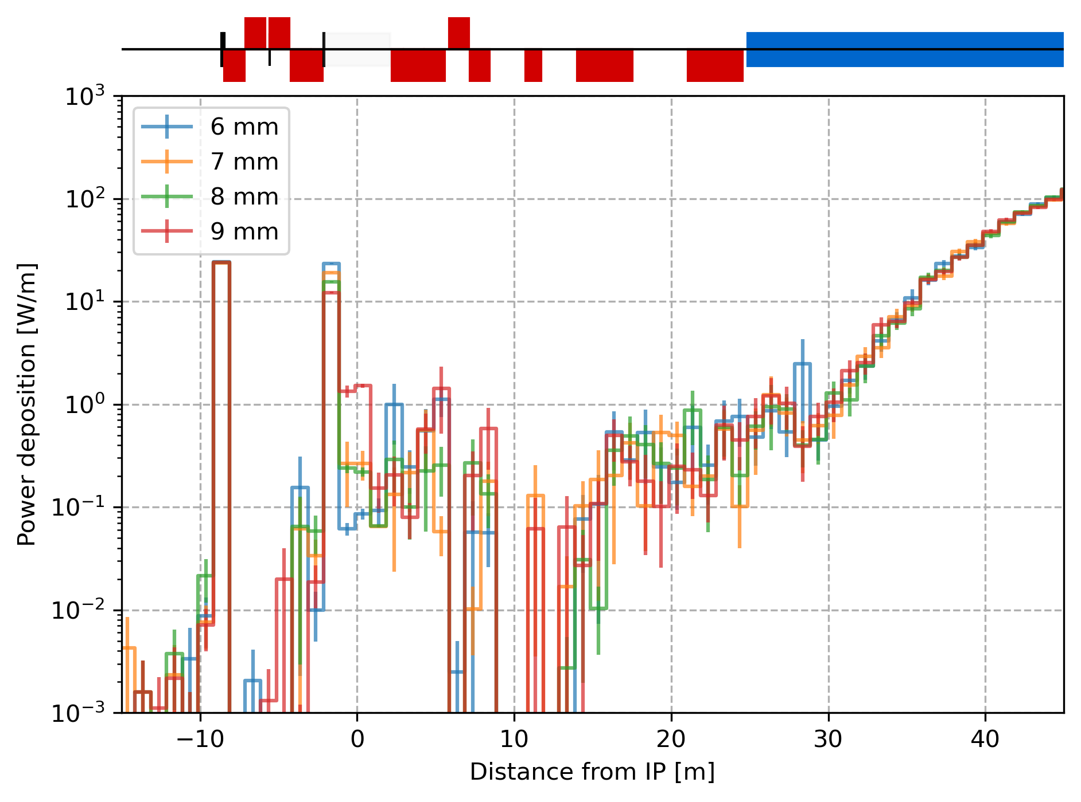
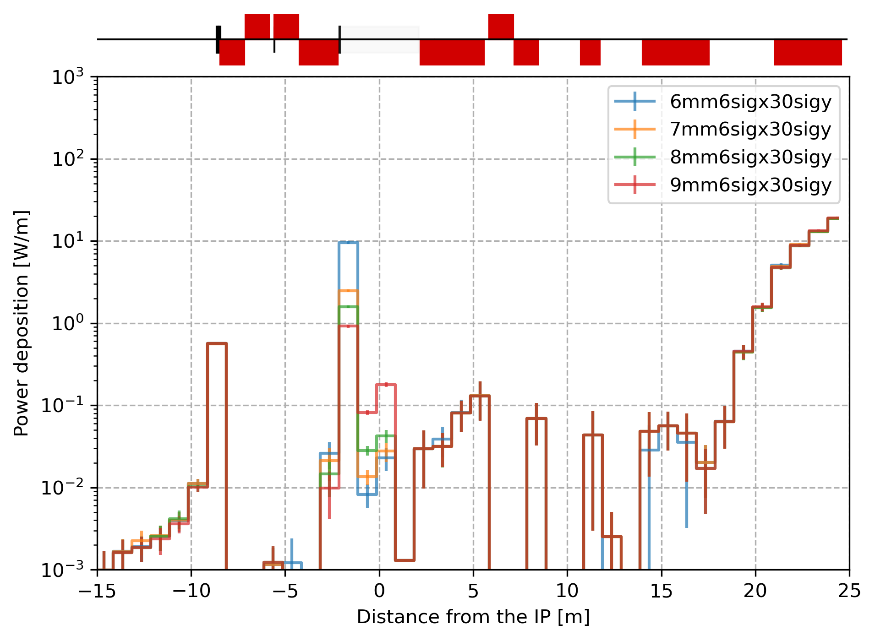
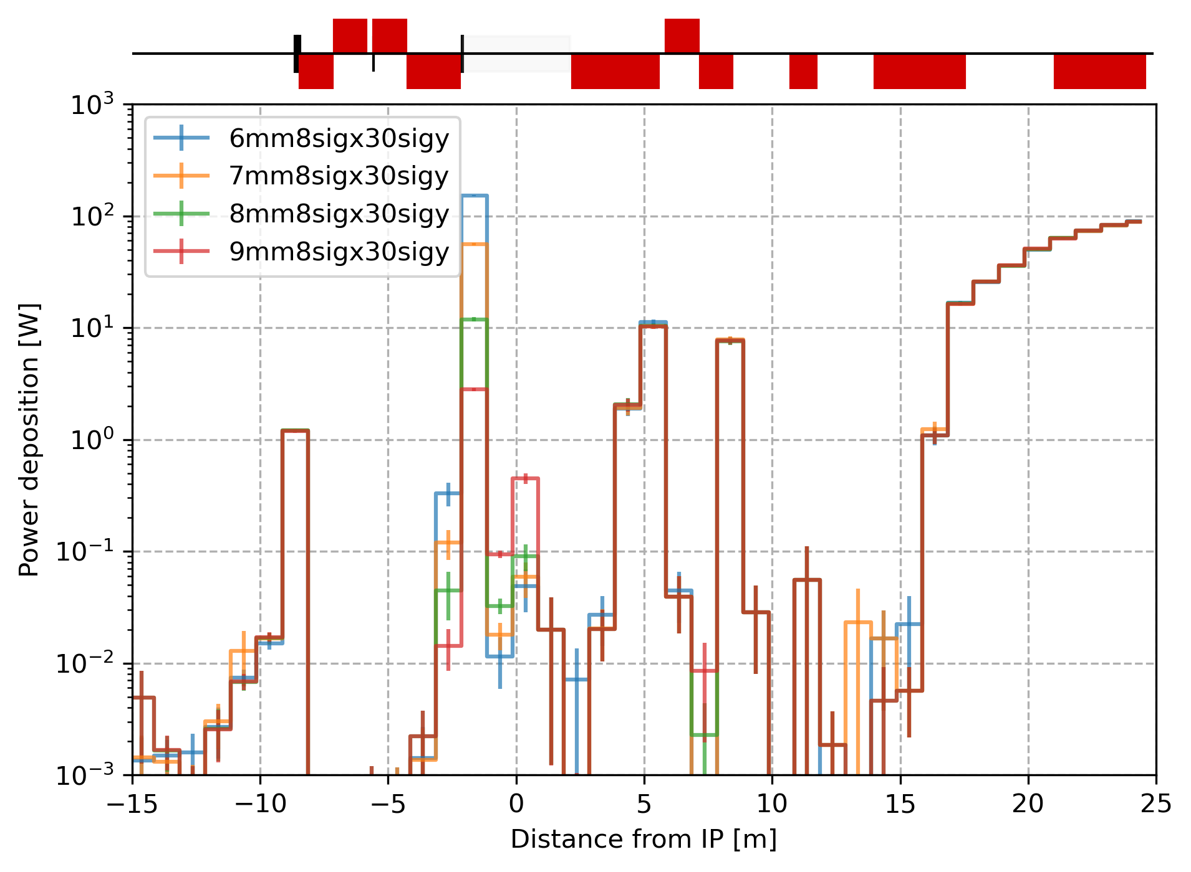
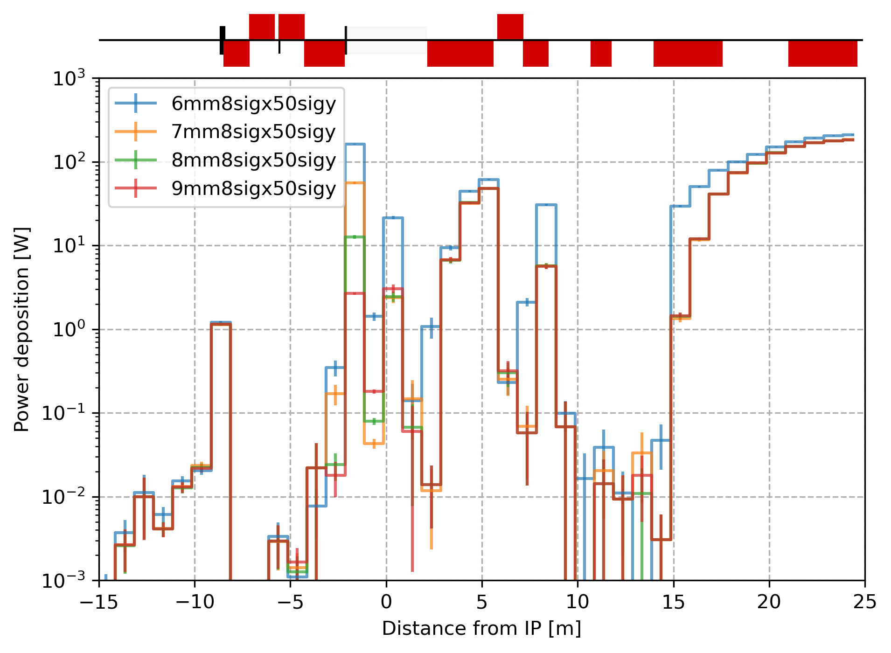
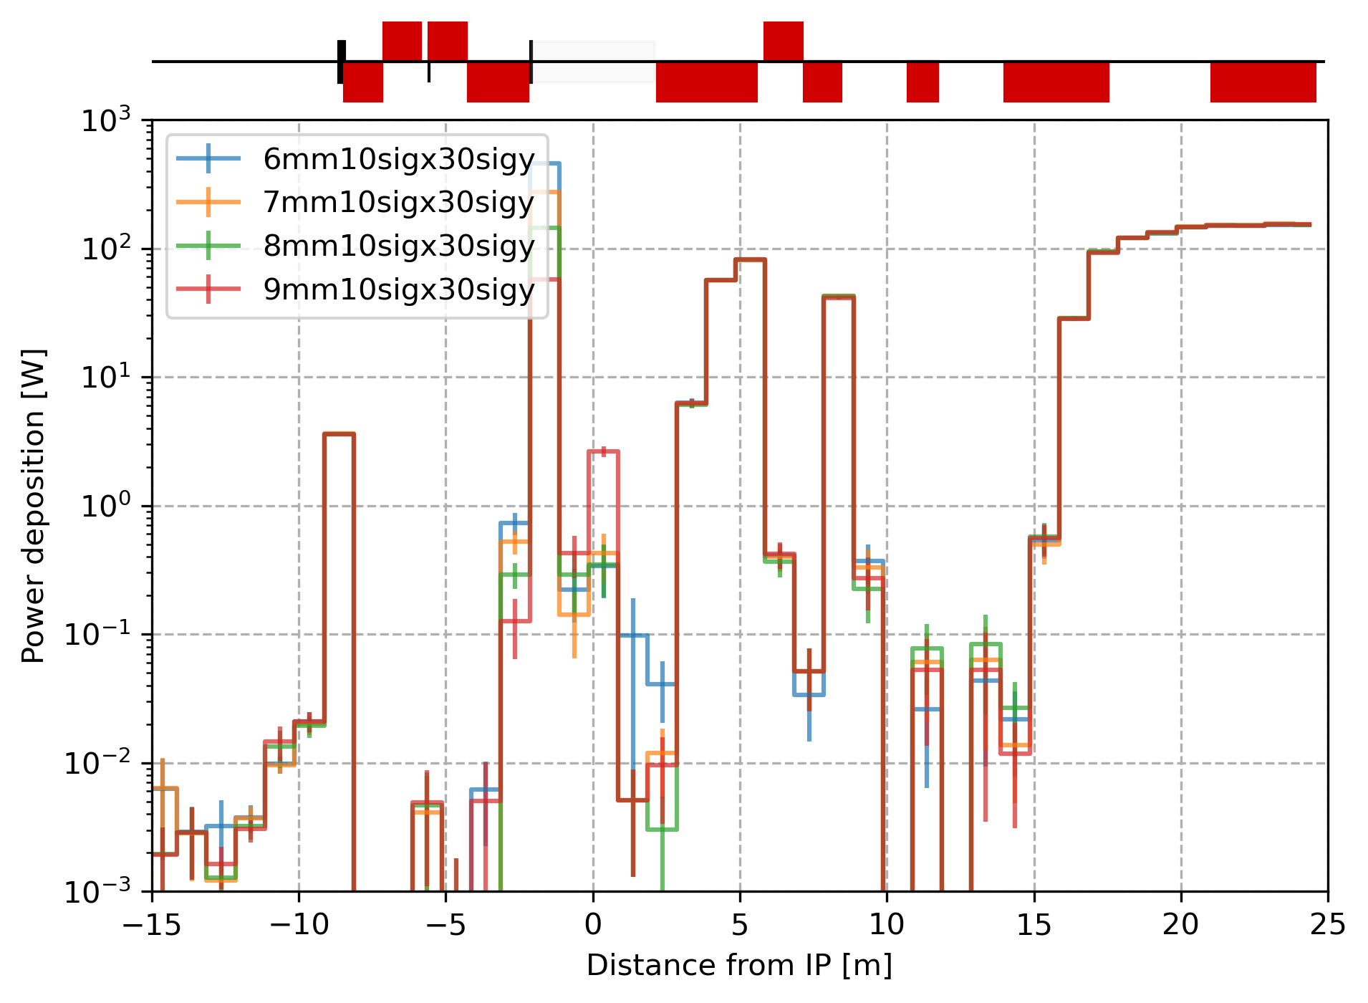
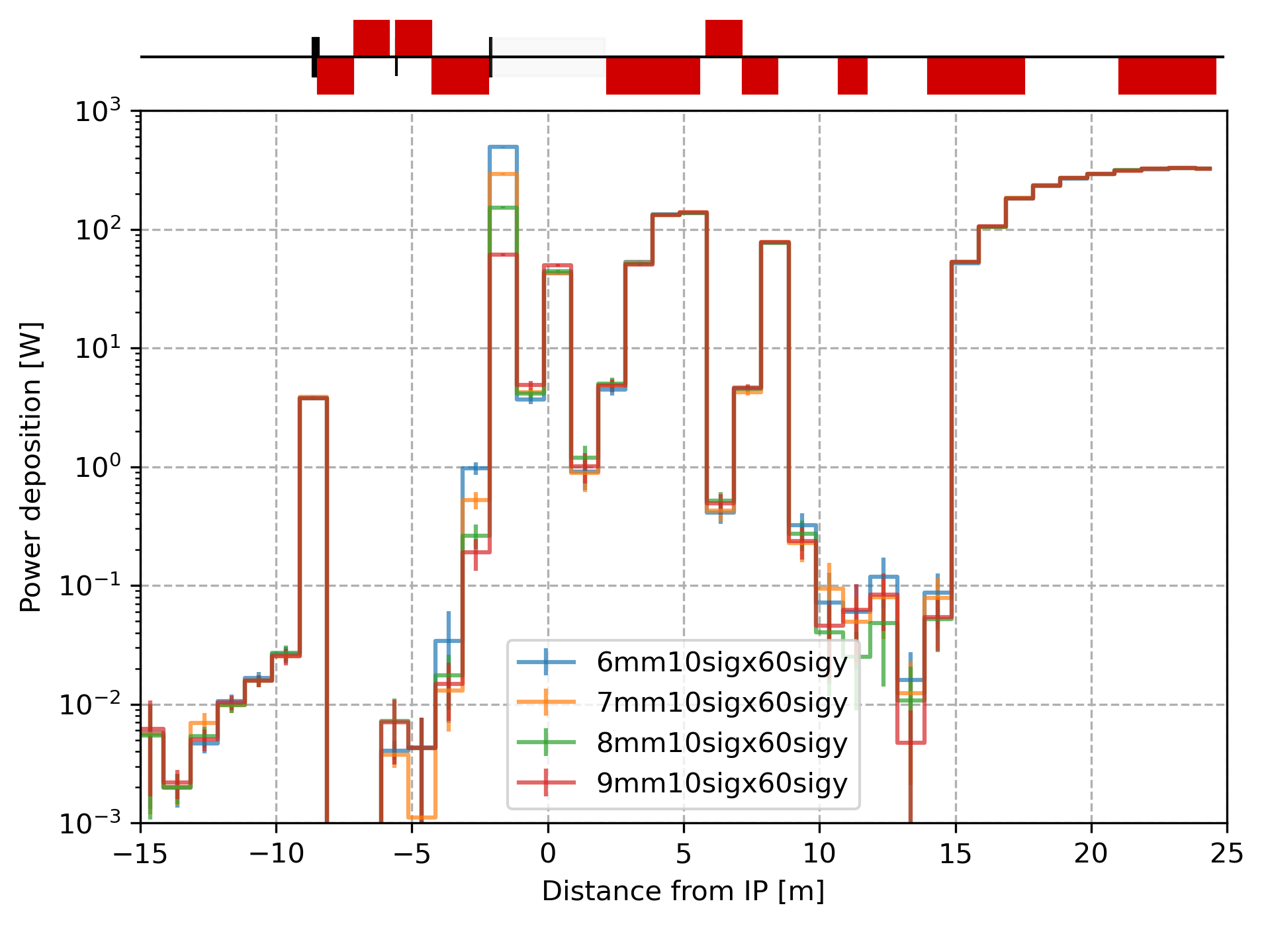
Synchrotron radiation collimation at the Z mode - Core/Tail
With increasing horizontal halo width the mask gets more SR heat load.
With increasing vertical halo width more SR photons hit the central chamber.
SR from a beam tail with several mask aperture
SR from a Gaussian core with several mask apertures
A smaller aperture of the last mask reduces the power deposited in the central chamber. Leaving only the SR from the solenoid fringe field. 6 mm is better than 7 and 8 mm with same result and 9 mm is not sufficient.

Slide 5
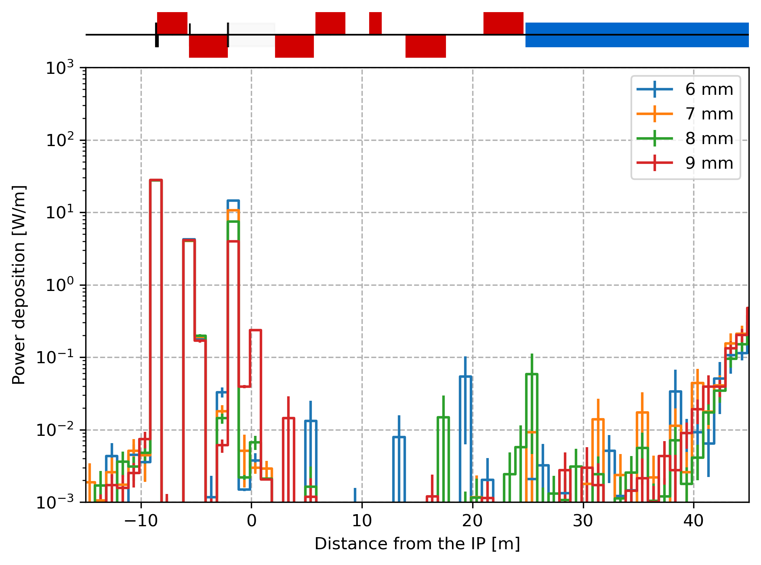
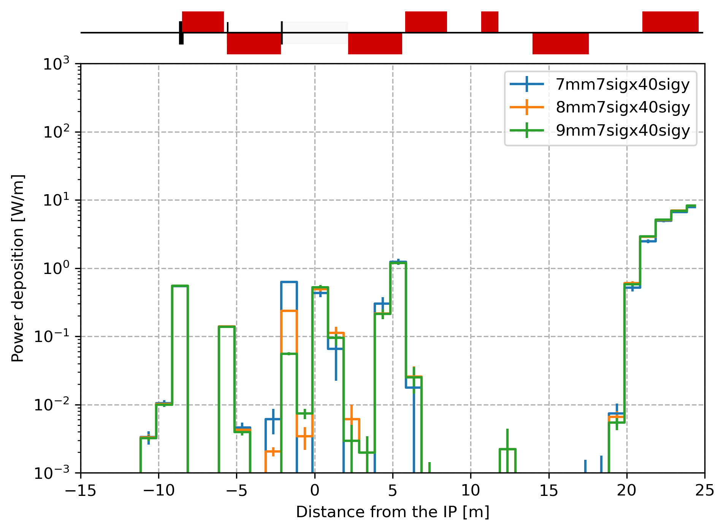
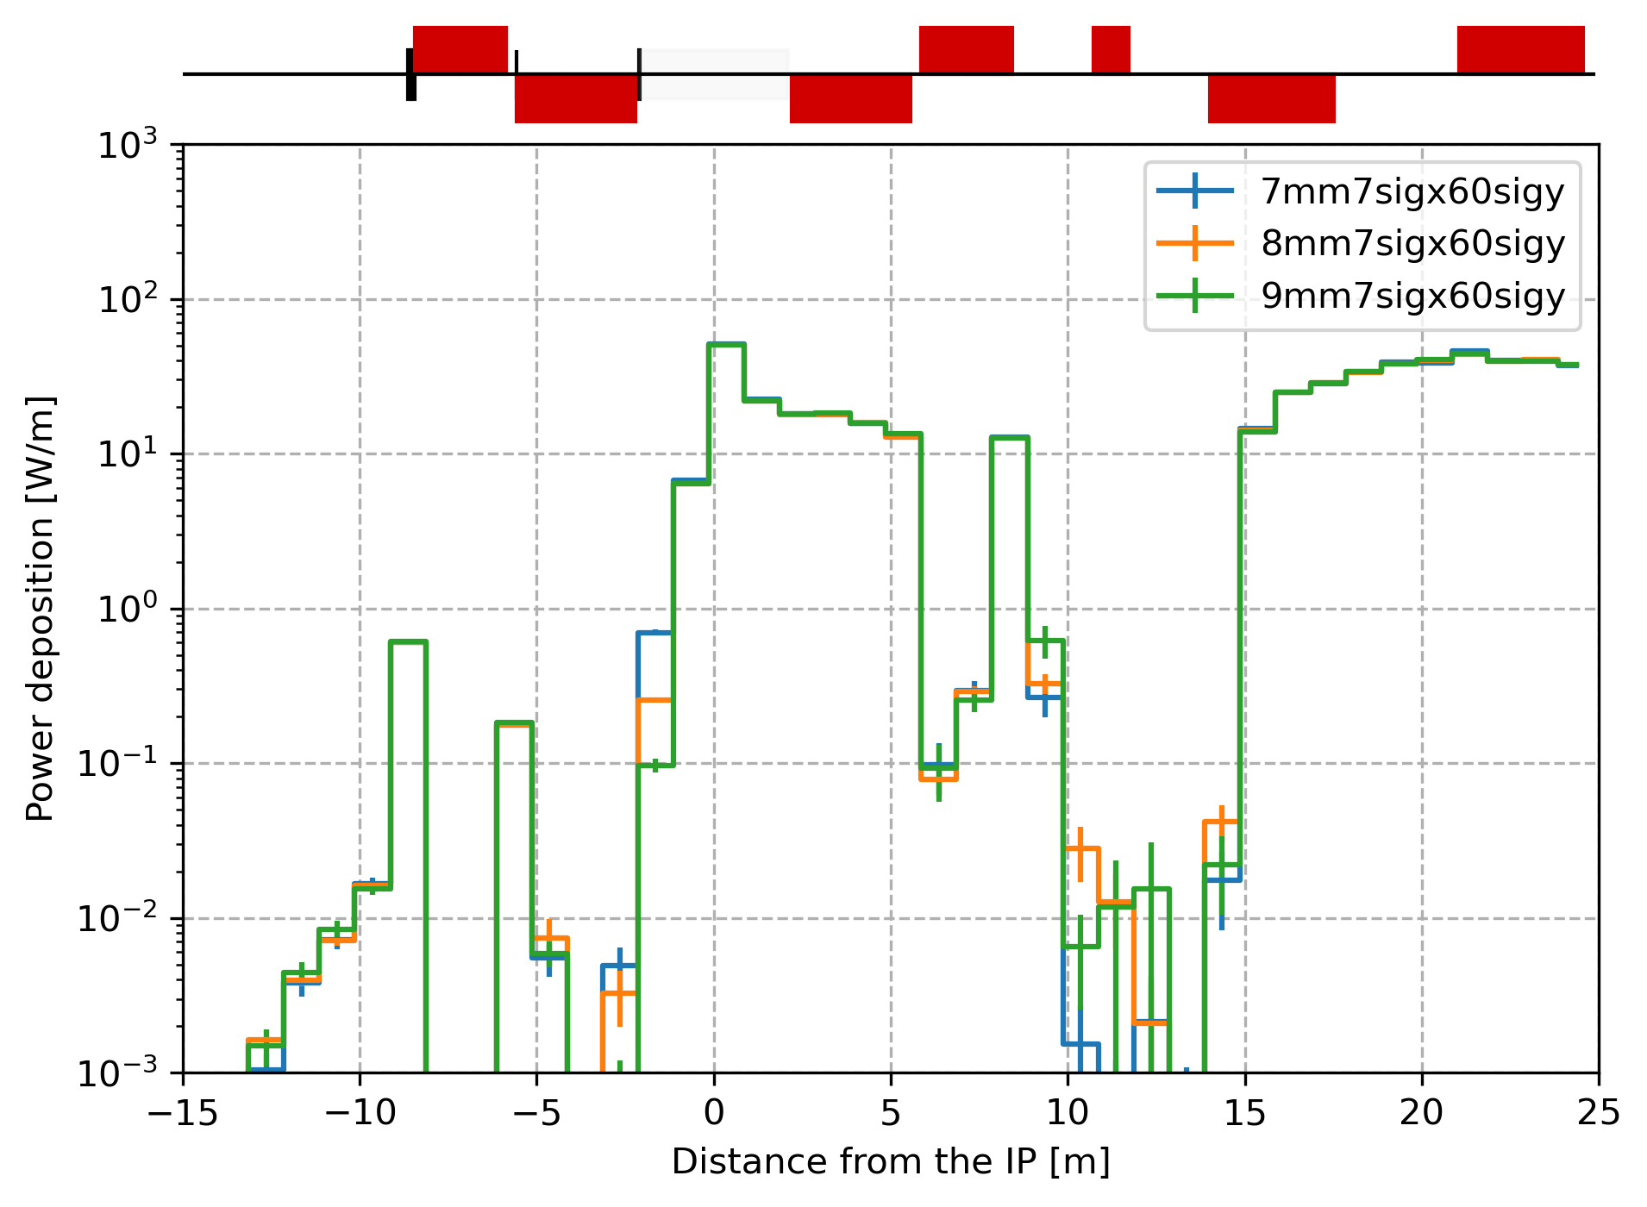
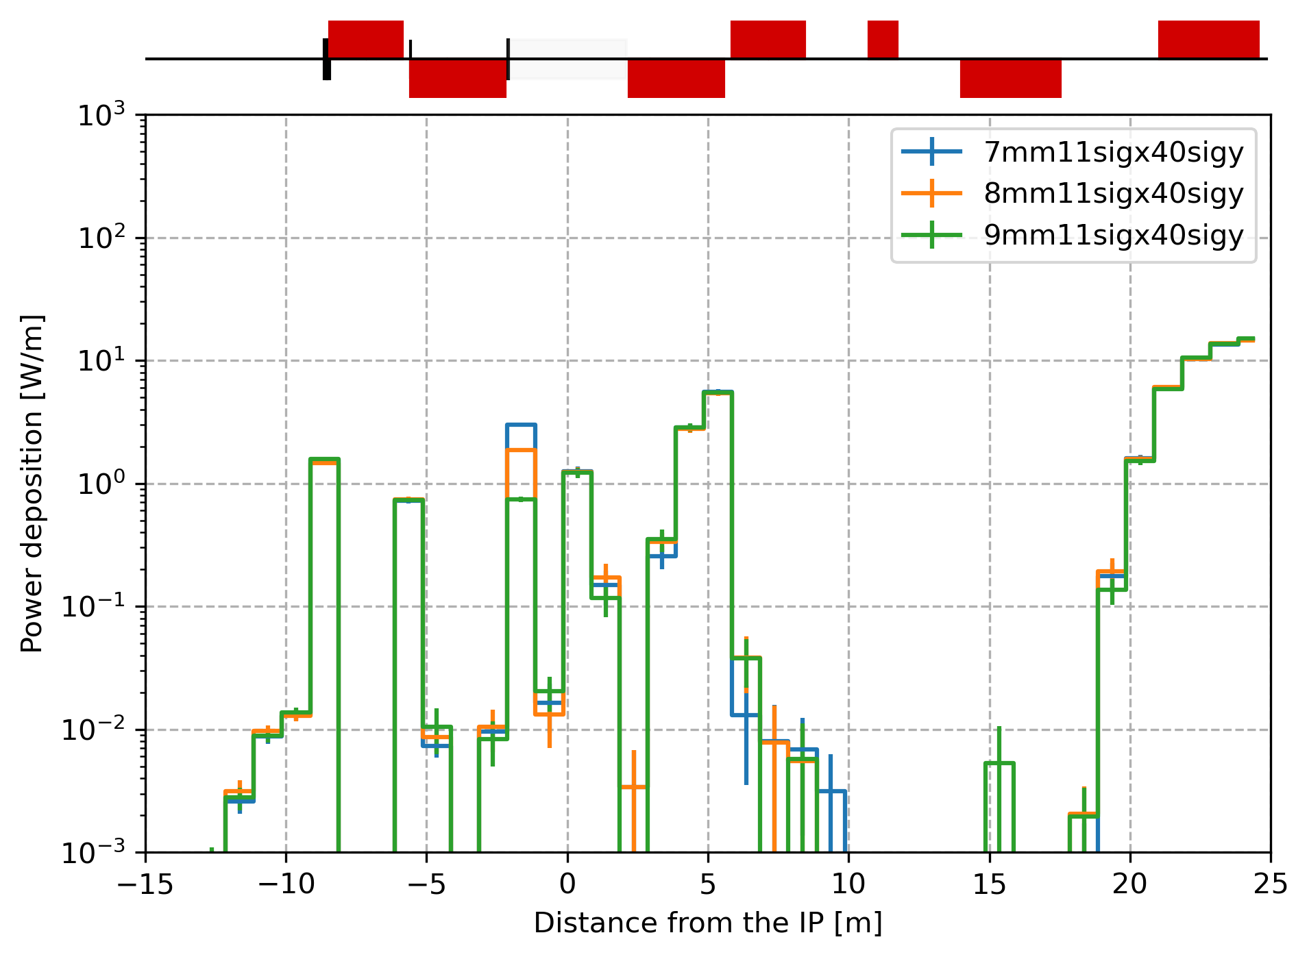
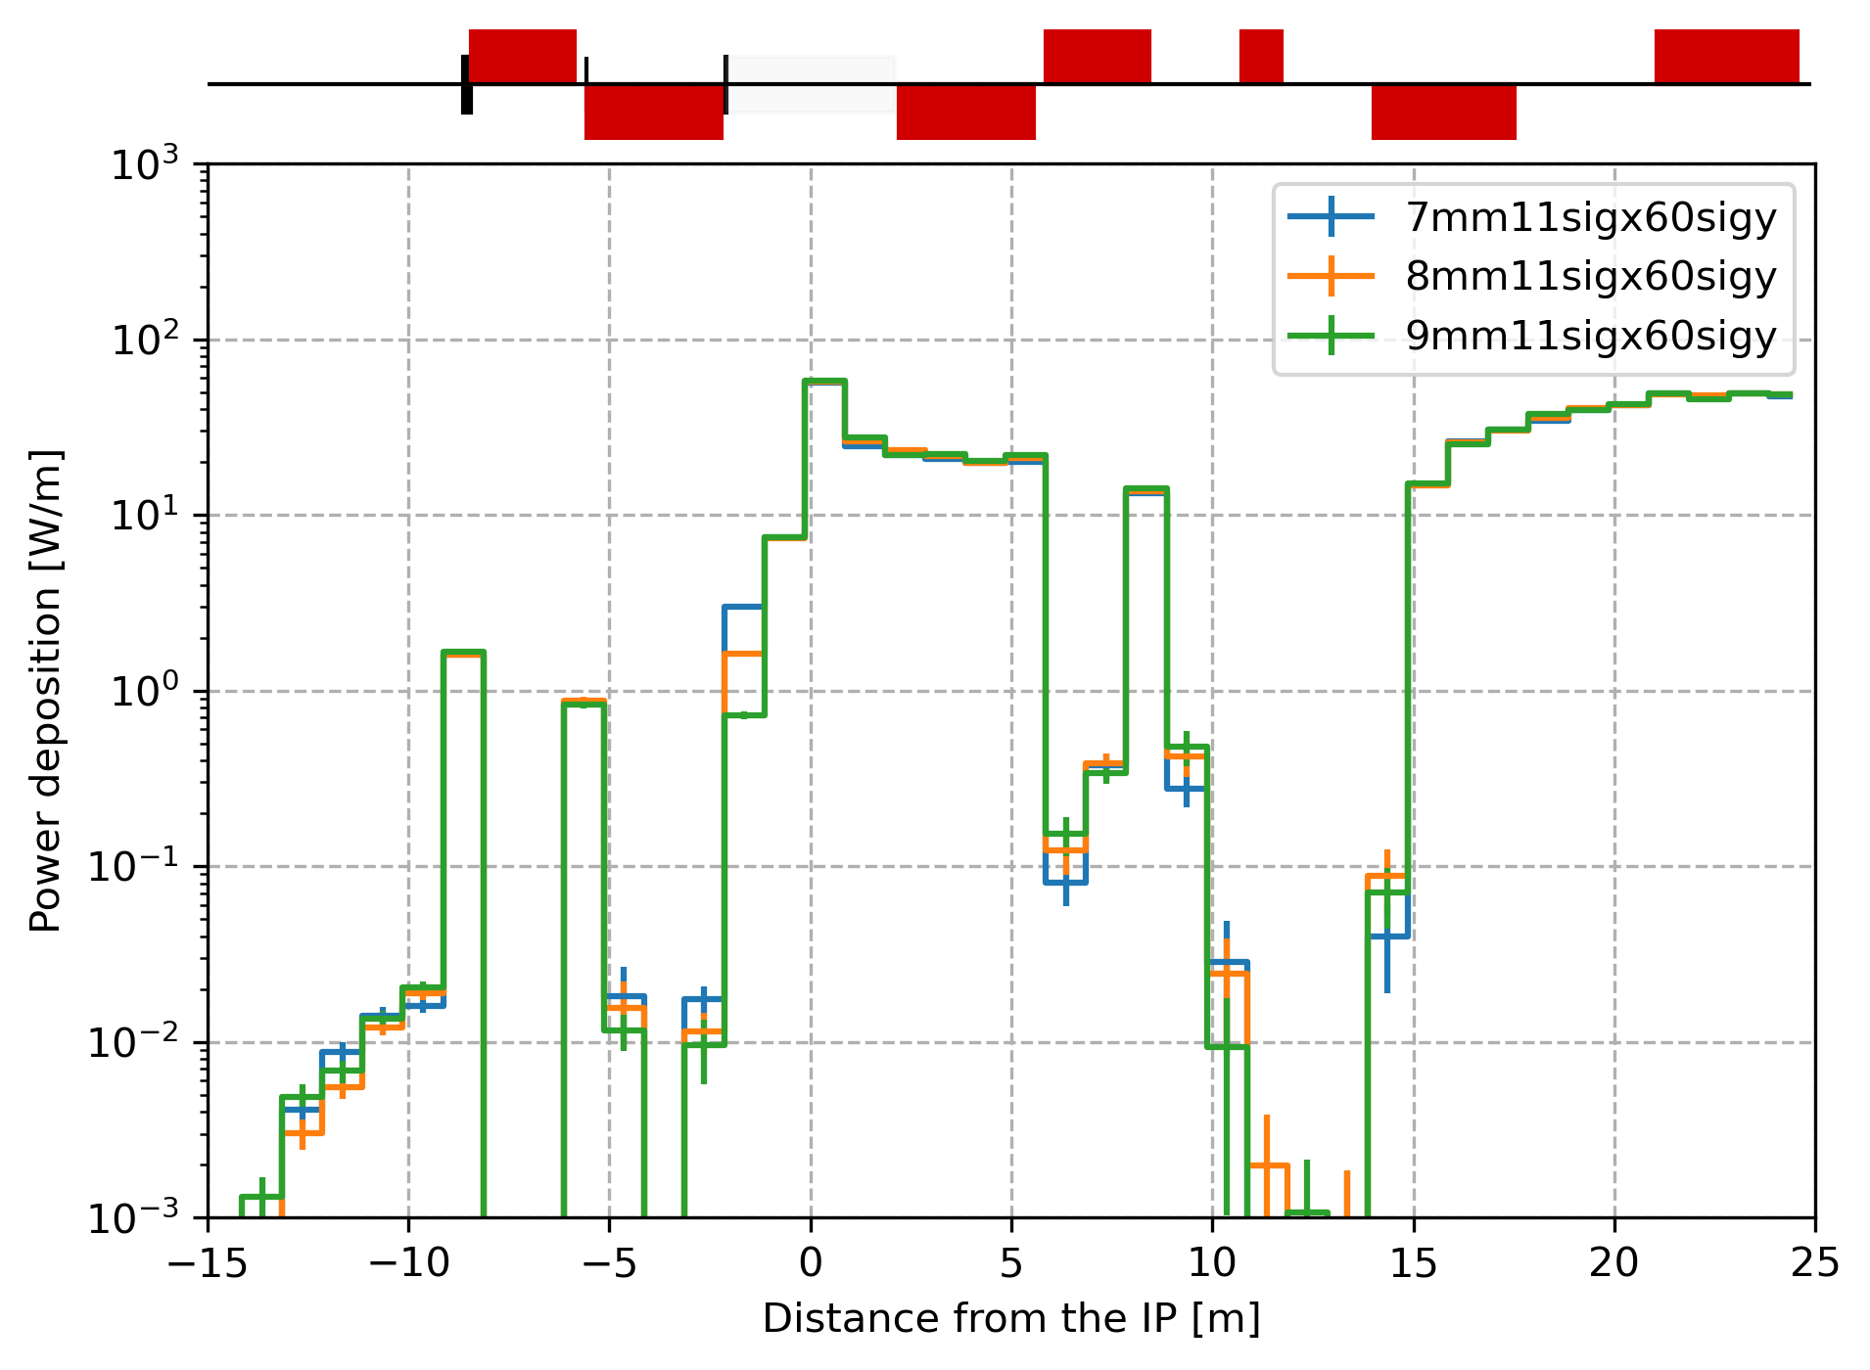
Synchrotron radiation collimation at the tt mode - Core/Tail
SR from a beam tail with several mask aperture
SR from a Gaussian core with several mask apertures
A smaller aperture of the last mask reduces the power deposited in the central chamber. Mask aperture of 6, 7 and 8 mm provide the same heat load in the CC. Similarly to the Z energy, 9 mm is not sufficient.
The extension of the horizontal tail increases the heat load on the mask but has no effect downstream. The vertical tail extending to 60 σ_{y} create a non negligible heat load on the CC.

Slide 6
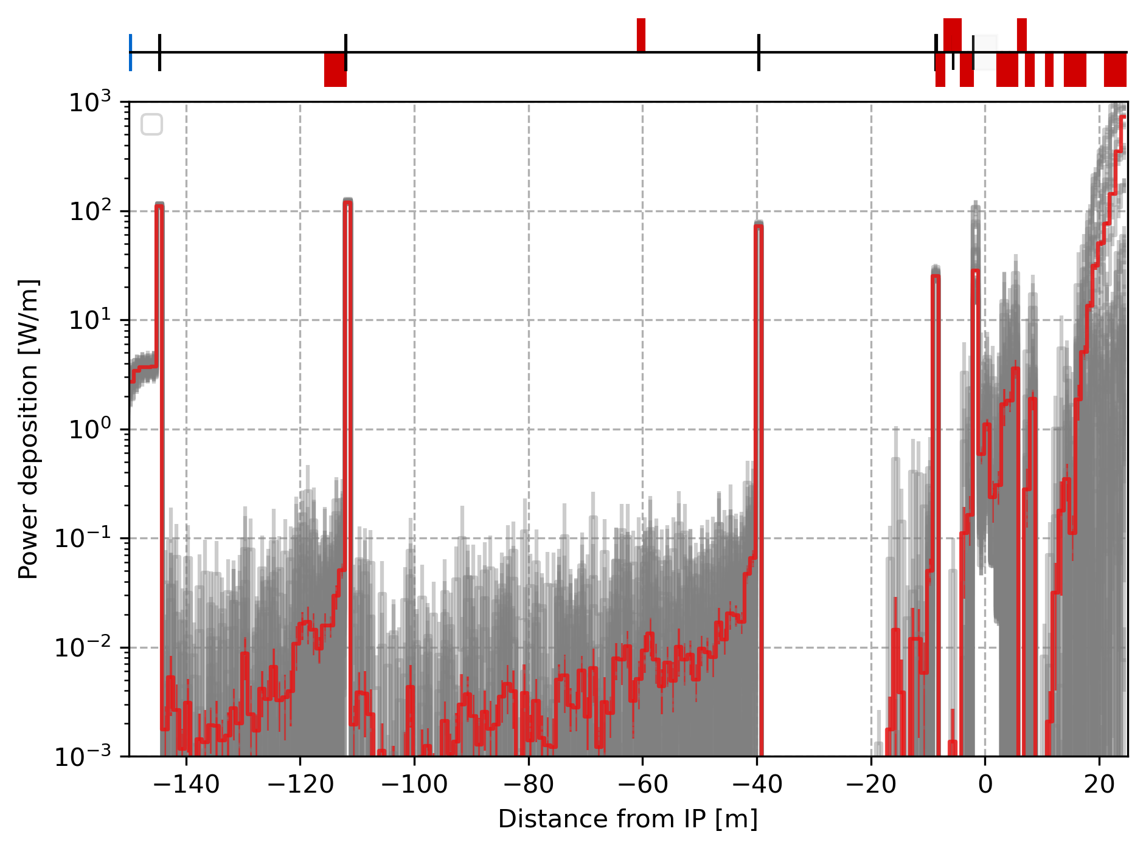
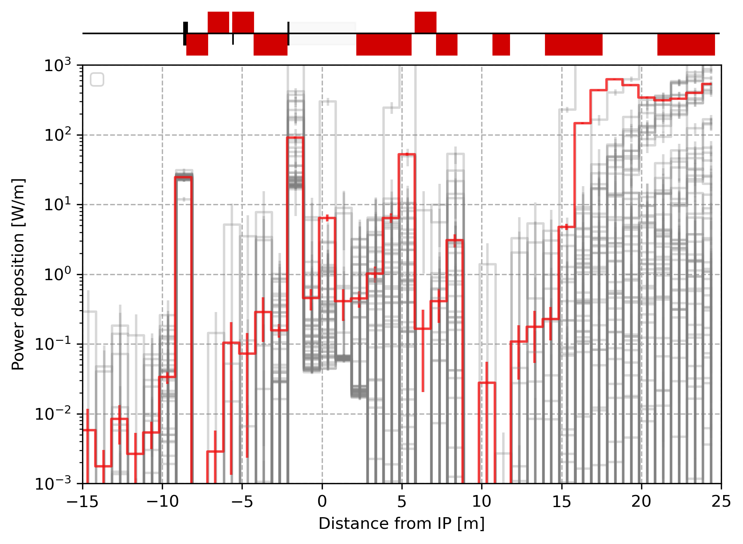
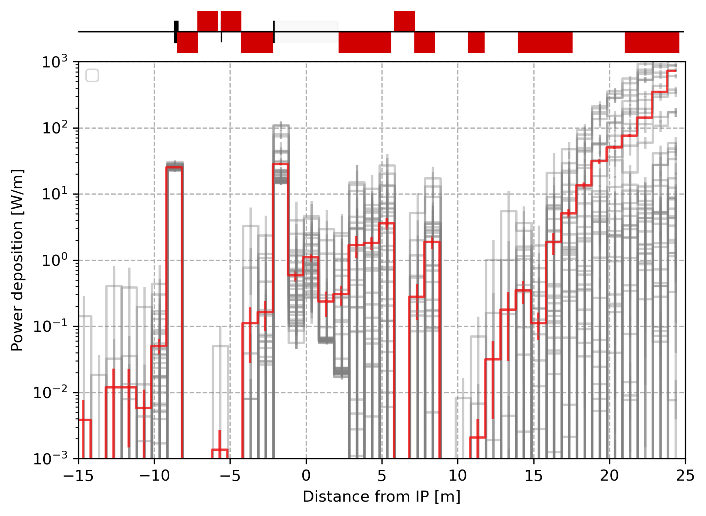
Synchrotron radiation collimation at the Z mode - Jitter
Hor. & Ver. beam jitter only with σ_{x,y}= 100 microns do not show significant difference with the case without beam jitter.
However, a value of the transverse beam direction jitter beyond ± 15 µrad.
Beyond this number a large amount of SR power is deposited near the IP, mostly due to SR created in the FF quadrupoles upstream or the solenoid.
7mm mask aperture
Simulations made with a Gaussian positron beam with position and divergence beam tolerance starting from BWL.
At Z energy:
std of 100 µm eq. to 0.06σ_{x} at BWL and 5.1σ_{y} at BWL.
std of 10 µrad eq. to 1.8 σ’_{x} at BWL and 14.7σ’_{y} at BWL
At tt energy:
std of 100 µm eq. to 0.06σ_{x} at BWL and 7.6σ_{y} at BWL.
std of 10 µrad eq. to 1.4σ’_{x} at BWL and 13.6σ’_{y} at BWL
Simulations made with a Gaussian positron beam with jitter of σ_{x,y}= 100 microns and σ’_{x,y}= 10 microradians. The grey color highlights 50 simulations, the red is the average.
8mm mask aperture

Slide 7
Summary from V22 studies
The SR from the beam core without beam position and divergence tolerances is mostly suppressed by the SR collimation around the IP (SR collimators and horizontal mask).
However, at Z energy a beam divergence above ~15µrad seemed to cause large SR energy deposition in the CC and past the IP.
  Study the SR from beam position and divergence tolerances at Z and tt energies.
Additionally, the SR from the beam halo showed non negligible energy deposition as the vertical halo increases (~tens of watts). No vertical SR collimation after the FF quadrupole focusing horizontally (defocusing vertically).
  Perform SR energy deposition studies from beam halo for Z and tt energies with non-uniform halo distribution (e.g. exponential) and consider an elliptical mask to compare with an horizontal slab.

Slide 8
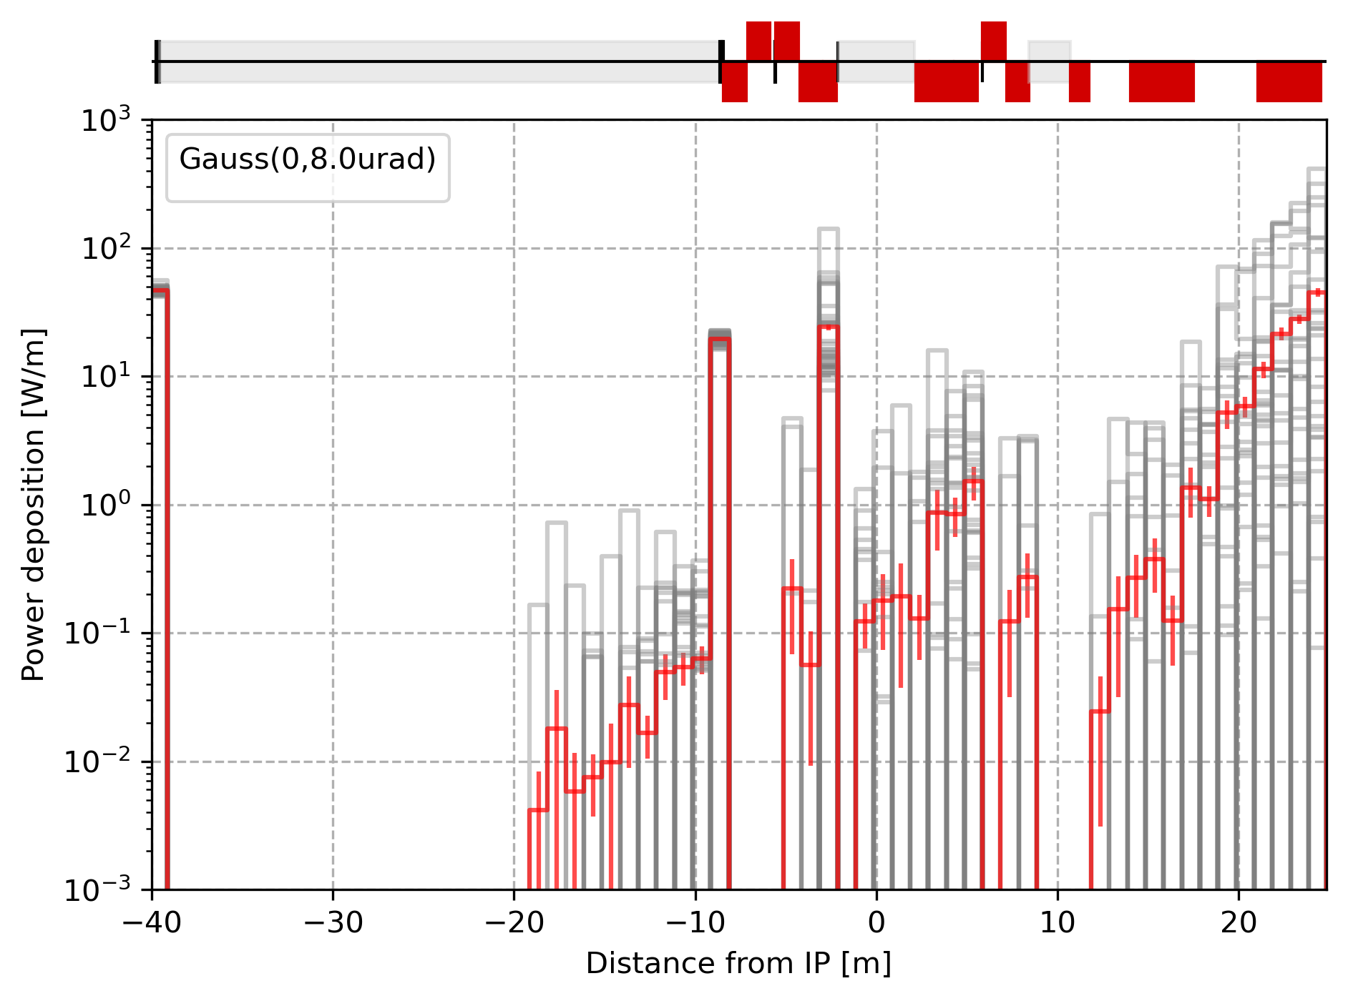
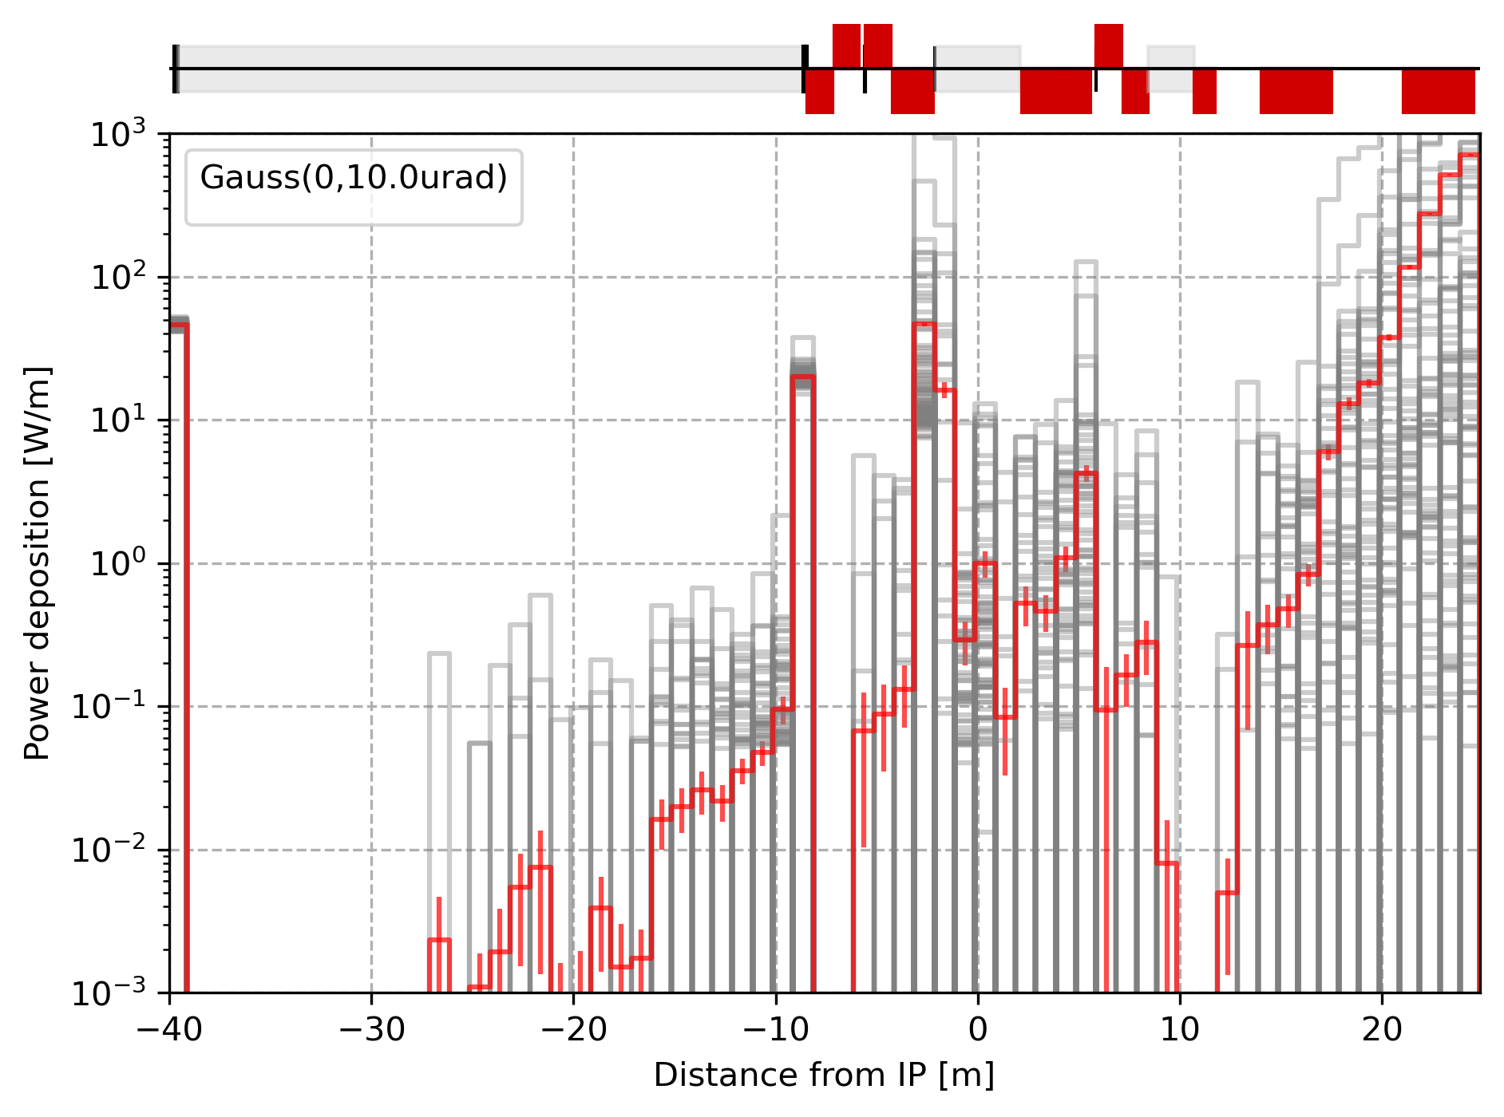
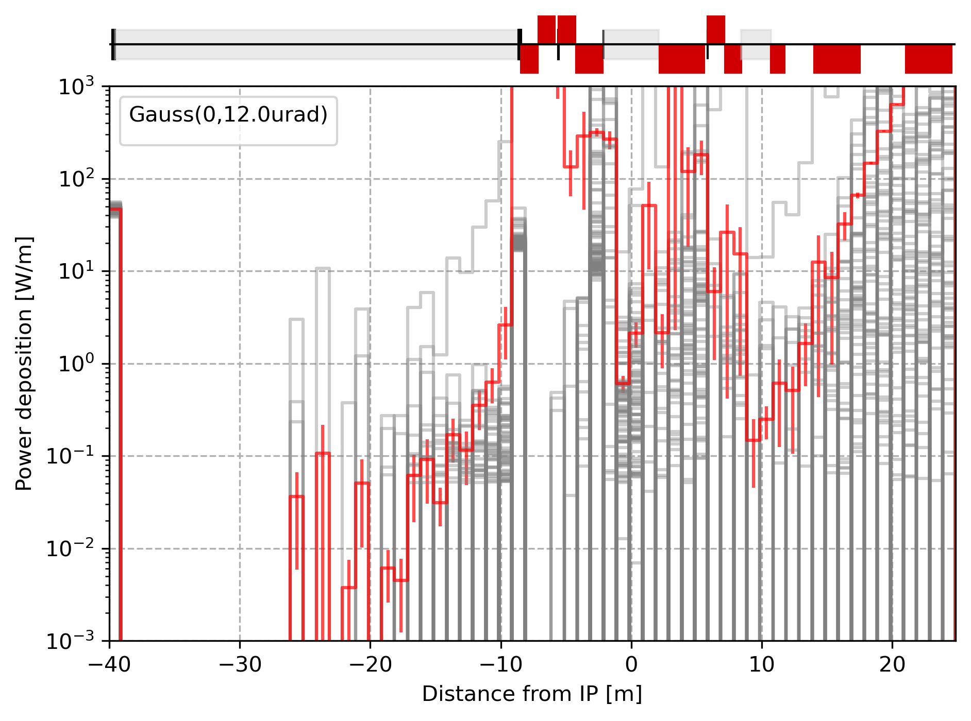
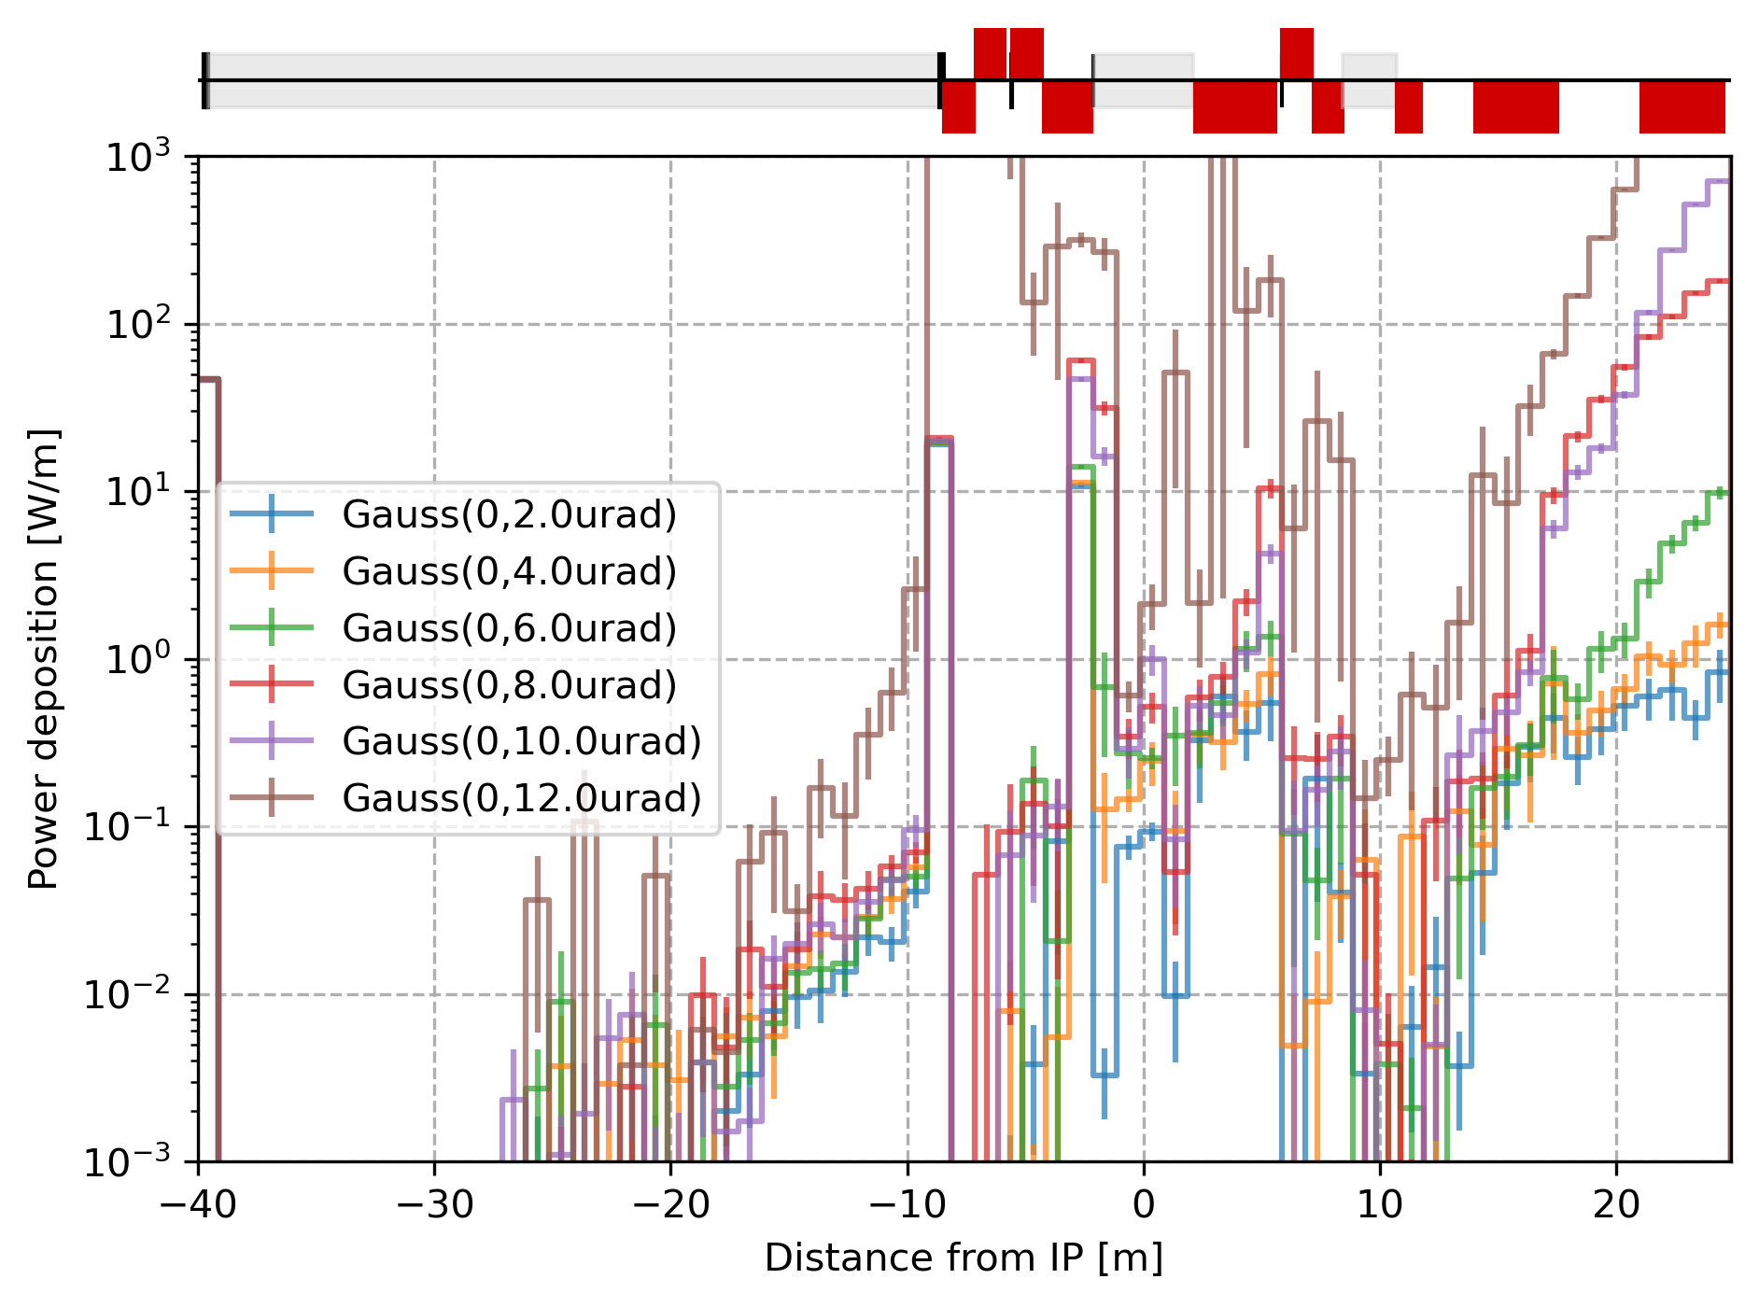
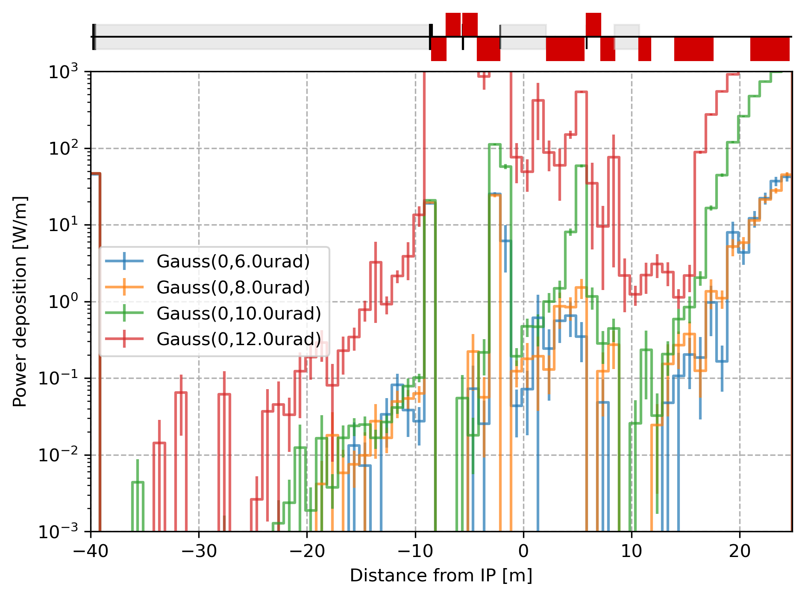
SR from transverse and divergence beam tolerance - Z pole
From ΔX’=ΔY’=Gauss(0, 10µrad) they are seeds reaching very divergence (up to 25µrad) leading to high heat load in the mask.
A second peak appears between QC1R3 and QC2R1. An elliptical mask marginally helps.
Study independently ΔX’ & ΔY’ ?
Horizontal slab mask
Elliptical mask

Slide 9
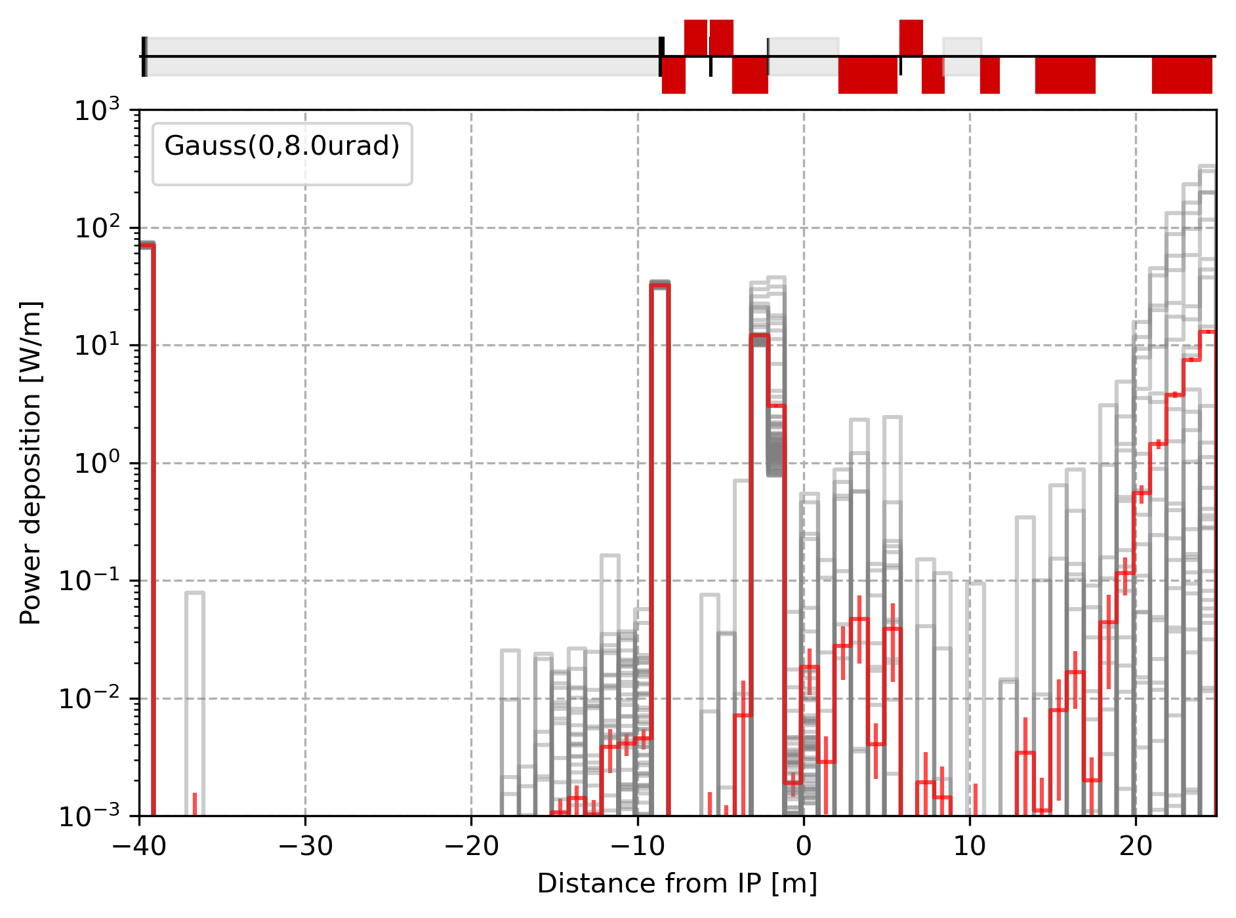
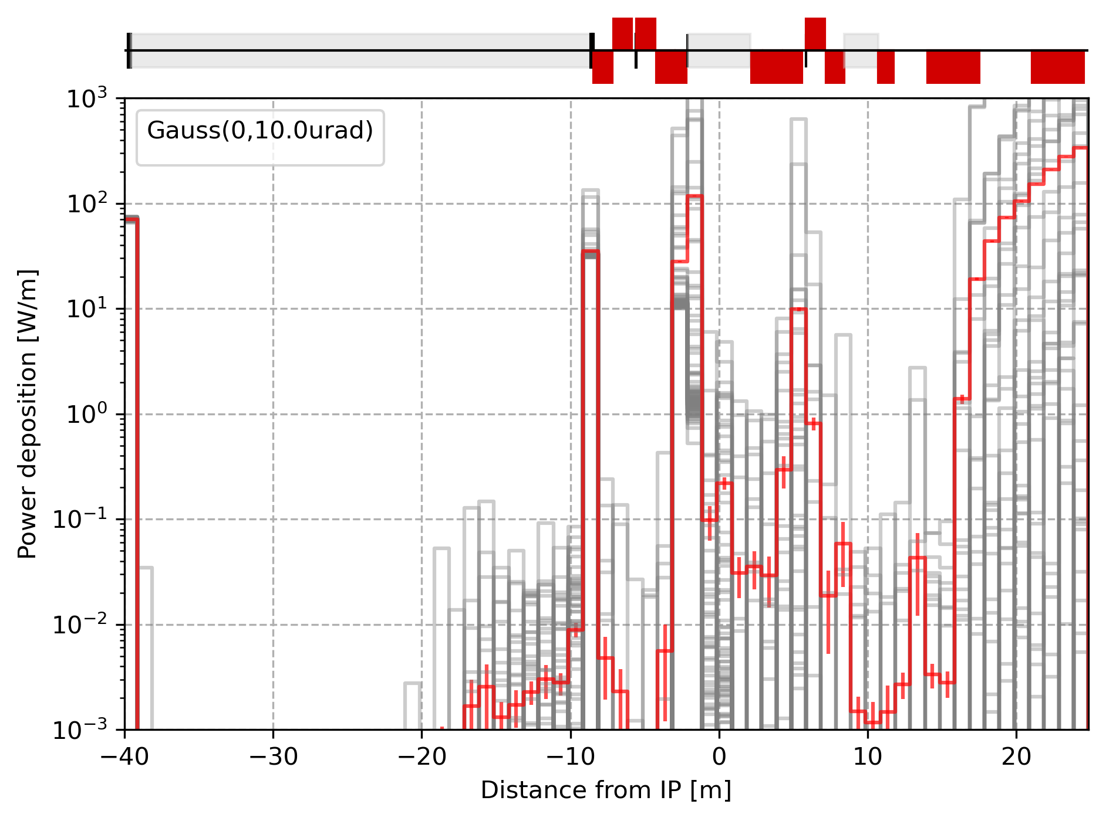
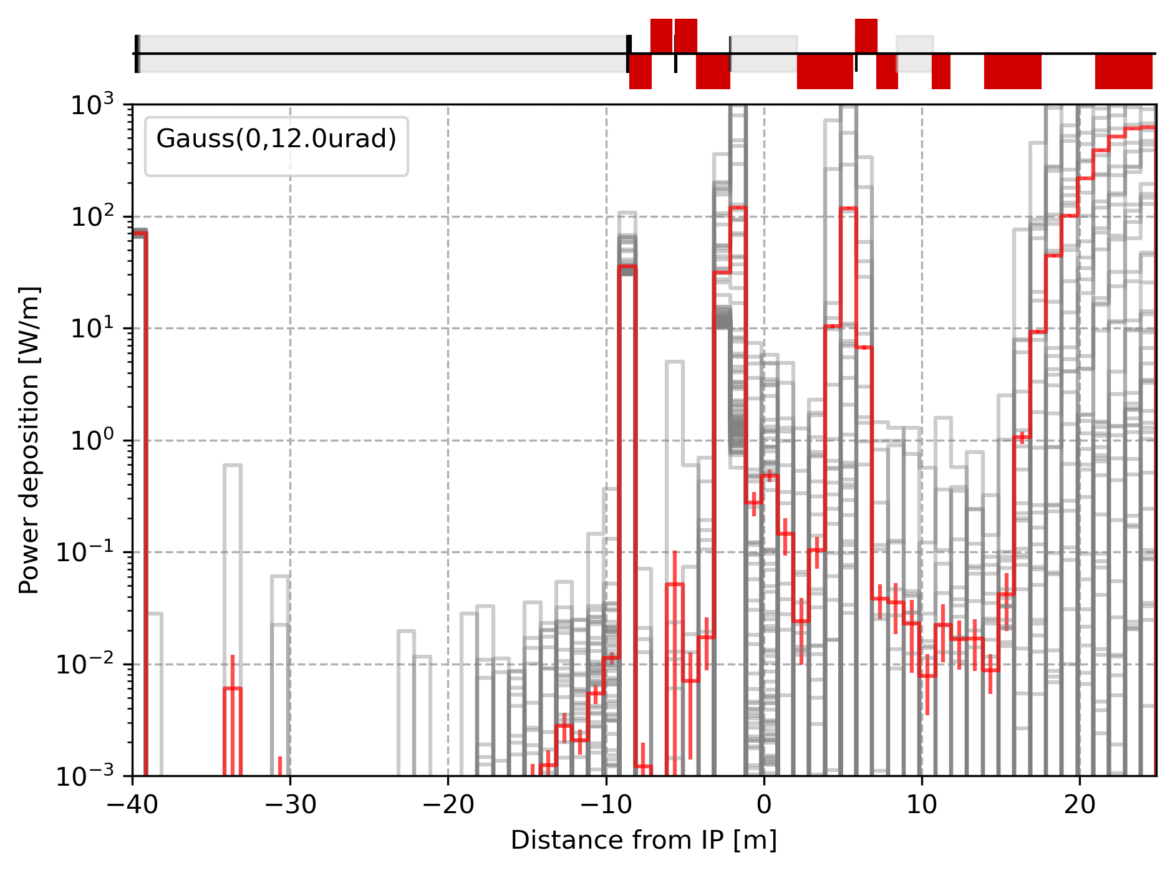
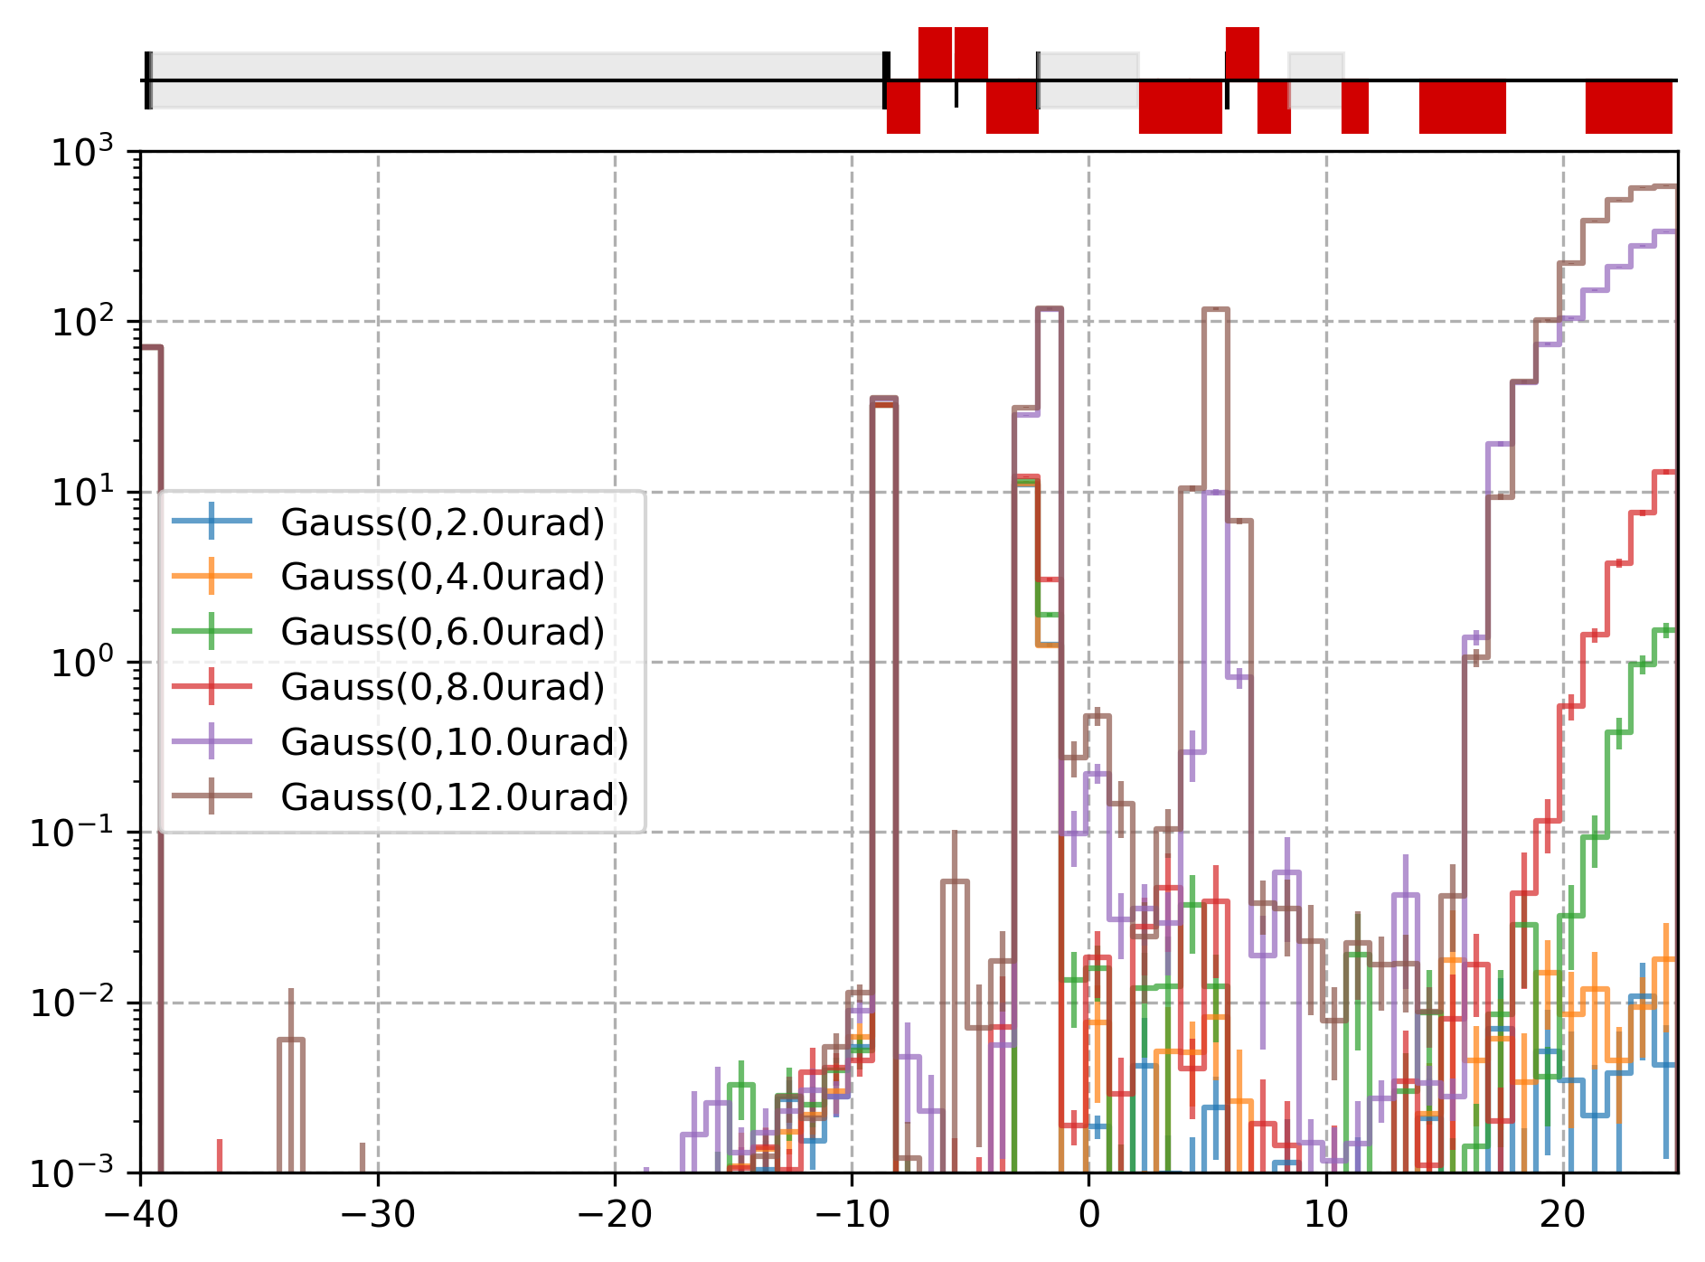
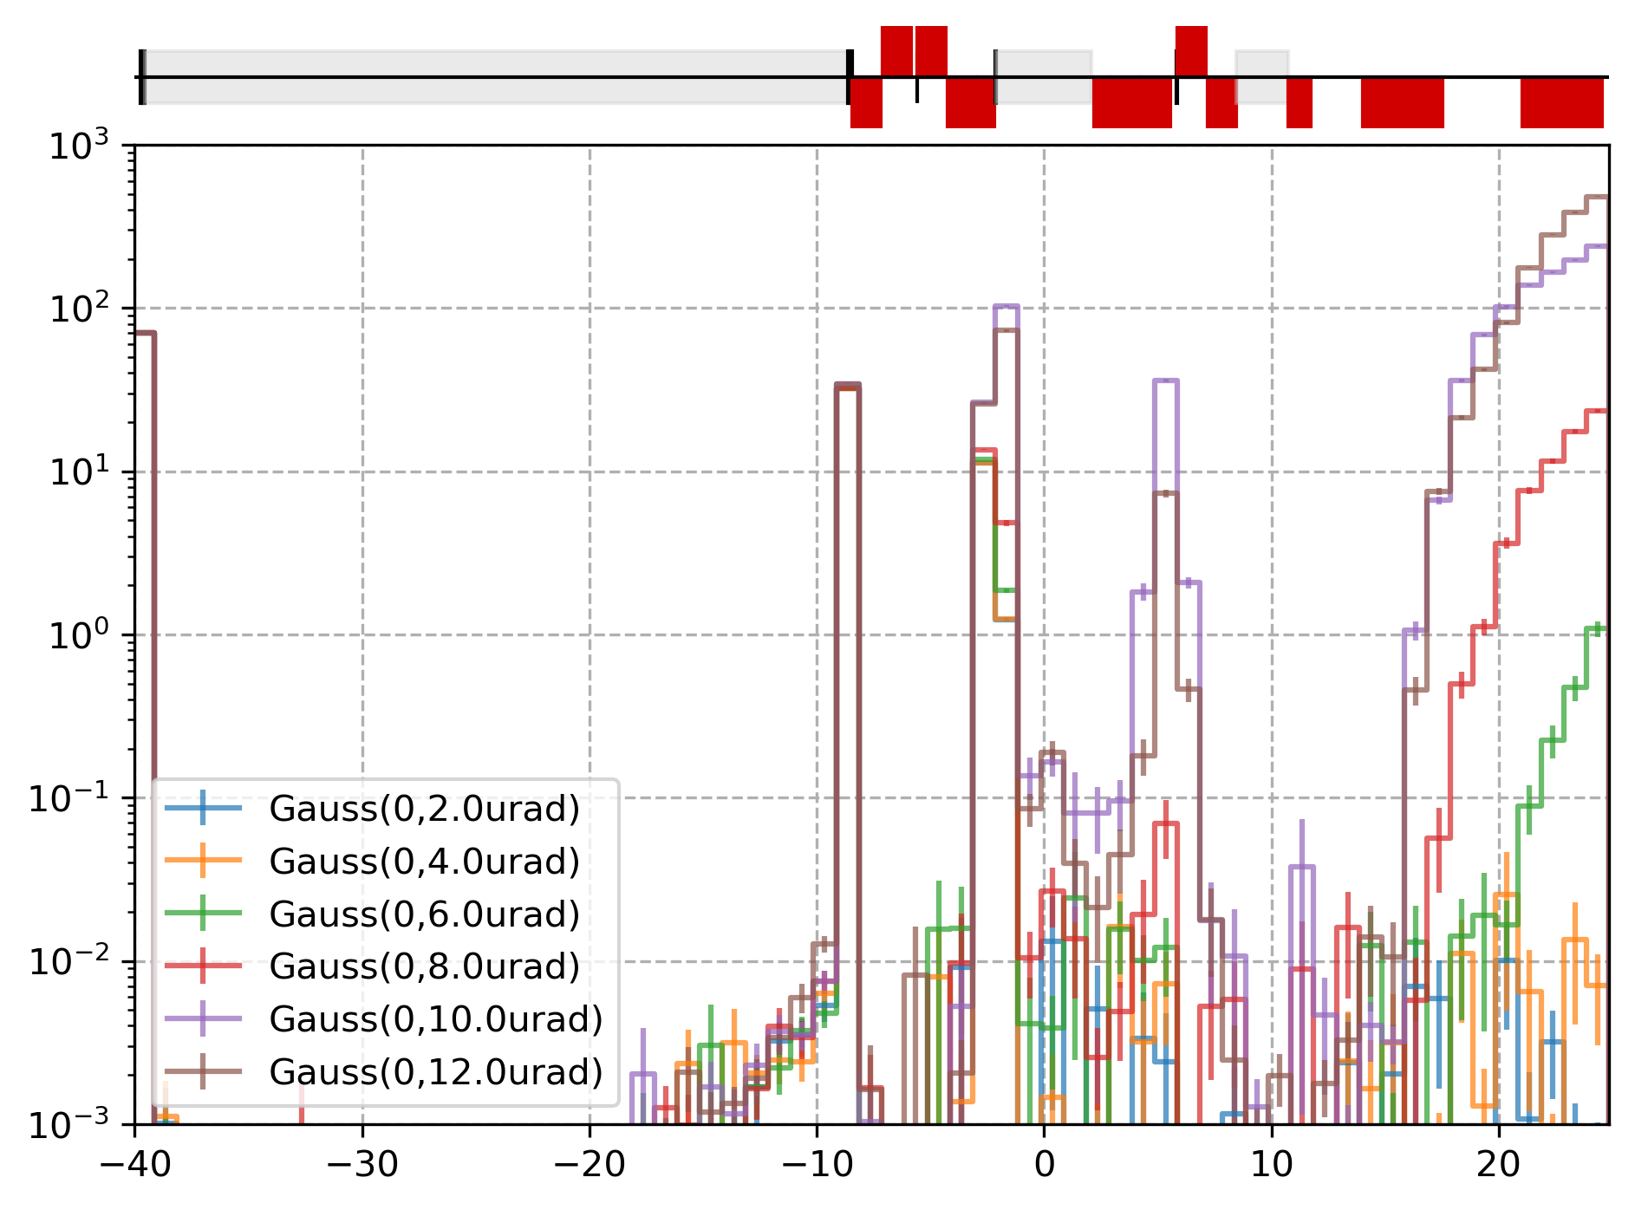
SR from transverse and divergence beam tolerance - tt pole
From ΔX’=ΔY’=Gauss(0, 10µrad) they are seeds reaching very divergence (up to 25µrad) leading to high heat load in the mask.
A second peak appears between QC1R3 and QC2R1. An elliptical mask marginally helps.
Study independently ΔX’ & ΔY’ ?
Horizontal slab mask
Elliptical mask

Slide 10
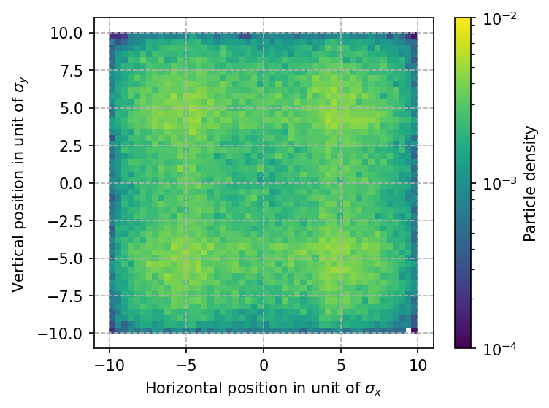
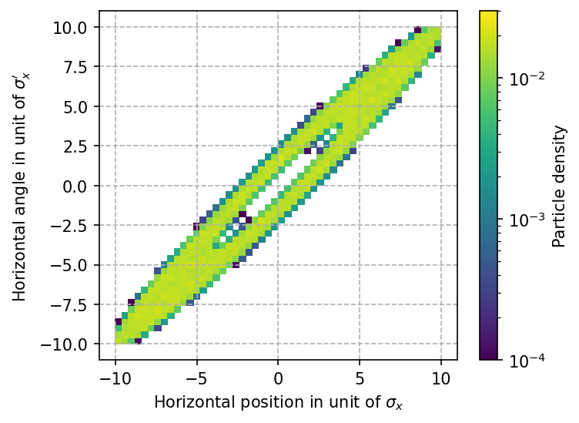
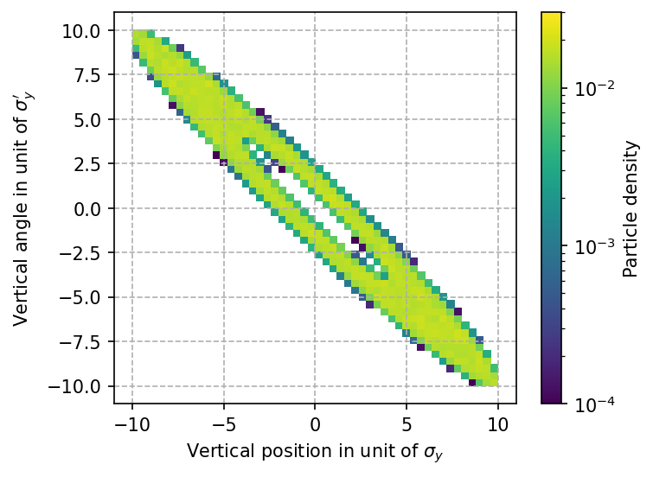
Beam model | Core and tail description
Previous studies from M. Sullivan [1, 2] showed that the non-gaussian beam tails will create a large amount of photons especially in the final focus quadrupoles, hence it needs to be modeled and studied.
Gaussian distribution for the beam core extends to around 4(5) sigmas and a correlated uniform distribution is used to fill the X-X’ (and Y-Y’) phase space from 3.5 σ_{x} to 6 (8 or 10) σ_{x} along the horizontal positions and angles and from 3.5 σ_{y} to 30 (50 or 60) σ_{y} along the vertical positions and angles. Assuming 98% of the particles in the core and 2% in the tails.
Uniform along X-Y
Correlated in X-X’ and Y-Y’

Slide 11
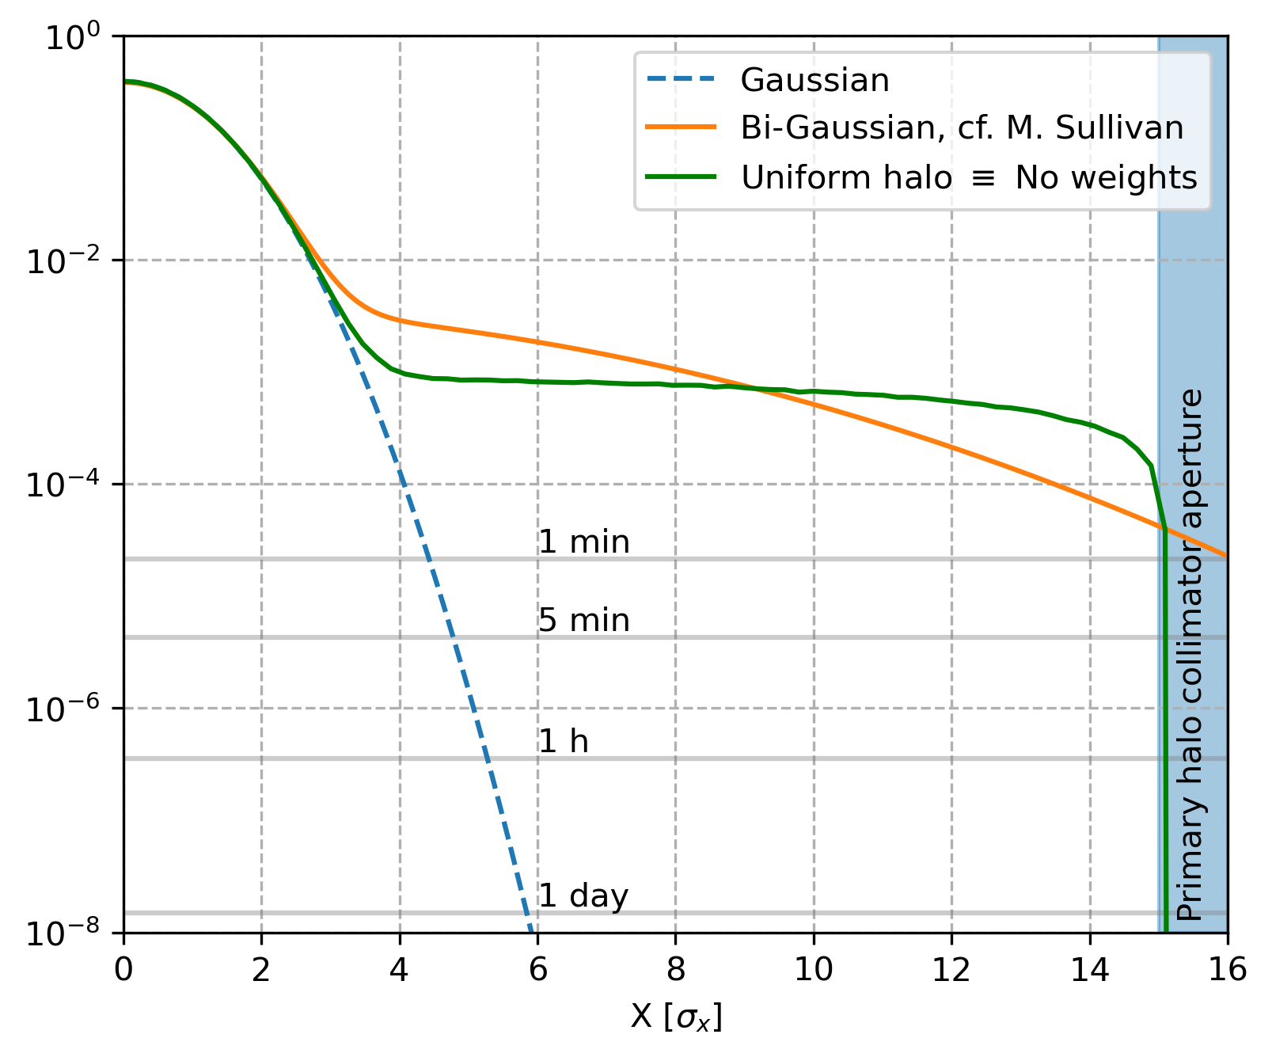
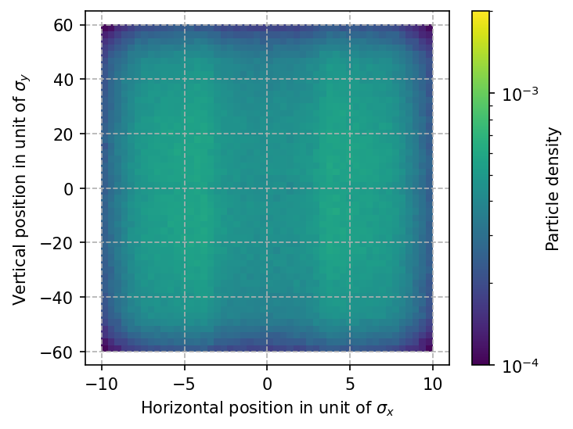
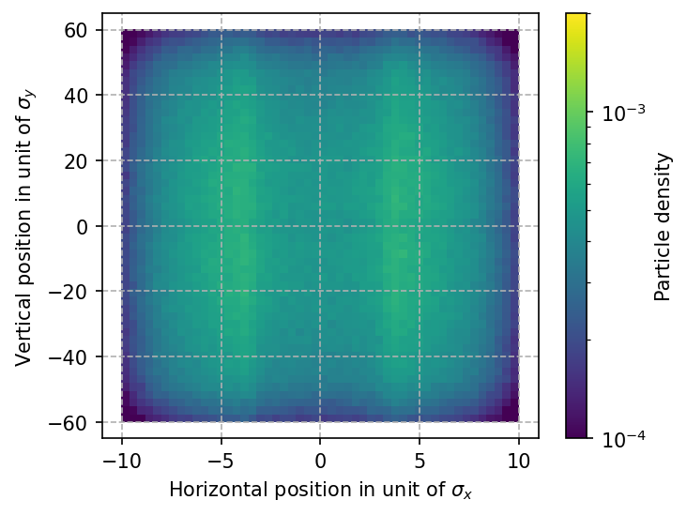
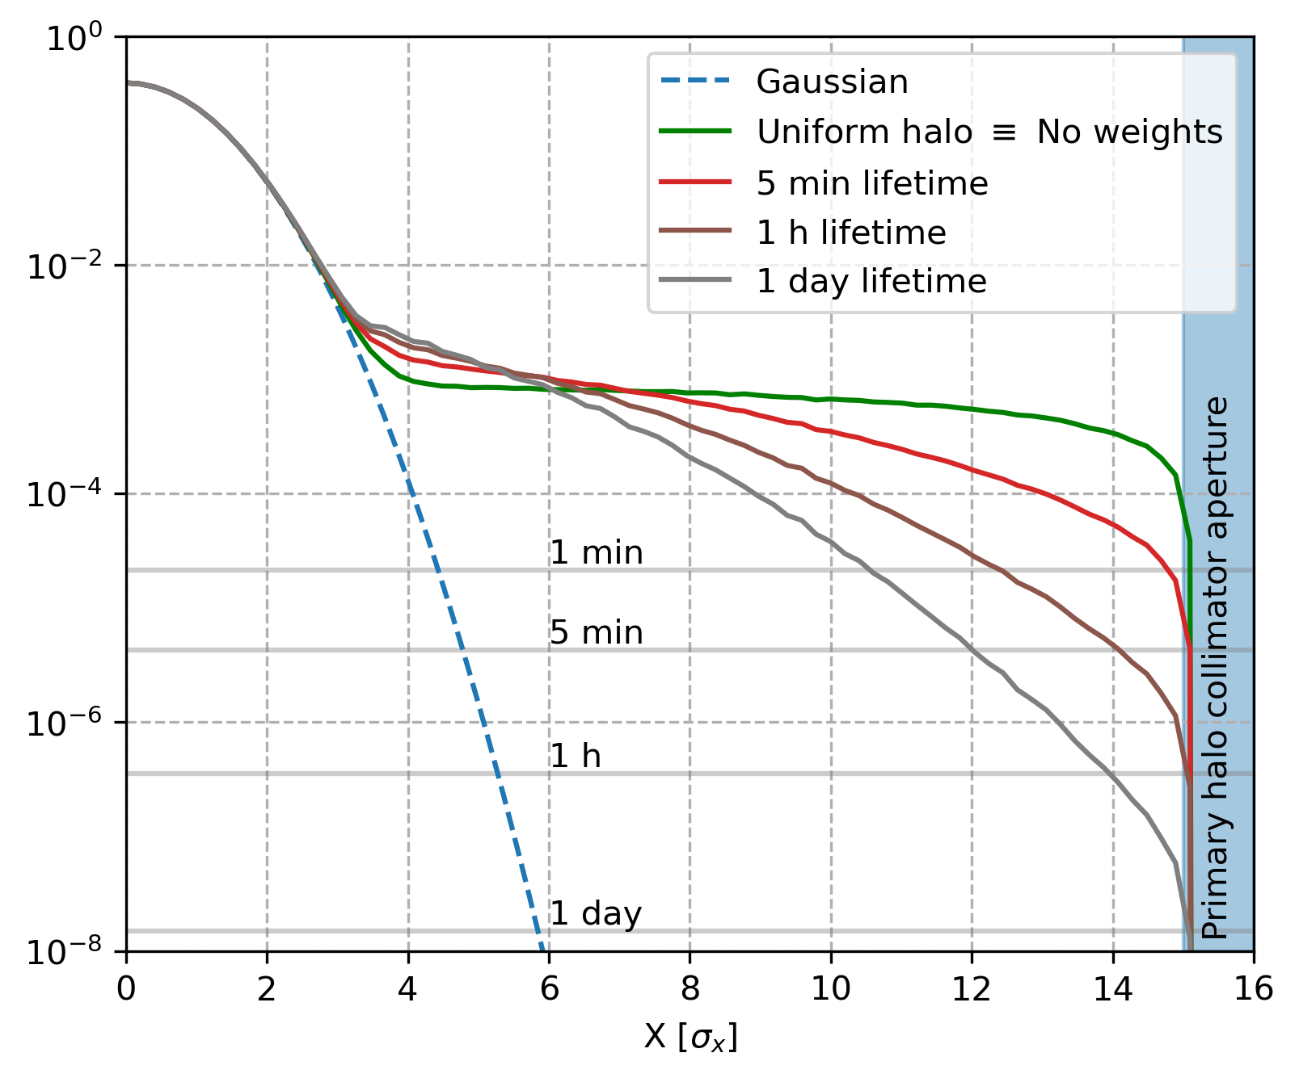
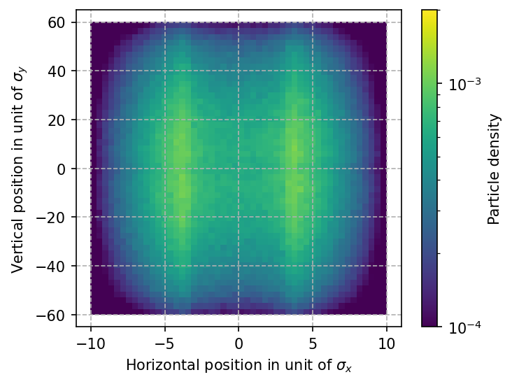
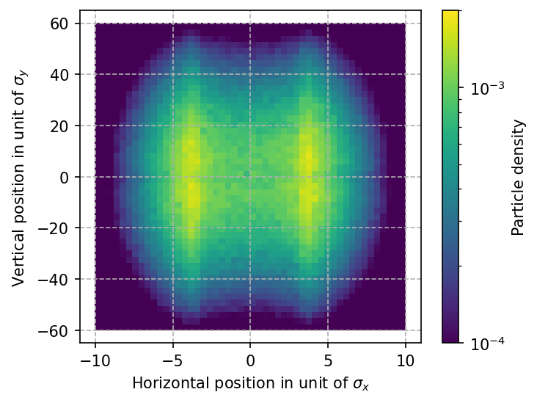
Beam model | Weighted tail description
Correlated uniform distribution vs. correlated exponential distribution.
Uniform - green
Exponential - red
Exponential - brown
Exponential - grey

Slide 12
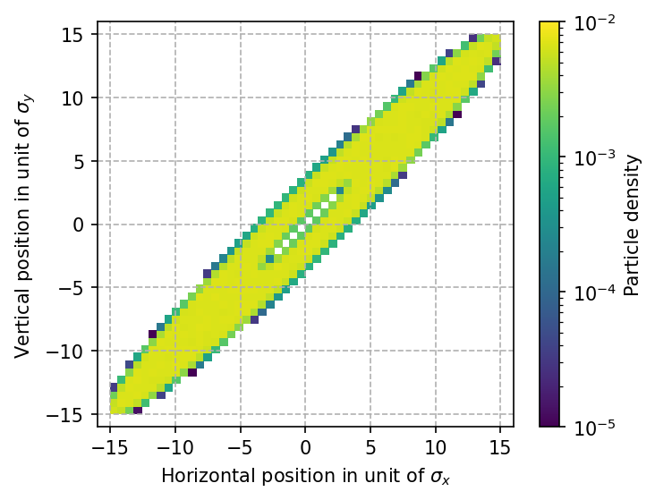
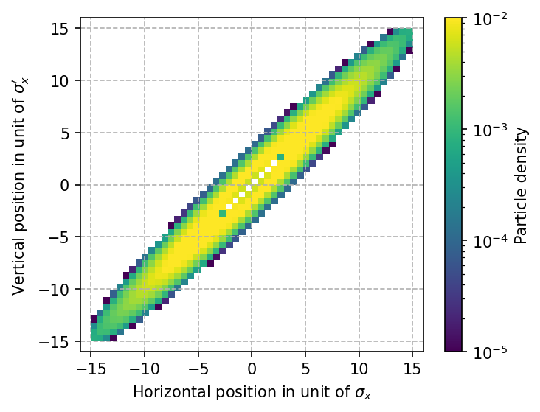
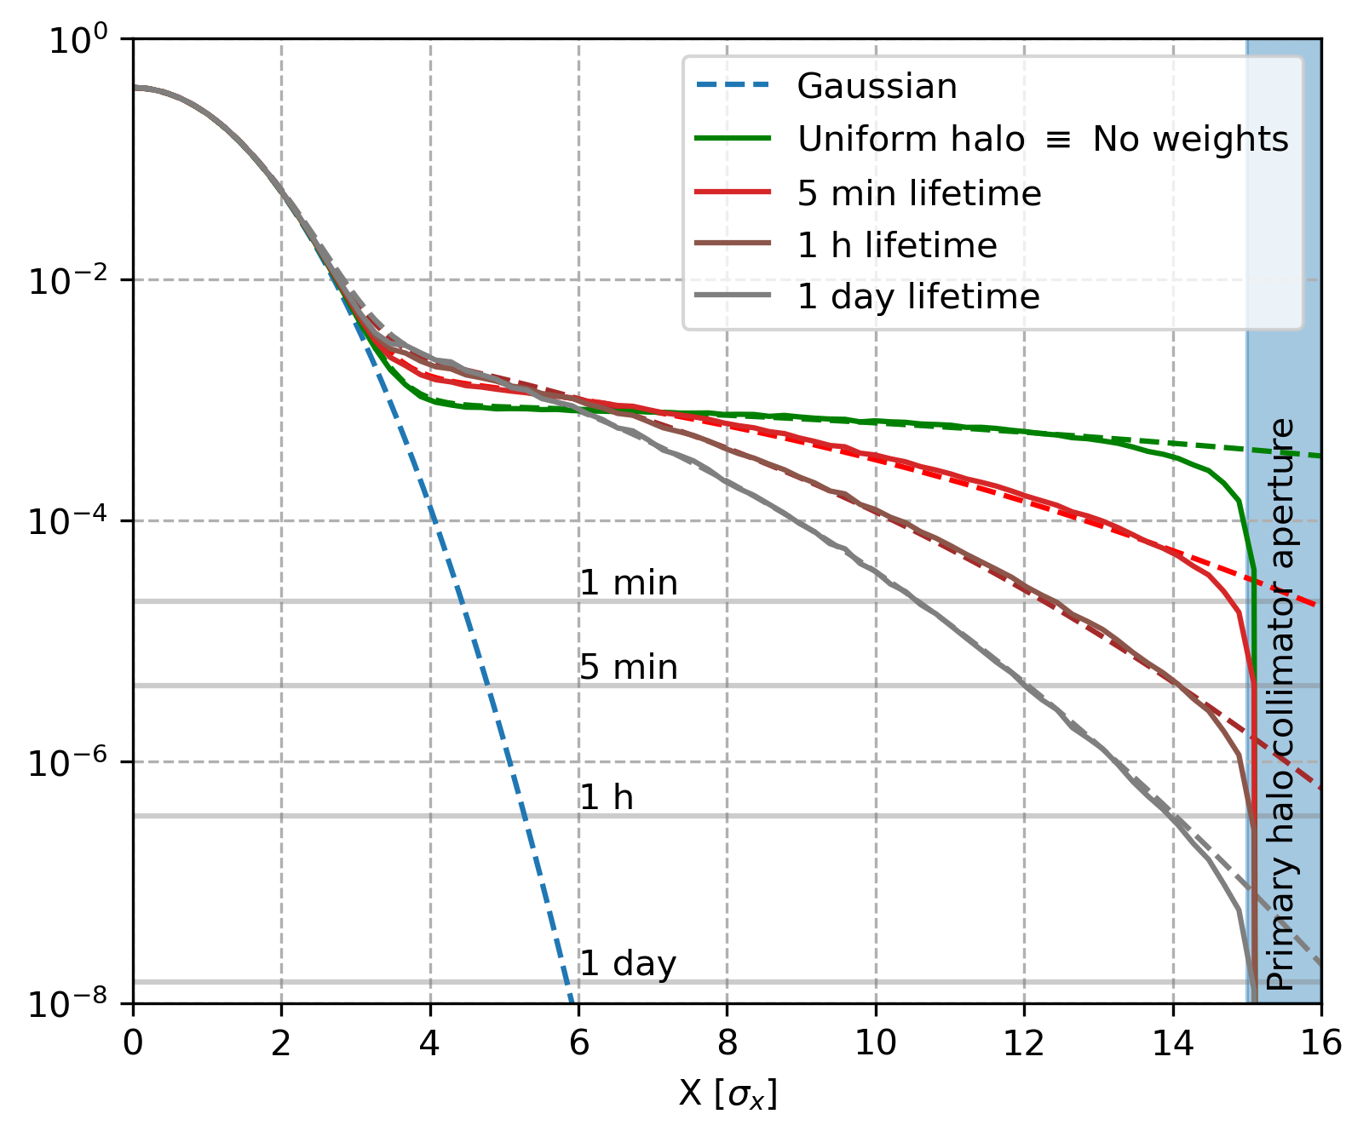
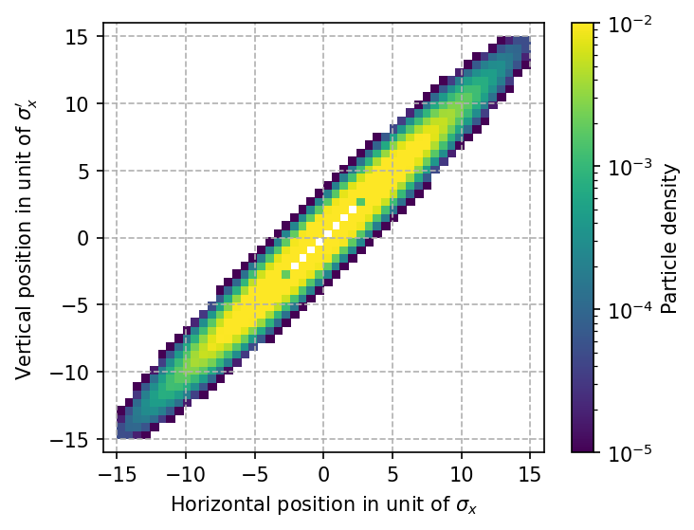
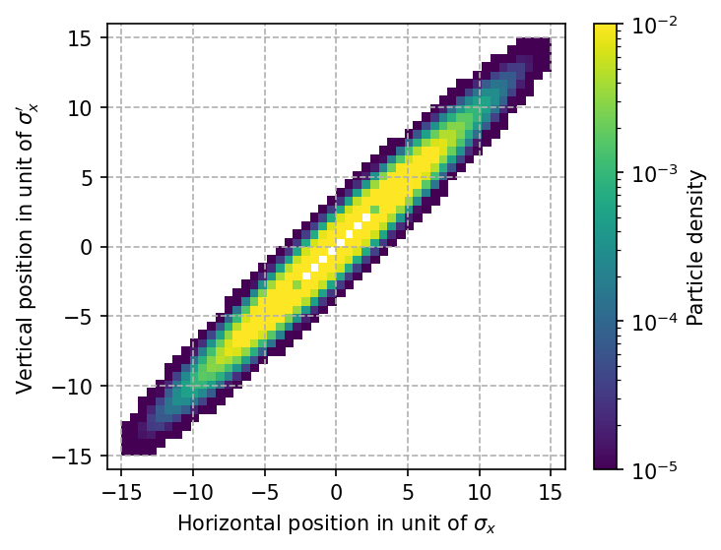
Beam model | Weighted tail description
Correlated uniform distribution vs. correlated exponential distribution.
Uniform - green
Exponential - red
Exponential - brown
Exponential - grey

Slide 13
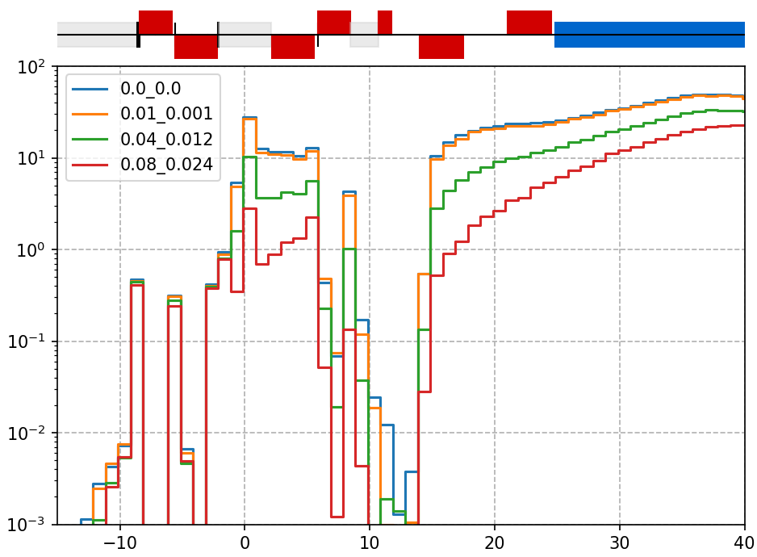
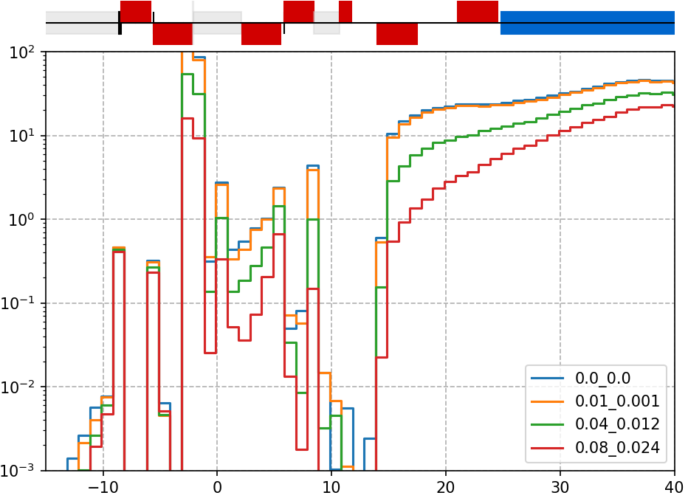
Result from V22 - tt mode energy
The primary collimator aperture is set to 15 sigmas horizontally and 80 sigmas vertically - M. Hofer (talk).
The following lifetime have been studied: uniform <1min, 5 min, 1h, 1day.
Assuming 1% of the particle in the halo, and halo cut at 10 sigmas horizontally and 60 sigmas vertically.
Horizontal slab mask
Elliptical mask

Slide 14
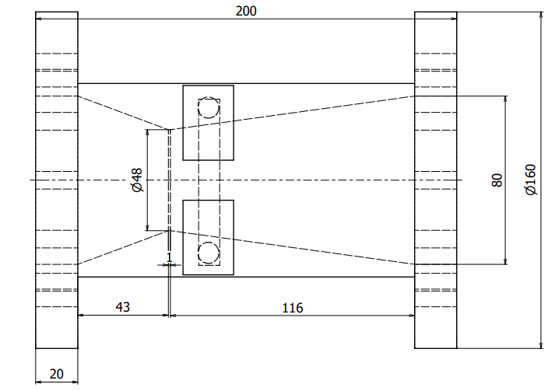
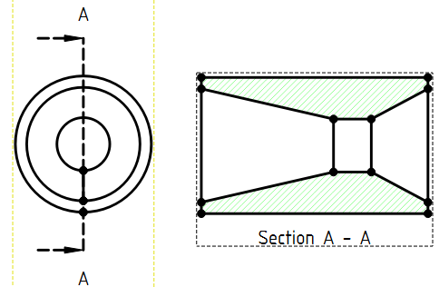
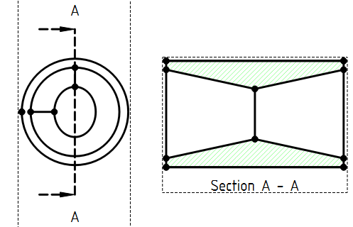
Mask designs - One jaw, two jaws, elliptical or round
At s=-2.1m from the IP the primary halo collimator apertures define as 78σ_{x} (7mm) and 90σ_{y} (8.3mm).
A round mask could only be opened at 8.3mm whereas an elliptical can have 7x8.3.
Then the length of the plateau and taper can be adjusted:
SuperKEKB design
Round mask design
Elliptical mask design

Slide 15
Summary
The SR from beam position and divergence tolerances have been studied - at Z, the power deposition increases in the CC beyond 15µrad and even more in the FF downstream the IP. At tt energy, the power deposition can be relatively high in the mask protecting the CC and also large downstream the IP.
The SR from beam halo can be mitigated by a vertical collimation with an elliptical mask.
Comments on beam halo description and beam tolerances are welcomed
Proceed to perform these studies for W and H energies and move to V23.

Slide 16
Thank you for your attention.

Slide 17
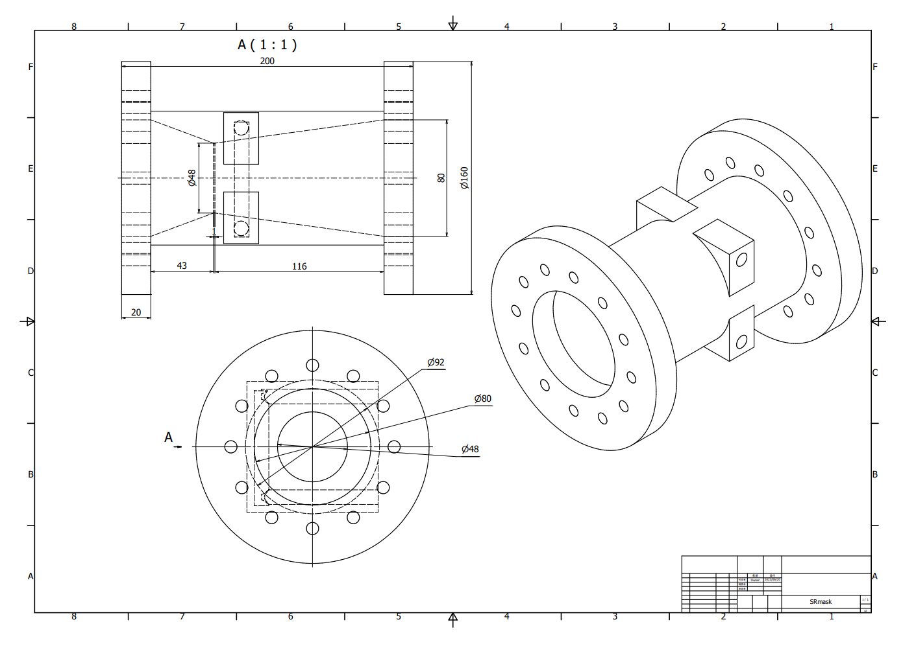
https://kds.kek.jp/event/47519/contributions/244635/attachments/169490/222475/230626_SRMask.pdf

