Slide 1

Status of MuCol
R. Losito, CERN

Slide 2
News
EU project Officer changed: it is now
  Sotirios KAKARANTZAS
New deliverable enforced by EU:
  Communication and Dissemination plan, due by 31 March 2024
Consortium:
  29 out of 32 Institutes signed
  2 informed us they cannot sign (BNL and UNIBO)
  1 still pending (RHUL)
Many of you have requested a copy of all signaturs for their due diligence, we should set a deadline... What about March 31st ?

Slide 3
Hirings
Table of hirings kept up to date by Muon Collider Secretariat
Please send to them any information as soon as available.

Slide 4
Hirings
Table of hirings kept up to date by Muon Collider Secretariat
Please send to them any information as soon as available.

Slide 5
Deliverables
Plus the communication & Dissemination plan

Slide 6
Milestones

Slide 7
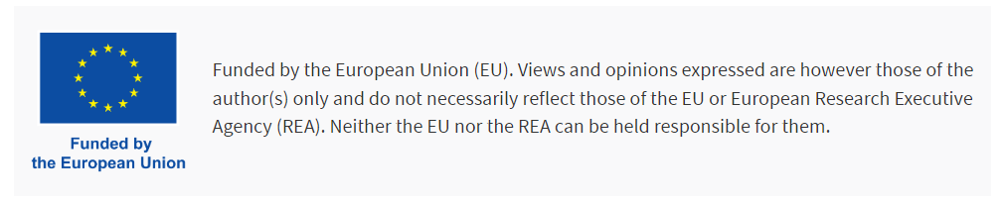
Publications
The guidelines for acknowledgement of the EU funding are available on the MuCol website:
  https://mucol.web.cern.ch/guidelines
Please note the Grant Agreement Number is not necessary, while the sentence below is mandatory:
Elias Metral is keeping a list of all papers and presentations that have an explicit acknowledgement (even if not perfect…).
Any paper signed by those hired with MuCol funds has to show the acknowledgemnt (funded can be replaced by “co-funded” if the funding is only partial…

Slide 8
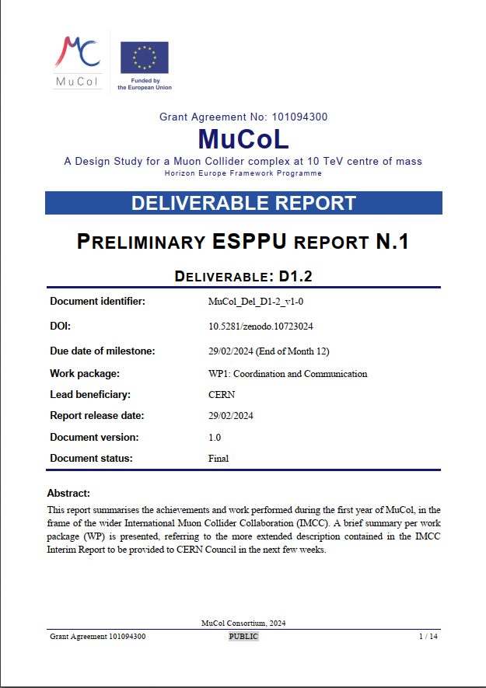
Technical achievements
Described in the “ESPPU Preliminary Report n 1” (D2)
Many of the results presented this week have been produced with the participation of MuCol resources (either from EU or matching…)

Slide 9
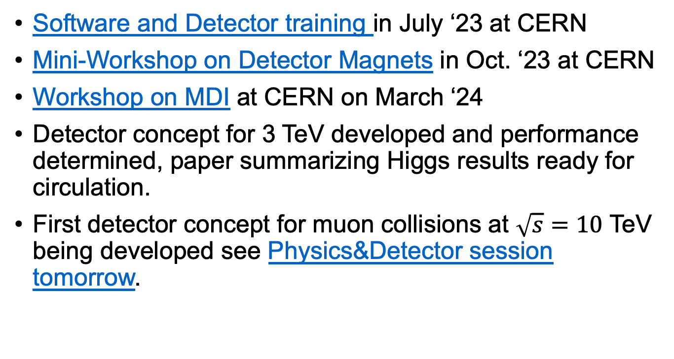
WP2 highlights
Software and Detector training in July ‘23 at CERN
Mini-Workshop on Detector Magnets in Oct. ‘23 at CERN
Workshop on MDI at CERN on March ‘24
Detector concept for 3 TeV developed and performance determined, paper summarizing Higgs results ready for circulation.
First detector concept for muon collisions at $\sqrt{s}=10$ TeV being developed see Physics&Detector session tomorrow.

Slide 10
WP3 highlights
Focus on assessing the performances that can be achieved (e.g. following up the developments of the H- source of LINAC4 at CERN)
Baseline lattice of accumulator and compressor for 5 GeV case established
  Investigating space charge…

Slide 11
WP4 highlights
Conceptual design of a graphite target inside its solenoid
3D FLUKA model available, radiation load to surrounding elements evaluated
Work on liquid metal and powder targets started
Beam physics design is progressing, going through iterations and optimisations.
Trying to improve simulation tools based on BDSIM.

Slide 12
WP5 highlights
High energy RCS design being optimized for reduced muon decay losses
Hybrid RCS being optimised to minimise orbit lenght variations
Design of 10 TeV collider started, evaluation of Neutrino radiation at surface also addressed

Slide 13
WP6 highlights
The activities of the WP6 proceed during the first months of the project focusing on some specific elements related to objective of each of the subWP.
WP 6.1 specifically addressed different approaches to the analysis of the problems related to the HOM of the SC cavities involved. The study of specific aspects relating to these cavities was addressed in a general sense with an overview of the skills available in the components involved.
WP 6.2 focused on carrying out an overview of possible technologies to be applied to the construction of RF cavities for the cooling system. In parallel, in concert with WP4, we focused on the definition of the main parameters (frequency, aperture, ...) as well as how these derive from the beam dynamics in the channel.
WP 6.3 is probably the WP where the most part of the efforts concentrated. Computer simulations and theoretical analysis have been carried out to outline and face the problems related to the coexistence of high electric RF fields in strong magnetic fields. The requirement to carry out deep analysis on the experimental side to define the technologies to be used in such application has been deeply discussed. A pulsed DC test set is under realization at INFN Milano and a couple of different RF cavities (with related power couplers) have been electromagnetically designed to be used in a test stand based on a SC solenoid and one of these cavities.

Slide 14
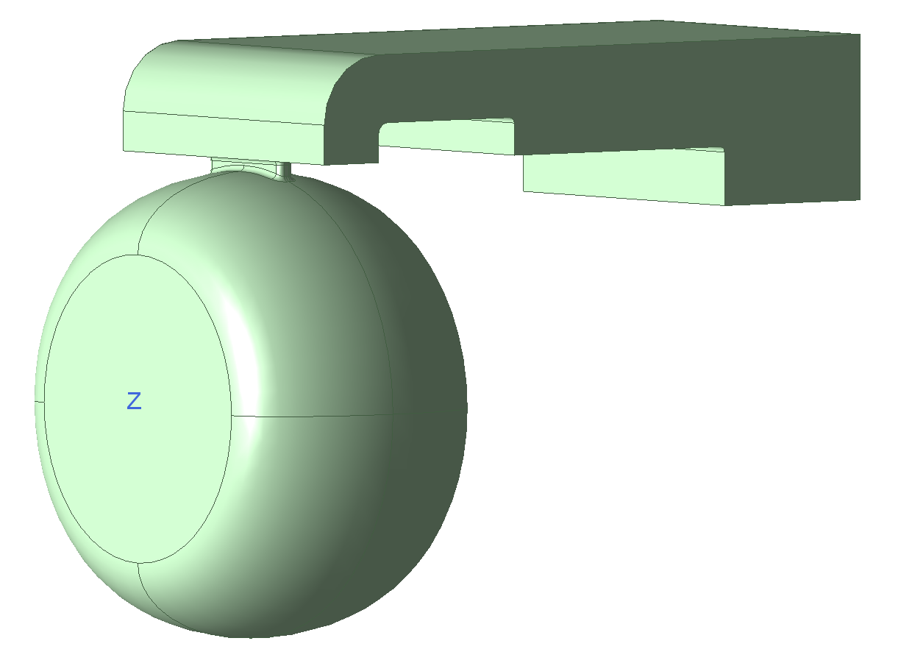
RF test facilities under consideration
The pulsed DC test set has been conceived taking into account the experience made at CERN on a similar bench.
The innovative feature of this new test set is that we may apply the pulsed DC voltage along with a static magnetic field up to 1 Tesla.
We will expect to get more and more data on materials and surface treatments.
The picture below report the RF design for a 3 GHz cavity which may be inserted in a SC solenoid with a bore of nearly 350 mm. The design of the solenoid will provide a field up to 7 Tesla while the electric fields may reach a value of 50 MV/m.

Slide 15
WP7 highlights
Design of the magnet system for muon beam production, involving HTS cable at 20 K has been developed, and analyses performed thus far indicate a magnet roughly half the size radially and with better energy efficiency when compared to the US-MAP LTS coil, while maintaining similar muon capture efficiency.
Advances have been made towards the magnetic design of compact and high field final cooling solenoids, with potential to reach and exceed 40 T.
Large progress toward the design of the pulsed NC magnet configurations in the acceleration chain
Design charts for collider dipoles and quadrupoles produced, iterations to be foreseen with WP5 to optimise the design of the collider.

Slide 16
WP8 highlights
Cooling Cell workshop at CERN, Jan. ’24
Agreement on the type of Cooling cell to be built (B5)
Starting engineering optimization..

Slide 17


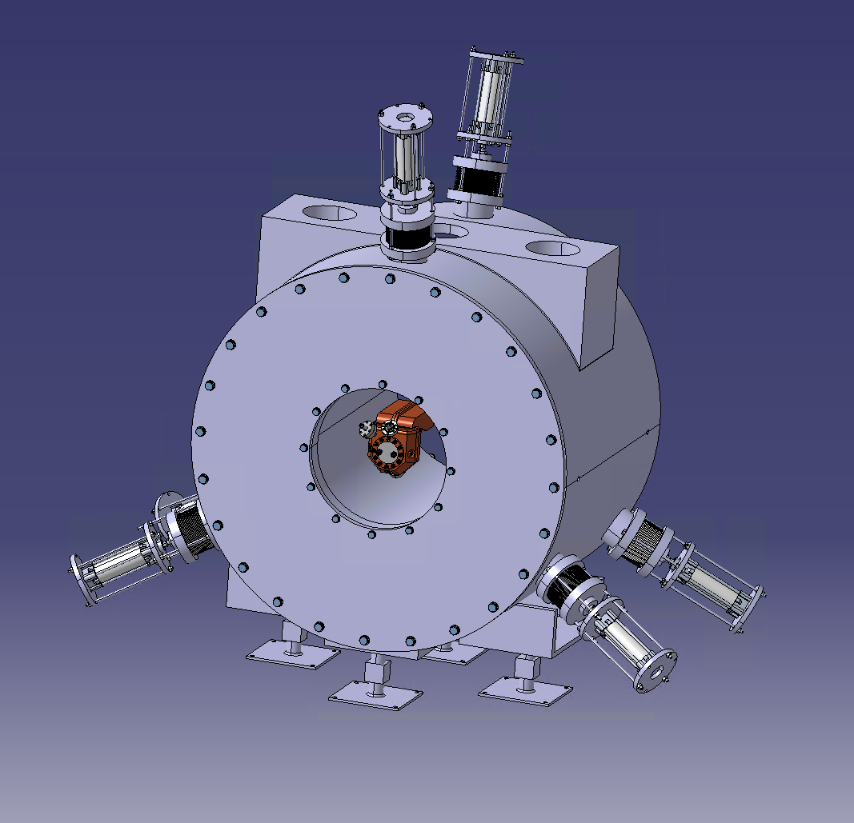
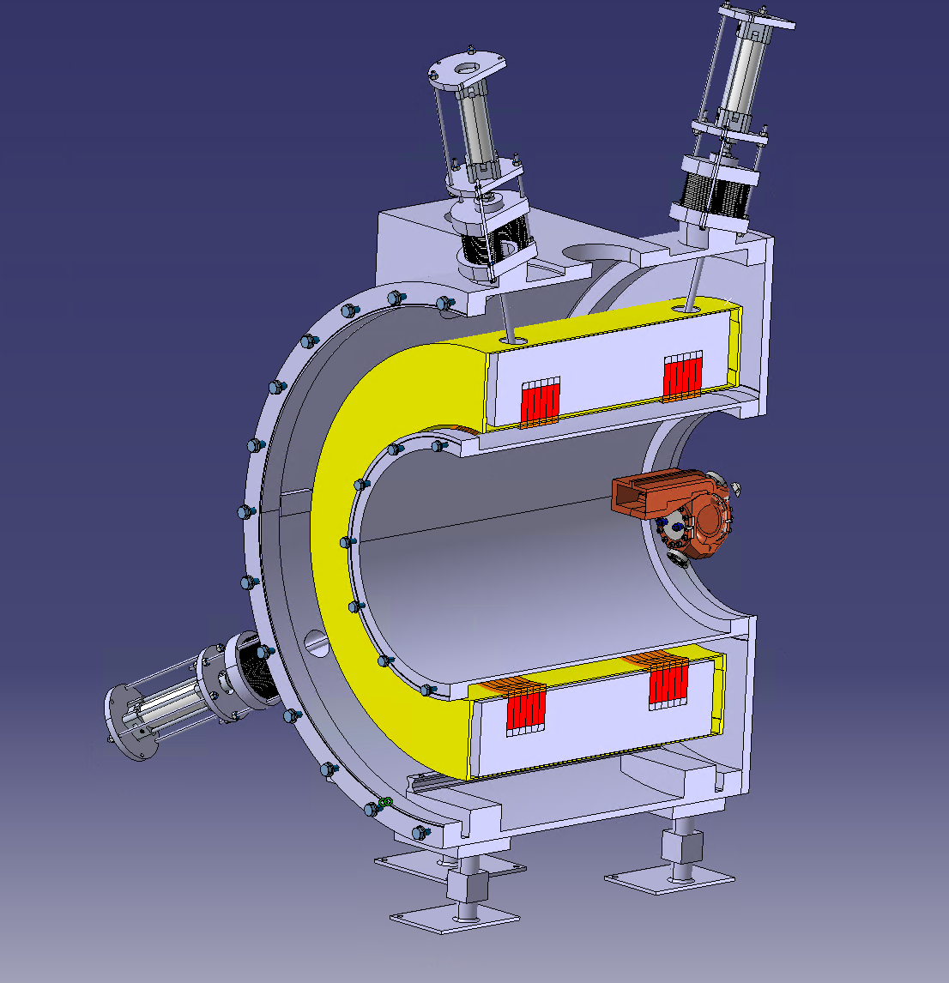
WP8 – design for RFMFTF
Design of a 7 T splti coil – B_{field} parallel and opposite
  First conceptual design for 700 mm free bore (CM 2023)
  → Rescaled to 320 mm free bore for cost saving; starting engineering design
  Test facility for RF but also for other components ; 3 GHz RF cavity for studies
  Excellent “test” for a real design of solenoid pairs + integration
  Necessary first of a kind of HTS liquid-free magnet system
Manipulation system
Cryogenic
System support
Vacuum
vessel
Magnet
support
RF cavity
Thermal
screen
Ground
support
Guide
system

Slide 18
Questions?

