Slide 1

12 March 2024
3rd MuCol Governing Board
Dissemination and Exploitation plan
Kristiane Bernhard-Novotny

Slide 2
Requests by EU officer
Planned measures to maximise the impact of project results
Target groups (e.g. scientific community, end users, financial actors, general public) and proposed channels
Communication measures for promoting the project and its findings throughout the full lifespan of the project
A comprehensive and feasible strategy for the management of intellectual property and convincing justification that exploitation is still in the Union’s interest, if it is expected primarily on non-associated third countries

Slide 3


Target groups

Slide 4
Different groups
Decision-makers
Particle physics community
Financial actors
General public

Slide 5
Knowledge about the MuCol Initiative & physics
Huge previous knowledge
Little previous knowledge
Financial actors
Particle physics community
General public
Decision-makers

Slide 6
Values, Knowledge
And
Messages

Slide 7
Decision makers & financial actors
Values | Communication goal | Messages
- Influence on the global scientific agenda - Economic and social return on investment -Scientific excellence - Sustainability, energy efficiency, and other resource efficiency | - Investing in STEM skills, technological and industrial development for your region or country - Your region/country is part of world-class research, whose cutting-edge technologies have transformed society and hold potential to help address current global challenges | - Through funding, EU’s vision plays vital role in the global context - Supporting MuCol Design study creates new EU-driven projects - Funding this project might attract other large-scale research infrastructures
Decision-makers
Financial actors

Slide 8
General public
Values | Communication goal | Messages
Interested in science in general More interested in societal applications Not interested in science at all | One can ask deeper questions about the Higgs boson: its couplings to other particles, which role it had in the early universe and why it is so light Technological innovations can help to reduce energy consumption | Muon Collider aims to at least shed light on some of these questions, and even answer them MuCol Design study is the first and important step in this direction
General public

Slide 9
Requests by EU officer
Planned measures to maximise the impact of project results
Target groups (e.g. scientific community, end users, financial actors, general public) and proposed channels
Communication measures for promoting the project and its findings throughout the full lifespan of the project
A comprehensive and feasible strategy for the management of intellectual property and convincing justification that exploitation is still in the Union’s interest, if it is expected primarily on non-associated third countries

Slide 10
Content
Type | Purpose | Platform (example)
Articles | engages the audience with specific context in a more detailed way about one specific subject | Homepage, Magazines
Brochure | engagement with audience on high level | Homepage
Newsletter | engage audiences with news about conferences, workshops, events, milestones regularly | E-mail
Goals:
Communicating in an easy, understandable way
Posts can be applied to multiple outlets, e.g. text in brochure can go on homepage and in chunks as LinkedIn posts

Slide 11
Channels
Channel | Audience | Frequency
Homepage | All target groups, “heart” | As often as possible
Brochure | Financial actors (e.g. BMBF) Decision-makers | To be defined
LinkedIn | All target groups | At least once per week
Conferences | Particle physics community (e.g. IPAC) | To be defined
Magazines | Particle physics community, Financial actors, decision makers | To be defined

Slide 12
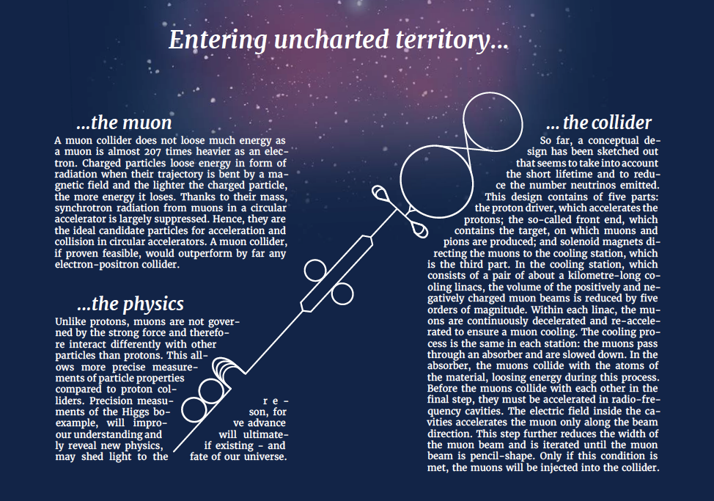
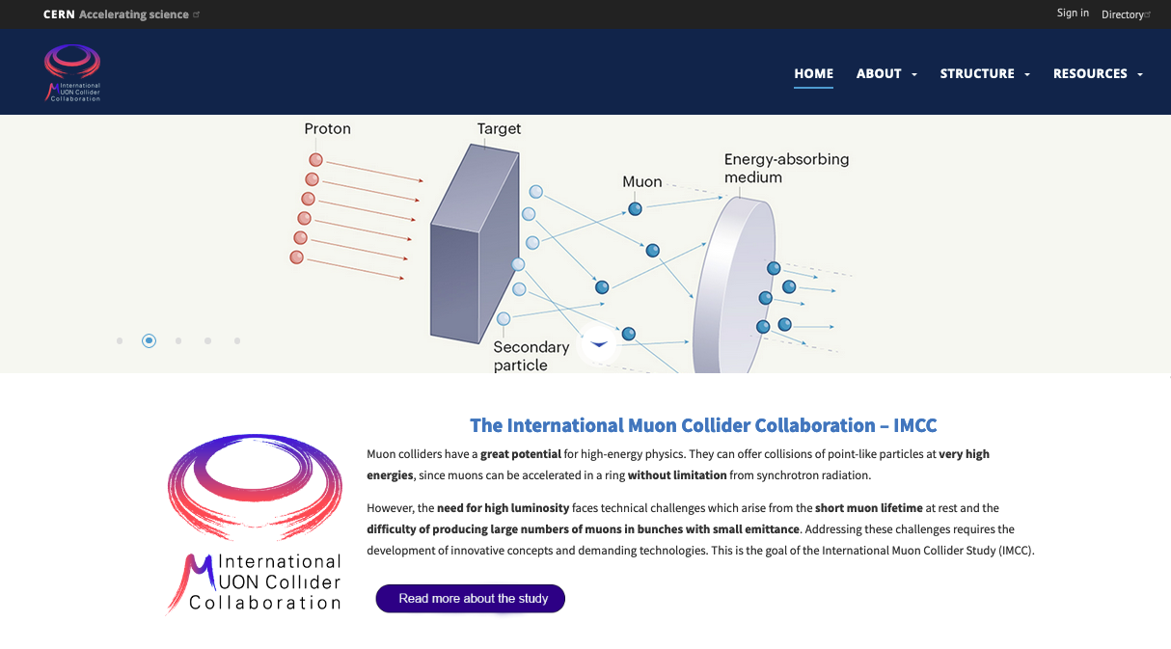
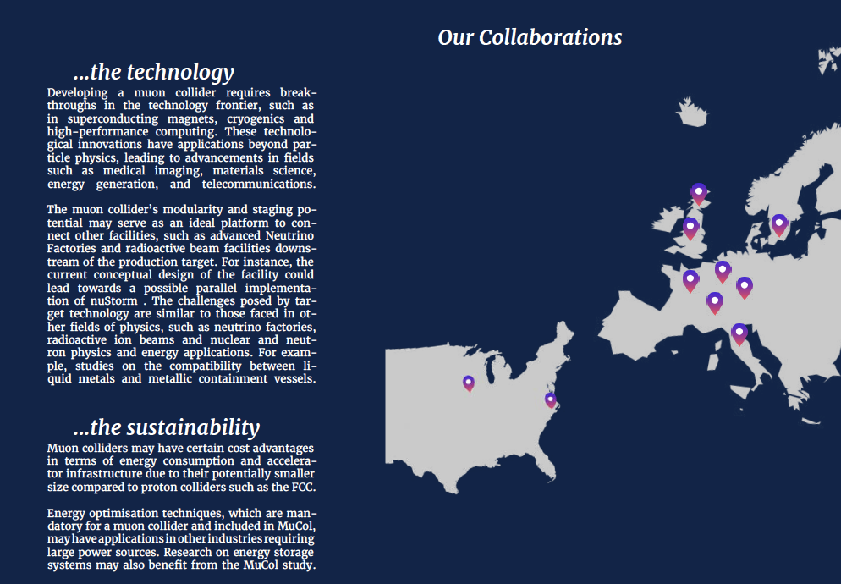
Channels
Homepage
Brochure

Slide 13
Measures
Analysis on content performance (e.g., number of engagements per post, follower growth) to tailor content to different channels for targeting people efficiently
Impact analysis of alignment with Sustainable Development Goals

