Slide 1


OPEN SOURCE PARTNERSHIPS
Han DOLS
Business Development &
Entrepreneurship Section
KT GROUP

Slide 2

WHAT IS HAPPENING AROUND US?
HOW IS CERN CONTRIBUTING?
WHAT IS IN IT FOR YOU?
Han Dols | OSPO Community Workshop | 2023-11-29

Slide 3
WHAT IS HAPPENING AROUND US?
HOW IS CERN CONTRIBUTING?
WHAT IS IN IT FOR YOU?
Han Dols | OSPO Community Workshop | 2023-11-29

Slide 4

Software technology dominates
…Everything becomes (became?) digital
…Disruption of traditional industries
…Global access, fast scaling, all connected
Han Dols | OSPO Community Workshop | 2023-11-29

Slide 5

Who eats who?
open source
software
world

Slide 6
Open source adoption is growing everywhere
… 90% of all companies use open-source components*
… 98% of IT leaders believe OS is at least as secure as proprietary software**
… 80% of IT leaders expect to increase the use of OS software for emerging tech**
* “State of Open: The UK in 2021 Phase Three The Values of Open.” October 2021. Open UK. Accessed August 5, 2022.
** RedHat The State of Enterprise Open Source 2022

Slide 7
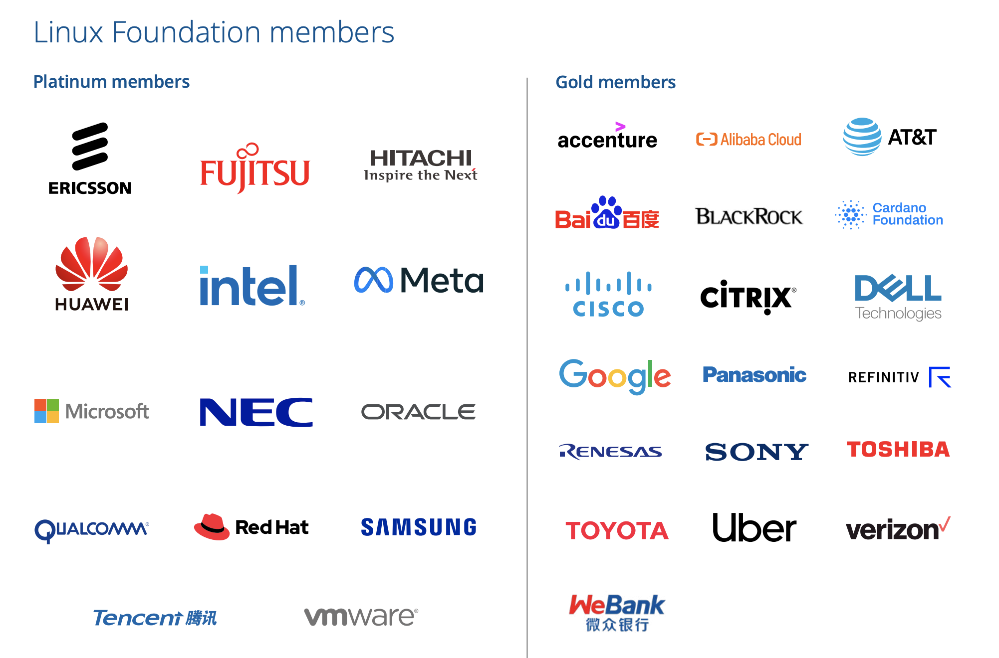

Slide 8
Who eats who?
open source
software
world

Slide 9
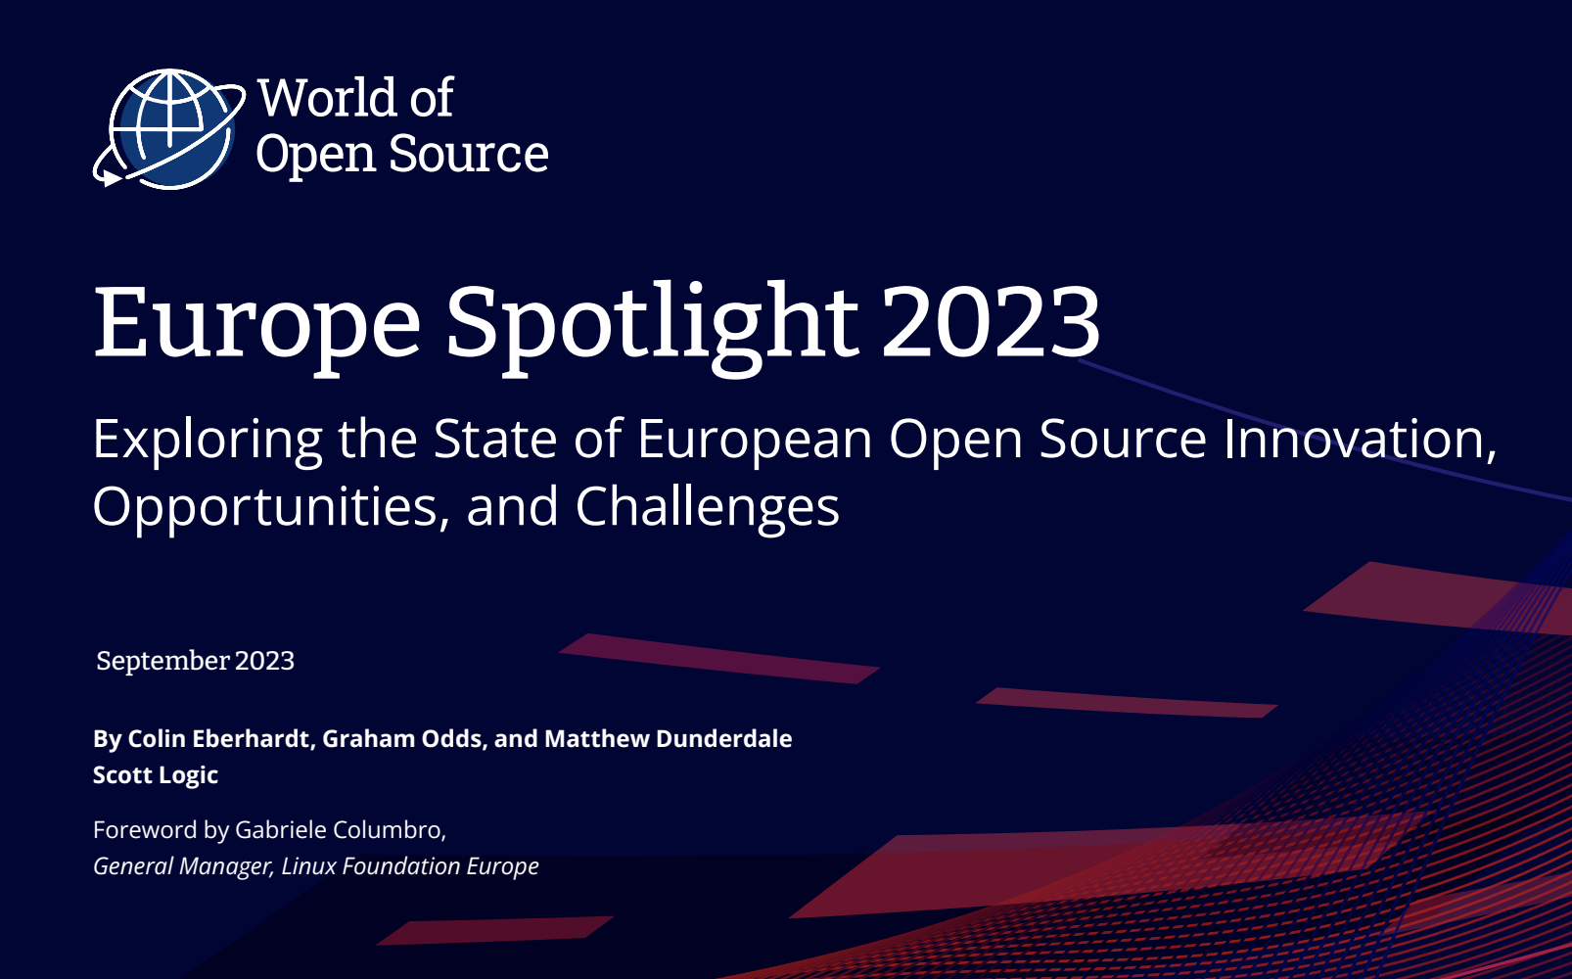
What drives these companies?
~1000 respondents
~40 different European countries
Sectors:
-technical
-scientific
-manufacturing
-public sector
-information technology
-education
-telecommunications
-finance
-insurance

Slide 10
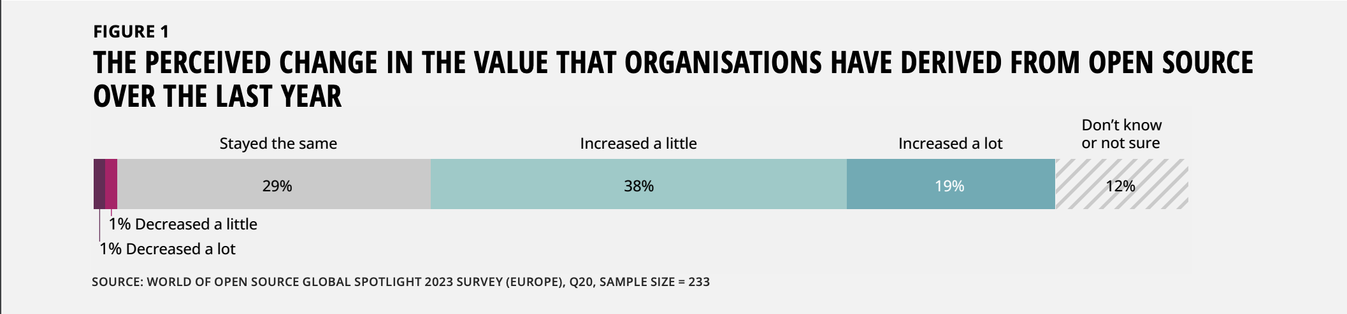
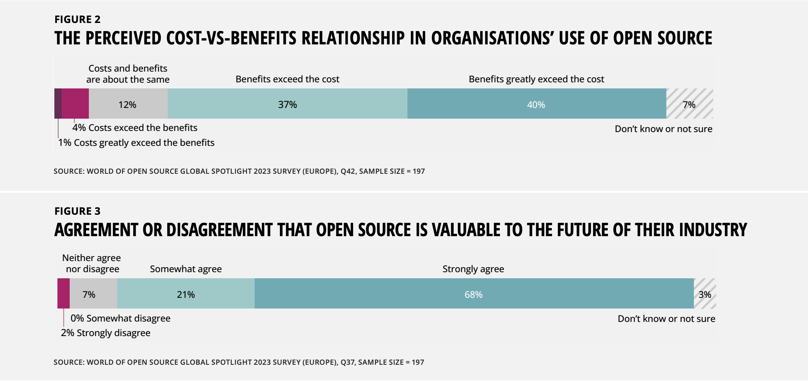

Slide 11
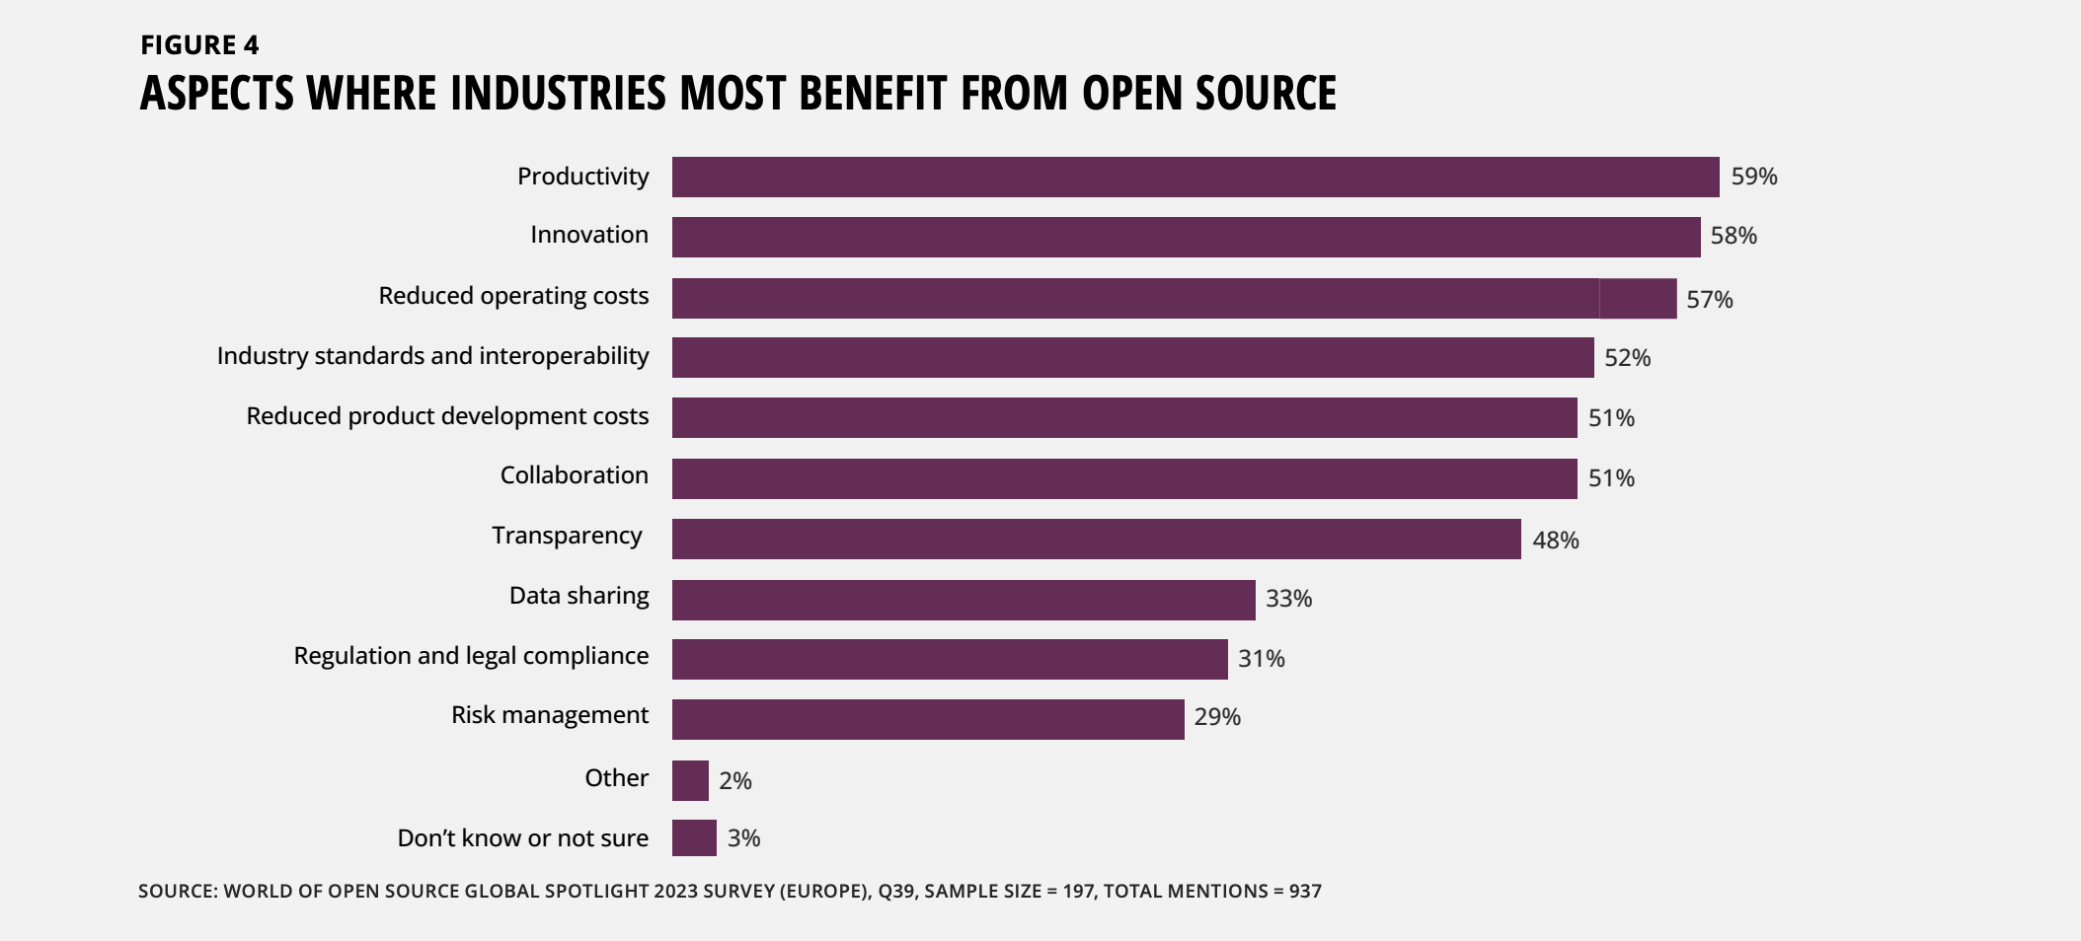

Slide 12
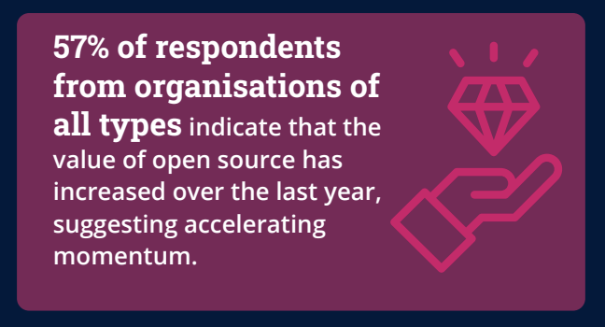
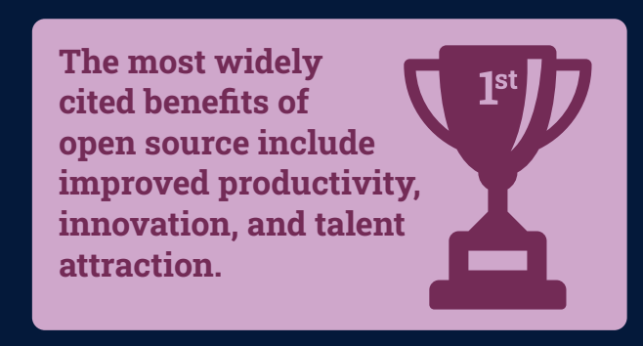
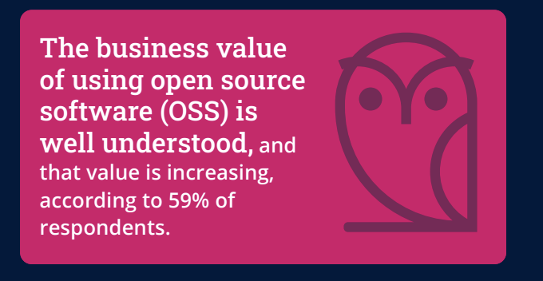
OS helps productivity, innovation & talent attraction
Han Dols | OSPO Community Workshop | 2023-11-29

Slide 13
WHAT IS HAPPENING AROUND US?
HOW IS CERN CONTRIBUTING?
WHAT IS IN IT FOR YOU?
Han Dols | OSPO Community Workshop | 2023-11-29

Slide 14


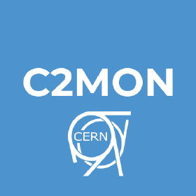
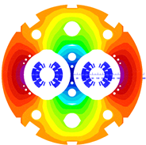



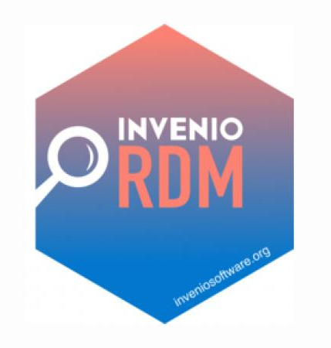

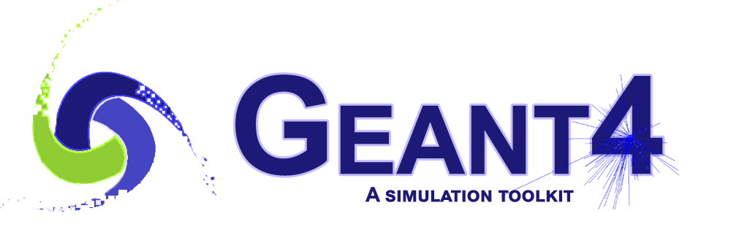

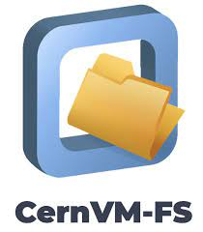

Inside world of (particle) science: obvious match
ROXIE
United
Industrial Controls
System
UNICOS
BioDynaMo

Slide 15
Partnerships on OS outside physics?
Volvo / Zenseact → build around open source HLS4ML
Jumptrading → build on top of open source CVMFS
TIND → build with open source Invenio
CEVA → build with open source HSL4ML
Orvium → build using open source Zenodo / Invenio
Market Surveillance → build using open source ROOT
YES WE CAN

Slide 16
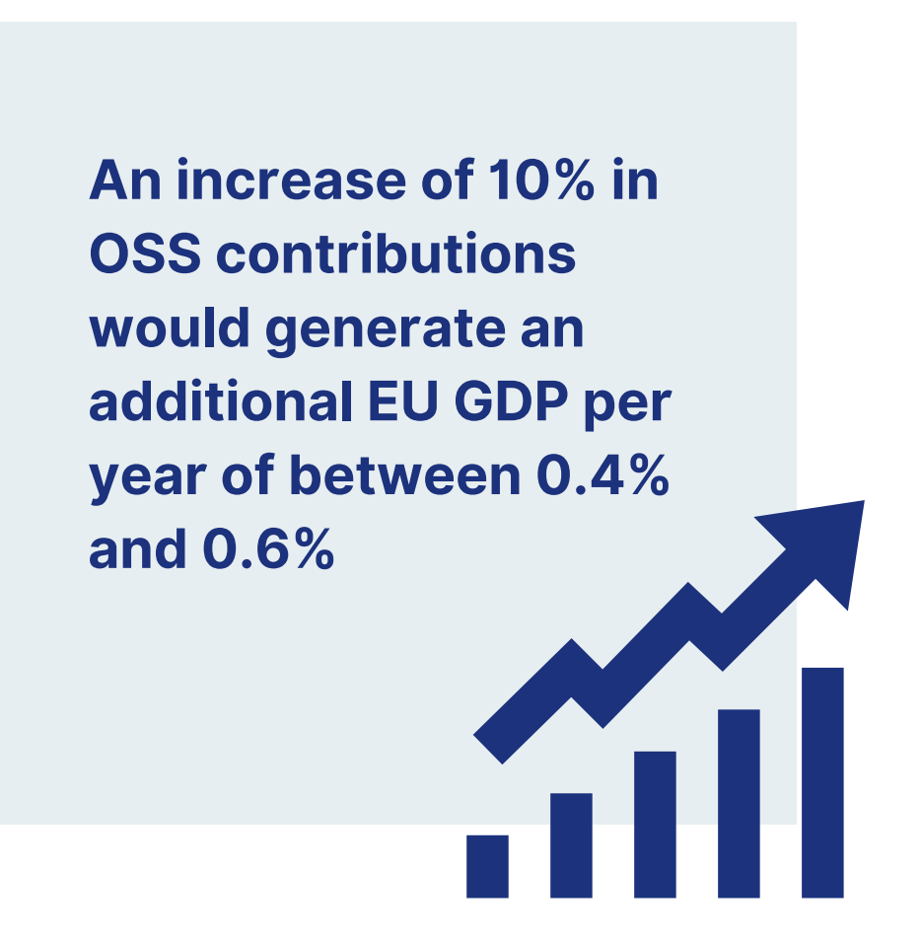
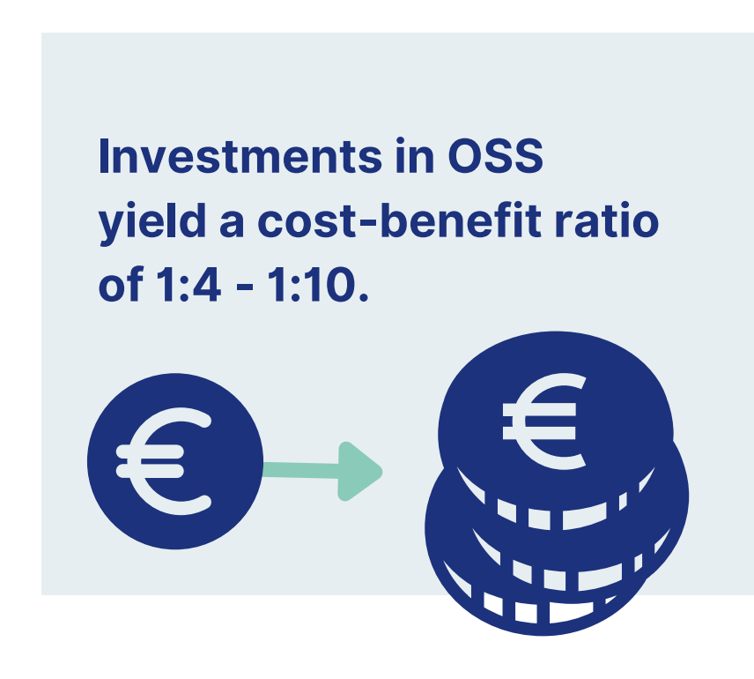
Good for EU and the CERN Member States
European Commission’s study (Sept 2022) concludes that Open Source Software is having a large impact
on European economy

Slide 17
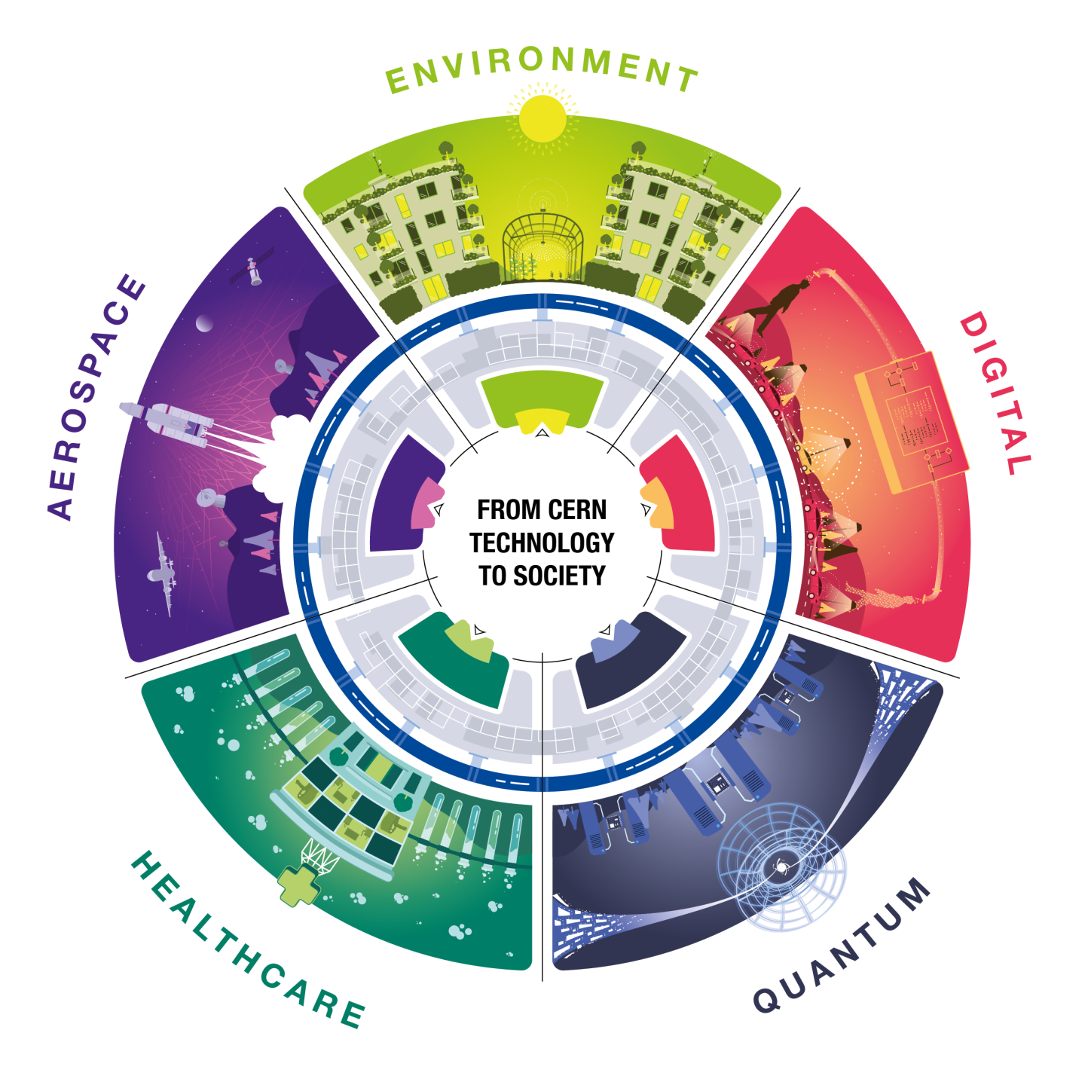
The OSPO will help in spotting opportunities to create more societal impact!

Slide 18
WHAT IS HAPPENING AROUND US?
HOW IS CERN CONTRIBUTING?
WHAT IS IN IT FOR YOU?
Han Dols | OSPO Community Workshop | 2023-11-29

Slide 19



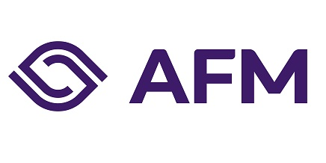

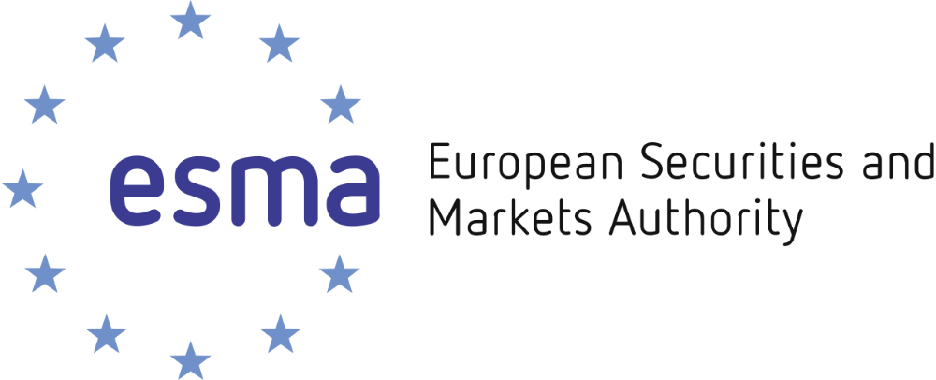
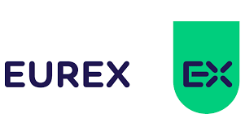





Collaborative R&D
First International Expert Group on Market Surveillance hosted at CERN. Program explores CERN knowhow and software (ROOT) to support national banks and regulators in detecting fraud in financial markets.

Slide 20
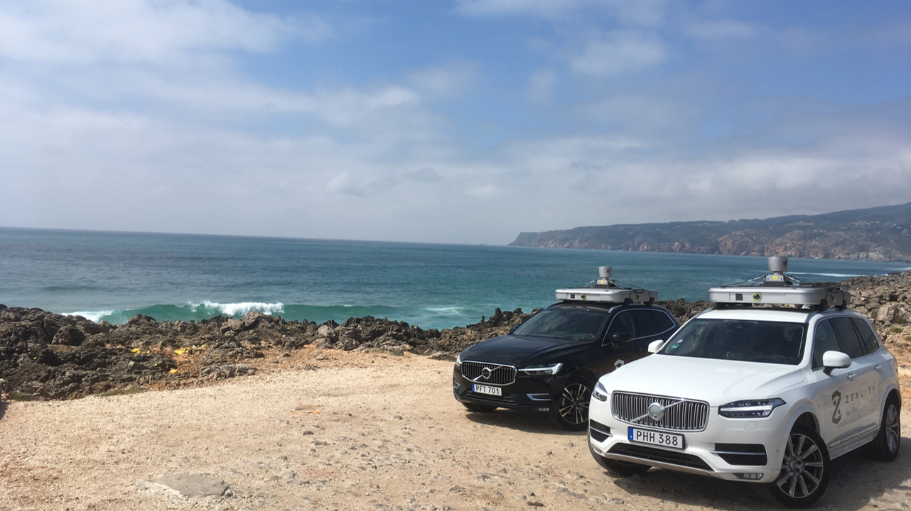

ZENSEACT (Volvo Cars Company) teamed up with CERN on extremely fast machine learning using FPGAs.
Collaborative R&D

Slide 21
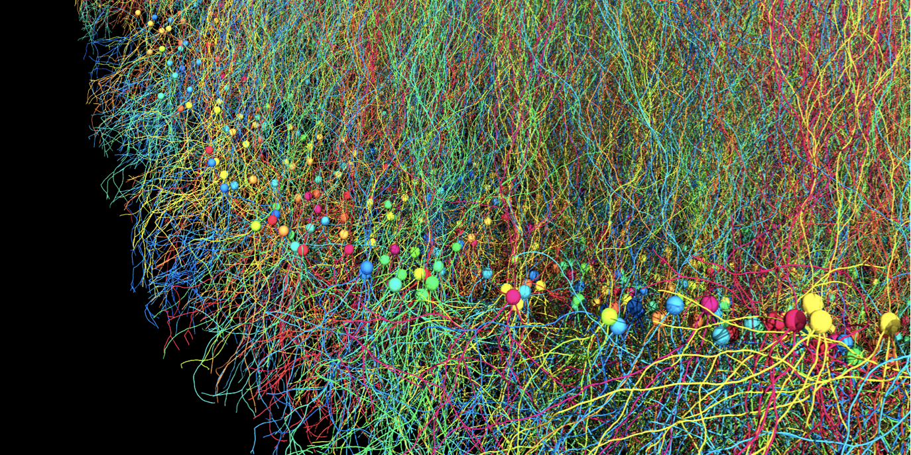
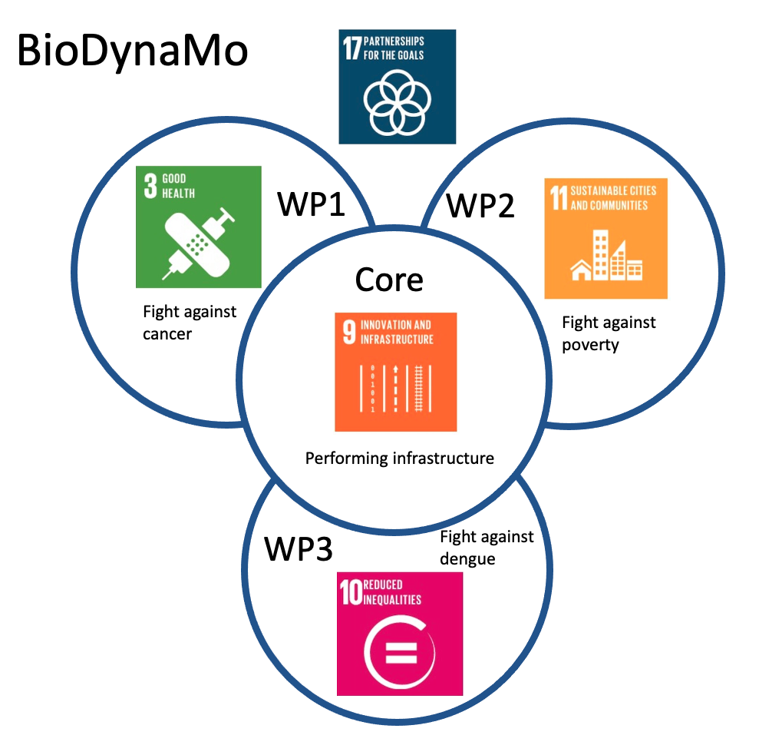

Impact Fund
BIODYNAMO
a modular, high-performance, open source
agent-based simulation platform
BioDynaMo: modular, high-performance, agent-based simulation platform, used to simulate cells and tissue.
A. Raimondo, CERN & Society Foundation Board Meeting, 26.04.2022

Slide 22
Contract Research
CernVM-FS used by Roche and Jump Trading. Industry is funding activities to help scalability
and challenges with very large applications involving >1 million file.
Han Dols | OSPO Community Workshop | 2023-11-29

Slide 23

Edge SpAIce EU program: extremely efficient Deep Neural Network (DNN) deployment "at the edge”, used for monitoring marine plastic litter from satellites
EU Project
Notes:
Example 1 - Medtech
CERN experts train Sanofi in machine learning - potential application in their vaccine production
Training was in 2017

Slide 24

And not just software
CERN Open Hardware Licence 2.0: family of licences that governs the use, copying, modification and distribution of hardware designs.
Han Dols | OSPO Community Workshop | 2023-11-29

Slide 25
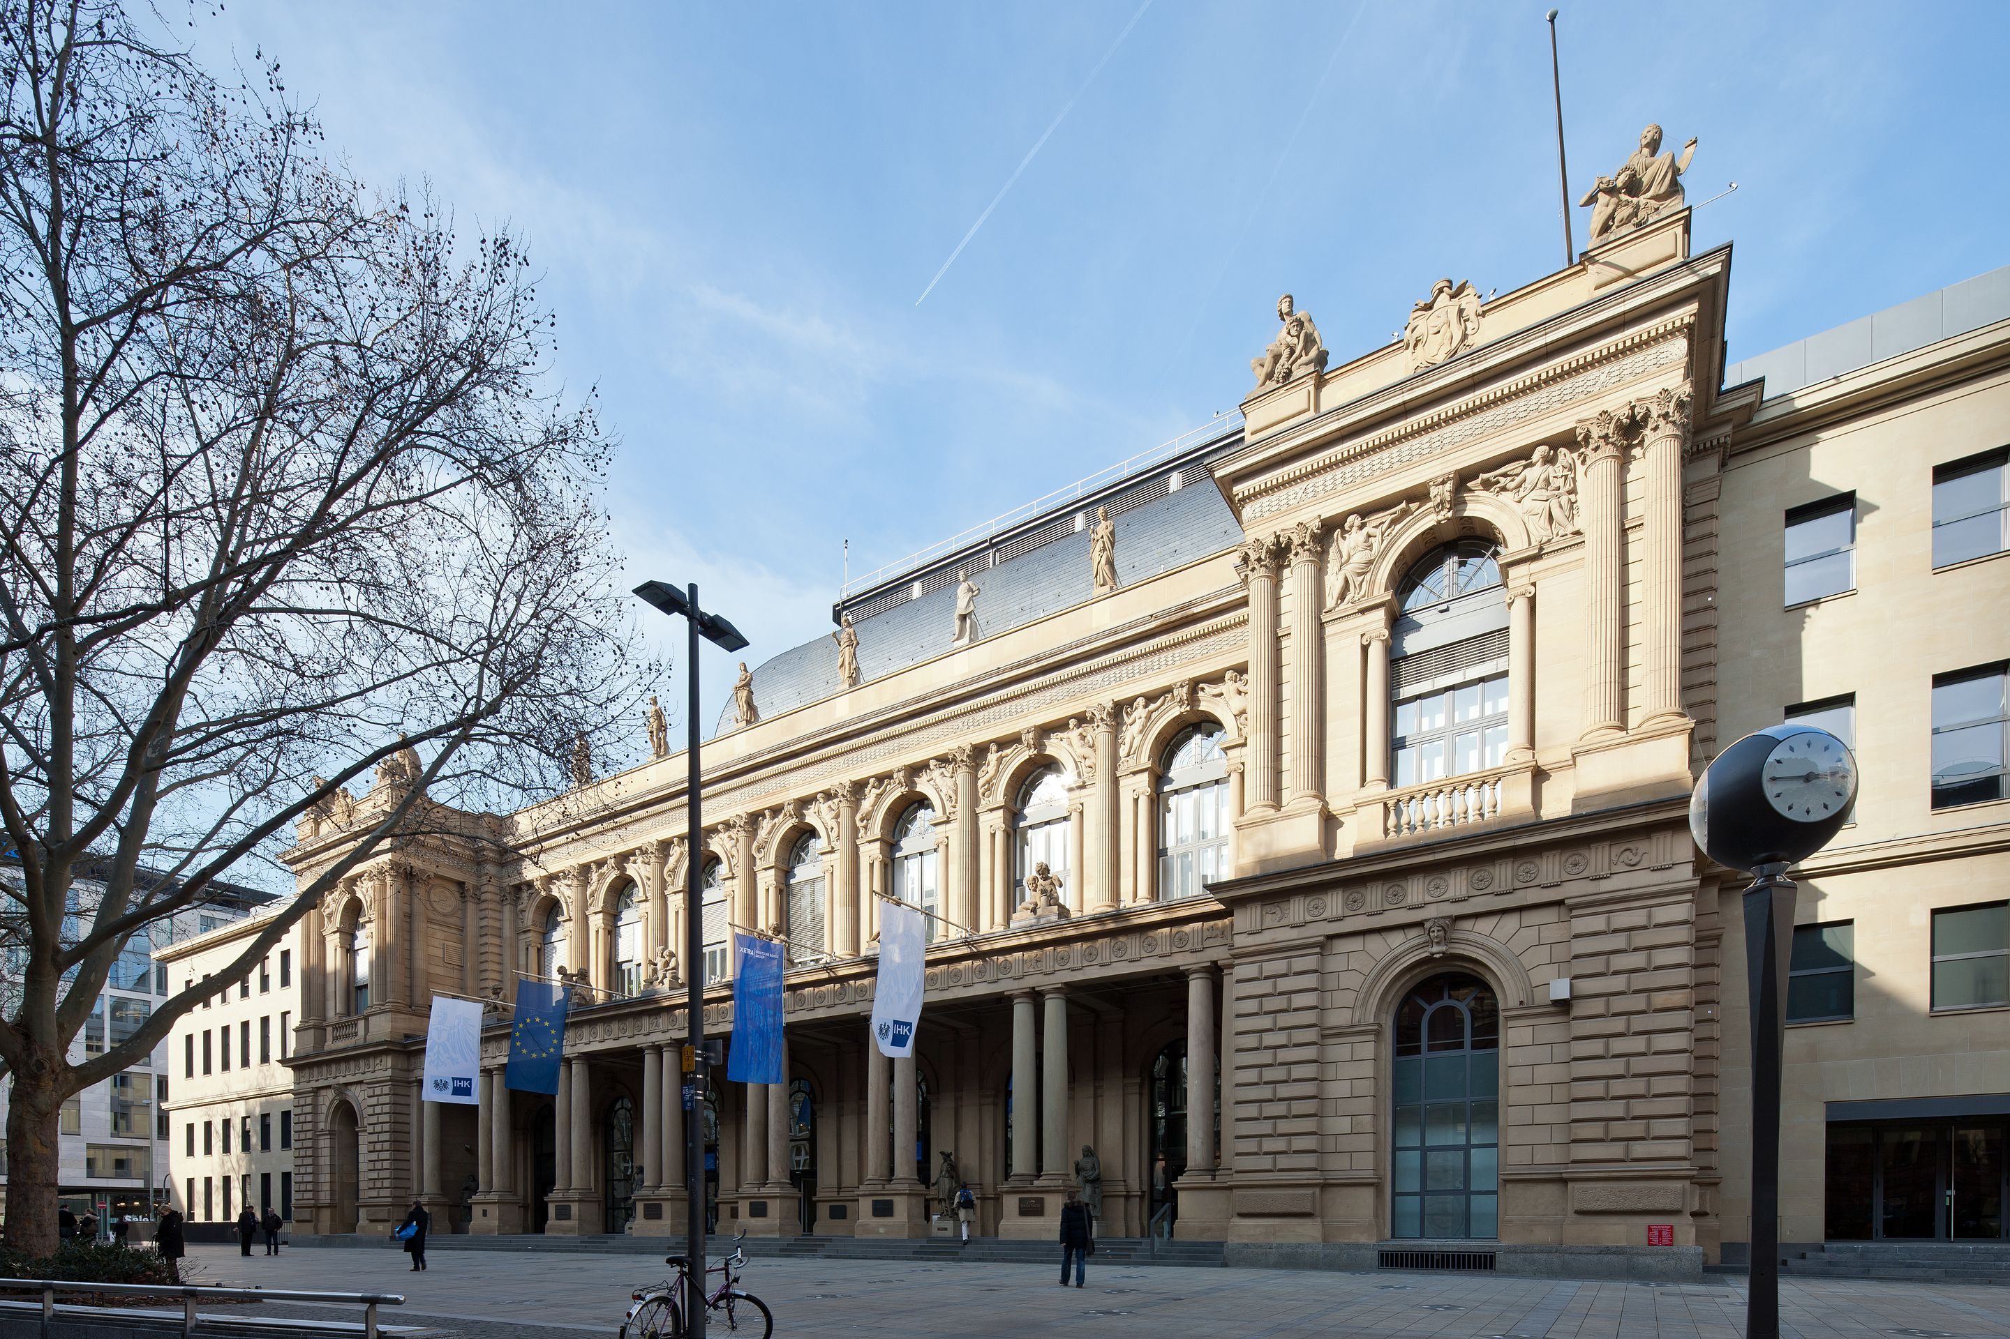
Frankfurt Stock Exchange is using CERN’s White Rabbit technology to synchronize timing in their trading infrastructure to less than a nanosecond.
Open Source

Slide 26
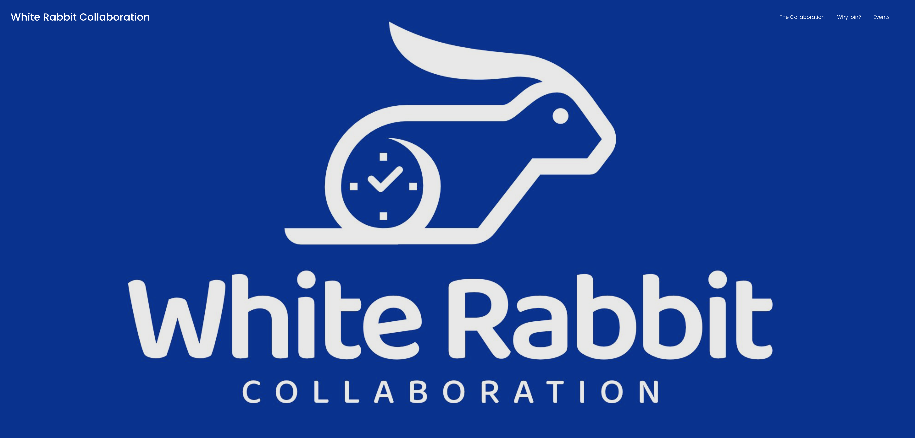
Together with KT Group new collaboration being shaped, to start 1.1.2024
Open Source

Slide 27


Slide 28
Startup TIND: Digital archive, library management and preservation.
CERN spin-off

Slide 29
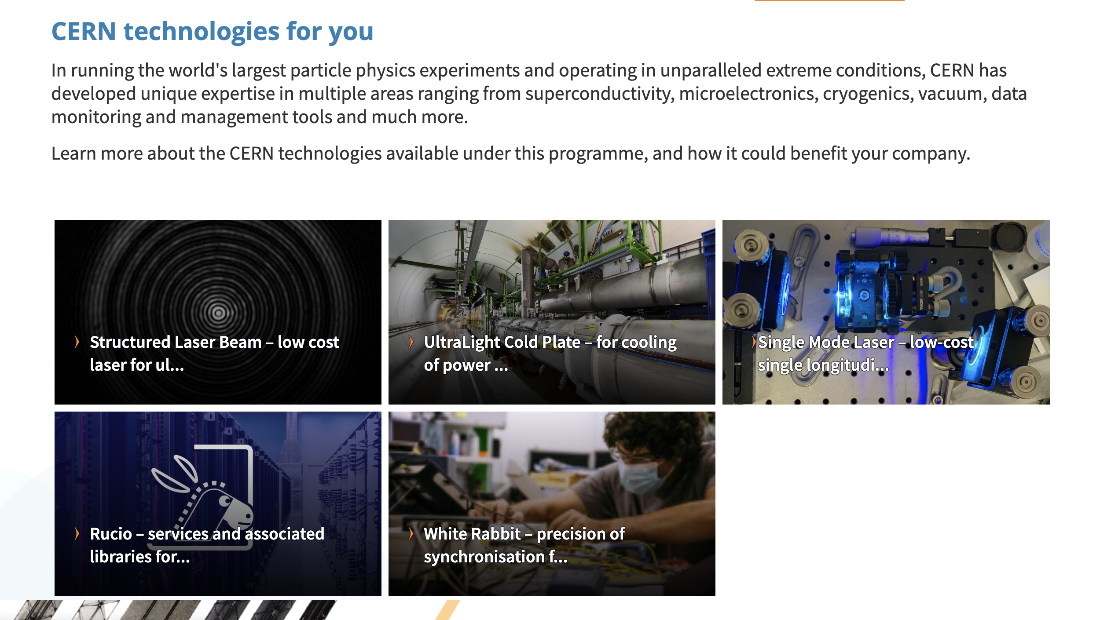
Open Source Software and Open Source Hardware included in CERN Venture Connect!

Slide 30
Conclusion
Companies embrace OS: more productivity, innovation and talent attraction
European Commission study: every 1 Euro invested brings a return of 4-10 Euros
CERN has track record as OS software and hardware creator and contributor
Many examples of partnerships with CERN OS tech outside High Energy Physics
Open Source Partnerships help knowledge exchange, community building, funding
OSPO & KT Group team up to help create more Open Source Partnerships: reach out!
Han Dols | OSPO Community Workshop | 2023-11-29

