Slide 1
RFQ2 Tuning Update
L. Millar, A. Grudiev
SY-RF-MKS
RFQ2 45th Meeting - 21/09/2023
Notes:
https://indico.cern.ch/event/1327955/

Slide 2

Overview
Since last time:
Ridge1 machined and installed.
Cavity tuned (results in the slides which follow).

Slide 3
RFQ2 Tuning Summary

Slide 4
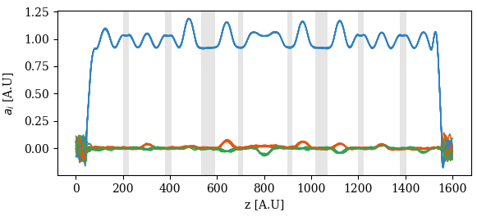
Tuning Summary
Sum and difference of the quadrants is calculated to obtain:
Q = (Q1 - Q2 + Q3 - Q4) / 4
1st dipole = (Q1 - Q3) / 2
2nd dipole = (Q2 - Q4) / 2
Ideally, there would be no dipole components and a flat quadrupole component.
Sampling windows shown in grey.

Slide 5
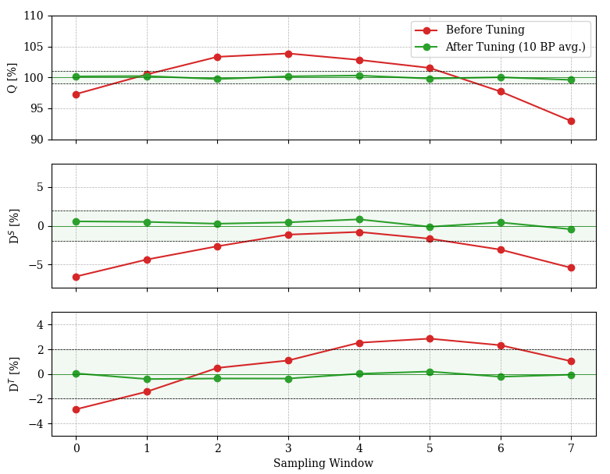
Tuning Summary
Current parameters:
Q: 100 ± 0.4%. ✅
Dipole 1 (D_{s}): ± 0.82%. ✅
Dipole 2 (D_{T}): ± 0.41%. ✅
f₀ = 352.2043 MHz @ 25° in vacuum. ✅

Slide 6
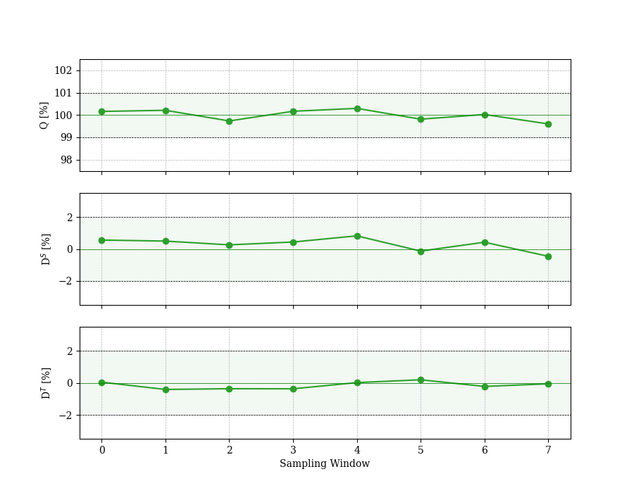
Tuning Summary
Current parameters:
Q: 100 ± 0.4%. ✅
Dipole 1 (D_{s}): ± 0.82%. ✅
Dipole 2 (D_{T}): ± 0.41%. ✅
f₀ = 352.2043 MHz @ 25° in vacuum. ✅

Slide 7
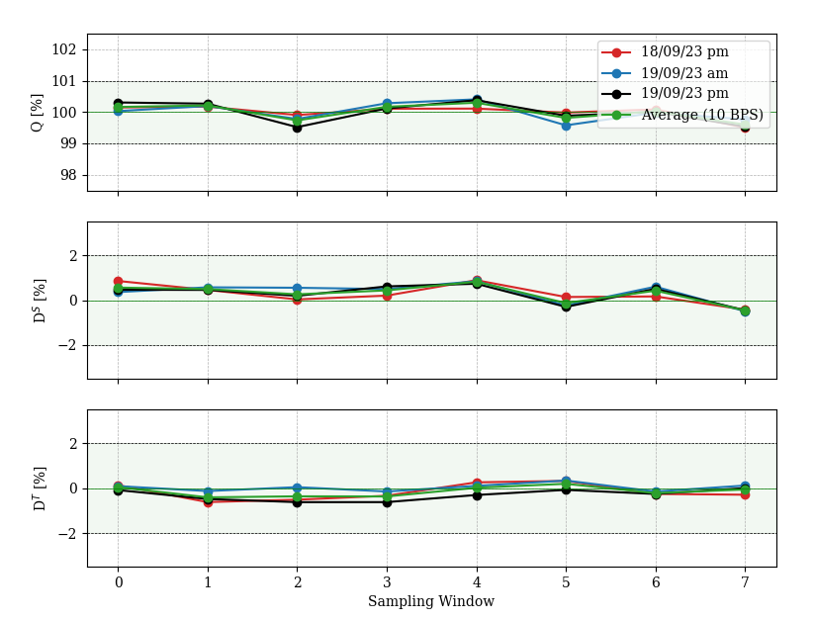
Tuning Summary
Current parameters:
Q: 100 ± 0.4%. ✅
Dipole 1 (D_{s}): ± 0.82%. ✅
Dipole 2 (D_{T}): ± 0.41%. ✅
f₀ = 352.2043 MHz @ 25° in vacuum. ✅

Slide 8
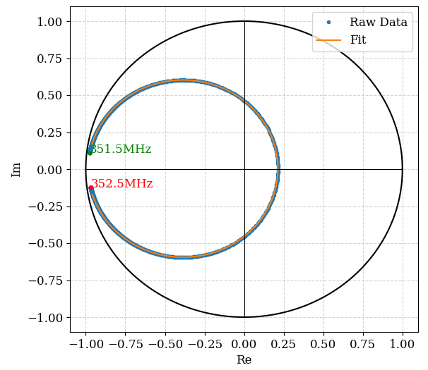
Tuning Summary – Q Factor
Results for the 352.2 MHz operating mode:
Q₀ = 6127 (8.65% lower than RFQ1)
Q_{ext} = 4106
β = ~1.49
Q_{ext} is 6% higher than anticipated, while Q₀ increased by ~3% after copper ridge installation.
β is 2% lower than the planned 1.52 value (critically coupled with a 70 mA beam).

Slide 9
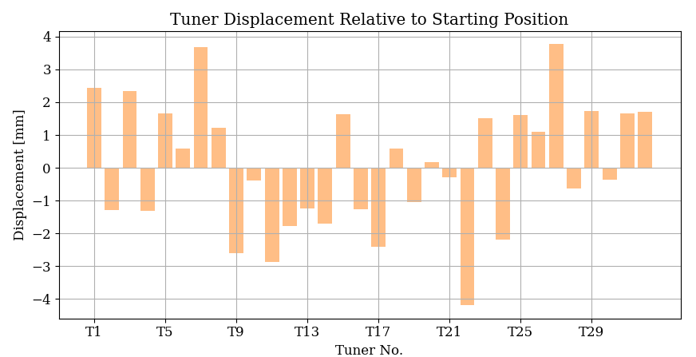
Tuning Summary
Displacement relative to “nominal” starting position.
Max retraction (+ve): 3.77 mm
Max insertion (-ve): 4.2 mm
Final dimensions to be calculated and checked with calipers.

Slide 10
Effect of Q on Operation

Slide 11
RFQ1 Parameters
Taken from RFQ1. Cavity designed to be critically coupled with a ~70 mA beam.
Parameter | Value
F_{o} | 352.2 MHz
Q_{O,} | 6772
Q_{Ext} | 4250
β | 1.6
I_{Beam} | 70 mA
Beam energy | 0.045 MeV
Beam output energy | 3.0 MeV
Beam Power, P_{Beam} | 207 kW peak
Resistive losses, P_{Loss} | 393 kW
Total losses, P_{Tot} | 600 kW
Input Power, P_{For} | ~600 kW peak
Notes:
Nominal values shown (beam/power not what are currently used in operation).

Slide 12
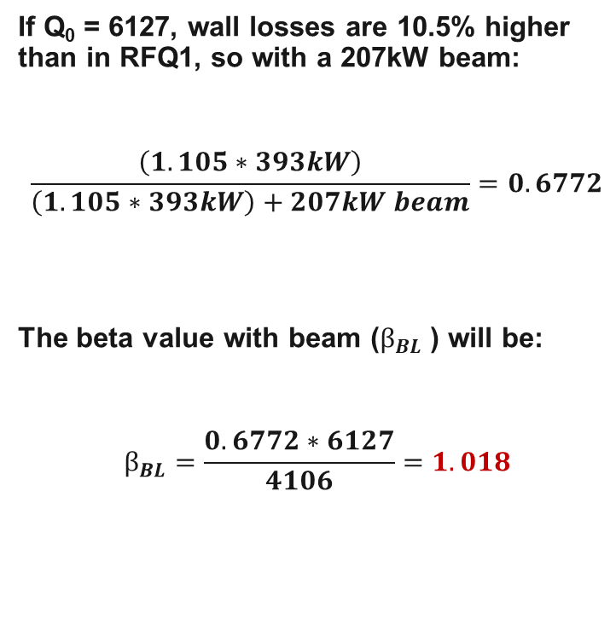
RFQ2 Parameters
If Q₀ = 6127, wall losses are 10.5% higher than in RFQ1, so with a 207kW beam:
$$\frac{\left(1.105∗393kW\right)}{\left(1.105∗393kW\right)+207kW beam}=0.6772$$
The beta value with beam ($β_{BL}$) will be:
$$β_{BL}=\frac{0.6772∗6127}{4106}=1.018$$
Parameter | Value
F_{o} | 352.2 MHz
Q_{O,} | 6127
Q_{Ext} | 4106
β | 1.49
I_{Beam} | 70 mA
Beam energy | 0.045 MeV
Beam output energy | 3.0 MeV
Beam Power, P_{Beam} | 207 kW peak
Resistive losses, P_{Loss} | 1.105*393 = 434.265 kW
Total losses, P_{Tot} | 207+434.265 = 641.265 kW

Slide 13
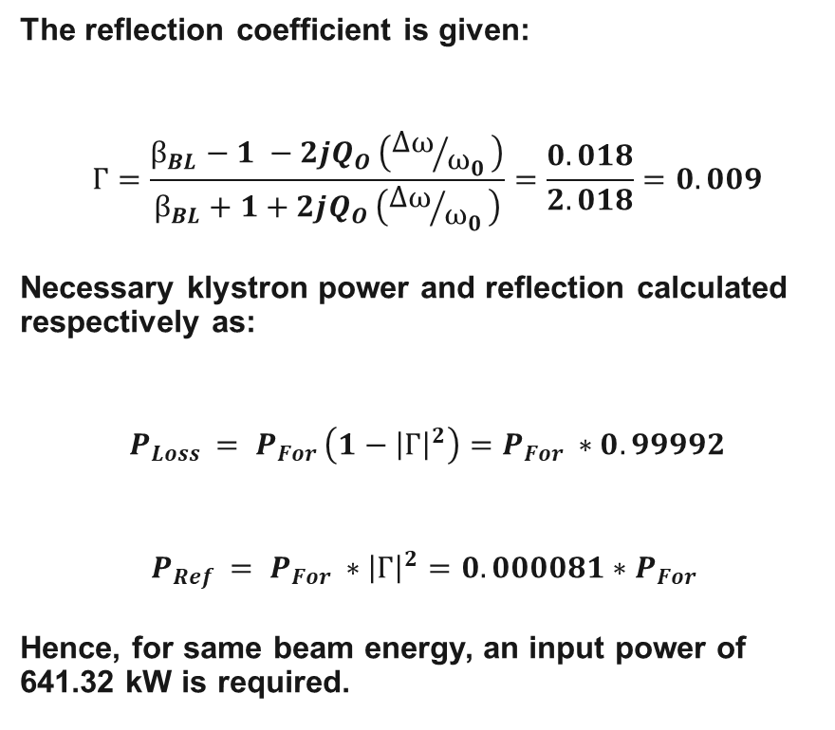
RFQ2 Parameters
The reflection coefficient is given:
$$Г=\frac{β_{BL}−1 −2jQ_{O }\left({Δω}/{ω_{0 }}\right)}{β_{BL}+1+2jQ_{O }\left({Δω}/{ω_{0 }}\right)}=\frac{0.018}{2.018}=0.009$$
Necessary klystron power and reflection calculated respectively as:
$$P_{Loss }= P_{For }\left(1−{\left|Г\right|}^{2}\right)=P_{For }∗0.99992$$
$$P_{Ref }= P_{For }∗{\left|Г\right|}^{2}=0.000081∗P_{For }$$
Hence, for same beam energy, an input power of 641.32 kW is required.
Parameter | Value
F_{o} | 352.2 MHz
Q_{O,} | 6772
Q_{Ext} | 4106
β | 1.49
I_{Beam} | 70 mA
Beam energy | 0.045 MeV
Beam output energy | 3.0 MeV
Beam Power, P_{Beam} | 207 kW peak
Resistive losses, P_{Loss} | 393 kW
Total losses, P_{Tot} | 207+(1.105*393) = 641.265 kW
Input Power, P_{For} | 641.265/(1-0.009^2) = 641.32 kW

Slide 14
Effect on Operation
The consequences are:
6.9% (41 kW) more power required from klystron.
~10.5% increase in surface heating. Corresponds to an extra ~40 W for water cooling (434 kW instead of 393kW in copper, pulsed for 1 ms at ~1Hz).
Slightly overcoupled with 70 mA beam, very small (~0.01%) reflection.
Overall, due to the increase in Q the numbers are better than we had anticipated previously.

Slide 15
Discussion

Slide 16
Measurement Plan for Full Assembly
Use Ø 12 mm dummy iris for coupler
Use copper RF plugs
Copper ridge2, waveguide, wg-coax transition.
Tuner lengths fixed
Confirm
bead-pull/Qex, antenna calibration
Tune Q_{ex} using 3 aluminum dummy irises
Assemble all modules and auxiliaries
Bead-pull measurement / Tuning
Tuner recutting,
antenna spacers fabrication
Final bead-pull/tuning if necessary
Coupler iris fixed
Coupler (ridge1) fabrication & installation
✅
✅
✅
✅
✅
✅
with copper ridge1
(final configuration)
Drawing of tuner body w/o antenna hole
Drawing of coupler iris (ridge1 body)
Drawing of tuner body w/ antenna hole
Drawing of ridge1 assembly
Drawing of antenna spacer
Drawing of dummy RF plug body
Drawing of dummy RF plug assembly

Slide 17
Discussion
The proposed next steps are:
Collect final tuner dimensions and send tuners for machining. Antenna spacers to be machined simultaneously. Tuner mechanisms packaged and moved to storage area?
Reinstall machined tuners, bead pull the cavity.
Install tuners and antennas with gaskets, bead pull.
Calibrate the antennas w.r.t. the bead pull.
Remove bead pull and perform vacuum test.
Hand RFQ2 over to Suitbert for test stand transport/installation (bead pull in the test stand? If so, time/space will be required.).

