Slide 1
MD 9263
Schottky-based chromaticity measurements with ion beams
Participants:
Diogo Alves, Christophe Lannoy, Kacper Lasocha, Nicolas Mounet, Tom Levens, Ole Marqversen, Manfred Wendt
1

Slide 2
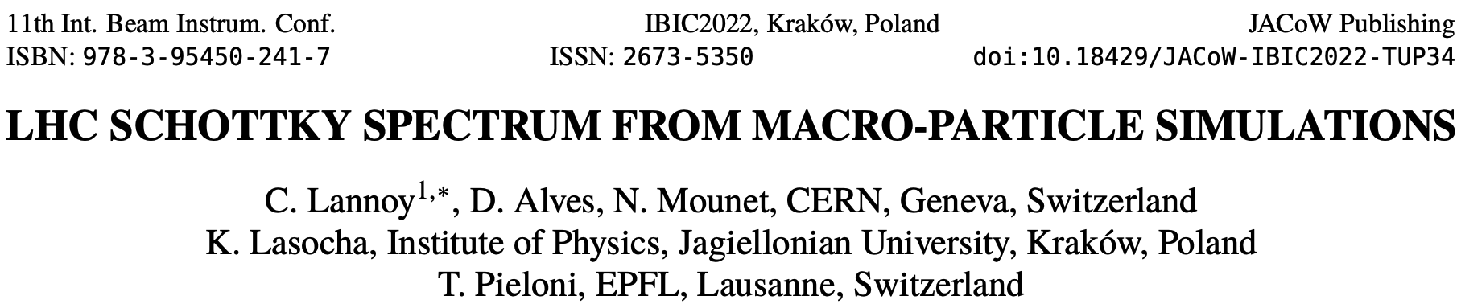
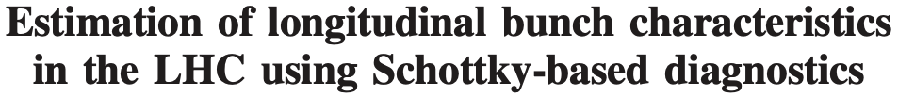

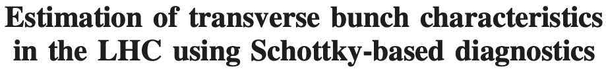


MD Motivation
Schottky spectra can in principle provide non-invasive means to measure different quantities including tune and chroma
j
In practice it can be challenging, spectra are very sensitive to any change in beam dynamics or coherence in particle motion
j
In recent years significant progress has been made on:
  Development of more robust analysis (fitting) techniques
  Understanding impact of machine operation (abort gap cleaning, collimators motion, blow ups, ...) on the measured spectrum
  Computing Schottky spectra using macro-particle simulations (PyHeadTail) – joint BE-ABP + SY-BI PhD student
    Study effect of, e.g., octupoles and beam-coupling impedance, not described in available literature
  Statistical properties of Schottky spectra
2

Slide 3
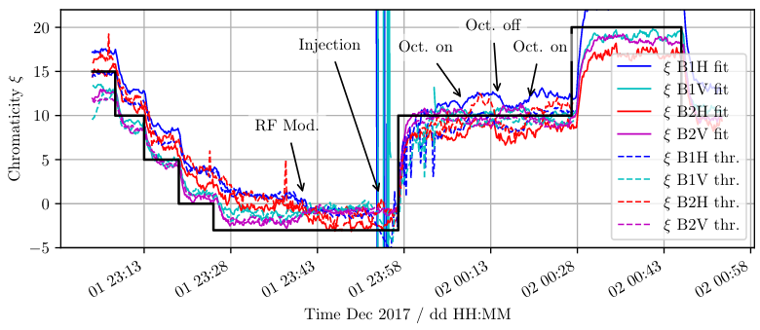
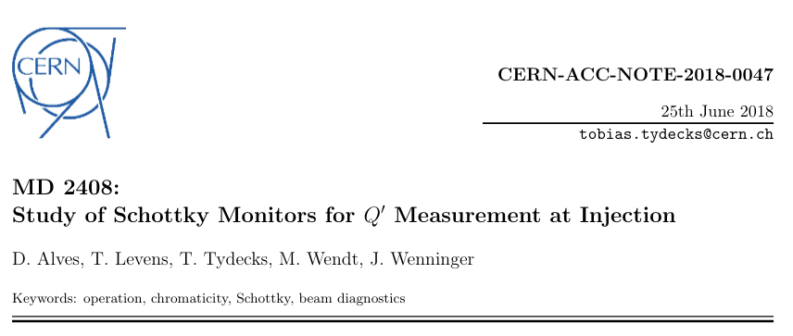
MD Motivation
Main goal: gather data and assess the Schottky based chromaticity estimates for different sextupole and octupole settings.
Similar to the last Schottky MD six years ago:
Main changes:
  Octupole current scan:
    Include effect of octupoles into Q’ measurement procedure, benchmark simulations
  27 bunches, "as similar as possible", equidistantly distributed over the ring:
    Verify experimentally studies on statistical properties of spectra
  Ions instead of protons:
    Stronger Schottky signals, easier analysis of spectra distortions
3

Slide 4
MD Plan
LHC Schottky Monitor is a gated system. We plan to sequentially measure Schottky signals of different bunches, in two different ways:
Fast scan (~8 min):
  2 bunches observed for 100 seconds each
  25 bunches observed for 10 seconds each
Slow scan (~46 min):
  27 bunches observed for 100 seconds
The scans are fully automatized with Python scripts.
The idea is to perform, both at INJ and Flattop energies:
One slow scan, for typical LHC chroma (10), with minimal octupole current
One fast scan for each chroma/octupole step
4

Slide 5
MD Plan
Procedure:
  Inject 27 bunches
  Set Qξ = 15. Octupole scan in 5 steps. Fast bunch scan at each step
  Set Qξ = 5. Octupole scan in 5 steps. Fast bunch scan at each step
  Set Qξ = 10. Minimal octupole current. Slow bunch scan
  Set Qξ = 0. Minimal octupole current. Fast bunch scan
  Set Qξ = 20. Minimal octupole current. Fast bunch scan
  Energy ramp
  Redo steps 2-6 (with higher octupole current)
INJ octupole scan: 13 A, 10 A, 7 A, 4 A, 1 A.
Flattop octupole scan: 460 A, 370 A, 270 A, 190 A, 100 A
5

Slide 6
MD Summary
Specie: Pb⁸²⁺
Beam phase: Inj & Flattop
Beam: Ideally 1&2
Total number of bunches: 27, uniformly distributed every 132 buckets
Number of hours needed: 8 h
Bunches:
  Nominal Pb⁸²⁺ intensity
  Located at non-colliding buckets, e.g B1 pattern shifted by few buckets with respect to B2
Time:
  Estimated time for data taking is 4.5 h. The rest is for injections, ramp, chroma & octupole changes
  If needed, we can skip Flattop. Then we'd need 4 h overall
  If needed, we can use only one beam, but the parallel MD needs to be compatible (octupoles, ramps, bunch pattern)
6

