Slide 1
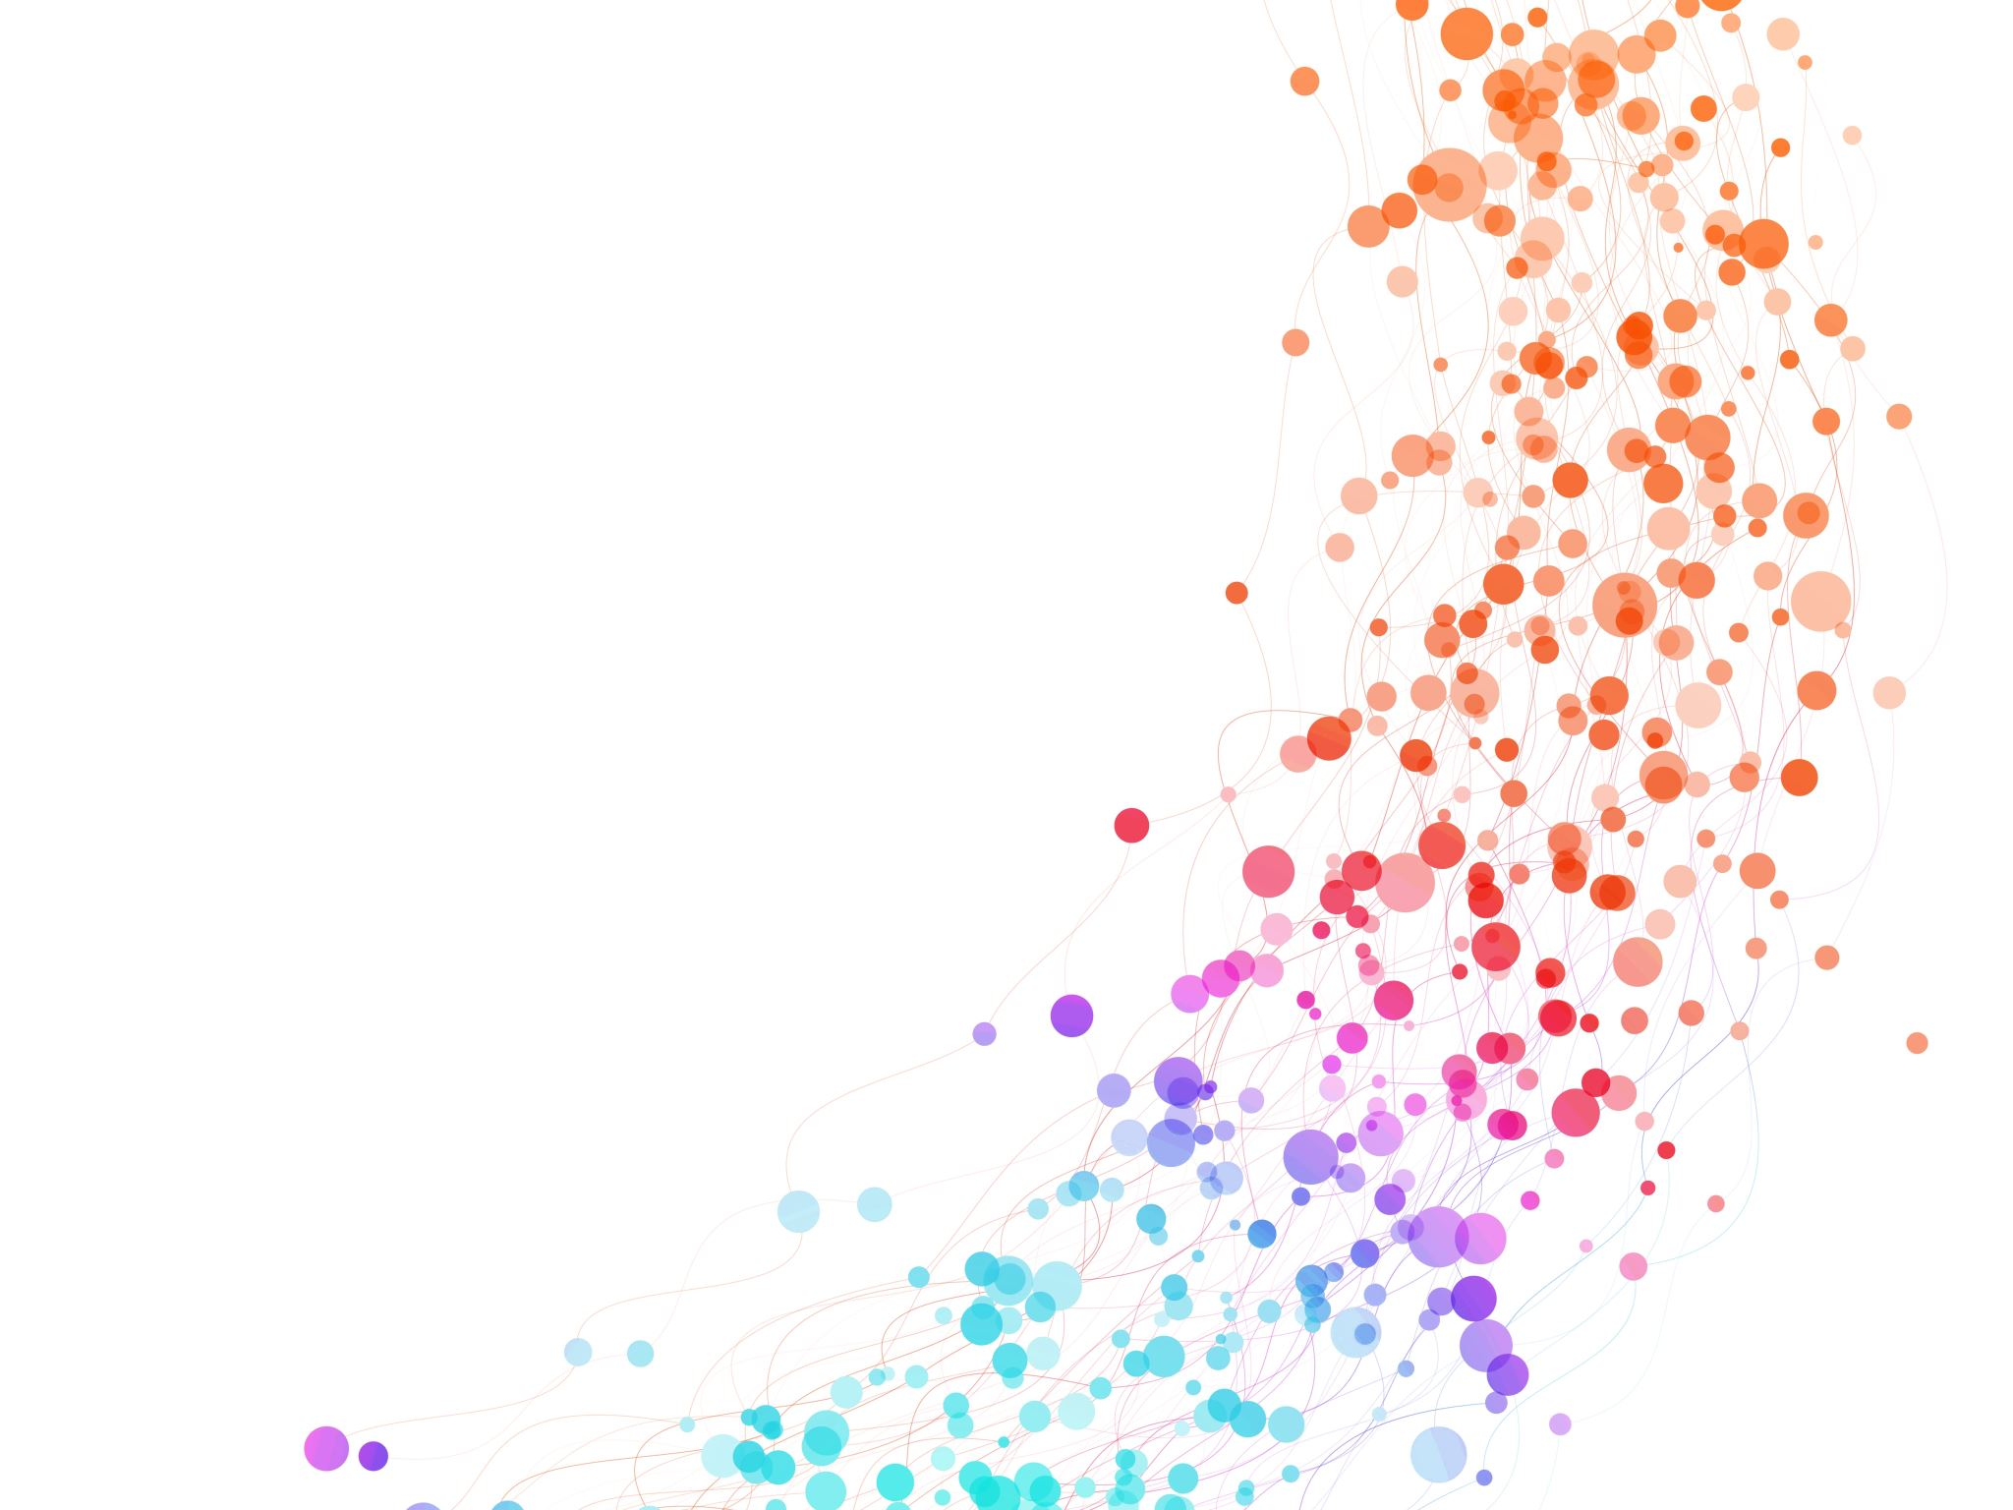

Concept Maps
International Teacher Weeks Programme 2024
Milena Vujanović
Date 05/08/2024

Slide 2

Introduction to Concept Maps
Graphic Orgnisers
Need to answer a focus question!
Consist of Key Concepts
and Linking words
Milena loves CERN.
Connected!
Milena loves CERN.
Milena loves CERN.
Hierarchical Structure!

Slide 3
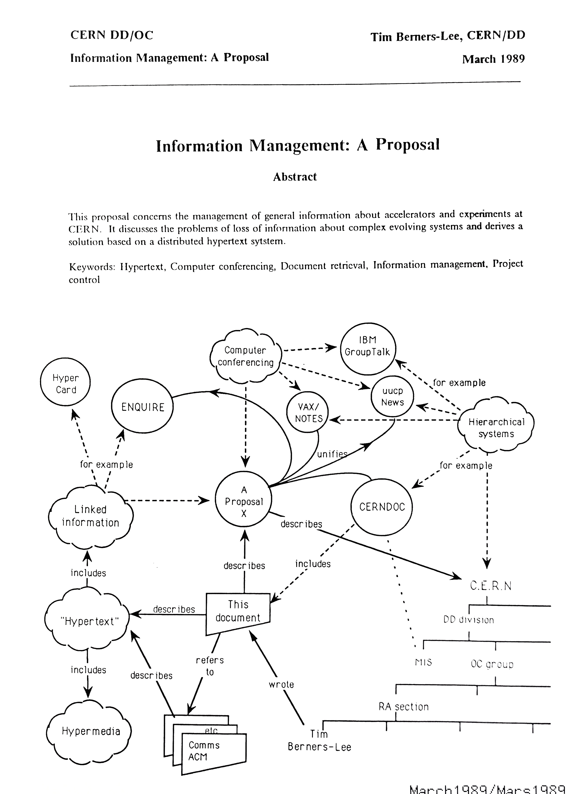
Milena loves to read.
Milena loves to read.
Milena loves to read.

Slide 4
Why do we do this?
01. It is beneficial to you, because:
it will help you organise your knowledge.
02. It is beneficial to me, because:
I get a PhD! ☺
Milena loves to read.
Milena loves to read.
Milena loves to read.

Slide 5
How to Construct a Concept Maps
01. Focus Question
What do you know about Hogwarts?
02. Stop and think!
Chose a starting concept and 2-5 key concepts
Milena loves to read.
Milena loves to read.
Milena loves to read.

Slide 6
What do you know about Hogwarts?
2-5 key concepts
Link
School for magic
Students
Hogwarts
6

Slide 7
What do you know about Hogwarts?
2-5 key concepts
Link and use ARROWS
School for magic
Students
Hogwarts
7

Slide 8
What do you know about Hogwarts?
2-5 key concepts
Link and use ARROWS and LINKING WORDS !!!
School for magic
Students
is a
Hogwarts
has
VERY IMPORTANT!
8

Slide 9
What do you know about Hogwarts?
2-5 key concepts
Link and use ARROWS and LINKING WORDS !!!
Expand
SECRET TIP !!!
… and expand some more
attend
School for magic
Students
has
is a
Hogwarts
has
has many
are sorted in
attend
Secret Rooms
has
Four houses
Classes
e.g.
Gryffindor
Chamber of Secrets
e.g.
are
e.g.
Hufflepuff
Flying
e.g.
Potions
created
Ravenclaw
was opened by
Slytherin
Transfiguration
is heir of
USE EXAMPLES !!!
Voldemort
was a
9

Slide 10
Now, it is your turn!
You will use a software to create a concept map.
Milena loves to read.
Milena loves to read.
Milena loves to read.

Slide 11
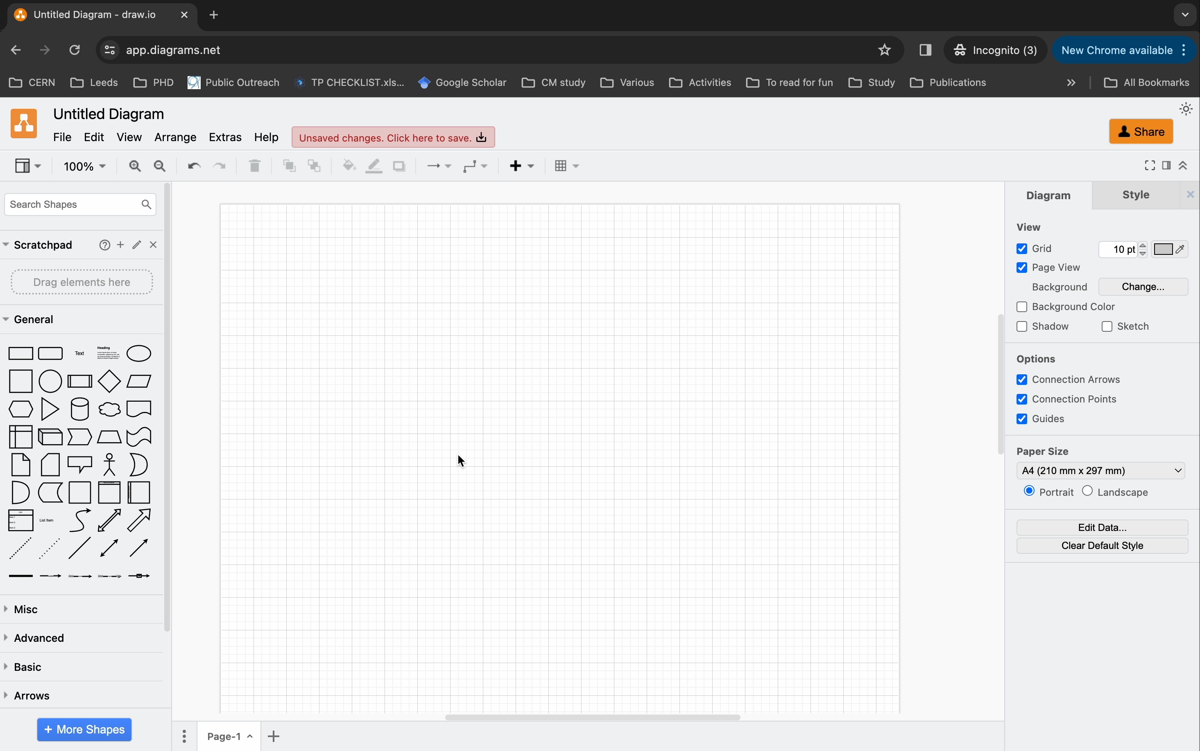
Milena loves to read.
Milena loves to read.
Milena loves to read.

Slide 12
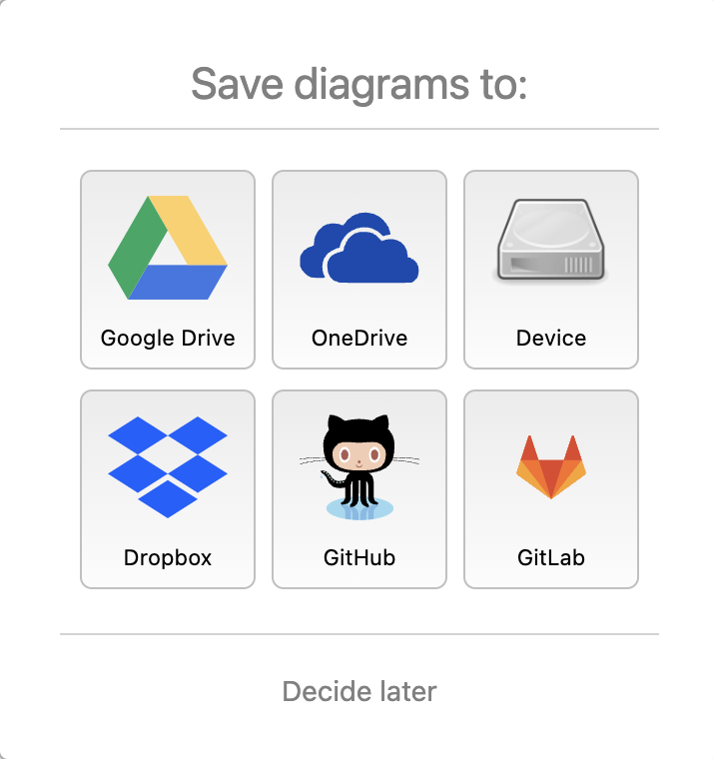
Now, it is your turn!
Personal Laptop:
CERN Laptop:
Open your laptop
Open an internet browser
Type: www.draw.io
Open the laptop in front of you
Enter the password: Tsp@2023
Open an internet browser
Type: www.draw.io
Milena loves to read.
Milena loves to read.
Milena loves to read.

Slide 13
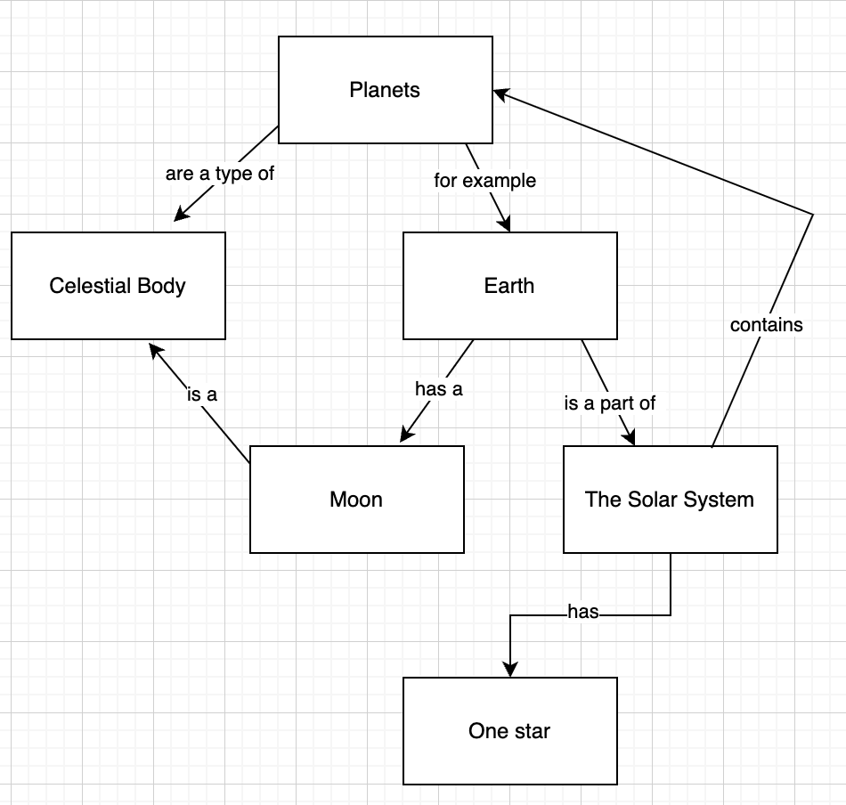
For practice, recreate this map:

Slide 14
1. Please select all the elements (Ctrl/Cmd+A)
2. Click the delete button:

Slide 15
How to make your personal code:
                First letter of your first name (e.g. Colin = C)
                Second letter of your mother’s name (e.g. Kathy = A)
                A
                C
                3
                1
                T
                7
                Last two digits of your phone number
                (e.g. 012 268 537 = 37)
                Third letter of your mother’s name (e.g. Kathy = T)
                Last digit of your year of birth (e.g. 1961 = 1)

Slide 16
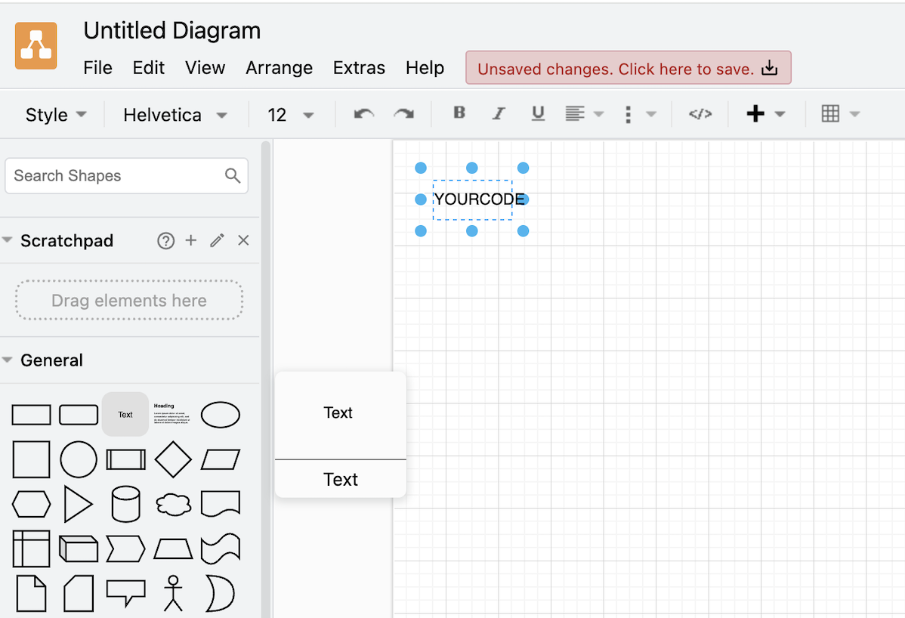
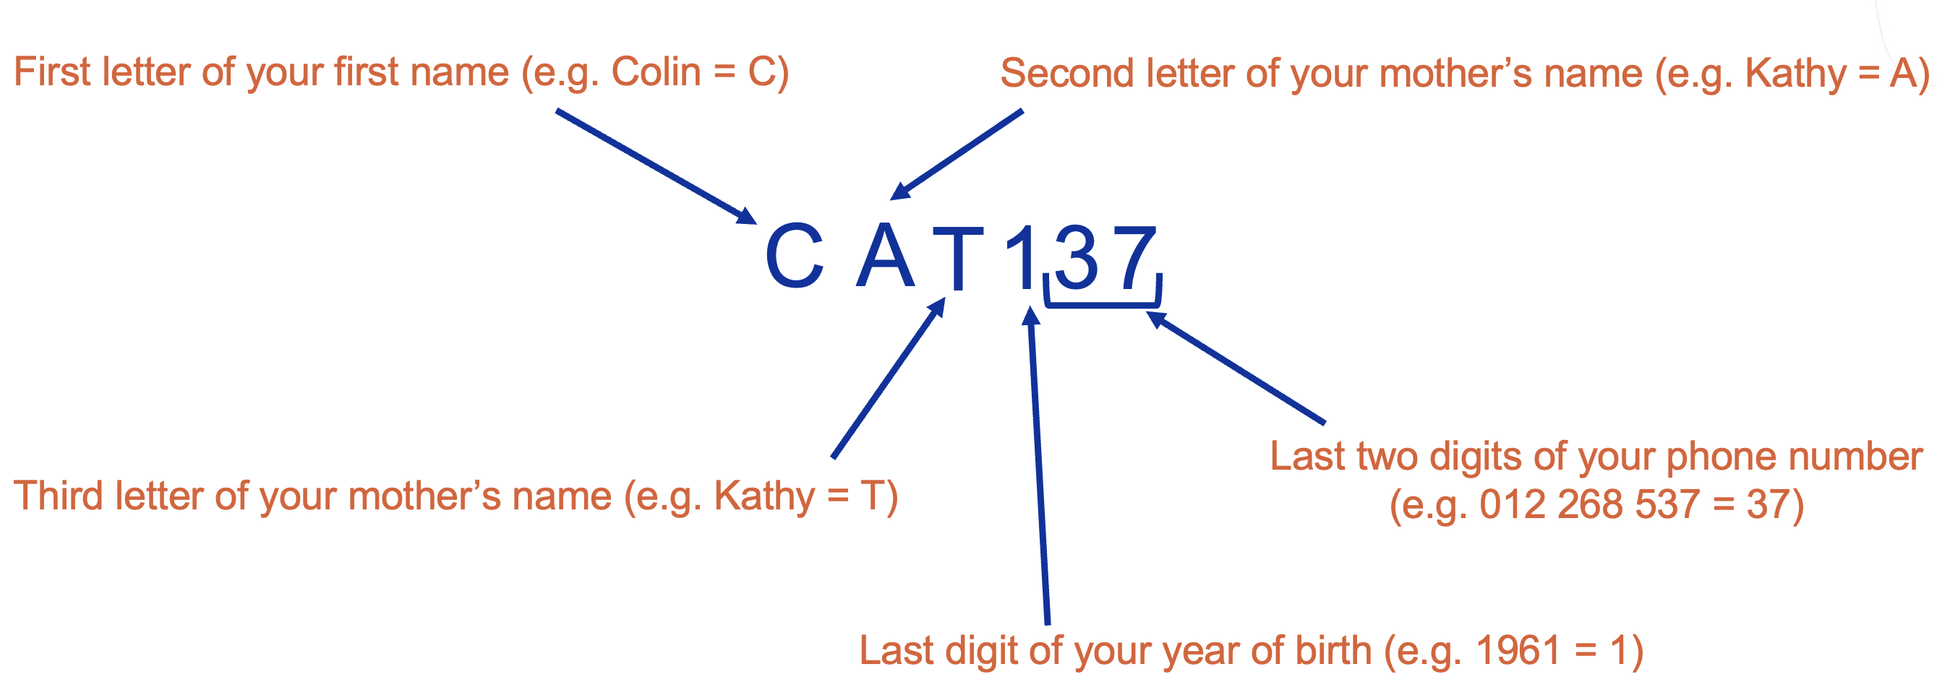
1. Drag and drop the text icon anywhere
2. Double click on the text icon to write your personal code:

Slide 17
Stop and think about the focus question
2. Chose your starting concept
3. Then chose 2 – 5 key concepts to start your map
What would you like your students to know about
PARTICLE PHYSICS and CERN?
4. Connect concepts with arrowed lines and linking words
5. Expand
Milena loves to read.
Milena loves to read.
Milena loves to read.
20 minutes
Please do not delete your maps!

Slide 18
Milena loves to read.
Milena loves to read.
Milena loves to read.
QUESTIONS?

Slide 19
Questions?
Milena loves to read.
Milena loves to read.
Milena loves to read.
QUESTIONS?

Slide 20
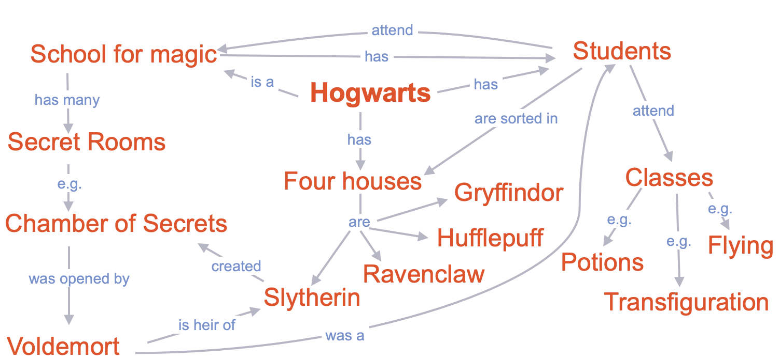
What would you like your students to know about Particle Physics and CERN?
Stop and think about the focus question
2. Chose your starting concept
3. Then chose 2 – 5 key concepts to start your map
4. Connect concepts with arrowed lines and linking words
5. Expand

Slide 21
20 minutes are up!
Please do not delete your concept map!
Milena loves to read.
Milena loves to read.
Milena loves to read.
QUESTIONS?

Slide 22
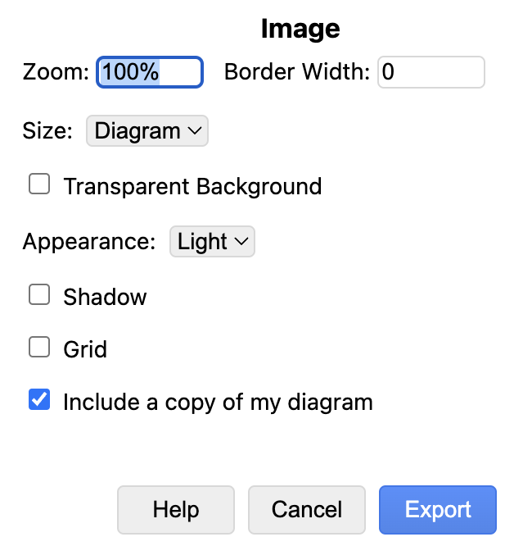
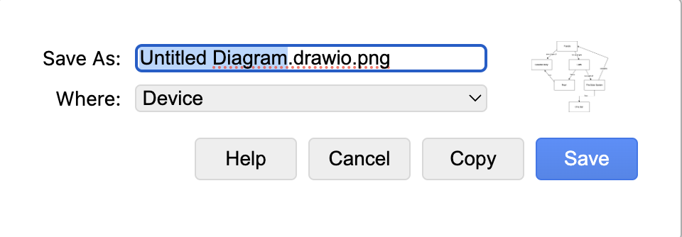
It is time to save your work!
1. Memorise your code
2. Go to File and click Export as
3. Chose PNG
4. Tick ‘Include a copy of my diagram’ and then Export
5. Instead of ‘Untitled Diagram’, write your Personal Code
6. Chose ‘Device’ or ‘Downloads’ in dropdown menu for ‘Where’
7. Click Save

Slide 23

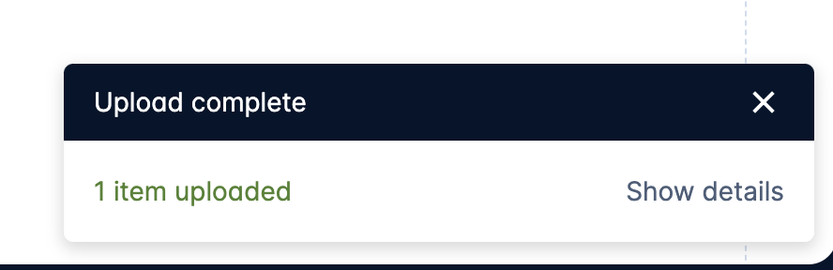
1. Go to: cern.ch/conceptmap
2. Upload your saved concept map by clicking this
3. Chose your file from the computer

Slide 24



Thank you for your participation!
milena.vujanovic@cern.ch
Nariel_137

