Slide 1

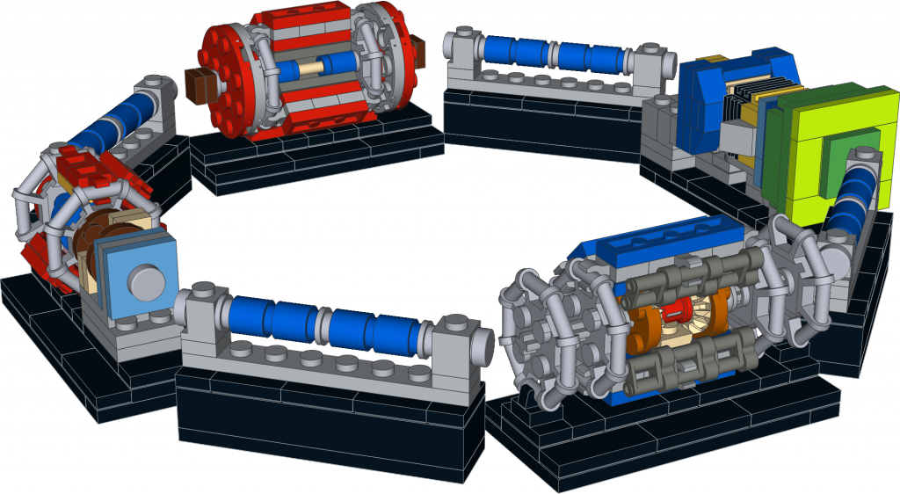
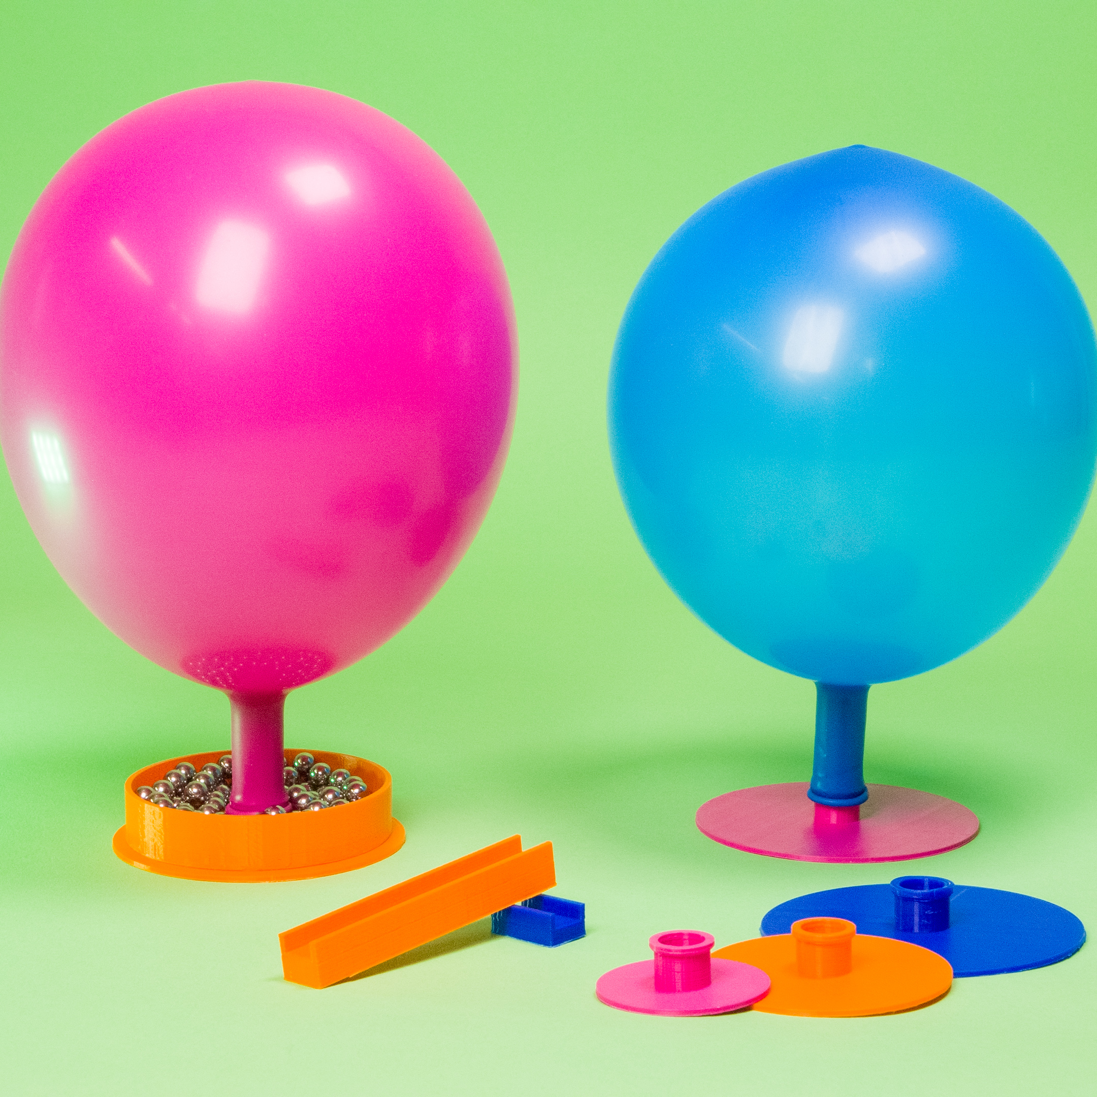
Science Gateway workshop
Julia WOITHE
12/08/2024
LEGO Detectors &
The Power of Air

Slide 2
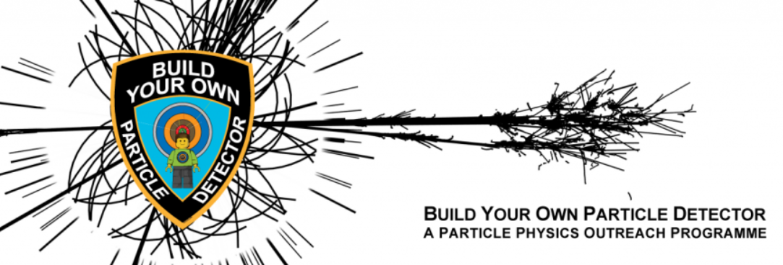
Build your own particle detector
Idea, models and Images by Nathan Readioff
More information & files: https://build-your-own-particle-detector.org
Notes:
What applications, food sterialisation
Quiz slide: what else can you do with electron accelerators? Cut things, produce solar cells, start chemical, sterialise food, generate light, generate X-ray – all correct

Slide 3
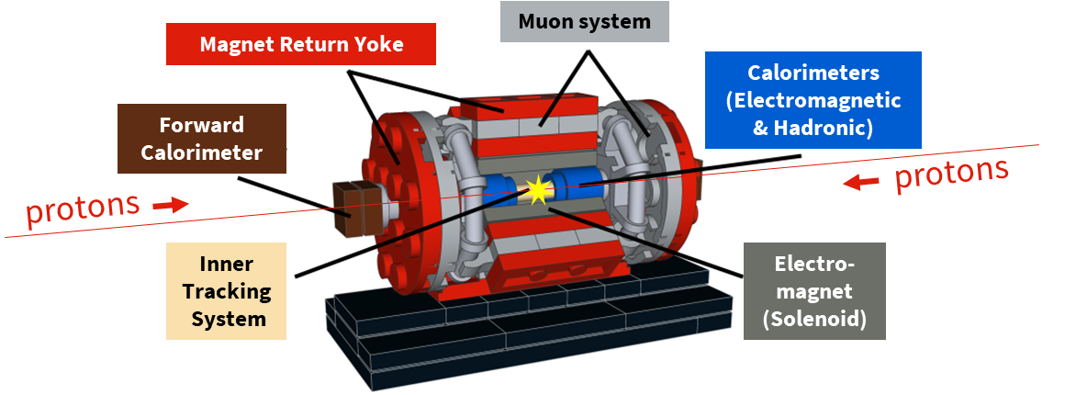
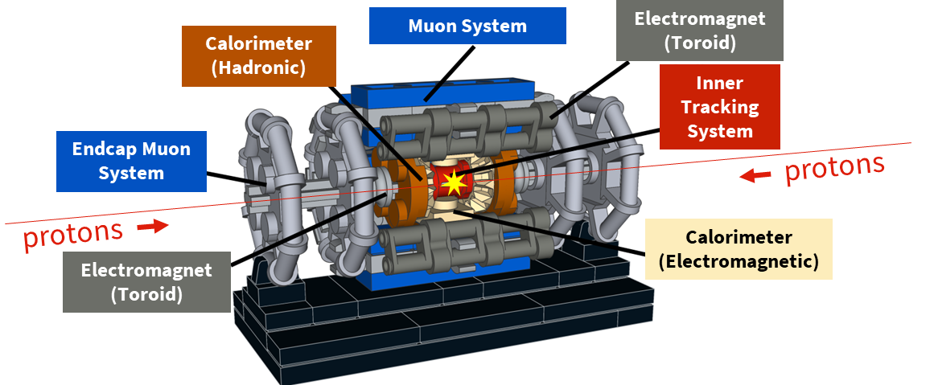
CMS
ATLAS

Slide 4
Time for a quiz! Which detector system is doing what?
Electromagnet
Control the magnetic field & support the detector
Magnet Return Yoke
Bend the path of electrically charged particles
Inner Tracking System
Detect muons
Calorimeters
Track the paths of electrically charged particles
Muon system
Measure the energy of particles

Slide 5
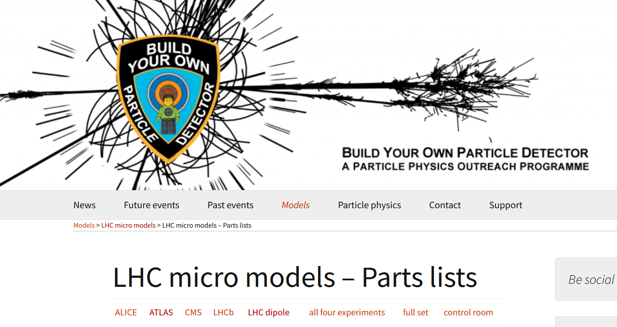
https://build-your-own-particle-detector.org/models/lhc-micro-models/lhc-micro-models-parts-lists/

Slide 6
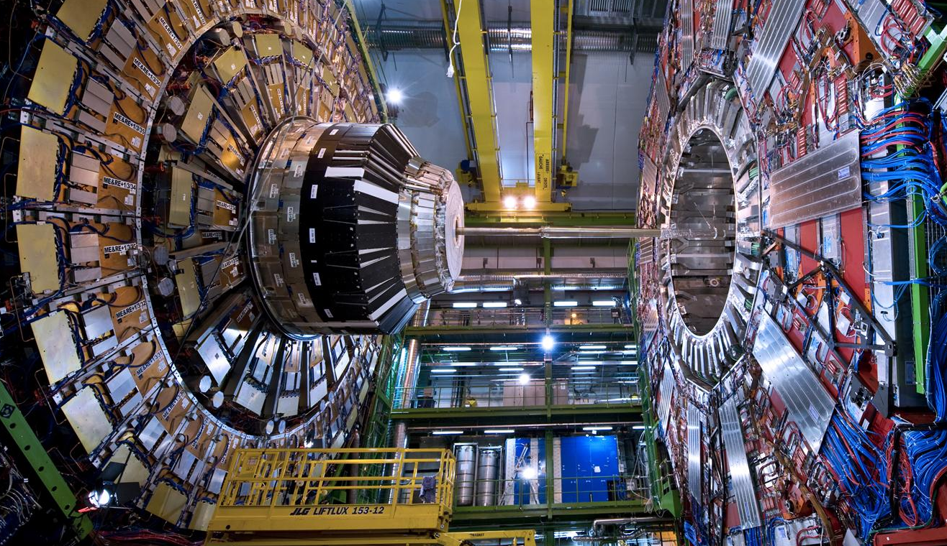
CMS
Notes:
Here is a CMS.
Like ATLAS, this is another multi-purpose experiment. It also discovered the Higgs Boson in 2012.
The C in CMS stands for Compact. Even though it does not look compact to most of you, this experiment is twice as small as ATLAS but twice as heavy: 2 times the Eiffel Tower (14’000 tonnes)!
It gathers 2600 physicists from 182 universities and institutes in 42 countries.

Slide 7
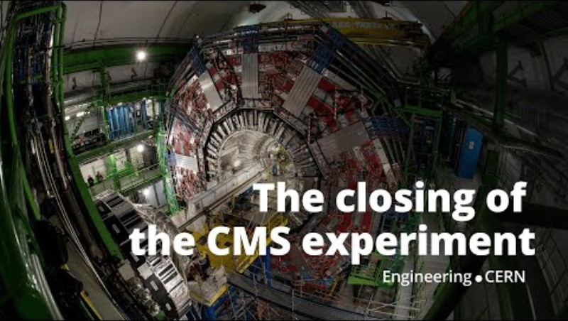
CMS moving
Insert video

Slide 8
The Power of Air
1 ballon and 1 hovercraft per person (no exchanges)
Try out your hovercraft on different surfaces
Compare with your neighbours
Work together in teams of 2 to move your detectors

Slide 9
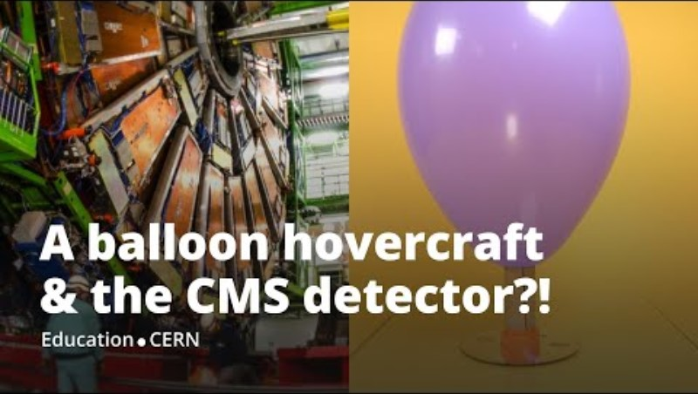

Slide 10
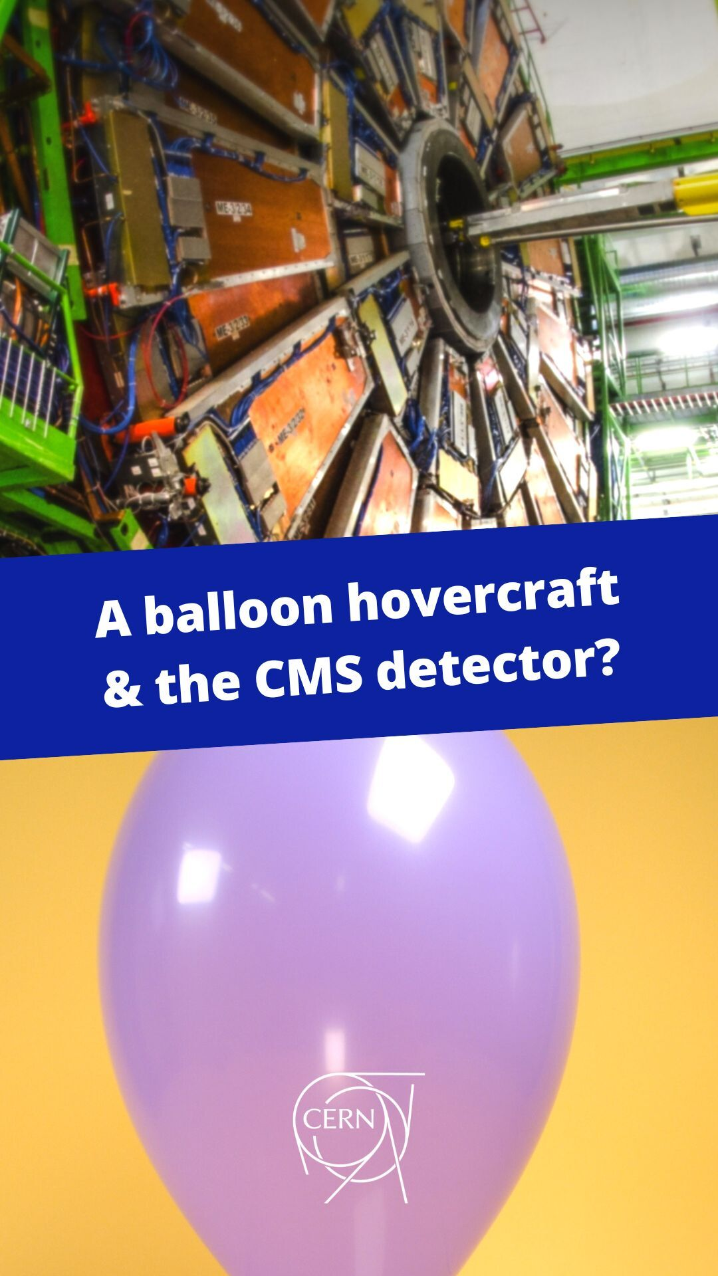
DIY Balloon Hovercraft
A smooth surface
A CD or DVD
Super glue
A sports bottle cap
A cardboard tube
A balloon
https://solvay-education-programme.web.cern.ch/balloon-hovercraft-cms-particle-detector

Slide 11
Science Gateway workshop
Julia WOITHE
09/07/2024
Thanks for exploring with us!

