Slide 1
Future Particle Accelerators
Frank Zimmermann
International Teacher Programme 2024
15 August 2024

Slide 2
outline
accelerators
particle colliders, including luminosity & beam-beam
next and next-next(-next) generation high-energy machines
  hadron colliders, both circular and linear electron-positron colliders, and muon colliders, along with challenges and merits
  collider energy efficiency, including energy recovery
  advanced accelerators incl. accelerators for the dark sector
  elements of the recent US Snowmass process
  approximate technical timelines
brief outlook to the far future
back to next generation

Slide 3
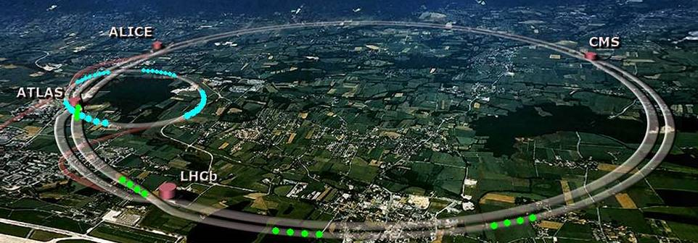
accelerator landscape in the 21st century
worldwide >30,000 particle accelerators:
<1% for basic research
5% for applied research
35% for medicine
~ 60% in industry
Engines of discovery: 1/3 of all Nobel prizes in physics since 1939 are connected to particle accelerators. [E.Haussecker & A. Chao, Phys. in Persp. 13]
Advanced scientific tools: 18 synchrotron and 8 FEL based light sources in operation in Europe, 1 neutron source in operation and another in construction, more Nobel prizes and strong impact on all scientific domains.
Providers of quality healthcare: >10’000 accelerators for radiotherapy installed in hospitals worldwide, >500 radioisotope production accelerators, 19 particle therapy centers in Europe.
Cutting-edge industrial equipment: analysis and modification of surfaces across many fields (ion implantation, polymer treatment, sterilization, environment, etc.).
M. Vretenar

Slide 4
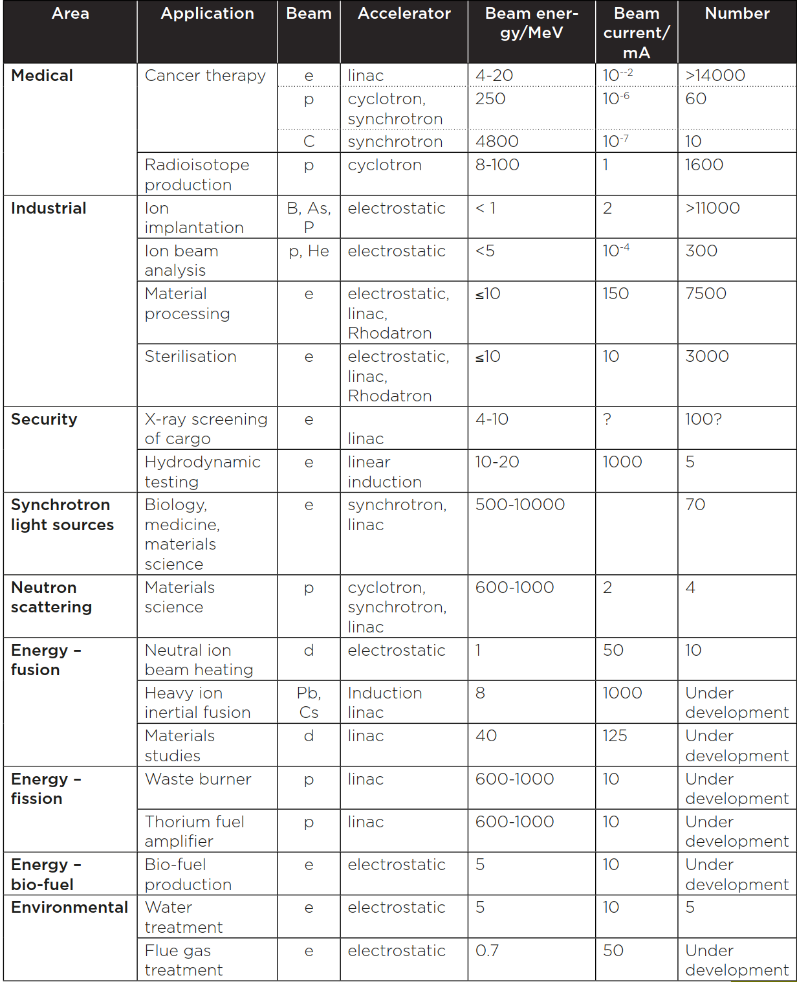
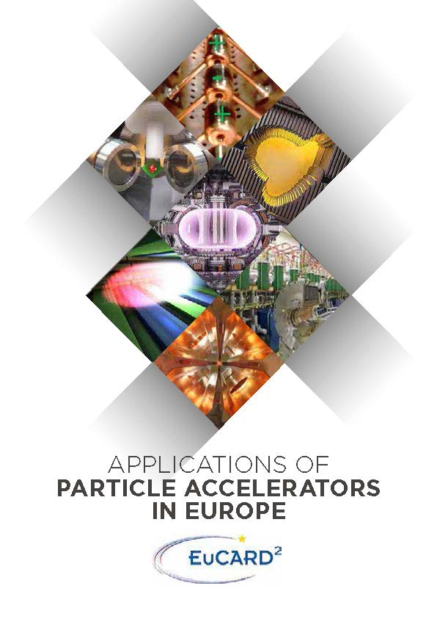
Applications of Particle Accelerators
Source: R. Edgecock, A. Faus Golfe, EuCARD-2, 2017
CERN-ACC-2020-0008 http://cds.cern.ch/record/2716155

Slide 5
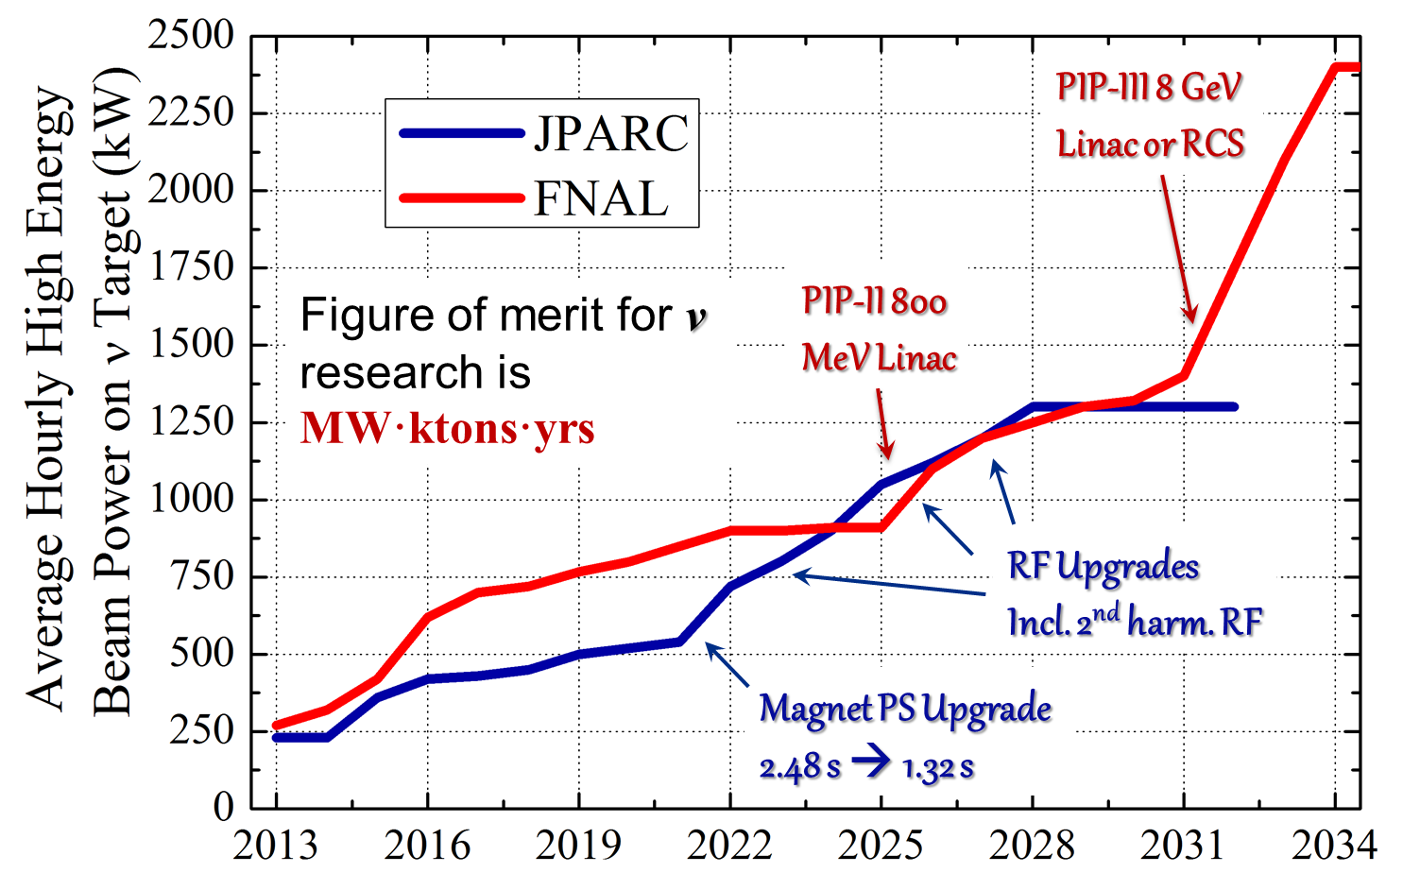
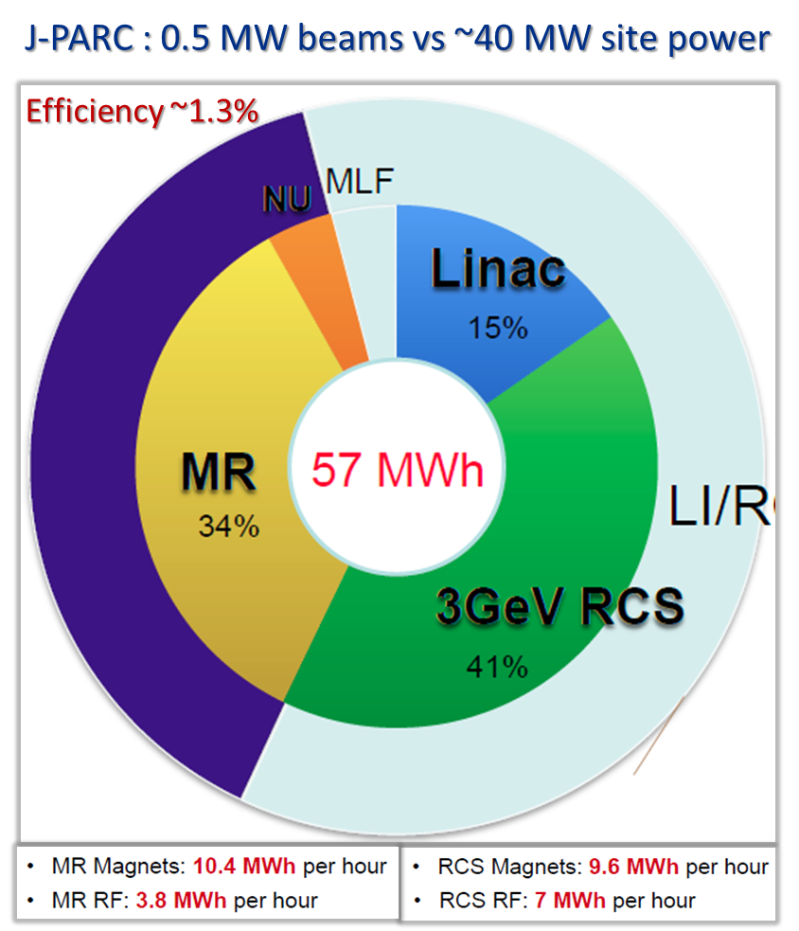
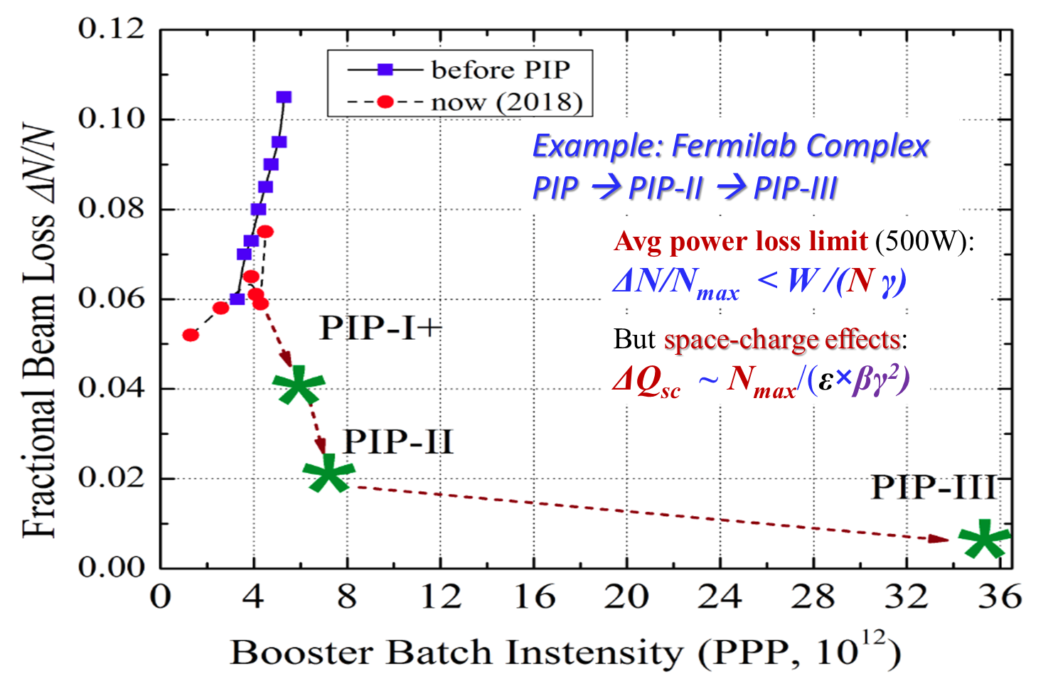
example: super-beam facilities & upgrades
power efficiency challenge
Fermilab & J-PARC Power Upgrades
protons per pulse
challenge
V. Shiltsev

Slide 6
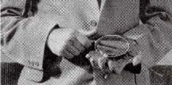
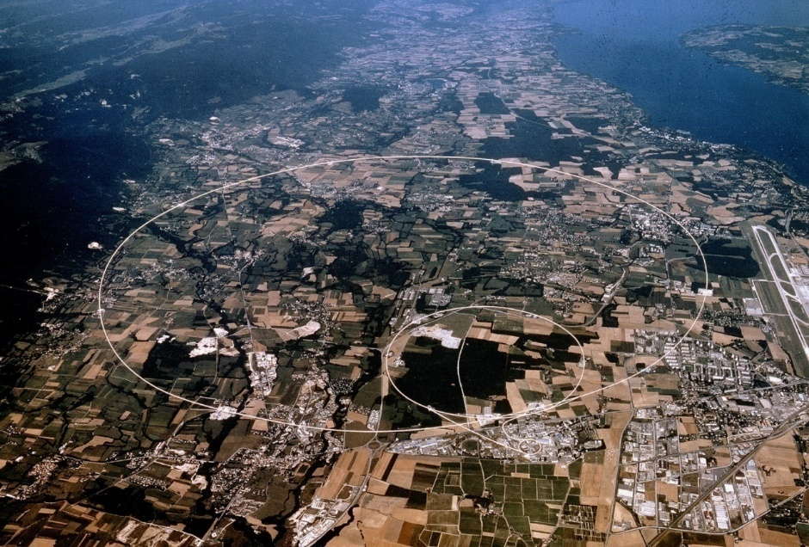

examples: high energy particle accelerators
G. Hoffstaetter
then $\sim$1930
now
first cyclotron
E.O. Lawrence
11 cm diameter
1.1 MeV protons
Large Hadron Collider
9 km diameter, 7 TeV protons

Slide 7
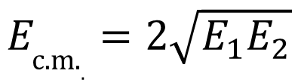
why colliders ? - energy
colliders were invented (1943) and patented (1953) by Rolf Wideröe
centre-of-mass energy:
beam hits
a “fixed target”
two equal
beams collide
colliding two beams against each other can provide much higher centre-of-mass energies than fixed target!
$$E_{\text{c}\text{.}\text{m}\text{.}.}=2\sqrt{E_{1}E_{2}}$$
for two high-energy beams
of unequal energy

Slide 8
particle colliders constructed and operated
A. Ballarino
advances by new technologies and new materials
(important
example
SC)
Colliders with
superconducting RF system
Colliders with
superconducting arc magnet system
Colliders with
superconducting magnet & RF
Notes:
New slide from Davide.
Showing that conductor development is launched at international level, Russia, Japan, (Korea and Europe in preparation)
Underline importance of that development as main cost driver for the hadron collider machine.

Slide 9
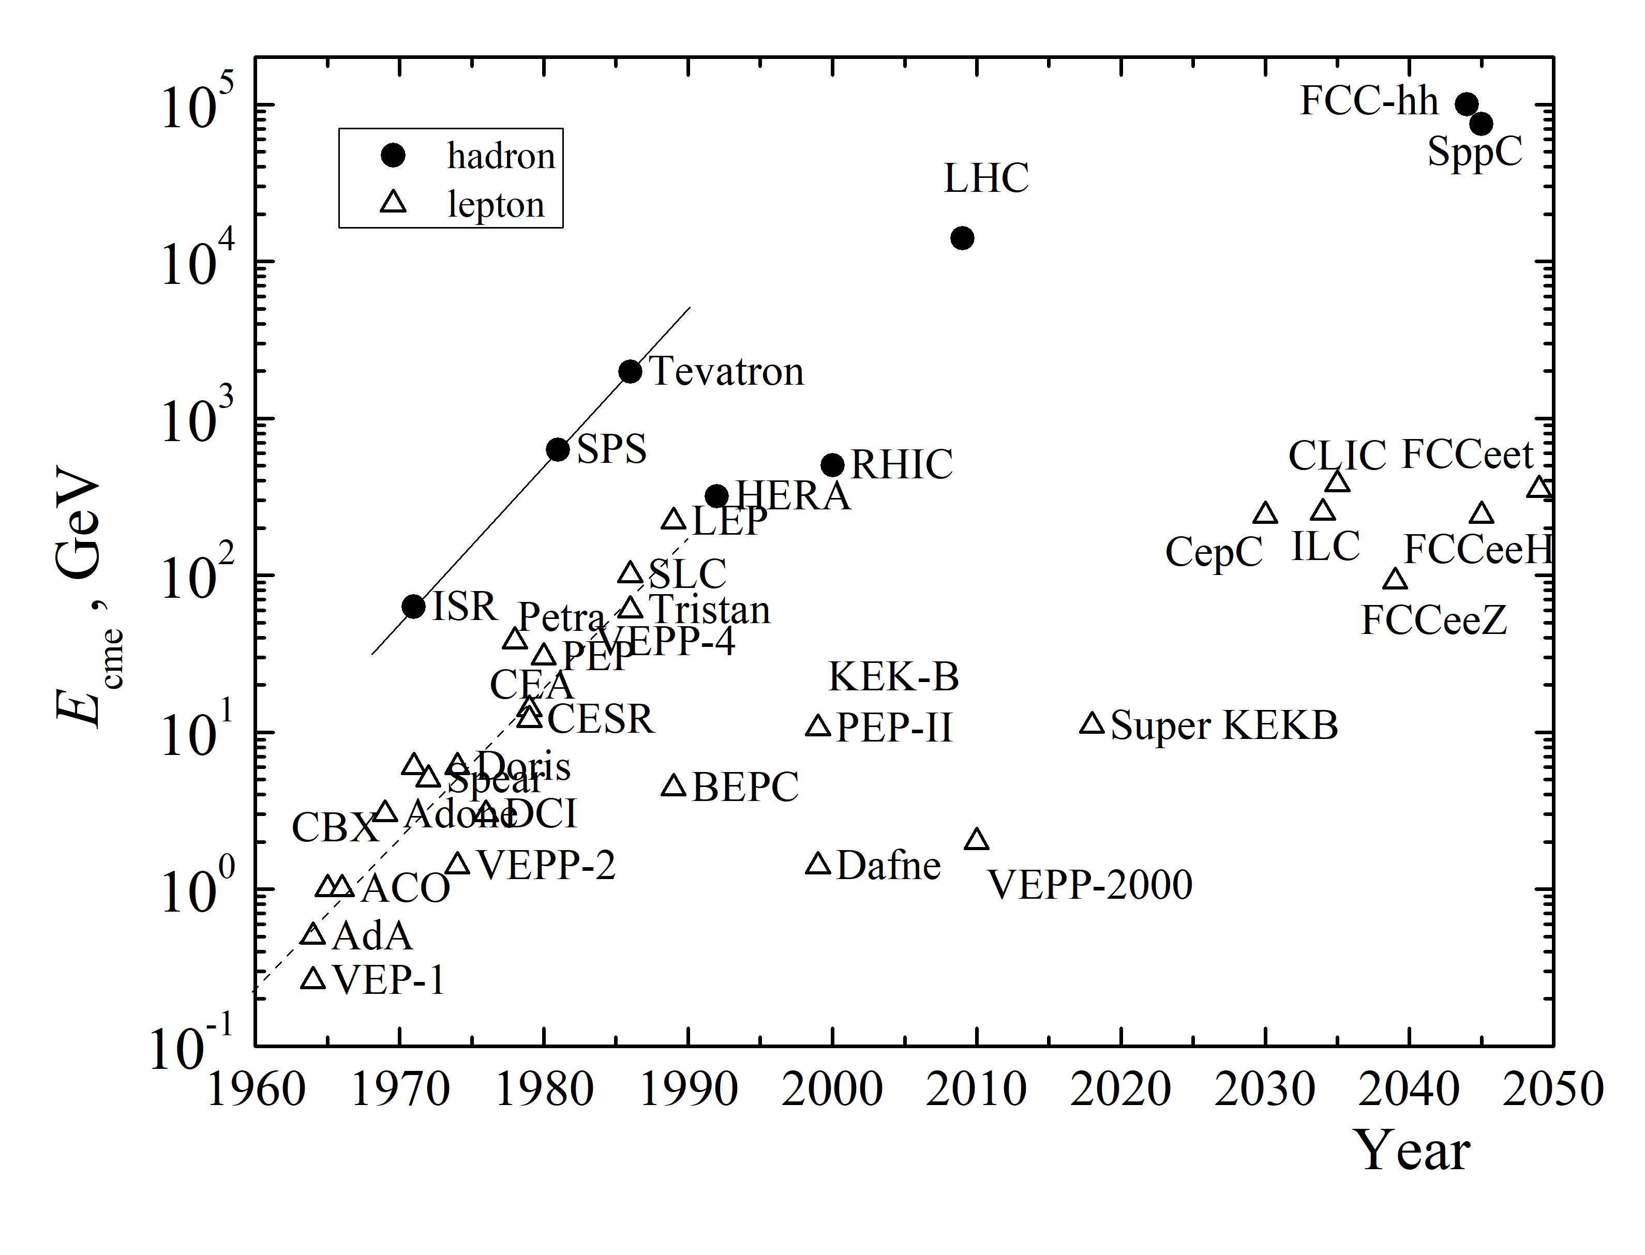
more key collider technologies & concepts
stochastic cooling and bunched beam stochastic cooling of antiprotons and heavy ions:
  SPS, Tevatron, RHIC + … ?
development of asymmetric B factories: PEP-II, KEKB, SuperKEKB
highest energy hadron and lepton colliders: LHC, HL-LHC, FCC, CLIC, ILC, μ colliders, γγ colliders, plasma-based colliders
+ energy recovery for colliders
Rev. Mod. Phys. 93, 015006 (2021)

Slide 10

colliders and discoveries
A. Ballarino
Standard Model
Particles and forces
powerful instruments for discovery and precision measurement
Notes:
New slide from Davide.
Showing that conductor development is launched at international level, Russia, Japan, (Korea and Europe in preparation)
Underline importance of that development as main cost driver for the hadron collider machine.

Slide 11
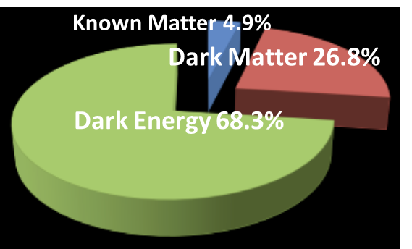
still many open questions
    Known matter is only 5% of universe!
F. Gianotti
    what is dark matter?
    what is dark energy?
    why more matter than antimatter?
    what about gravity?
also QCD,
quark-gluon plasma,
proton spin, etc.
Notes:
New slide from Davide.
Showing that conductor development is launched at international level, Russia, Japan, (Korea and Europe in preparation)
Underline importance of that development as main cost driver for the hadron collider machine.

Slide 12
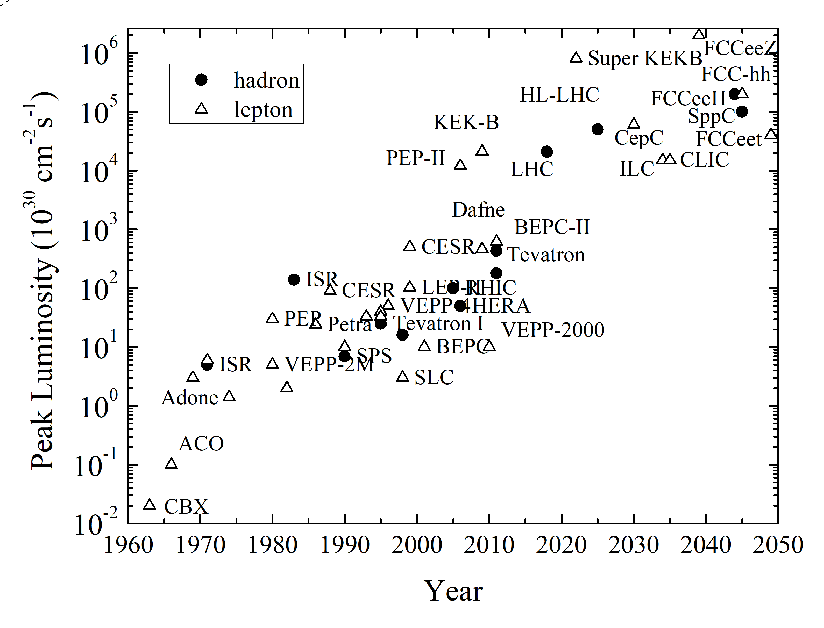
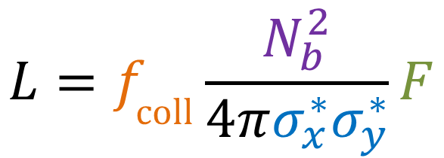
collider figure of merit: luminosity
R= σ L
tends to decrease as energy⁻²
luminosity
reaction rate
cross section
V. Shiltsev & F.Z., arXiv:2003.09084, submitted to RMP
geometric factor
(crossing angle,
hour glass, pinch, …)
bunch
population
$$L=f_{\text{coll}}\frac{N_{b}^{2}}{4πσ_{x}^{∗}σ_{y}^{∗}}F$$
peak luminosity increased by almost
7 orders of magnitude over 60 years
bunch
collision
rate
horizontal & vertical
rms beam size
at collision point

Slide 13
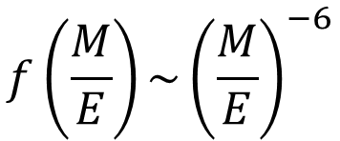
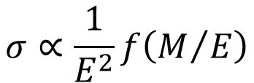
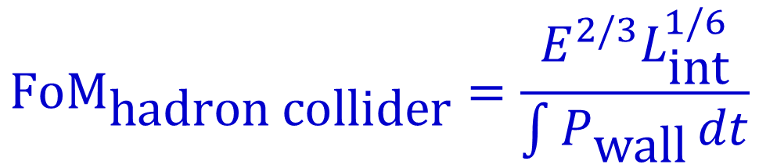


collider figure of merit: integrated luminosity
Example: hadron collider energy reach with M the mass of new particle to be discovered
$$σ∝\frac{1}{E^{2}}f\left(M/E\right)$$
$$f\left(\frac{M}{E}\right)\sim {\left(\frac{M}{E}\right)}^{−6}$$
$$⟶$$
$$M∝E^{2/3}L_{\text{int}}^{1/6}$$
Lee Teng, APAC 2001
also V.Shiltsev, F.Z., RMP 93, 015006 (2021)
proposed figure of merit
$${\text{FoM}}_{\text{hadron} \text{collider}}=\frac{E^{2/3}L_{\text{int}}^{1/6}}{\int{P_{\text{wall}}}dt}$$

Slide 14
another
collider figure of merit

Slide 15
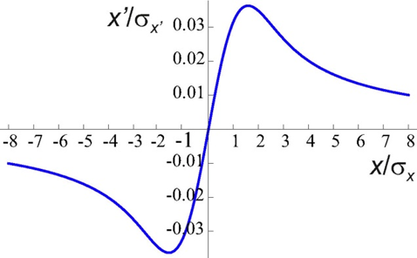
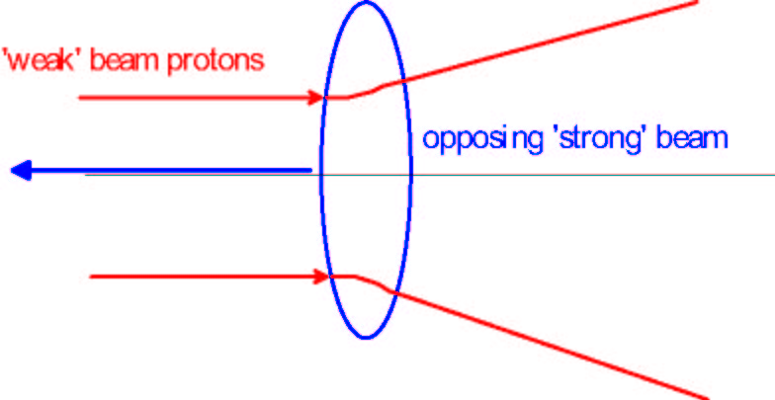
collider figure of merit: beam-beam tune shift
(nonlinear) beam-beam force
head-on beam-beam collision in the LHC
at small amplitude similar to effect of defocusing quadrupole
for single
collision
(nominal
LHC ~0.0033)
for pure head-on collision

Slide 16
beam-beam tune spread
vertical tune Q_{y}
particles in the
transverse tail
tune spread
ΔQ_{y}
maximum
acceptable
tune
spread
is limited
by resonances
nQ_{x}+mQ_{y}=p
up to resonance
order |n|+|m|~13
tune footprint
particles at the center of the bunch
tune spread
ΔQ_{x}
horizontal tune Q_{x}

Slide 17
multiple interaction points
vertical tune Q_{y}
particles in the
transverse tail
tune spread
ΔQ_{y}
1 collision / turn
particles at the center of the bunch
2 collisions / turn
horizontal tune Q_{x}

Slide 18
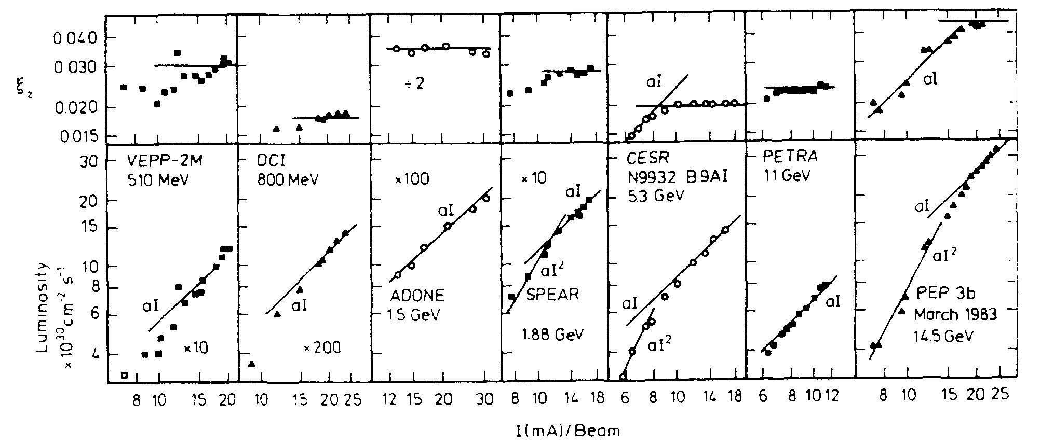
beam-beam limit in e⁺e⁻ colliders
J. Seeman
luminosity and vertical tune-shift parameter versus beam current for various electron-positron colliders; the tune shift saturates at some current value, above which the luminosity grows linearly

Slide 19
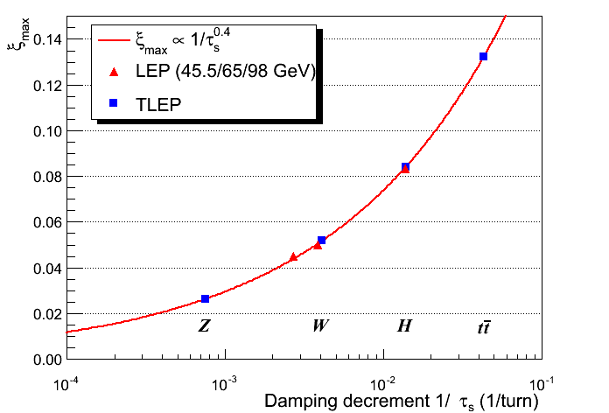
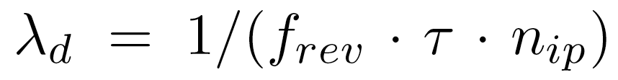
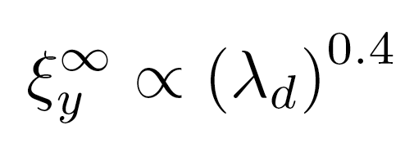
beam-beam limit w strong SR damping
R. Assmann
damping decrement per IP

Slide 20
Modern Colliders

Slide 21
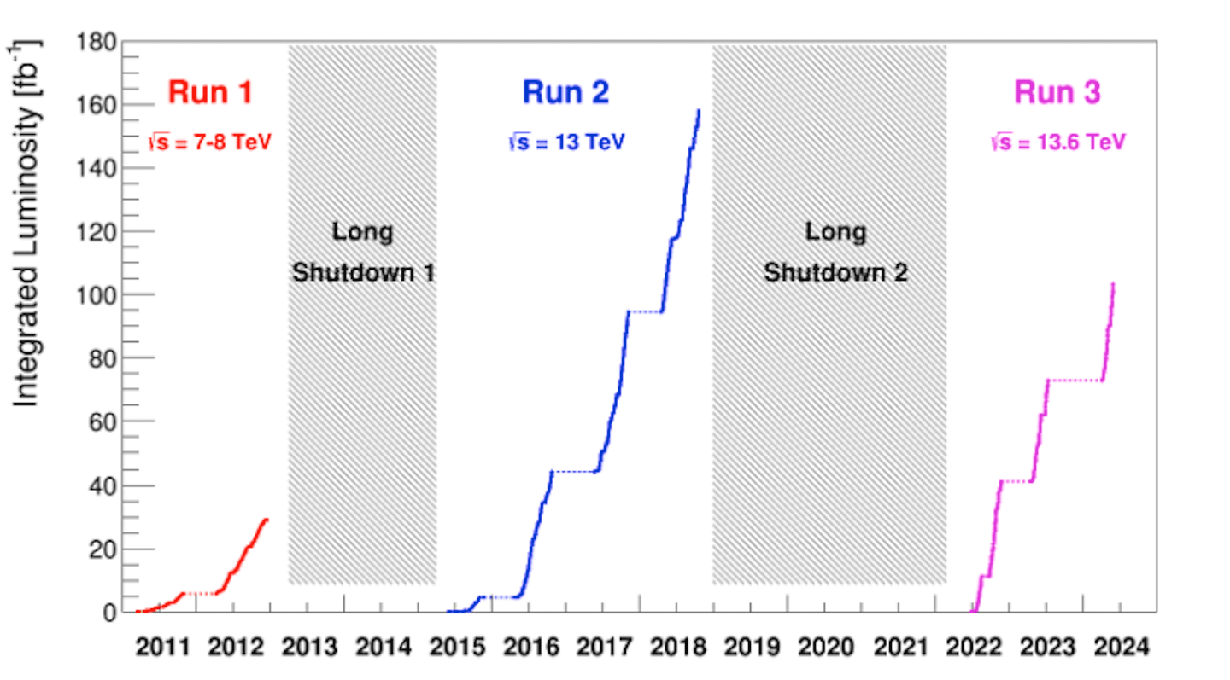
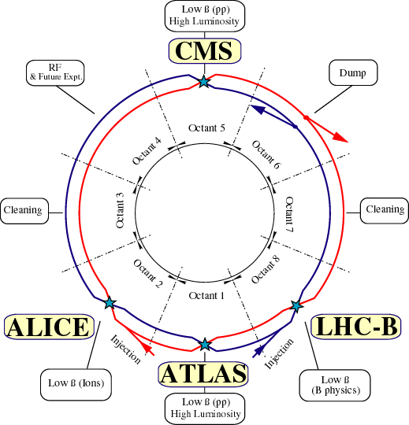
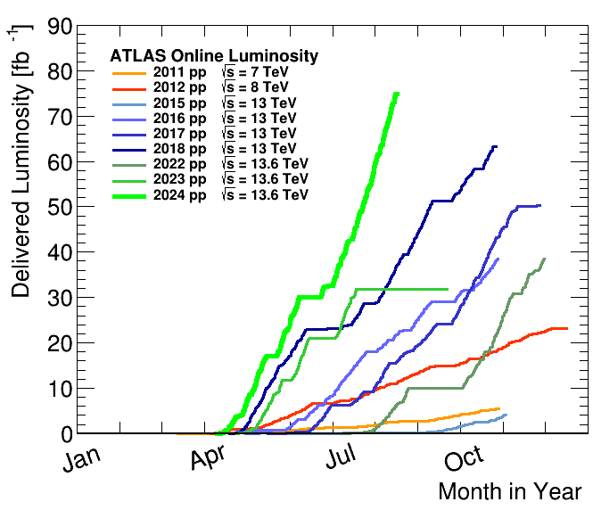
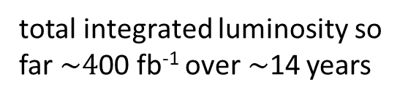
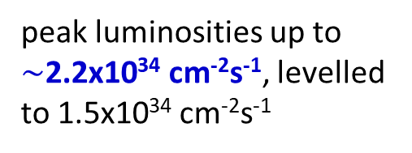
Large Hadron Collider (LHC)
circumference 27 km
world’s highest energy p-p collider at CERN/Geneva
running
extremely well
total integrated luminosity so far $\sim 4$00 fb⁻¹ over$\sim$14 years
peak luminosities up to $\sim$2.2x10³⁴ cm⁻²s⁻¹, levelled to 1.5x10³⁴ cm⁻²s⁻¹

Slide 22
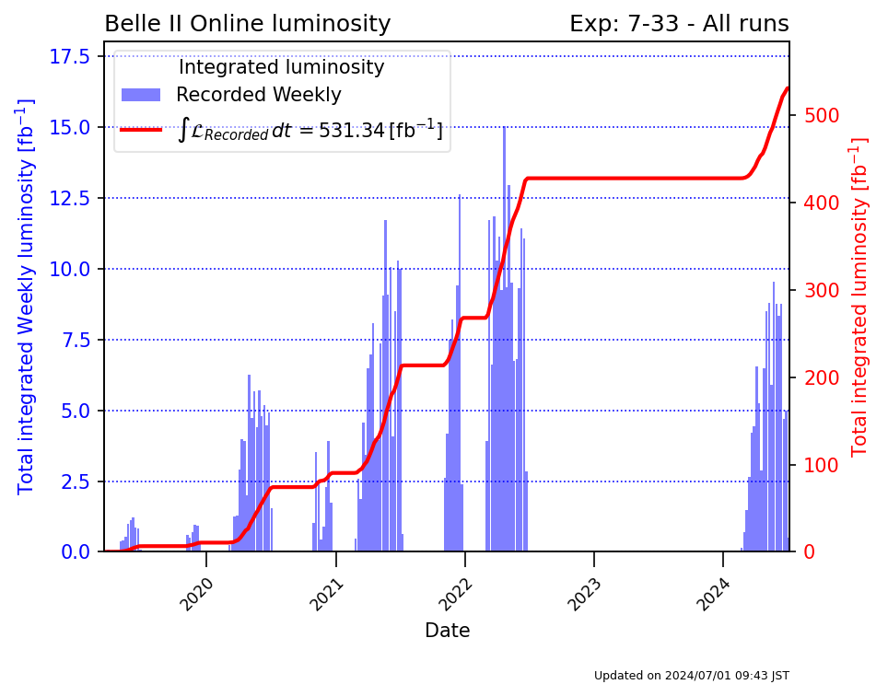
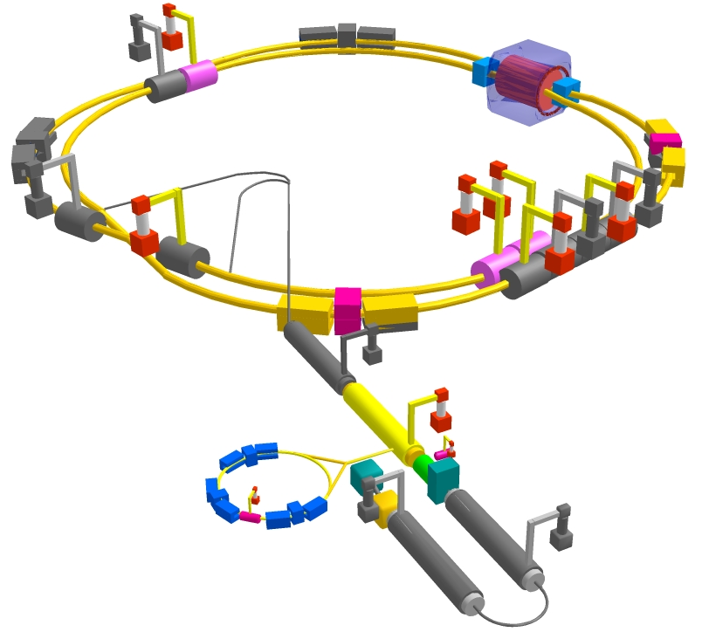
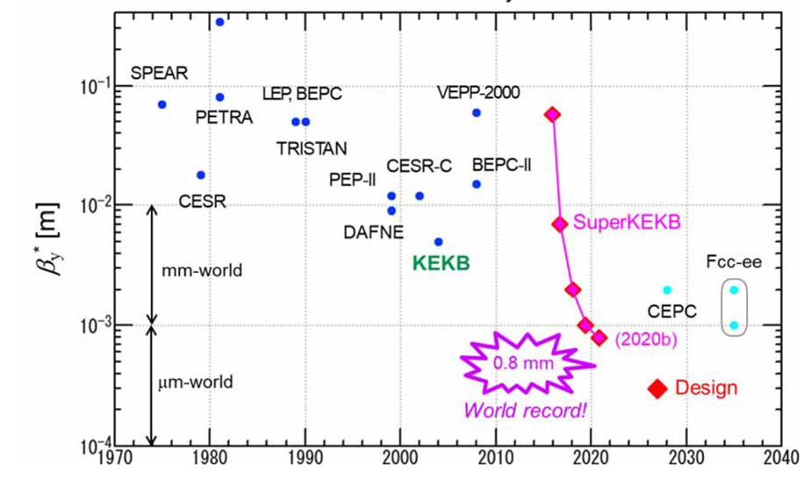
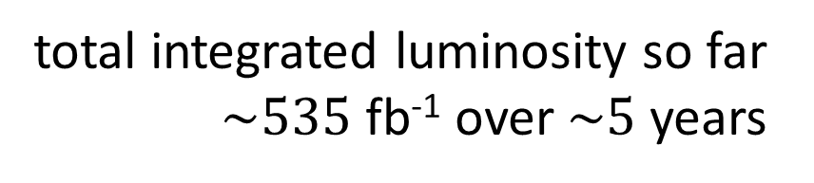
SuperKEKB
circumference 3 km
world’s highest luminosity & lowest β* e⁺e⁻ collider at KEK/Tsukuba
total integrated luminosity so far $\sim 535$ fb⁻¹ over$\sim 5$ years
world record luminosity of 4.71x10³⁴ cm⁻²s⁻¹, β_{y}* = 1.0 mm routinely, also β_{y}* = 0.8 mm shown – with “virtual” crab-waist collision scheme originally developed for FCC-ee (K. Oide)

Slide 23
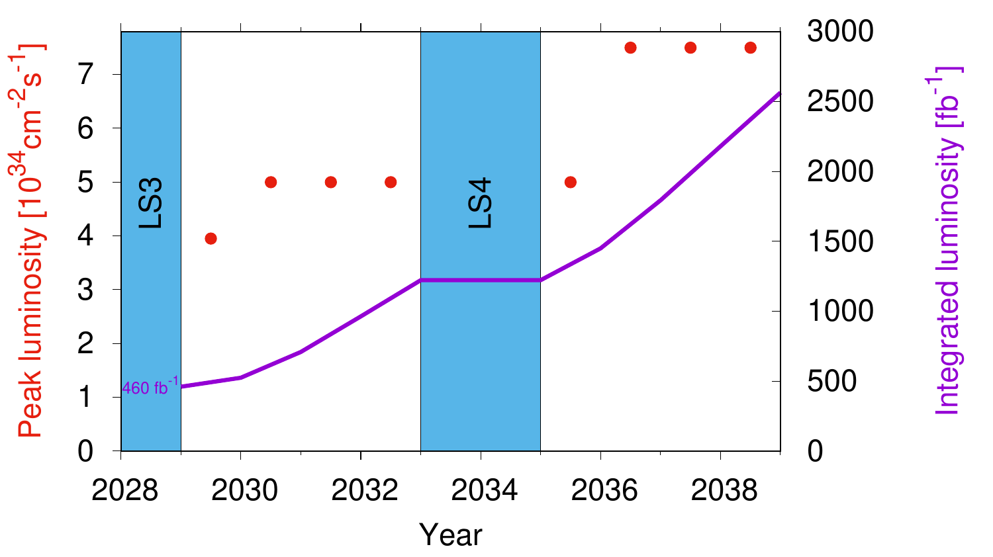

near-future collider 1: High-Luminosity LHC
High-Luminosity LHC at CERN: E_{p-p,cm}=14 TeV, L=5 or 7.5x10³⁴cm⁻²s⁻¹ levelled
goal: increase LHC integrated luminosity x10 to >3 ab⁻¹ around 2040
we are here
from $\sim$2027
\
L. Rossi

Slide 24
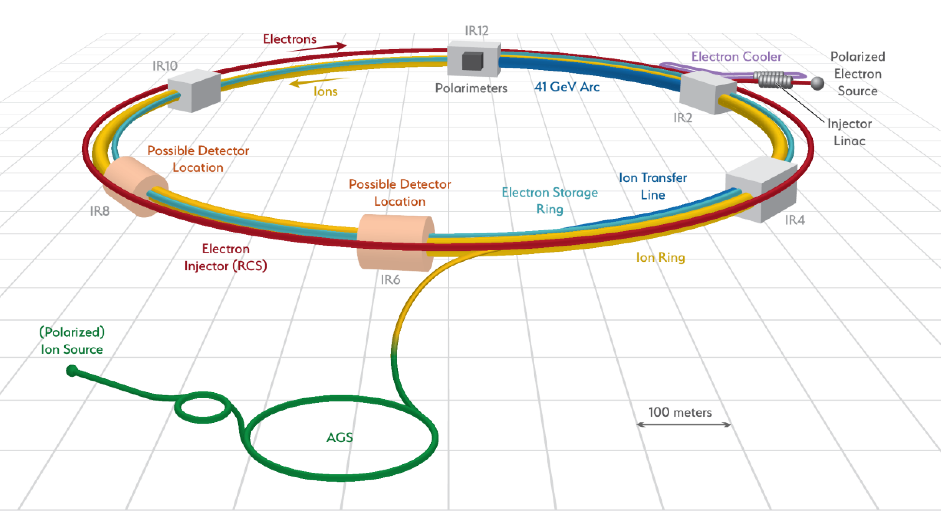
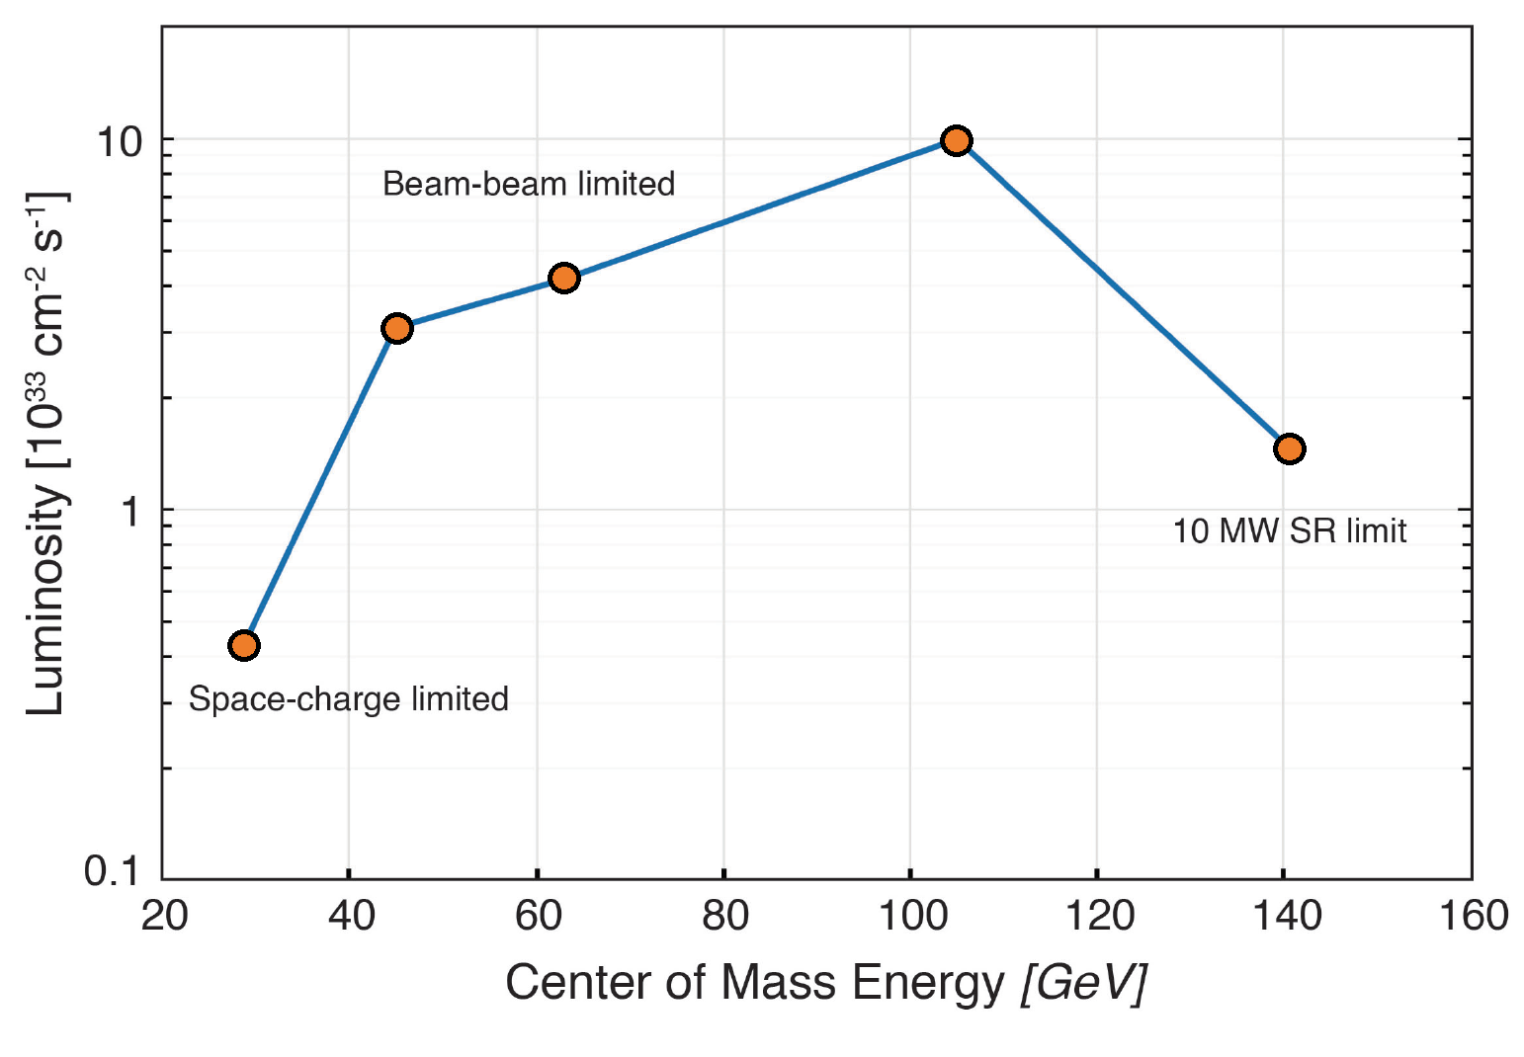
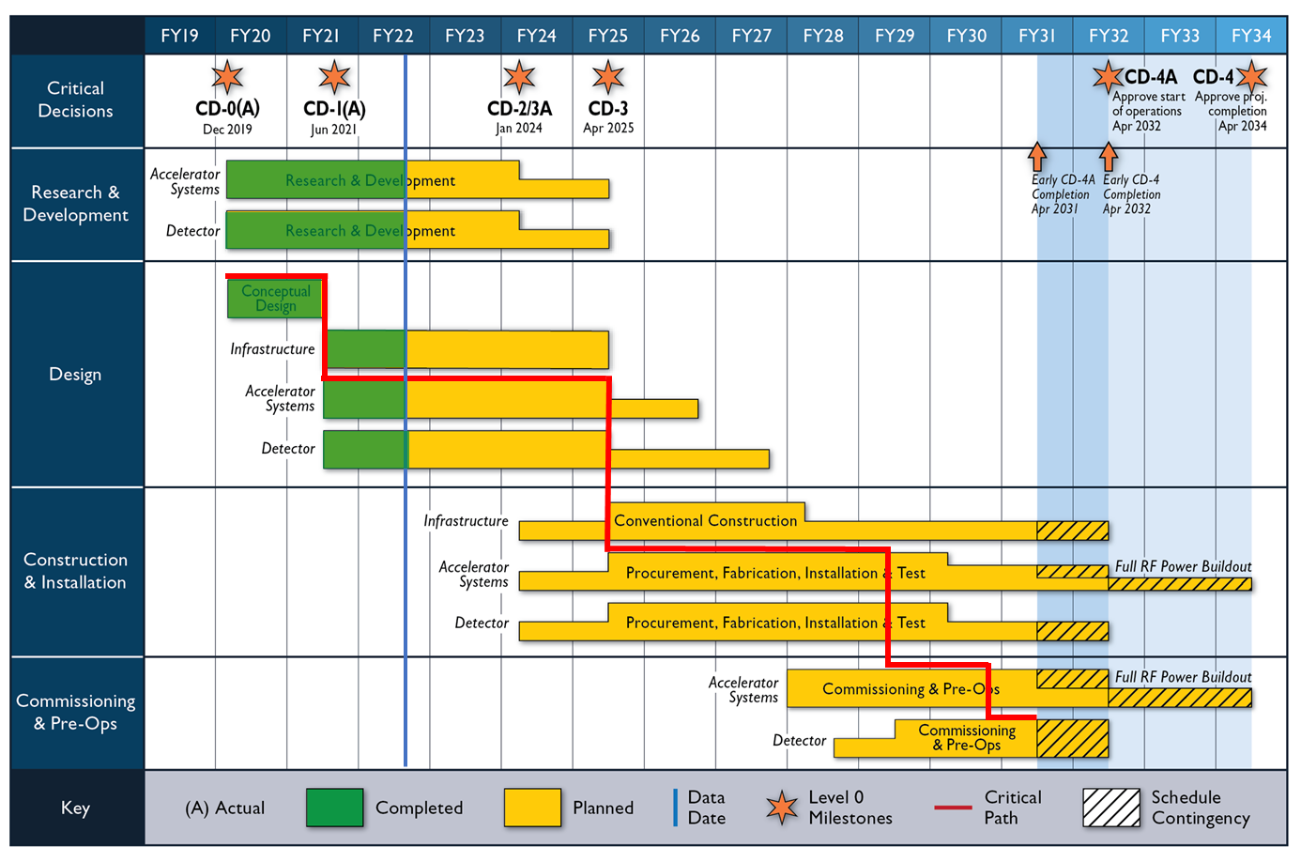
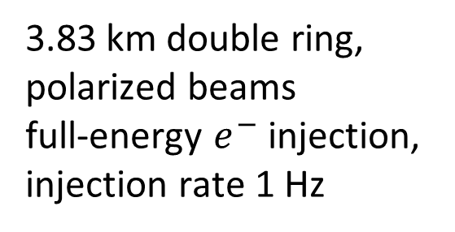
near-future collider 2: Electron-Ion Collider
3.83 km double ring,
polarized beams
full-energy $e^{−}$ injection,
injection rate 1 Hz
F. Willeke

Slide 25
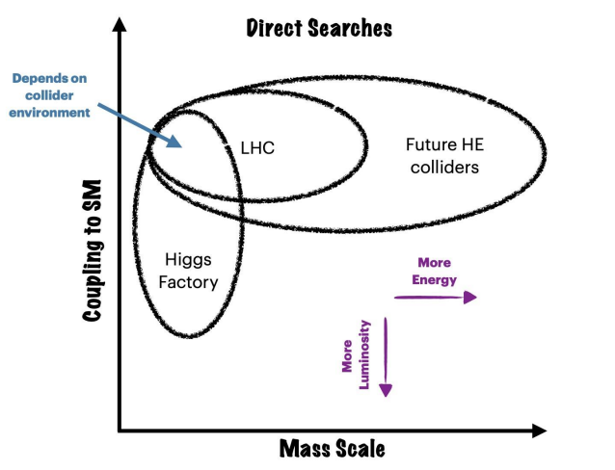
Energy Frontier Machines – Energy & Precision
L. Reina,
Snowmass’21 (22)

Slide 26
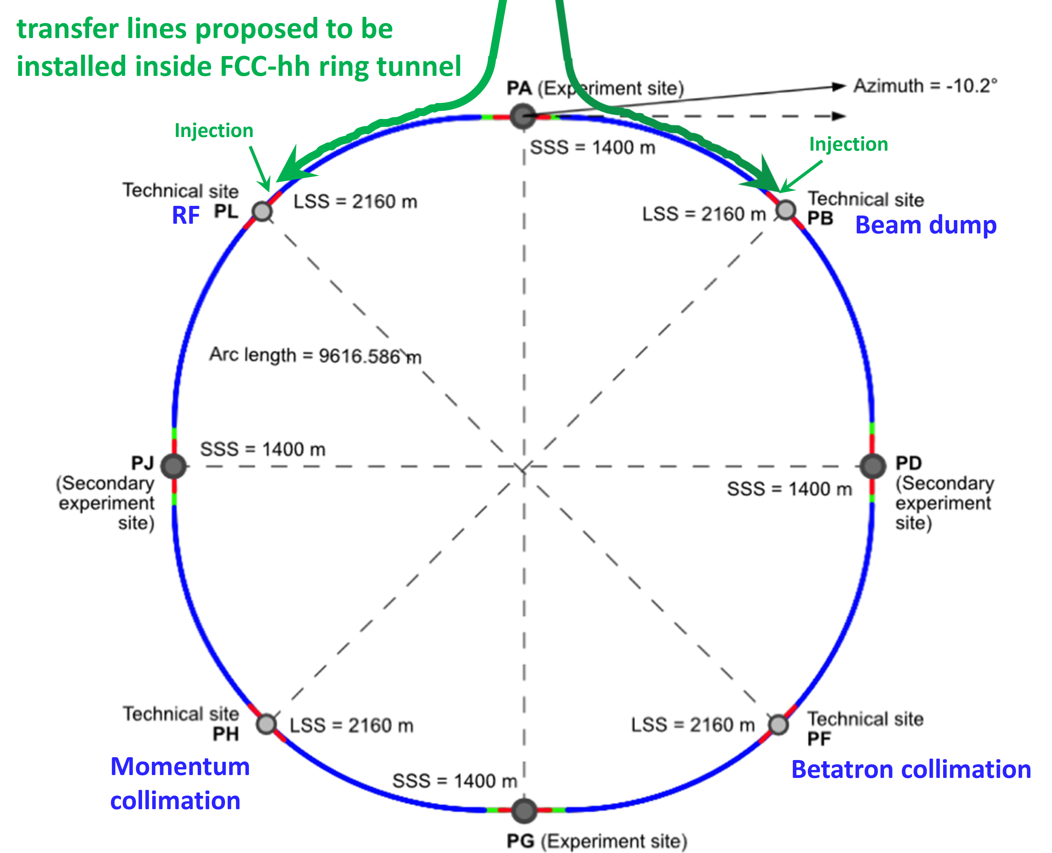
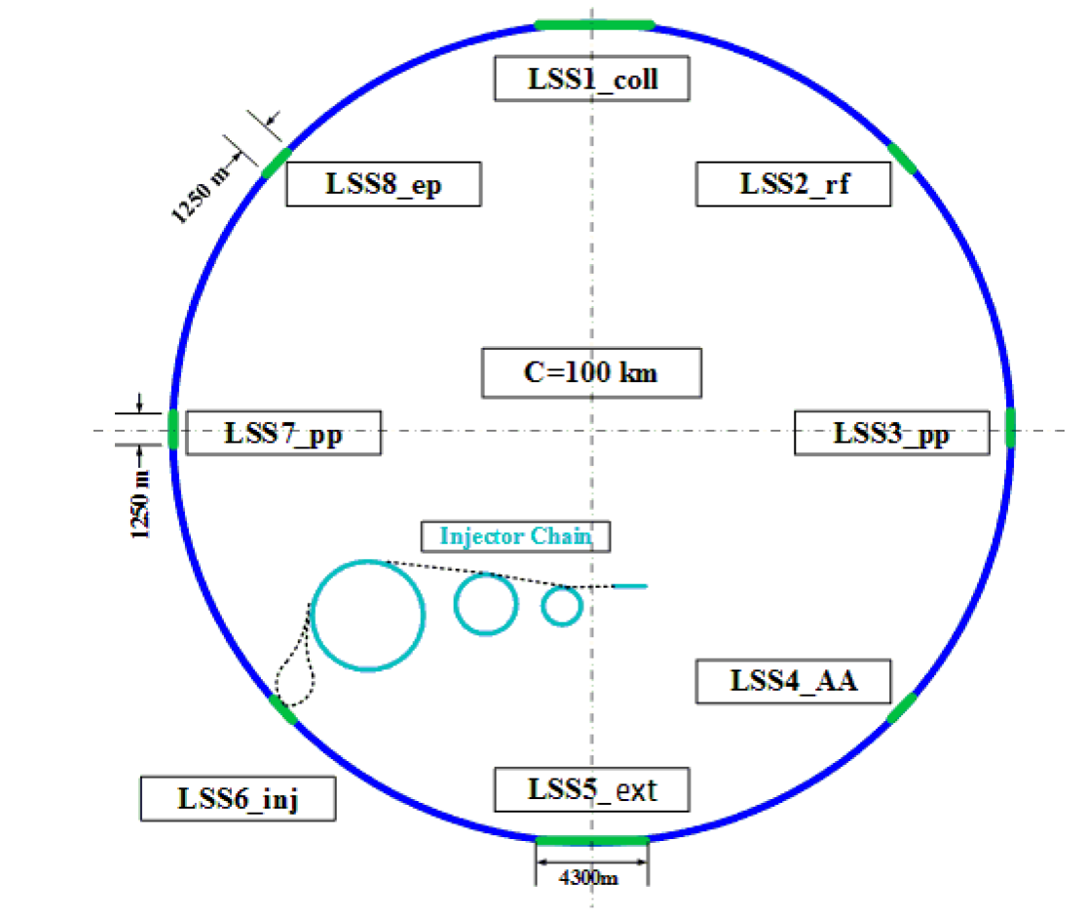
Proposed Higher-Energy Hadron Colliders
FCC-hh
SPPC
Snowmass ‘21

Slide 27
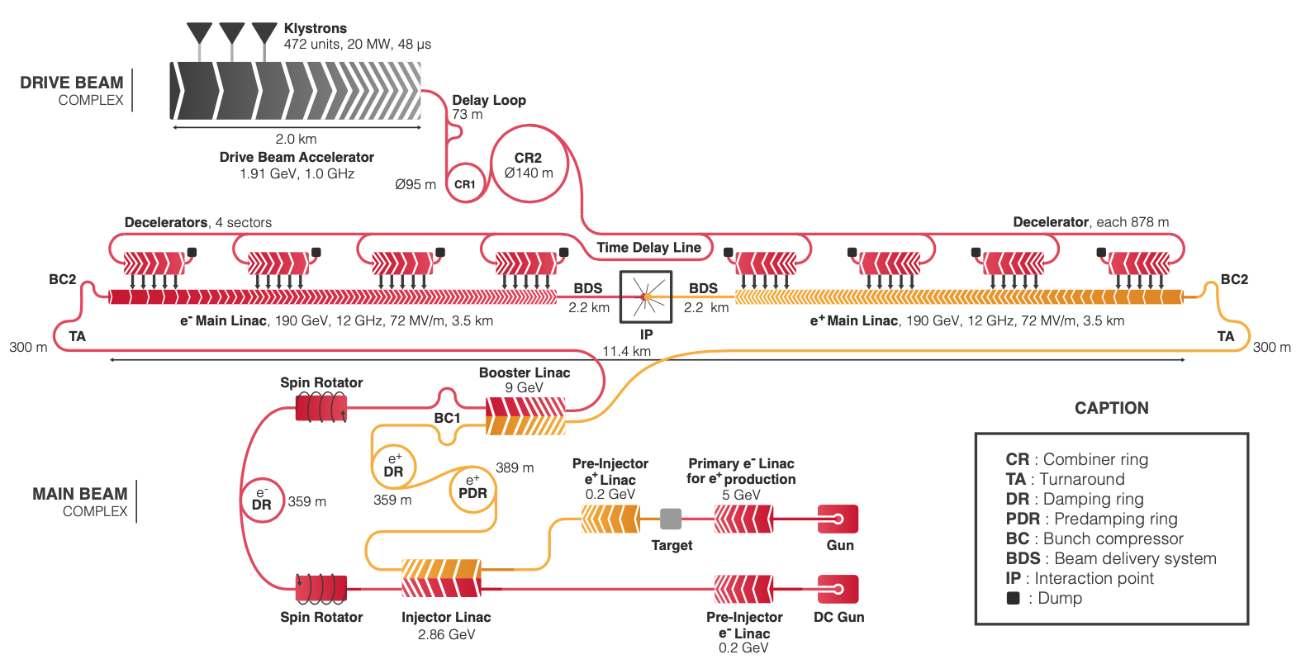
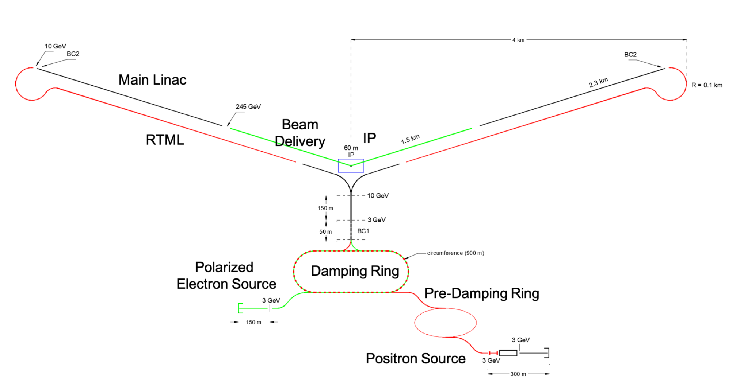
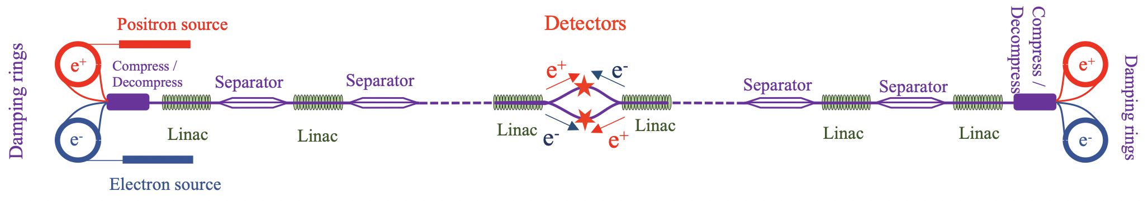
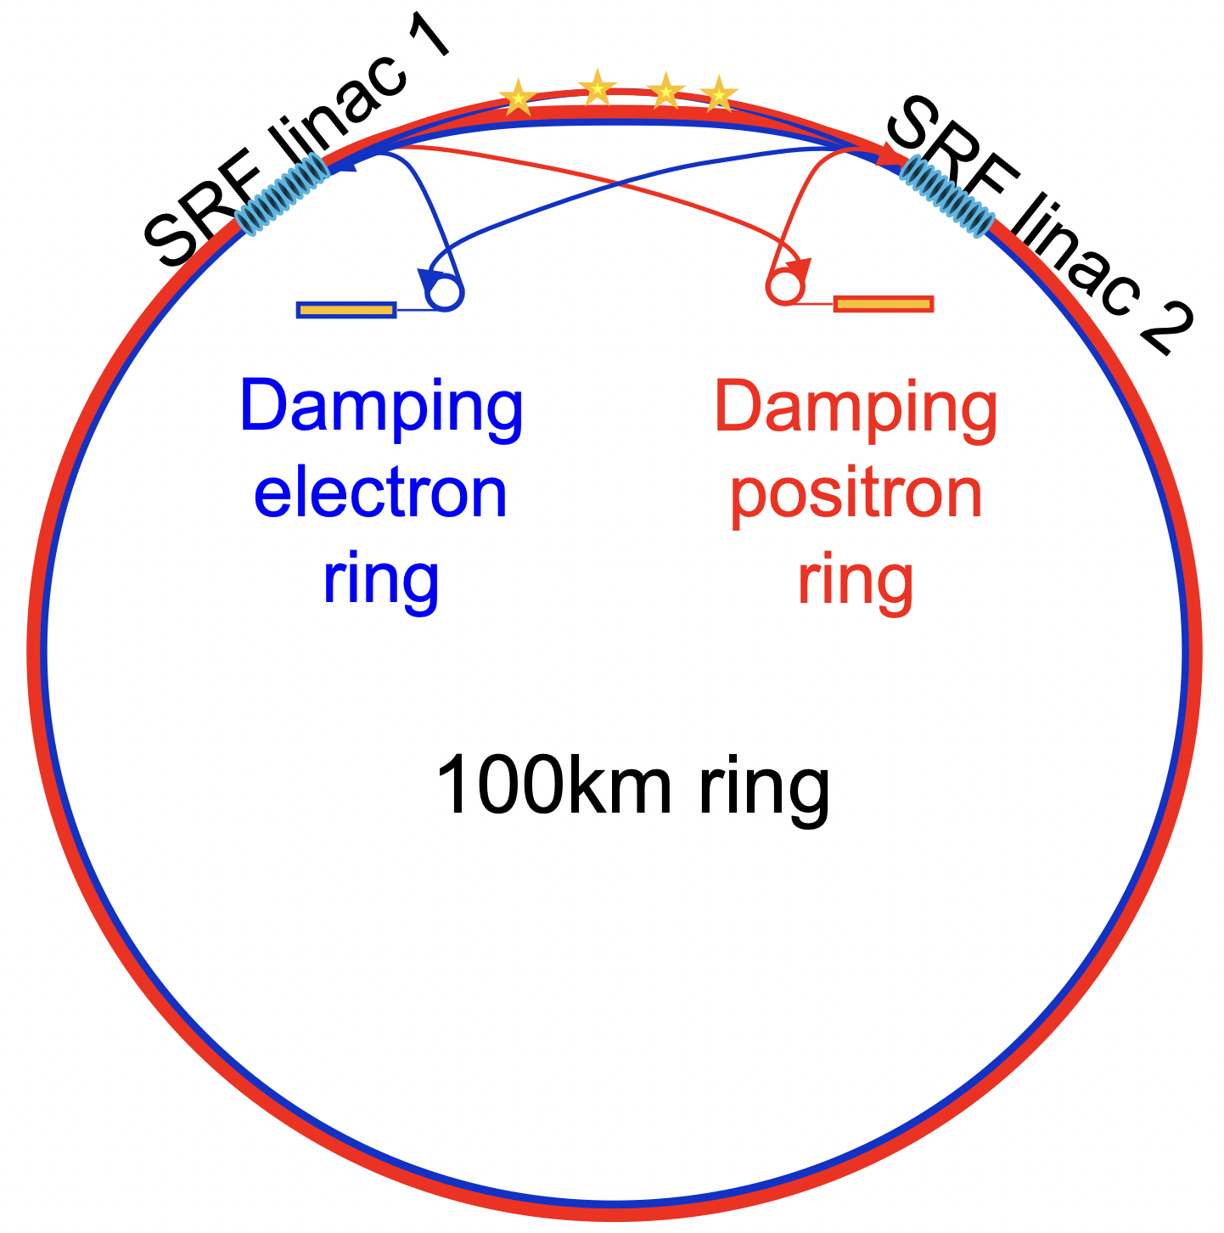
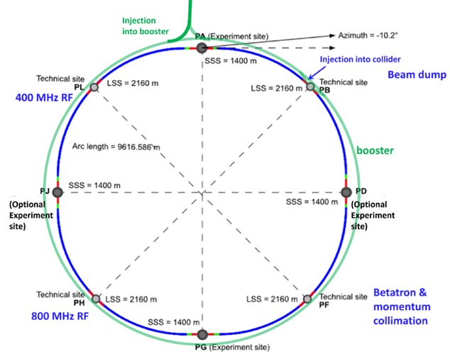
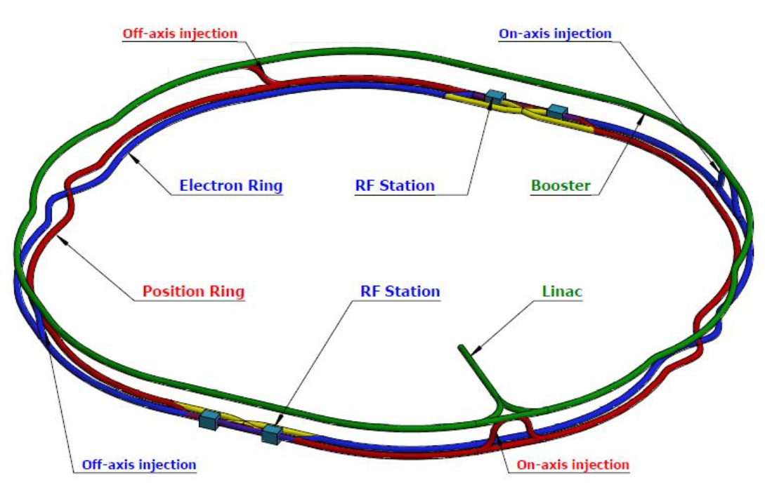
Proposed e⁺e⁻ Higgs & EW Factories
ILC
CLIC
C³
HELEN
RELIC
CEPC
CERC
FCC-ee
Snowmass ‘21

Slide 28





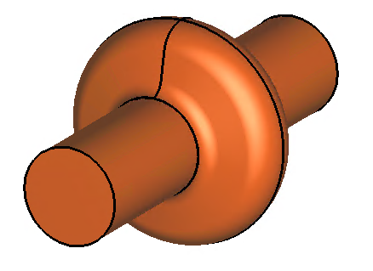
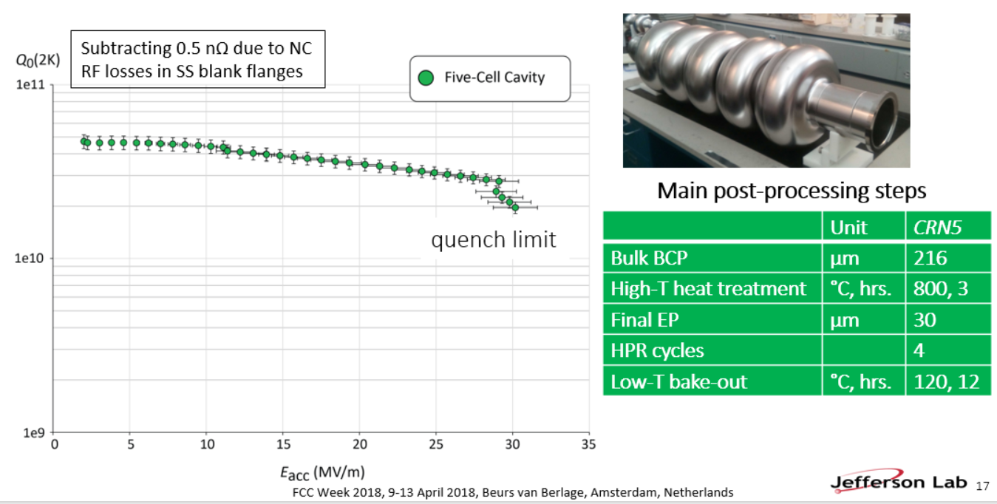
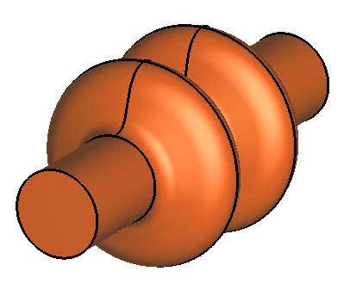
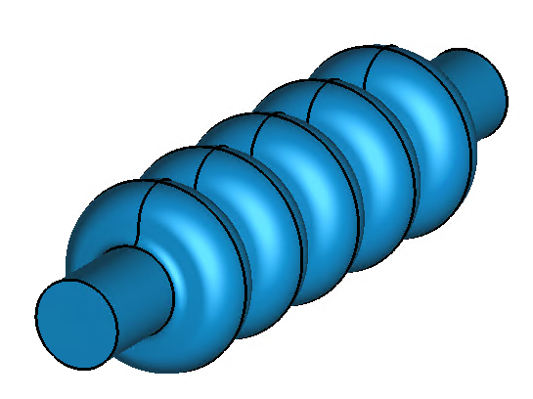
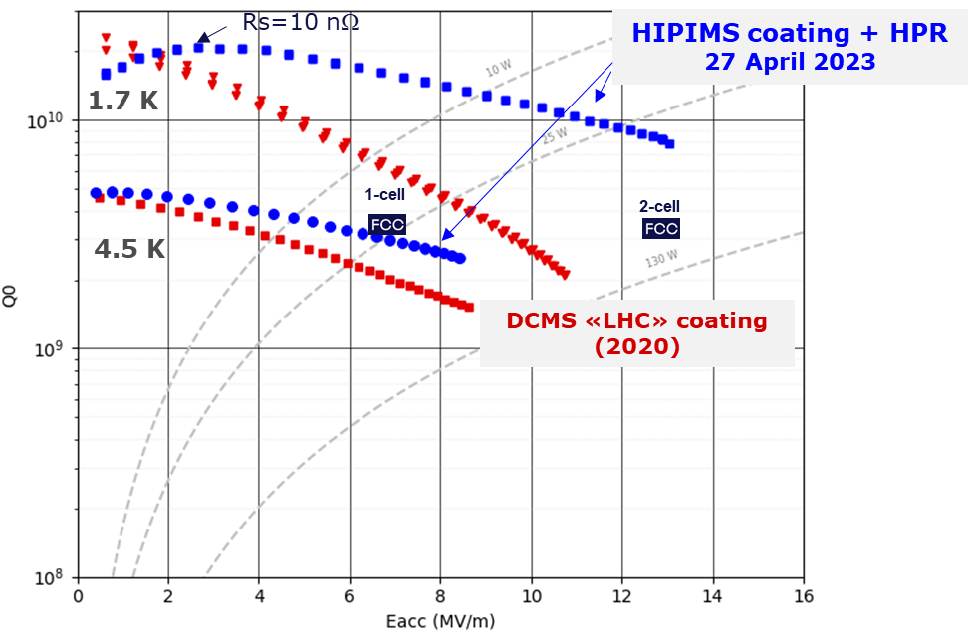


FCC-ee SRF system
Z
low R/Q, HOM damping, powered by 1 MW RF coupler and high efficiency klystron
F. Peauger,
O. Brunner
5-cell cavity development (2018), successful collaboration with JLAB
  1-cell
  400 MHz,
  Nb/Cu
W, H
moderate gradient and HOM damping requirements; 500 kW / cavity, allowing reuse of klystrons already installed for Z
  2-cell
  400 MHz,
  Nb/Cu
ttbar,
booster
high RF voltage and limited footprint thanks to multicell cavities and higher RF frequency; 200 kW/ cavity
  5-cell
  800 MHz,
  bulk Nb
F. Marhauser
Promising R&D towards ultra-high Q₀. Collaboration with FNAL
First attempt of HiPIMS* niobium coating on a 400 MHz Cu cavity
*High-power impulse magnetron sputtering

Slide 29
Number of 800 MHz cavities: 1088
Total number of cavities: 1456
FCC-ee RF parameter table
F. Peauger,
May 2023
20-Apr-23 | Z |  | W |  | H |  | ttbar2
 | Collider per beam | booster | Collider per beam | booster | Collider 2 beams | booster | Collider 2 beams | Collider 2 beams | booster
RF Frequency [MHz] | 400 | 800 | 400 | 800 | 400 | 800 | 400 | 800 | 800
RF voltage [MV] | 120 | 140 | 1050 | 1050 | 2100 | 2100 | 2100 | 9200 | 11300
Eacc [MV/m] | 5.93 | 6.23 | 10.78 | 20.76 | 10.78 | 20.76 | 10.78 | 20.12 | 20.10
# cell / cav | 1 | 5 | 2 | 5 | 2 | 5 | 2 | 5 | 5
Vcavity [MV] | 2.22 | 5.83 | 8.08 | 19.44 | 8.08 | 19.44 | 8.08 | 18.85 | 18.83
#cells | 54 | 120 | 260 | 270 | 520 | 540 | 520 | 2440 | 3000
# cavities | 54 | 24 | 130 | 54 | 260 | 108 | 260 | 488 | 600
# CM | 13.5 | 6 | 32.5 | 13.5 | 65 | 27 | 65 | 122 | 150
T operation [K] | 4.5 | 2 | 4.5 | 2 | 4.5 | 2 | 4.5 | 2 | 2
dyn losses/cav * [W] | 23 | 0.3 | 158 | 4 | 158 | 4 | 158 | 23 | 3
stat losses/cav [W] | 8 | 8 | 8 | 8 | 8 | 8 | 8 | 8 | 8
Qext | 6.9E+04 | 3.2E+05 | 1.1E+06 | 8.0E+06 | 1.1E+06 | 1.6E+07 | 5.4E+06 | 4.2E+06 | 8.3E+07
Detuning [kHz] | 8.620 | 4.393 | 0.479 | 0.136 | 0.096 | 0.014 | 0.007 | 0.056 | 0.003
Pcav [kW] | 912 | 205 | 379 | 91 | 379 | 46 | 79 | 163 | 8
rhob [m] | 9937 | 9937 | 9937 | 9937 | 9937 | 9937 | 9937 | 9937 | 9936
Energy [GeV] | 45.6 | 45.6 | 80.0 | 80.0 | 120.0 | 120.0 | 182.5 |  | 182.5
energy loss [MV] | 38.49 | 38.49 | 364.63 | 364.63 | 1845.94 | 1845.94 | 9875.14 |  | 9876.13
cos phi | 0.32 | 0.27 | 0.35 | 0.35 | 0.88 | 0.88 | 0.98 | 0.86 | 0.87
Beam current [A] | 1.280 | 0.128 | 0.135 | 0.0135 | 0.0534 | 0.003 | 0.010 | 0.010 | 0.0005
* heat loads from power coupler and HOM couplers not included
  one RF system per beam
  common RF system for both beams
  Cavity performances: 20 % margin added on Eacc and Q0 between vertical test and operation
  In total: 364 cryomodules, 1456 cavities, 25% with Nb/Cu technology, 75% with bulk niobium technology
  Limiting parameters for RF

Slide 30






FCC-ee recent breakthrough
I. Karpov,
August ‘24
Reverse phase operation (RPO) mode allows increasing RF cavity voltage (Y. Morita et al., SRF, 2009)
Experimentally verified with high beam loading in KEKB (Y. Morita et al., IPAC, 2010)
Baseline solution for EIC ESR (e.g., J. Guo et al., IPAC, 2022)
Phasors
RF waves
$$φ_{s}+π/2$$
$$φ_{foc}$$
$$φ_{s}$$
$$φ_{defoc}$$
We can use the same 2-cell SRF system for all collisions energies, Z, WW, and ZH, at constant cavity voltage and
external coupling → faster installation, lower cost, much more flexible operation

Slide 31








FCC-ee collider optics development: 2 options
arc
interaction region
K. Oide, 2023 EPS
Rolf Wideroe award winner
Phys. Rev. Accel. Beams 19, 111005
FODO lattice, many -I sext pairs; periodic unit cell length $\sim$260 m
baseline for 2023 FCC “mid-term” review
“1.5” sext.s per final focus,
asymmetric
P. Raimondi, 2017 EPS Gersh Budker award winner
design in progress -
further relaxed tolerances,
reduced power consumption,
larger momentum acceptance !?
5 sext.s per final focus, modular
hybrid FODO lattice,
with few sext. families,
periodic unit cell length
$\sim 30$0 m
Phys. Rev. Accel. Beams 26, 021601

Slide 32
Towards the next, next-next and next-next-next generation of accelerators – main themes
Energy Recovery Linacs
γγ colliders
Muon Collider(s)
Advanced Accelerator Concepts
Sustainability
High-field magnets
SC Radiofrequency systems
Efficient RF power sources
e⁺ production
Gamma Factory
Monochromatization

Slide 33



SC Radiofrequency Systems
Anna Grasselino
P. Dhakal
Gradient growth SRF linac accelerating gradient achievements and application specifications since 1970 (CERN Courier., Nov. 2020)

Slide 34



More Efficient RF Power Sources
1937: the Varian brothers
of Palo Alto invent
the klystron
80 years later, another breakthrough in klystron technology
I. Syratchev
New bunching technologies

Slide 35




Gamma Factory concept
Witek Krasny
arXiv:1511.07794
partially stripped heavy-ion beam in LHC (or FCC):
resonant scattering of laser photons off ultrarelativistic
atomic beam; high-stability laser-light-frequency converter
Gamma Factory proof-of-principle experiment in the LHC
proposed applications:
intense source of e⁺ (10¹⁶-10¹⁷/s) , π, μ etc
doppler laser cooling of high-energy beams
HL-LHC w. laser-cooled isocalar ion beams
Pb⁺⁸¹ beam lifetime
$\sim$38 hours (and first electrons in the LHC…)

Slide 36

The LHC as a driver of secondary beams
Schematic transformation of the LHC into a Gamma-Factory-based driver of secondary beams [Witek Krasny].

Slide 37






Gamma Factory driving subcritical nuclear reactor?
K_{eff} – subcritical effective neutron multiplication factor
Required beam intensity:
O(10 MW) power
Required photon-beam energy:
5-20 MeV -- He(H)- like Ca or Kr beams +
commercial ~ 1 μm lasers
LLFP loaded material: Uranium dioxide pellets-fast breeder reactor core at 50 GWd/t
Fuel: ²³⁵U
case for a GF based photon driver
Witek Krasny
https://indico.cern.ch/event/1137276
Proton beam J-PARC
Photon beam CERN-GF
Efficiency = 1.3 %
Efficiency ~ 20 %
plus targeting specific isotopes and transitions

Slide 38






Monochromatization for e⁺e⁻ → H at FCC-ee
nonvanishing IP dispersion
w crab cavities
e⁻ Yukawa coupling
$$D_{x}^{∗}≠0$$
w/o crab cavities
$$D_{x}^{∗}≠0$$
chromatic waist shift
Pantaleo
Raimondi
EPJ Plus 137,
31 (2022)

Slide 39

Energy Recovery Linac - Principle
V. Litvinenko, T. Roser, M. Chamizo
Illustration of ERL principle (intentionally simplified): accelerating bunches take energy from SRF linac, while decelerating bunches return energy back.

Slide 40



Energy Recovery Linacs - Historical Proposals 1960s & 70s
early linear-collider proposals
1-6 GeV c.m.
Maury Tigner, “A Possible Apparatus for Clashing-Beam Experiments”, Nuovo Cimento 37, 1228 (1965)
these early proposal always
recovered the energy of the spent beam!
Ugo Amaldi, “A possible scheme to obtain e-e- and e+e- collisions at energies of hundreds of GeV”, Physics Letters B61, 313 (1976)
w/o ER: “Although in principle it may be
possible to produce and handle this
large power the sheer brutishness of the
scheme robs it of all appeal.” [M. Tigner]
300 GeV c.m.

Slide 41



Energy Recovery Linacs : recent revival
European LDG roadmap
Main advances: flat instead of round beams, much smaller (vertical) beam sizes, higher beam current →$\sim$10,000x higher luminosity
LHeC ERL was first proposed by Swapan Chattopadhyay
650 MHz coll rate, 20 MV/m, Q~10¹¹
ReLIC
Litvinenko
L$\sim$4x10³⁶ , 21 km,
3 MHz coll rate
1.5 GHz RF, Q$\sim$10¹¹

Slide 42

ERL prospects & promises
V. Litvinenko, et al.

Slide 43

comparison of ERL collider proposals then and now
 | Tigner 1965 | Amaldi 1976 | Gerke – Steffen 1979 | Litvinenko-Roser-Chamizo 2019 |  | Telnov 2021
c.m. energy [GeV] | 1-6 | 300 | 200 | 240 | 600 | 250 | 500
average beam current [mA] | 120 | 10 | 0.3 | 2.5 | 0.16 | 100 | 100
vertical rms IP beam size [nm] | 40,000 (round) | 2,000 (round) | 900 (round) | 6 | 5 | 6.1 | 7.4
luminosity [10³⁴ cm⁻²s⁻¹] | 0.0003 | 0.01 | 0.004 | 73 | 8 | 90 | 64
Main differences: flat instead of round beams, much smaller (vertical) beam sizes, higher beam current →$\sim$10,000x higher luminosity

Slide 44

ERL landscape
LDG ERL report
beam
energy
LHeC
CEBAF-ER
JLAB FEL
ALICE
beam current

Slide 45



PERLE
Multi-pass high-current ERL test facility for LHeC (and FCC-ee-ERL) under construction at IJClab
1 : 3 : 5
W. Kaabi,
A. Bogacz,
O. Bruning, M. Klein
injector
7 MeV
ΔE = 80 MeV
2 : 4 : 6
7 MeV
dump
ΔC = λ_{RF}/2
Footprint: 24 x 5.5 x 0.8 m³
arXiv:1705.08783

Slide 46




Muon Colliders
$\sim$1.6x10⁹ x less SR than e⁺e⁻, no beamstrahlung problem
two production schemes proposed
US-MAP (2015) p-driven
Italian LEMMA (2017) e⁺-annihilation
needs large 45 GeV e⁺ ring like FCC-ee, possible upgrade path to FCC-μμ
μ‘s decay within a few 100 - 1000 turns:
→ rapid acceleration
(perhaps plasma?)
→ ν radiation hazard
(limits maximum μ energy)
Bruce King 1999
$$σ_{ν}∝E, flux ∝E^{2} (Lorentz boost)$$
solution beyond 10 TeV unclear

Slide 47



Muon Colliders – Example Challenges
target design for p driven μ collider
plasma target for e⁺ driven μ collider
D. Schulte, IPAC’22
J. Farmer et al., IPAC’22

Slide 48


γγ colliders
XCC
HE - HL γγ Collider
E. Barzi, Snowmass ‘21
T. Barklow, Snowmass ‘21

Slide 49


Advanced Accelerators: Plasma
R. Assmann
A plasma cell compared with the superconducting accelerator FLASH (credit DESY)
R. Assmann, E. Gschwendtner, R. Ischebeck, LDG Draft

Slide 50


Advanced Accelerator “Demonstrator” EuPRAXIA
R. Assmann,
iFAST BWS2022
construction
at INFN-LNF

Slide 51



Plasma Accelerator Challenge: Positron Acceleration
“ballistic injection”: a ring-shaped laser beam and a coaxially propagating Gaussian laser beam are employed to create donut and center bubbles in the plasma, resp.
Z.Y. Xu

Slide 52

Advanced Accelerator Types
Required parameters for a linear collider with advanced high gradient acceleration [R. Assmann]. Three published parameter cases are listed. This table is taken from the LDG report [N. Mounet (ed.), “European Strategy for Particle Physics - Accelerator R&D Roadmap”, arXiv:2201.07895 CERN-2022-001]

Slide 53
Accelerators for Indirect
Dark Sector Searches

Slide 54

Feynman diagram for coupling of Standard Model particles & photons to corresponding Dark Sector objects 𝐴′ and 𝜒, with coupling strength 𝜖.

Slide 55

reference experiments:
NA64 experiment at CERN [4]
proposed LDMX based on the LCLS-II linac at SLAC [3] – goal: 1.6× 10¹⁵ 8-GeV electrons on target over 4 years
Concept of indirect DM search by missing momentum with spectrometer and trackers upstream and calorimeter downstream of a thin target, based on Refs. [1–3]. 𝐴′ indicates a particle carrying missing energy.

Slide 56

perfect match with indirect
searches for dark sector !
from European LDG roadmap & Assmann, 2022

Slide 57

Principle of Dielectric Laser Acceleration (DLA)
The DLA structure is illuminated by laser light from the top. Green arrows indicate the positive force of the laser's electric field that can accelerate electrons.

Slide 58




Example DLA structures
K.J. Leedle et al.,
Opt. Lett. 43,
2181-2184 (2018)
R. Dadashi (2022/23)
U. Niedermayer et al., Phys Rev Accel. Beams 20, 111302 (2017)

Slide 59


Slide 60

A pair of orthogonal dielectric laser deflectors installed at the exit of the DLA (DADLA setup) is sending each electron in a train of ∼160 onto separate segments of the detector, thereby overcoming the time resolution limit and allowing bunch spacing of <10 ps within a train

Slide 61

DLA structure as part of a laser oscillator (OEDLA); e⁻ pass rightwards through the structure; laser pulse circulates at 100 GHz (path ∼3 mm).

Slide 62

LDMX:
4x10¹⁴ e⁻/yr

Slide 63

The interaction strength between dark matter and Standard Model matter versus the possible mass of the dark matter particles. The black lines show the interaction strength compatible with the dark matter abundance in the universe, and for the types of dark matter particles that are not excluded from the analysis of the Cosmic Microwave Background. The grey area shows the already excluded region. The colored lines show the reach of LDMX. The plot is taken from T. Akesson et al., Dark Sector Physics with a Primary Electron Beam Facility at CERN, tech. rep., CERN-SPSC-2018-023, 2018, URL: http://cds.cern.ch/record/2640784

Slide 64


Two snapshots from iFAST WP5.2 topical dark-sector accelerator meeting at CERN, 31 October 2022
Rasmus Ischebeck
Raziyeh Dadashi, Rasmus Ischebeck, Jeremy Jacobsson, Richard Jacobsson, Massimiliano Ferro-Luzzi, Witek Krasny, Frank Zimmermann

Slide 65



Enrico Fermi’s space-based world machine
Rivkin

Slide 66


ultimate limit on electromagnetic acceleration
Schwinger critical fields E_{cr} ≈10¹² MV/m, B_{cr}=4.4 x10⁹ T
Planck scale: 10²⁸ eV
0.8x10¹⁰ m
“not an inconceivable task for an advanced technological society”
P. Chen, R. Noble, SLAC-PUB-7402, April 1998
1.0x10¹⁰ m
circular & linear
Planck-scale colliders
$\sim$1/10th for distance earth-sun

Slide 67




stepping stone towards Planck scale collider ?!
Very large hadron collider on the Moon (CCM), $C\sim$11 Mm, E_{c.m.}$\sim$14 PeV (1000x LHC’s), 6x10⁵ dipoles with 20 T field, either ReBCO, requiring ~7-13 k tons rare-earth elements, or IBS, requiring $\sim$a million tons of IBS. Many of the raw materials required to construct machine, injector complex, detectors, and facilities can potentially be sourced directly on the Moon. 11000-km tunnel a few 10 to 100 m under lunar surface to avoid lunary day-night temperature variations, cosmic radiation damage, and meteoroid strikes. Dyson band or belt to continuously collect sun power. Required: <0.1% sun power incident on Moon surface.
J. Beacham, F. Zimmermann, 2022 New J. Phys., https://doi.org/10.1088/1367-2630/ac4921

Slide 68


tentative CCM parameters & layout
J. Beacham, F. Zimmermann, 2022 New J. Phys., https://doi.org/10.1088/1367-2630

Slide 69







a timely consideration ?!
CNRS News
techeblog.com

Slide 70
back to the next generation

Slide 71

design parameters
of future hadronic &
muon colliders
from Particle Data Group
Draft update July 2023
V. Shiltsev,
F. Zimmermann

Slide 72

design parameters
of future e⁺e⁻ colliders
from Particle Data Group
Draft update July 2023
V. Shiltsev,
F. Zimmermann

Slide 73
From Snowmass ITF report*
 | CME (TeV) | Lumi per IP (10^34) | Years, pre-project R&D | Years to 1st physics | Cost range (2021 B$) | Electric Power (MW)
FCCee-0.24 | 0.24 | 8.5 | 0-2 | 13-18 | 12-18 | 280
ILC-0.25 | 0.25 | 2.7 | 0-2 | <12 | 7-12 | 140
CLIC-0.38 | 0.38 | 2.3 | 0-2 | 13-18 | 7-12 | 110
HELEN-0.25 | 0.25 | 1.4 | 5-10 | 13-18 | 7-12 | 110
CCC-0.25 | 0.25 | 1.3 | 3-5 | 13-18 | 7-12 | 150
MC-Higgs | 0.13 | 0.01 | >10 | 19-24 | 4-7 | ~200
CLIC-3 | 3 | 5.9 | 3-5 | 19-24 | 18-30 | ~550
ILC-3 | 3 | 6.1 | 5-10 | 19-24 | 18-30 | ~400
MC-3 | 3 | 2.3 | >10 | 19-24 | 7-12 | ~230
MC-FNAL | 6-10 | 20 | >10 | 19-24 | 12-18 | O(300)
MC-IMCC | 10-14 | 20 | >10 | >25 | 12-18 | O(300)
FCChh-100 | 100 | 30 | >10 | >25 | 30-50 | ~560
*CEPC missing

Slide 74

Energy efficiency: Higgs factories
Total luminosity per electrical power. (Nature Physics vol. 16, 402, 2020)

Slide 75


Energy Consumption & Carbon Footprint per Higgs
P. Janot and A. Blondel, The carbon footprint of proposed e⁺e⁻ Higgs factories, arXiv 2208.10466 (2022); The European Physical Journal Plus volume 137, Article number: 1122 (2022) https://link.springer.com/content/pdf/10.1140/epjp/s13360-022-03319-w.pdf also see https://www.nature.com/articles/d41586-022-03551-5

Slide 76



Further sustainability considerations
Higher magnet temperature helps
1.9 K Nb-Ti or Nb₃Sn magnets
→ 4.5 K/20 K Nb₃Sn/HTS magnets
Future: fluctuating energy sources
Simulation for Germany 2050
varying #bunches
in circular colliders
still far from ideal Carnot efficiency
M. Seidel

Slide 77

Future e⁺e⁻ Collider Positron Requirements
?

Slide 78


Positron Production
Challenging demands
Innovative high-yield source
I. Chaikovska, P. Craievich, et al.
P³: PSI e⁺ production experiment with HTS solenoid at SwissFEL
planned for 2024/25

Slide 79


Snowmass’21 (2022) – maturity ranking
arXiv:2209.05827
A. Faus-Golfe et al.

Slide 80










FCC Feasibility Study 2021-2025
http://cern.ch/fcc
Work supported by the European Commission under the HORIZON 2020 projects EuroCirCol, grant agreement 654305; EASITrain, grant agreement no. 764879; iFAST, grant agreement 101004730, FCCIS, grant agreement 951754; E-JADE, contract no. 645479; EAJADE, contract number 101086276; and by the Swiss CHART program
photo: J. Wenninger

Slide 81


Regional implementation activities
Meetings with municipalities concerned
in France (31) and Switzerland (10)
PA – Ferney Voltaire (FR) – experiment site
PB – Présinge/Choulex (CH) – technical site
PD – Nangy (FR) – experiment site
PF – Roche sur Foron/Etaux (FR) – technical site
PG – Charvonnex/Groisy (FR) – experiment site
PH – Cercier (FR) – technical site
PJ – Vulbens/Dingy en Vuache (FR) experiment site
PL – Challex (FR) – technical site
Detailed work with municipalities and host states
identify land plots for surface sites
understand specific aspects for design
identify opportunities (waste heat, tec.)
reserve land plots until project decision
Status 1 June 2024
The support of the host states is greatly appreciated and essential for the study progress!

Slide 82




Expected time line till start of construction
2024 |  |  |  | 2025 |  |  |  | 2026 |  |  |  | 2027 |  |  |  | 2028 |  |  |  | 2029 |  |  |  | 2030 |  |  |  | 2031 |  |  |  | 2032 |  |  |  | 2033
Q1 | Q2 | Q3 | Q4 | Q1 | Q2 | Q3 | Q4 | Q1 | Q2 | Q3 | Q4 | Q1 | Q2 | Q3 | Q4 | Q1 | Q2 | Q3 | Q4
Feasibility Study
Pre-TDR Phase
TDR Phase
Construction →→→
FS Report
cost update
ESPPU
2025/26
pre TDR
cost update
TDR
cost update
Project Decision
accelerator design, technical infrastructure design, R&D, towards TDR
engineering design →
Environmental Impact study & Authorization Process
Phase 1 Site Investigations
Phase 2 Site Investigations
CE Concept Design update
CE Tender Design
Construction Design
Start construction
Detector EOI submissions
FC³ formation, call for CDRs
Detector CDRs submitted to FC³

Slide 83
A few conclusions
Great progress in SC RF and in high-field magnets
Accelerators & colliders getting ever more efficient
Synergies with other applications and other fields
Numerous innovative concepts and challenges for the future
Advanced DLAs for indirect dark sector searches ?
Sustainability has become important design criterion
Several promising paths forward – circular and/or linear
FCC-ee is CERN’s “plan A” and a wonderful one
“A circle is a round straight line with a hole in the middle”- Mark Twain

Slide 84











surely great times ahead !
“Pief” Panofsky
Kjell Johnsen
Nan Phinney
thank you !
Helen Edwards
Lucio Rossi
Mike Lamont
Steve Myers
Robert H. Wilson
Lyn Evans
Herwig Schopper
Satoshi Ozaki

