Slide 1
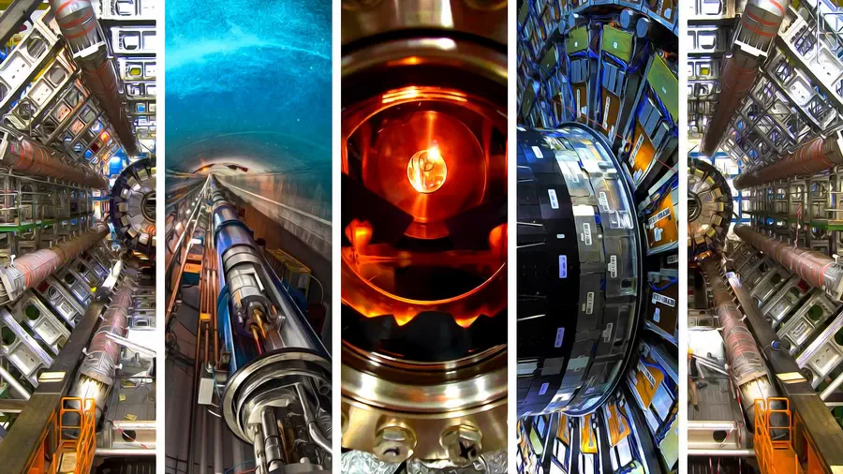

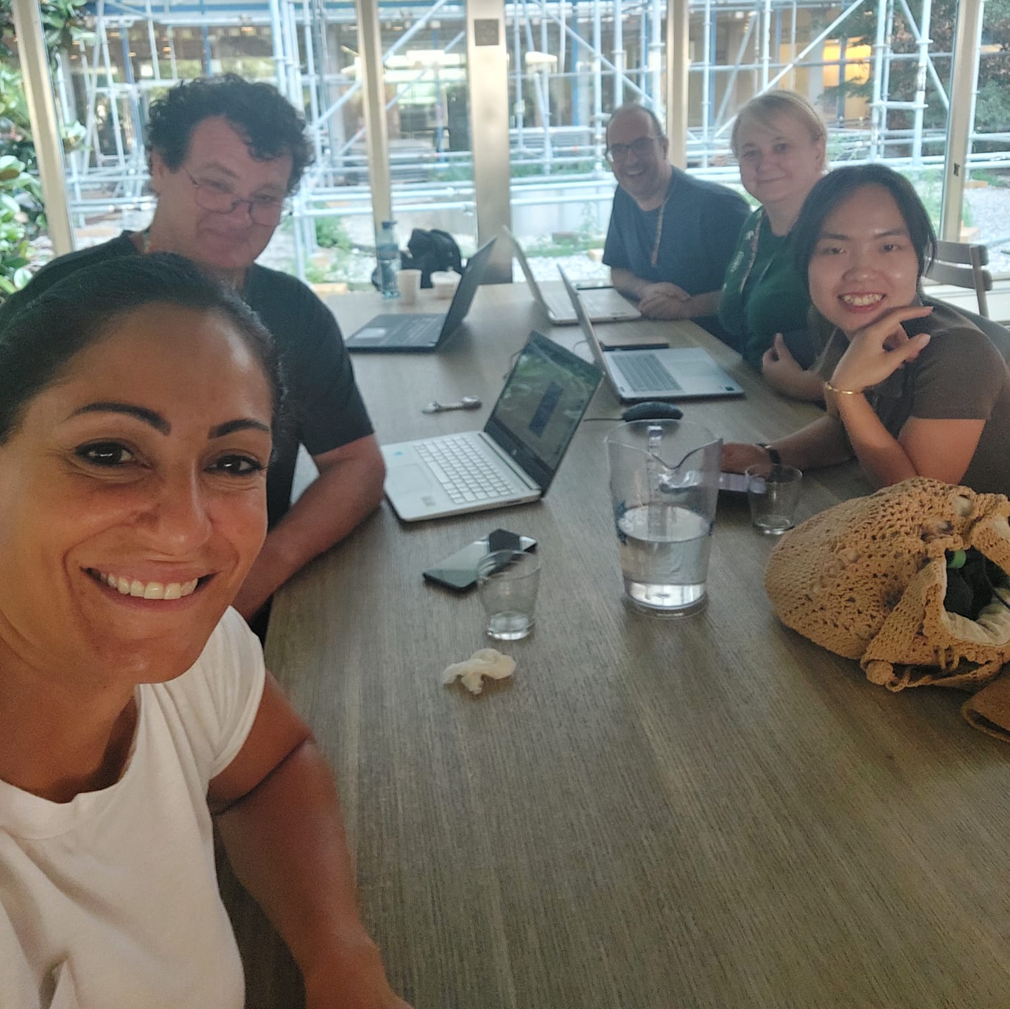
Computing & Data Analysis at CERN
ITW2024 Study Group 3
@ CERN
the computing in charge of selecting the data.
In 1 second, there are 1.7 billion events, that means we need a lot of storage capacity
In reality only a very small % of the data will be collected, stored, and analysed

Slide 2
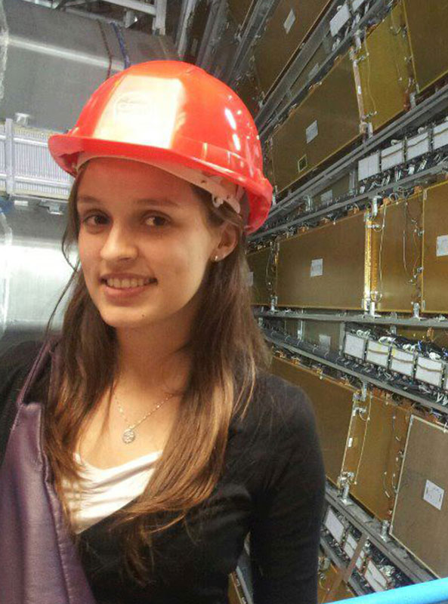

Curriculum & Classroom Connections
Necessity is the mother of all invention.
Computing Algorithms
Experimentation & Data collection
Humans!
Multiple subjects:
Mathematics
Technology
All Natural Sciences
Geography
Economics
Data analysis

Slide 3

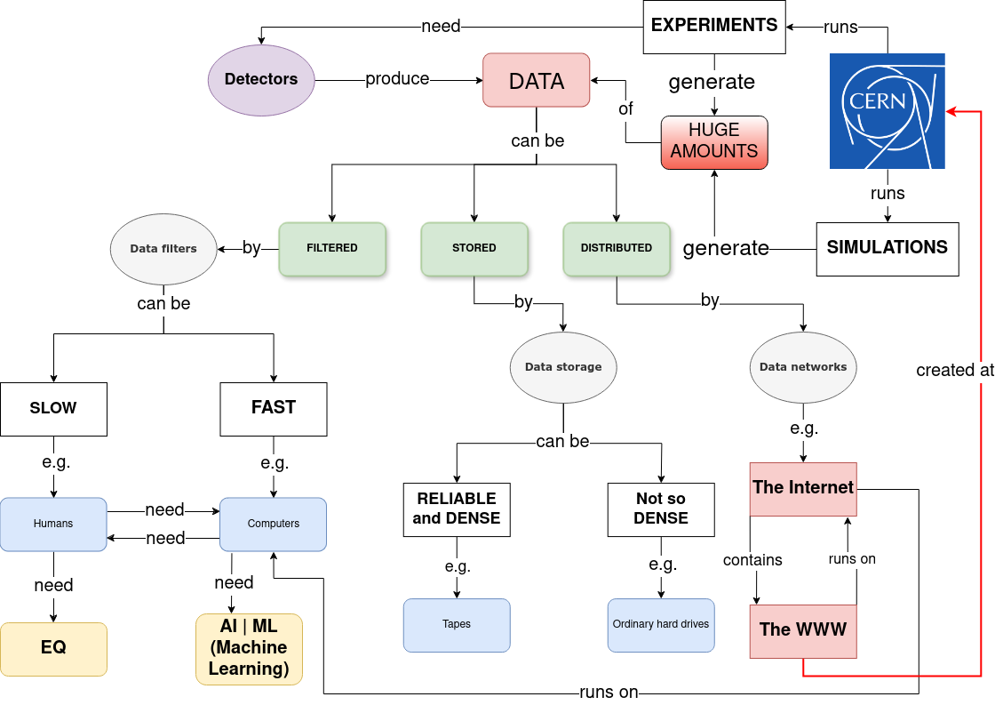
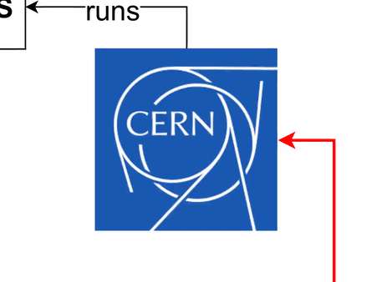
Key words
DATA
FILTERS
STORAGE
NETWORKS
ML | AI
…

Slide 4

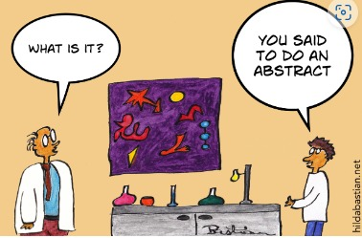
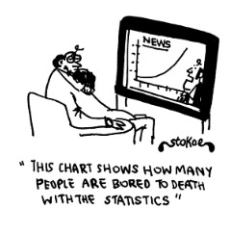
Potential Students’ Challenges
Overwhelming Scale of Data
2) Difficulty in Understanding Abstract Concepts
3) Difficulty in Understanding the Role of Probability and Uncertainty

Slide 5
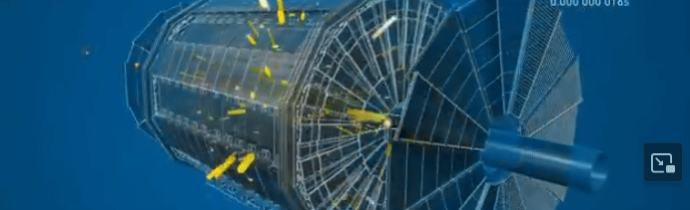
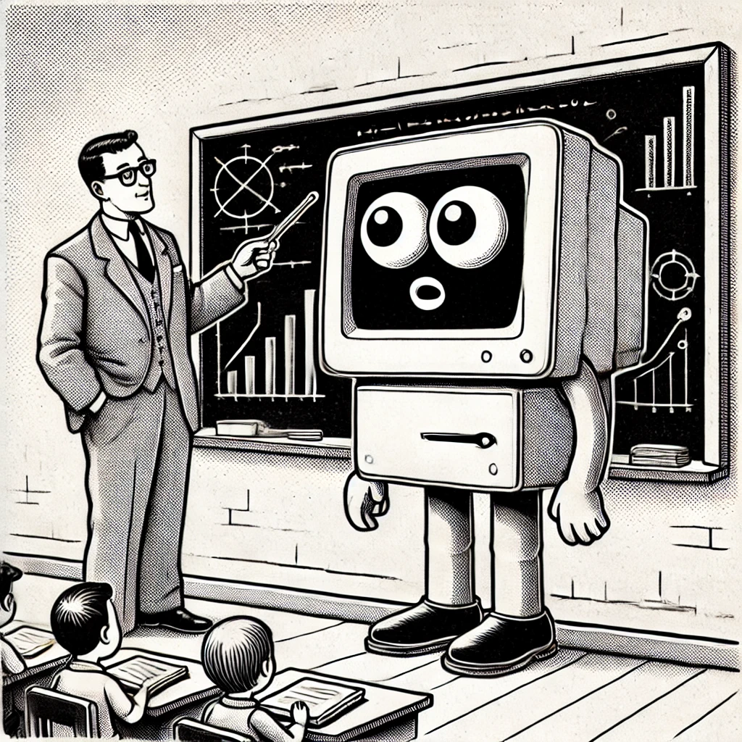
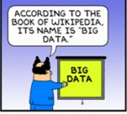

Potential Students’ misconceptions
1) When collecting data, all events are equally important
→ We have to select events of interest.
2) Data Analysis is purely a Computer Task
→ We have to train the computer to do so!
3) Computing and Data Analysis are Only for Experts
Do or Die?

Slide 6

Best Practice Example
Large data
Generate strings of random numbers (0’s and 1’s) a whole page worth.
Ask ‘Is the number of 1’s and 0’s random’
Analyse the data
Is it random?
Leads to
- What is ‘random’?
- Signal to noise ratios
- Standard deviations
1 0 1 1 1 1 1 1 1 1 0 1 0 1 0 1 1 1 0 0 1 1 1 0 1 1 0 0 1 1 1 1 0 1 0 0 1 1 0 1 1 0 1 1 1 1 1 0 0 0 1 0 1 0 1 0 0 0 0 1 0 1 1 0 0 1 1 0 0 0 1 1 1 1 0 1 1 0 1 1 0 1 0 0 0 0 0 1 1 1 0 1 1 1 1 0

Slide 7


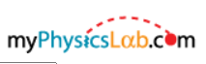







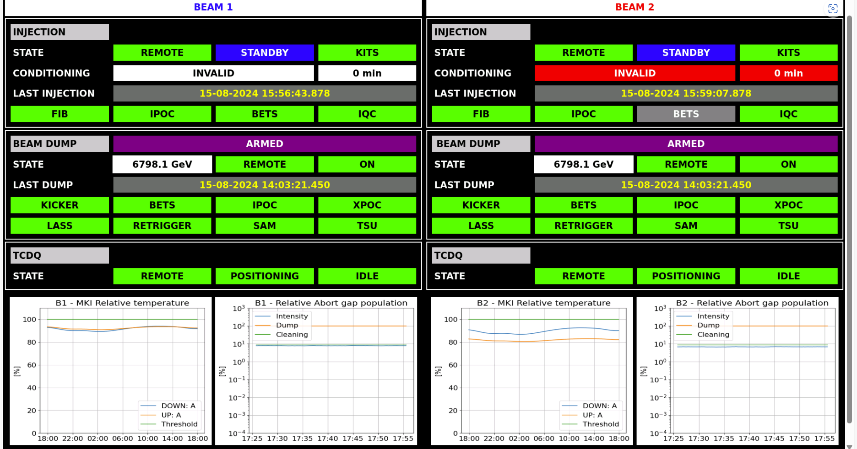

Best Practice Example
Step
(Linux only)

Slide 8
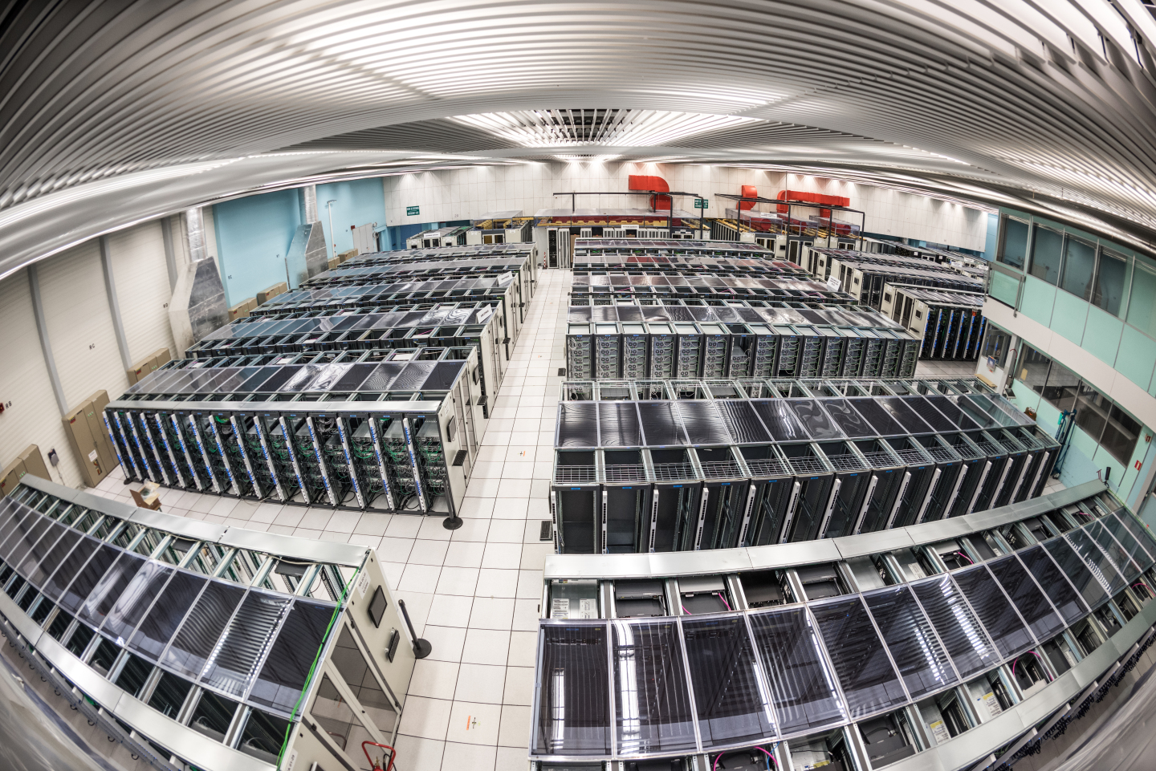


ITW2024 Study Group 3
Margaret (Poland), Mỹ Uyên (Việt Nam), Cath (Malta), Mathew (Australia), Salvador (Spain → Slovakia)
Highlights
Cutting-Edge Research
Big Data and High-Performance Computing
Innovative Algorithms
Collaboration
Snapshots
Worldwide LHC Computing Grid
An open-source software
LHC Experiments

Slide 9
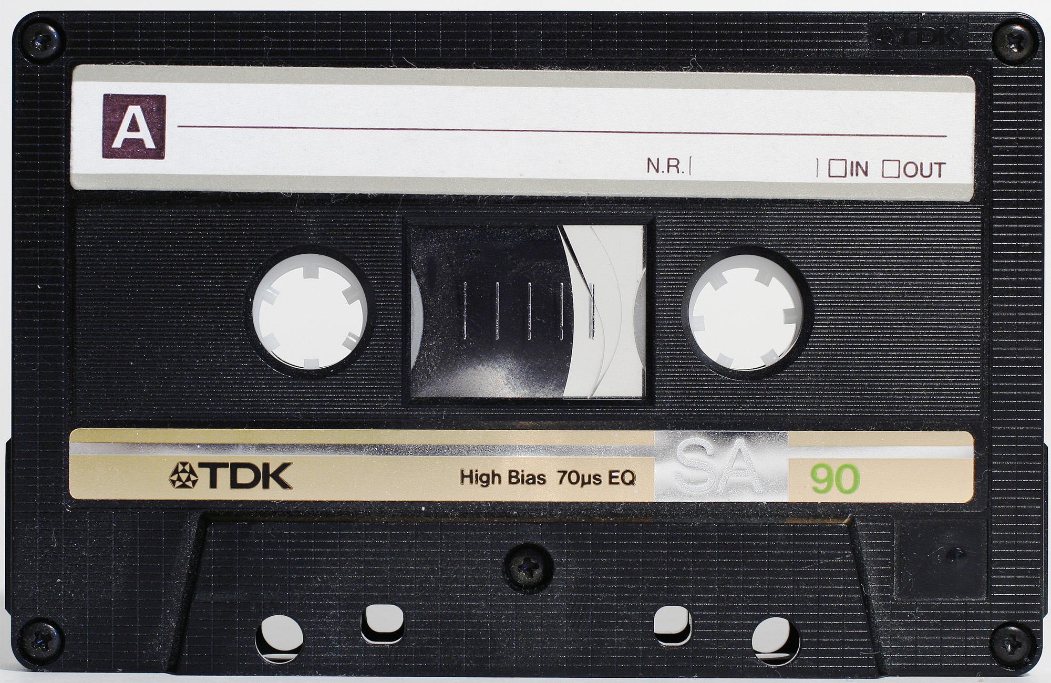


ITW2024 Study Group 3
Margaret (Poland), Mỹ Uyên (Việt Nam), Cath (Malta), Mathew (Australia), Salvador (Spain → Slovakia)
The ways in which our thinking has changed…
LHC processes more data per second than any other search engine/streaming service
Not all data is collected - first filtering is done inside the detector
Data is collected on tapes!!!
Anomalies are being checked even though a high amount of data is discarded
ALL professions are needed!!

Slide 10

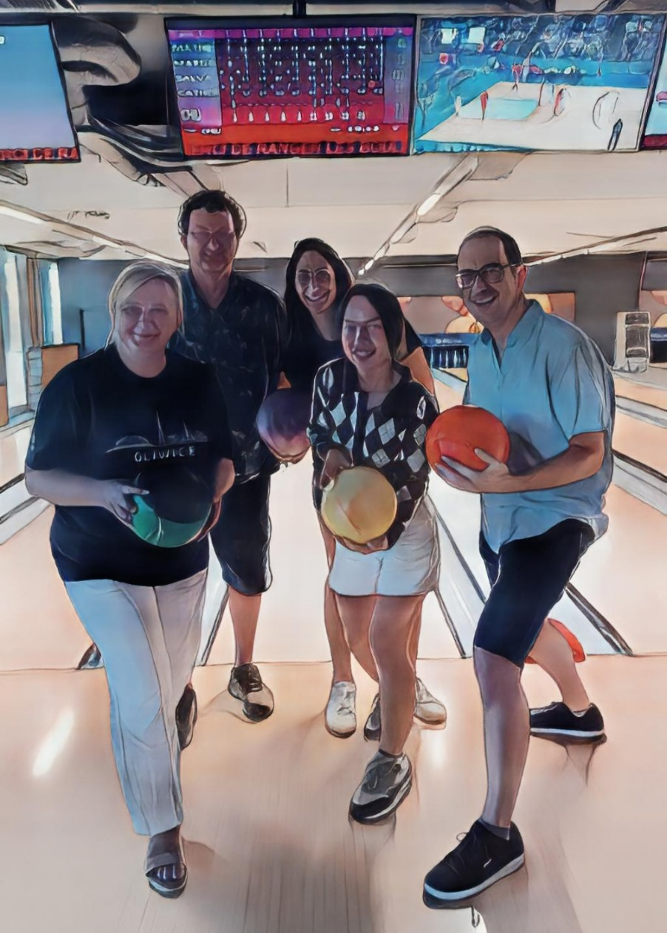
ITW2024 Study Group 3
Margaret (Poland), Mỹ Uyên (Việt Nam), Cath (Malta), Mathew (Australia), Salvador (Spain → Slovakia)

