Slide 1
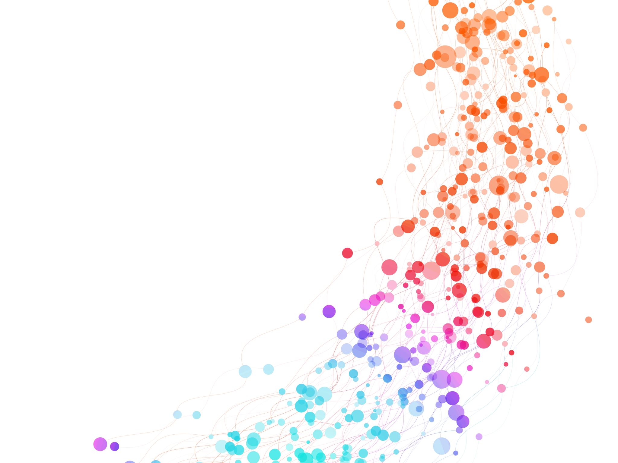

Concept Maps
International Teacher Weeks Programme 2024
Milena Vujanović
Date 16/08/2024

Slide 2
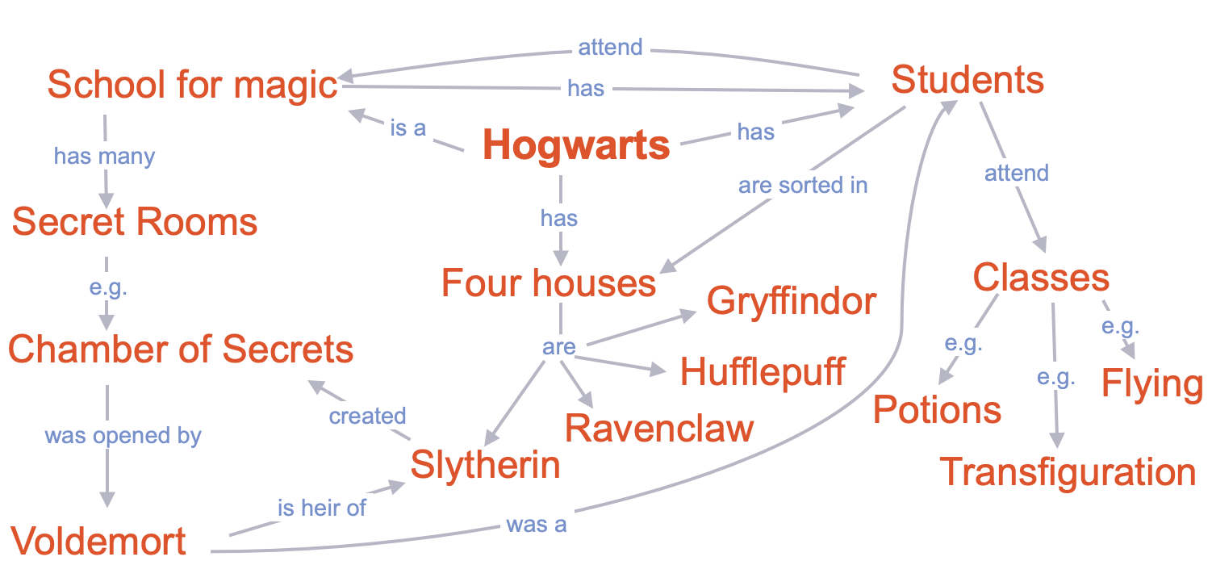

How to Construct a Concept Maps
Use linking words
2. Connect all the concepts
Milena loves to read.
Milena loves to read.
Milena loves to read.
Start your map from beginning please ☺

Slide 3
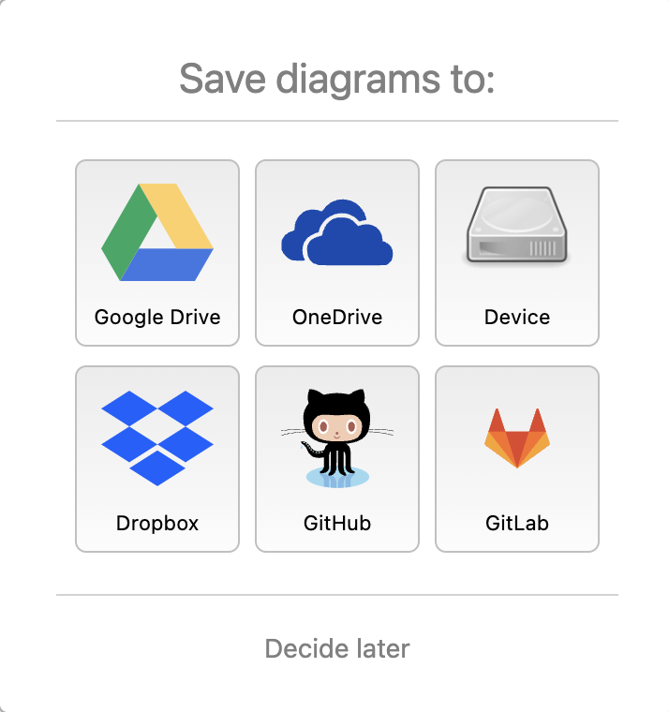
Now, it is your turn!
Personal Laptop:
CERN Laptop:
Open your laptop
Open an internet browser
Type: www.draw.io
Open the laptop in front of you
Enter the password: Tsp@2023
Open an internet browser
Type: www.draw.io
Milena loves to read.
Milena loves to read.
Milena loves to read.

Slide 4
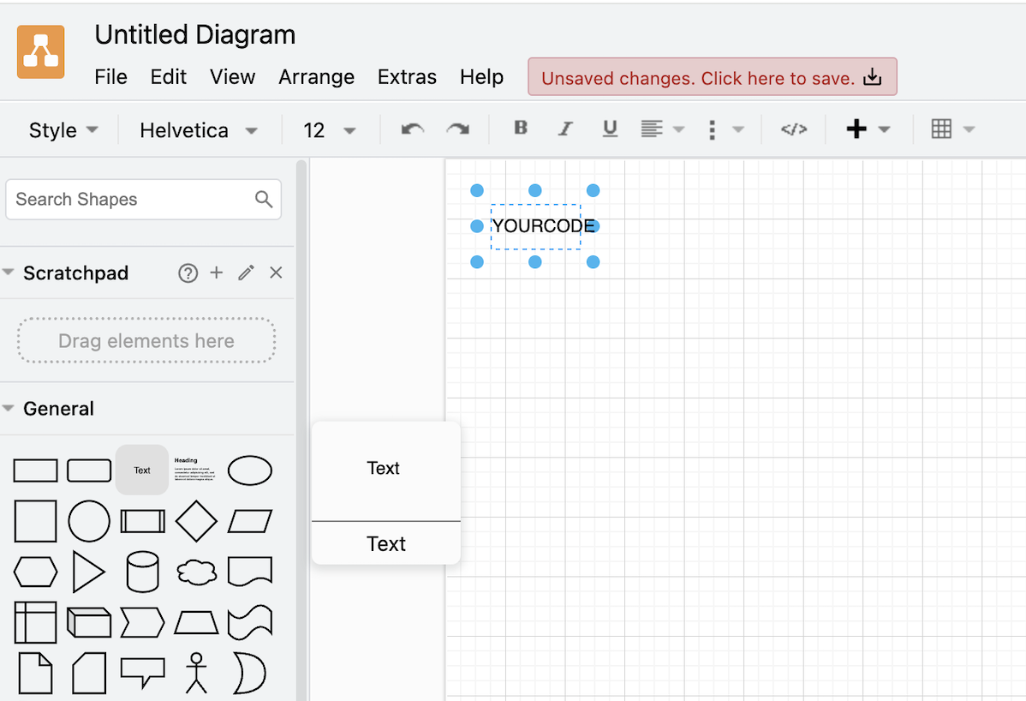
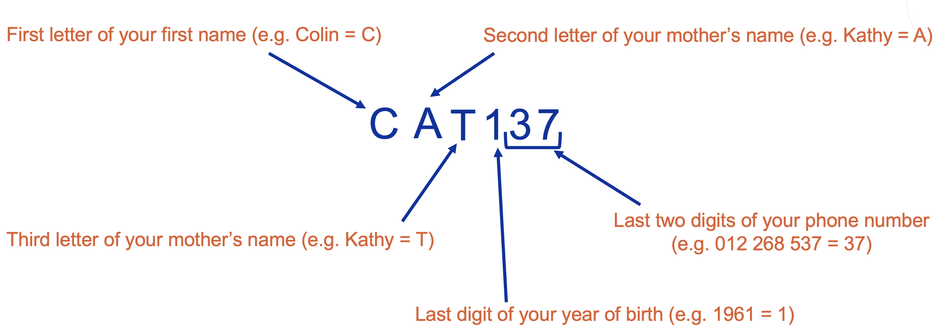
1. Drag and drop the text icon anywhere
2. Double click on the text icon to write your personal code:

Slide 5
Stop and think about the focus question
2. Chose your starting concept
3. Then chose 2 – 5 key concepts to start your map
What would you like your students to know about
PARTICLE PHYSICS and CERN?
4. Connect concepts with arrowed lines and linking words
5. Expand
Milena loves to read.
Milena loves to read.
Milena loves to read.
20 minutes
Please do not delete your maps!

Slide 6
Milena loves to read.
Milena loves to read.
Milena loves to read.
QUESTIONS?

Slide 7
Questions?
Milena loves to read.
Milena loves to read.
Milena loves to read.
QUESTIONS?

Slide 8
What would you like your students to know about Particle Physics and CERN?
Stop and think about the focus question
2. Chose your starting concept
3. Then chose 2 – 5 key concepts to start your map
4. Connect concepts with arrowed lines and linking words
5. Expand

Slide 9
20 minutes are up!
Please do not delete your concept map!
Milena loves to read.
Milena loves to read.
Milena loves to read.
QUESTIONS?

Slide 10
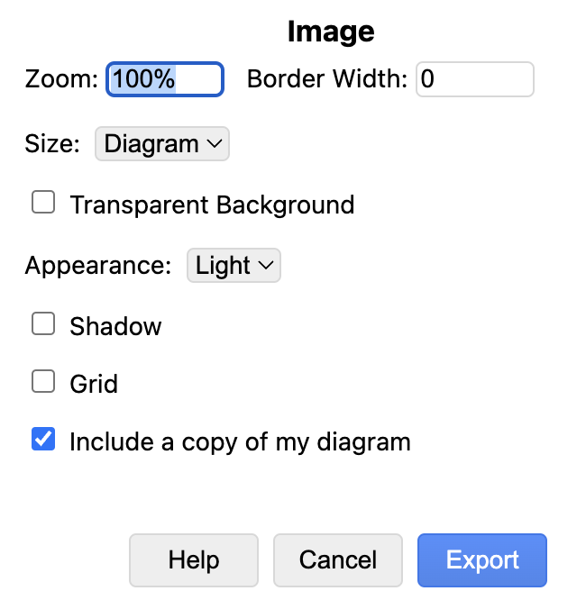
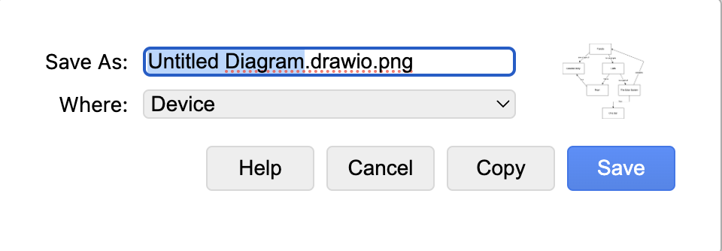
It is time to save your work!
1. Go to File and click Export as
2. Chose PNG
3. Tick ‘Include a copy of my diagram’ and then Export
4. Instead of ‘Untitled Diagram’, write your Personal Code
5. Chose ‘Device’ or ‘Downloads’ in dropdown menu for ‘Where’
6. Click Save

Slide 11

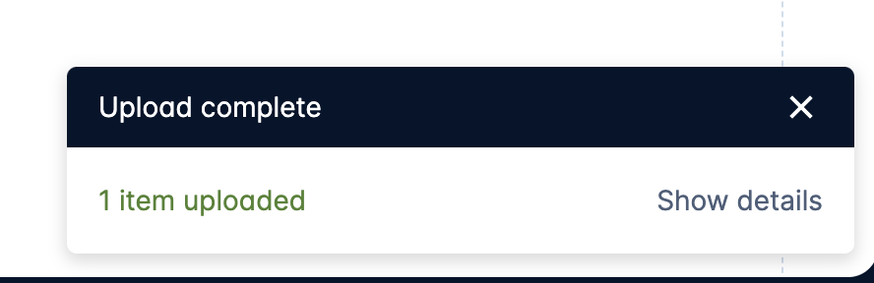
1. Go to: cern.ch/conceptmap
2. Upload your saved concept map by clicking this
Make sure to ADD your NEW Map!
3. Chose your file from the computer

Slide 12
Let’s talk!

Slide 13
How can concept maps be used in a classroom?
Teaching new concepts/topics
Teaching new concepts/topics
Assessment of your students’ understanding

Slide 14

Teaching new concepts/topics
and shares with class
1. Teacher creates a map
with students’ help
2. Your students create a map
individually
in a small group
Maps can be made using a software or a paper and pen.

Slide 15
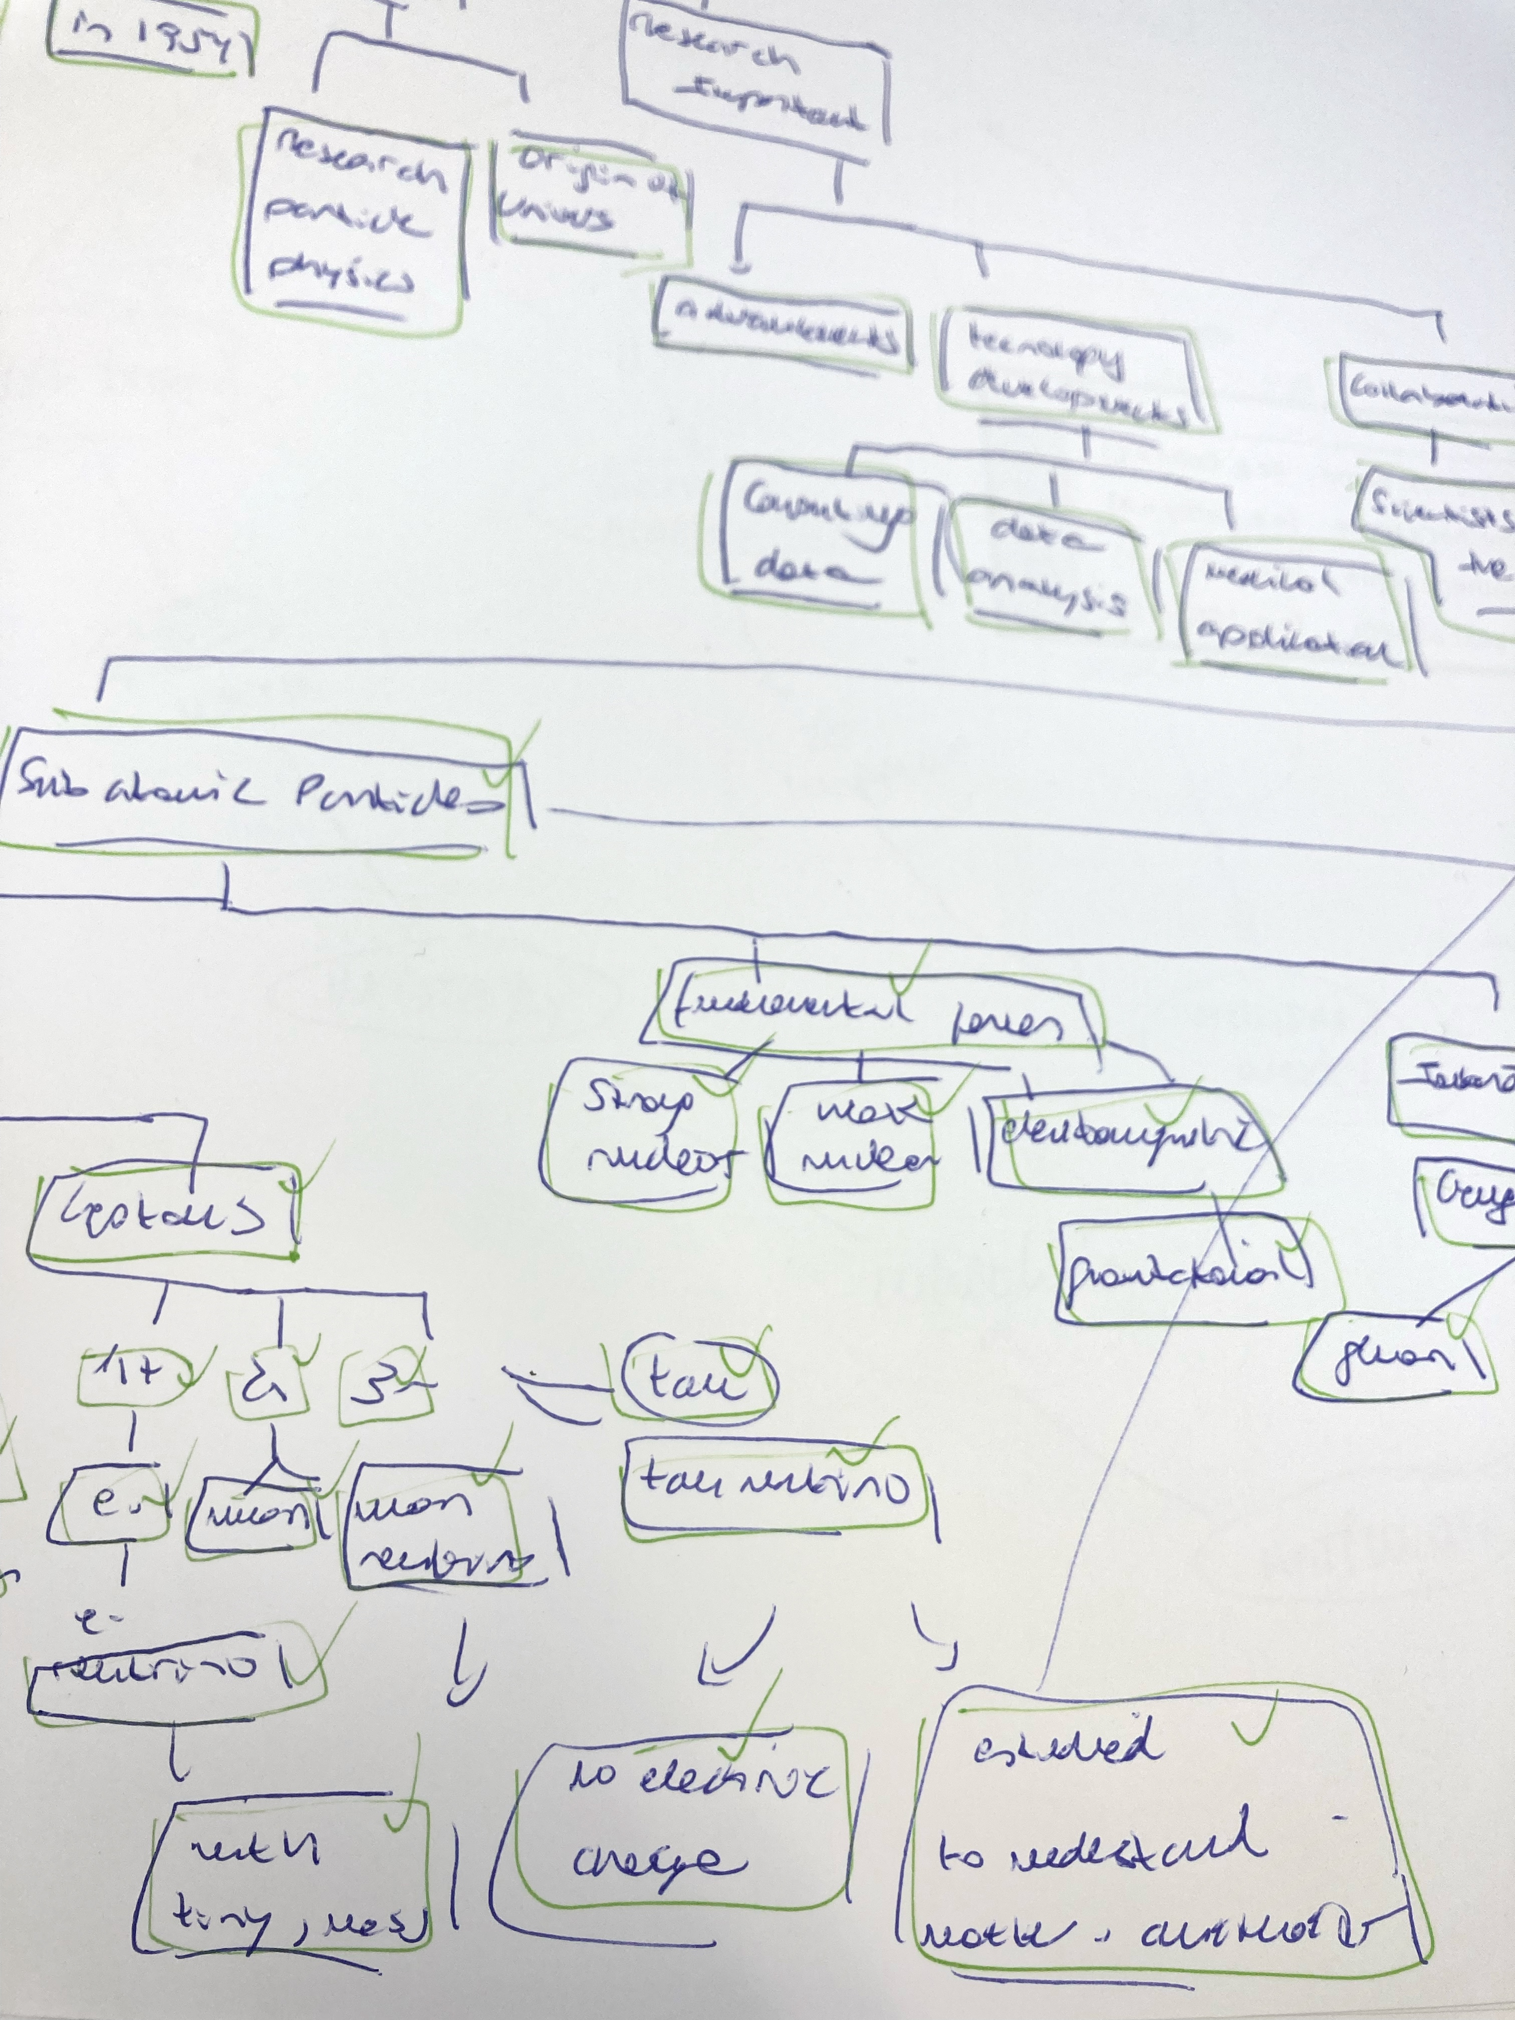
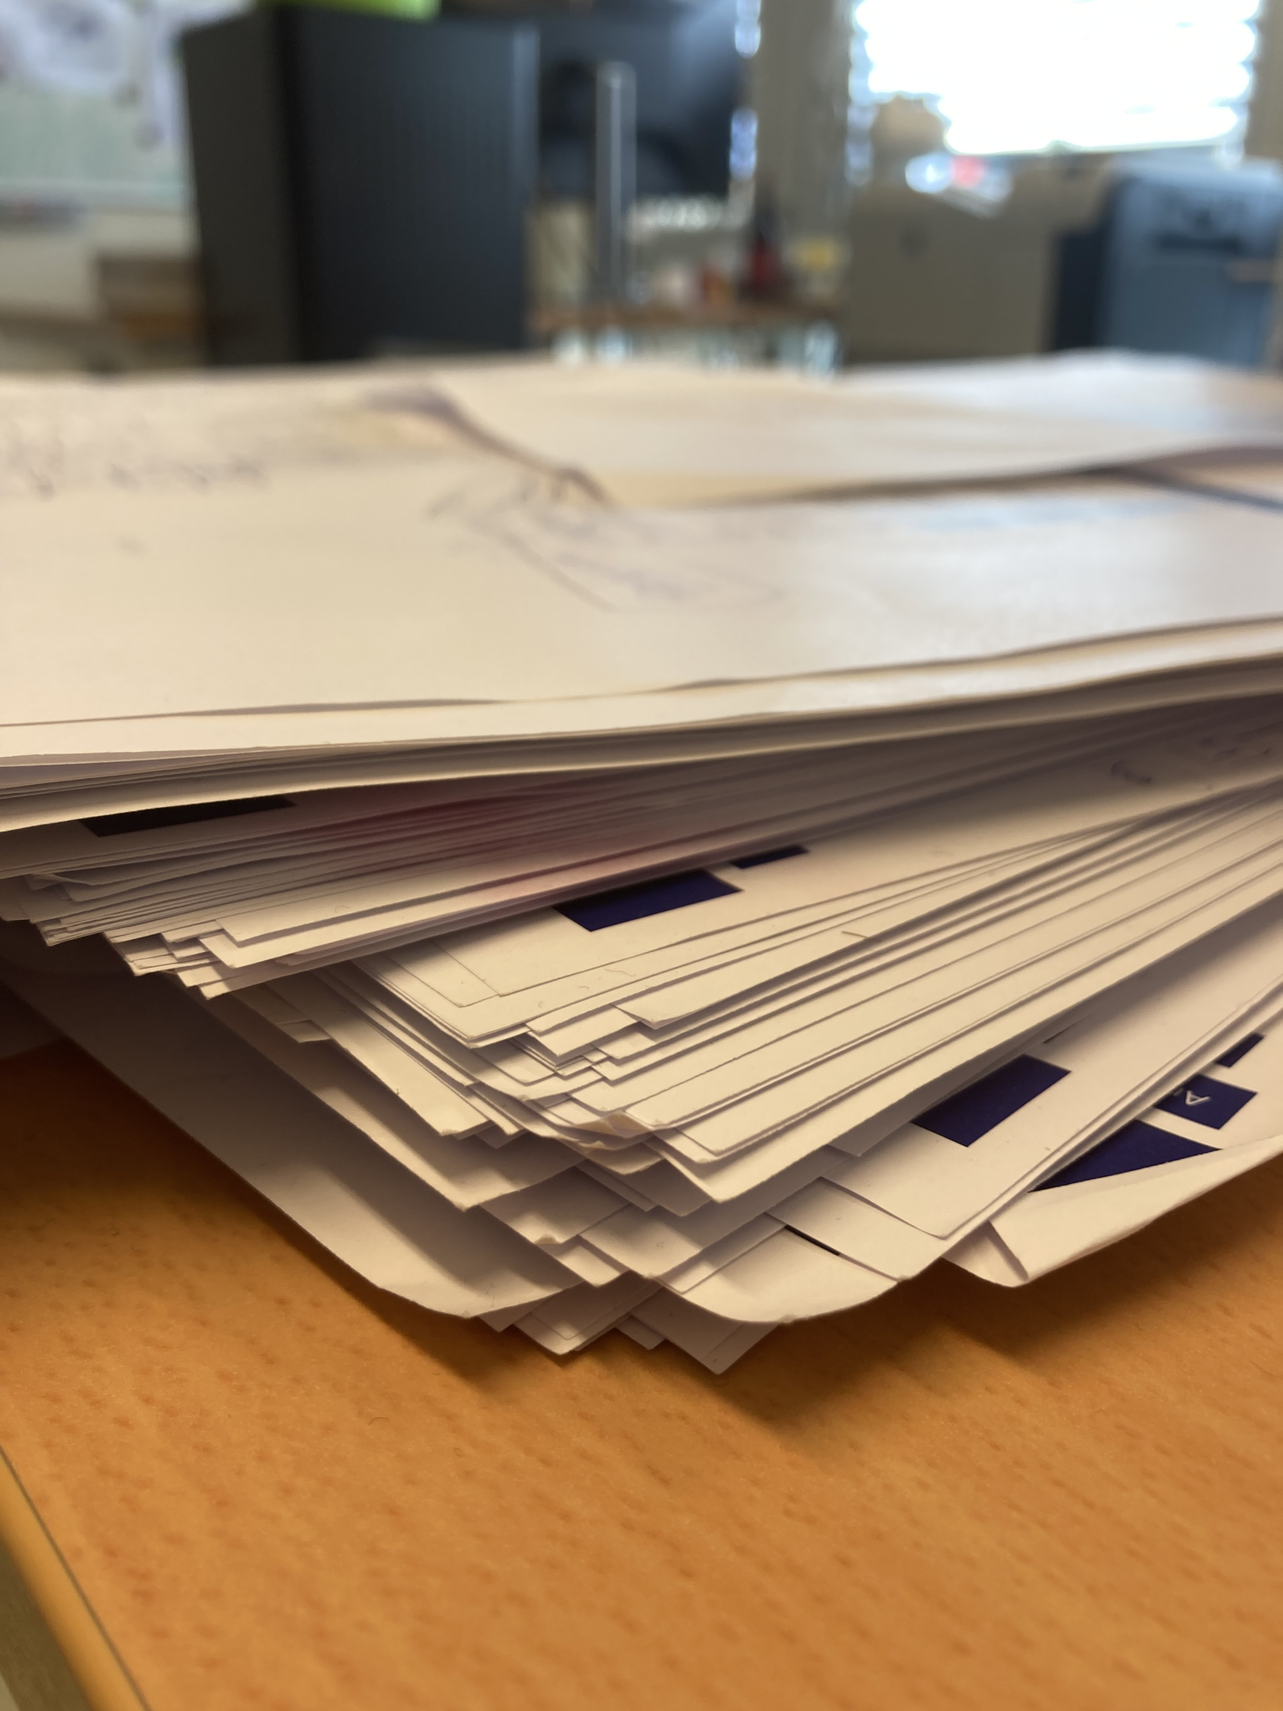
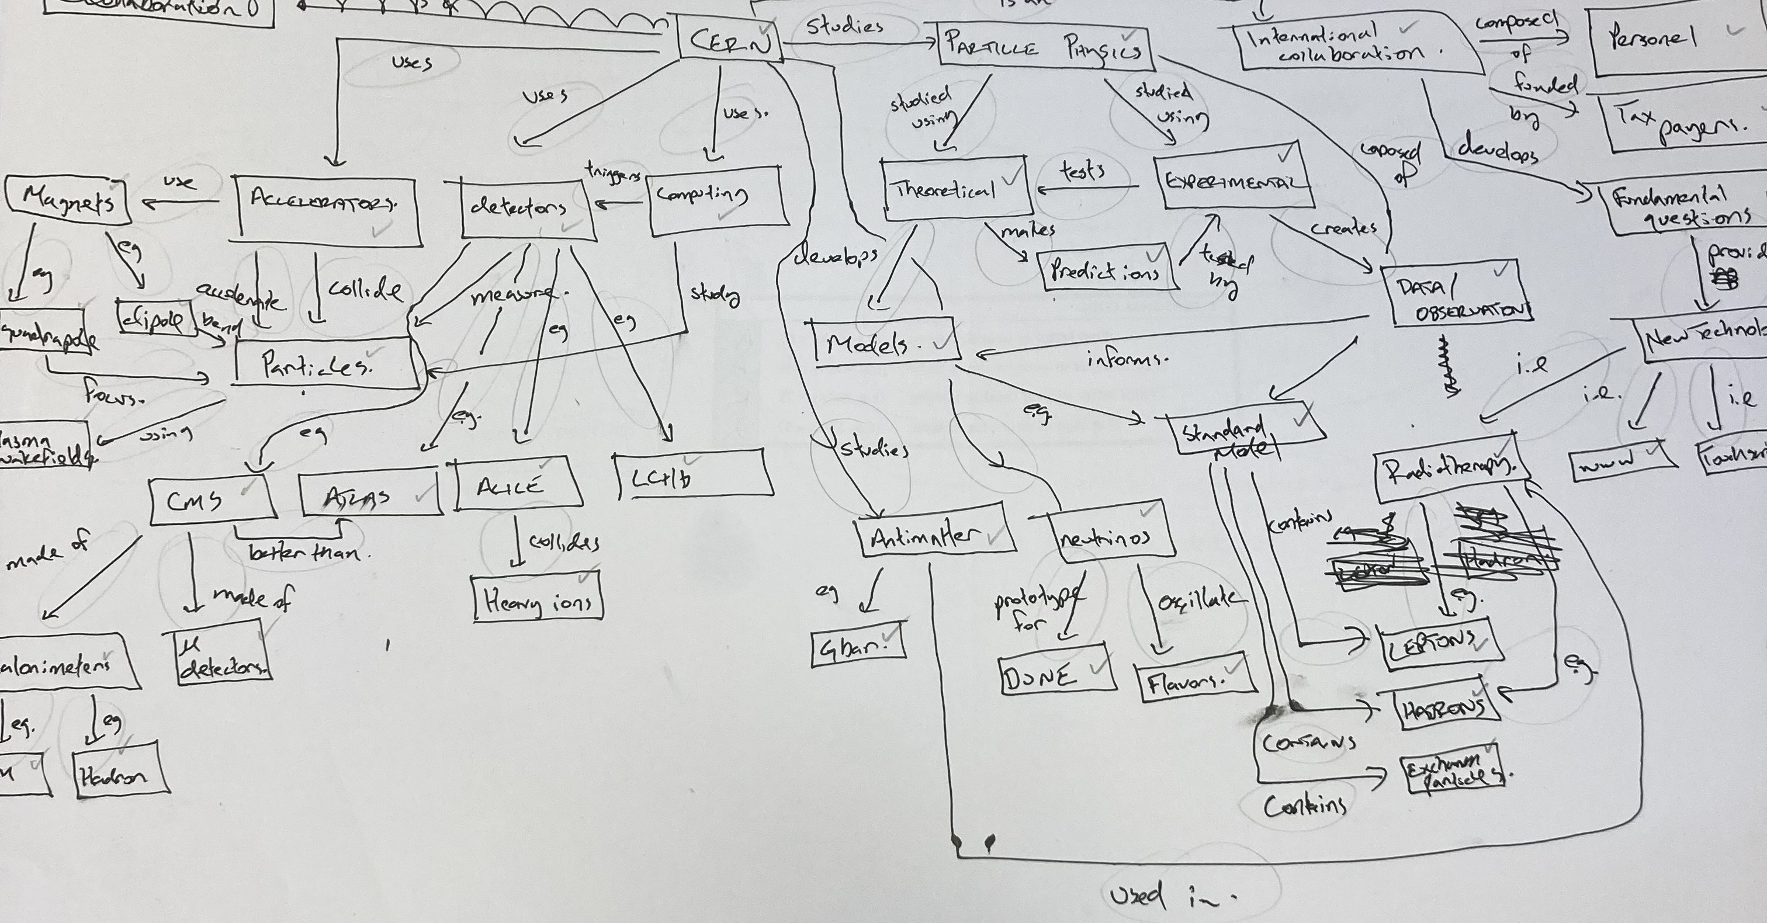

Slide 16
Parking Lot Method
Blank Paper Method
Fill-In Method

Slide 17
How can concept map be used in a classroom?
Teaching new concepts/topics
Assessment of your students’ understanding
Assessment of your students’ understanding

Slide 18
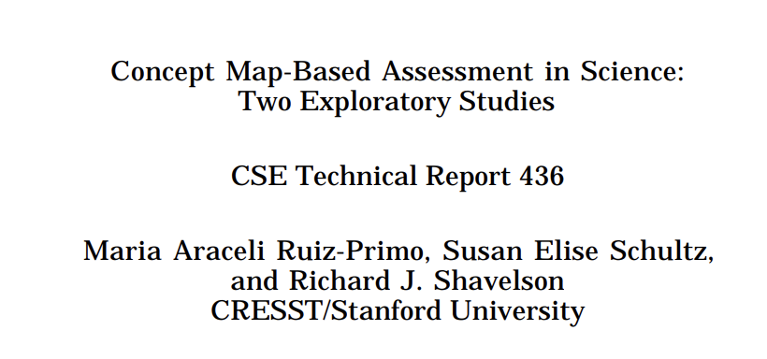
Assessment of your students’ understanding
Validity
Misconceptions

Slide 19
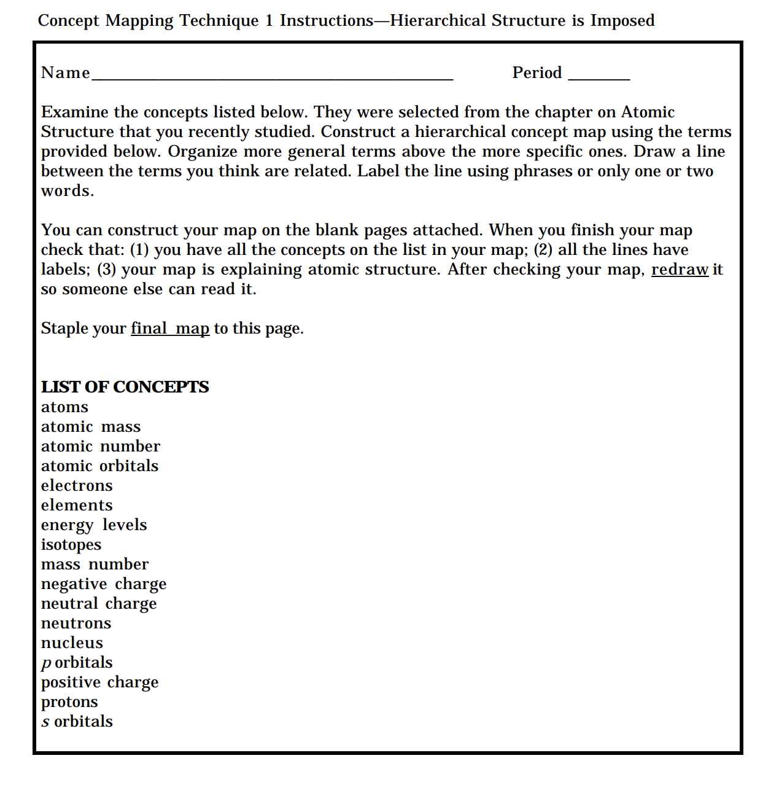

Slide 20
How Milena evaluates your concept maps
Milena loves to read.
Milena loves to read.
Milena loves to read.

Slide 21
How Milena evaluates your concept maps
Concepts (and Chunks)
Concept knowledge
Density
= (L / T) * C
Integration of knowledge
Complexity
= W * H
Depth of knowledge
Propositions
Higher number = higher accuracy
Milena loves to read.
Milena loves to read.
Milena loves to read.
Accuracy of knowledge
L = links; T = total number of concepts; C = T-1;
W = width; H = lenght/height
21

Slide 22
Expert Concept Map

Slide 23



Thank you for your participation!
milena.vujanovic@cern.ch
Nariel_137

