Slide 2
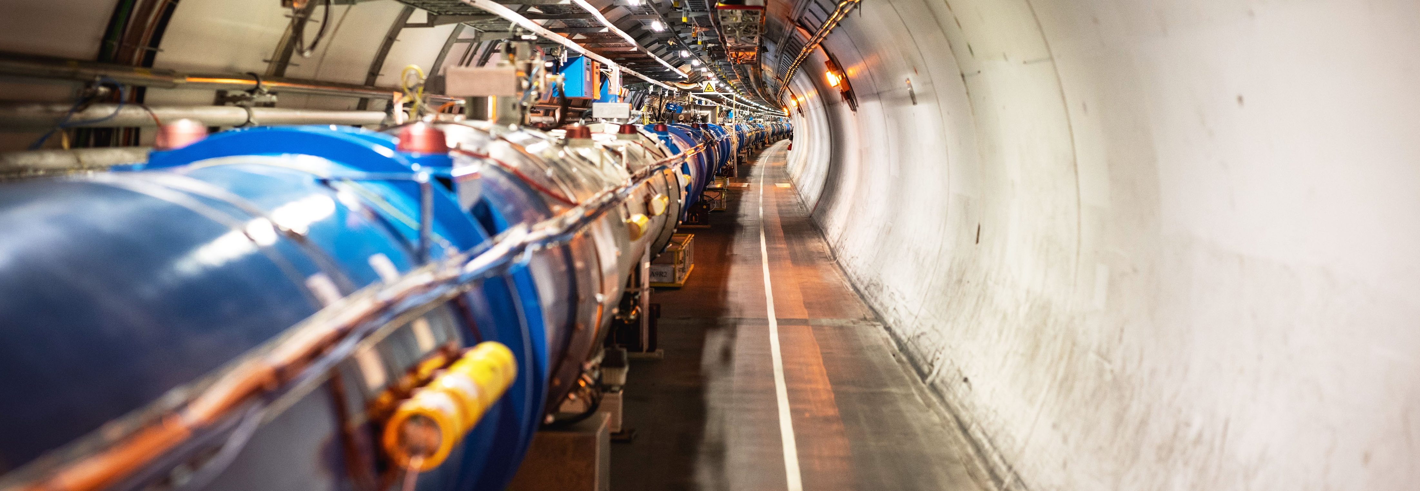
WELCOME TO CERN
Institute for Power Electronics and Control of Drives
TU Darmstadt
21 Sept 2023
Notes:
THE WELCOME SLIDE
With this slide the speaker:
Introduces him/herself
Describes how this brief presentation aims to give an overview of CERN, as an introduction to the visit that will follow.

Slide 3
„Dass ich erkenne, was die Welt im Innersten zusammenhält.“
Goethe

Slide 4
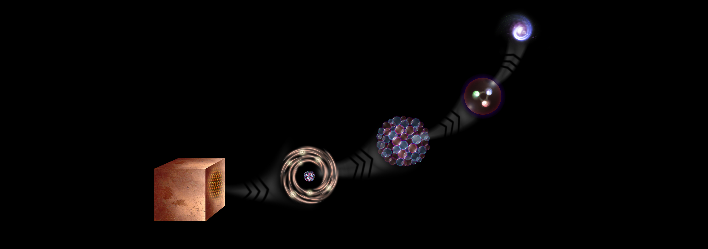
What is the universe made of?
We study the elementary building blocks of matter and the forces that control their behaviour
Quark
<10⁻¹⁸ m
Proton
~10⁻¹⁵ m
Nucleus
~10⁻¹⁴ m
Electron
Matter
0,1 m
Atom
~10⁻¹⁰ m
Notes:
This slide and the next address the questions that underpin research in particle physics.
One of the questions is “What are we made of?”
To answer this question, we study the fundamental particles that make up matter.
The speaker takes the visitors on a brief journey from visible matter to the electron and the quark: electrons and quarks are the fundamental particles of matter

Slide 5
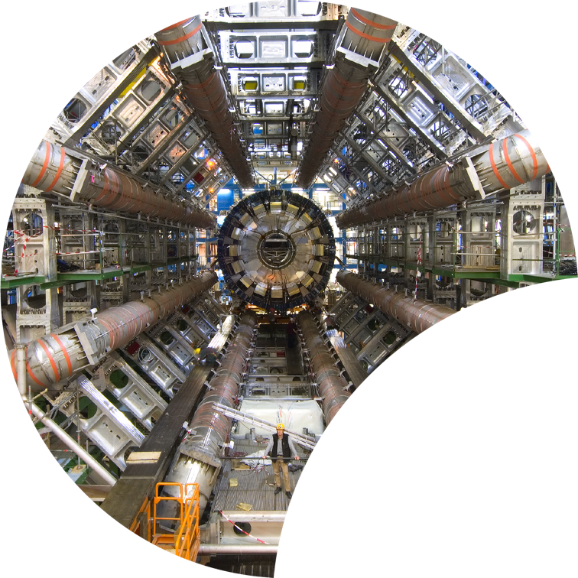
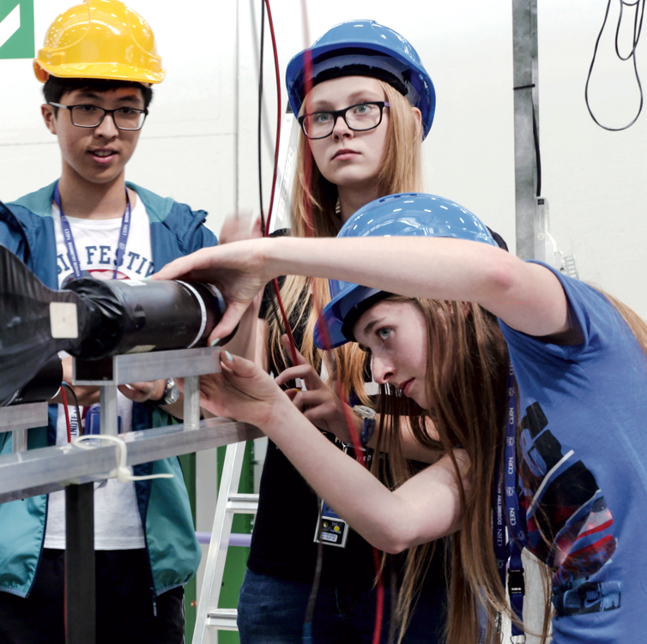
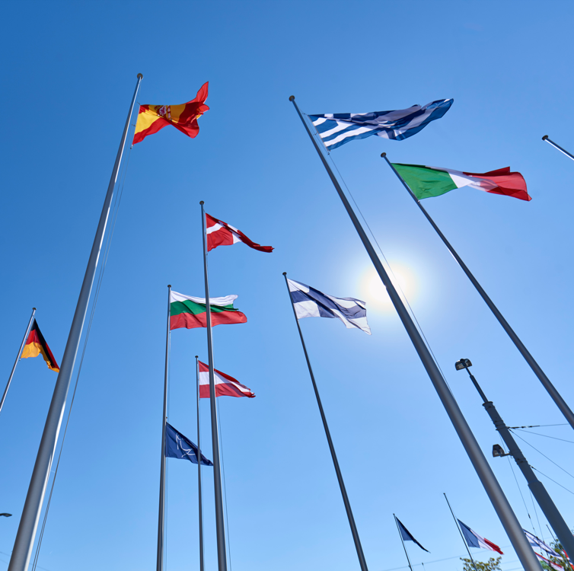
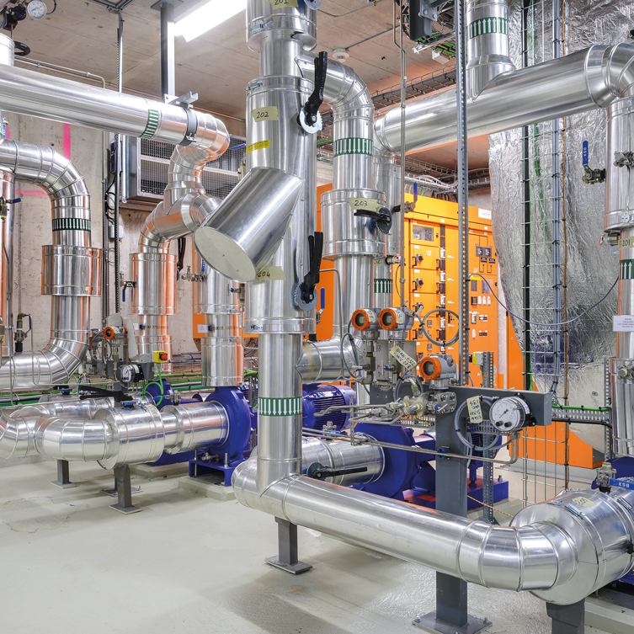

Four pillars underpin CERN’s mission
RESEARCH
EDUCATION
& TRAINING
COLLABORATION
TECHNOLOGY
& INNOVATION
Notes:
This slide introduces the four pillars that underpin CERN’s mission:
Research: To perform world-class research in experimental and theoretical particle physics; and to provide the particle physics community a range of accelerators that enable that research
Collaboration: To unite people from all over the world in the common goal of advancing the frontiers of human knowledge, in a spirit of equal collaboration and openness
Innovation: To push the technology underpinning accelerators, detectors and computing, to drive innovation in order to transfer knowledge to other scientific and technological areas, for the benefit of society
Education and Training: To train future physicists and engineers, to promote careers in science and engineering, and to foster citizens’ engagement in particle physics and in fundamental research.
FROM THIS POINT FORWARD, THE PRESENTATION IS DIVIDED INTO FOUR SECTIONS: ONE SECTION PER PILLAR

Slide 6
Where are we located ?

Slide 7
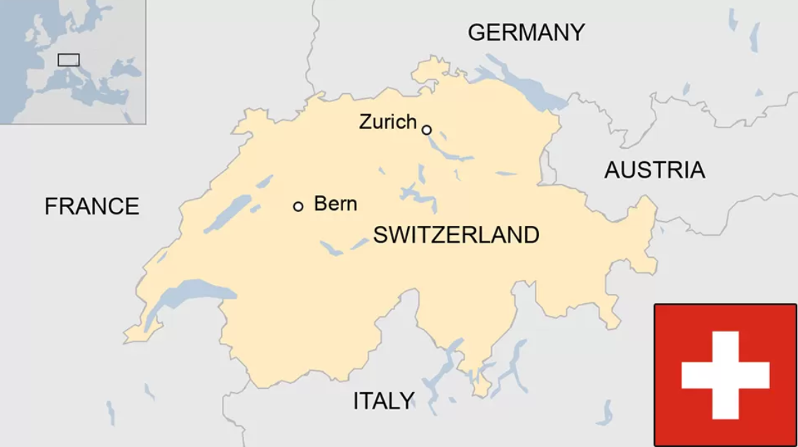


Geneva

Slide 8
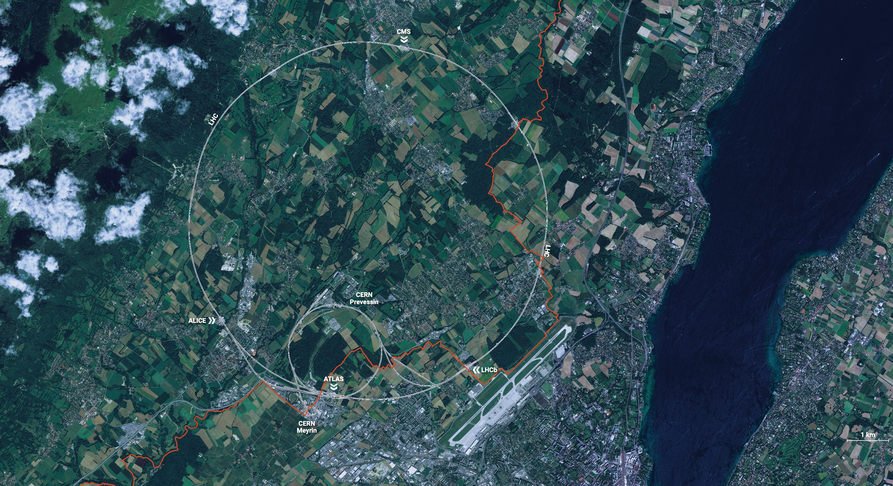
FR
CH

Slide 9
FR
CH

Slide 10
Our agenda of today
Morning: Presentations
Intro Particle Physics & Accelerator Technology
The HL-LHC upgrade project
The Future Circular Collider Study
HR: Job opportunities at CERN
Afternoon: Visits
Power converter with energy storage for the PS Booster accelerator
Assembly hall for superconducting magnets
Power Quality and Static Var Compensators
Radio-frequency systems for the SPS accelerator
The CERN Control Center
The Control Center of AMS in the International Space Station ISS

Slide 11
Basic Safety Rules for today
Please wear solid shoes for the visits.
No alcohol during lunch break, as we visit electrical equipment in the afternoon.
No pacemakers or electronic implants, when visiting CERN’s electric installations (strong magnetic and electric fields).
The particle accelerators are in operation, all electrical systems operate at full power. Keep a safety distance of at least one meter from any electrical cabinet, power converter or substation fence. Presence of low voltage and high voltage in the vicinity.
Do not touch any power converter cubicles. They are all equipped with sensitive door contacts. Touching the door of a power converter may cause the stop of the particle accelerators.
Please stay with the group at all times.
Photos are allowed, for private and for educational use, but not for commercial use. If you want to use a photo for publication, please ask for CERN’s written permission.

Slide 12
It’s time to start the presentations ….

