Slide 1
SpaceRadMon-NG from underground to the sky
S. Danzeca (BE-CEM-EPR),
A. Zimmaro (BE-CEM-EPR),

Slide 2
Outline
What is SpaceRadMon
  History, versions and improvements
Qualification process
Space missions
Conclusions

Slide 3
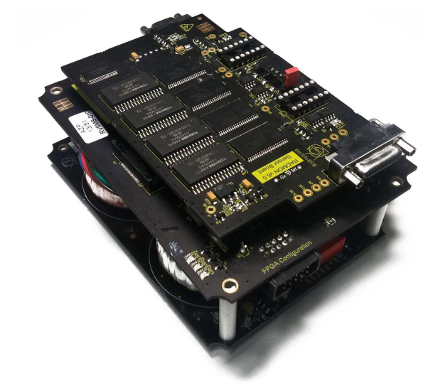

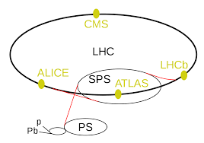
SpaceRadMon
SpaceRadMon is a Radiation Monitor device designed for CubeSats
It was developed with knowledge/experience from RADMON - board used for radiation monitoring in the harsh environment of LHC
Measures the TID and HEHs fluence
Diagnostic and environmental monitoring
Attractive solution for space missions
RadMon

Slide 4
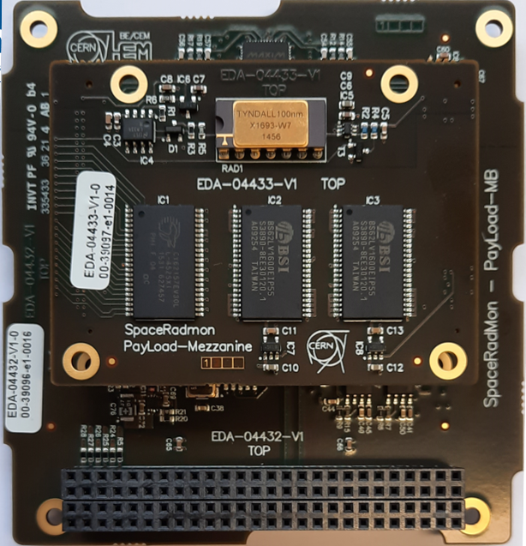





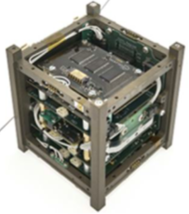
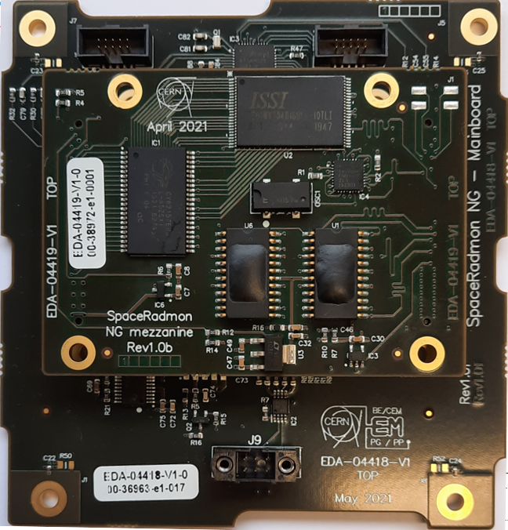
SpacePayloads timeline
Space RadMon NG
2015
2020
These features make it the first example of a new generation of payloads for radiation monitoring in space, making it attractive for a larger number of missions.
Funded by KT
CELESTA
Challenges
Low power
More radiation tolerant
Better sensor resolution
CErn Latchup Experiment and STudent sAtellite
The first CERN driven 1U satellite
Collaboration of CERN and CSU
Space RadMon V2
  SRAM Latch-up Experiment: Compare radiation levels between equator and poles
  Comparison of radiation effects between LEO space environment and CHARM
  Nanosatellites radiation qualification procedure at CHARM
While CELESTA was developed for a specific mission, SpaceRadMon is intended to be a platform that can be used by multiple customers.
Funded by KT
2018

Slide 5
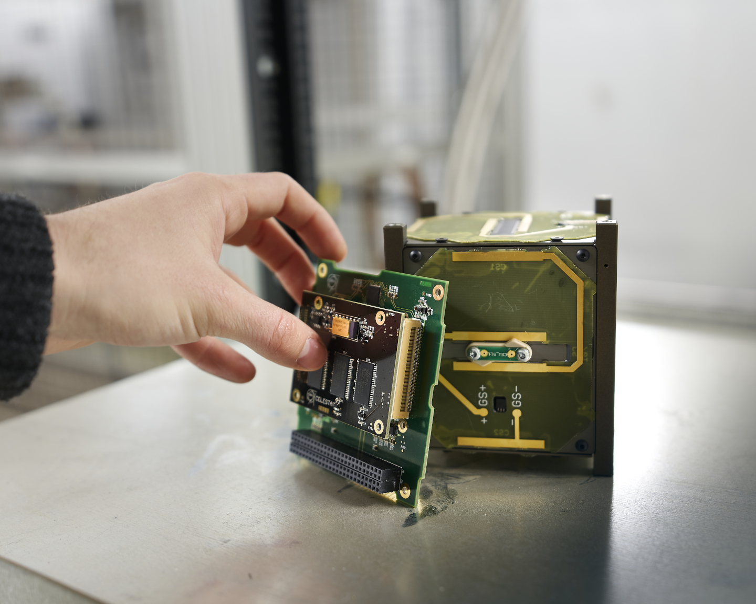
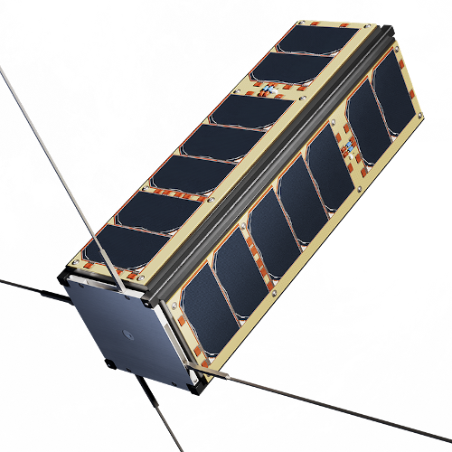
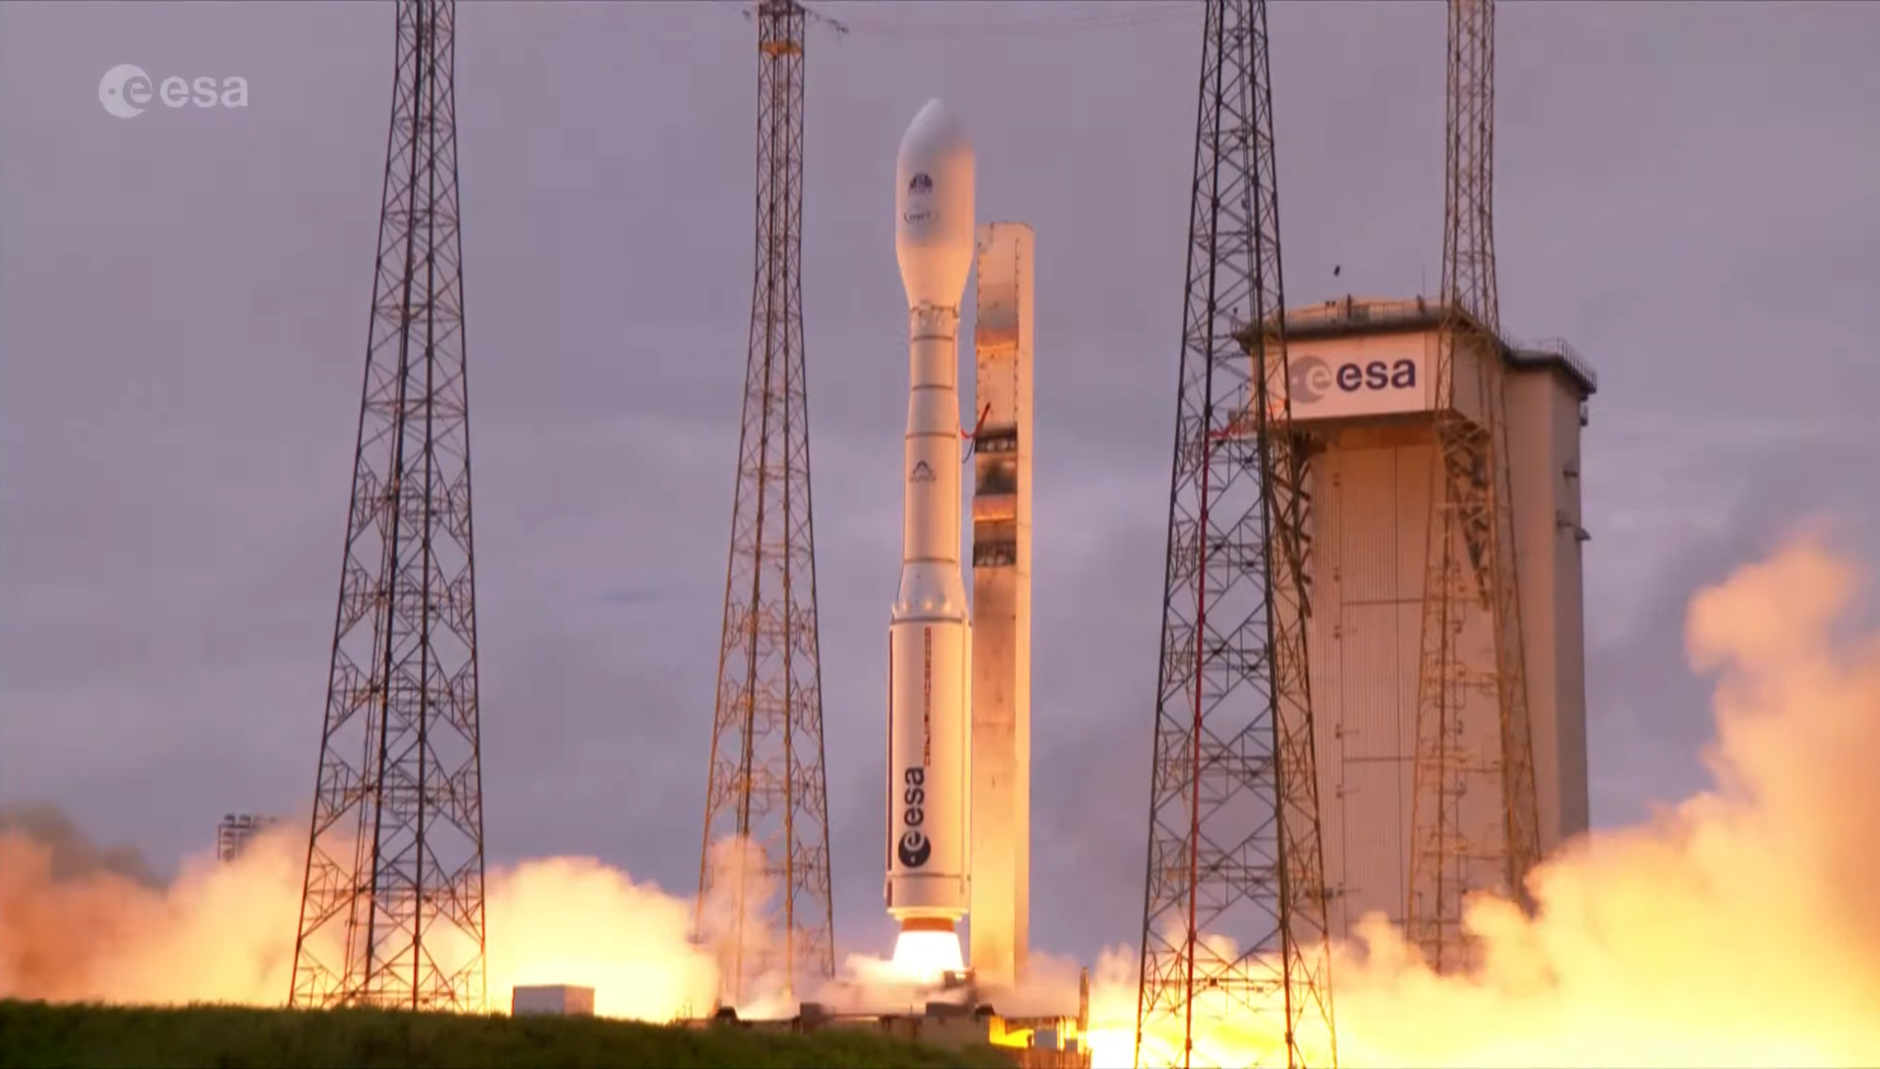
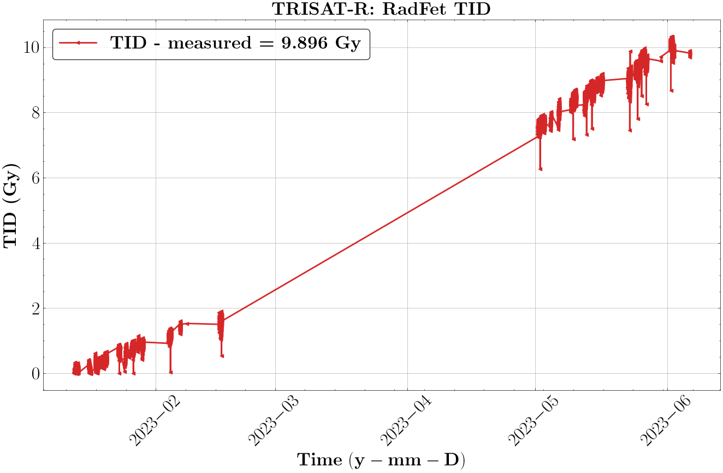
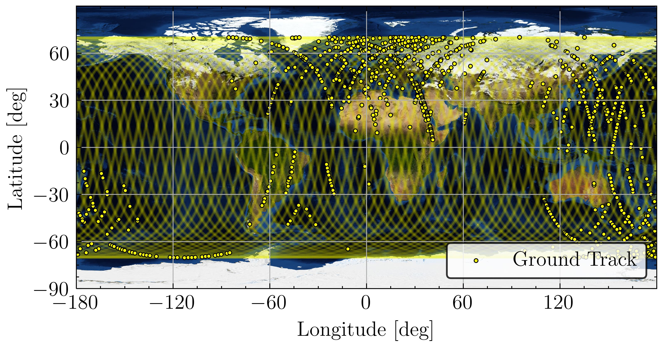
Mission already in orbit: CELESTA and TRISAT-R
CERN tech in space: the first CERN-driven satellites have been successfully launched in 2022 orbiting at ~6000km
  CELESTA (1U cubesat) in collaboration with University of Montpellier: CELESTA Payload
  TriSAT-R (3U cubesat) in collaboration with University of Maribor: SpaceRadMon V2 payload
CELESTA
TriSAT-R

Slide 6
SpaceRadMon NG
  More radiation tolerant
    ADC was replaced by a MCU with embedded ADC
  Better resolution
    Floating gate dosimeter instead of RadFET
  Lowest current consumption
    Microsemi ProASIC3L FPGA with Flash-Freeze functionality (sleep mode - no clocks active)
  I²C interface – now compatible with PC104
SpaceRadmon NG

Slide 7
SpaceRadMon V2 vs NG
  What we succeeded:
Characteristics | V2 | NG
Tolerance | 250 Gy | > 418 Gy
Power consumption | 165 mW | 63.5 mW Idle - 45.0 mW Sleep
Mass | 60 g | 57.5 g
TID Sensor | Radiation Field Effect Transistor | Floating Gate Dosimeter
Resolution (TID) | 57 mGy | 2 mGy
SRAMs | 1 SEU and 2 SEL | 2 SEUs
Voltage monitoring | No | Yes
Temperature monitoring | Yes | Yes
Communication protocol | I²C | I²C

Slide 8
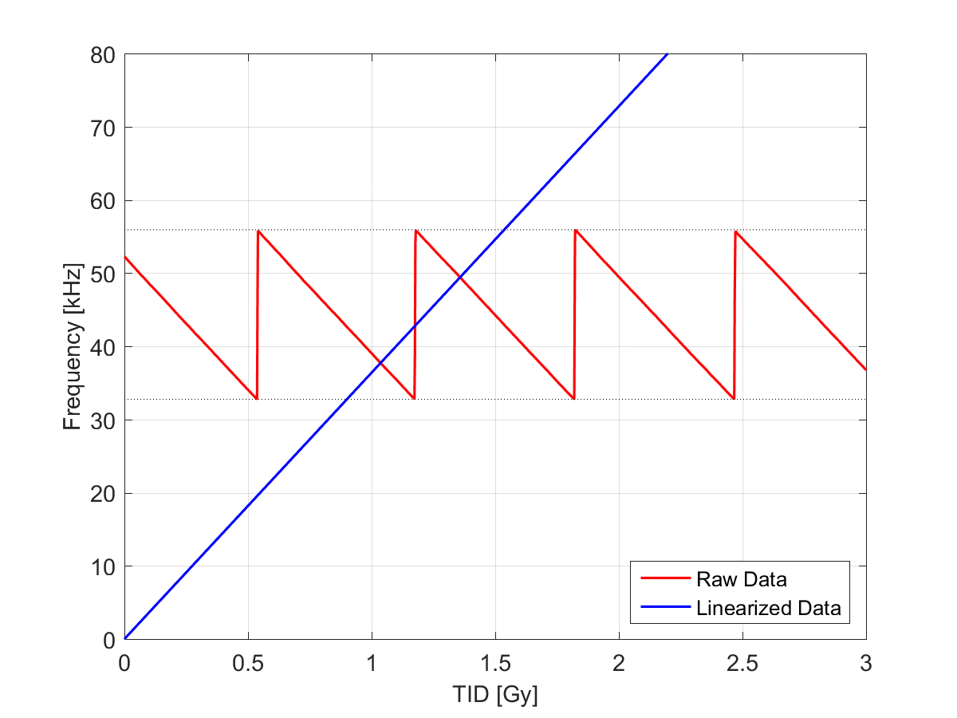
Floating gate working principle
Target current
I_{out}
I_{out}
Ionizing
Radiation
Threshold current
Total Ionizing Dose
SiO₂
SiO₂
Si p-type
Si p-type
26/09/2023

Slide 9
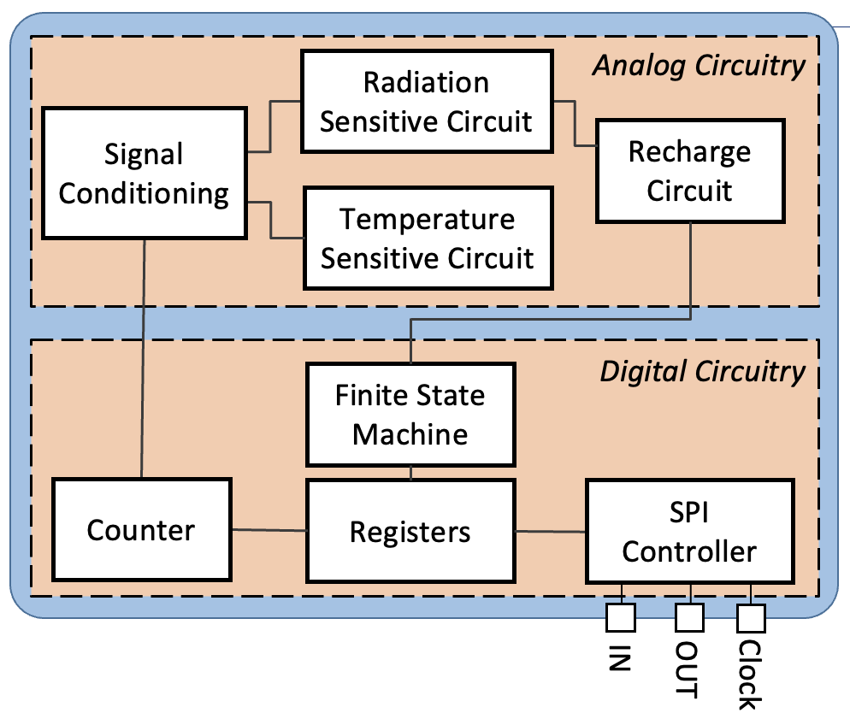
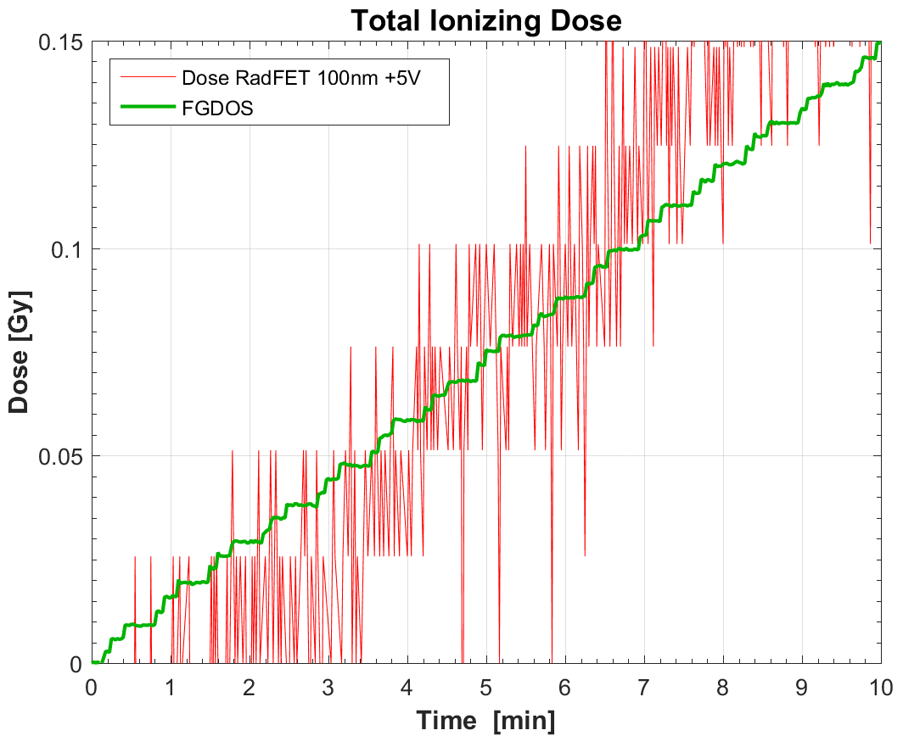
The Floating Gate Dosimeter (FGDOS)
It is developed to measure Ionizing Radiation (TID)
Radiation sensor integrated in a System-On-Chip
  Easy integration in more complex systems
Linear radiation response
High Sensitivity (resolution < 2 mGy)
Works in mixed radiation field environment
Sensor | Bias | Resolution [mGy] | Dose Range [kGy]
RadFET | 5V | 57 | 2.3
FGDOS | - | 2 | 0.3
x 30

Slide 10


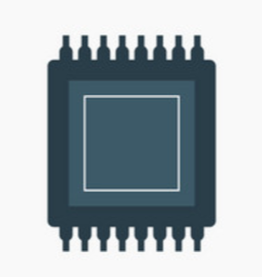



Sensor Development → An Iterative Process
Design
Fabrication
Functional Tests
Radiation Characterization
Results
Analysis
Test chips and prototypes provided on request
FGDOS
A collaboration that keeps going since 2013!

Slide 11
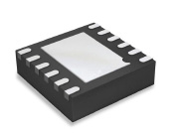
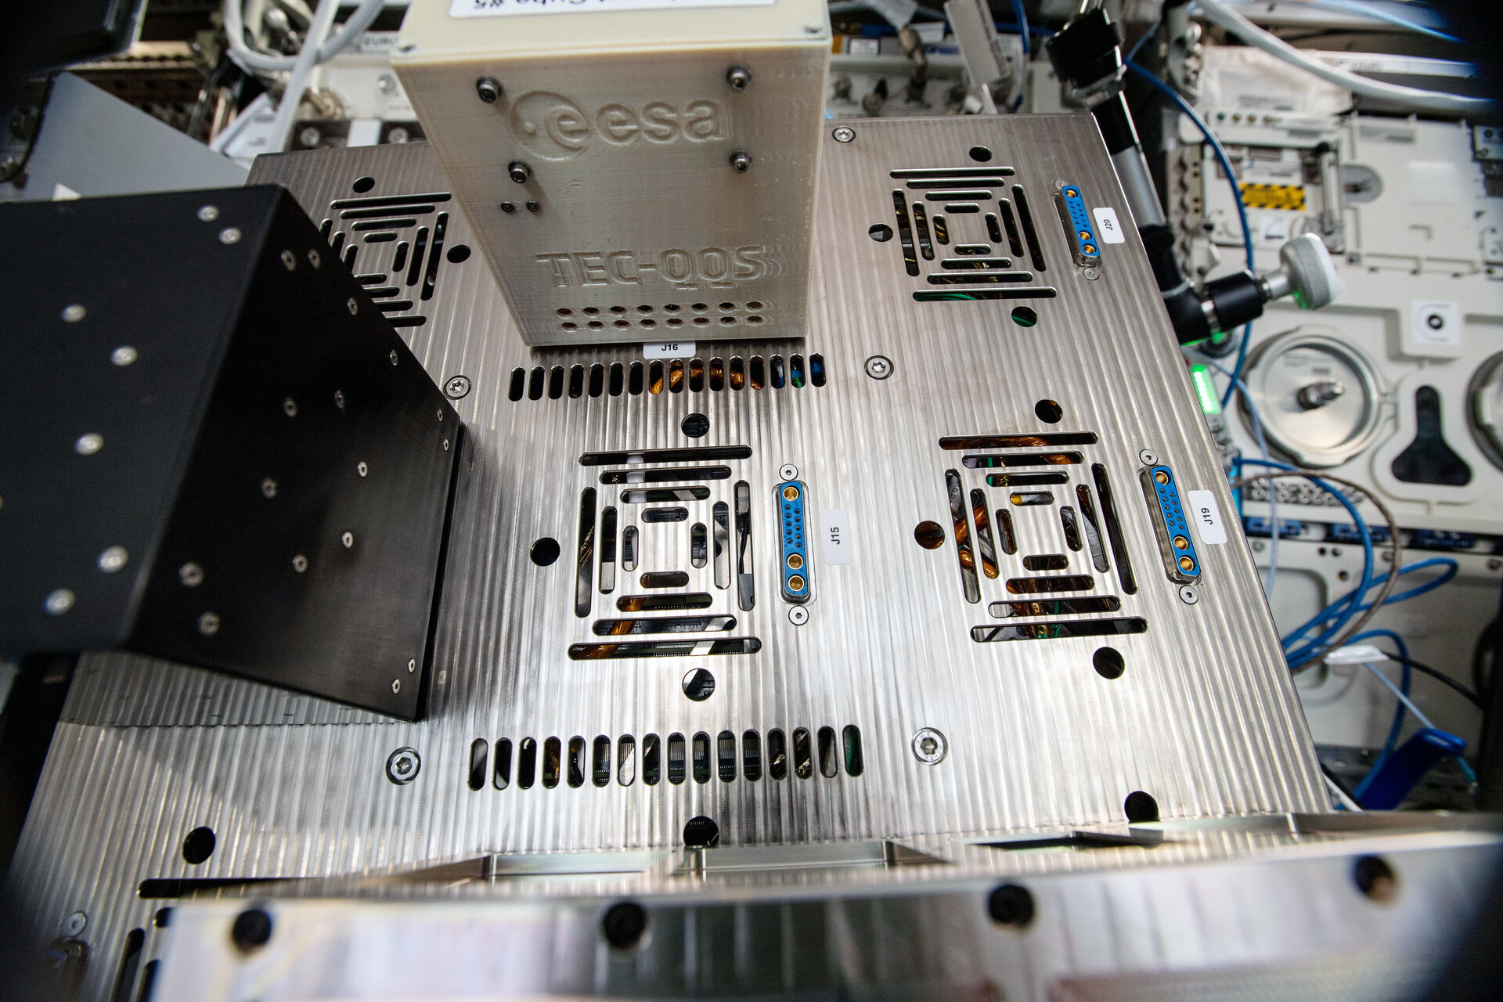

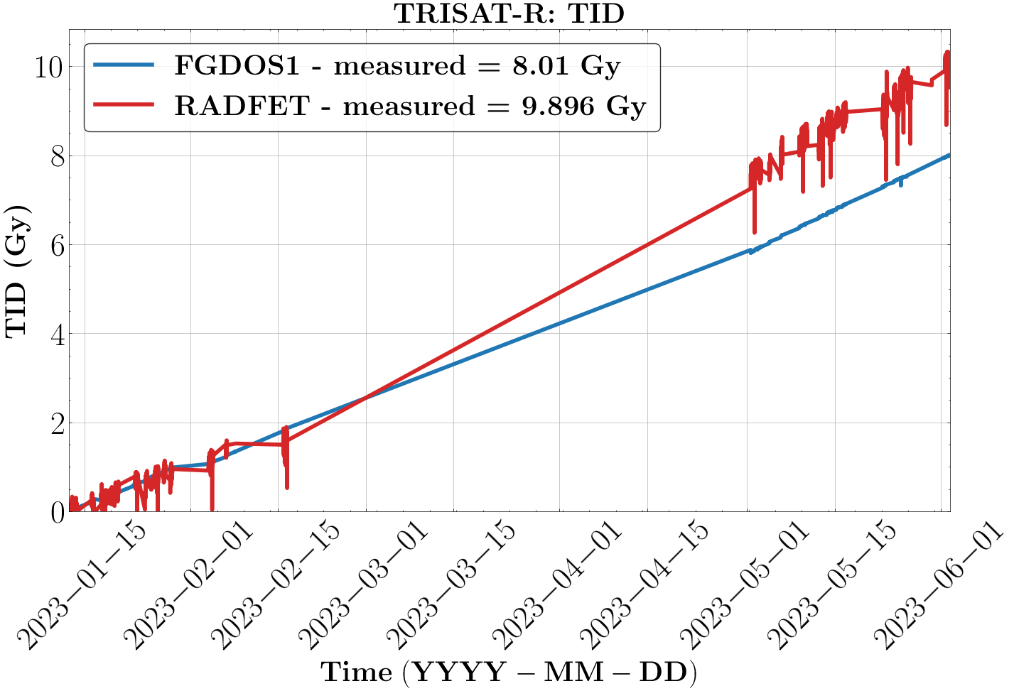
FGDOS in space
Flying FGDOS
FGDOS integrated in the CryptIC project (link) on the International Space Station
FGDOS in TRISAT-R
  Measuring RADFET and FGDOS
  Measurements well compatible
 | Dose rate [mGy/day]
Expected Dose Rate by ESA | 0.24
Data processed by CERN | 0.22
11

Slide 12
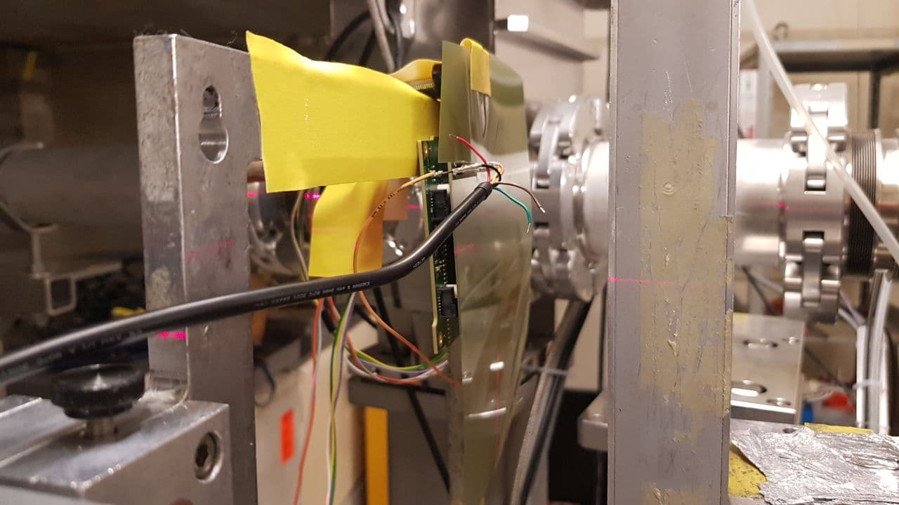
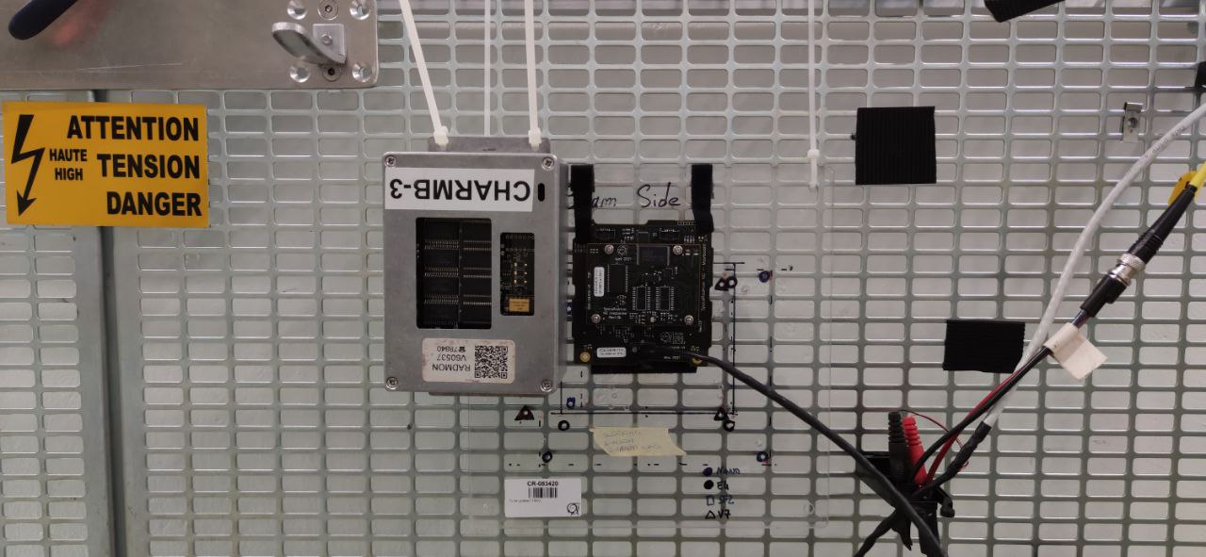

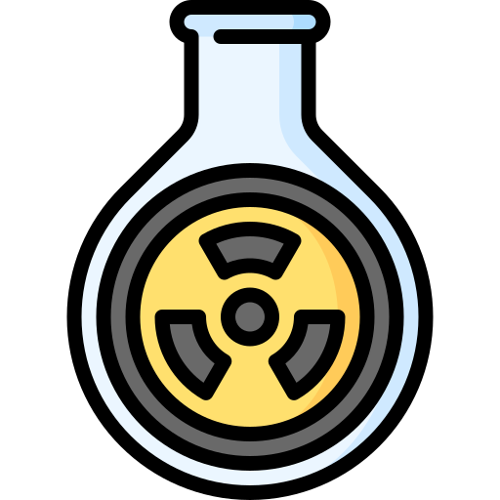
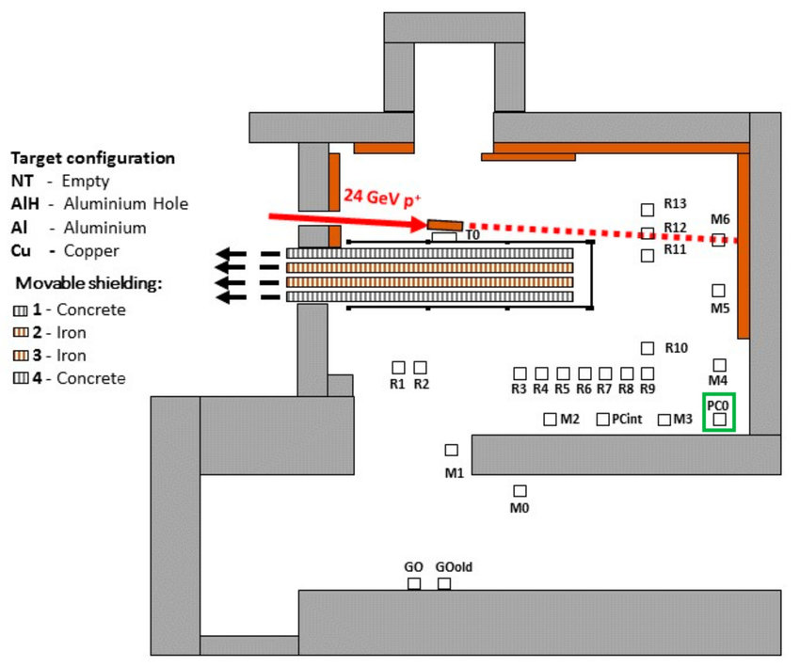

SpaceRadMon: Radiation Qualification
PSI
PSI Test
System ready to be used
4 Radiation Campaigns performed at PSI allowed to test system:
Test lifetime and sensitivity inducing all TID, DD, and SEE
Evaluate efficiency of the mitigation schemes
CHARM
Using the RadMon instrument as a reference, it was possible to assess the system quality of measurement performance and verify the functioning of the burst detection algorithm.
1st NG prototype
Co60 Test
A first radiation campaign was performed at CO60 facility to test the whole system under only TID → No SEE
Hardware and firmware finalized, and radiation test can start
CHARM
Successful test with measurements compatible respect the one of the reference
System lifetime > 418 GY
No sefi oBSERVED
2020 - 2021
July
2021
July – Oct. 2021
March – Nov. 2022
December
2022

Slide 13
Conclusions
The SpaceRadMon NG is a result of the knowledge/experience gained all those years in radiation monitoring
Is a continuous effort to improve, characterize and qualify the system (hardware, firmware/software stability, SRAM calibration, TID/DD irradiation, data analysis)
SpaceRadMon NG is an ideal tool for measuring TID and HEH fluence in harsh radiation environments
It has a high sensitivity with a resolution of 2mGy
Extremely low power consumption
Was tested extensively and is fully qualified for space missions

Slide 14
Thank you for your attention!

Slide 15
FGDOS as System-on-Chip
Extremely flexible system
Auto-recharge Control
  Embedded Charge Pump
Temperature Compensation Circuit
Recharge counter
Configurable for different applications
Active Mode
  Highest resolution, High data rate
Autonomous Mode
  Low power consumption, low data rate
Passive Mode
  No power consumption, limited dose range
Radiation
Sensitive Circuit
Analog Circuitry
Signal Conditioning
Recharge Circuit
Temperature
Sensitive Circuit
Finite State Machine
Digital Circuitry
Counter
Registers
SPI Controller
IN
OUT
Clock

