Slide 1
Radiation Monitoring During Artemis EVA

Slide 2
Context for Space Radiation on the Lunar Surface
Quiescent GCR ~ 0.15 uGy/min (0.3 in free space/2)
Solar Particle Events
  The size, and corresponding maximum dose rate follows a negative power law distribution
  I.e. most SPE are small, but a minority are big and they can get very big
  Realistically up to mGy/min in a spacesuit (based on Oct 89, 30 year storm)
  The duration of these events is from several hours to days
NASA exposure limit for acute effects is 167 mGy to blood forming organs in 30 days -> this is the low threshold for acute effects
The goal then of suit monitoring is to act as part of a suite of monitoring instruments and tools to prevent crew from exceeding this limit

Slide 3
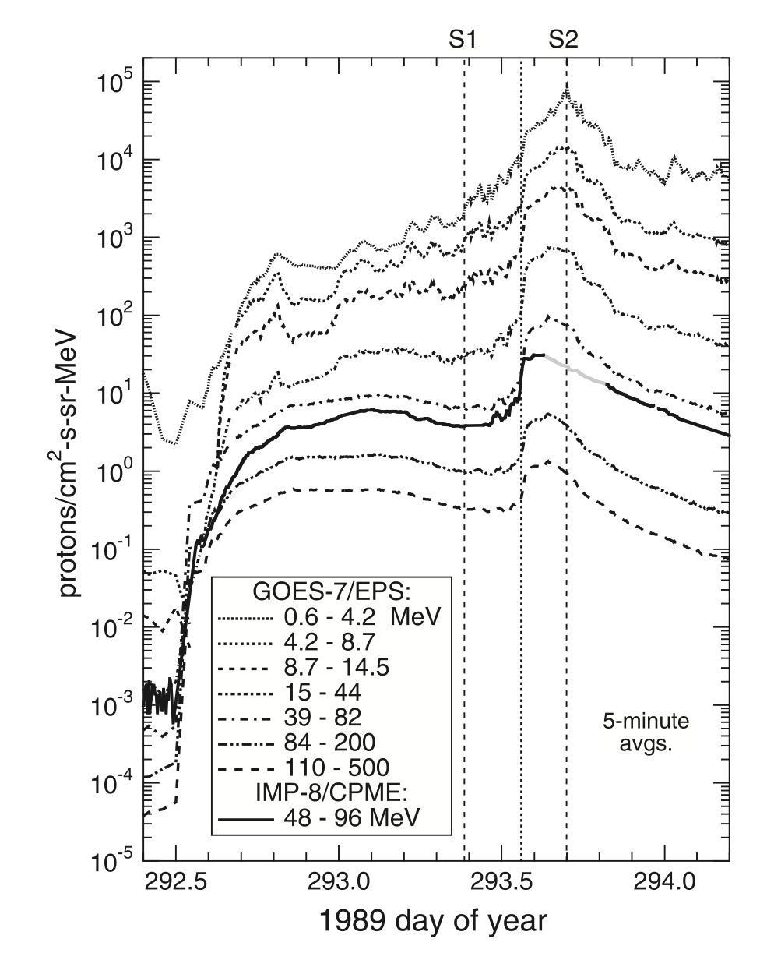
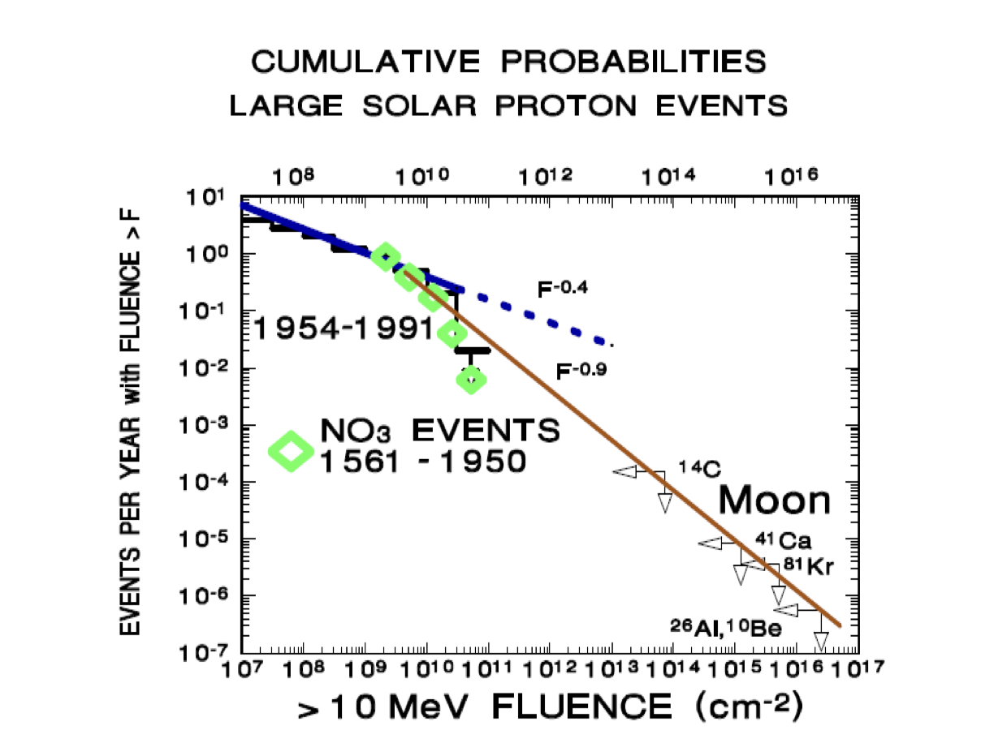
Oct 89 GOES Differential Proton Flux vs Time

Slide 4
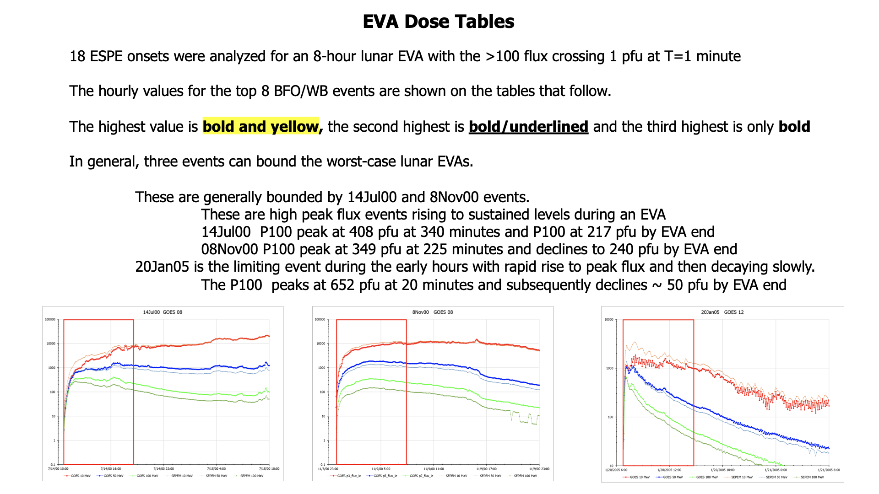

Slide 5
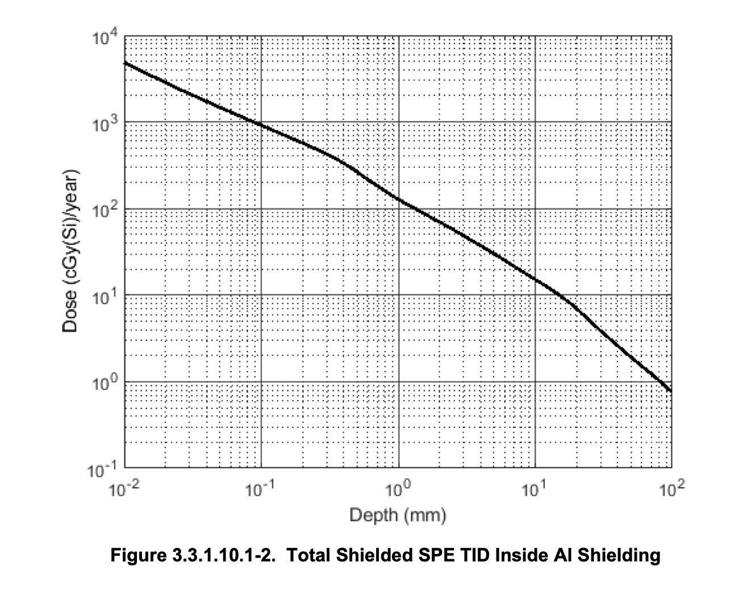
How to Mitigate Solar Particle Events
The energy spectra of solar particle events follows a power law distribution with lots of low energy protons
The low energy protons are easily stopped with shielding
The mitigation for SPE is thus in principal quite simple – put crew into the most shielded environment possible as soon as possible
How this interacts with other mission constraints is the interesting question
What does As Low As Reasonably Achievable look like in the context of a $2 billion mission with 5 days on the surface?

Slide 6
Artemis III Conops
The essential tension is managing the needs to crew protection with the needs to do necessary work in the event of space weather during the short duration of a lunar landing.
Goal is to have crew take no more than 10 mGy (TBD) due to EVA related SPE exposures during a mission
Notionally, if an event is in progress while the crew is in the vehicle, they remain until the projected exposure is less than the threshold – based on vehicle monitoring and other tools
If an event starts while the crew is outside of the vehicle, crew returns (1 hr) once the event dose rate crosses some threshold and remains until the projected exposure is less than 10 mGy

Slide 7
Energetic Solar Particle Event
Peak
Dose Rate
Proton Flux
EVA Start Time Relative to Proton Event
No Event
Before Egress:
Go
If Onset
During EVA:
Terminate??
Prior to and During
Event Peak:
No Go
After Event Peak:
Steady Decline
Proceed based on caution
Dose rate limit or reduced Duration.
Toward Event End:
Go

Slide 8
Scenario/ConOps: EVA Rad Event
*HLS Shelter is A/L
EVA monitor Hi Rad Level
(and no comm)
Suit-based Alert/
Measurement
Local alert to crew
Y
Orderly EVA Termination
Return to HLS*
FCT to replan EVA based on event decay
Telemetered to SRAG
HLS-based Alert/
Measurement
Telemetered to SRAG
N
SRAG
Event Analysis/
Recommendations
FCT Guidance
(Flight Rules)
Continue: Y/N
Y
Continue EVA
Space weather-based Alert/ Measurement
Available to SRAG
If EVA suit High Radiation Level alarm and no comm, EVA would return to lander/shelter

Slide 9
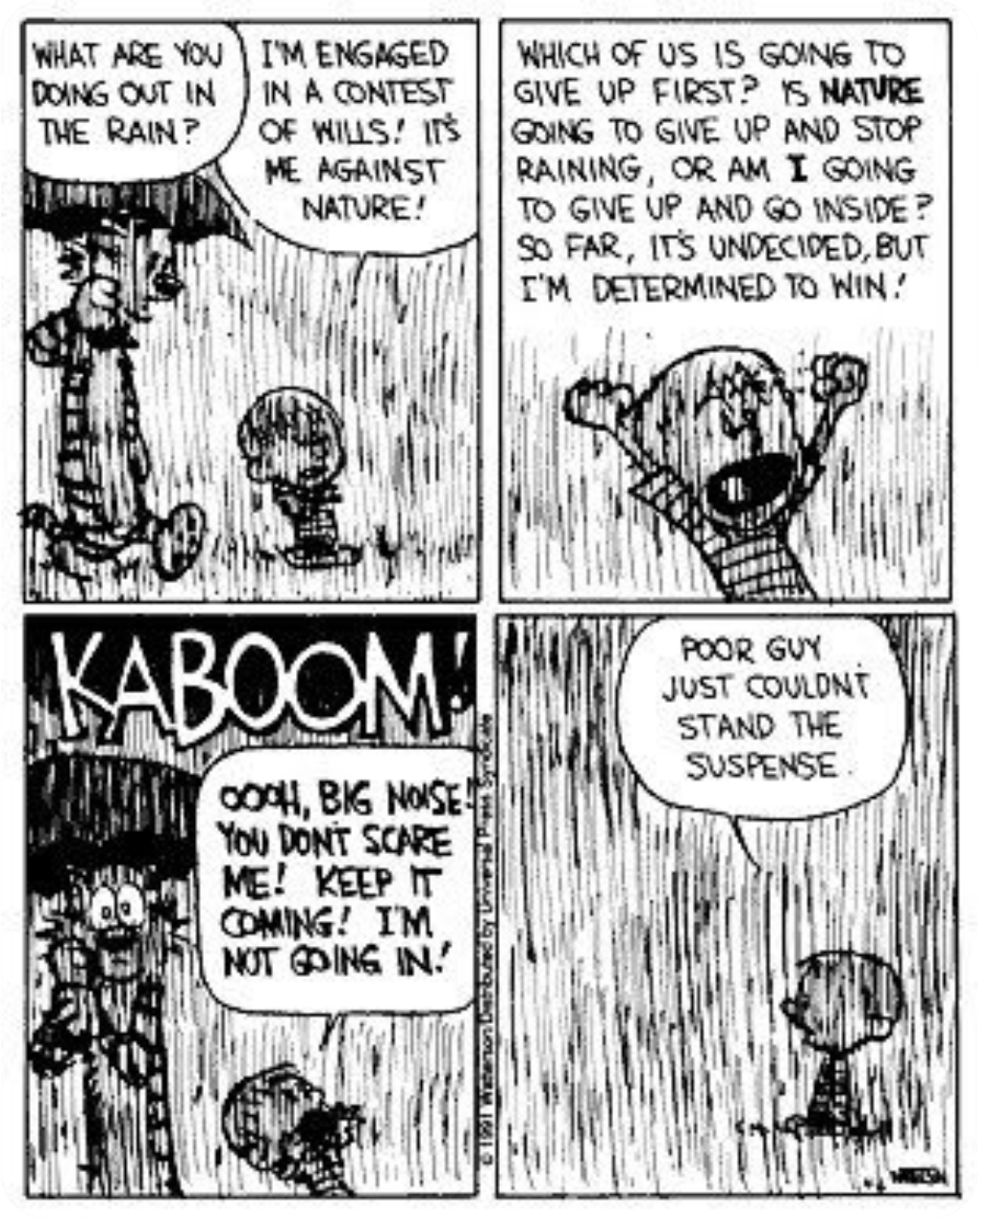
Artemis III Conops
To follow with a weather analogy
If its raining hard, stay inside till it lets up a bit
If the storm is coming, go inside
But still do your work in the rain as best you can

Slide 10
ARD Requirements
NASA EVA suits are being manufactured by Axiom space and Collins Aerospace
There is not an extensive formal requirements set for a radiation monitoring instrument on these suits
The following are requirements developed for the ARD detector, which was developed in house for the earlier NASA designed EVA suit

Slide 11
ARD Requirements - Measurements
PTRS.FUN.xARD.001 xEMU ARD Detection
The xEMU ARD shall measure and record the absorbed dose as a function of time within +/-10% accuracy that results from protons at 2 g/cm^2 water equivalent shielding
PTRS.FUN.xARD.002 Absorbed Dose Rates
The xEMU ARD shall calculate an average dose rate utilizing the current and previous sensor measurement event times and accumulated dose information.
PTRS.FUN.xARD.005 Radiation Exposure, Absorbed Dose Rates
The xEMU ARD shall meet its functional and performance requirements under exposure of dose rates from 1 μGy/min to 5 mGy/min of reference radiation.
Is 1 uGy/min a reasonable lower bound – likely in actuality this is much higher if the goal is to return crew to shelter expeditiously to avoid 10 mGy dose ..

Slide 12
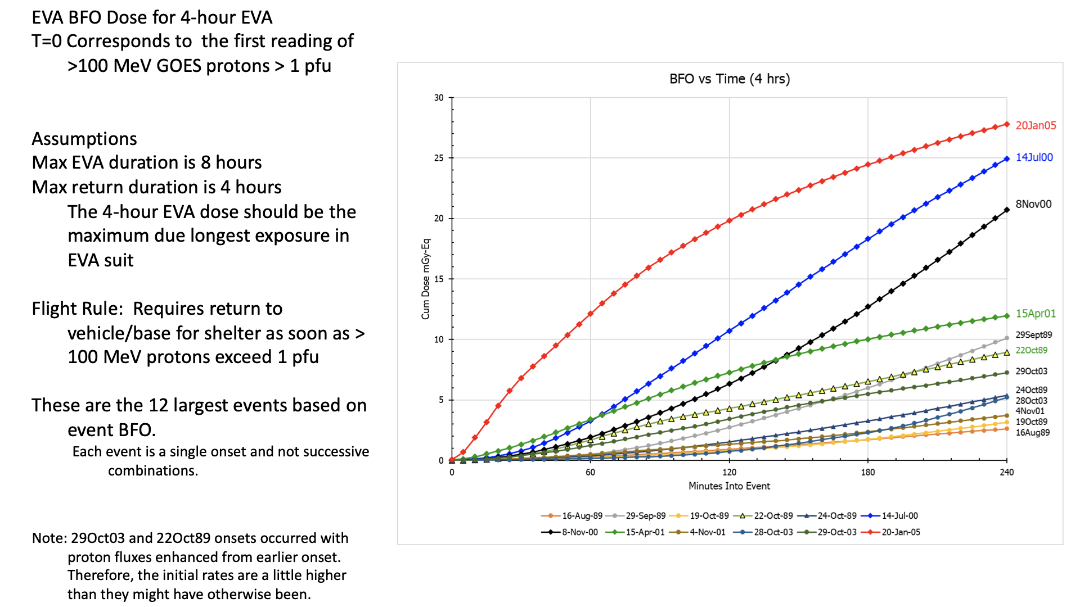

Slide 13
ARD Requirements - Measurements
PTRS.FUN.xARD.007 Time Resolution
The xEMU ARD shall measure the absorbed dose accumulated in consecutive Ground Configurable time intervals of one minute.
PTRS.FUN.xARD.008 Absorbed Dose Resolution
The xEMU ARD shall measure the absorbed dose in increments not exceeding 1 μGy.
PTRS.FUN.xARD.009 Absorbed Dose Calibration
The xEMU ARD shall be delivered calibrated to measure the dose deposited in silicon

Slide 14
ARD Requirements Physical
PTRS.PHY.xARD.001 Weight
The xEMU ARD shall have a maximum weight of 430 g (0.9 lbs) pounds.
PTRS.PHY.xARD.002 Exterior Dimensions
The xEMU ARD exterior dimensions shall be less than 7 cm x 6 cm x 3 cm.
PTRS.PHY.xARD.003 Exterior Cover
The xEMU ARD shall include an aluminum enclosure.
PTRS.ENV.xARD.001 Operational Thermal Environments
The xEMU ARD shall meet its functional and performance requirements during exposure to a
thermal environment between -30C and 40C.
Weight and dimensions based on original ARD system

Slide 15
ARD Requirements Operational
PTRS.LIFE.xARD.002 Calibration Stability
Response to charged particle radiation shall remain constant to within +/- 10% throughout its
service life.
PTRS.LIFE.xARD.004 Operational Life
The xEMU ARD shall be certified for an operational life of 624 hours.
PTRS.LIFE.xARD.005 Service Life
The xEMU ARD shall have a service life of at least 6 years.
PTRS.VINT.xARD.003 Power Consumption
The xEMU ARD power consumption shall be limited to the following:
- 750 mW active power consumption at 4% duty cycle
- 250 mW quiescent power consumption at 96% duty cycle
= 270 mW

