Slide 1
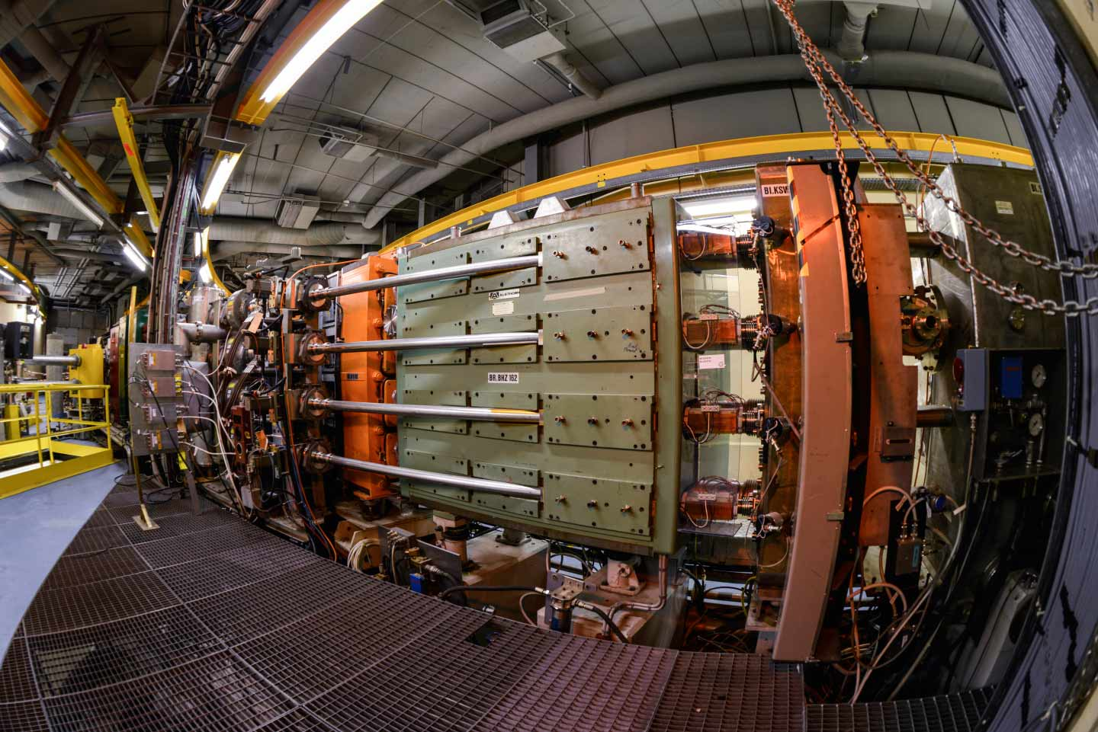
Training possibilities at the PSB
F. Asvesta, H. Bartosik, T. Prebibaj
26/09/2023
EURO-LABS Training Sessions @ CERN Facilities

Slide 2
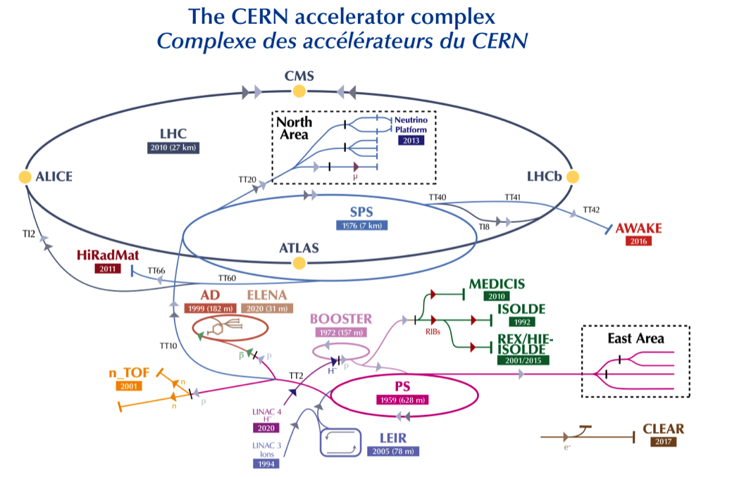
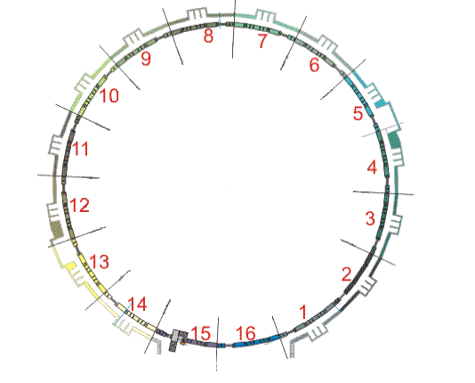
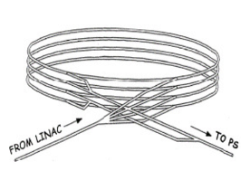
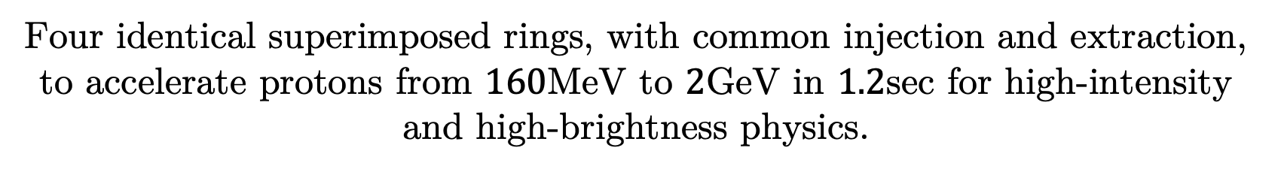
PSB overview
Four identical superimposed rings, with common injection and extraction, to accelerate protons from $160$MeV to $2$GeV in $1.2$sec for high-intensity and high-brightness physics.

Slide 3
PSB overview
Covers wide range of beam parameters (intensities, emittances, etc.).
Variety of available instrumentation.
Good machine availability (training can run in parallel with normal operation).
Safe for the equipment (with only a few constraints).

Slide 4
Past trainings in the PSB
2 sessions of ~4h for newcomers (students, fellows) in 2022-2023.
Groups of 4-6 people per session.
Three main subjects:
    MD arangement
          Cycle preparation
          MD request
          Collaboration with operators
    Accelerator control systems
          Controls framework
          Scripting MDs with python
    Beam dynamics measurements
          Beam adjustments (intensity, tune, emittance, energy spread etc.)
          Beam measurement (orbit, tune, chromaticity, profiles etc.)
          More advanced topics (resonance/beta-beating compensation, instabilites etc.)

