Slide 1

THE EUROPEAN PHYSICAL SOCIETY
IS GLAD TO WELCOME YOU AT
THE SECOND EPS FORUM
Luc Bergé, EPS President

Slide 2
Welcome by:
Piet Brouwer, Dean of FUB Faculty of Physics
Klaus Richter, President of German Physical Society
Ralf Metzler, Board Member of Berlin Physical Society

Slide 3

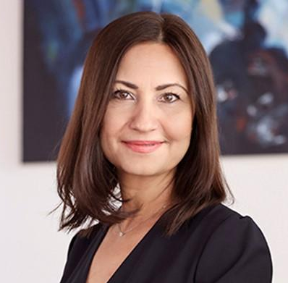
ILIANA IVANOVA,
European Commissioner
for Innovation, Research, Culture,
Education and Youth

Slide 4
WHY AN EPS FORUM?
HOW DOES IT WORK?
Luc Bergé, EPS President

Slide 5
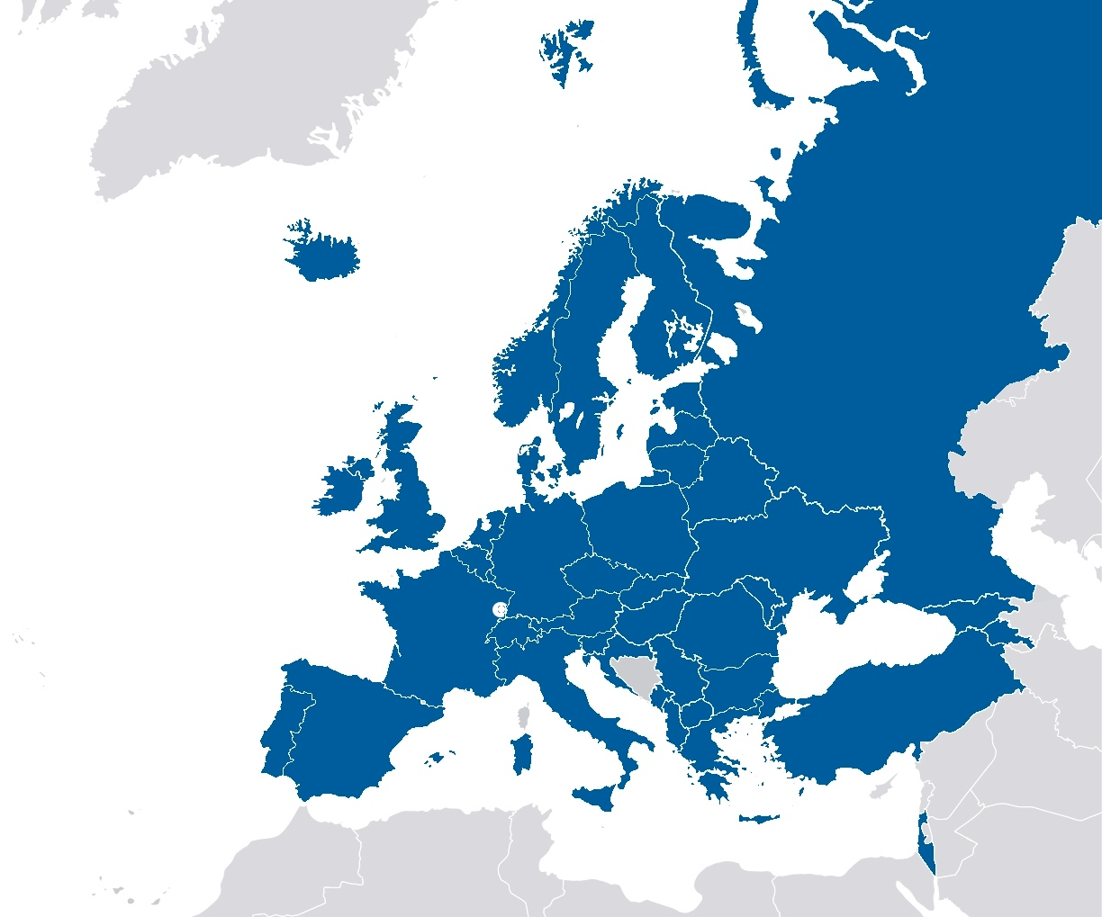
The European Physical Society (EPS)
Headquarters in Mulhouse, France
Office in Brussels,
Belgium
42 Member Societies
3500 Individual Members
  40 Associated Members
  30 Collaborating societies
Representing
130,000 European Physicists

Slide 6
Facilitating physics research
11 scientific divisions
7 Interdisciplinary thematic groups
Conferences, grants
Scientific journals
EPL, EJP, EPN
Prizes and Awards
& addressing societal challenges
  Forum Physics and Society
  Physics Education
Equal Opportunities
European Integration
EPS Historic Sites
  Physics for Development

Slide 7
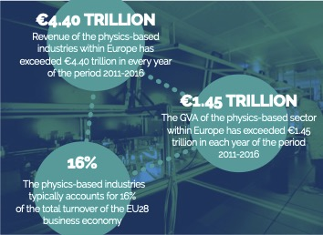

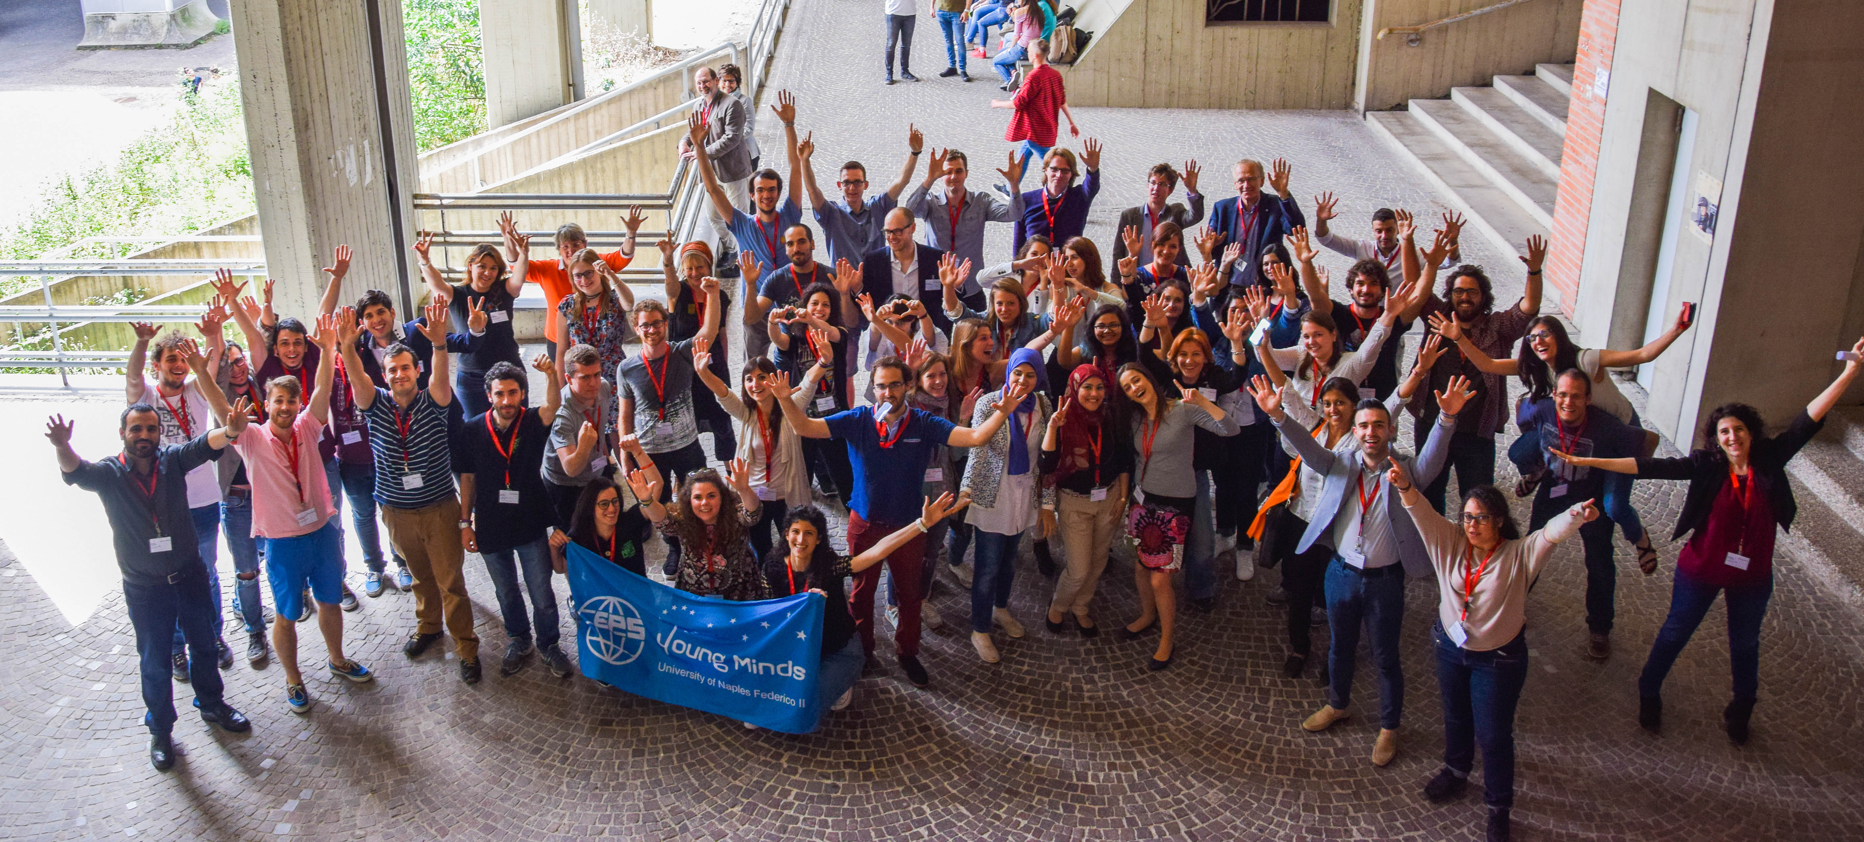
Contributing to the public debate
& supporting the young generation
Young Minds:
73 local sections in 33 countries
The Importance of Physics
to the Economies of Europe

Slide 8
| The Young Minds Network (2023)
73 Sections in 33 countries
divided in 6 zones for communications
Zone 1
Zone 2
Zone 3
Zone 4
Zone 5
Zone 6

Slide 9
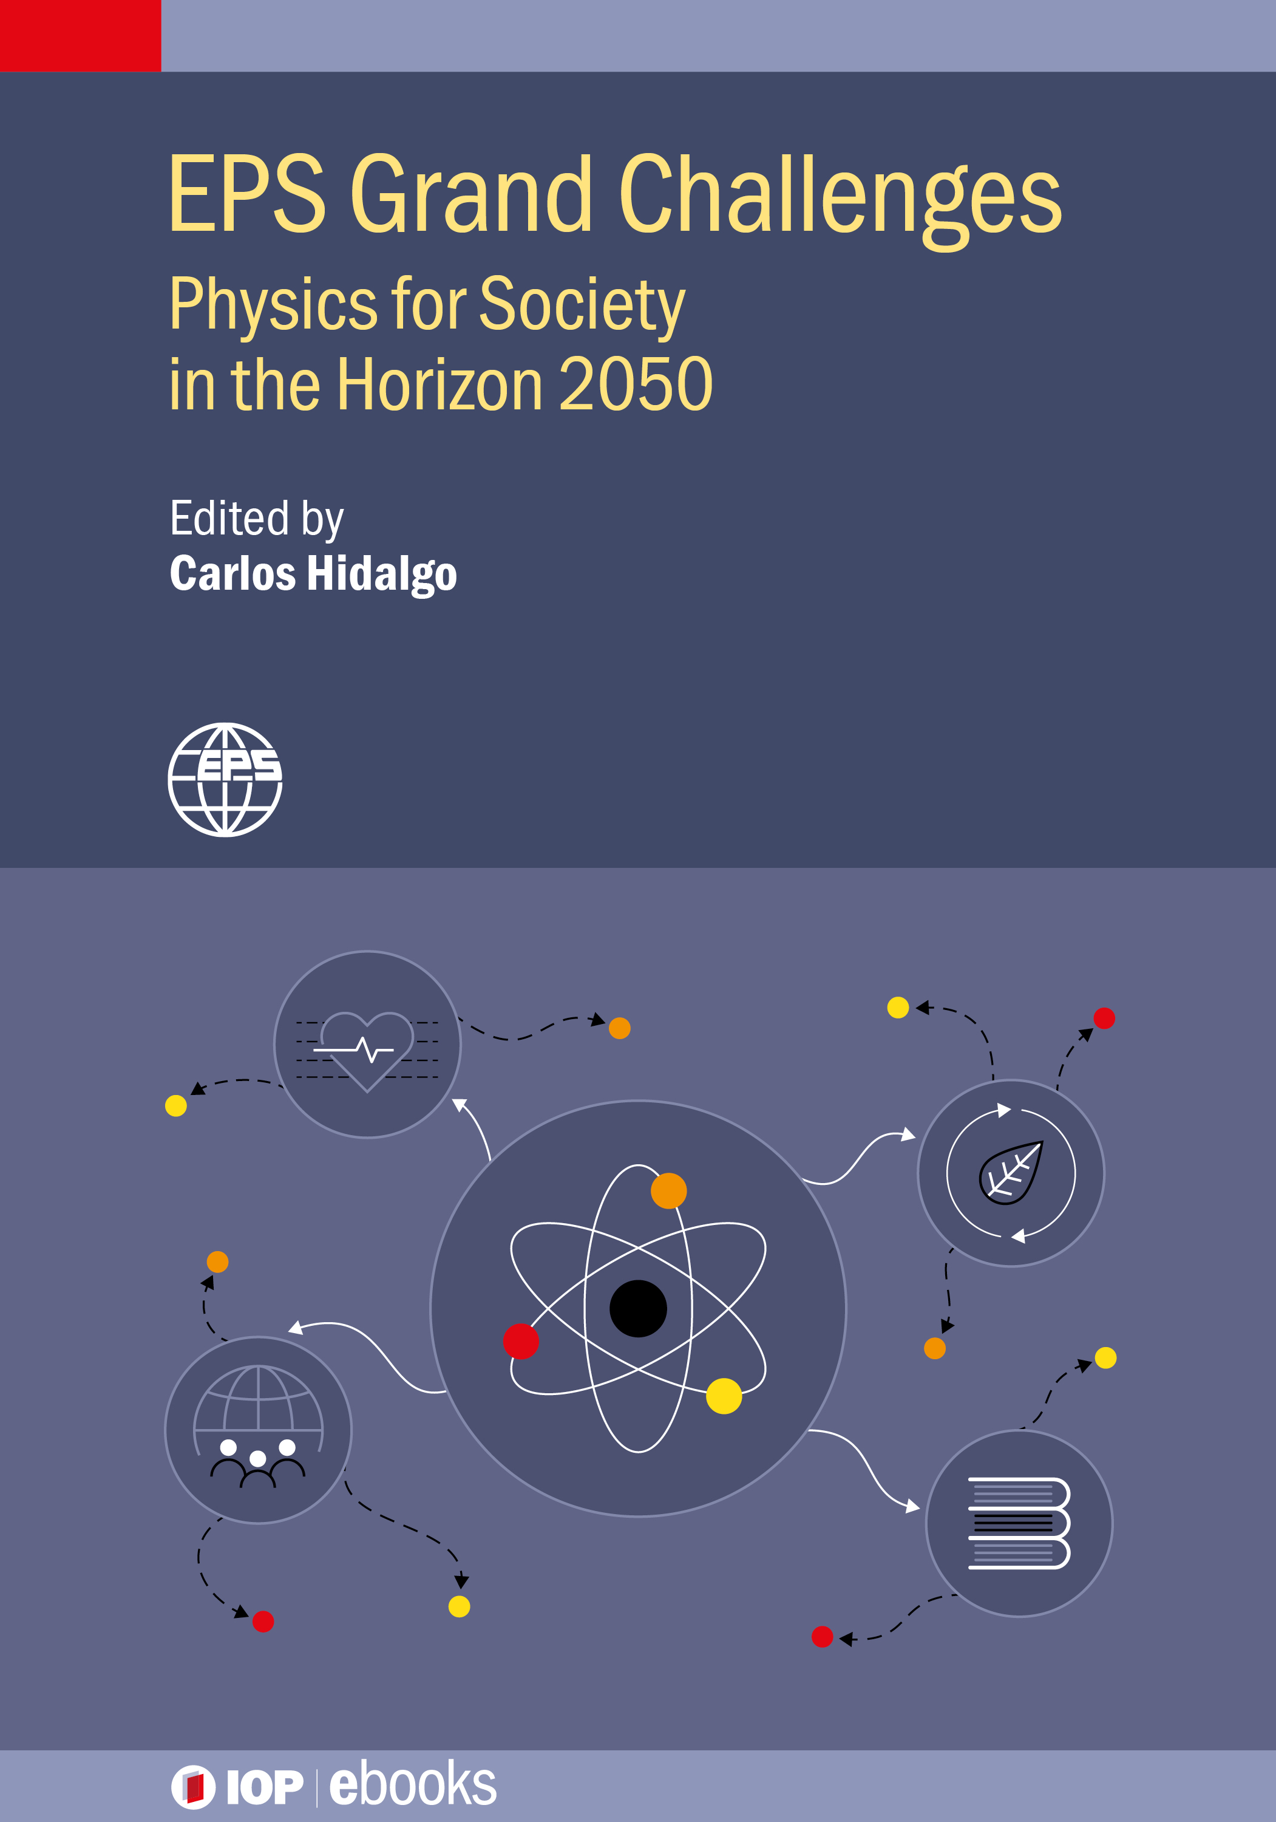
Download today
What are the biggest challenges facing society in the coming decades and how can physics address them?
This new open access ebook from the European Physical Society looks at how physics can tackle the major issues affecting humanity.
An open access book, free to read for all.
Investigates how current trends in science and technology may play out in the coming decades.
Explores how we can imagine and shape the future through science.
Edited by Carlos Hidalgo, director of the National Fusion Lab at CIEMAT.

Slide 10
WHY AN EPS FORUM?

Slide 11
A collective achievement:
The EPS joins forces
with its Member Societies,
Divisions and Groups, and
Associate Members
- Bring together master, PhD students, postdocs in physics & representatives of the industry
Day 1:
Physics Meets Industry
Day 2:
Scientific Colloquium & Societal Challenges
- Provide a FORUM to address advancement in physics research and related societal issues
Day 3:
The EPS Council
- Provide a FORUM for EPS Members

Slide 12
WHAT SCIENTIFIC TOPICS?
1/ Atomic, molecular and optical physics for quantum technologies
2/ Applications of nuclear and particle physics to society
3/ Condensed matter and applications to industry
4/ Energy management, pollution and climate;
Artificial intelligence, brain inspired processing systems and applications
5/ Photonics
# PARTICIPANTS = 400
# STUDENTS = 213 (> 74% non-EPS members)
# COUNTRIES = 34

Slide 13
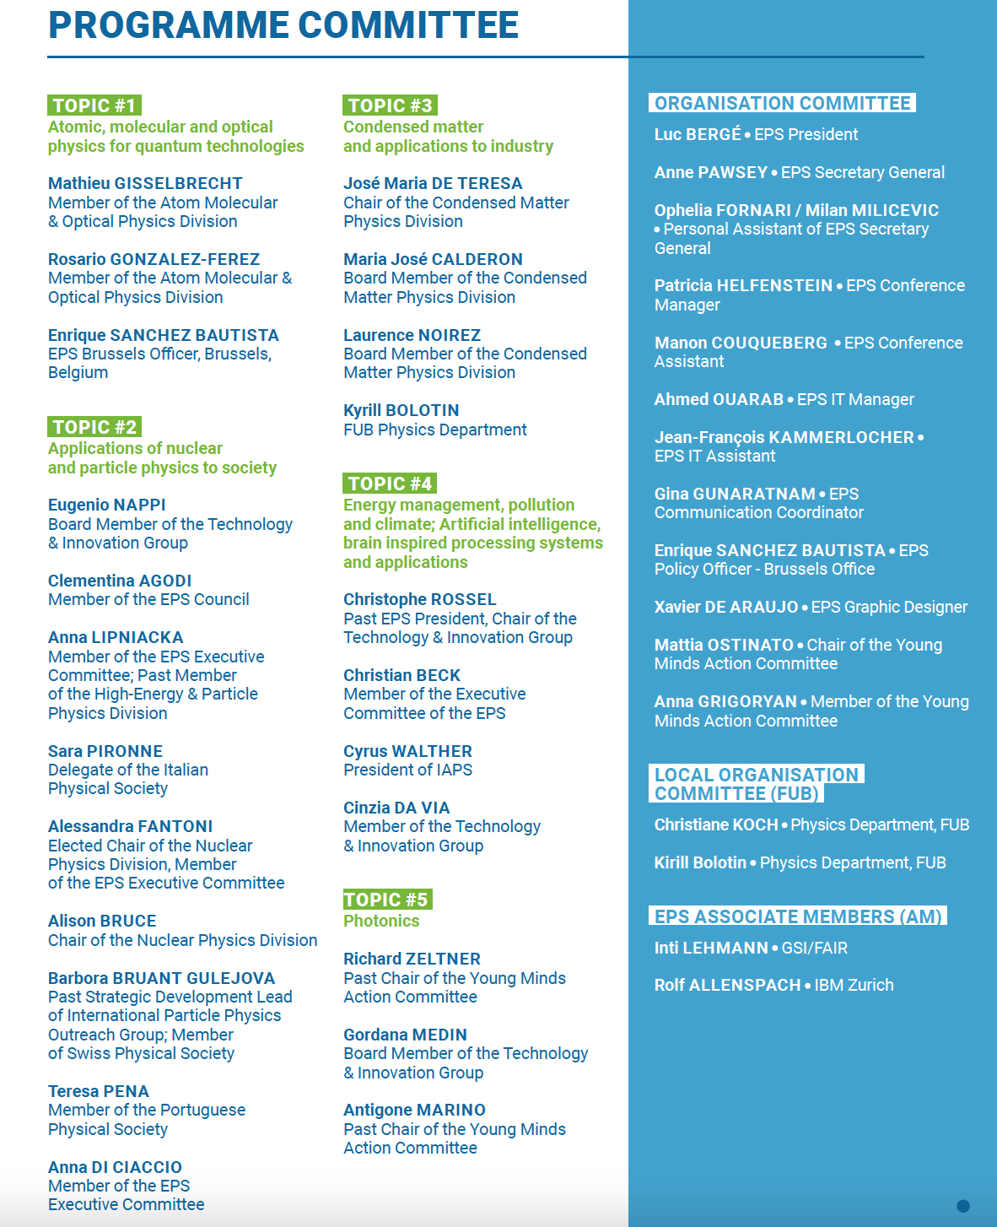
THE PROGRAMME & ORGANISATION COMMITTEES
(> 40 physicists incl. Secretariat staff members)

Slide 14
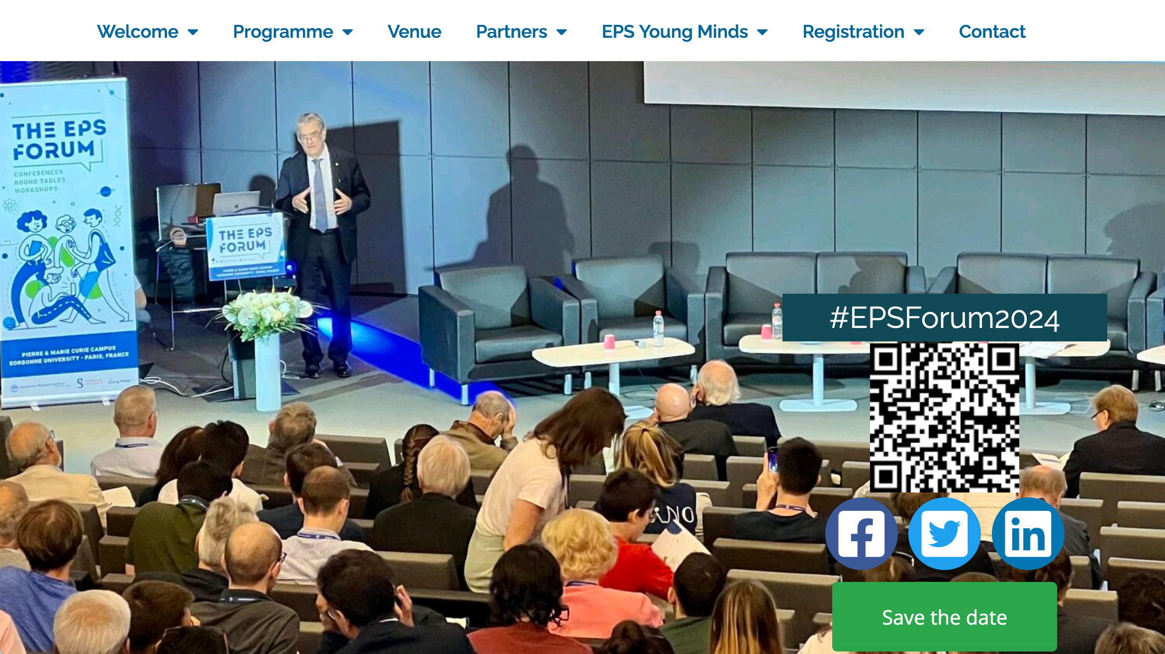
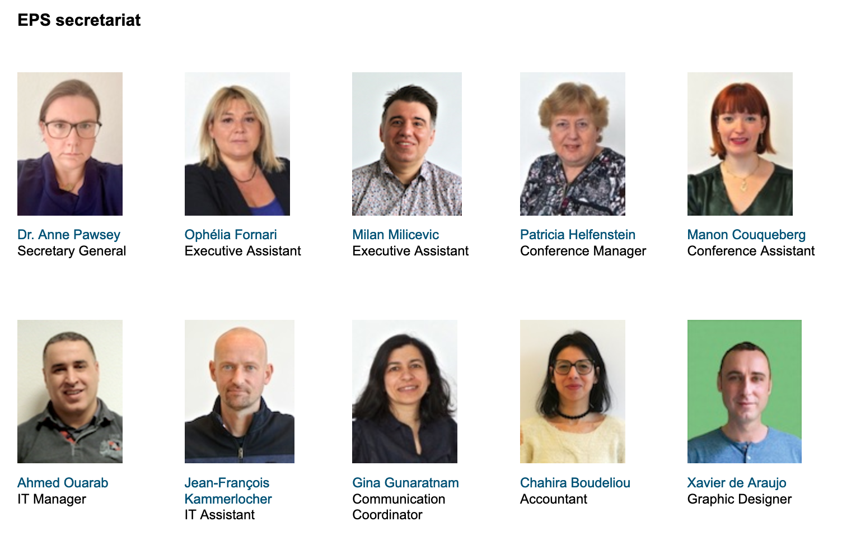
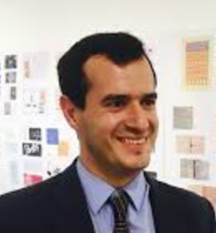
THE EPS SECRETARIAT
Enrique Sanchez
Policy Officer Brussels

Slide 15


THE EPS SUPPORTS STUDENTS WITH 100 BEDS & MEALS, HELP FOR TRAVEL (+ support to « Ukrainian helpers »)
EPS Young Minds
International Association of Physics Students (IAPS)
THANKS ALSO TO OUR STUDENT HELPERS!

Slide 16


THANKS TO OUR SPONSORS & EXHIBITORS

Slide 17
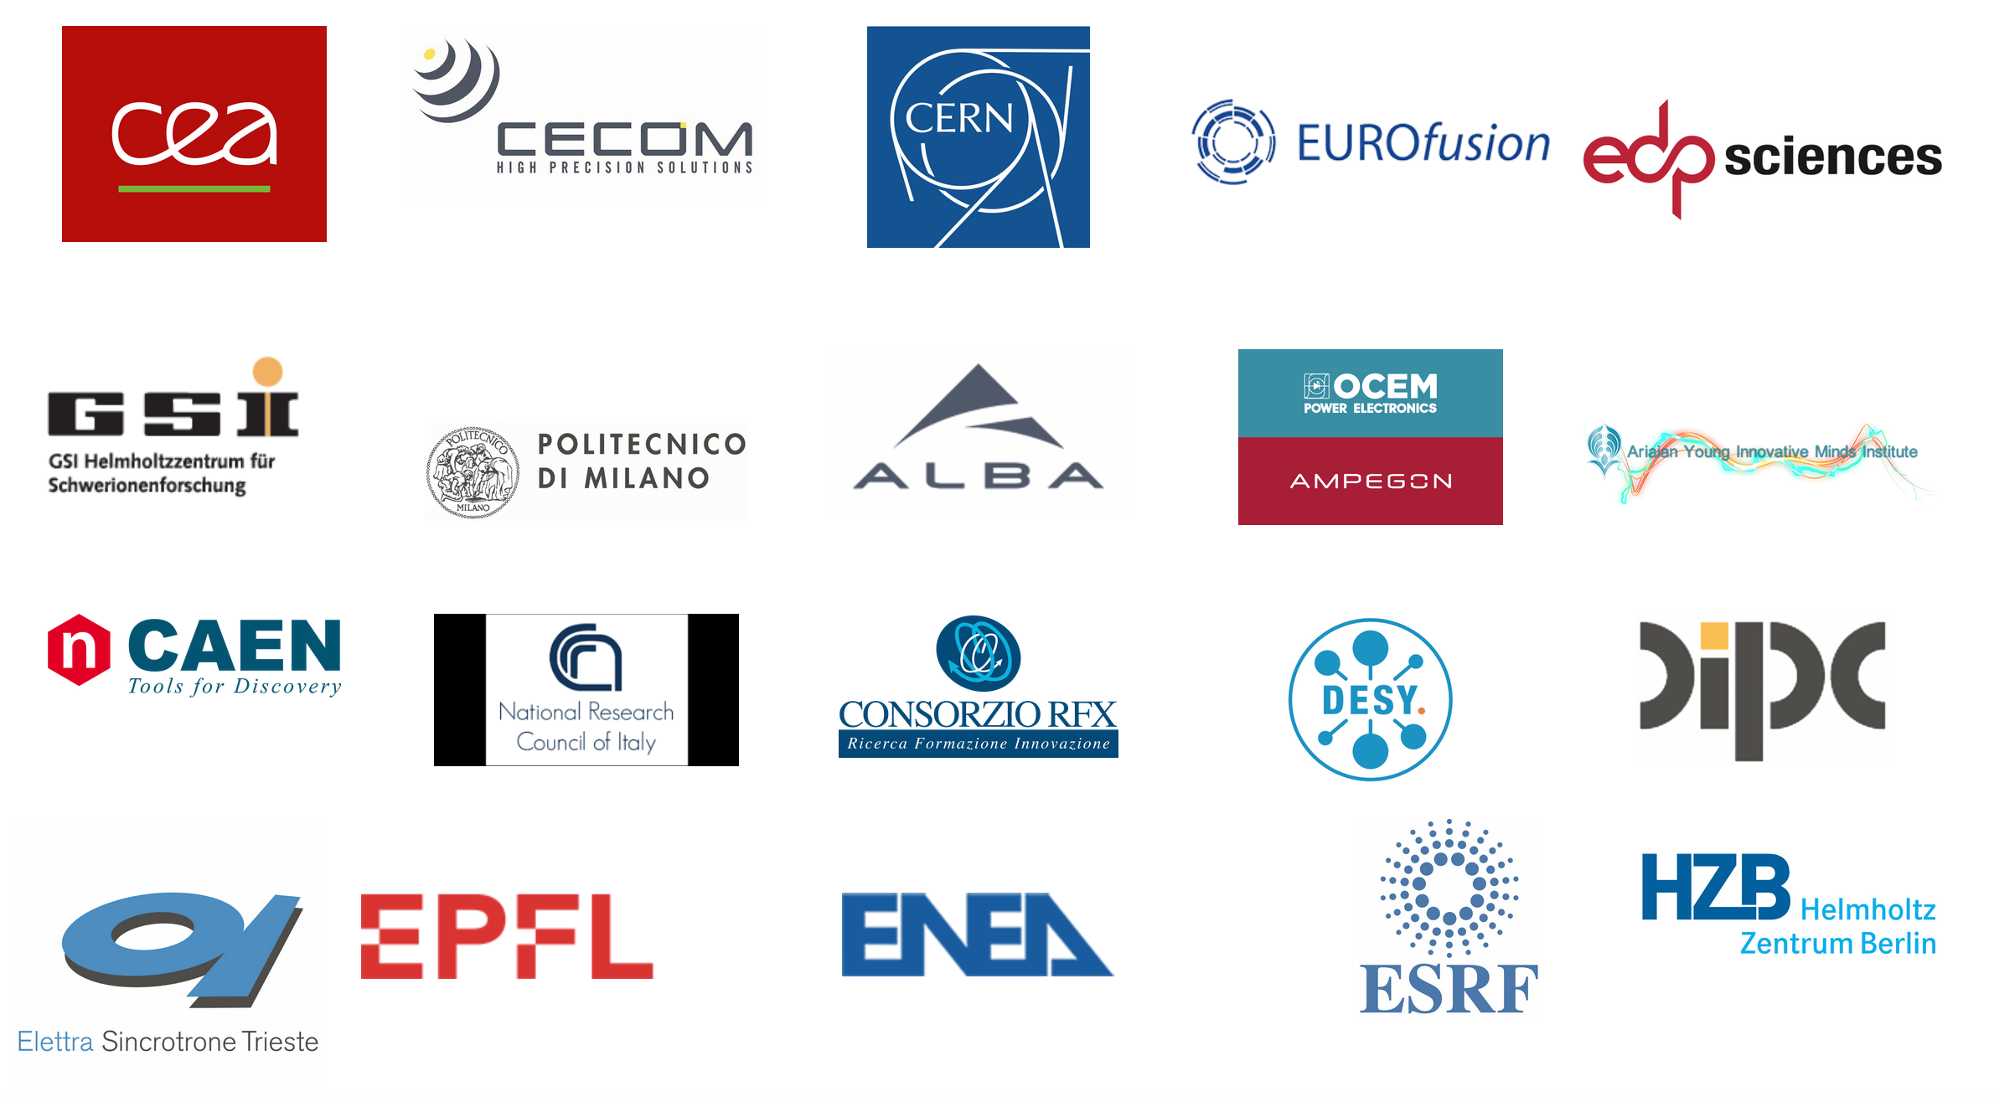

THANKS TO OUR ASSOCIATE MEMBERS

Slide 18
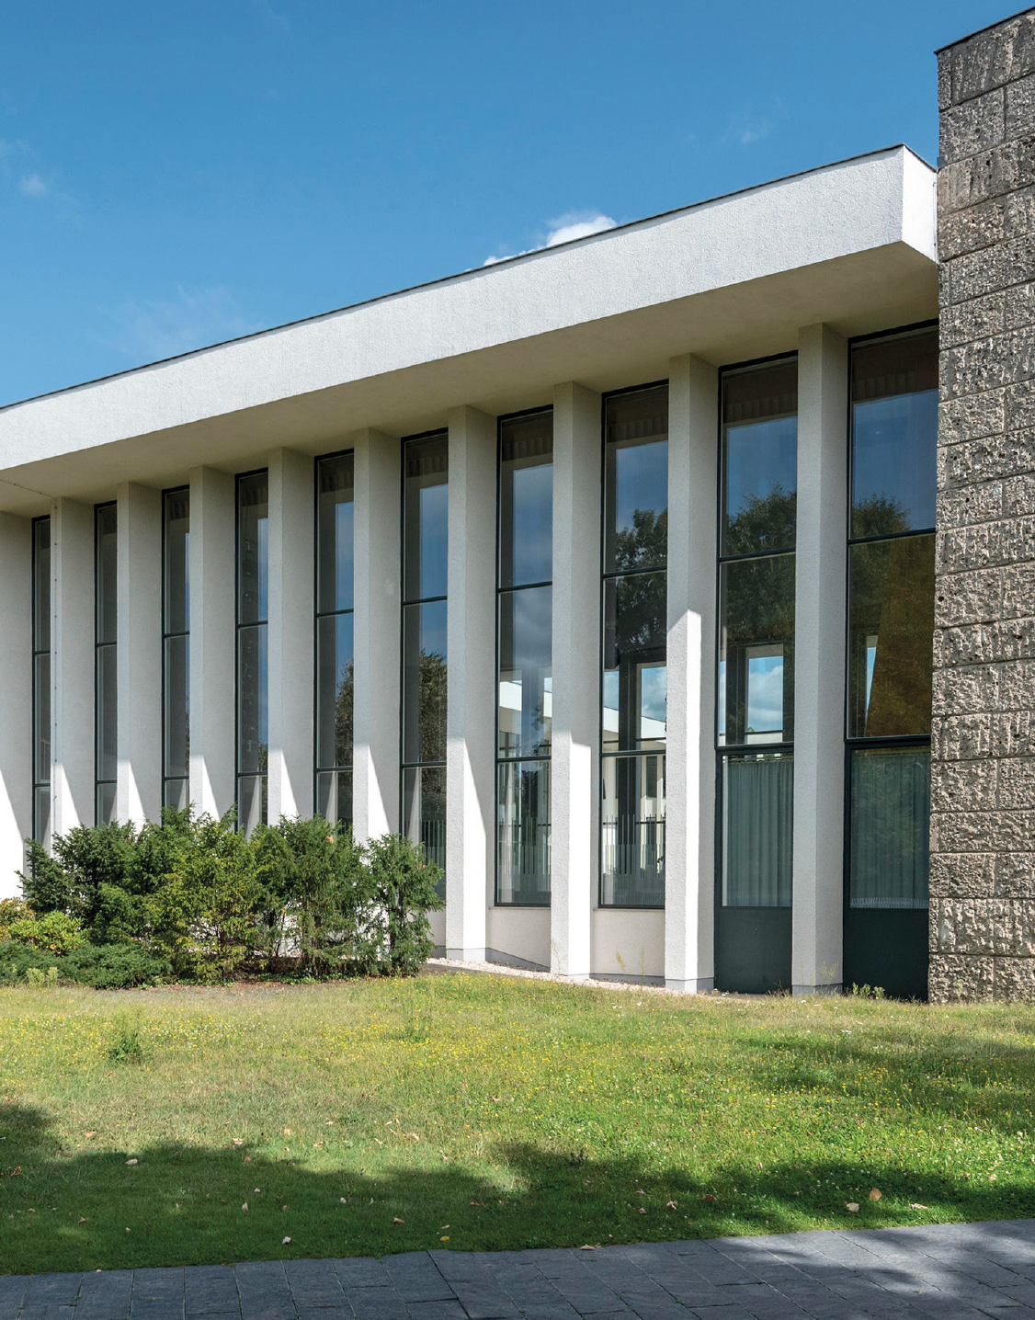
HOW DOES
THE FORUM
WORK?

Slide 19
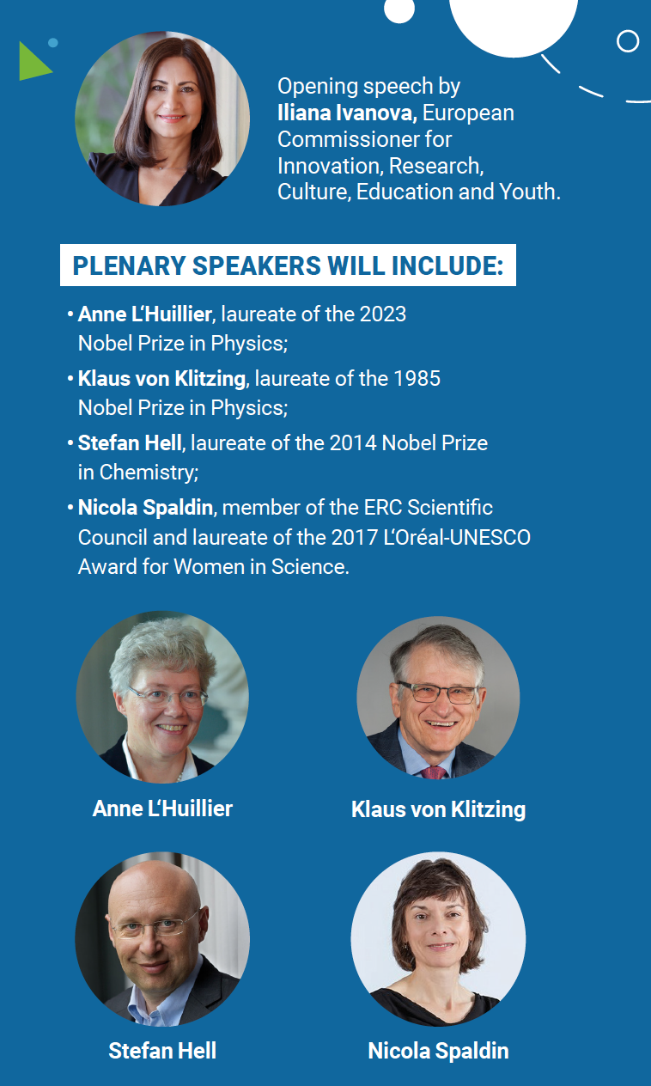
Two plenary sessions
DAY1 & DAY 2: 8h30/12h30
Parallel sessions
14h00/18h30-19h00
1/ Topical plenary sessions
2/ Scientific parallel sessions
3/ Round Tables
4/ Networking session (Day 1 at 17h30)
5/ Young Minds Leadership Meeting

Slide 20
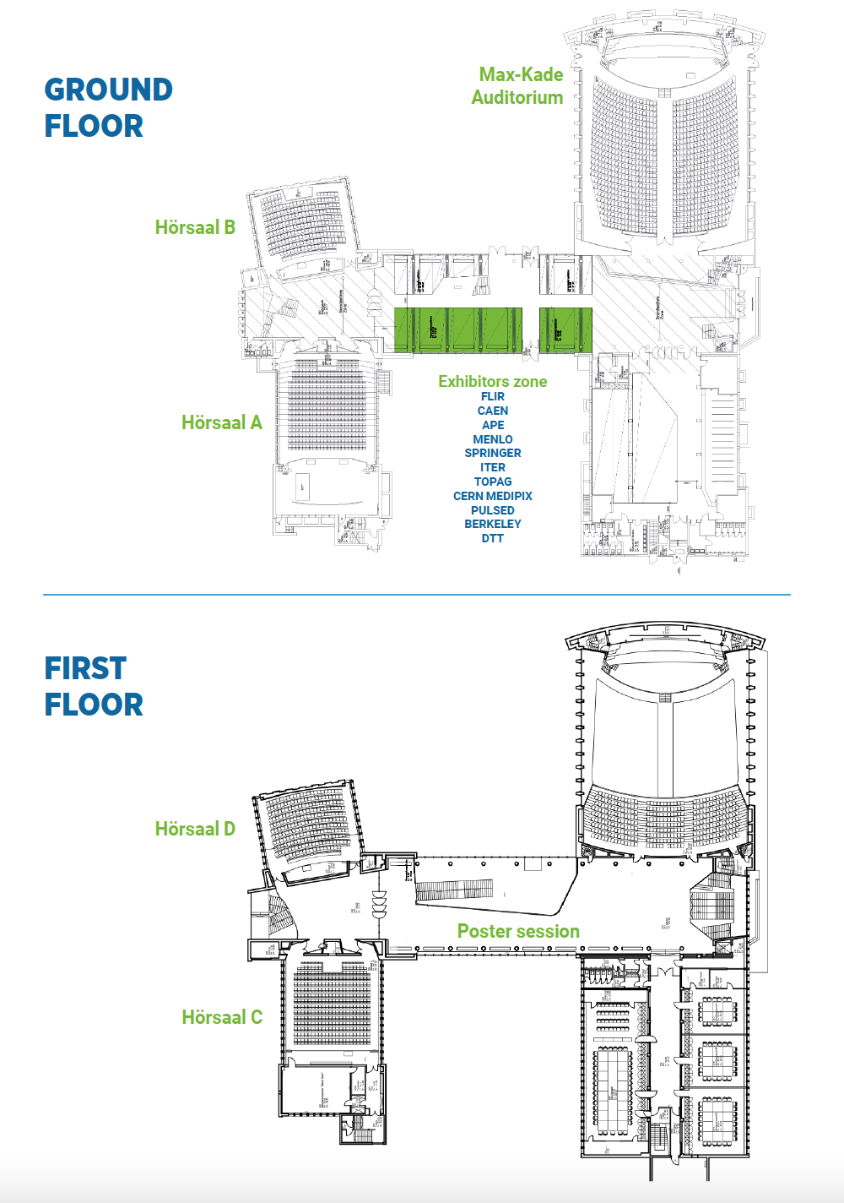
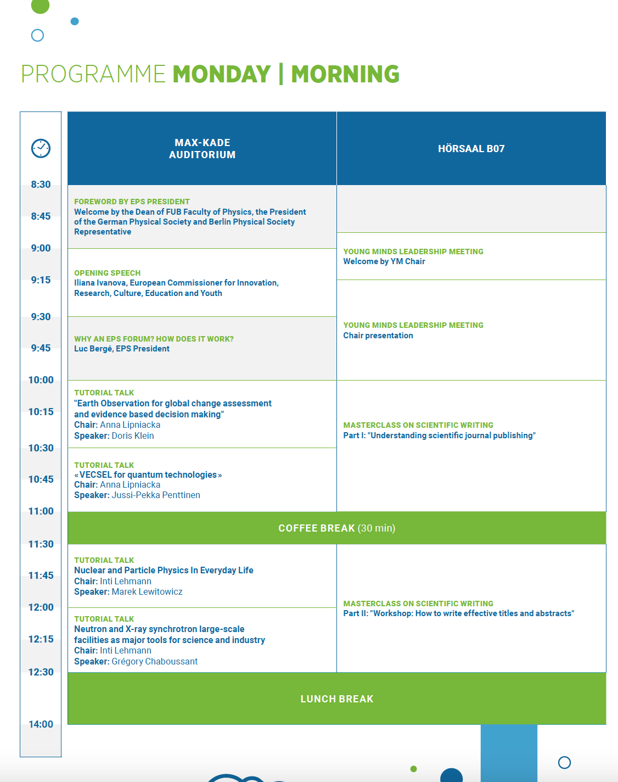
HAVE A LOOK AT THE PROGRAMME
AT THE MAP TOO …
YM Leadership Meeting

Slide 21
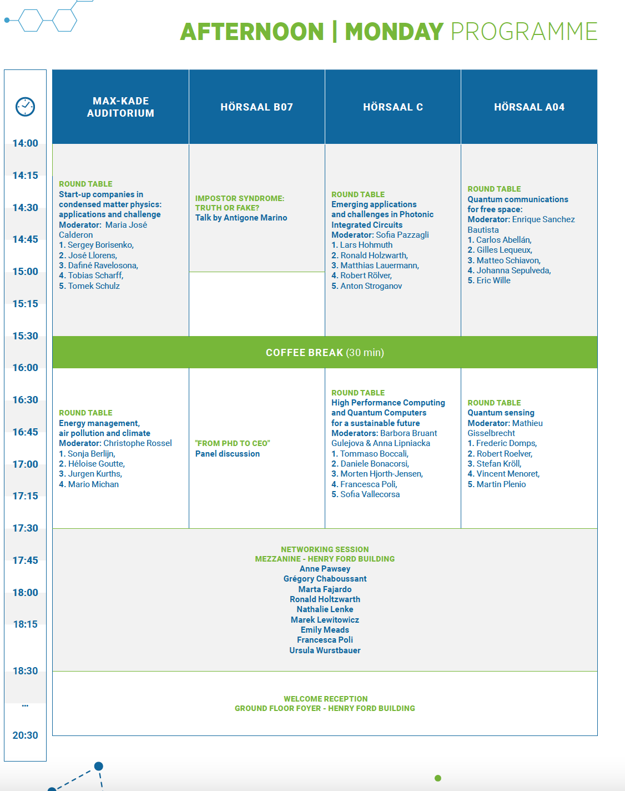
Several transversal events:
YM Leadership Meeting
Networking session
Welcome reception

Slide 22
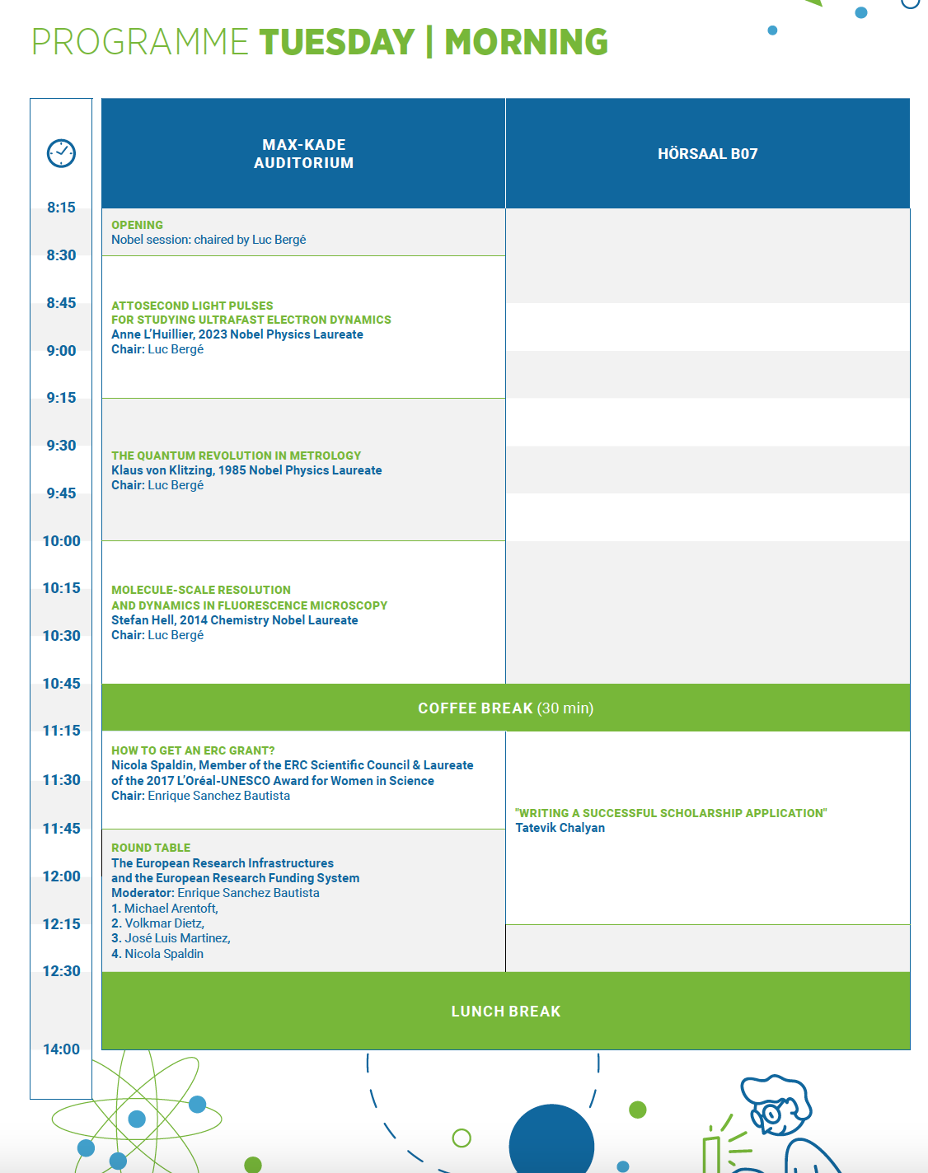
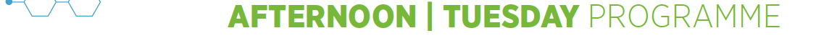
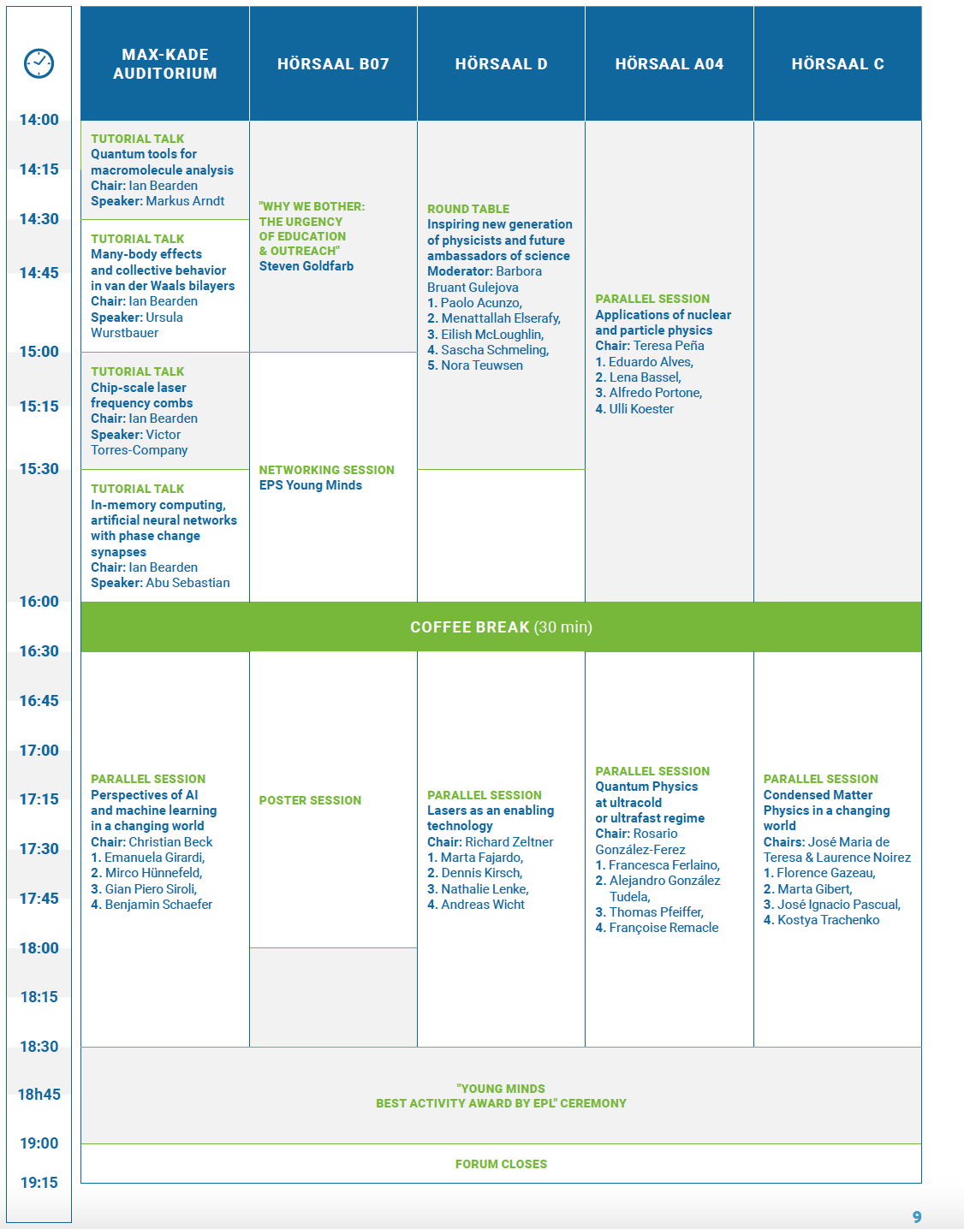
Nobel session
Poster session
ERC Round Table

Slide 23
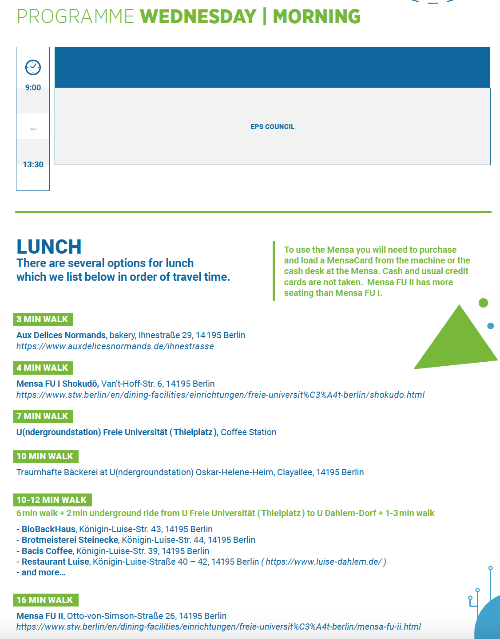
EPS Council
Where to have lunch?

Slide 24
ENJOY THE SECOND EPS FORUM!

