Slide 1


Round Table: Energy management, air pollution and climate
25 March 2024, 16.00- 17.30, Max-Kade Auditorium, Henri Ford Building
Sonja Berlijn, Royal Institute of Technology, Stockholm, Sweden
Héloise Goutte, Direction des Énergies, CEA Saclay, France
Jürgen Kurths, Potsdam Institute for Climate Impact Research (PIK), Potsdam, Germany
Mario Michan, Daphne Technology SA, Saint-Sulpice, Switzerland
Moderator: Christophe Rossel, IBM Research Europe -Zurich, Switzerland
https://epsforum.org/

Slide 2
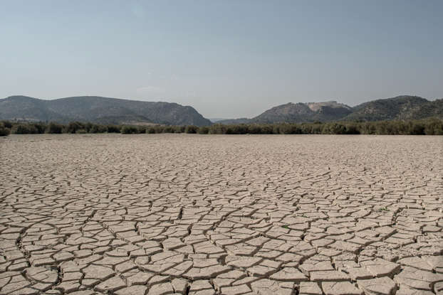
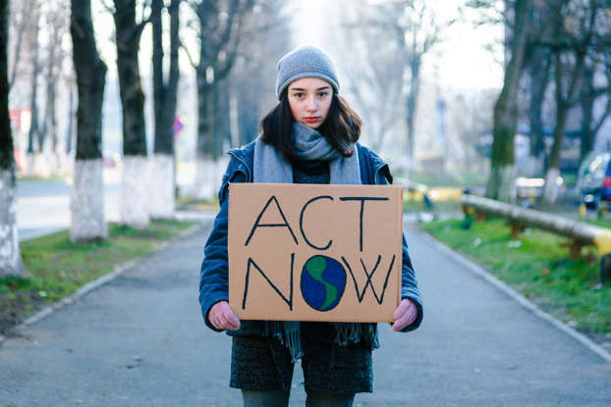
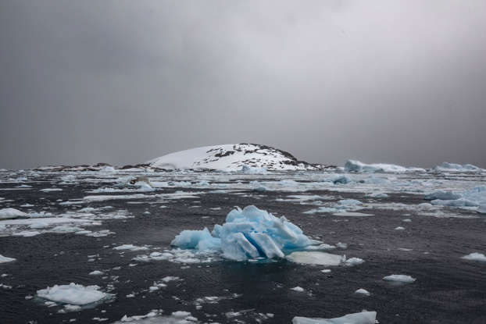
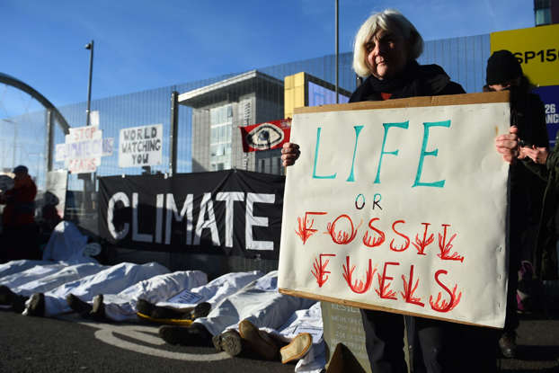
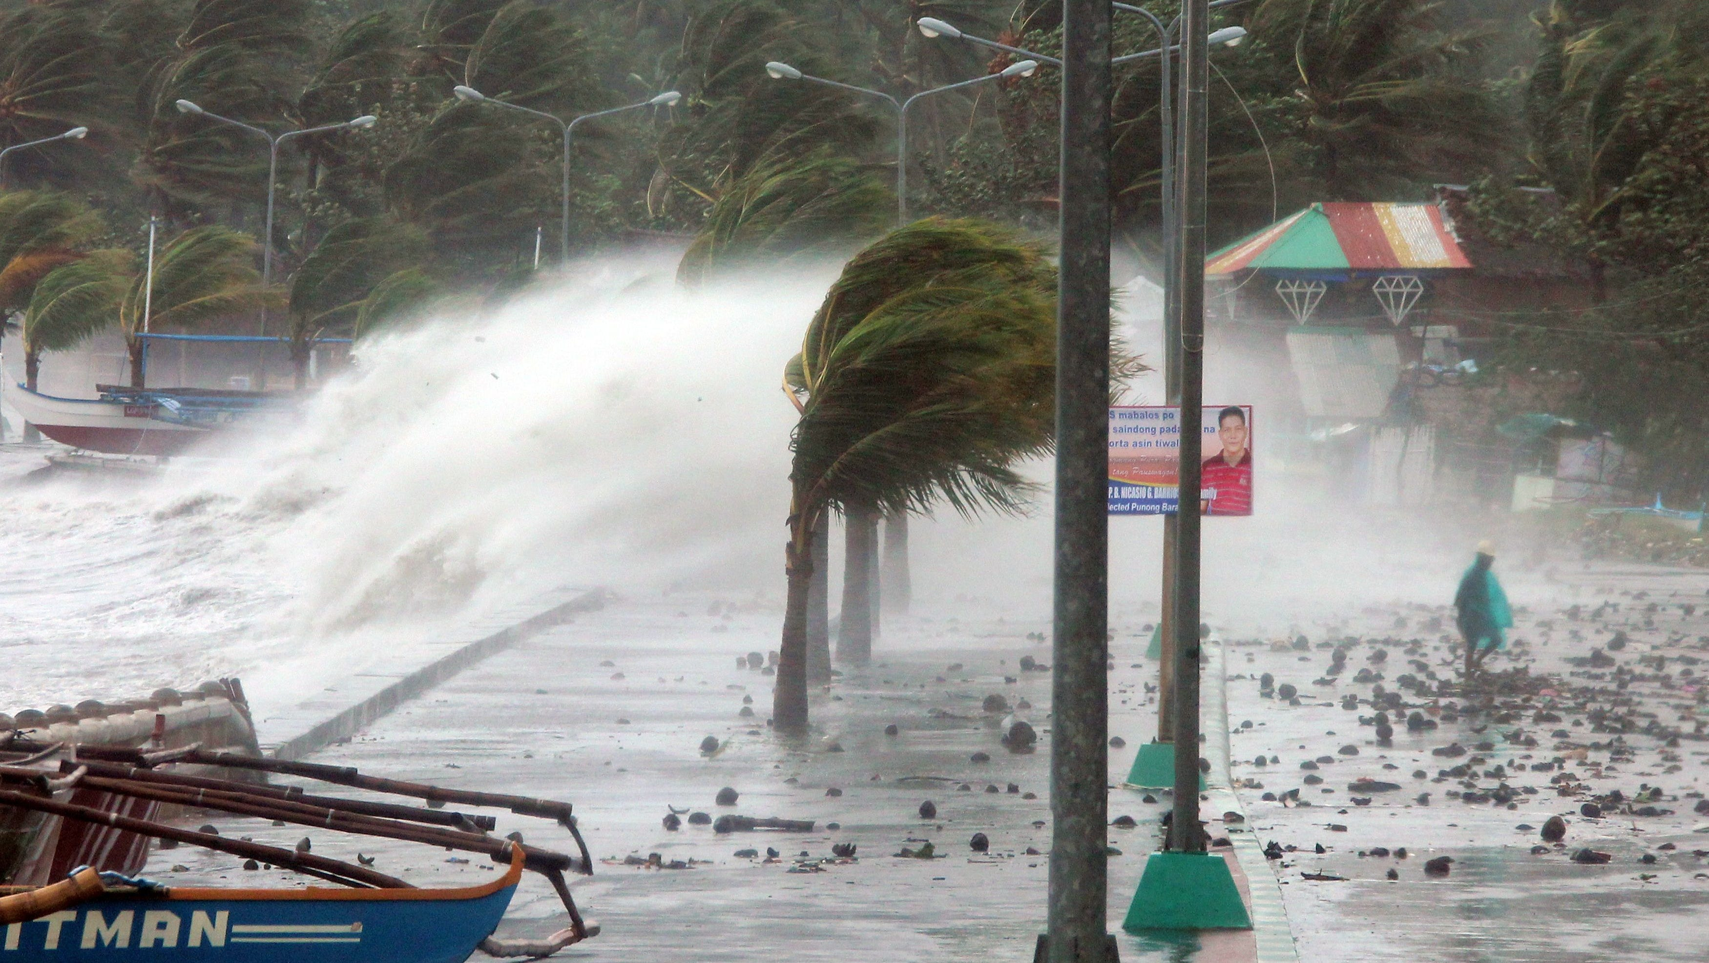
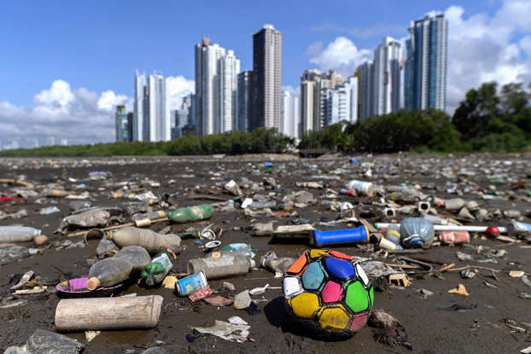
The challenges we are facing: climate change, energy supply, policy issues

Slide 3
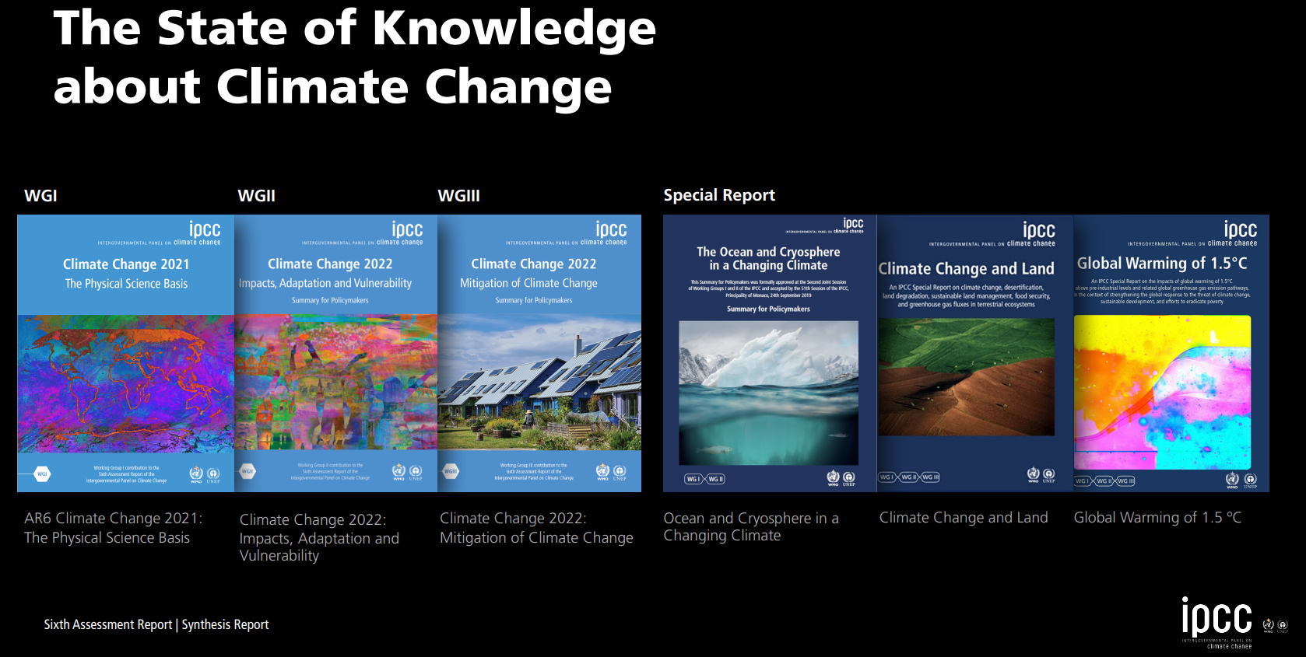
https://www.ipcc.ch/report/sixth-assessment-report-cycle/
Notes:
13-19 March 2023: IPCC synthesis report closes sixth AR6 assessment cycle focuses on impacts climate change. Hence the need to keep the warming ceiling at +1.5°C. Too little has been put in place since the Paris Agreement in 2015 (COP21) and we must now redouble efforts in an increasingly short period of time to maintain the +1.5°C target. "We were able to highlight that in the current situation, 3.3 to 3.6 billion people are in a context that is very vulnerable to climate change and they are fifteen times more likely to die from floods, droughts and storms than those living in less vulnerable areas. The message is: you're not doing enough, but the climate doesn't wait." Carbon removal is necessary to avoid
Limit global warming: reducing emissions is no longer enough. There is more than a 50% chance that the increase will of global temperature reaches or exceeds 1.5°C in this decade or the next.

Slide 4
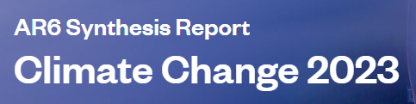
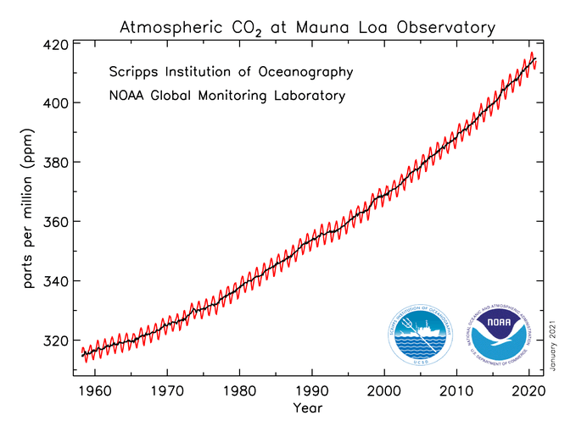
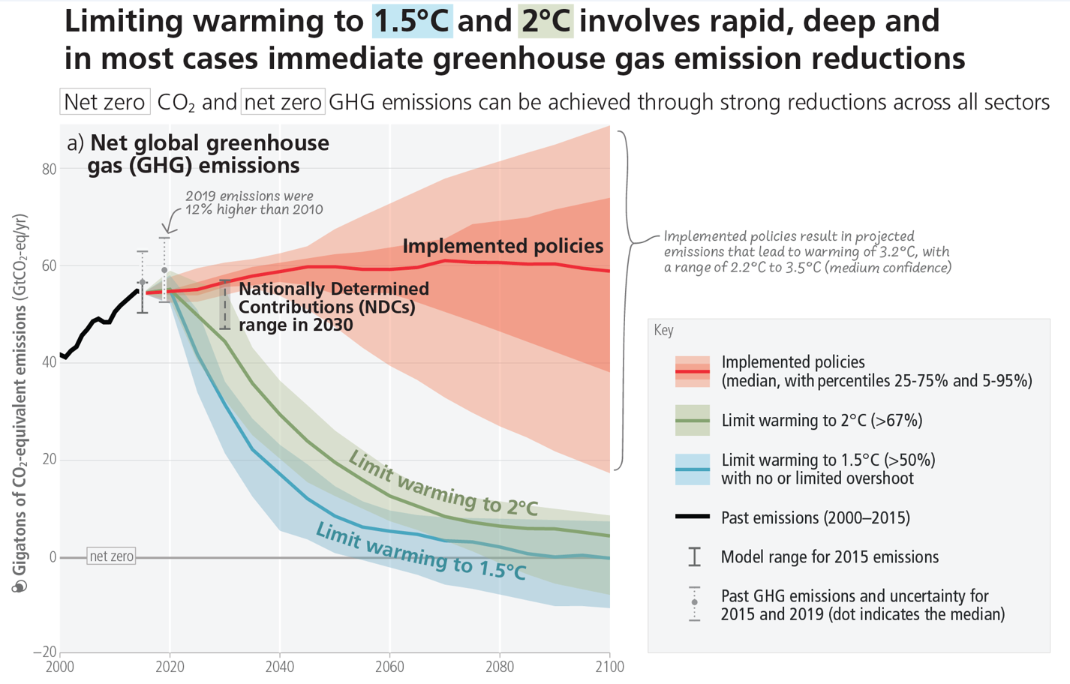
Net Zero GHG emissions by 2050
Source: Dr. Pieter Tans, NOAA/ESRL
(www.esrl.noaa.gov/gmd/ccgg/trends)
CO₂ increase by >51% since 1850,
reaching 424 ppm in 2023 !
2023 was the warmest year since global
records began in 1850 → +1.45°C
or 1.18°C above the 20th-century average of 13.9°C ! (WMO)
AR6 Synthesis Report: Climate Change 2023
Notes:
IPCC SIXTH ASSESSMENT REPORT (AR6)
The concept of net zero GHG emissions was first popularized by the Paris Agreement a landmark deal negotiated at the 2015 United Nations Climate Change Conference (COP21) to limit the impact of greenhouse gas emissions.
To avert the worst impacts of climate change, global temperature increase needs to be capped at 1.5°C (2.7°F) above pre-industrial levels.1 Today, the Earth is already 1.1°C (2°F) warmer than it was in the late 1800s. Meanwhile, global emissions continue to rise and the Earth’s temperature is on track to increase 2.7°C (4.7°F) by the end of this century, according to the UNDP’s Emissions Gap Report 2021
CO2 levels at NOAA's Mauna Loa Reference Atmospheric Observatory in Hawaii reached nearly 424 parts per million (ppm) in May 2023, up from 421 ppm in May 2022.

Slide 5
Global Warming Potential and Atmospheric Lifetime for Major GHG
Gases | Global Warming Potential (GWP), 100-year time horizon | Atmospheric Lifetime (years)
CO₂ | 1 | 100
CH₄ | 25 | 12
N₂O | 265 | 121
CCl₂F₂ (Freon) | 10200 | 100
CHF₃ | 12400 | 222
SF₆ | 23500 | 3200
NF₃ | 16100 | 500
CO₂ contribution of all GHG >50%
Nord Stream leak 2022: 152’500 t
Fifth Assessment Report (IPCC, 2014)
Notes:
Carbon Dioxide, Methane, Nitrous Oxide, Chlorofluorocarbon-12 (CFC-12), Hydrofluorocarbon-23 (HFC-23), Sulfur Hexafluoride, Nitrogen Trifluoride
The "Global Warming Potential" (GWP) of a gas is its ability to keep heat in the atmosphere for a set period of time. CO₂, because it serves as a reference, was given the value of 1. In order to be able to compare the gases with each other, the warming potential of each gas is converted into CO₂ equivalent over a period of one hundred years (reference period used by the IPCC).
https://www.c2es.org/content/main-greenhouse-gases/.
SF₆ is a synthetic, odourless gas that's used in the electricity industry to keep networks running safely and reliably. It's highly stable, non-toxic, non-flammable and electronegative
NF3 is used in a relatively small number of industrial processes. It is primarily produced in the manufacture of semiconductors and LCD (Liquid Crystal Display) panels, and certain types of solar panels and chemical lasers
CHF3 is used in the semiconductor industry in plasma etching of silicon oxide and silicon nitride. Known as R-23 or HFC-23, it was also a useful refrigerant, sometimes as a replacement for chlorotrifluoromethane (CFC-13) and is a byproduct of its manufacture.

Slide 6
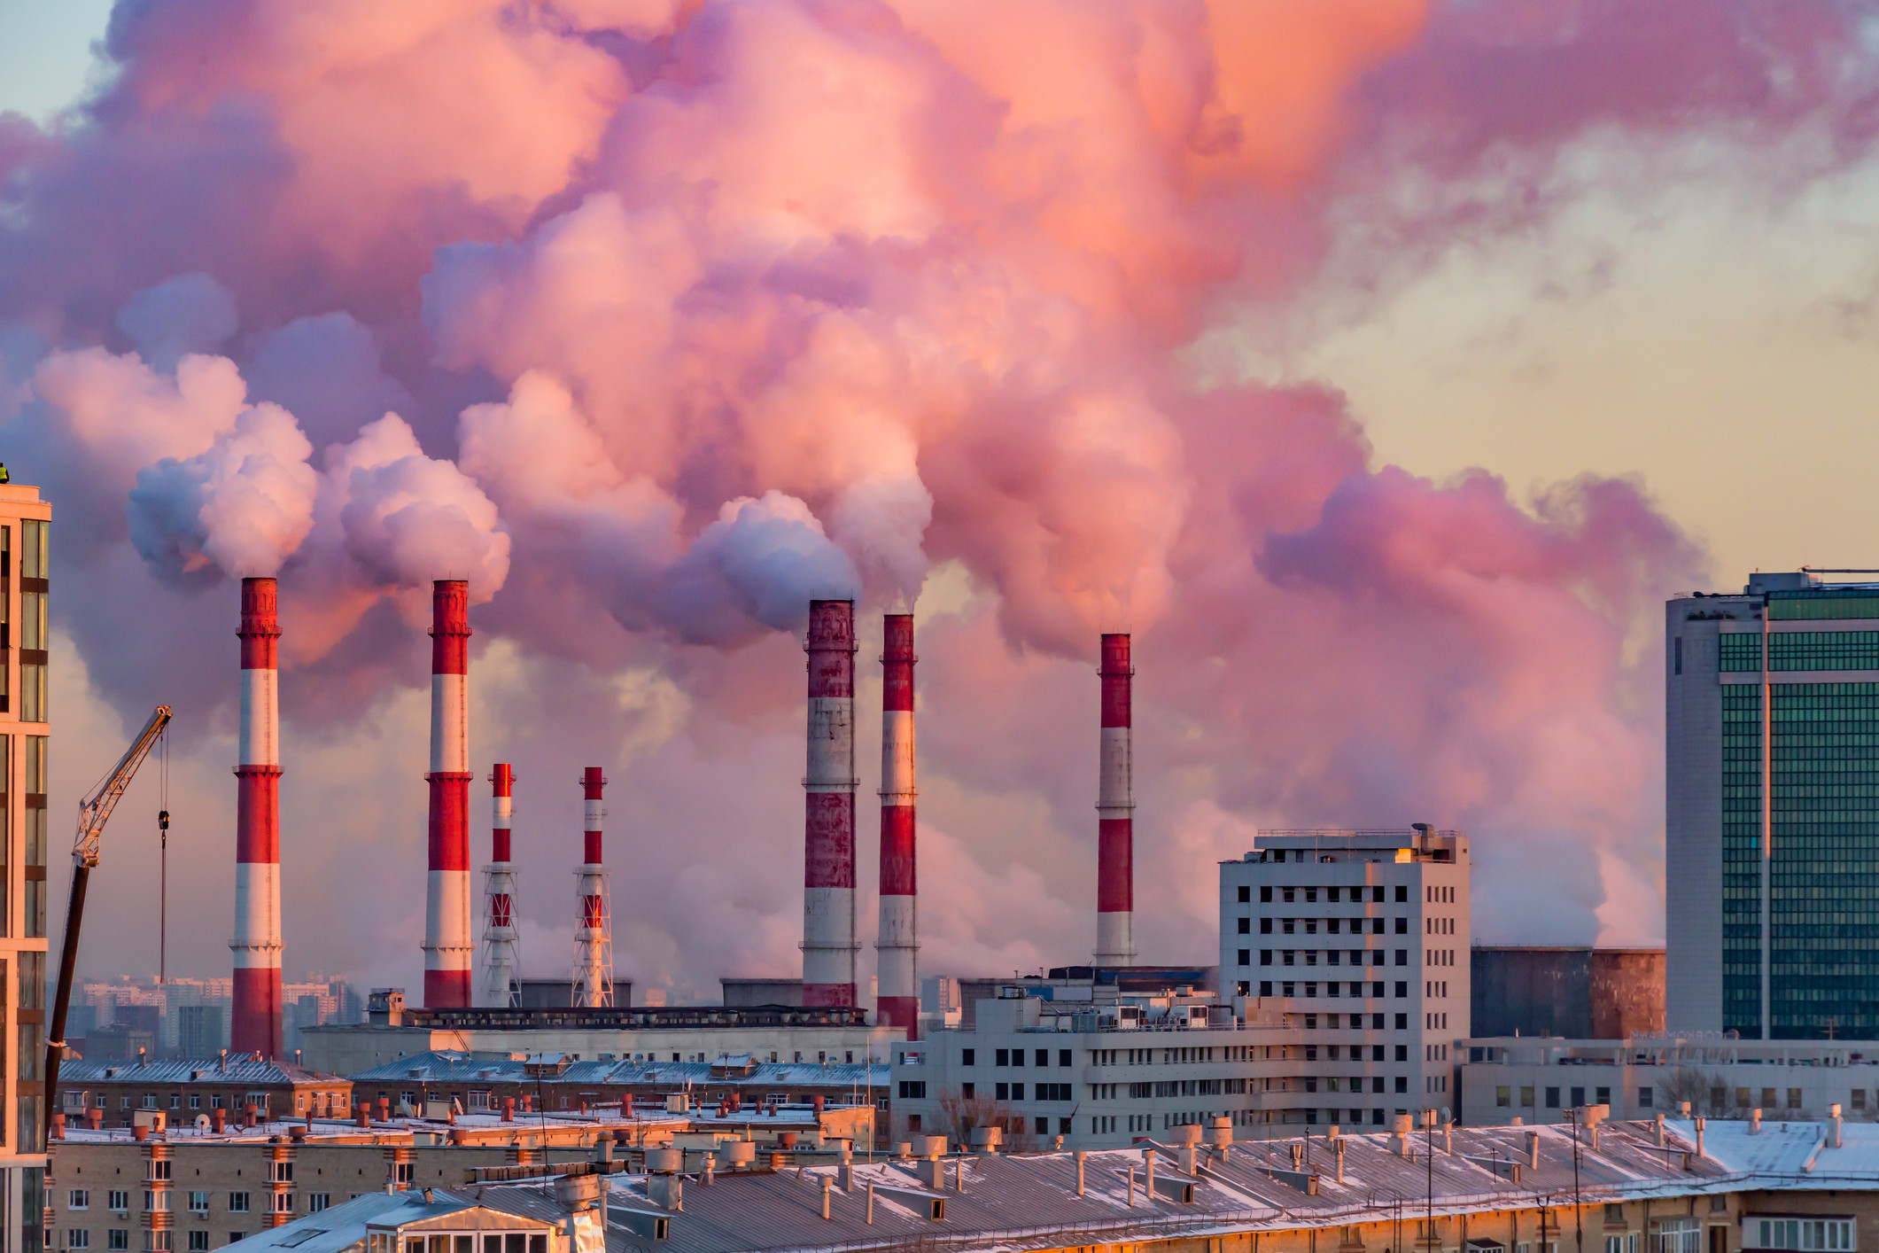
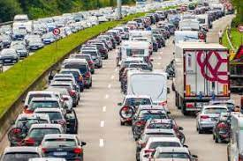
Causes of Climate Change
Power generation: Electricity and heat by burning fossil fuels coal, oil, or gas.
Manufacturing of goods: Production of cement, iron, steel, electronics, plastics, clothes,
and other goods, mining, construction running on coal, oil, gas.
Deforestation: For agriculture or other reasons. Each year ~12 million hectares of forest are destroyed. Fires.
Transportation: Most cars, trucks, ships, and planes run on fossil fuels.
Transport accounts for nearly ¼ of global energy-related CO₂ emissions.
Food production: Farming, fertilizer, digestion by livestock (CH₄ by cattle, sheep, etc.)
Agricole machines, fishing boats. from packaging and distributing food.
Powering buildings: Heating and cooling of residential and commercial buildings consume
over 1/2 of all electricity in addition to lighting, appliances, and connected devices.
Lifestyle, overconsumption and wastes: Goods such as clothing, electronics, plastics, food, etc.
Notes:
Manufacturing industry is one of the largest contributors to greenhouse gas emissions worldwide.
Responsibility: Richest 1% of the global population account for more GHG than the poorest 50%.

Slide 7
Some Challenges for Renewable Energy
Energy Storage
Fluctuations in sunlight levels and wind mean variability in energy production→ need of storage → batteries improvement and lower price + environmental issues
Economic and Financial Challenges
Transition from carbon and fossil fuel industry is major shift with large financial costs → investment required, crowdfunding
Political Challenges
Political posturing, isolationism, popularism, and anti-science rhetoric threaten the renewable energy sector
Public perception of climate emergency competes with self interest and other priorities (jobs, finance…)
Infrastructure Challenges Infrastructure gap, lack of reliable large-scale energy grids in several developed nations
Land Use
Balance needed between land for energy production (solar, wind) and for housing, farming, food production, industry
Industry
Need to decarbonize the industrial sector with strong GHG emission → energy transition pathways still unclear, inertia
Technical Challenges
Production processes with lower CO₂ emissions, CO₂ capture and storage, Green H2 mobility, New materials, …
Greenwashing source: https://www.trvst.world/renewable-energy/challenges-for-renewable-energy/
Notes:
With these challenges for renewable energy in mind, it may seem difficult to foresee a future with clean energy. However, it is possible if we all take a collaborative approach. Countries like Iceland and Paraguay are already at 100% renewables. We can replicate these results globally.

Slide 8
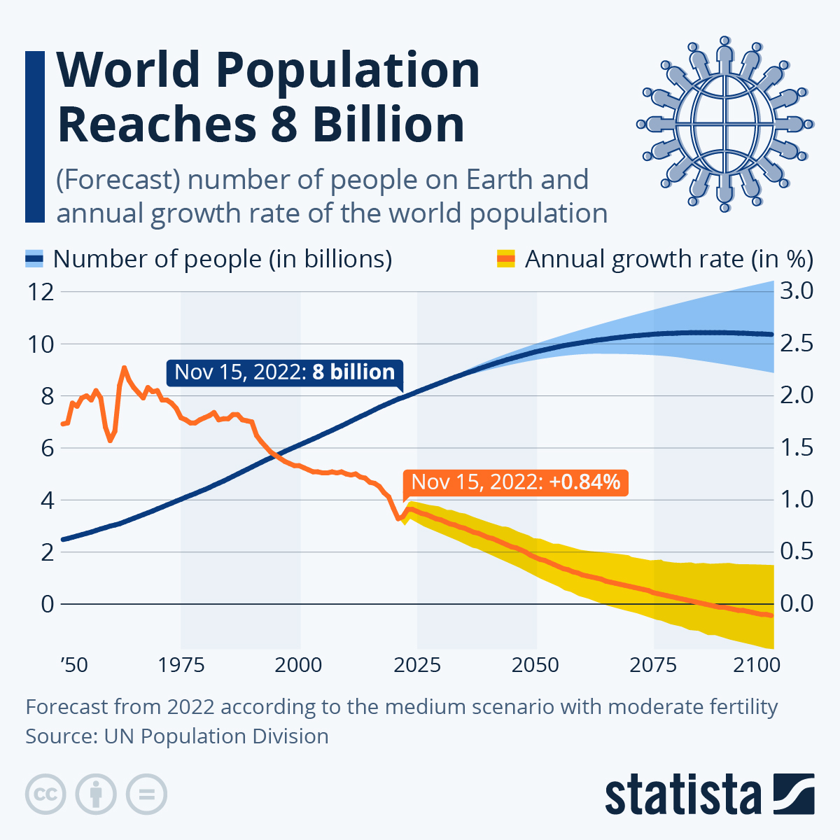

altogether 117 billion people lived on Earth
since the beginning of humankind !
Notes:
Currently, the world's population is just over 8 billion people. To maintain the population, women need to have an average of 2.1 children. In 2021, this figure was 2.23. According to experts, the downward trend continues. They expect it to be only 1.83 in 2050 and only 1.59 in 2100. By way of comparison, in 1950 the figure was 4.84.

Slide 9
Our panelists

Slide 10
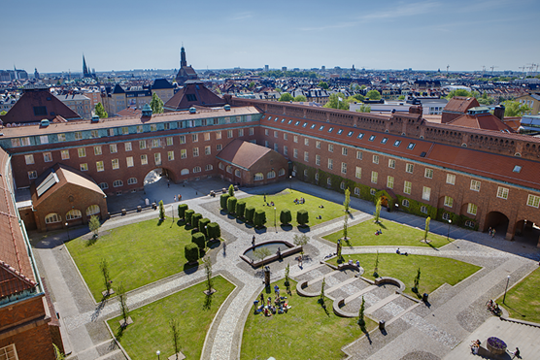
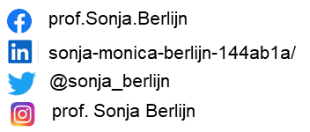

Royal Institute of Technology, Sweden
Since 1827, KTH has grown to become an international leading technical university.
As the largest institution in Sweden for technical education and research, we bring together students, researchers, and educators worldwide.
Our activities are grounded in a strong tradition of advancing science and innovation, focusing on contributing to sustainable societal development
Sonja Monica Berlijn
Professor in Sustainable Integrated Energy Systems
Senior Principal Consultant

Slide 11



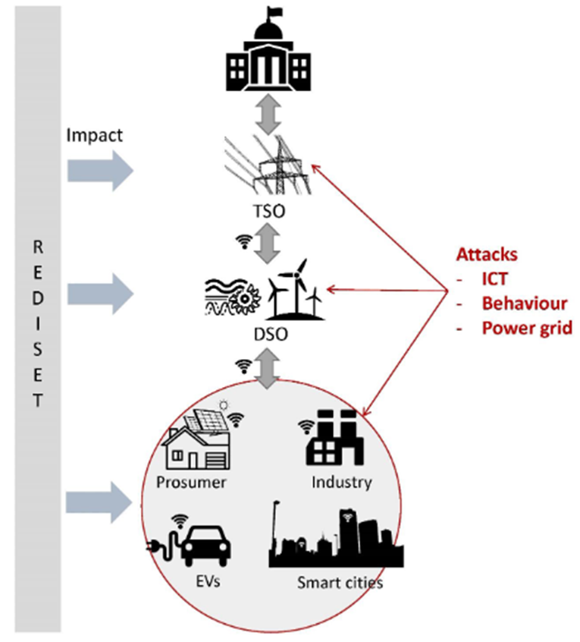

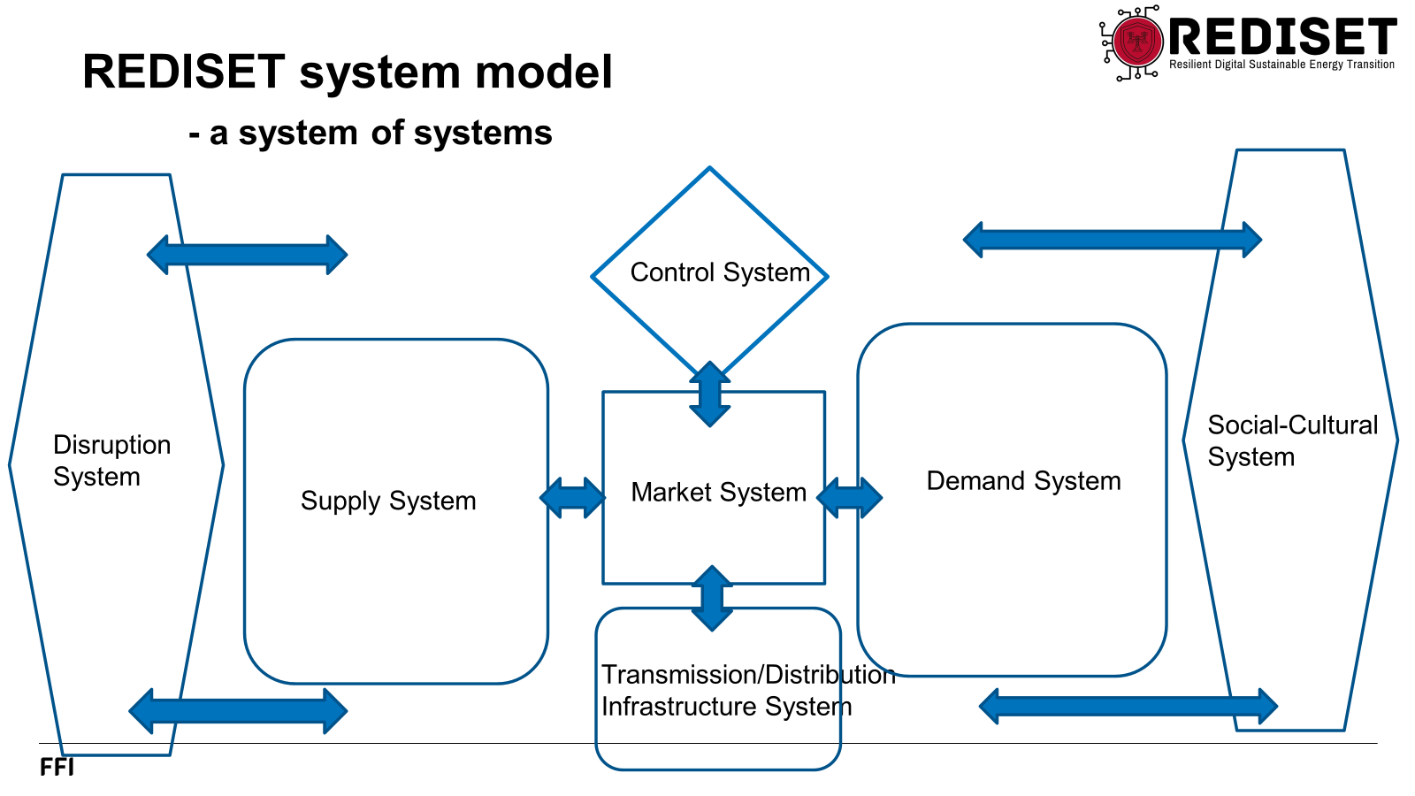
REDISET: Resilient Digital Sustainable Energy Transition
There are many challenges for the electricity systems:
  The share and total volume of unstable production is increasing
  The cost level increases
  There is lack of public support for new infrastructure
  There is an increasing risk of cyber attacks.
The integrity of data and cyber security in a future, fully digitalized energy system needs to be ensured
The objective of the REDISET project is to:
  Analyse, identify and find proposals for mitigation of possible weaknesses of the digital security and resilience of a highly cross sectoral-integrated digital energy system as a whole
The project will identify vulnerabilities and analyse threats and develop threat scenarios in the future sector coupled energy system. It will develop competences and methods for mitigating threats.
Notes:
This project seeks to address the concerns expressed by the TSOs by taking a holistic approach to analysing the security and resilience of a highly cross sectoral-integrated energy system, and approaching the sector as a complex web of social-cyber-physical system dependencies
The goals of the project are to develop competences and methods for identifying, analysing, and mitigating threats by targeting: The end users (local communities, prosumers and consumers) and their behaviour in the energy system ICT infrastructures and its components. The energy system including its technical/physical components and its surrounding business processes, as well as the interdependencies between these domains.
A goal of the project is to use these methods and competences on scenarios of various types of attacks on energy systems and use them to assist in the development of resilience criteria for a resilient and reliable energy system in the Nordic region.

Slide 12
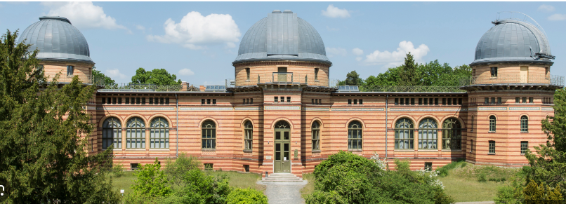
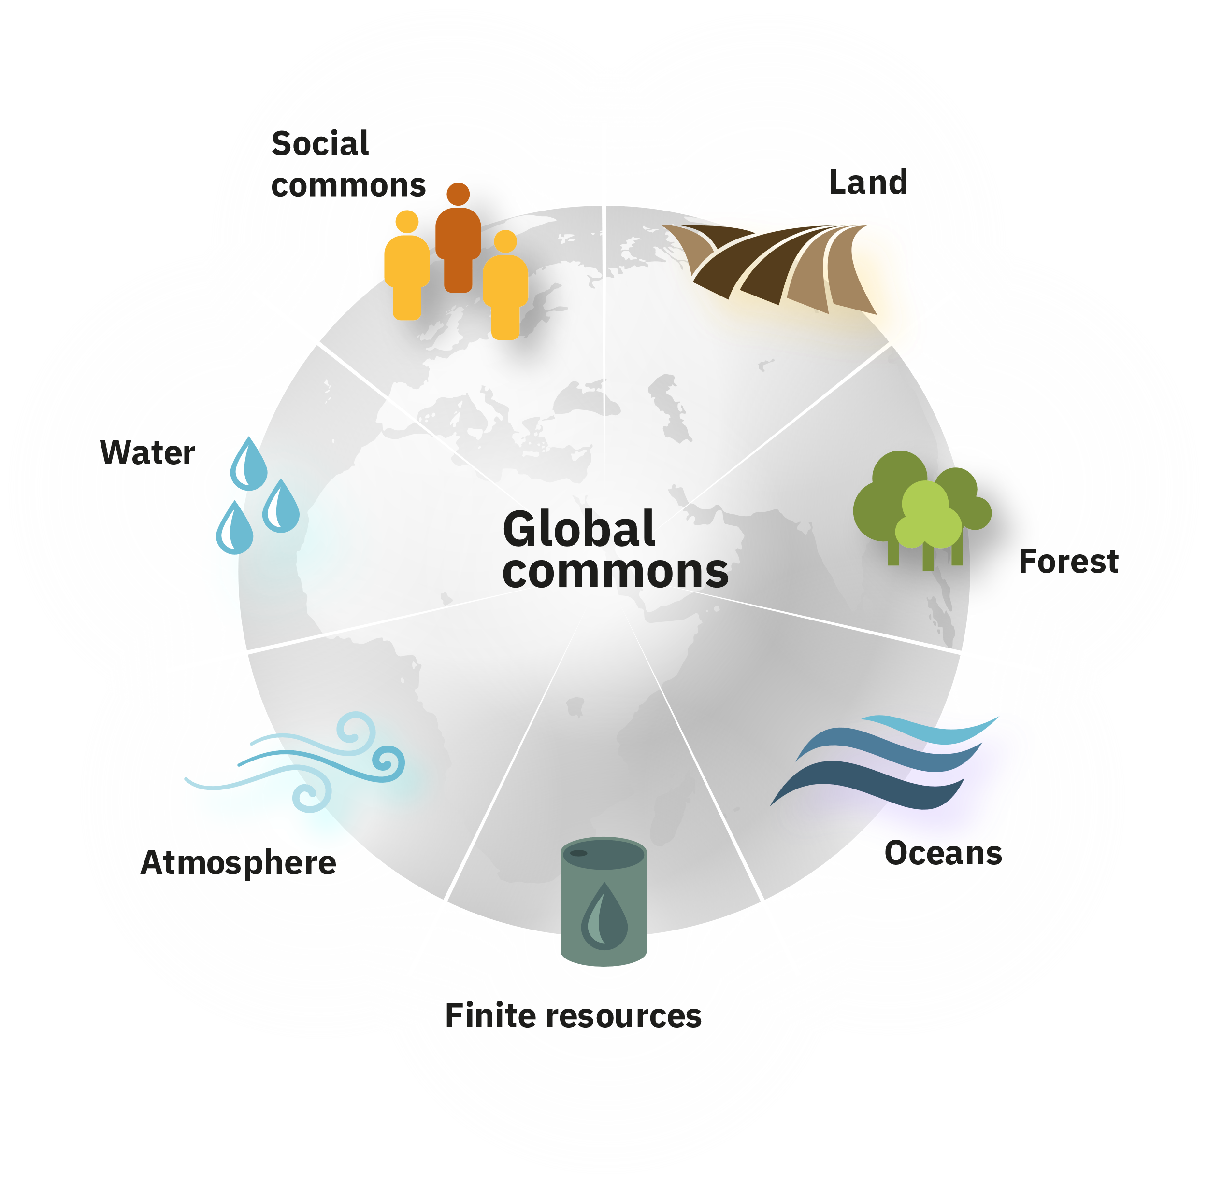
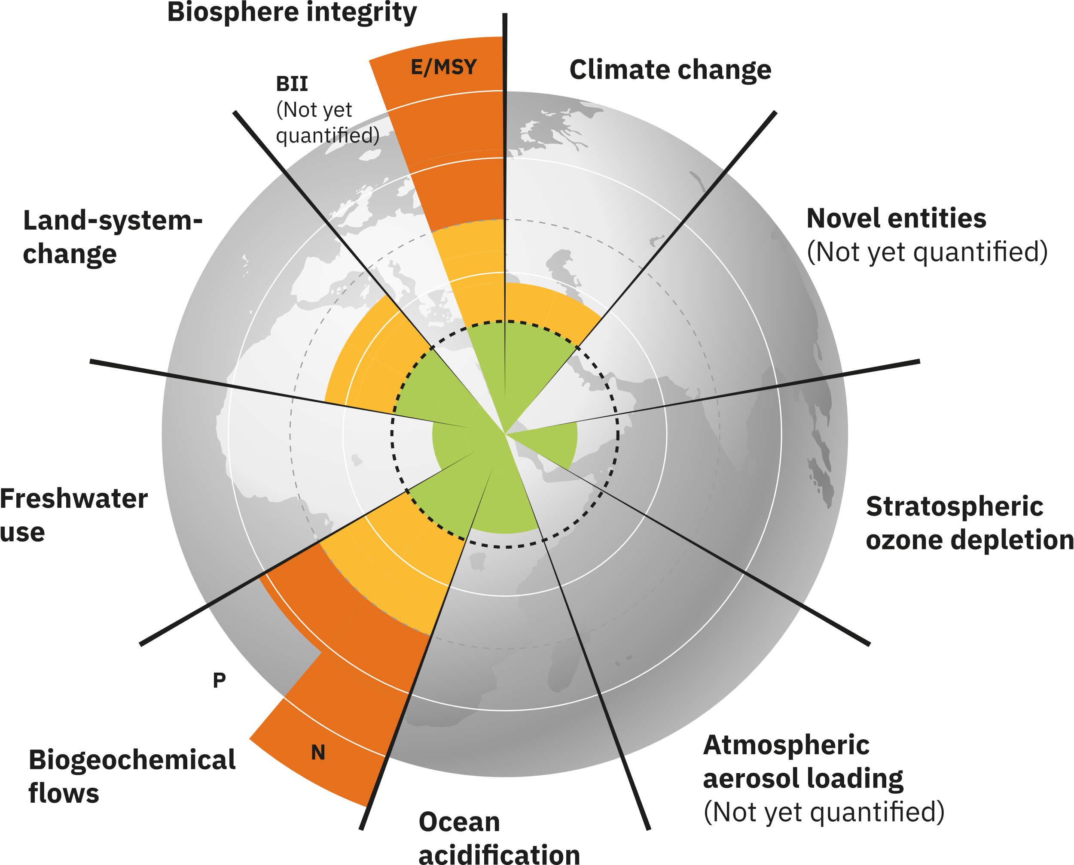
Potsdam Institute for Climate Impact Research – Jürgen Kurths
Mission:
Governing the global commons within planetary boundaries.

Slide 13
Power Grids – Stability - Jürgen Kurths
Against: Cyber Attacks or Climate Extreme Events
Analysis, Identification of “key elements”, Mitigation
Damages due to Hurricane Harvey, Texas, August 2017
(Monster) Blackouts due to Cascading
Nature Phys. 2013, Nat. Comms 2014, 2020
Nat Energy 2024

Slide 14
Identification of critical lines - Jürgen Kurths
Identification of most critical lines (6…20) by the co-evolution model
Hardening them ➔
probability of large scale outages reduced by a factor of 5…20

Slide 15

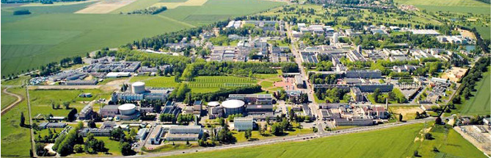
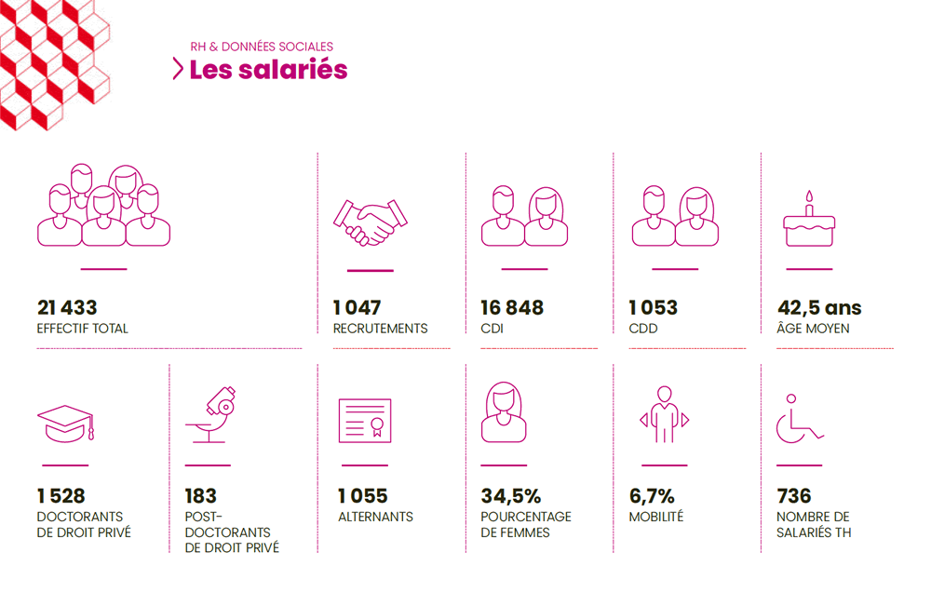
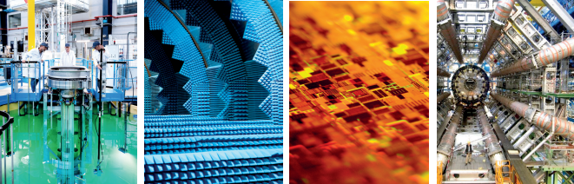
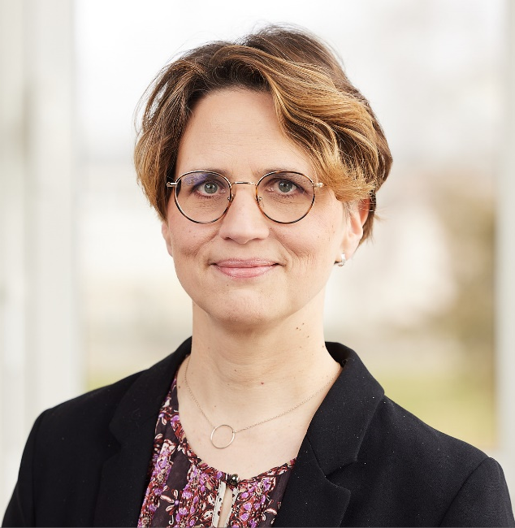
The CEA proactive in its commitment to secure the present and the future
A major French Research and Technical Organization (RTO)
in:
  Low carbon energy (nuclear and renewable)
  Security and defense
  Technology research for industry
  Fundamental research (materials and life science)
~ 21 000 staff
~ 1 000 recruitments/year
Héloïse Goutte
Scientific director for energy

Slide 16
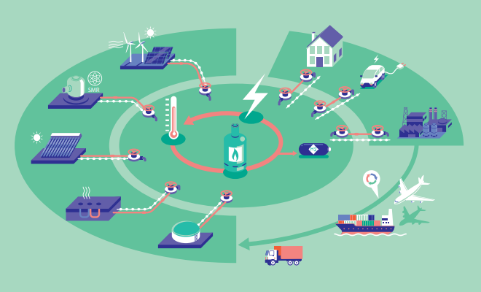



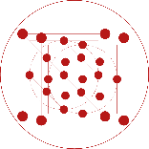



A holistic, integrated approach to the energy mix
How to reach net zero by 2050?
USAGE
VALUE CHAIN
SYSTEM
MATERIALS
COMPONENTS
PROCESS
- Diversify the low-carbon energy mix for a sovereign,
cost efficient energy supply
- Build a more flexible electricity system
- Reduce energy consumption and GHG emissions
- Lay the groundwork for the Hydrogen and synthetic fuel
industries

Slide 17





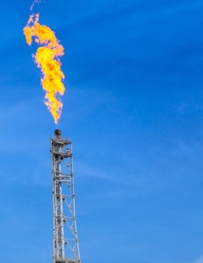
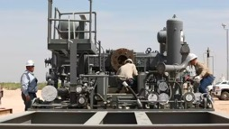
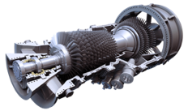
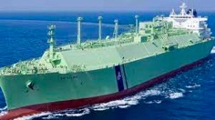
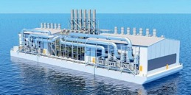
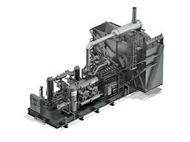
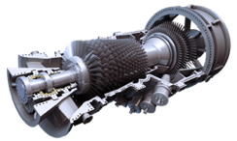
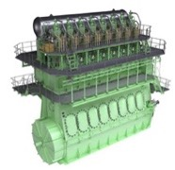
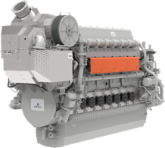
Daphne Technology is a Climate Deep Tech company pioneering innovative technologies to reduce GHG and toxic emissions.
Mission: Solving the methane challenge in hard-to-decarbonise industries.
We measure, reduce and monetise the reduction of methane emissions from industrial sources.
Onshore Energy Sector
Offshore - Maritime
Upstream
(Oil, Heavy Gas Flaring)
Midstream
(Natural Gas, Biogas Treatment)
Downstream
(Power Generation)
Fuel
Energy Conversion
Flares, Burners
(CH₄, SO_{X}, CO₂)
Gas Treatment, Compression Engine
(CO₂, CH₄)
Power Plants
(CH₄, SO_{X}, CO₂)
LNG (Methane)
CH₄
Dr. Mario Michan
Founder CEO.

