Slide 1
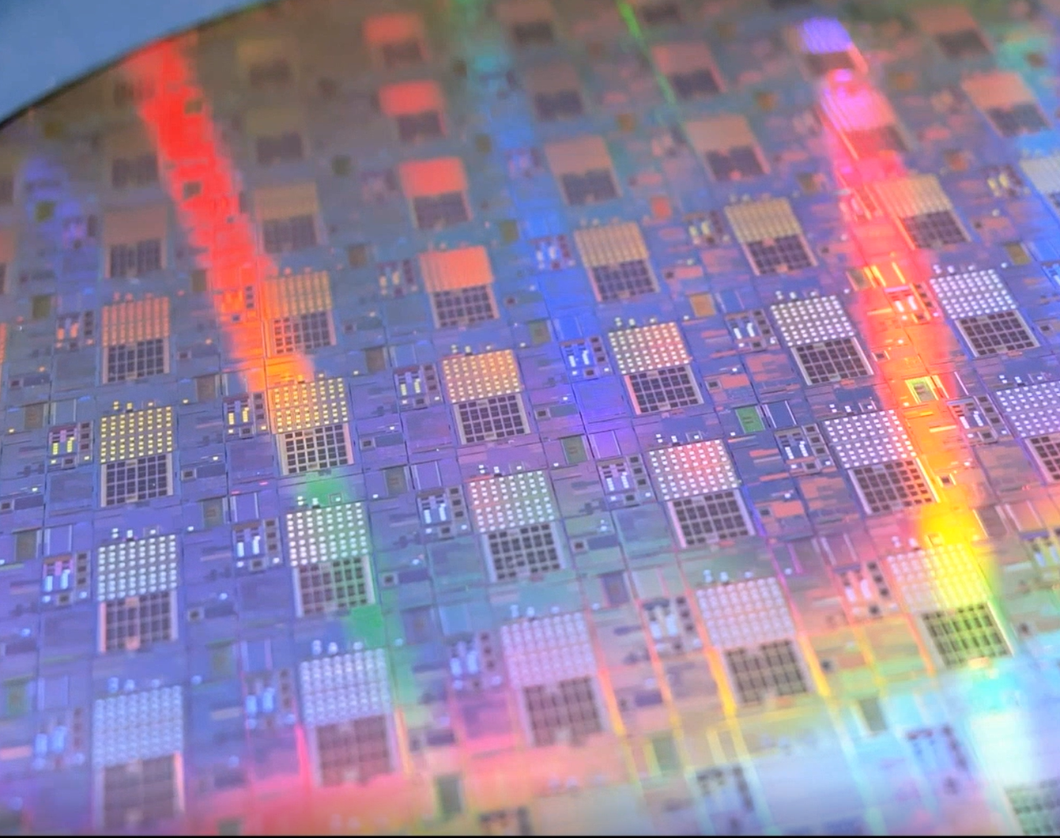
In memory computing, artificial neural networks with phase change synapses
Abu Sebastian
Distinguished Research Scientist
IBM Research - Zurich
EPS Forum, Berlin
26th Mar. 2024

Slide 2
OUTLINE
Artificial neural networks and the associated computational challenge
What is in-memory computing and how to use it for ANNs?
What is the state-of-the-art?
What next?

Slide 3
OUTLINE
Artificial neural networks and the associated computational challenge
What is in-memory computing and how to use it for ANNs?
Where is the state-of-the-art?
What next?

Slide 4
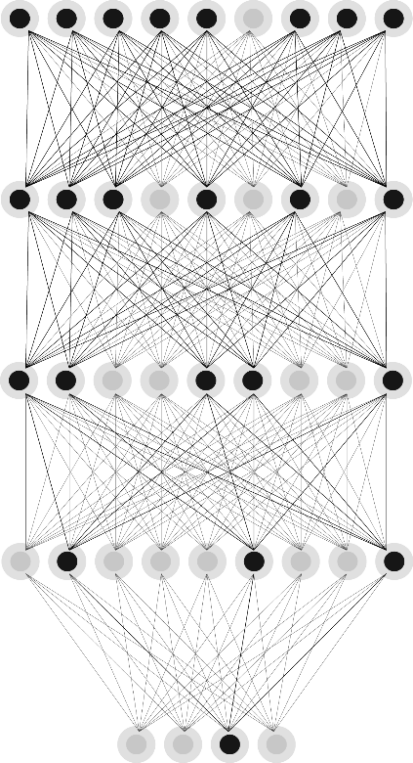
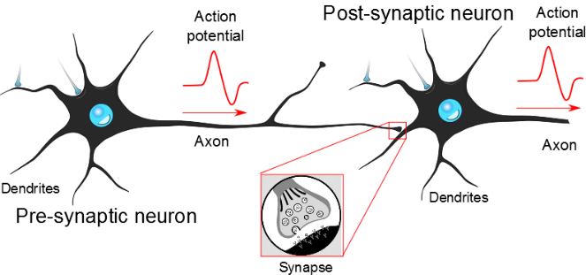

ARTIFICIAL [DEEP] NEURAL NETWORKS (DNNs)
dog
Neuron
Neuron
Algorithmic origins in computational neuroscience
Almost entirely hijacked by computer scientists in recent years
Remarkable recent success with models such as CNNs and transformers
Have revolutionized the field of AI
Synapse
0.42
0.21
0.21
0.5
Scalar multiply units
Static non-linear functions
Information transmitted as floating-point numbers
Hassabis et al., “Neuroscience-inspired artificial intelligence”, Neuron (2017)

Slide 5
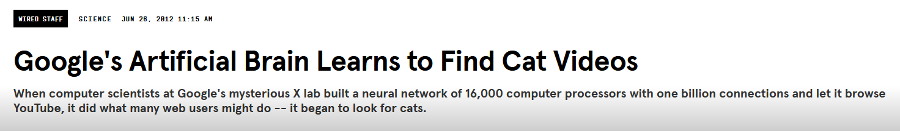
DNNs AND THE PERENNIAL HARDWARE CHALLENGE
Training a single LLM such as ChatGPT3 → 10 gigawatt-hour (GWh) power consumption roughly equivalent to the yearly electricity consumption of over 1,000 U.S. households
Inference on ChatGPT can consume the equivalent energy consumed by 33,000 U.S. households — around one gigawatt-hour a day
The lost decades
DNN + backprop (1980s)
2010
The arrival of Graphical Processing Units
16,000 Central Processing Units (CPUs) (2010)
→ 48 Graphical Processing Units (GPUs) (2012)
Hooker, “The hardware lottery”, Comm. ACM (2021)
Prof. Sajjad Moazeni, University of Washington
Dally et al., “Evolution of the Graphics Processing Unit”, IEEE Micro (2021)
DNNs were not well suited to the conventional computing hardware of the time (resulting in the lost decades)
Even with GPUs, significant energy efficiency gap to be bridged
Area/Power footprint is prohibitive for many applications

Slide 6
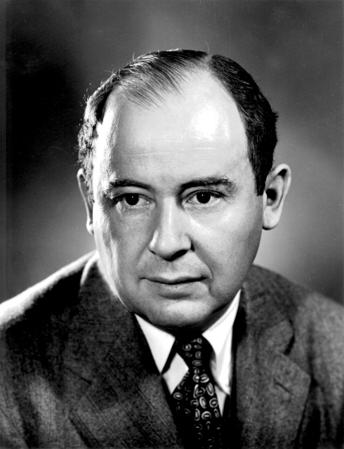
WHY CONVENTIONAL HARDWARE IS UNSUITABLE?
Main memory
Precise digital computation
SYNAPTIC WEIGHTS
Processor
John von Neumann (1945)
DNN algorithms require lots of parallel processing
Significant data movement between the physically separated memory and processing units

Slide 7
THE AGE OF CUSTOM DIGITAL ACCELERATORS
PE
PE
PE
CORE
DRAM
SRAM
DRAM
PE
PE
PE
SRAM
General purpose processor core
Multiple levels of cache hierarchy
PE
PE
PE
DRAM: Dynamic Random Access Memory
SRAM: Static Random Access Memory
PE: Digital processing elements customized for DNNs
Gupta et al, “Deep learning with limited numerical precision”, ICML (2015)
Sze et al, “Efficient Processing of Deep Neural Networks: A Tutorial and Survey”, Proc. IEEE (2017)
Explosive growth in the number of custom digital accelerators for DNNs
Key innovations: Support for reduced arithmetic precision and sparsity, better data locality, complex instructions etc.

Slide 8
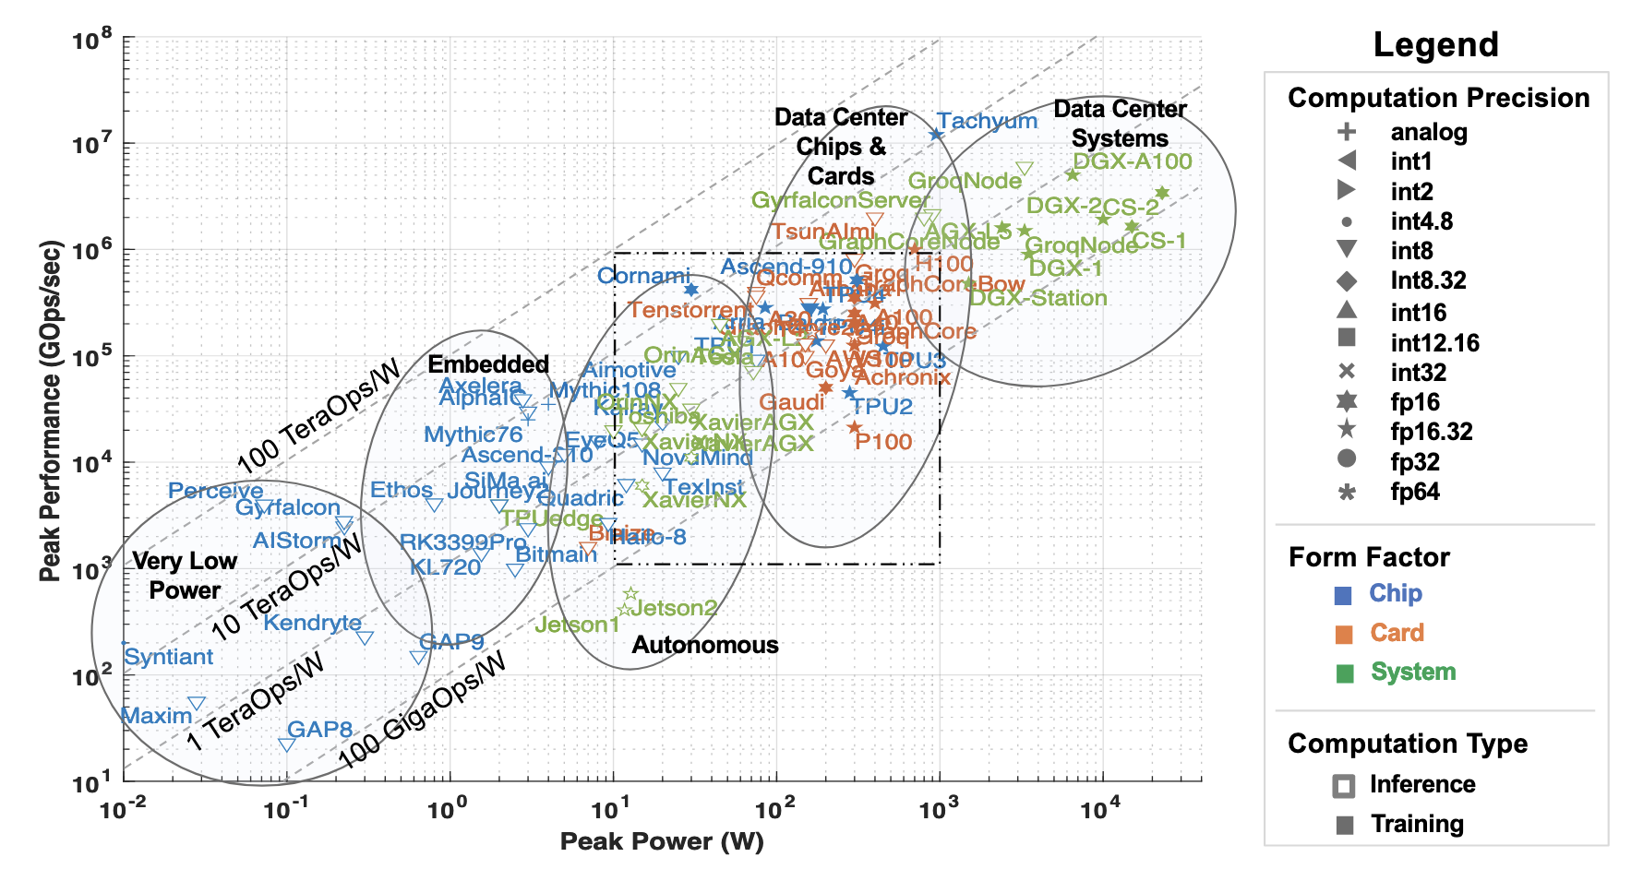
THE PLATEAUING OF ENERGY EFFICIENCY
100fJ/Operation
Reuther et al., “AI and ML Accelerator Survey and Trends”, IEEE HPEC (2022 )
Peak performance vs. power scatter plot of publicly announced DNN accelerators show that achieving energy efficiencies better than 100fJ/Operation is proving to be challenging

Slide 9
NON-STATIONARITY OF SYNAPTIC WEIGHTS
~150-200fJ/Operation
32-bit add operation takes only 20fJ and 150ps
Moving the two 32-bit words to feed this operation over 1mm takes 1.9pJ and 400ps
Fetching two 32-bit words from main memory expends 1.3nJ of energy
PE
PE
PE
DRAM
SRAM
PE
PE
PE
PE
PE
PE
> 100 MB
40-100pJ/byte
10-100KB
1-10pJ/byte
Murmann, “Mixed-Signal Computing for Deep Neural Network Inference”, IEEE TVLSI (2020)
Dally and Vishkin, “On the model of computing”, Communications of the ACM (2022)
Physically separated memory and processing → the synaptic weights need to be shuttled between the two units resulting in significant latency and energy penalty
This disparity has become starker in more advanced CMOS technology nodes

Slide 10
OUTLINE
Artificial neural networks and the associated computational challenge
What is in-memory computing and how to use it for ANNs?
What is the state-of-the-art?
What next?

Slide 11
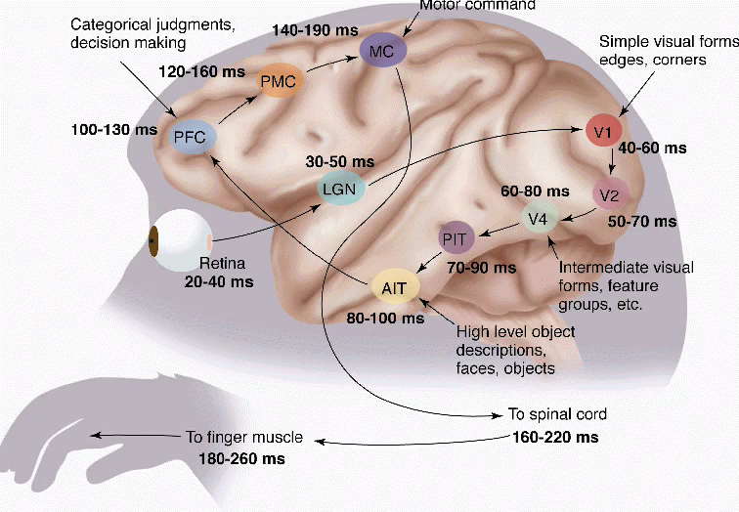
MORE BRAIN INSPIRATION
Conventional computers
Mammalian brains
Main memory
Precise digital computation
Physically stationary neurons and synapses
SYNAPTIC WEIGHTS
Processor
Less precise analog computation
Memory devices should be able to compute in addition to storing information → In-memory computing
Notes:
Can we get inspired by the brain again, this time from a hardware realization point of view?

Slide 12
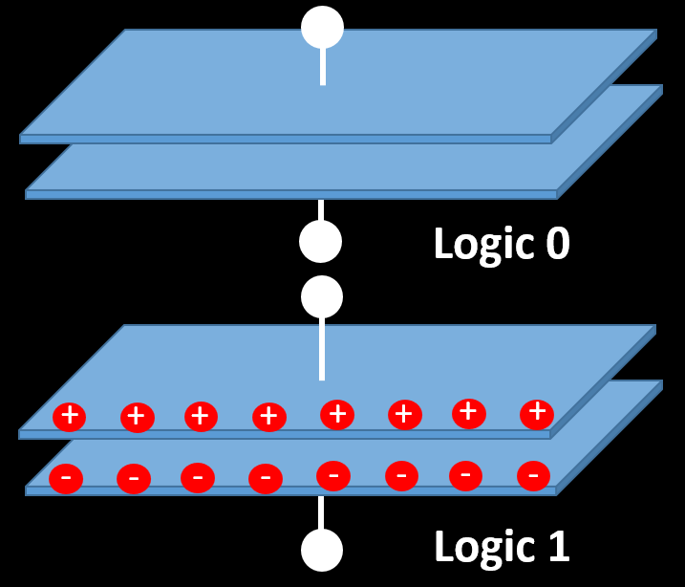
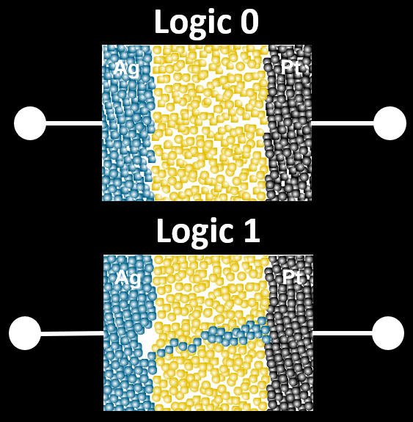
MEMORY DEVICES
Charge-based memory devices
Resistance-based memory devices (memristive devices)
Static random-access memory (SRAM)
Dynamic random-access memory (DRAM)
Flash memory
Phase-change memory (PCM)
Resistive random-access memory (ReRAM)
Magneto-resistive random-access memory (MRAM)
Notes:
Charge state of a storage node
Vast majority of memory is based on this
Resistance-based memory devices or also known as memristive devices
Resistance state of a nanoscale device

Slide 13
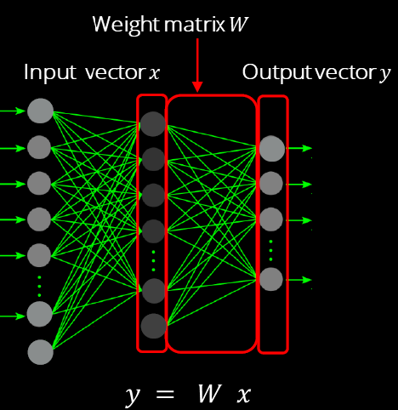
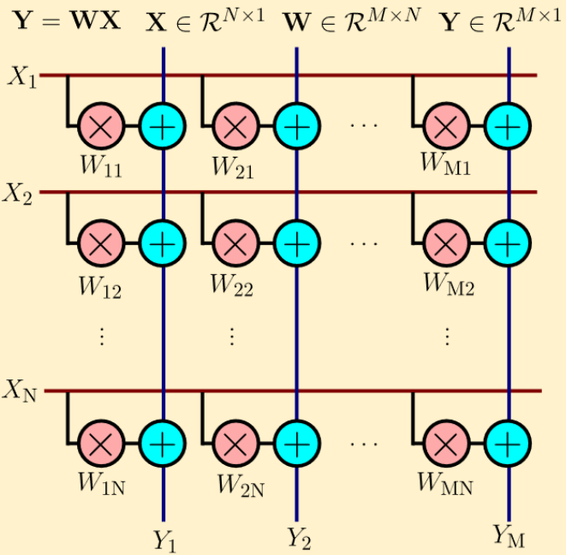
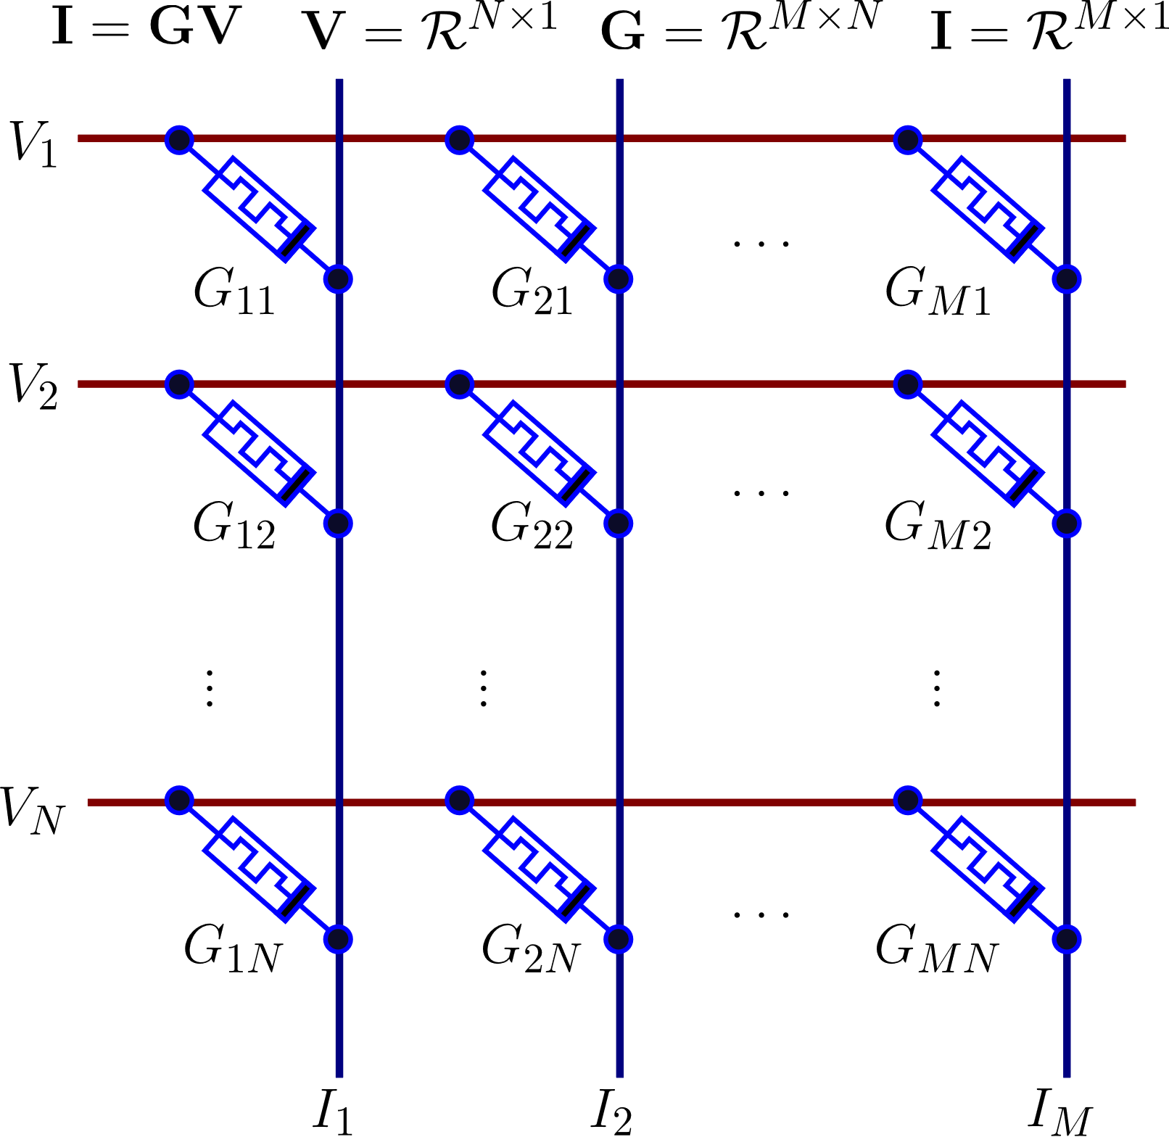
IN-MEMORY MATRIX-VECTOR MULTIPLICATION (MVM)
If the weights are mapped onto conductance values of resistive memory (memristive) devices, can perform MVM by exploiting Ohm’s law (multiplication) and Kirchhoff’s current summation law (accumulation)

Slide 14
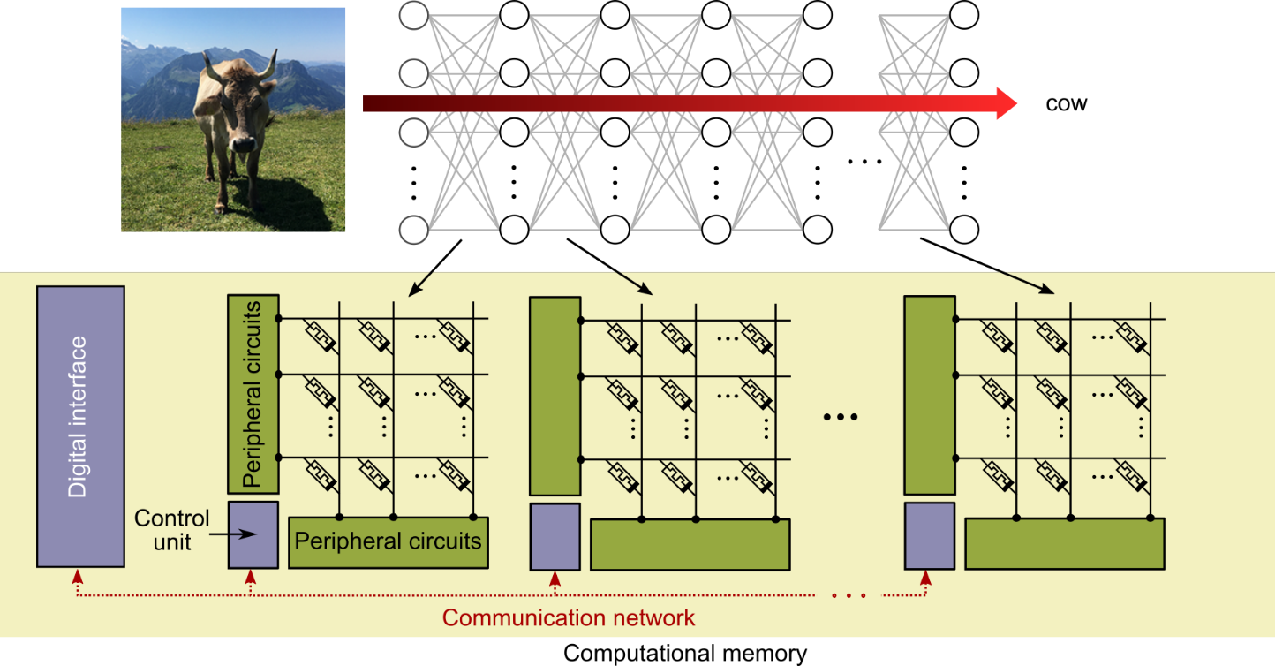
DEEP LEARNING INFERENCE WITH IN-MEMORY MVM
Synaptic weights mapped to the memory devices
Perform the matrix-vector multiply operations corresponding to each layer
With full-weight stationarity, potential for very good latency and energy per inference
Notes:
Highly amenable to spatial pipelining

Slide 15
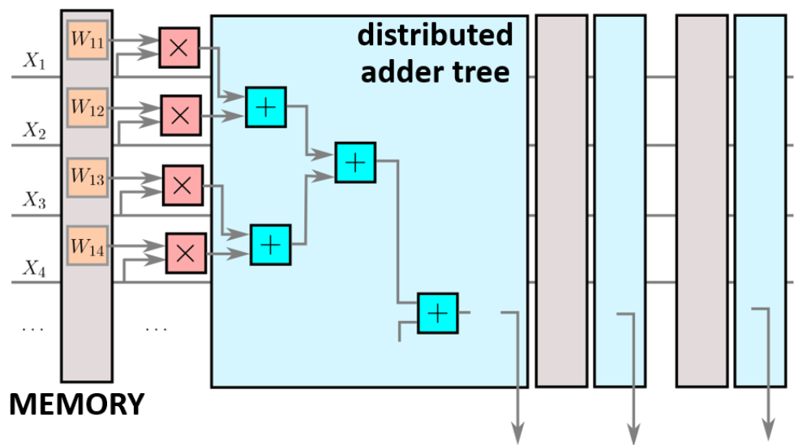
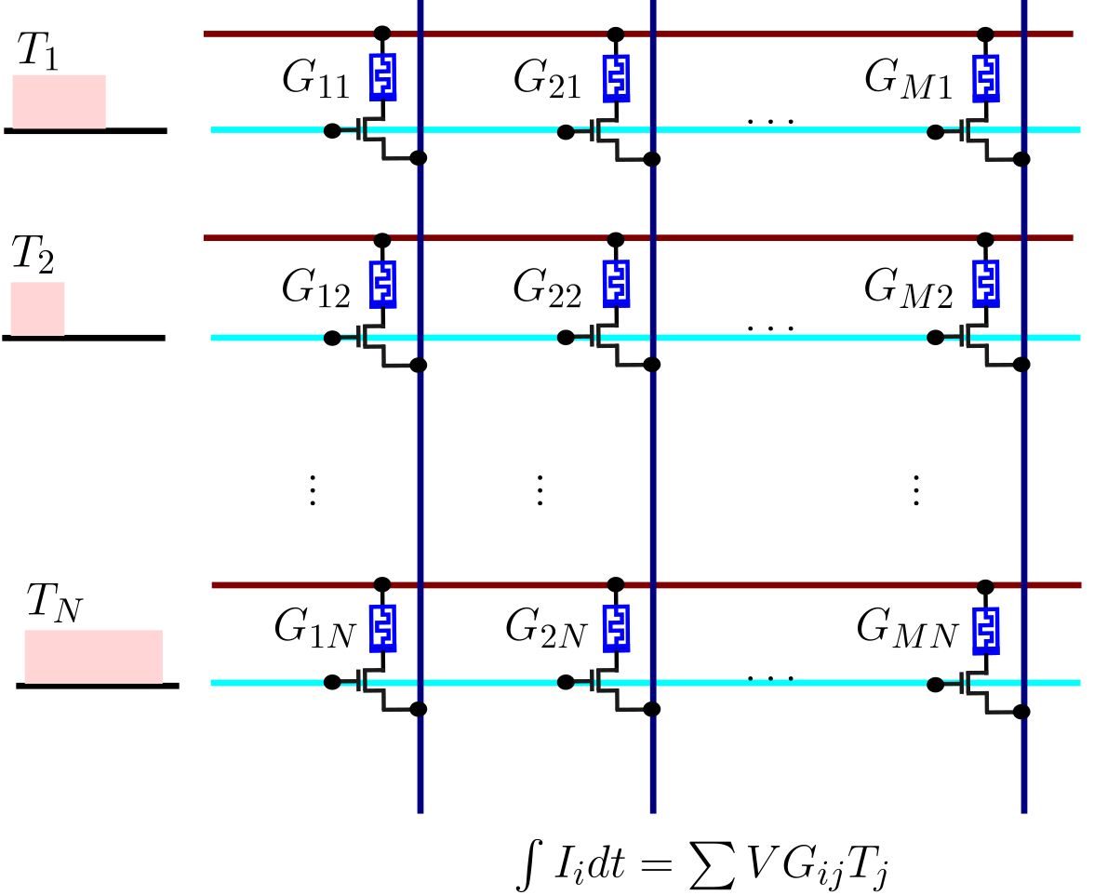
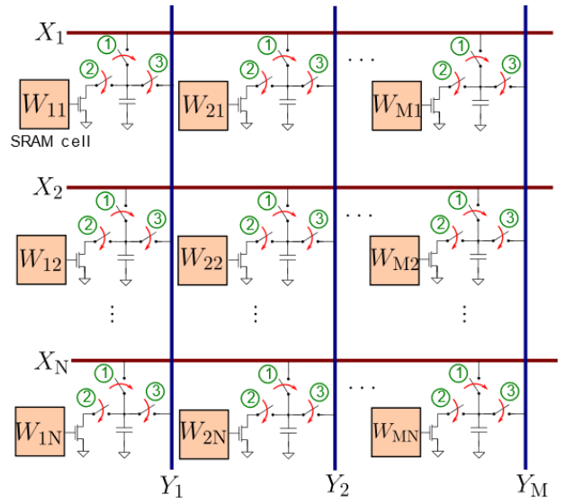
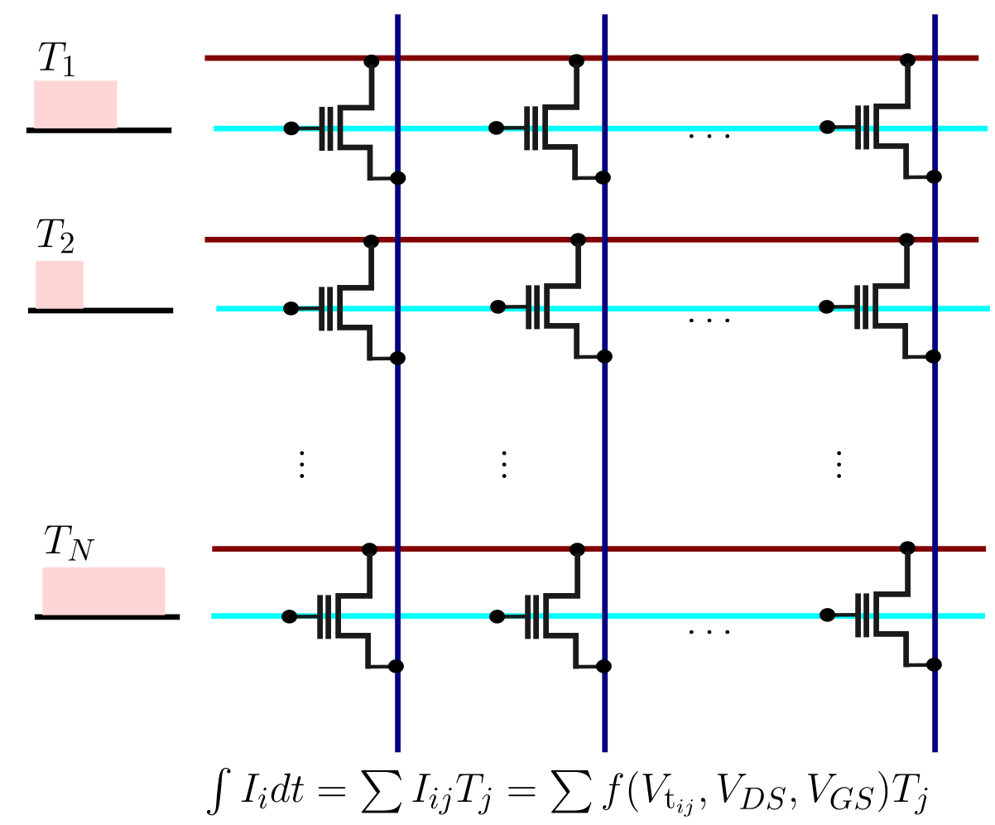
IN-MEMORY MATRIX-VECTOR MULTIPLICATION
Digital In-memory Computing (DIMC) with SRAM
Analog In-memory Computing (AIMC) with PCM/ReRAM
Analog In-memory Computing (AIMC) with SRAM
Analog In-memory Computing (AIMC) with Flash memory
Sebastian et al., “Memory devices and applications for in-memory computing”, Nature Nano (2020)

Slide 16

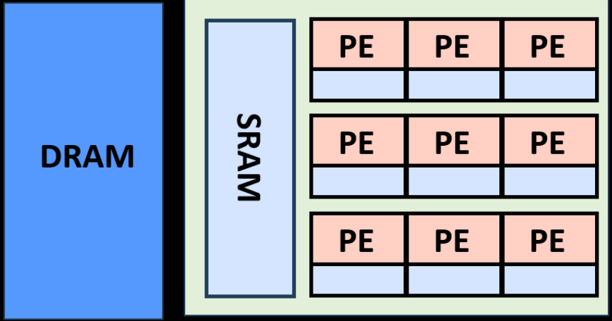
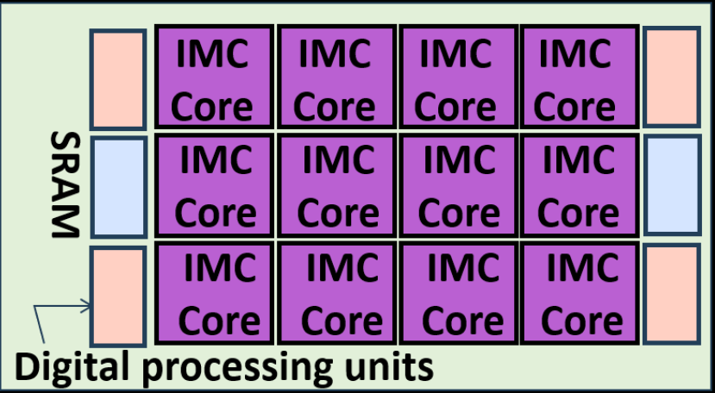
IN-MEMORY COMPUTING BASED DNN ACCELERATORS
input block
Tile interface
Digital-to-time
converters, buffers
Analog-to-digital
converters
Programming circuitry
Digital processing, buffers
Control
output block
Lanza, Sebastian et al., Science (2022)

Slide 17
OUTLINE
Artificial neural networks and the associated computational challenge
What is in-memory computing and how to use it for ANNs?
What is the state-of-the-art?
What next?

Slide 18
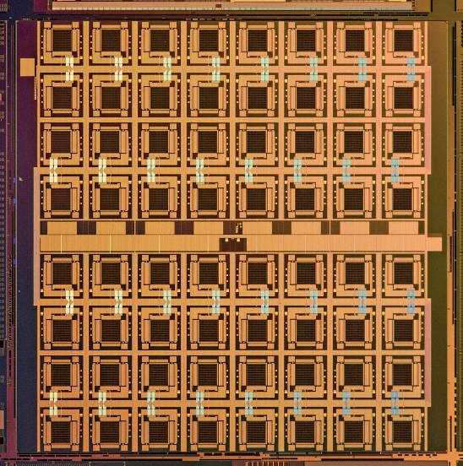
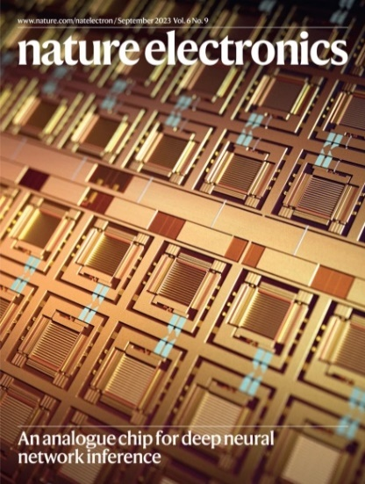
IBM HERMES PROJECT CHIP
Le Gallo et al., Nature Electronics (2023)
Designed in IBM Research – Europe
Fabricated within the IBM Research AI Hardware Center
Arguably the most advanced in-memory computing-based DNN chip based on memristive devices

Slide 19
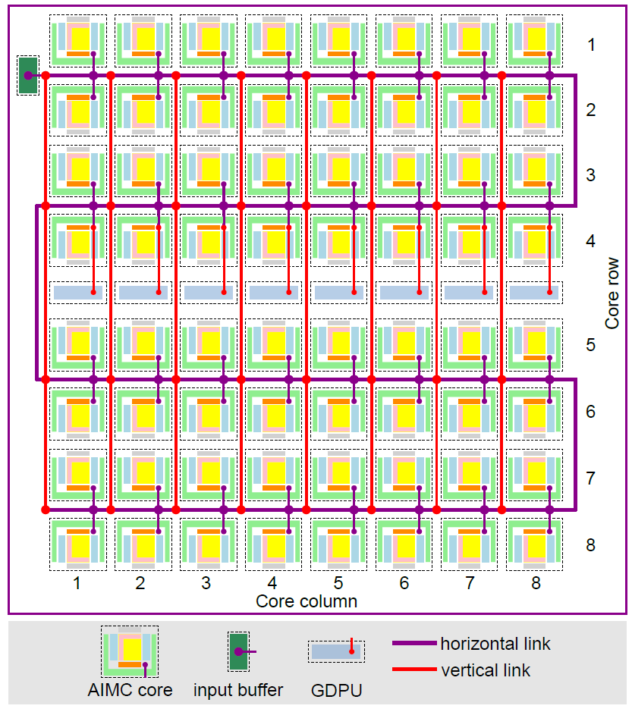
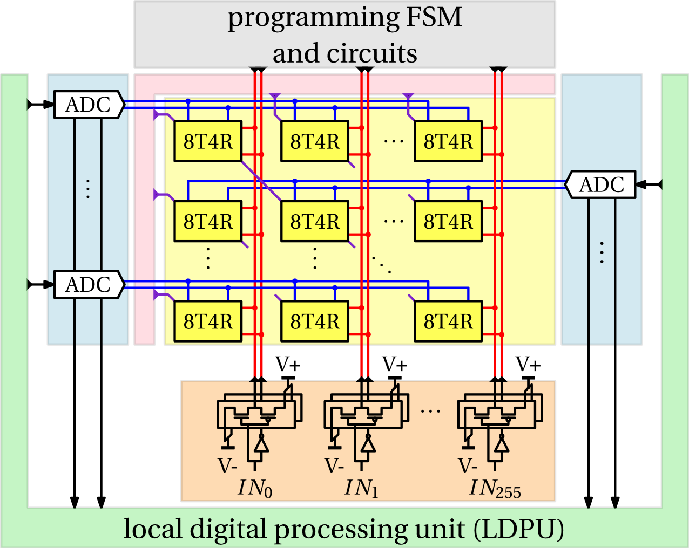
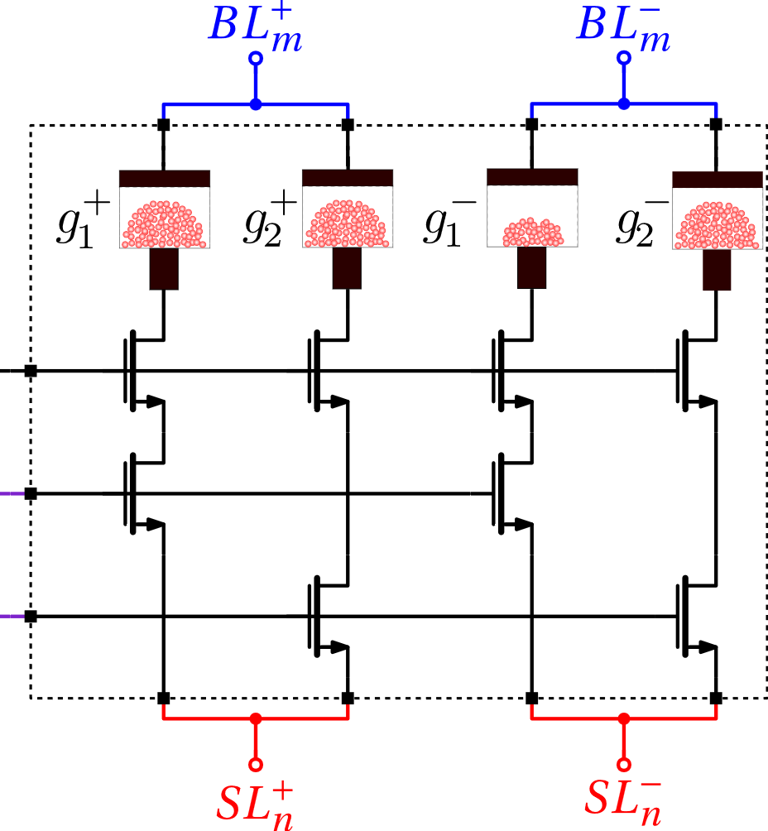
IBM HERMES PROJECT CHIP: ARCHITECTURAL OVERVIEW
Each of the 64 cores comprises 256x256 crossbar arrays of synaptic unit cells with peripheral circuitry (4M unit-cells)
Each unit cell comprises four phase-change memory devices (Total: 16M PCM devices)
On-chip local and global digital processing as well as a communication fabric

Slide 20
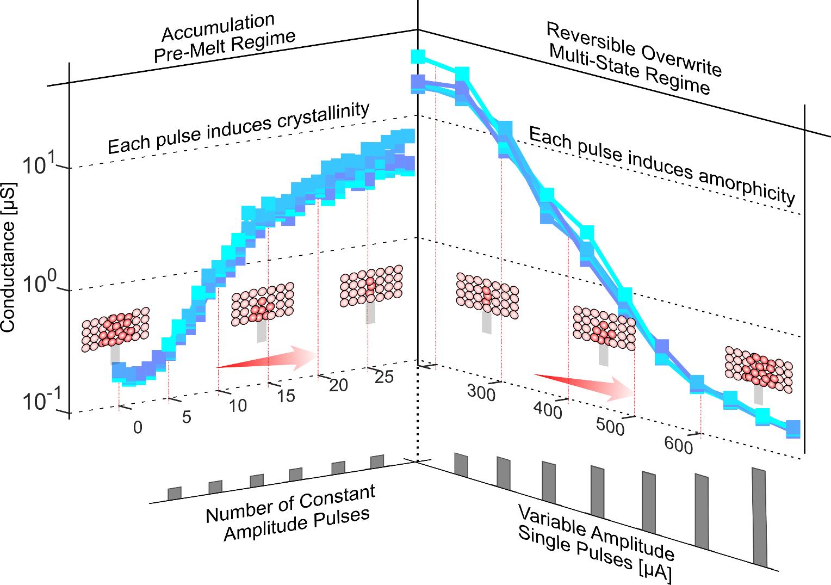
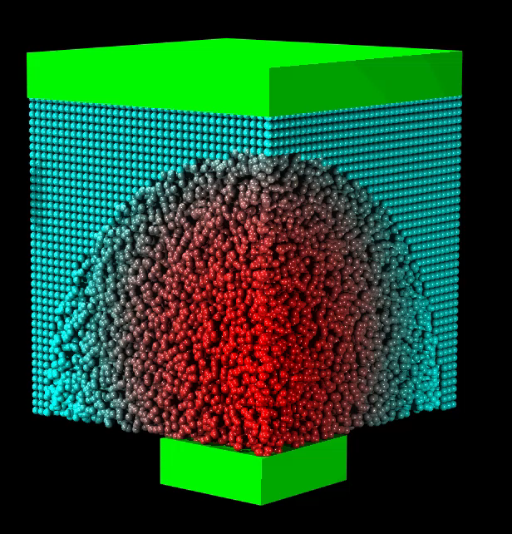
PHASE-CHANGE MEMORY
Bottom electrode radius ~ 20nm
Typical conductance window: 0.1uS to 10uS
Le Gallo & Sebastian, An overview of phase-change memory device physics, J. Phys. D: Appl. Phys. (2020)
Can program the PCM device to an arbitrary conductance value by:
  Melt-quench of larger and larger volumes of phase change material
  Progressive crystallization from an initial RESET state

Slide 21






MAPPING SYNAPTIC WEIGHTS
Differential configuration to facilitate storage of bipolar weights
Synaptic weights stored in terms of analog conductance values of one or two devices per polarity

Slide 22
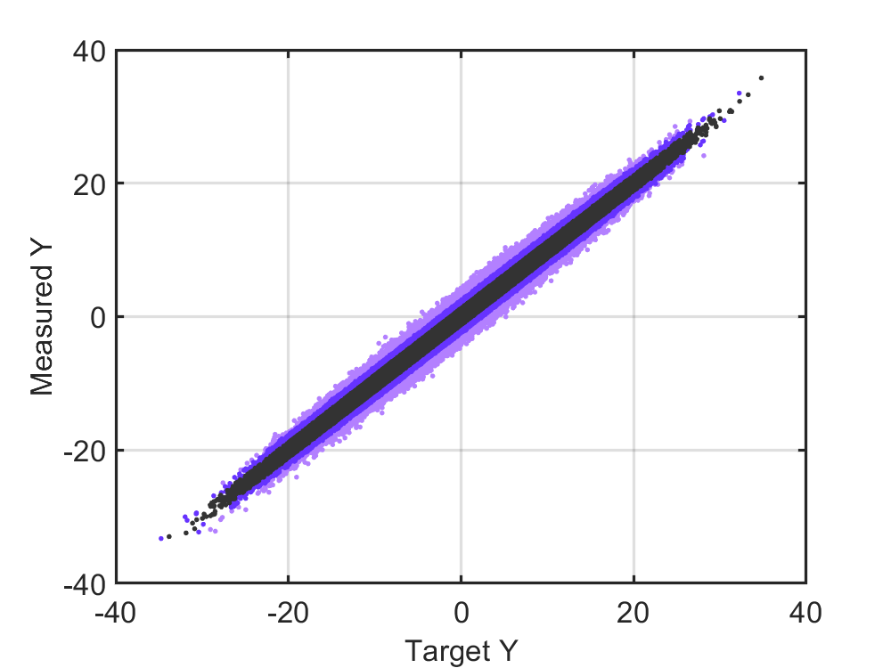





IN-MEMORY MATRIX-VECTOR MULTIPLICATION
2048 MVM operations
Each MVM operation takes either 128ns (~1 TOPS) or 512ns (~0.25 TOPS)
Achieved precision between 3 and 4 bits compared with 8-bit input/output and N-bit weight digital computation

Slide 23
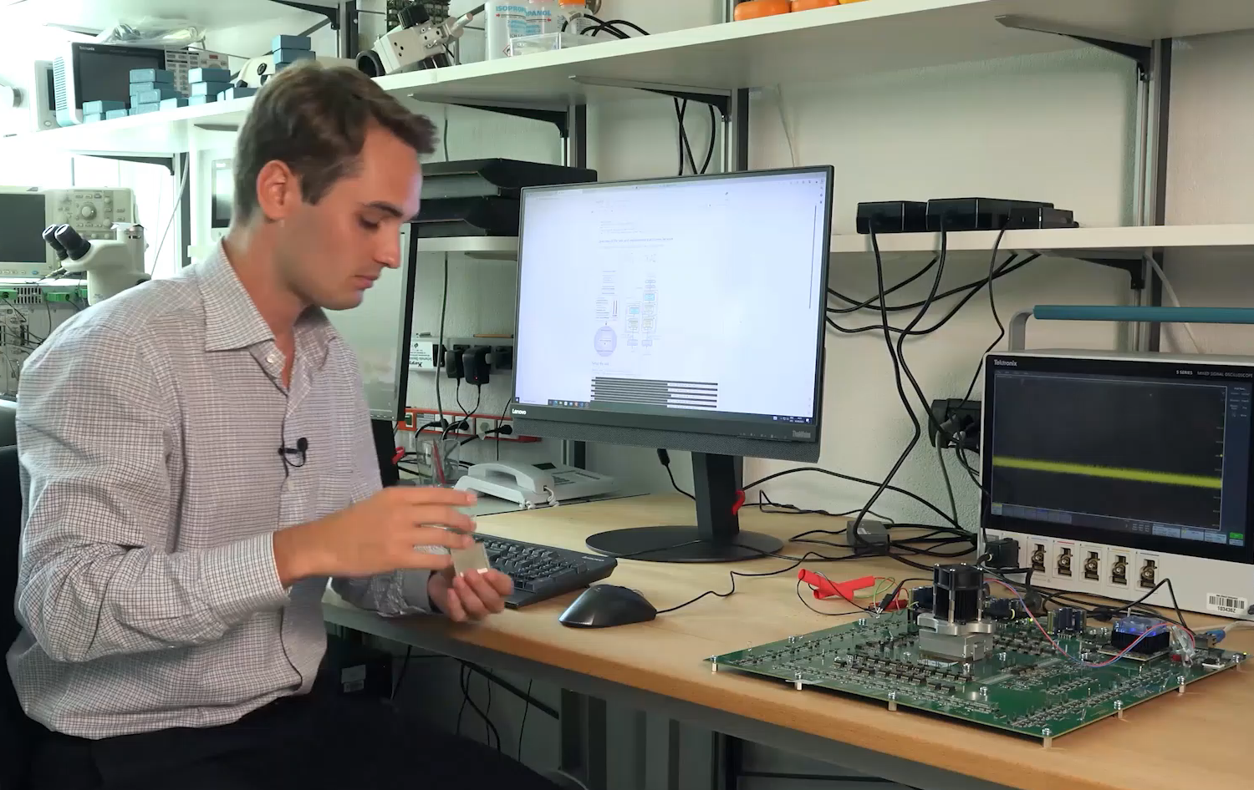
SOFTWARE STACK & NETWORK DEPLOYMENT
A preliminary software stack to deploy networks
Operations not supported by the IBM HERMES Project Chip are implemented on an FPGA board or the host CPU

Slide 24
OUTLINE
Artificial neural networks and the associated computational challenge
What is in-memory computing and how to use it for ANNs?
What is the state-of-the-art?
What next?

Slide 25
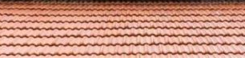
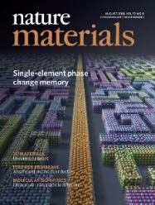
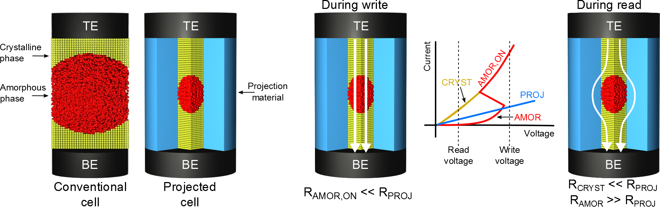
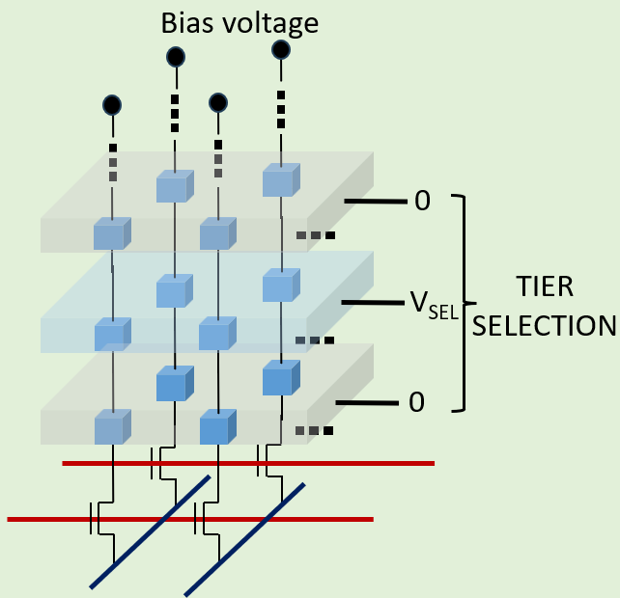
KEY RESEARCH QUESTIONS
How to robustify ANNs to run on analog hardware?
How to build compilers for these new type of computers?
How to design ANNs specifically for this new hardware?
Can we exploit attributes such as intrinsic stochasticity?
APPLICATIONS
APPLICATIONS
Software stack including training libraries
System-level architecture
How to perform domain conversions efficiently?
How to seamlessly interface digital and analog compute units?
How to communicate efficiently?
AIMC Core
Memory technology
How to design memory devices with better density and capacity?
How to enhance the compute precision?

Slide 26
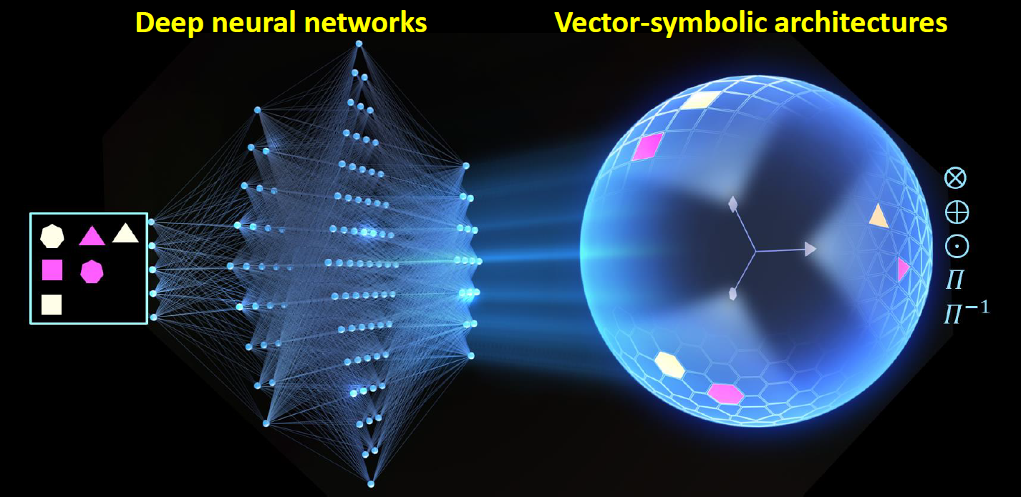
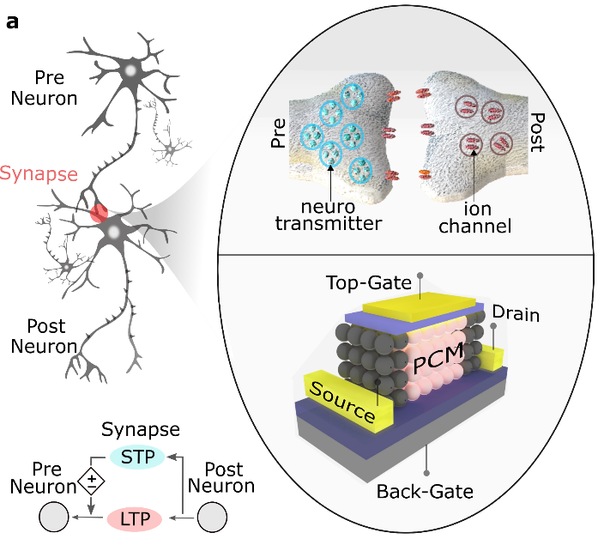
APPLICATIONS BEYOND DNN INFERENCE
DNN training
NeuroVSA
More Bio-realistic ANNs
Karunaratne et al., Nature Communications (2021)
Hersche et al., Nature Machine Intelligence (2023)
Few-shot continual learning:
Karunaratne et al., ESSCIRC (2022)
Tsai et al., J. Phys. D (2018)
Disentangling visual attributes:
Langenegger et al., Nature Nanotechnology (2023)
Nandakumar et al., Front. Neuroscience (2020)
Sarwat et al., Nature Nanotechnology (2022)
In-situ training of DNNs using AIMC
DNNs + Vector-symbolic architectures (hyperdimensional computing) for few-shot and continual learning, analogical reasoning etc.
Can we realize additional dynamics and features necessary for more bio-realistic ANNs?

Slide 27
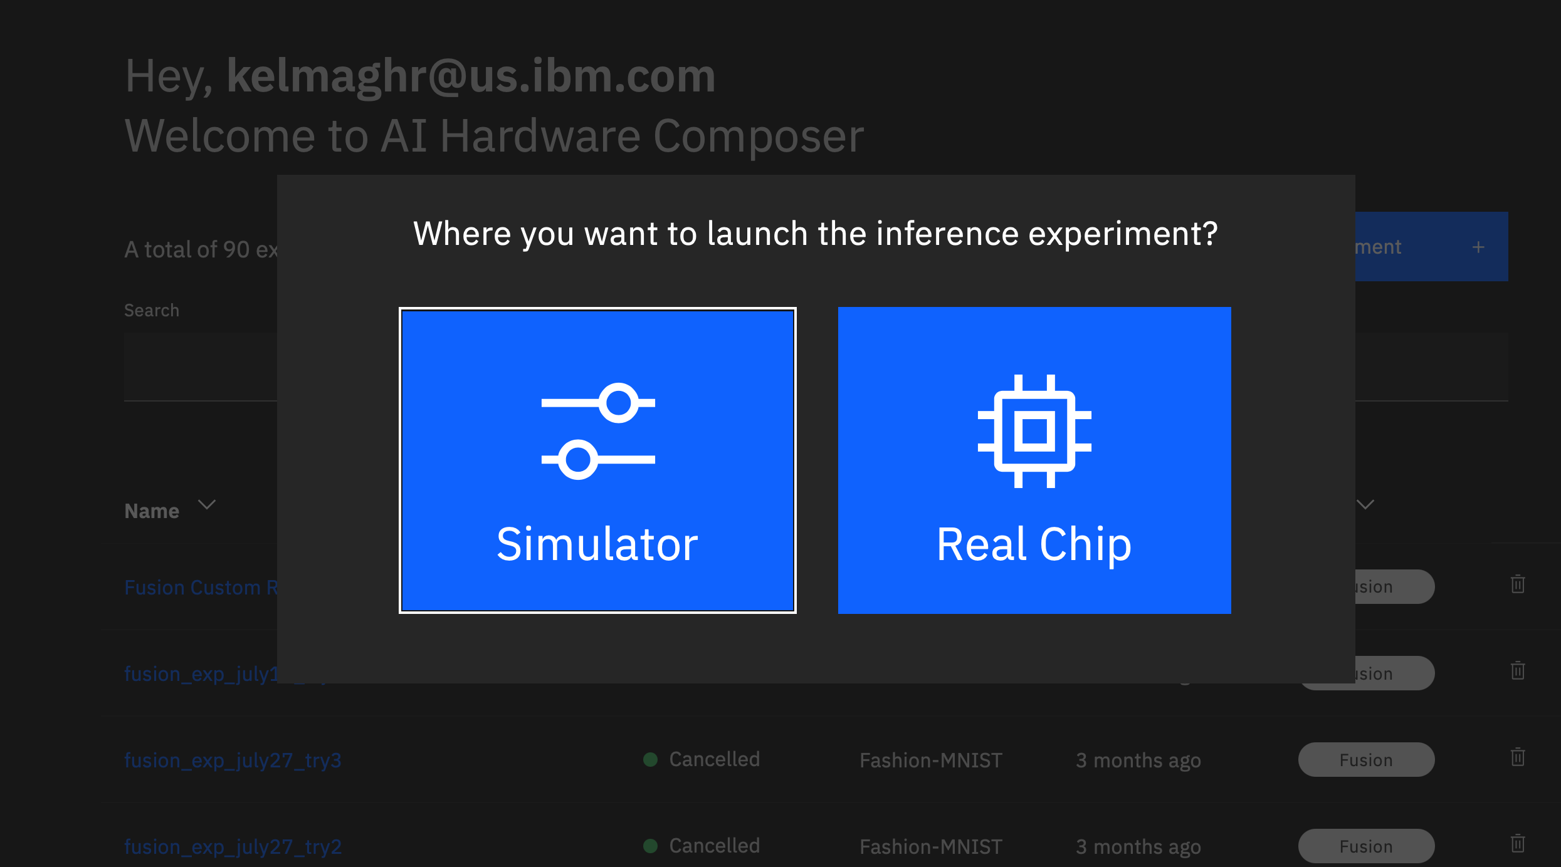
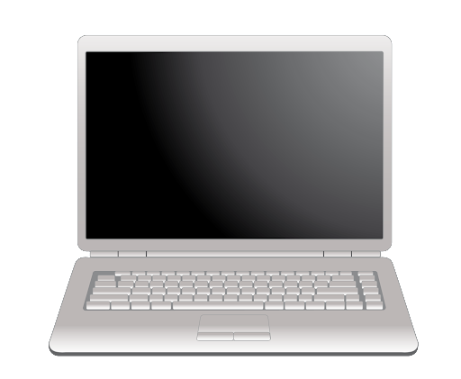
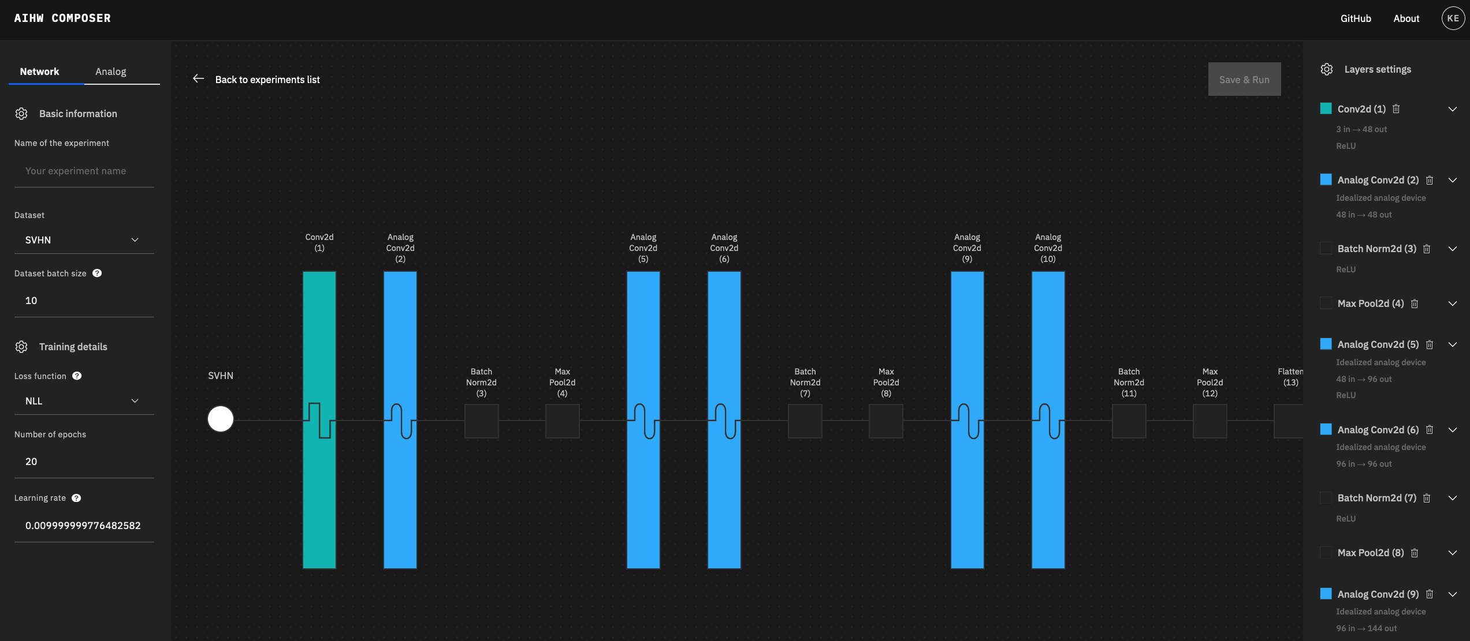
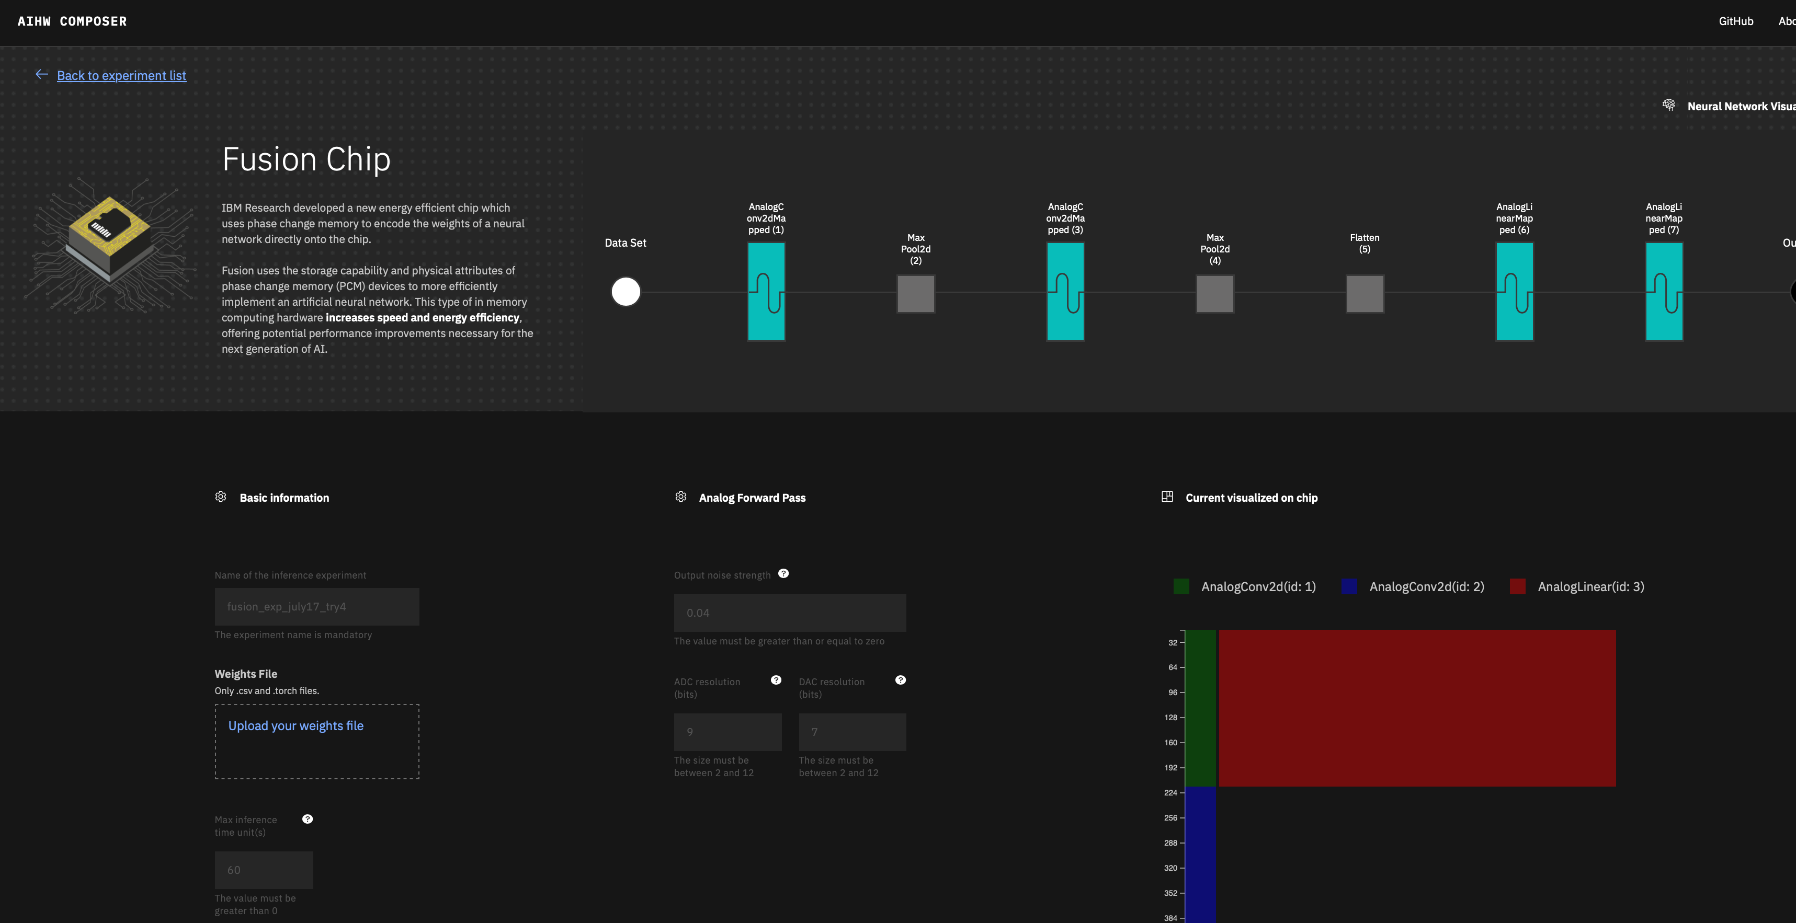
First of a Kind AIMC Chip Access
IBM Analog Cloud Composer
A brand-new Interactive Experience for Inference on Real Analog AI Hardware
Interactive Cloud Composer
No code experience. Explore training with analog and neural networks
https://aihw-composer.draco.res.ibm.com
New Release in January 2024

Slide 28
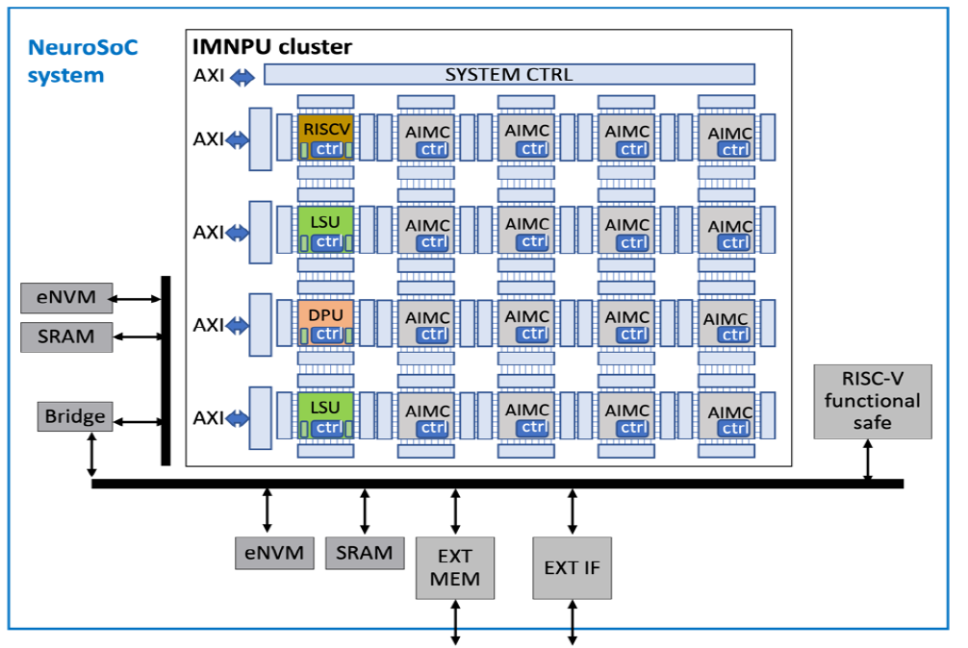
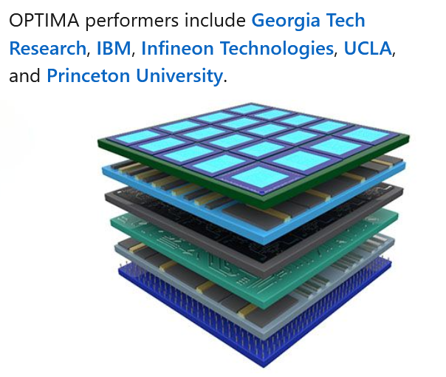

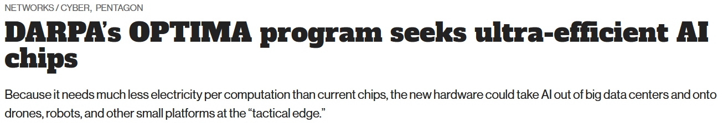
GOVERNMENT FUNDED PROJECTS

Slide 29
SUMMARY
Essential to reduce the energy consumption associated with realizing artificial neural networks
In-memory computing is a brain-inspired approach towards improving the computational efficiency of deep neural networks
Advanced research prototype chips demonstrate the feasibility of achieving software-equivalent accuracies as well as seamless interface of analog computing with digital processing units
Significant on-going work on improved memory devices, tile periphery, heterogeneous architectures, algorithms, software and applications
Several opportunities for physicists to contribute to the research effort!

Slide 30
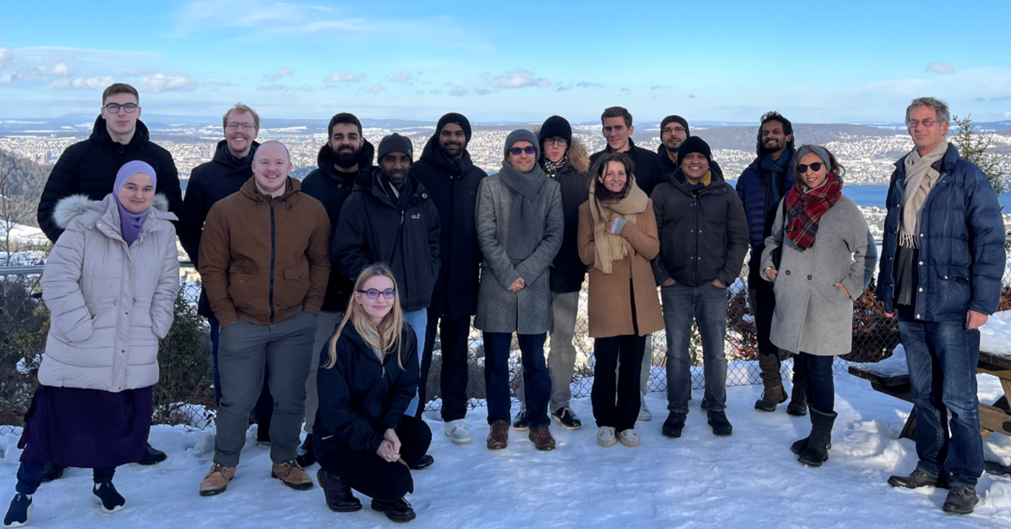
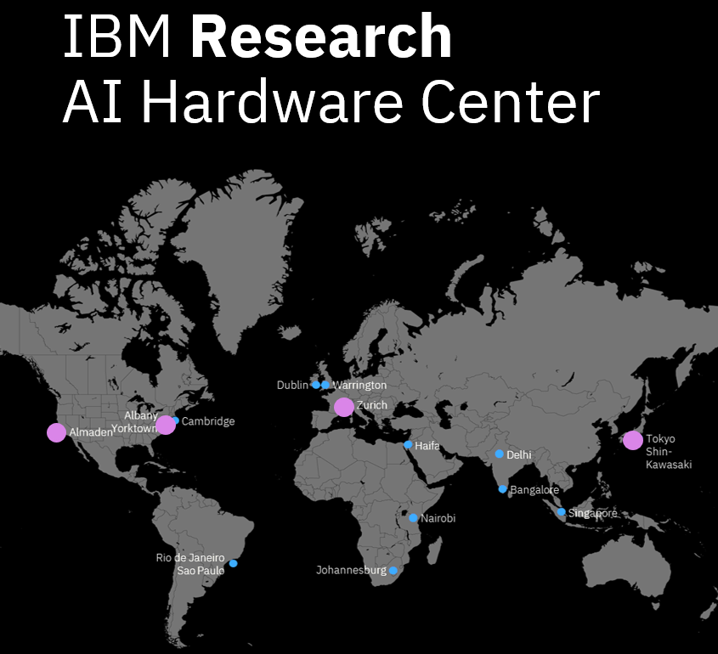





ACKNOWLEDGEMENTS
IBM Research – Zurich, Switzerland
IBM Research – Almaden, CA, USA (Geoffrey Burr, Sidney Tsai et al.)
IBM Research – Albany, NY, USA (Nicole Saulnier et al.)
IBM Research – Tokyo, Kawasaki, Japan (Kohji Hosokawa et al.)
IBM TJ Watson Research Center, NY, USA (Vijay Narayanan et al.)
KCL, Oxford, Patras, ETH Zürich, EPFL, WWU Münster, Heidelberg,
Groningen etc.

