Slide 1




Plasma light measurements with fast cameras
Arthur CLAIREMBAUD

Slide 2
Plasma light set-up
10 PMTs
Rb vapor source
3.5m
5m
9.5m
Motivation
1 Basler camera
2 Fast cameras
Consistency between signal of PMTs and cameras
Plasma light shape in the vapor source
Effect of a plasma density step
39us of no signal + 1us of signal
1us integration time

Slide 3
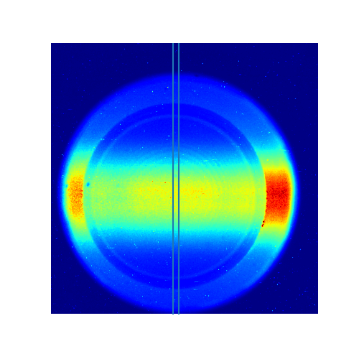
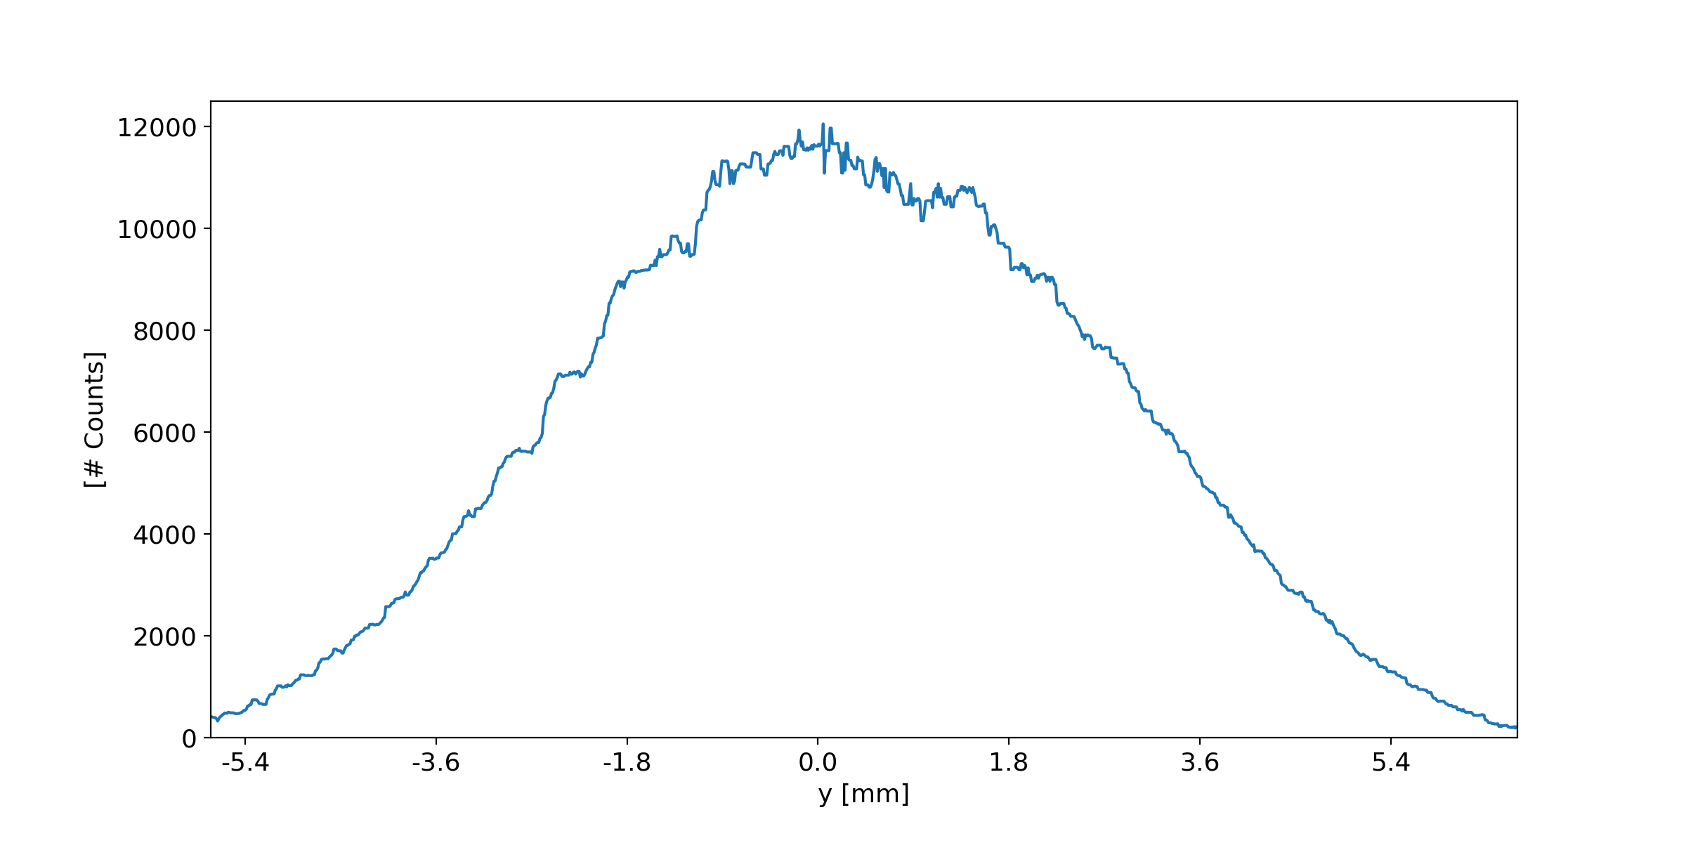
Signal of the cameras
16 bits camera : 2^16 = 65535
Lineout is taken for light in the window (remove reflections)
Background subtracted
Raw image – Fast camera
Reflections of the plasma light on the viewport
Lineout at the center of the image

Slide 4
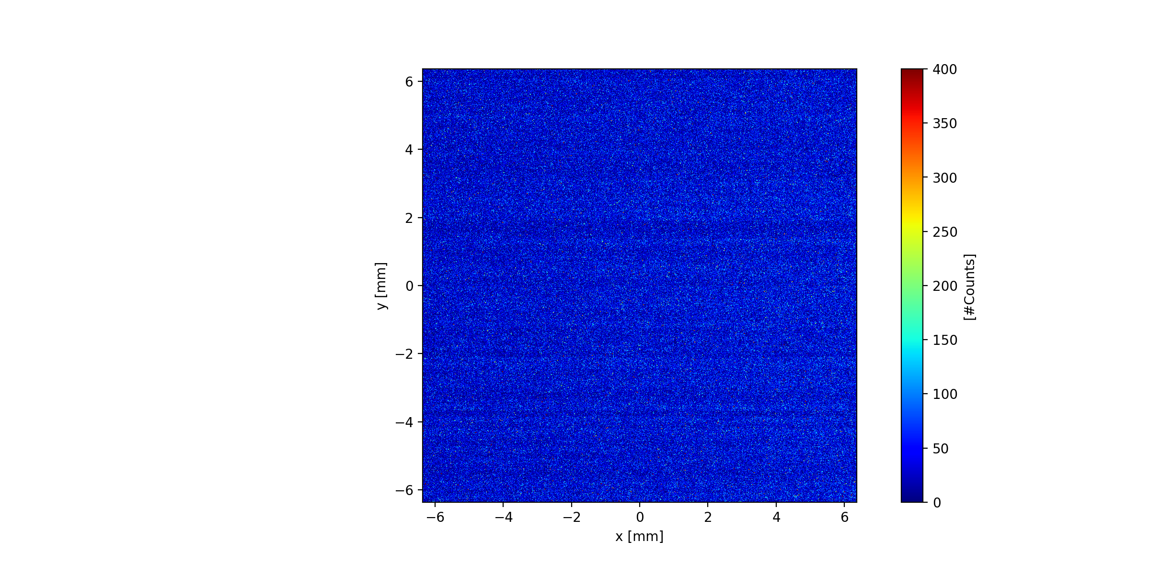
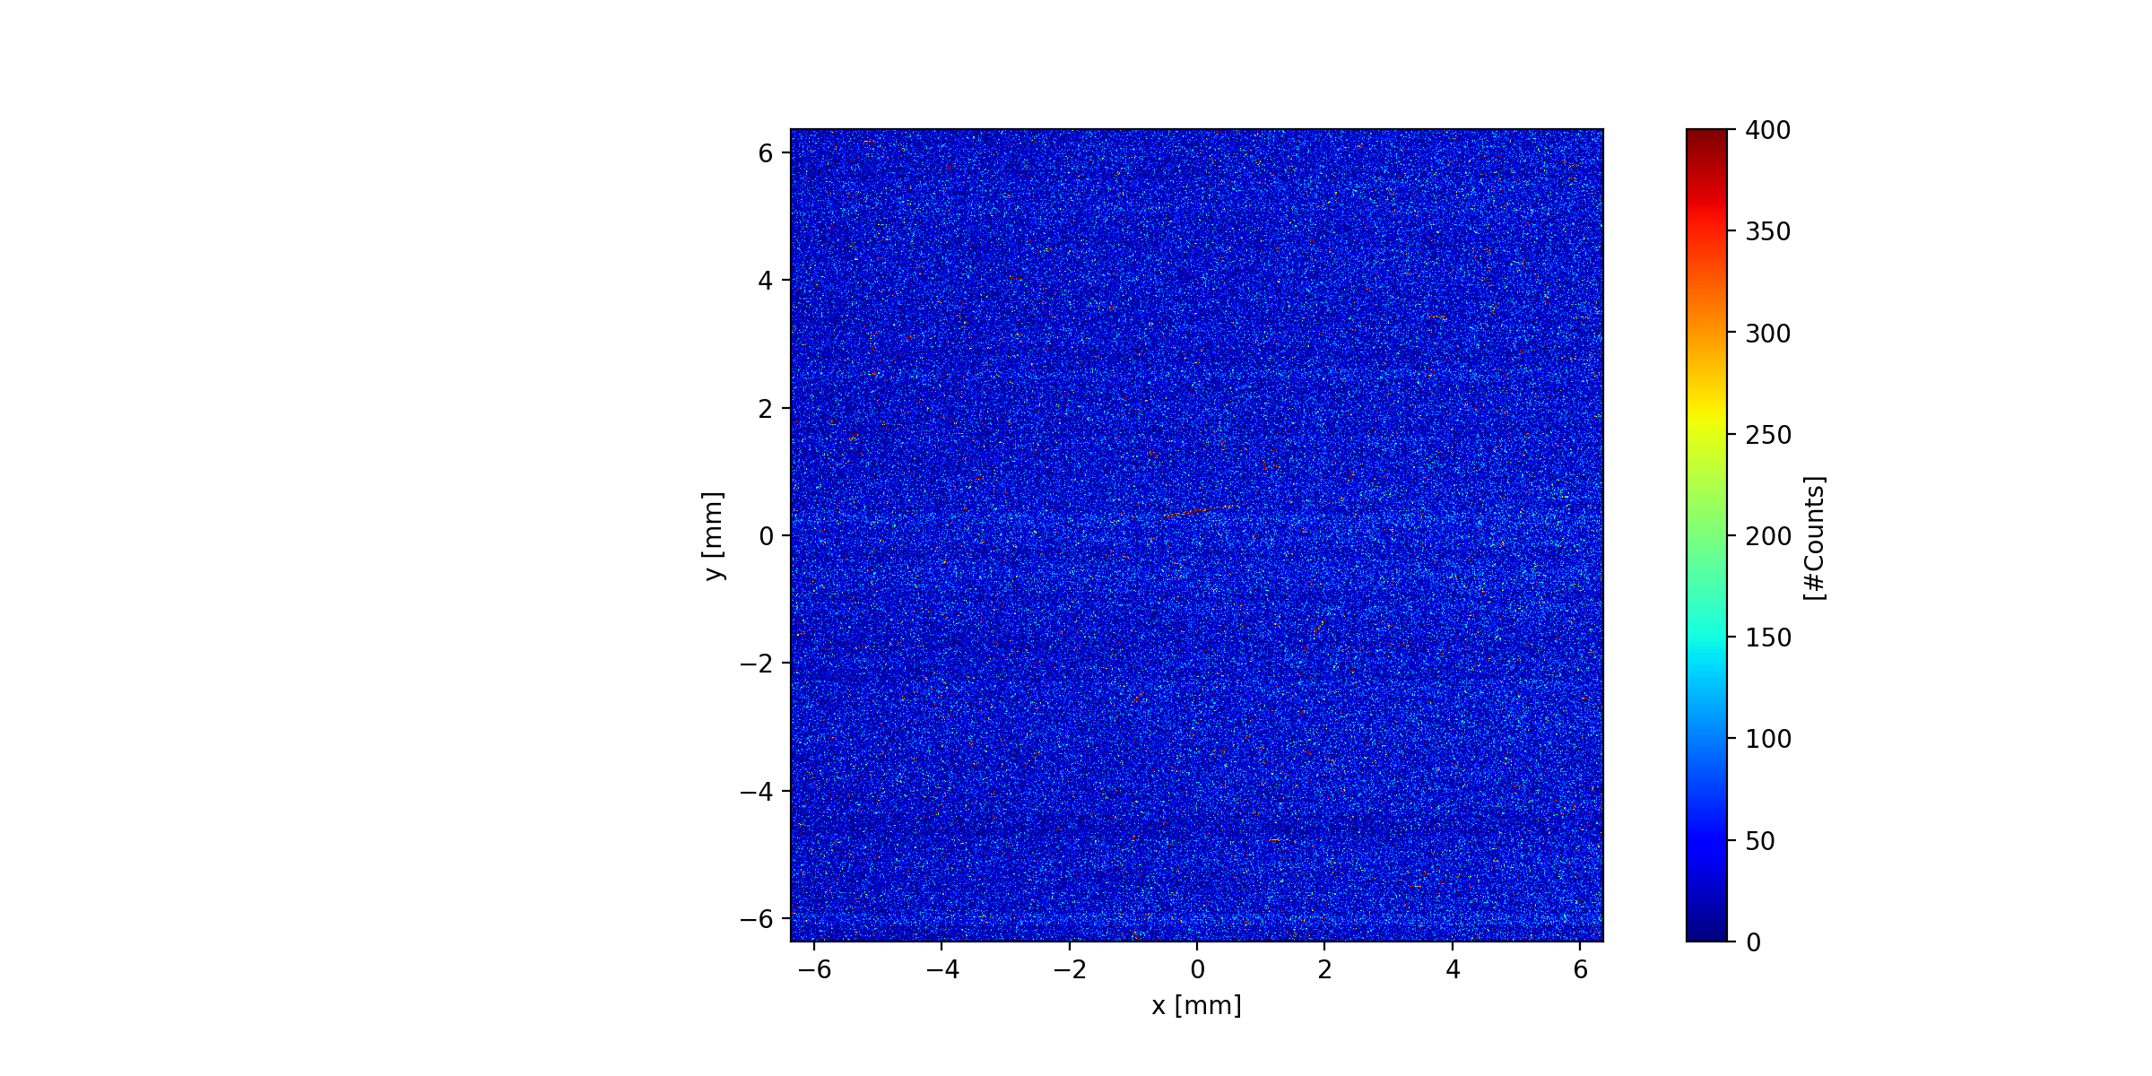
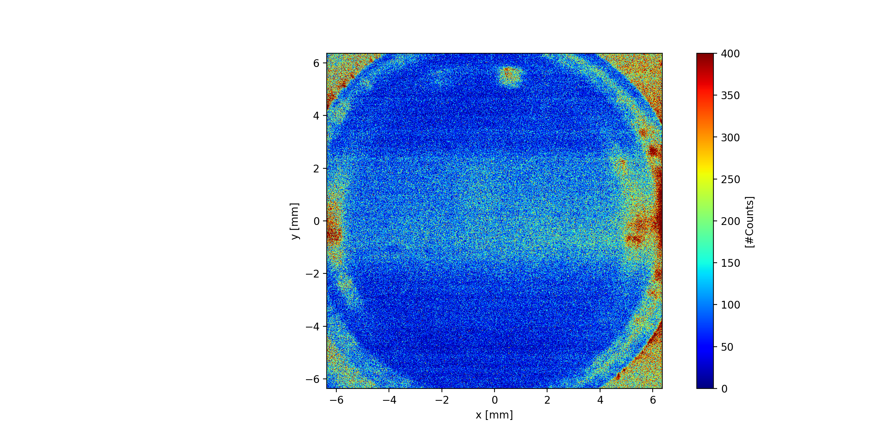
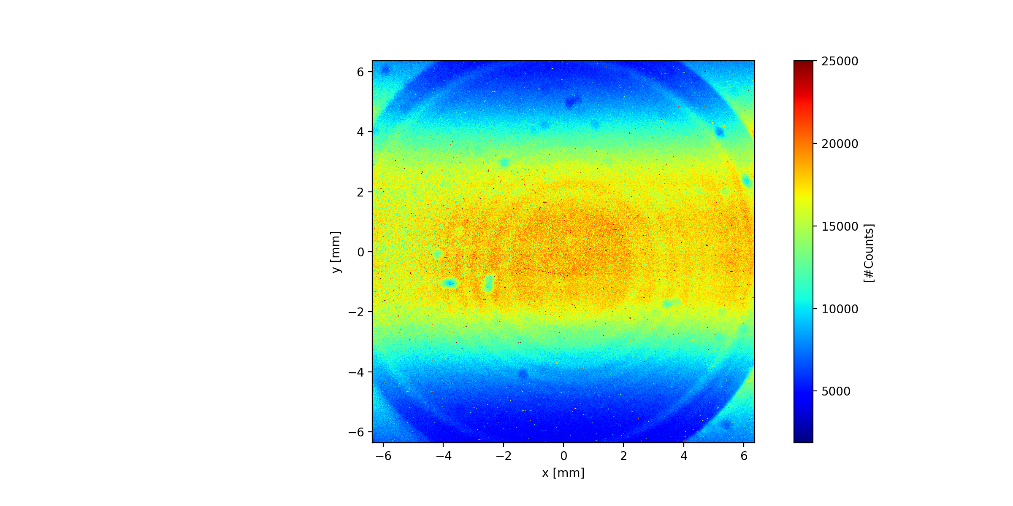
Wakefield light ?
Electronic background | Protons | Laser | Laser + Protons
vmax = 400
vmax = 25000
Light observed comes from energy deposited by proton bunch when propagating in plasma
Comes from kinetic energy lost by wakefield electrons after the passage of proton bunch

Slide 5
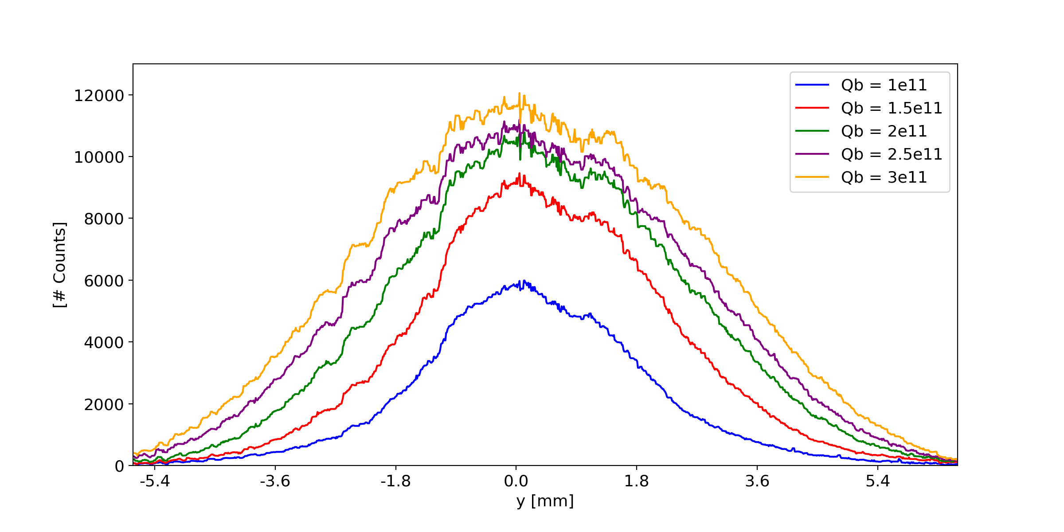
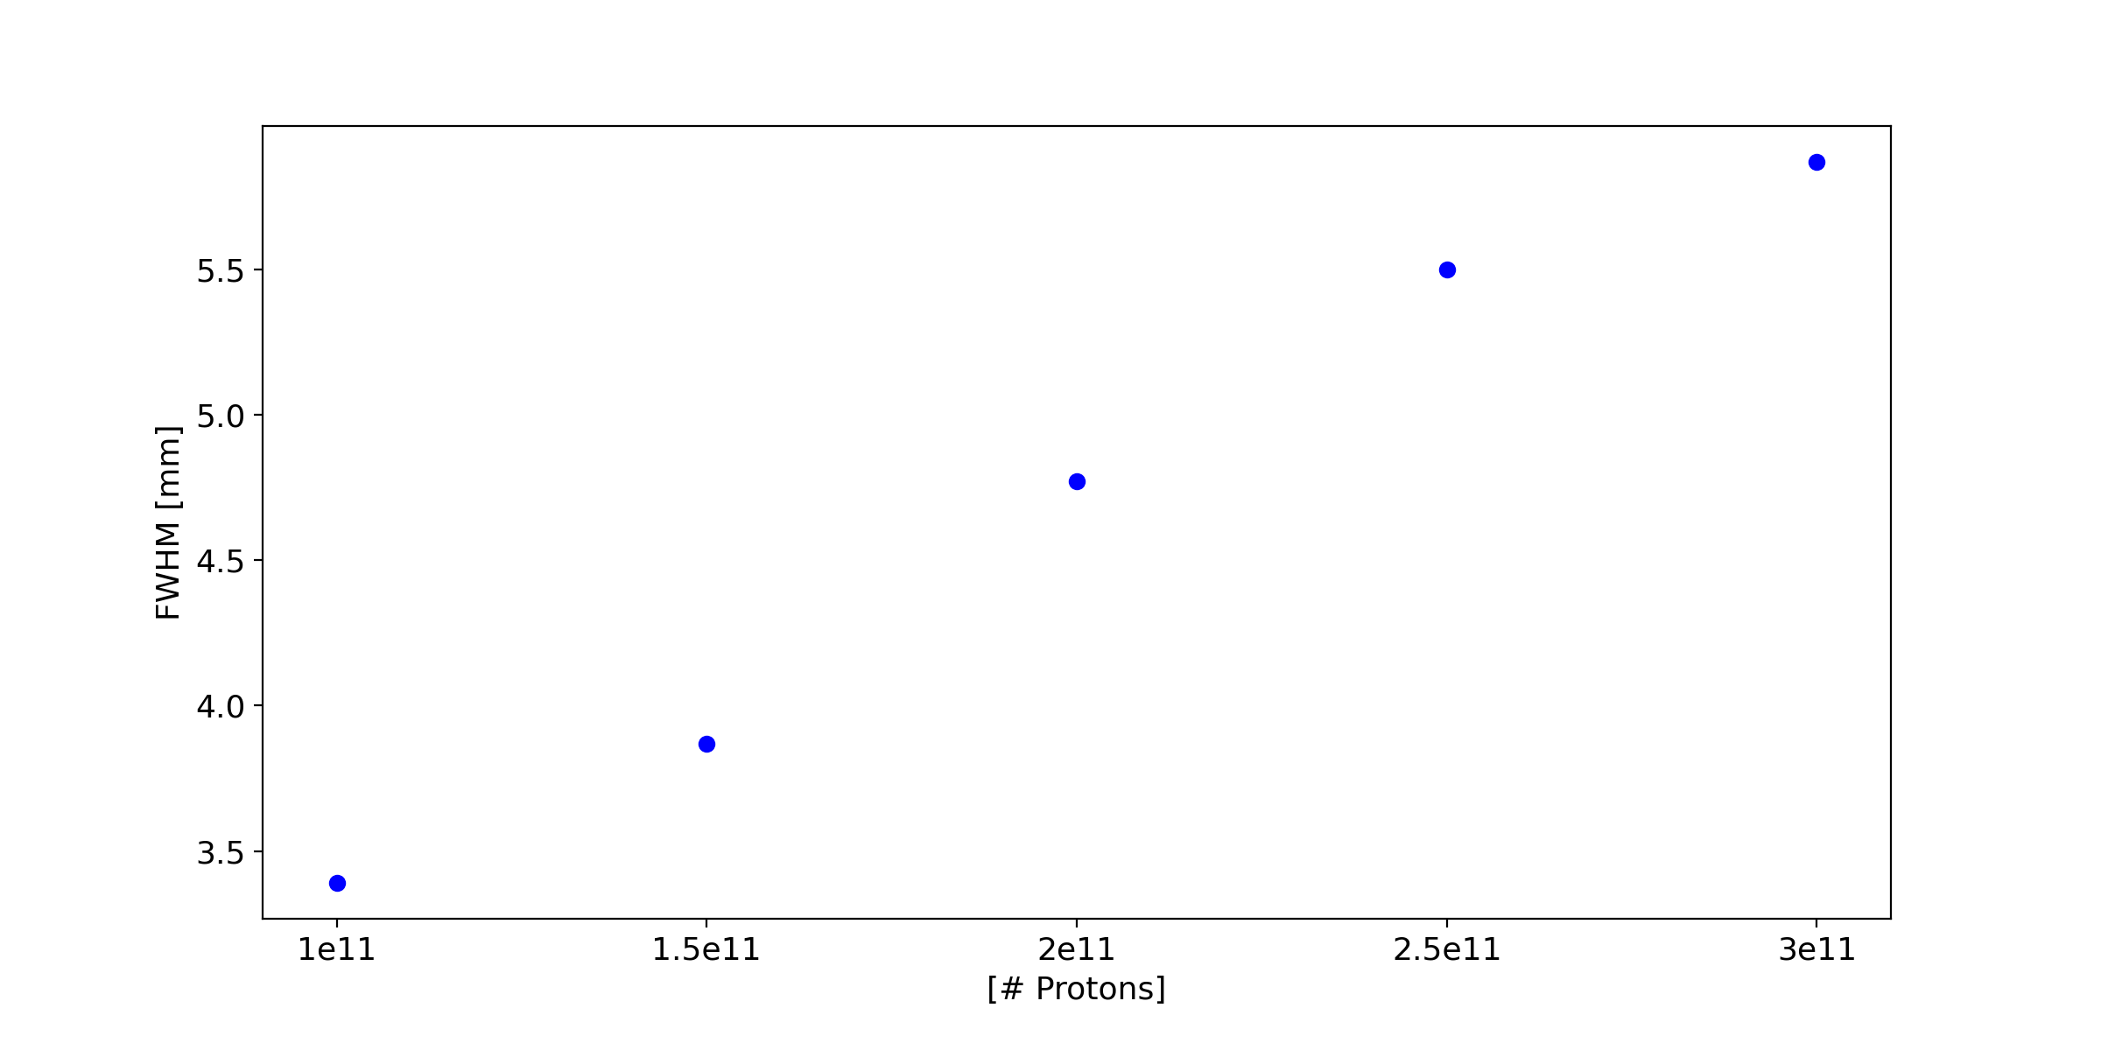
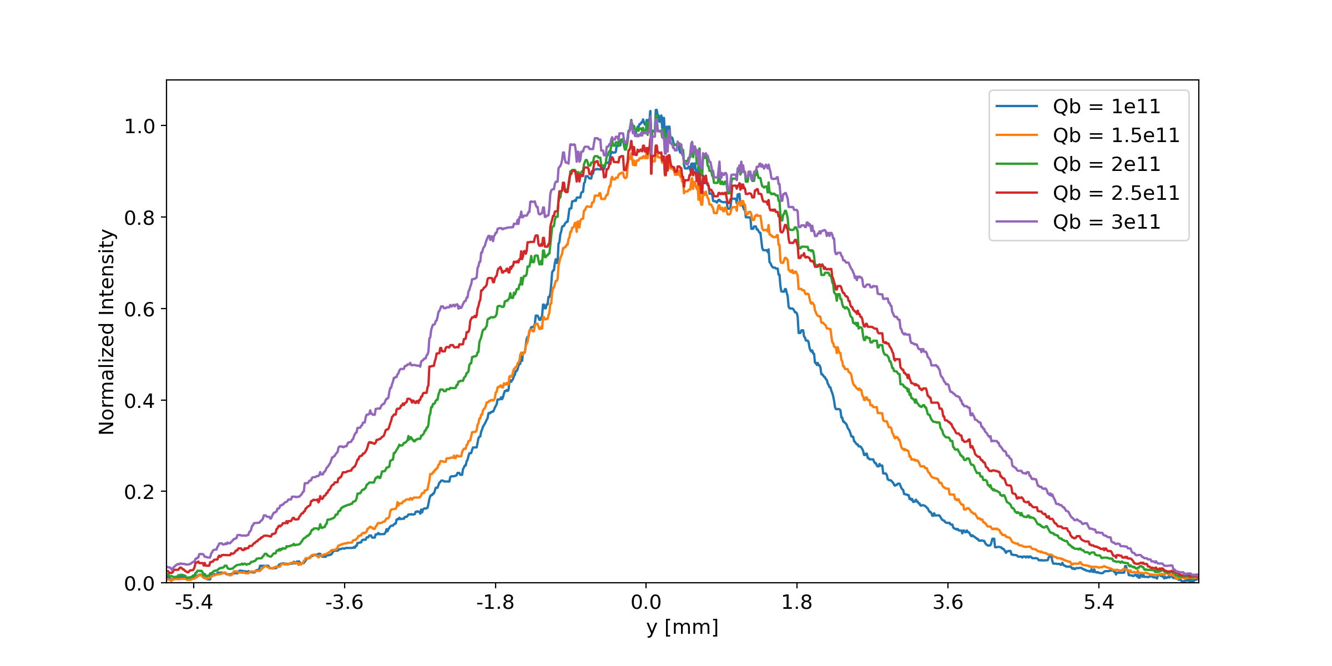
Shape of the signal
Uniform plasma density – npe = 3.7e14/cc
Bunch population scan
RIF position 3 sigma SMI (unseeded)
Integration
Averaged over 20 events
Shape of plasma light column changes with bunch population or light intensity
FWHM from 3.5 to 5.8 mm
5 m

Slide 6
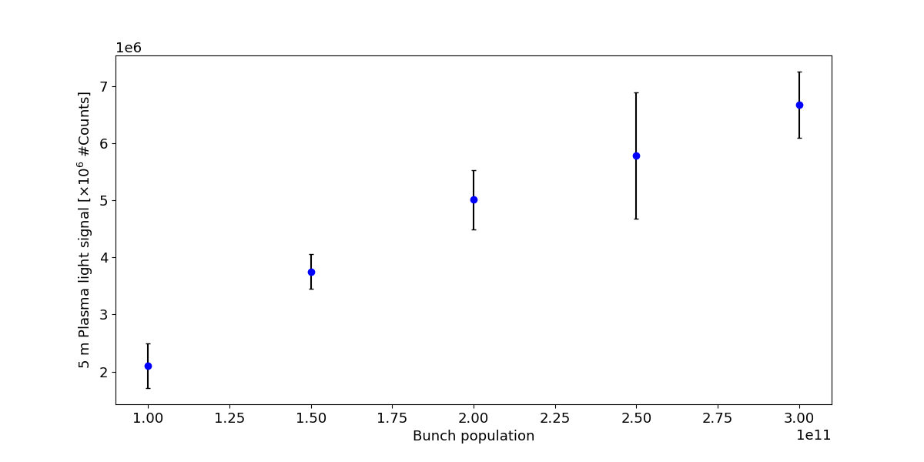
Integrated signal
Uniform plasma density – npe = 3.7e14
RIF position 3 sigma SMI (unseeded)
Proton bunch population scan
Error bars = r.m.s for 20 events
Signal increases with bunch population
Linear increase
From 1e11 to 3e11 – 3 times more signal
5 m

Slide 7
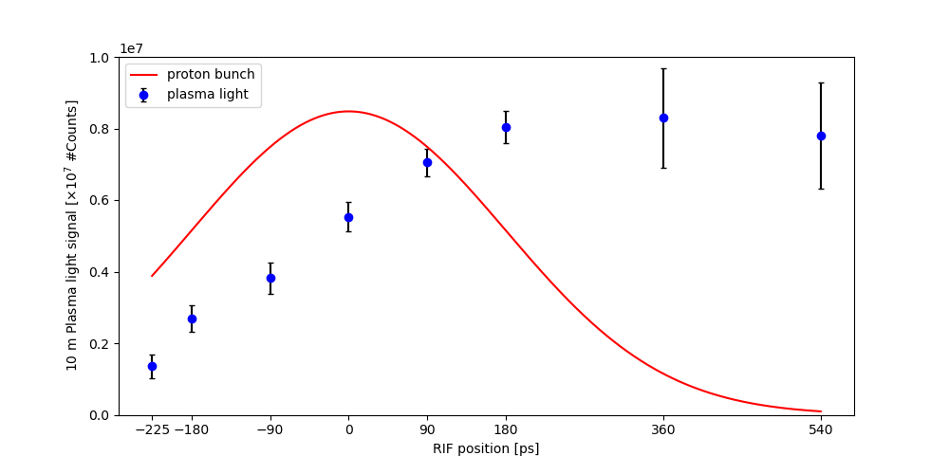
Reproducibility and RIF scan
Uniform plasma density – npe = 3.7e14
Bunch population – Qb = 2.85e11
Different RIF position
9.5 m camera light
Sigma = 180ps
Error bars = r.m.s for 20 events
Position of RIF along bunch determines signal level: number of protons driving wakefields
Position of RIF affects reproducibility in signal
Clear difference between seeded and unseeded (SSM vs SMI) in r.m.s. variations
SSM
SMI

Slide 8
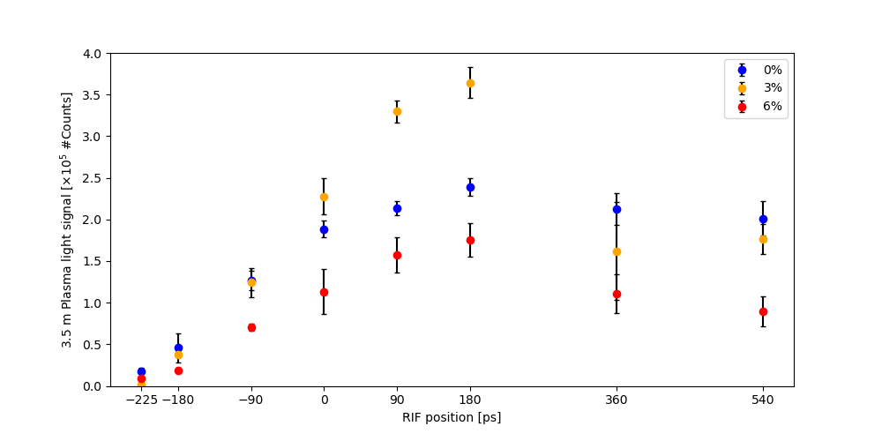
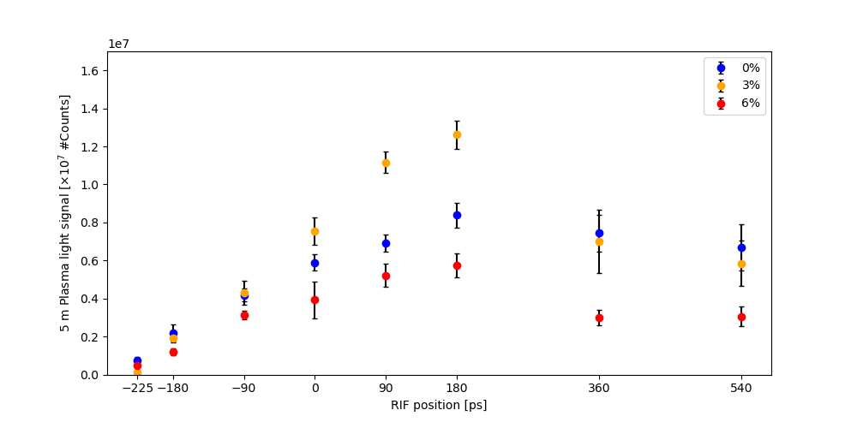
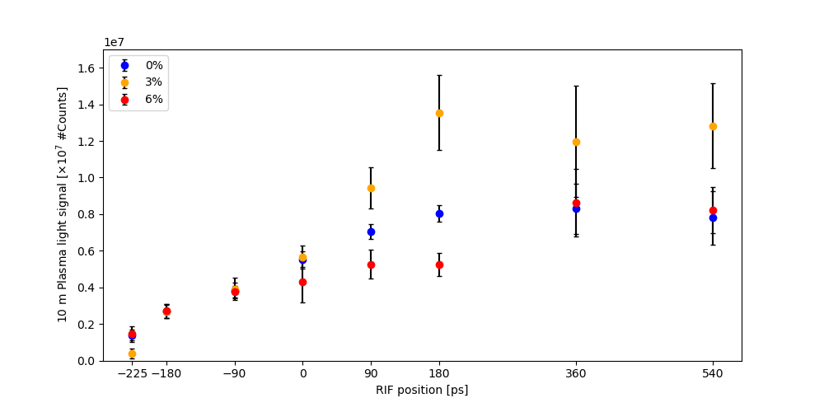
With and without step
3.5 m
n_pe = 3.7e14
Qb = 2.85e11
Step position : z = 1.75m
3 % step at RIF position 1 sigma (180ps):
  Signal increase 52% at 3.5m
  Signal increase 50% at 5m
  Signal increase 69% at 9.5m
6 % step:
  Signal lower at any RIF position and at any position along plasma
Lower reproducibility at 10m with 3% step ?
5 m
9.5 m

Slide 9
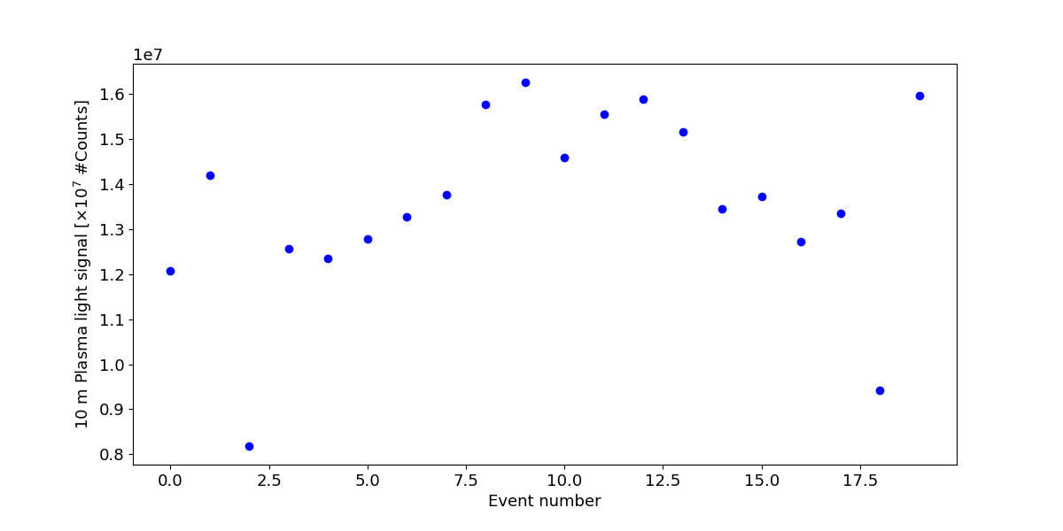
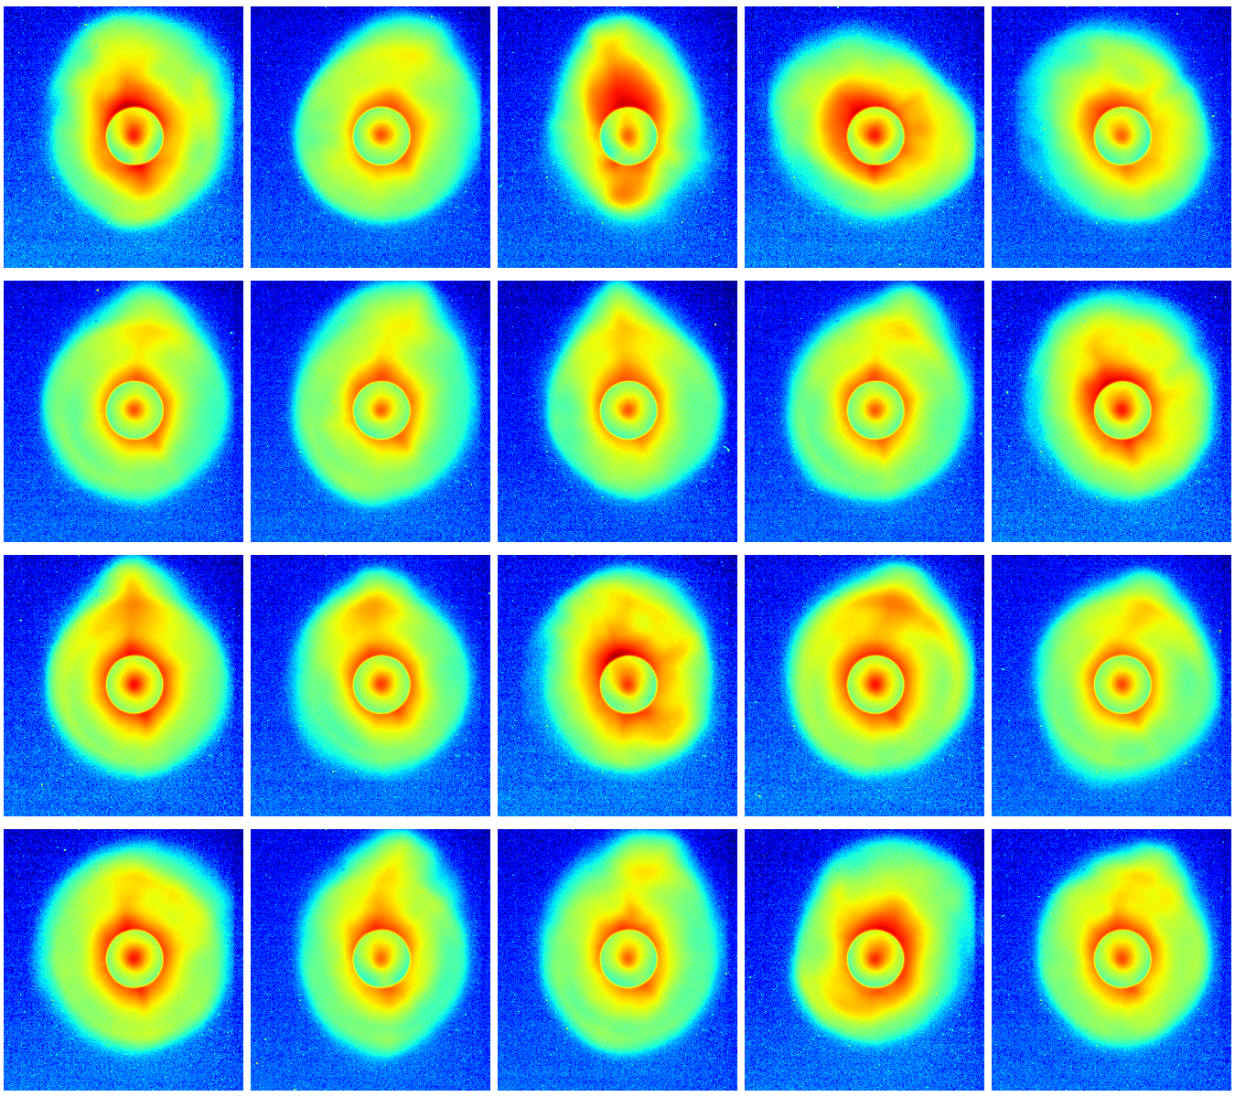
Intensity variations
Halo 442 camera
9.5 m – 3% step
20 events – Plasma light intensity and transverse distribution of protons at IS2

Slide 10
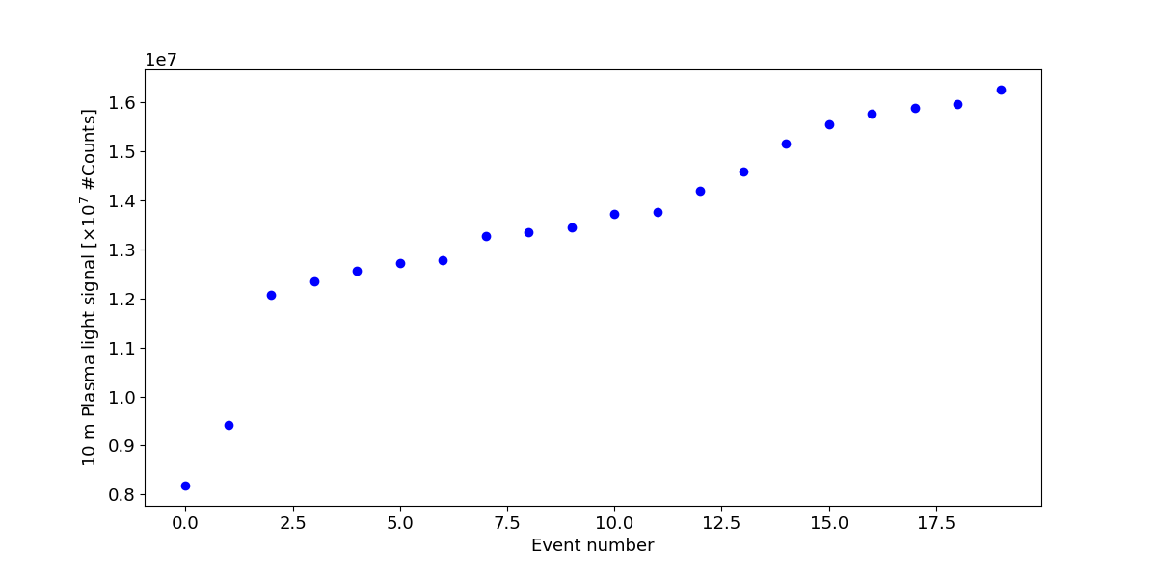
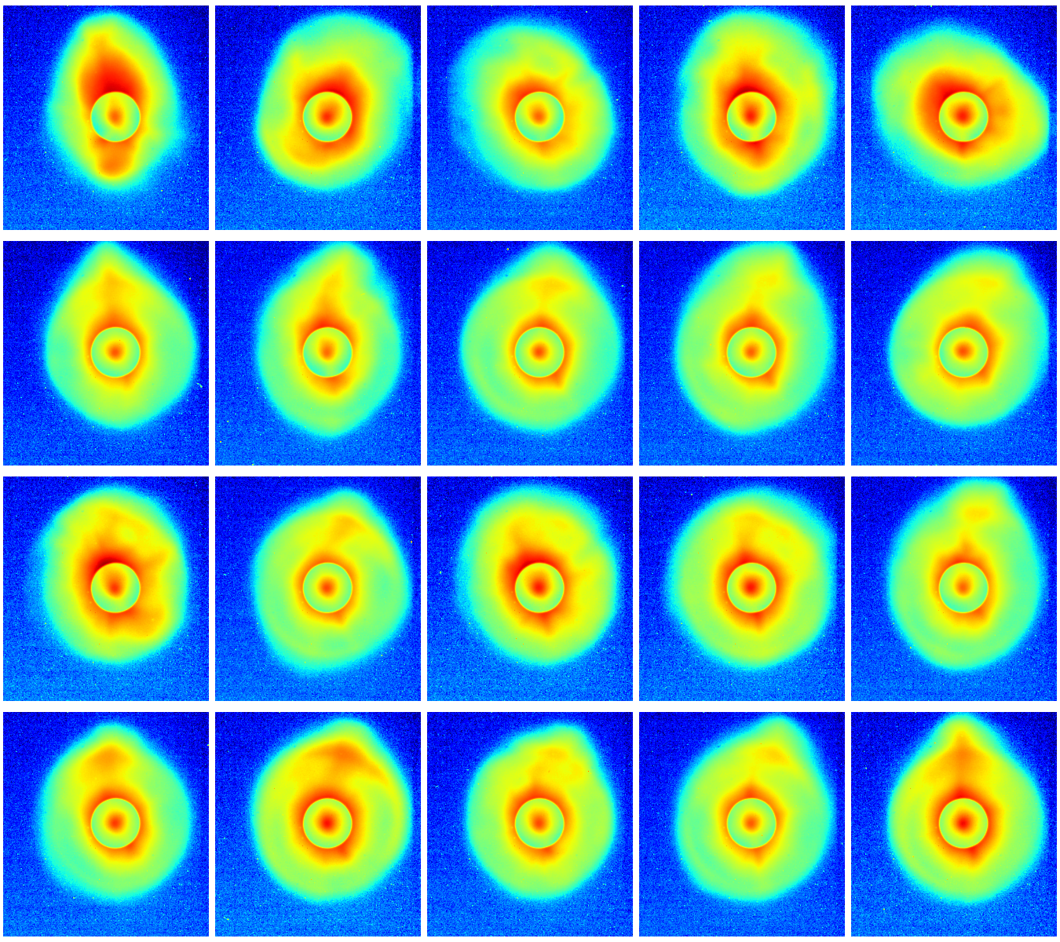
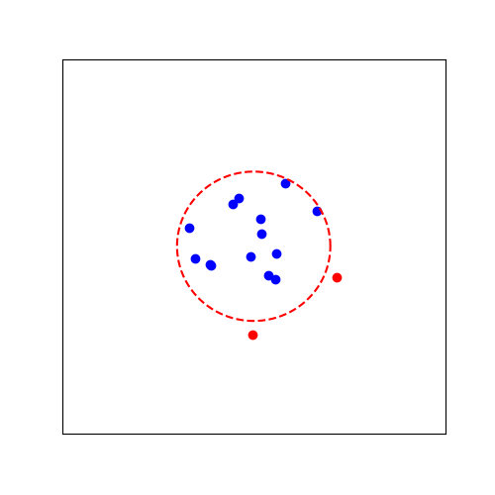
Intensity variations
Halo 442 camera - sorted
9.5 m – 3% step – sorted
Laser position at IS1 – VLC5
0.5 mm radius
circle centered on mean position
Asymmetric halos ➔ less plasma light when seeded

Slide 11
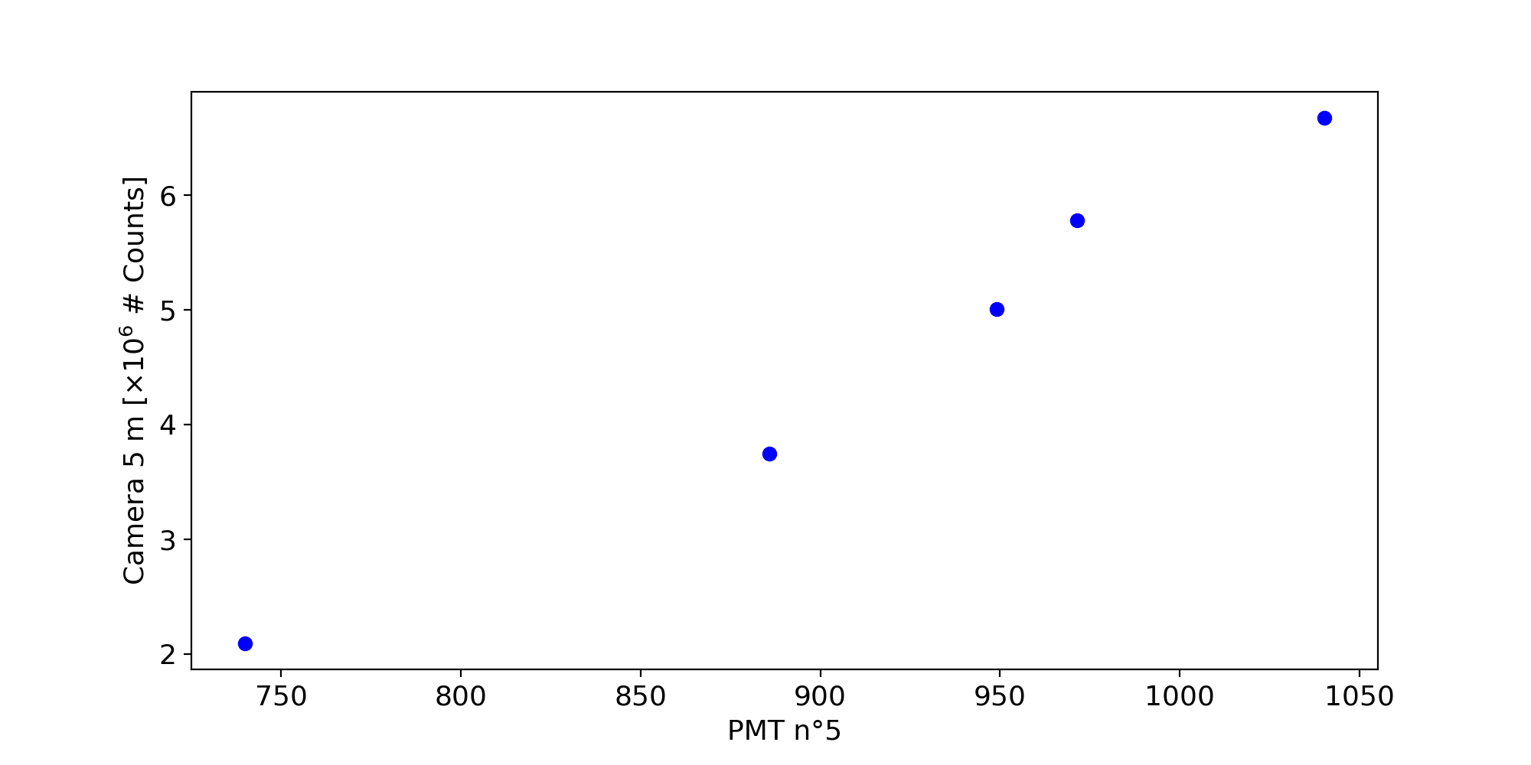
Consistency PMTs / Cameras
Fast Camera vs PMT – 5m
Uniform plasma density – npe = 3.7e14
RIF position = 3 sigma (SMI)
Bunch population scan
PMT and camera show same trends
Variations of signal usually larger with cameras than PMTs
Factor of 3 on camera 5m – factor of 1.3 on PMT5

Slide 12
Summary and conclusion
We observe that:
Plasma light signal increases with bunch population
Plasma light column expands with signal intensity (at 5m and 10m – lower expansion at 3.5m)
Plasma light signal more reproducible with SSM – largest at intensity RIF = 1 sigma
3% at 1.75m (npe = 3.7e14) density step increases plasma light signal at all three positions (z = 3.5 m, z = 5 m, z = 9.5m) by 50% or more
6% density step decreases signal everywhere
Plasma light signal can be related to other diagnostics (halo cameras) when proton-laser alignment is off
Consistency in trends with PMTs but signal variations larger with cameras
Next run: 1 camera in front of each PMT

