Slide 1


Summary of Scalable Plasma Source Internal Review
Edda Gschwendtner, CERN
AWAKE Collaboration Meeting, 4 – 6 October 2023

Slide 2
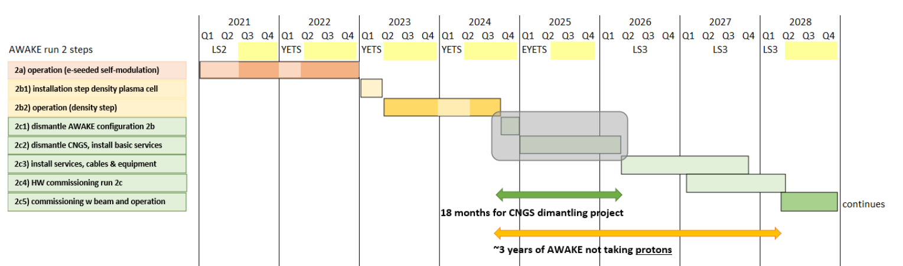
AWAKE Run 2 Timeline
Scalable plasma source R&D
2d1) scalable plasma design, installation
2d2) scalable plasma commissioning and operation
Decision scalable plasma source in Run 2c

Slide 3
Scalable Plasma Source R&D
Scalable Plasma Source R&D
1) R&D 2021-2024: Address physics and technical challenges
Helicon Plasma Source
Discharge Plasma Source
Demonstrate AWAKE nominal density
Development and test of high reproducibility, low jitter pulsed power supplies for ignition and heating
Study and optimize different electrode materials/geometries
Arc discharge plasma simulations
Development/share of plasma diagnostics with HPS
Demonstrate AWAKE nominal density
First assessment of axial plasma density uniformity (Nov 2021)
Development of plasma diagnostics with high accuracy
2) R&D 2021-2024 Address physics and technical challenges
Helicon Plasma Source
Discharge Plasma Source
Design and build scalable tunnel-compatible prototype
Tailor all required parameters to achieve desired density x homogeneity
Guarantee stable and reproducible control and operation
Trade off to scale properly address physics and technical challenges
Optimize with extensive modeling and plasma diagnostics deployment
Design and build scalable tunnel-compatible prototype
Tailor all required parameters to achieve desired density x homogeneity
Guarantee stable and reproducible control and operation
Test different common anode/cathode schemes for scalability
Proof of principle possible YETS 2022/23 test in tunnel 2a and 2b

Slide 4
Scalable Plasma Sources: From R&D to Tunnel
Scalable Plasma Source R&D
2) Implementation 2025-2028 (readiness for Run 2c)
Decision end 2024: three scenarios, cost-neutral:
Further studies needed: ➔ keep baseline of Rb vapour source as 2nd plasma source ➔ scalable sources in Run 2d
Decision for discharge source in Run 2c: ➔ save ~800kCHF (700kCHF DPS – 1400 kCHF for 2nd laser for 2nd Rb vapour source)
Decision for helicon plasma source in Run 2c: 2300kCHF HPS, save ~1400kCHF for 2nd laser, get contributions from institutes
Option 2) or 3): + 1 fellow + 3.2FTE.yrs (2025-2028)
HPS: ~2.3MCHF
DPS: ~0.7MCHF
Build test and document the tunnel 10m prototype cell and diagnistcs in dedicated surface infrastructure
Prepare tunnel integration/facilitites/interface/control, installation and commissioning

Slide 5
Scalable Plasma Source Internal Review, 29 Aug 2023
Charge to the reviewers (AWAKE management board):
How can the progress to achieve the deadline for end 2024 be improved?
What are the consequences if we can’t meet the deadlines?
How can we focus the investment?
Charge to the presenters:
What is the committment of the different institutes?
What is the state of the art?
Uniformity, density, reproducibility, industrialisation, status of diagnostics, etc…
How do you organize yourself?
workforce, budget, resources
R&D at CERN vs R&D at institutes
What’s your plan?

Slide 6
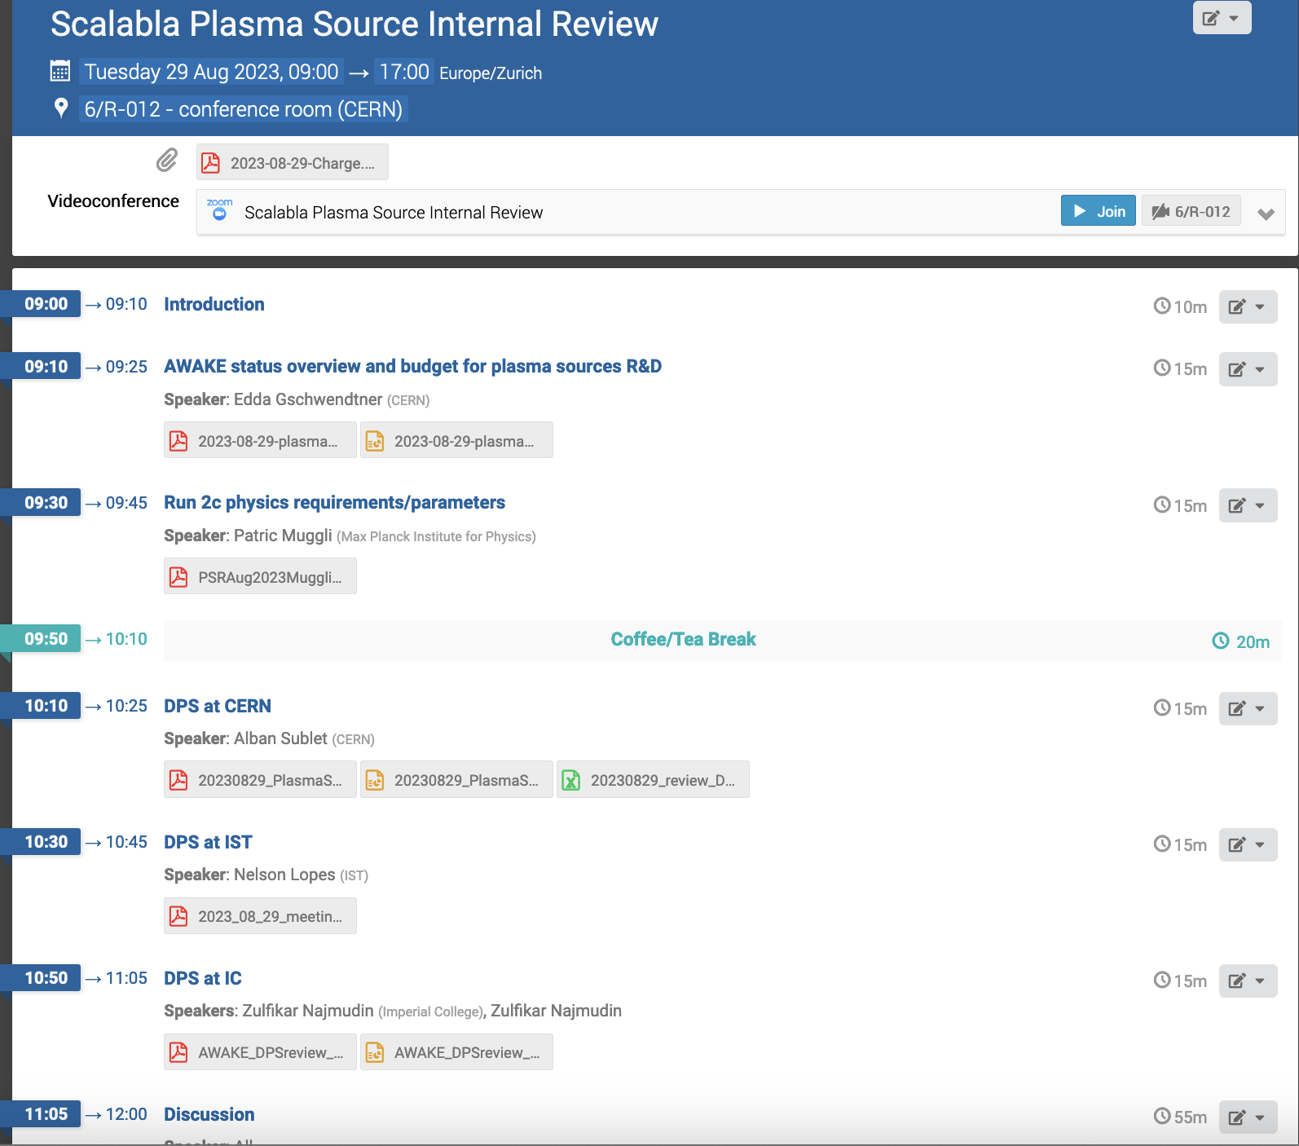

Slide 7
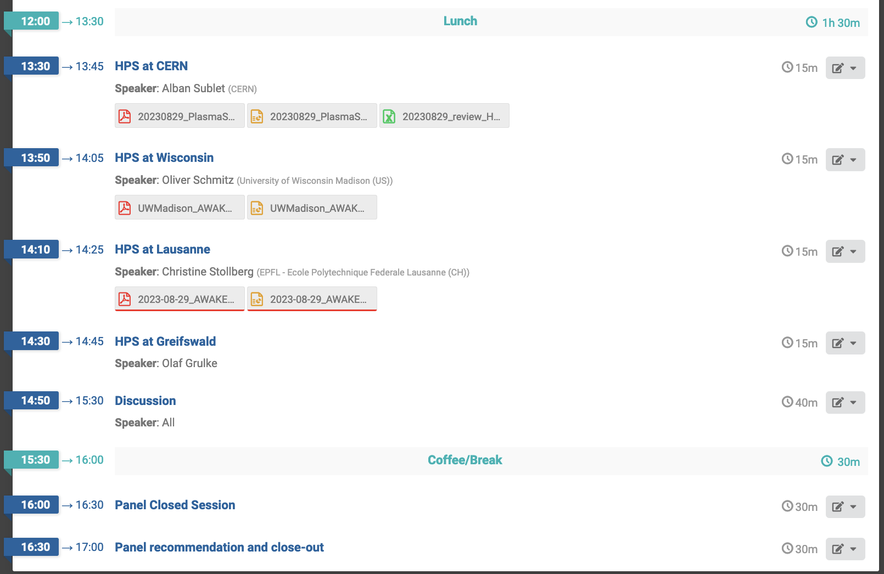

Slide 8
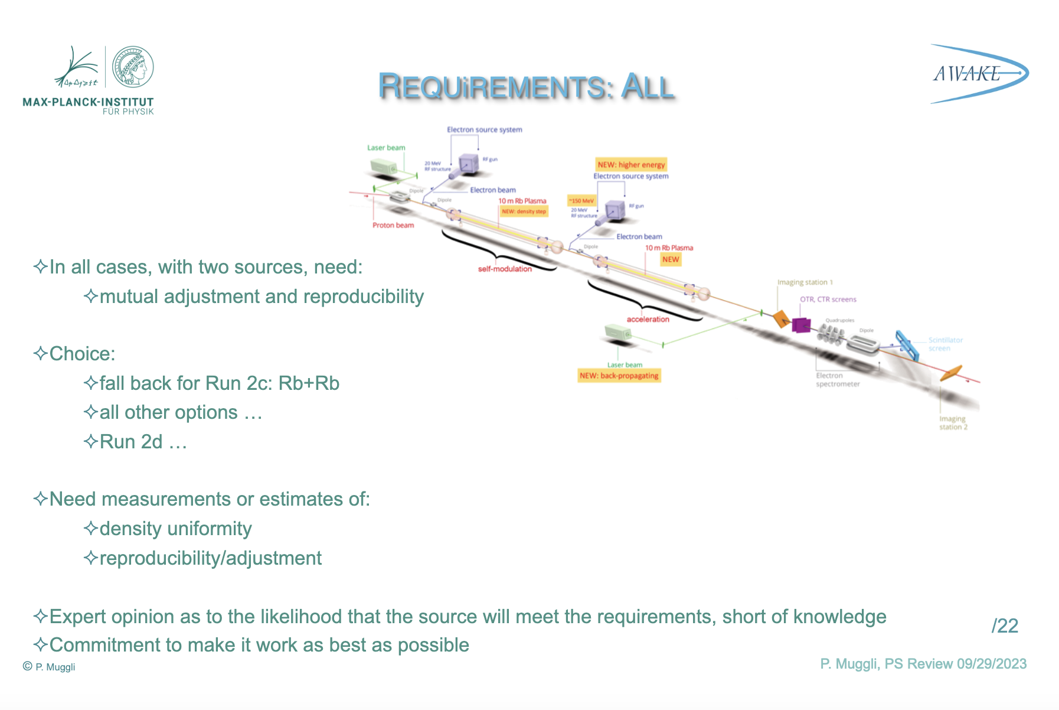
Patric

Slide 9
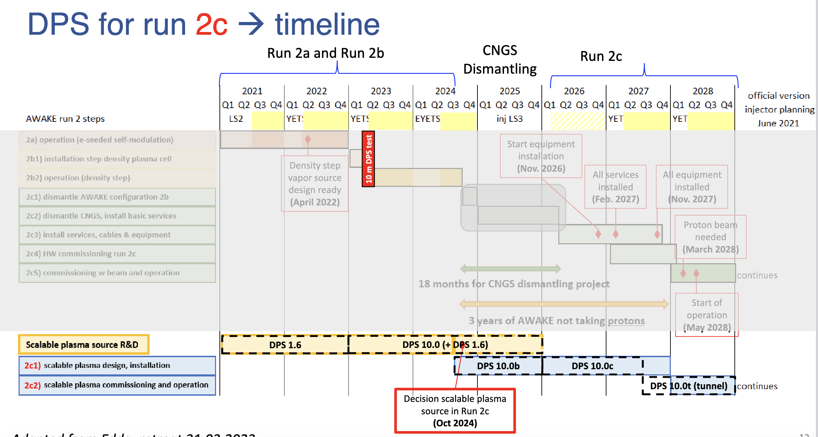
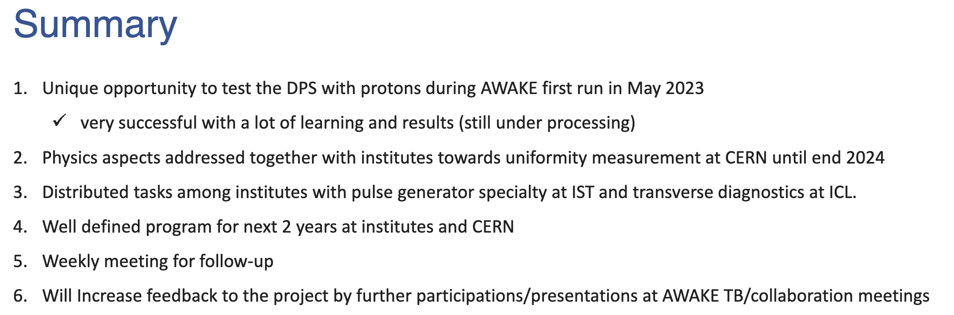
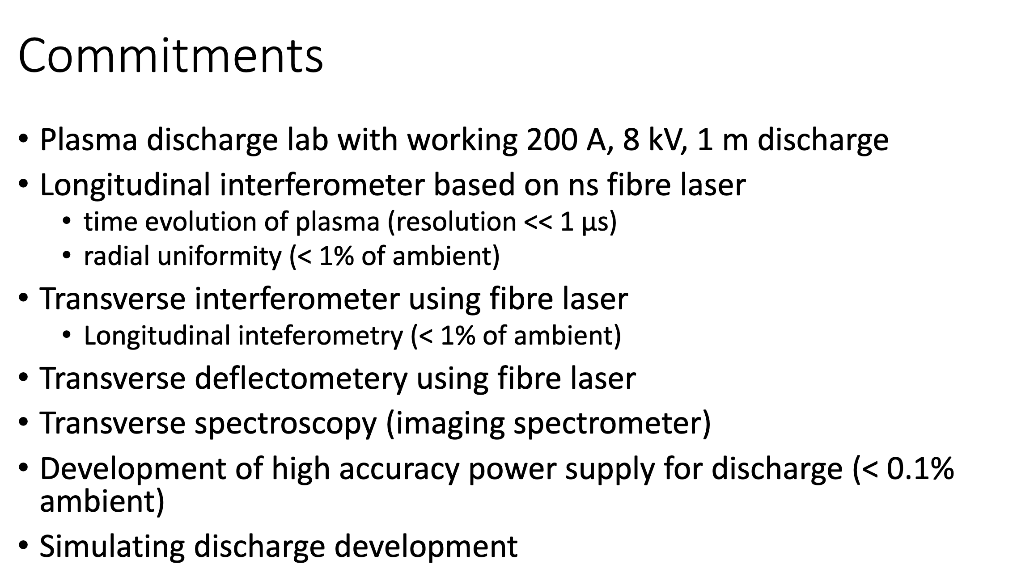
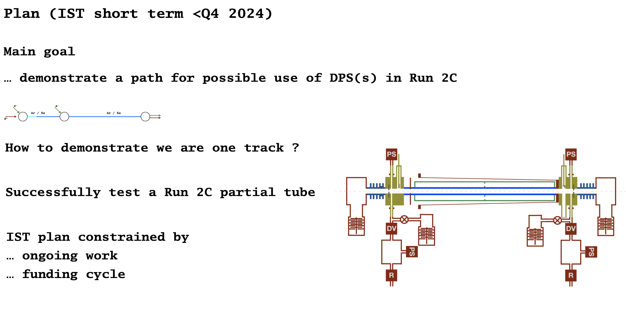
DPS, CERN, Alban
DPS, IC, Zulfikar
DPS, IST, Nelson

Slide 10
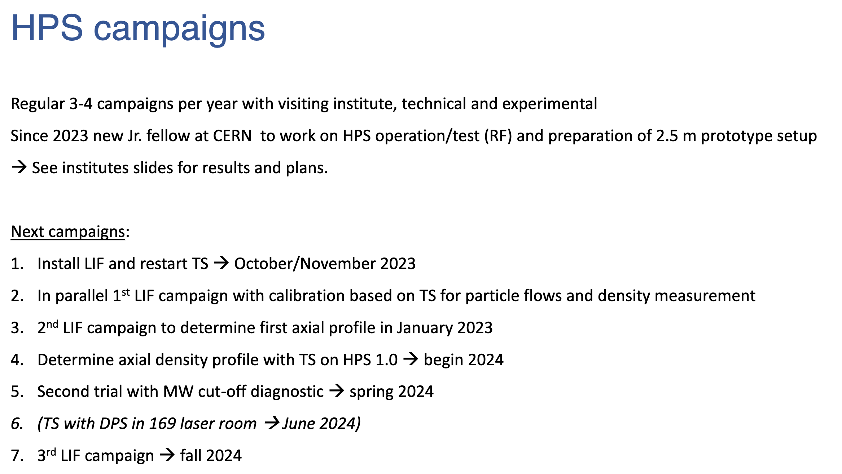
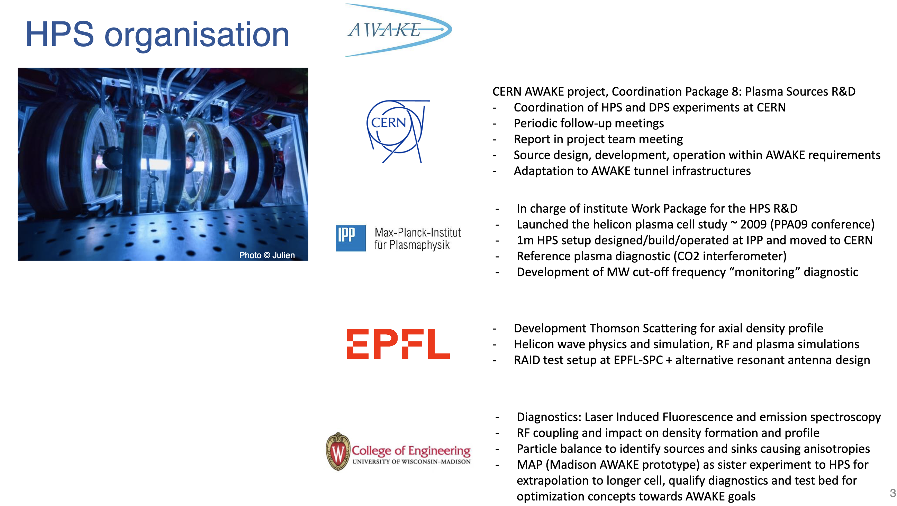
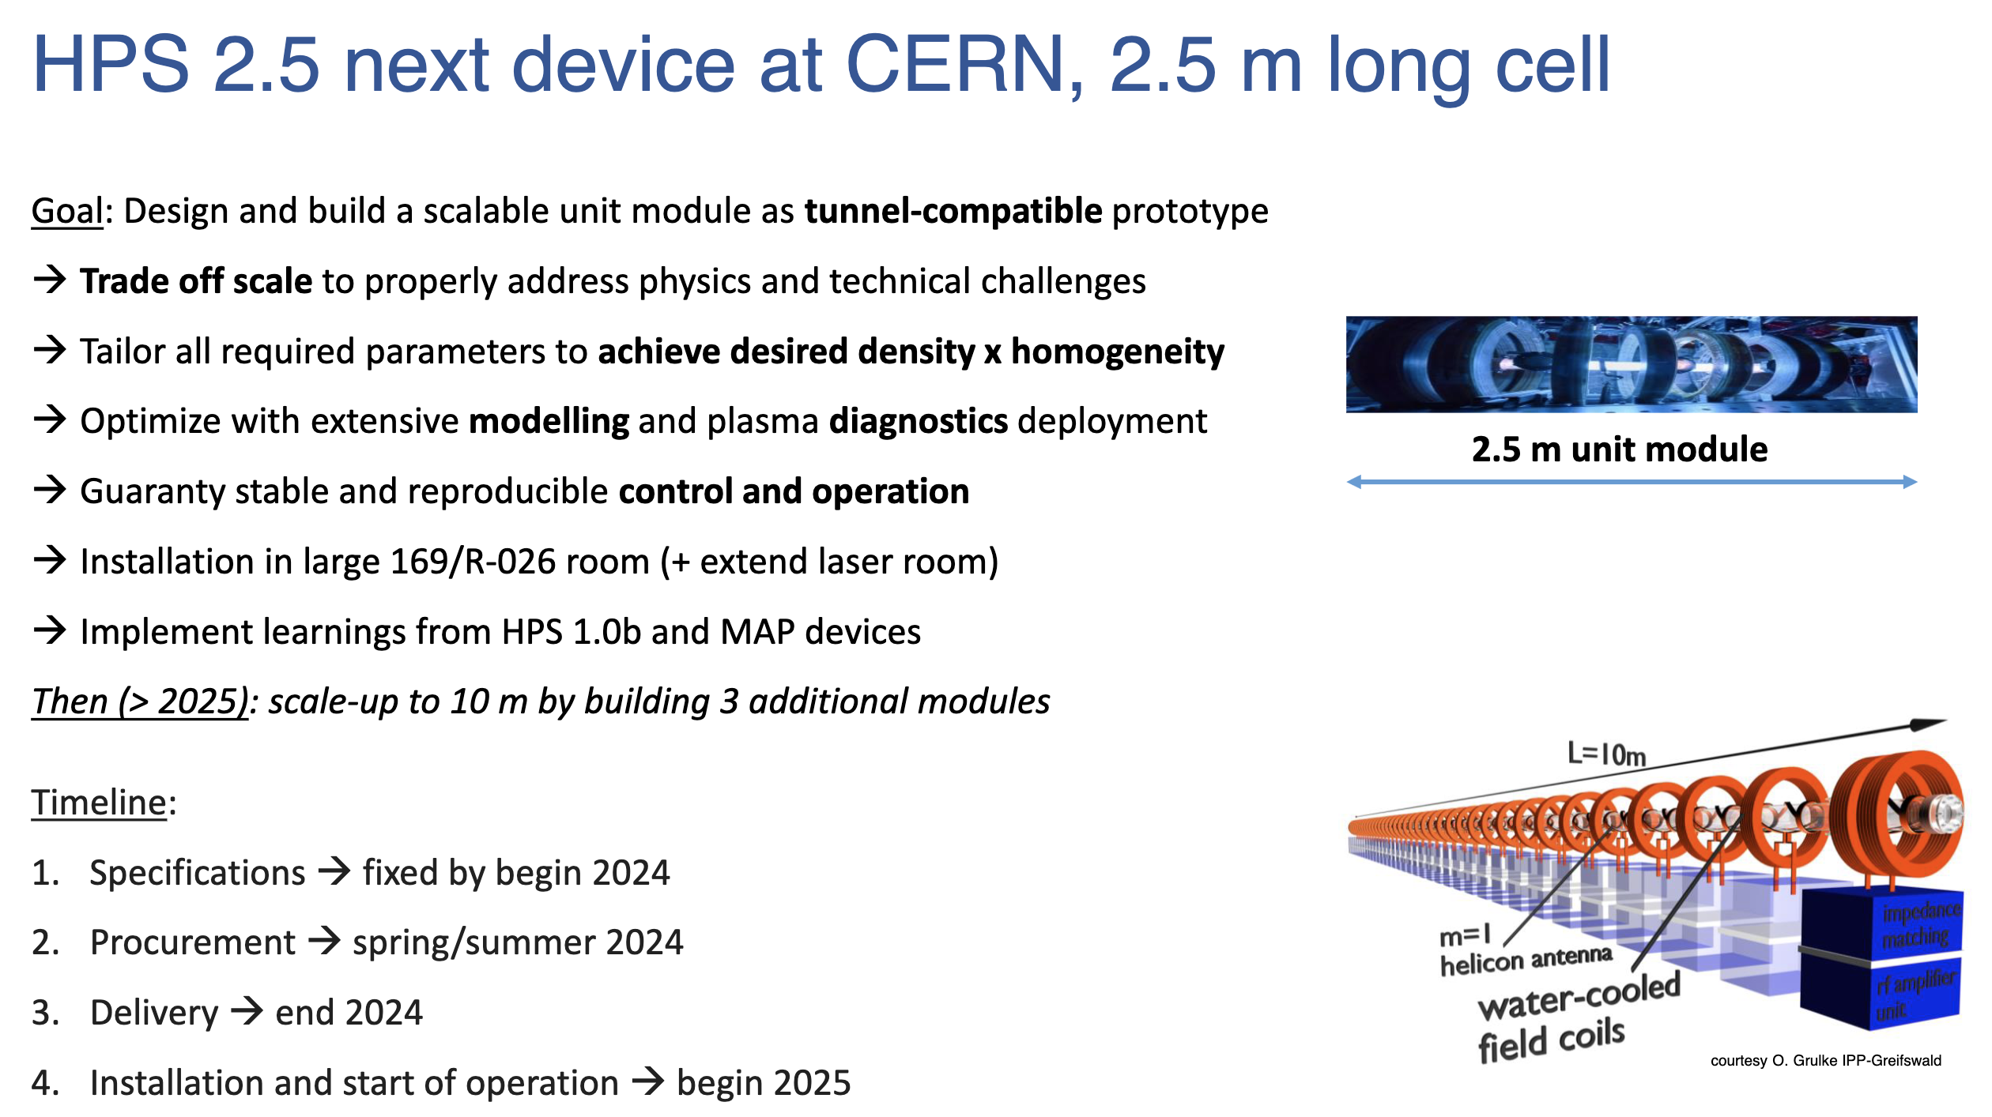
HPS, CERN, Alban

Slide 11
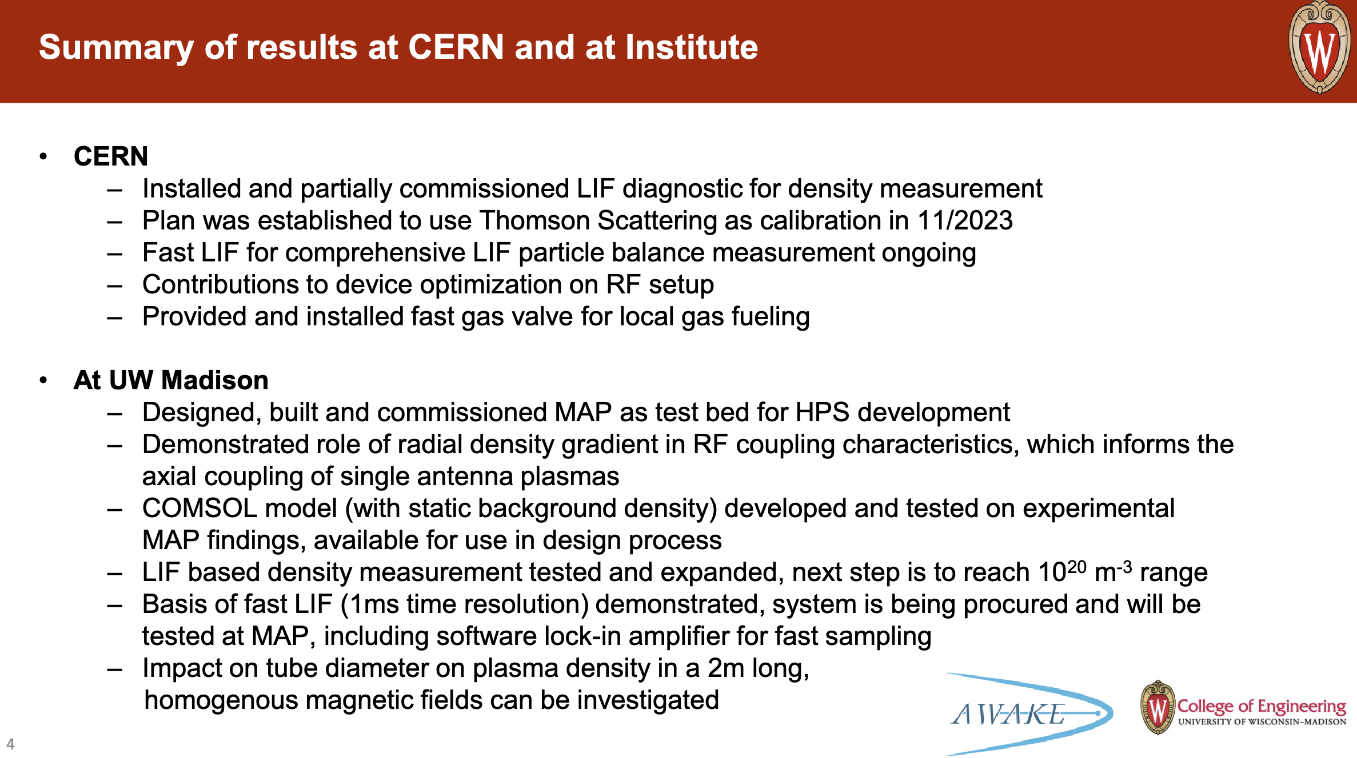
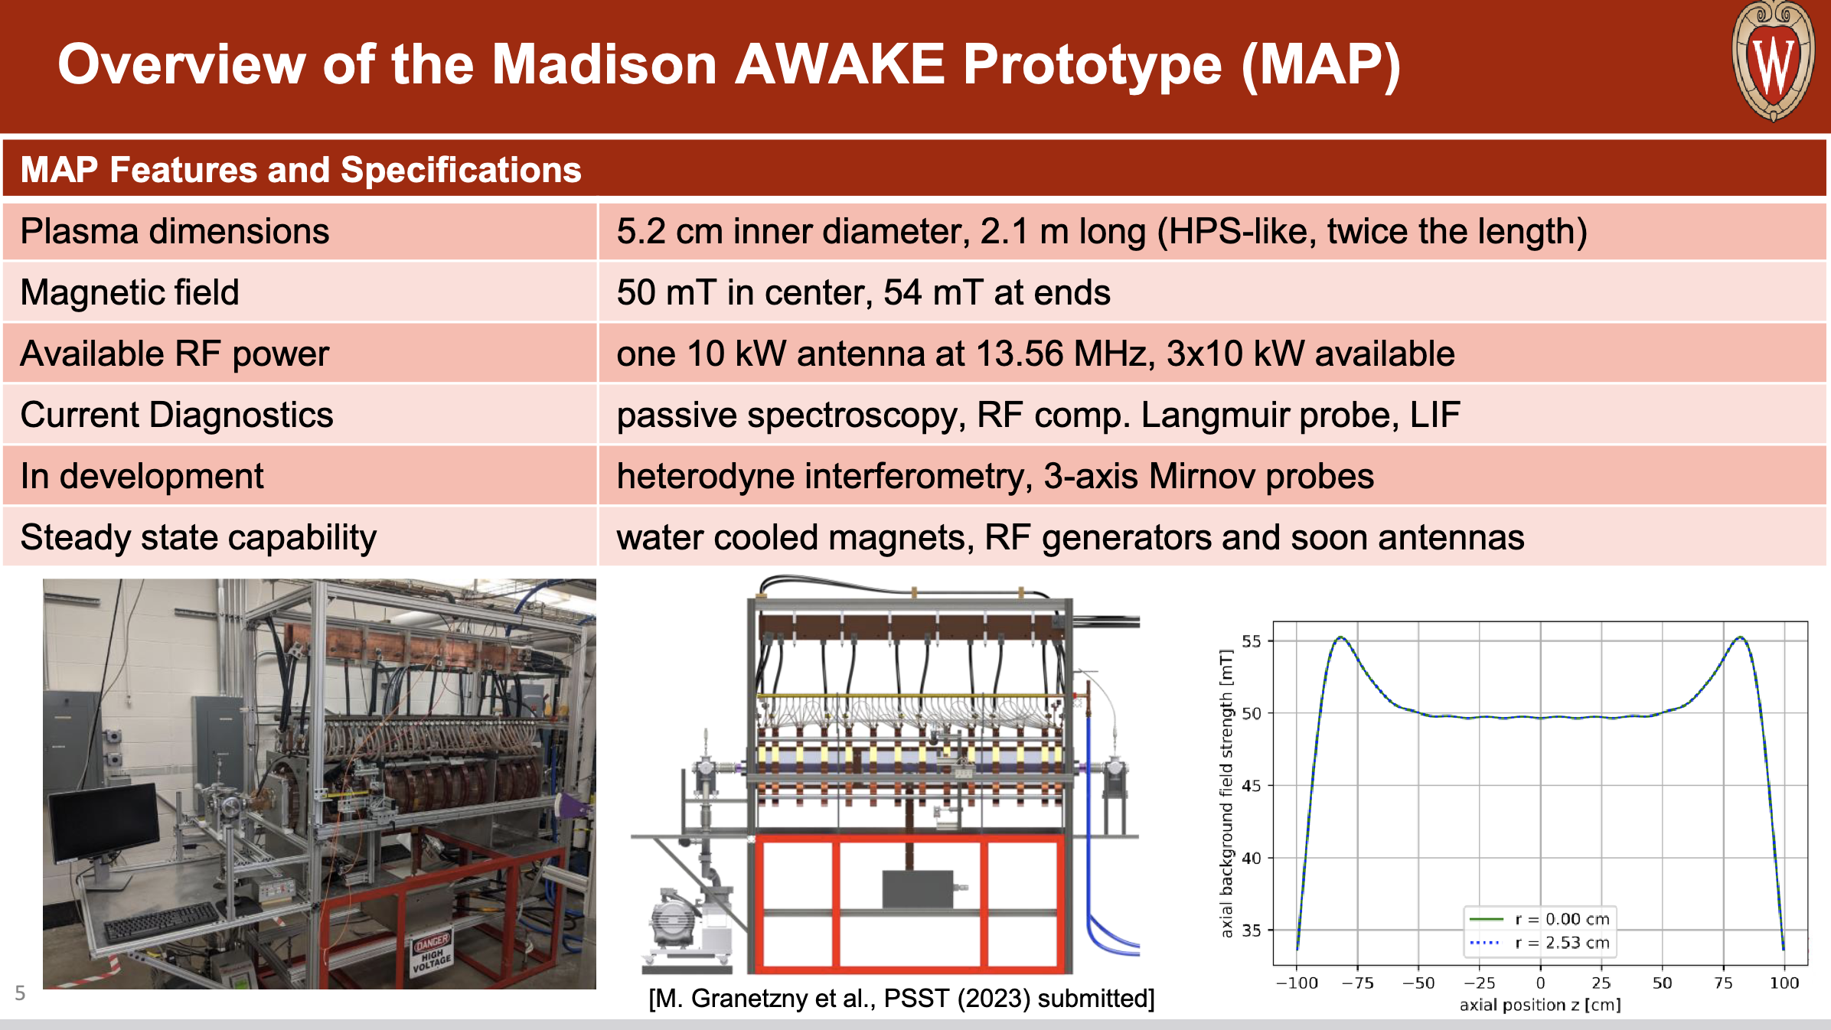
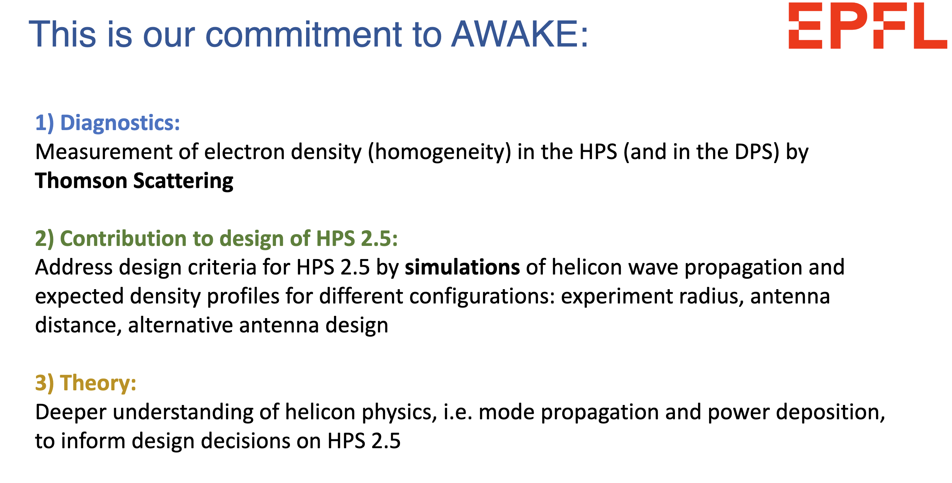
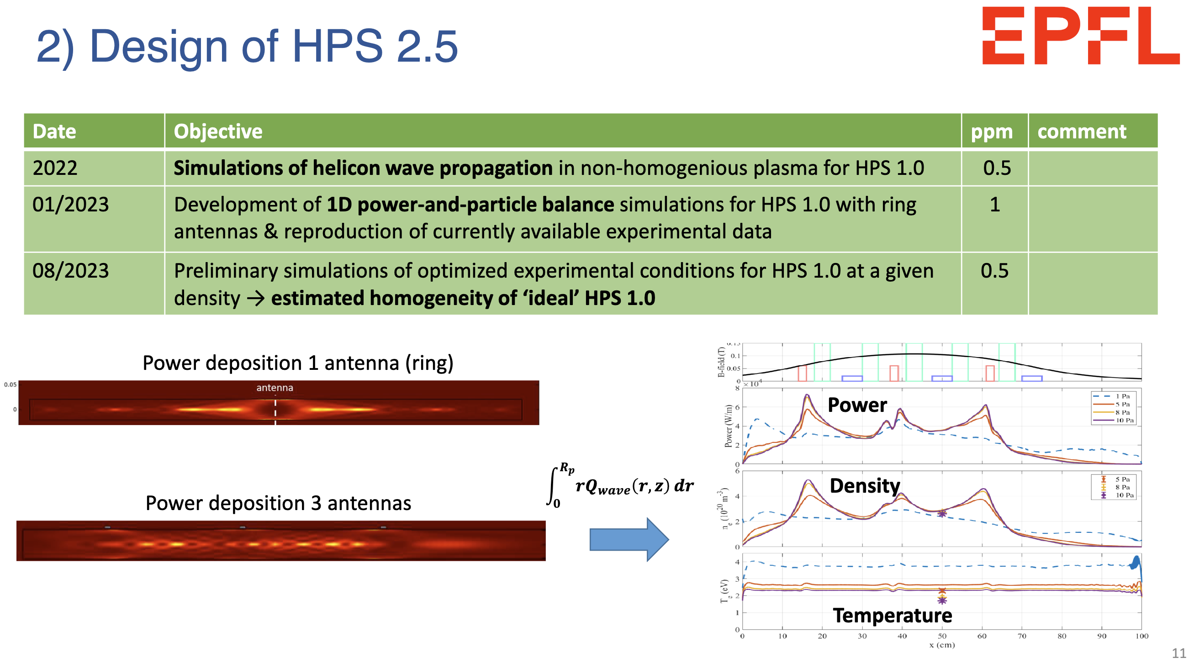
HPS, Wisconsin, Oliver
HPS, EPFL, Christine

Slide 12
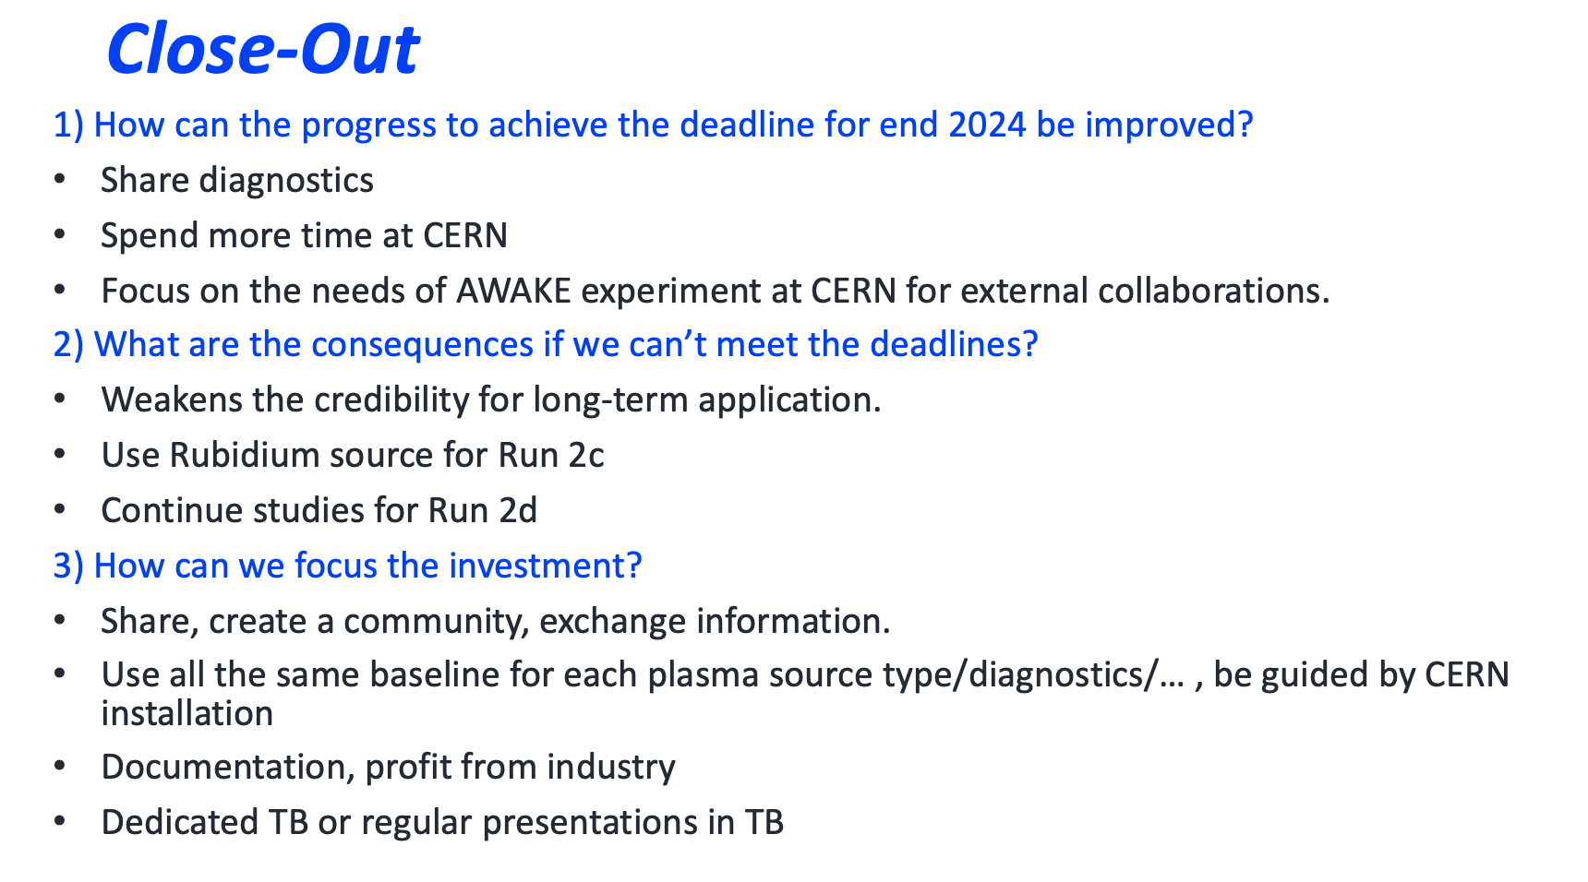
Summary
Very useful to get the different institutes all together!
Great summaries of all the activities!

