Slide 1

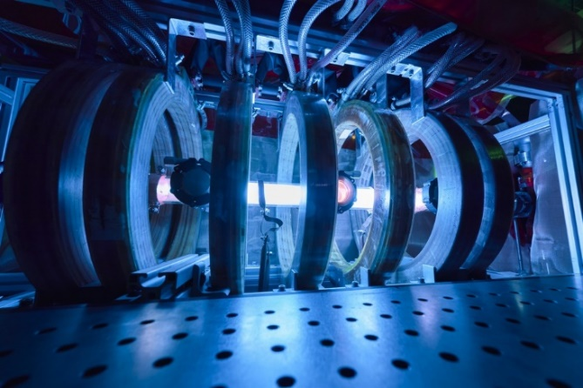
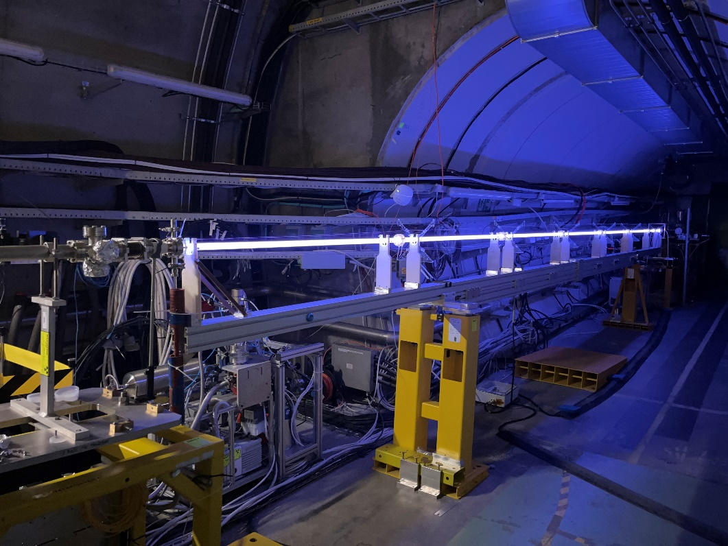





Scalable plasma sources R&D program at CERN
Helicon Plasma Source (HPS)
Discharge Plasma Source (DPS)
Helicon Plasma Source (HPS)
photo © Julien Ordan
photo © Julien Ordan
photo © Alban Sublet
A. Sublet, M. Santos (CERN)
O. Grulke, B. Buttenschön, T. Windisch (IPP-Greifswald),
I. Furno, C. Stollberg, P. Guittienne, R. Karimov (EPFL-SPC),
O. Schmitz, M. Zepp, M. Granetzny, B. Elward (Univ. of Wisconsin),
A. Sublet, C. Amoedo, (CERN)
N. C. Lopes, F. A. Silva, N. Torrado (IST-Lisbon),
Z. Najmudin (IC-London),

Slide 2
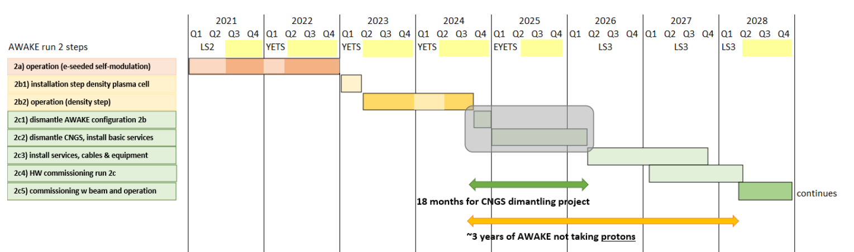
AWAKE Run 2 Global Schedule
Run 2a
Run 2b
CNGS Dismantling
Run 2c
10 m DPS test
10 m DPS test
Scalable plasma source R&D
2d1) scalable plasma design, installation
2d2) scalable plasma commissioning and operation
Decision scalable plasma source in Run 2c
From Edda, 29.08.2023

Slide 3
Scalable plasma sources R&D: CERN mandate and budget
Goal: develop and build a scalable plasma source (10 m and beyond) to be installed in the AWAKE tunnel
CP8 | CERN coordination Package: | Plasma cell R&D
 | Mandate: The coordination package leader, is responsible for the plasma sources test facilities, the interface between the CERN equipment in this area and the equipment/diagnostics delivered by the collaborating institutes.
Plasma cell R&D budget | 2022 | 2023 | 2024 | 2025 | Total
Material [kCHF] (BC 98715) | 201 | 516 | 346 | 0 | 1063
MtoP [kCHF] (PhD Carolina) | 50 | 100 | 100 | 50 | 300
MtoP [kCHF] (PhD Nuno) | 0 | 24 | 0 | 0 | 24
MtoP [kCHF] (Jr. fellow Miguel) | 0 | 100 | 110 | 110 | 320
Total [kCHF] | 251 | 740 | 556 | 160 | 1707
DPS
DPS
HPS
WP14 |  | Helicon Plasma Source @ CERN |  |  | WP15 | Discharge Plasma Source @ CERN
Collaborating institutes:
IPP-Greifswald (Olaf Grulke)
EPFL-SPC (Ivo Furno)
University of Wisconsin, Madison (Oliver Schmitz)
→ Helicon source, plasma diagnostics, helicon wave physics, …
Collaborating institutes:
IST-Lisbon (Nelson Lopes)
IC-London (Zulfikar Najmudin)
→ plasma diagnostics, power supplies and sources designs, …

Slide 4
HPS @ CERN
photo © Julien Ordan

Slide 5
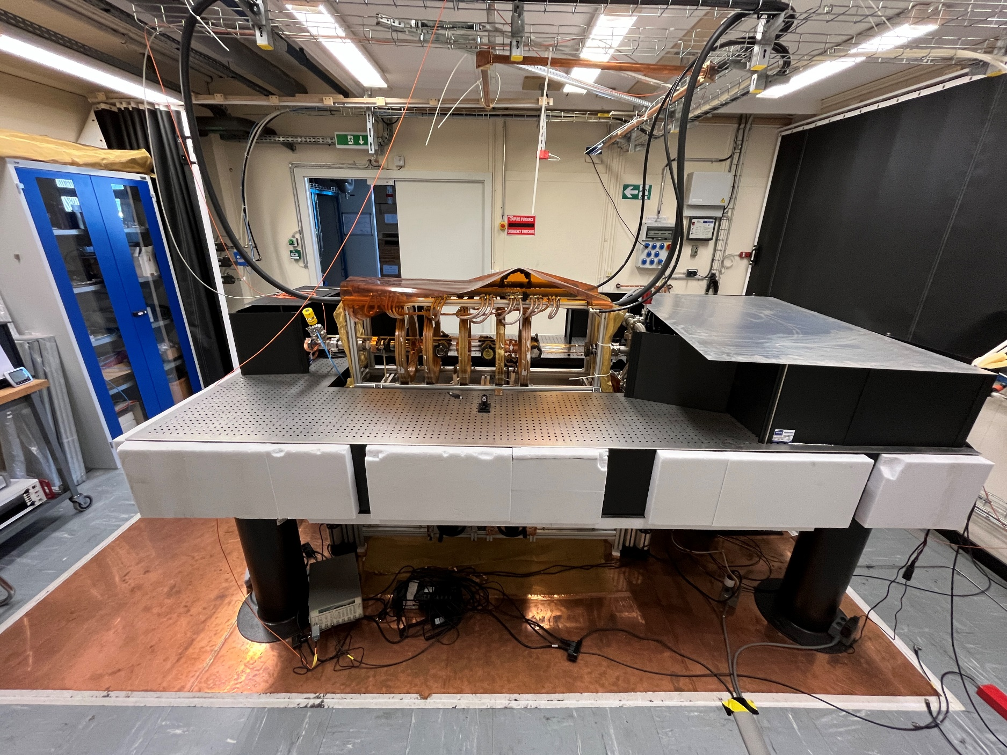
HPS 1.0 setup in CERN premisses (169/R-024 lab)
From IPP Greifswald
Installed in 2019 at CERN

Slide 6
HPS 1.0 setup in CERN premisses (169/R-024 lab)
From IPP Greifswald
Installed in 2019 at CERN
1 m quartz tube

Slide 7
HPS 1.0 setup in CERN premisses (169/R-024 lab)
From IPP Greifswald
Installed in 2019 at CERN
pulsed RF → 5 ms at 10 Hz
up to 10 kW/antenna
1 m quartz tube
3 antennas
half turn helical or ring
3 matchboxes + RF-generators

Slide 8
HPS 1.0 setup in CERN premisses (169/R-024 lab)
From IPP Greifswald
Installed in 2019 at CERN
pulsed RF → 5 ms at 10 Hz
up to 10 kW/antenna
up to ~ 130 mT B-field
5 field coils
1 m quartz tube
3 antennas
half turn helical or ring
3 matchboxes + RF-generators

Slide 9
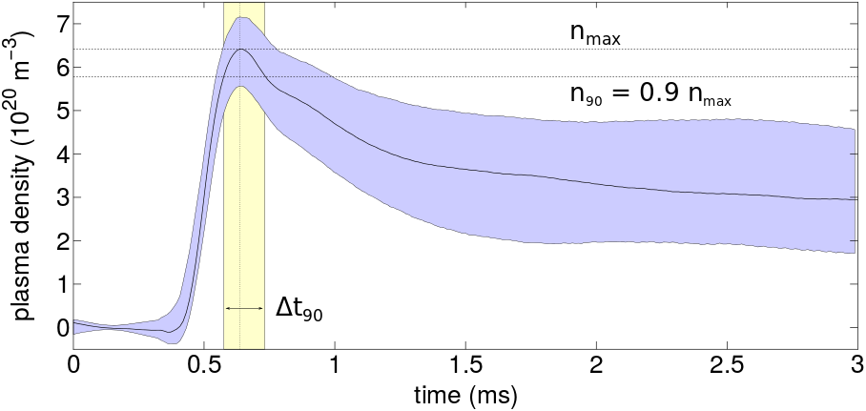
HPS diagnostics
MW → cut-off density measurement
IPP-Greifswald
Nominal e- density
obtained at IPP
Uniformity < 10%
in non-uniform B-field
Reproducibility to be assessed
Thomson Scattering (TS)
axial density profile
EPFL-SPC
CO2 interferometer → radial density profile
IPP-Greifswald
Laser Induced Fluorescence (LIF)
→ axial neutral/ion particle flows and density (with calibration)
Univ. Wisconsin
B. Buttenschön et al 2018 Plasma Phys. Control. Fusion 60 075005
https://doi.org/10.1088/1361-6587/aac13a

Slide 10
HPS campaigns
Regular 3-4 campaigns per year with visiting institute, technical and experimental
Since Feb. 2023 new Jr. fellow (Miguel V. Do Santos) at CERN → HPS operation, RF optimization and preparation of 2.5 m prototype setup.
Next campaigns:
Finalise LIF installation and restart TS → calibration, particle balance, TS uniformity setup, November 2023
2nd LIF campaign to determine first axial profile in January 2024
Determine axial density profile with TS on HPS 1.0 → begin 2024
Second trial with MW cut-off diagnostic → spring 2024
(TS with DPS in 169 laser room → June 2024)
3rd LIF campaign → fall 2024

Slide 11
HPS 1.0 issues/limitation of 1 m setup
Non-uniform B-field, large coils/cooling efficiency → limited by available coils/design
RF-generators aging: update/repair/refurbishment required → currently 2 out of 3 at Hüttinger for repair
RF noise → GND scheme, cable routing, …
Manual matching → ok for 3 antennas, more challenging beyond…
Antenna arcing → mitigated in June 2023 campaign (mostly) by installing ceramic breakers at both ends (like at IPP)
Need for a more stable/uniform setup and longer to continue R&D and assess scalability:
  2 steps, implementation in between campaigns
    HPS 1.0b upgrade
    HPS 2.5, scalable module of 2.5 m

Slide 12
HPS 1.0b → fix issues and improve HW
Goal = short term upgrade of existing system to assess axial uniformity before end 2024
Get uniform B-field, add/upgrade coils to get to < 1% uniformity over 1 m → Until spring 2024
RF-generators → get 3 generators upgraded, possibly purchase a 4th one to operate 4 antenna/m → pending
RF noise mitigation for diagnostics → install Faraday screen around the tube, pending
Ground scheme → short ground path to building GND (~ 6 m instead of 30 m) to be installed by end October
Matching → use available match boxes with position indicators + “live” Smith chart (Miguel) → almost ready
Test of a pulsed only RF power amplifier module → spring 2024

Slide 13

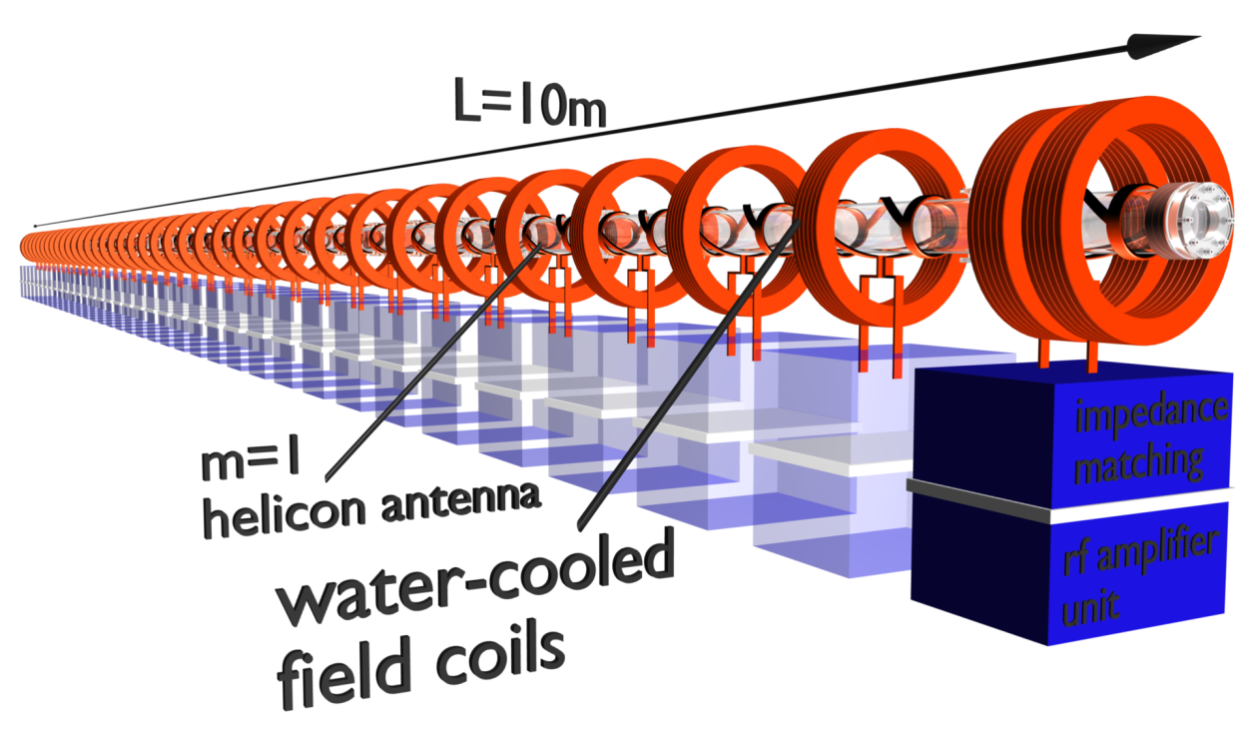
HPS 2.5 next device at CERN, 2.5 m long cell
Goal: Design and build a scalable module as tunnel-compatible prototype
Trade off scale to address physics and technical challenges
Implement learnings from HPS 1.0b, RAID and MAP devices (Oliver’s talk)
Optimize according to modelling and plasma diagnostics outcomes
Use new pulsed-RF (matchless?) generators and DC coils setup
Guaranty stable and reproducible control and operation
Installation in large 169/R-026 room (+ extend laser room)
> 2025: scale-up to 10 m → build 3 additional modules
2.5 m unit module
Timeline (2.5 m unit module):
Specifications → fixed by begin 2024
Procurement → spring/summer 2024
Delivery → end 2024
Installation and start of operation → begin 2025
courtesy O. Grulke IPP-Greifswald

Slide 14
AWAKE Run 2 Global Schedule
Run 2a
Run 2b
CNGS Dismantling
Run 2c
10 m DPS test
10 m DPS test
Scalable plasma source R&D
2d1) scalable plasma design, installation
2d2) scalable plasma commissioning and operation
Decision scalable plasma source in Run 2c
From Edda, 29.08.2023

Slide 15
HPS for run 2c → timeline
Run 2a
Run 2b
CNGS Dismantling
Run 2c
Scalable plasma source R&D
HPS 1.0
HPS 1.0b + HPS 2.5
2d1) scalable plasma design, installation
HPS 10.0
2d2) scalable plasma commissioning and operation
Decision scalable plasma source in Run 2c
HPS 10.0t (tunnel)
From Edda, 29.08.2023

Slide 16
DPS @ CERN
photo © Alban Sublet

Slide 17
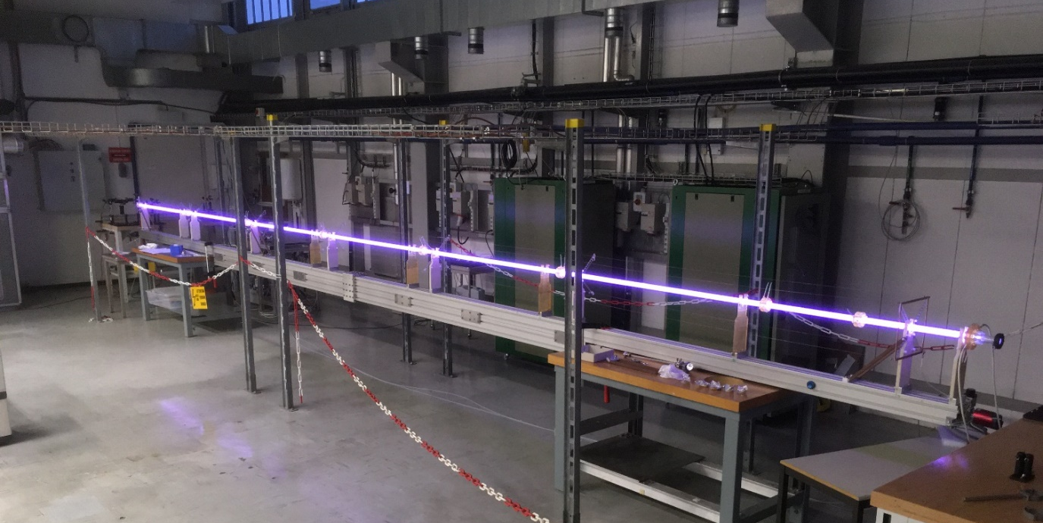
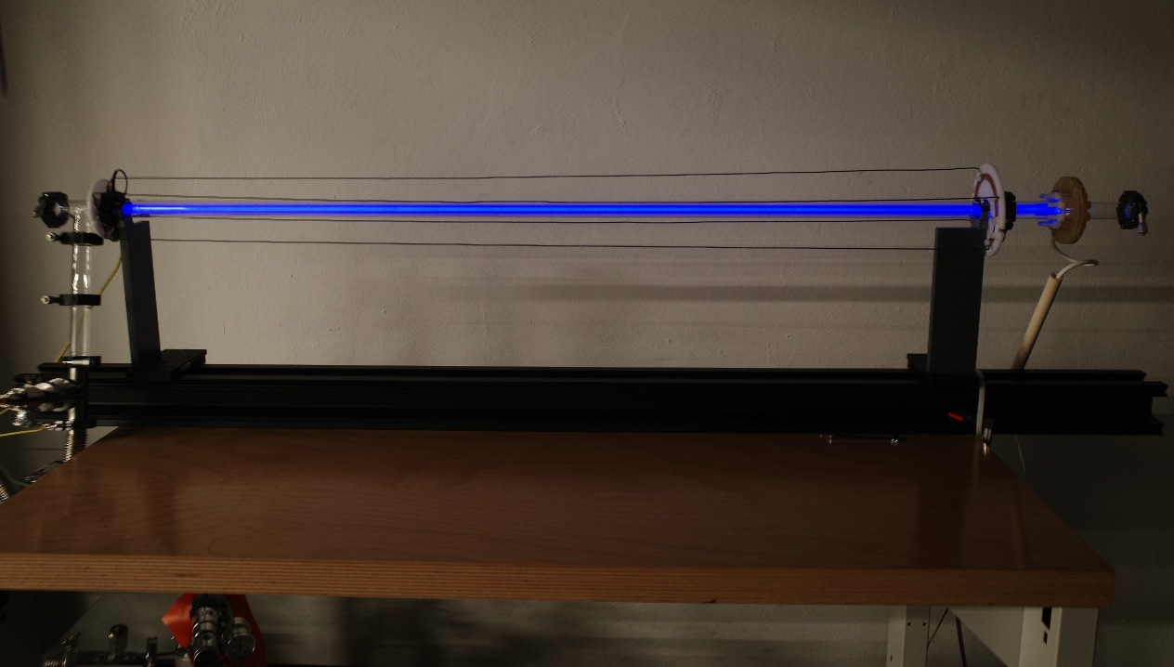
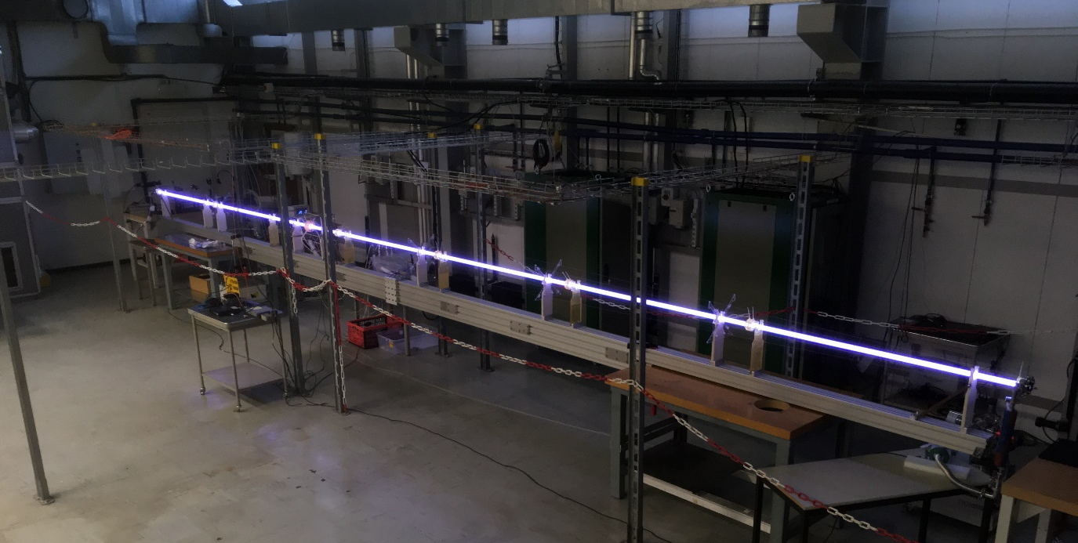
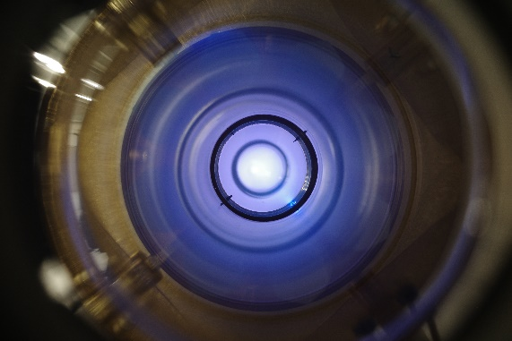
DPS 1.5 and DPS 10.0 setup in CERN premisses (101/1-015)
2x generation 2 pulse generators
1x generation 1 pulse generator
10 m single plasma, 24 Pa Ar, 500 A (24.03.2023)
1.6 m plasma, 8 Pa Ar, 320 A (13.12.2022)
→ Both systems can operate in parallel in the 101 lab
3.5 m + 6.5 m double plasma, 8 Pa Ar, 250 A (10.03.2023)

Slide 18
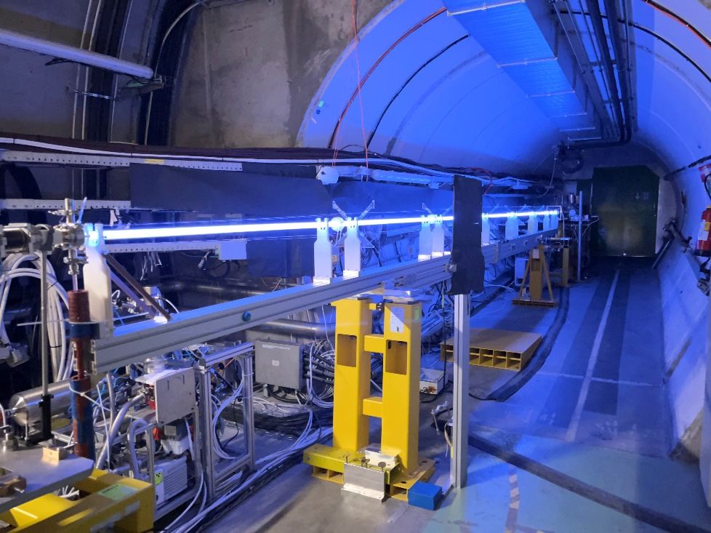
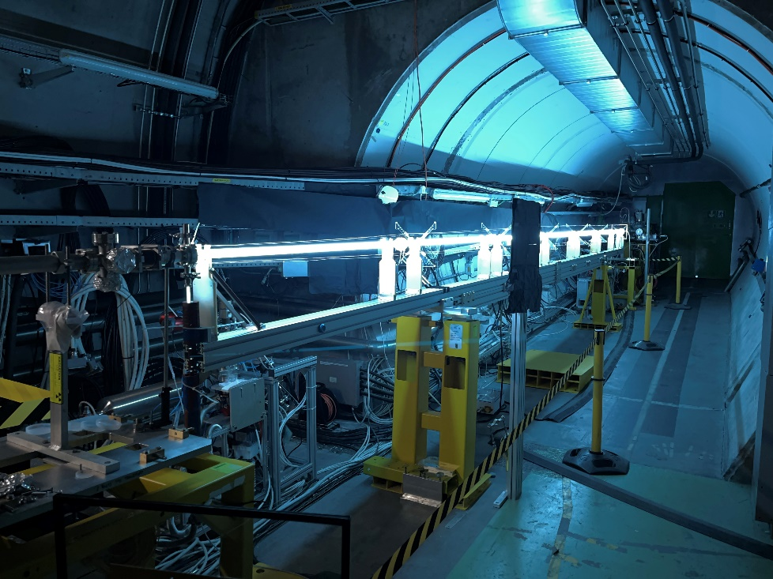
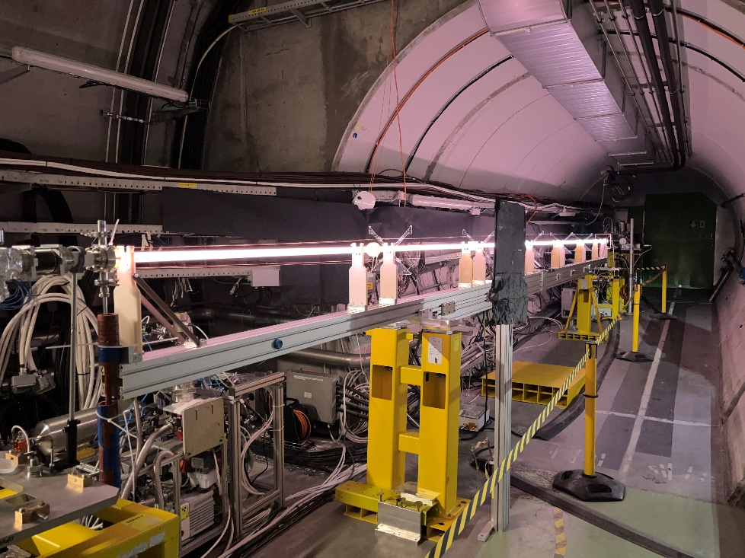
DPS 10.0 setup in the tunnel → AWAKE May run
Ar
Xe
He
Unique chance to test the DPS during first AWAKE run in May 2023!
→ Overall, very smooth operation of the DPS, tunnel remote control system ready
~ 22000 discharges over 3 weeks, peak current stability < 1 % with ~20 ns maximum jitter (Nuno’s talk)
3 gases: Ar/Xe/He at 5 pressures 8/16/24/30/45 Pa and 3 plasma lengths (3.5/6.5/10 m)
density range span over 2 orders of magnitude: 2x10¹³ to 2x10¹⁵ cm⁻³
proof of principal with SMI measurement, benchmarking with interferometry (Carolina’s talk) and several data set recorded to study ion motion (Marlene’s talk), current filamentation instability (Livio’s talk), plasma light, hosing, etc.

Slide 19
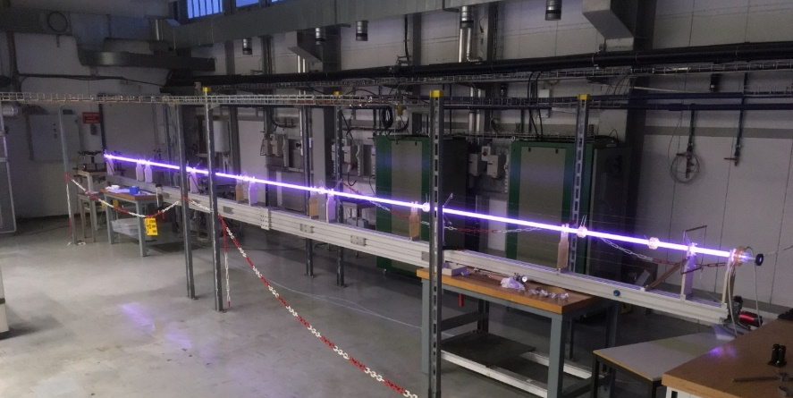
DPS 10.0 CERN program → uniformity x scalability
Long plasmas mostly for scalability, with longitudinal interferometry, μs cameras imaging and electrical characterisation:
Single plasma (10 m), complete datasets, time/space/spectral resolved imaging of the whole plasma (until end 2023)
Double plasma (5 m + 5 m) with common cathode: A/C/A scheme and 1 or 2 pulse generators (begin 2024)
Quadruple plasma (1.5 m + 1.5 m + 1.5 m + 1.5 m): A/C/A/C/A scheme with 2 pulse generators to test common anode and common cathodes and dedicated current balancing modules (mid 2024)
10 m single plasma, 24 Pa Ar, 500 A (24.03.2023)
10 m
A
C
10 m
A1
C
A2
5 m
5 m
6 m
A1
C1
A2
C2
A3
4x 1.5 m

Slide 20
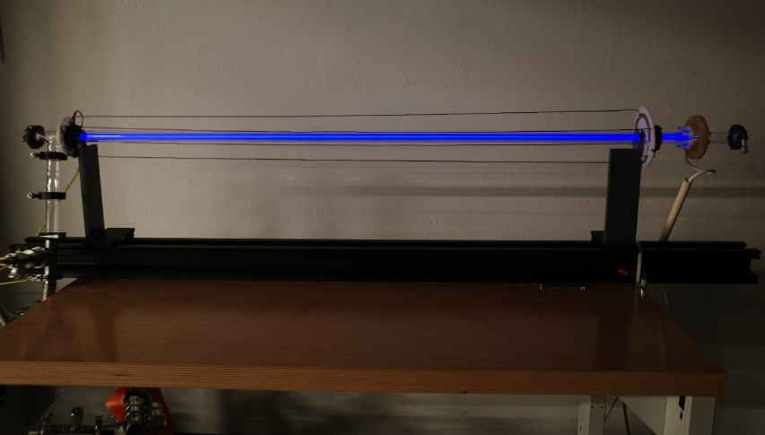
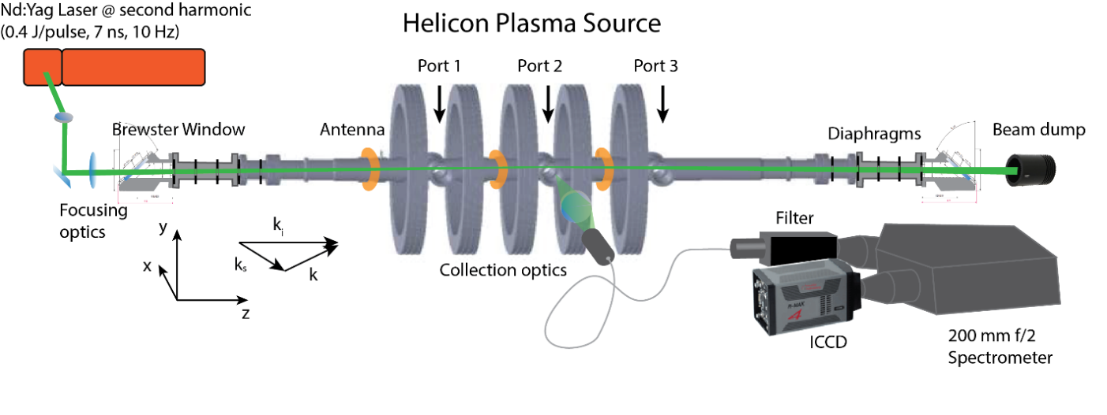
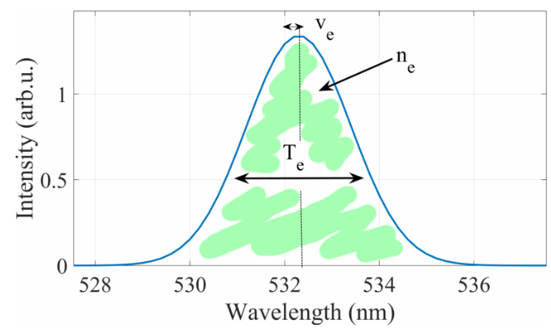

DPS 1.5 CERN program → uniformity x scalability
Short plasmas for longitudinal density uniformity measurements and scalability
1.5 m single and 1.5 m + 1.5 m double plasmas configurations:
  plasma light and interferometry → benchmark with 10 m / 5+5 m plasma
  prepare for Thomson scattering in HPS laser room → May 2024
Thomson scattering on DPS with EPFL-SPC → June 2024, TS/plasma light for uniformity assessment, comparison with HPS
1.6 m plasma, 8 Pa Ar, 320 A (13.12.2022)
3 m
A
C
A1
C1
A2
1.5 m
1.5 m
1.5 m
Christine’s talk
Thomson scattering spectrum
Operating regime: 1x10¹⁸ - 1x10²¹ m⁻³
Uncertainties: 0.1 eV and ~ 10% in density
Courtesy Christine Stollberg, EPFL-SPC

Slide 21
AWAKE Run 2 Global Schedule
Run 2a
Run 2b
CNGS Dismantling
Run 2c
10 m DPS test
10 m DPS test
Scalable plasma source R&D
2d1) scalable plasma design, installation
2d2) scalable plasma commissioning and operation
Decision scalable plasma source in Run 2c
From Edda, 29.08.2023

Slide 22
DPS for run 2c → timeline
Run 2a
Run 2b
CNGS Dismantling
Run 2c
10 m DPS test
Scalable plasma source R&D
DPS 1.5
DPS 10.0 + DPS 1.5
2d1) scalable plasma design, installation
DPS 10.0b
DPS 10.0c
2d2) scalable plasma commissioning and operation
Decision scalable plasma source in Run 2c
DPS 10.0t (tunnel)
From Edda, 29.08.2023

Slide 23
Run 2c technical challenges for plasma sources (HPS/DPS)
Beyond plasma density uniformity and scalability, specific challenges of life in the AWAKE tunnel:
Pulse RF/DC generator/long cable/tube diameter/antenna/electrodes → design optimization for tunnel operation, industrialisation of pulse generators and components → specifications/documentation/know-how transfer/spare units
Vacuum/pressure/flow profile/interfaces/windows/beam orifice (gas injection, temperature control, pumping...)
  → addressed by CERN + institutes expertise (see Nelson’s talk)
Plasma source: Which one, where? self-modulator and/or accelerator?
Density requirements beyond 10 m → density step/ramp to correct dephasing?
Tunnel operation/timing: proton/plasma delay range?, plasma current/beam(s) interactions? Plasma trigger delays along the scalable source? Earth magnetic field shielding? …
Tunnel plasma diagnostic(s)
→ Deserves dedicated studies in parallel to on going sources R&D

Slide 24
Summary
Dedicated scalable plasma sources R&D program launched at CERN, in spring 2019 for the HPS and in summer 2020 for the DPS, in collaboration with 5 institutes in total
Both sources reached the AWAKE nominal density, but both are lacking uniformity and scalability assessment
Several HW issues on the HPS still to be fixed
Physics aspects addressed together with institutes towards uniformity measurement at CERN until end 2024
Unique opportunity to test the DPS with protons during AWAKE first run in May 2023
Decision point end of 2024 between the 3 sources candidates for run 2c (Rb/HPS/DPS)
Set of technical challenges common to all plasma sources to be addressed in parallel, in view of Run 2c
R&D MUST continue on both scalable sources in parallel to keep maximum options open until all AWAKE requirements are fulfilled

Slide 25
Scalable plasma sources R&D organisation
In charge of institute Work Package for the HPS R&D
1m HPS setup designed/build/operated at IPP and moved to CERN
Diagnostics: CO2 interferometer and MW cut-off frequency
3 senior scientists
Development Thomson Scattering for axial density profile
Helicon wave physics and simulation, RF and plasma simulations
RAID test setup at EPFL-SPC + alternative resonant antenna design
1 senior scientist, 1 scientist, 1 PhD
Diagnostics: Laser Induced Fluorescence and emission spectroscopy
RF coupling and impact on density formation and profile
Particle balance to identify sources and sinks causing anisotropies
Dedicated MAP (Madison AWAKE prototype) test setup
1 senior scientist, 2 PhDs

Slide 26

Scalable plasma sources R&D organisation
In charge of institute Work Package for the HPS R&D
1m HPS setup designed/build/operated at IPP and moved to CERN
Diagnostics: CO2 interferometer and MW cut-off frequency
3 senior scientists
Development Thomson Scattering for axial density profile
Helicon wave physics and simulation, RF and plasma simulations
RAID test setup at EPFL-SPC + alternative resonant antenna design
1 senior scientist, 1 scientist, 1 PhD
Diagnostics: Laser Induced Fluorescence and emission spectroscopy
RF coupling and impact on density formation and profile
Particle balance to identify sources and sinks causing anisotropies
Dedicated MAP (Madison AWAKE prototype) test setup
1 senior scientist, 2 PhDs
In charge of institute Work Package for the DPS R&D
Pulsed DC power supplies (ignition/heater) design, test, fabrication
5 m DPS setup and 0D longitudinal interferometry
1 senior scientist, 2 PhDs
2D longitudinal and transverse interferometry, deflectometry, OES
Discharge current control/shaping studies, plasma modelling
1 m DPS test setup at ICL
1 senior scientist, 1 PostDoc, 1 PhD

Slide 27
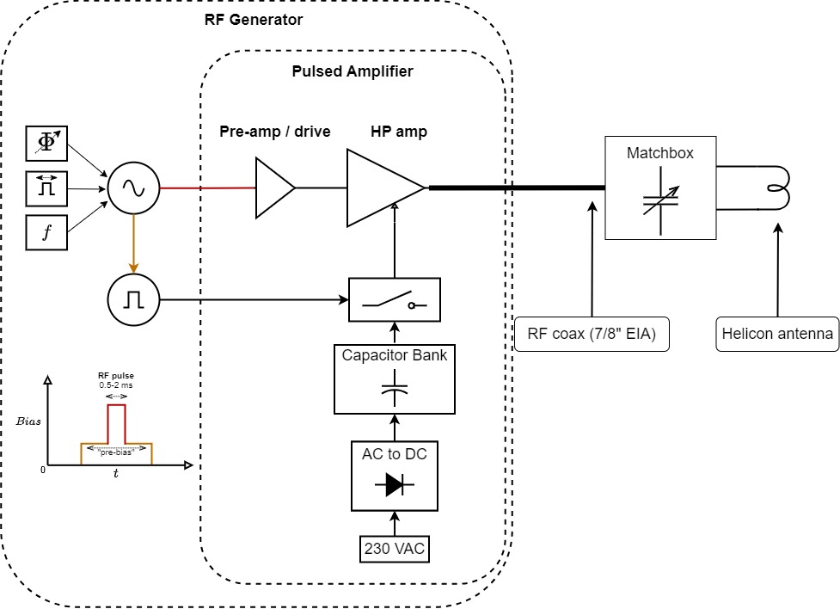
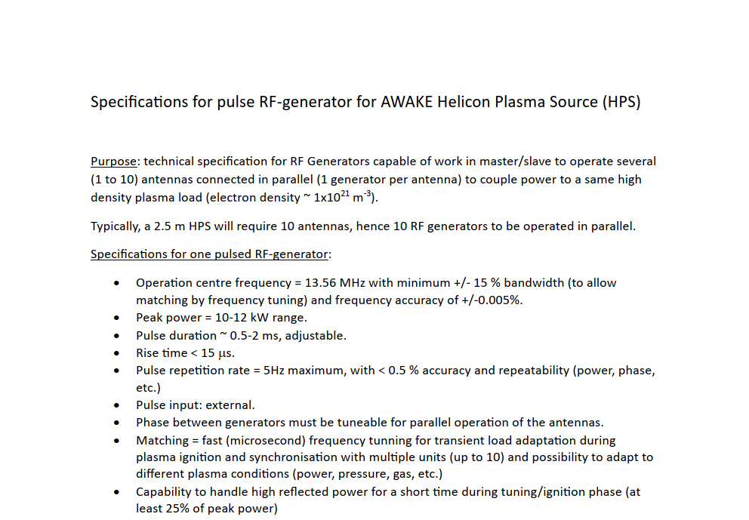
HPS 2.5 setup → RF
Ideally, pulsed RF “matchless” design → optimized for short (ms) pulse at 1 Hz and minimum power consumption
Technical specifications draft → under review by CERN RF-expert, to be discussed with HPS team+AWAKE
In parallel, proof of principal test of pulsed-amplifier with frequency tuning (+/-2 MHz) on HPS 1.0b
Investigate single vs parallel powering of antennas → can we reduce the number of RF-generators?
Operation from service gallery → ~ 30 m cable length!
Otherwise 8x standard RF-generators + matchboxes (~ 400 kCHF)

Slide 28
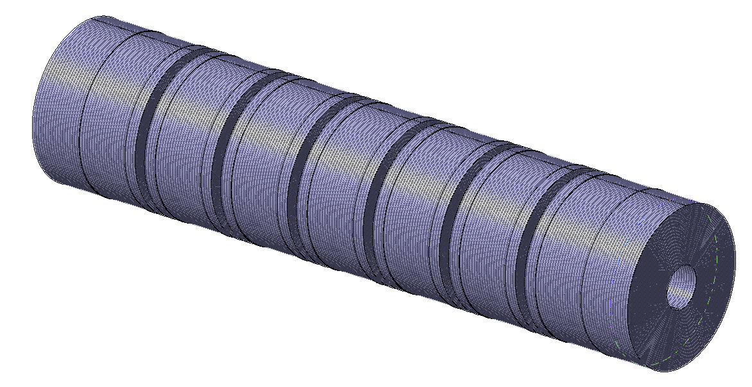
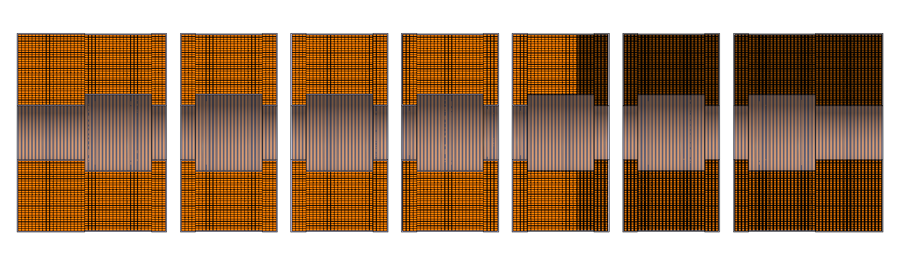
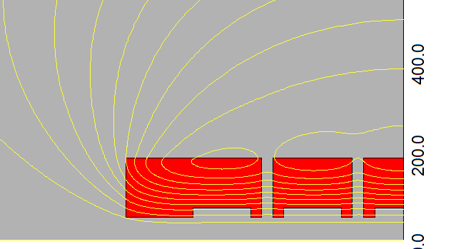
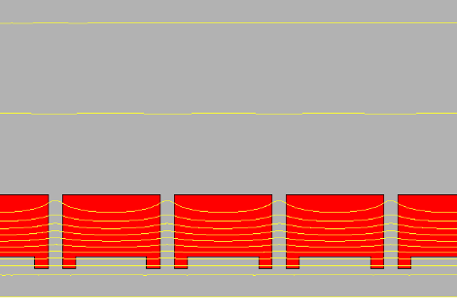
HPS 2.5 setup → DC power supply/coils
Optimized coils design/arrangement
guaranty < 1% B-filed homogeneity along the 2.5 m plasma column
minimize power consumption (DC and cooling)
pulsed DC operation questionable (depending on coil design)
Preliminary specifications and simulation example for a 1 m HPS (bulk Cu, air cooled):
Nominal magnetic field: 130 mT
Axial uniformity: 1%
Good-field-region: Ø40 mm
Minimum physical diameter: 100 mm → to be updated according to tube design/access!
Minimum gap in between two coils: 25 mm → to be updated for diagnostics access!
4 antennas/m
Air-cooled → most likely not doable, but water cooling must be minimized
courtesy P. Schwarz, Oct. 2021

Slide 29
HPS 2.5 setup → tube/antennas/vacuum/beam...
Tube diameter/antenna design → tuned according to simulation studies to optimize coupling efficiency
  → Specifications require institutes inputs
Vacuum/pressure/flow profile optimized (gas injection, temperature...)
  CERN inputs + institutes simulations, common with DPS
Open technical question for a tunnel accelerator cell:
  Interfaces with self-modulator cell,
  witness e-beam injection,
  windows,
  earth magnetic field shielding
Tunnel requirements beyond the nominal density and uniformity?
Tunnel operation/timing: proton with respect to RF pulse/ peak density and its consequence on cell design/operation?

Slide 30
HPS for run 2c → detailed timeline (also attached to the Indico page ☺)

Slide 31
DPS for run 2c → detailed timeline (also attached to the Indico page ☺)

