Slide 1

Alexander Pukhov
Heinrich-Heine-University Dusseldorf
Germany
Short proton driver for 125 GeV e-e+
(Higgs factory)

Slide 2
Proton bunch constraints
Looking for the lowest possible energy, < 1 TeV
Proton bunch length >100 um
Maximum population: 1e11 particles
Transverse emittance ~1 um
Suitable for positron acceleration

Slide 3
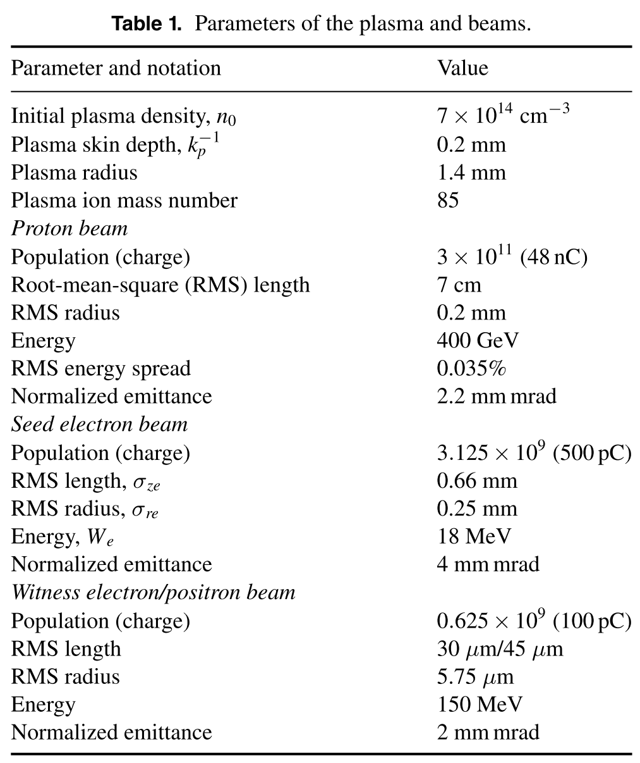
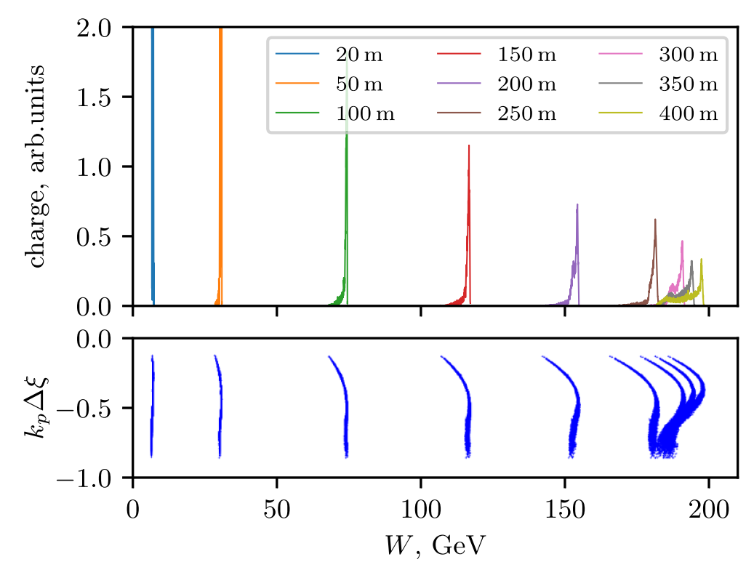

AWAKE configuration
Lotov, Tuev PPCF 63 (2021) 125027
Overall energy efficiency $η≈1⋅{10}^{−3}$
High Lumi is needed (John & Jovanni)
Final witness emittance?

Slide 4
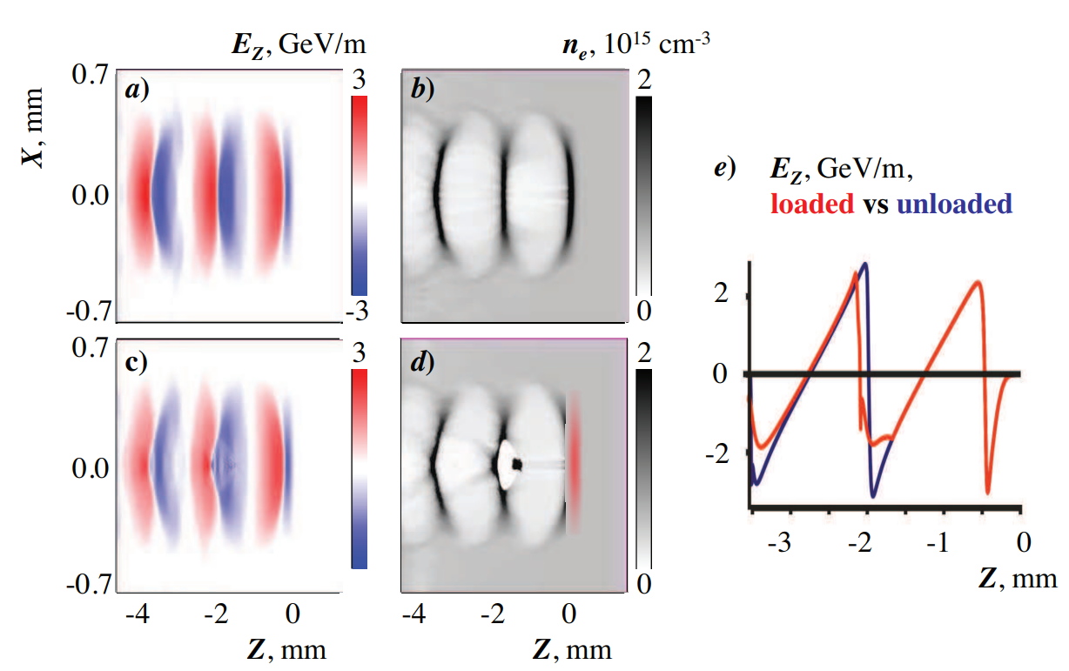
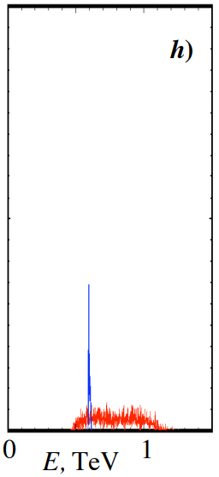
Short proton driver
A Caldwell, K Lotov, A Pukhov, F Simon Nature Phys. 2008
1 TeV, 100 um short proton bunch

Slide 5
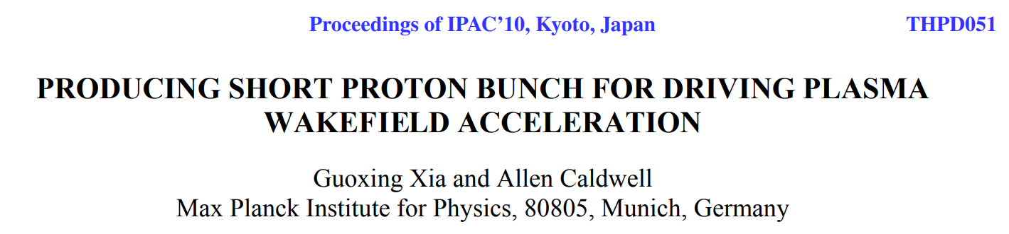
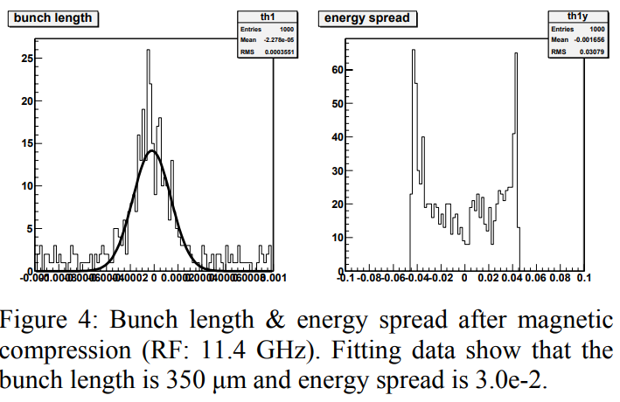
Producing short proton driver
TeV proton bunch compression would require km size system
SPS-like bunch might be compressed within ~400m and fit into channel

Slide 6
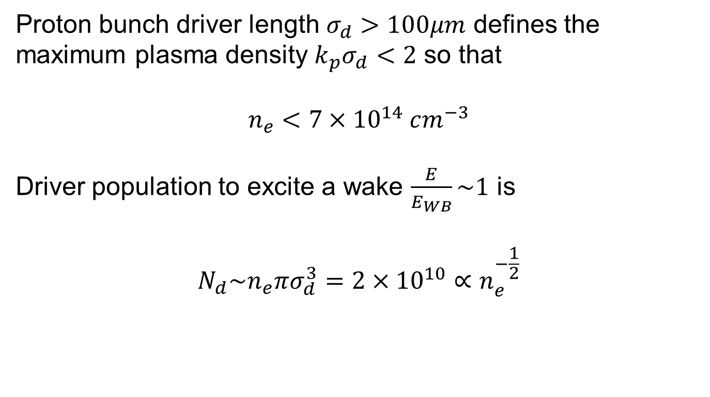
Plasma density
Proton bunch driver length $σ_{d}>100μm$ defines the maximum plasma density $k_{p}σ_{d}<2$ so that
$$n_{e}<7×{10}^{14} cm^{−3}$$
Driver population to excite a wake $\frac{E}{E_{WB}}\sim 1$ is
$$N_{d}\sim n_{e}πσ_{d}^{3}=2×{10}^{10}∝n_{e}^{−\frac{1}{2}}$$

Slide 7
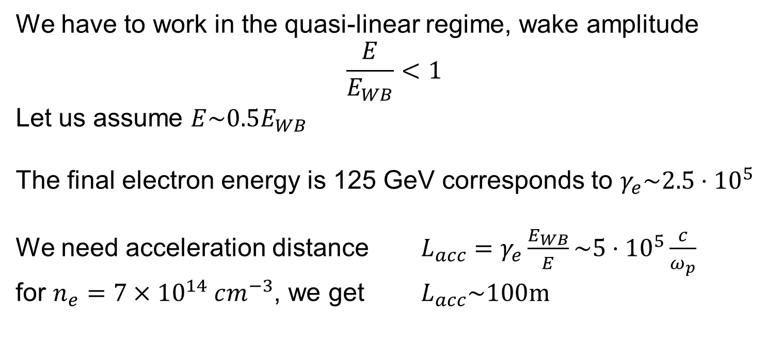
Suitable for positron acceleration
We have to work in the quasi-linear regime, wake amplitude
$$\frac{E}{E_{WB}}<1$$
Let us assume $E\sim 0.5E_{WB}$
The final electron energy is 125 GeV corresponds to $γ_{e}\sim 2.5⋅{10}^{5}$
We need acceleration distance $L_{acc}=γ_{e}\frac{E_{WB}}{E}\sim 5⋅{10}^{5}\frac{c}{ω_{p}}$
for $n_{e}=7×{10}^{14} cm^{−3}$, we get $L_{acc}\sim 100m$

Slide 8
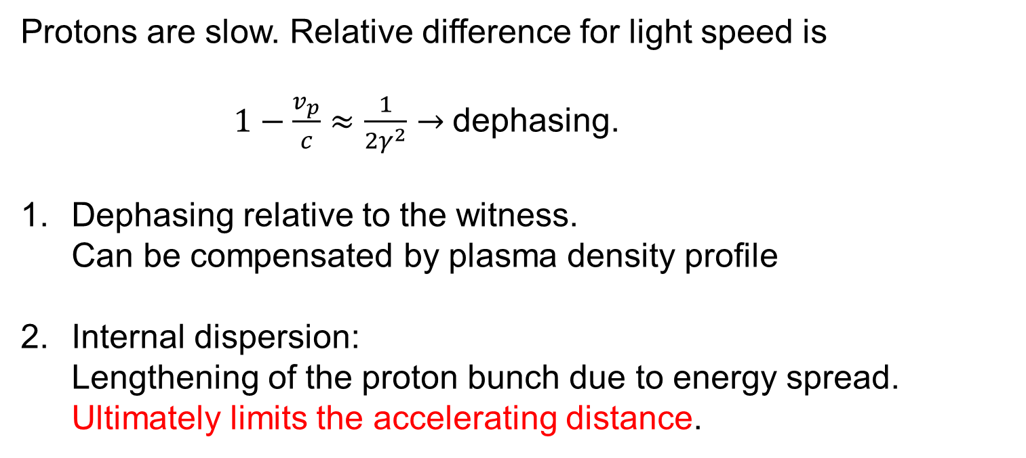
Lowest possible proton energy
Protons are slow. Relative difference for light speed is
$1−\frac{v_{p}}{c}≈\frac{1}{2γ^{2}}→$dephasing.
Dephasing relative to the witness.
Can be compensated by plasma density profile
Internal dispersion:
Lengthening of the proton bunch due to energy spread. Ultimately limits the accelerating distance.

Slide 9
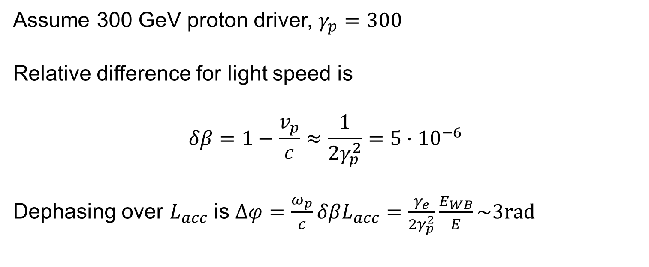
Dephasing to witness
Assume 300 GeV proton driver, $γ_{p}=300$
Relative difference for light speed is
$$δβ=1−\frac{v_{p}}{c}≈\frac{1}{2γ_{p}^{2}}=5⋅{10}^{−6}$$
Dephasing over $L_{acc}$ is $Δφ=\frac{ω_{p}}{c}δβL_{acc}=\frac{γ_{e}}{2γ_{p}^{2}}\frac{E_{WB}}{E}\sim 3rad$

Slide 10
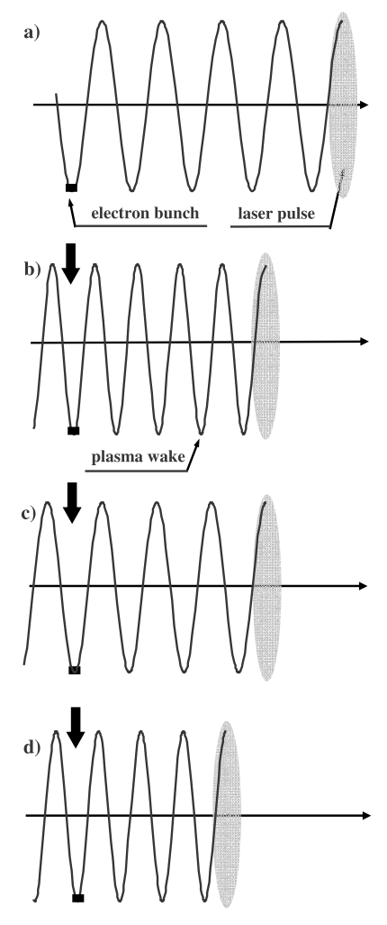
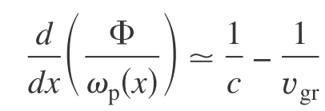
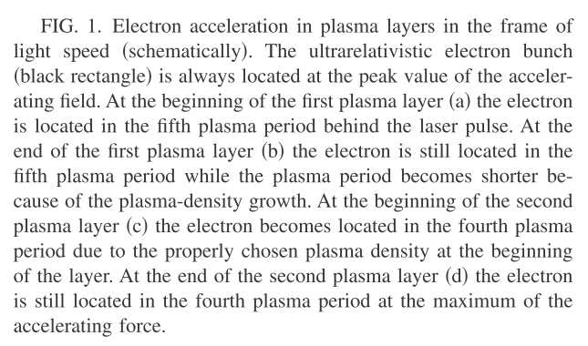
Overcoming Dephasing:
Plasma Density Gradient
Pukhov & Kostyukov Phys. Rev. E77, 025401R (2008)
T. Katsouleas, Phys. Rev. A 33, 2056 (1986)

Slide 11
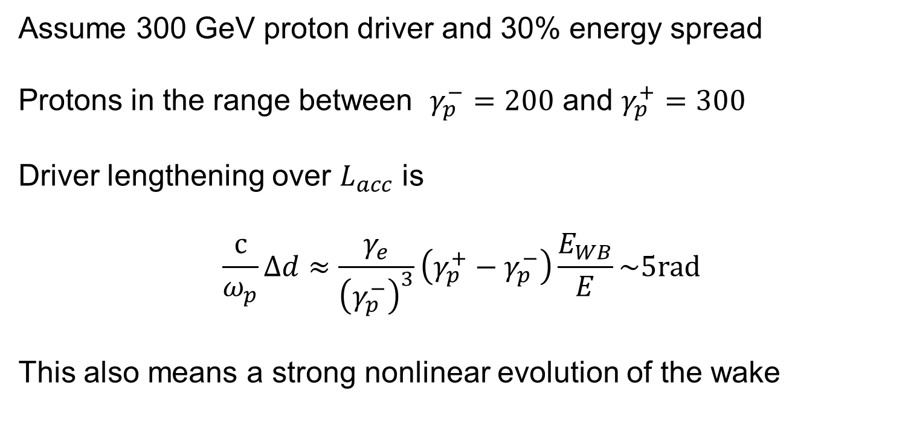
Driver dispersion (lengthening)
Assume 300 GeV proton driver and 30% energy spread
Protons in the range between $γ_{p}^{−}=200$ and $γ_{p}^{+}=300$
Driver lengthening over $L_{acc}$ is
$$\frac{c}{ω_{p}}Δd≈\frac{γ_{e}}{{\left(γ_{p}^{−}\right)}^{3}}\left(γ_{p}^{+}−γ_{p}^{−}\right)\frac{E_{WB}}{E}\sim 5rad$$
This also means a strong nonlinear evolution of the wake

Slide 12
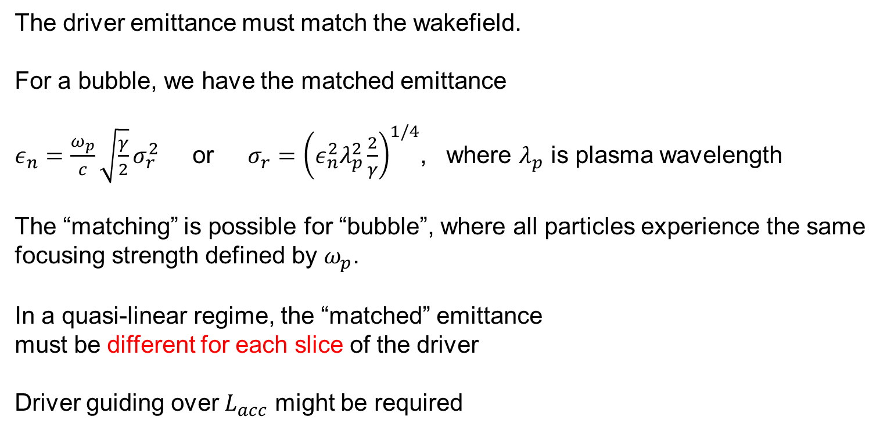
Transverse driver evolution
The driver emittance must match the wakefield.
For a bubble, we have the matched emittance
$ε_{n}=\frac{ω_{p}}{c}\sqrt{\frac{γ}{2}}σ_{r}^{2}$ or $σ_{r}={\left(ε_{n}^{2}λ_{p}^{2}\frac{2}{γ}\right)}^{1/4}$, where $λ_{p}$ is plasma wavelength
The “matching” is possible for “bubble”, where all particles experience the same focusing strength defined by $ω_{p}$.
In a quasi-linear regime, the “matched” emittance
must be different for each slice of the driver
Driver guiding over $L_{acc}$ might be required

Slide 13
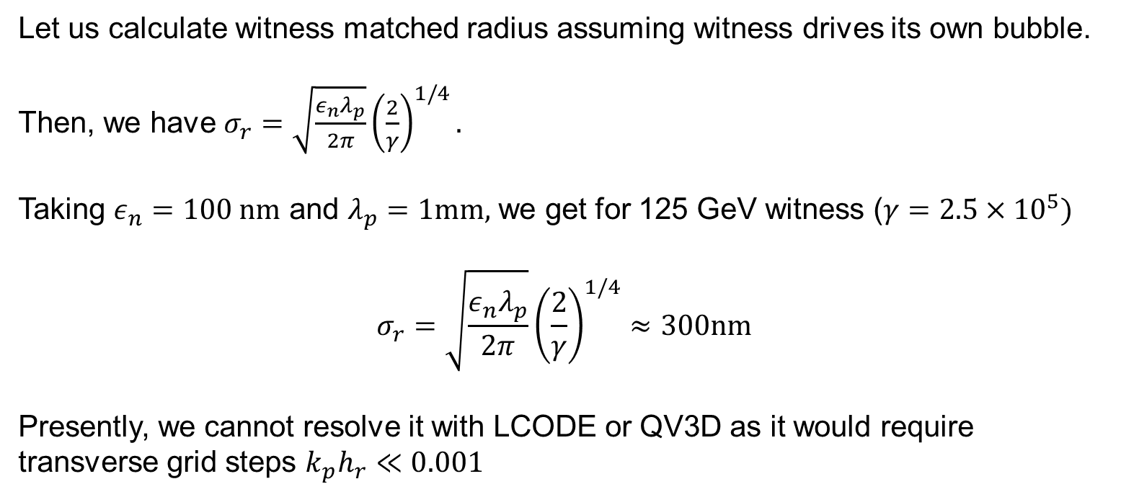
Witness matched radius
Let us calculate witness matched radius assuming witness drives its own bubble.
Then, we have $σ_{r}=\sqrt{\frac{ε_{n}λ_{p}}{2π}}{\left(\frac{2}{γ}\right)}^{1/4}.$
Taking $ε_{n}=100 nm$ and $λ_{p}=1mm,$ we get for 125 GeV witness ($γ=2.5×{10}^{5})$
$$σ_{r}=\sqrt{\frac{ε_{n}λ_{p}}{2π}}{\left(\frac{2}{γ}\right)}^{1/4}≈300nm$$
Presently, we cannot resolve it with LCODE or QV3D as it would require transverse grid steps ${k_{p}h}_{r}≪0.001$

Slide 14
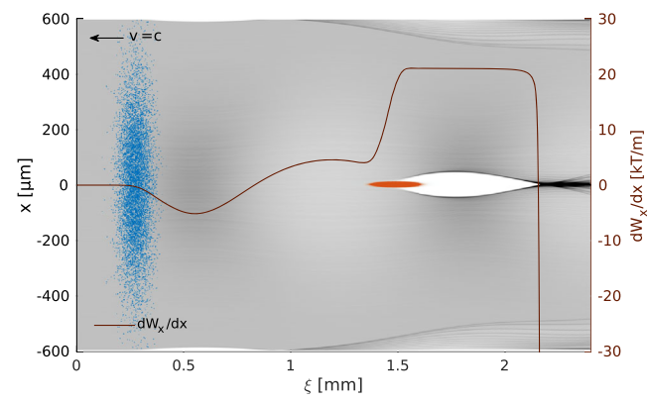
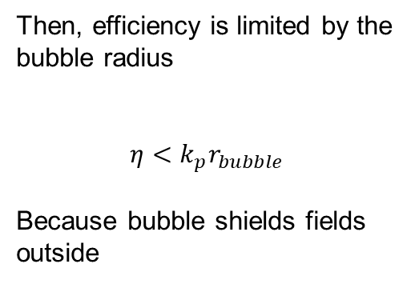
Efficiency
Let us assume, we work in the bubble self-generated by the witness (V. Olsen and E. Adli, 2018)
Then, efficiency is limited by the bubble radius
$$η<k_{p}r_{bubble}$$
Because bubble shields fields outside

Slide 15
Conclusions
Proton driver with energy >300 GeV required because of dispersion
Witness dephasing can be compensated by proper plasma density profiles
All drawbacks scale down very fast with driver energy. TeV proton driver avoids all of them

