Slide 1
Beam Instrumentation for run 2b
S. Mazzoni for the BI team
AWAKE collaboration meeting @ CERN, 4-6 October 2023

Slide 2
Beam instrumentation for AWAKE
Presently:
  optimisation of digital camera readout system
  commissioning of ChDR camera system
  support to UCL team for spectrometer upgrade (S. Senes)
New team!
  Collette Pakuza new BI QUEST since 1st of September
  Laurence Stent new QUEST for BPMs since 1st October
For run 2c:
  allocating resources for new / refurnished BI systems (BTV, BPMs)

Slide 3
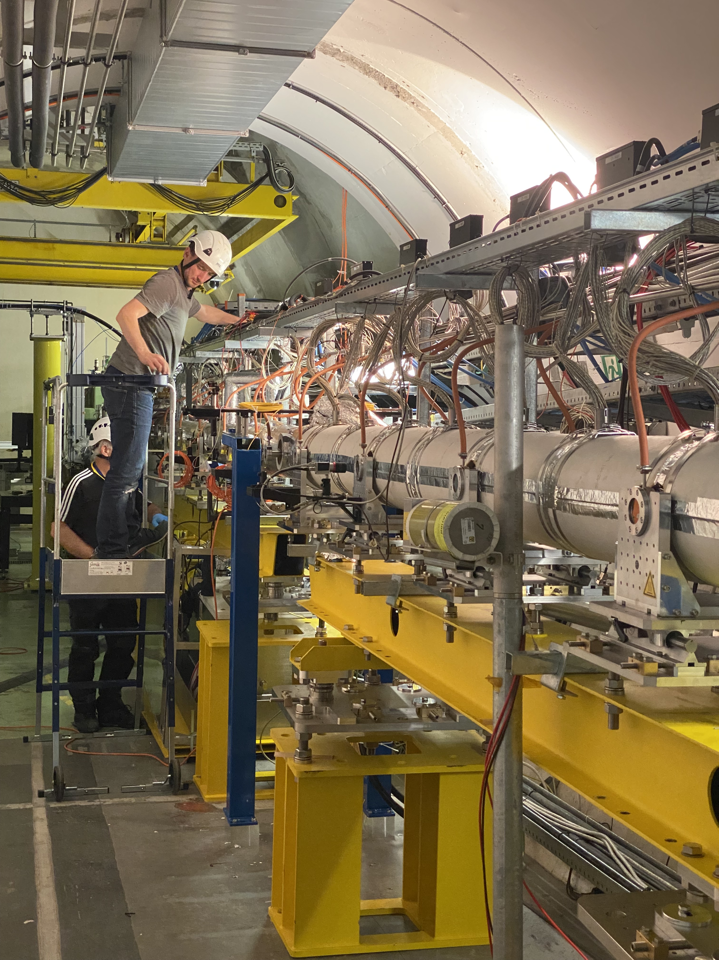
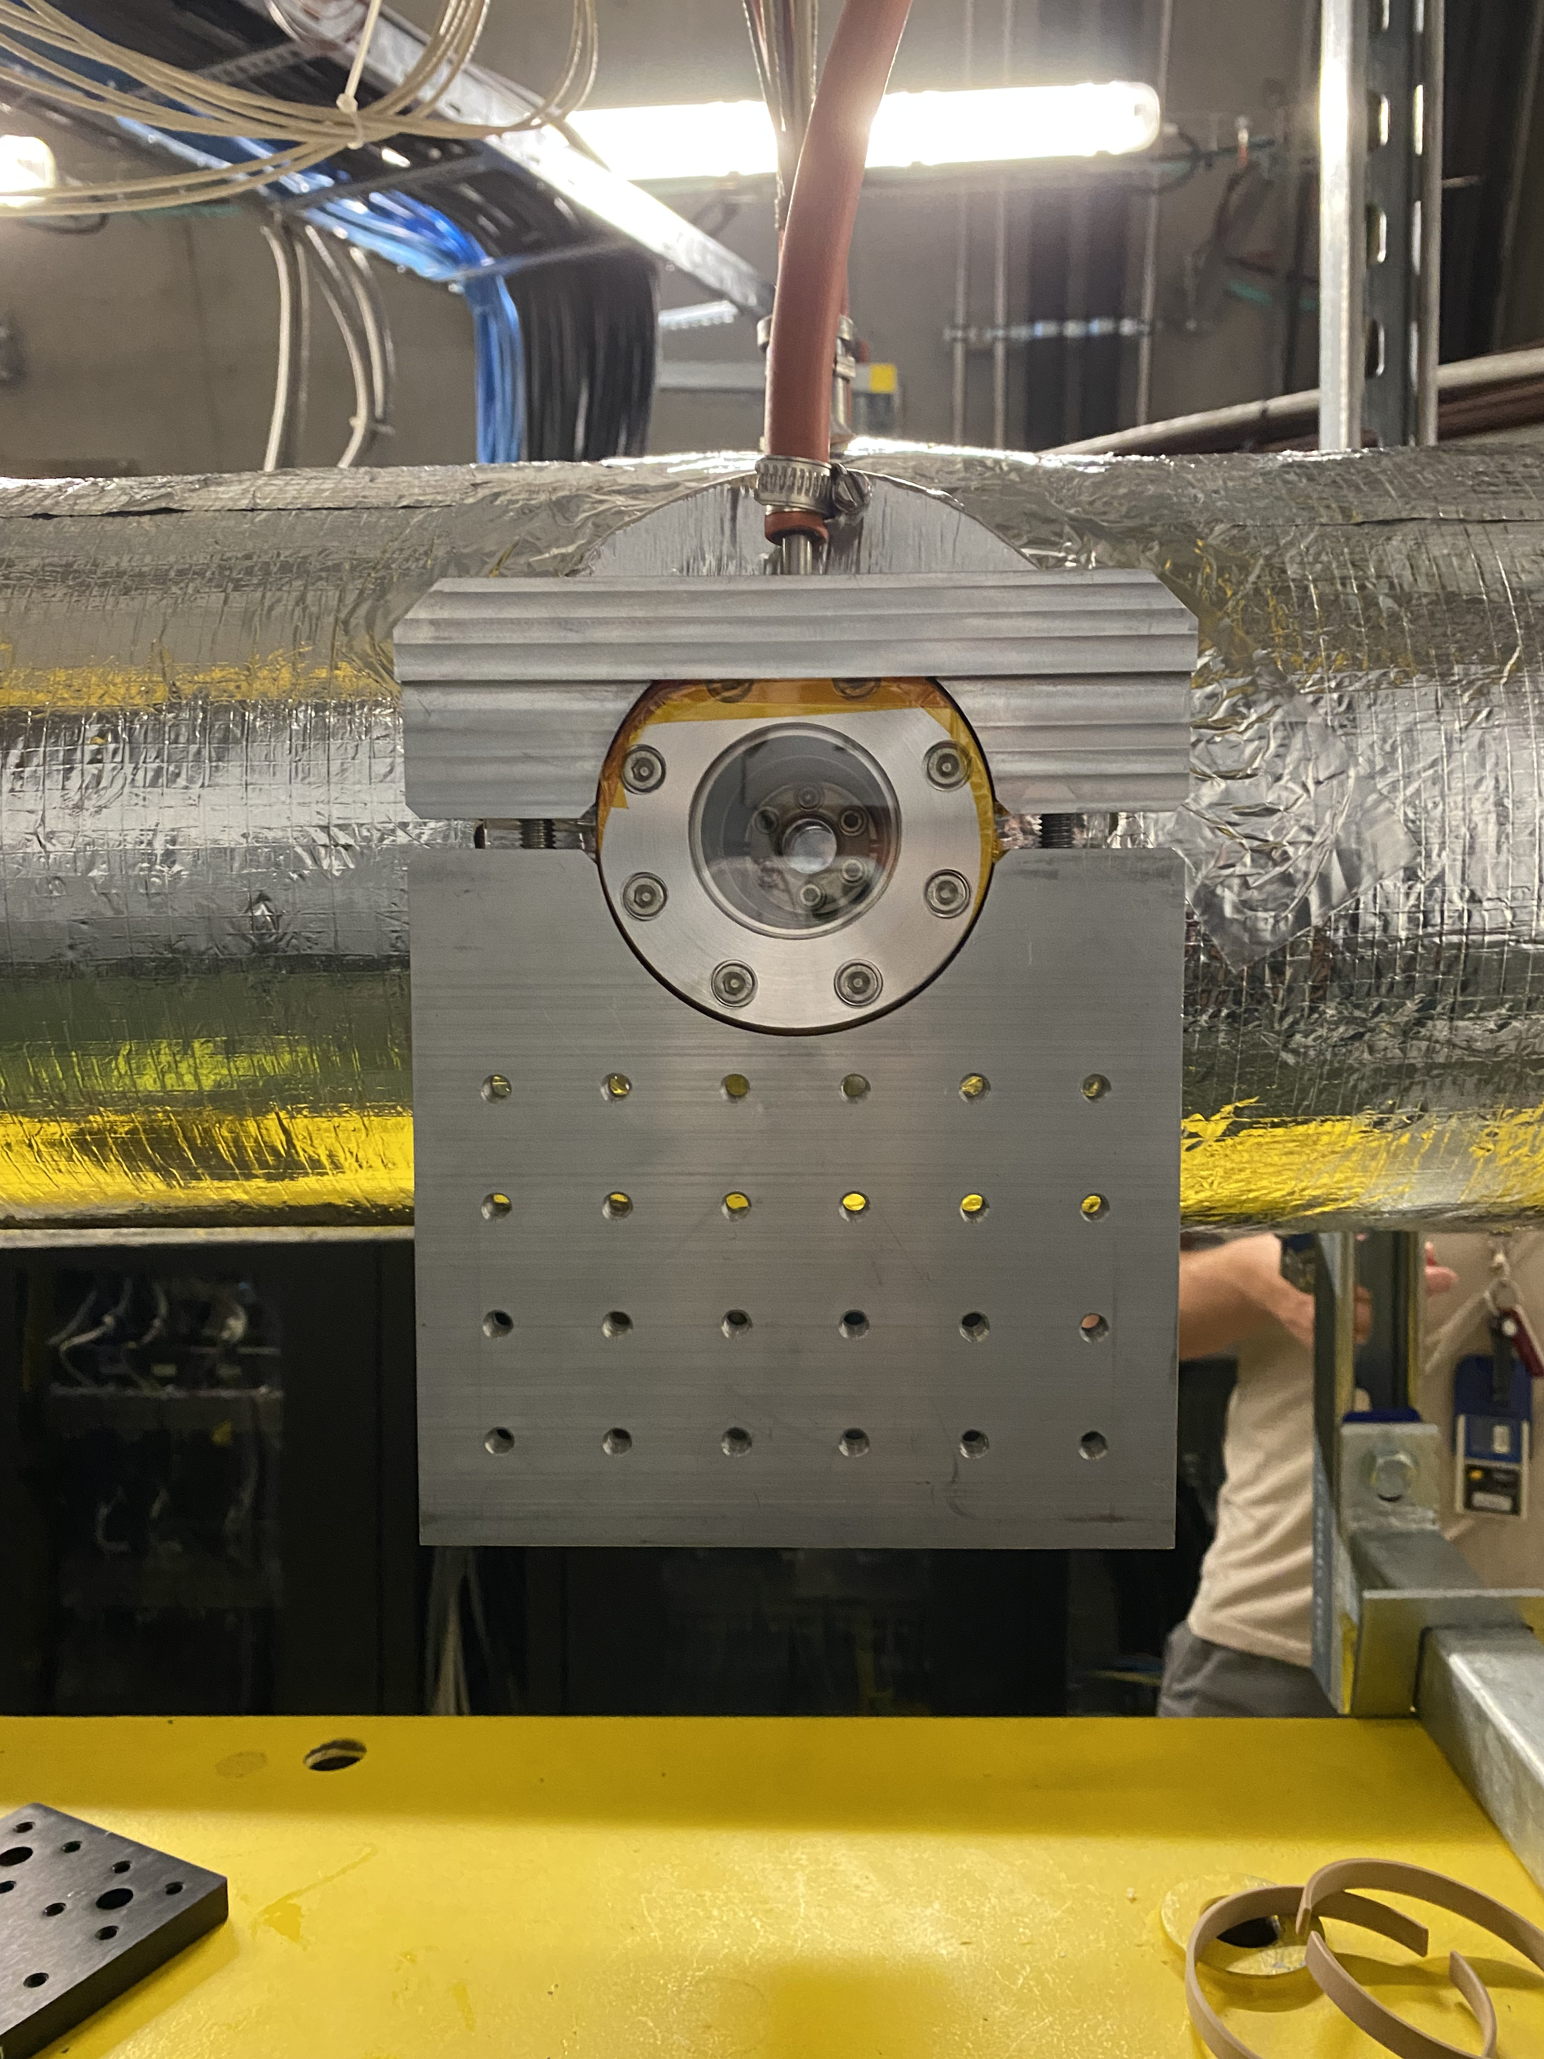
Digital cameras
C. Pakuza
A. Topaloudis
E. Poimenidou
E. Senes
S. Burger
Until last run: 9+ 6 beam cameras connected to servers cs-ccr-awakecam / -awakecam2 and 8(5?) laser cameras on cs-ccr-awakecam1
For next run: 10 additional cameras (TT41.PLASMA.CAM#.DigiCam) connected to both servers.
all material in tunnel, SW in place , fine SPS extraction trigger available. Installation Friday?
Plasma cell
Support
10 viewports along the cell

Slide 4
Digital cameras - continued
C. Pakuza
A. Topaloudis
E. Poimenidou
E. Senes
S. Burger
Effort to improve performance of readout system. Goal is zero loss of extraction images
Presence performance OK!
  at times cameras get into parameters synchronization loop. An automatic disconnect / connect loop is being implemented
  loss of extraction images very low after re-synch code (August run). ‘A few images lost per day’. Getting to ZERO!
10 additional cameras might affect performance! Evaluating possibility of connecting a 4th server (lead time for server approx. 4 months. EN/EL team contacted to understand if fibre connection is available)

Slide 5
ChDR and HFB BPMs
C. Pakuza
B. Spear
W. Zhang
M. Wendt
E. Senes
M. Krupa
E. Poimenidou
V. Verzilov
S. Liu
Connecting the second TRIUMF electronics module to the HF button for comparison between ChDR BPM and HF with the same electronics
  FESA set-up for the device
  Device connected. Tests planned for today or tomorrow
  To be tested next run – Oxford University (Beth and Weida) & BI

Slide 6
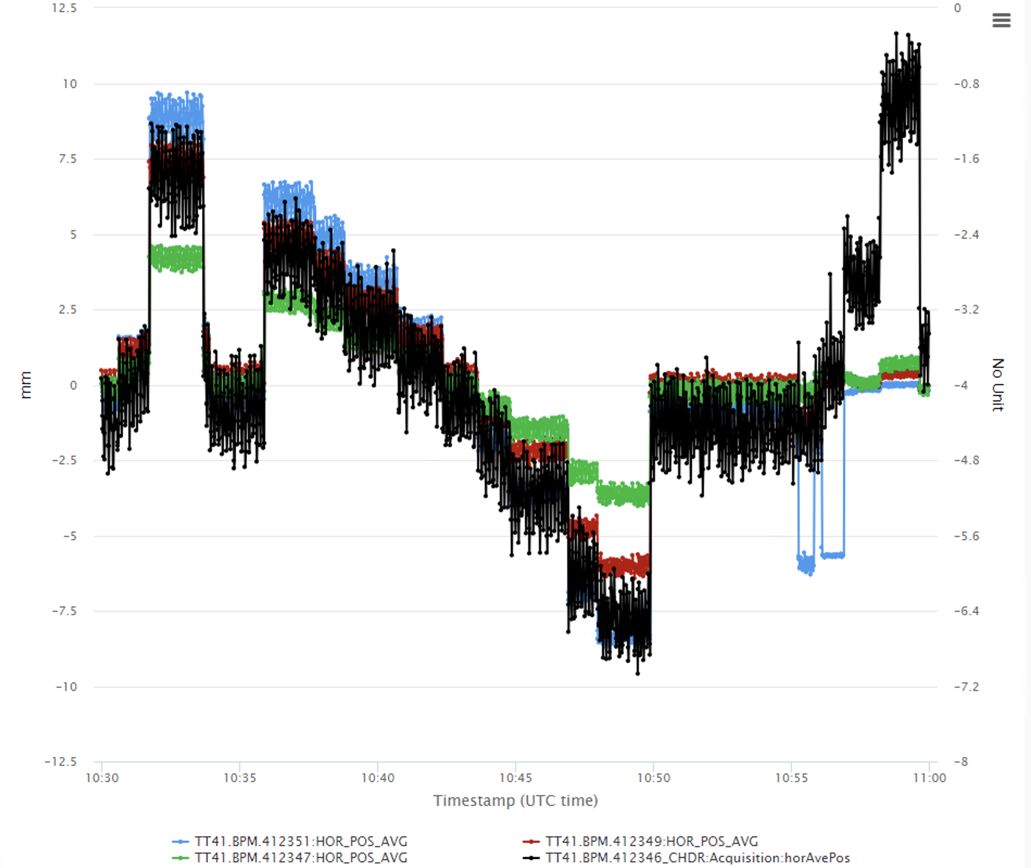
ChDR and HFB BPMs
As agreed during last TB, analysis of logged ChDR BPM signals
  Test with electrons only, 21 September
  Ballistic beam
  No magnetic elements between the relevant BPMs
  Horizontal position scan only
  Requires more tests (protons!)
ChDR BPM
Stripline eBPMs

Slide 7
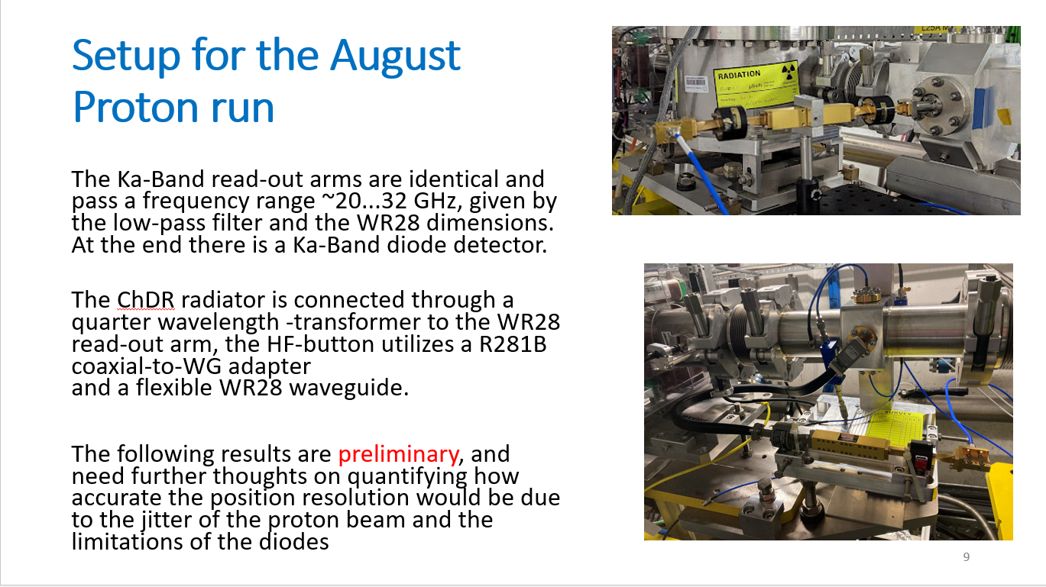
ChDR and HFB BPMs
from B. Spears’ presentation to August TB
https://indico.cern.ch/event/1316989/

Slide 8
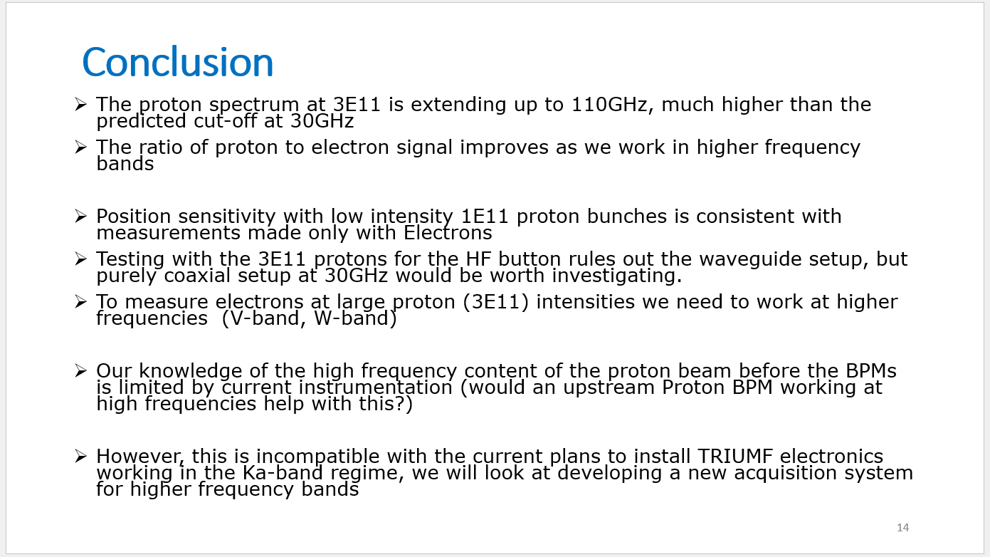
ChDR and HFB BPMs
from B. Spears’ presentation to August TB
https://indico.cern.ch/event/1316989/

Slide 9
AWAKE BI meetings
Monthly BI meetings will resume. Next 18 October https://indico.cern.ch/event/1332385/
Join egroup ‘awake-instrumentation’ (egroups.cern.ch) or ask me

