Slide 1
X-Box Update
04.10.2023

Slide 2
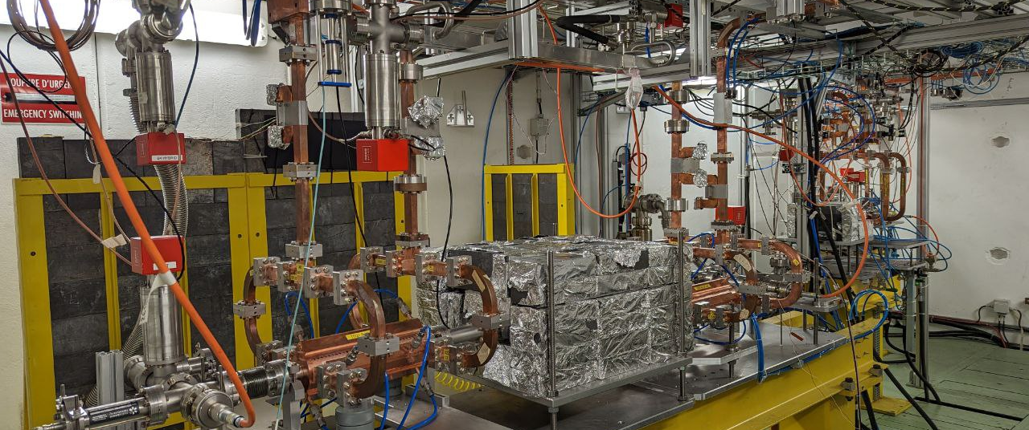
X-Box 2: TD31 N3 N4

Slide 3
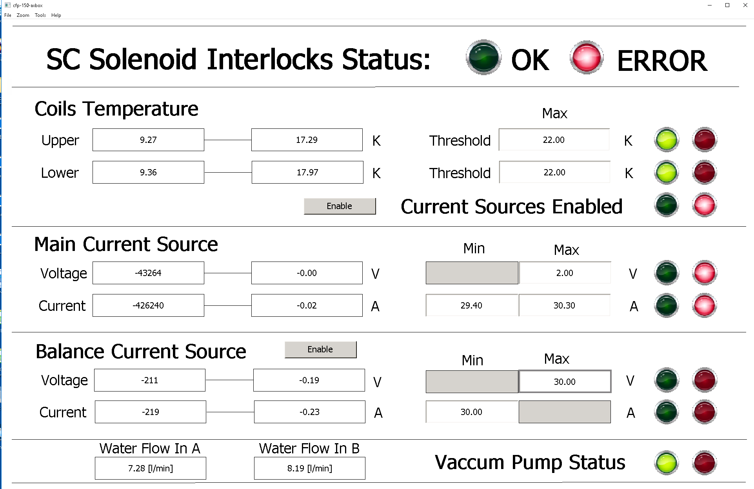
X-Box 2
No operation for 2 weeks
Interlock in modulator not allowing triggering
\Waiting for HP switching units for modulator
Currently:
Readout of water flow
Duplication of channel DC_DOWN_B, with and without attenuation
Addition of extra temperature channels

Slide 4
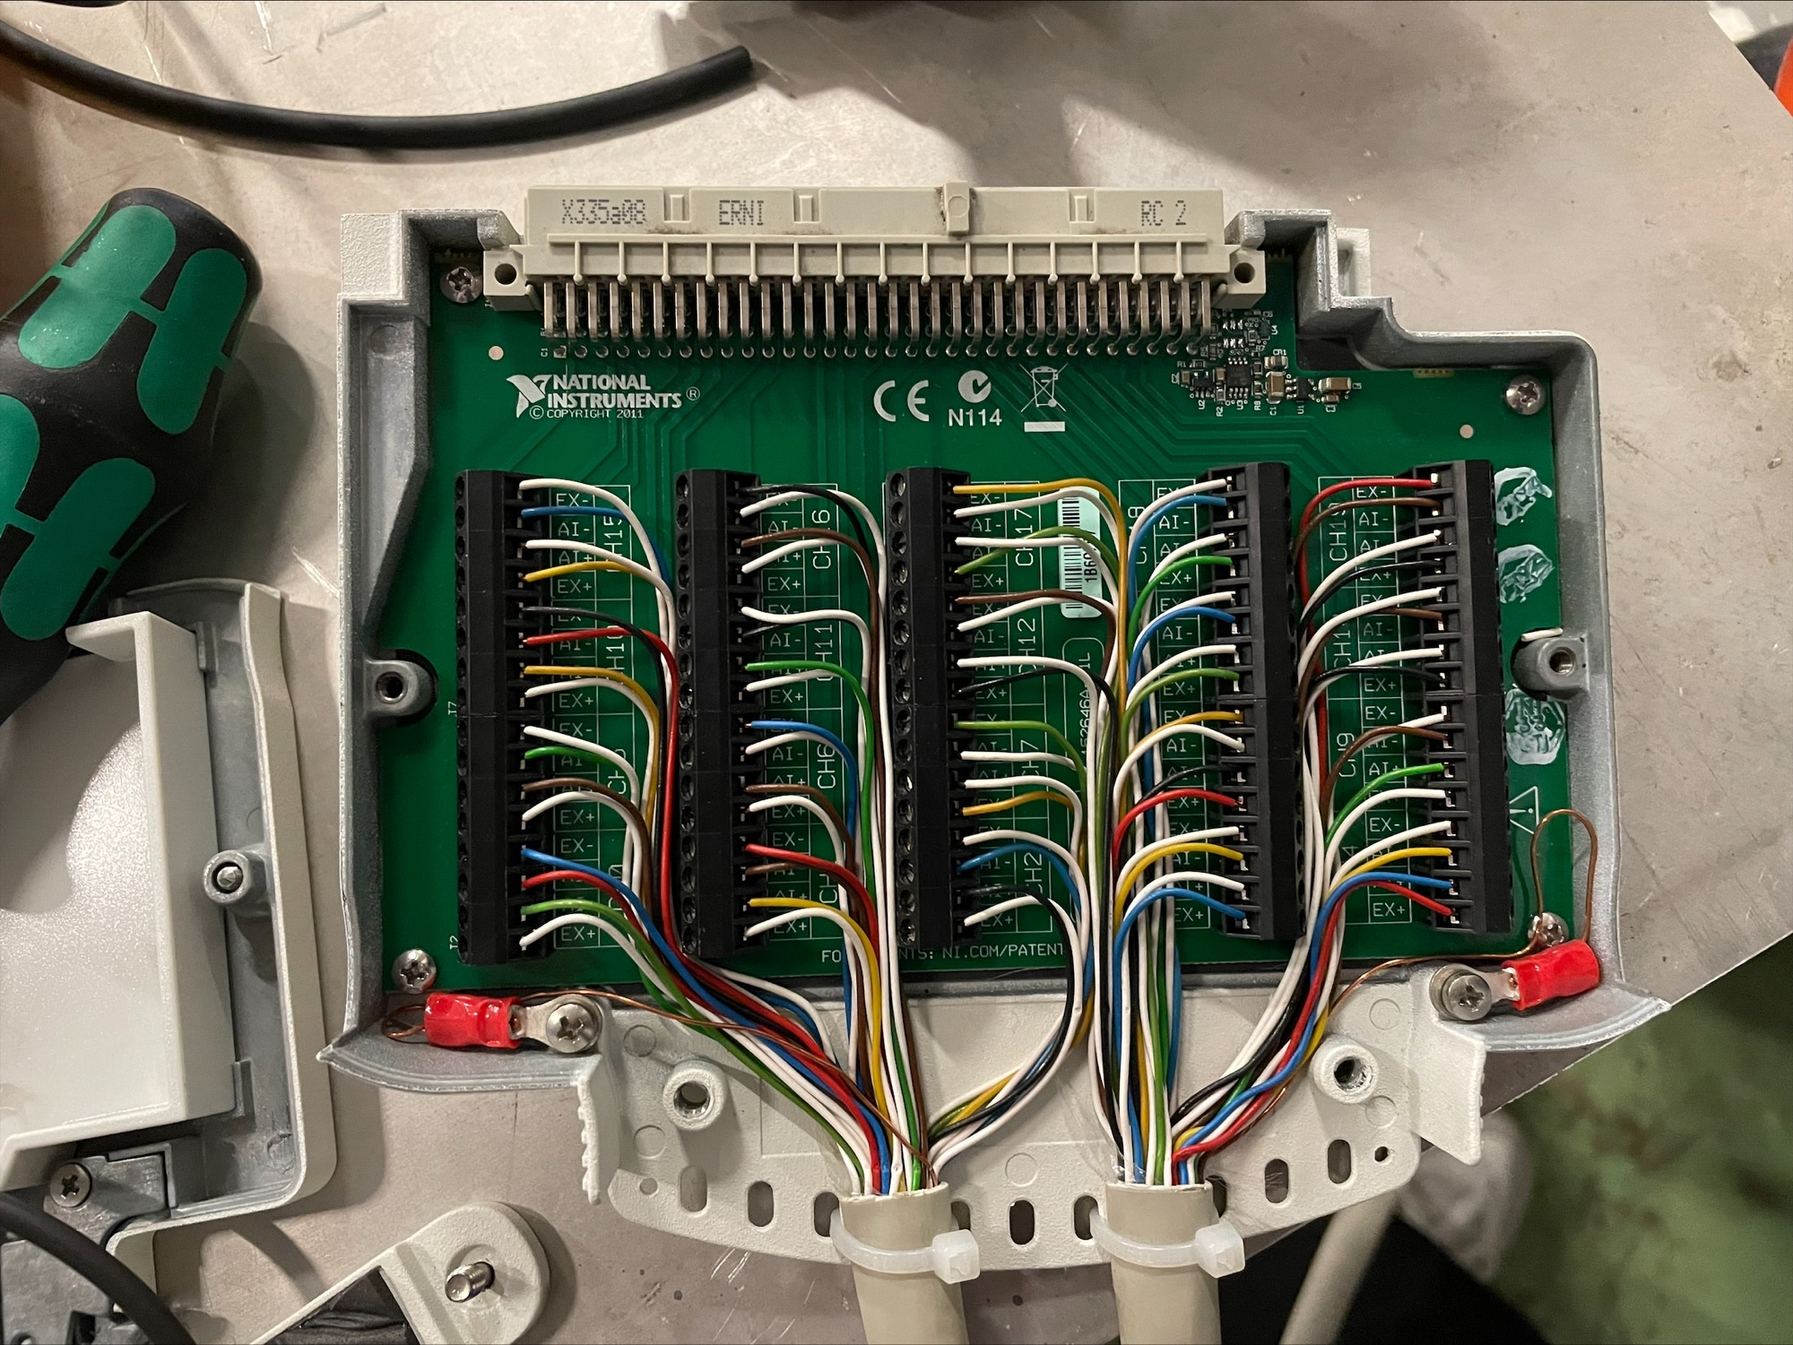
X-Box 2
No operation for 2 weeks
Interlock in modulator not allowing triggering
\Waiting for HP switching units for modulator
Currently:
Readout of water flow
Duplication of channel DC_DOWN_B, with and without attenuation
Addition of extra temperature channels

Slide 5
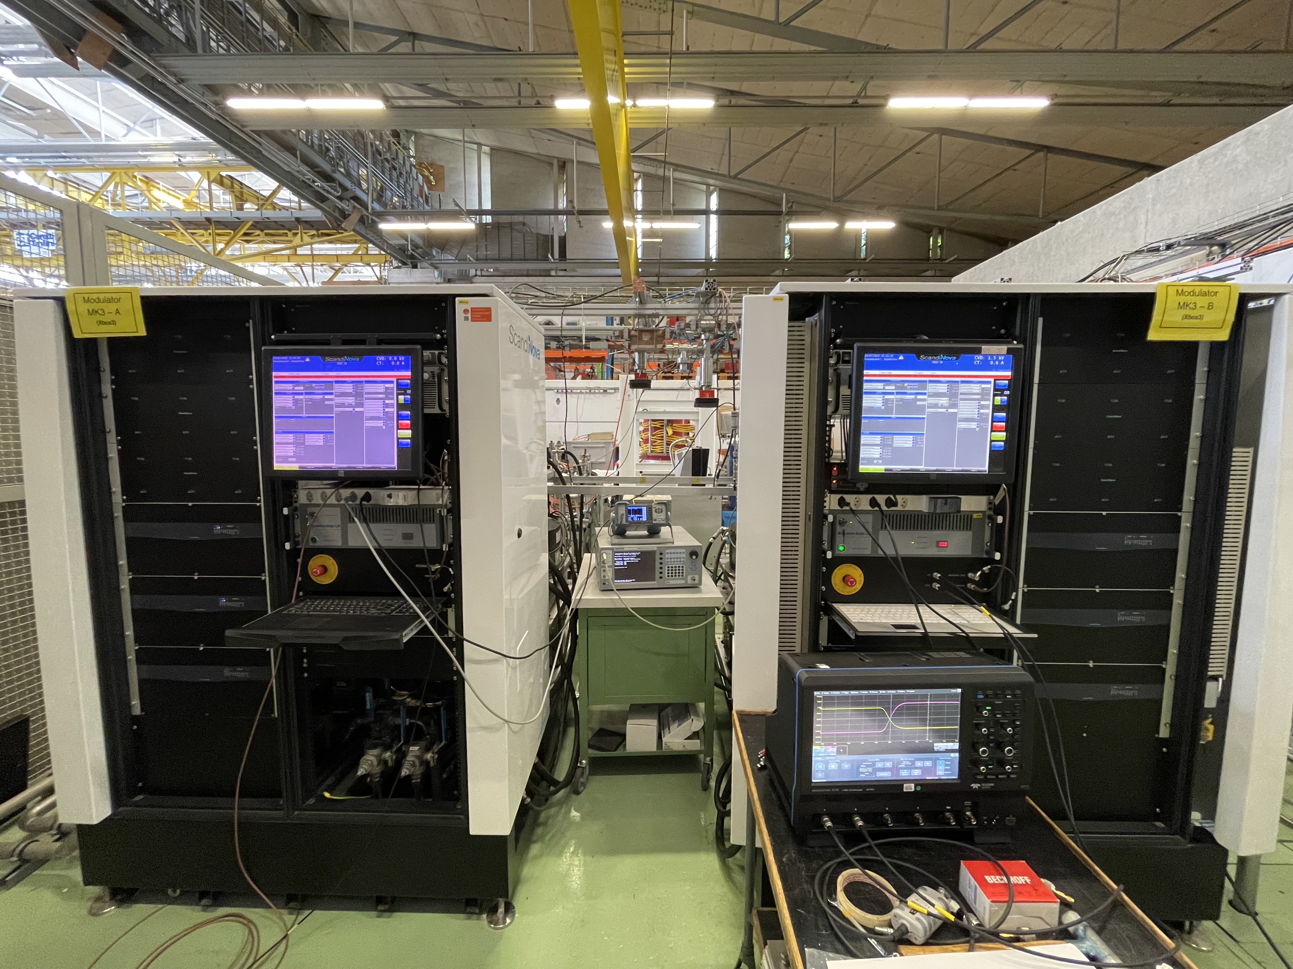
X-Box 3: High Efficiency Tubes Characterisation
Completed measuring campaign for both klystrons
TUBE1 22M001 (left)
CAV 22G002 (right)

Slide 6
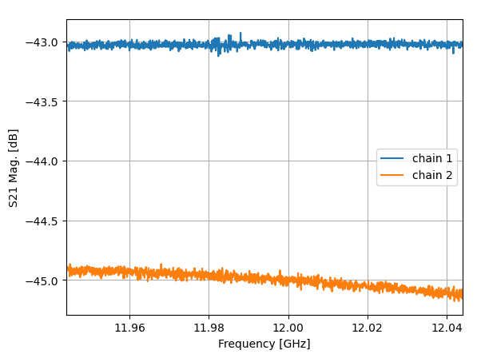
High Efficiency Tubes Characterisation Measurement setup
Klystron
RF Gen
SSA
HP DC
Load
DC
Attenuation
Isolation + Transition + Attenuation
Power Meter 1 - PKI
Power Meter 2 - PKI

Slide 7
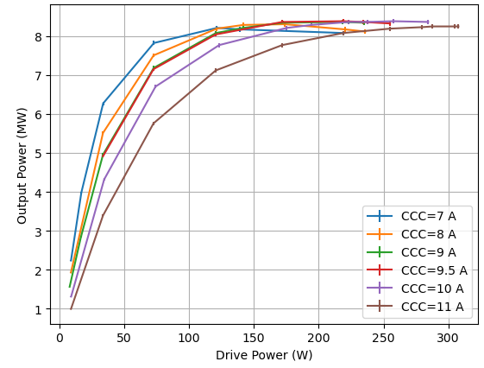
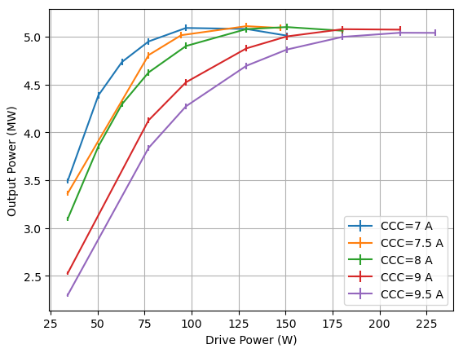
High Efficiency Tubes Characterisation Gain curves vs Counter Coil Current
22M001 TUBE
22G002 CAV

Slide 8
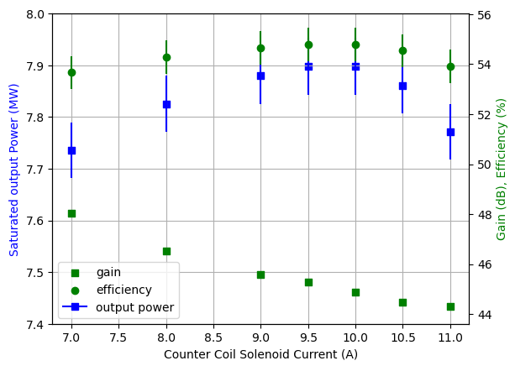
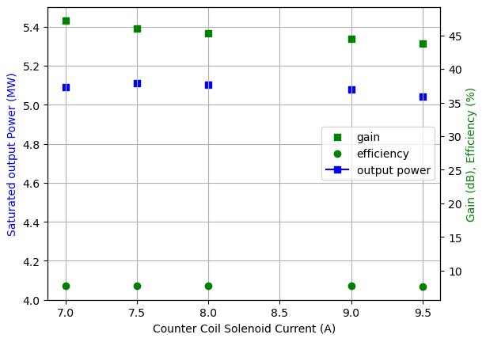
High Efficiency Tubes Characterisation Gain curves vs Counter Coil Current
22M001 TUBE
22G002 CAV

Slide 9
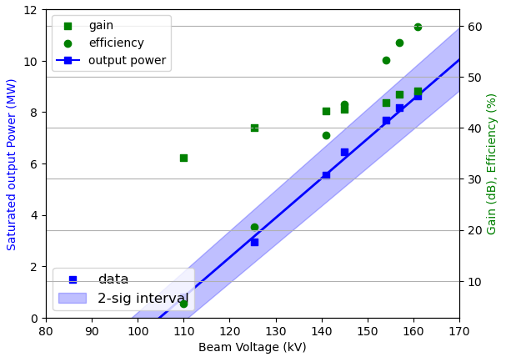
High Efficiency Tubes Characterisation Output power vs Beam Voltage
22M001 TUBE
22G002 CAV

Slide 10
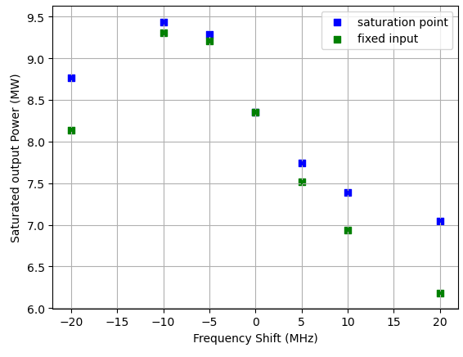
High Efficiency Tubes Characterisation Frequency Behaviour
22M001 TUBE
22G002 CAV

Slide 11
Dark Current Analysis
Idea:
Retrieve knowledge about amount of energy lost due to Dark Current (DC)
Energy lost due to acceleration of emitted electrons
Procedure:
Simulate electric and magnetic field
Calculate energy of electrons due to heat transfer
Simulate Particle in Cell (PIC) and compare with measurements
Estimate energy loss due to acceleration

Slide 12
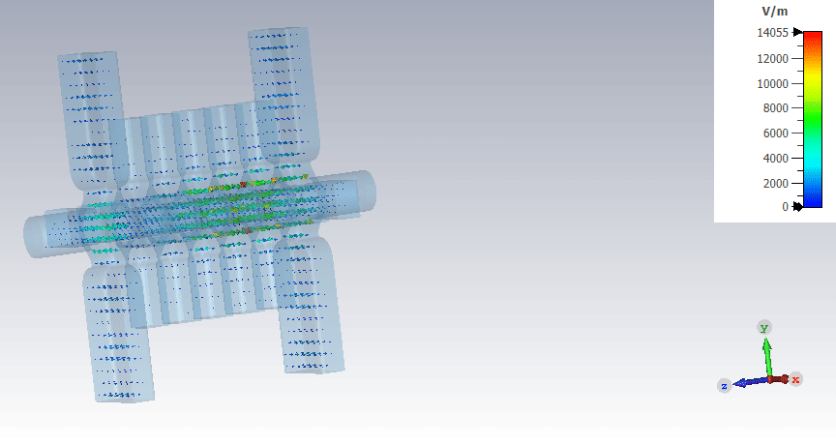
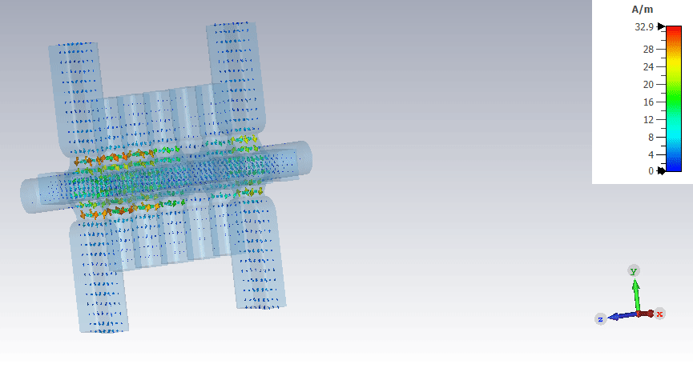
E and H field of small structure
E-field
H-field

Slide 13
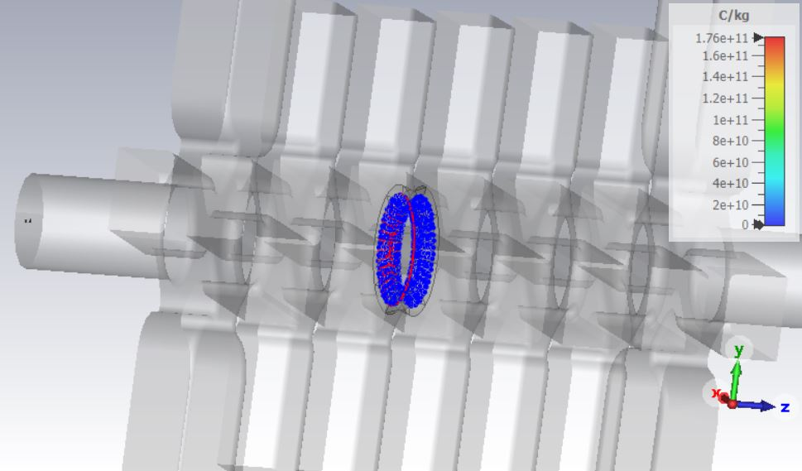
Particles at iris
Number of emission points: 704
Particle type: electron
PIC emission model: DC (rise time: 1e-3, absolute current: 1A)
Kinetic energy: 0.043044eV (calculated by temperature of iris)

Slide 14
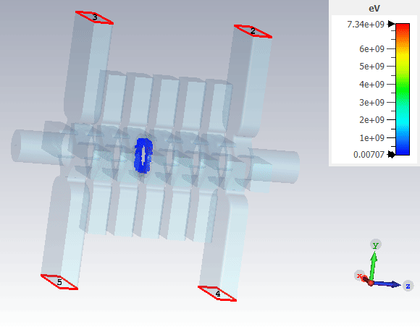
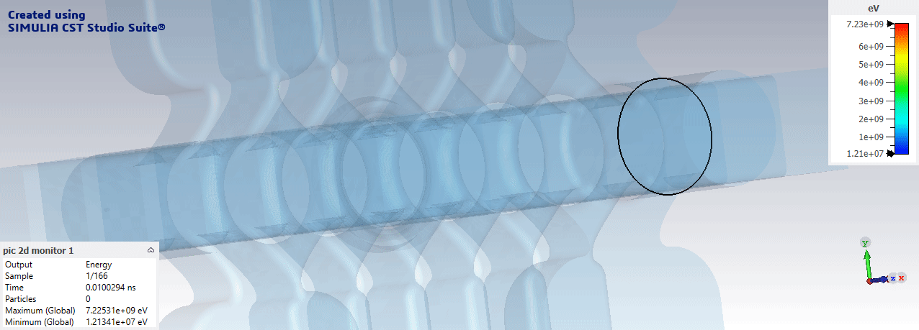
PIC simulation

Slide 15
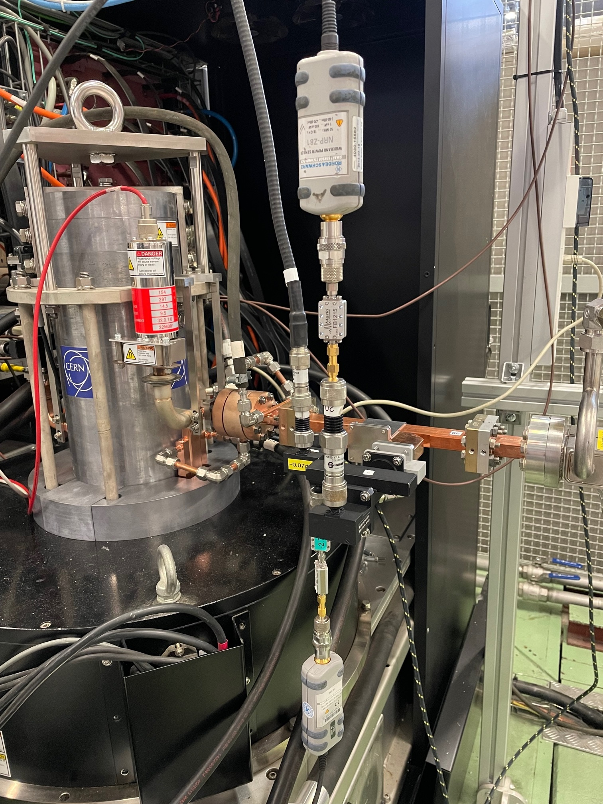
High Efficiency Klystron ER37117 TUBE1 Measurement setup
Klystron
RF Gen
SSA
HP DC
Load
DC
Attenuation
Isolation + Transition + Attenuation
PKI to Power Meter 1
Power Meter 1 - PKI
HP DC
Power Meter 2 - PKI
Chain | Att(dB)@11.994GHz
PKI, chain 1 | 43.04
PKI, chain 2 | 45.0
KLYIN | 49.68
PKI to Power Meter 2

Slide 16
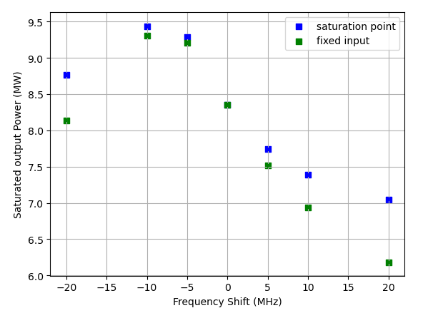
High Efficiency Klystron ER37117 TUBE1 Frequency behaviour

Slide 17
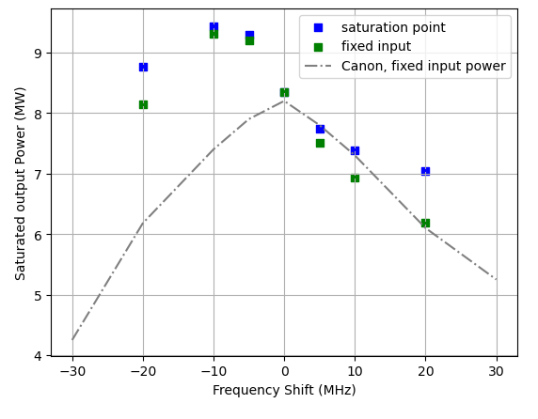
High Efficiency Klystron ER37117 TUBE1 Frequency behaviour

Slide 18
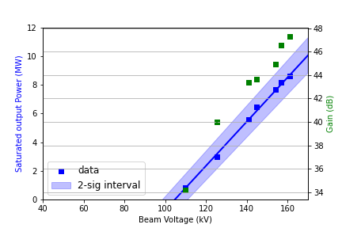
High Efficiency Klystron ER37117 TUBE1 Beam voltage dependency

Slide 19
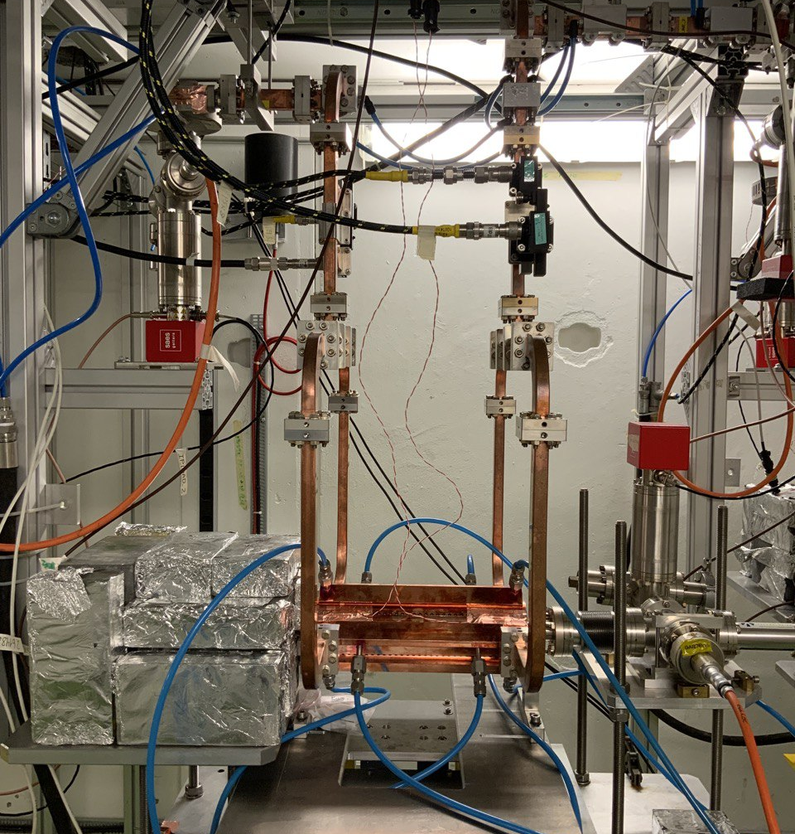
X-Box 3 Line 1: TD31 N1
Shut down

Slide 20
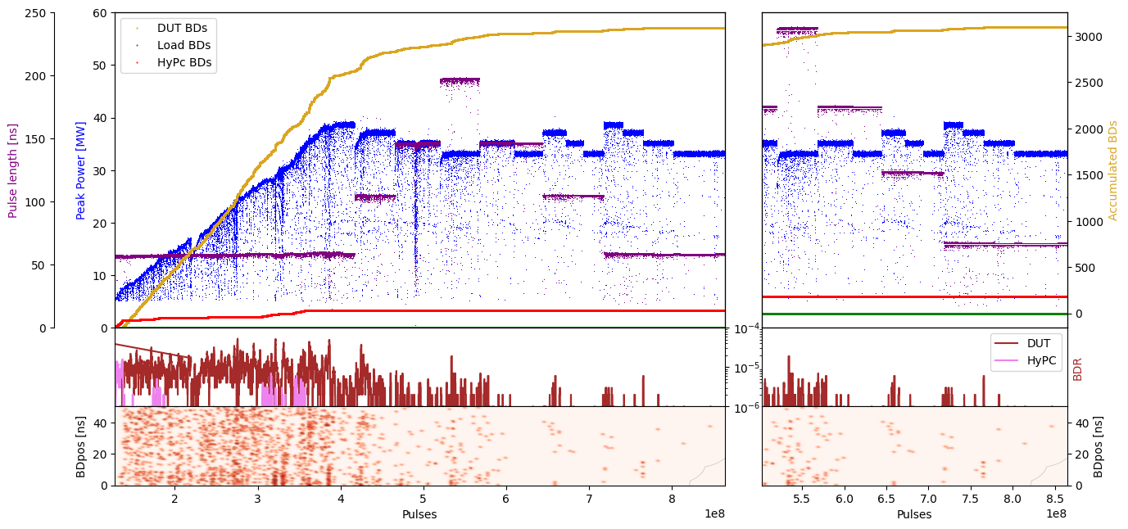
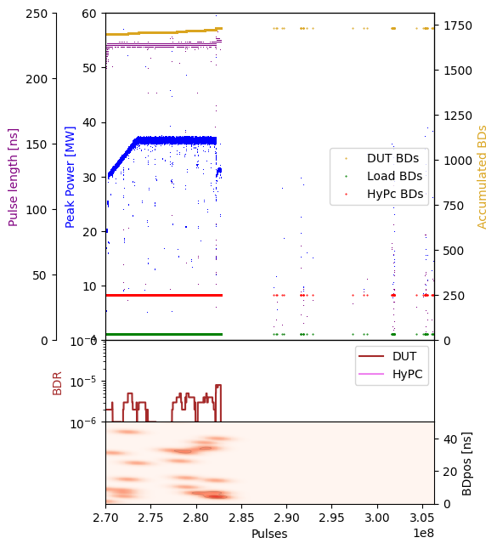
X-Box 3 Line 1: TD31 N1 – Peak Power

Slide 21
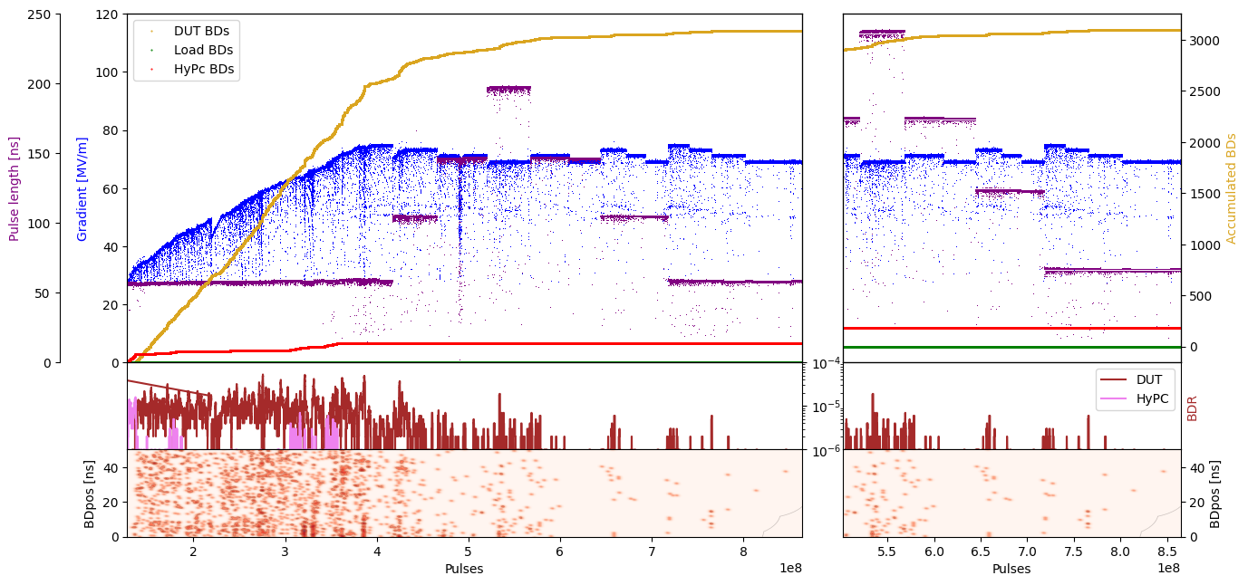
X-Box 3 Line 1: TD31 N1 – Gradient

Slide 22
X-Box 3 Line 2: TD31 N2
Shut down

Slide 23
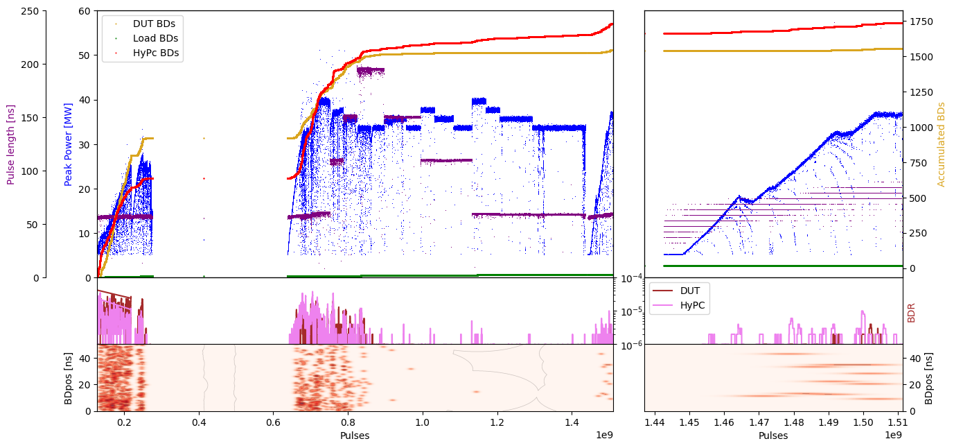
X-Box 3 Line 1: TD31 N2 – Peak Power

Slide 24
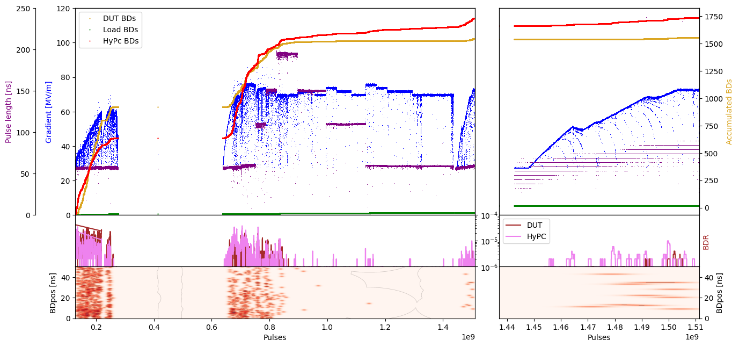
X-Box 3 Line 1: TD31 N2 – Gradient

