Slide 1


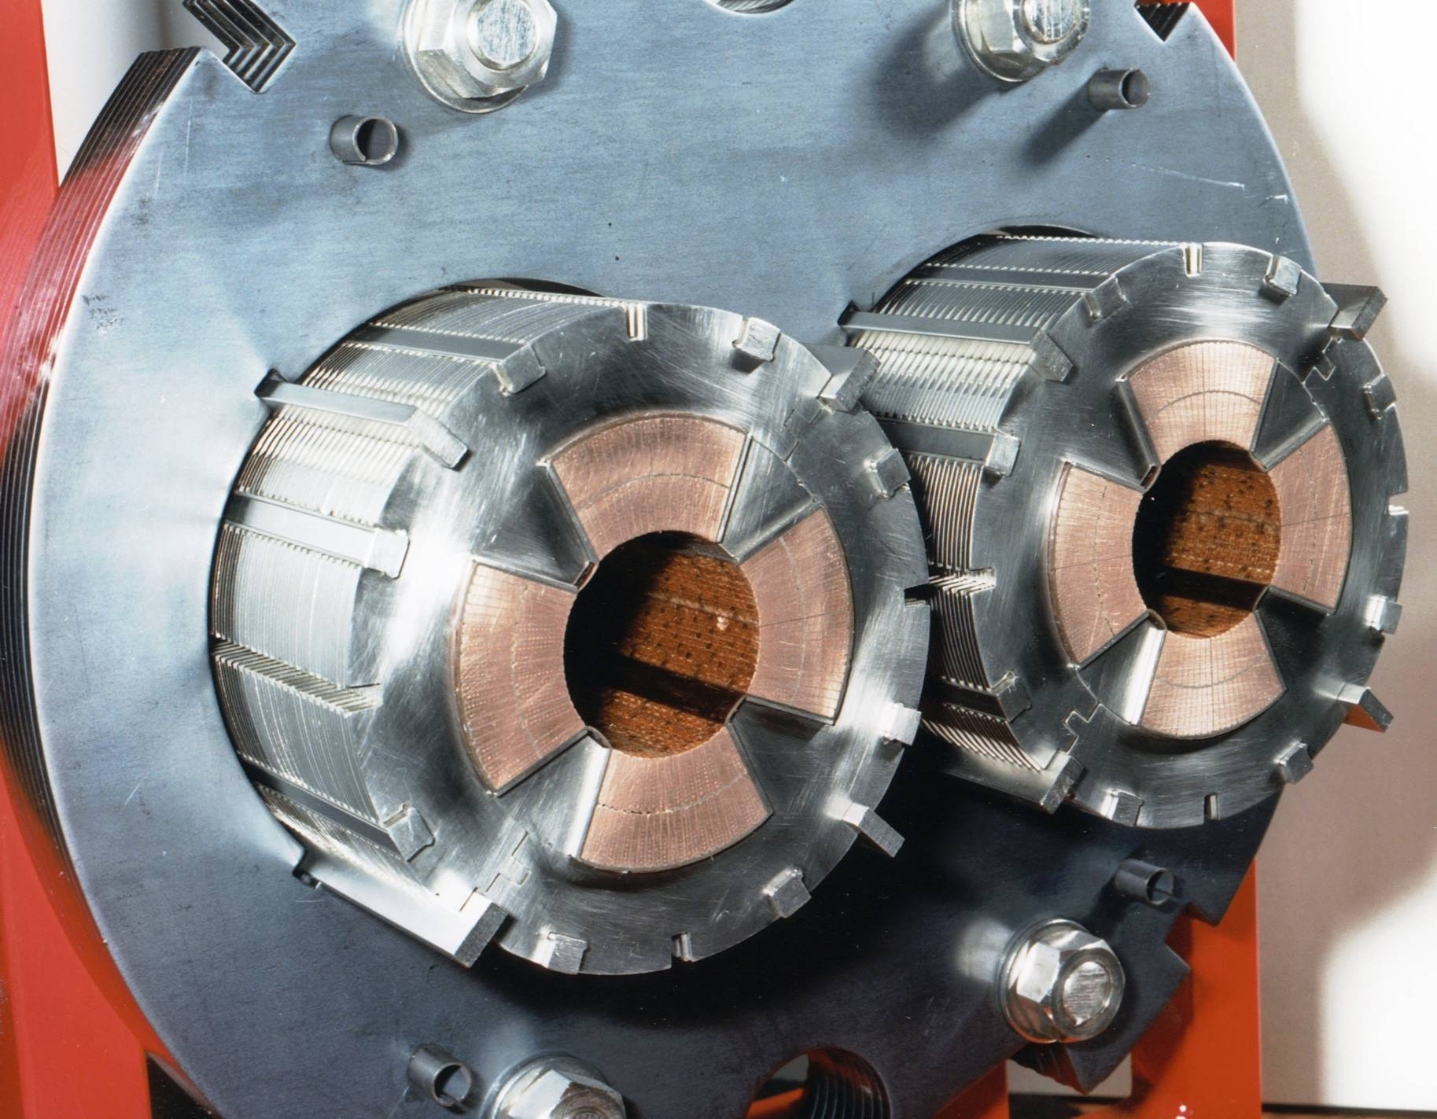

STAARQ project
Station Test Aimant AccélérateuR Quadripole
MQ and MQYY Anti-cryostats
Hervé Allain, Jean-Marc Gheller
Visio CERN - 22/09/2023
www.cea.fr

Slide 2
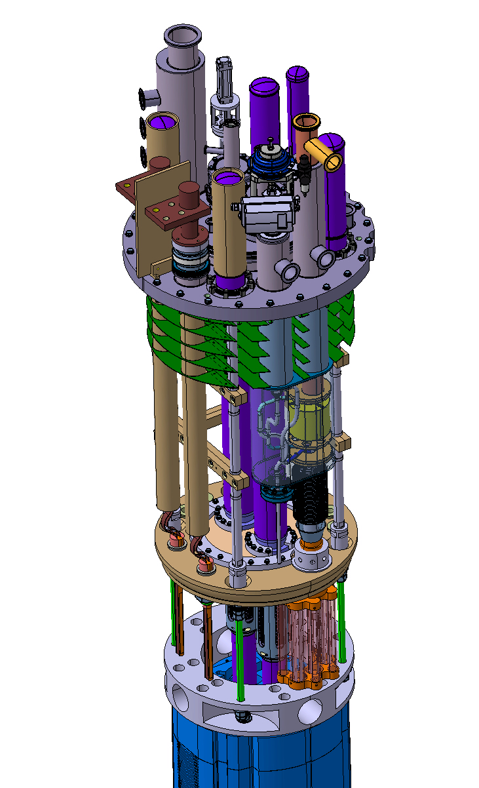
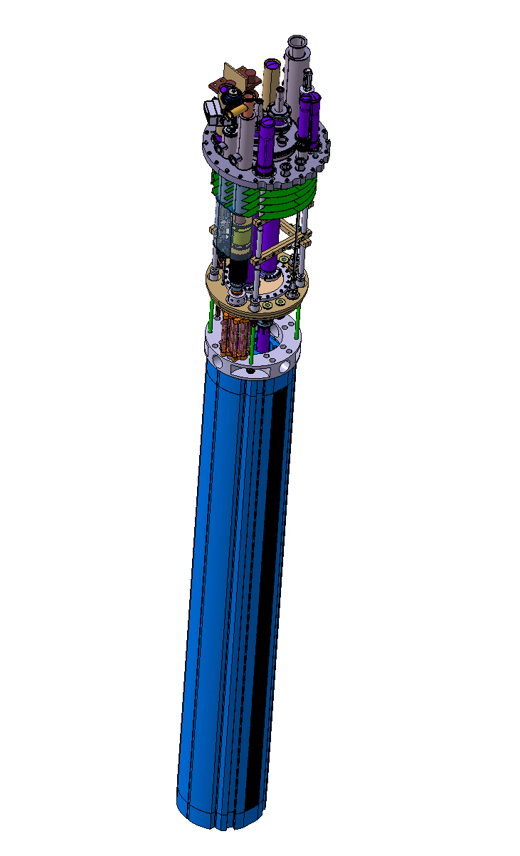
STAARQ project: anti-cryostat
OUTLINE
ANTI-CRYOSTAT manufacturing
Next step
Hold point
Transport beam
Magnetic measurement system
7.65 meter

Slide 3
anti-cryostat manufacturing
Anti-cryostat manufacturing status?
Next steps
Hold point:
    before insertion of the inner tube in the outer tube
    Jean-Marc and Hervé will come to CERN
    Approximative date?
Remark:
  photographs of the different step of manufacturing would be appreciated
  Only one anti-cryostat needed for MQYYM test and STAARQ test
  Station commissionning

Slide 4
anti-cryostat transport beam
Anti-cryostat
Anti-cryostat arrival
(horizontal):
Transport and turning beam
Drawings needed
1
Anti-cryostat turning
to vertical position:
CERN supply
CEA supply
(turnaround plot)
2
Drawings needed
Once vertical, the anti-cryostats will always stay vertical (manipulation and storage)

Slide 5
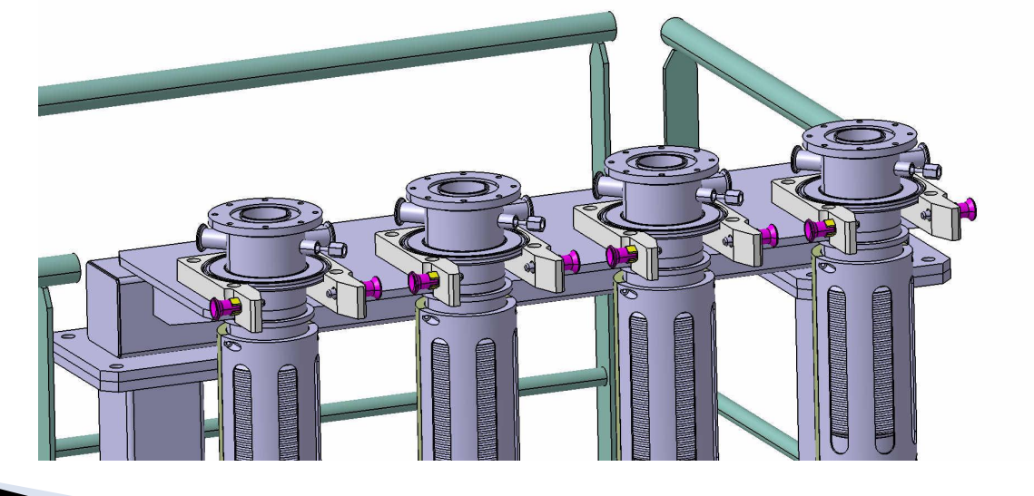
anti-cryostat storage
Anti-cryostat storage
Anti-cryostat support for vertical storage
Plateform for magnet preparation

Slide 6
Magnetic measurement system
Status
Insertion at CERN
Transport in the anti-cryostat on the transport beam

Slide 7
Thank you for your attention

Slide 8

Anti-cryostat (VIII)
Instrumentation:
  4 temperature sensors dispatched along the bottom part
  Of the anti-cryostats to control and regulate the temperature (placed
  Between inner and outer tube)
  3 flexible PCB heaters: 2 heaters 2.2 m long and 1 heater 0.65 m long, all on the internal tube to maintain room temperature inside the measuring tube (manufactured by CERN)
Helium flow:
  One small tube to feed and generate a helium mass flow in the
  measuring tube from the bottom (1.5 mm inner diameter, 0.25 mm
  Of wall thickness)
MLI:
  MLI will be wrapped around the inner tube to minimise the heat
  Load on the superfluid bath (15 layers minimum, more is better)
PCB heater
(0.65 m long)
1 T sensor
PCB heater
(2.2 m long)
1 T sensor
PCB heater
(2.2 m long)
2 T sensors

