Slide 1

Power Converters Parameters
Fulvio Boattini, Davide Aguglia
2/10/2023

Slide 2
Scope of the talk
Evolution of the design study
Important parameters
Important issues
Summary
This is still work in progress

Slide 3
Design study status September 2023
Only the power converters for the RCS resistive magnets are approached so far;
Main parameter for magnets are known and two power converter topologies have been identified;
Several “partial studies” of the magnets and power converters have been carried on and have identified some directions of the analysis but also some issues;

Slide 4
Muon Collider magnet “team”
CERN
UniBO
TUDa
UniTwente
UniMalta
HEIA-FR / Uni-Laval
RCS
Task 7.3
F. Boattini (CERN)

Slide 5
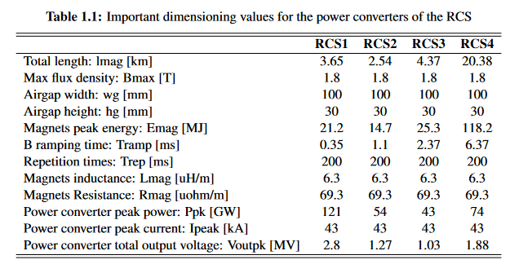
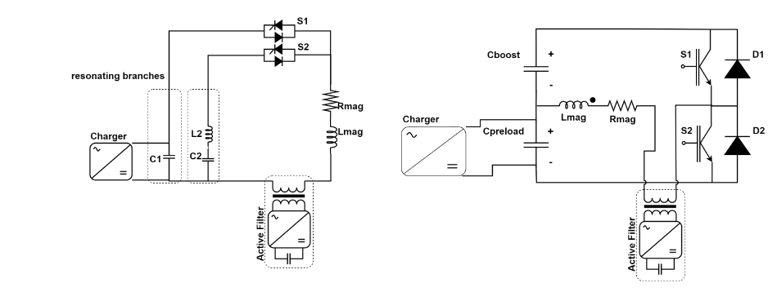
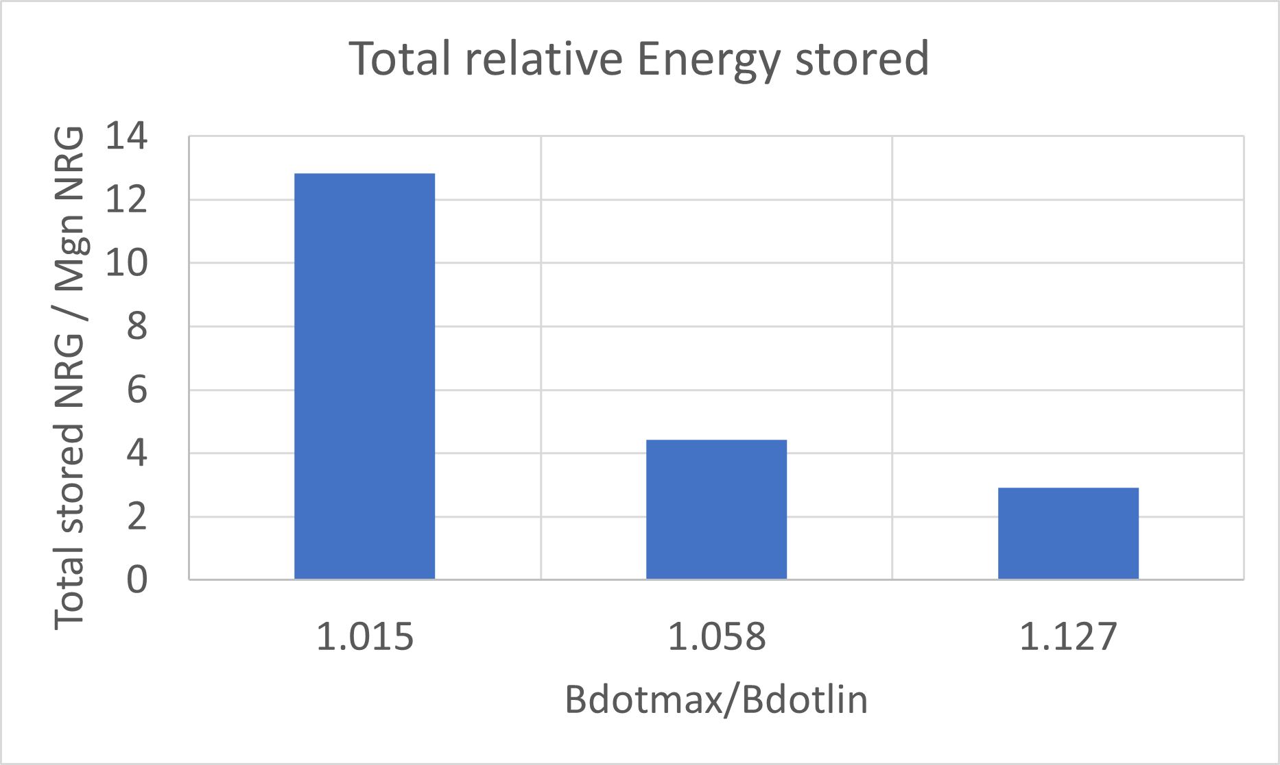
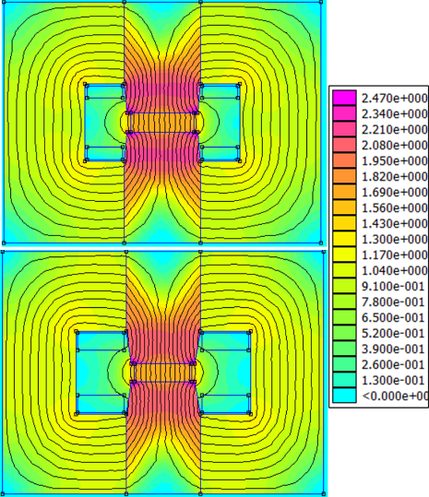

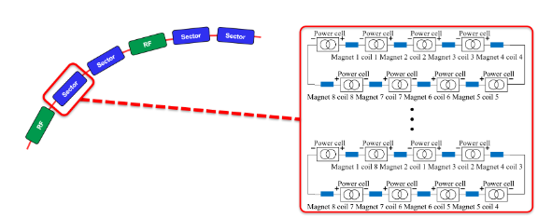
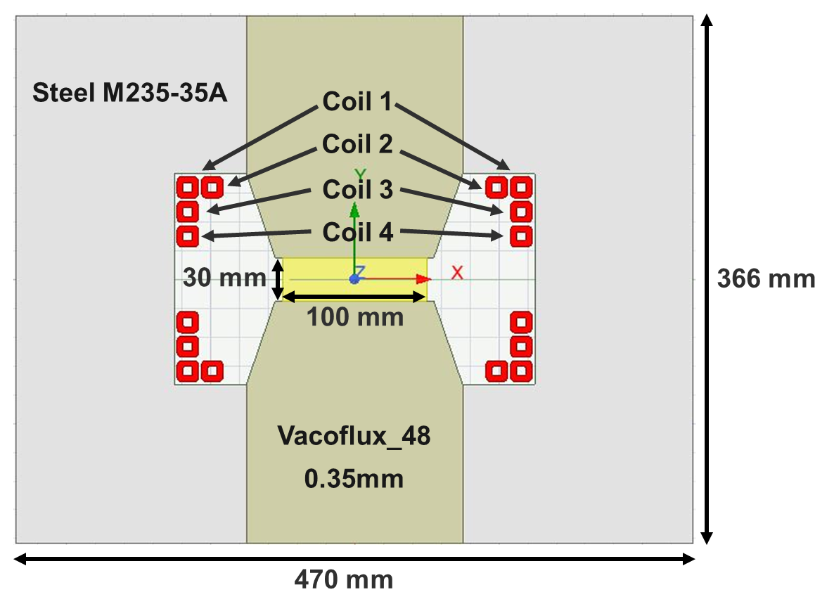
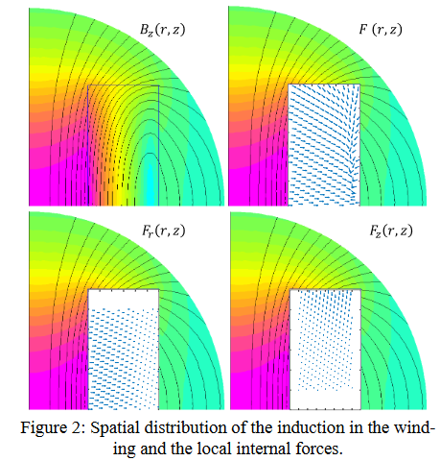
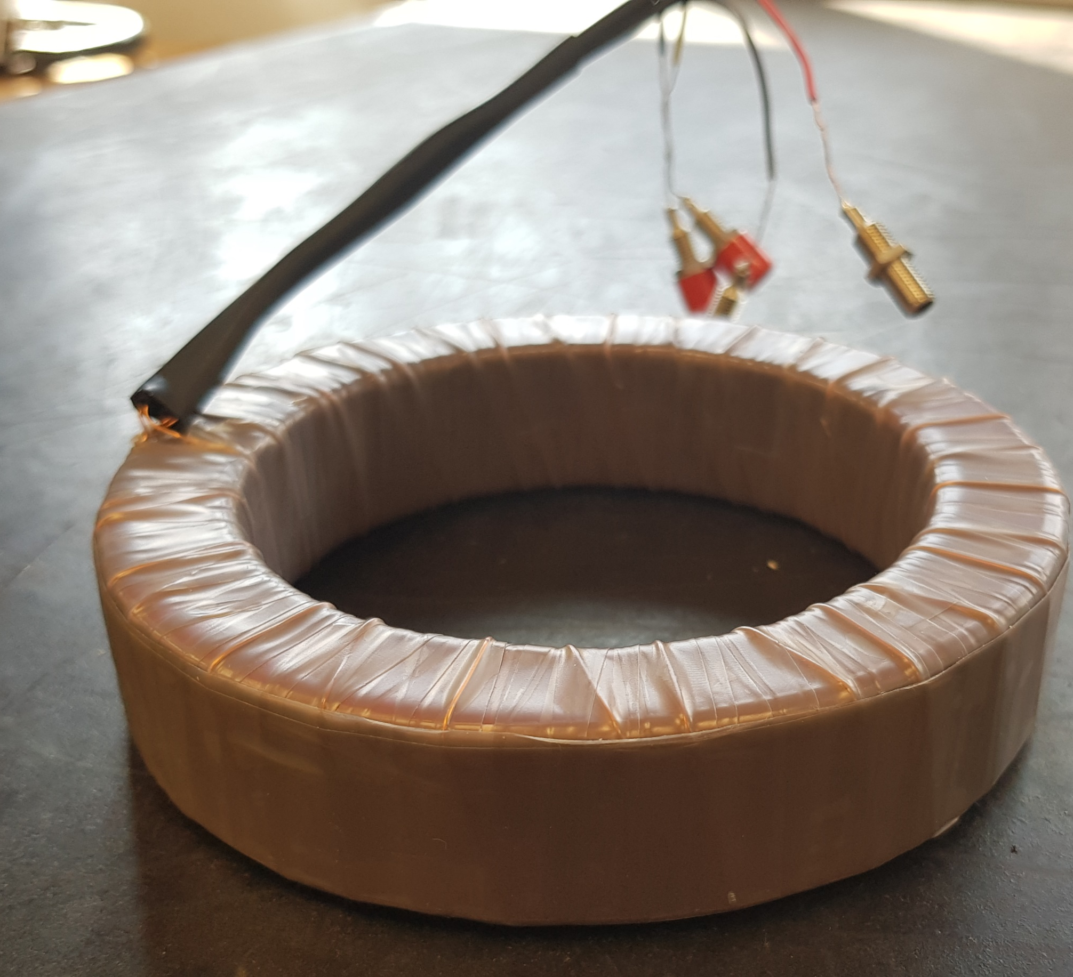
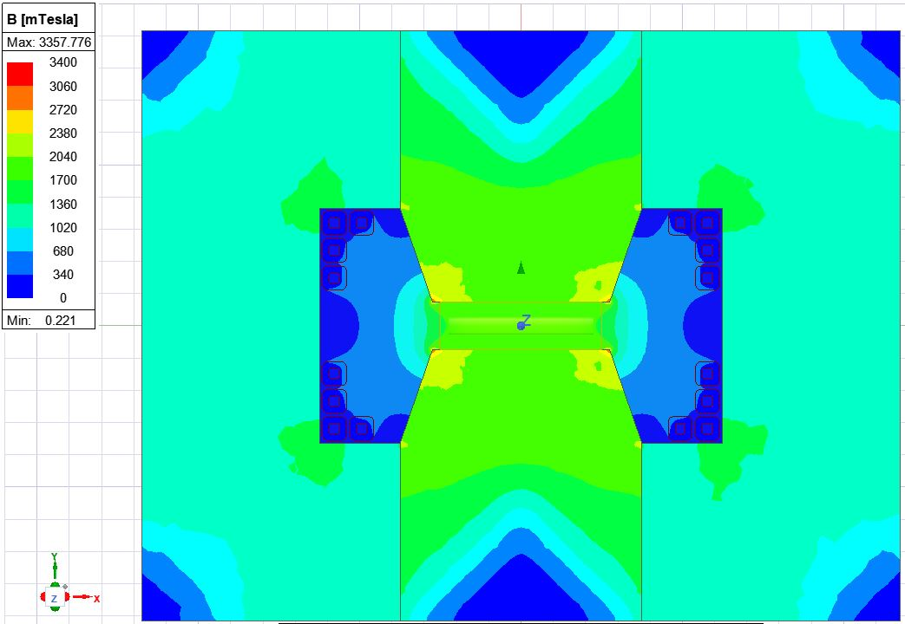
Evolution of the design study
Initial calculations (CERN)
Two resonating circuit concepts identified (CERN)
Preliminary magnets optimization for energy and losses (M. Breschi UNIBO)
Optimal Design
Global circuit studies (CERN)
Emag=5.74 kJ/m/cycle
Eloss=0.42 kJ/m/cycle
Additional insights with more detailed geometry and 2D transient solver. (CERN)
High frequency magnetic material characterization (N. Sammut (UniMalta) / CERN)
Magnets analytical models with ANN models
(CERN/HEIA-FR/Uni-Laval)
Emag=6.3 kJ/m/cycle
Eloss=0.36 kJ/m/cycle

Slide 6
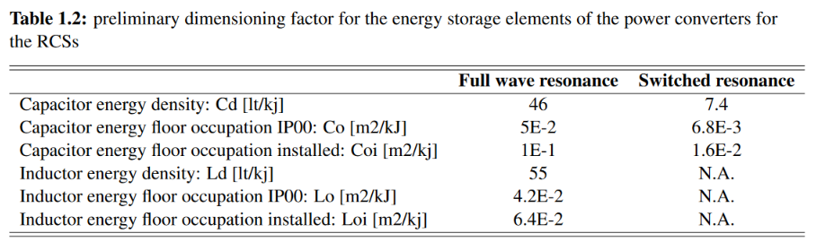
Important Parameters
General parameters
The most sensitive parameters for the power converters design are:
Airgap dimensions:
  influence the total energy storage to be installed should be kept as small as possible. Can we not reduce the 100mm size?
Rising times:
  Influence the peak power that the power converters must provide. Should be kept as big as possible
Bref shape:
  Closer to sinus makes it “easier” to achieve with pure resonating circuits;
A common parameter for RF and PC/Mags is under definition
Storage elements parameters
We want to compare solutions on the basis of cost. The storage elements sizing is the main driver:
Capacitors:
  Energy density depends upon use conditions. Surface occupation is the important parameter;
  Values reported in Table are derived from existing installation (CERN POPS);
Inductors:
  Required if multi harmonics resonance is employed;
  Surface occupation calculated from existing big inductors;

Slide 7
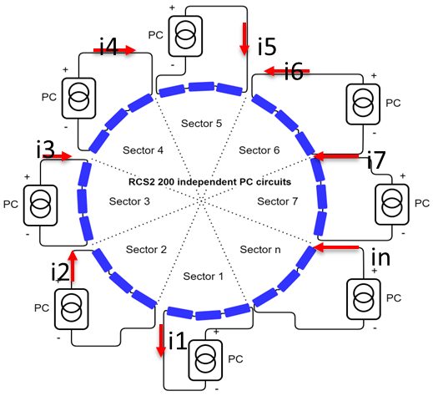
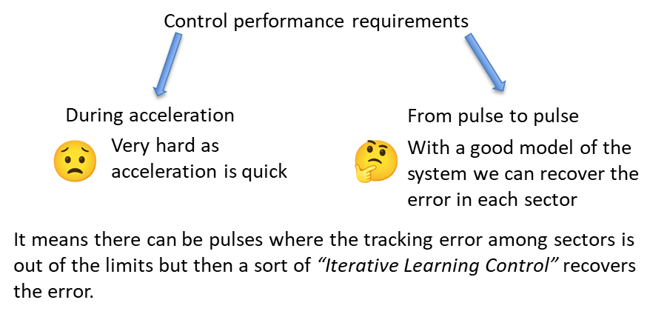
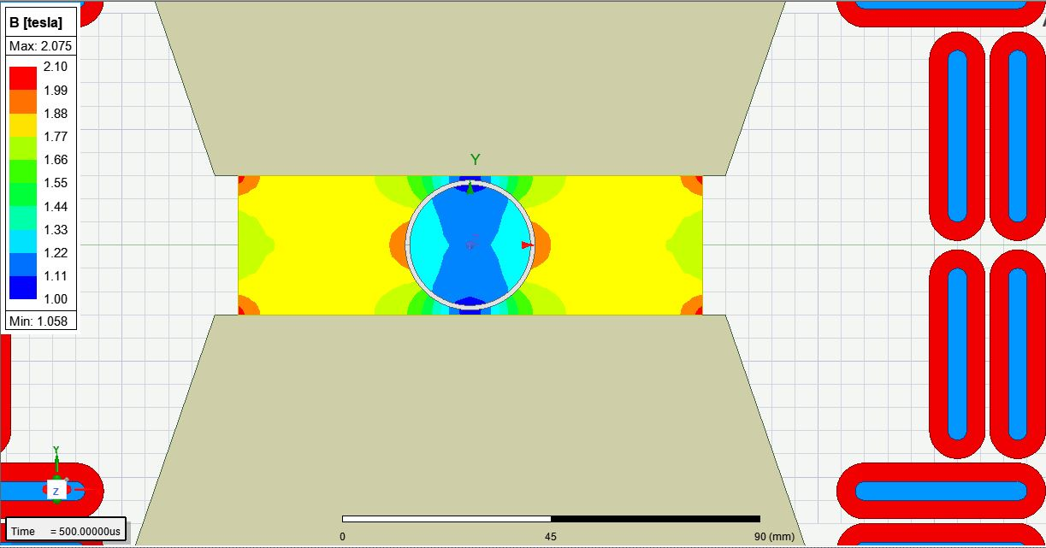
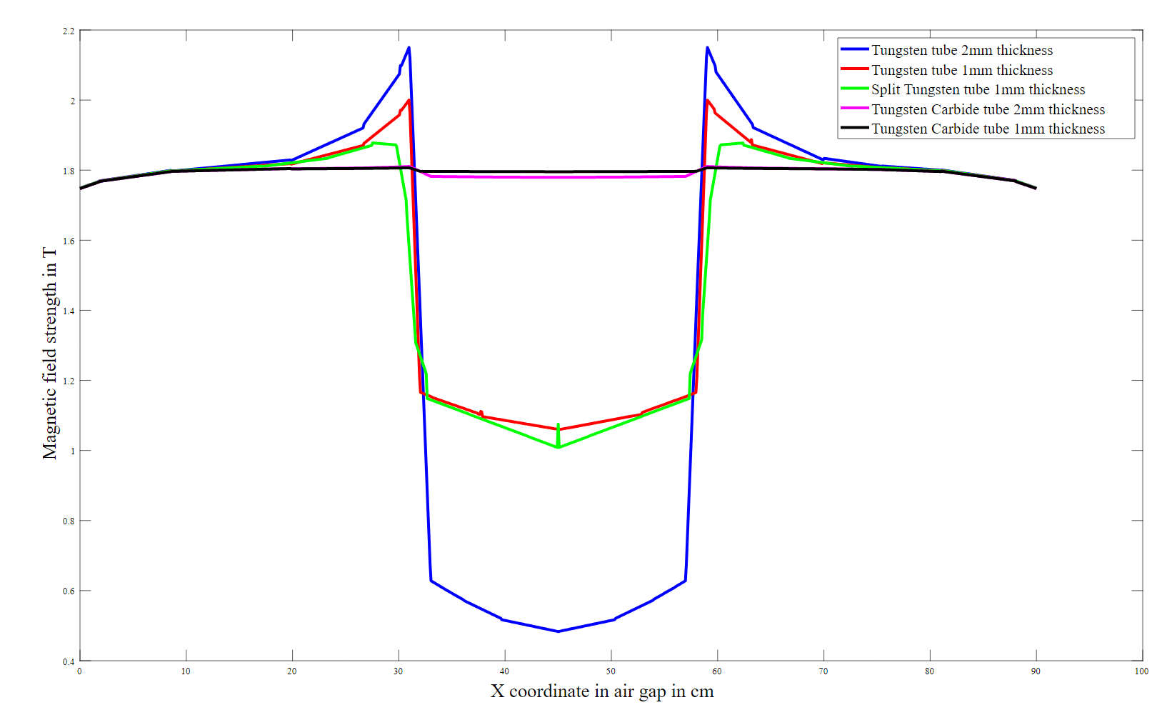
Important Issues
Control accuracy from sector to sector
Vacuum chamber material
Due to high rate of change of the B in the gap, conductive vacuum chambers sensibly decreases the field inside the chamber. Expert advice is required asap.

Slide 8
Summary
Several analysis have been done aiming at the dimensioning of both the power converters and the resistive magnets;
Two important issues have been identified that should be approached asap to provide more defined guidelines for the design of Power Converters and magnets;
Next priorities (proposal) are:
  Integrate the design of power converters and magnets in a single computation script. The model would start from the definition of the brefshape (to be agreed with RF) and design all the rest using the parameters presented in the tables 1.1 and 1.2;
  Analyze the inter-sector control problem;
  Address the vacuum chamber issue with the help of experts (rather urgent);
  Define the cost model for the power converters/magnets system;
  What about the other power converters?

