Slide 1
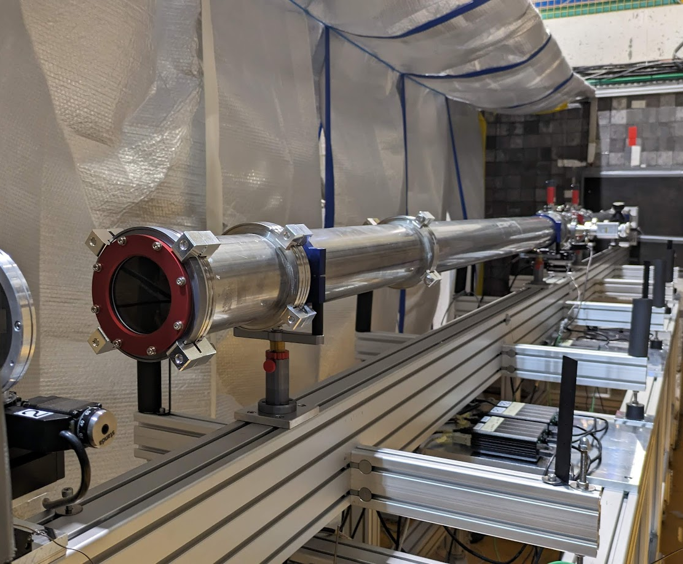


QNeutron
Measuring the Neutron Electric Charge with Time-of-Flight Interferometry
Marc Persoz
PhD student at University of Bern
PSAS 2024
Zürich ETH, 12th of June 2024

Slide 2


QNeutron
A technical motivation
- High-precision measurement of a neutron beam deflection using newly developed techniques
- Neutron electric charge measurement
- Theoretical searches on neutrino mass, potential contribution to BAU
Time plan
September 2020 : Start of the project
April 2021 – June 2023 : Characterisation at Paul Scherrer Institute, BOA beamline
November 2023 (30 days): Characterisation at Laue-Langevin Institute, PF1b beamline
March 2024 (20 days): First neutron electric charge measurement at ILL, PF1b beamline
Marc Persoz | PSAS2024
Notes:
See katrin

Slide 3
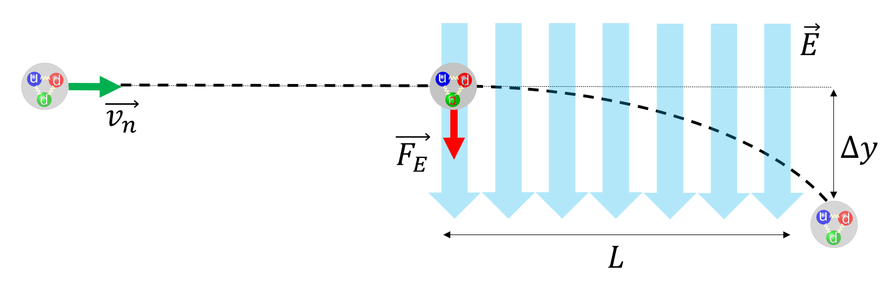
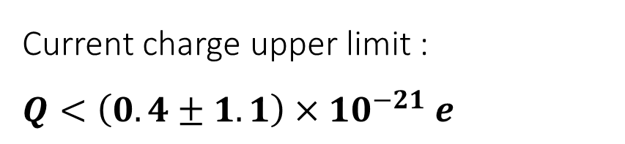
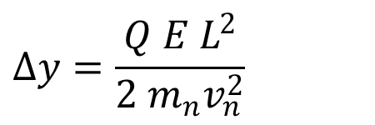
QNeutron
Measurement of a beam deflection
$$Δy=\frac{Q E L^{2}}{2 m_{n}v_{n}^{2}}$$
Current charge upper limit :
$Q<\left(0.4±1.1\right)×{10}^{−21} e$
Baumann et al.,
Phys. Rev. D 37, 3107 (1988)
Two orders of magnitude improvement at ESS : $Δy$ in picometer scale !
Piegsa, Phys. Rev. C 98, 045503 (2018)
Marc Persoz | PSAS2024

Slide 4
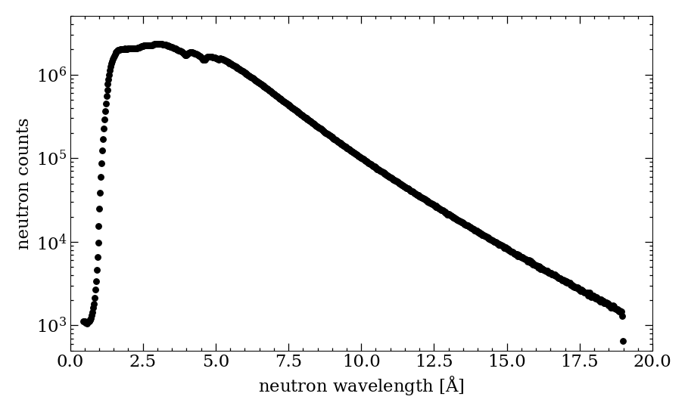
Grating interferometry
Interference or ballistic ?
Δt = 5 min
Wavelength (velocity) distribution
at PF1b beamline :
Marc Persoz | PSAS2024

Slide 5
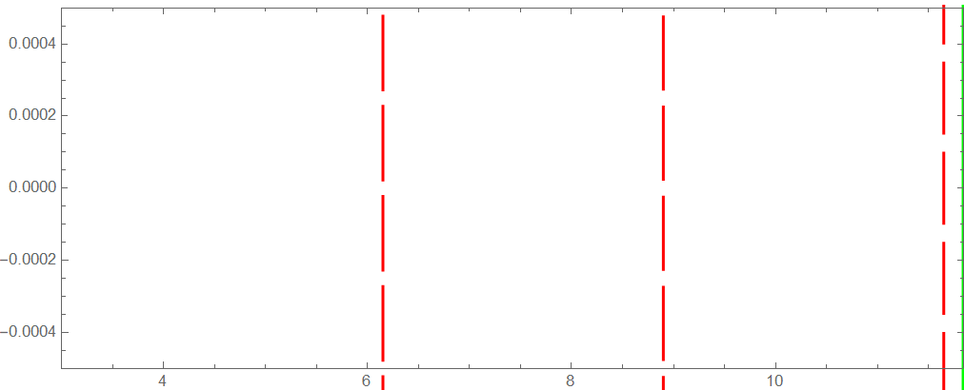
General principle
Top view
G₀ : Source grating
G₁ : Diffraction grating
G₂ : Analyzer grating
Neutron detector
Beam exit
Marc Persoz | PSAS2024

Slide 6
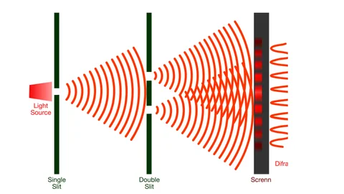
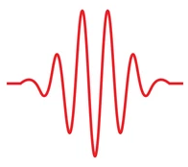
2 behaviours
«interferometer» or «ballistic» configuration
Narrow gap = DIFFRACTION
p = 25 µm
Wide gap = NO DIFFRACTION
p = 250 µm
neutron
neutron
No diffraction
Trajectories not affected
Diffraction
Trajectories are affected
narrow gap
wide gap
«interferometer» configuration
Wavelength-dependant !
«ballistic» configuration
Marc Persoz | PSAS2024

Slide 7
General principle
Top view
G₀ : Source grating
G₁ : Diffraction grating
G₂ : Analyzer grating
p = 250 µm
2.75 m
2.75 m
Neutron detector
Beam exit
Marc Persoz | PSAS2024

Slide 8
General principle
Ballistic trajectories
G₀ : Source grating
G₁ : Diffraction grating
G₂ : Analyzer grating
Random slope and starting point
If Neutron is absorbed
removed
Neutron detector
Beam exit
Marc Persoz | PSAS2024

Slide 9
General principle
Ballistic trajectories
G₀ : Source grating
G₁ : Diffraction grating
G₂ : Analyzer grating
Neutron hits the detector
saved
Neutron detector
Beam exit
Marc Persoz | PSAS2024

Slide 10
General principle
Ballistic trajectories
G₀ : Source grating
G₁ : Diffraction grating
G₂ : Analyzer grating
Neutron detector
Beam exit
Marc Persoz | PSAS2024

Slide 11
General principle
Ballistic trajectories
G₀ : Source grating
G₁ : Diffraction grating
G₂ : Analyzer grating
Neutron detector
Beam exit
Marc Persoz | PSAS2024

Slide 12
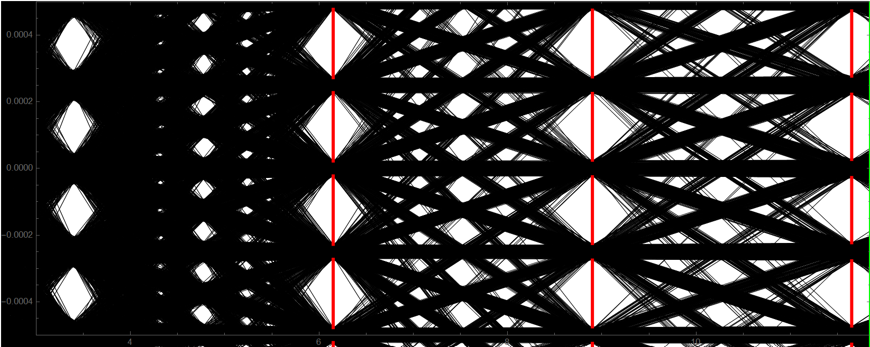
General principle
Ballistic trajectories
G₀ : Source grating
G₁ : Diffraction grating
G₂ : Analyzer grating
Neutron detector
Beam exit
Marc Persoz | PSAS2024

Slide 13
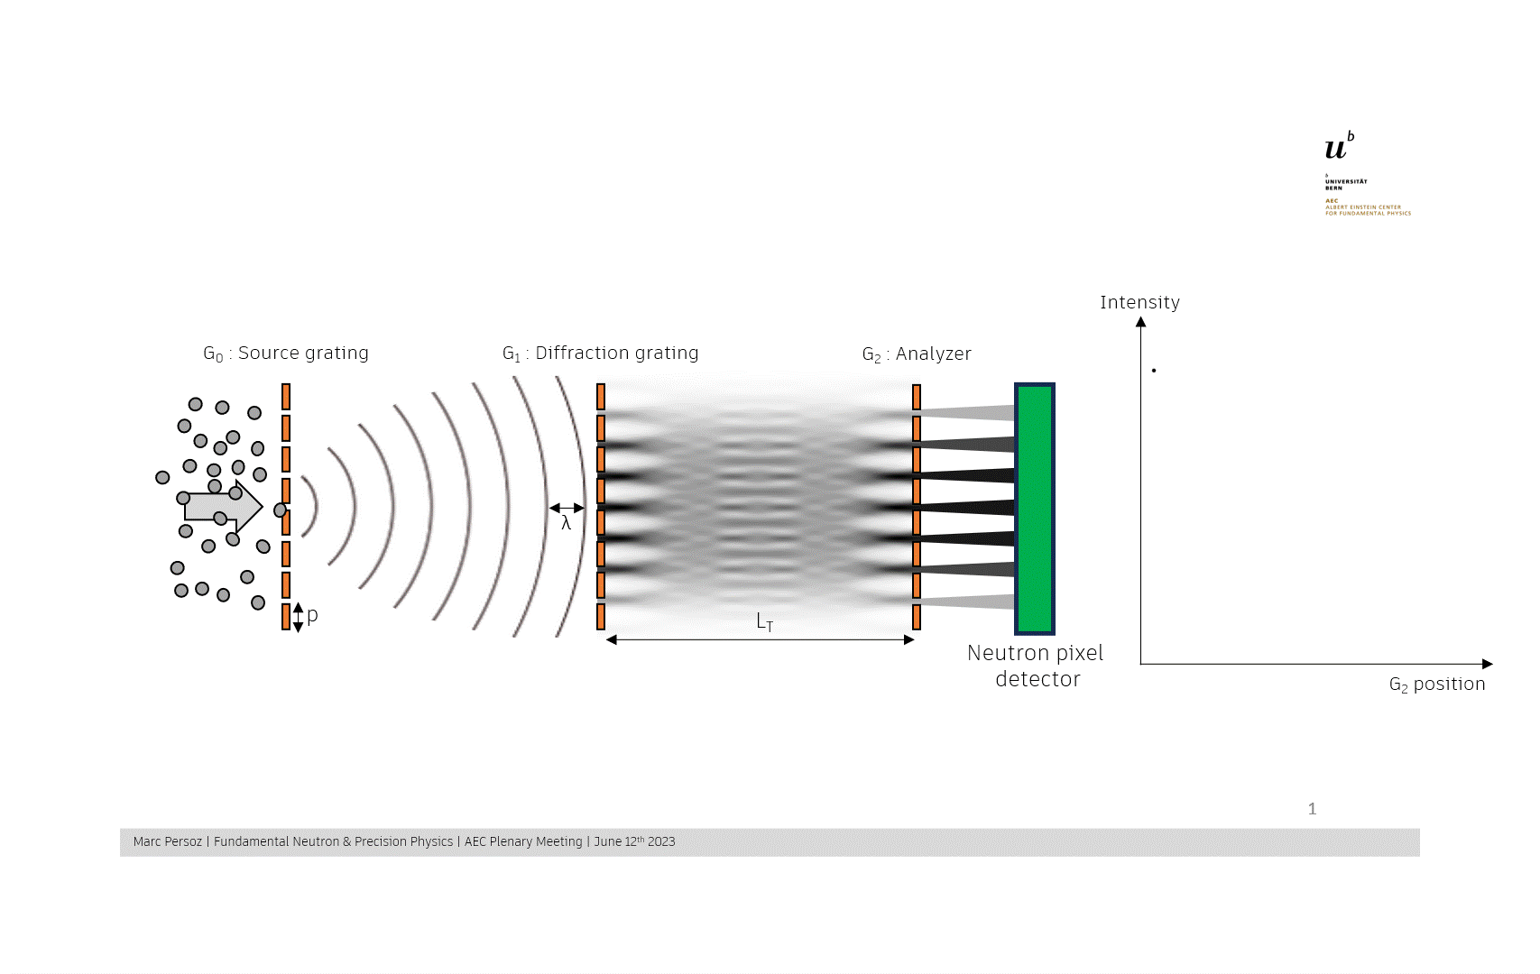
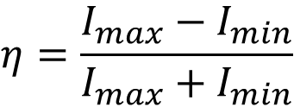
General principle
Ballistic trajectories
Oscillating intensity pattern produced by scanning the analyser G₂
G₀
Source grating
G₁
Diffraction grating
G₂
Analyzer grating
Neutron detector
Beam exit
$$η=\frac{I_{max}−I_{min}}{I_{max}+I_{min}}$$
Extraction of visibility :
Marc Persoz | PSAS2024

Slide 14
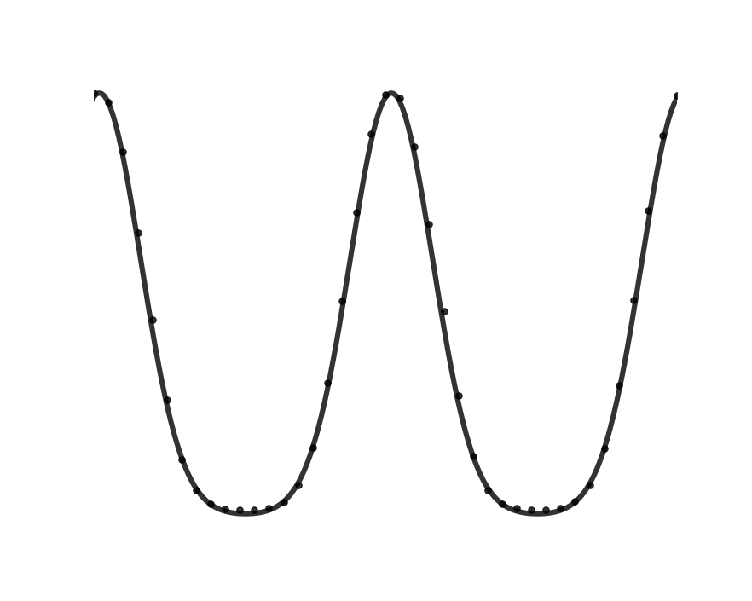
Grating interferometry
2-beam method
Identifying the working point of the interferometer
Intensity
G₀ : Source grating
G₁ : Diffraction grating
G₂ : Analyzer
λ
Working point : Most sensitive position of the interferometer
Beam separator
L_{T}
p
Detector
G₂ position
Look for a shift of the intensity modulation
Marc Persoz | PSAS2024
Notes:
Detail a bit the two-beam method, that it would be to simulate the central electrode. Take time here to explain the working point and stability measurement

Slide 15
Grating interferometry
2-beam method
Application of an antiparallel Electric field
Intensity
G₀ : Source grating
G₁ : Diffraction grating
G₂ : Analyzer
Electric field
L_{T}
p
Detector
G₂ position
Intensity variations = shift of the interference pattern
Marc Persoz | PSAS2024
Notes:
Detail a bit the two-beam method, that it would be to simulate the central electrode. Take time here to explain the working point and stability measurement

Slide 16
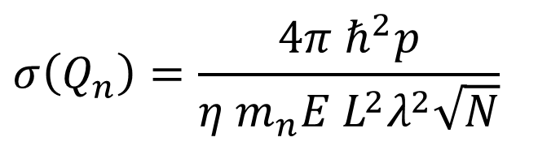
TOF Characterisation at ILL-PF1b
« Ballistic » setup
$$σ\left(Q_{n}\right)=\frac{4π ℏ^{2}p}{η m_{n}E L^{2}λ^{2}\sqrt{N}}$$
Investigation for the best compromise between p, N and η
=
Optimisation of period, duty cycle and absorber thickness
Piegsa, Phys. Rev. C 98, 045503 (2018)
1mm
Monte-Carlo simulation – «Ballistic» setup
6m
Marc Persoz | PSAS2024

Slide 17
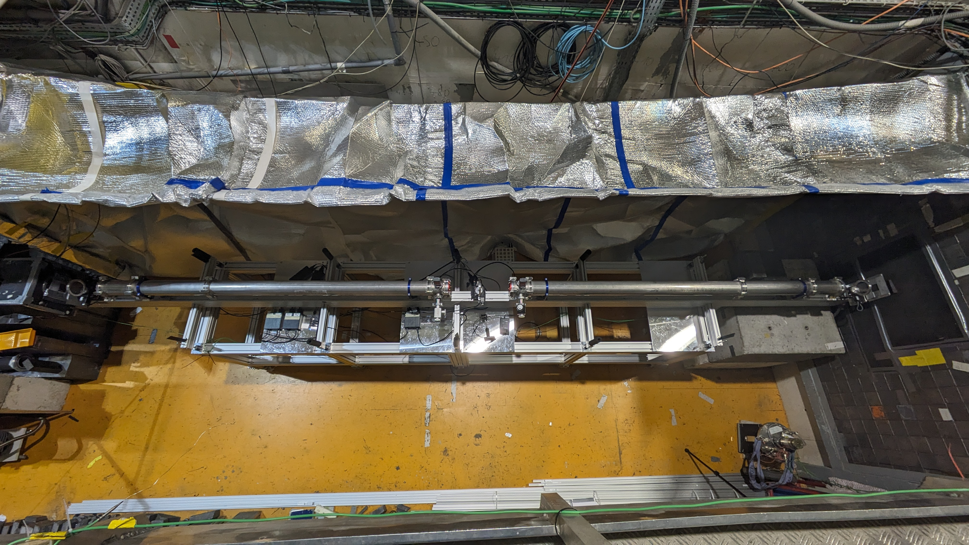
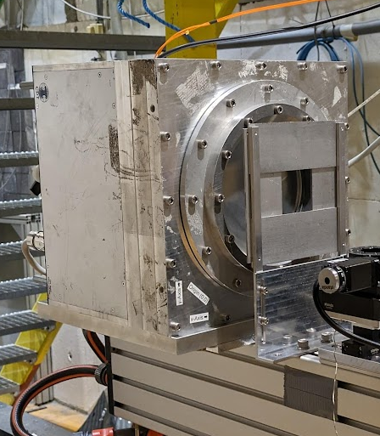
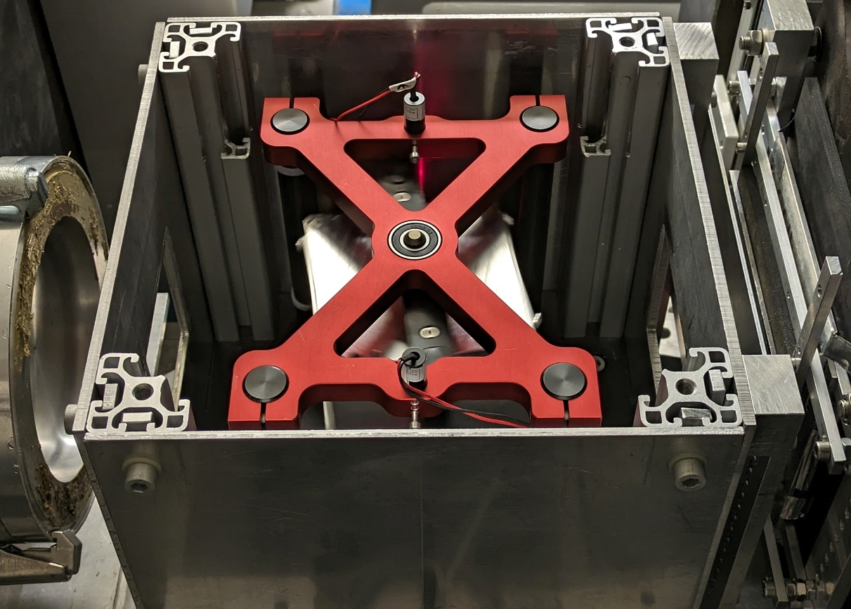
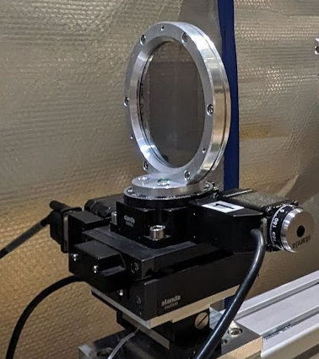
Qneutron – general overview
Experimental apparatus
2.75 m
2.75 m
G₀
Vacuum pipe
p = 10⁻² mbar
G₁
G₂
Z
30cm
X - Beam axis
Y - Grating axis
Fermi chopper
f_{pulses} = 25 Hz
Grating
6x6 cm² area
Cascade detector
10x10 cm² area
Marc Persoz | PSAS2024
Notes:
Maybe the frame with the setup characterized doesn’t fit here… Maaybe in the summary after the ballistic case of one dedicated slide after this one.

Slide 18
Grating design optimisation
Marc Persoz | PSAS2024

Slide 19
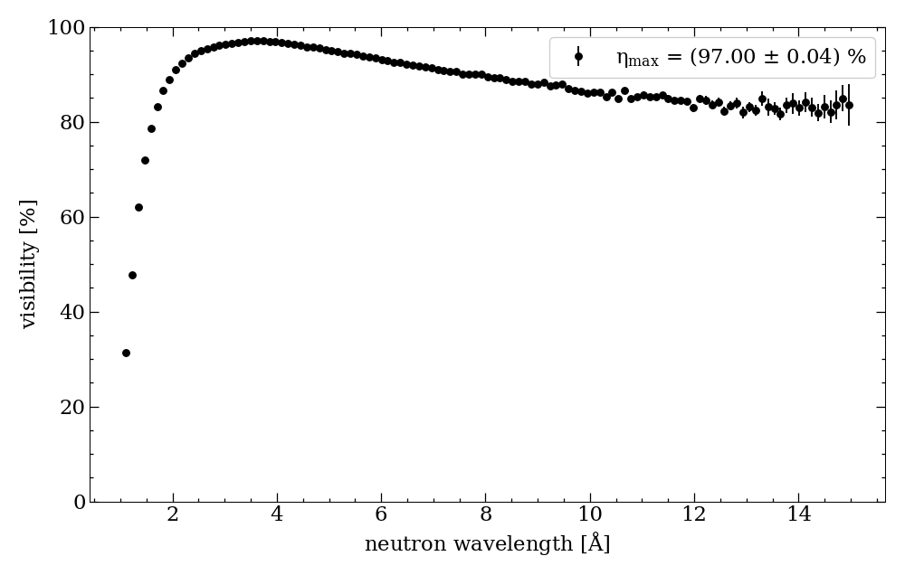
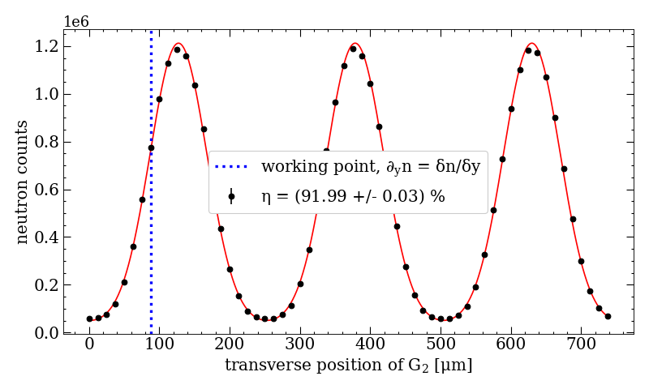
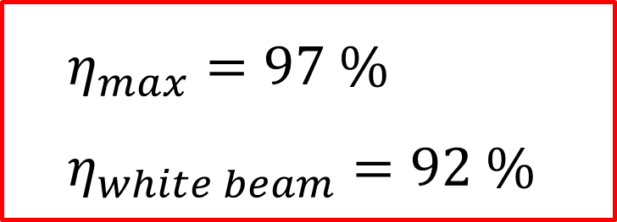
Design optimisation
Grating parameters
Gratings parameters to optimize (p = 250 µm) :
Duty cycle (opening fraction of 10%, 20% and 40%)
Absorber thickness (20 µm and 30 µm gadolinium)
Relative alignments
Manufacturing process
$$η_{max}=97 \% \\ η_{white beam}=92 \%$$
Marc Persoz | PSAS2024
Notes:
Make two slides with only 1 distance on the first

Slide 20
Beam deflection measurement
Marc Persoz | PSAS2024

Slide 21
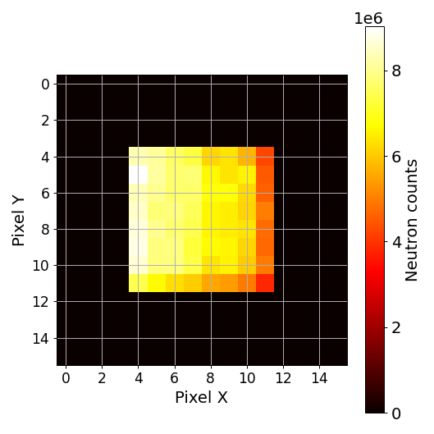
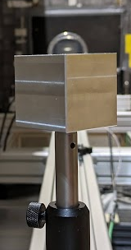
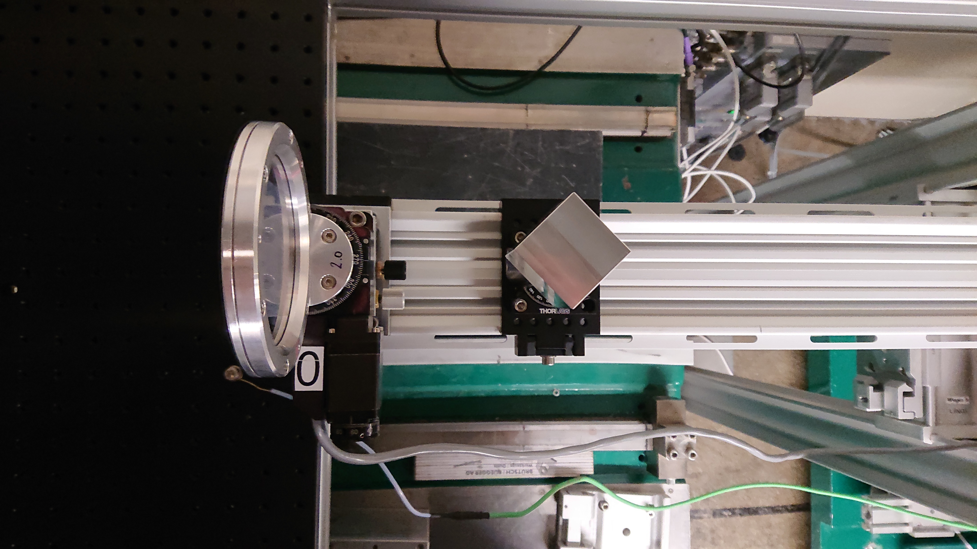
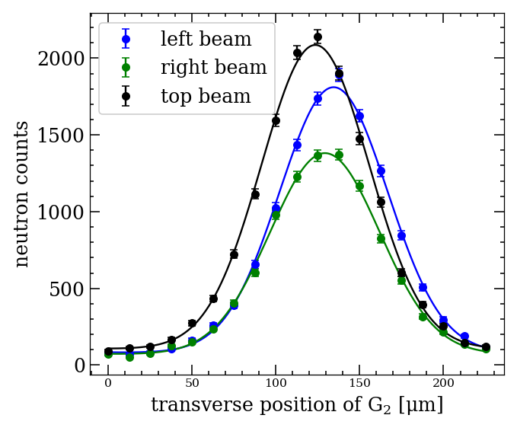
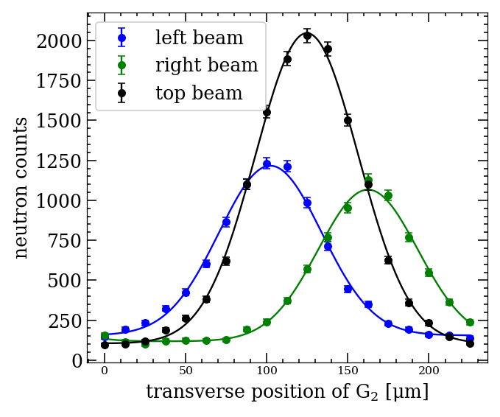
Beam deflection
Aluminium prism
G₂
3 zones
Top
Left
Right
L_{CUBE}
Extraction of the center value for “Left”, “Right” and “Top” zone
Time-of-Flight measurement
Difference Ref – Sample
Ref : no prism
prism
Marc Persoz | PSAS2024
Notes:
Left image is not so useful, maybe find another one with beeter view on the cube
Put a PAD with the 3 zones

Slide 22
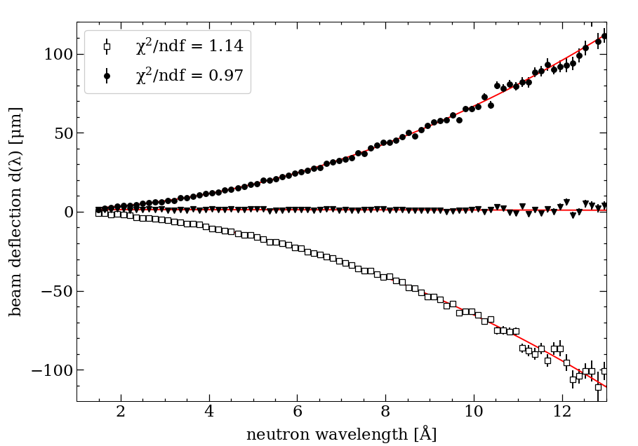

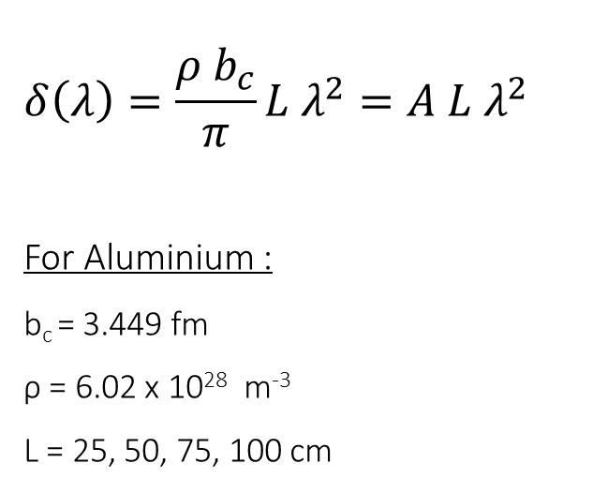
Beam deflection
Aluminium prism, L = 1m
Snell-Descartes
$$δ\left(λ\right)=\frac{ρ b_{c}}{π}{L λ}^{2}=A{ L λ}^{2}$$
For Aluminium :
b_{c} = 3.449 fm
ρ = 6.02 x 10²⁸ m⁻³
L = 25, 50, 75, 100 cm
$$A_{th}=\frac{ρb_{c}}{π}=66.12 ×{10}^{−12}{ m}^{−2}$$
Marc Persoz | PSAS2024
Notes:
Make two slides with only 1 distance on the first

Slide 23
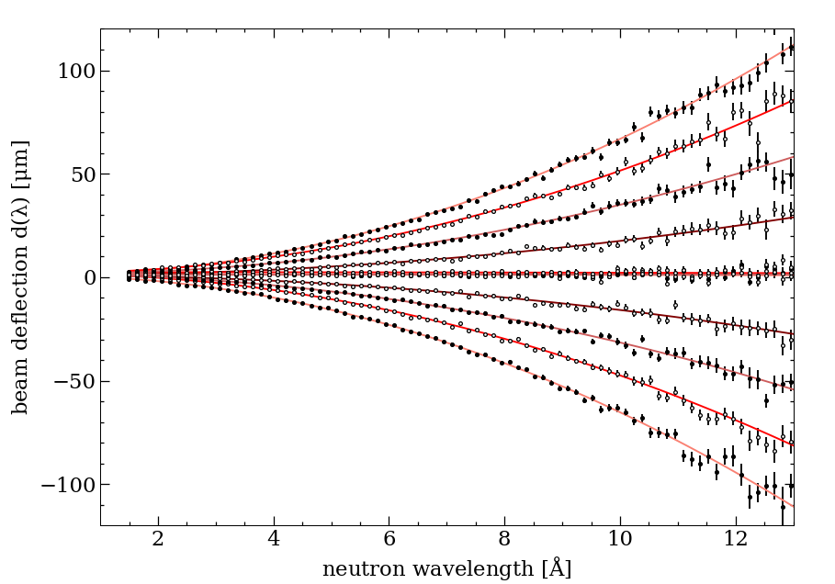

Beam deflection
Aluminium prism
L_{CUBE} = 100cm
L_{CUBE} = 75cm
$$A_{th} L=\frac{ρb_{c}}{π}L=66.12×{10}^{−12} L m^{−2}$$
L_{CUBE} = 50cm
L_{CUBE} = 25cm
L [cm] | 25 | 50 | 75 | 100
A_{th} * L * 10⁻¹² | 16.5 | 33.1 | 49.6 | 66.1
A_{meas} * 10⁻¹² | 16.8 | 33.2 | 49.7 | 66.0
Δa_{meas} * 10⁻¹² | 0.1 | 0.1 | 0.1 | 0.2
$$A_{th} =66.12×{10}^{−12} m^{−2}$$
$$A_{exp} =(66.5±0.6)×{10}^{−12} m^{−2}$$
Marc Persoz | PSAS2024
Notes:
Make two slides with only 1 distance on the first

Slide 24
Stability and sensitivity
2-beam method
Marc Persoz | PSAS2024

Slide 25
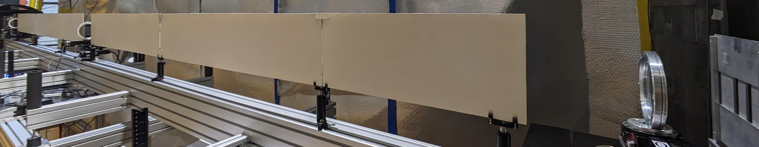
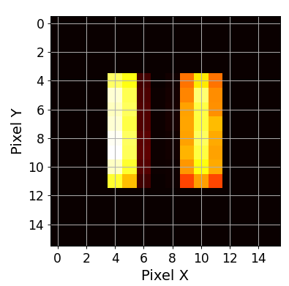
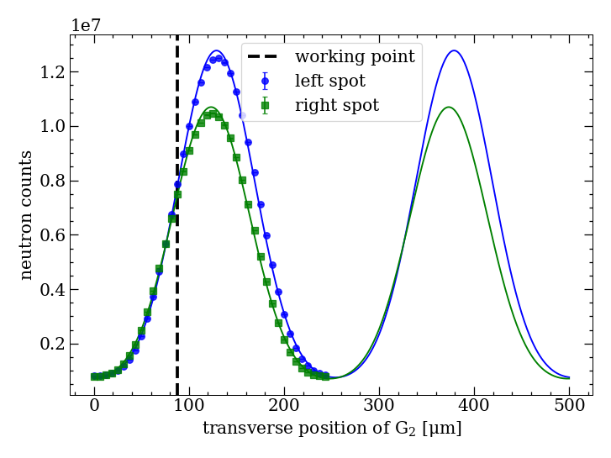
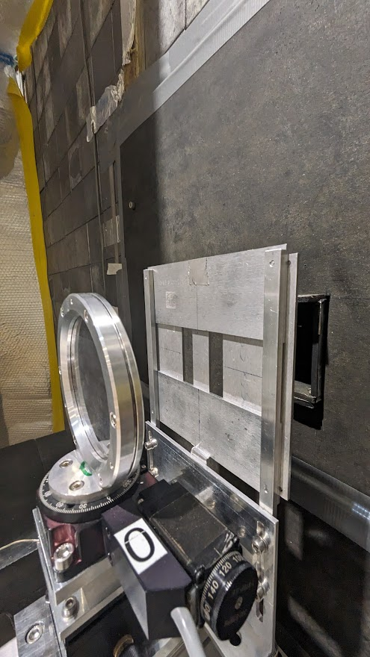
Setup stability
2-beam method
Beam separator :
- Gadolinium powder painted plexiglass
- BorAl aperture before and after the gratings
Oscillating intensity pattern :
Extraction of the working point (steepest slope)
Slope in count/µm
Marc Persoz | PSAS2024
Notes:
Axis label X : Transverse position of G2

Slide 26
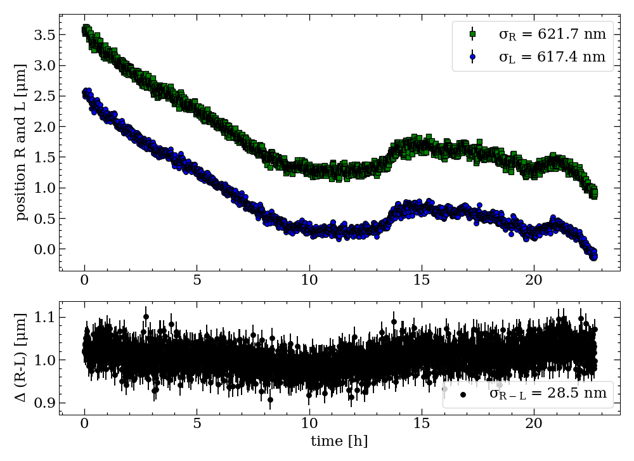
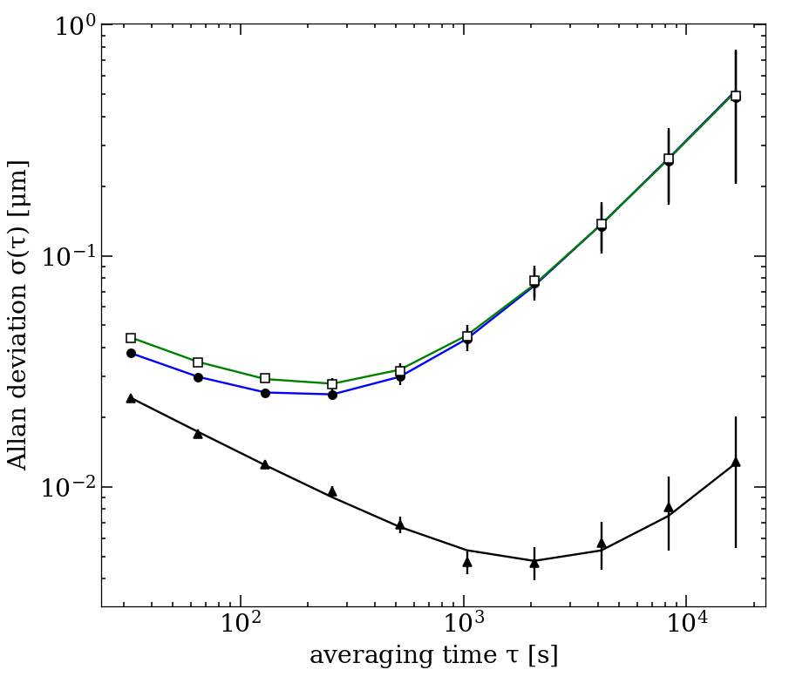
Setup stability
2-beam method
Beamspot position & difference
Allan deviation
Left
Right
Diff.
σ(Δy) = 4,7 nm
in 2’000 sec
Best averaging time :
Marc Persoz | PSAS2024
Notes:
Remove legend of the ASD plot, not readable and can be emphasized orally
Include a plot of the temperature

Slide 27
Neutron electric charge measurement
Ballistic configuration
Marc Persoz | PSAS2024

Slide 28
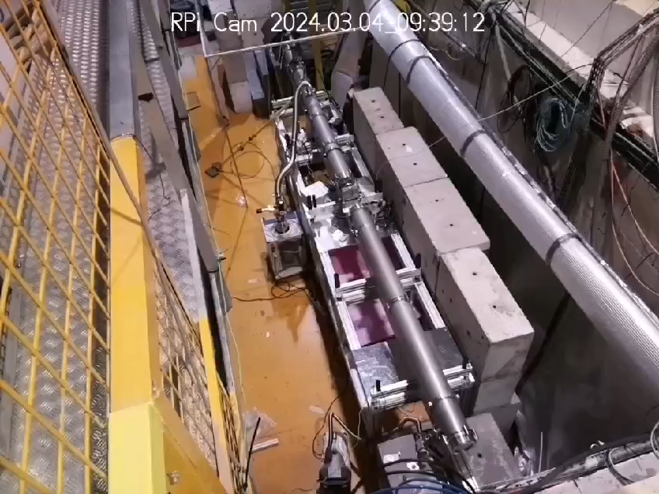
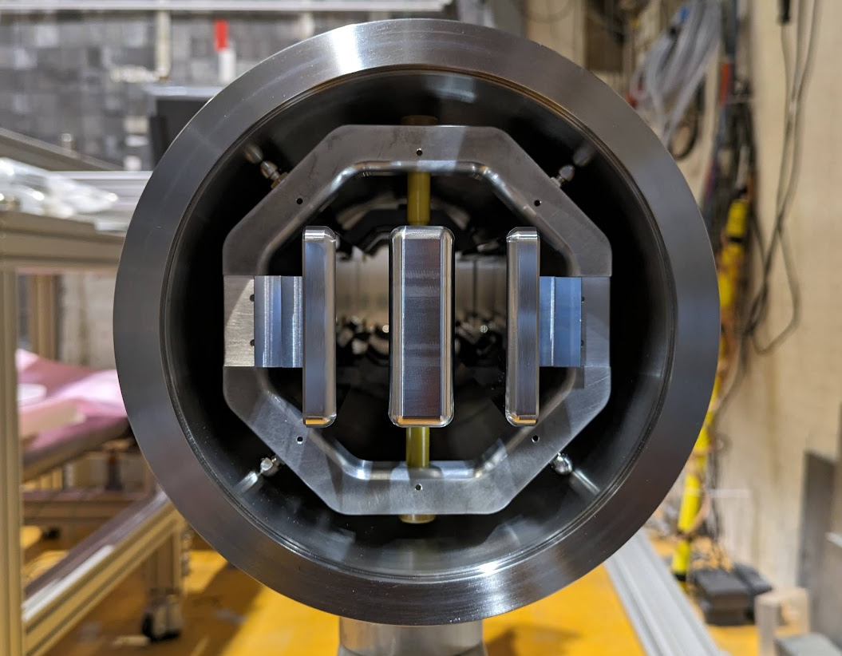
QNeutron
First charge measurement at ILL-PF1b | 20 days in March 2024
Chopper removed for high intensity
Implementation of HV electrodes (2.5m)
Lead and concrete shield
Thermal shield
Oscillating pattern and working point
Ground electrodes
Ø 150 mm
2 polarities
Gap = 15 mm
HV electrode
Marc Persoz | PSAS2024
Notes:
Don’t need so much details, maybe just mention that we work on several experiments.

Slide 29
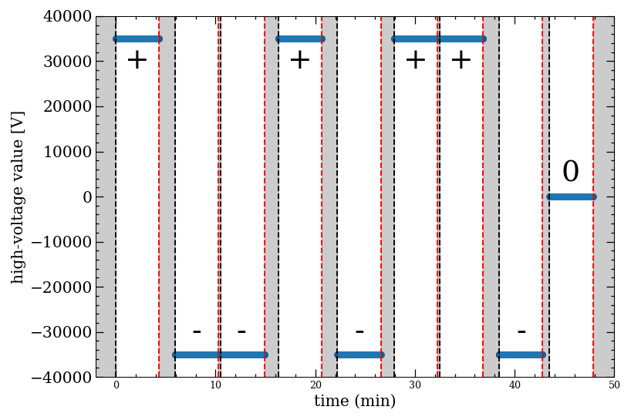
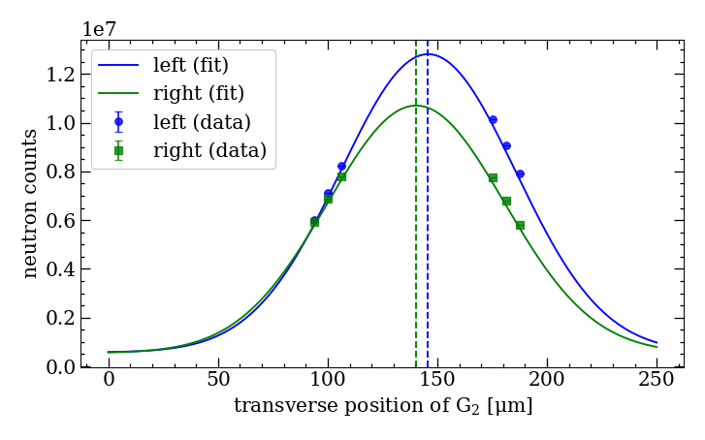
QNeutron
First charge measurement at ILL-PF1b | 20 days in March 2024
«6-points» measurement
6 points measured at every polarity for 20s
Extraction of µ_{L} and µ_{R} and consider difference
Compare (HV+) – (HV-)
Determination of sensitivity on a beam deflection
Total cycle time = 2800 sec
µ_{R}
µ_{L}
High-voltage
Polarity start
Dead time
Polarity stop
Marc Persoz | PSAS2024
Notes:
Don’t need so much details, maybe just mention that we work on several experiments.

Slide 30
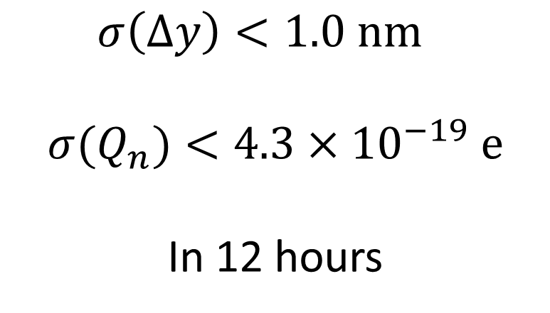
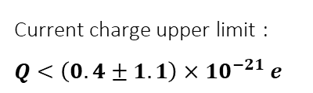
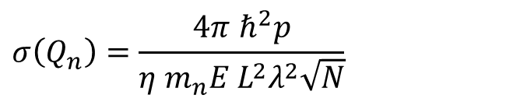
QNeutron
Results and prospects
$$σ\left(Q_{n}\right)=\frac{4π ℏ^{2}p}{η m_{n}E L^{2}λ^{2}\sqrt{N}}$$
Current charge upper limit :
$Q<\left(0.4±1.1\right)×{10}^{−21} e$
«6-points» measurement
1 cycle (8 polarities + zero) = 30 minutes
4 values extracted per cycle
44 cycles of 30 minutes = 22 h (deadtime = 45%)
Total measurement time = 12,2 hours
Piegsa F.,
Phys. Rev. C 98, 045503 (2018)
 | Curent meas. «Ballistic» |  | Future plans «Inter.»
p [µm] | 250 |  | 25
η [%] | 75 |  | 90
E [kV/cm] | 23 |  | 100
L [m] | 2.5 |  | 5
λ [Å] | 4.3 |  | 4.6
N [kHz] | 500 |  | 1’600
σ(Q_{n}) [e] | 1.0 x 10⁻¹⁹ in 10 days |  | 7.2 x 10⁻²³ in 100 days
$$σ\left(Δy\right)<1.0 nm$$
$$σ(Q_{n})<4.3×{10}^{−19} e$$
In 12 hours
Marc Persoz | PSAS2024
Notes:
Don’t need so much details, maybe just mention that we work on several experiments.

Slide 31
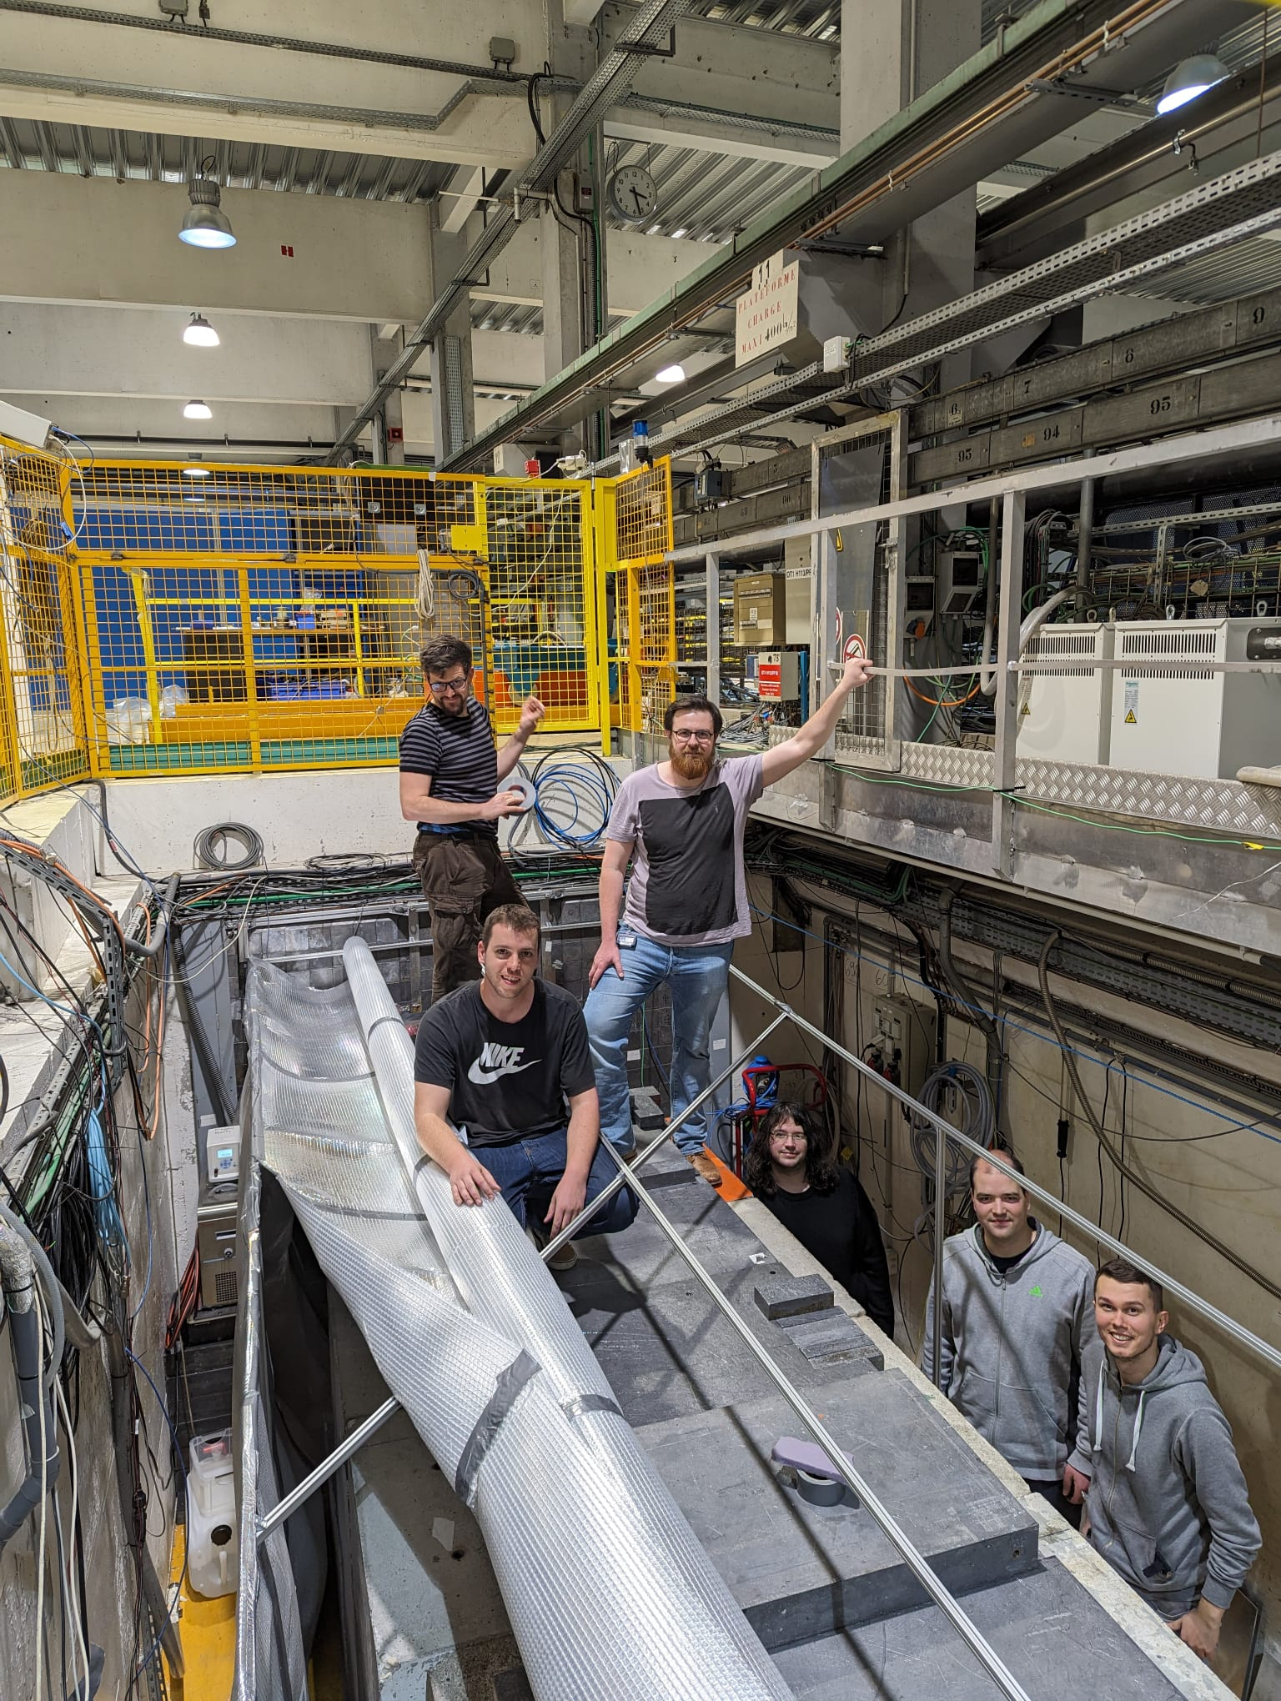

QNeutron
Measuring the neutron charge with interferometry
Thank you !
Neutron group in March 2024
Marc Persoz | PSAS2024
Notes:
Don’t need so much details, maybe just mention that we work on several experiments.

