Slide 1
Rydberg atom interferometry for testing the Weak Equivalence Principle with antimatter
Department of Physics and Astronomy
Louise McCaul
Stephen Hogan
David Cassidy
Department of Physics and Astronomy
University College London

Slide 2
Outline
Motivation – WEP tests with positronium
Concept of measurement
Rydberg atom interferometry
Test experiments with helium
Outlook
Notes:
Change outline

Slide 3


Motivation
The Standard Model is incomplete for what we observe
Experiments with positronium complement those with antihydrogen and muonium
Positronium is a purely leptonic system
Easier to produce than antihydrogen and muonium
$$e^{−}$$
$$e^{+}$$
Notes:
REFS!
Origin of observed matter/antimatter asymmetry unknown
The Standard Model allows for CP-violation that leads to some matter/antimatter asymmetry
Not at the scale we observe in the universe
Could matter and antimatter interact gravitationally differently
Test of Weak Equivalence Principle for matter/antimatter

Slide 4




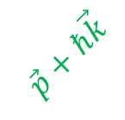

Interferometry for gravity measurements
Light-pulse interferometry with cold atoms is an established method for precision measurement of g ^{[1]}
Positronium has a triplet ground state lifetime of 142ns ^{[2]}
𝛑/2
𝛑
𝛑/2
|e⟩
$$\vec{p}$$
|g⟩
$$\vec{p}+ℏ\vec{k}$$
|e⟩
$$∆φ=\vec{k} \vec{\text{g}} T^{2}$$
$$\vec{\text{g}}$$
|g⟩
$$\vec{p}+ℏ\vec{k}$$
$$\vec{p}$$
|g⟩
0
T
2T
Time
[1] J.M. Hogan, D.M.S. Johnson, M.A. Kasevich (2007) https://doi.org/10.48550/arXiv.0806.3261
[2] R. S. Vallery, P. W. Zitzewitz, and D. W. Gidley, Phys. Rev. Lett.
90, 203402 (2003)
Notes:
Don’t say free fall – this is a different thing! Comment on the time – need 10s us for sensitivity <10%
Ref light pulse
Ref Ps lifetime 142ns

Slide 5
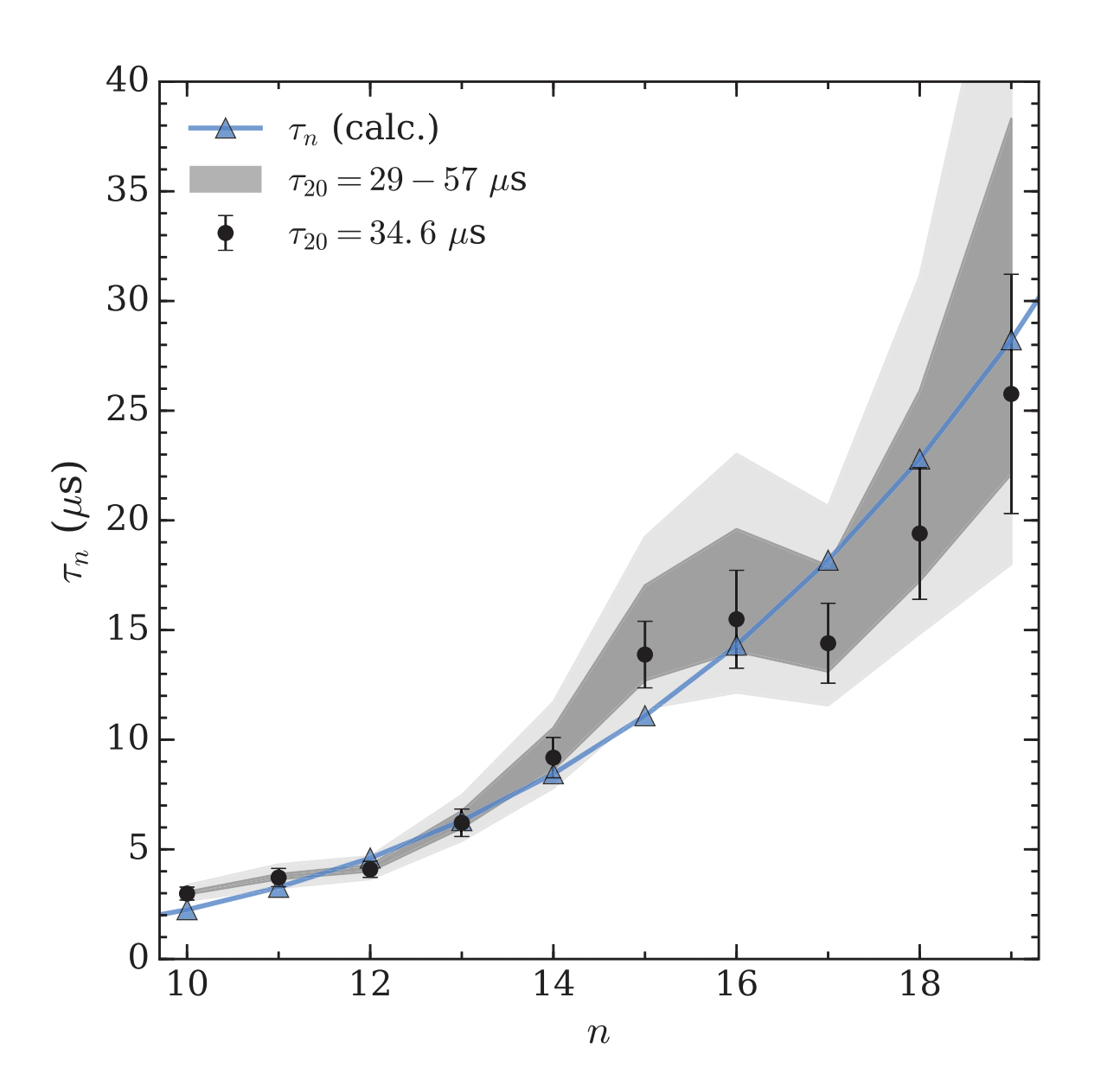
Interferometry for gravity measurements
Light-pulse interferometry with cold atoms is an established method for precision measurement
Positronium has a triplet ground state lifetime of 142ns
Rydberg states give longer lifetimes
Light-pulse very challenging
A. Deller, B. S. Cooper, S. D. Hogan and D. B. Cassidy, Phys. Rev. A 93, 062513 (2016)
Notes:
10s to 100s of us
Need several 10s of us to get a good measurements >50us

Slide 6
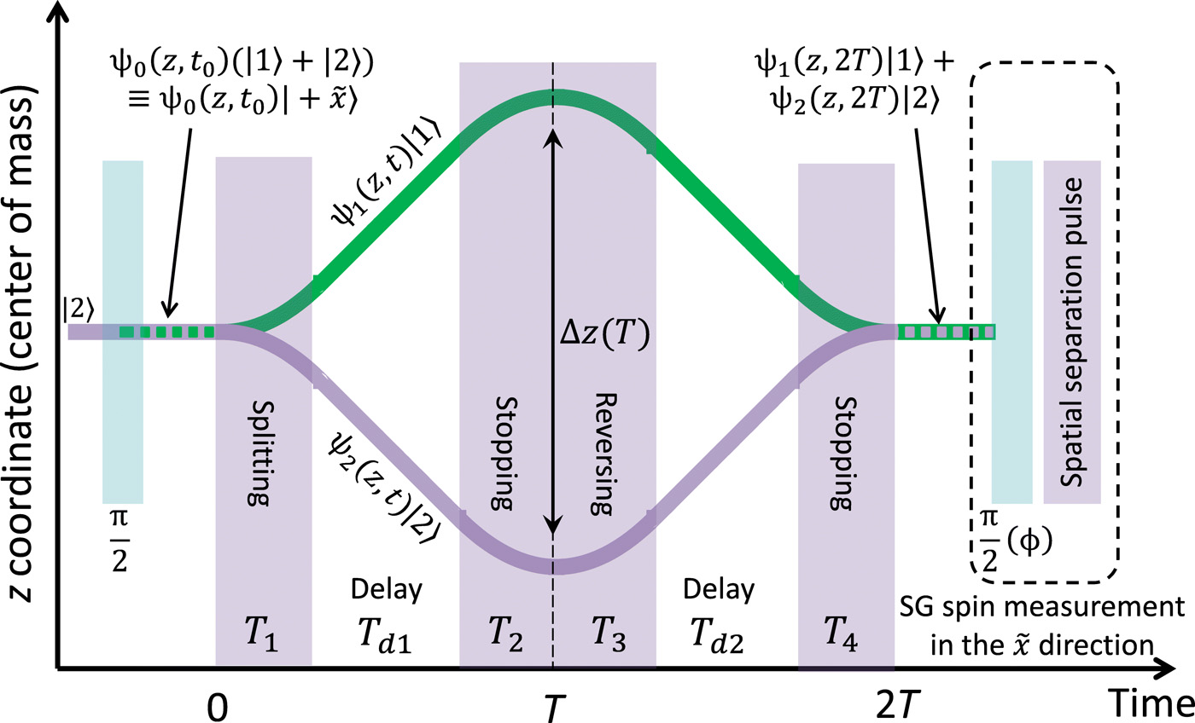
Interferometry with positronium
Need something more like Stern-Gerlach interferometry
Atoms in superpositions of spin states
Forces exerted by inhomogeneous magnetic fields
Cold ground state atoms
Rydberg atoms have large static electric dipole moments
Implement electric analogue of this
Put some figure from SG interferometry?
J. E. Palmer and S. D. Hogan, Phys. Rev. Lett 122, 250404 (2019)
Y. Margalit, O. Dobkowski, Z. Zhou, O. Amit, Y. Japha, S. Moukouri, D. Rohrlich, A. Mazumdar, S. Bose, C. Henkel, R. Folman, Sci. Adv 7, 22 (2021)
Notes:
This needs some work..
Why is this not possible with positronium?

Slide 7
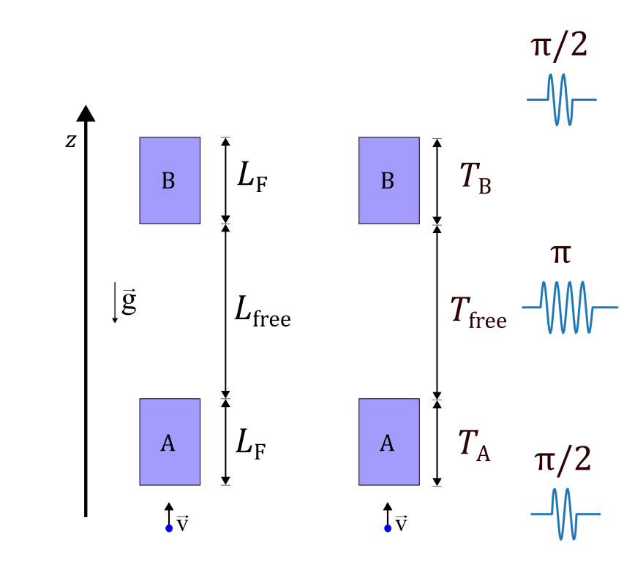
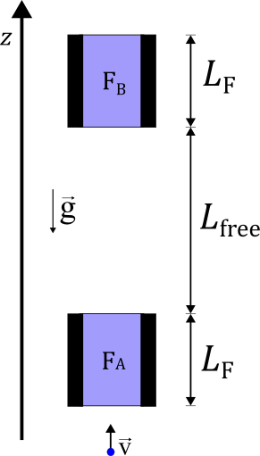

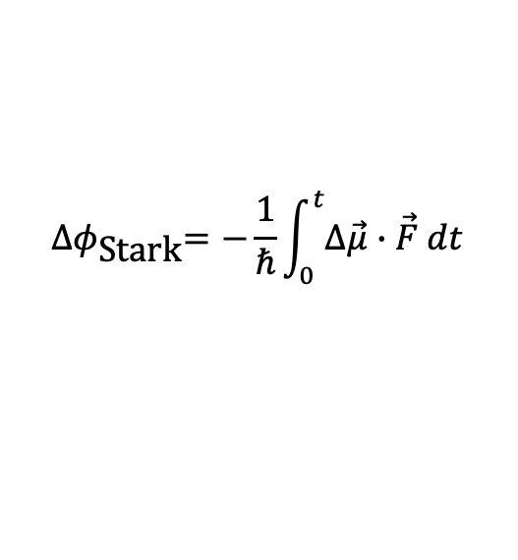
Basic concept
Atoms travel vertically through two identical electric field regions
Measure difference in flight times through each region
Can use atom as a clock
Measure Stark phase accumulated by atom in superposition of states with different electric dipole moments
$${∆φ}_{\text{Stark}}=−\frac{1}{ℏ}\int_{0}^{t}{∆\vec{μ}}∙\vec{F} dt$$
$$∆φ_{\text{Stark}\text{,}A}≠∆φ_{\text{Stark}\text{,}B}$$
Notes:
TIME TIME TIME – it’s a time measurement and we use the phase to measure the time!
If we could measure phase diff at the end of each. Delta Stark A /neq Delta Stark B – add eq

Slide 8
Rydberg-atom interferometer
Superposition of Rydberg states prepared before entering field region A
We must account for forces in field gradients
These forces result in the generation of separated momentum states as in an atom interferometer
Notes:
Preparation in weak homogeneous field – i.e. << fixed field region
Relocate pi pulses to more obvious spatial location
Considering how this happens in reality, must consider the effects of the field gradients on the Rydberg states

Slide 9
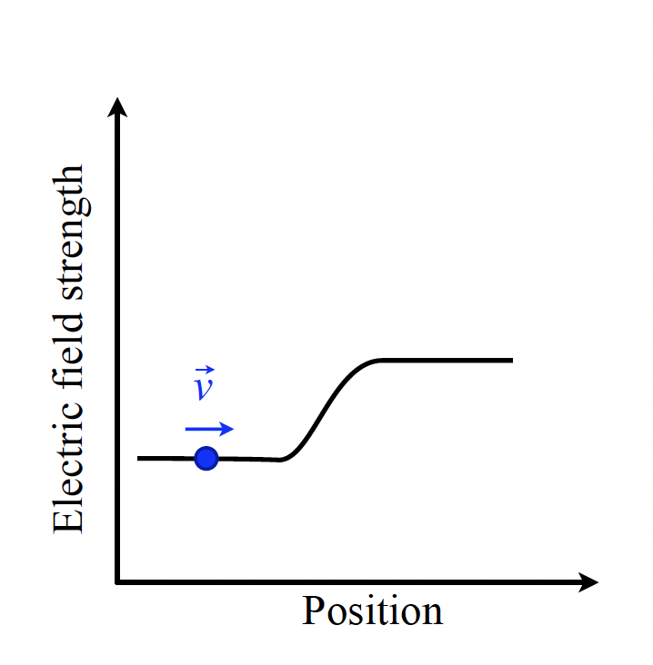

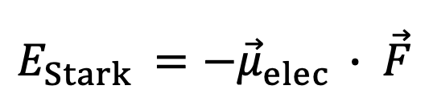

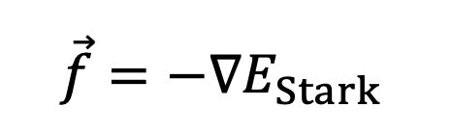
Stark effect
$$E_{Stark }={−\vec{μ}}_{elec }∙ \vec{F}$$
$$\vec{f}=−∇E_{Stark }$$
$$n=21$$
$$n=20$$
Notes:
This is a Stark map – pos/neg/zero-ish
Add some n on the grey ones within the plot

Slide 10
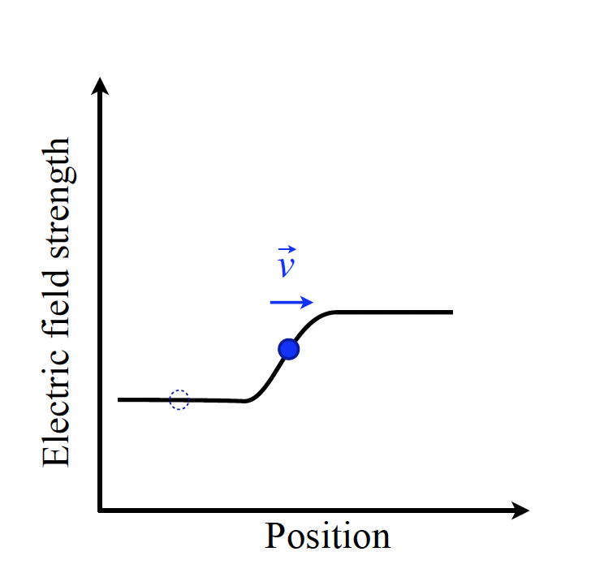
Stark effect
$$E_{Stark }={−\vec{μ}}_{elec }∙ \vec{F}$$
$$\vec{f}=−∇E_{Stark }$$
$$n=21$$
$$n=20$$

Slide 11
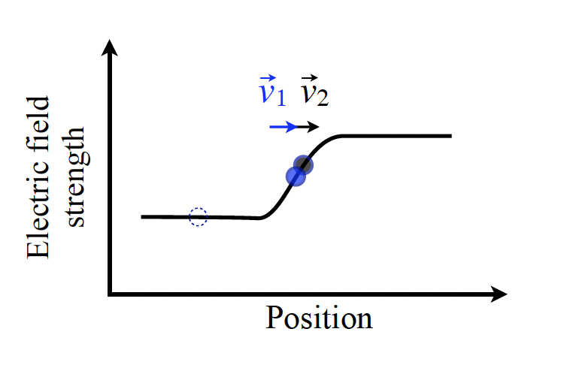
Stark effect
$$E_{Stark }={−\vec{μ}}_{elec }∙ \vec{F}$$
$$\vec{f}=−∇E_{Stark }$$
$$n=21$$
$$n=20$$

Slide 12
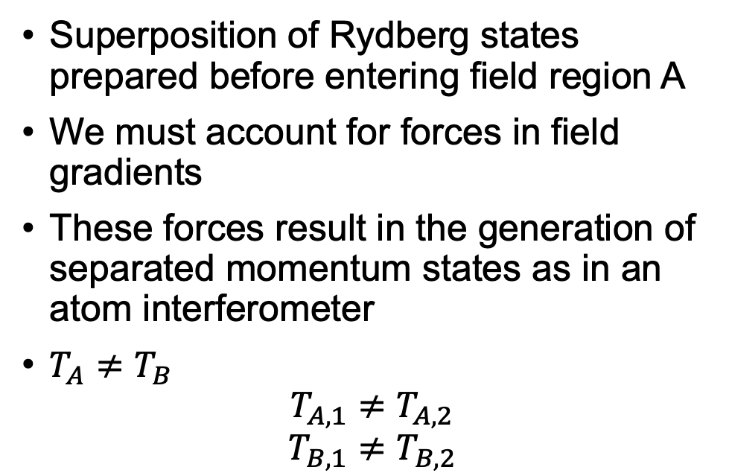
Rydberg-atom interferometer
Superposition of Rydberg states prepared before entering field region A
We must account for forces in field gradients
These forces result in the generation of separated momentum states as in an atom interferometer
$T_{A}≠T_{B}$
$$T_{A,1}≠T_{A,2}$$
$$T_{B,1}≠T_{B,2}$$
1
2
Notes:
The times in each of the field regions is different, but also the time in each region is different for each component of the superposition

Slide 13
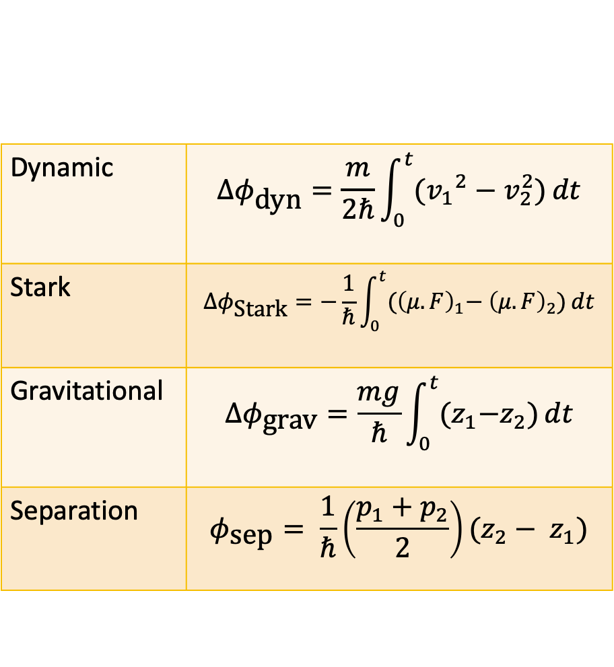
Phase contributions
Dynamic | $$Δφ_{\text{dyn}}=\frac{m}{2ℏ}\int_{0}^{t}{({v_{1}}^{2}−v_{2}^{2})}dt$$
Stark | $$Δφ_{\text{Stark}}=−\frac{1}{ℏ}\int_{0}^{t}{{(\left(μ.F\right)}_{1}− {\left(μ.F\right)}_{2})}dt$$
Gravitational | $$Δφ_{\text{grav}}=\frac{mg}{ℏ}\int_{0}^{t}{{(z}_{1}−z_{2})}dt$$
Separation | $$φ_{\text{sep}}= \frac{1}{ℏ}\left(\frac{p_{1}+p_{2}}{2}\right)(z_{2}− z_{1})$$
Using a semiclassical description, the atoms accumulate phase as they propagate through the interferometer due to:
Path of least action (gravity)
Electric fields
Spatial separation of wavepackets
$$∆φ\left(t_{\text{f}}\right)= {∆φ}_{\text{dyn}}(t_{\text{f}})− {∆φ}_{\text{grav} }(t_{\text{f}}){ − ∆φ}_{\text{Stark} }(t_{\text{f}})+ φ_{\text{sep}}(t_{\text{f}})$$
Notes:
Don’t say complicated – just adds contributions that have to be accounted for

Slide 14
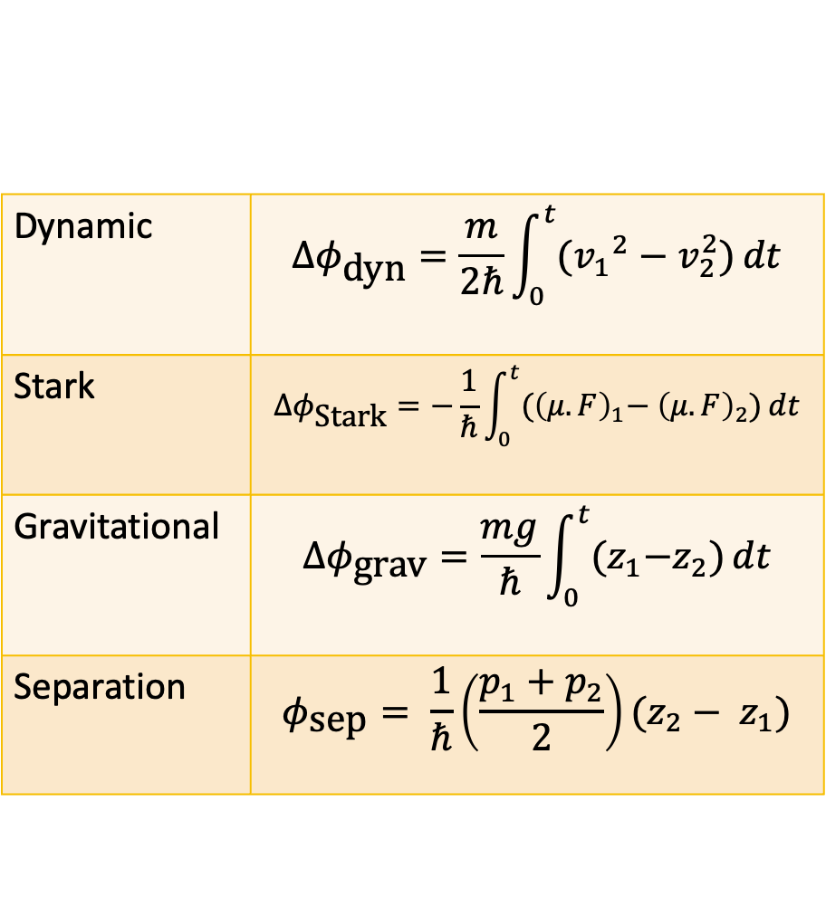
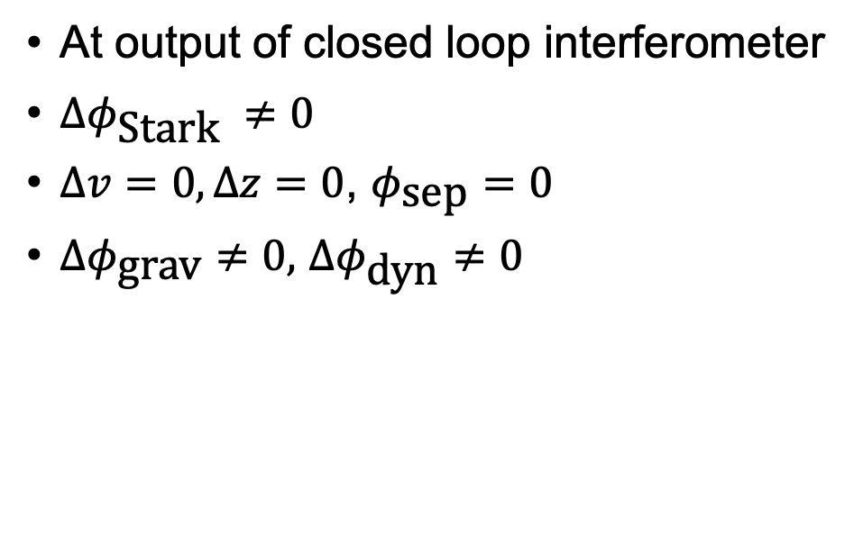
Phase contributions
Dynamic | $$Δφ_{\text{dyn}}=\frac{m}{2ℏ}\int_{0}^{t}{({v_{1}}^{2}−v_{2}^{2})}dt$$
Stark | $$Δφ_{\text{Stark}}=−\frac{1}{ℏ}\int_{0}^{t}{{(\left(μ.F\right)}_{1}− {\left(μ.F\right)}_{2})}dt$$
Gravitational | $$Δφ_{\text{grav}}=\frac{mg}{ℏ}\int_{0}^{t}{{(z}_{1}−z_{2})}dt$$
Separation | $$φ_{\text{sep}}= \frac{1}{ℏ}\left(\frac{p_{1}+p_{2}}{2}\right)(z_{2}− z_{1})$$
At output of closed loop interferometer
$∆φ_{\text{Stark} }≠0$
$∆v=0, ∆z=0$, $φ_{\text{sep}}=0$
$∆φ_{\text{grav}}≠0,$ $∆φ_{\text{dyn}}≠0$
$$∆φ\left(t_{\text{f}}\right)= {∆φ}_{\text{dyn}}(t_{\text{f}})− {∆φ}_{\text{grav} }(t_{\text{f}}){ − ∆φ}_{\text{Stark} }(t_{\text{f}})+ φ_{\text{sep}}(t_{\text{f}})$$

Slide 15
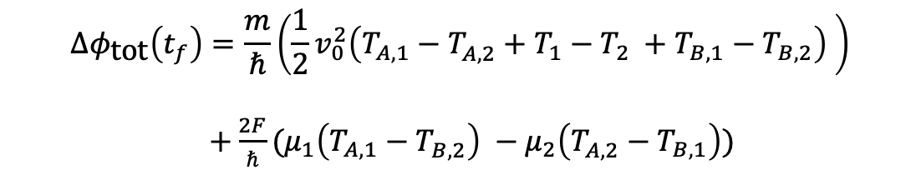
Phase contributions
Total phase has multiple g-dependent components
Each T is g-dependent
Also consider time spent in gradient
$$Δφ_{\text{tot}}\left(t_{f}\right)=\frac{m}{ℏ}\left(\frac{1}{2}v_{0}^{2}\left(T_{A,1}−T_{A,2}^{ }+T_{1}−{T_{2}}^{ }+T_{B,1}−T_{B,2}^{ }\right) \right)$$
$+\frac{2F}{ℏ}{(μ}_{1}\left(T_{A,1}−T_{B,2}^{ }\right) −μ_{2}\left(T_{A,2}^{ }−T_{B,1}\right))$
Notes:
Add pi pulses here. Make brackets look less confusing

Slide 16
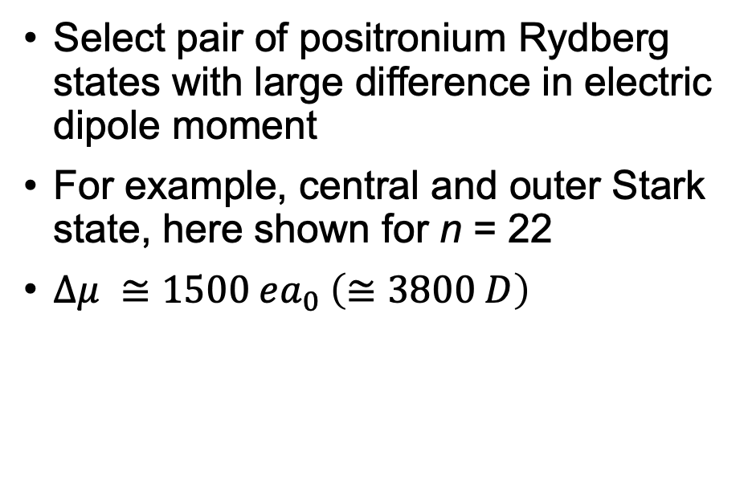


Planned experimental setup
Select pair of positronium Rydberg states with large difference in electric dipole moment
For example, central and outer Stark state, here shown for n = 22
$∆μ ≅1500 ea_{0} \left(≅3800 D\right)$
$$n=21$$
$$n=20$$
Notes:
Upper limit of UCL, but achievable, needs narrow bandwidth lasers.
Label the states on the plot
Check delta mu number on DAMOP poster! (NB a_0 is normal a_0!)
This is n = 22 Stark map

Slide 17
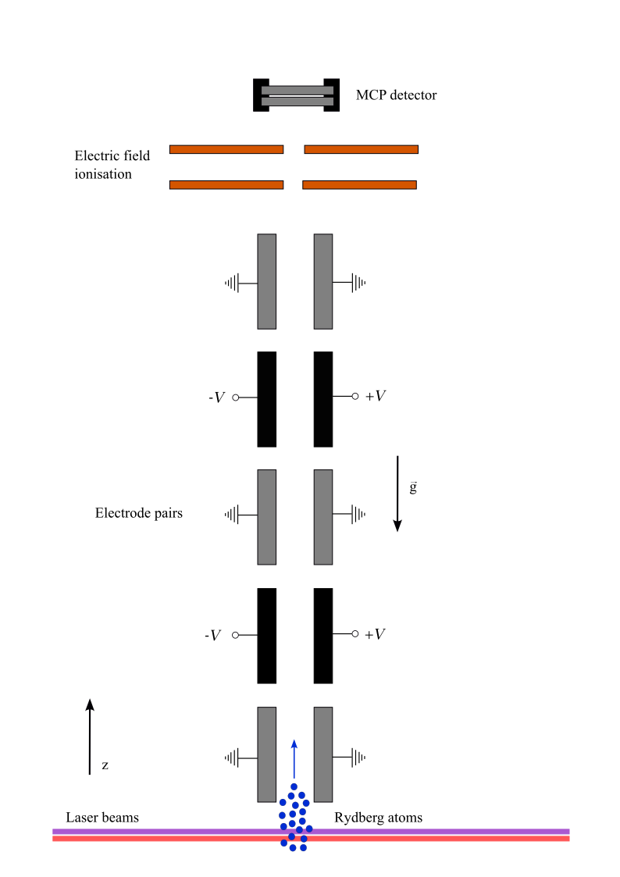
Planned experimental setup
Prepare Rydberg atoms
Series of pairs of parallel electrodes
Internal states evolved by microwave/mm-wave pulses
State selective electric field ionisation

Slide 18
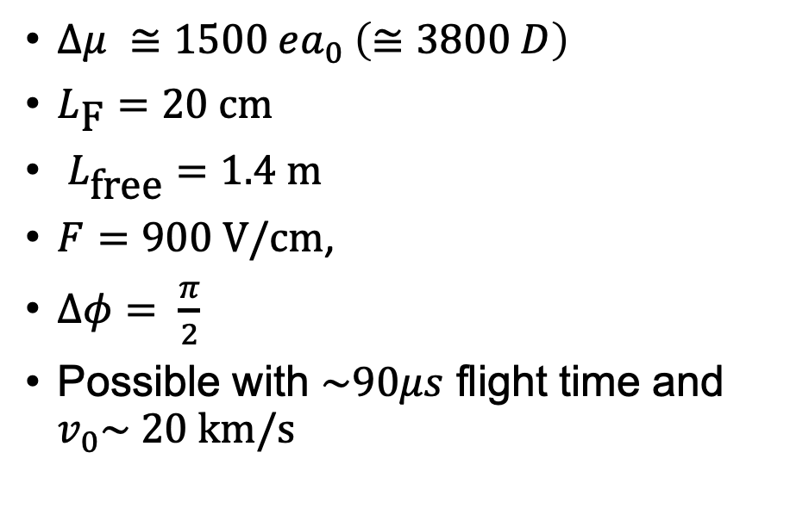
Expected magnitude of phase shifts
$∆μ ≅1500 ea_{0} \left(≅3800 D\right)$
$L_{\text{F}}=20 \text{cm}$
$L_{\text{free}}=1.4 \text{m}$
$F=900 \text{V}\text{/}\text{cm}$,
$∆φ= \frac{π}{2}$
Possible with $\sim 90μs$ flight time and $v_{0}\sim 20 \text{km}\text{/}\text{s}$

Slide 19
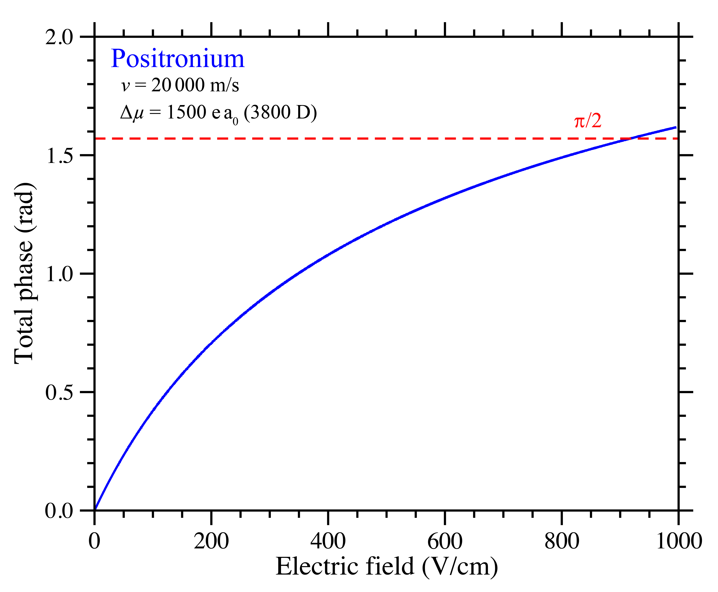
Expected magnitude of phase shifts
$∆μ ≅1500 ea_{0} \left(≅3800 D\right)$
$L_{\text{F}}=20 \text{cm}$
$L_{\text{free}}=1.4 \text{m}$
$F=900 \text{V}\text{/}\text{cm}$,
$∆φ= \frac{π}{2}$
Possible with $\sim 90μs$ flight time and $v_{0}\sim 20 \text{km}\text{/}\text{s}$

Slide 20
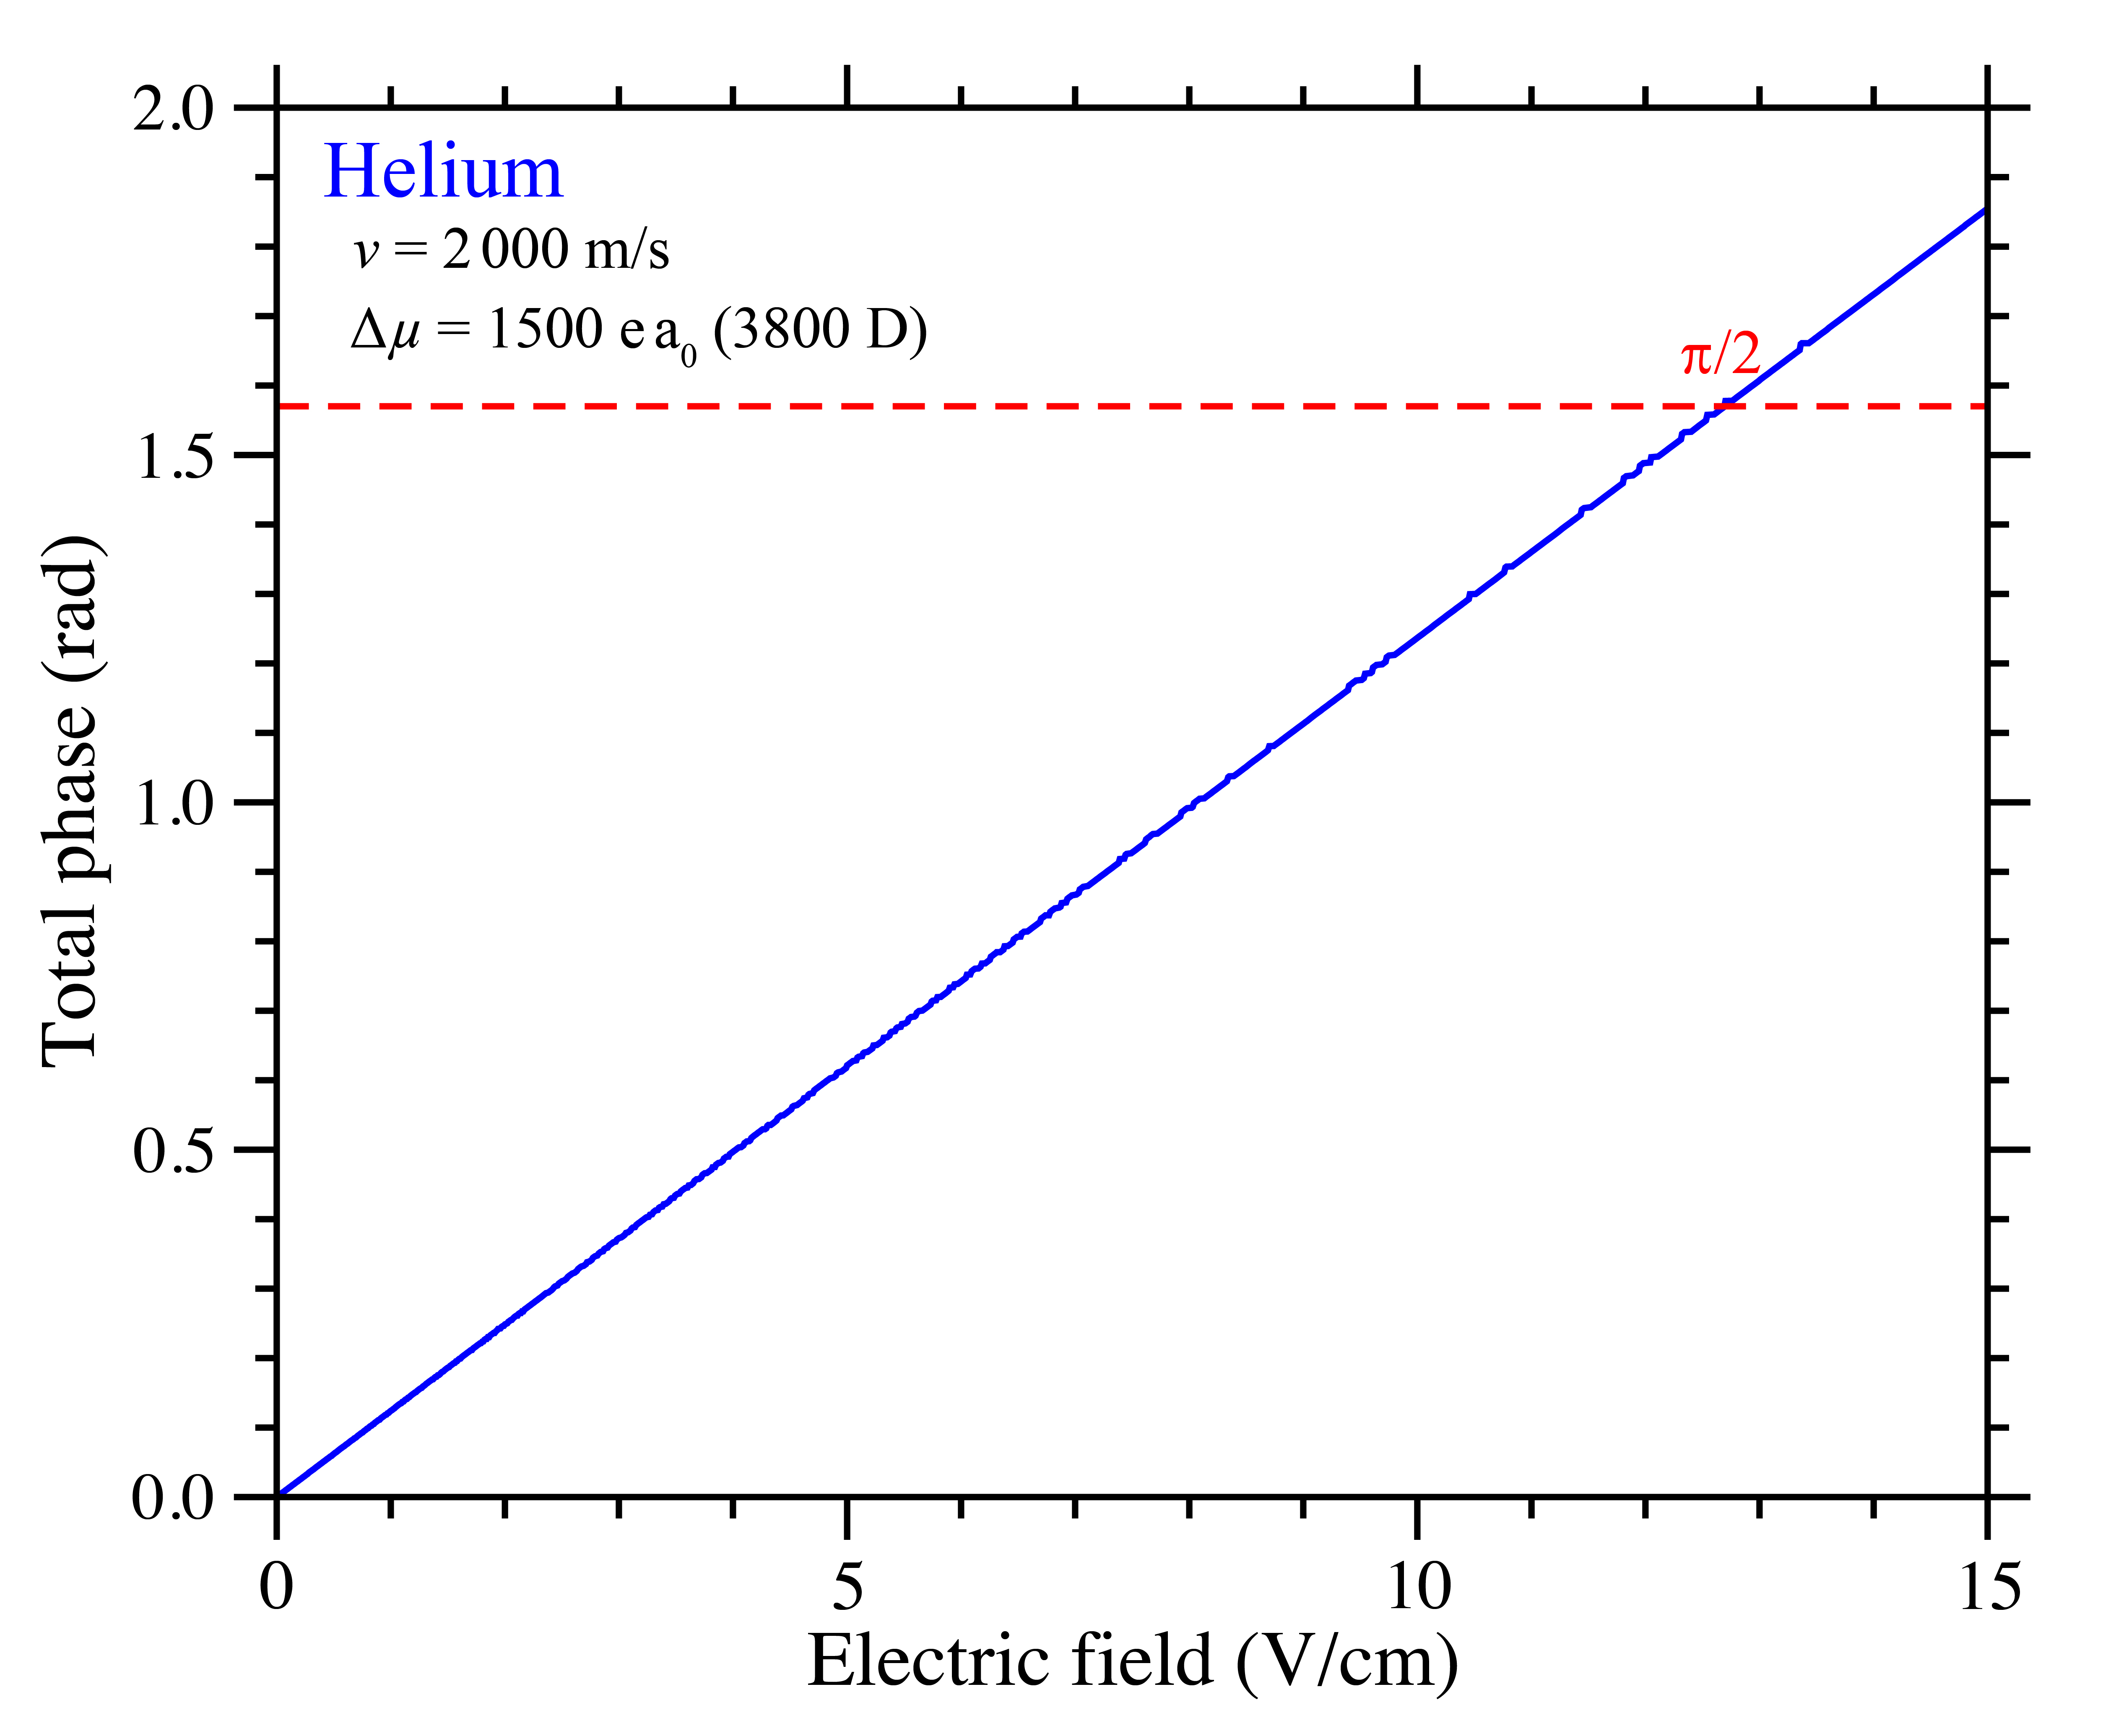
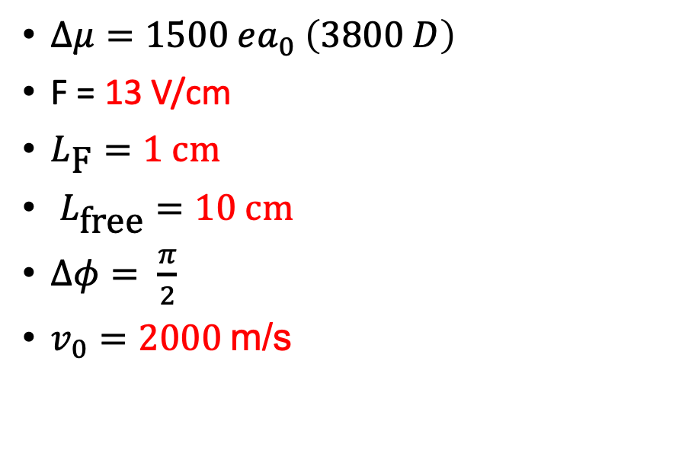
Phase shifts in test apparatus with helium
$Δμ=1500 ea_{0}$ $\left(3800 D\right)$
F = 13 V/cm
$L_{\text{F}}=1 \text{cm}$
$L_{\text{free}}=10 \text{c}\text{m}$
$∆φ= \frac{π}{2}$
$v_{0}=2000$m/s
Notes:
Beam is better controlled -

Slide 21
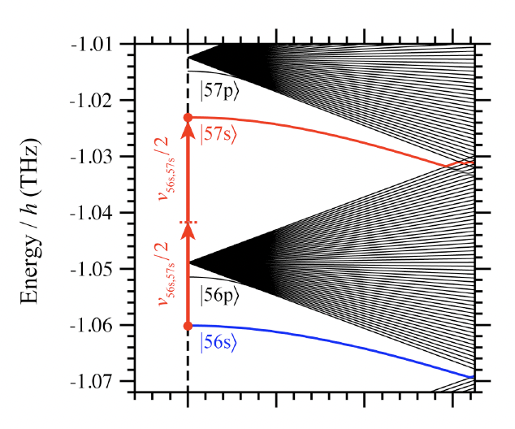
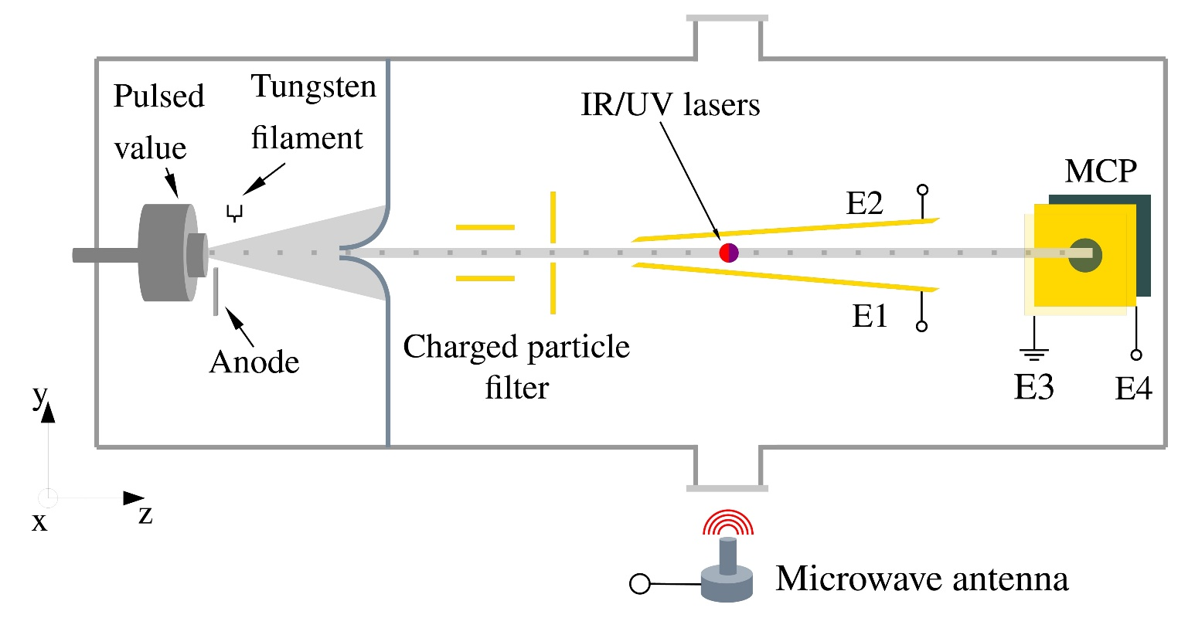

Previous experiments with helium
Coherent moment splitting with helium atoms in superpositions of $\left|\left.ns\right\rangle \right.$ Rydberg states
Horizontal half-loop interferometer
Implemented with pulsed electric field gradients
J. D. R. Tommey and S. D. Hogan, Phys. Rev. A 104, 033305 (2021)

Slide 22
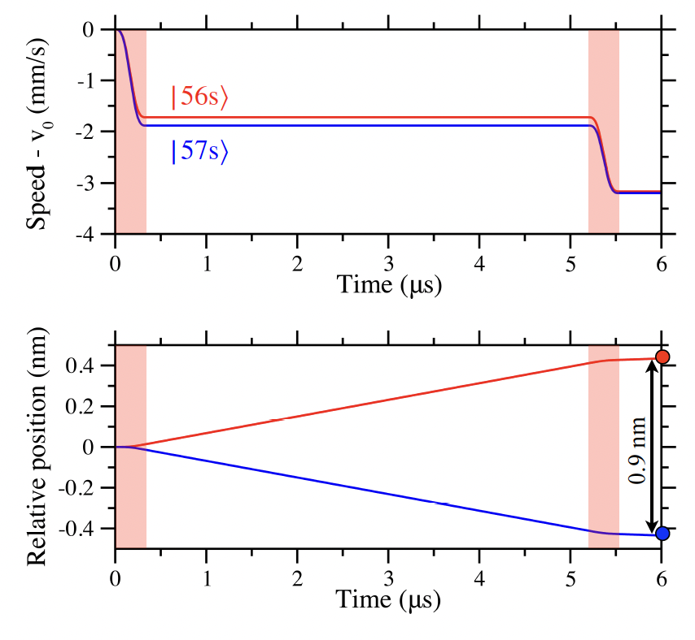
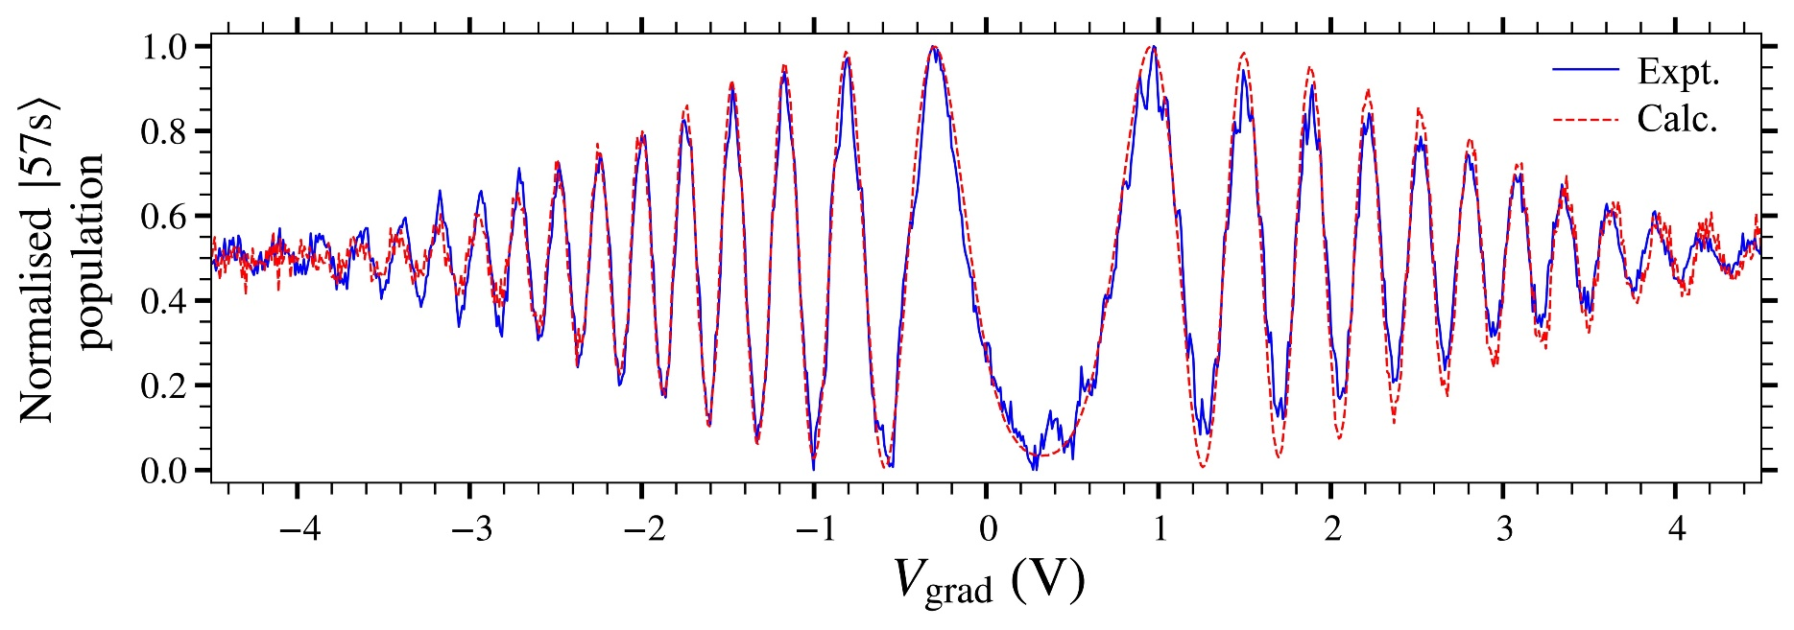
Current status with helium
Phases determined by measuring populations of the Rydberg states
Coherent evolution observed for momentum state separation up to 1 nm
J. D. R. Tommey and S. D. Hogan, Phys. Rev. A 104, 033305 (2021)
Notes:
Dephasing due to velocity spread, matches what you would expect for decoherence due to this

Slide 23
Next steps
Demonstrate full loop interferometer with helium in horizontal configuration
Characterise stray fields and systematic errors
Rotate setup for g-sensitive measurement
Further in the future -> positronium!

Slide 24
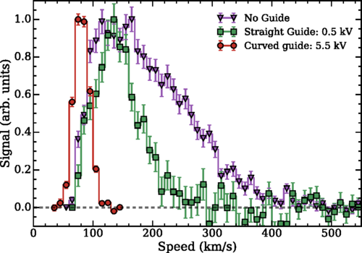
Next steps
Perform full loop interferometer with helium in horizontal configuration
Characterise stray fields and systematic errors
Rotate setup for g-sensitive measurement
Further in the future -> positronium!
Continued development of Ps techniques:
Rydberg positronium state production/coherent manipulation
Guiding of positronium
Velocity selection
A. M. Alonso, B. S. Cooper, A. Deller, L. Gurung, S. D. Hogan, and D. B. Cassidy Phys. Rev. A 95, 053409

Slide 25
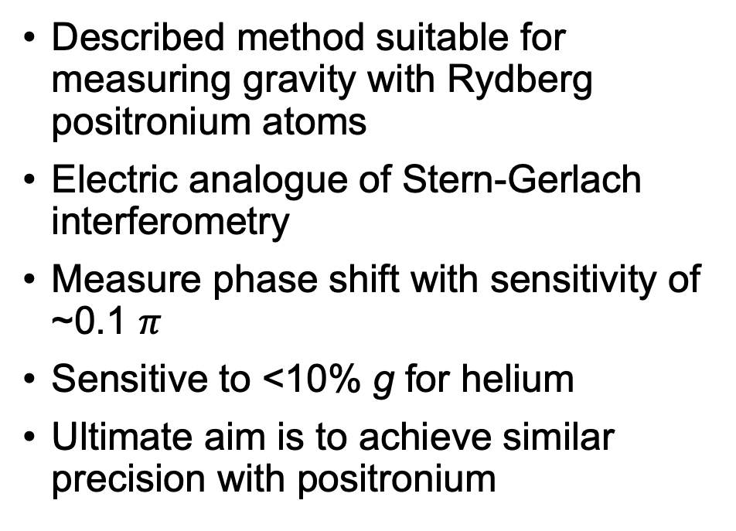


Conclusions
Described method suitable for measuring gravity with Rydberg positronium atoms
Electric analogue of Stern-Gerlach interferometry
Measure phase shift with sensitivity of ~0.1 $π$
Sensitive to <10% g for helium
Ultimate aim is to achieve similar precision with positronium
$$e^{−}$$
$$e^{+}$$
Notes:
0.2 pi < 10% of g for helium for conditions described previously. Put some figs in – Stark map, electrodes setup

