Slide 1
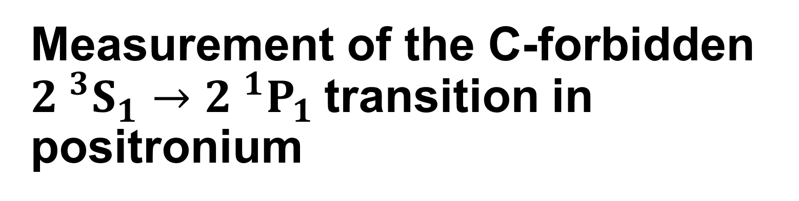
Measurement of the C-forbidden ${2 }^{3}S_{1}→{2 }^{1}P_{1}$transition in positronium
Rebecca J. Daly
Department of Physics and Astronomy, University College London,
Gower Street, London, WC1E 6BT, United Kingdom
rebecca.daly.18@ucl.ac.uk

Slide 2
R. E. Sheldon, K. P. Habdas, S. D. Hogan and D. B. Cassidy Department of Physics and Astronomy, University College London, Gower Street, London, WC1E 6BT, United Kingdom J. Pérez-Ríos Department of Physics and Astronomy, Stony Brook University, Stony Brook, New York 11794, US

Slide 3
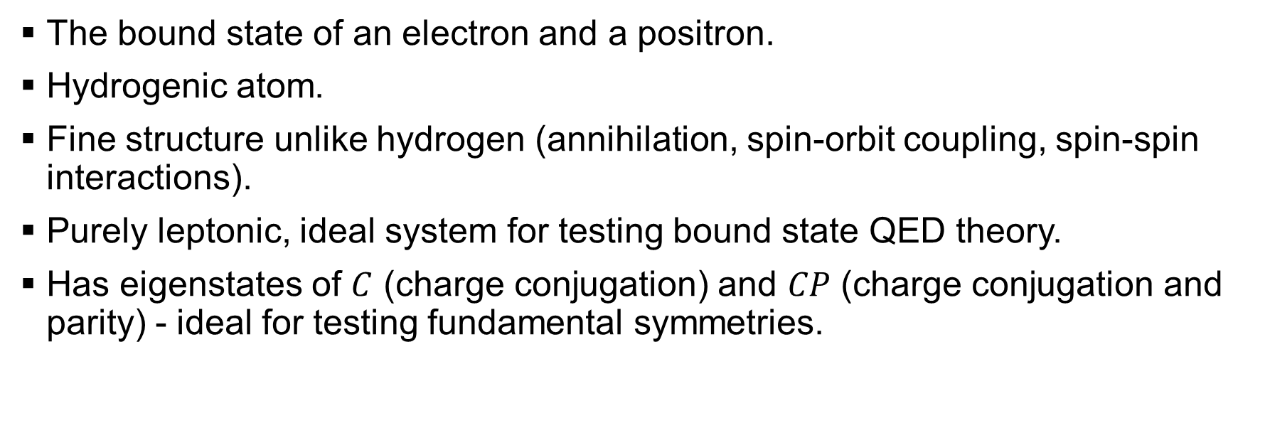
Positronium (Ps)
The bound state of an electron and a positron.
Hydrogenic atom.
Fine structure unlike hydrogen (annihilation, spin-orbit coupling, spin-spin interactions).
Purely leptonic, ideal system for testing bound state QED theory.
Has eigenstates of $C$ (charge conjugation) and $CP$ (charge conjugation and parity) - ideal for testing fundamental symmetries.

Slide 4
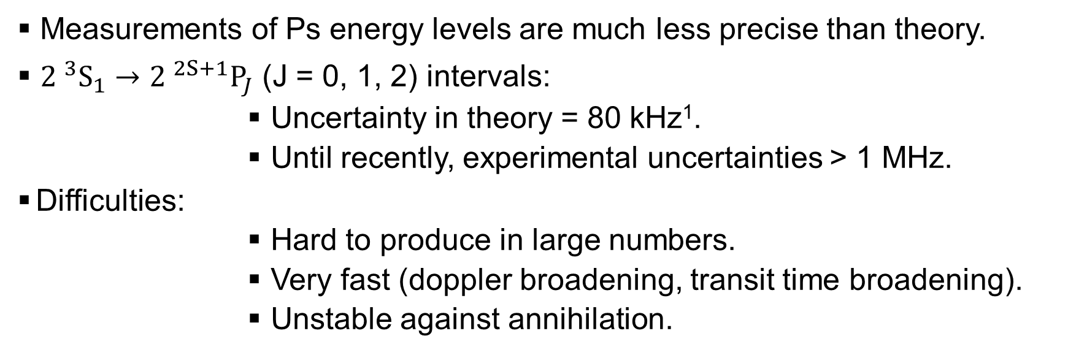
Ps n = 2 transition measurements
Measurements of Ps energy levels are much less precise than theory.
${2 }^{3}{\text{S}}_{1}→{2 }^{2S+1}{\text{P}}_{J}$ (J = 0, 1, 2) intervals:
Uncertainty in theory = 80 kHz¹.
Until recently, experimental uncertainties > 1 MHz.
Difficulties:
Hard to produce in large numbers.
Very fast (doppler broadening, transit time broadening).
Unstable against annihilation.
¹ A. Czarnecki et al, Phys. Rev. A 59, 4316 (1999).

Slide 5
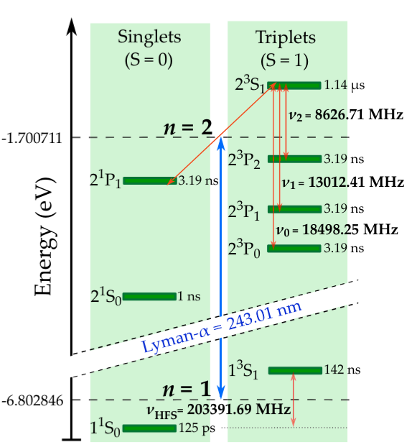
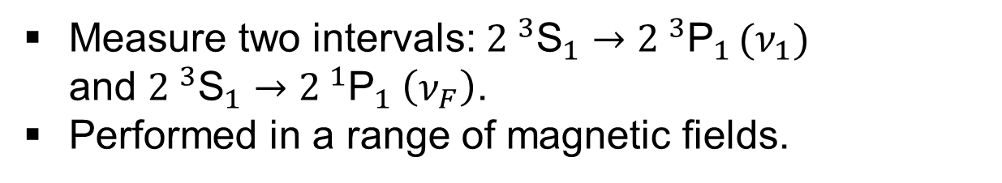

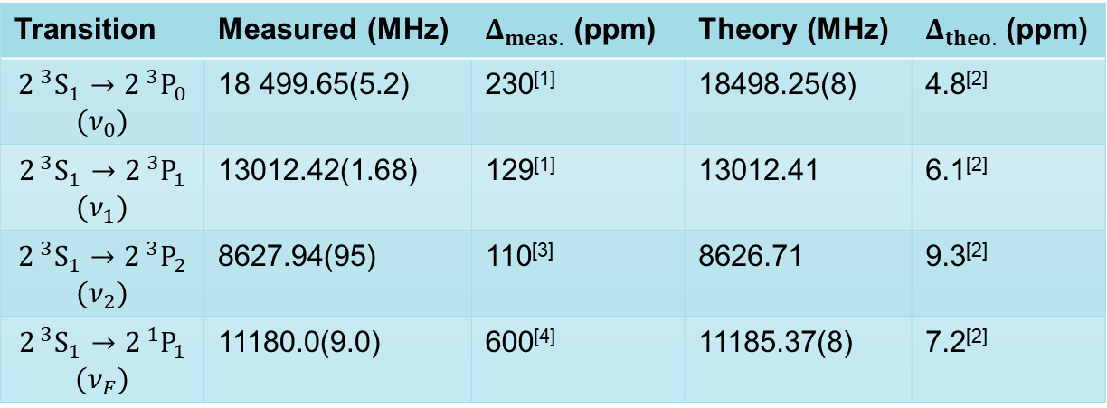
State of Ps n = 2 tests
Measure two intervals: ${2 }^{3}{\text{S}}_{1}→{2 }^{3}{\text{P}}_{1 }(ν_{1})$ and ${2 }^{3}{\text{S}}_{1}→{2 }^{1}{\text{P}}_{1} \left(ν_{F}\right)$.
Performed in a range of magnetic fields.
$ν_{F}$ = 11185.37 MHz
Transition | Measured (MHz) | $Δ_{meas.}$ (ppm) | Theory (MHz) | $Δ_{theo.}$ (ppm)
$$2^{ 3}S_{1}→2^{ 3}P_{0}$$ $$(ν_{0})$$ | 18 499.65(5.2) | 230^{[1]} | 18498.25(8) | 4.8^{[2]}
$$2^{ 3}S_{1}→2^{ 3}P_{1}$$ $$(ν_{1})$$ | 13012.42(1.68) | 129^{[1]} | 13012.41 | 6.1^{[2]}
$$2^{ 3}S_{1}→2^{ 3}P_{2}$$ $$(ν_{2})$$ | 8627.94(95) | 110^{[3]} | 8626.71 | 9.3^{[2]}
$$2^{ 3}S_{1}→2^{ 1}P_{1}$$ $$(ν_{F})$$ | 11180.0(9.0) | 600^{[4]} | 11185.37(8) | 7.2^{[2]}
¹D. Hagena, et al, Phys. Rev. Lett., 71:2887–2890 (1993).
²A. Czarnecki et al, Phys. Rev. A 59, 4316 (1999).
³R. E. Sheldon et al, Phys. Rev. Lett. 131, 043001 (2023).
⁴R. Ley et al, Hyperfine Interactions, 89(1):327–341 (1994).

Slide 6
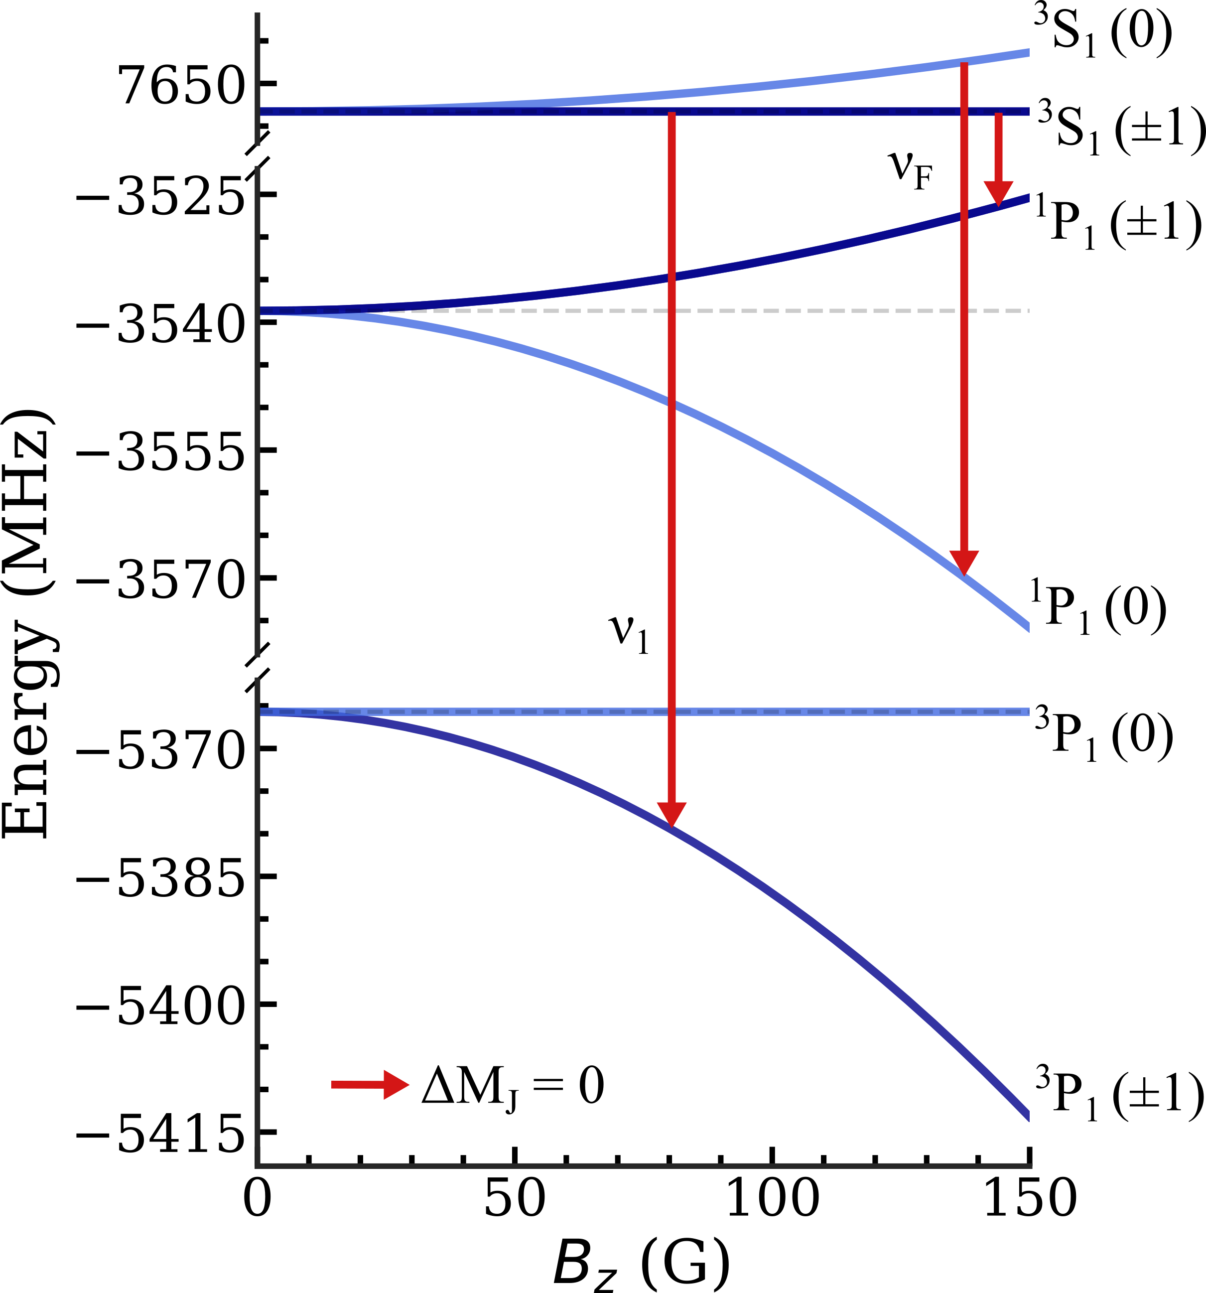
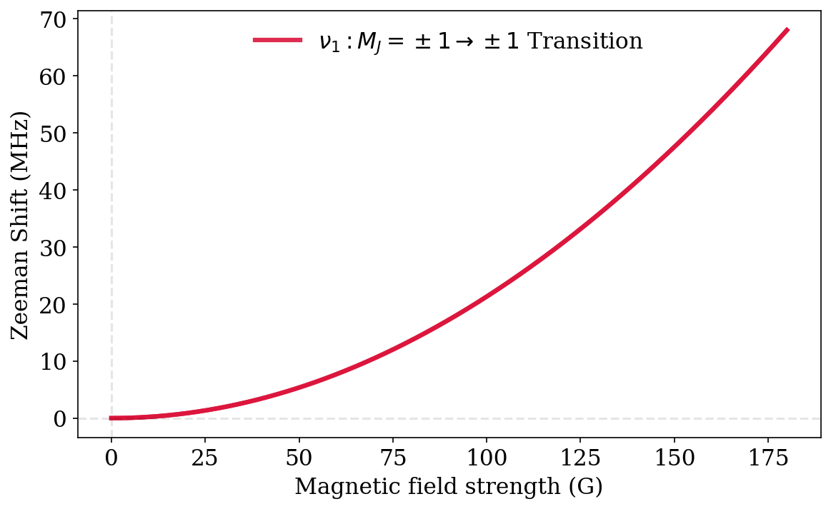
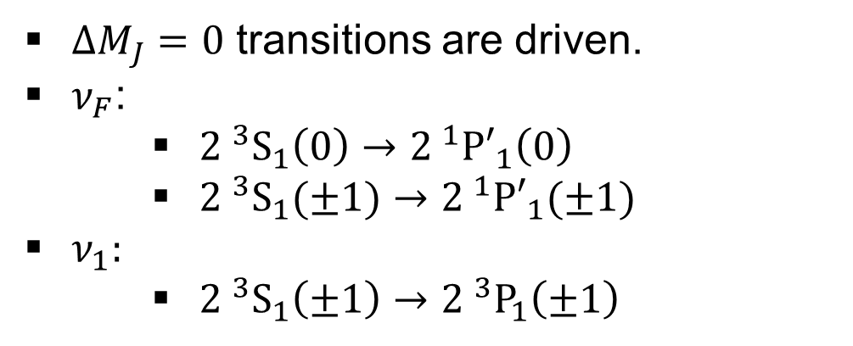

Microwave transitions
$ΔM_{J}=0$ transitions are driven.
$ν_{F}$:
${2 }^{3}S_{1}\left(0\right)→{2 }^{1}{P′}_{1}\left(0\right)$
${2 }^{3}S_{1}(±1)→{2 }^{1}{P′}_{1}(±1)$
$ν_{1}:$
${2 }^{3}S_{1}\left(±1\right)→{2 }^{3}P_{1}\left(±1\right)$
$$ν_{1}$$

Slide 7
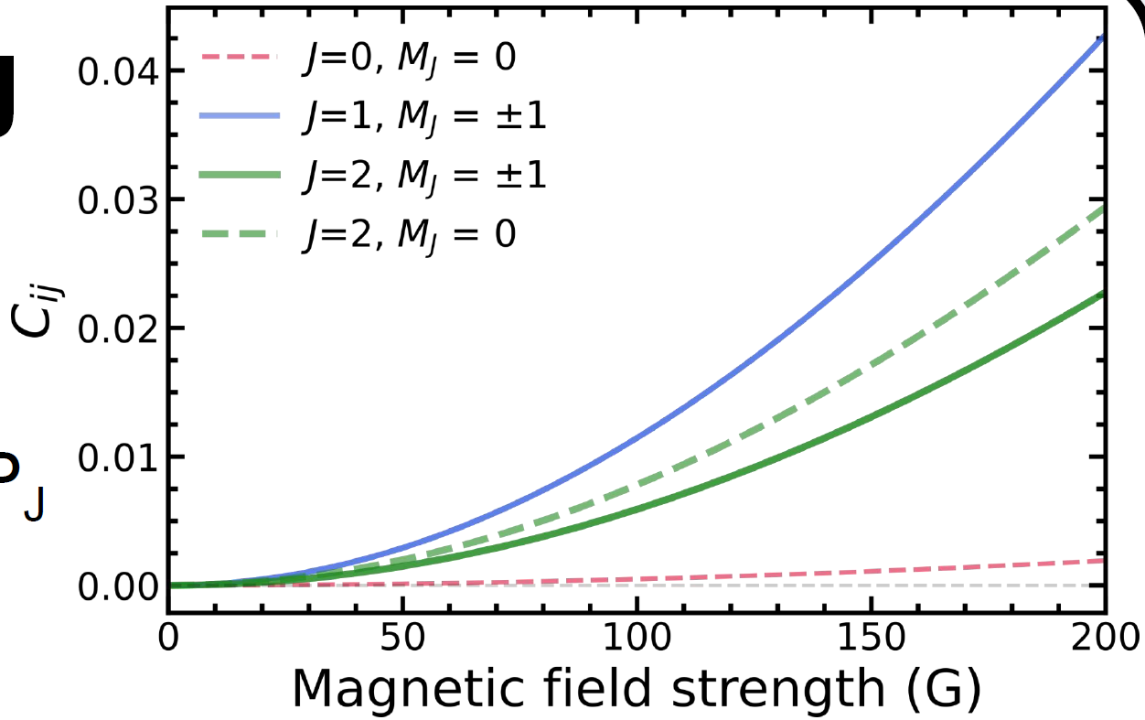
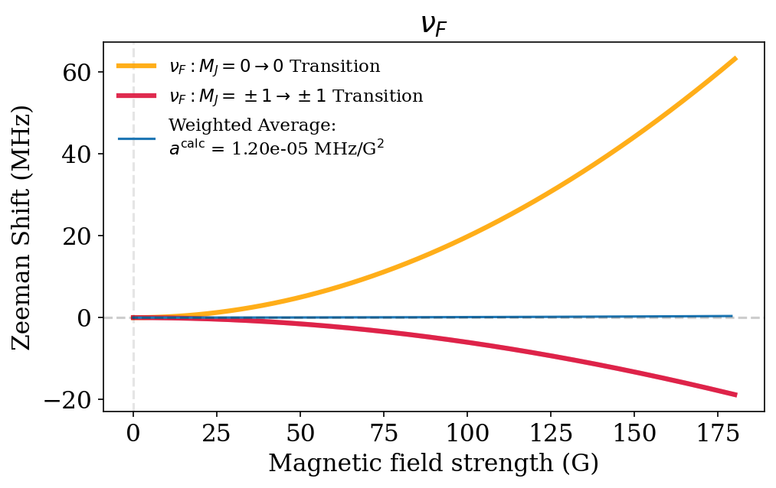
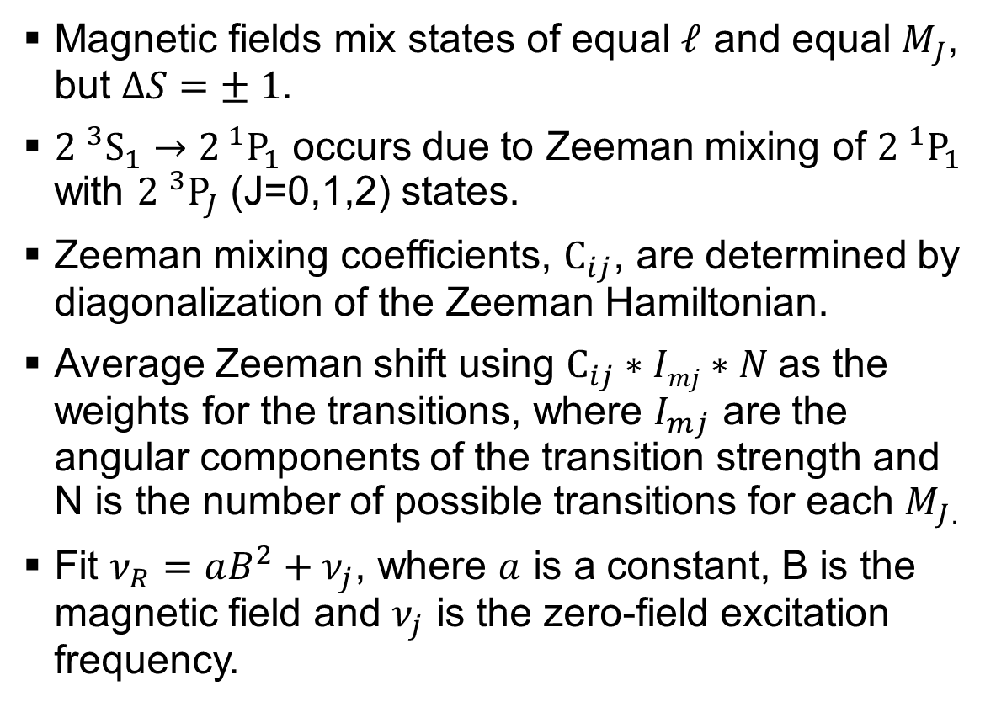

Microwave transitions
Magnetic fields mix states of equal $ℓ$ and equal $M_{J}$, but $ΔS=± 1$.
${2 }^{3}S_{1}→2^{ 1}P_{1}$ occurs due to Zeeman mixing of ${2 }^{1}P_{1}$ with ${2 }^{3}P_{J}$ (J=0,1,2) states.
Zeeman mixing coefficients, $C_{ij}$, are determined by diagonalization of the Zeeman Hamiltonian.
Average Zeeman shift using $C_{ij}∗Imj∗N$as the weights for the transitions, where $I_{mj}$ are the angular components of the transition strength and N is the number of possible transitions for each $M_{J}$.
Fit $ν_{R}=aB^{2}+ν_{j}$, where $a$ is a constant, B is the magnetic field and $ν_{j}$ is the zero-field excitation frequency.
$$ν_{F}$$

Slide 8
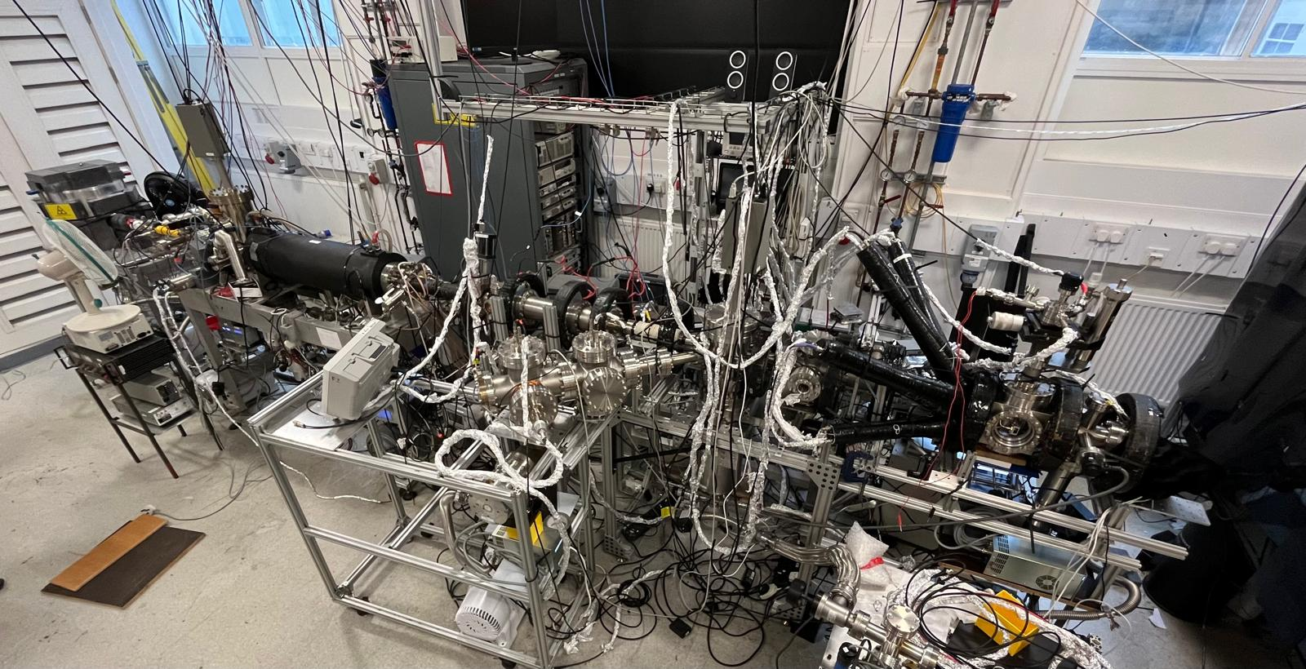
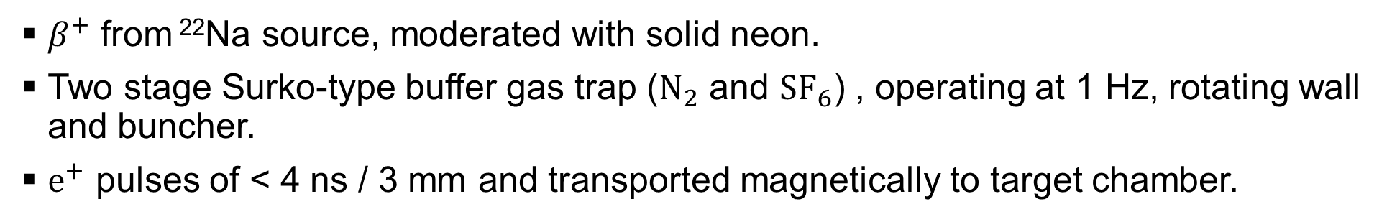
Beamline
z
See B. S. Cooper et al, Rev. Sci. Instrum. 86, 103101 (2015) for details on beamline
$β^{+}$ from ²²Na source, moderated with solid neon.
Two stage Surko-type buffer gas trap ($N_{2}$ and ${SF}_{6}$) , operating at 1 Hz, rotating wall and buncher.
$e^{+}$ pulses of < 4 ns / 3 mm and transported magnetically to target chamber.

Slide 9
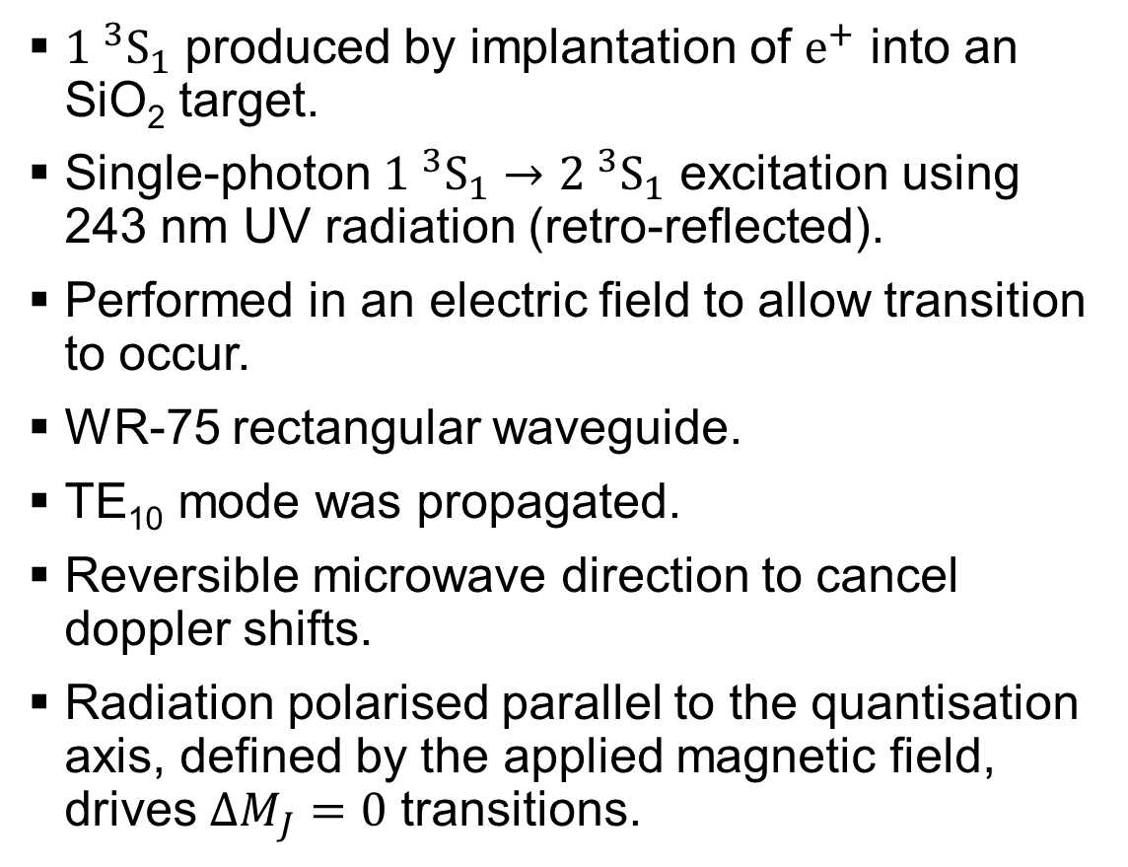
Ps production and excitation
${1 }^{3}S_{1}$ produced by implantation of $e^{+}$ into an SiO₂ target.
Single-photon ${1 }^{3}S_{1}→{2 }^{3}{\text{S}}_{1}$ excitation using 243 nm UV radiation (retro-reflected).
Performed in an electric field to allow transition to occur.
WR-75 rectangular waveguide.
TE₁₀ mode was propagated.
Reversible microwave direction to cancel doppler shifts.
Radiation polarised parallel to the quantisation axis, defined by the applied magnetic field, drives $ΔM_{J}=0$ transitions.

Slide 10
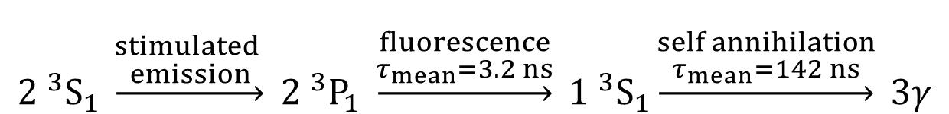
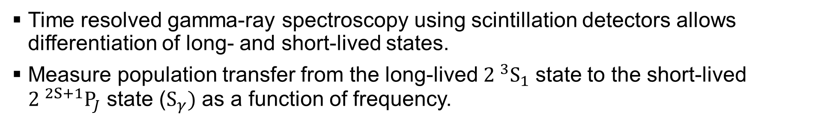
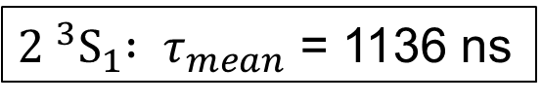
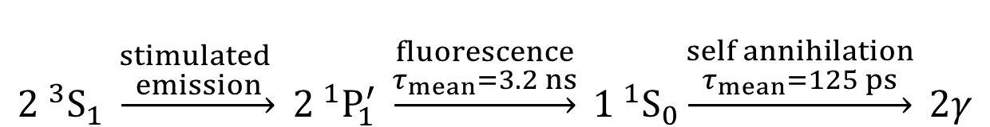
Line shape measurements
Time resolved gamma-ray spectroscopy using scintillation detectors allows differentiation of long- and short-lived states.
Measure population transfer from the long-lived ${2 }^{3}S_{1}$ state to the short-lived ${2 }^{2S+1}P_{J}$ state ($S_{γ})$ as a function of frequency.
$${2 }^{3}S_{1} \underset{→}{\begin{aligned}stimulated \\ emission\end{aligned}} {2 }^{3}P_{1} \underset{→}{\begin{aligned}fluorescence \\ τ_{mean}=3.2 ns\end{aligned}} {1 }^{3}S_{1}\underset{→}{\begin{aligned}self annihilation \\ τ_{mean}=142 ns\end{aligned}} 3γ$$
$${2 }^{3}S_{1} \underset{→}{\begin{aligned}stimulated \\ emission\end{aligned}} {2 }^{1}P_{1}^{′} \underset{→}{\begin{aligned}fluorescence \\ τ_{mean}=3.2 ns\end{aligned}} {1 }^{1}S_{0}\underset{→}{\begin{aligned}self annihilation \\ τ_{mean}=125 ps\end{aligned}} 2γ$$
${2 }^{3}S_{1}{ : τ}_{mean}$ = 1136 ns

Slide 11
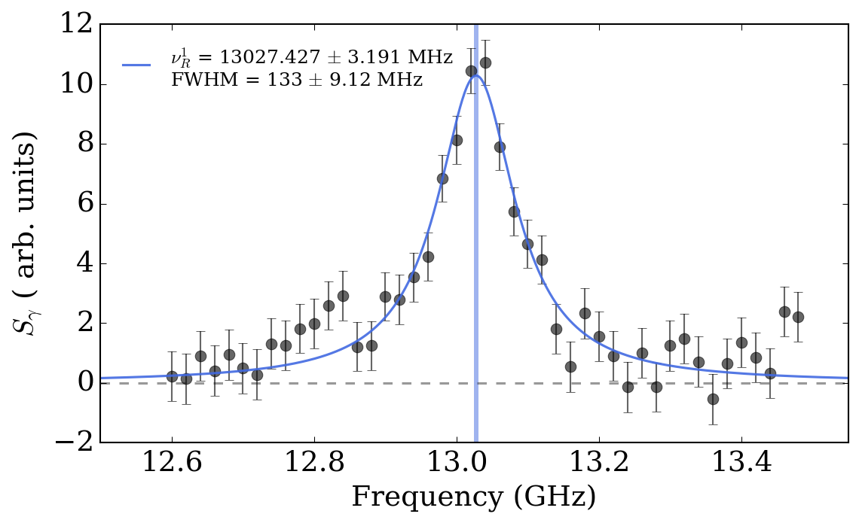
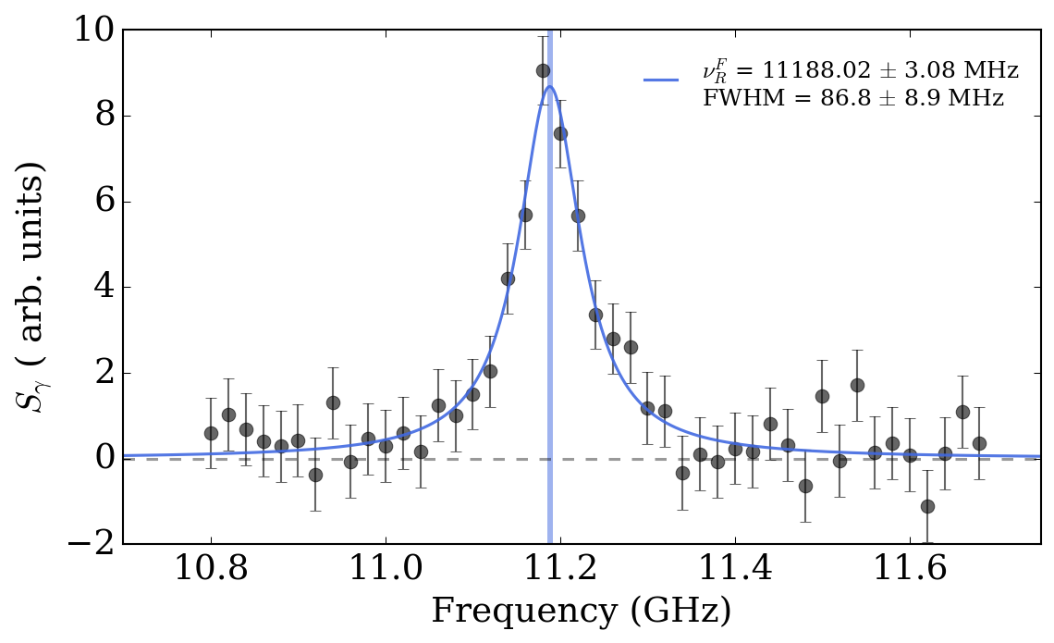


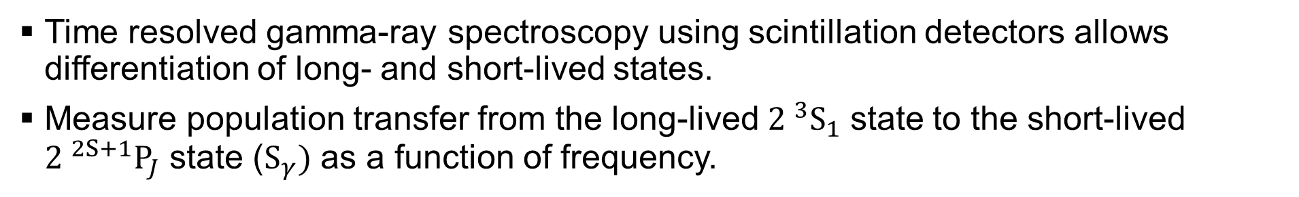
Line shape measurements
Time resolved gamma-ray spectroscopy using scintillation detectors allows differentiation of long- and short-lived states.
Measure population transfer from the long-lived ${2 }^{3}S_{1}$ state to the short-lived ${2 }^{2S+1}P_{J}$ state ($S_{γ})$ as a function of frequency.
$$ν_{1}$$
$$ν_{F}$$
Fit Lorentzian functions to extract centroids, $ν_{R}^{1}$ and $v_{R}^{F}$.

Slide 12
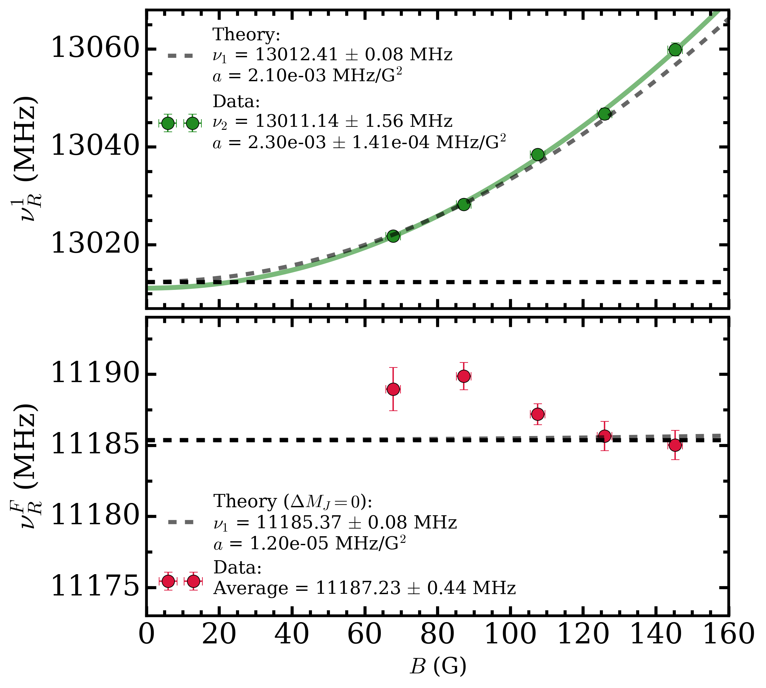

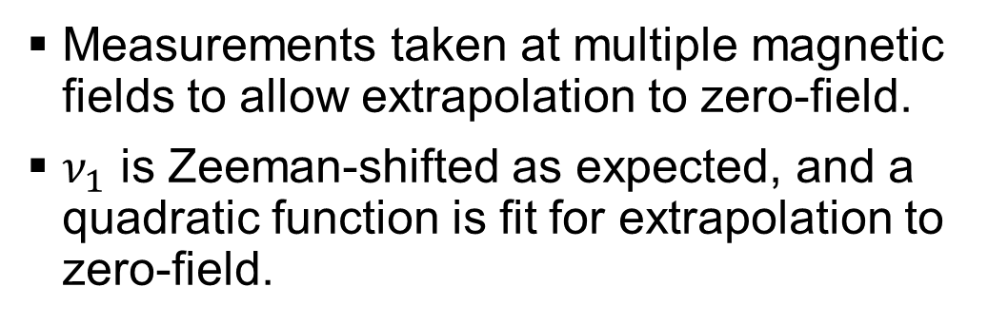



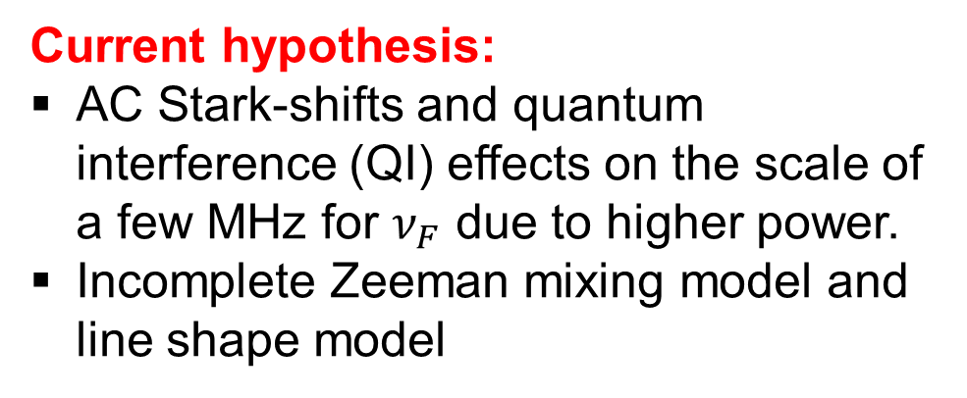
Zeeman shifts
Measurements taken at multiple magnetic fields to allow extrapolation to zero-field.
$ν_{1}$ is Zeeman-shifted as expected, and a quadratic function is fit for extrapolation to zero-field.
$P_{in}$=106 mW
$$ν_{1}$$
Current hypothesis:
AC Stark-shifts and quantum interference (QI) effects on the scale of a few MHz for $ν_{F}$ due to higher power.
Incomplete Zeeman mixing model and line shape model
$P_{in}$= 646 mW
$$ν_{F}$$

Slide 13
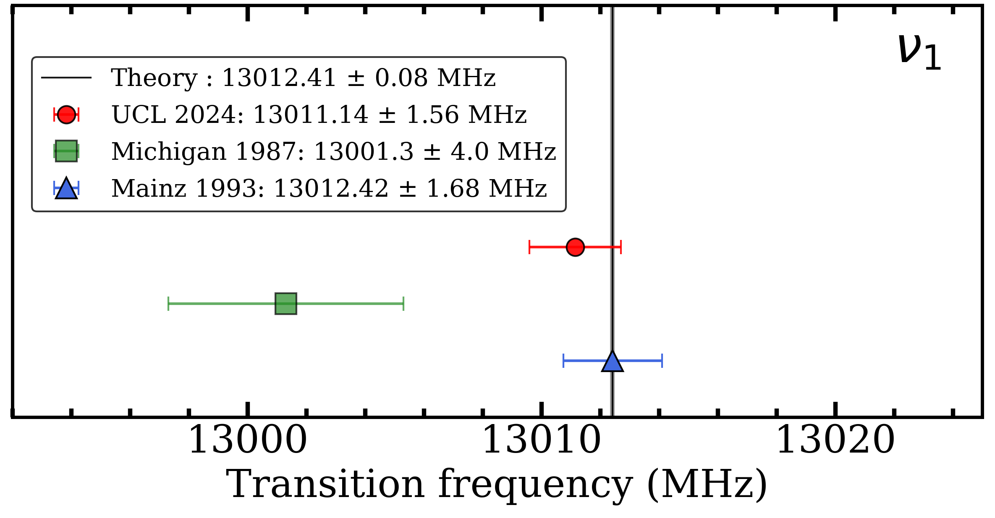
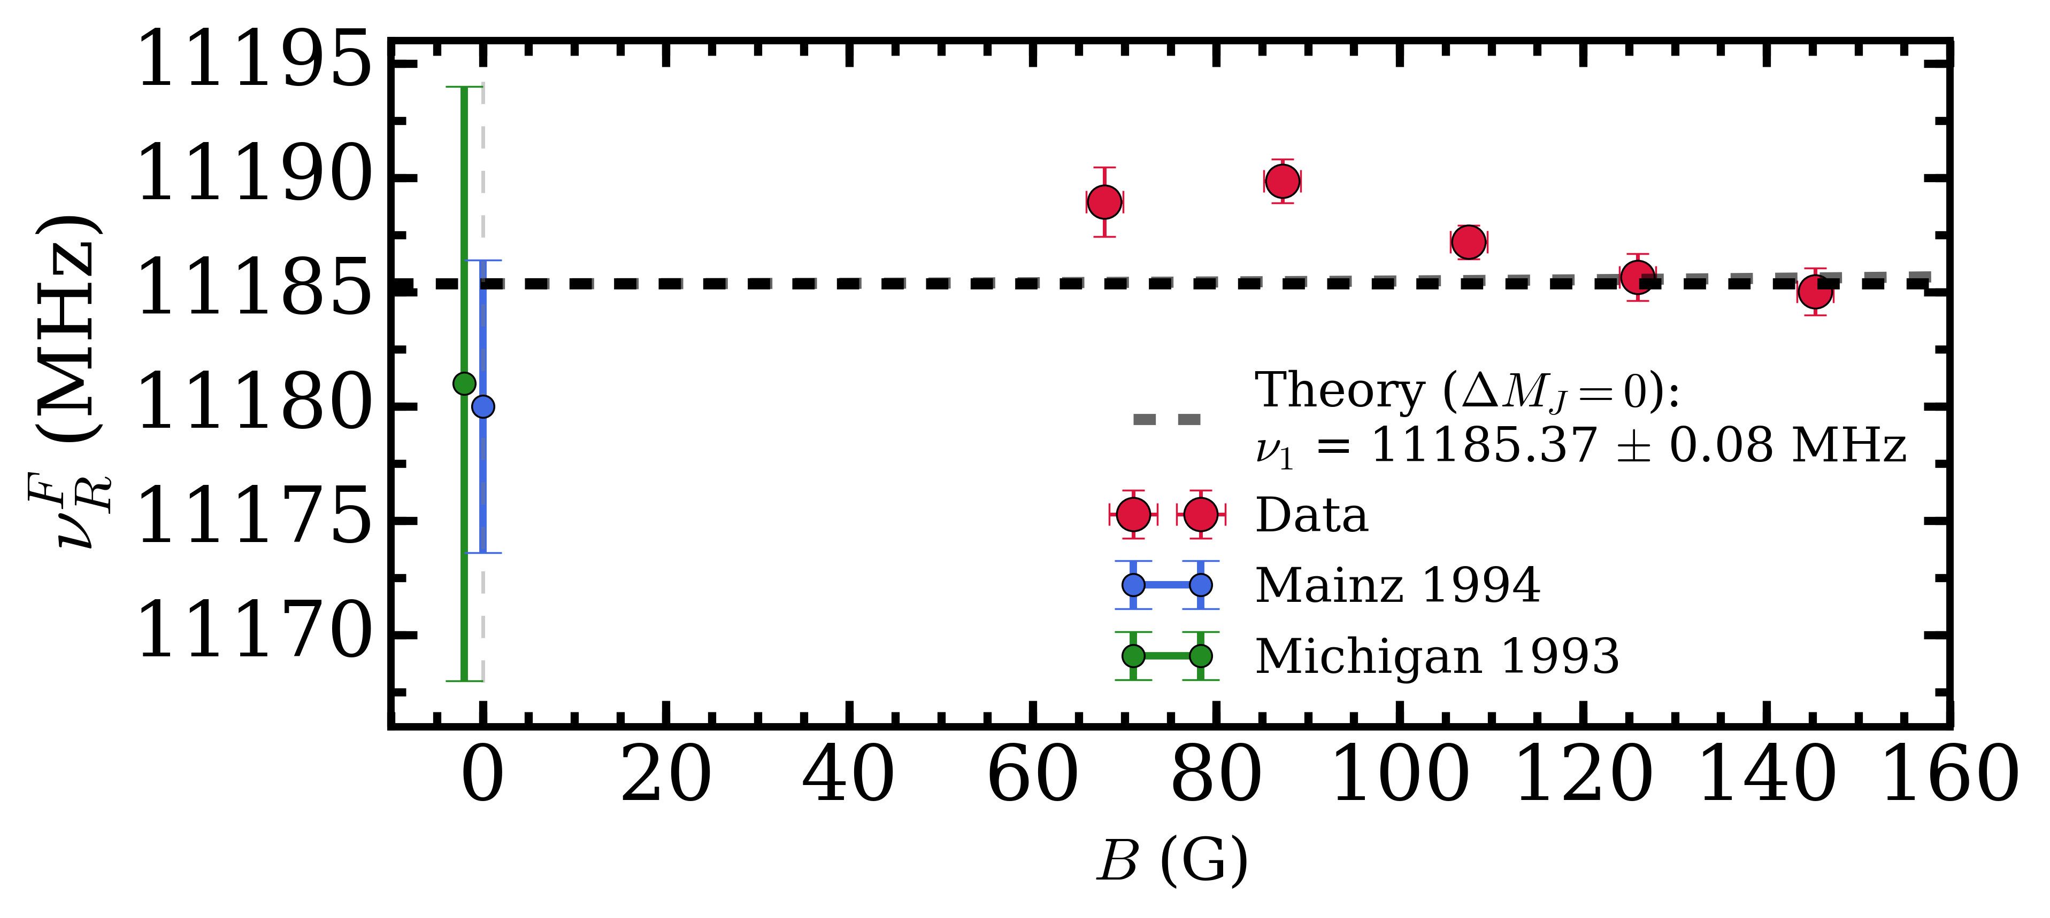

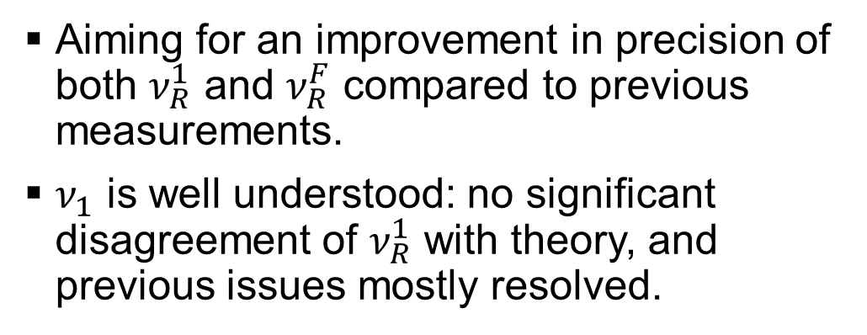
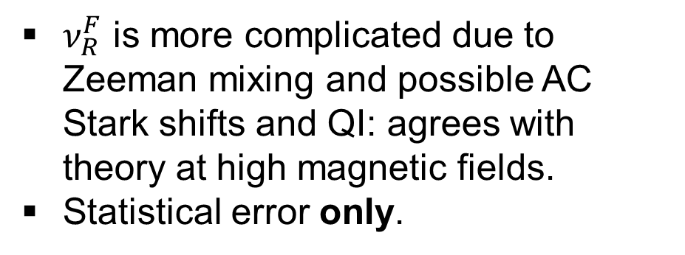

Zero-field transition frequencies
$$ν_{1}$$
Aiming for an improvement in precision of both $ν_{R}^{1}$ and $ν_{R}^{F}$ compared to previous measurements.
$ν_{1}$ is well understood: no significant disagreement of $ν_{R}^{1}$ with theory, and previous issues mostly resolved.
$ν_{R}^{F}$ is more complicated due to Zeeman mixing and possible AC Stark shifts and QI: agrees with theory at high magnetic fields.
Statistical error only.
$$ν_{F}$$

Slide 14
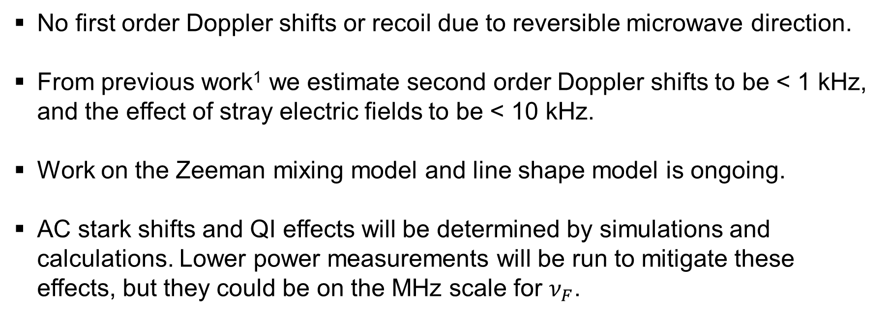
Systematic errors
No first order Doppler shifts or recoil due to reversible microwave direction.
From previous work¹ we estimate second order Doppler shifts to be < 1 kHz, and the effect of stray electric fields to be < 10 kHz.
Work on the Zeeman mixing model and line shape model is ongoing.
AC stark shifts and QI effects will be determined by simulations and calculations. Lower power measurements will be run to mitigate these effects, but they could be on the MHz scale for $ν_{F}$.
¹L. Gurung et al, Phys. Rev. A 103, 042805 (2021).

Slide 15
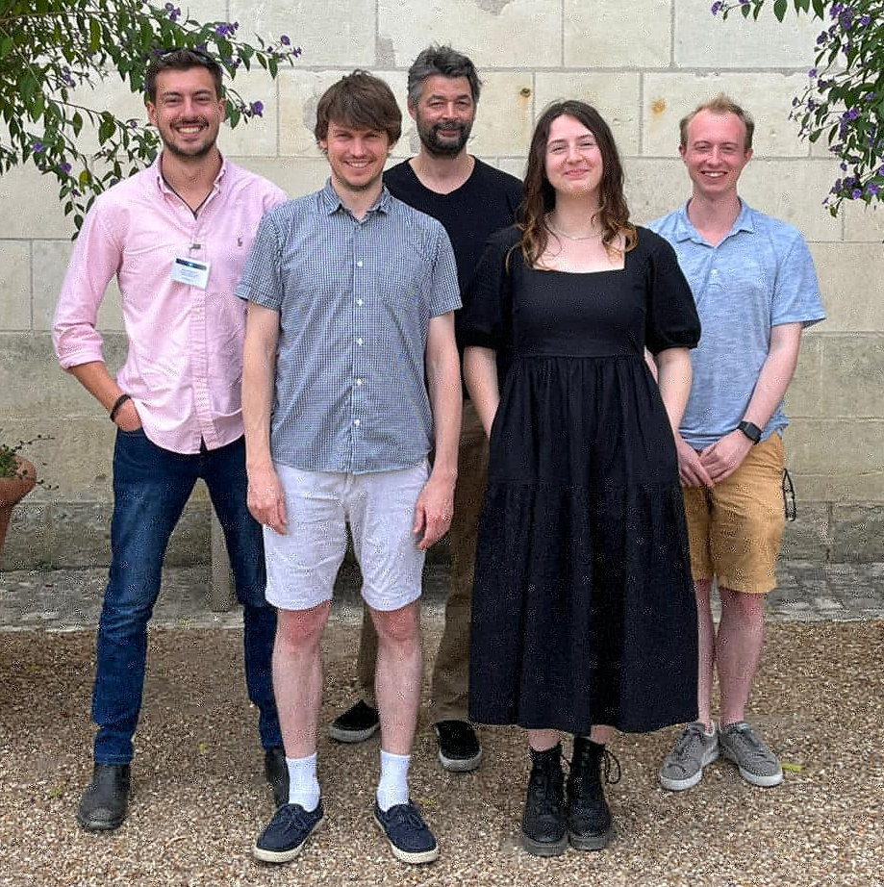


Ongoing work
Continue development of Zeeman mixing and line shape models
Continue with measurements at a range of powers
Thank you!
Future plans
@PsSpectroscopy
Slower Ps
Production of polarized Ps using microwave or laser selection

