Slide 1
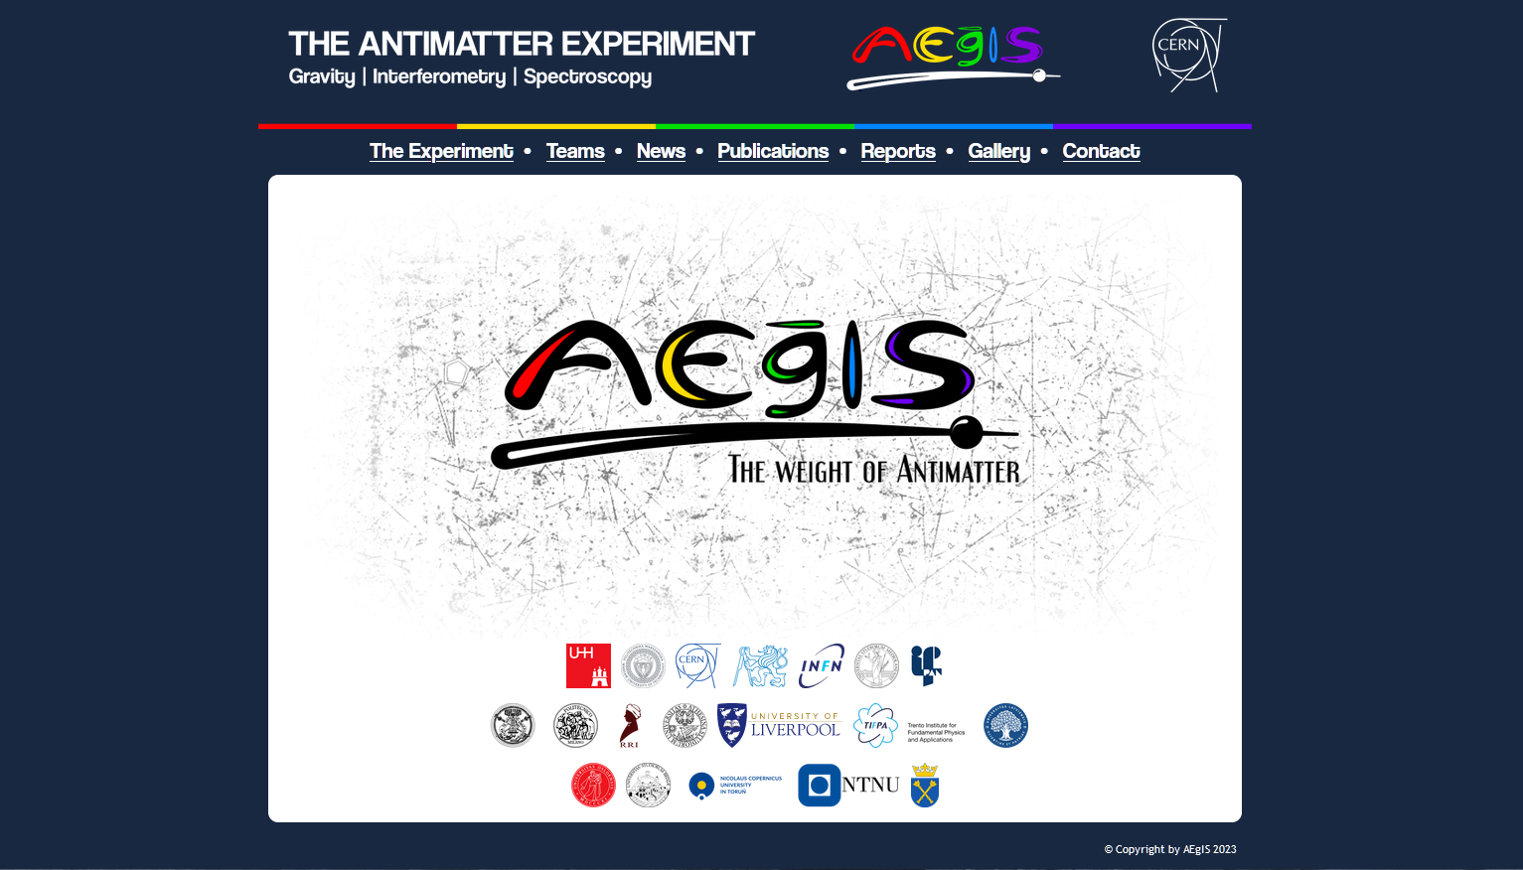


PSAS’2024: Broadband Positronium Laser Cooling
Speaker: Benjamin Rienäcker

Slide 2


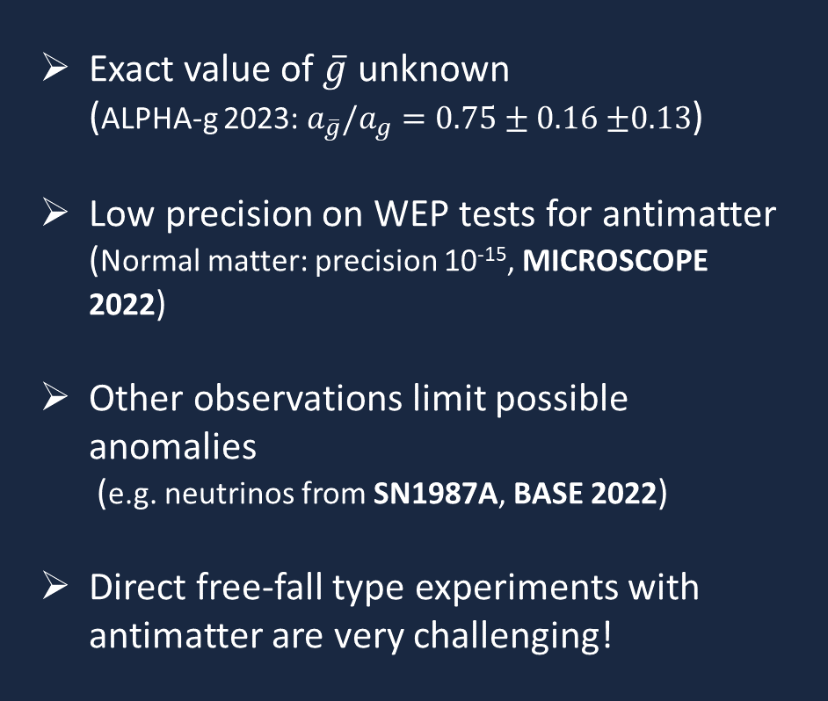
How does gravity affect antimatter?
Exact value of $\overline{g}$ unknown
(ALPHA-g 2023: $a_{\overline{g}}/a_{g}=0.75±0.16$ $±0.13$)
Low precision on WEP tests for antimatter
(Normal matter: precision 10⁻¹⁵, MICROSCOPE 2022)
Other observations limit possible anomalies
(e.g. neutrinos from SN1987A, BASE 2022)
Direct free-fall type experiments with antimatter are very challenging!

Slide 3
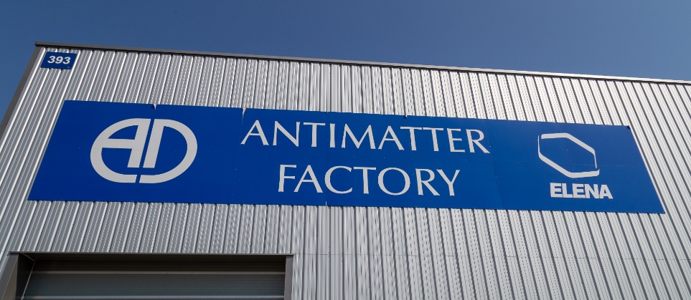
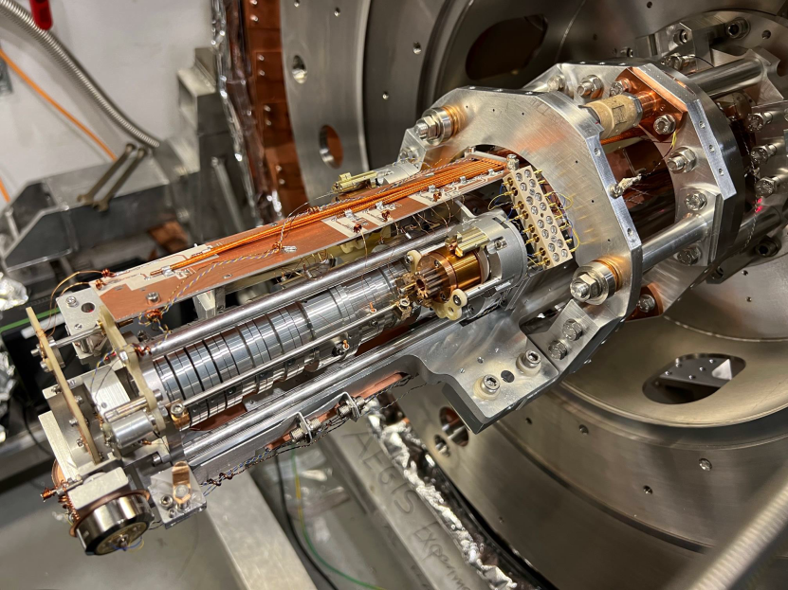

Production of antihydrogen
Charge exchange reaction:
$${Ps}^{∗}+ \overline{p}→ e^{−}+{\overline{H}}^{∗}$$
H*
laser excitation
Ps*
Ps converter
e⁺
antiprotons
H*
The heart of AEgIS

Slide 4
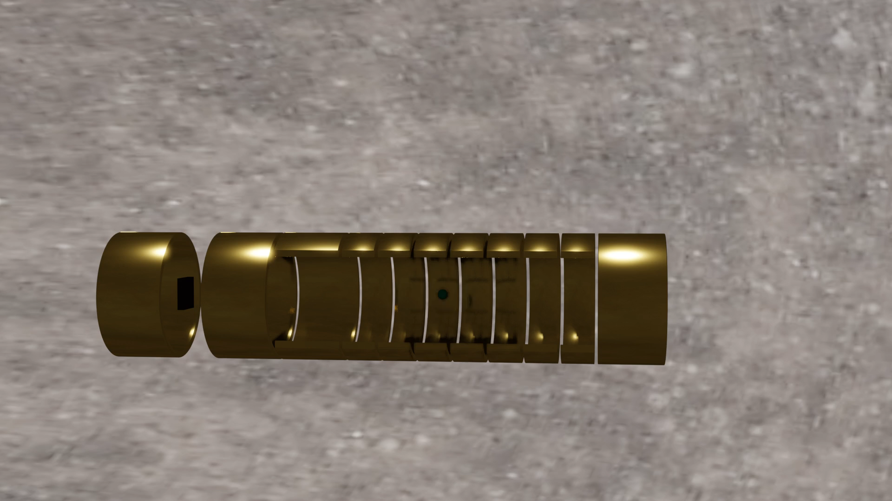


Production of antihydrogen
antiproton
positron
electron
positronium
antihydrogen

Slide 5
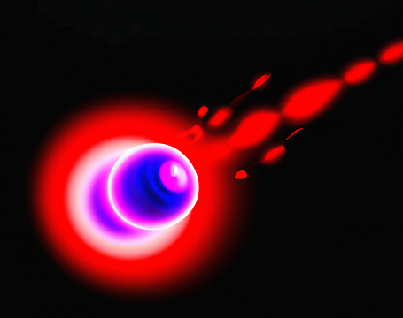
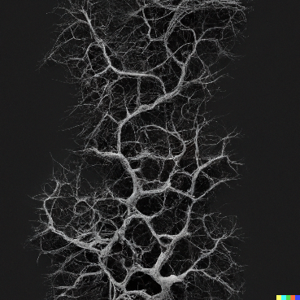


How to get positronium?
Cooling
Ps
The ²²Na isotope
emits positrons (e⁺)
Injecting e⁺ into
nanoporous Si
Thermal emission
(300K or 10⁵ m/s)
… e⁻ meets e⁺

Slide 6
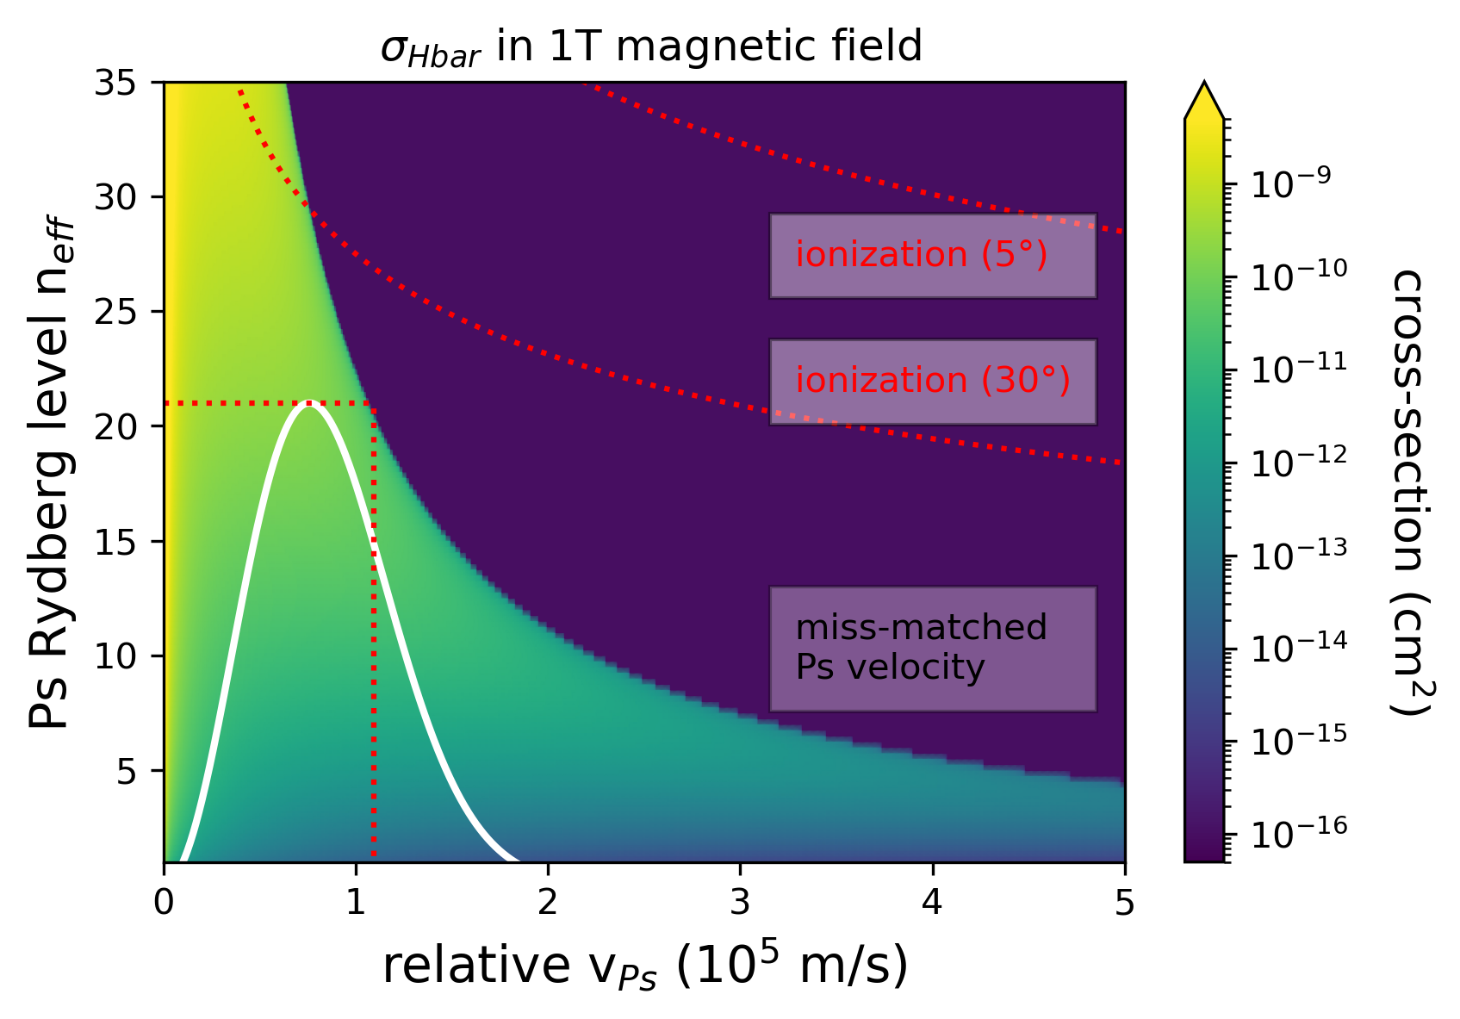
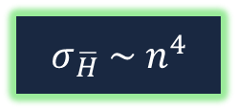
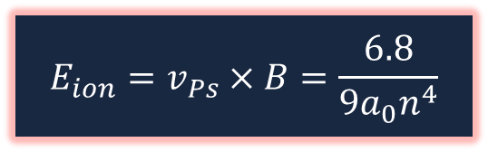
Hbar cross-section 2023
$$σ_{\overline{H}} \sim n^{4}$$
$$E_{ion}=v_{Ps}×B=\frac{6.8}{{9a}_{0}n^{4}}$$
Phys. Rev. A 94, 022714 (2016)
https://doi.org/10.1103/PhysRevA.94.022714
Ps v-distribution (380K)
Commun. Phys 4, 19 (2021)
https://doi.org/10.1038/s42005-020-00494-z
Too hot Ps!

Slide 7


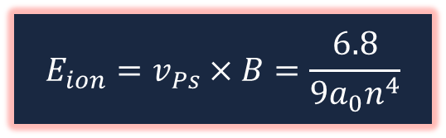
Hbar cross-section ideal
$$σ_{\overline{H}} \sim n^{4}$$
$$E_{ion}=v_{Ps}×B=\frac{6.8}{{9a}_{0}n^{4}}$$
Ps v-distribution (150K)

Slide 8
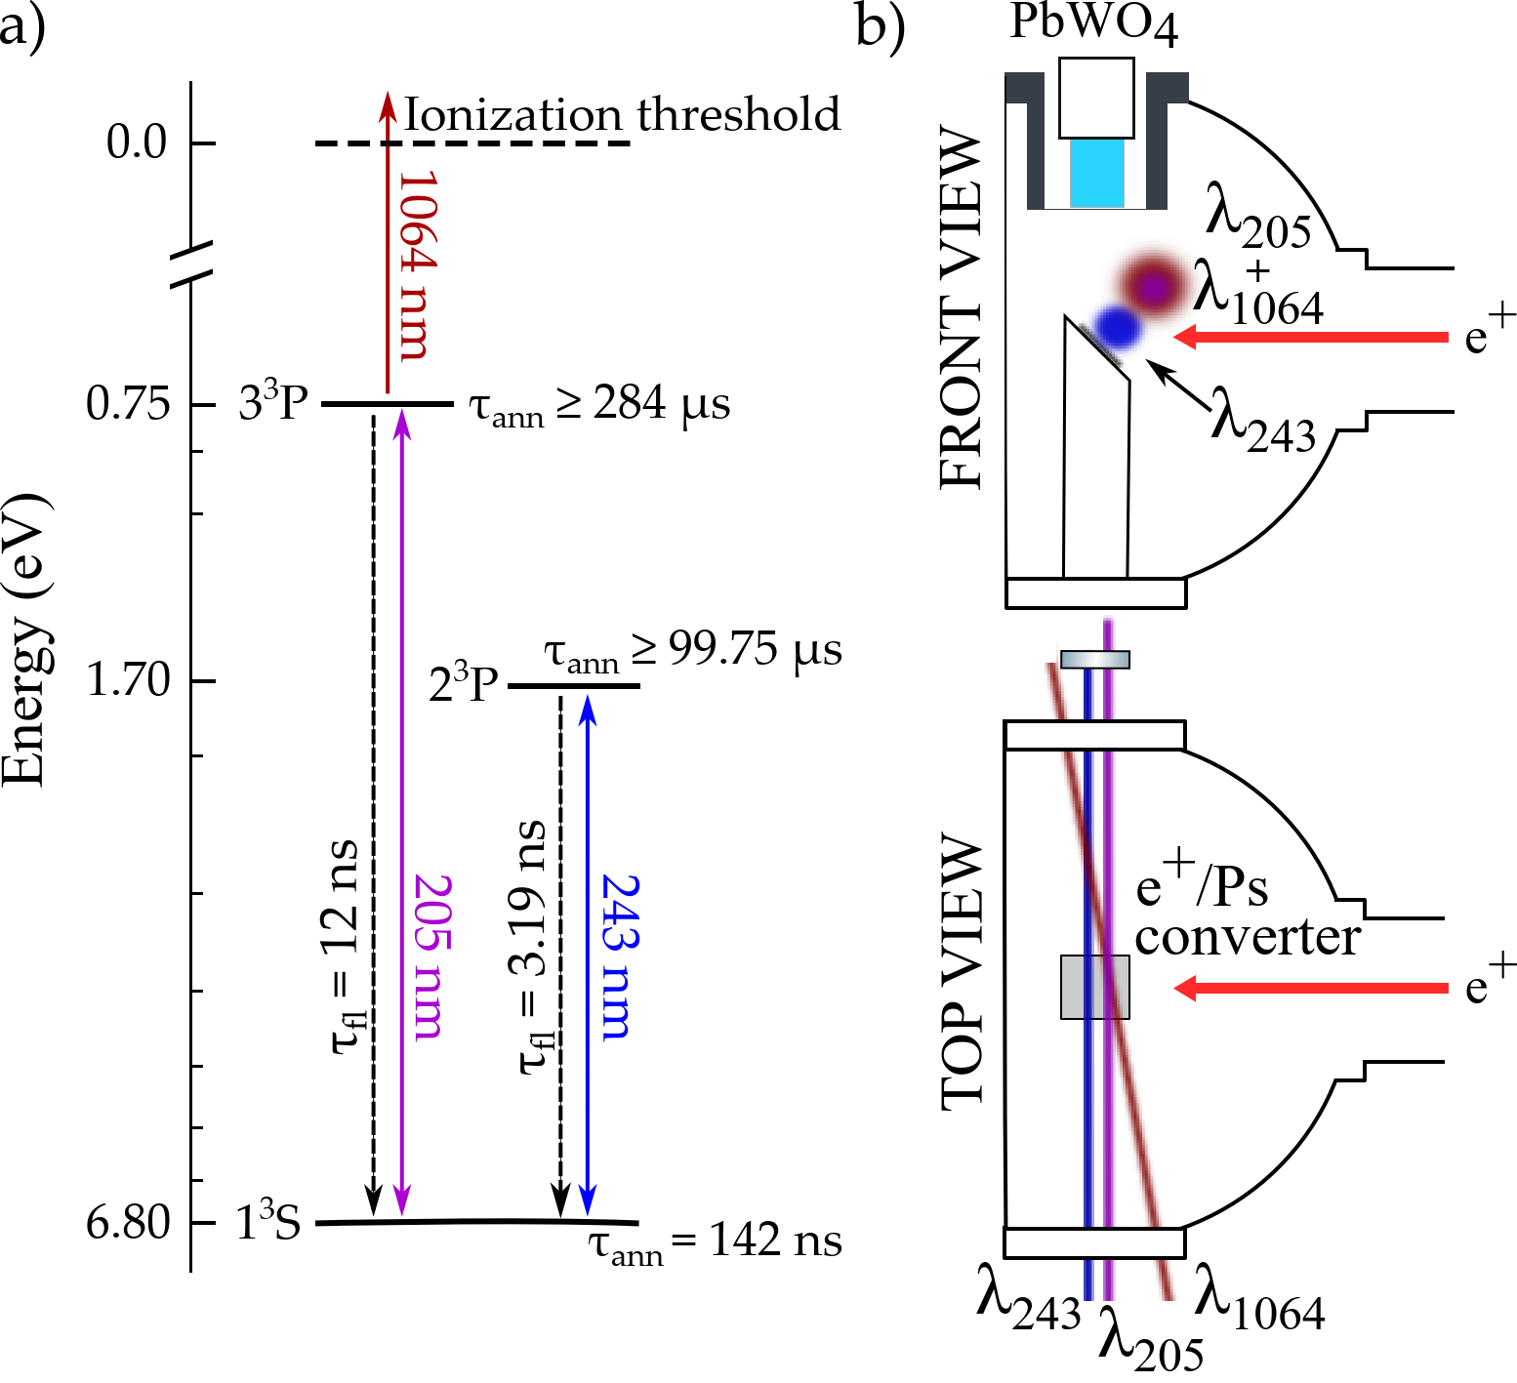







AEgIS positronium laser cooling scheme
Photon absorption and
directional momentum transfer
$$−ℏk$$
$$−ℏk$$
BW 180 GHz
1³S Ps
2³P Ps
Cooling Laser
$$ℏk$$
$$ℏk$$
BW 100 GHz
Spontaneous emission and
random momentum transfer
Technical paper submitted to Optics and Laser Technology
“An alexandrite laser system for positronium laser cooling”

Slide 9
AEgIS choice: Broadband 70ns laser pulse
COOLING LASER + MIRROR
-600 GHz
0
+600 GHz
1D Doppler profile of Ps

Slide 10
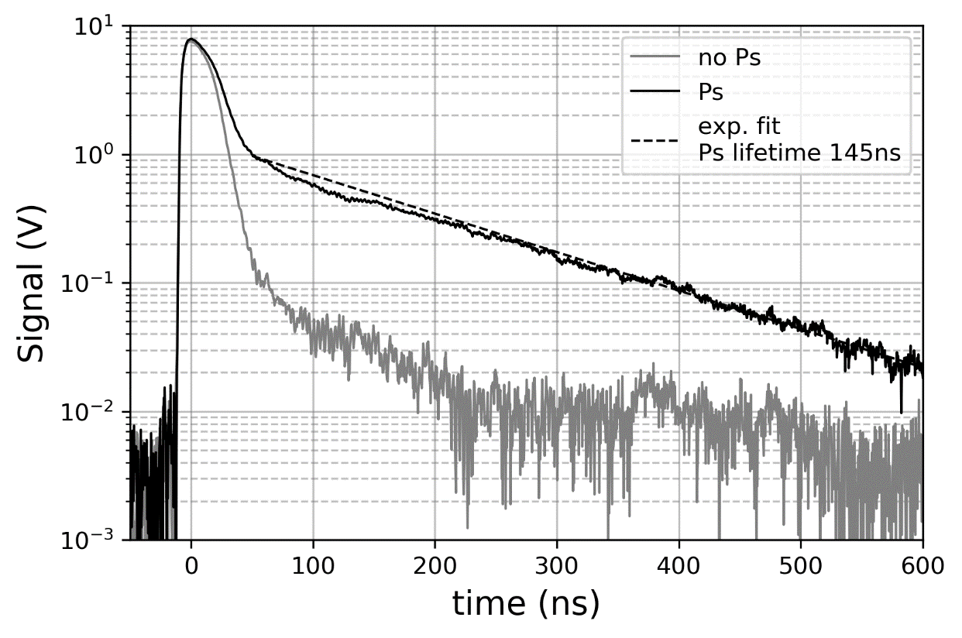
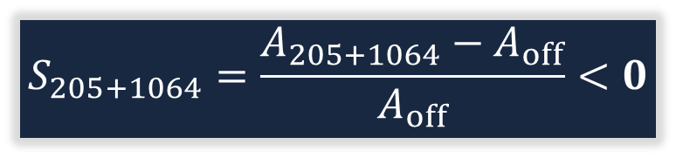
SSPALS reference by 205 probing laser
OFF – no lasers
A
205+1064 laser
--- exp. line (142ns)
$$S_{205+1064}=\frac{A_{205+1064}−A_{off}}{A_{off}}<0$$

Slide 11
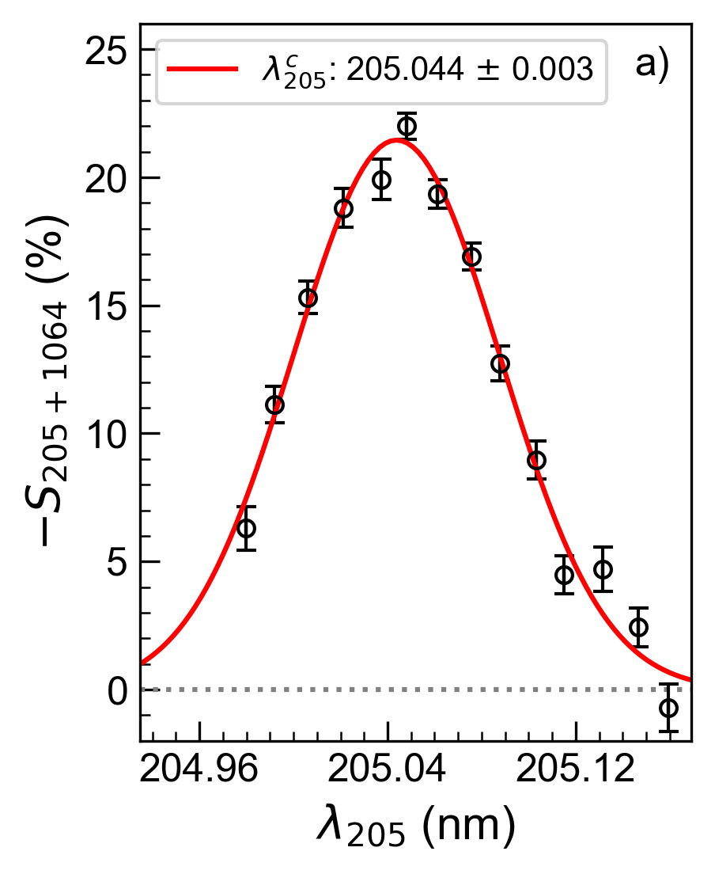


Result for the 205nm probing laser alone
Ps Doppler Scan on the 1³S – 3³P transition
QED: 205.047 nm, B = 0
From the width of a Gaussian fit and the 205 BW (180 GHz):
$$v_{rms}\text{= (}\text{5}\text{.}\text{4}\text{ ± 0.}\text{2}\text{)}\text{∙}{10}^{4} \text{m}s^{−1}$$
$$T\text{= (}\text{3}\text{80}\text{ ± }\text{2}\text{0}\text{)} \text{K}$$

Slide 12

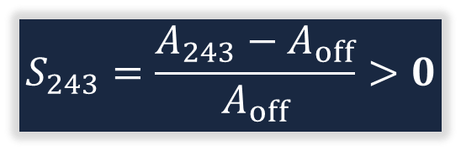
SSPALS with 243 cooling laser alone
OFF – no lasers
A
A
$$S_{243}=\frac{A_{243}−A_{off}}{A_{off}}>0$$
243 laser only
First experimental observation:
“Laser-induced preservation of
decaying atoms”
The average lifetime of the excitable Ps
fraction during the interaction with the
cooling laser pulse is $≈$284ns

Slide 13
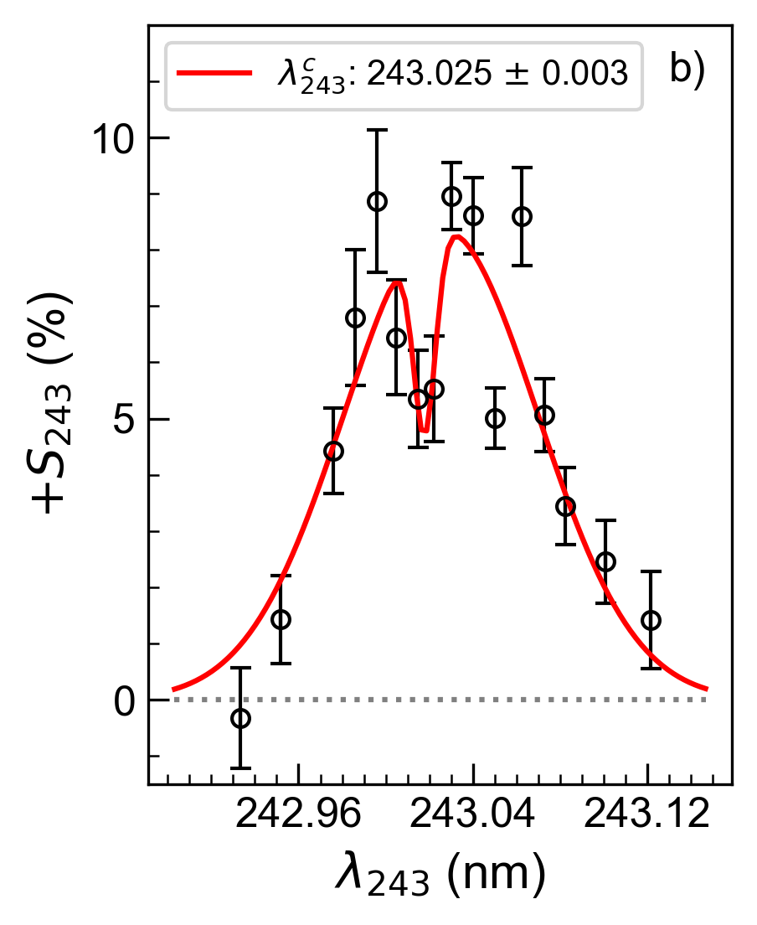


Result for the 243nm cooling laser alone
Ps Doppler Scan on the 1³S – 2³P transition
QED: 243.022 nm, B = 0
From a 2-Gaussian fit and the 243 BW (100 GHz):
$$v_{rms}\text{= (4.}\text{9}\text{ ± 0.}\text{4}\text{)}\text{∙}{10}^{4} \text{m}s^{−1}$$
$$T\text{= (}\text{3}\text{20}\text{ ± }\text{50}\text{)} \text{K}$$

Slide 14
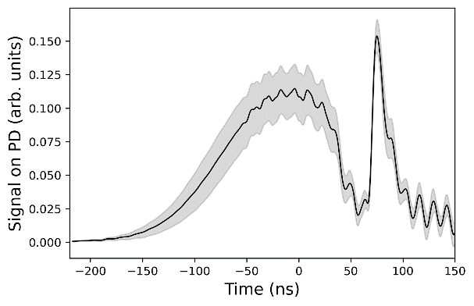

Timing synchronisation between 243 and 205 lasers
$S_{cool}=$ $S_{243+205+1064}−S_{243}$
OFF – no lasers
A
243 laser only
205 laser only
Both lasers
243nm
205nm

Slide 15
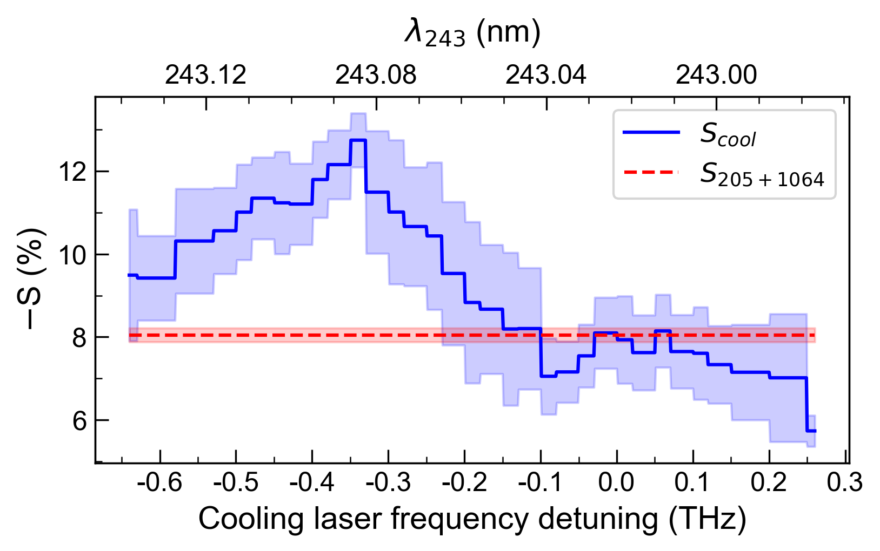
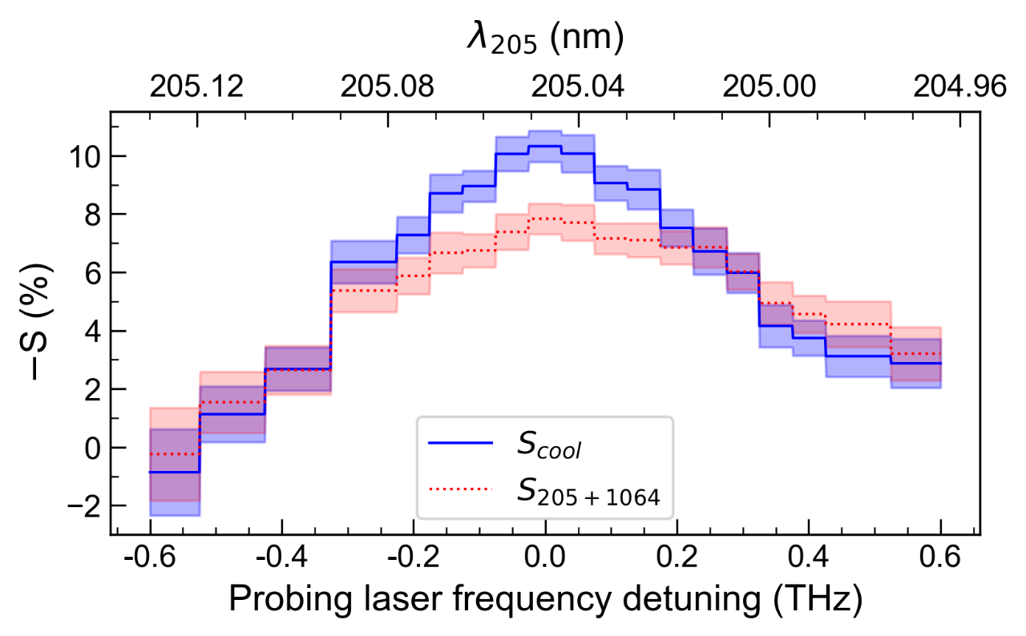

Positronium laser cooling: result
1D rms-velocity reduces from
${5.4∙10}^{4} \frac{m}{s}$ to ${3.7∙10}^{4} \frac{m}{s}$
170(20)K
380(20)K
A maximum increase of 58(9)% of Ps with
|v|< 3.7e4 at -0.35 THz red-detuning
Phys. Rev. Lett. 132, 083402 (2024)
https://doi.org/10.1103/PhysRevLett.132.083402

Slide 16
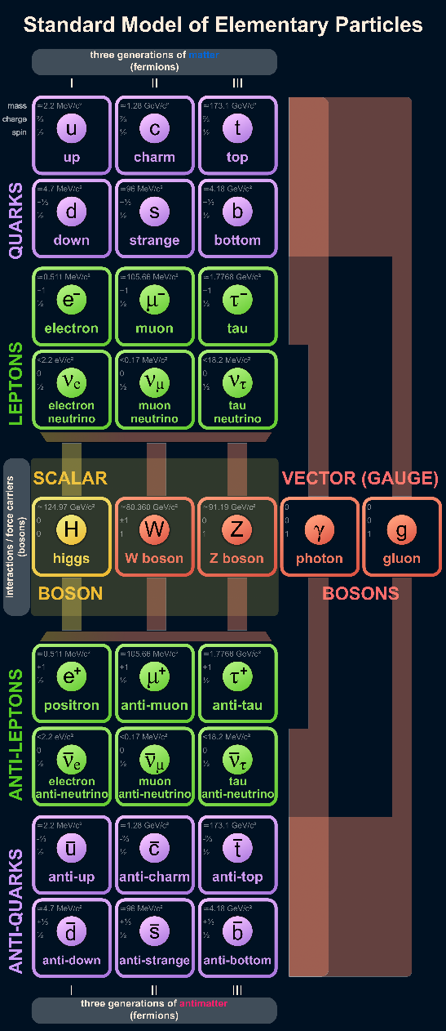

Gravitational tests with Ps?
The absolute gravitational potential U(x) affects energy levels and transition frequencies (clocks)
$$E_{0+g}=mc^{2}+U(x)$$
Savely G Karshenboim 2016
J. Phys. B: At. Mol. Opt. Phys. 49 144001
https://doi.org/10.1088/0953-4075/49/14/14400
The gravitational redshift of clocks is a measure for U(x)
If you know U(x) for a matter system from spectroscopic measurements, you can measure and compare the redshift of an antimatter system
Ps has no nucleus, theory well described by QED -> Tests for (W)EP are very interesting … but are limited by the second order Doppler shift by the Ps velocity
Cool Ps further!

Slide 17
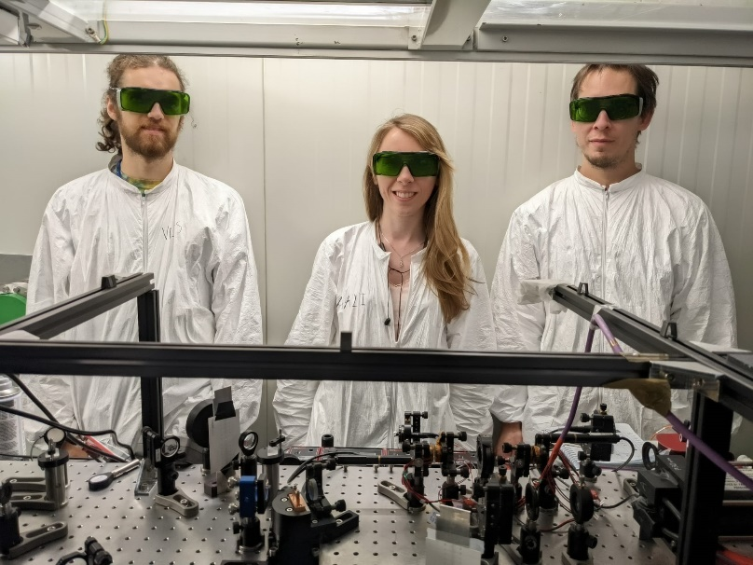
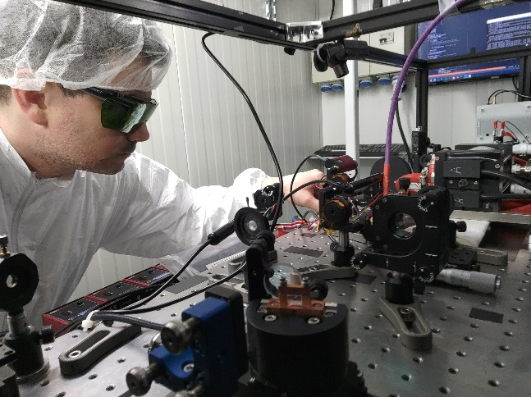
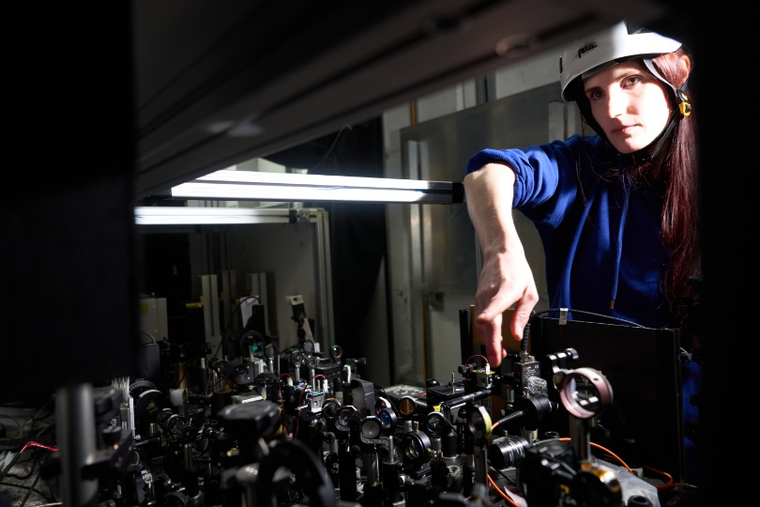
Summary
1D Ps laser cooling with broadband 70ns long laser pulse along the 1³S->2³P transition achieved
Cooling by 200K or 1.7e4 ms⁻¹, i.e. maximum momentum transfer that can be achieved within 70ns
Next steps: 2D (3D) laser cooling; using cryogenically precooled Ps; applying the technique to AEgIS‘ antihydrogen production scheme
Thank
You

Slide 18
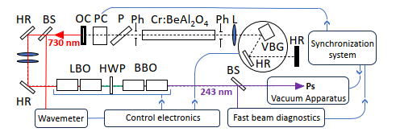
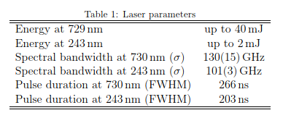
Backup: The cooling laser

