Slide 1


AdaptivePerf: a profiler for single- and multi-threaded applications
Maksymilian Graczyk (CERN, IT-GOV-INN)

Slide 2
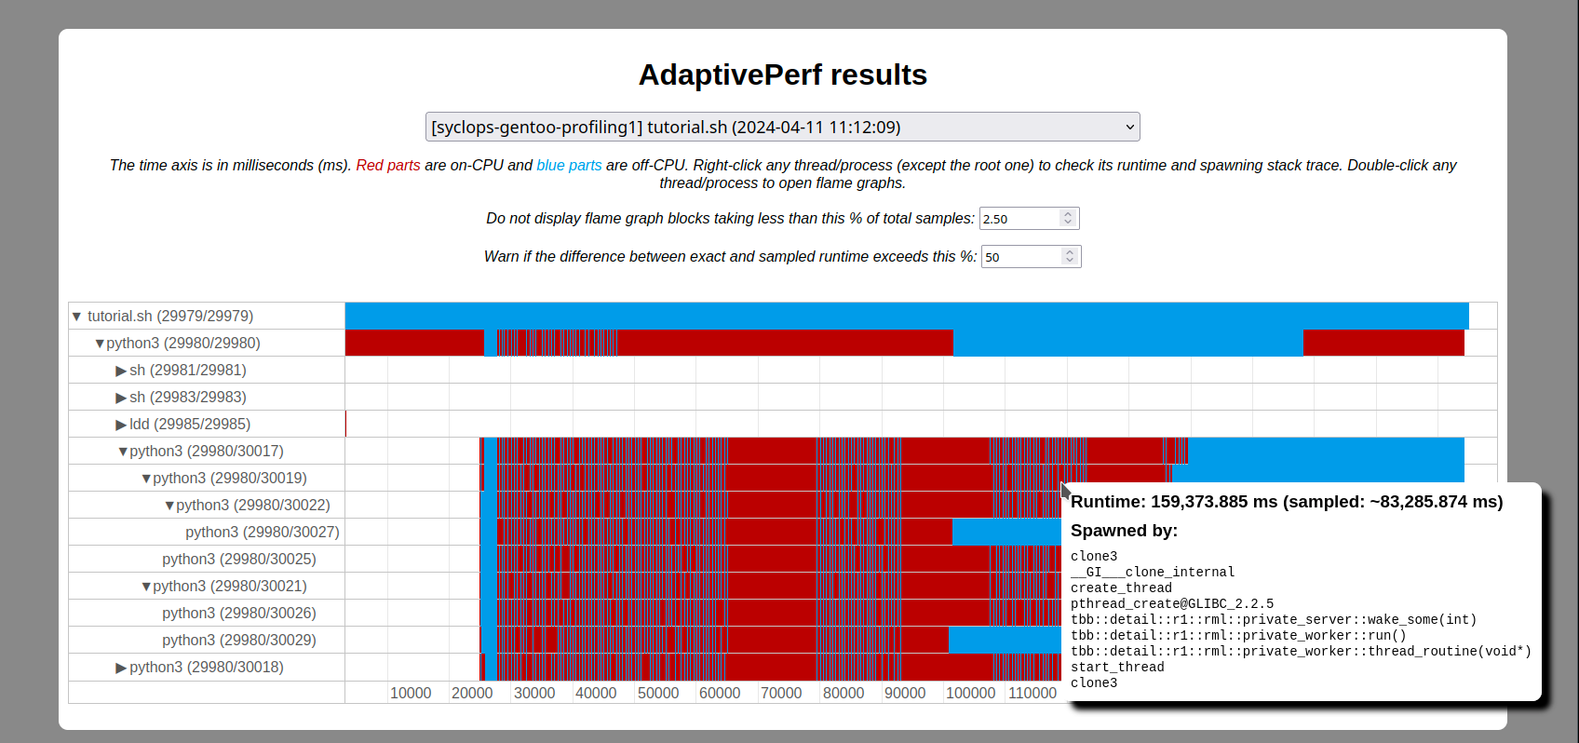
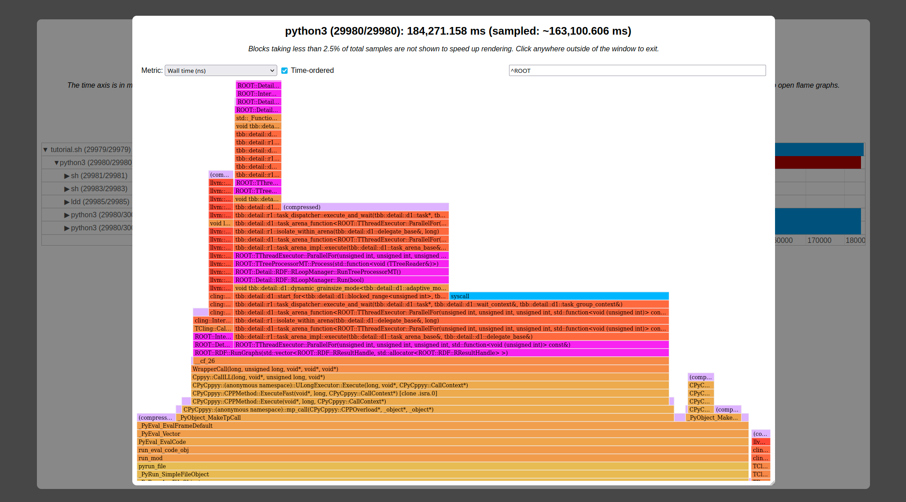
What is AdaptivePerf?
NB: AdaptivePerf is not a continuous profiler! It profiles single commands and is not meant for 24/7 monitoring.
The main target audience is SW and HW developers optimising their software and/or hardware, also as part of software-hardware co-design for specific applications.
Open-source code profiler for Linux, based on "perf" with custom patches and developed in the context of the SYCLOPS project
Samples both on-CPU and off-CPU activity
Traces every spawned thread and process
Minimises risk of broken profiled stacks for programs compiled with frame pointers by detecting inappropriate kernel and CPU configurations automatically
Produces interactive flame graphs and charts viewable in a web browser
Main functionality designed with hardware portability in mind (tested on x86-64, RISC-V in progress, arm64 planned)
Supports custom sampling-based "perf" events for profiling interactions with hardware
Allows TCP streaming of profiling data to a separate machine for real-time processing

Slide 3
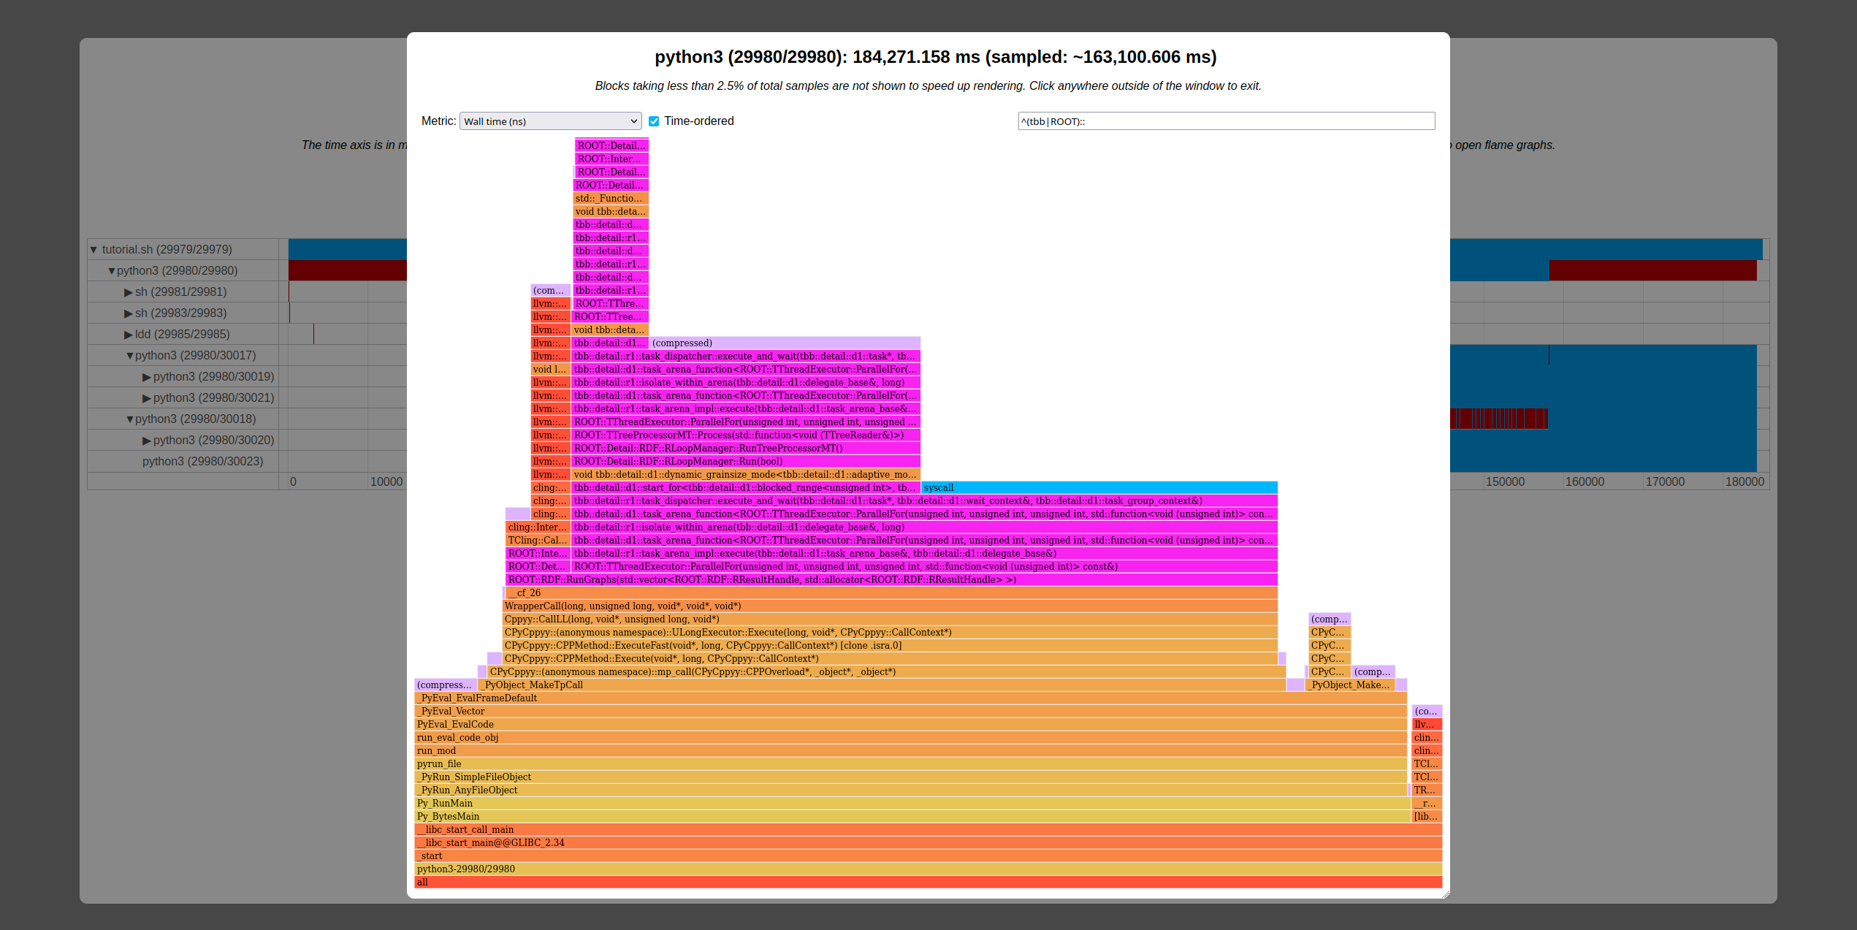
How does AdaptivePerf work under the hood?
AdaptivePerf frontend
configures and runs
perf
PAPI and/or other profilers*
streams TCP data through Python API
stream data*
displays
adaptiveperf-server (backend)
post-processes results and produces files for
AdaptivePerfHTML
adaptiveperf-analysis with API*
Can be run on a different machine without the profiled programs and debug info!
*Planned.
Notes:
Remember to add that post-processing has been moved to adaptiveperf-server written in C++ which accepts events on-the-go through TCP.

Slide 4

What is SYCLOPS?
An EU-funded project about hardware acceleration with open standards using SYCL and RISC-V
Website: https://www.syclops.org
CERN project tasks:
  Implementing SYCL support in ROOT and cling + demonstrating it on a Lorentz vector calculation example.
  Benchmarking and profiling + integration testing of all use cases envisaged in SYCLOPS (ROOT, genomics analysis, and autonomous systems).
AdaptivePerf is part of task 2, but its applications extend beyond SYCLOPS!

Slide 5
Where outside of SYCLOPS can AdaptivePerf be potentially used?
Profiling software used for online and offline computing at CERN and other physics experiments, e.g. Madgraph5 and Geant4
Software-hardware co-design, e.g. in heterogeneous computing and development of triggering and DAQ systems at the LHC experiments
And more!

Slide 6
How to download AdaptivePerf?
It's open-source and you can get it for free from our GitHub: https://github.com/AdaptivePerf.
AdaptivePerf is available as a dev version. Feedback and feature requests are welcome.
There are 3 parts:
  AdaptivePerf: the main program which is the command-line profiling tool (frontend) and server (backend), licensed under GNU GPL v2 only.
  AdaptivePerfHTML: the web server for displaying profiling results as an interactive website, licensed under GNU GPL v3.
  Linux: the Linux kernel source tree with patched "perf", stored temporarily on CERN GitLab and licensed on the same terms as the vanilla Linux kernel (only installing “perf” is required, no kernel patching needed).

Slide 7
Quick start with AdaptivePerf
Install AdaptivePerf and AdaptivePerfHTML according to the instructions on GitHub. Pay close attention there to the kernel settings and information about NUMA!
Run adaptiveperf "<command to be profiled>" (quotes are important!) and wait until it finishes and produces the "results" directory.
Set the FLASK_PROFILING_STORAGE environment variable to the "results" path.
Run Flask (a Python web framework) and point it to AdaptivePerfHTML: adaptiveperf.app:app.
Open the website in your web browser. Done!

Slide 8
Live demo / Screenshots
Notes:
Talk about:
the UI redesign
difference between sampled and exact runtimes
spawning stack traces

Slide 9
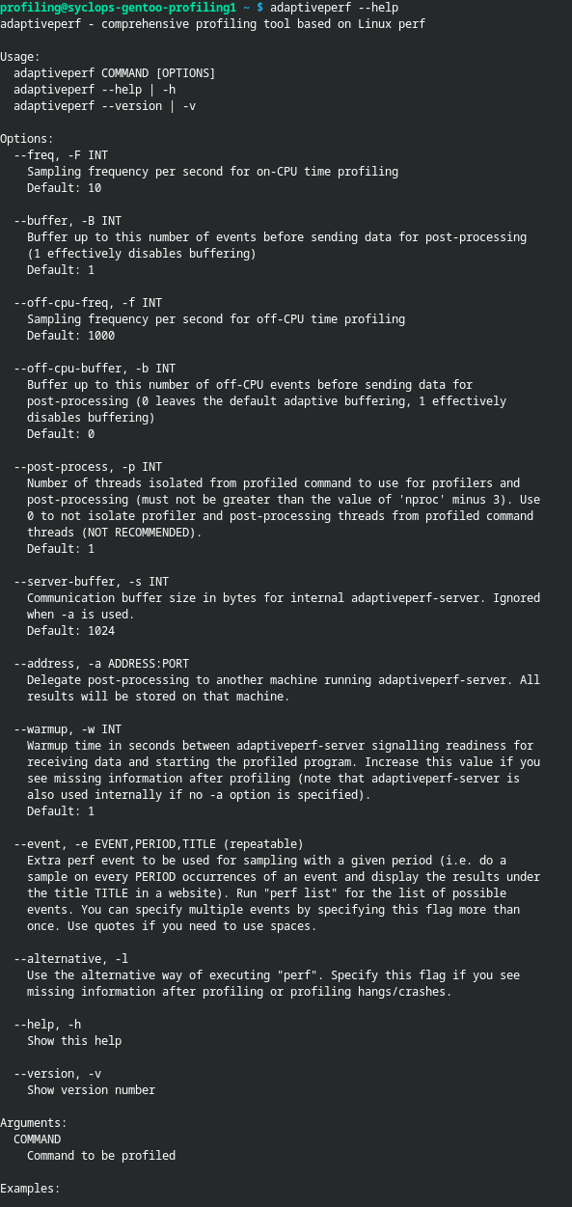
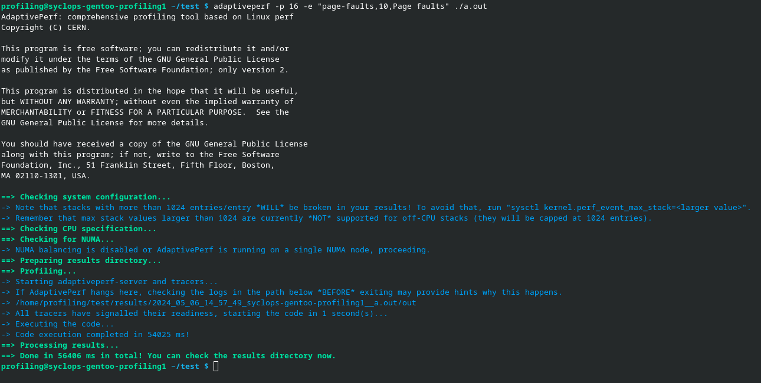

Slide 10
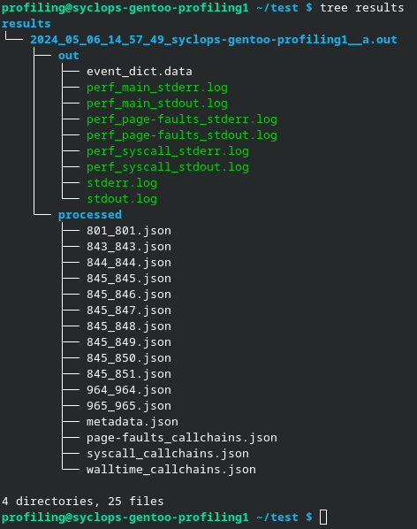

Slide 11
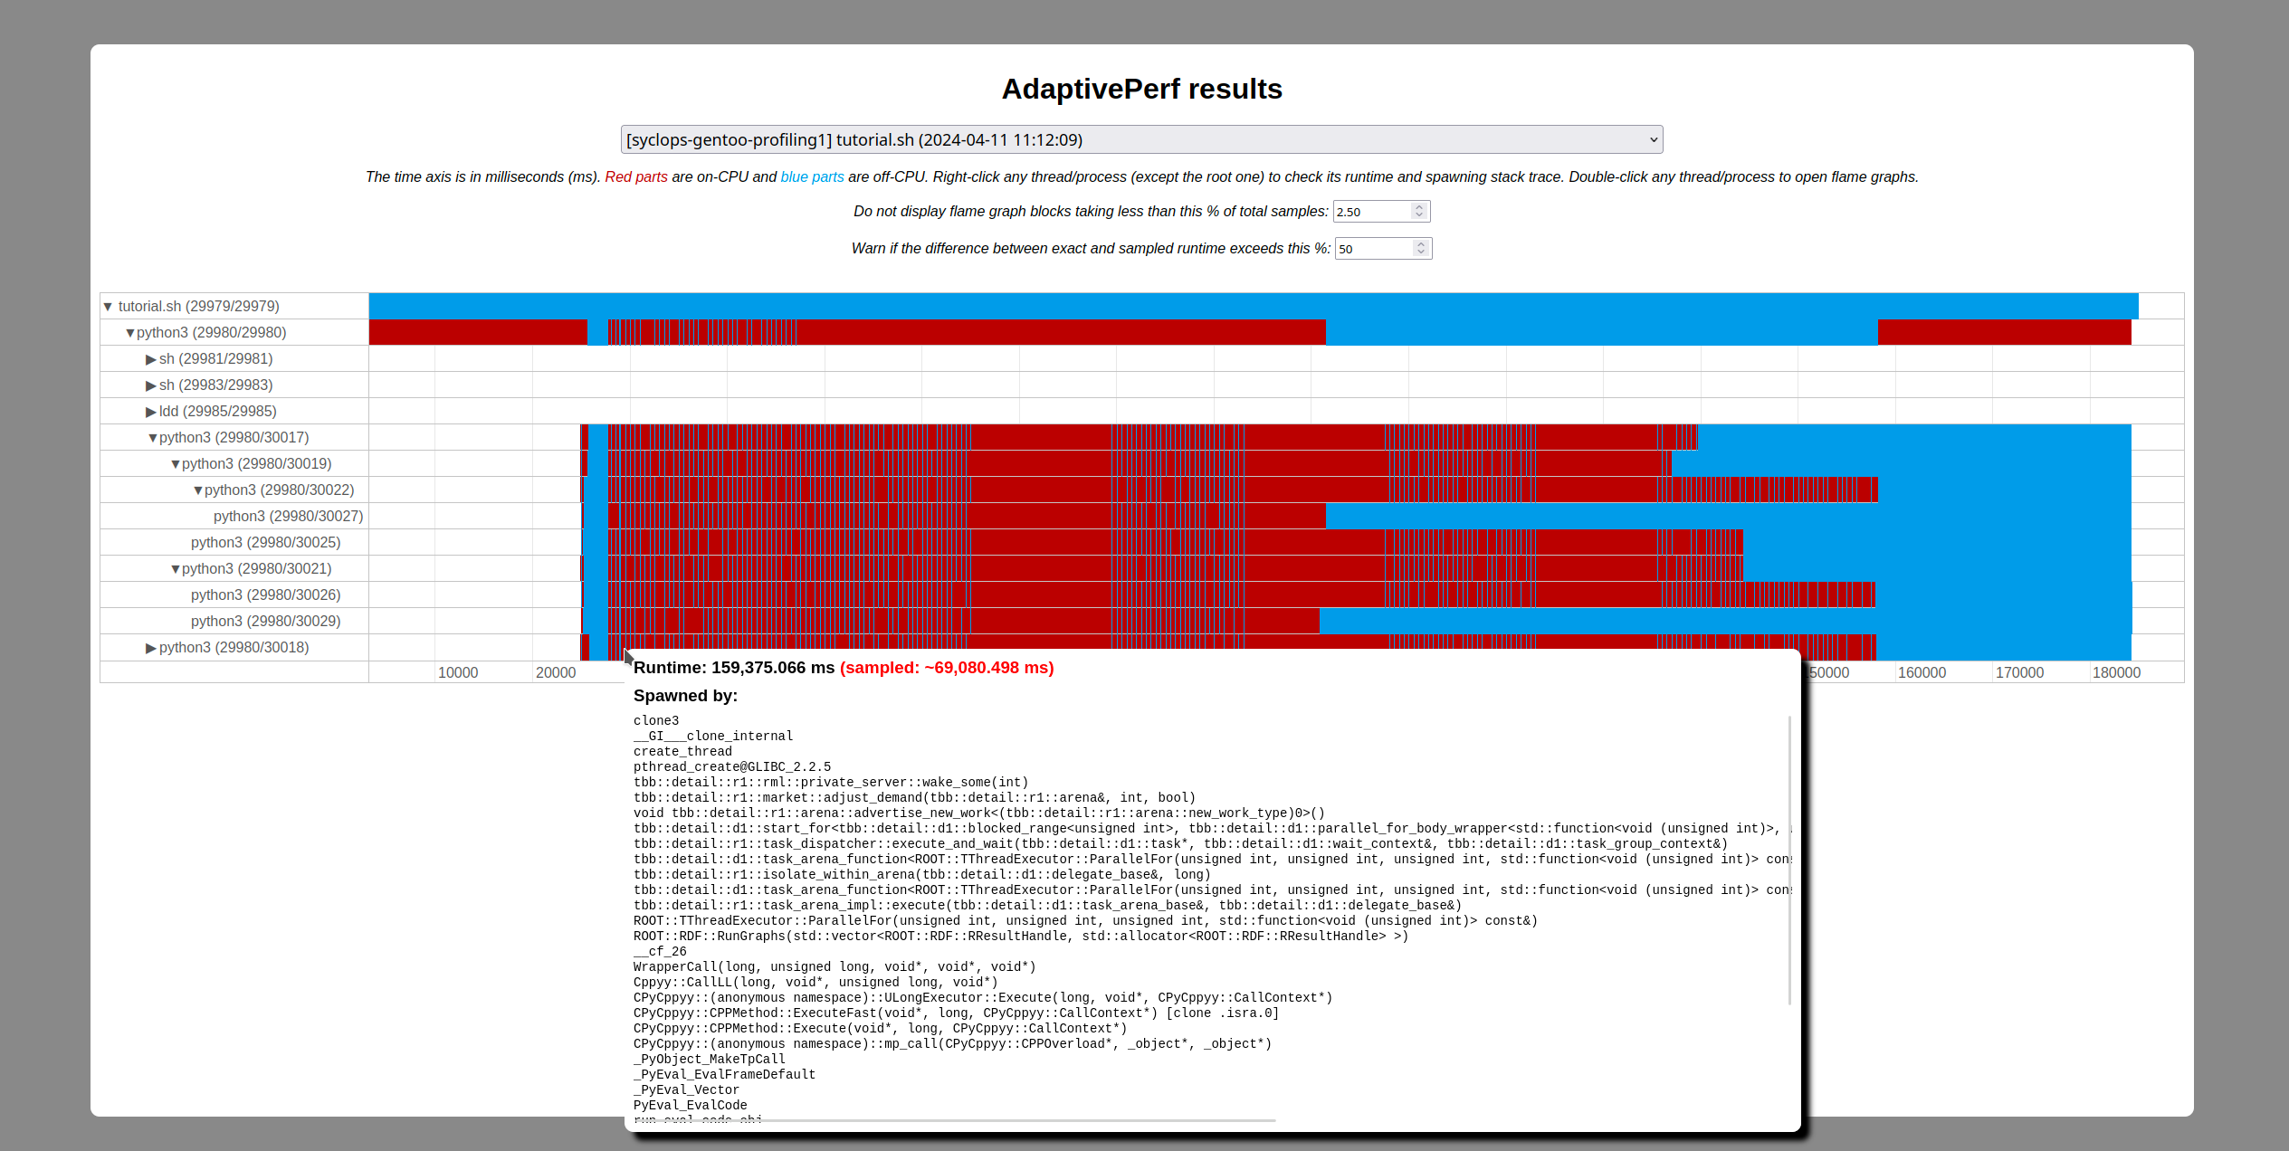

Slide 13
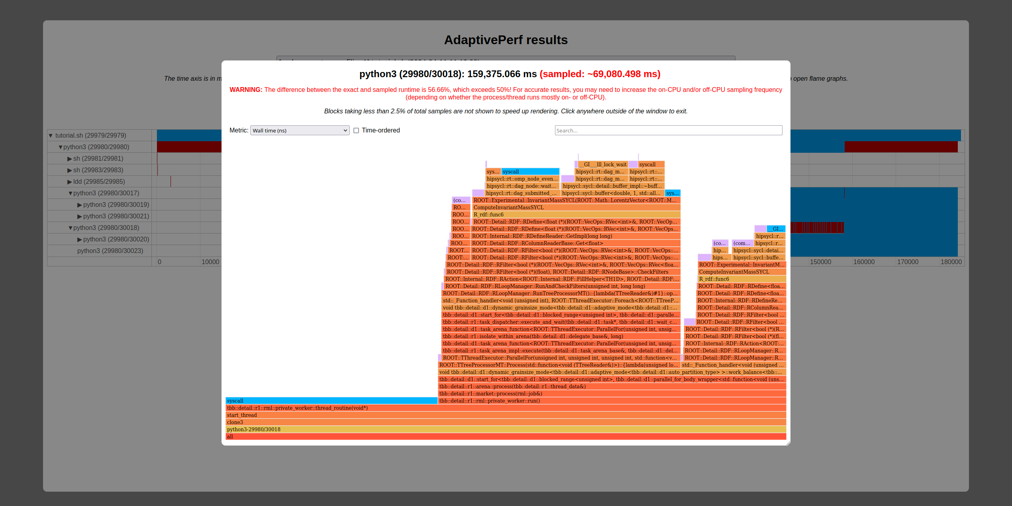

Slide 14
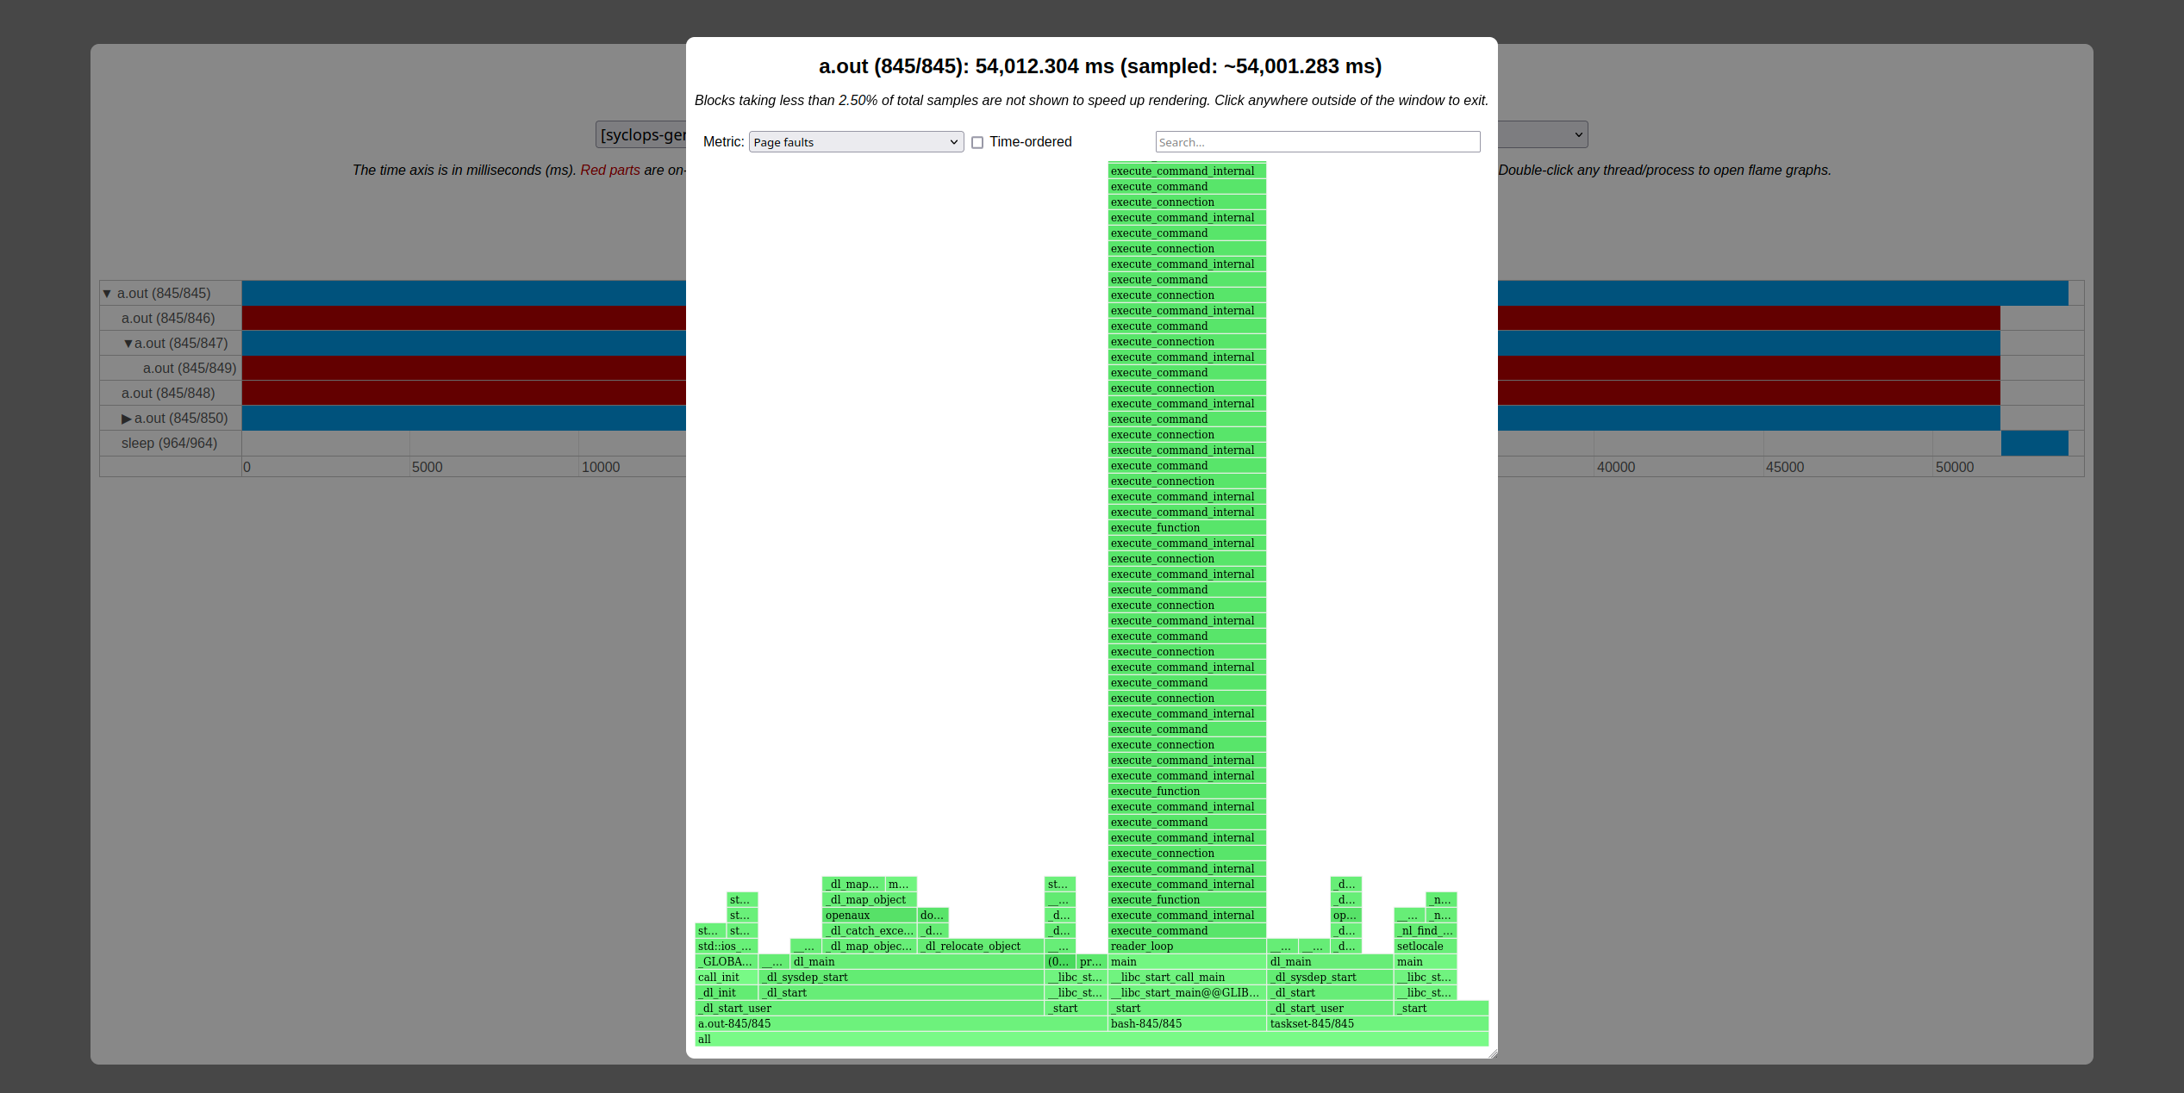

Slide 15
How does AdaptivePerf compare to other similar and maintained profilers?
 | Hardware-vendor-portable | Profiles software-hardware interaction* | Low profiling overhead | Open-source | Off-CPU profiling | Heterogeneous architecture support
AdaptivePerf | Yes | Yes | Yes | Yes | Yes | Planned!
Original "perf" | Yes | Yes | Yes | Yes | Limited | No
Intel VTune Profiler | No | Yes | Yes | No | Yes | Intel GPUs/FPGAs only
AMD μProf | No | Yes | Yes | No | Yes | AMD GPUs only
valgrind | Yes | No | No | Yes | No | No
gprof | Yes | No | Needs CI** | Yes | No | No
gperftools | Yes | No | Needs CI** | Yes | No | No
NVIDIA profilers | No | Yes | No | No | Yes | NVIDIA GPUs only
*If supported by a user’s hardware architecture.
**Code instrumentation other than not omitting frame pointers.

Slide 16
Future plans
Profiling heterogeneous architectures and non-CPU devices in a maximally open-source way
  One idea of doing this is through PAPI: https://github.com/icl-utk-edu/papi.
Applying AdaptivePerf to cache-aware roofline modelling and potentially RISC-V core customisation by collaborating with some of our SYCLOPS partners: INESC-ID, Codasip, EURECOM
Expanding the analysis functionality by making a separate library with the API and adding the plugin API to AdaptivePerfHTML
Setting up automated tests (already in progress)

Slide 17
Future plans
Adding profiling on a lower level and with more debug info, e.g. showing line numbers, going down to LLVM IR / MLIR / assembly etc.
Downloading debug info for a given process automatically if not present, e.g. through debuginfod (a server providing debugging information, there are public ones available)
Matching non-sampling-based metrics from “perf” and/or other programs (e.g. power consumption) to code segments
  An openlab summer student is coming to CERN on 1 July to work on this.

Slide 18
Future plans
Decreasing profiling overhead even more
  For example, by replacing "perf"'s Python API with its C/C++/Rust/... equivalent. This may require another set of "perf" patches, as "perf" supports only Python and Perl out-of-the-box.
Removing or weakening the frame pointer compilation requirement
  For example, by DWARF processing whenever frame pointers cannot be used, see: https://www.polarsignals.com/blog/posts/2022/11/29/profiling-without-frame-pointers (this is more compact than what “perf” currently does).
  Full removal may be unnecessary, see: https://brendangregg.com/blog/2024-03-17/the-return-of-the-frame-pointers.html.
All other suggestions are welcome!

Slide 19
Thank you!
Any questions or comments?

