Slide 1








Status Report on FCC Accelerator Science and Technology
Frank Zimmermann, CERN
India, Engagement Meeting,
27 September 2023
LHC
PS
SPS
FCC
http://cern.ch/fcc
Work supported by the European Commission under the HORIZON 2020 projects EuroCirCol, grant agreement 654305; EASITrain, grant agreement no. 764879; ARIES, grant agreement 730871, FCCIS, grant agreement 951754, and I.FAST, grant agreement 101004730.
photo: J. Wenninger

Slide 2

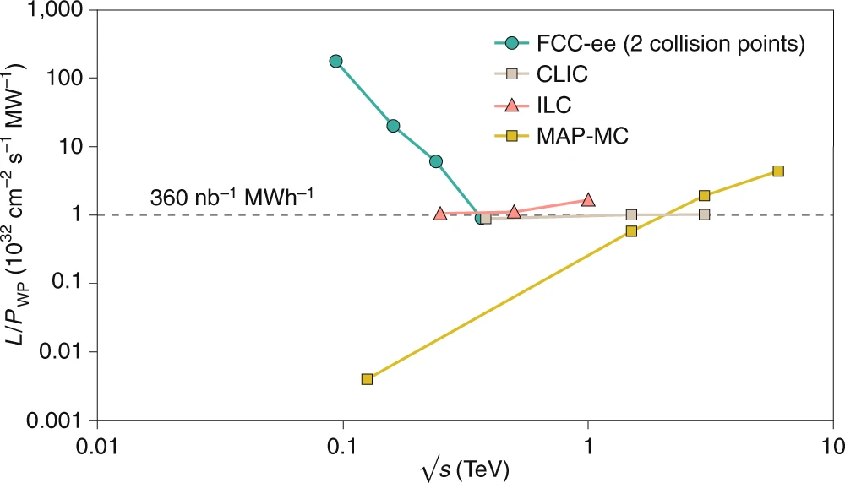
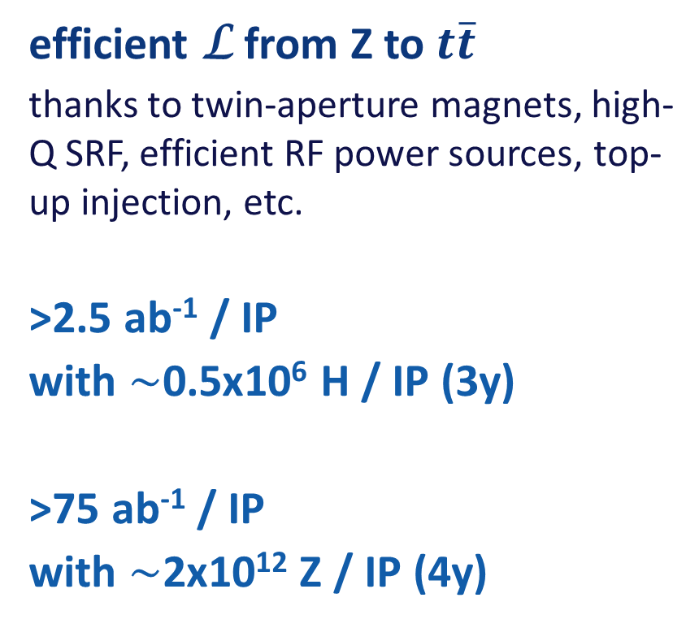
Stage 1: FCC-ee – highest-luminosity lepton collider
efficient L from Z to $t\overline{t}$
  thanks to twin-aperture magnets, high-Q SRF, efficient RF power sources, top-up injection, etc.
>2.5 ab⁻¹ / IP
with $\sim$0.5x10⁶ H / IP (3y)
>75 ab⁻¹ / IP
with $\sim$2x10¹² Z / IP (4y)
luminosity vs. electricity consumption
collects LEP data statistics in few minutes
highest lumi/power of all H fact. proposals
Nature Physics 16, 402–407 (2020)

Slide 3





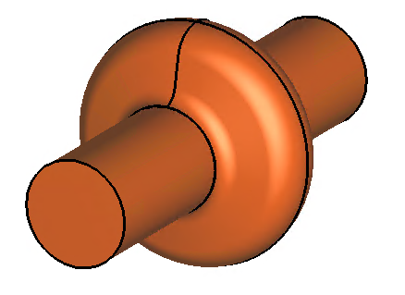
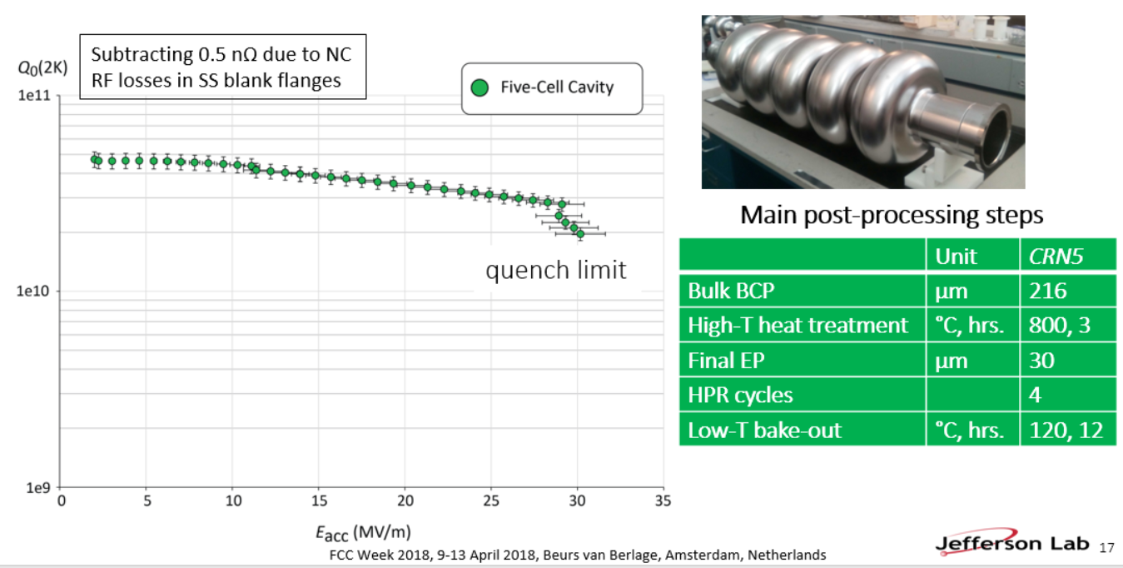
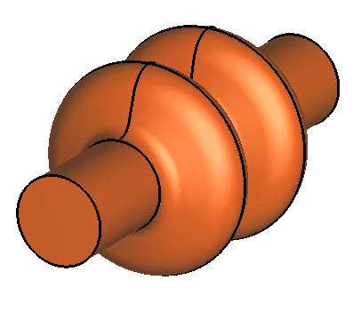
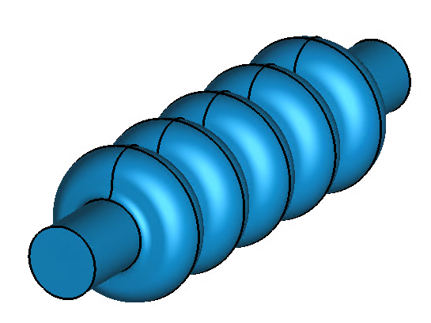
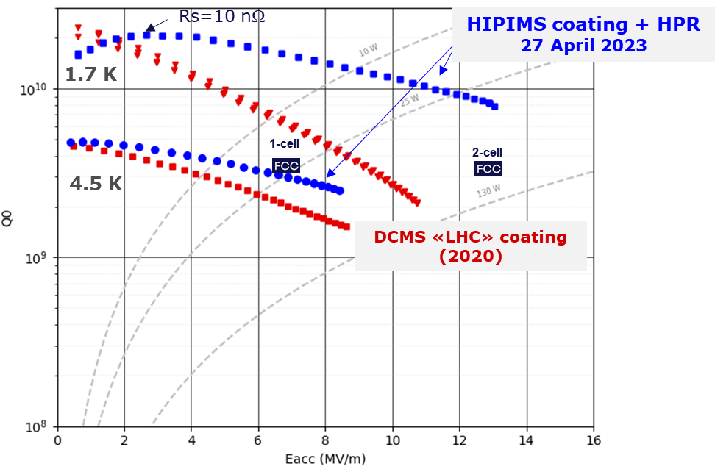
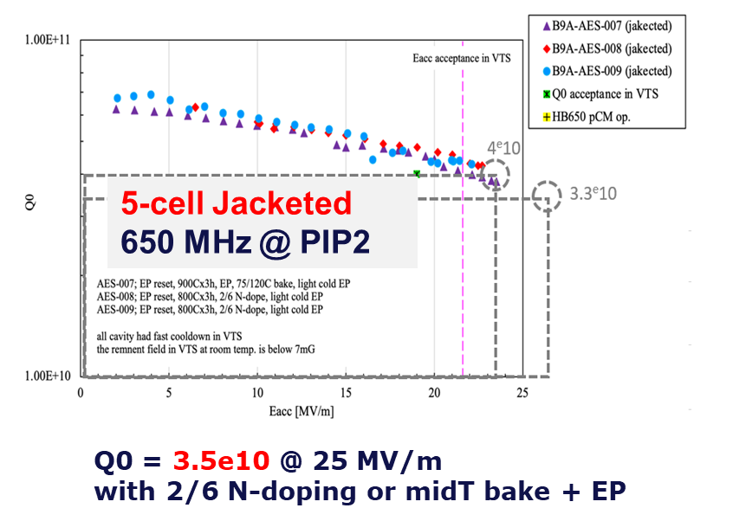
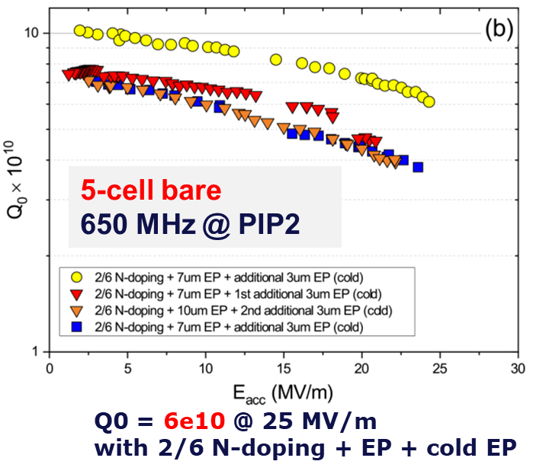
FCC-ee SRF system
Z
low R/Q, HOM damping, powered by 1 MW RF coupler and high efficiency klystron
F. Peauger,
O. Brunner
5-cell cavity development (2018), successful collaboration with JLAB
  1-cell
  400 MHz,
  Nb/Cu
W, H
moderate gradient and HOM damping requirements; 500 kW / cavity, allowing reuse of klystrons already installed for Z
  2-cell
  400 MHz,
  Nb/Cu
ttbar,
booster
high RF voltage and limited footprint thanks to multicell cavities and higher RF frequency; 200 kW/ cavity
  5-cell
  800 MHz,
  bulk Nb
F. Marhauser
Promising R&D towards ultra-high Q₀. Collaboration with FNAL
First attempt of HiPIMS* niobium coating on a 400 MHz Cu cavity
*High-power impulse magnetron sputtering

Slide 4
Number of 800 MHz cavities: 1088
Total number of cavities: 1456
FCC-ee RF parameter table
Recently updated
F. Peauger
20-Apr-23 | Z |  | W |  | H |  | ttbar2
 | Collider per beam | booster | Collider per beam | booster | Collider 2 beams | booster | Collider 2 beams | Collider 2 beams | booster
RF Frequency [MHz] | 400 | 800 | 400 | 800 | 400 | 800 | 400 | 800 | 800
RF voltage [MV] | 120 | 140 | 1050 | 1050 | 2100 | 2100 | 2100 | 9200 | 11300
Eacc [MV/m] | 5.93 | 6.23 | 10.78 | 20.76 | 10.78 | 20.76 | 10.78 | 20.12 | 20.10
# cell / cav | 1 | 5 | 2 | 5 | 2 | 5 | 2 | 5 | 5
Vcavity [MV] | 2.22 | 5.83 | 8.08 | 19.44 | 8.08 | 19.44 | 8.08 | 18.85 | 18.83
#cells | 54 | 120 | 260 | 270 | 520 | 540 | 520 | 2440 | 3000
# cavities | 54 | 24 | 130 | 54 | 260 | 108 | 260 | 488 | 600
# CM | 13.5 | 6 | 32.5 | 13.5 | 65 | 27 | 65 | 122 | 150
T operation [K] | 4.5 | 2 | 4.5 | 2 | 4.5 | 2 | 4.5 | 2 | 2
dyn losses/cav * [W] | 23 | 0.3 | 158 | 4 | 158 | 4 | 158 | 23 | 3
stat losses/cav [W] | 8 | 8 | 8 | 8 | 8 | 8 | 8 | 8 | 8
Qext | 6.9E+04 | 3.2E+05 | 1.1E+06 | 8.0E+06 | 1.1E+06 | 1.6E+07 | 5.4E+06 | 4.2E+06 | 8.3E+07
Detuning [kHz] | 8.620 | 4.393 | 0.479 | 0.136 | 0.096 | 0.014 | 0.007 | 0.056 | 0.003
Pcav [kW] | 912 | 205 | 379 | 91 | 379 | 46 | 79 | 163 | 8
rhob [m] | 9937 | 9937 | 9937 | 9937 | 9937 | 9937 | 9937 | 9937 | 9936
Energy [GeV] | 45.6 | 45.6 | 80.0 | 80.0 | 120.0 | 120.0 | 182.5 |  | 182.5
energy loss [MV] | 38.49 | 38.49 | 364.63 | 364.63 | 1845.94 | 1845.94 | 9875.14 |  | 9876.13
cos phi | 0.32 | 0.27 | 0.35 | 0.35 | 0.88 | 0.88 | 0.98 | 0.86 | 0.87
Beam current [A] | 1.280 | 0.128 | 0.135 | 0.0135 | 0.0534 | 0.003 | 0.010 | 0.010 | 0.0005
* heat loads from power coupler and HOM couplers not included
  one RF system per beam
  common RF system for both beams
  Cavity performances: 20 % margin added on Eacc and Q0 between vertical test and operation
  In total: 364 cryomodules, 1456 cavities, 25% with Nb/Cu technology, 75% with bulk niobium technology
  Limiting parameters for RF

Slide 5
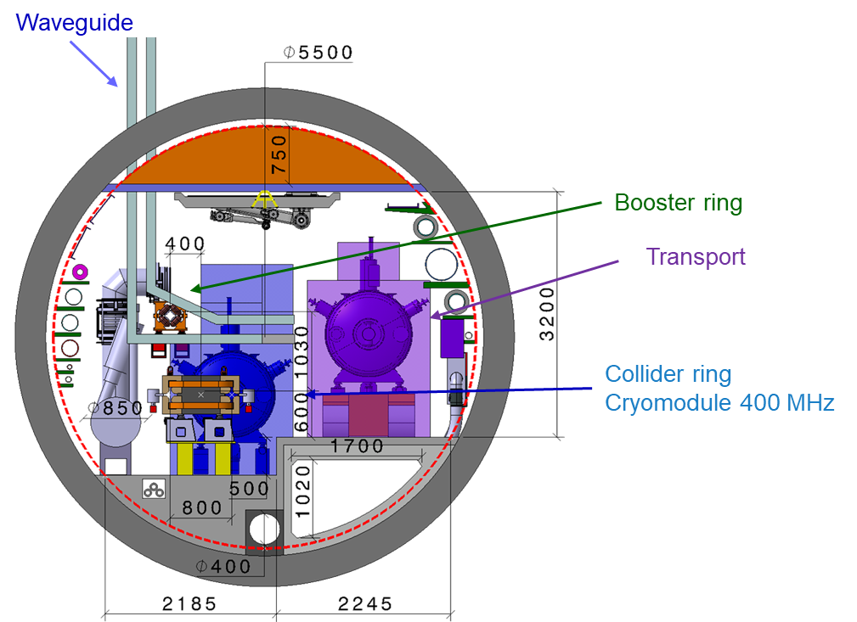
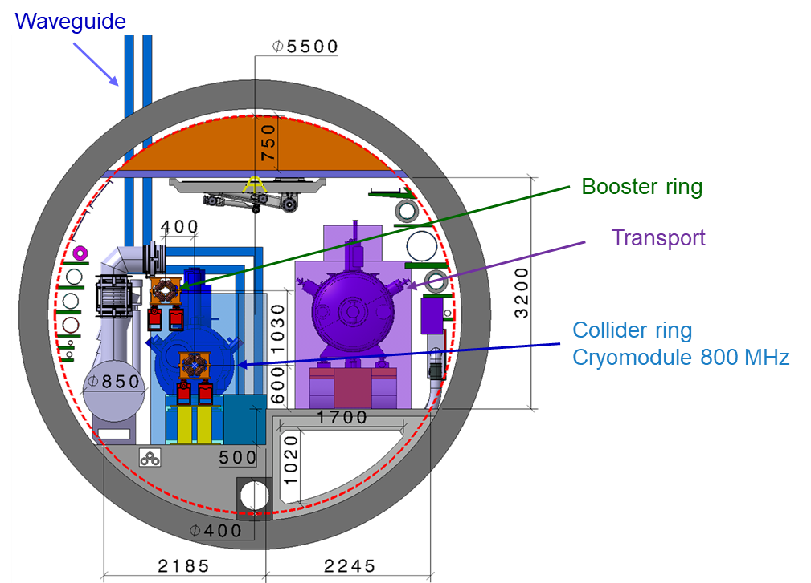
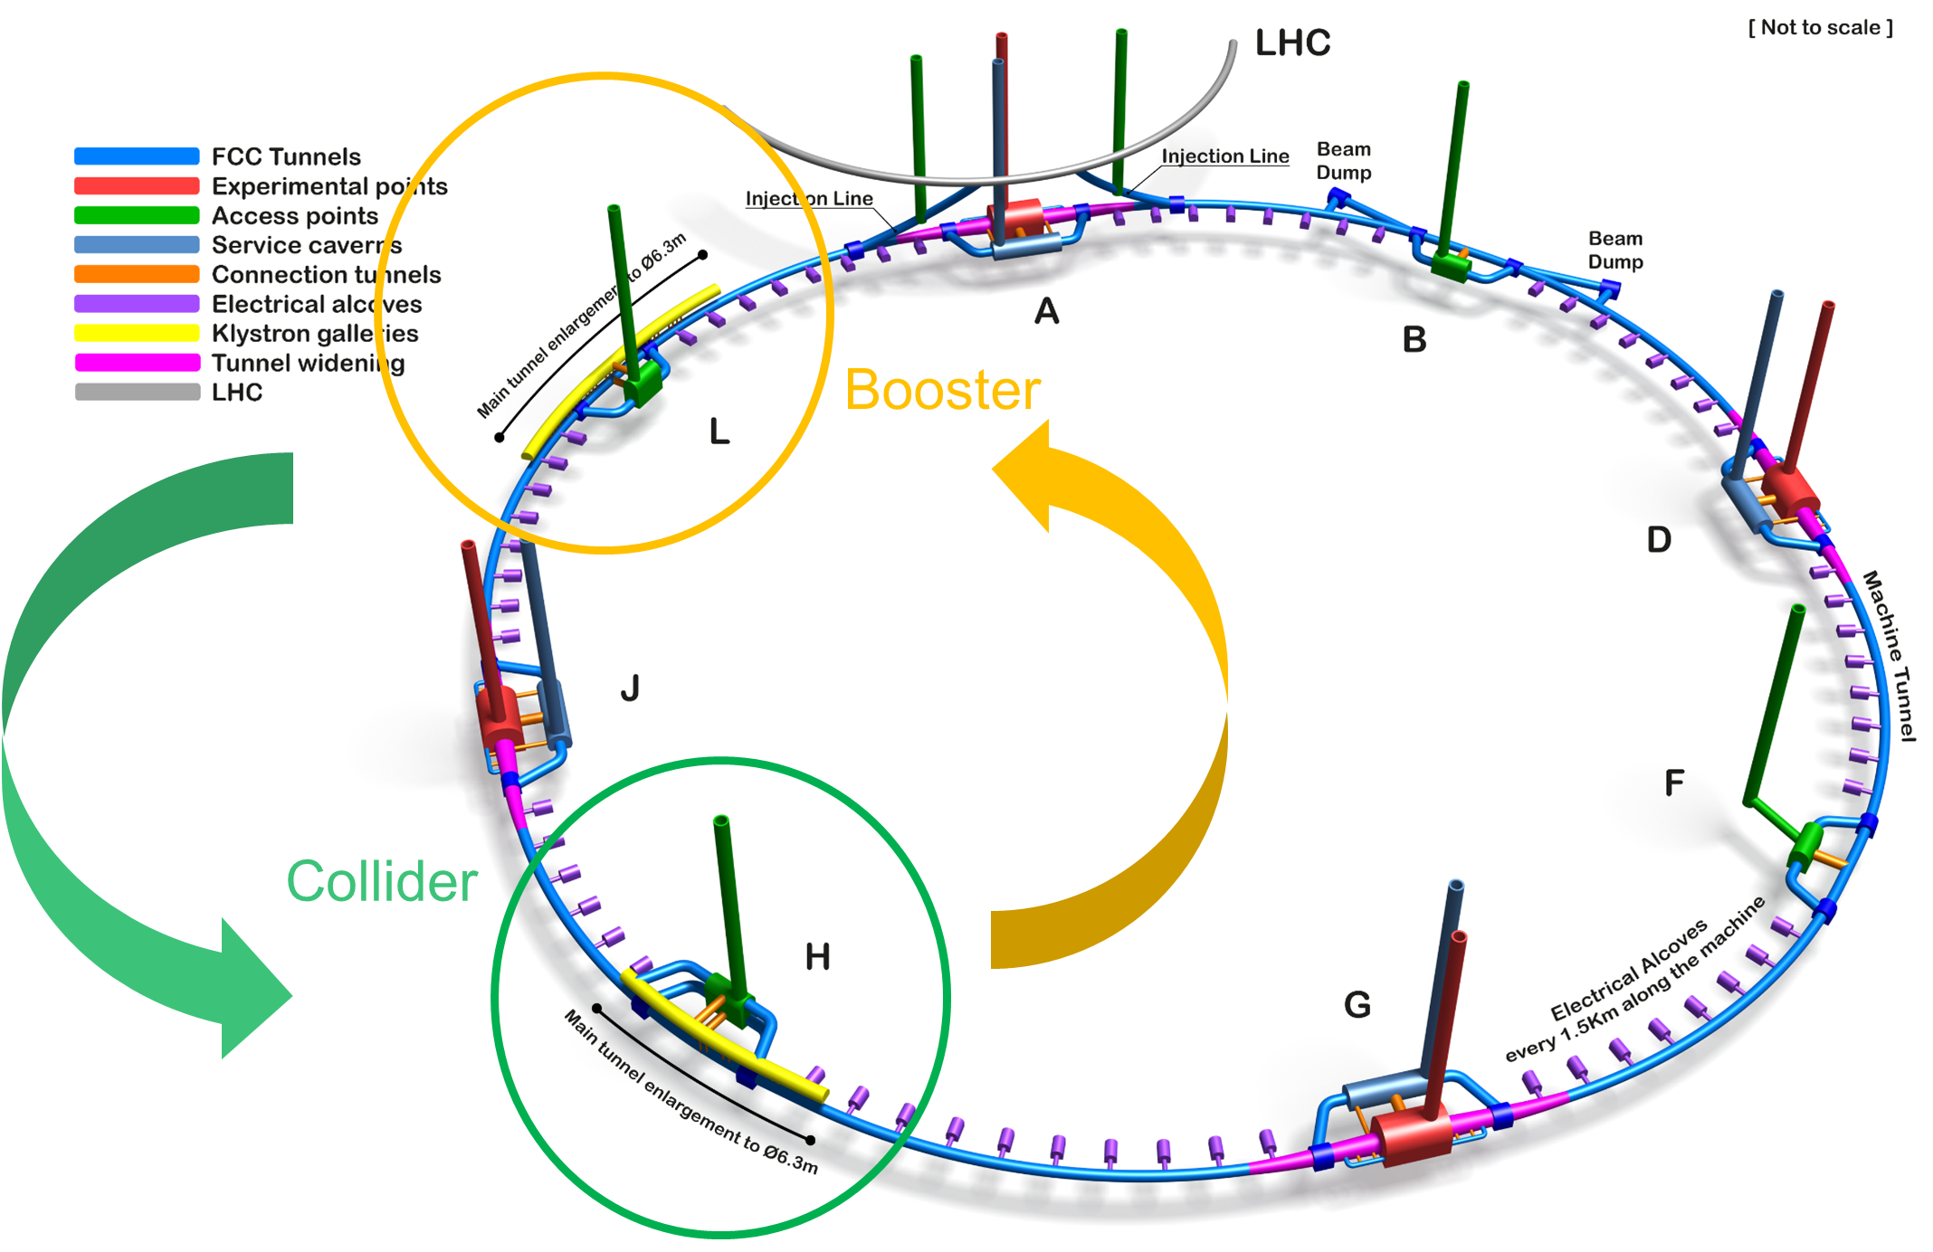
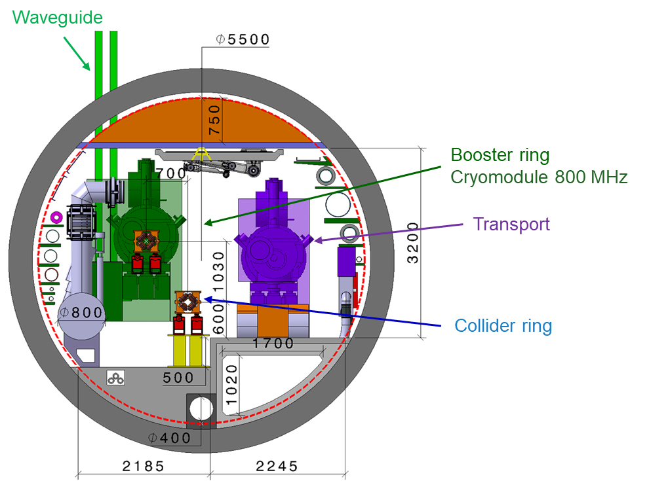
modified FCC-ee RF layout
RF for collider and booster in separate straight sections H and L
fully separated technical infrastructure systems (cryogenics)
collider RF (highest power demand) in point H with optimum connection to existing 400 kV grid line and better suited surface site
Collider RF - Point H (400 and 800 MHz)
Booster RF - Point L
(800 MHz only)
J.-P. Burnet
F. Valchkova, F. Peauger

Slide 6
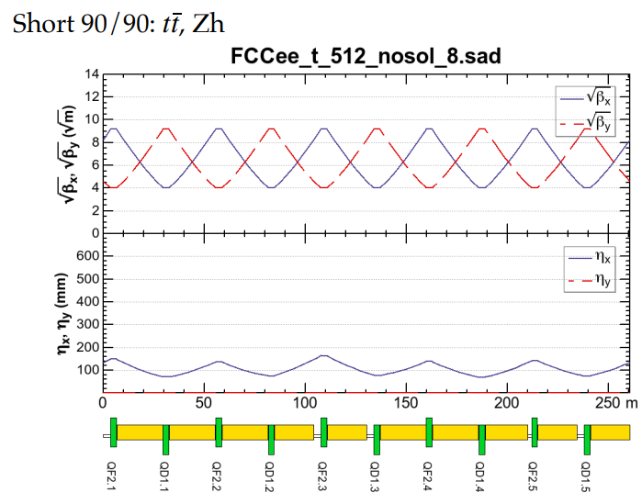
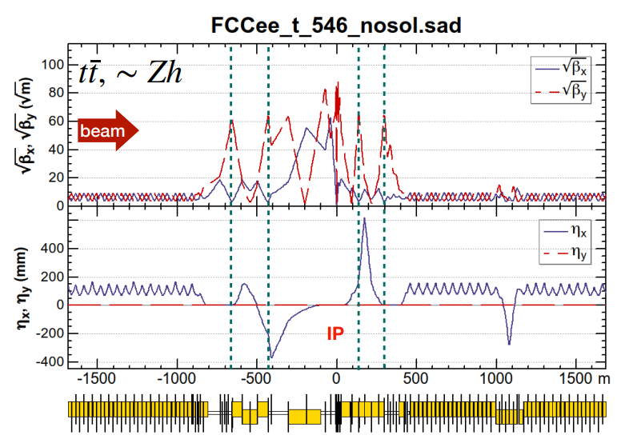
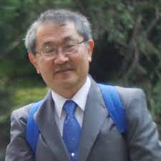
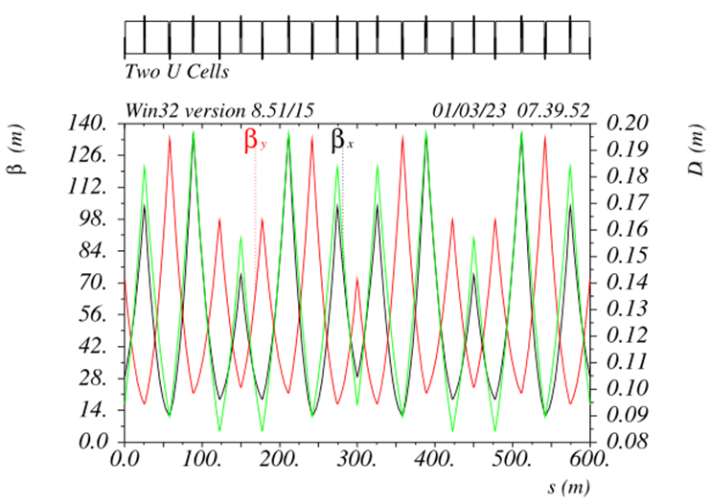
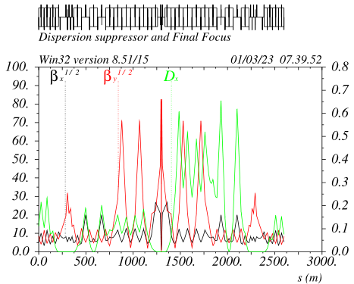
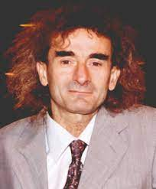
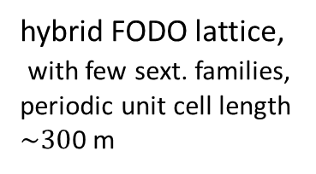
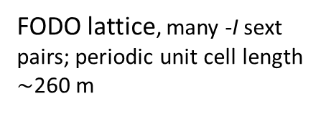
FCC-ee collider optics development: 2 options
arc
interaction region
K. Oide, 2023 EPS
Rolf Wideroe award winner
Phys. Rev. Accel. Beams 19, 111005
FODO lattice, many -I sext pairs; periodic unit cell length $\sim$260 m
baseline for 2023 FCC “mid-term” review
“1.5” sext.s per final focus,
asymmetric
P. Raimondi, 2017 EPS Gersh Budker award winner
design in progress -
further relaxed tolerances,
reduced power consumption,
larger momentum acceptance !?
5 sext.s per final focus, modular
hybrid FODO lattice,
with few sext. families,
periodic unit cell length
$\sim 30$0 m
Phys. Rev. Accel. Beams 26, 021601

Slide 7
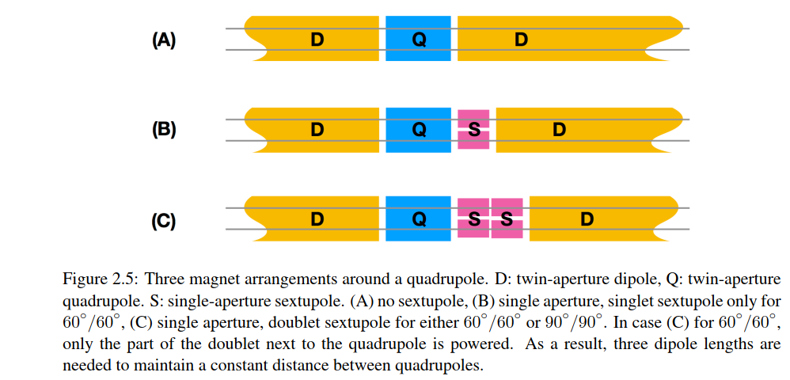
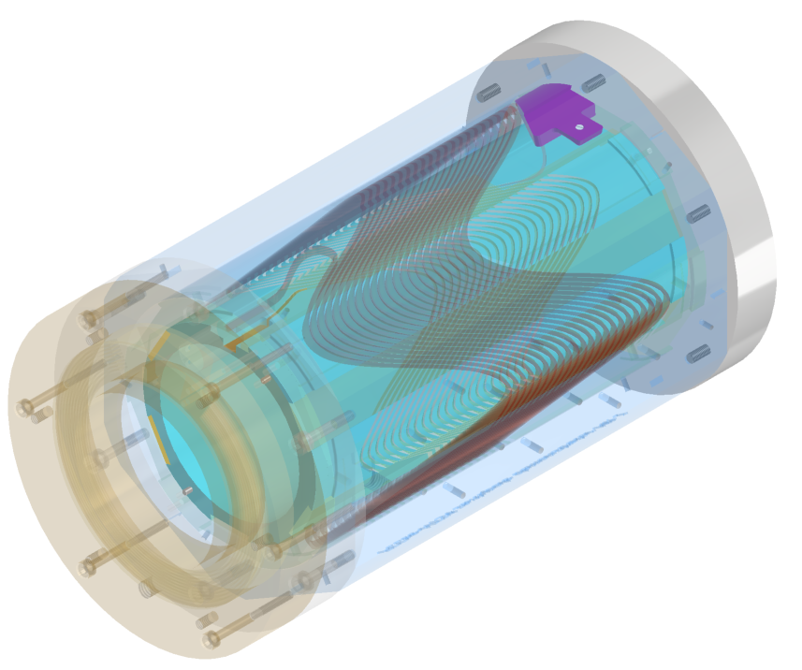
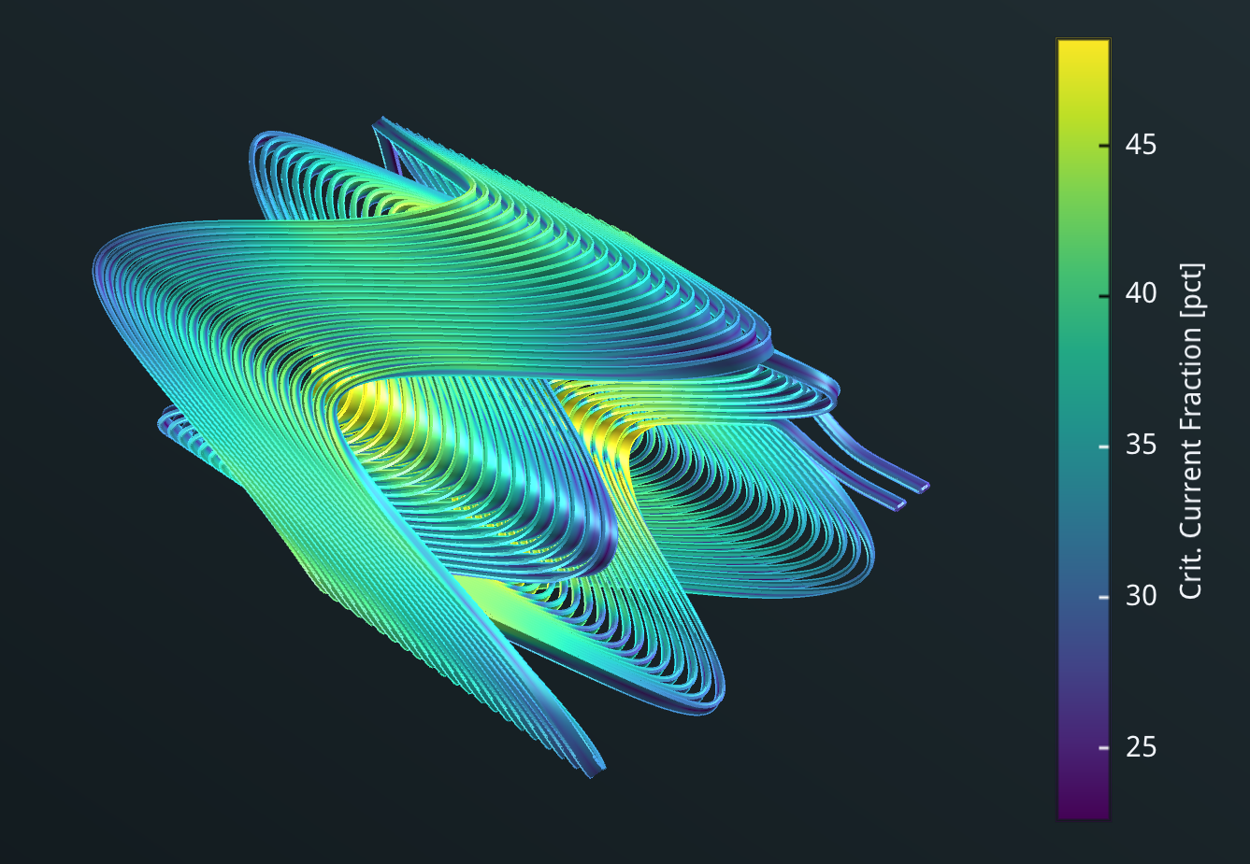
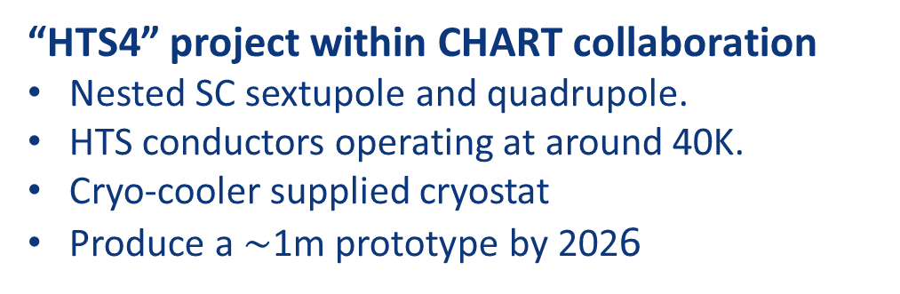
R&D on HTS option for FCC-ee arc quads and sextupoles
CDR: 2900 quads & 4700 sextupoles
Normal conducting, ~50 MW @ ttbar
3 different types of short straight sections
“HTS4” project within CHART collaboration
Nested SC sextupole and quadrupole.
HTS conductors operating at around 40K.
Cryo-cooler supplied cryostat
Produce a $\sim$1m prototype by 2026
CDR arc lattice
CAD design of HTS short
sextupole demonstrator based on CCT coils
HTS option proposal
“HTS4” potential
Power saving
Reduced length and increased dipole filling factor
Optics flexibility
M. Koratzinos, B. Auchmann

Slide 8
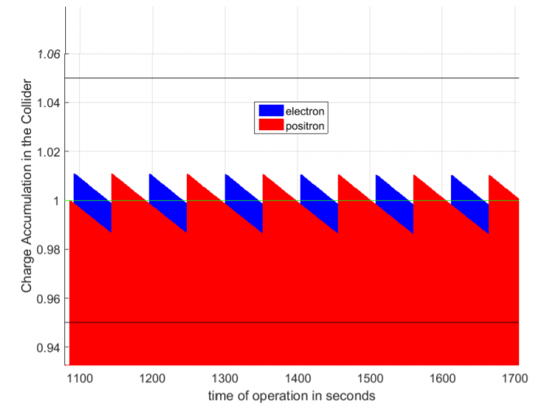
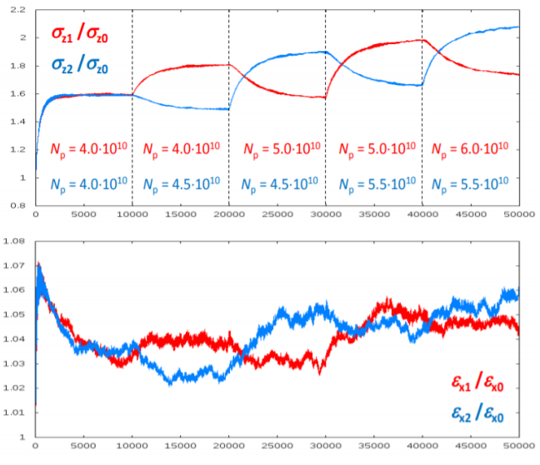
“bootstrapping” & top-up injection
injection from zero, alternating between beams to avoid beam-beam flip-flop effect
alternating replenishment of the two colliding beams, keeping beam currents stable within a few per cent
D. Shatilov
S. Ogur
average luminosity ~ peak luminosity

Slide 9
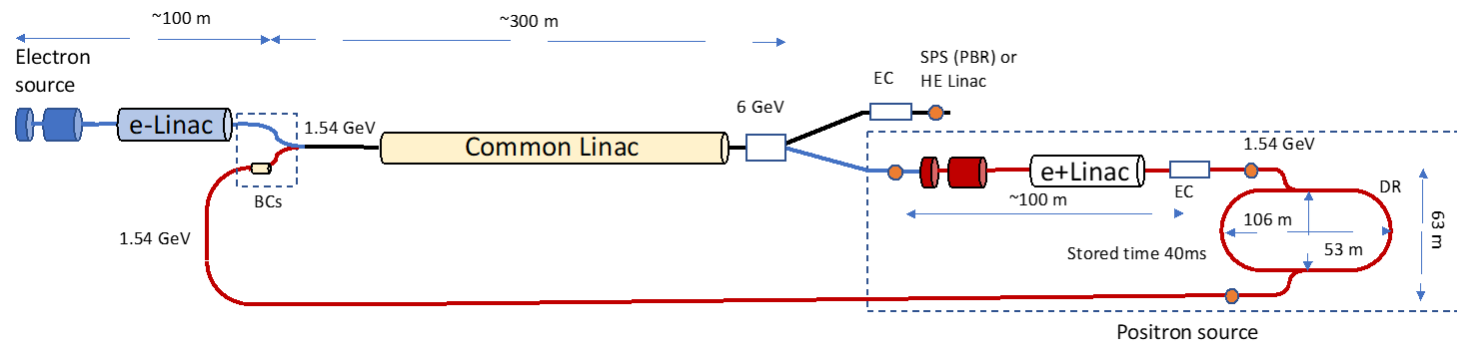
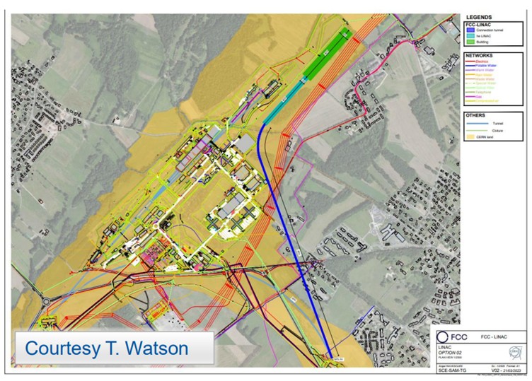
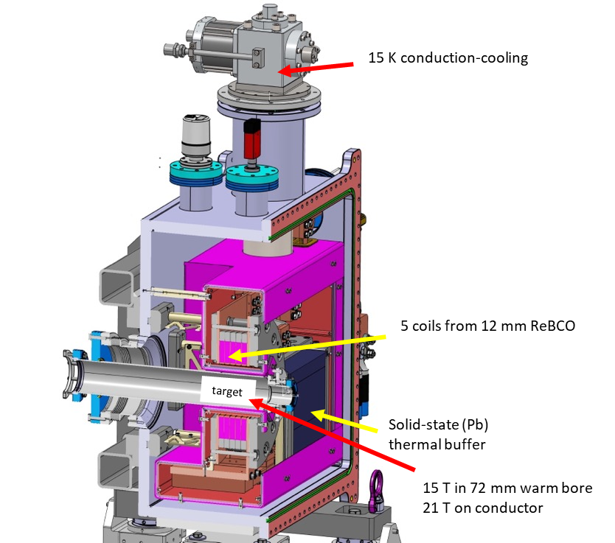
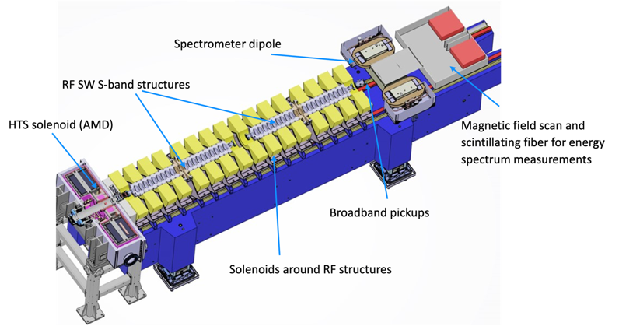
new FCC-ee injector layout & implementation
P. Craievich, I. Chaikovska, A. Grudiev, C. Milardi, et al
implementation study on Prevessin site
“Positron production experiment” at PSI’s SwissFEL,
beam tests from 2025/26
6 GeV linac
20 GeV linac
W. Bartmann
HTS NI target solenoid
J. Kosse, T. Michlmayr, H. Rodrigues

Slide 10
FCC-ee: main machine parameters
Parameter | Z | WW | H (ZH) | ttbar
beam energy [GeV] | 45.6 | 80 | 120 | 182.5
beam current [mA] | 1270 | 137 | 26.7 | 4.9
number bunches/beam | 11200 | 1780 | 440 | 60
bunch intensity [10¹¹] | 2.14 | 1.45 | 1.15 | 1.55
SR energy loss / turn [GeV] | 0.0394 | 0.374 | 1.89 | 10.4
total RF voltage 400/800 MHz [GV] | 0.120/0 | 1.0/0 | 2.1/0 | 2.1/9.4
long. damping time [turns] | 1158 | 215 | 64 | 18
horizontal beta* [m] | 0.11 | 0.2 | 0.24 | 1.0
vertical beta* [mm] | 0.7 | 1.0 | 1.0 | 1.6
horizontal geometric emittance [nm] | 0.71 | 2.17 | 0.71 | 1.59
vertical geom. emittance [pm] | 1.9 | 2.2 | 1.4 | 1.6
horizontal rms IP spot size [μm] | 9 | 21 | 13 | 40
vertical rms IP spot size [nm] | 36 | 47 | 40 | 51
beam-beam parameter ξ_{x} / ξ_{y} | 0.002/0.0973 | 0.013/0.128 | 0.010/0.088 | 0.073/0.134
rms bunch length with SR / BS [mm] | 5.6 / 15.5 | 3.5 / 5.4 | 3.4 / 4.7 | 1.8 / 2.2
luminosity per IP [10³⁴ cm⁻²s⁻¹] | 140 | 20 | 5.0 | 1.25
total integrated luminosity / IP / year [ab⁻¹/yr] | 17 | 2.4 | 0.6 | 0.15
beam lifetime rad Bhabha + BS [min] | 15 | 12 | 12 | 11
currently assessing
technical feasibility
of changing operation
sequences
(e.g. starting at ZH energy)
4 years
5 x 10¹² Z
LEP x 10⁵
2 years
> 10⁸ WW
LEP x 10⁴
3 years
2 x 10⁶ H
5 years
2 x 10⁶ tt pairs
x 10-50 improvements on all EW observables
up to x 10 improvement on Higgs coupling (model-indep.) measurements over HL-LHC
x10 Belle II statistics for b, c, τ
indirect discovery potential up to ~ 70 TeV
direct discovery potential for feebly-interacting particles over 5-100 GeV mass range
Up to 4 interaction points → robustness,
statistics, possibility of specialised detectors
to maximise physics output
F. Gianotti

Slide 11
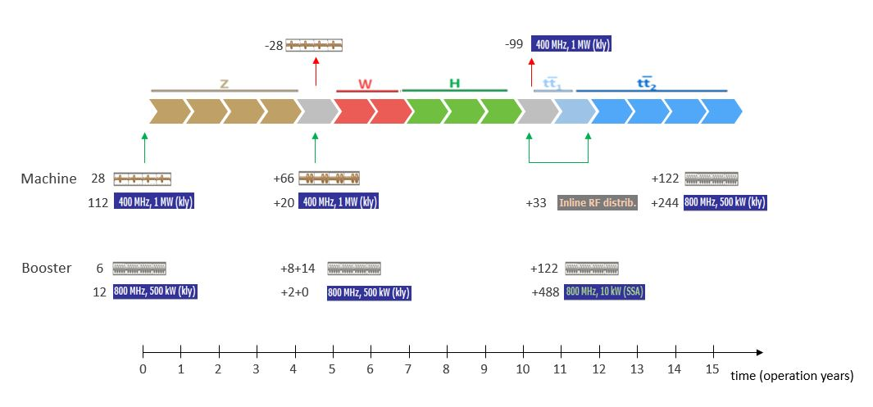
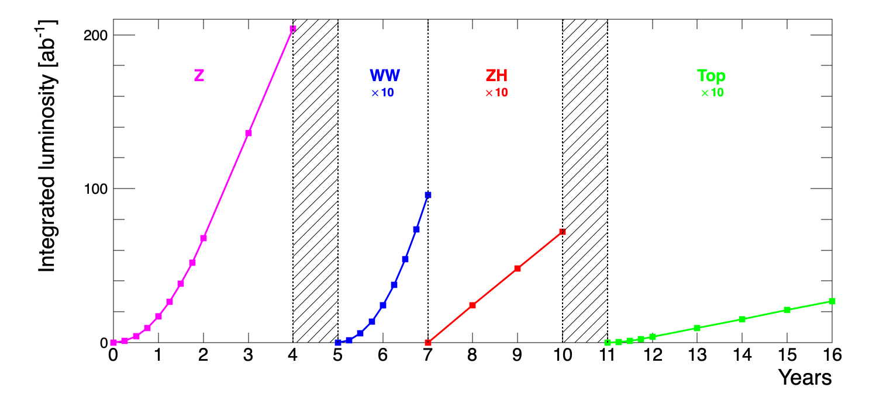
baseline operational sequence starting from Z
O. Brunner, F. Peauger
P. Janot

Slide 12
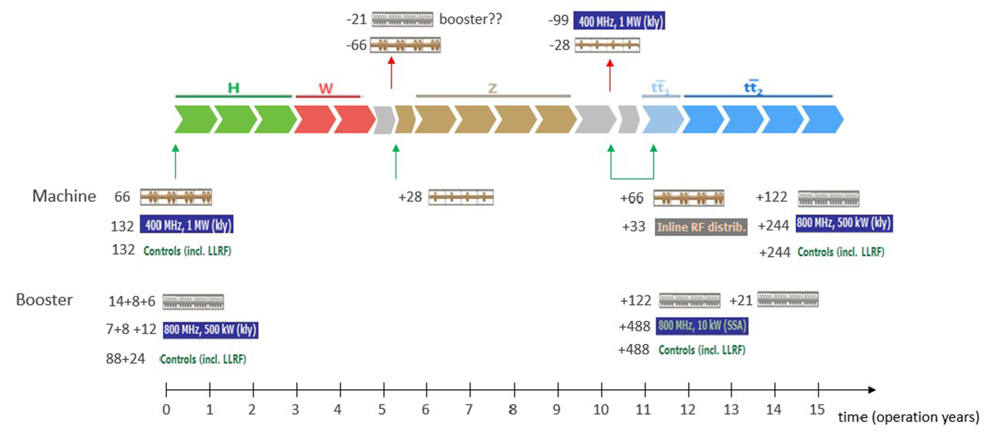
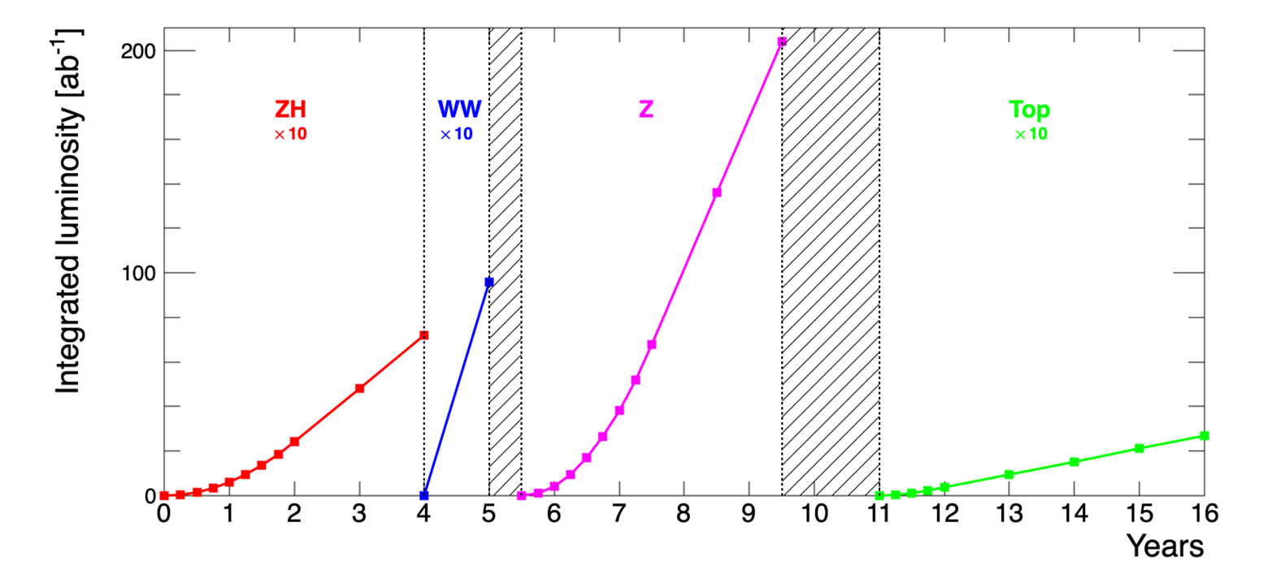
alternative operational sequence starting from ZH
O. Brunner, F. Peauger
P. Janot

Slide 13
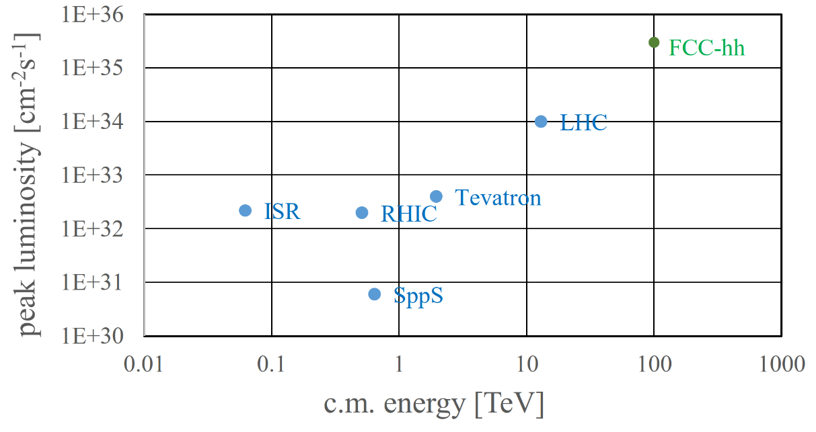
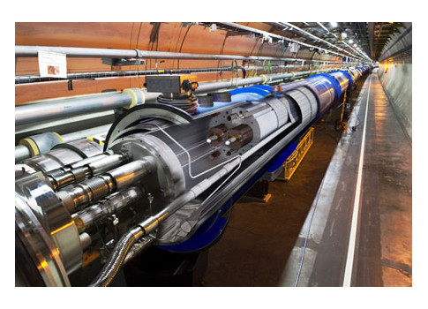
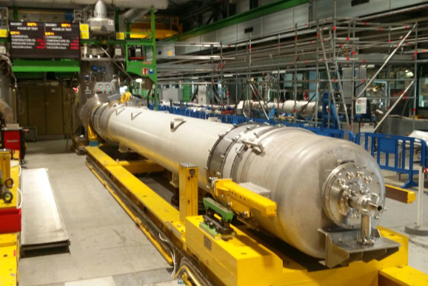
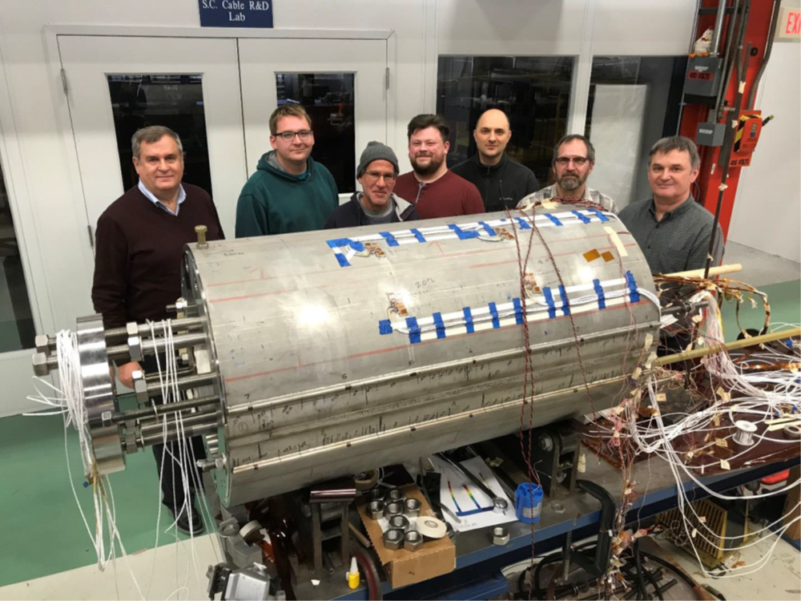
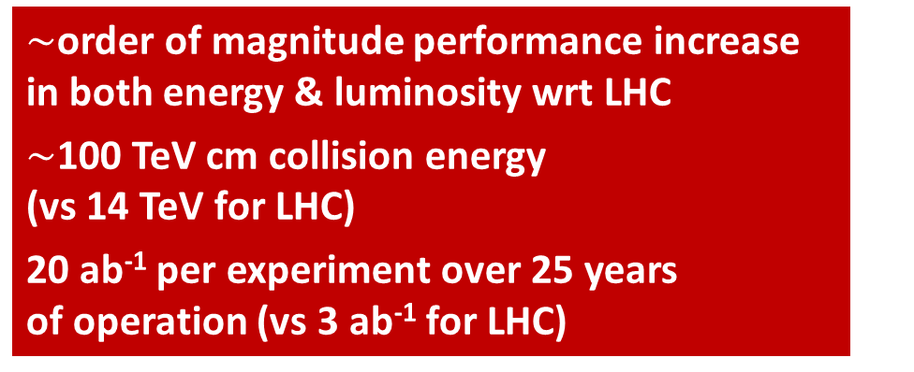
Stage 2: FCC-hh: highest collision energies
$\sim$order of magnitude performance increase in both energy & luminosity wrt LHC
$\sim$100 TeV cm collision energy (vs 14 TeV for LHC)
20 ab⁻¹ per experiment over 25 years of operation (vs 3 ab⁻¹ for LHC)
similar performance increase as from Tevatron to LHC
key technology: high-field magnets
from
LHC technology
8.3 T NbTi dipole
via
HL-LHC technology
12 T Nb₃Sn quadrupole
FNAL dipole demonstrator
4-layer cosϑ
14.5 T Nb₃Sn in 2019
HTS technology
Hybrid Nb-Ti/HTS
A. Zlobin

Slide 14
FCC-hh: main machine parameters
parameter | FCC-hh | HL-LHC | LHC
collision energy cms [TeV] | 81 - 115 | 14 | 14
dipole field [T] | 14 - 20 | 8.33 | 8.33
circumference [km] | 90.7 | 26.7 | 26.7
arc length [km] | 76.9 | 22.5
beam current [A] | 0.5 | 1.1 | 0.58
bunch intensity [10¹¹] | 1 | 2.2 | 1.15
bunch spacing [ns] | 25 | 25 | 25
synchr. rad. power / ring [kW] | 1020 - 4250 | 7.3 | 3.6
SR power / length [W/m/ap.] | 13 - 54 | 0.33 | 0.17
long. emit. damping time [h] | 0.77 – 0.26 | 12.9 | 12.9
peak luminosity [10³⁴ cm⁻²s⁻¹] | ~30 | 5 (lev.) | 1
events/bunch crossing | ~1000 | 132 | 27
stored energy/beam [GJ] | 6.1 - 8.9 | 0.7 | 0.36
With FCC-hh after FCC-ee: significantly
more time for high-field magnet R&D
aiming at highest possible energies
Formidable challenges:
high-field superconducting magnets: 14 - 20 T
power load in arcs from synchrotron radiation: 4 MW → cryogenics, vacuum
stored beam energy: ~ 9 GJ → machine protection
pile-up in the detectors: ~1000 events/xing
energy consumption: 4 TWh/year → R&D on cryo, HTS, beam current, …
Formidable physics reach, including:
Direct discovery potential up to ~ 40 TeV
Measurement of Higgs self to ~ 5% and ttH to ~ 1%
High-precision and model-indep (with FCC-ee input)
measurements of rare Higgs decays (𝛄𝛄, Z𝛄, µµ)
Final word about WIMP dark matter
F. Gianotti

Slide 15

Status of FCC global collaboration
increasing international collaboration as a prerequisite for success
150
Institutes
32
Companies
34
Countries
EC
H2020
FCC Feasibility Study: Aim is to increase further the collaboration, on all aspects,
in particular, on Accelerator and Particle/Experiments/Detectors (PED).

Slide 16

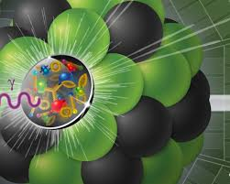
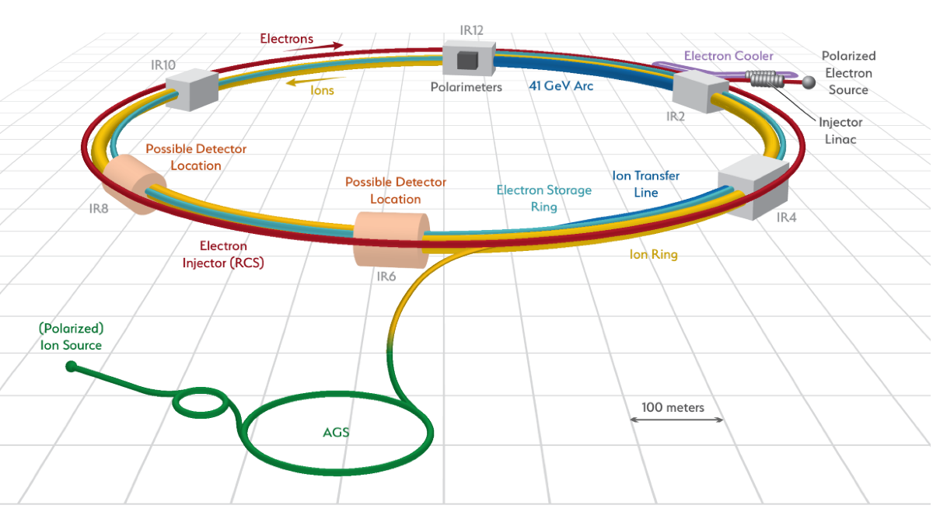
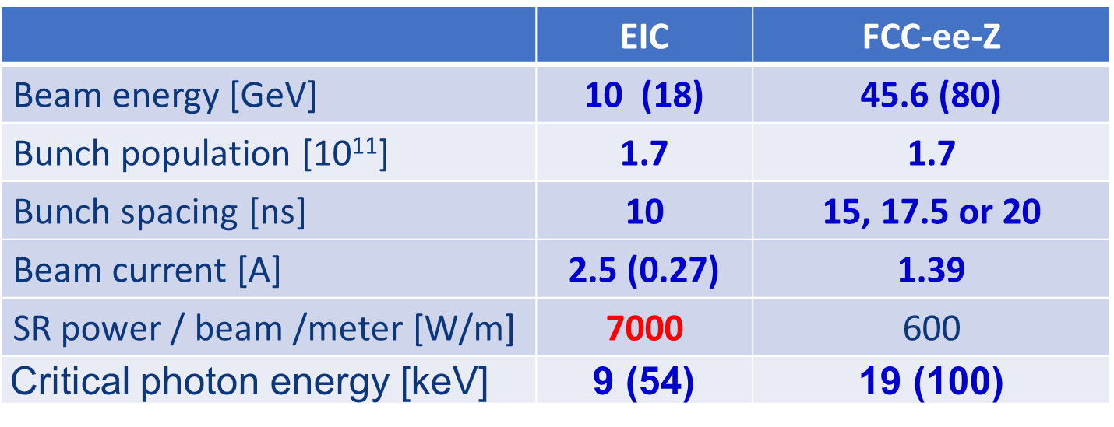
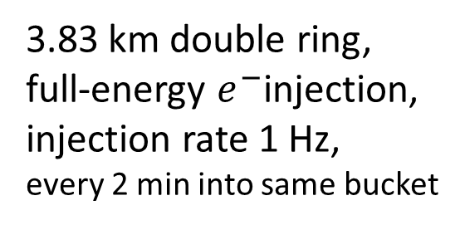
US Electron Ion Collider (EIC)
US EIC Electron Storage Ring similar to, but more challenging than, FCC-ee
beam parameters almost identical, but twice the maximum electron beam current, or half the bunch spacing, and lower beam energy
>10 areas of common interest identified by the FCC and EIC design teams, addressed through joint EIC-FCC working groups, still evolving
EIC will start beam operation about a decade prior to FCC-ee
The EIC will provide another invaluable opportunity to train next generation of accelerator physicists on an operating collider, to test hardware prototypes, beam control schemes, etc.
3.83 km double ring,
full-energy $e^{−}$injection,
injection rate 1 Hz,
every 2 min into same bucket

Slide 17





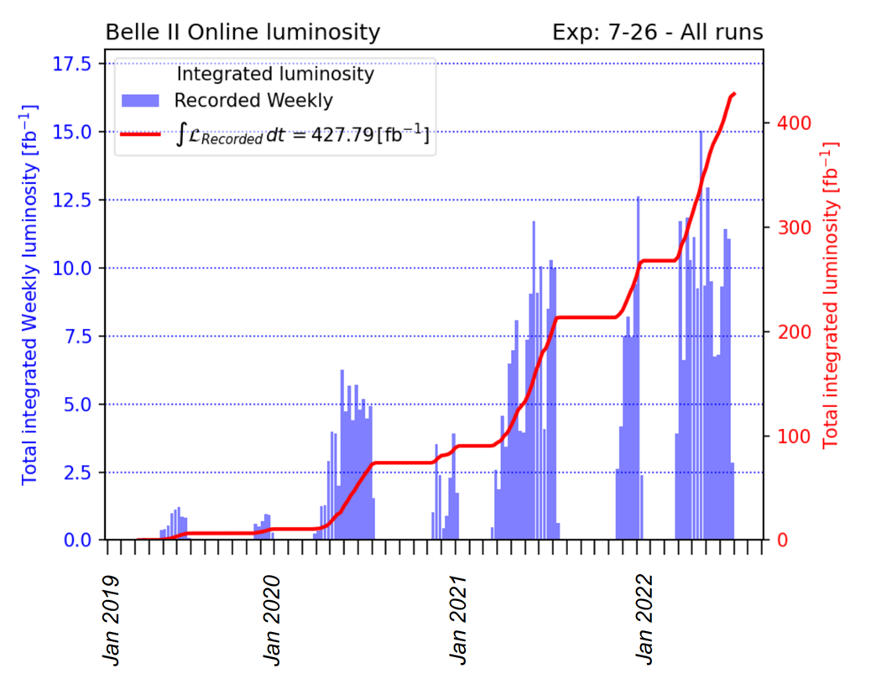
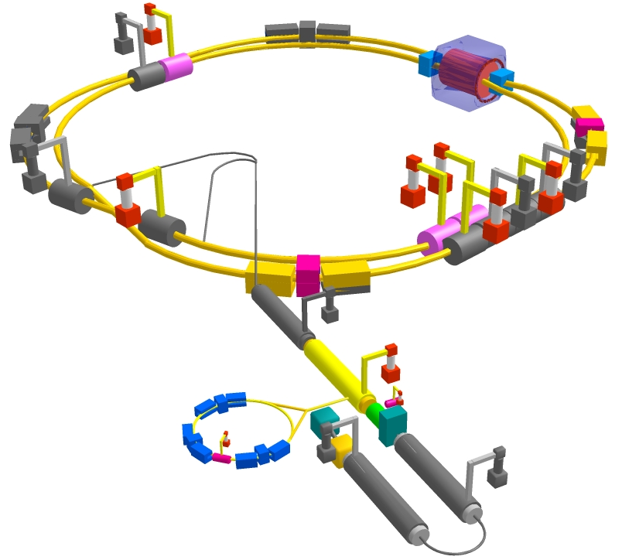
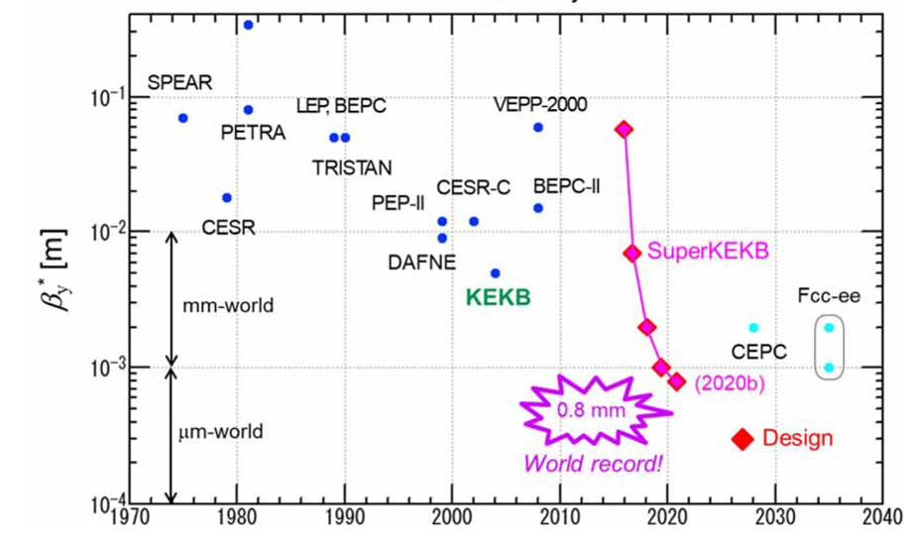
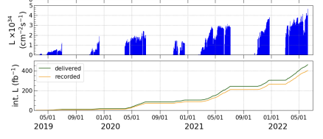
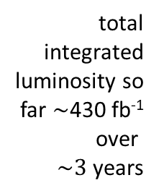
SuperKEKB*
world’s highest luminosity & lowest β* e⁺e⁻ collider
total integrated luminosity so far $\sim$430 fb⁻¹ over
$\sim 3$ years
3 km double ring,
top-up injection
world record luminosity of 4.7x10³⁴ cm⁻²s⁻¹,
β_{y}* = 1.0 mm (= FCC), also β_{y}* = 0.8 mm shown – with “virtual” crab-waist collision scheme originally developed for FCC-ee (K. Oide)
1) SuperKEKB is, and may further serve as, FCC-ee test-bed
2) Training of next-generation e⁺e⁻ accelerator physicists

Slide 18
Take home messages
FCC-ee is first stage of FCC integrated programme; 1st physics ~2046
FCC-ee design incorporates many lessons from recent & present e⁺e⁻ colliders, and goes further! SuperKEKB demonstrates key concepts
FCC-ee = efficient and sustainable collider at the e⁺e⁻ energy frontier: highest luminosity per input power, highest luminosity per construction cost, most precise energy calibration, and ultimate upgrade potentials (100 TeV FCC-hh, …); prototypes of FCC-ee key components including SC cavities & RF power sources
Superconducting cable & high-field magnet programme prepares for 100 TeV proton-proton collider, FCC-hh, in the same tunnel, to begin operation around ~2065/70

