Slide 1


Emittance measurements in AD and ELENA
G. Russo
D. Gamba, B. Dupuy, L. Ponce and the AD & ELENA OP team

Slide 2

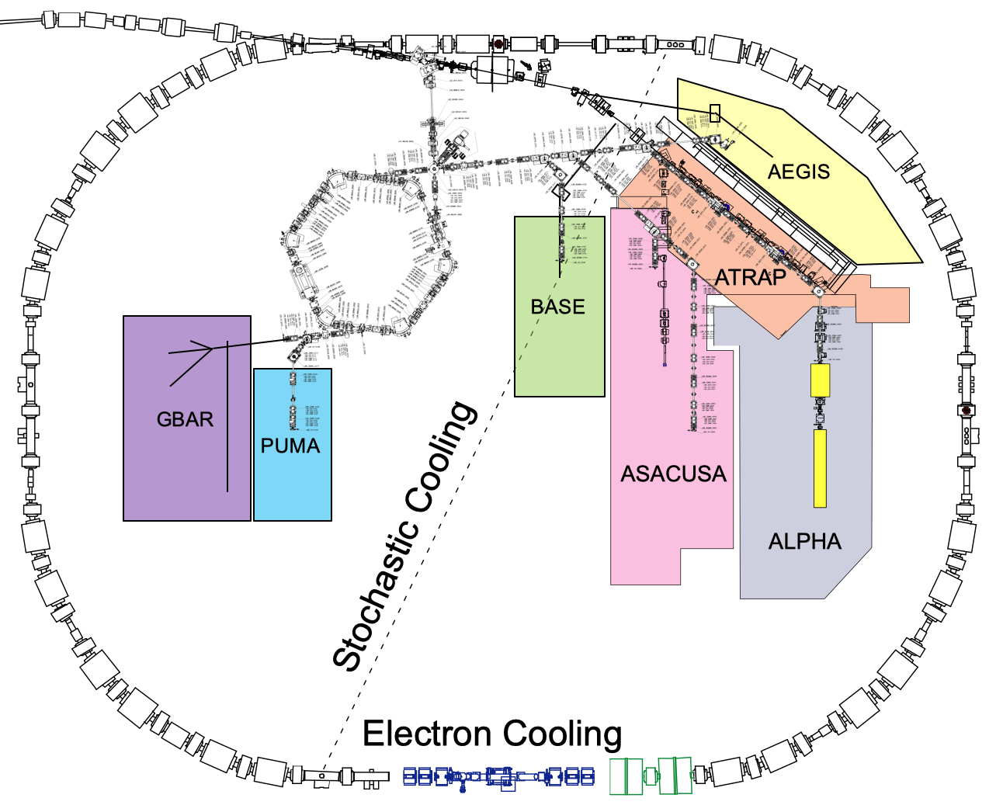
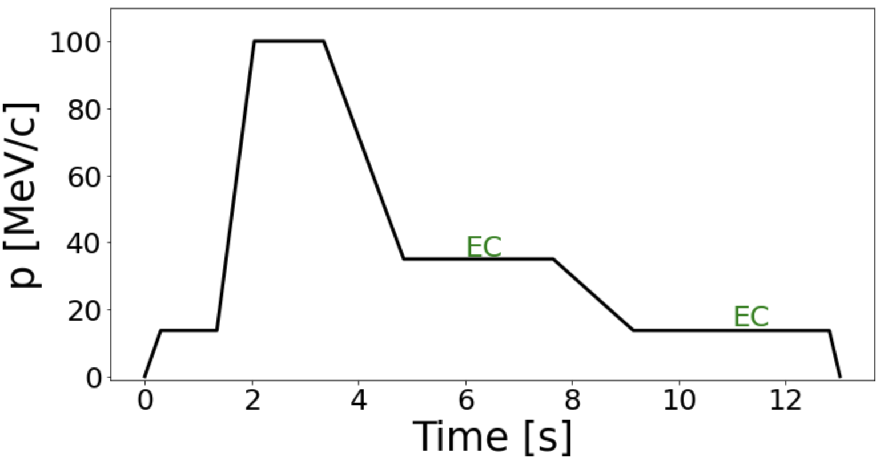
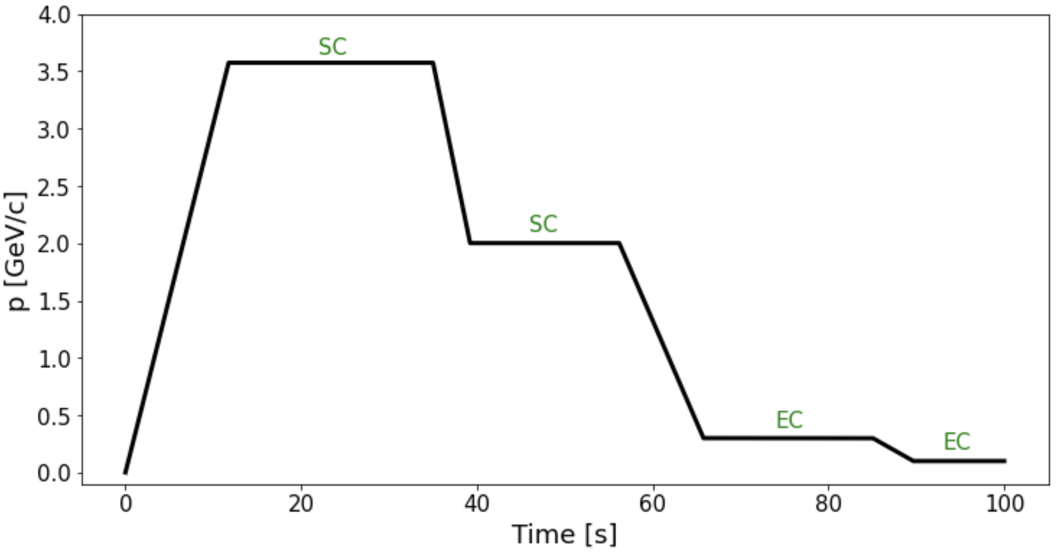
BI Technical Board on Emittance Measurements in AD and ELENA
Overview of AD and ELENA rings
kickers
Ring | User dependent | Multi-particle | Short cycle
AD | No | No (p-bar only) | No (~110s)
ELENA | Yes | Yes (H- and p-bar) | Yes (~14sec)
EC
SCRAPER
pick-ups
2
Notes:
Having non-destructive measurements of emittance would be a game changing to allow real-time machine tuning parameters and optimisation.

Slide 3
BI Technical Board on Emittance Measurements in AD and ELENA
Reasons for doing emittance measurements
Emittance measurements are used for:
  Stochastic cooling setting up
  Electron cooling performance assessment
  Deceleration performance
  Acceptance measurements
Previous usage:
  Collimator (due to present limitation in available time and instrumentation is not used anymore, but we are interested in keeping this flexibility for future operations)
Used during operations:
  Daily checks
  MD days (~ 1day/week)
  Commissionings and re-starts
  Performance assessments after repairs and/or replacements
Repeatable, user-independent and stable procedure
Solved and now operational in both rings
Proper communication between several instruments and their synchronization
Topic of the following slides
3

Slide 4
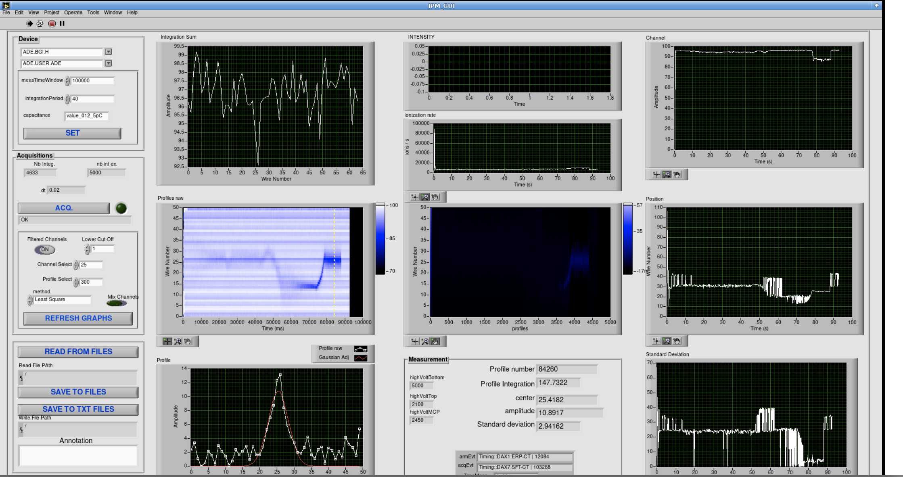
BI Technical Board on Emittance Measurements in AD and ELENA
IPMs in AD: present outputs
Data collection: 18th October 2023
At the moment, with no gass injected in the vacuum chamber the signal is quite low.
However, having a reconstruction of the profile along the AD cycle would be strongly beneficial for machine operation, optimisation and to enhance troubleshooting.
4
Notes:
At the moment we don’t have this opportunity but would be highly appreciated for the future.
However, it is worth mentioning that the present scraper system has been somehow adapted for emittance measurements and it is foreseen to be still used in the future for specific application where the IPMs would not work properly. I will discuss about these applications later on in the presentation.

Slide 5
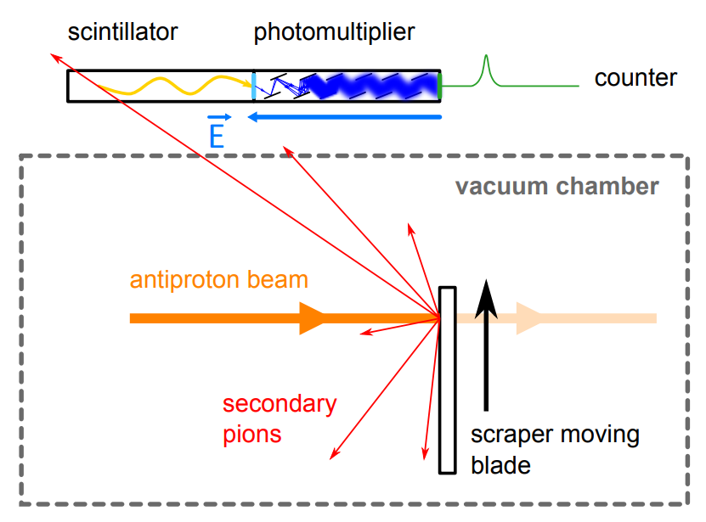
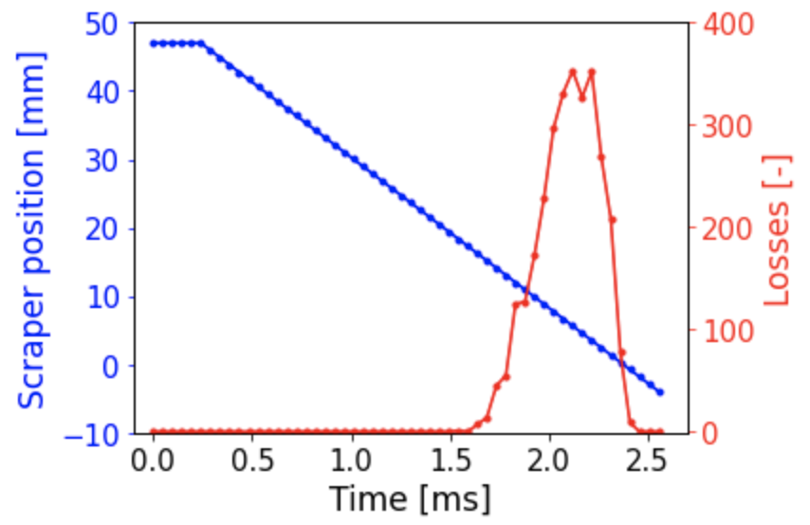
BI Technical Board on Emittance Measurements in AD and ELENA
Scraper measurements: general working principle
From the knowledge of the scraper position vs. time and losses vs. time. IFF the time between the two is the same it is possible to retrieve the emittance and the beam orbit with a single measurement.
Picture from: https://edms.cern.ch/document/1732558/0.1
5
Notes:
However, it is a destructive measurement it provides.

Slide 6
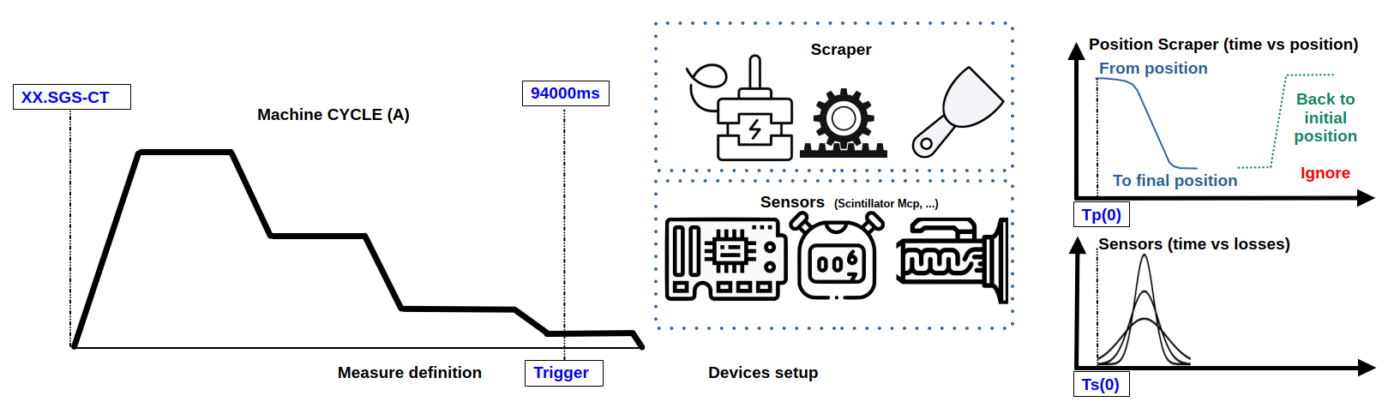
BI Technical Board on Emittance Measurements in AD and ELENA
Present issues
From B. Dupuy personal exchange
Synchronization issue
We have to wait 2 cycles before having a measurement:
0) Deciding where to do the measurement
Trigger is sent
Measurement is done
This is done through the application written by B. Dupuy
6

Slide 7
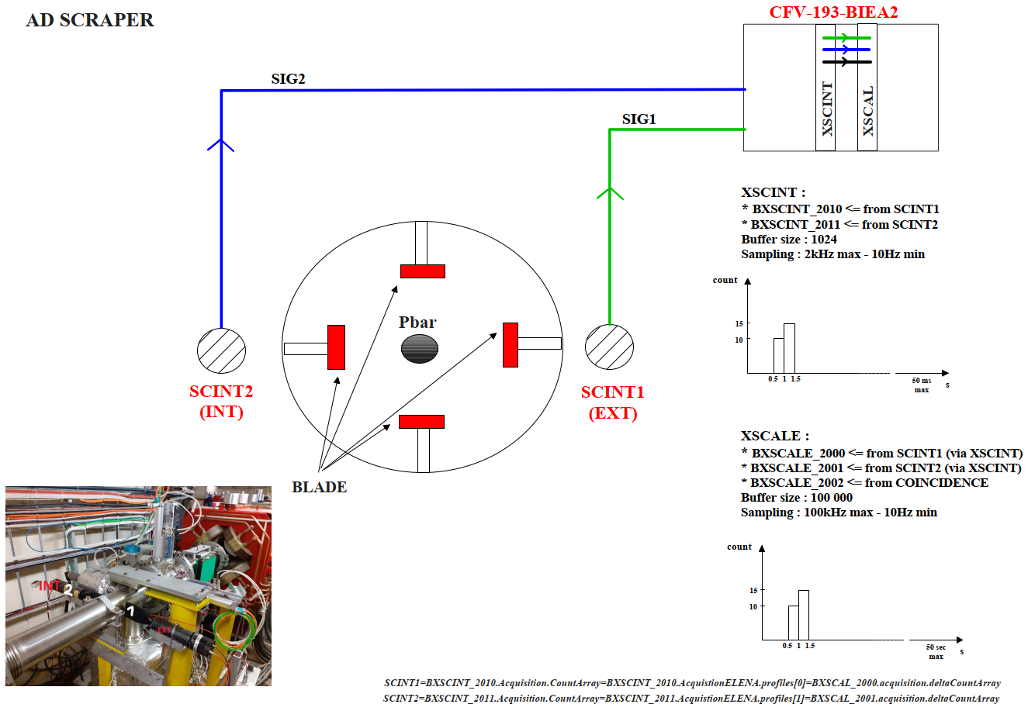
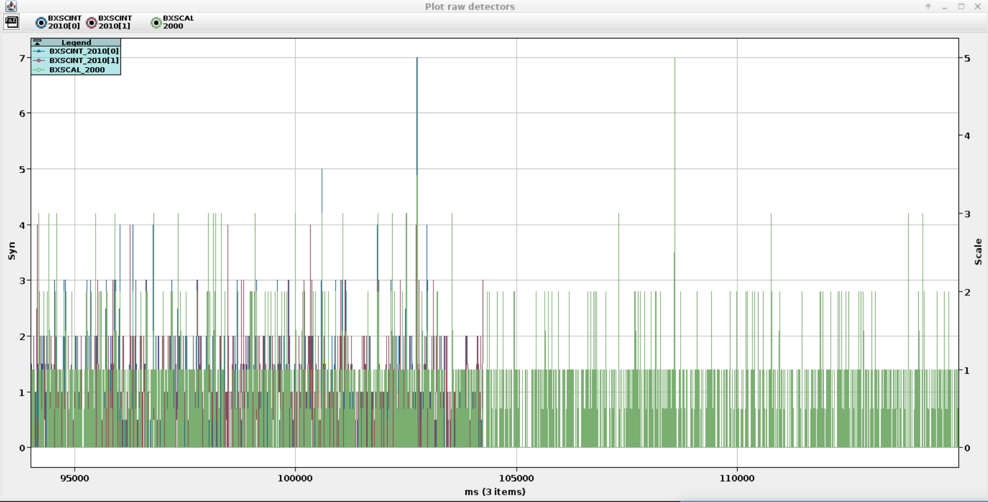
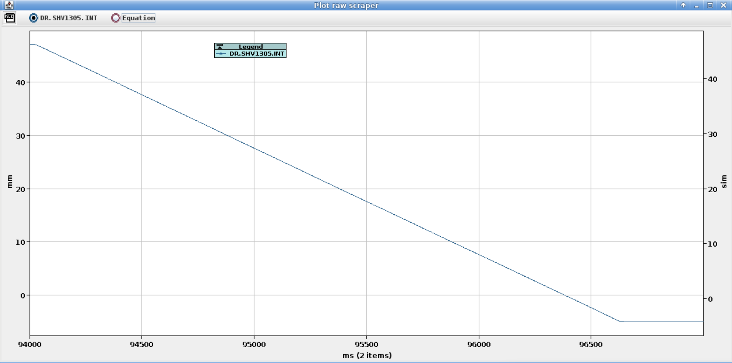
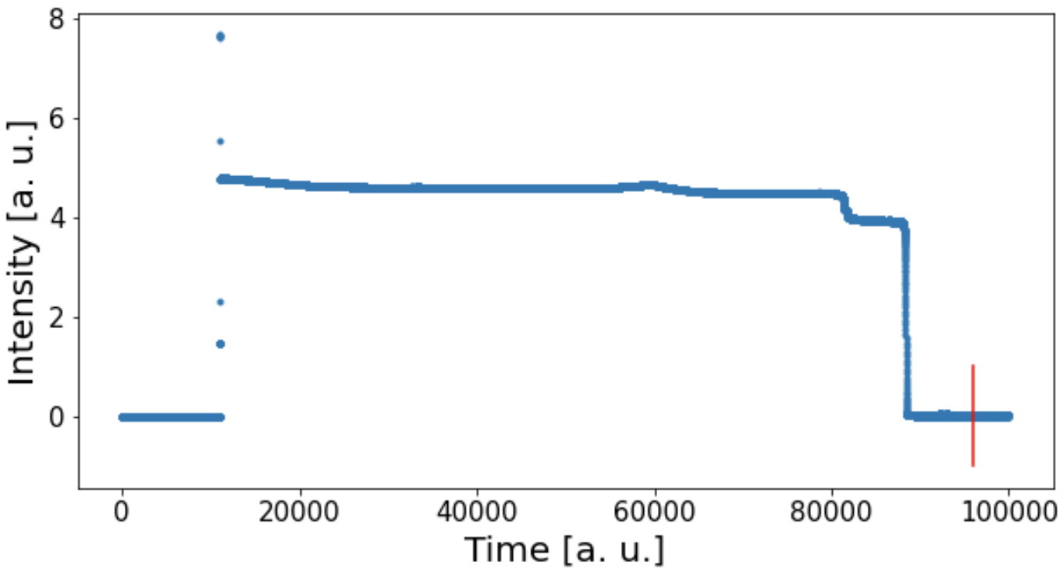
BI Technical Board on Emittance Measurements in AD and ELENA
Synchronization issues: AD
20.09.2023 09h40:20.319
In this case we are sure that the beam has been scraped but no info on losses is received. Zero losses from all the detectors when the scraper intercepts a beam of nominal intensity.
Intensity from BCCCA
AD:
4 blades (2 per plane)
2 detectors
7

Slide 8
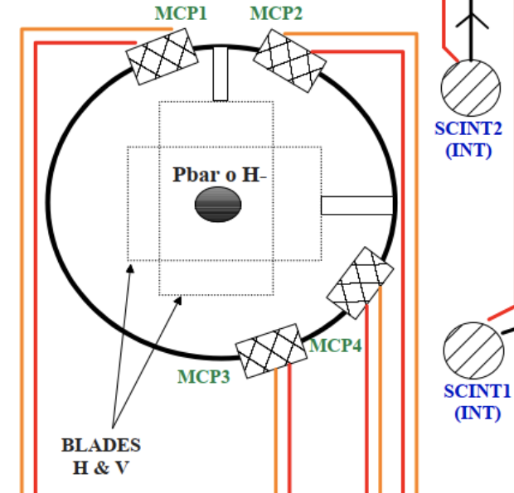
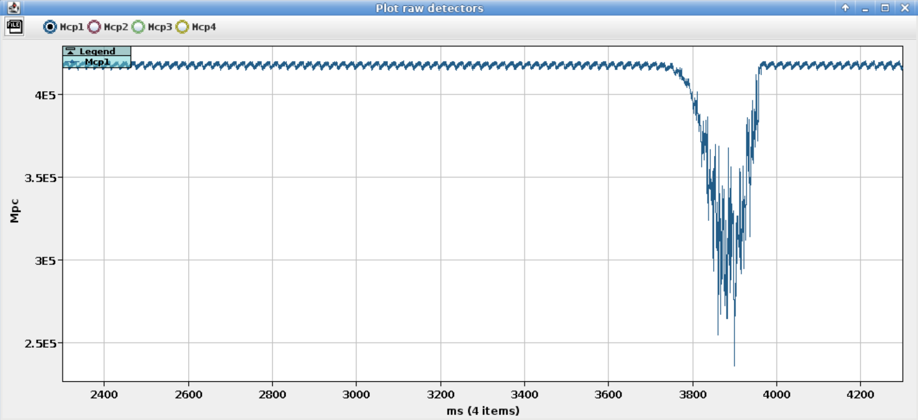
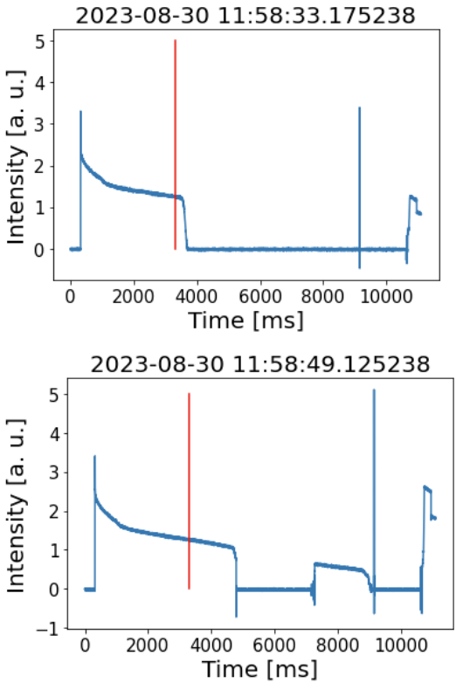
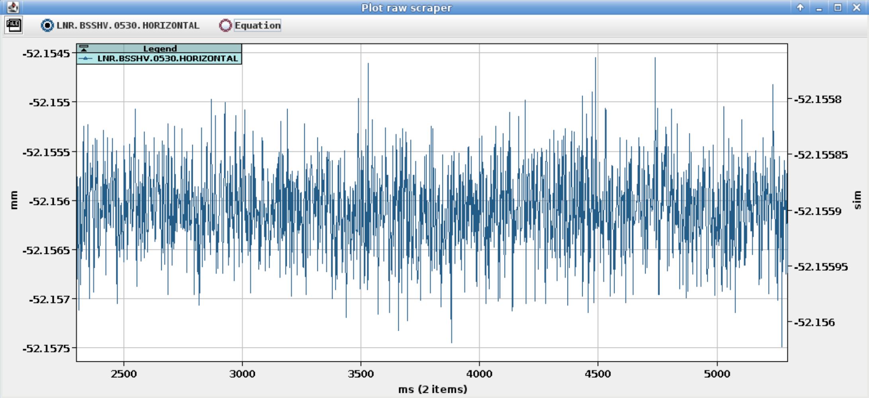
BI Technical Board on Emittance Measurements in AD and ELENA
Synchronization issues: ELENA (H-)
Intensity drop after scraping
30.08.2023 11h58:35.777
Standard intensity profile
ELENA:
2 frames (1 per plane)
2 type of detectors (H- and p-bar)
8

Slide 9
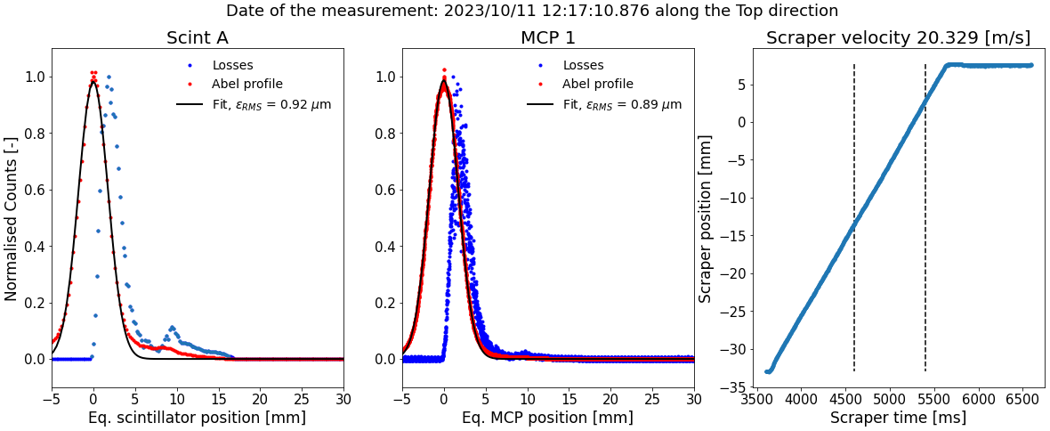
BI Technical Board on Emittance Measurements in AD and ELENA
ELENA instrumentation: pbar
Features visible on the scintillator seems to be hidden within the noise of the MCP
9

Slide 10
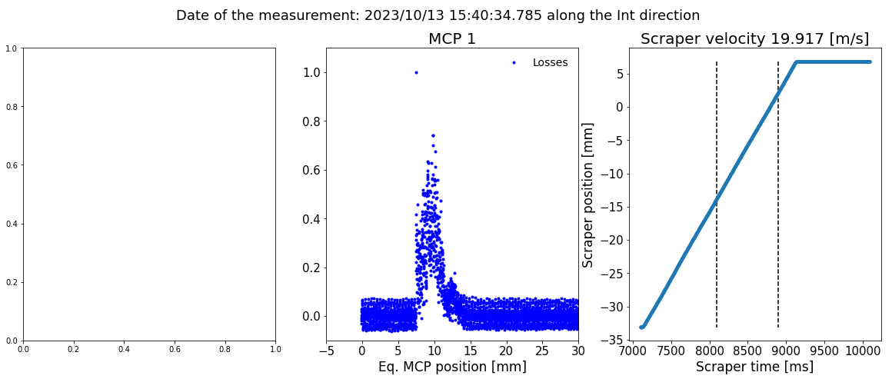
BI Technical Board on Emittance Measurements in AD and ELENA
ELENA instrumentation: H-
For H- we only have MCP, no signal from the scintillators
The level of noise is really high (~7%) compared to the one of pbars (for the same values of voltage on the anode and the MCP plates) → high uncertainty on the value of emittance.
10

Slide 11
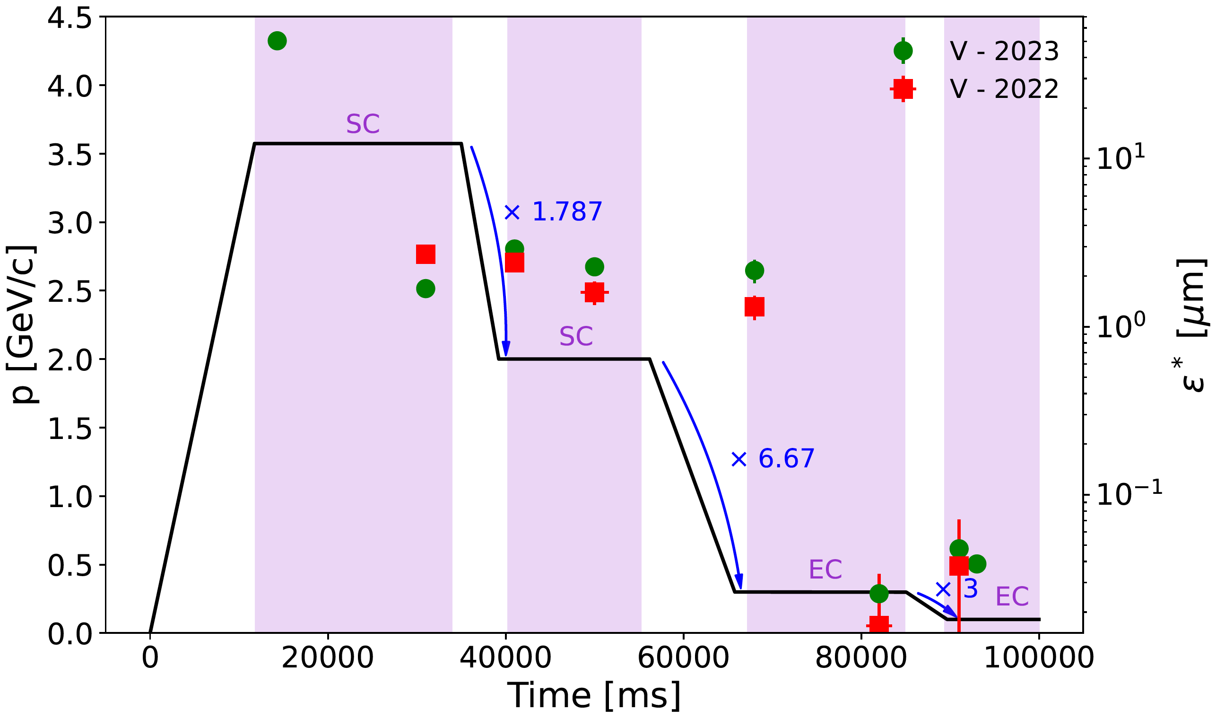
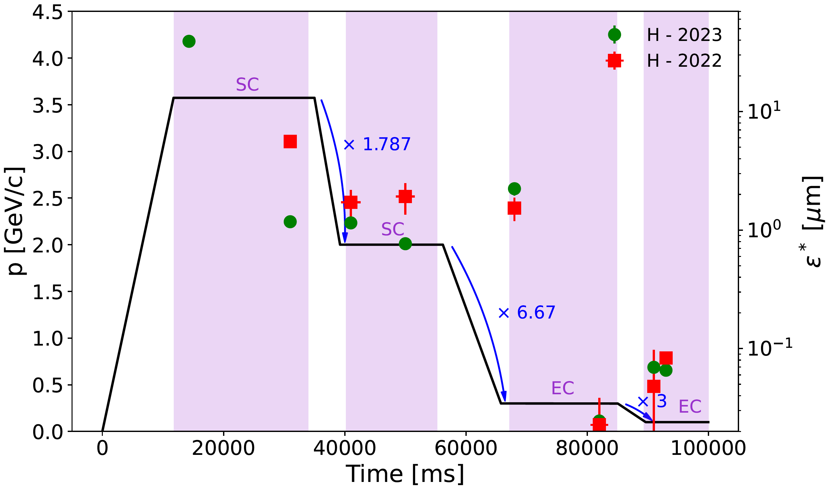
BI Technical Board on Emittance Measurements in AD and ELENA
Most recent results: AD emittance
Using the same procedure, previous year (2022) data have been re-analysed and new measurements have been taken to compare AD performance (SC, EC and deceleration) between last year and today.
11

Slide 12
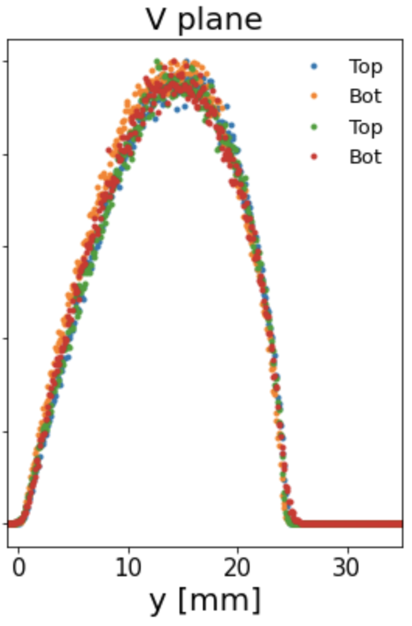
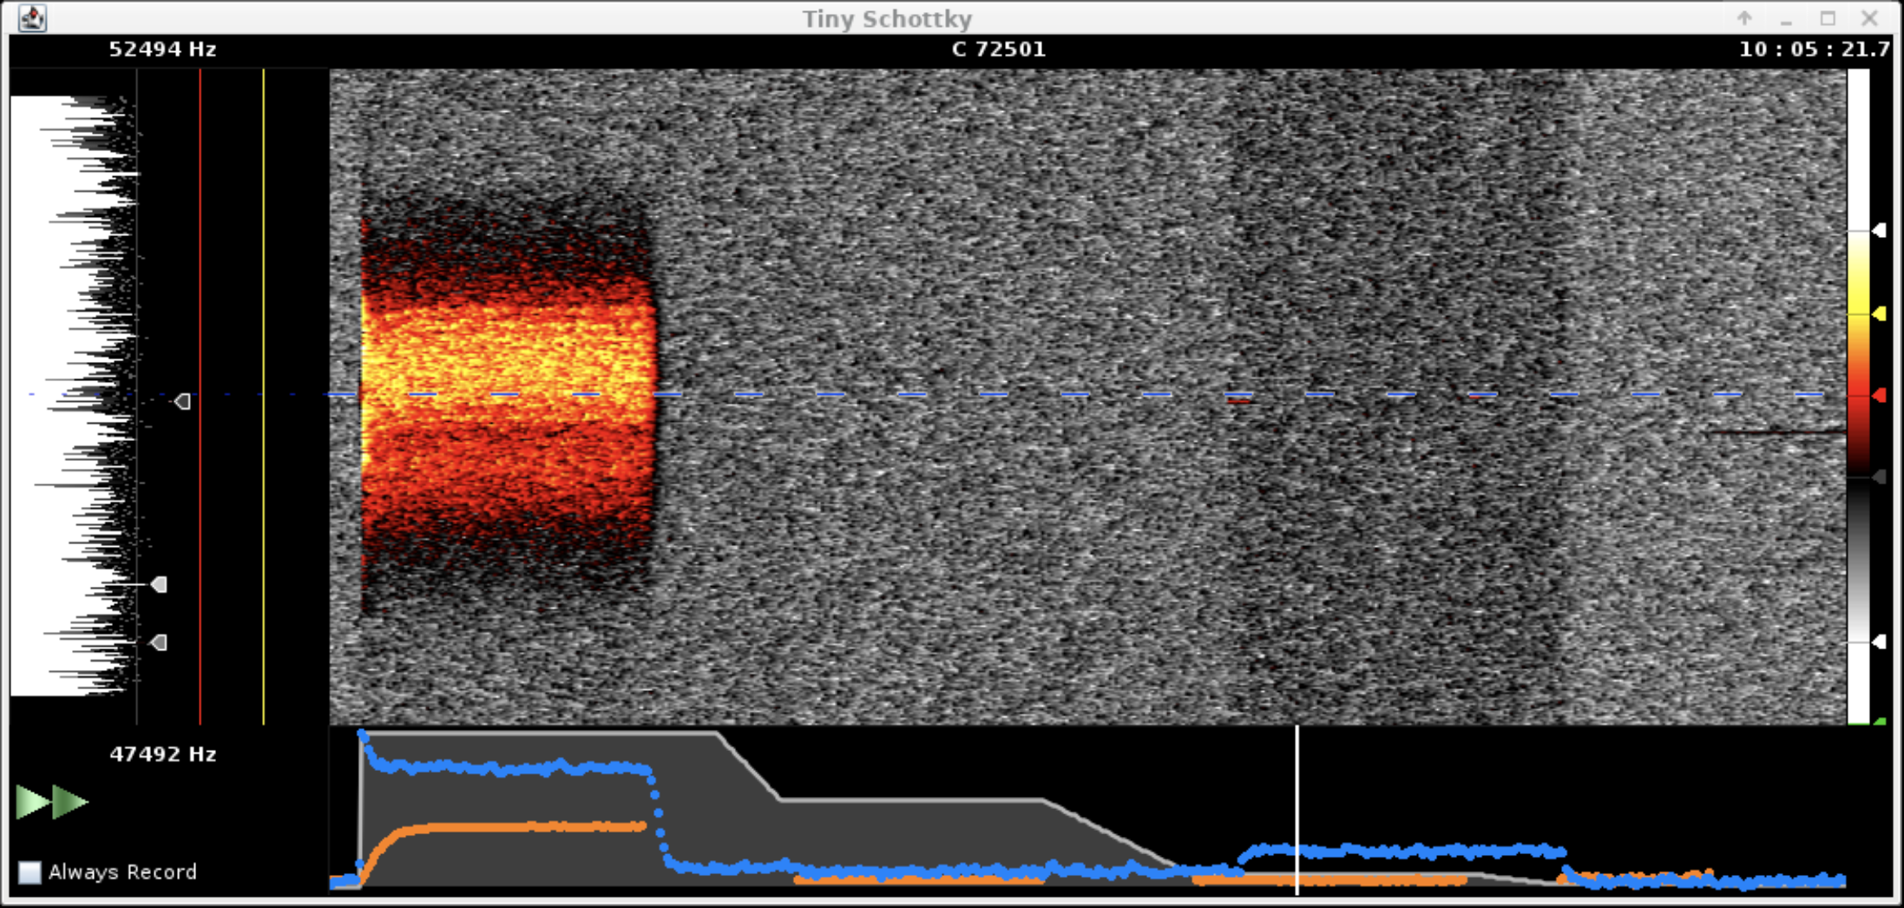
BI Technical Board on Emittance Measurements in AD and ELENA
Most recent results: AD acceptance
Acceptance measurements are done by exciting the beam and then performing a scraping (either V or H) once the losses are constant.
Proportional
acceptance
12

Slide 13
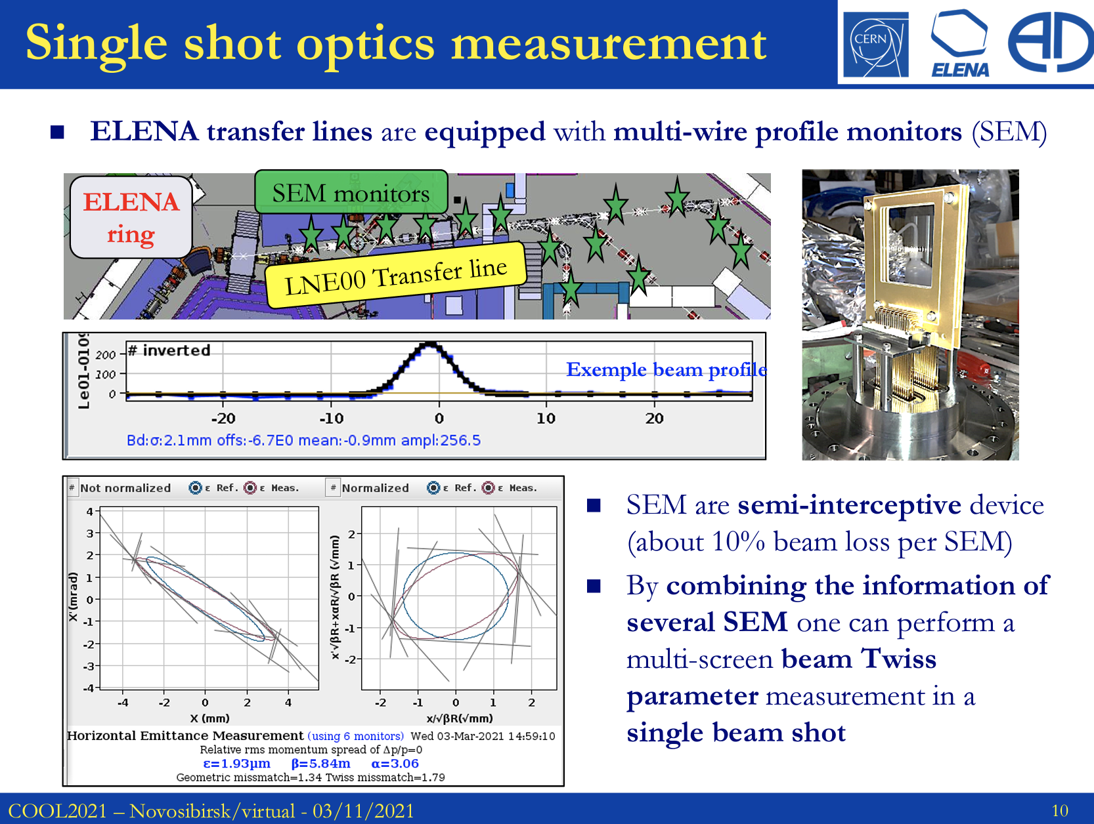
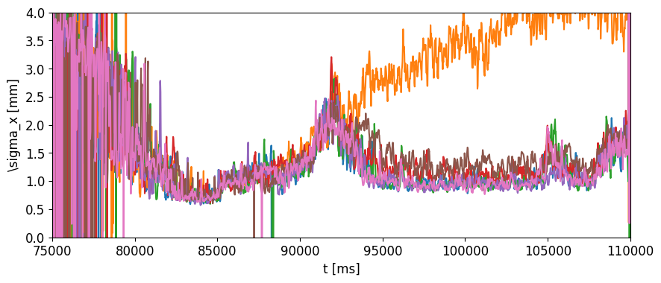
BI Technical Board on Emittance Measurements in AD and ELENA
Other ways to measure the emittance in ELENA
From D. Gamba presentation
@ EXTRACTION: multiple SEM grids along the extraction line (00) of ELENA allow to reconstruct the emittance (+ other optic parameters) by adopting a fitting procedure
In principle, having an IPM would allow to observe real-time the evolution of the emittance and thus identify immediately possible issues.
300 MeV/c
ramp
100 MeV/c
RF ON
Bad settings!
OK-ish settings
Best setup
13

Slide 14
BI Technical Board on Emittance Measurements in AD and ELENA
Conclusions
At the moment we have a stable, reproducible and user independent procedure for emittance reconstruction for both AD and ELENA and for both beams (H- and pbars)
  The interface between scraper and detection systems is done through an interface developed and maintained by OP
  There is the criticality that the scraper position is not known precisely, therefore the 50% of the possible results is lost
  There are synchronization issues between scraper and detection systems (as the examples showed before)
The flexibility of using the scraper for emittance and acceptance measurements is a strong plus, and in the futre is foreseen to use it also as a collimator (as was done in the past)
Given the long AD cycle lenght (110s) having non-destructive emittance measurements would be a strong plus in setting-up and optimize the machine as well as in enhancing troubleshooting. Considering an IPM for ELENA might be interesting too.
Thank you for your attention!
14

Slide 15
BI Technical Board on Emittance Measurements in AD and ELENA
Back-up slides
15

Slide 16
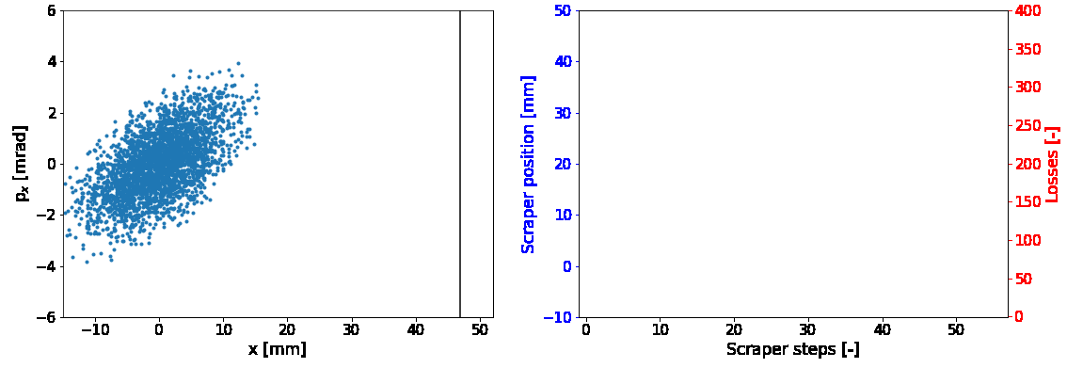
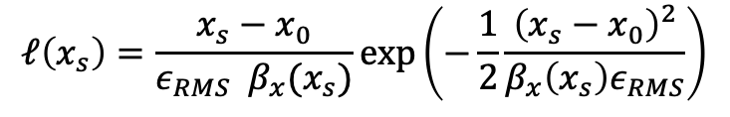
Transverse emittance reconstruction along the cycle of the CERN Antiproton Decelerator
Working principle
For a 4D Gaussian beam, in the absence of any coupling, the losses can be described as:
$$ℓ\left(x_{s}\right)=\frac{x_{s}−x_{0}}{ε_{RMS} β_{x}(x_{s})}\exp\left(−\frac{1}{2}\frac{{\left(x_{s}−x_{0}\right)}^{2}}{β_{x}\left(x_{s}\right)ε_{RMS}}\right)$$
16

Slide 17
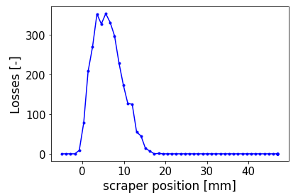
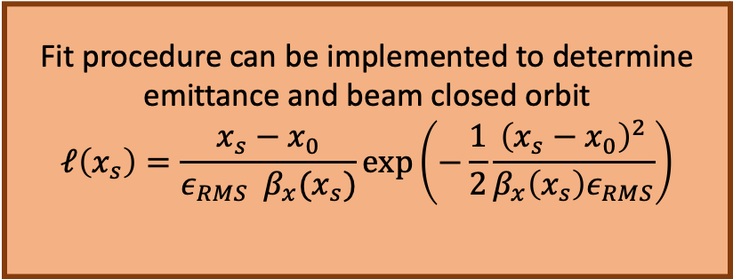
Transverse emittance reconstruction along the cycle of the CERN Antiproton Decelerator
Emittance reconstruction
Python-based routine
Fit procedure can be implemented to determine emittance and beam closed orbit
$$ℓ\left(x_{s}\right)=\frac{x_{s}−x_{0}}{ε_{RMS} β_{x}(x_{s})}\exp\left(−\frac{1}{2}\frac{{\left(x_{s}−x_{0}\right)}^{2}}{β_{x}\left(x_{s}\right)ε_{RMS}}\right)$$
The transverse beam profile can be reconstructed by means of the Abel Transform (AT)
Benchmarking tool
Now operational in AD
17

Slide 18
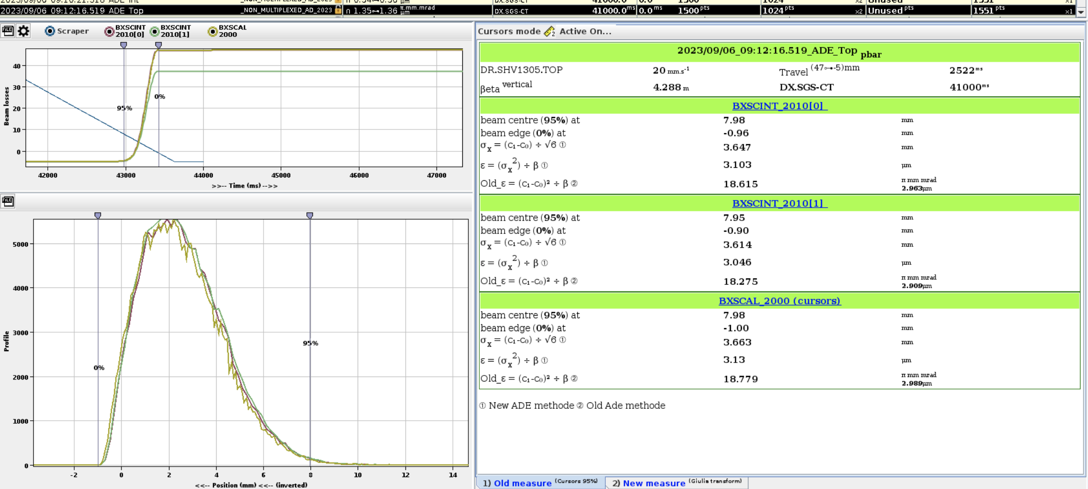
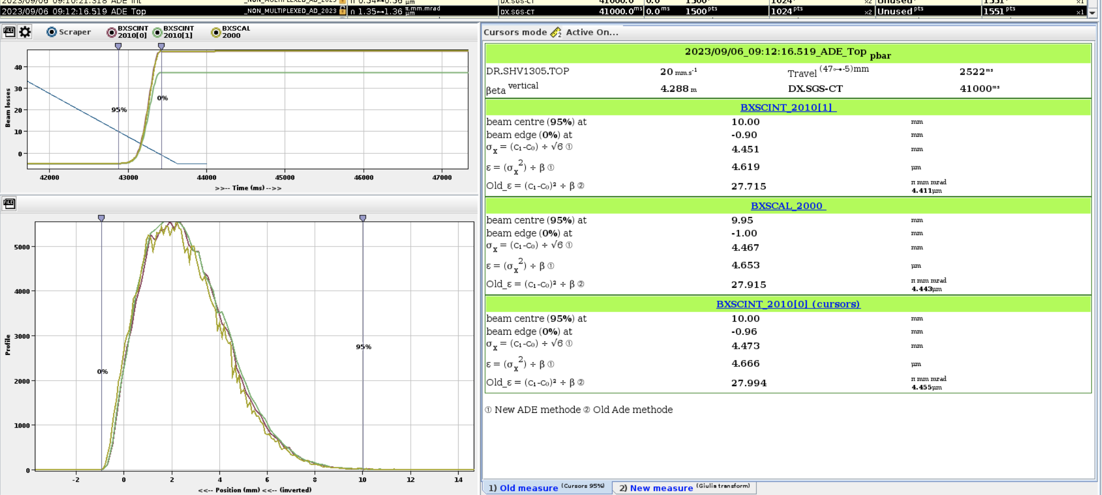
Transverse emittance reconstruction along the cycle of the CERN Antiproton Decelerator
Problem discussion
In the past, emittance was calculated considering the distance between the 0% and the 95% of loss particles → user dependent
18

Slide 19
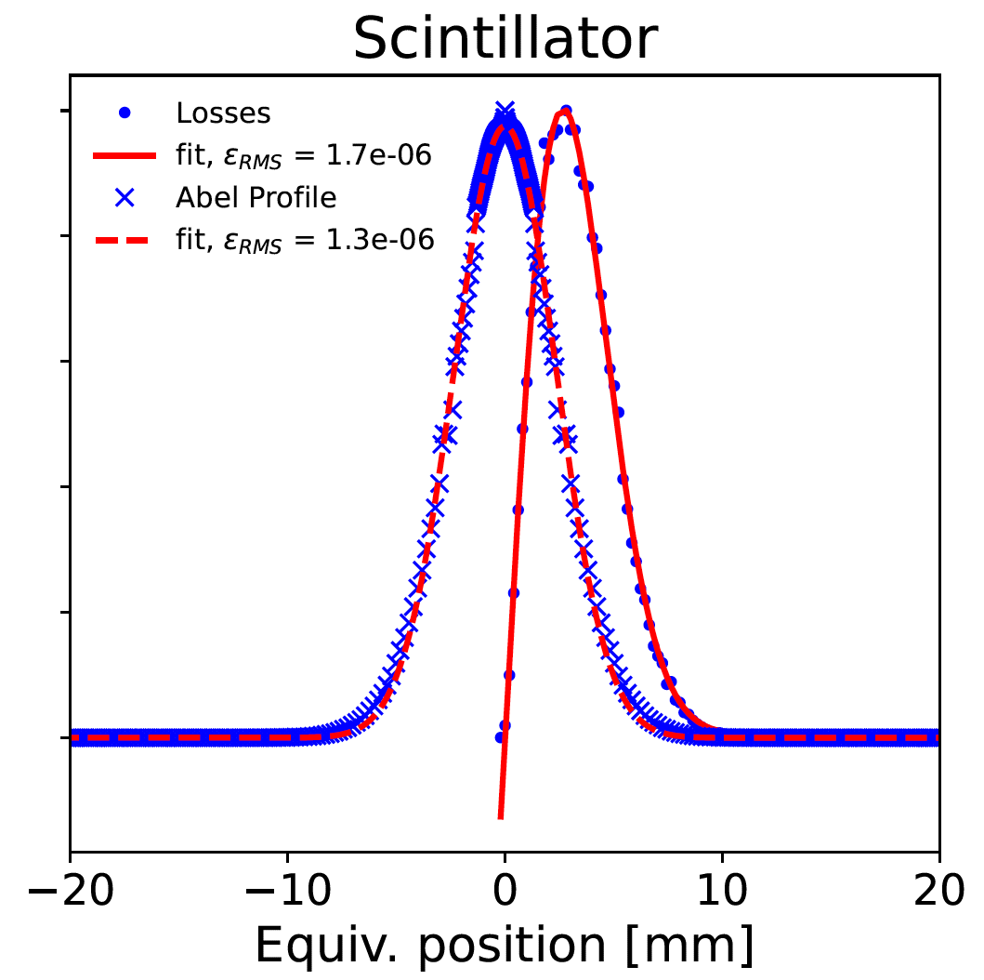
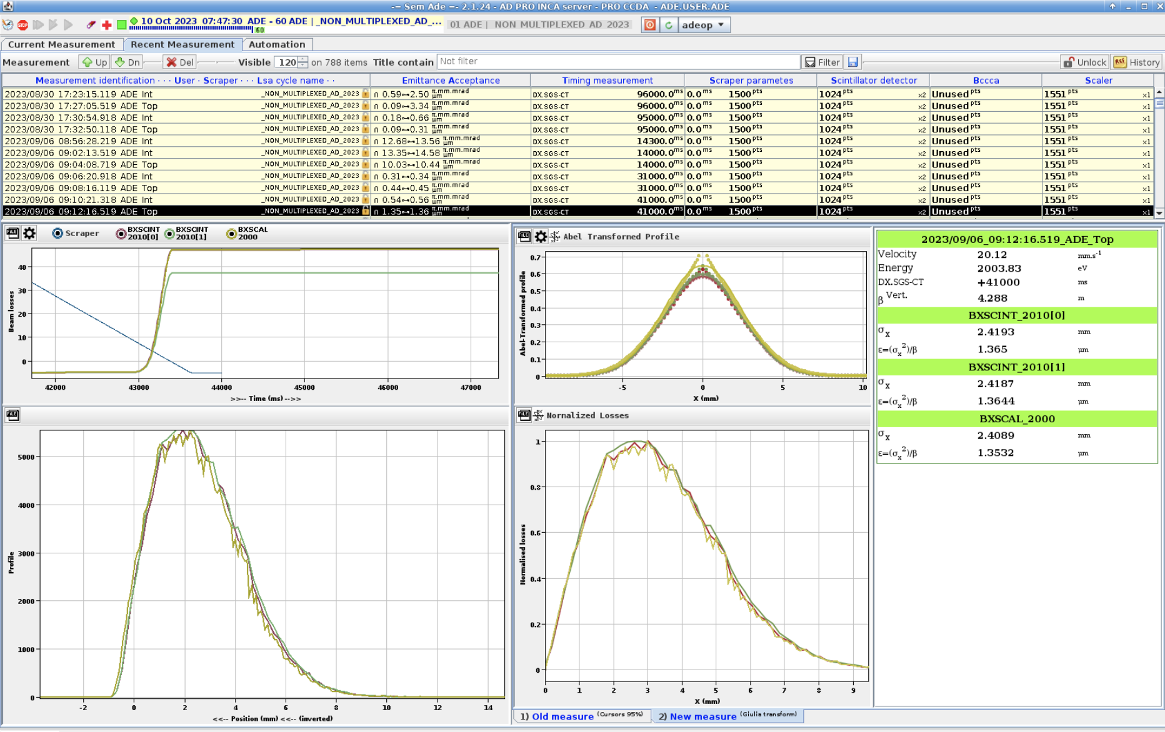
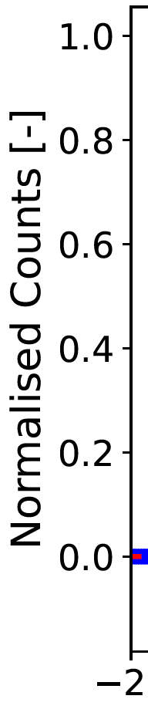
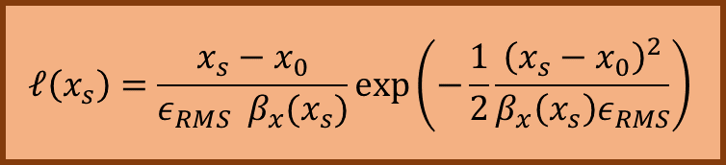
Transverse emittance reconstruction along the cycle of the CERN Antiproton Decelerator
Emittance comparison
$$ℓ\left(x_{s}\right)=\frac{x_{s}−x_{0}}{ε_{RMS} β_{x}(x_{s})}\exp\left(−\frac{1}{2}\frac{{\left(x_{s}−x_{0}\right)}^{2}}{β_{x}\left(x_{s}\right)ε_{RMS}}\right)$$
End of 2GeV/c
V plane
06.09.2023
The transverse beam profile can be reconstructed by means of the Abel Transform (AT)
19

Slide 20
BI Technical Board on Emittance Measurements in AD and ELENA
Hardware needs
Setting the timing of the measurement:
  Define min and max scraper moving position
  Define scraper speed
  Define window detection for scintillators and MCPs
Wait for the timing to be released
Receiving the data from the measurements:
  Calculate scraper velocity and compare with initial one
  Get data from detection system
Merge together scraper position and losses data:
  Retrieve beam emittance
  Retrieve beam orbit position
20

