Slide 1
Thin Films for Accelerator Components
G. Rosaz – CERN – TE/VSC-SCC
On behalf of the SCC section

Slide 2
Outline
Methods / Materials
Main applications
NEG films
a-C films
SC thin films
Challenges

Slide 3
Methods / Materials

Slide 4
Needs and technological solutions
Main requirements:
metallic thin films
Ultra-pure (UHV compatibility)
Technological choice: Physical Vapor Deposition

Slide 5
Needs and technological solutions
Main requirements:
metallic thin films
Ultra-pure (UHV compatibility)
Technological choice: Physical Vapor Deposition
Ar (10⁻¹ mbar)

Slide 6
Needs and technological solutions
Main requirements:
metallic thin films
Ultra-pure (UHV compatibility)
Technological choice: Physical Vapor Deposition
Ar (10⁻¹ mbar)

Slide 7
Needs and technological solutions
Main requirements:
metallic thin films
Ultra-pure (UHV compatibility)
Technological choice: Physical Vapor Deposition
Ar (10⁻¹ mbar)

Slide 8
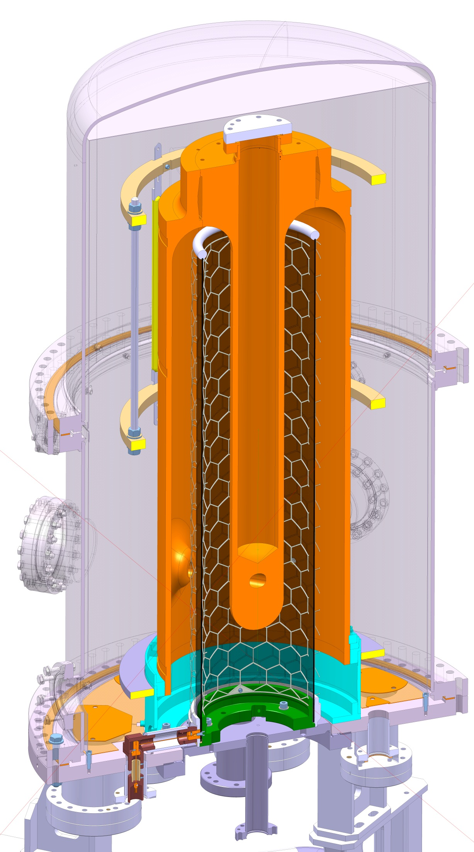
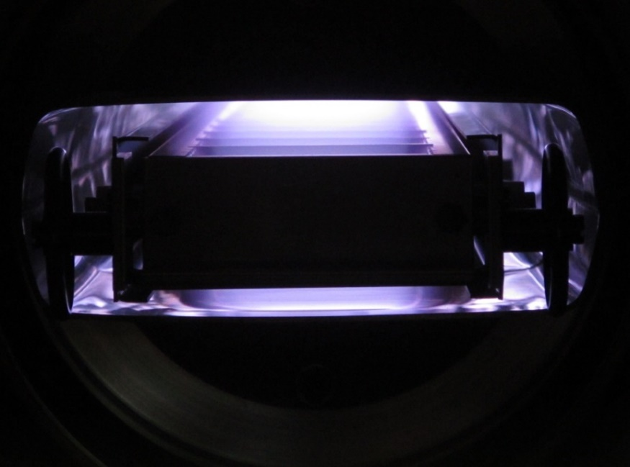
Needs and technological solutions
Main requirements:
metallic thin films
Ultra-pure (UHV compatibility)
Technological choice: Physical Vapor Deposition
~20cm
Ar (10⁻¹ mbar)
Courtesy P. Costa-Pinto
Simple set-up
High working pressure
higher contamination
low energy
Diode Sputtering

Slide 9
Needs and technological solutions
Main requirements:
metallic thin films
Ultra-pure (UHV compatibility)
Technological choice: Physical Vapor Deposition
Ar (10^{-4/-3} mbar))

Slide 10
Needs and technological solutions
Main requirements:
metallic thin films
Ultra-pure (UHV compatibility)
Technological choice: Physical Vapor Deposition
e⁻
Ar (10^{-4/-3} mbar))

Slide 11
Needs and technological solutions
Main requirements:
metallic thin films
Ultra-pure (UHV compatibility)
Technological choice: Physical Vapor Deposition
e⁻
Ar (10^{-4/-3} mbar))
Magnetron Sputtering

Slide 12
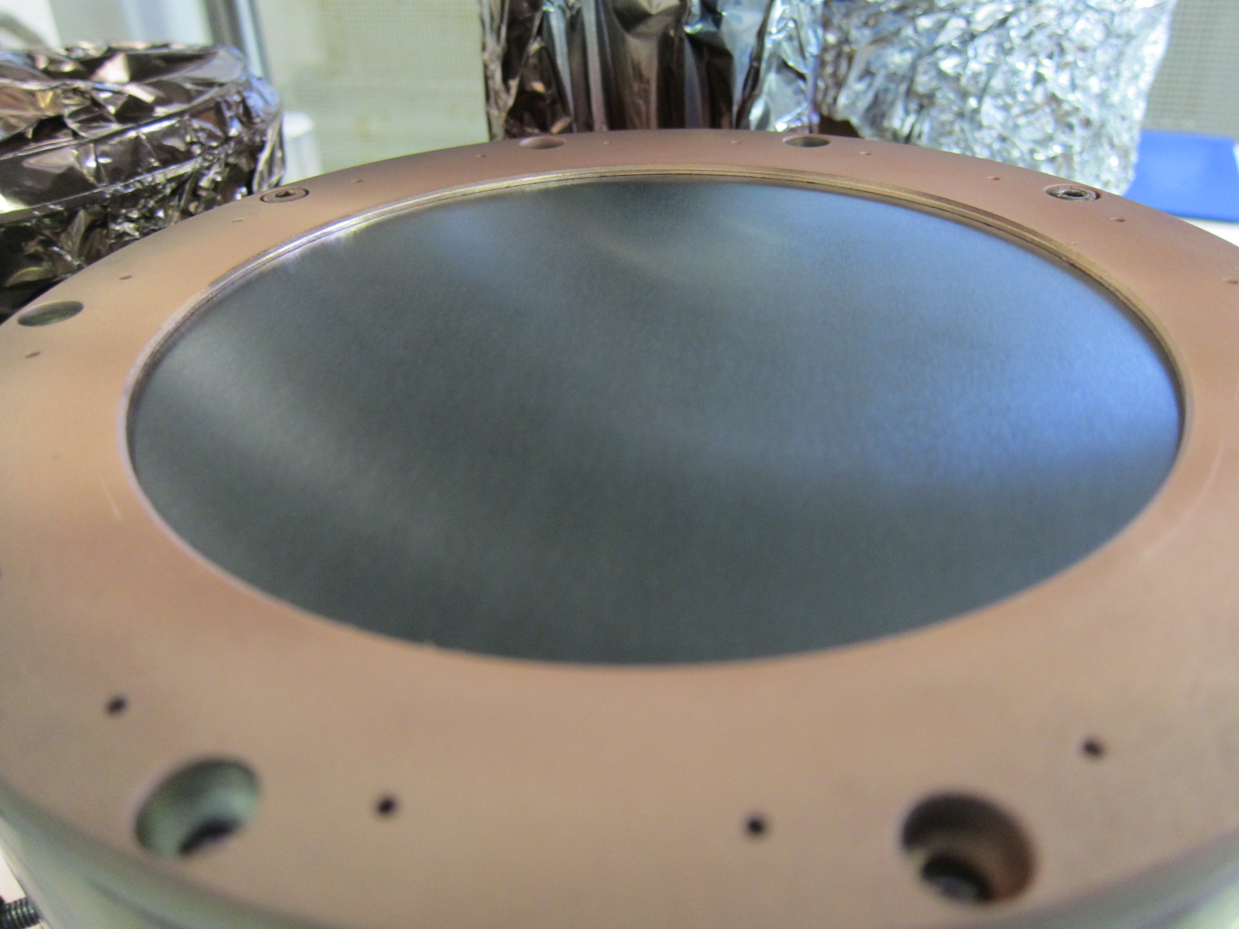
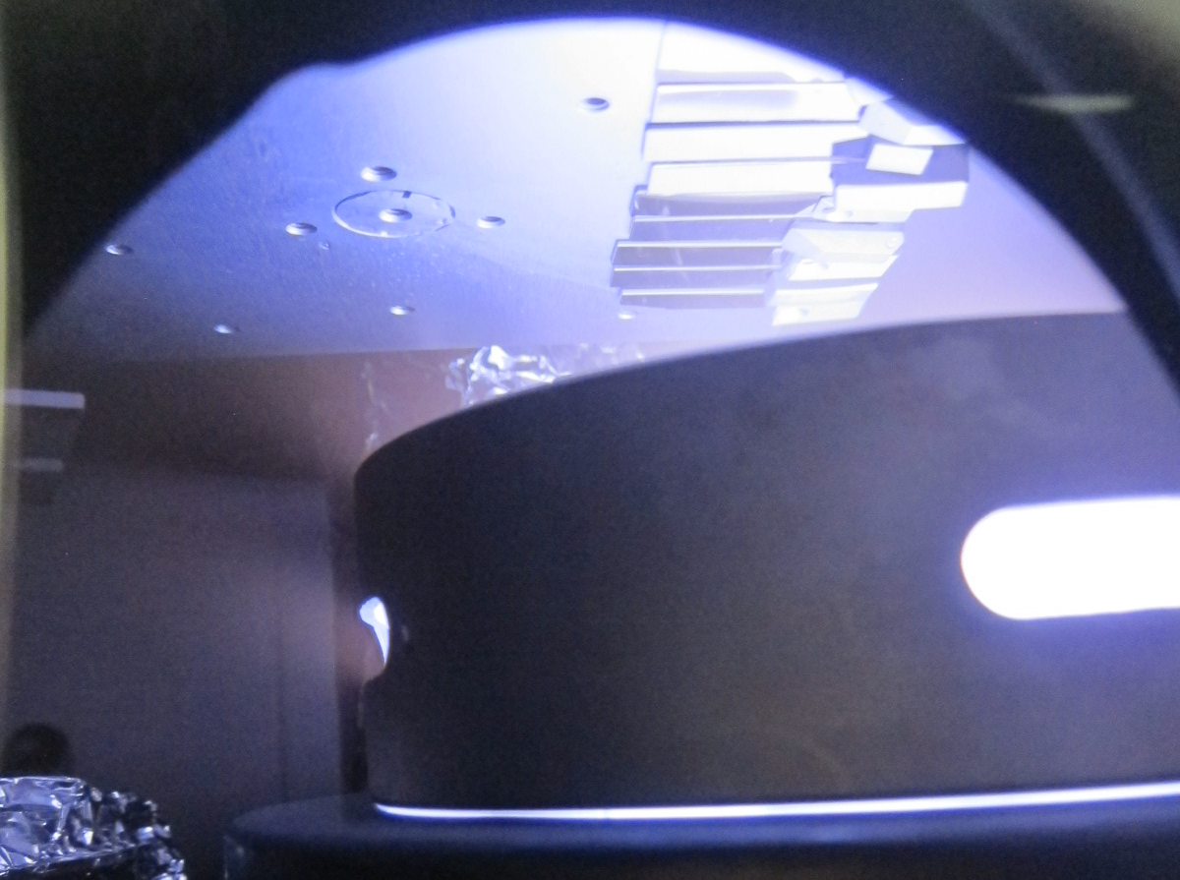
Needs and technological solutions
Main requirements:
metallic thin films
Ultra-pure (UHV compatibility)
Technological choice: Physical Vapor Deposition
e⁻
Ar (10^{-4/-3} mbar))
Low working pressure
High coating rate
More complex set-up

Slide 13
Needs and technological solutions
Main requirements:
metallic thin films
Ultra-pure (UHV compatibility)
Technological choice: Physical Vapor Deposition
e⁻
Ar (10^{-4/-3} mbar))
Low working pressure
High coating rate
More complex set-up

Slide 14
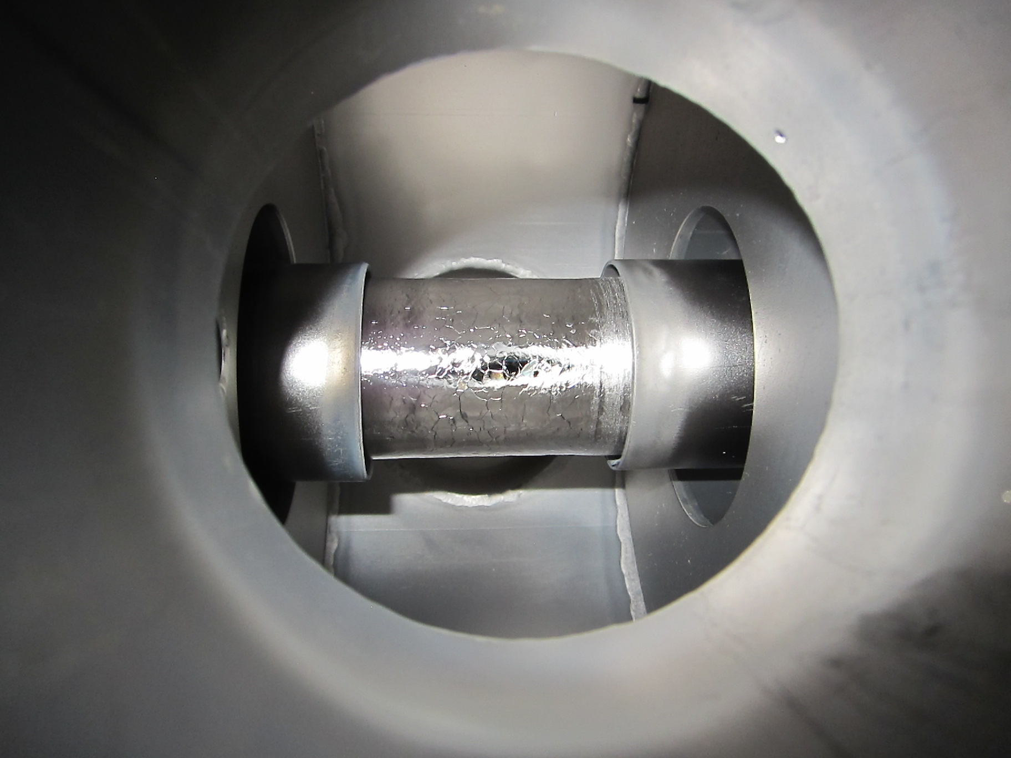
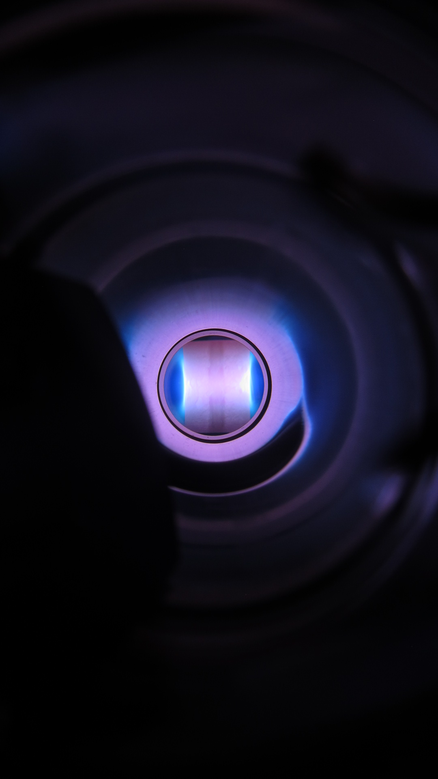
Needs and technological solutions
Main requirements:
metallic thin films
Ultra-pure (UHV compatibility)
Technological choice: Physical Vapor Deposition
e⁻
Ar (10^{-4/-3} mbar))
Low working pressure
High coating rate
More complex set-up

Slide 15
Needs and technological solutions
Main requirements:
metallic thin films
Ultra-pure (UHV compatibility)
Technological choice: Physical Vapor Deposition
e⁻
Ar (10^{-4/-3} mbar))
Low working pressure
High coating rate
More complex set-up

Slide 16
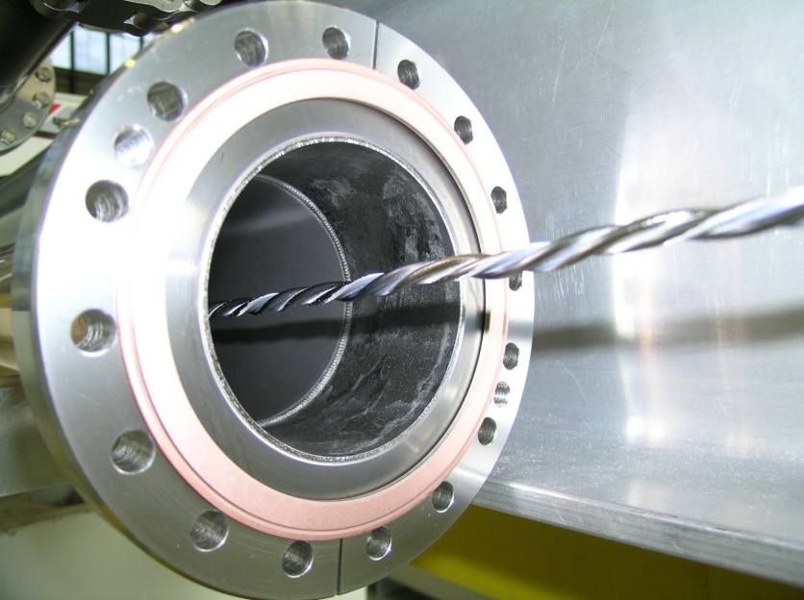
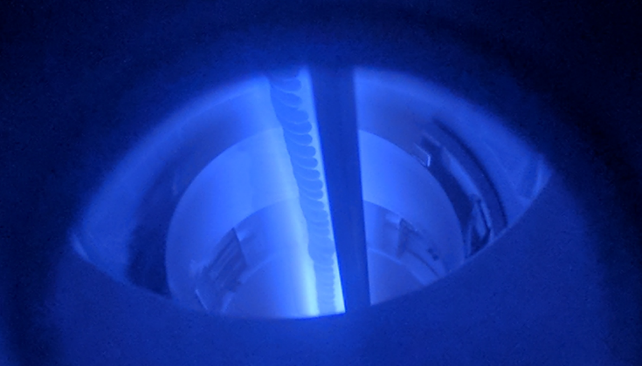
Needs and technological solutions
Main requirements:
metallic thin films
Ultra-pure (UHV compatibility)
Technological choice: Physical Vapor Deposition
Courtesy S. Leith
e⁻
Ar (10^{-4/-3} mbar))
Courtesy P. Costa-Pinto
Low working pressure
High coating rate
More complex set-up

Slide 17
Needs and technological solutions
Direct Current Magnetron Sputtering
DC power supply
Power regulated
High coating rate
Poor conformality, porosities
Pulsed DCMS
Pulsed DC power supply
Arc mitigation
Dielectrics
Reactive sputtering
High Power Impulse Magnetron Sputtering
Pulsed power supply
Low duty cycle (~2%)
Metallic vapor ionization (~70%)
Dense layers (using biasing voltage)
Bombardment energy control
Low substrate heating
Low coating rate
Main requirements:
metallic thin films
Ultra-pure (UHV compatibility)
Technological choice: Physical Vapor Deposition
e⁻
Ar (10^{-4/-3} mbar))
Low working pressure
High coating rate
More complex set-up

Slide 18
Main Applications

Slide 19
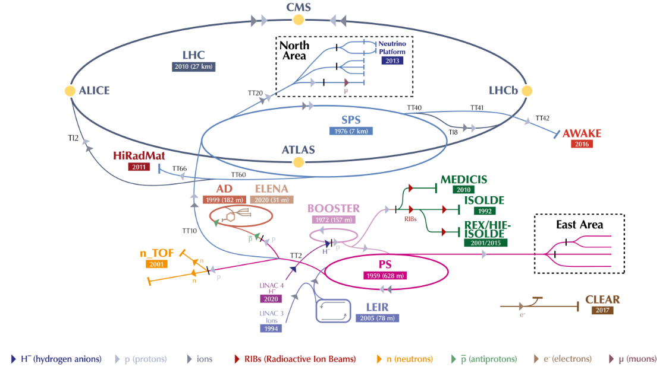
Thin films for accelerator complex

Slide 20
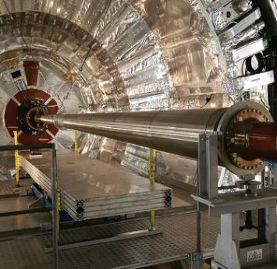
Thin films for accelerator complex
Non Evaporable Getters Ti-Zr-V

Slide 21
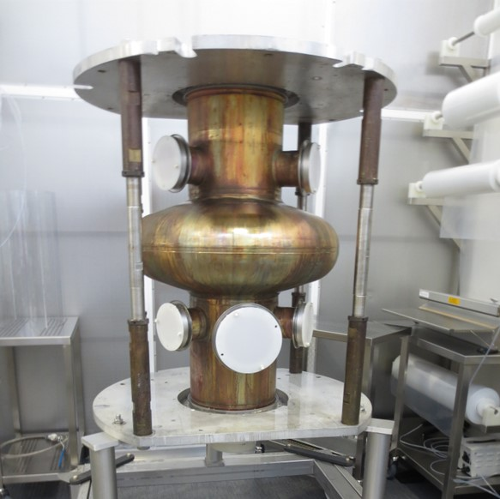
Thin films for accelerator complex
Non Evaporable Getters Ti-Zr-V
Accelerating Cavities (Nb/Cu)

Slide 22
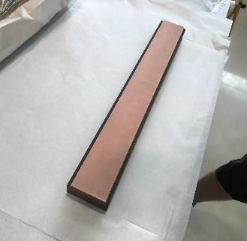
Thin films for accelerator complex
Non Evaporable Getters Ti-Zr-V
Accelerating Cavities (Nb/Cu)
Cu coating on graphite blocks (collimation)

Slide 23
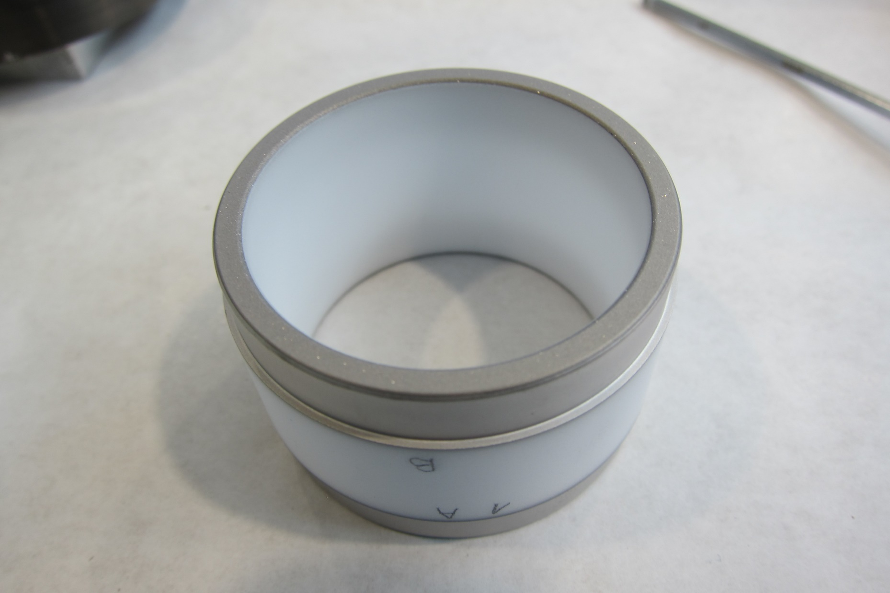
Thin films for accelerator complex
Non Evaporable Getters Ti-Zr-V
Accelerating Cavities (Nb/Cu)
Cu coating on graphite blocks (collimation)
High resistivity coatings on ceramics

Slide 24
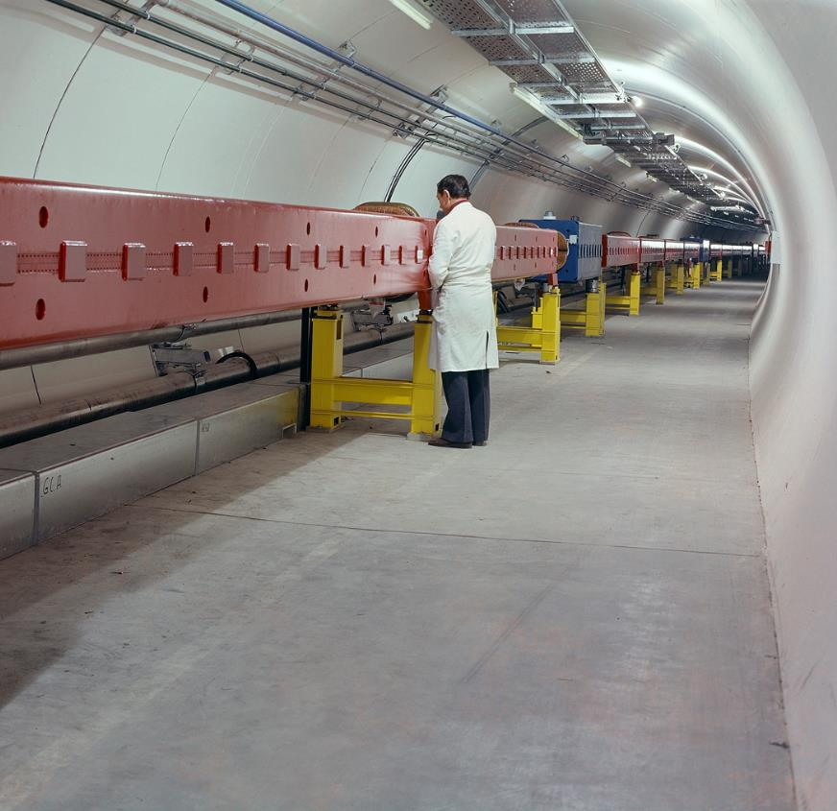
Thin films for accelerator complex
Non Evaporable Getters Ti-Zr-V
Accelerating Cavities (Nb/Cu)
Cu coating on graphite blocks (collimation)
High resistivity coatings on ceramics
Low Secondary Electron Yield coatings

Slide 25
Non Evaporable Getters

Slide 26
NEG coatings
Principle
Active surface for pumping
Oxide layer
Temperature
Oxygen in the film
Activation temperature
RT
NEG
Time
Chemically adsorbing gas molecules (CO, O₂, H₂O, CO₂, N₂, H₂).
Not pumped: noble gases and CH₄ (at room temperature)

Slide 27
NEG coatings
Principle
Why is it interesting?
Active surface for pumping
Oxide layer
Temperature
Oxygen in the film
Activation temperature
RT
NEG
Time
…
…
Chemically adsorbing gas molecules (CO, O₂, H₂O, CO₂, N₂, H₂).
Not pumped: noble gases and CH₄ (at room temperature)
PUMP

Slide 28
NEG coatings
Principle
Why is it interesting?
P(x)
Active surface for pumping
P_{max} (no NEG)
Oxide layer
Temperature
Oxygen in the film
Activation temperature
RT
x
NEG
Time
…
…
Chemically adsorbing gas molecules (CO, O₂, H₂O, CO₂, N₂, H₂).
Not pumped: noble gases and CH₄ (at room temperature)
PUMP

Slide 29
NEG coatings
Principle
Why is it interesting?
P(x)
Active surface for pumping
P_{max} (no NEG)
Oxide layer
Temperature
Oxygen in the film
Activation temperature
P_{max} (NEG)
RT
x
NEG
Time
…
…
Chemically adsorbing gas molecules (CO, O₂, H₂O, CO₂, N₂, H₂).
Not pumped: noble gases and CH₄ (at room temperature)
PUMP

Slide 30
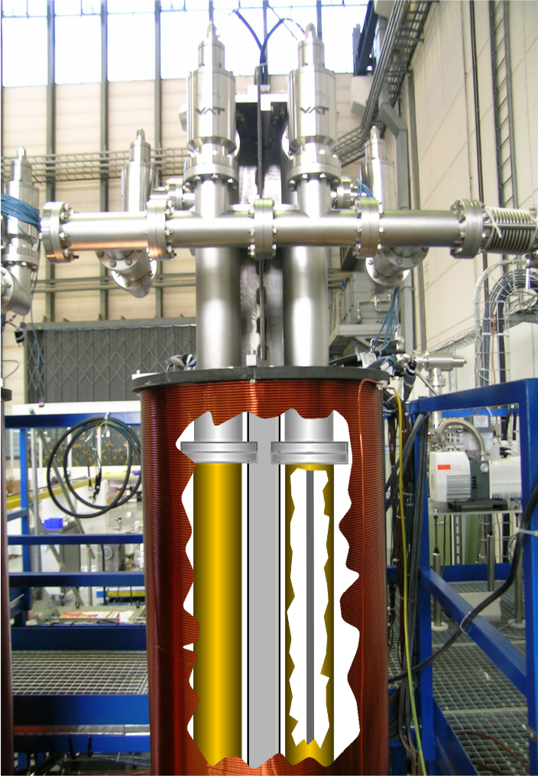
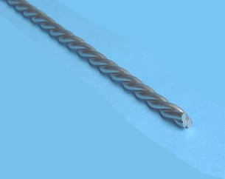
NEG production at CERN
3mm wires of Ti, Zr and V

Slide 31
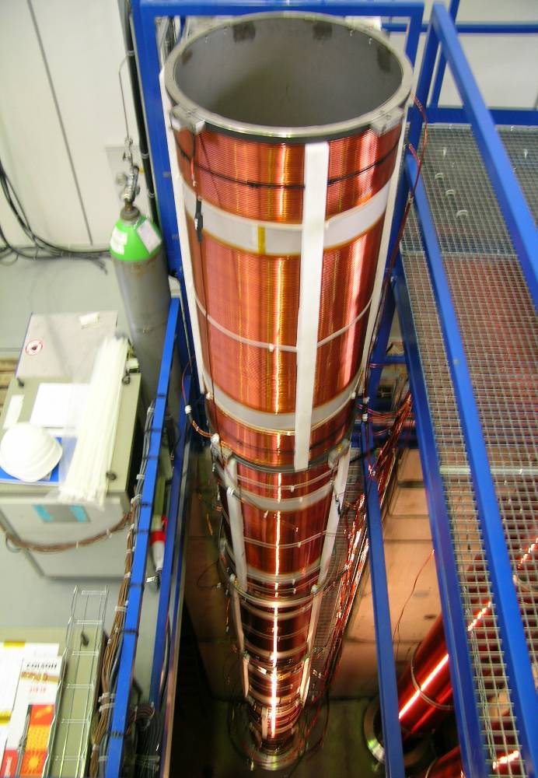
NEG production at CERN
3mm wires of Ti, Zr and V

Slide 32
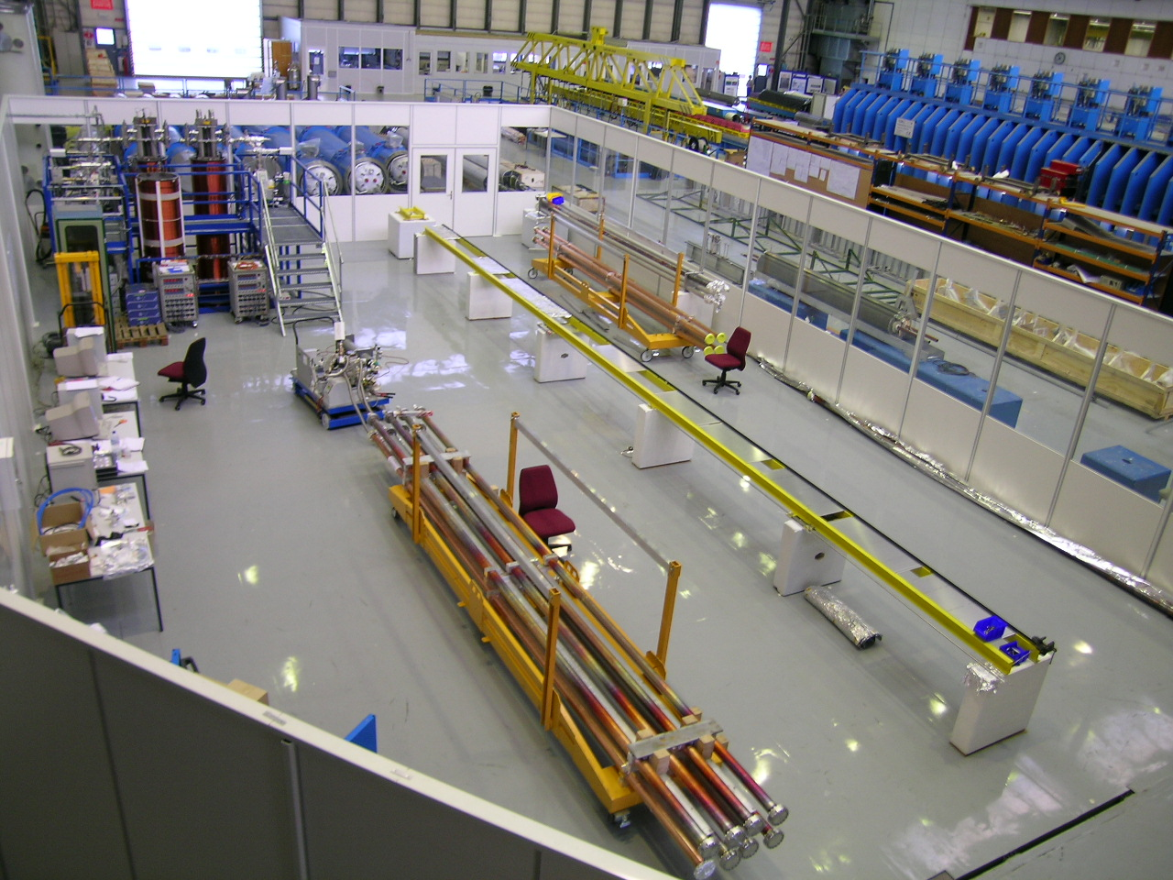
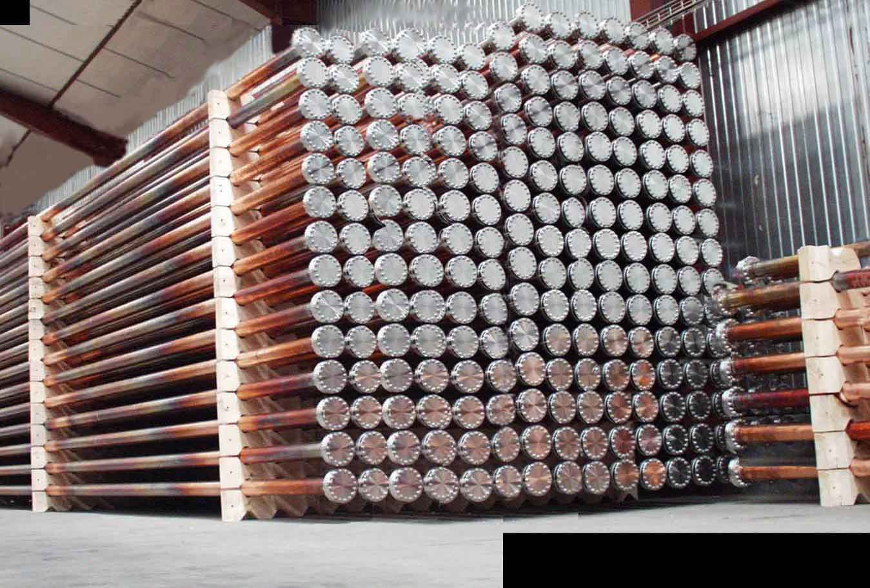
NEG production at CERN
>3km of beam pipes in the LHC
3mm wires of Ti, Zr and V
Courtesy P. Costa-Pinto

Slide 33
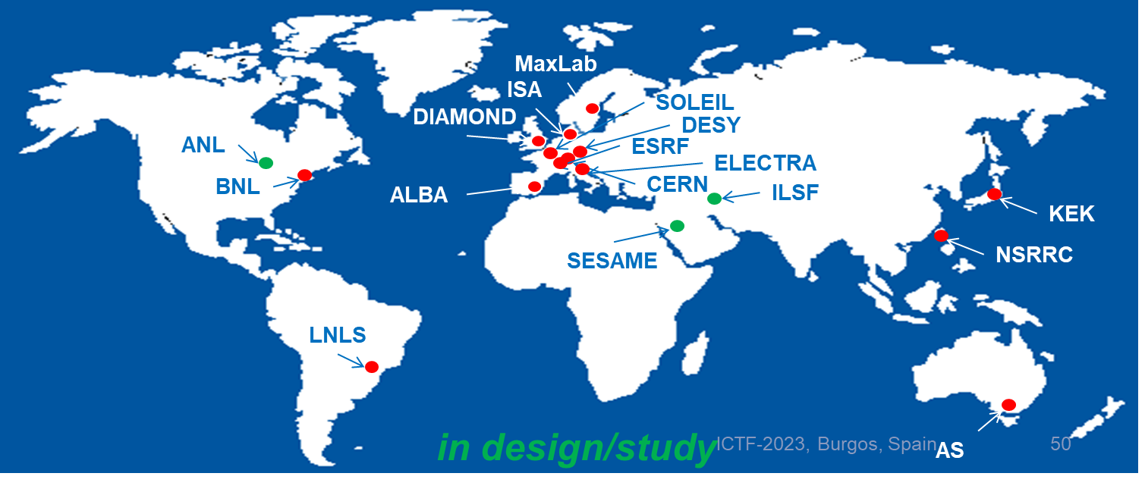
NEG production beyond CERN

Slide 34
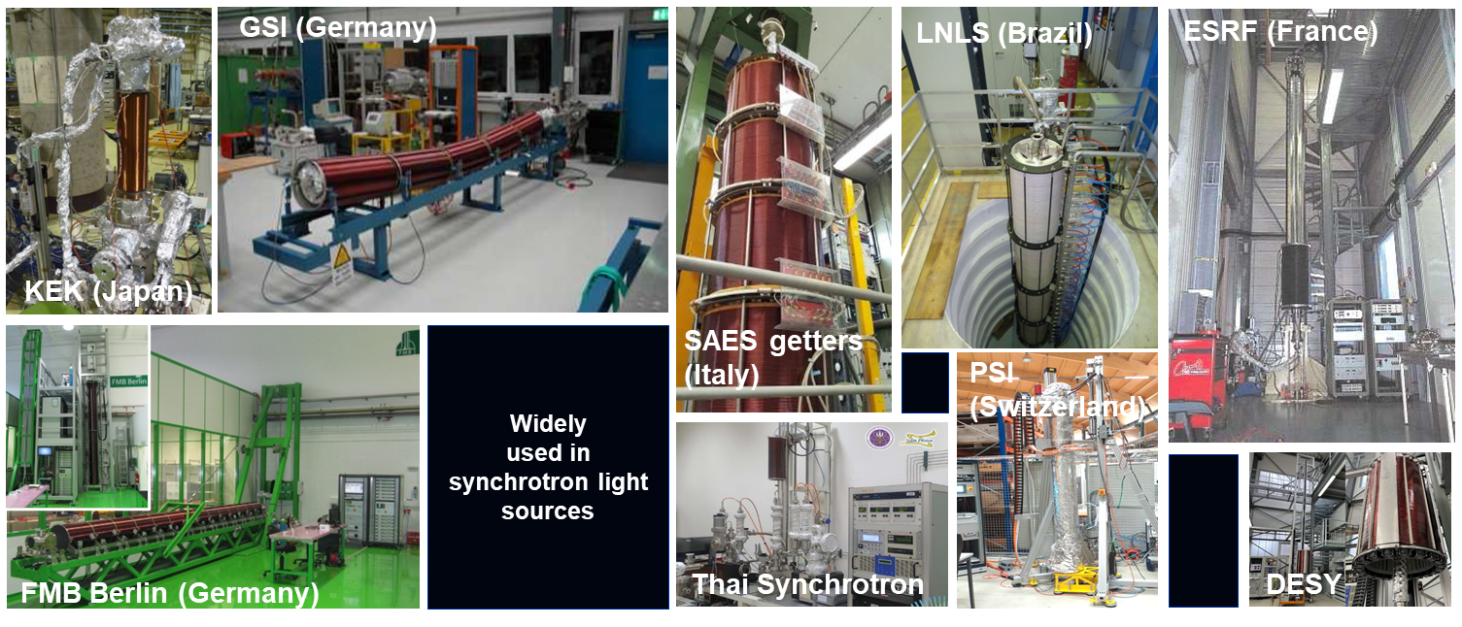
NEG production beyond CERN
Courtesy P. Costa-Pinto

Slide 35
a-C coatings

Slide 36
e- Cloud Problematic
Thermal load
Sec. e⁻
p⁺
p⁺
p⁺
p⁺
Prim. e⁻
hν
Electron Stimulated Desorption
Courtesy P. Costa-Pinto

Slide 37
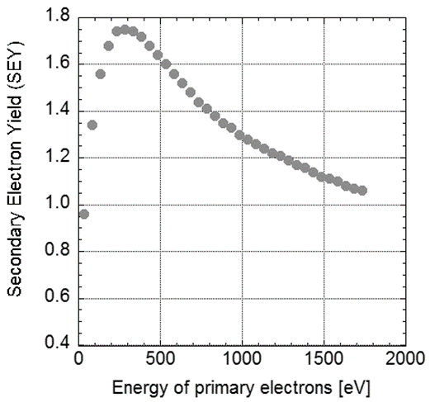
e- Cloud Problematic
Thermal load
Mitigation
Reduce Secondary Electron Yield of the surfaces
Sec. e⁻
p⁺
p⁺
p⁺
p⁺
Prim. e⁻
hν
Electron Stimulated Desorption
Courtesy P. Costa-Pinto

Slide 38
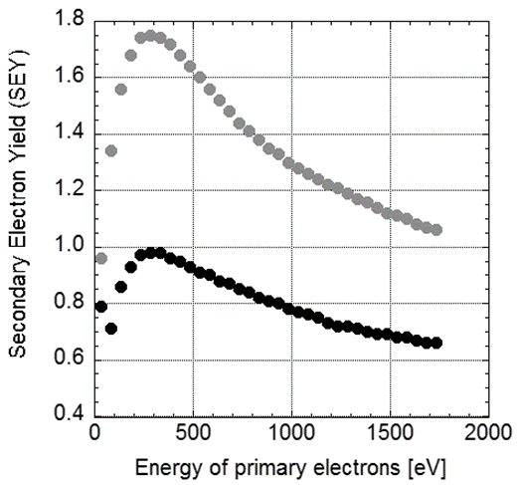
e- Cloud Problematic
Thermal load
Mitigation
Reduce Secondary Electron Yield of the surfaces
Sec. e⁻
p⁺
p⁺
p⁺
p⁺
Prim. e⁻
hν
Electron Stimulated Desorption
Courtesy P. Costa-Pinto

Slide 39
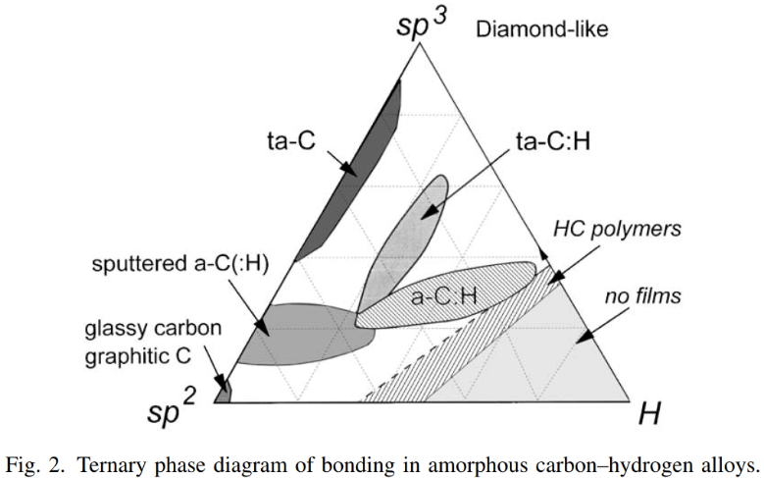
e- Cloud Problematic
Thermal load
Mitigation
Reduce Secondary Electron Yield of the surfaces
Sec. e⁻
p⁺
p⁺
p⁺
p⁺
Prim. e⁻
hν
Electron Stimulated Desorption
Courtesy P. Costa-Pinto

Slide 40
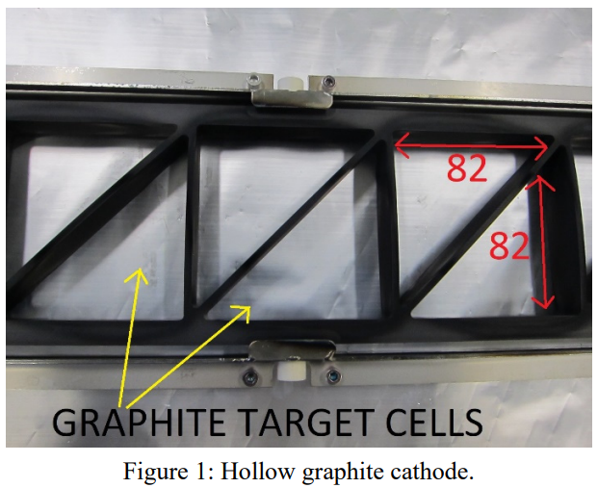
Coatings for our machines (in-situ)
Courtesy P. Costa-Pinto
> 200 components coated in the SPS tunnel

Slide 41
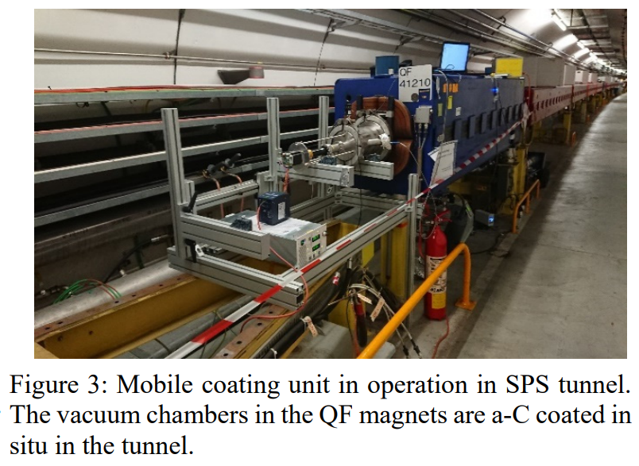
Coatings for our machines (in-situ)
Courtesy P. Costa-Pinto
doi:10.18429/JACoW-IPAC2021-WEPAB338
> 200 components coated in the SPS tunnel

Slide 42
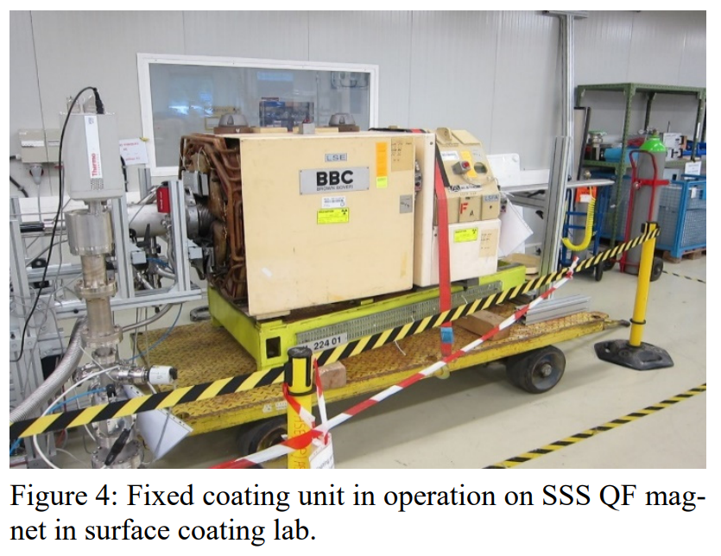
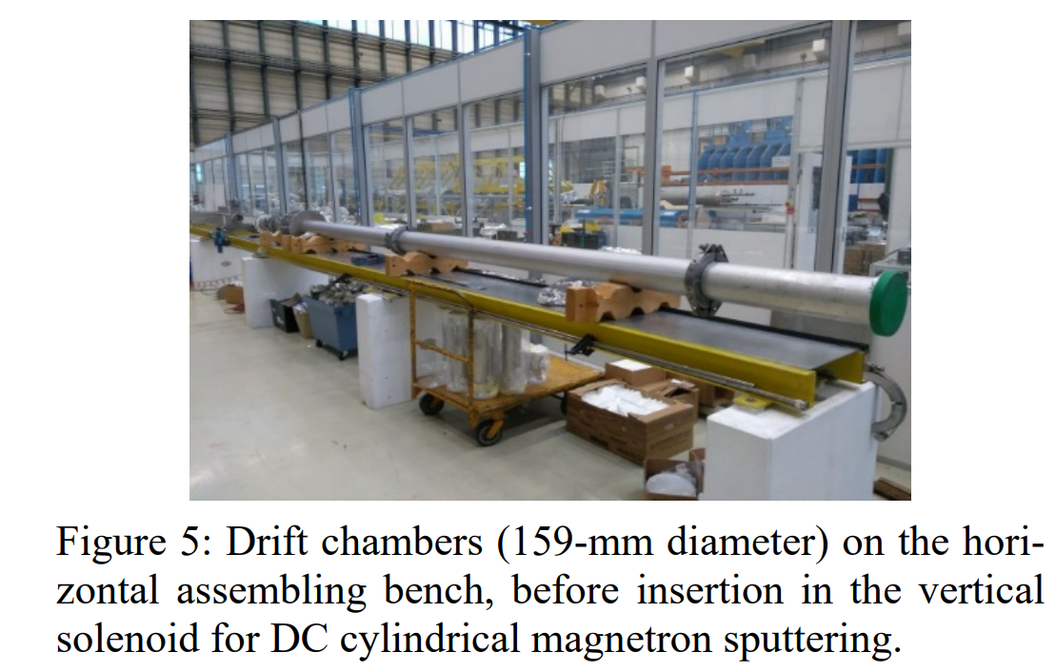
Coatings for our machines (ex-situ)
Courtesy W. Vollenberg
doi:10.18429/JACoW-IPAC2021-WEPAB338

Slide 43
Superconducting thin films

Slide 44
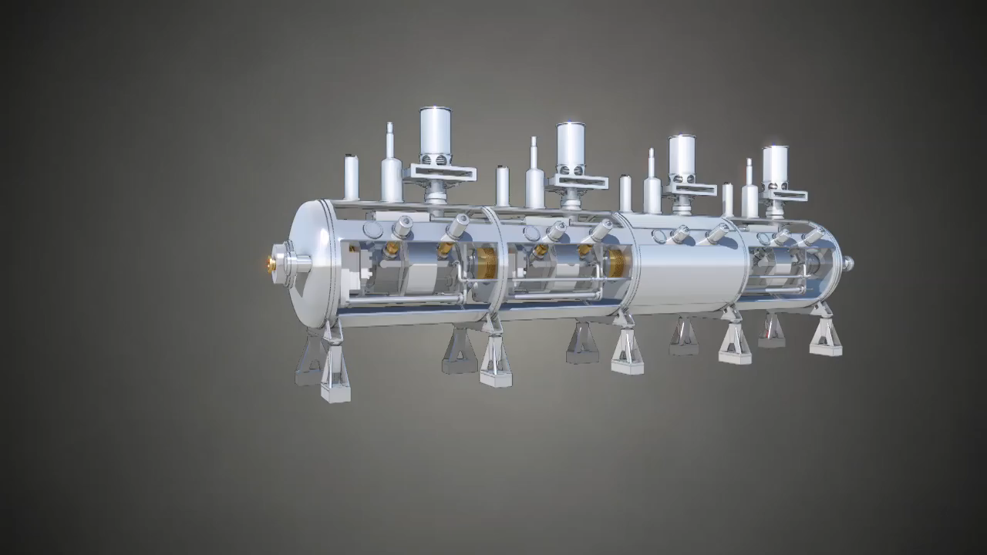
Accelerating cavities

Slide 45
Needs
Superconducting thin film (Nb)
Low surface resistance (nOhms)
Low power consumption (high quality factor)
High accelerating fields
PURITY AND CLEANLINESS ARE CRITICAL

Slide 46
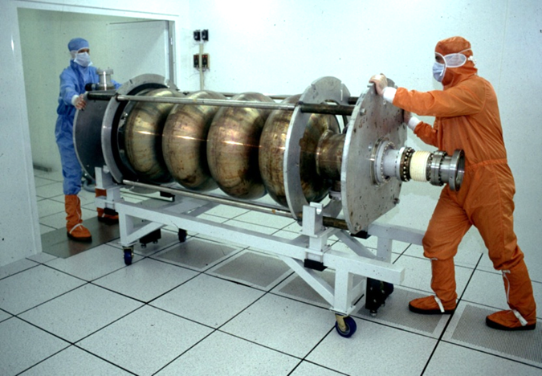
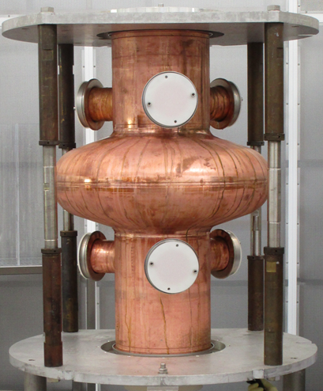
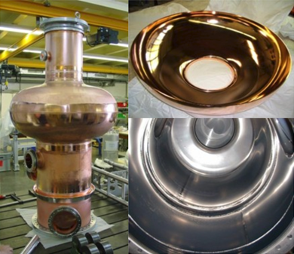
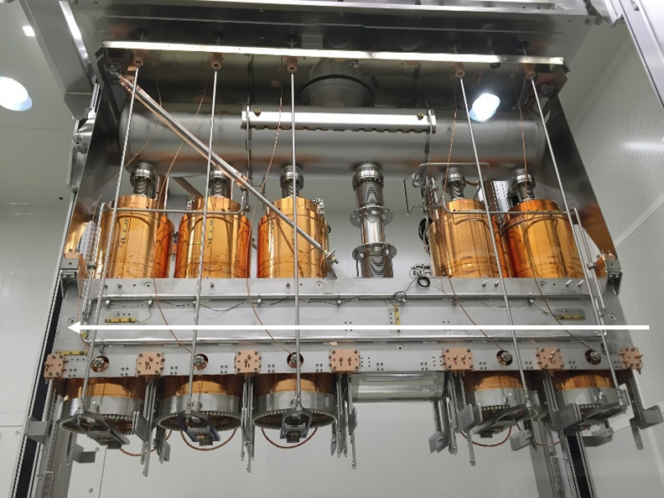
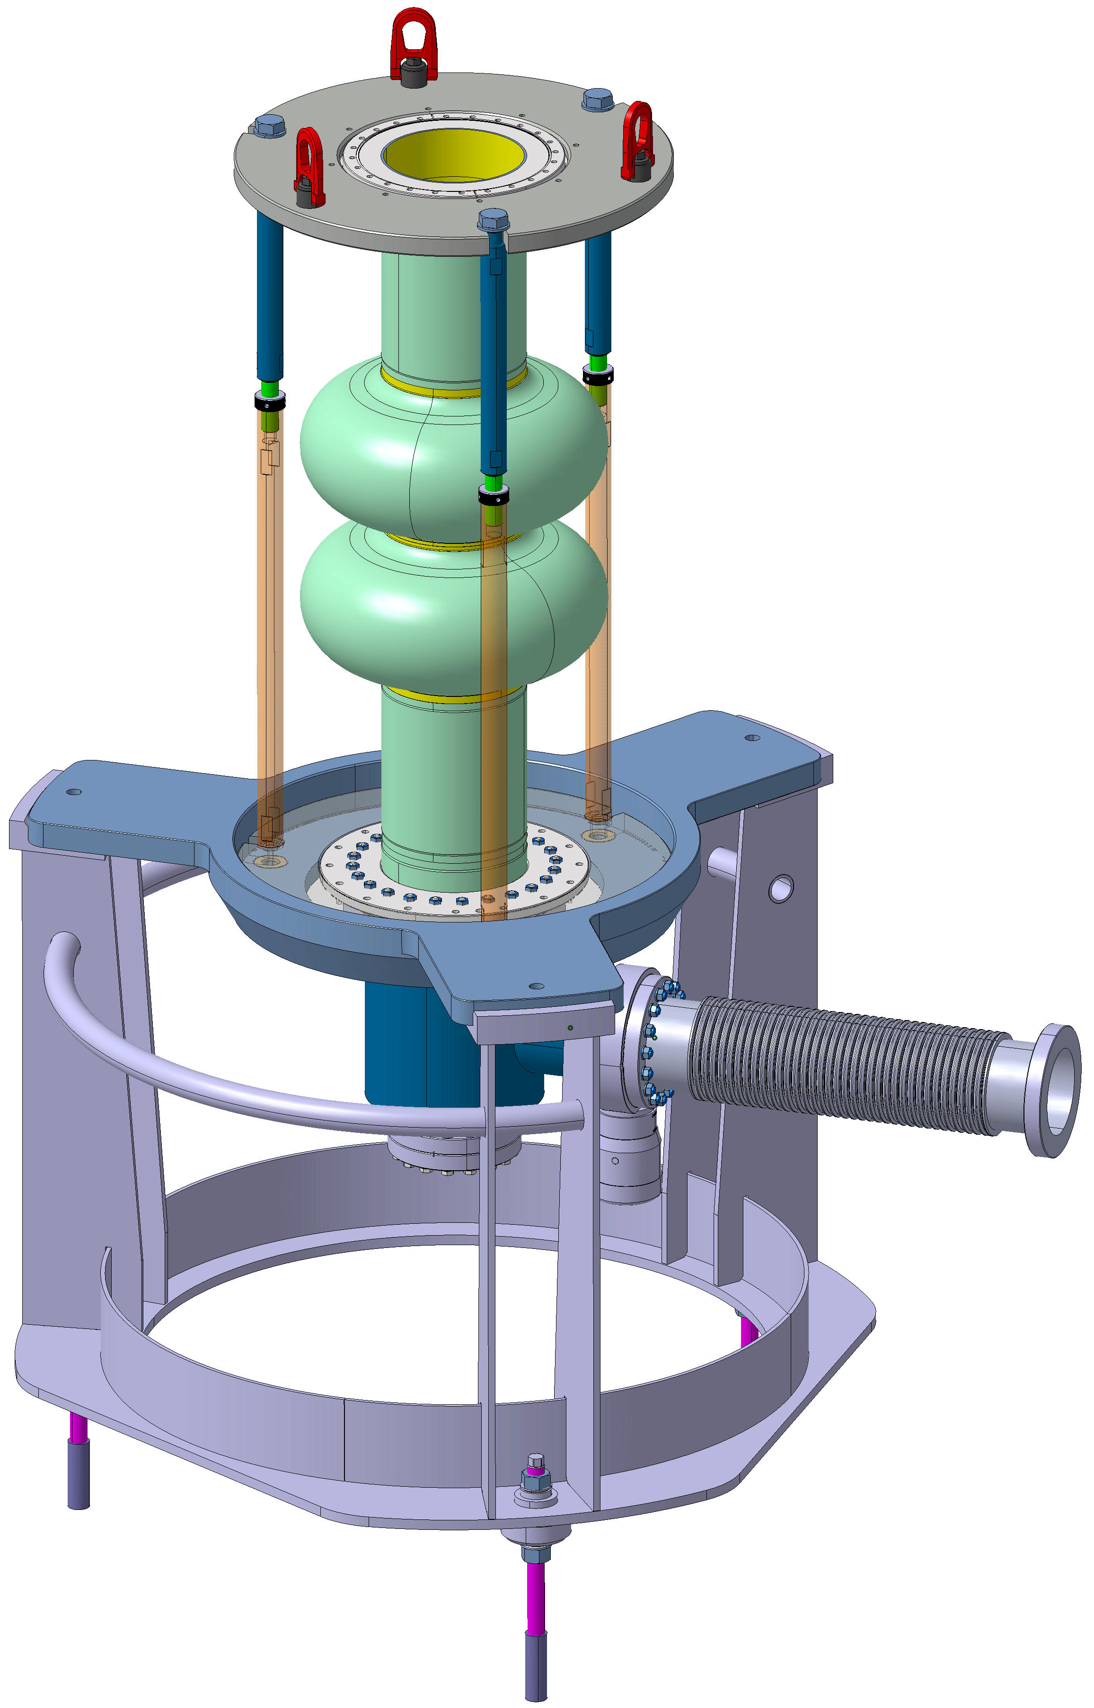
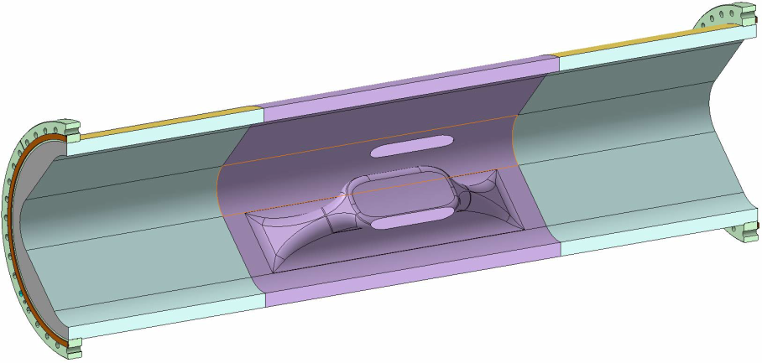
Activities overview
LEP
216 elliptical cavities (352 MHz) coated in industry
LHC
21 elliptical cavities (400MHz) coated in industry
8 new spares to be manufactured
SOLEIL
2 elliptical cavities (352 MHz) coated at CERN
HIE-ISOLDE
23 quarter wave cavities (101 MHz) coated at CERN
R&D Programs
1.3 / 1.5 GHz / low beta 704MHz Cu cavities
Others
Cornell Cavity (200MHz), Super-3HC cavities (double cell 1.5 GHz)
FCC
400/800 MHz elliptical cavities
WOW (Nb/Cu crabbing cavities)

Slide 47
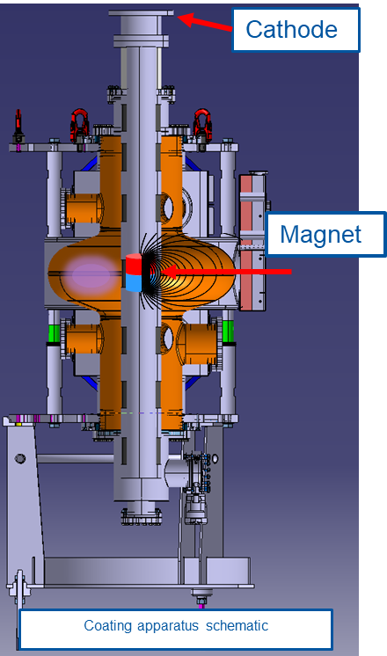
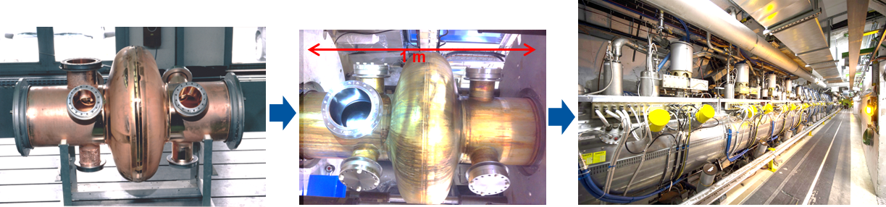
Methods

Slide 48
Methods

Slide 49
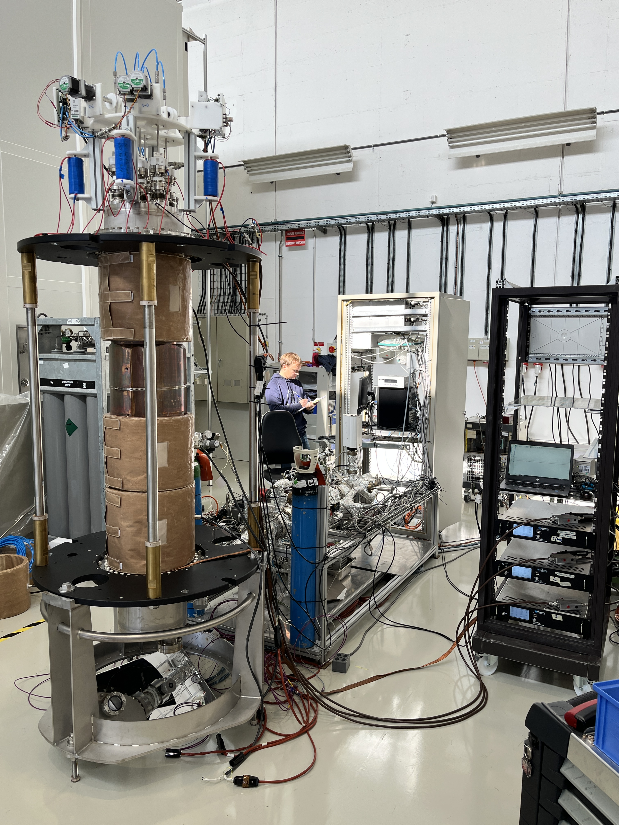
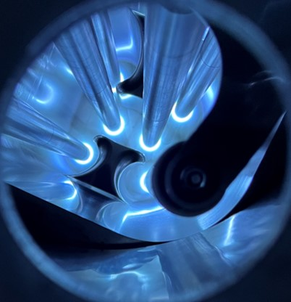
Methods

Slide 50
Challenges / Opportunities

Slide 51
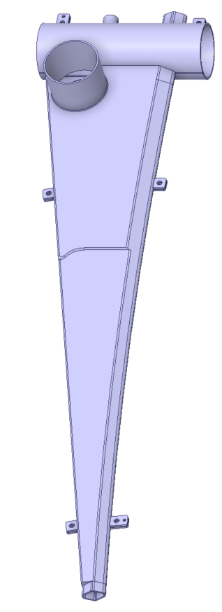
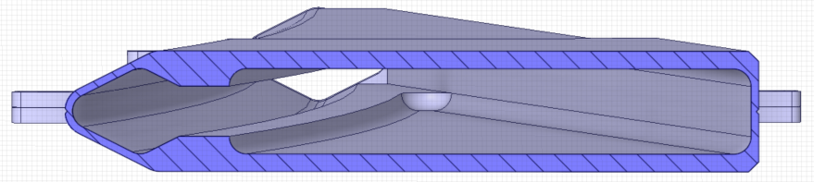
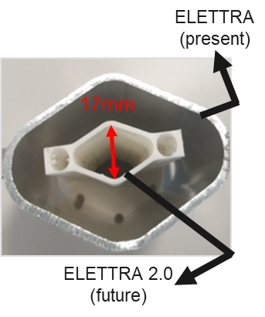
NEG coatings
Electrons
chamber
photons
chamber
ELETTRA Chambers
927 mm
17
mm
Courtesy S. Saroglia
110 mm
6.5º
Defining
coating method
Coating recipe
Transfer to industry for production (72 chambers)

Slide 52
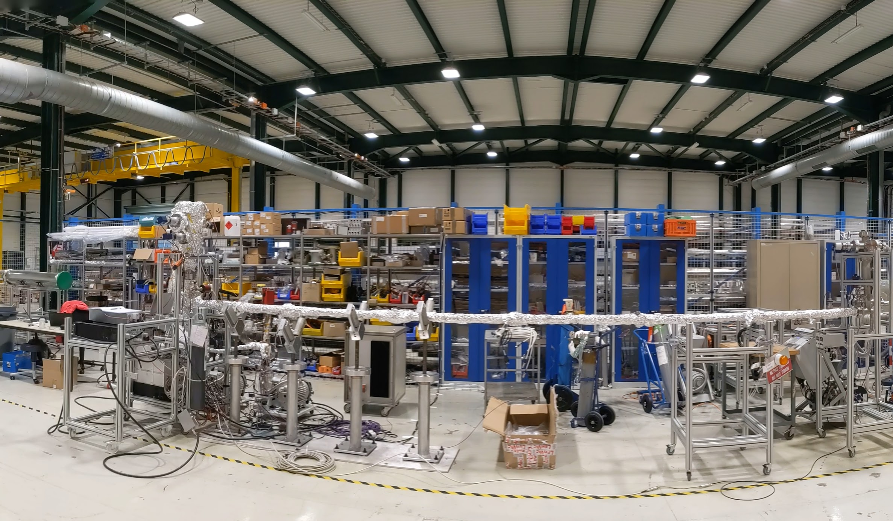
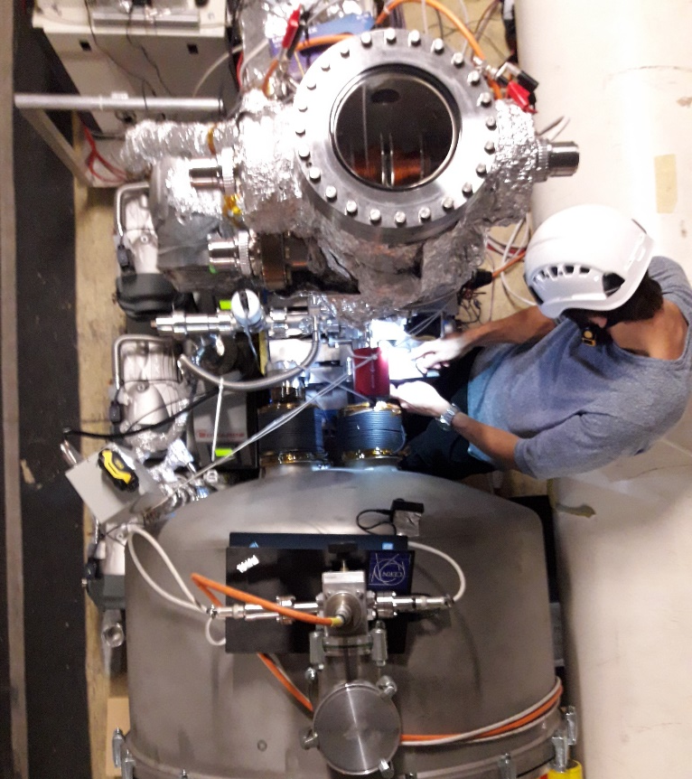
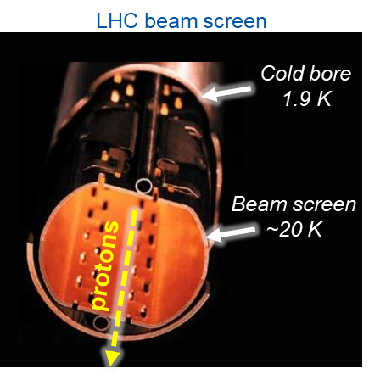
a-C coatings: Beam Screens Treatment project
LHC in-situ coating of the cryomagnets
Goal: reduce overall e-cloud induced heat load
In total: 10.6 km of beam screen to be coated (2026-2028)
Coating by sections of 53m
Full mock-up to be built
Coating robots to be designed and built
Limited space < 250 mm
Courtesy V. Petit

Slide 53
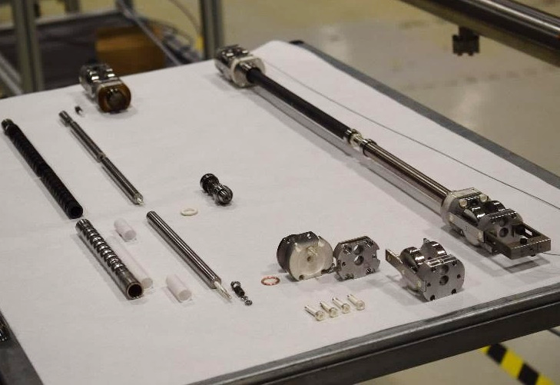
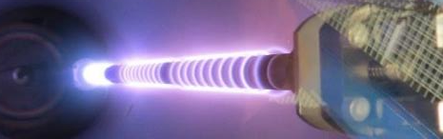
a-C coatings: Beam Screens Treatment project
LHC in-situ coating of the cryomagnets
Goal: reduce overall e-cloud induced heat load
In total: 10.6 km of beam screen to be coated (2026-2028)
Coating by sections of 53m
Full mock-up to be built
Coating robots to be designed and built
Modular sputtering source displaced by cables
Courtesy V. Petit

Slide 54
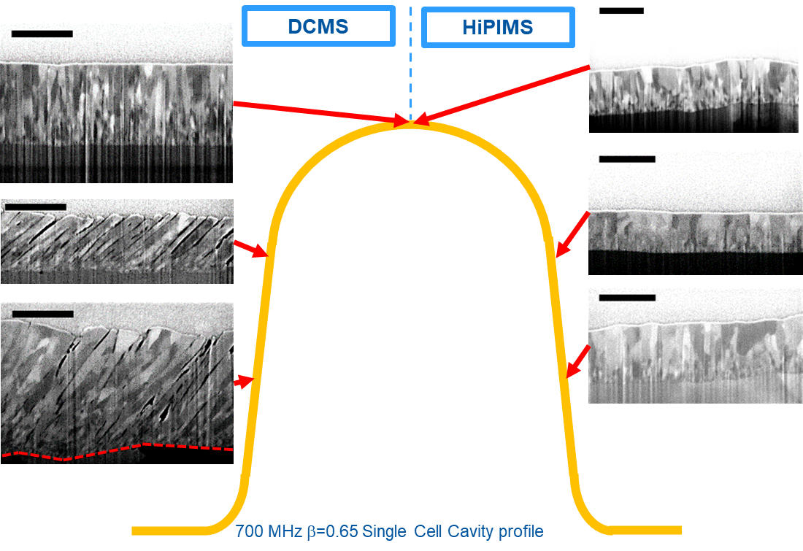
SC coatings
Reduce surface resistance
Increase maximum reachable field

Slide 55
SC coatings
Courtesy F. Peauger
Reduce surface resistance
Increase maximum reachable field
1.7 K
2 K
FCC-ee
1-cell
2-cell
4.5 K
LHC
4.5 K

Slide 56
SC coatings
Courtesy F. Peauger
Reduce surface resistance
Increase maximum reachable field
1.7 K
2 K
FCC-ee
1-cell
2-cell
4.5 K
LHC
4.5 K

Slide 57
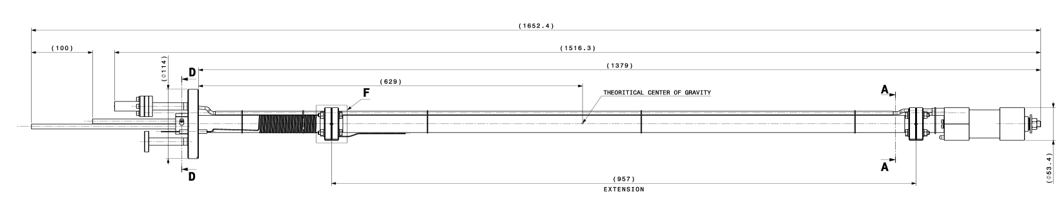
SC coatings
Reduce surface resistance
Increase maximum reachable field
Mobile and compact sputtering source

Slide 58
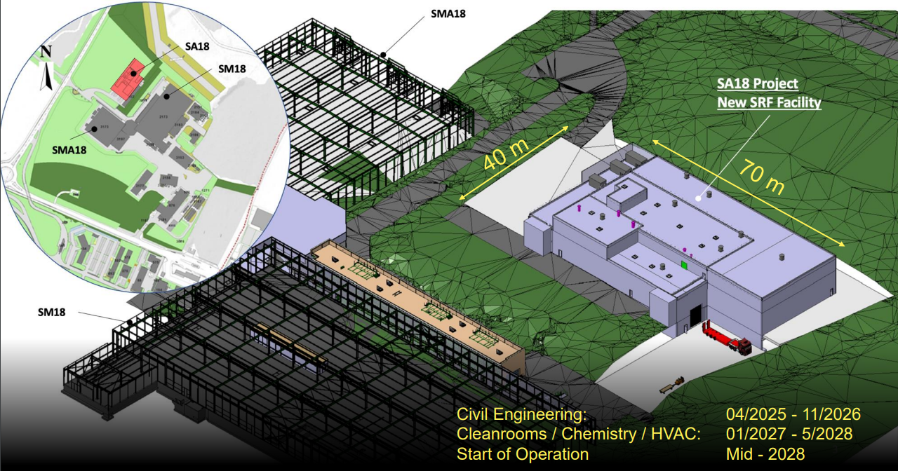

SC coatings
Courtesy D. Smekens
Trending up field
New investments

Slide 59
Conclusion
Wide use of surface modification by thin film coating
Broad range of applications / materials / substrates
Short term future of CERN strongly relies on that expertise
Worldwide demand for coatings for accelerators
CUSTOM COATING SETUPS : industry support needed
- Setup manufacturing
- Targets procurement
- Large productions (outsourcing)

Slide 60
Thank you for your attention

