Slide 1



UK XFEL: Conceptual Design and Options Analysis Phase
Dave Dunning
ASTeC, STFC Daresbury Laboratory and The Cockcroft Institute
UK Accelerator Institutes Seminar
19th October 2023
xfel.ac.uk

Slide 2
Contents
Introduction to XFELs
UK Context
The Conceptual Design and Options Analysis (CDOA) Project
Overview of Progress
Facility Design Progress
Next steps

Slide 3
Introduction to XFELs

Slide 4
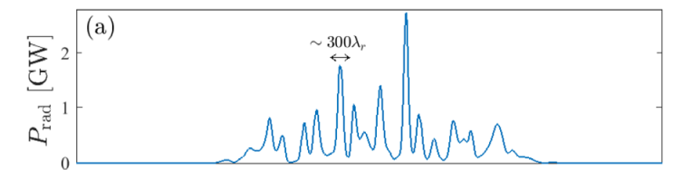
X-ray free-electron lasers
Undulator (period λ_{u} ~0.01 m)
Input for x-rays:
Low emittance, narrow energy spread,
relativistic electron bunch
4 – 15 GeV accelerated in 100 m - > 1 km electron linear accelerators (LINACS)
(relativistic electrons with a Lorentz factor ϒ ~ several thousand)
Output
High brightness,
short pulse of coherent
soft to hard X-rays
XFEL radiation wavelength
λ_{r} ~ λ_{u} ϒ⁻²
Electron energy modulation
Electron micro-bunching
Radiation emission
Exponential amplification
Very wide range of wavelengths with unprecedented power in X-ray range
Very short pulses – hundreds of attoseconds to femtoseconds
Rapidly tuneable & can be synchronised to other sources
There is an intrinsic coherence length of ~hundreds of attoseconds, but with several demonstrated or emerging techniques for transform limited pulses
The amplification process spoils the bunch, making it more challenging to serve multiple experiments
t

Slide 5
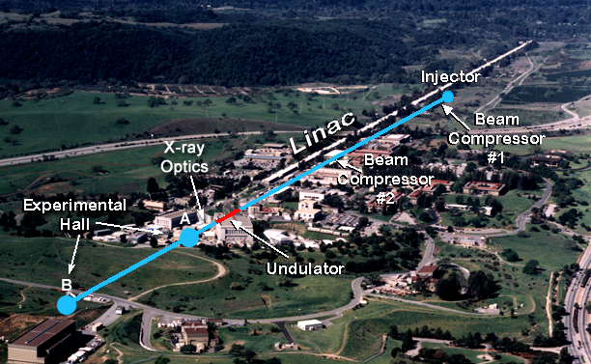
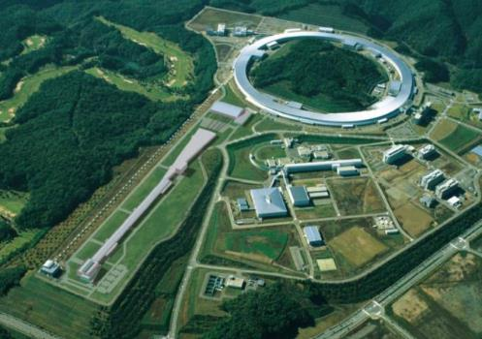
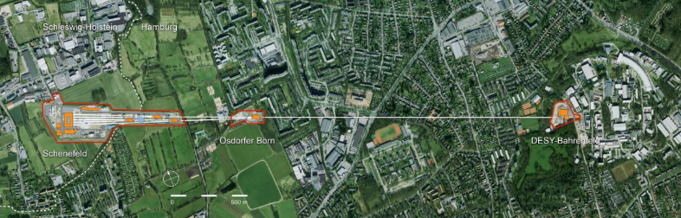
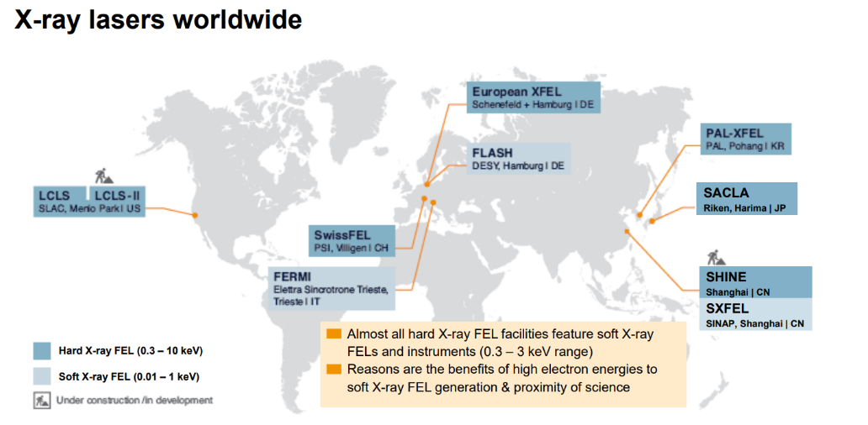
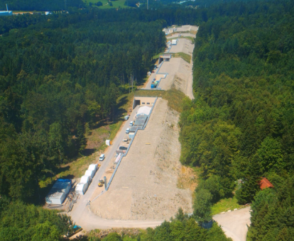
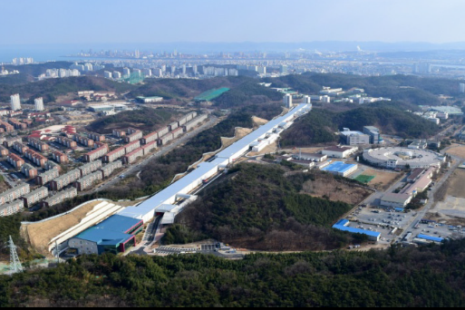
International X-ray FEL facilities
LCLS (USA)
LCLS II & LCLS II HE (USA)
SACLA (Japan)
European XFEL (Germany)
Flash I & II (Germany)
Fermi@Elettra (Italy)
Swiss FEL (Switzerland)
PAL XFEL (Korea)
SHINE (China)
LCLS, USA – 2009
SACLA, Japan – 2011
European XFEL, Germany – 2016/17
SwissFEL – 2016/17
PAL XFEL, Korea – 2016/17
https://accelconf.web.cern.ch/ipac2022/talks/tuiysp1_talk.pdf

Slide 6
Science driver for ultrafast X-rays is real-time access to the processes and fluctuations in matter down to the quantum scale
Electron-ion coupling timescales in conductors/ thermalisation in hot dense plasma
Material damage spallation, melting etc
Primary photoexcitation event
Lattice dynamics, exciton dynamics, magnon dynamics, phase changes etc.
Nuclear processes
Vibronic coupling timescales (chemical reaction)
Secondary/tertiary structure dynamics in biomolecules timescales
Valence electron dynamics
Ro-vibronic coupling timescales (structural fluctuation)
Inner shell electron dynamics
Timescales of excited modes at thermal equilibrium (T = 10K)
Timescales of excited modes at thermal equilibrium (T = 300 K)
10⁻¹⁷
10⁻¹⁶
10⁻¹⁵
10⁻¹⁴
10⁻¹³
10⁻¹²
10⁻¹¹
10⁻¹⁰
10⁻⁹
10⁻⁸
10⁻⁷
Time s
Synchrotron
XFEL
(future)
(current)

Slide 7
UK Context

Slide 8
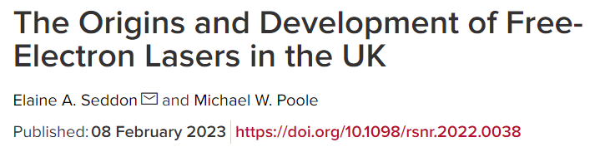

Background
2006
4GLS
Conceptual Design
VUV FEL,
600MeV @ 1.3GHz
XUV FEL,
950MeV @ 1kHz
+ IR FELs
Led to the ALICE ERL FEL

Slide 9
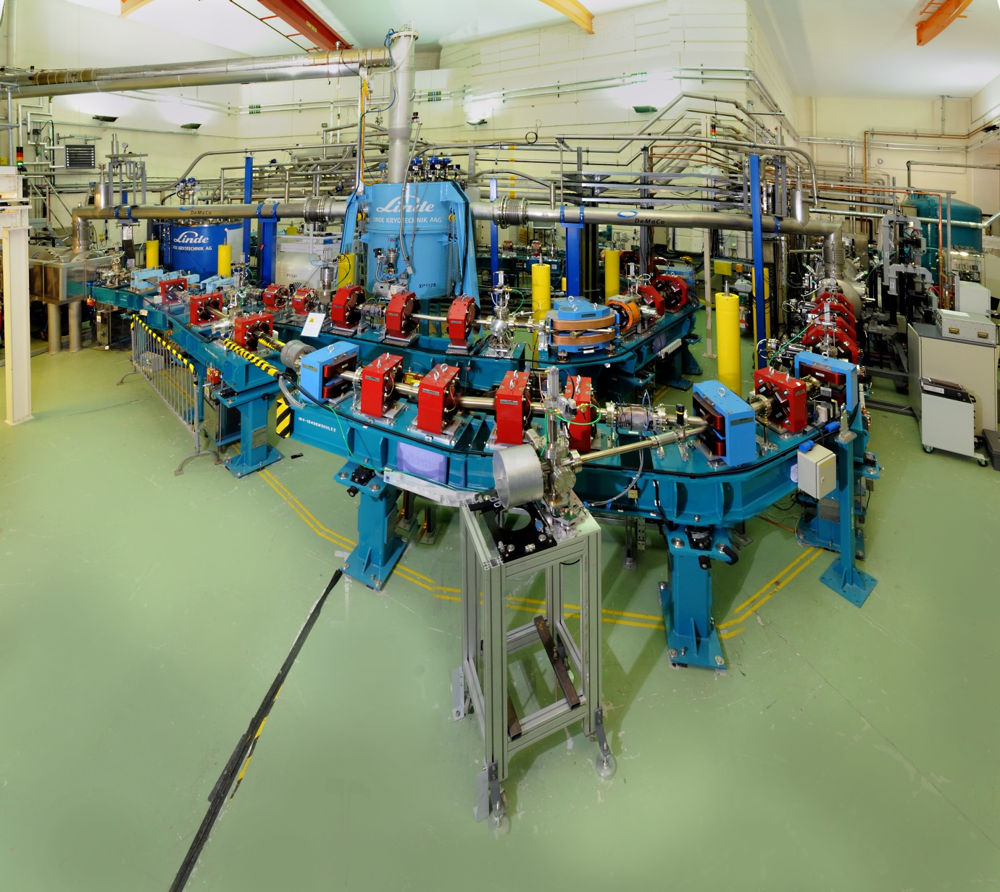
ALICE 27.5 MeV ERL IR FEL

Slide 10

Background
2006
2010
4GLS
Conceptual Design
VUV FEL,
600MeV @ 1.3GHz
XUV FEL,
950MeV @ 1kHz
+ IR FELs
Led to the ALICE ERL FEL
NLS
Conceptual Design
FEL-1: 50-300 eV
FEL-2: 250-850 eV
FEL-3: 430-1000 eV
2.25 GeV, 1 kHz to 1 MHz
Led to the CLARA facility

Slide 11
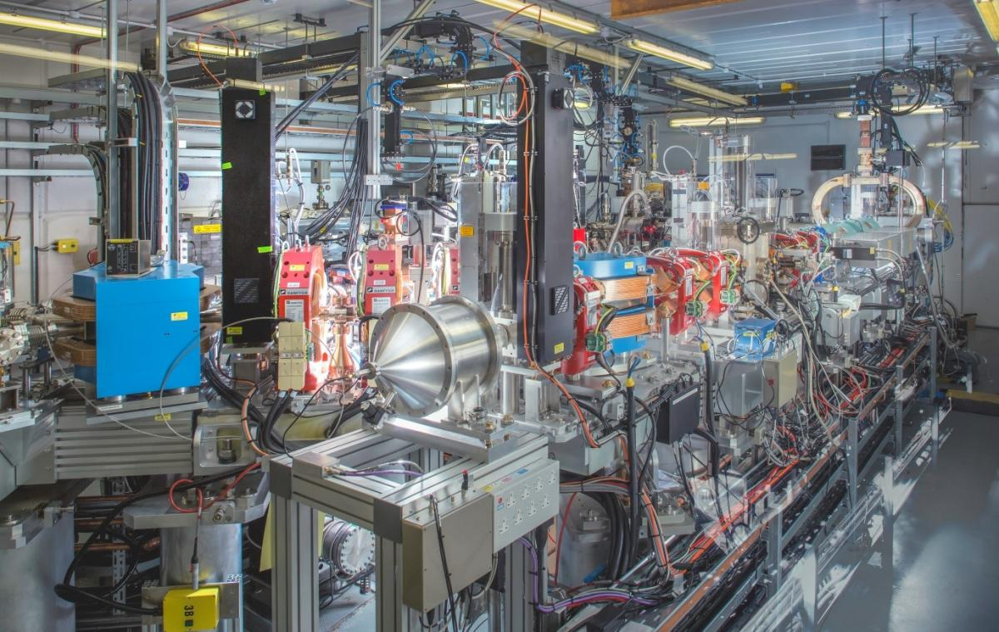
CLARA 250 MeV Test Facility

Slide 12
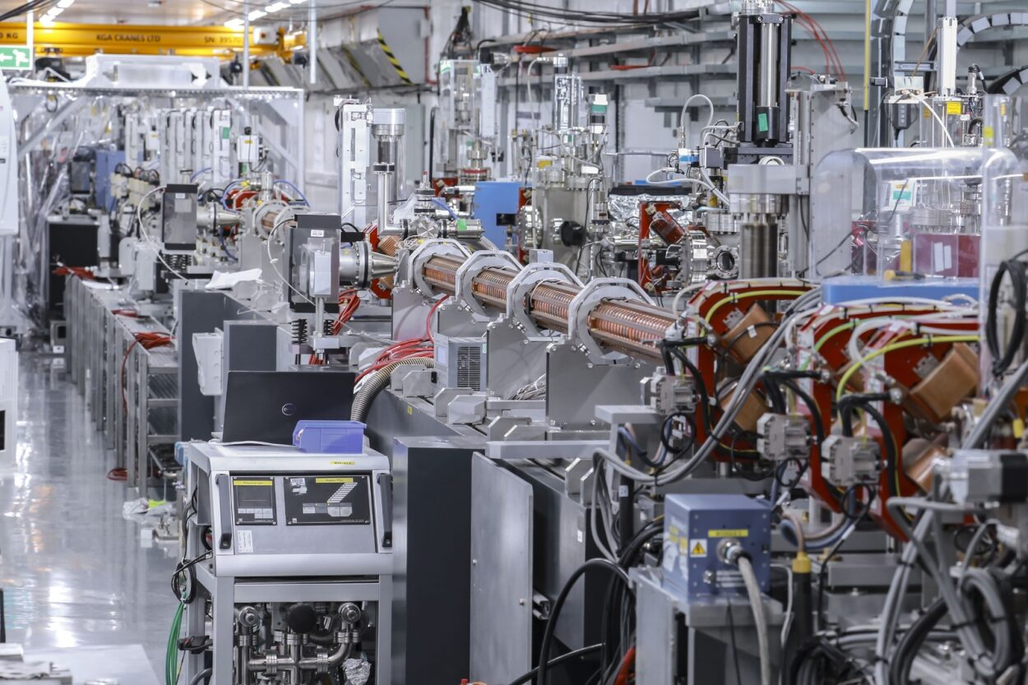
CLARA 250 MeV Test Facility

Slide 13



Background
2006
2010
2016
2018
2020
4GLS
Conceptual Design
VUV FEL,
600MeV @ 1.3GHz
XUV FEL,
950MeV @ 1kHz
+ IR FELs
Led to the ALICE ERL FEL
NLS
Conceptual Design
FEL-1: 50-300 eV
FEL-2: 250-850 eV
FEL-3: 430-1000 eV
2.25 GeV, 1 kHz to 1 MHz
Led to the CLARA facility
FELs
Strategic Review
Not a facility design but highlighted a SwissFEL-like option + increased international engagement
Eu-XFEL + UK
UK becomes a member of Eu-XFEL
UK XFEL
Science Case
Soft x-rays @ 1 MHz
Hard x-rays @ 1 kHz to 1 MHz

Slide 14



The Science Case for UK XFEL 2019-2020
xfel.ac.uk
In the last decade XFELs have had an impressive scientific impact, but there is clearly scope to do much, much more.
Taking a long view we looked at what kind of science we will do with an advanced XFEL operating from mid 2030’s. Extrapolating current technology advances to frame what will be possible.
Science Case Objectives:
To demonstrate scientific need
To define a next generation XFEL capability
To inform the technology that must be developed
Published in 2020 – available online at xfel.ac.uk
xfel.ac.uk
Notes:
1274-WP0-prs-0025-v1.0-UKXFEL Community Slides Extended

Slide 15
Authored by an expert science team
Matter in extreme conditions: Andy Higginbotham (York), Andy Comley (AWE), Sam Vinko (Ox), Marco Borghesi (QUB), Malcolm McMahon (Edinburgh), Justin Wark (Ox)
Nano/Quantum materials: Anna Regoutz (UCL), Marcus Newton (Soton), Ian Robinson (UCL/Brookhaven), Mark Dean (Brookhaven), Simon Wall (ICFO)
Engineering/Materials/Applications: David Rugg (RR), Sven Schroeder (Leeds), David Dye (IC)
Life sciences: Allen Orville (DLS), Jasper van Thor (IC), Xiaodong Zhang (IC)
Chemical sciences: Julia Weinstein (Sheffield), Russell Minns (Soton), Sofia Diaz-Moreno (DLS), Andrew Burnett (Leeds), Tom Penfold (Newcastle)
Physical sciences: Amelle Zair (KCL), Adam Kirrander (Edinburgh), Jason Greenwood (QUB),
Jon Marangos (IC and Science Lead)
*plus around 100 additional experts from around the world contributing to Science Case
Team significantly expanded in 2022 to also include:
Emma McBride (QUB), Awan Shakil (Plymouth), Paolo Raedelli (Oxford), Rebecca Ingle (UCL), Dan Eakins (Oxford), Mark Brouard (Oxford), Claire Vallance (Oxford), Elaine Seddon (Cockcroft), Sarnjeet Dhesi (Diamond), Adrian Mancuso (Diamond)
Notes:
1274-WP0-prs-0025-v1.0-UKXFEL Community Slides Extended

Slide 16
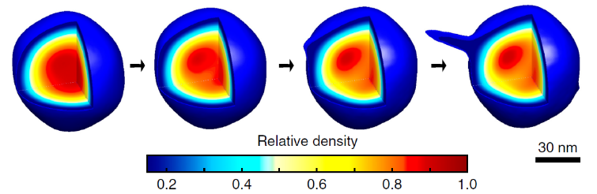
Ultrafast X-rays to probe attosecond electron dynamics, radiation interaction with materials & biomolecules & elementary processes in chemical reactions
High X-ray intensity and high data rate allow exploration of fundamentals of X-ray matter interaction & new concepts in time resolved imaging at nanoscopic scale of living systems and materials
Future XFEL Science Highlights
High energy/power optical lasers combined with bright X-rays access the conditions inside planets, stars and shocked materials in engineering, defence & fusion energy technologies

Slide 17
Transform limited X-rays and high data rates enable probing and optimisation of photochemical technologies, quantum materials, ultrafast magnetisation, & nanotechnologies
Future XFEL Science Highlights
X-rays synchronized to ultrafast lasers, THz and electrons uncover the fundamentals of chemical dynamics in the environment, space, engineering & energy materials
High rep-rate multi-colour ultrafast X-rays provide powerful approaches to systematic advances in e.g. catalysis, MEC, biochemistry & structural materials

Slide 18
UK XFEL
A next generation XFEL
Key next-generation capabilities identified in the UK XFEL Science Case:
- Transform limited operation across entire X-ray range
- High efficiency facility, with a step-change in the simultaneous operation of multiple end stations
- Evenly spaced, high-rep rate pulses to match samples & detectors
- Improved synchronisation/timing data with external lasers to < 1 fs
- Widely separated multiple colour X-rays to least one end-station
- Full array of synchronised sources:
XUV-THz, e-beams, high power & high energy lasers at high rep-rate
UK XFEL Science Case available at xfel.ac.uk

Slide 19

Where are we now?
2006
2010
2016
2018
2020
UK XFEL
Conceptual Design
& Options Analysis
(CDOA)
4GLS
Conceptual Design
VUV FEL,
600MeV @ 1.3GHz
XUV FEL,
950MeV @ 1kHz
+ IR FELs
Led to the ALICE ERL FEL
NLS
Conceptual Design
FEL-1: 50-300 eV
FEL-2: 250-850 eV
FEL-3: 430-1000 eV
2.25 GeV, 1 kHz to 1 MHz
Led to the CLARA facility
FELs
Strategic Review
Not a facility design but highlighted a SwissFEL-like option + increased international engagement
Eu-XFEL + UK
UK becomes a member of Eu-XFEL
UK XFEL
Science Case
Soft x-rays @ 1 MHz
Hard x-rays @ 1 kHz to 1 MHz

Slide 20
The Conceptual Design and Options Analysis (CDOA) Project

Slide 21
The Conceptual Design and Options Analysis (CDOA) Project
UKRI Infrastructure Fund supports step changes in infrastructure capability and capacity, including new infrastructures across the complete disciplinary spectrum from fundamental research to innovation-focused activities
The Infrastructure Fund enables the development of future infrastructures by supporting pilot, design and scoping studies. This can help UKRI better understand the costs or de-risk and refine the approach before a full proposal is developed.
The CDOA is just this type of Preliminary Activity.
The budget allocated is £3.2m over three years.
The CDOA project formally started on 1st October 2022.
https://www.ukri.org/what-we-offer/creating-world-class-research-and-innovation-infrastructure/

Slide 22
Purpose and Aims
The Science Case has identified the potential for UK academics to deliver world leading science through access to next generation XFEL capability, the key question which the CDOA aims to answer is 'how best to achieve this?’.
To do that the CDOA will fully evaluate different options to enable UK researchers' access to next generation XFEL capability, including their costs, benefits, risks and sustainability.
The conceptual design and options to build a UK XFEL will be investigated during this CDOA, along with other options, including investigation into investments in overseas XFELs to enhance their​ current capabilities as part of a strategic development to create a next generation XFEL.
It is currently planned that the science case will also undergo a refresh during this period along with research and development into new technologies required to deliver a sustainable next generation XFEL.

Slide 23
Objectives
By October 2025 we will have:
mapped out how best to deliver advanced XFEL capabilities identified in the Science Case:
explored a Conceptual Design for a unique new machine that can fulfil all required capabilities
examined other investment options and collaborations in existing XFELs
updated the Science Case to feed into the process and inform future decisions
held multiple Townhall Meetings around UK engaging with the user community
investigated the socioeconomic impact of a next generation XFEL
delivered the CDOA report which compares all of the options assessed in terms of research capability & capacity, costs, benefits, risks and sustainability.

Slide 24
WP0 - Management
The Design Team
Science Lead
- Jon Marangos
Technical Lead
- Jim Clarke
Sponsor
– John Collier
Project Manager – Paul Aden
Chief Engineer – Barry Fell
WP1 - Champion lead – Jim Clarke
International
– Ed Snedden
UK-XFEL
– Dave Dunning
European
– Deepa Angal-Kalinin
Machine Design team:
WP13 -Socioeconomic
WP3. Low Energy Beam - Boris Militsyn
WP4. High Energy Beam - Peter Williams
WP5. FELs & Undulators - Neil Thompson
WP6. Photon Beams - Mark Roper
WP7. Data & ML - Storm Mathisen
WP8. Synchronous Sources - Dave Walsh
WP9. End Stations - James Green
WP10. Synchronization - James Henderson
WP11. Project Delivery - Barry Fell
WP12. Detector Systems - Matt Wilson
+ connections to the International Advisory Board, Project Board, Sustainable Accelerators Task Force
Notes:
Two main work streams.

Slide 25
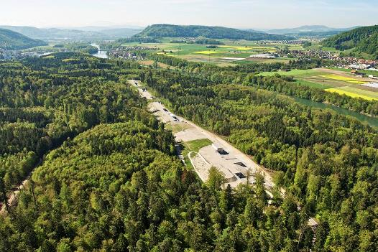

Cost and Location
For the UK based option the CDOA project will not take any account of the possible facility location. The conceptual design will assume a green field site.
For an idea of the scale of the facility cost and physical layout we can refer to existing XFELs:
  SwissFEL cost ~275 MCHF (2013) and is ~750m long and ~15m wide
  European XFEL cost ~1220 Meuro (2005) and is ~3.4km long
SwissFEL, PSI
European XFEL
https://www.psi.ch/en/media/our-research/hollywood-in-the-wuerenlingen-woods
https://www.xfel.eu/facility/overview/facts_amp_figures/index_eng.html

Slide 26
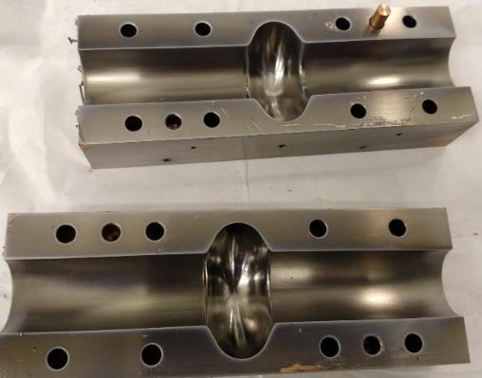
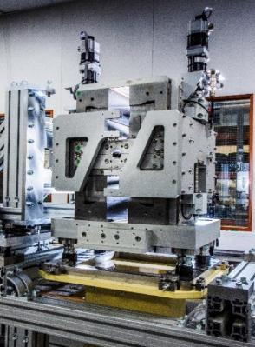

Sustainability
It is essential that we assess, and optimise where possible, all of the options from a sustainability perspective.
The UK accelerator community is already very active in developing more sustainable technologies:
  Using permanent magnets instead of electromagnets
  Making use of different superconducting materials and coatings for RF cavities so that they can operate at 4K instead of 2K.
  Developing more efficient RF power sources and much faster RF cavity tuners.
In addition we are assessing accelerators more broadly in terms of carbon footprint throughout the full project life cycles. This analysis will continue and feed directly into the CDOA project.
Notes:
It is essential that we assess, and optimise where possible, all of the options from a sustainability perspective.
many of which would have a significant positive impact on the power requirements of a new XFEL facility

Slide 27
Future Phases
The CDOA phase is expected to be followed by a more detailed Technical Design phase, which is likely to include prototyping and other risk mitigation activities, and then by a Construction phase.
Clearly future phases are not yet approved or funded by UKRI Infrastructure Fund and planning and costing for these subsequent phases will be an important part of our work.
The costs and timescales associated with these later phases depends very much on which option is adopted and approved by UKRI.

Slide 28
Expected timelines
Evaluate
  2019 to 2020 Science Case – Completed
  Oct 2022 to Oct 2025 Conceptual Design and Options Analysis
  Oct 2025 to ~2029 Technical Design Review
  ~2029 onwards Civil Construction work
  ~2030 onwards Accelerator Construction work
Design
Currently here
Construction
Funding Bids would need to be approved before the start dates suggested.

Slide 29
Overview of Progress

Slide 30
Overview
xfel.ac.uk
We are presently one year into the project. The Year 1 activities below are largely complete – the focus is on developing the conceptual design and making progress on the Year 2 activities.
Year 1
Project launch event January 2023
Initial conceptual design and layout
Preliminary engagement with overseas XFEL facilities
Survey of the science team, workshops and town halls meetings begin
Year 2
Developing the concepts
R&D targeting gaps in key physics and technology areas
Collaborative activities and working groups with overseas XFEL facilities
Workshops and town hall meetings continue
Year 3
Summary of R&D activities
Preferred options identified, socio-economic analysis
Revision to science case published
CDOA phase completed September 2025

Slide 31
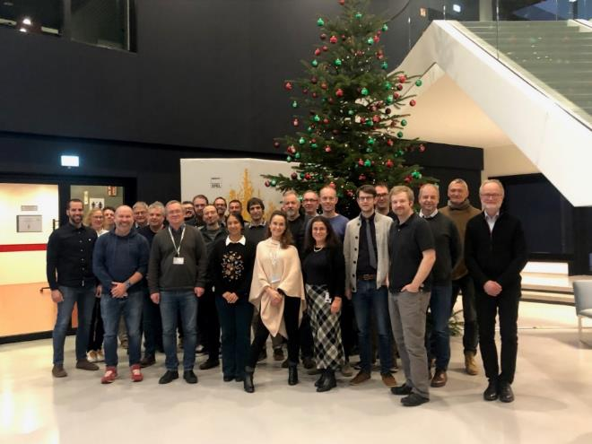
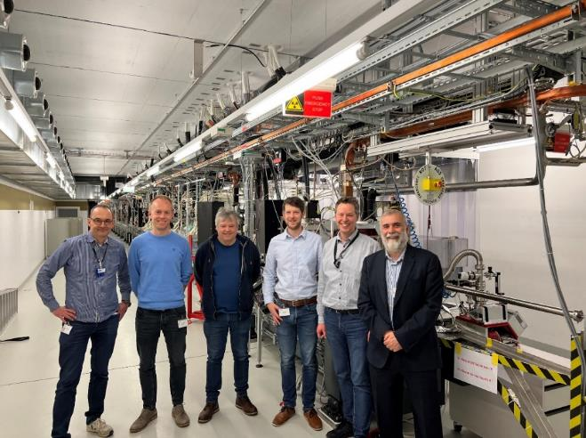
Progress so far
  Stakeholder Engagement
  Eu-XFEL visits + regular collaboration seminars
  SwissFEL visit + continuing engagement
  LCLS Visit in November
  Multiple Conferences attended
  Science team meets monthly
    Facility Design Team presents updates at this meeting
  International Advisory Board – Dec 23
  Communications
  Website now live, and updated – xfel.ac.uk
  Community slides produced for use by anyone
  Social media presence via twitter and linkedin

Slide 32
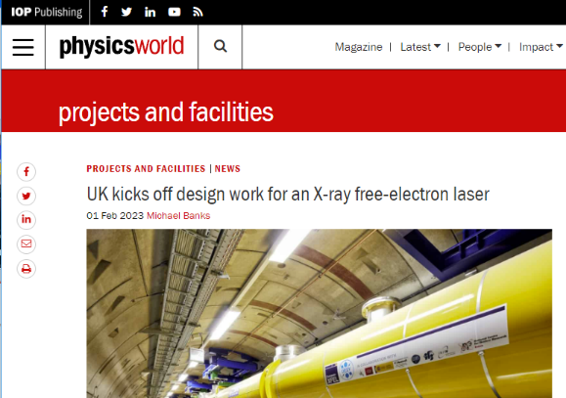

Launch Event
The UK XFEL project was successfully launched at the Royal Society on 30th January 2023
Over 150 in-person attendees from a range of institutions, with another 150 attending virtually.
The event attracted positive attention on social media from the research community, including articles from leading research outlets:
  Physics World, including podcast including interview with John Collier, Chemistry World
Presentations from the meeting are now available on the UK XFEL website: https://xfel.ac.uk/

Slide 33
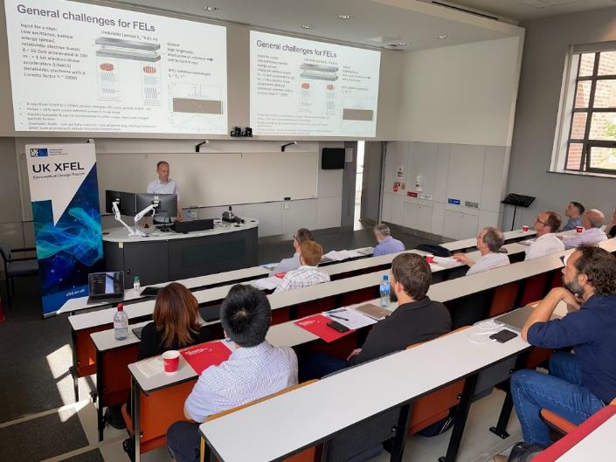
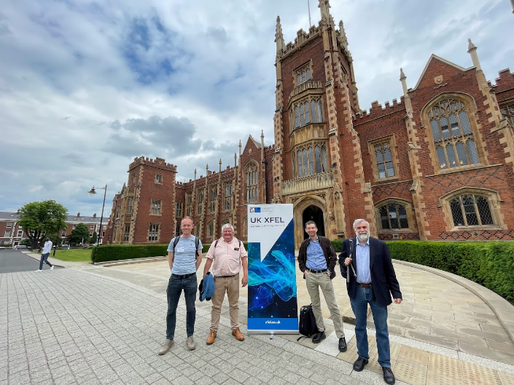

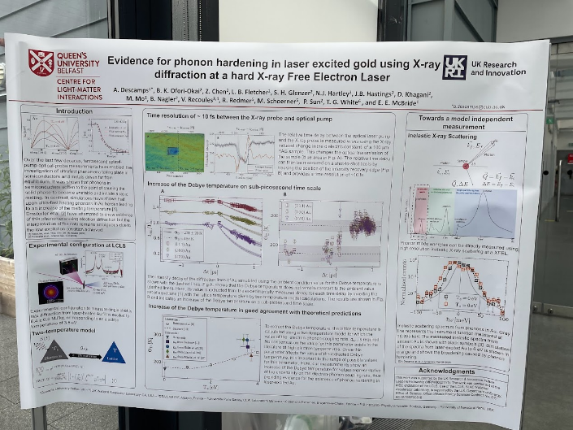
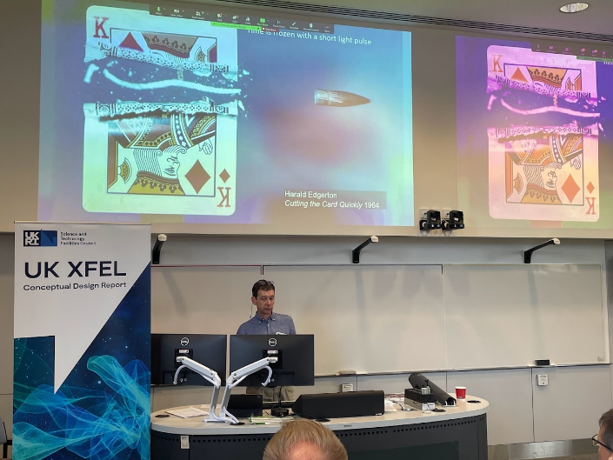
NI Townhall
Frontiers of Measurement Technology
2 Day event
~45 people attended
16 Speakers
10 Posters

Slide 34
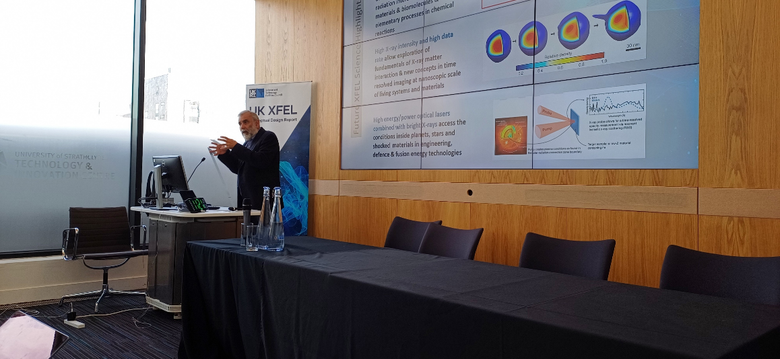

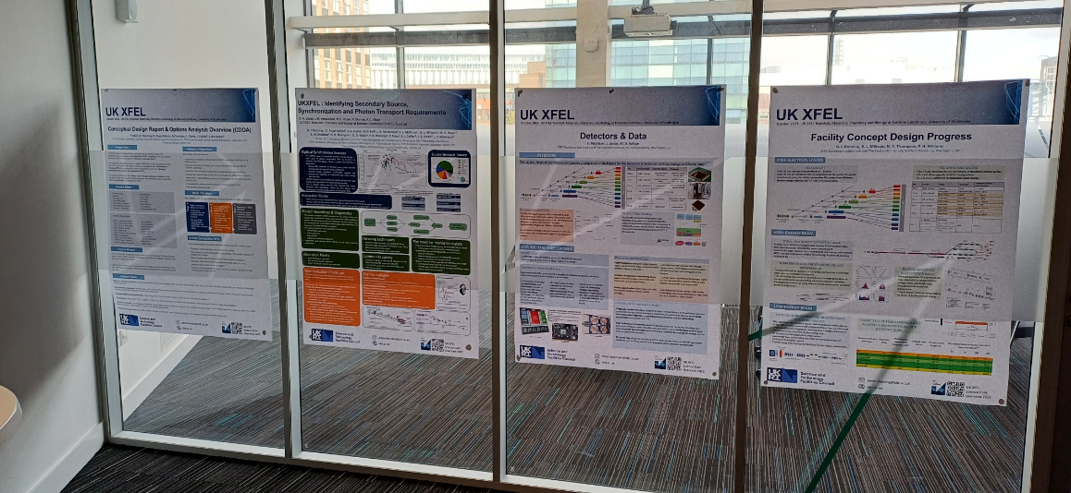
Scotland Townhall
Materials, Chemistry, and Biology at extreme conditions
2 Day event
~40 people in the room
~40 People Online

Slide 35
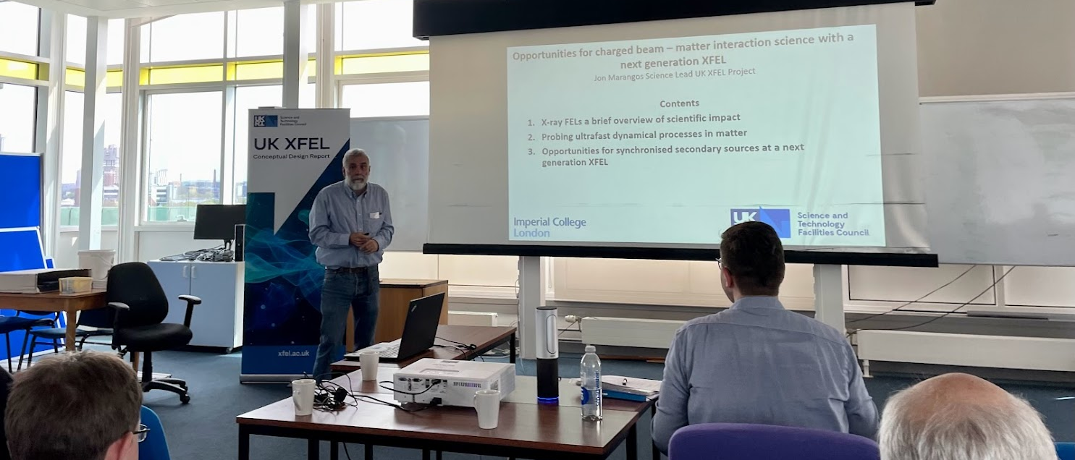
Ion-Beams workshop at
The University of Manchester

Slide 36
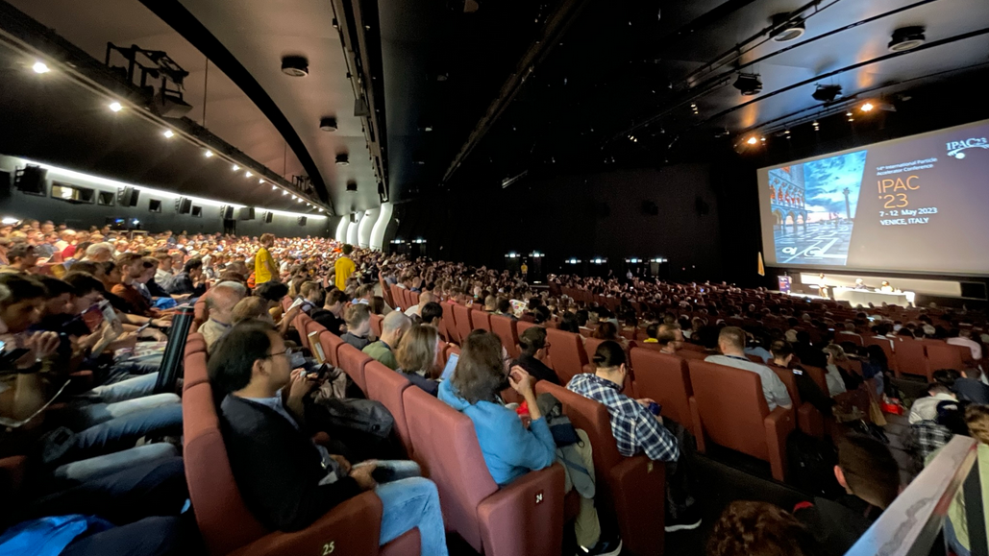
IPAC ‘23
Amongst our own presentations there was also a large number of other FEL based presentations and posters. It is clear that FEL technology is still rapidly advancing and that there is significant interest in these machines.

Slide 37
Facility Design Progress

Slide 38
Challenges for facility design team
Understanding/ Defining the Specification
Specific Technical Solutions
Compelling Facility Concepts
Understanding the specification
  Not one spec. but several interlinked sets
  Continuing to incorporate new ideas
Developing specific technical solutions
  e.g. science case requires X then the best possible solution is Y
Developing compelling facility proposals
  UK-based and international investment options
  Compatibility of technical features
  Scope, international context
  Sustainability, socioeconomic factors

Slide 39
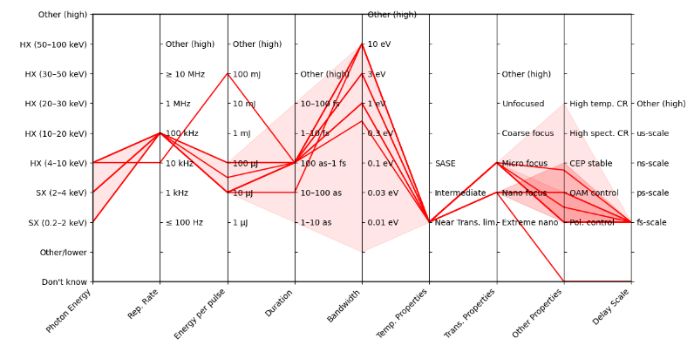
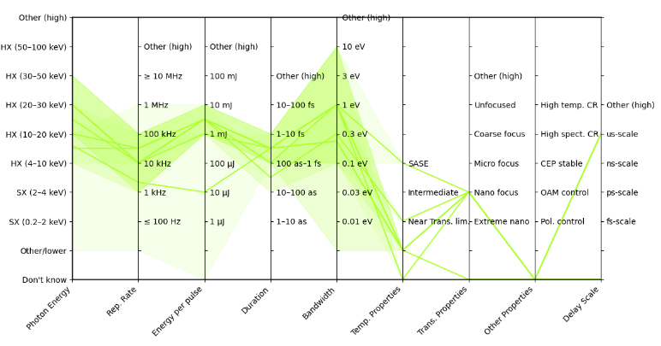
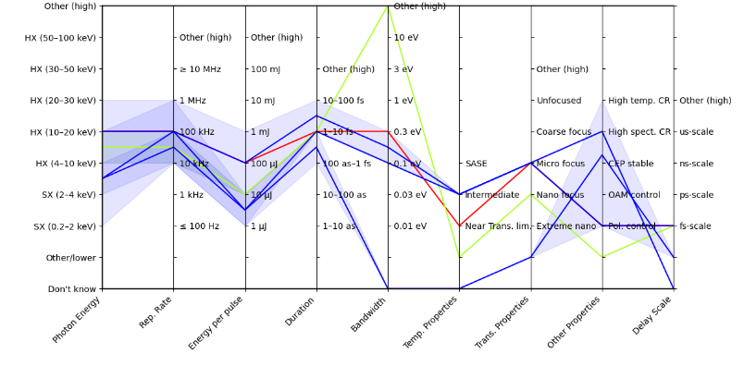
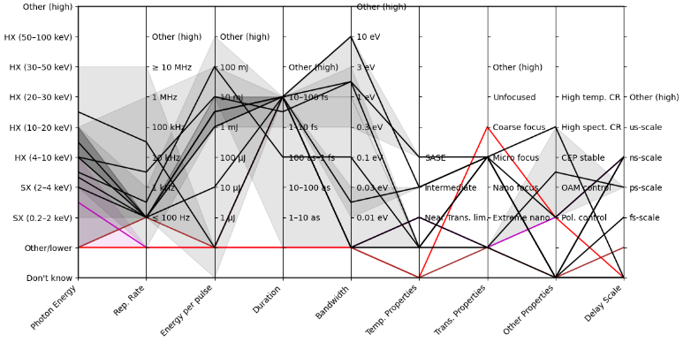
Defining the specification: User Survey
One of the first major activities of this phase was a detailed survey to capture requirements
Physical sciences
Life sciences
Chemical sciences
MEC

Slide 40
UK XFEL
Preliminary activities focused on the most challenging features
Key next-generation capabilities identified in the UK XFEL Science Case:
- Transform limited operation across entire X-ray range (from approximately 0.1 keV to 20 keV)
- High efficiency facility with a step change in the simultaneous operation of multiple end stations
- Evenly spaced, high-rep rate pulses to match samples & detectors
- Improved synchronisation/timing data with external lasers to < 1 fs
- Widely separated multiple colour X-rays to at least one end-station
- Full array of synchronised sources:
XUV-THz, e-beams, high power & high energy lasers at high rep-rate
MEC interests also include:
High pulse energy (>>1 mJ)
High photon energy (> 20 keV)
In some cases, less demand for high rep rate
- How coupled are these parameters?

Slide 41
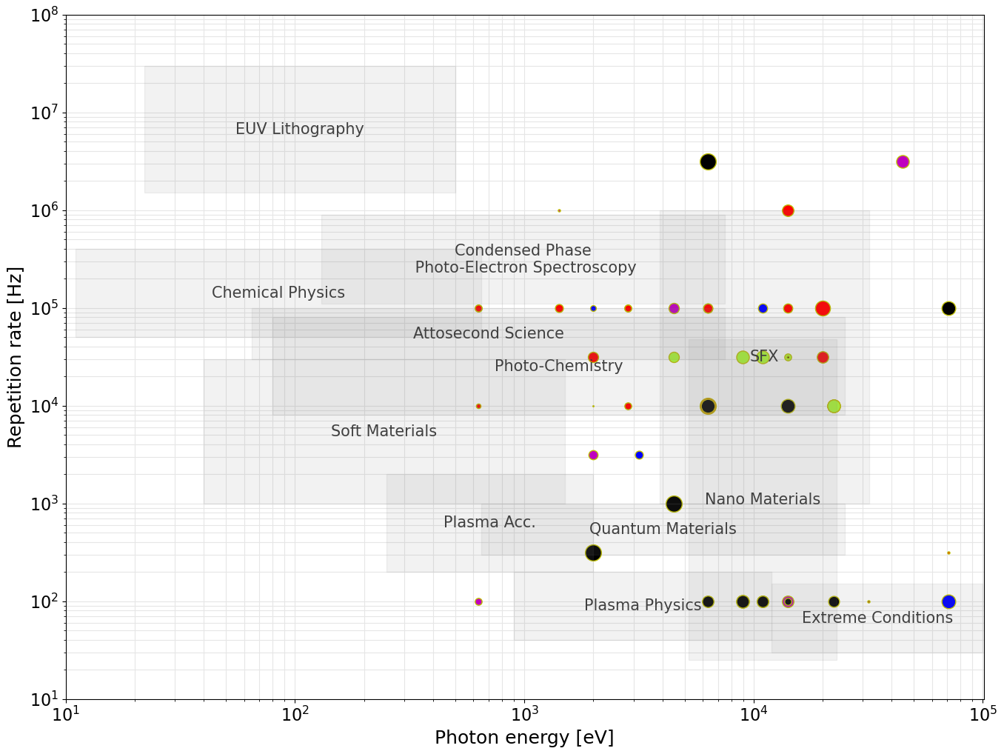

Acceleration Technology:
Evenly spaced, high-rep rate pulses
User Requirements from the Science Case & Survey
ERLs
SRF
(CW)
Preliminary focus for
UK-based option:
~8 GeV SRF CW
Max. photon energy strongly influences the required electron beam energy
Repetition rate largely dictates the type of acceleration technology
Requirements suggest
~8 GeV superconducting RF linac
For comparison:
~17.5 GeV SRF in pulsed mode
potential performance
(European XFEL)
SRF
(Pulsed)
HRR NC
NC
Electron Beam Energy:
~1-1.5 GeV
~2-3 GeV
~6-8 GeV
≥10 GeV

Slide 42
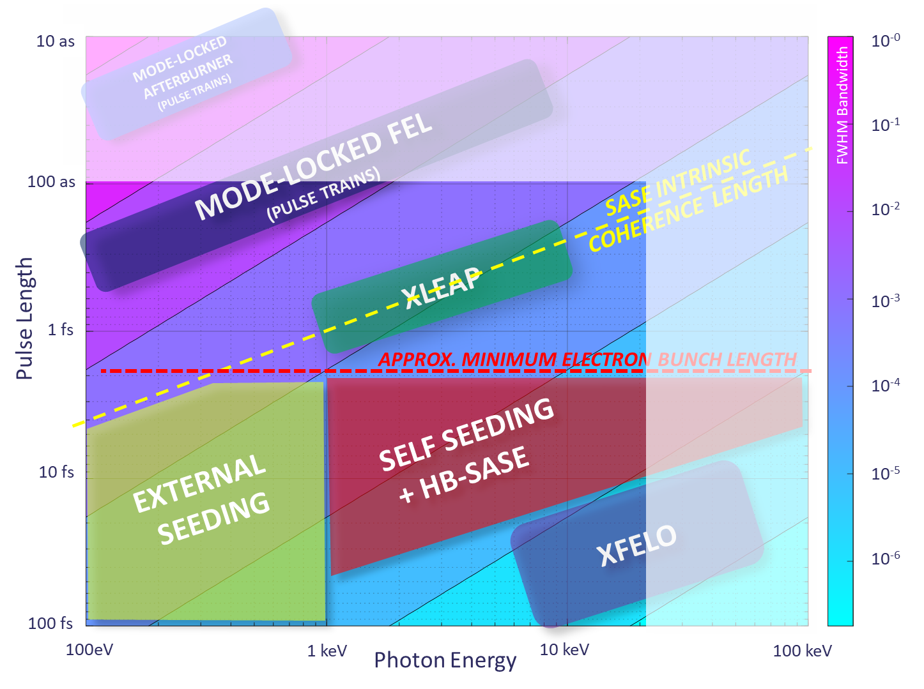
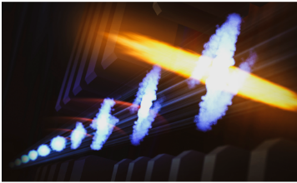

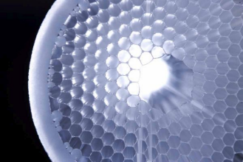
Transform-limited pulses
Transform-limited pulses across a wide range of energies and pulse lengths requires a wide range of techniques.
Attosecond pulses tightly synchronised to external sources (e.g. XLEAP)
HB-SASE-2.0 for 25 keV, 2.5 fs duration, TW peak power, >mJ pulse energy, 8 × 10⁻⁵ FWHM BW, at any e-beam repetition rate
XLEAP
HB-SASE schematic
Advances in high rep-rate lasers (e.g. Kagome fibres) for ≤ 1MHz UV seeding + harmonic FEL conversion to ≤ 2 keV
Enhanced self-seeding for few-GW 30 fs stable coherent SXR pulses
Cavity XFELs: RAFEL, XFELO for narrowest bandwidth
Notes:
Single-cycle undulator light with carrier-envelope phase control

Slide 43
A step change in the simultaneous operation of multiple end stations
Electron Bunches at ~1 MHz
FEL-6
FEL-5
~8 GeV
FEL-4
Multiple end stations per FEL – layout discussions to begin soon
FEL-3
FEL-2
ACCELERATION
BOOST?
FEL-1
  Bunches from the linac at ~1 MHz
  Kicker magnets to split MHz bunches at ~100 kHz
  Each line can tailor the electron bunch independently allowing a common electron bunch from the linac
  Size of the spreader section increases with electron beam energy
100kHz Kicker Magnet

Slide 44
Latest thinking following science team feedback
FEL tuning ranges
Assuming a fixed electron beam energy from the spreader of 8 GeV. To cover photon energy range from ~50 eV – 20 keV with some overlap: best covered by ~6 FELs (at least)
SXR: 0.2 – 4 keV
TXR: 2 – 7 keV
Tuning
0.05 – 1.0 keV
0.25 – 3.0 keV
1.0 – 5.0 keV
3.0 – 13.0 keV
5.0 – 20.0 keV
9 – 20 keV
13 – 30keV
20 – 40 keV
HXR: 4 – 100 keV
Tuning
0.05 – 1.0 keV
0.25 – 3.0 keV
1.0 – 5.0 keV
3.0 – 13.0 keV
5.0 – 20.0 keV
9 – 20 keV
13 – 30keV
20 – 40 keV
FEL-6
FEL-5
FEL-4
FEL-3
FEL-2
FEL-1
FEL-1: ≈ 10 GeV
FEL-1: ≈ 11.5 GeV
0.05
0.25
1
3
5
9
13
20
30
40
keV
Potential booster in FEL-1 line
Potential booster in FEL-1 line

Slide 45
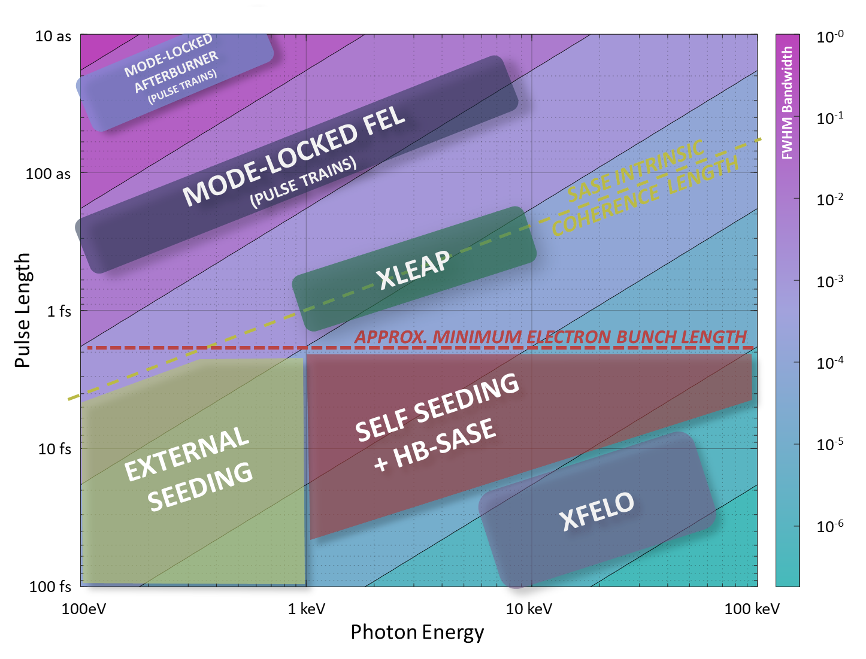
Presently under development following science team feedback
Potential FEL modes
FEL | Tuning | Mode | Technique | Transform Limited Pulse Duration
FEL-6 | 0.05 – 1.0 keV | Seeded | EEHG | 5 – 100 fs
FEL-5 | 0.25 – 3.0 keV | Long pulse | EEHG/HB | 100 fs – 20 fs
 |  | Short Pulse | XLEAP | 2 fs – 350 as
FEL-4 | 3.0 – 13.0 keV | Long Pulse | HB-SASE | 20 fs – 10 fs
 |  | Short Pulse | XLEAP | 400 as – 200 as
FEL-3 | 1.0 – 5.0 keV | Long Pulse | HB-SASE | 40fs – 15fs
 |  | Short Pulse | XLEAP | 800 as – 275 as
FEL-2 | 5.0 – 20.0 keV | Long Pulse | HB-SASE | 16 fs - 12 fs
 |  | Short Pulse | XLEAP | 300 as – 200 as
 |  | Cavity | XFELO | ~ 100 fs
FEL-1 | 9 – 20 keV | High Power | SASE | ~ 60 fs (not TL)
 | 13 – 30keV | High Energy
 | 20 – 40 keV | High Energy
100 eV – 20 keV
100 as to 100 fs
Short Pulse Modes
Seeded
Long Pulse Modes
High Energy
Cavity
Pulse durations estimated from simulations/scaling, intermediates between short and long pulse modes also accessible
Notes:
Single-cycle undulator light with carrier-envelope phase control

Slide 46
Widely separated multiple colour X-rays to at least one end-station
Electron Bunches at 1MHz
FEL-6
FEL-5
FEL-4
FEL-3
FEL-2
FEL-1
Each FEL can be combined with its neighbour for FEL-pump FEL-probe experiments giving the ability to combine FEL pulses from different photon energy regimes with +/- 100 fs temporal delay.
100kHz Kicker Magnet
GHz Subharmonic Deflecting Cavity

Slide 47
E.g. FEL 1/2 combined, others independent
Double Bunches Adjacent RF Cycles
Electron Bunches at 1MHz
FEL-6
FEL-5
FEL-4
FEL-3
FEL-2
FEL1/2 Path Length Difference Equal to
Double-Bunch Spacing
FEL-1
100kHz Kicker Magnet
GHz Subharmonic Deflecting Cavity

Slide 48
E.g. FEL 2/3 combined, others independent
Double Bunches Adjacent RF Cycles
FEL-6
FEL-5
FEL-4
FEL-3
FEL-2
FEL-1
100kHz Kicker Magnet
GHz Subharmonic Deflecting Cavity

Slide 49
E.g. FEL 2/3 + FEL 5/6 combined, others independent
Double Bunches Adjacent RF Cycles
Double Bunches Adjacent RF Cycles
FEL-6
FEL-5
FEL-4
FEL-3
FEL-2
FEL-1
100kHz Kicker Magnet
GHz Subharmonic Deflecting Cavity

Slide 50
Presently under development following science team feedback
Layout of the FEL lines for 2-colour
Layout of the FEL lines for 2-colour
Re-ordering the FEL lines would help extend the photon energy separation of 2-colour pulses, e.g. swapping FEL-3 and FEL-4 would extend range of SXR-HXR combinations
Re-ordering the FEL lines would help extend the photon energy separation of 2-colour pulses, e.g. swapping FEL-3 and FEL-4 would extend range of SXR-HXR combinations
SXR: 0.2 – 4 keV
TXR: 2 – 7 keV
Tuning
0.05 – 1.0 keV
0.25 – 3.0 keV
1.0 – 5.0 keV
3.0 – 13.0 keV
5.0 – 20.0 keV
9 – 20 keV
13 – 30keV
20 – 40 keV
HXR: 4 – 100 keV
Tuning
0.05 – 1.0 keV
0.25 – 3.0 keV
1.0 – 5.0 keV
3.0 – 13.0 keV
5.0 – 20.0 keV
9 – 20 keV
13 – 30keV
20 – 40 keV
FEL-6
FEL-5
FEL-4
FEL-3
FEL-2
FEL-1
FEL-1: ≈ 10 GeV
FEL-1: ≈ 11.5 GeV
0.05
0.25
1
3
5
9
13
20
30
40
keV

Slide 51
Preliminary focus parameters
Parameter / specification | UK XFEL target | Comment
Focus on...transform-limited operation
Photon energy range (fundamental) | 0.1*→20 keV | Beam energy will be around 8 GeV, based on pulse energy requirement, injector and undulator technology
Pulse duration | 0.1→100 fs | Multiple beam modes and undulator lines identified, but further work is required to show how to operate these in parallel
Pulse energy | Based on scheme, target at high end of ‘typical’ operation
Polarization | Control as standard | Variable polarization undulators required
Synchronization | <1 fs with time-tools | <10 fs electron beam arrival time stability + time-tools for each photon source (energy, duration)
Focus on…parallel operation, maximizing user throughput
Repetition rate | 100 kHz, delivered to each experiment | Parallel operation of multiple 100 kHz means multiplexing of >100 kHz at full energy
Multiple photon pulses | At least one station allowing combined SXR/HXR from beamlines, otherwise within tuning range of undulators | Flexible solution combining adjacent lines is preferred but alternatives have been identified e.g. SXR/HXR FELs in series
Synchronized sources | Centralised as far as possible, with a suite of sources available on demand to users, with minimal facility intervention | Centralisation needs to be tensioned against complexity of source(s) transport and other factors.
Data management | Data acquisition, management (including machine learning assisted interpretation) at 100 kHz | Approach must support simultaneous acquisition on multiple beam lines, and be easy for a wide range of users to interact with
*likely updated to 0.05 keV following Science Team engagement

Slide 52
Next Steps

Slide 53
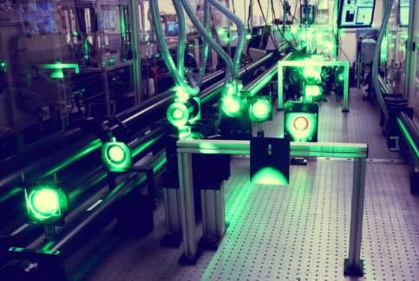
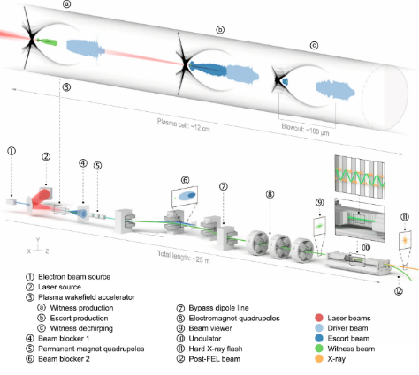
Beyond the preliminary focus
Beyond the preliminary focus, there are several other technical capabilities we will consider:
Central Laser Facility's Gemini facility
Very high pulse energy (~10s-100s mJ)
To consider: an additional feature of UK XFEL, or delivered at another facility?
Very high photon energy
(>20 keV, to 50-100 keV)
To consider: an additional feature of UK XFEL, or delivered at another facility?
Transform-limited pulses not necessary.
Synchronous sources
After NIR/ Visible lasers, terahertz is the most requested synchronous source.
Transform-limited pulses not necessary.
Potentially low repetition rate, matched to high power lasers
What photon energy? High pulse energy more readily accessible <<20 keV
Beam based sources have potential implications for machine layout.
Requests for protons, ions and gamma sources need further exploration with Science Team.
Considering a booster section in FEL-1 line (conventional or plasma)
Low repetition rate, matched to high power lasers (for some applications)
Focus so far on high power and high rep. rate lasers:
High rep. rate femtosecond pumping from 10 nm - 10 µm, as per UK Artemis and Ultra facilities
A high power (multi-PW, >1022 Wcm-2)
and high energy (kJ-class) laser facility as large as budget allows
  Scalable and tunable diode-pumped laser technology (e.g. CLF DiPOLE)
  High repetition-rate (> 10 Hz)

Slide 54
Opportunities to engage
Townhall events – every ~3 months, around the UK: day 1: general audience, day 2: focused topic
Facility design events (e.g. plasma acceleration workshop being planned)
How to join the team – contact paul.aden@stfc.ac.uk or direct contact to relevant team members
Website + mailing list: https://xfel.ac.uk/
The Impact of XFELs on Catalysis – in conjunction with the UK Catalysis Hub – Rutherford Appleton Lab – November 27th 2023
Southwest England Townhall (hosted by Plymouth) 18th & 19th Jan 2024
Focus discussion topic: AI, Quantum Computing and Fundamental Physics
Central England Townhall (hosted by Diamond, Spring 2024)
Focus discussion topic: Engineering biology, genomics and healthcare
Wales Townhall (in Cardiff ~ September 2024)
Focus discussion topic: Advanced materials and manufacturing
North-West England Townhall (hosted by Royce Institute, Autumn 2024)
Focus discussion topic: Electronics, photonics and quantum technologies
North-East England Townhall (hosted by Sheffield)
Focus discussion topic: Energy, environmental and climate technologies
The Impact of XFELs on Catalysis – in conjunction with the UK Catalysis Hub – Rutherford Appleton Lab – November 27th 2023
Southwest England Townhall (hosted by Plymouth) 18th & 19th Jan 2024
Focus discussion topic: AI, Quantum Computing and Fundamental Physics
Central England Townhall (hosted by Diamond, Spring 2024)
Focus discussion topic: Engineering biology, genomics and healthcare
Wales Townhall (in Cardiff ~ September 2024)
Focus discussion topic: Advanced materials and manufacturing
North-West England Townhall (hosted by Royce Institute, Autumn 2024)
Focus discussion topic: Electronics, photonics and quantum technologies
North-East England Townhall (hosted by Sheffield)
Focus discussion topic: Energy, environmental and climate technologies
CDOA 1st Birthday Lunch!
24th October 12:30 Daresbury Walton Room

Slide 55
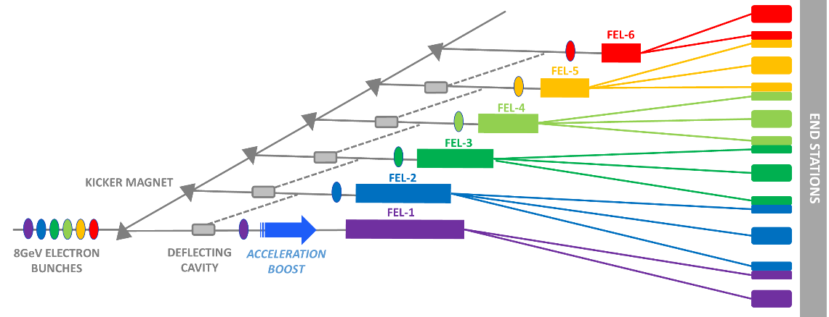
Summary
One year into the conceptual design and options analysis
phase, we’ve made significant progress in producing a
concept to deliver:
  Transform-limited pulses
  A step change in the simultaneous
  operation of multiple end stations
  Evenly spaced, high-rep rate pulses
  Widely separated multiple colour X-rays
Work is progressing in many technical areas in collaboration with existing XFELs, including performance and sustainability as key criteria
We’re aiming to identify high impact examples in each science area that really exploit the unique capabilities of the proposed next generation XFEL

Slide 56

Thank you
xfel.ac.uk
@STFC_Matters @UKXFEL

