Slide 1
Research Facility 2.0: Towards a more energy-efficient and sustainable path
TT-Prof. Dr.-Ing. Giovanni De Carne, Prof. Dr. Anke-Susanne Müller, Dr. Andrea-Santamaria Garcia, Dr. Falastine Abusaif, M.Sc. Mashid Zadeh, Dr. Erik Bründermann, Dr. Julian Gethmann
Karlsruhe Institute of Technology – ATS Sustainable Panel - 05/10/2023

Slide 2
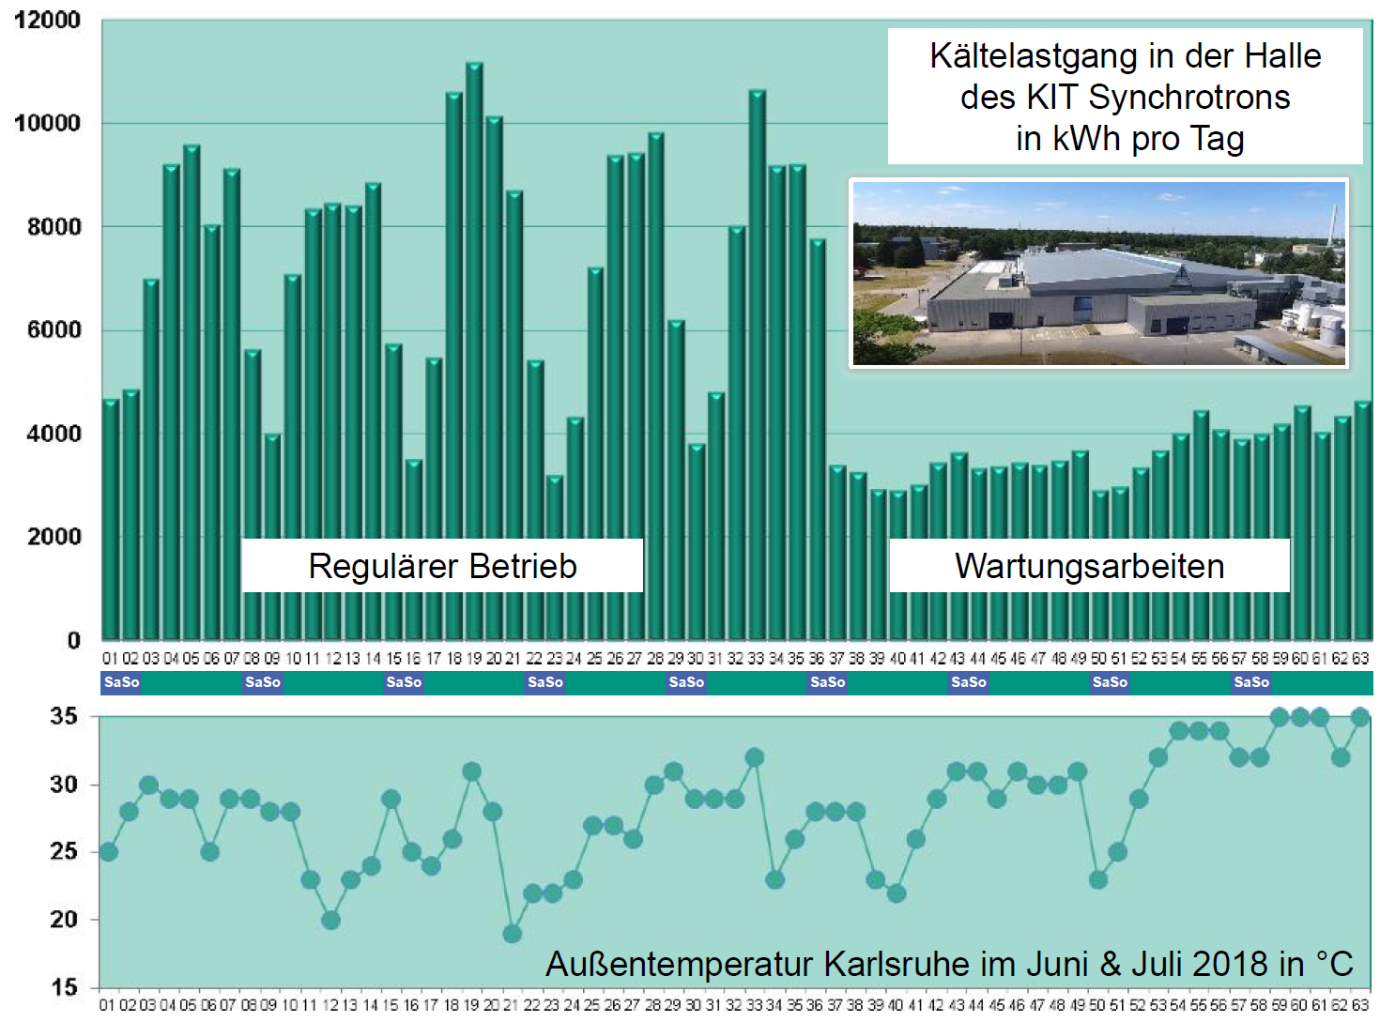

The starting point
High energy consumption
  Small accelerators (KARA) → 11GWh
  Large accelerators (FCC) → 1÷2 TWh
  ≈ Karlsruhe (300.000 inhabitants)
High power peak
  Large difference between “stand-by” and “beam” operations → KARA 200kW vs. 650kW
High power supply quality required
  Stable voltage profile → Low inertia grids bring larger and more frequent disturbance
  Low harmonic content → power electronics may create resonances
11GWh ≈ 10.000 citizens city
Variable consumption ≈ 8 MWh
Power consumption of the cold chain at KARA in kWh per day
Regular Operations
Maintenance
Temperature in Karlsruhe in June & Juli 2018 in °C

Slide 3
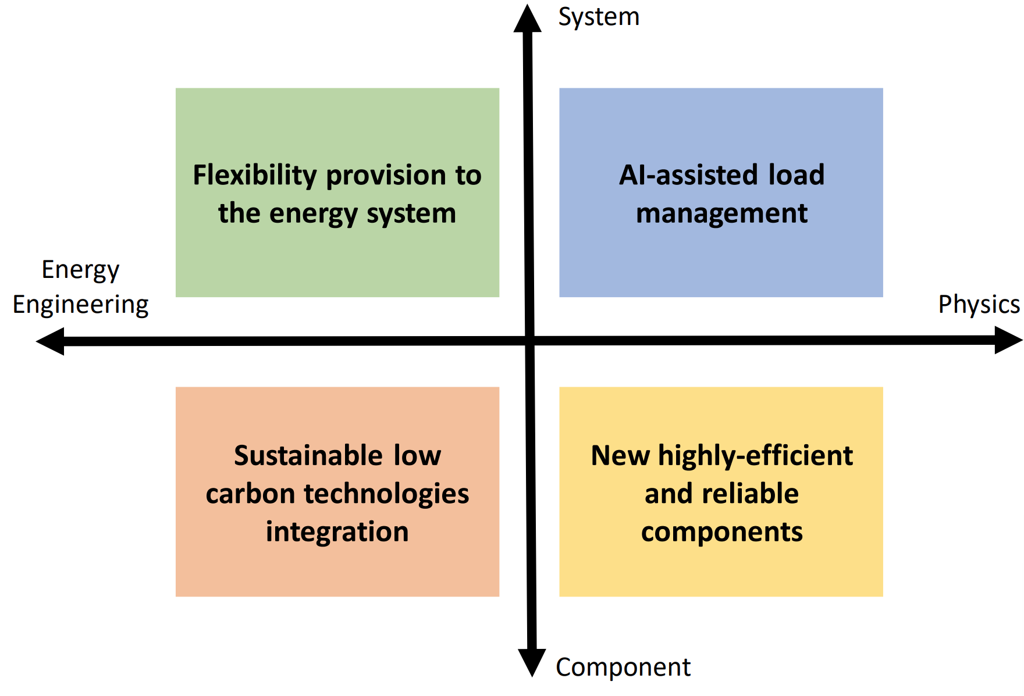
HORIZON-INFRA-2023-TECH-01-01: New technologies and solutions for reducing the environmental and climate footprint of Ris
Innovative technologies and solutions which reduce the environmental and climate footprint of Ris through the full life cycle of research infrastructures.
New Technologies and solutions for research infrastructures enabling transformative resource efficiency (e.g., energy consumption) and reduction of environmental (including climate-related) impacts.
Validation and prototyping

Slide 4
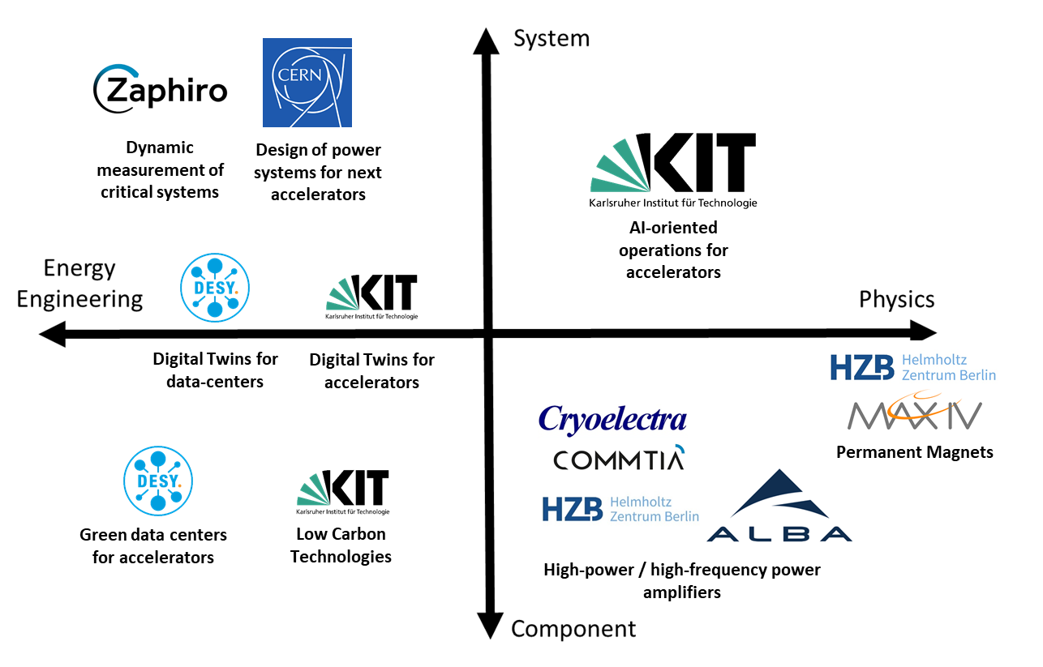
RF2.0 Consortium
10 partners
Accelerators
  ALBA (Spain)
  CERN (Switzerland)
  DESY (Germany)
  HZB (Germany)
  MAX IV (Sweden)
University
  KIT
Manufacturers
  Commtia (Spain)
  Cryoelectra (Germany)
  Zaphiro (Swiss)

Slide 5
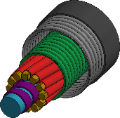
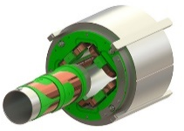
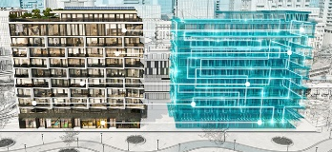
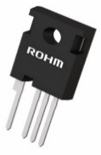

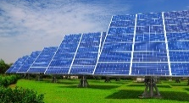
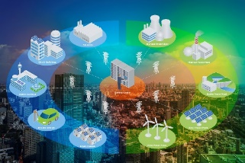
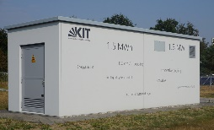
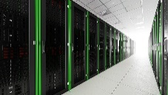
Potential improvements in the energy solutions
New highly-efficient and reliable components
Novel design for permanent magnets
SiC / GaN-based solid state amplifiers
AI-assisted infrastructure
load management
Real time digital
twin of accelerators & data centers
Optimized energy consumption by AI
Low carbon technologies integration
Optimal integration of ESS with RES
Green high power computing
Life-cycle resource and cost assessment
Flexible
energy system
Energy management strategies
Future accelerator design
Dynamic measurement systems

Slide 6
The Impact – 4 target groups
TG1 – Large research facilities (current and future ones)
Actors: Particle accelerators, medical facilities, other ESFRI facilities
Expected impact: Electricity costs reduction (≥10-25%) 100% renewable energy supply Fully digitalized infrastructure
TG2 – System operators
Actors: Grid operators (TenneT), eng. Companies, utilities
Expected impact: Power flexibility strategies for accelerators and computing centers (≥10-25%) for reduced consumption
TG3 – Technology manufacturers
Actors: Manufacturers, software and AI companies
Expected impact: Improved magnets, power electronics, (TRL 1-3 → 4-6, -20% consumption)
TG4 – Policymaking & General Society
Actors: Policy makers (EU, DG-RTD), regulatory bodies (e.g., IEC, IEEE), geneal public (schools, NGOs)
Expected impact: Higher awareness of sustainable energy solutions Training of public managers by means of demonstrators, schools, and workshops. | Reduction of operation costs for public (hospitals, schools) and private (industry) facilities Open-access data & Benchmark results

Slide 7
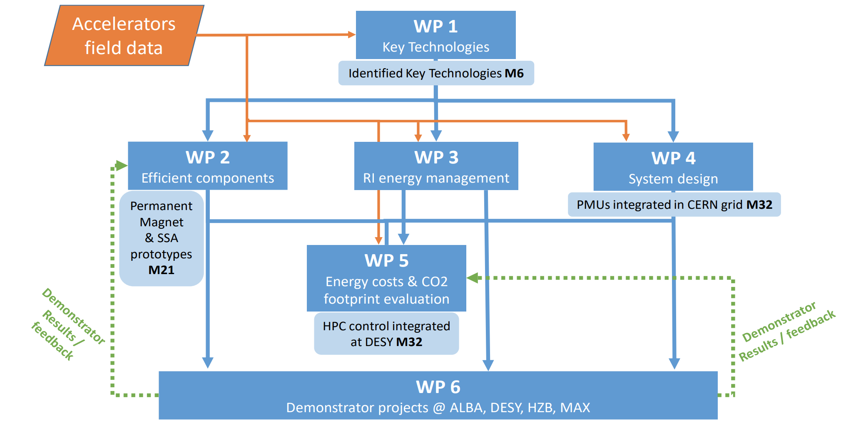
Structure and work flow of the project

Slide 8
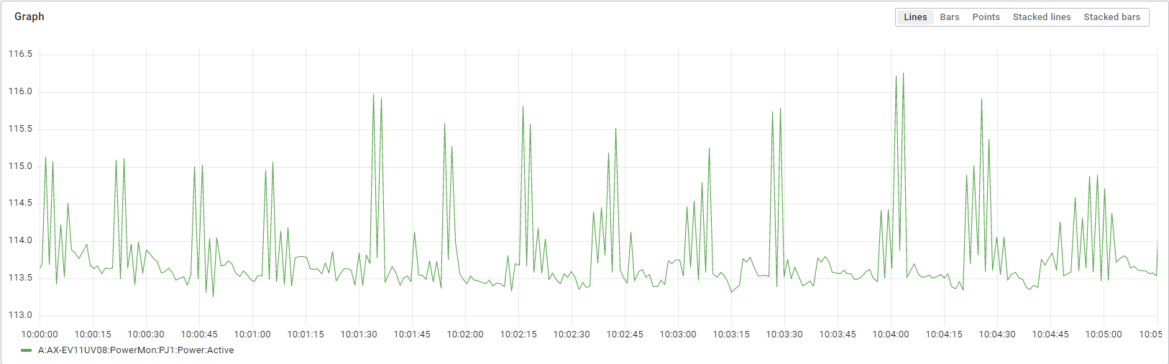

Initial findings: power analysis of KARA
2023-03-01 10:00:00 to 10:05:15

Slide 9
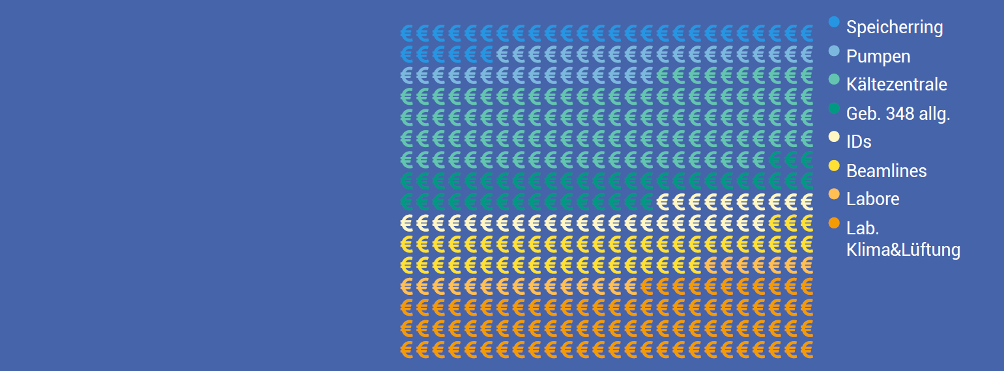
Initial findings: Cost analysis for KARA
Base Load
Around 40% of the base load of 7GWh is related to labs and beamlines. 8% for the insertion devices.
Around 40% goes for the building power and the cooling system.
The storage ring and pumps take only 8% of the base load.

Slide 10
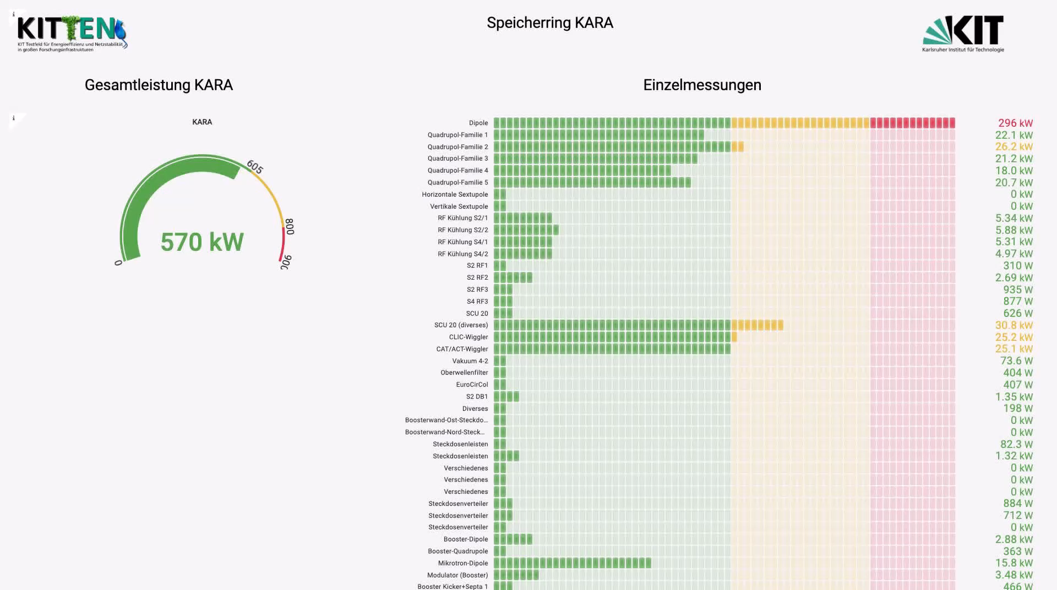

Slide 11

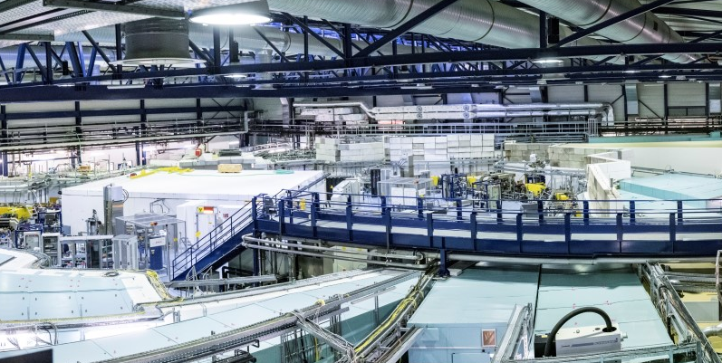
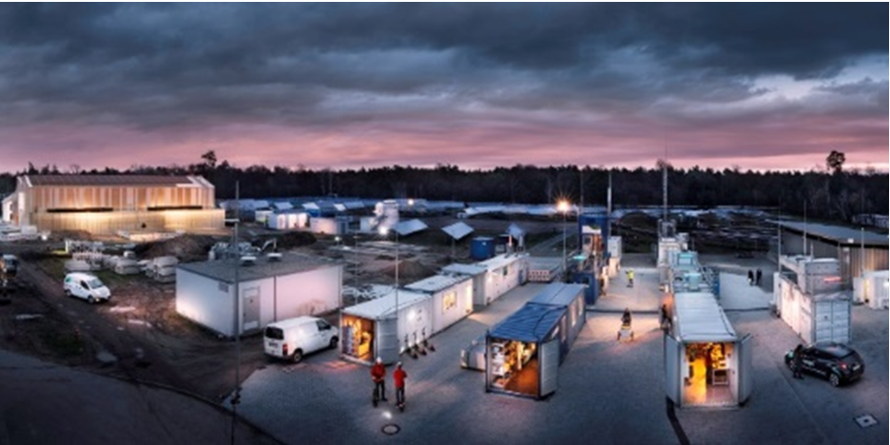

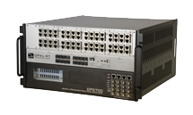

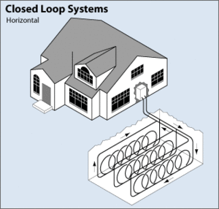
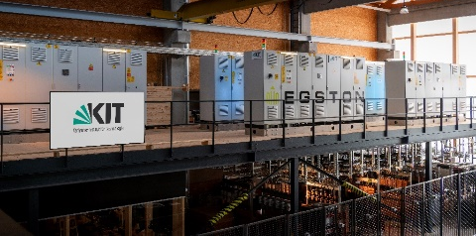
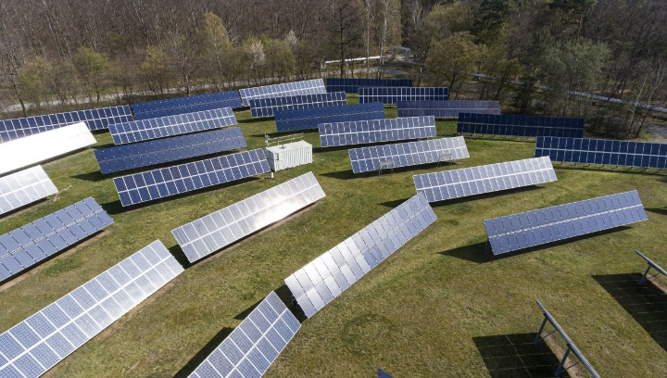
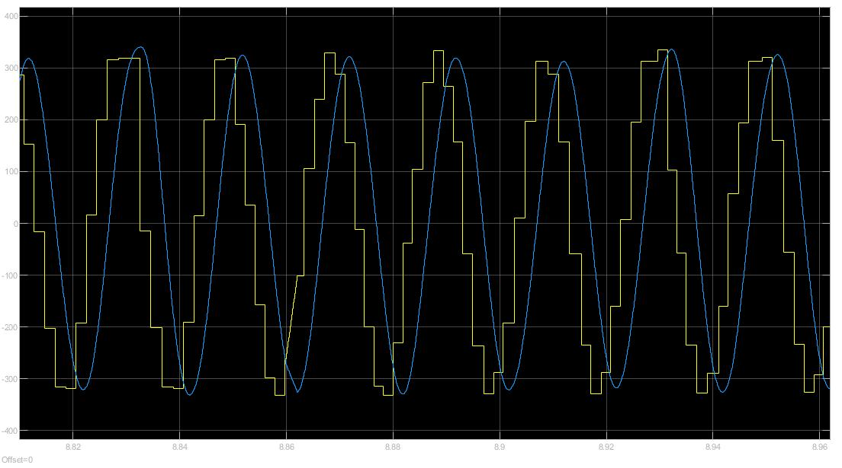
KITTEN experimental setup
Energy Lab 2.0
Sampling rate 1kHz → 10kHz
ModBus → Ethercat
Voltage & Current → thermal and magnetic variables
Karlsruhe Research Accelerator (KARA)
5 – 10 m
1 – 1.5 km
Real Time Simulator
Communication
Infrastructure
50 – 100 m
First voltage transmission in real time between KARA and EL2.0
Power Hardware In the Loop Lab
Solar PV park 225 kW
Thermal Groundwater Cooling System 1 MW

Slide 12
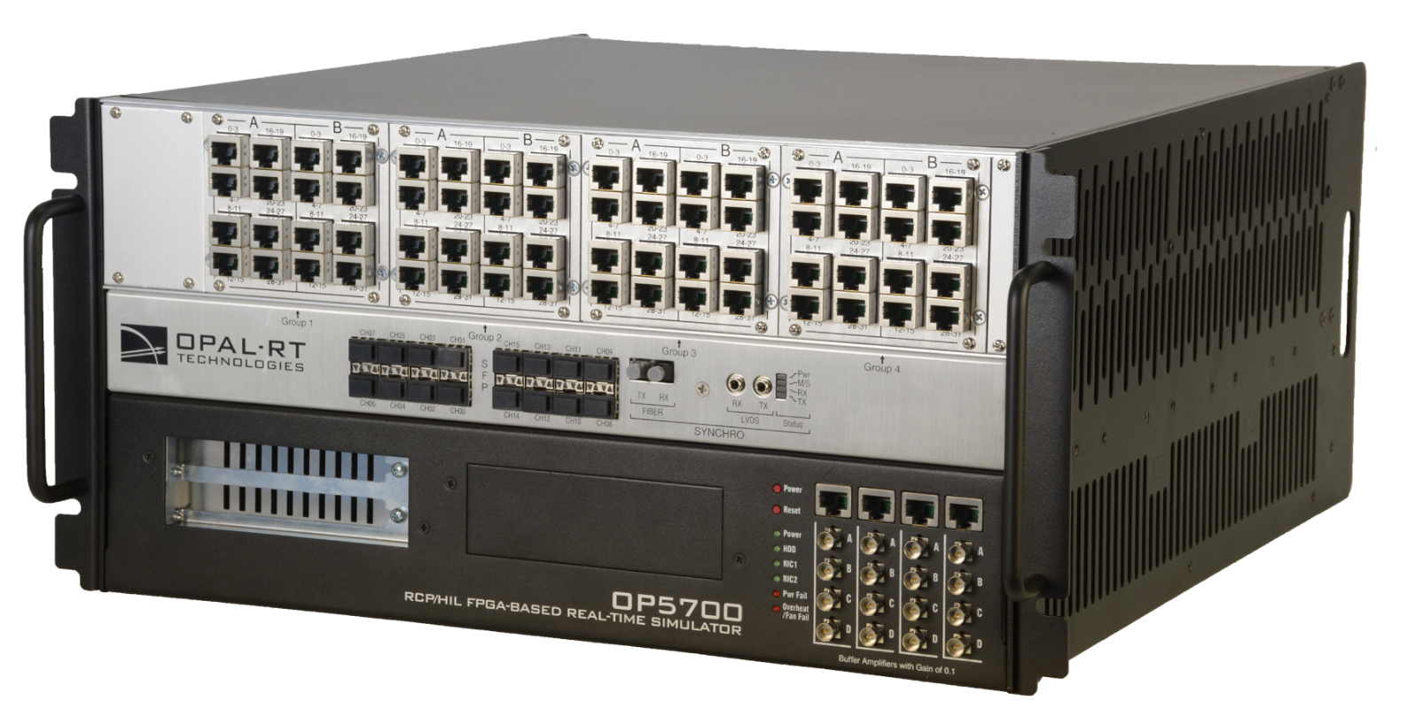
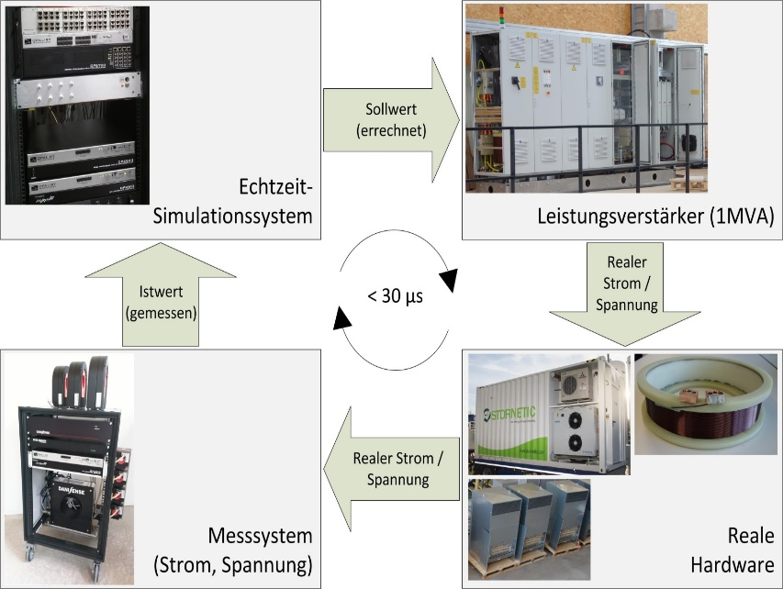

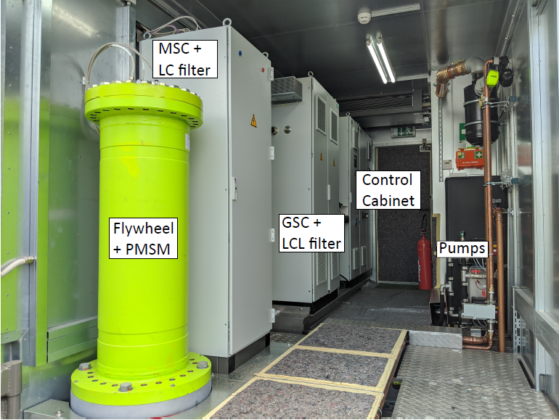

Unique selling point: Validation by means of
Power Hardware In the Loop
Digital real time simulator: simulate the KARA electrical grid
Power amplifier: reproduce a point of the simulated grid in lab (e.g., measured voltage)
Hardware under Test: this is the technology, which performances we want to test
Digital real Time Simulation
1MVA Power Amplifier
Real Time Simulator
OPAL-RT 5700
Egston
COMPISO 200kVA
V*
~
~
~
~
~
~
~
~
~
~
KARA Digital Twin
I
Measurement system
Current / Voltage
Flywheel
Hardware under Test

Slide 13
Research Facility 2.0
First comprehensive project on Energy Efficiency and Sustainability in Accelerators
  Accelerators of European Importance (ALBA, CERN, DESY, HZB, MAX IV)
  Inter-disciplinary approach between physics and electrical engineering
Strong focus on transfer
  Three high-tech SME involved
  Transfer-to-society with workshops and training
Setting an example
  Sustainability approaches and indices for design future accelerators (and in general research facilities)

Slide 14
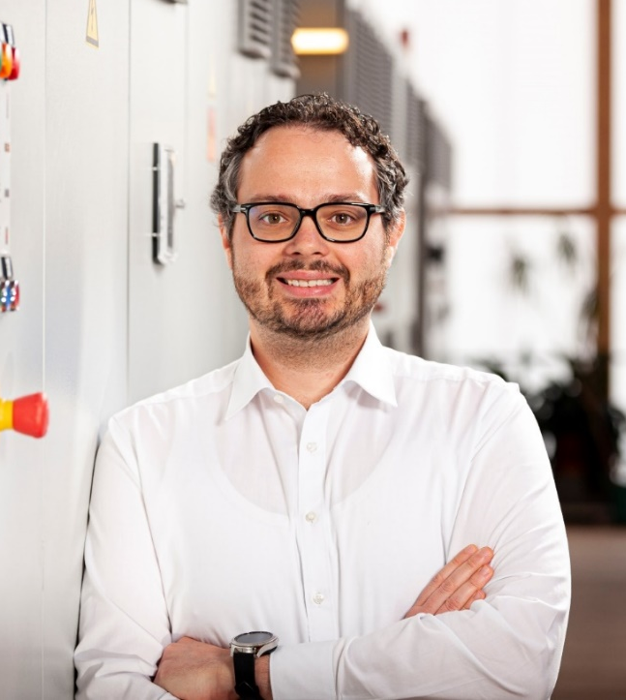
THANK YOU
Questions?
HIRING!!!
Looking for talented PhDs and Post-docs to work on the topic!
TT-Prof. Dr.-Ing. Giovanni De Carne
Head of „Real Time System Integration“ group
Helmholtz young investigator group leader
Karlsruhe Institute of Technology
Institute for Technical Physics (ITEP)
Phone: +49 721 608-25924
Email: giovanni.carne@kit.edu
www.itep.kit.edu

