Slide 1






Funded by the European Union (EU). Views and opinions expressed are however those of the author only and do not necessarily reflect those of the EU or European Research Executive Agency (REA). Neither the EU nor the REA can be held responsible for them.
EU Project MuCol
Status and Plans
R. Losito
CERN

Slide 2
WP1
Coordination and Communication
All Deliverables (D) and Milestones (M) achieved and declared on EU portal
D & M falling in summer over the entire project have been moved to end of October of the corresponding year (list in spare slides)
Few Associated Institutes didn’t sign yet the Consortium Agreement…

Slide 3
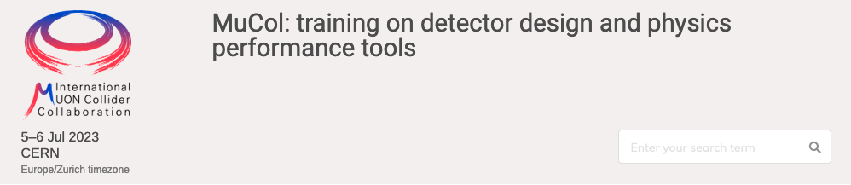
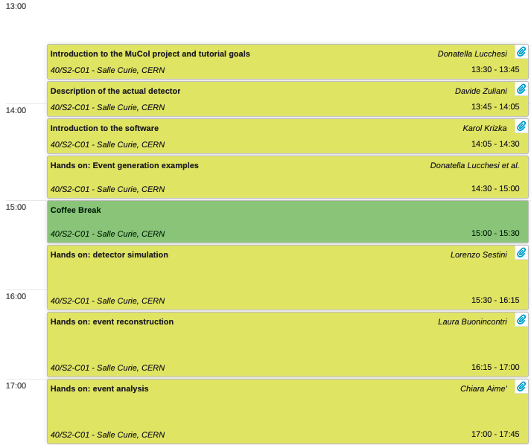
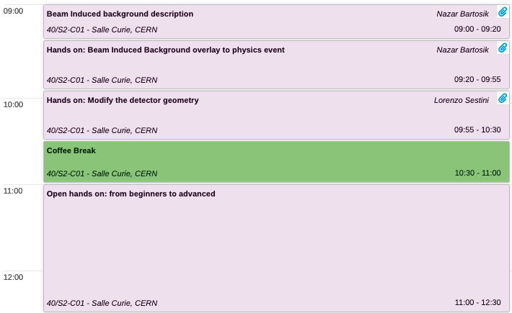
WP2
Physics And Detector Requirements
Software and detector training
46 participants in person and remote
Presentations and hands-on sessions very well attended

Slide 4
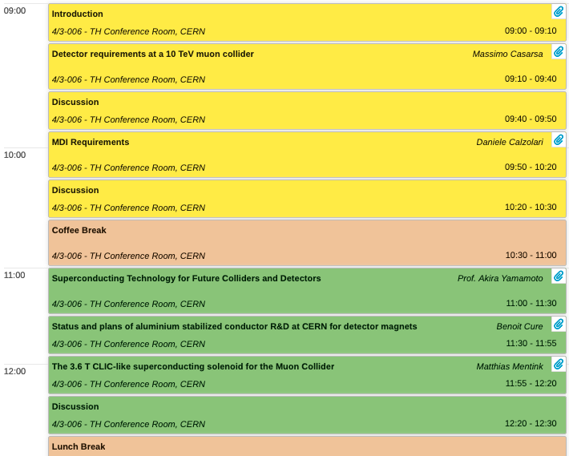

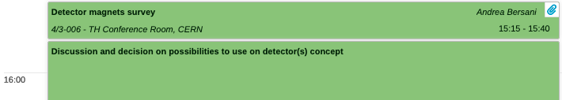
WP2
Physics And Detector Requirements
Definitions of requisites for detector design at $\sqrt{s}=10$ TeV
We received several suggestions and recommendations on how to proceeds on magnet assumptions.
Activities starting on first concept of a base design.

Slide 5
WP3
Proton Complex
PhD student started in August and looking into transport of the beam from compressor to target.
Hiring of a postdoc to work on the compressor ring design ongoing and on final round of interview (expected start Jan 2024).
Collecting some data from PS and Booster on merging and bunch rotation.
Work on the tentative parameter list and interim report for MuCol and IMCC.

Slide 6
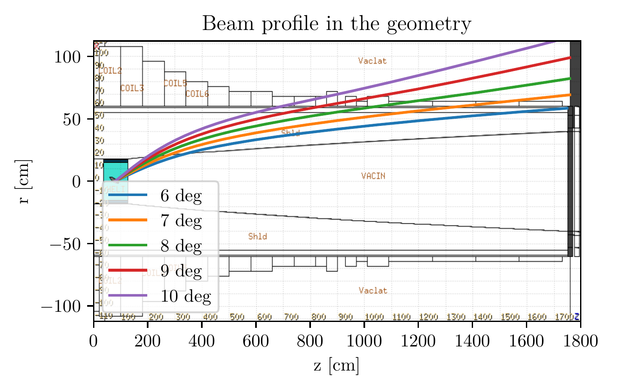
WP4
Muon Production & Cooling
Established preliminary radial build
Optimising dose levels, heat load etc to shielding and magnet
  Close liaison with magnets team
  Discussion around 60 vs 70 cm magnet bore
Looking at beam window
Looking at spent proton beam extraction

Slide 7
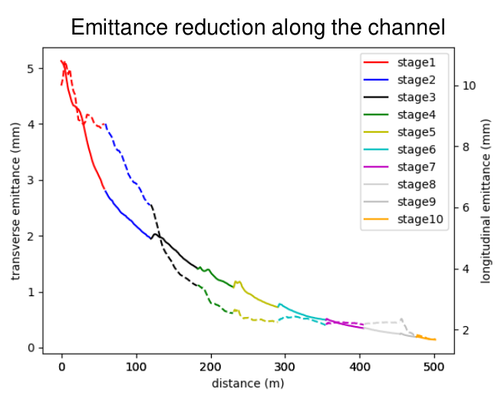
WP4
Muon Production & Cooling
Lattice optimisation ongoing
Rectilinear cooling (Zhu Ruihu)
  Drive optimisation
Final cooling (Elena Fol, Bernd Stechauner)
  Improved scattering model in RFTrack
  Implement realistic RF
    Phase rotation and acceleration of muon beam
New!

Slide 8
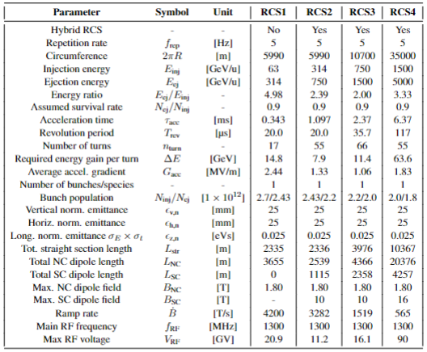
WP5 - High Energy Complex
Parameter table
A first parameter table is proposed for the high-energy acceleration.
  The RCS4 is the most preliminary and needs more studies to be consolidated.
  The needed total dipole length and RF voltage are evaluated and can be a first step for costing considerations.
  The optics is based on FODO cells and should be reviewed.
  The acceleration ramp is quasi-linear and may evolve.
Future versions of the parameter table should include also an FFA alternative.
We need to continue the discussions to see how to marry RF, magnet, powering, costing, vacuum, collective effects, and optics considerations.

Slide 9
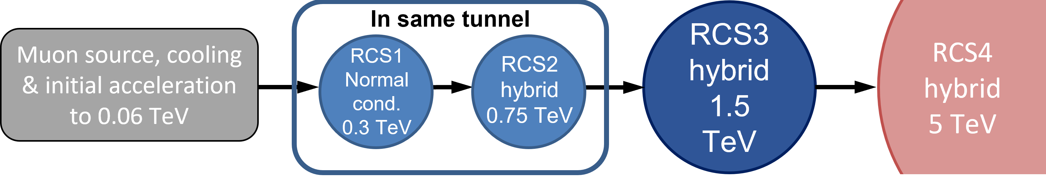
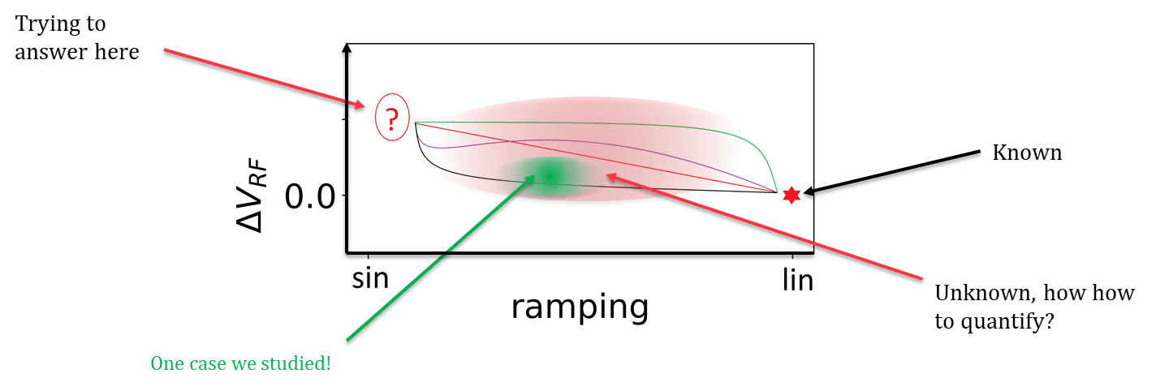
WP5 High Energy Complex
Ramp optimization
20 September 2023: First meeting art CERN dedicated to Impact of RCS acceleration ramp shape on magnets and RF
2 powering circuits are being considered (full-wave and switched resonances).
Some cost model (RF and powering) is under development. Clearly, the choice of the ramp has a big impact on the total cost.
Next steps: Integrating in a python environment the different scaling laws (costing, powering, optics, RF,…) to reduce the number of free parameters and improve the optimization process.
Courtesy: F. Batsch and H. Damerau

Slide 10
WP6
RF
The activities of the WP6 proceed during the first months of the project focusing on some specific elements related to objective of each of the subWP.
WP 6.1 specifically addressed different approaches to the analysis of the problems related to the HOM of the SC cavities involved. The study of specific aspects relating to these cavities was addressed in a general sense with an overview of the skills available in the components involved.
WP 6.2 focused on carrying out an overview of possible technologies to be applied to the construction of RF cavities for the cooling system. In parallel, in concert with WP4, we focused on the definition of the main parameters (frequency, aperture, ...) as well as how these derive from the beam dynamics in the channel.
WP 6.3 is probably the WP where the most part of the efforts concentrated. Computer simulations and theoretical analysis have been carried out to outline and face the problems related to the coexistence of high electric RF fields in strong magnetic fields. The requirement to carry out deep analysis on the experimental side to define the technologies to be used in such application has been deeply discussed. A pulsed DC test set is under realization at INFN Milano and a couple of different RF cavities (with related power couplers) have been electromagnetically designed to be used in a test stand based on a SC solenoid and one of these cavities.

Slide 11
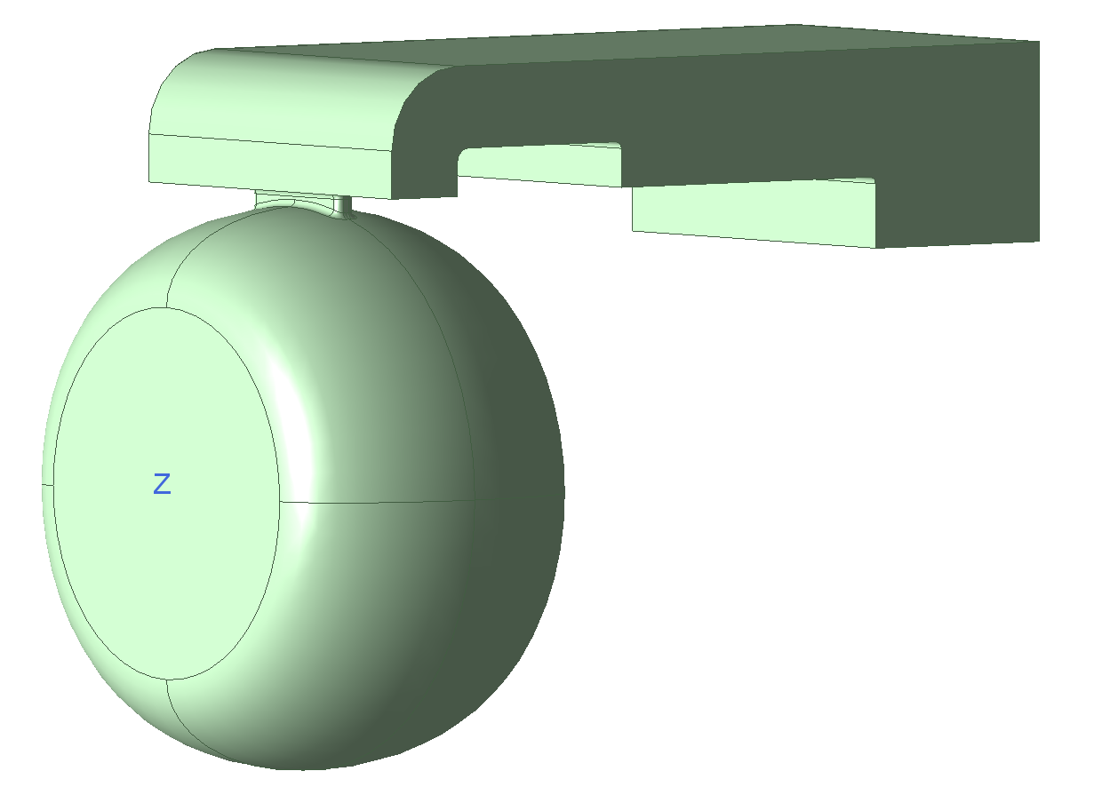
The pulsed DC test set has been conceived taking into account the experience made at CERN on a similar bench.
The innovative feature of this new test set is that we may apply the pulsed DC voltage along with a static magnetic field up to 1 Tesla.
We will expect to get more and more data on materials and surface treatments.
The picture below report the RF design for a 3 GHz cavity which may be inserted in a SC solenoid with a bore of nearly 350 mm. The design of the solenoid will provide a field up to 7 Tesla while the electric fields may reach a value of 50 MV/m.

Slide 12
WP7
Magnets
Review held during annual meeting, preliminary report presented to the Community
Working at precising responsibilities and refining parameters for the parameter list (see next slide)

Slide 13
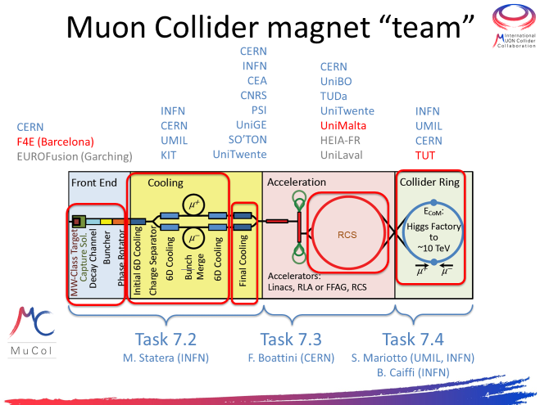
WP7
Magnets

Slide 14
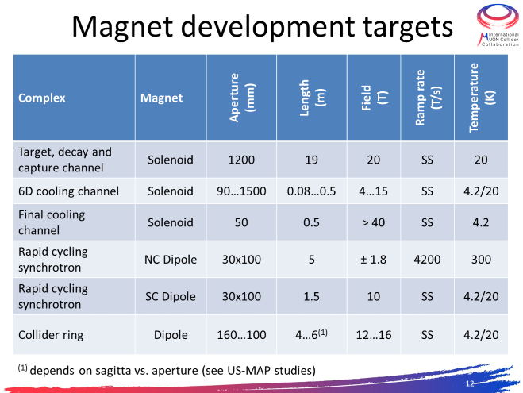
WP7
Magnets

Slide 15
WP8
Cooling Cell
Working on the definition of the prototype cooling cell to be designed
Training on the design of the RF-in-magnetic-field test stand
First preliminary ideas will be presented and discussed in a workshop at CERN on 18 and 19 January in order to collect feedback from the community. Design work will then start

Slide 16
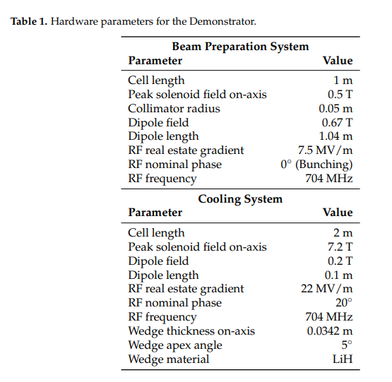
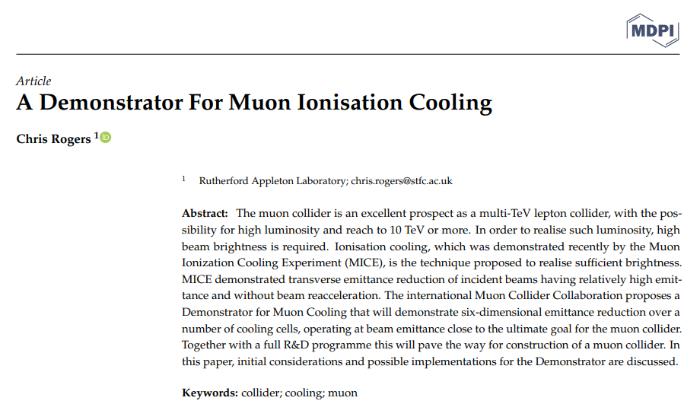
WP8
Cooling cell
C. Rogers, NuFact 22

Slide 17
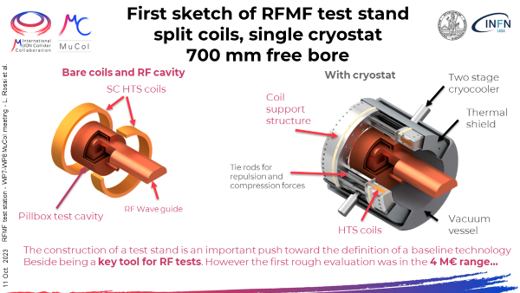
WP8
Cooling Cell

Slide 18
Thank you
for your attention

Slide 19
Deliverables new dates
Deliverable Name | Work Package No | Lead Beneficiary | l'pc | Date
Data-management plan | WPI | 1 -CERN | DMP — Data Management Plan | 8 |  | 31/10/2023
Preliminary ESPPU report No. 1 | WPI | 1 - CERN | R — Document, report | 12 |  | 29/02/2024
Preliminary ESPPU report No. 2 | WPI | 1 -CERN | R — Document, report | 24 |  | 28/02/2025
Intermediate ESPPU report | WPI | - CERN | R — Document, report | 36 |  | 28/02/2026
Consolidated ESPPU report | WPI | 1 - CERN | R — Document, report | 48 |  | 28/02/2027
Beam-induced background and detector configuration | WP2 | 8 - UNIPD | DATA — data sets, microdata, etc | 32 |  | 31/10/2025
Detector performance by using physics processes | WP2 | 2 - DESY | R — Document, report | 36 |  | 28/02/2026
Final report on parameters and initial study for the Proton Complex | WP3 | 11 -ESS | R — Document, report | 45 |  | 30/11/2026
Development of BDSIM simulation | WP4 | 16 -UKRI | OTHER | 24 |  | 28/02/2025
Preliminary Report on key subsystems for ESPPU input | WP4 | 16 -UKRI | R — Document, report | 33 |  | 30/11/2025
Consolidated Report on key subsystems | WP4 | 16 -UKRI | R — Document, report | 45 |  | 30/11/2026
Report on the collider ring design | WP5 | 5 - CEA | R — Document, report | 44 |  | 30/10/2026
Report on the design of the HEC | WP5 | 5 - CEA | R — Document, report | 45 |  | 30/11/2026
Report on design of high power and high efficiency RF power sources | WP6 | 5 - CEA | R — Document, report | 44 |  | 31/10/2026
Report on RF for MCC and HEC | WP6 | 5 - CEA | R — Document, report | 45 |  | 30/11/2026
Preliminary report on muon collider magnets | WP7 | 1 - CERN | R — Document, report | 33 |  | 30/11/2025
Consolidated report on muon collider magnets | WP7 | 1 - CERN | R — Document, report | 45 |  | 30/11/2026
Presentation of cooling cell conceptual design | WP8 | 7 - UMIL | OTHER | 15 |  | 31/05/2024
Final report on cooling cell design | WP8 | 7 - UMIL | R — Document, report | 44 |  | 31/10/2026

Slide 20
Milestones new Dates
Milestone No | Milestone Name | Work Package No | Lead Beneficiary | Means of Verification | Due Date (month) |  | Date
1 | Website Available | WP1 | 1 -CERN | Website online | 2 |  | 30/04/2023
2 | Kick-off meeting | WP1 | 1-CERN | Indico site | 3 |  | 31/05/2023
3 | Tentative parameters available | WP1 | 1-CERN | Database | 8 |  | 30/10/2023
4 | First annual meeting | WP1 | 1 -CERN | Indico site | 15 |  | 31/05/2024
5 | Preliminary parameters | WP1 | 1-CERN | Database | 20 |  | 30/10/2024
6 | Second annual meeting | WP1 | 1-CERN | Indico site | 27 |  | 31/05/2025
7 | Consolidated parameters | WP1 | 1-CERN | Database | 32 |  | 30/10/2025
8 | Third annual meeting | WP1 | 1-CERN | Indico site | 39 |  | 31/05/2026
9 | Training on detector design and physics performance tools | WP2 | 8-UNIPD | Training material | 6 |  | 31/08/2023
10 | Workshop on MDI and IR design | WP2, WP5 | 8-UNIPD | Indico site | 13 |  | 31/03/2024
11 | Release of simplified detector performance model (DELPHES card or/and similar format) | WP2 | 8-UNIPD | Model published on the website | 20 |  | 31/10/2024
12 | Workshop on detector design and physics performance with a public lecture on Muon Collider | WP2 | 8-UNIPD | Indico site | 25 |  | 31/03/2025
13 | Publication of report of detector performance with major physics process at several ECM | WP2 | 8-UNIPD | Article ready for submission | 48 |  | 28/02/2027
14 | Mini-Workshop on pulsed magnets | WP7, WP5 | 5-CEA | Indico site | 15 |  | 31/05/2024
15 | Tentative design of the interaction region | WP2, WP5 | 1-CERN | Optics files | 20 |  | 31/10/2024
16 | Tentative optics of the collider ring and pulsed synchrotrons | WP5 | 5-CEA | Optics files | 19 |  | 30/09/2024
17 | Tentative design of the FFA | WP5 | 5-CEA | Optics files | 25 |  | 31/03/2025
18 | Tentative impedance budget in the collider and pulsed synchrotron | WP5 | 5-CEA | Dataset | 26 |  | 30/04/2025
19 | Workshop on ultra-high-field solenoids | WP7 | 1 -CERN | Indico site | 32 |  | 31/10/2025
20 | Workshop on high-field collider magnets | WP7, WP5 | 1-CERN | Indico site | 44 |  | 31/10/2026
21 | Cooling cell design 3D model | WP8 | 7-UMIL | 3D model completed & Report | 33 |  | 30/11/2025

