Slide 1
Willkommen!
Advancing Image Classification: Integrating NAQSS Encoding with Hybrid Quantum-Classical PQC Models via Intel Quantum SDK

Slide 2

Contents
Introduction
Quantum in Fake Art
Quantum Machine Learning
Quantum Image Representation
Implementation
Results
1

Slide 3
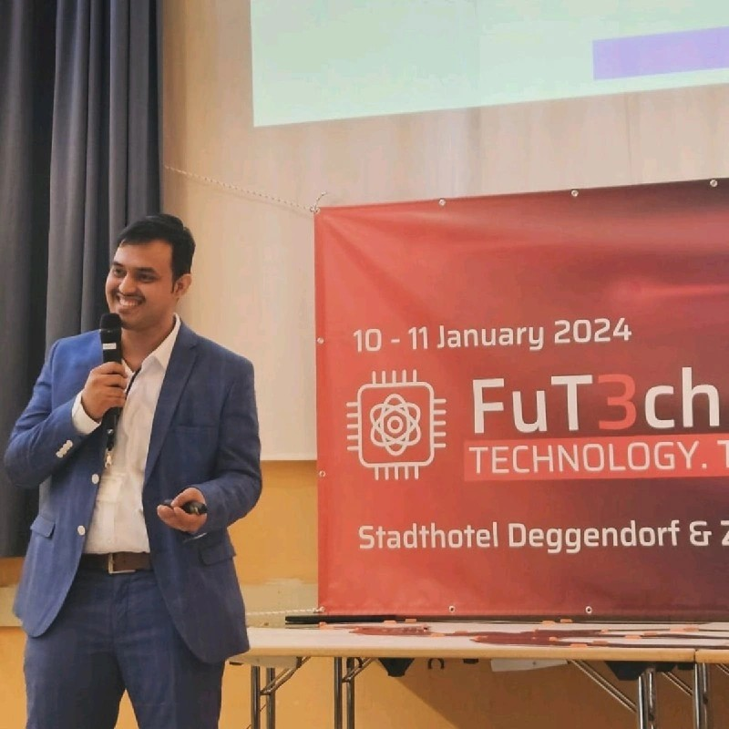
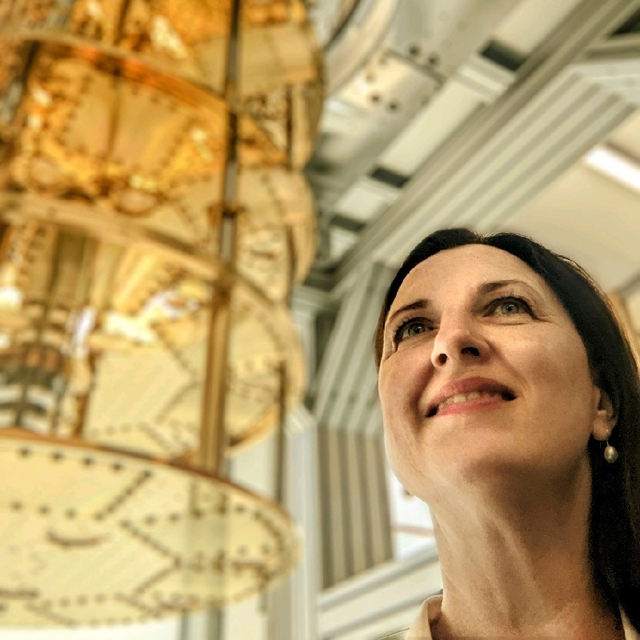
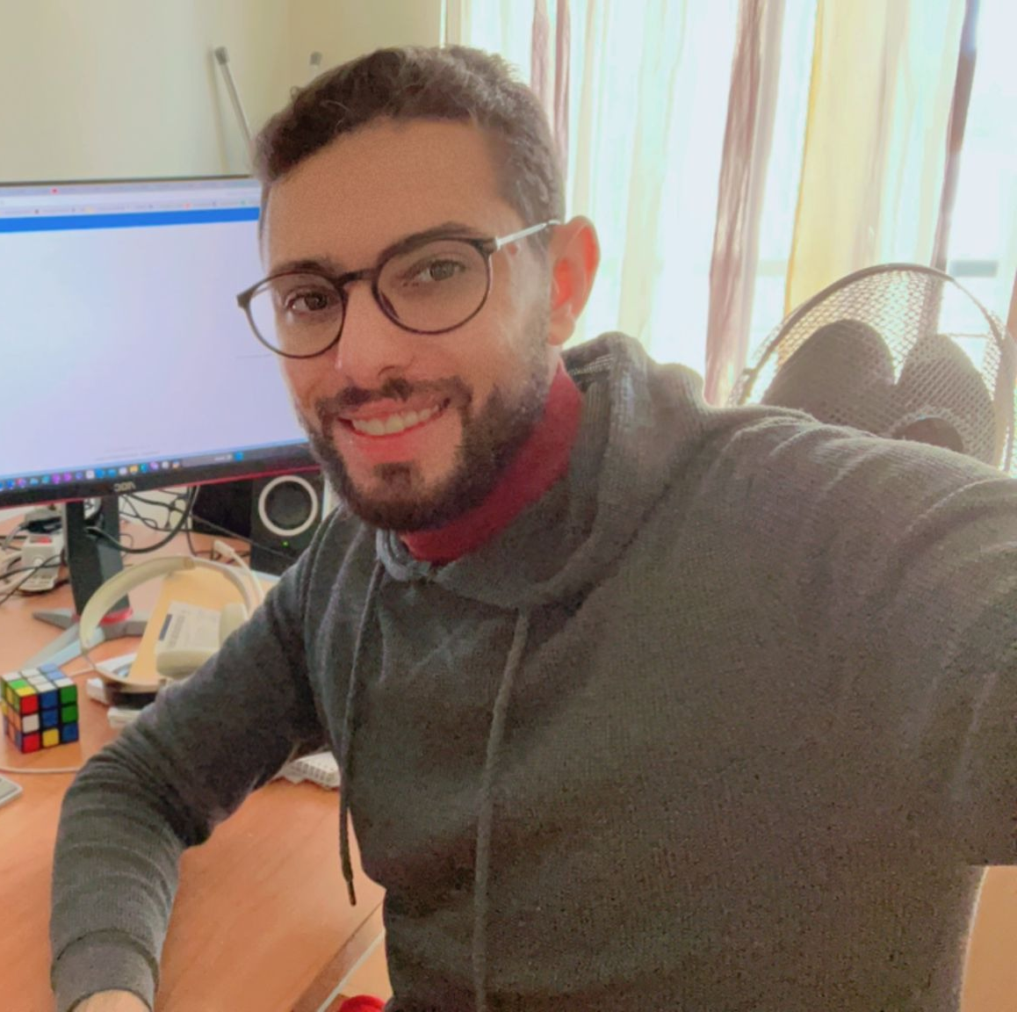
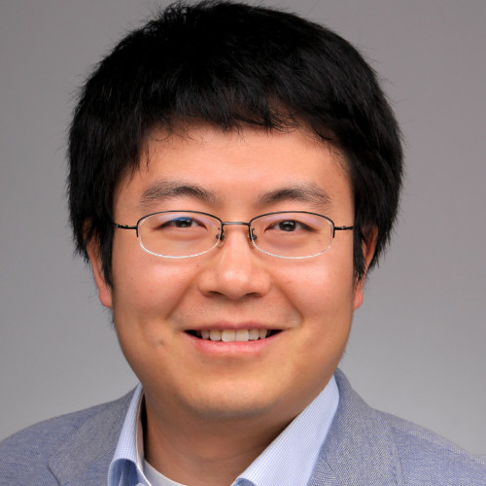
Team
ÜBER BAYERN
Digvijaysinh Ajarekar
Student, HPC-QC, Deggendorf Institute of Technology
2nd Rank Intel Quantum Challenge
Best Poster Presentation @FUT3CH Symposium 2024
Abstract Accepted @Quantum Matter 2024, San Sabastian, Spain
Prof. Dr. Helena Liebelt
Director
Institute of Future Technologies,
Deggendorf Institute of Technology
Suhaib Al-Rousan
Student, HPC-QC, Deggendorf Institute of Technology
Research Assistant, Quantum Applications
and Research Laboratory (QAR-Lab), LMU, Munich
2nd Rank Intel Quantum Challenge
Best Poster Presentation @FUT3CH Symposium 2024
Abstract Accepted @Quantum Matter 2024, San Sabastian, Spain
Prof. Dr. Rui Li
Co-Founder
Institute of Future Technologies,
Deggendorf Institute of Technology
Research
Quantum Image Classification for Fake Art Identification
Quantum Computational Fluid Dynamics with Intel Quantum SDK
2

Slide 4
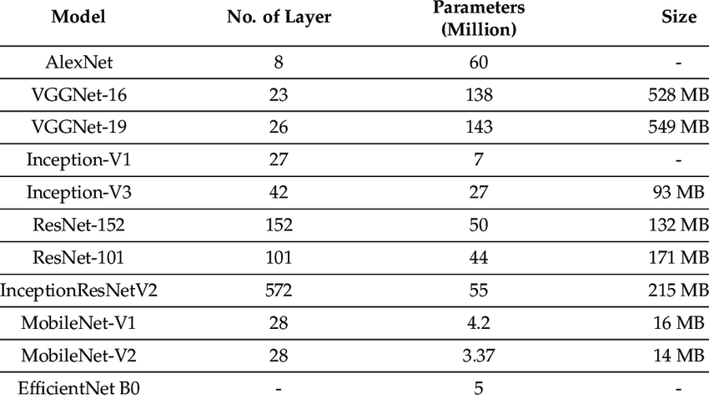
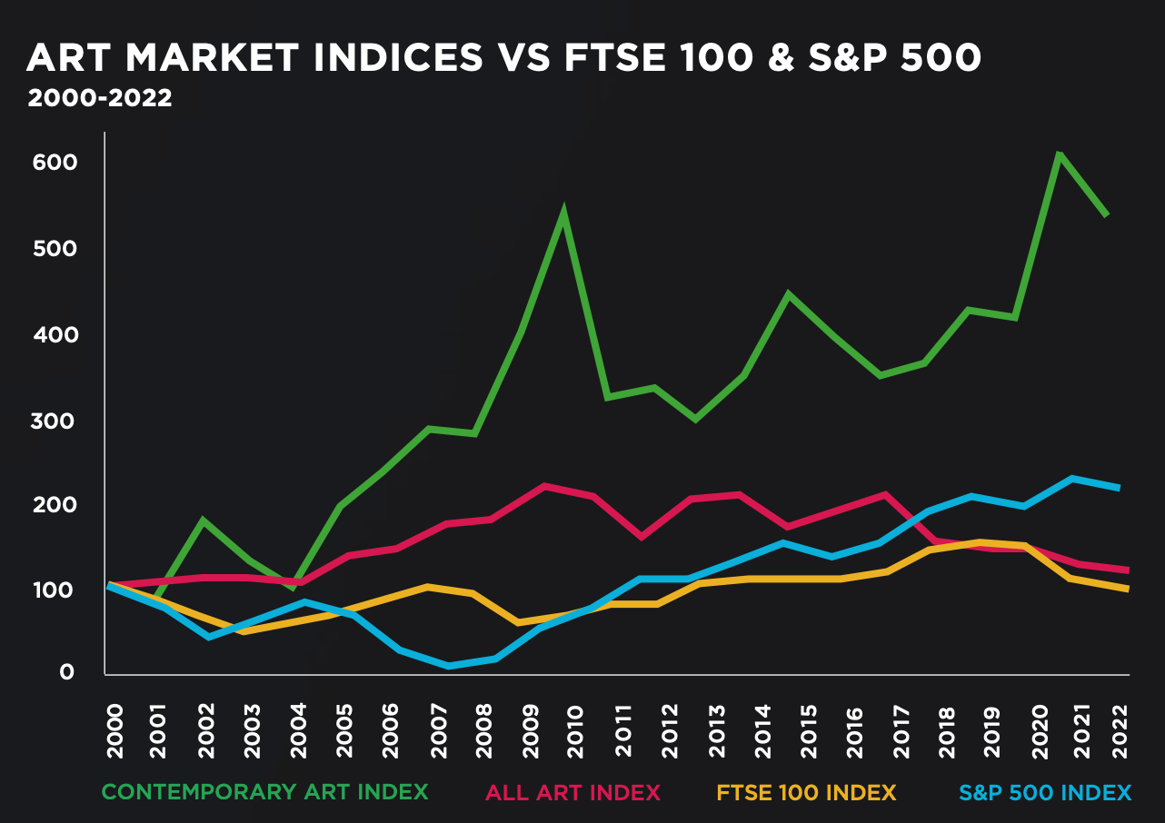
Quantum in Fake Art
The art world grapples with the issue of art forgery, where replicas are created and passed off as genuine works.
This can lead to significant financial losses and erosion of trust in the art market.
Growing Luxury Asset
Fake Art threat to Global Art Market
Traditional Methods,
Require expertise
Subjective
Time Consuming
AI to the Rescue,
Increased Accuracy
Efficient
These concepts can be
Applied to Fake Currency Detection and other authenticity detection tasks.
Quantum Computing provides exponential speed up with linear combination of all the
possible basis states in superposition.
3

Slide 5
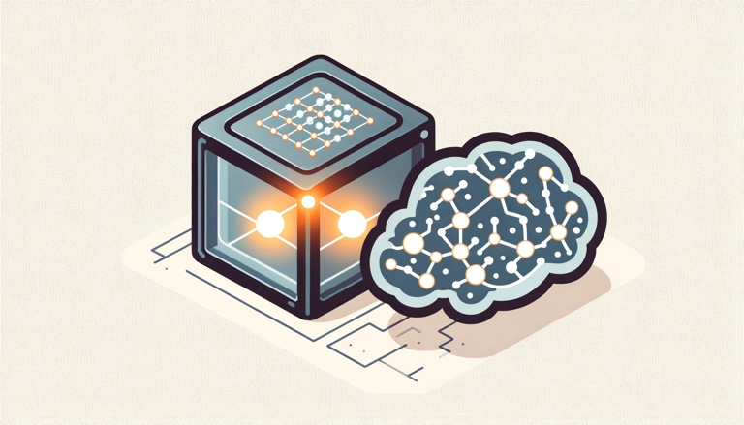
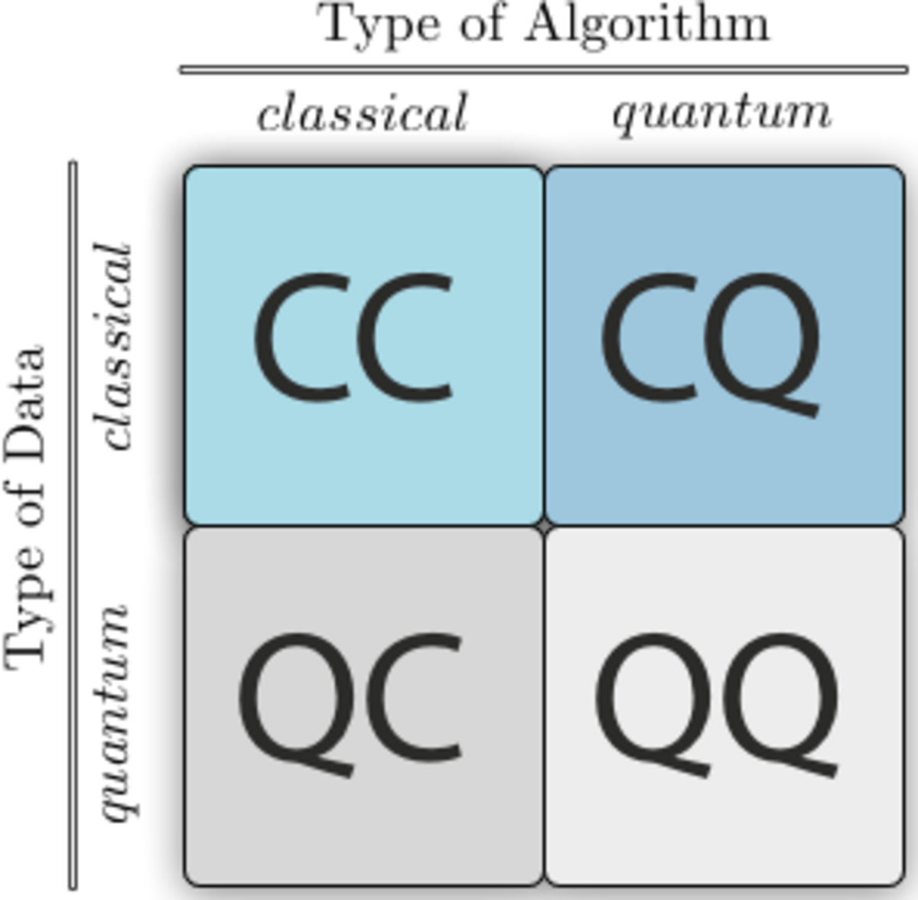
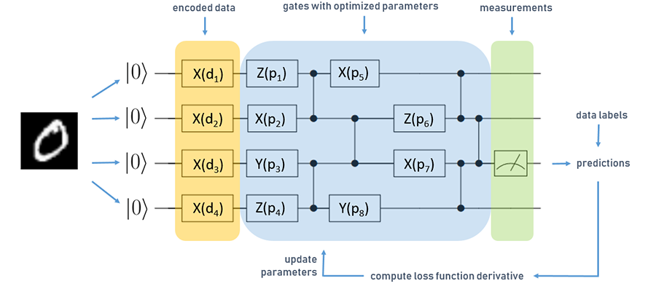
QML: marraige of power houses
Quantum machine learning represents the potent amalgamation of quantum computing and machine learning.
Quantum computers possess the ability to solve problems that are too intricate for classical computers, while machine learning algorithms can leverage the unique properties of quantum computers to achieve superior performance.
4

Slide 6
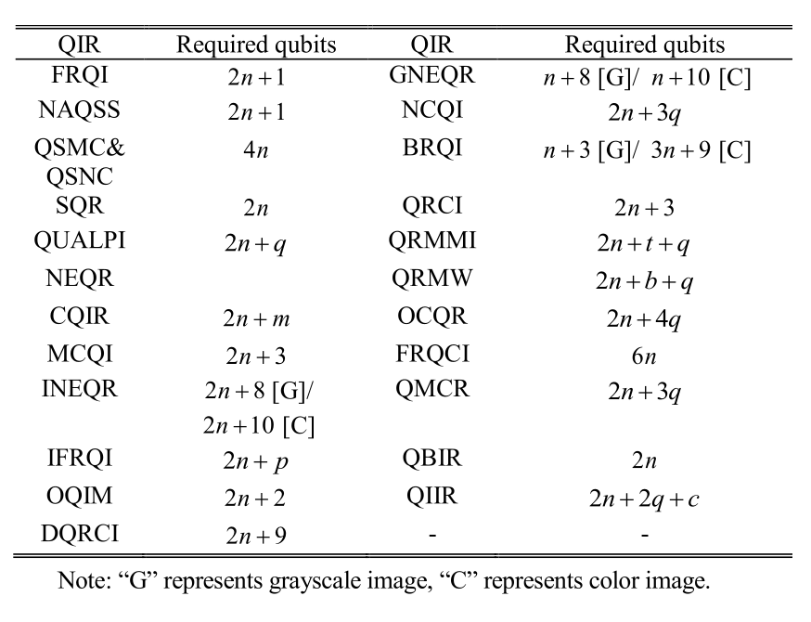
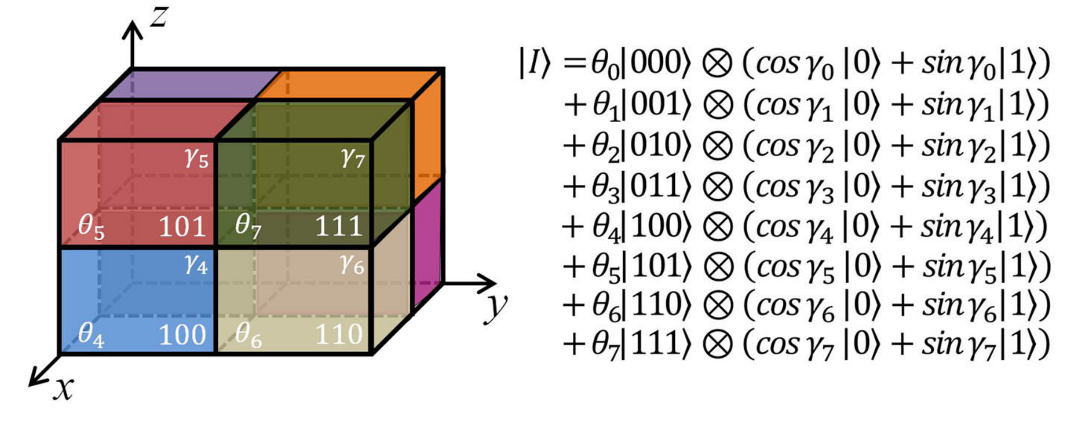
Quantum Image represention
Quantum Image Representation
Amplitude
Phase
FTQR
Mixed
Continuous
Discrete
SQR, Qubit Lattice, FRQI, MCRQI
QSMC, QSNC, NAQSS, OQIM
NEQR, QUALPI, GQIR, QRMW, BRQI, QIIR
5

Slide 7
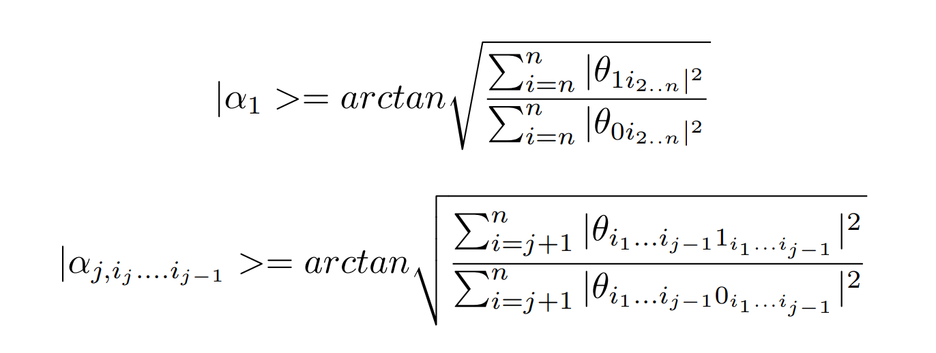
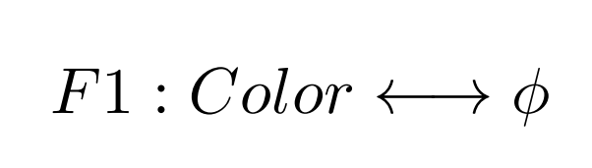
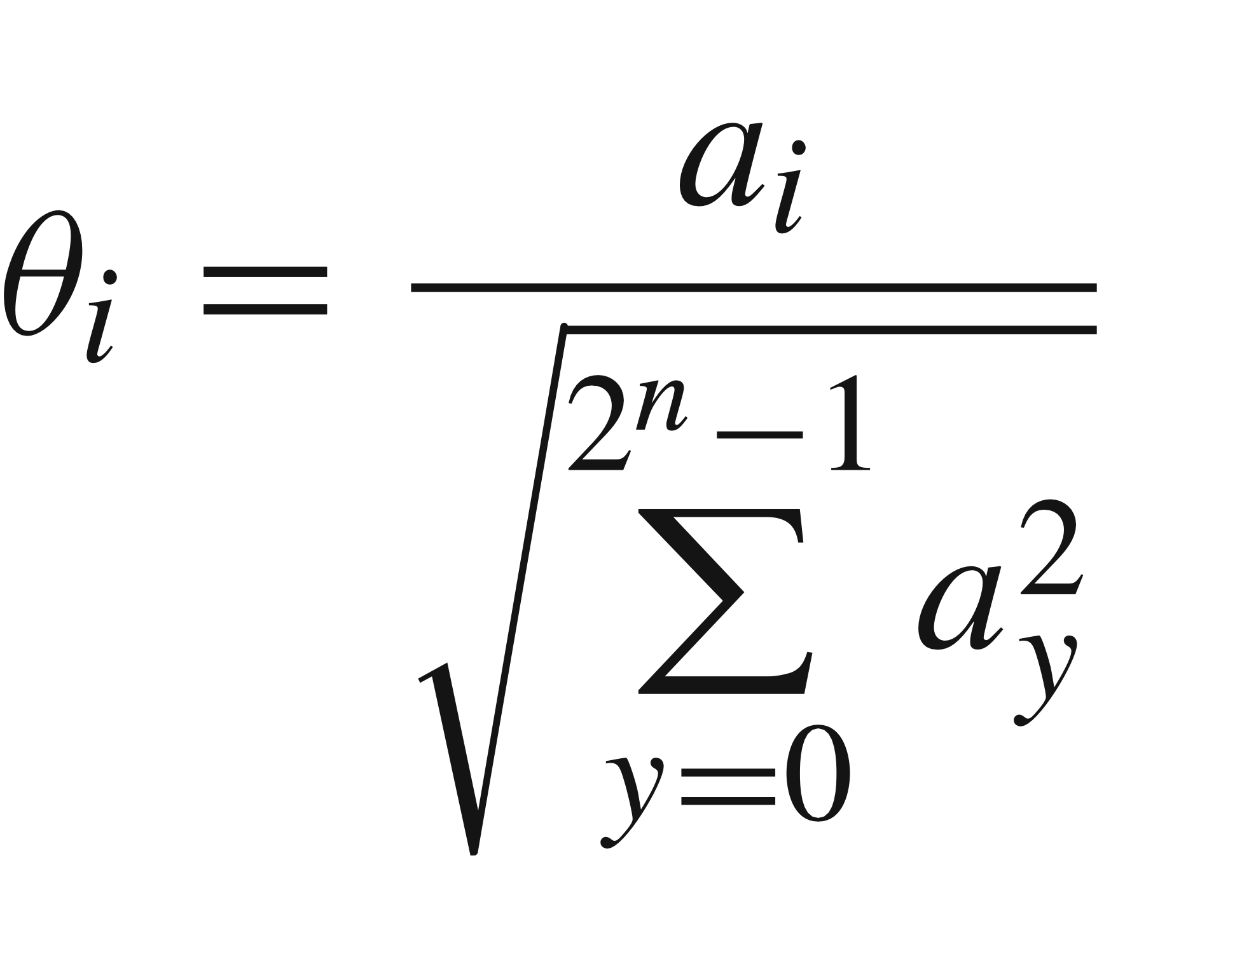
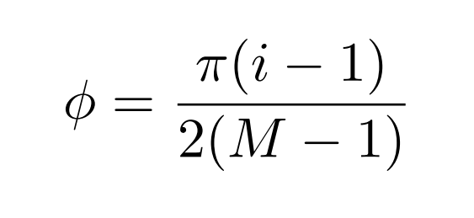
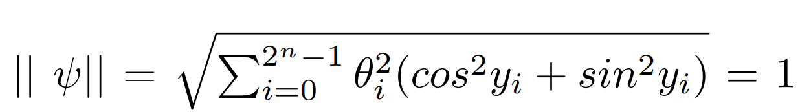






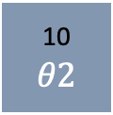

NAQSS
columns
00
$$θ0$$
01
$$θ1$$
10
$$θ2$$
11
$$θ3$$
rows
i = R * 256 * 256 + G * 256 + B + 1
|0>
R(α1)
PQC
M
|0>
Ra(α2, 0)
Ra(α2, 1)
|0>
Φ $0$
Φ $1$
Φ $2$
Φ $3$
c0
6

Slide 8
Image Classification with NAQSS and QNN
Algorithm
Data Preprocessing and transformations on the Images.
Encode Image into Quantum Circuit using NAQSS implementation.
Pass the state to QNN
Measure the Qubits
Get Loss and Gradients with Parameter Shift Rule
Update the Parameters
Repeat step 2 – 6 for all the images in dataset.
NAQSS
VQC
Measure
|0>
|0>
|0>
|0>
|0>
Dataset
Hybrid Training
7

Slide 9
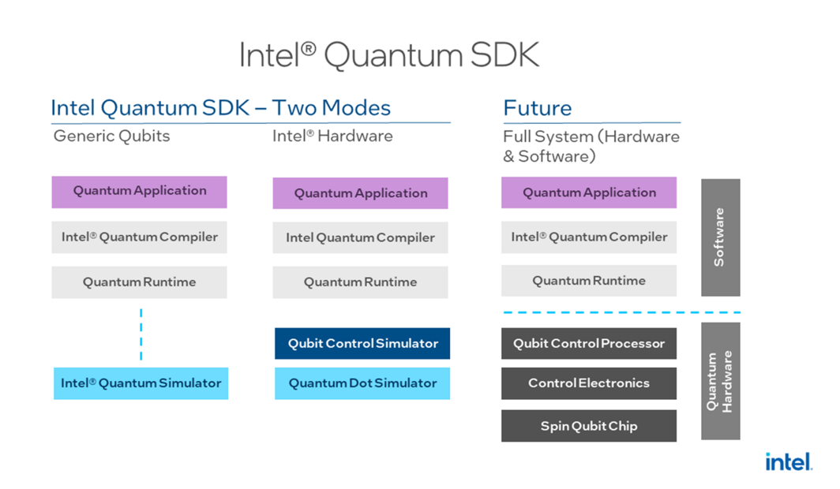
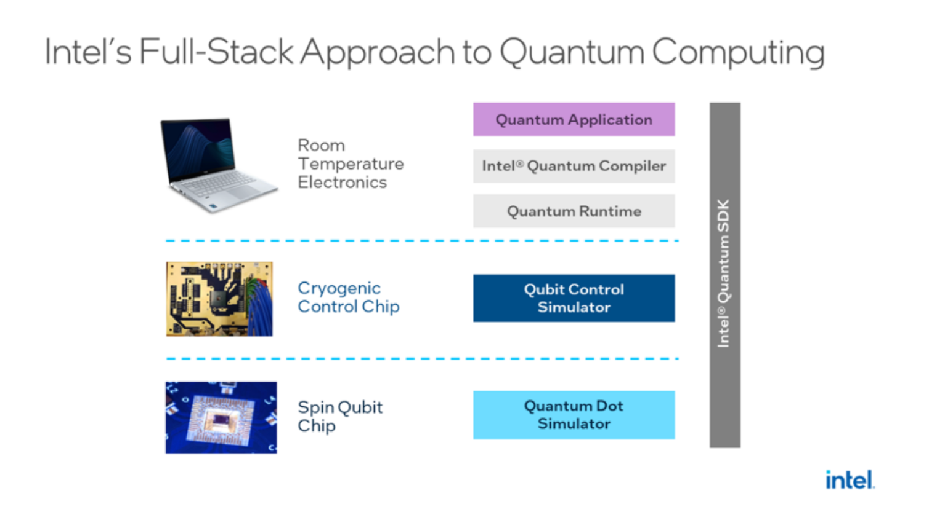
Intel Quantum SDK
The Intel® Quantum SDK is a complete quantum computing stack in simulation. It includes:
An intuitive user interface
A compiler toolchain
A quantum runtime environment optimized for running hybrid quantum-classical algorithms
A choice of qubit simulation back ends
8

Slide 10
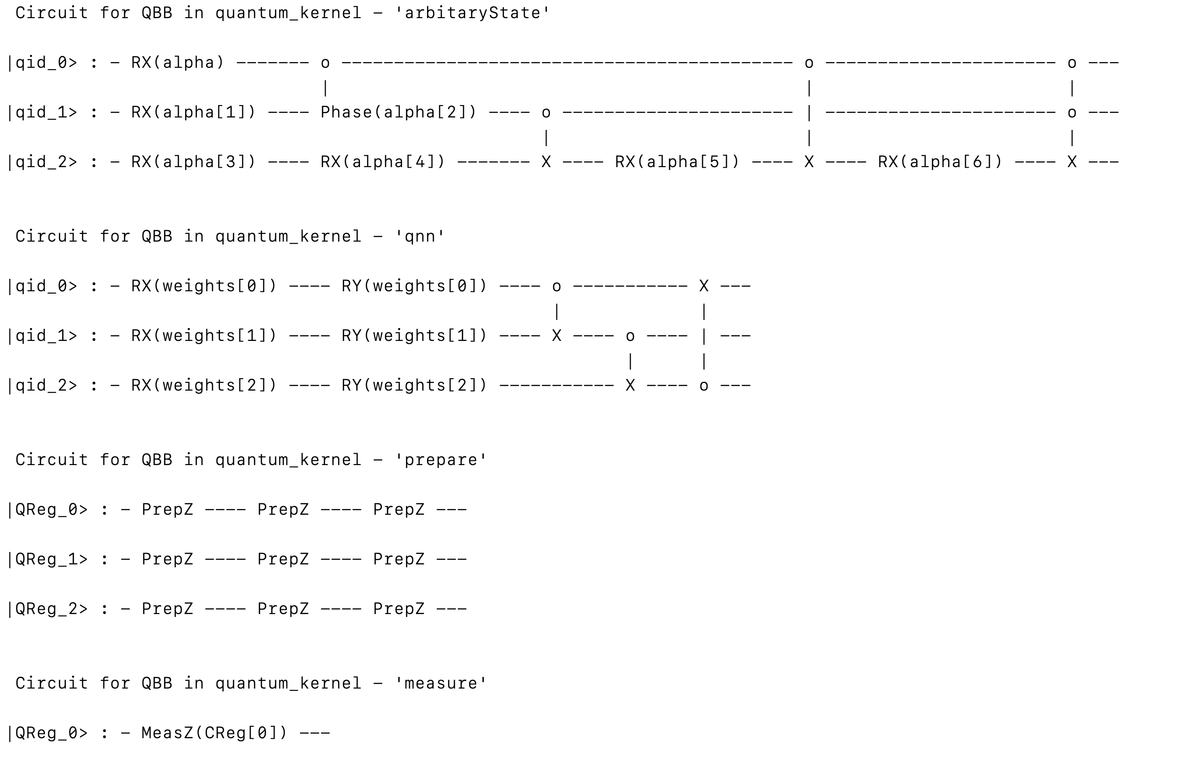
Image Classification with NAQSS and QNN
9

Slide 11
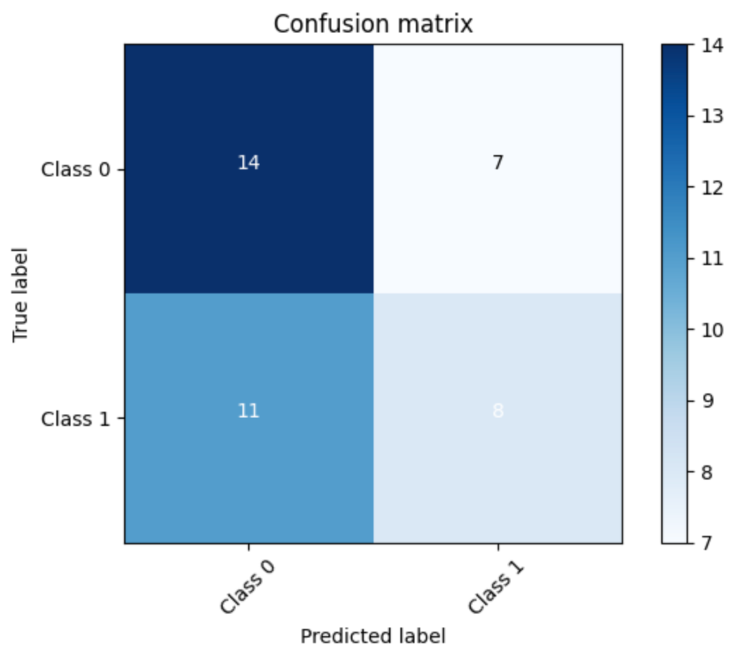
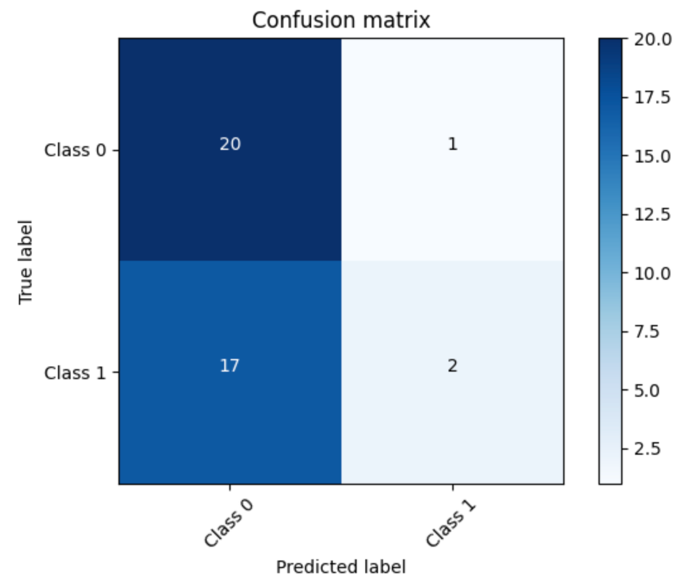
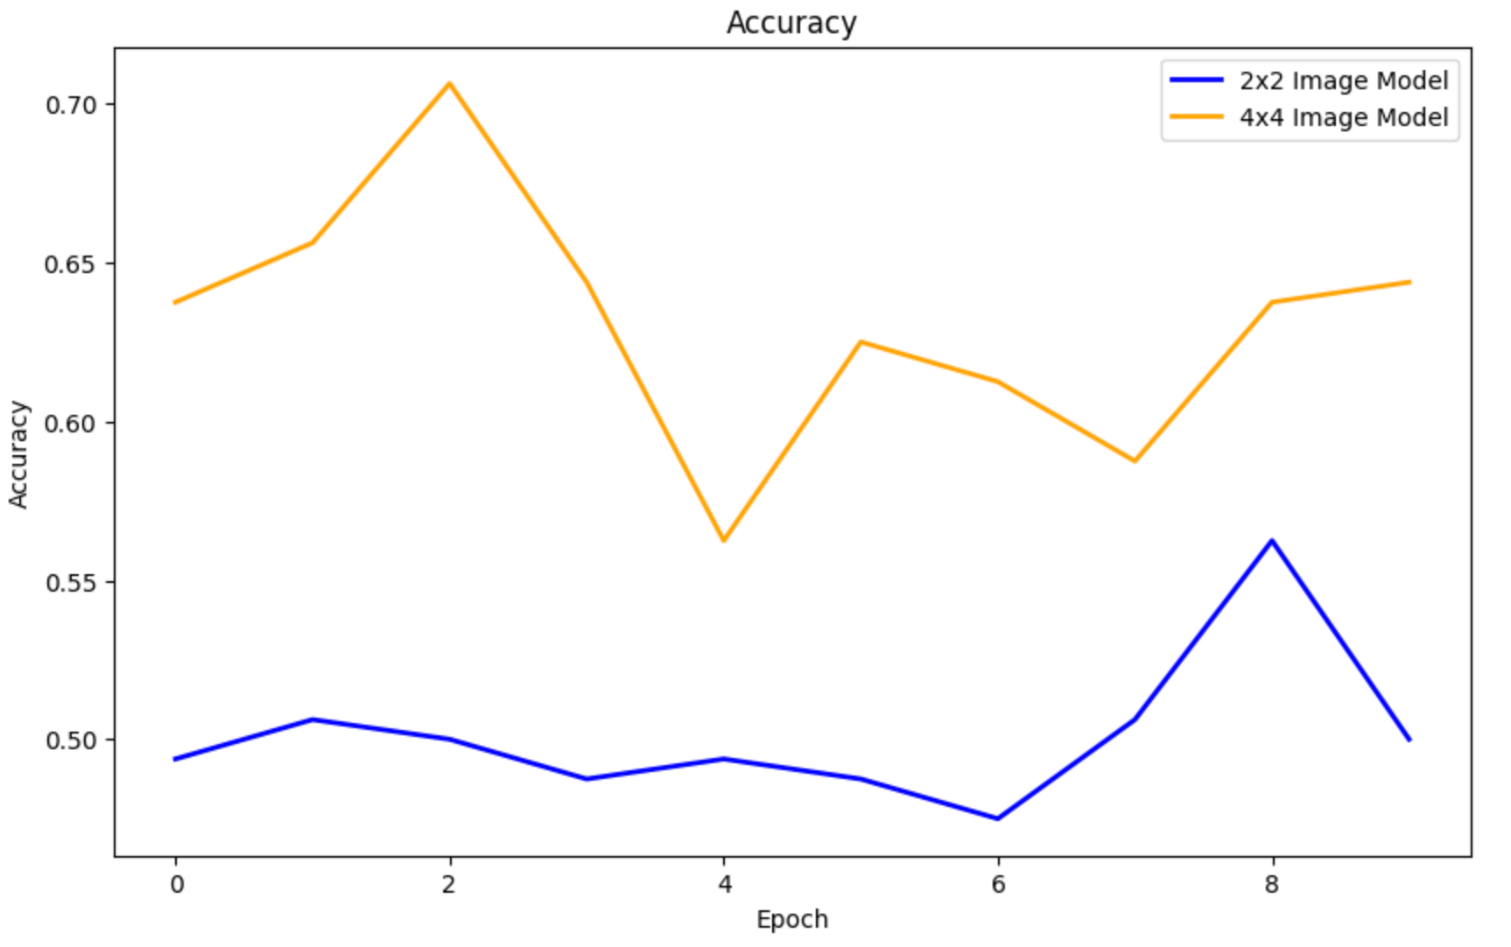
Results
2x2 Image
4x4 Image
Model | Image Size | Epochs | Parameters | Accuracy
Quantum | 2x2 | 10 | 90 | 51%
Quantum | 4x4 | 10 | 70 | 64.5%
10

Slide 12
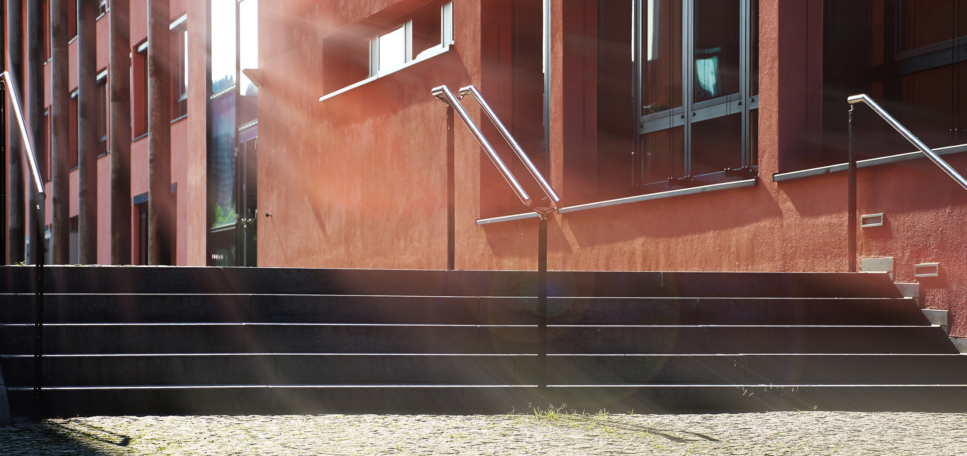
Vielen Dank
Contact:
digvijaysinh.ajarerekar@stud.th-deg.de
suhaib.al-rousan@stud.th-deg.de
helena.liebelt@th-deg.de
rui.li@th-deg.de
11

